Slide 1
Discrete Choice Modeling
William Greene
Stern School of Business
New York University

Slide 2
Part 10
Multinomial Logit Extensions

Slide 3
What’s Wrong with the MNL Model?
I.I.D. ➔ IIA (Independence from irrelevant alternatives)
  Peculiar behavioral assumption
  Leads to skewed, implausible empirical results
  Functional forms, e.g., nested logit, avoid IIA
  IIA will be a nonissue in what follows.
Insufficiently heterogeneous:
“… economists are often more interested in aggregate effects and regard heterogeneity as a statistical nuisance parameter problem which must be addressed but not emphasized. Econometricians frequently employ methods which do not allow for the estimation of individual level parameters.” (Allenby and Rossi, Journal of Econometrics, 1999)

Slide 4
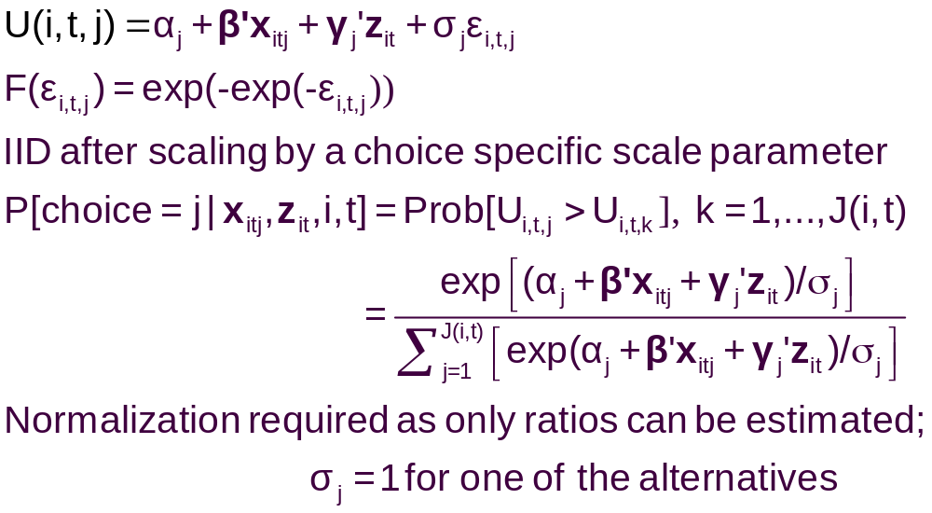
A Model with Choice Heteroscedasticity

Slide 5
Heteroscedastic Extreme Value Model (1)
+---------------------------------------------+
| Start values obtained using MNL model |
| Maximum Likelihood Estimates |
| Log likelihood function -184.5067 |
| Dependent variable Choice |
| Response data are given as ind. choice. |
| Number of obs.= 210, skipped 0 bad obs. |
+---------------------------------------------+
+--------+--------------+----------------+--------+--------+
|Variable| Coefficient | Standard Error |b/St.Er.|P[|Z|>z]|
+--------+--------------+----------------+--------+--------+
GC | .06929537 .01743306 3.975 .0001
TTME | -.10364955 .01093815 -9.476 .0000
INVC | -.08493182 .01938251 -4.382 .0000
INVT | -.01333220 .00251698 -5.297 .0000
AASC | 5.20474275 .90521312 5.750 .0000
TASC | 4.36060457 .51066543 8.539 .0000
BASC | 3.76323447 .50625946 7.433 .0000

Slide 6
Heteroscedastic Extreme Value Model (2)
+---------------------------------------------+
| Heteroskedastic Extreme Value Model |
| Log likelihood function -182.4440 |
| Number of parameters 10 |
| Restricted log likelihood -291.1218 |
+---------------------------------------------+
+--------+--------------+----------------+--------+--------+
|Variable| Coefficient | Standard Error |b/St.Er.|P[|Z|>z]|
+--------+--------------+----------------+--------+--------+
---------+Attributes in the Utility Functions (beta)
GC | .11903513 .06402510 1.859 .0630
TTME | -.11525581 .05721397 -2.014 .0440
INVC | -.15515877 .07928045 -1.957 .0503
INVT | -.02276939 .01122762 -2.028 .0426
AASC | 4.69411460 2.48091789 1.892 .0585
TASC | 5.15629868 2.05743764 2.506 .0122
BASC | 5.03046595 1.98259353 2.537 .0112
---------+Scale Parameters of Extreme Value Distns Minus 1.0
s_AIR | -.57864278 .21991837 -2.631 .0085
s_TRAIN | -.45878559 .34971034 -1.312 .1896
s_BUS | .26094835 .94582863 .276 .7826
s_CAR | .000000 ......(Fixed Parameter).......
---------+Std.Dev=pi/(theta*sqr(6)) for H.E.V. distribution.
s_AIR | 3.04385384 1.58867426 1.916 .0554
s_TRAIN | 2.36976283 1.53124258 1.548 .1217
s_BUS | 1.01713111 .76294300 1.333 .1825
s_CAR | 1.28254980 ......(Fixed Parameter).......
Normalized for estimation
Structural parameters

Slide 7
HEV Model - Elasticities
+---------------------------------------------------+
| Elasticity averaged over observations.|
| Attribute is INVC in choice AIR |
| Effects on probabilities of all choices in model: |
| * = Direct Elasticity effect of the attribute. |
| Mean St.Dev |
| * Choice=AIR -4.2604 1.6745 |
| Choice=TRAIN 1.5828 1.9918 |
| Choice=BUS 3.2158 4.4589 |
| Choice=CAR 2.6644 4.0479 |
| Attribute is INVC in choice TRAIN |
| Choice=AIR .7306 .5171 |
| * Choice=TRAIN -3.6725 4.2167 |
| Choice=BUS 2.4322 2.9464 |
| Choice=CAR 1.6659 1.3707 |
| Attribute is INVC in choice BUS |
| Choice=AIR .3698 .5522 |
| Choice=TRAIN .5949 1.5410 |
| * Choice=BUS -6.5309 5.0374 |
| Choice=CAR 2.1039 8.8085 |
| Attribute is INVC in choice CAR |
| Choice=AIR .3401 .3078 |
| Choice=TRAIN .4681 .4794 |
| Choice=BUS 1.4723 1.6322 |
| * Choice=CAR -3.5584 9.3057 |
+---------------------------------------------------+
Multinomial Logit
+---------------------------+
| INVC in AIR |
| Mean St.Dev |
| * -5.0216 2.3881 |
| 2.2191 2.6025 |
| 2.2191 2.6025 |
| 2.2191 2.6025 |
| INVC in TRAIN |
| 1.0066 .8801 |
| * -3.3536 2.4168 |
| 1.0066 .8801 |
| 1.0066 .8801 |
| INVC in BUS |
| .4057 .6339 |
| .4057 .6339 |
| * -2.4359 1.1237 |
| .4057 .6339 |
| INVC in CAR |
| .3944 .3589 |
| .3944 .3589 |
| .3944 .3589 |
| * -1.3888 1.2161 |
+---------------------------+

Slide 8
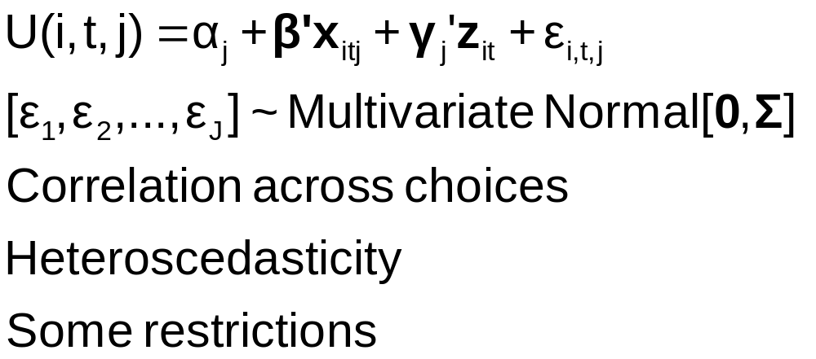
The Multinomial Probit Model

Slide 9
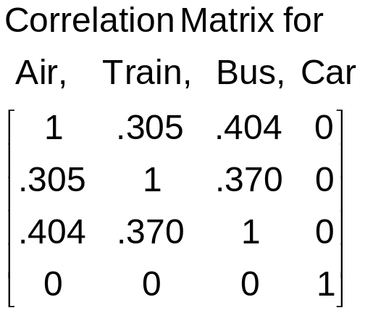
Multinomial Probit Model
+---------------------------------------------+
| Multinomial Probit Model |
| Dependent variable MODE |
| Number of observations 210 |
| Iterations completed 30 |
| Log likelihood function -184.7619 | Not comparable to MNL
| Response data are given as ind. choice. |
+---------------------------------------------+
+--------+--------------+----------------+--------+--------+
|Variable| Coefficient | Standard Error |b/St.Er.|P[|Z|>z]|
+--------+--------------+----------------+--------+--------+
---------+Attributes in the Utility Functions (beta)
GC | .10822534 .04339733 2.494 .0126
TTME | -.08973122 .03381432 -2.654 .0080
INVC | -.13787970 .05010551 -2.752 .0059
INVT | -.02113622 .00727190 -2.907 .0037
AASC | 3.24244623 1.57715164 2.056 .0398
TASC | 4.55063845 1.46158257 3.114 .0018
BASC | 4.02415398 1.28282031 3.137 .0017
---------+Std. Devs. of the Normal Distribution.
s[AIR] | 3.60695794 1.42963795 2.523 .0116
s[TRAIN]| 1.59318892 .81711159 1.950 .0512
s[BUS] | 1.00000000 ......(Fixed Parameter).......
s[CAR] | 1.00000000 ......(Fixed Parameter).......
---------+Correlations in the Normal Distribution
rAIR,TRA| .30491746 .49357120 .618 .5367
rAIR,BUS| .40383018 .63548534 .635 .5251
rTRA,BUS| .36973127 .42310789 .874 .3822
rAIR,CAR| .000000 ......(Fixed Parameter).......
rTRA,CAR| .000000 ......(Fixed Parameter).......
rBUS,CAR| .000000 ......(Fixed Parameter).......

Slide 10
Multinomial Probit Elasticities
+---------------------------------------------------+
| Elasticity averaged over observations.|
| Attribute is INVC in choice AIR |
| Effects on probabilities of all choices in model: |
| * = Direct Elasticity effect of the attribute. |
| Mean St.Dev |
| * Choice=AIR -4.2785 1.7182 |
| Choice=TRAIN 1.9910 1.6765 |
| Choice=BUS 2.6722 1.8376 |
| Choice=CAR 1.4169 1.3250 |
| Attribute is INVC in choice TRAIN |
| Choice=AIR .8827 .8711 |
| * Choice=TRAIN -6.3979 5.8973 |
| Choice=BUS 3.6442 2.6279 |
| Choice=CAR 1.9185 1.5209 |
| Attribute is INVC in choice BUS |
| Choice=AIR .3879 .6303 |
| Choice=TRAIN 1.2804 2.1632 |
| * Choice=BUS -7.4014 4.5056 |
| Choice=CAR 1.5053 2.5220 |
| Attribute is INVC in choice CAR |
| Choice=AIR .2593 .2529 |
| Choice=TRAIN .8457 .8093 |
| Choice=BUS 1.7532 1.3878 |
| * Choice=CAR -2.6657 3.0418 |
+---------------------------------------------------+
Multinomial Logit
+---------------------------+
| INVC in AIR |
| Mean St.Dev |
| * -5.0216 2.3881 |
| 2.2191 2.6025 |
| 2.2191 2.6025 |
| 2.2191 2.6025 |
| INVC in TRAIN |
| 1.0066 .8801 |
| * -3.3536 2.4168 |
| 1.0066 .8801 |
| 1.0066 .8801 |
| INVC in BUS |
| .4057 .6339 |
| .4057 .6339 |
| * -2.4359 1.1237 |
| .4057 .6339 |
| INVC in CAR |
| .3944 .3589 |
| .3944 .3589 |
| .3944 .3589 |
| * -1.3888 1.2161 |
+---------------------------+

Slide 11
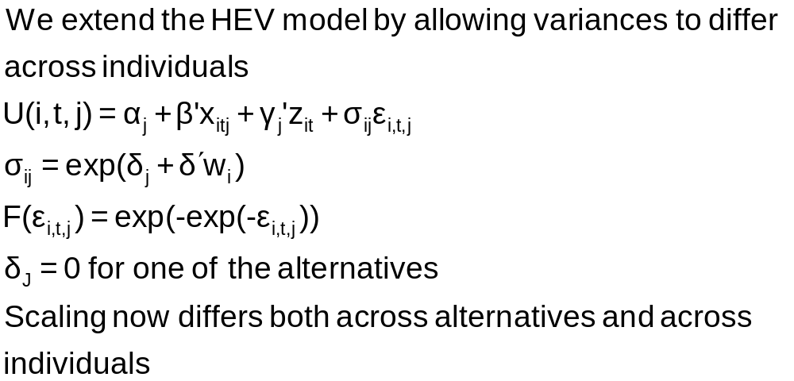
Variance Heterogeneity in MNL

Slide 12
Application: Shoe Brand Choice
Simulated Data: Stated Choice, 400 respondents, 8 choice situations, 3,200 observations
3 choice/attributes + NONE
  Fashion = High / Low
  Quality = High / Low
  Price = 25/50/75,100 coded 1,2,3,4
Heterogeneity: Sex, Age (<25, 25-39, 40+)
Underlying data generated by a 3 class latent class process (100, 200, 100 in classes)
Thanks to www.statisticalinnovations.com (Latent Gold)

Slide 13
NLOGIT Commands for HEV Model
Nlogit
; lhs=choice
; choices=Brand1,Brand2,Brand3,None
;Rhs = Fash,Qual,Price,ASC4
;heteroscedasticity
;hfn=male,agel25,age2539
; Effects: Price(Brand1,Brand2,Brand3)$

Slide 14
Multinomial Logit Starting Values
+---------------------------------------------+
| Discrete choice (multinomial logit) model |
| Number of observations 3200 |
| Log likelihood function -4158.503 |
| Number of obs.= 3200, skipped 0 bad obs. |
+---------------------------------------------+
+--------+--------------+----------------+--------+--------+
|Variable| Coefficient | Standard Error |b/St.Er.|P[|Z|>z]|
+--------+--------------+----------------+--------+--------+
FASH | 1.47890473 .06776814 21.823 .0000
QUAL | 1.01372755 .06444532 15.730 .0000
PRICE | -11.8023376 .80406103 -14.678 .0000
ASC4 | .03679254 .07176387 .513 .6082

Slide 15
Multinomial Logit Elasticities
+---------------------------------------------------+
| Elasticity averaged over observations.|
| Attribute is PRICE in choice BRAND1 |
| Effects on probabilities of all choices in model: |
| * = Direct Elasticity effect of the attribute. |
| Mean St.Dev |
| * Choice=BRAND1 -.8895 .3647 |
| Choice=BRAND2 .2907 .2631 |
| Choice=BRAND3 .2907 .2631 |
| Choice=NONE .2907 .2631 |
| Attribute is PRICE in choice BRAND2 |
| Choice=BRAND1 .3127 .1371 |
| * Choice=BRAND2 -1.2216 .3135 |
| Choice=BRAND3 .3127 .1371 |
| Choice=NONE .3127 .1371 |
| Attribute is PRICE in choice BRAND3 |
| Choice=BRAND1 .3664 .2233 |
| Choice=BRAND2 .3664 .2233 |
| * Choice=BRAND3 -.7548 .3363 |
| Choice=NONE .3664 .2233 |
+---------------------------------------------------+

Slide 16
HEV Model without Heterogeneity
+---------------------------------------------+
| Heteroskedastic Extreme Value Model |
| Dependent variable CHOICE |
| Number of observations 3200 |
| Log likelihood function -4151.611 |
| Response data are given as ind. choice. |
+---------------------------------------------+
+--------+--------------+----------------+--------+--------+
|Variable| Coefficient | Standard Error |b/St.Er.|P[|Z|>z]|
+--------+--------------+----------------+--------+--------+
---------+Attributes in the Utility Functions (beta)
FASH | 1.57473345 .31427031 5.011 .0000
QUAL | 1.09208463 .22895113 4.770 .0000
PRICE | -13.3740754 2.61275111 -5.119 .0000
ASC4 | -.01128916 .22484607 -.050 .9600
---------+Scale Parameters of Extreme Value Distns Minus 1.0
s_BRAND1| .03779175 .22077461 .171 .8641
s_BRAND2| -.12843300 .17939207 -.716 .4740
s_BRAND3| .01149458 .22724947 .051 .9597
s_NONE | .000000 ......(Fixed Parameter).......
---------+Std.Dev=pi/(theta*sqr(6)) for H.E.V. distribution.
s_BRAND1| 1.23584505 .26290748 4.701 .0000
s_BRAND2| 1.47154471 .30288372 4.858 .0000
s_BRAND3| 1.26797496 .28487215 4.451 .0000
s_NONE | 1.28254980 ......(Fixed Parameter).......
Essentially no differences in variances across choices

Slide 17
Homogeneous HEV Elasticities
Multinomial Logit
+---------------------------------------------------+
| Attribute is PRICE in choice BRAND1 |
| Mean St.Dev |
| * Choice=BRAND1 -1.0585 .4526 |
| Choice=BRAND2 .2801 .2573 |
| Choice=BRAND3 .3270 .3004 |
| Choice=NONE .3232 .2969 |
| Attribute is PRICE in choice BRAND2 |
| Choice=BRAND1 .3576 .1481 |
| * Choice=BRAND2 -1.2122 .3142 |
| Choice=BRAND3 .3466 .1426 |
| Choice=NONE .3429 .1411 |
| Attribute is PRICE in choice BRAND3 |
| Choice=BRAND1 .4332 .2532 |
| Choice=BRAND2 .3610 .2116 |
| * Choice=BRAND3 -.8648 .4015 |
| Choice=NONE .4156 .2436 |
+---------------------------------------------------+
| Elasticity averaged over observations.|
| Effects on probabilities of all choices in model: |
| * = Direct Elasticity effect of the attribute. |
+---------------------------------------------------+
+--------------------------+
| PRICE in choice BRAND1|
| Mean St.Dev |
| * -.8895 .3647 |
| .2907 .2631 |
| .2907 .2631 |
| .2907 .2631 |
| PRICE in choice BRAND2|
| .3127 .1371 |
| * -1.2216 .3135 |
| .3127 .1371 |
| .3127 .1371 |
| PRICE in choice BRAND3|
| .3664 .2233 |
| .3664 .2233 |
| * -.7548 .3363 |
| .3664 .2233 |
+--------------------------+

Slide 18
Heteroscedasticity Across Individuals
+---------------------------------------------+
| Heteroskedastic Extreme Value Model | Homog-HEV MNL
| Log likelihood function -4129.518[10] | -4151.611[7] -4158.503[4]
+---------------------------------------------+
+--------+--------------+----------------+--------+--------+
|Variable| Coefficient | Standard Error |b/St.Er.|P[|Z|>z]|
+--------+--------------+----------------+--------+--------+
---------+Attributes in the Utility Functions (beta)
FASH | 1.01640726 .20261573 5.016 .0000
QUAL | .55668491 .11604080 4.797 .0000
PRICE | -7.44758292 1.52664112 -4.878 .0000
ASC4 | .18300524 .09678571 1.891 .0586
---------+Scale Parameters of Extreme Value Distributions
s_BRAND1| .81114924 .10099174 8.032 .0000
s_BRAND2| .72713522 .08931110 8.142 .0000
s_BRAND3| .80084114 .10316939 7.762 .0000
s_NONE | 1.00000000 ......(Fixed Parameter).......
---------+Heterogeneity in Scales of Ext.Value Distns.
MALE | .21512161 .09359521 2.298 .0215
AGE25 | .79346679 .13687581 5.797 .0000
AGE39 | .38284617 .16129109 2.374 .0176

Slide 19
Variance Heterogeneity elasts
Multinomial Logit
+---------------------------------------------------+
| Attribute is PRICE in choice BRAND1 |
| Mean St.Dev |
| * Choice=BRAND1 -.8978 .5162 |
| Choice=BRAND2 .2269 .2595 |
| Choice=BRAND3 .2507 .2884 |
| Choice=NONE .3116 .3587 |
| Attribute is PRICE in choice BRAND2 |
| Choice=BRAND1 .2853 .1776 |
| * Choice=BRAND2 -1.0757 .5030 |
| Choice=BRAND3 .2779 .1669 |
| Choice=NONE .3404 .2045 |
| Attribute is PRICE in choice BRAND3 |
| Choice=BRAND1 .3328 .2477 |
| Choice=BRAND2 .2974 .2227 |
| * Choice=BRAND3 -.7458 .4468 |
| Choice=NONE .4056 .3025 |
+---------------------------------------------------+
+--------------------------+
| PRICE in choice BRAND1|
| Mean St.Dev |
| * -.8895 .3647 |
| .2907 .2631 |
| .2907 .2631 |
| .2907 .2631 |
| PRICE in choice BRAND2|
| .3127 .1371 |
| * -1.2216 .3135 |
| .3127 .1371 |
| .3127 .1371 |
| PRICE in choice BRAND3|
| .3664 .2233 |
| .3664 .2233 |
| * -.7548 .3363 |
| .3664 .2233 |
+--------------------------+

Slide 20
The Nested Logit Model

Slide 21
Extended Formulation of the MNL
Clusters of similar alternatives
Compound Utility: U(Alt)=U(Alt|Branch)+U(branch)
Behavioral implications – Correlations across branches
LIMB
Travel
BRANCH
Private
Public
TWIG
Air
Car
Train
Bus

Slide 22
Correlation Structure for a Two Level Model
Within a branch
  Identical variances (IIA applies)
  Covariance (all same) = variance at higher level
Branches have different variances (scale factors)
Nested logit probabilities: Generalized Extreme Value
Prob[Alt,Branch] = Prob(branch) * Prob(Alt|Branch)

Slide 23
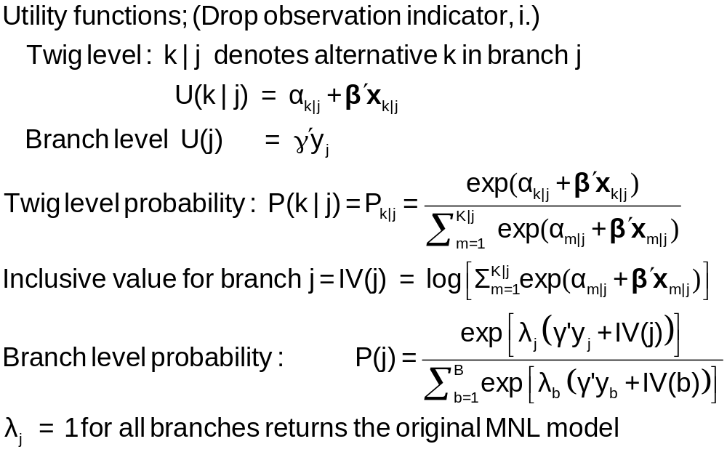
Probabilities for a Nested Logit Model

Slide 24
Estimation Strategy for Nested Logit Models
Two step estimation
  For each branch, just fit MNL
    Loses efficiency – replicates coefficients
    Does not insure consistency with utility maximization
  For branch level, fit separate model, just including y and the inclusive values
    Again loses efficiency
    Not consistent with utility maximization – note the form of the
    branch probability
Full information ML
Fit the entire model at once, imposing all restrictions

Slide 25
Estimates of a Nested Logit Model
NLOGIT ; Lhs=mode
; Rhs=gc,ttme,invt,invc
; Rh2=one,hinc
; Choices=air,train,bus,car
; Tree=Travel[Private(Air,Car),
Public(Train,Bus)]
; Show tree
; Effects: invc(*)
; Describe
; RU1 $ Selects branch normalization

Slide 26
Model Structure
Tree Structure Specified for the Nested Logit Model
Sample proportions are marginal, not conditional.
Choices marked with * are excluded for the IIA test.
----------------+----------------+----------------+----------------+------+---
Trunk (prop.)|Limb (prop.)|Branch (prop.)|Choice (prop.)|Weight|IIA
----------------+----------------+----------------+----------------+------+---
Trunk{1} 1.00000|TRAVEL 1.00000|PRIVATE .55714|AIR .27619| 1.000|
| | |CAR .28095| 1.000|
| |PUBLIC .44286|TRAIN .30000| 1.000|
| | |BUS .14286| 1.000|
----------------+----------------+----------------+----------------+------+---
+---------------------------------------------------------------+
| Model Specification: Table entry is the attribute that |
| multiplies the indicated parameter. |
+--------+------+-----------------------------------------------+
| Choice |******| Parameter |
| |Row 1| GC TTME INVT INVC A_AIR |
| |Row 2| AIR_HIN1 A_TRAIN TRA_HIN3 A_BUS BUS_HIN4 |
+--------+------+-----------------------------------------------+
|AIR | 1| GC TTME INVT INVC Constant |
| | 2| HINC none none none none |
|CAR | 1| GC TTME INVT INVC none |
| | 2| none none none none none |
|TRAIN | 1| GC TTME INVT INVC none |
| | 2| none Constant HINC none none |
|BUS | 1| GC TTME INVT INVC none |
| | 2| none none none Constant HINC |
+---------------------------------------------------------------+

Slide 27
MNL Starting Values
-----------------------------------------------------------
Discrete choice (multinomial logit) model
Dependent variable Choice
Log likelihood function -172.94366
Estimation based on N = 210, K = 10
R2=1-LogL/LogL* Log-L fncn R-sqrd R2Adj
Constants only -283.7588 .3905 .3787
Chi-squared[ 7] = 221.63022
Prob [ chi squared > value ] = .00000
Response data are given as ind. choices
Number of obs.= 210, skipped 0 obs
--------+--------------------------------------------------
Variable| Coefficient Standard Error b/St.Er. P[|Z|>z]
--------+--------------------------------------------------
GC| .07578*** .01833 4.134 .0000
TTME| -.10289*** .01109 -9.280 .0000
INVT| -.01399*** .00267 -5.240 .0000
INVC| -.08044*** .01995 -4.032 .0001
A_AIR| 4.37035*** 1.05734 4.133 .0000
AIR_HIN1| .00428 .01306 .327 .7434
A_TRAIN| 5.91407*** .68993 8.572 .0000
TRA_HIN3| -.05907*** .01471 -4.016 .0001
A_BUS| 4.46269*** .72333 6.170 .0000
BUS_HIN4| -.02295 .01592 -1.442 .1493
--------+--------------------------------------------------

Slide 28
FIML Parameter Estimates
-----------------------------------------------------------
FIML Nested Multinomial Logit Model
Dependent variable MODE
Log likelihood function -166.64835
The model has 2 levels.
Random Utility Form 1:IVparms = LMDAb|l
Number of obs.= 210, skipped 0 obs
--------+--------------------------------------------------
Variable| Coefficient Standard Error b/St.Er. P[|Z|>z]
--------+--------------------------------------------------
|Attributes in the Utility Functions (beta)
GC| .06579*** .01878 3.504 .0005
TTME| -.07738*** .01217 -6.358 .0000
INVT| -.01335*** .00270 -4.948 .0000
INVC| -.07046*** .02052 -3.433 .0006
A_AIR| 2.49364** 1.01084 2.467 .0136
AIR_HIN1| .00357 .01057 .337 .7358
A_TRAIN| 3.49867*** .80634 4.339 .0000
TRA_HIN3| -.03581*** .01379 -2.597 .0094
A_BUS| 2.30142*** .81284 2.831 .0046
BUS_HIN4| -.01128 .01459 -.773 .4395
|IV parameters, lambda(b|l),gamma(l)
PRIVATE| 2.16095*** .47193 4.579 .0000
PUBLIC| 1.56295*** .34500 4.530 .0000
|Underlying standard deviation = pi/(IVparm*sqr(6)
PRIVATE| .59351*** .12962 4.579 .0000
PUBLIC| .82060*** .18114 4.530 .0000
--------+--------------------------------------------------

Slide 29
Estimated Elasticities – Note Decomposition
+-----------------------------------------------------------------------+
| Elasticity averaged over observations. |
| Attribute is INVC in choice AIR |
| Decomposition of Effect if Nest Total Effect|
| Trunk Limb Branch Choice Mean St.Dev|
| Branch=PRIVATE |
| * Choice=AIR .000 .000 -2.456 -3.091 -5.547 3.525 |
| Choice=CAR .000 .000 -2.456 2.916 .460 3.178 |
| Branch=PUBLIC |
| Choice=TRAIN .000 .000 3.846 .000 3.846 4.865 |
| Choice=BUS .000 .000 3.846 .000 3.846 4.865 |
+-----------------------------------------------------------------------+
| Attribute is INVC in choice CAR |
| Branch=PRIVATE |
| Choice=AIR .000 .000 -.757 .650 -.107 .589 |
| * Choice=CAR .000 .000 -.757 -.830 -1.587 1.292 |
| Branch=PUBLIC |
| Choice=TRAIN .000 .000 .647 .000 .647 .605 |
| Choice=BUS .000 .000 .647 .000 .647 .605 |
+-----------------------------------------------------------------------+
| Attribute is INVC in choice TRAIN |
| Branch=PRIVATE |
| Choice=AIR .000 .000 1.340 .000 1.340 1.475 |
| Choice=CAR .000 .000 1.340 .000 1.340 1.475 |
| Branch=PUBLIC |
| * Choice=TRAIN .000 .000 -1.986 -1.490 -3.475 2.539 |
| Choice=BUS .000 .000 -1.986 2.128 .142 1.321 |
+-----------------------------------------------------------------------+
| Attribute is INVC in choice BUS |
| Branch=PRIVATE |
| Choice=AIR .000 .000 .547 .000 .547 .871 |
| Choice=CAR .000 .000 .547 .000 .547 .871 |
| Branch=PUBLIC |
| Choice=TRAIN .000 .000 -.841 .888 .047 .678 |
| * Choice=BUS .000 .000 -.841 -1.469 -2.310 1.119 |
+-----------------------------------------------------------------------+
| Effects on probabilities of all choices in the model: |
| * indicates direct Elasticity effect of the attribute. |
+-----------------------------------------------------------------------+

Slide 30
Testing vs. the MNL
Log likelihood for the NL model
Constrain IV parameters to equal 1 with
; IVSET(list of branches)=[1]
Use likelihood ratio test
For the example:
  LogL = -166.68435
  LogL (MNL) = -172.94366
  Chi-squared with 2 d.f. = 2(-166.68435-(-172.94366))
  = 12.51862
  The critical value is 5.99 (95%)
  The MNL is rejected

Slide 31
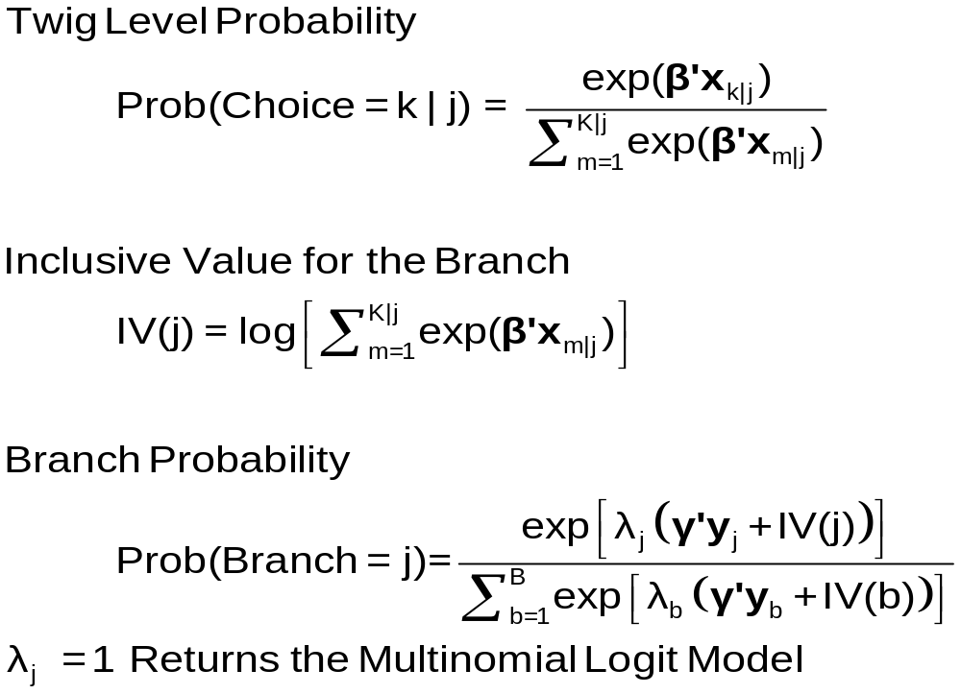
Model Form RU1

Slide 32
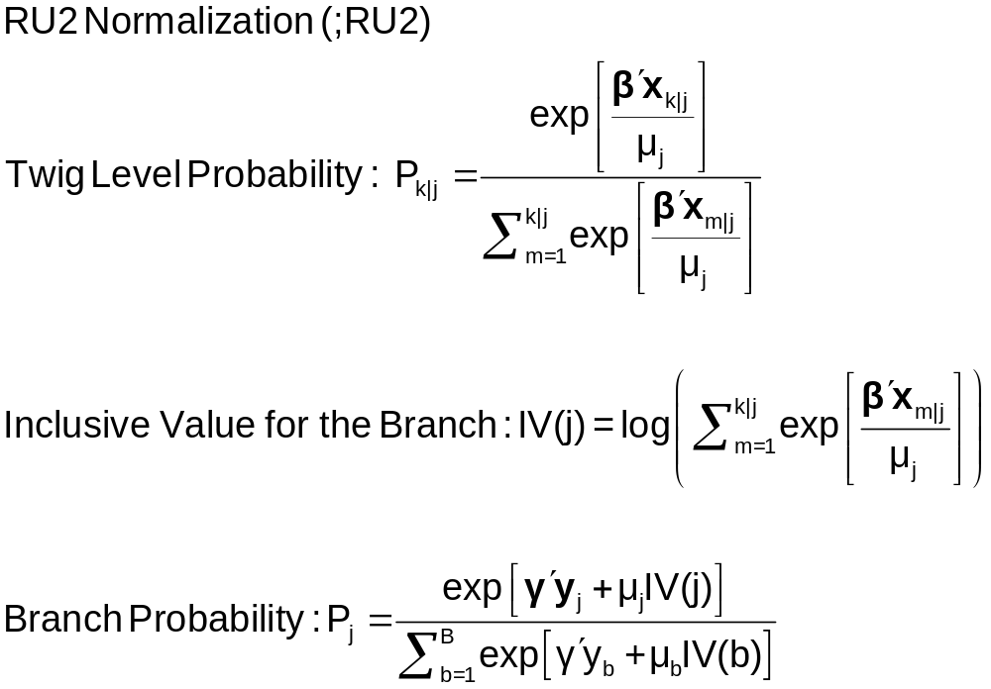
Moving Scaling Down to the Twig Level

Slide 33
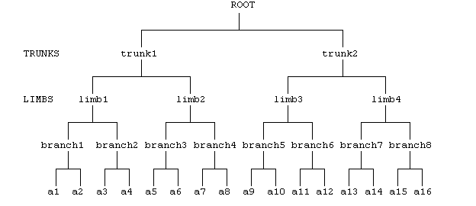
Higher Level Trees
E.g., Location (Neighborhood)
Housing Type (Rent, Buy, House, Apt)
Housing (# Bedrooms)

Slide 34
Degenerate Branches
LIMB
Travel
BRANCH
Fly
Ground
TWIG
Air
Train
Car
Bus

Slide 35
NL Model with Degenerate Branch
-----------------------------------------------------------
FIML Nested Multinomial Logit Model
Dependent variable MODE
Log likelihood function -148.63860
--------+--------------------------------------------------
Variable| Coefficient Standard Error b/St.Er. P[|Z|>z]
--------+--------------------------------------------------
|Attributes in the Utility Functions (beta)
GC| .44230*** .11318 3.908 .0001
TTME| -.10199*** .01598 -6.382 .0000
INVT| -.07469*** .01666 -4.483 .0000
INVC| -.44283*** .11437 -3.872 .0001
A_AIR| 3.97654*** 1.13637 3.499 .0005
AIR_HIN1| .02163 .01326 1.631 .1028
A_TRAIN| 6.50129*** 1.01147 6.428 .0000
TRA_HIN2| -.06427*** .01768 -3.635 .0003
A_BUS| 4.52963*** .99877 4.535 .0000
BUS_HIN3| -.01596 .02000 -.798 .4248
|IV parameters, lambda(b|l),gamma(l)
FLY| .86489*** .18345 4.715 .0000
GROUND| .24364*** .05338 4.564 .0000
|Underlying standard deviation = pi/(IVparm*sqr(6)
FLY| 1.48291*** .31454 4.715 .0000
GROUND| 5.26413*** 1.15331 4.564 .0000
--------+--------------------------------------------------

Slide 36
Estimates of a Nested Logit Model
NLOGIT ; lhs=mode
; rhs=gc,ttme,invt,invc
; rh2=one,hinc
; choices=air,train,bus,car
; tree=Travel[Fly(Air),
Ground(Train,Car,Bus)]
; show tree
; effects:gc(*)
; Describe
; ru2 $
(This is RANDOM UTILITY FORM 2. The different normalization shows the effect of the degenerate branch.)

Slide 37
RU2 Form of Nested Logit Model
-----------------------------------------------------------
FIML Nested Multinomial Logit Model
Dependent variable MODE
Log likelihood function -168.81283 (-148.63860 with RU1)
--------+--------------------------------------------------
Variable| Coefficient Standard Error b/St.Er. P[|Z|>z]
--------+--------------------------------------------------
|Attributes in the Utility Functions (beta)
GC| .06527*** .01787 3.652 .0003
TTME| -.06114*** .01119 -5.466 .0000
INVT| -.01231*** .00283 -4.354 .0000
INVC| -.07018*** .01951 -3.597 .0003
A_AIR| 1.22545 .87245 1.405 .1601
AIR_HIN1| .01501 .01226 1.225 .2206
A_TRAIN| 3.44408*** .68388 5.036 .0000
TRA_HIN2| -.02823*** .00852 -3.311 .0009
A_BUS| 2.58400*** .63247 4.086 .0000
BUS_HIN3| -.00726 .01075 -.676 .4993
|IV parameters, RU2 form = mu(b|l),gamma(l)
FLY| 1.00000 ......(Fixed Parameter)......
GROUND| .47778*** .10508 4.547 .0000
|Underlying standard deviation = pi/(IVparm*sqr(6)
FLY| 1.28255 ......(Fixed Parameter)......
GROUND| 2.68438*** .59041 4.547 .0000
--------+--------------------------------------------------

Slide 38
Using Degenerate Branches to Reveal Scaling
LIMB
Travel
BRANCH
Fly
Rail
Drive
GrndPblc
TWIG
Air
Train
Car
Bus

Slide 39
Scaling in Transport Modes
-----------------------------------------------------------
FIML Nested Multinomial Logit Model
Dependent variable MODE
Log likelihood function -182.42834
The model has 2 levels.
Nested Logit form:IVparms=Taub|l,r,Sl|r
& Fr.No normalizations imposed a priori
Number of obs.= 210, skipped 0 obs
--------+--------------------------------------------------
Variable| Coefficient Standard Error b/St.Er. P[|Z|>z]
--------+--------------------------------------------------
|Attributes in the Utility Functions (beta)
GC| .09622** .03875 2.483 .0130
TTME| -.08331*** .02697 -3.089 .0020
INVT| -.01888*** .00684 -2.760 .0058
INVC| -.10904*** .03677 -2.966 .0030
A_AIR| 4.50827*** 1.33062 3.388 .0007
A_TRAIN| 3.35580*** .90490 3.708 .0002
A_BUS| 3.11885** 1.33138 2.343 .0192
|IV parameters, tau(b|l,r),sigma(l|r),phi(r)
FLY| 1.65512** .79212 2.089 .0367
RAIL| .92758*** .11822 7.846 .0000
LOCLMASS| 1.00787*** .15131 6.661 .0000
DRIVE| 1.00000 ......(Fixed Parameter)......
--------+--------------------------------------------------
NLOGIT ; Lhs=mode
; Rhs=gc,ttme,invt,invc,one
; Choices=air,train,bus,car
; Tree=Fly(Air),
Rail(train),
LoclMass(bus),
Drive(Car)
; ivset:(drive)=[1]$

Slide 40
Simulating the Nested Logit Model
NLOGIT ; lhs=mode;rhs=gc,ttme,invt,invc ; rh2=one,hinc
; choices=air,train,bus,car
; tree=Travel[Private(Air,Car),Public(Train,Bus)]
; ru1
; simulation = *
; scenario:gc(car)=[*]1.5
+------------------------------------------------------+
|Simulations of Probability Model |
|Model: FIML: Nested Multinomial Logit Model |
|Number of individuals is the probability times the |
|number of observations in the simulated sample. |
|Column totals may be affected by rounding error. |
|The model used was simulated with 210 observations.|
+------------------------------------------------------+
-------------------------------------------------------------------------
Specification of scenario 1 is:
Attribute Alternatives affected Change type Value
--------- ------------------------------- ------------------- ---------
GC CAR Scale base by value 1.500
Simulated Probabilities (shares) for this scenario:
+----------+--------------+--------------+------------------+
|Choice | Base | Scenario | Scenario - Base |
| |%Share Number |%Share Number |ChgShare ChgNumber|
+----------+--------------+--------------+------------------+
|AIR | 26.515 56 | 8.854 19 |-17.661% -37 |
|TRAIN | 29.782 63 | 12.487 26 |-17.296% -37 |
|BUS | 14.504 30 | 71.824 151 | 57.320% 121 |
|CAR | 29.200 61 | 6.836 14 |-22.364% -47 |
|Total |100.000 210 |100.000 210 | .000% 0 |
+----------+--------------+--------------+------------------+

Slide 41
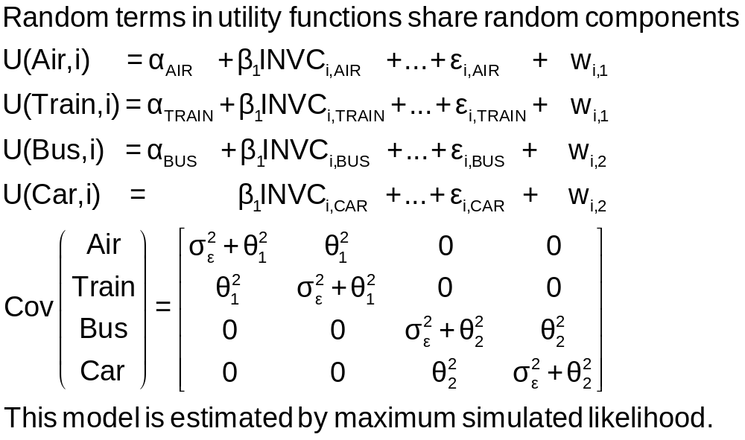
An Error Components Model

Slide 42
Error Components Logit Model
-----------------------------------------------------------
Error Components (Random Effects) model
Dependent variable MODE
Log likelihood function -182.27368
Response data are given as ind. choices
Replications for simulated probs. = 25
Halton sequences used for simulations
ECM model with panel has 70 groups
Fixed number of obsrvs./group= 3
Hessian is not PD. Using BHHH estimator
Number of obs.= 210, skipped 0 obs
--------+--------------------------------------------------
Variable| Coefficient Standard Error b/St.Er. P[|Z|>z]
--------+--------------------------------------------------
|Nonrandom parameters in utility functions
GC| .07293*** .01978 3.687 .0002
TTME| -.10597*** .01116 -9.499 .0000
INVT| -.01402*** .00293 -4.787 .0000
INVC| -.08825*** .02206 -4.000 .0001
A_AIR| 5.31987*** .90145 5.901 .0000
A_TRAIN| 4.46048*** .59820 7.457 .0000
A_BUS| 3.86918*** .67674 5.717 .0000
|Standard deviations of latent random effects
SigmaE01| -.27336 3.25167 -.084 .9330
SigmaE02| 1.21988 .94292 1.294 .1958
--------+--------------------------------------------------

