Slide 1
Discrete Choice Models
William Greene
Stern School of Business
New York University

Slide 2
Part 11
Modeling Heterogeneity

Slide 3
Several Types of Heterogeneity
Observational: Observable differences across
choice makers
Choice strategy: How consumers make
decisions. (E.g., omitted attributes)
Structure: Model frameworks
Preferences: Model ‘parameters’

Slide 4
Attention to Heterogeneity
Modeling heterogeneity is important
Attention to heterogeneity –
an informal survey of four literatures
 | Levels | Scaling
Economics | ● | None
Education | ● | None
Marketing | ● | Much
Transport | ● | Extensive

Slide 5
Heterogeneity in Choice Strategy
Consumers avoid ‘complexity’
  Lexicographic preferences eliminate certain choices ➔ choice set may be endogenously determined
  Simplification strategies may eliminate
  certain attributes
Information processing strategy is a
source of heterogeneity in the model.

Slide 6
“Structural Heterogeneity”
Marketing literature
Latent class structures
  Yang/Allenby - latent class random parameters models
  Kamkura et al – latent class nested logit models with fixed parameters

Slide 7
Accommodating Heterogeneity
Observed? Enter in the model in
familiar (and unfamiliar) ways.
Unobserved? Takes the form of
randomness in the model.

Slide 8
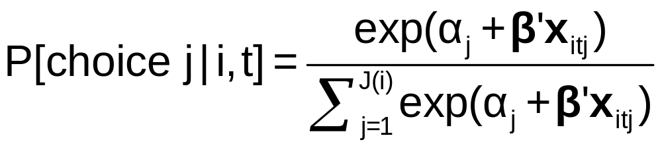
Heterogeneity and the MNL Model
Limitations of the MNL Model:
  IID ➔ IIA
  Fundamental tastes are the same across all individuals
How to adjust the model to allow variation across individuals?
  Full random variation
  Latent clustering – allow some variation

Slide 9
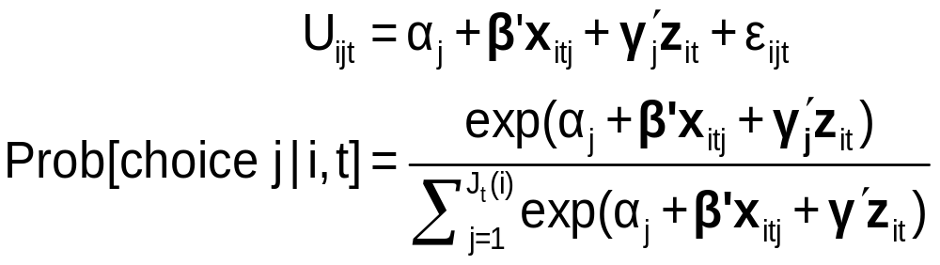
Observable Heterogeneity in Utility Levels
Choice, e.g., among brands of cars
x_{itj} = attributes: price, features
z_{it} = observable characteristics: age, sex, income

Slide 10
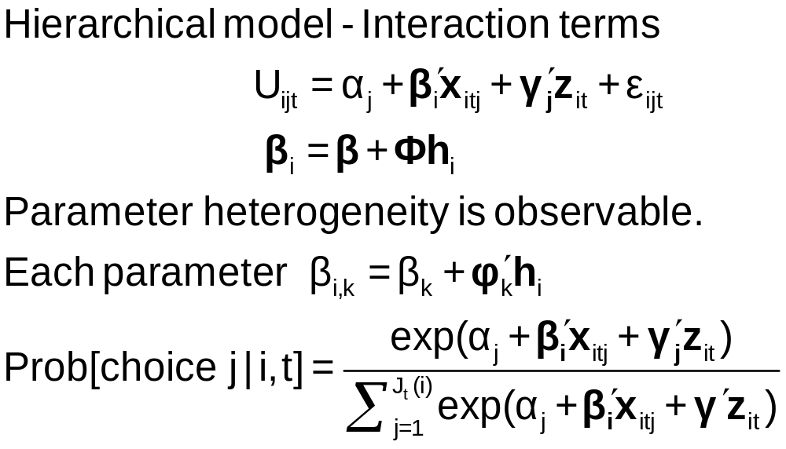
Observable Heterogeneity in
Preference Weights

Slide 11
Heteroscedasticity in the MNL Model
• Motivation: Scaling in utility functions
• If ignored, distorts coefficients
• Random utility basis
Uij = α_{j} + β’x_{ij} + γ’z_{i} + σ_{j}ε_{ij}
i = 1,…,N; j = 1,…,J(i)
F(ε_{ij}) = Exp(-Exp(-ε_{ij})) now scaled
• Extensions: Relaxes IIA
        Allows heteroscedasticity across
        choices and across individuals

Slide 12
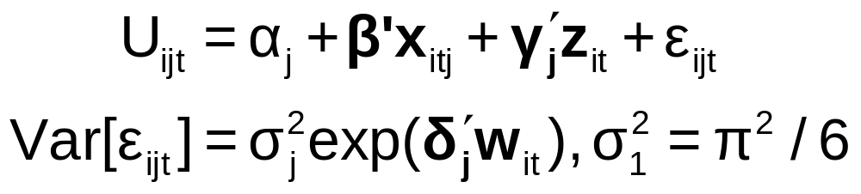
‘Quantifiable’ Heterogeneity in Scaling
w_{it} = observable characteristics:
age, sex, income, etc.

Slide 13
Modeling Unobserved Heterogeneity
Modeling individual heterogeneity
  Latent class – Discrete approximation
  Mixed logit – Continuous
  The mixed logit model (generalities)
Data structure – RP and SP data
  Induces heterogeneity
  Induces heteroscedasticity – the scaling problem

Slide 14
Heterogeneity
Modeling observed and unobserved individual heterogeneity
  Latent class – Discrete variation
  Mixed logit – Continuous variation
  The generalized mixed logit model

Slide 15
Latent Class Models

Slide 16
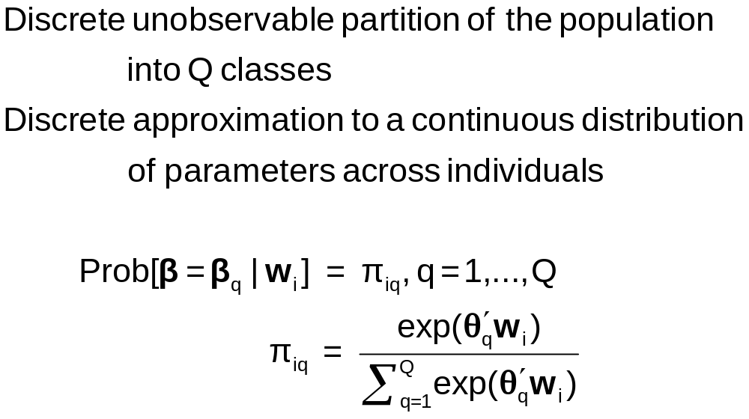
Discrete Parameter Heterogeneity
Latent Classes

Slide 17
Latent Class Probabilities
Ambiguous – Classical Bayesian model?
Equivalent to random parameters models with discrete parameter variation
  Using nested logits, etc. does not change this
  Precisely analogous to continuous ‘random parameter’ models
Not always equivalent – zero inflation models

Slide 18
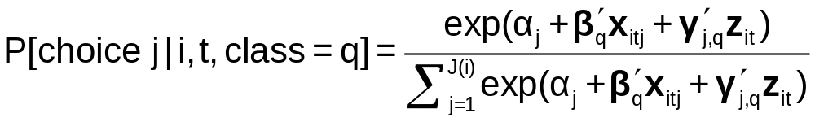
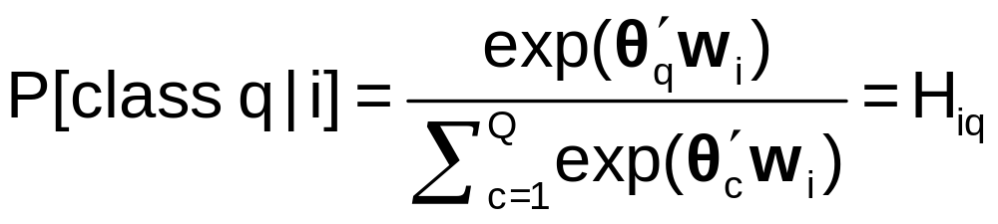
A Latent Class MNL Model
Within a “class”
Class sorting is probabilistic (to the analyst) determined by individual characteristics

Slide 19
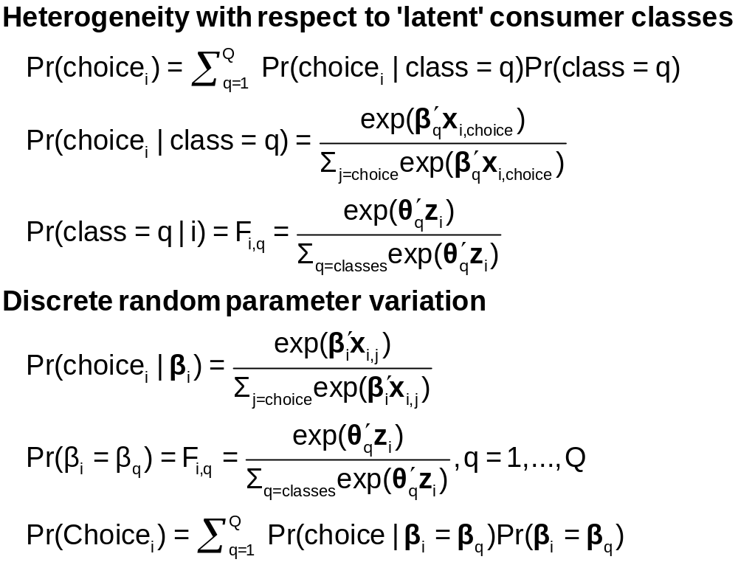
Two Interpretations of Latent Classes

Slide 20
Estimates from the LCM
Taste parameters within each class β_{q}
Parameters of the class probability model, θ_{q}
For each person:
  Posterior estimates of the class they are in q|i
  Posterior estimates of their taste parameters E[β_{q}|i]
  Posterior estimates of their behavioral parameters, elasticities, marginal effects, etc.

Slide 21
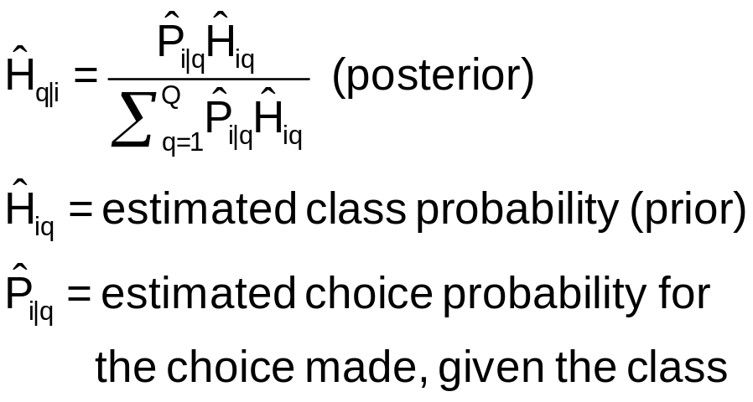
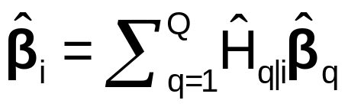
Using the Latent Class Model
Computing Posterior (individual specific) class probabilities
Computing posterior (individual specific) taste parameters

Slide 22
Application: Shoe Brand Choice
Simulated Data: Stated Choice, 400 respondents, 8 choice situations, 3,200 observations
3 choice/attributes + NONE
  Fashion = High / Low
  Quality = High / Low
  Price = 25/50/75,100 coded 1,2,3,4
Heterogeneity: Sex, Age (<25, 25-39, 40+)
Underlying data generated by a 3 class latent class process (100, 200, 100 in classes)
Thanks to www.statisticalinnovations.com (Latent Gold)

Slide 23
Application: Brand Choice
True underlying model is a three class LCM
NLOGIT
;lhs=choice
;choices=Brand1,Brand2,Brand3,None
;Rhs = Fash,Qual,Price,ASC4
;LCM=Male,Age25,Age39
; Pts=3
; Pds=8
; Par (Save posterior results) $

Slide 24
One Class MNL Estimates
-----------------------------------------------------------
Discrete choice (multinomial logit) model
Dependent variable Choice
Log likelihood function -4158.50286
Estimation based on N = 3200, K = 4
Information Criteria: Normalization=1/N
Normalized Unnormalized
AIC 2.60156 8325.00573
Fin.Smpl.AIC 2.60157 8325.01825
Bayes IC 2.60915 8349.28935
Hannan Quinn 2.60428 8333.71185
R2=1-LogL/LogL* Log-L fncn R-sqrd R2Adj
Constants only -4391.1804 .0530 .0510
Response data are given as ind. choices
Number of obs.= 3200, skipped 0 obs
--------+--------------------------------------------------
Variable| Coefficient Standard Error b/St.Er. P[|Z|>z]
--------+--------------------------------------------------
FASH|1| 1.47890*** .06777 21.823 .0000
QUAL|1| 1.01373*** .06445 15.730 .0000
PRICE|1| -11.8023*** .80406 -14.678 .0000
ASC4|1| .03679 .07176 .513 .6082
--------+--------------------------------------------------

Slide 25
Three Class LCM
Normal exit from iterations. Exit status=0.
-----------------------------------------------------------
Latent Class Logit Model
Dependent variable CHOICE
Log likelihood function -3649.13245
Restricted log likelihood -4436.14196
Chi squared [ 20 d.f.] 1574.01902
Significance level .00000
McFadden Pseudo R-squared .1774085
Estimation based on N = 3200, K = 20
Information Criteria: Normalization=1/N
Normalized Unnormalized
AIC 2.29321 7338.26489
Fin.Smpl.AIC 2.29329 7338.52913
Bayes IC 2.33115 7459.68302
Hannan Quinn 2.30681 7381.79552
R2=1-LogL/LogL* Log-L fncn R-sqrd R2Adj
No coefficients -4436.1420 .1774 .1757
Constants only -4391.1804 .1690 .1673
At start values -4158.5428 .1225 .1207
Response data are given as ind. choices
Number of latent classes = 3
Average Class Probabilities
.506 .239 .256
LCM model with panel has 400 groups
Fixed number of obsrvs./group= 8
Number of obs.= 3200, skipped 0 obs
--------+--------------------------------------------------
LogL for one class MNL = -4158.503
Based on the LR statistic it would seem unambiguous to reject the one class model. The degrees of freedom for the test are uncertain, however.

Slide 26
Estimated LCM: Utilities
--------+--------------------------------------------------
Variable| Coefficient Standard Error b/St.Er. P[|Z|>z]
--------+--------------------------------------------------
|Utility parameters in latent class -->> 1
FASH|1| 3.02570*** .14549 20.796 .0000
QUAL|1| -.08782 .12305 -.714 .4754
PRICE|1| -9.69638*** 1.41267 -6.864 .0000
ASC4|1| 1.28999*** .14632 8.816 .0000
|Utility parameters in latent class -->> 2
FASH|2| 1.19722*** .16169 7.404 .0000
QUAL|2| 1.11575*** .16356 6.821 .0000
PRICE|2| -13.9345*** 1.93541 -7.200 .0000
ASC4|2| -.43138** .18514 -2.330 .0198
|Utility parameters in latent class -->> 3
FASH|3| -.17168 .16725 -1.026 .3047
QUAL|3| 2.71881*** .17907 15.183 .0000
PRICE|3| -8.96483*** 1.93400 -4.635 .0000
ASC4|3| .18639 .18412 1.012 .3114

Slide 27
Estimated LCM: Class Probability Model
--------+--------------------------------------------------
Variable| Coefficient Standard Error b/St.Er. P[|Z|>z]
--------+--------------------------------------------------
|This is THETA(01) in class probability model.
Constant| -.90345** .37612 -2.402 .0163
_MALE|1| .64183* .36245 1.771 .0766
_AGE25|1| 2.13321*** .32096 6.646 .0000
_AGE39|1| .72630* .43511 1.669 .0951
|This is THETA(02) in class probability model.
Constant| .37636 .34812 1.081 .2796
_MALE|2| -2.76536*** .69325 -3.989 .0001
_AGE25|2| -.11946 .54936 -.217 .8279
_AGE39|2| 1.97657*** .71684 2.757 .0058
|This is THETA(03) in class probability model.
Constant| .000 ......(Fixed Parameter)......
_MALE|3| .000 ......(Fixed Parameter)......
_AGE25|3| .000 ......(Fixed Parameter)......
_AGE39|3| .000 ......(Fixed Parameter)......
--------+--------------------------------------------------
Note: ***, **, * = Significance at 1%, 5%, 10% level.
Fixed parameter ... is constrained to equal the value or
had a nonpositive st.error because of an earlier problem.
------------------------------------------------------------

Slide 28
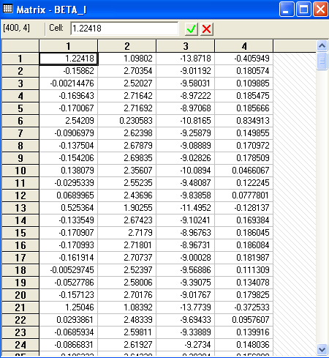
Estimated LCM:
Conditional Parameter Estimates

Slide 29
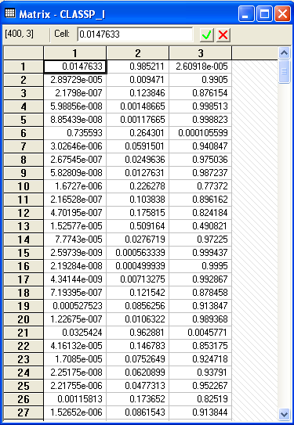
Estimated LCM:
Conditional Class Probabilities

Slide 30
Average Estimated Class Probabilities
MATRIX ; list ; 1/400 * classp_i'1$
Matrix Result has 3 rows and 1 columns.
1
+--------------
1| .50555
2| .23853
3| .25593
This is how the data were simulated. Class probabilities are .5, .25, .25. The model ‘worked.’

Slide 31
Elasticities
+---------------------------------------------------+
| Elasticity averaged over observations.|
| Effects on probabilities of all choices in model: |
| * = Direct Elasticity effect of the attribute. |
| Attribute is PRICE in choice BRAND1 |
| Mean St.Dev |
| * Choice=BRAND1 -.8010 .3381 |
| Choice=BRAND2 .2732 .2994 |
| Choice=BRAND3 .2484 .2641 |
| Choice=NONE .2193 .2317 |
+---------------------------------------------------+
| Attribute is PRICE in choice BRAND2 |
| Choice=BRAND1 .3106 .2123 |
| * Choice=BRAND2 -1.1481 .4885 |
| Choice=BRAND3 .2836 .2034 |
| Choice=NONE .2682 .1848 |
+---------------------------------------------------+
| Attribute is PRICE in choice BRAND3 |
| Choice=BRAND1 .3145 .2217 |
| Choice=BRAND2 .3436 .2991 |
| * Choice=BRAND3 -.6744 .3676 |
| Choice=NONE .3019 .2187 |
+---------------------------------------------------+
Elasticities are computed by averaging individual elasticities computed at the expected (posterior) parameter vector.
This is an unlabeled choice experiment. It is not possible to attach any significance to the fact that the elasticity is different for Brand1 and Brand 2 or Brand 3.

Slide 32
Application: Long Distance Drivers’
Preference for Road Environments
New Zealand survey, 2000, 274 drivers
Mixed revealed and stated choice experiment
4 Alternatives in choice set
  The current road the respondent is/has been using;
  A hypothetical 2-lane road;
  A hypothetical 4-lane road with no median;
  A hypothetical 4-lane road with a wide grass median.
16 stated choice situations for each with 2 choice profiles
  choices involving all 4 choices
  choices involving only the last 3 (hypothetical)
Hensher and Greene, A Latent Class Model for Discrete Choice Analysis: Contrasts with Mixed Logit – Transportation Research B, 2003

Slide 33
Attributes
Time on the open road which is free flow (in minutes);
Time on the open road which is slowed by other traffic (in minutes);
Percentage of total time on open road spent with other vehicles close behind (ie tailgating) (%);
Curviness of the road (A four-level attribute - almost straight, slight, moderate, winding);
Running costs (in dollars);
Toll cost (in dollars).

Slide 34
Experimental Design
The four levels of the six attributes chosen are:
Free Flow Travel Time: -20%, -10%, +10%, +20%
Time Slowed Down: -20%, -10%, +10%, +20%
Percent of time with vehicles close behind:
-50%, -25%, +25%, +50%
Curviness:almost, straight, slight, moderate, winding
Running Costs: -10%, -5%, +5%, +10%
Toll cost for car and double for truck if trip duration is:
1 hours or less 0, 0.5, 1.5, 3
Between 1 hour and 2.5 hours 0, 1.5, 4.5, 9
More than 2.5 hours 0, 2.5, 7.5, 15

Slide 35
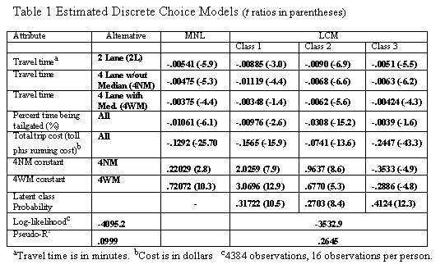
Estimated Latent Class Model

Slide 36
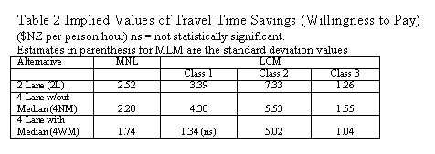
Estimated Value of Time Saved

Slide 37
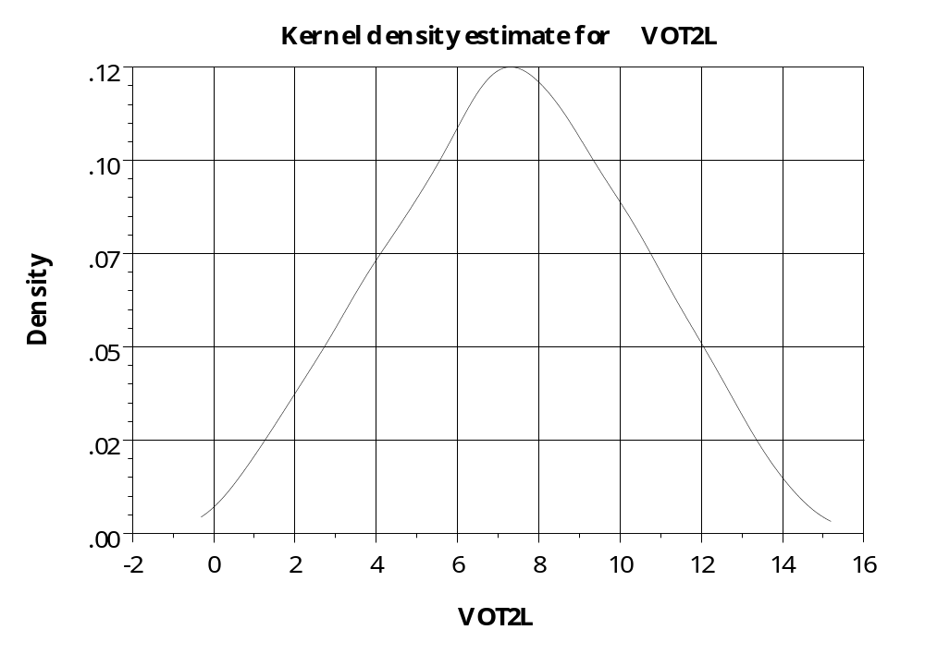
Distribution of Parameters –
Value of Time on 2 Lane Road

Slide 38
Mixed Logit Models

Slide 39
Random Parameters Model
Allow model parameters as well as constants to be random
Allow multiple observations with persistent effects
Allow a hierarchical structure for parameters – not completely random
U_{itj} = β₁’x_{i1tj} + β_{2i}’x_{i2tj} + γ_{i}’z_{it} + ε_{ijt}
Random parameters in multinomial logit model
  β1 = nonrandom (fixed) parameters
  β2i = random parameters that may vary across
  individuals and across time
Maintain I.I.D. assumption for ε_{ijt} (given β)

Slide 40
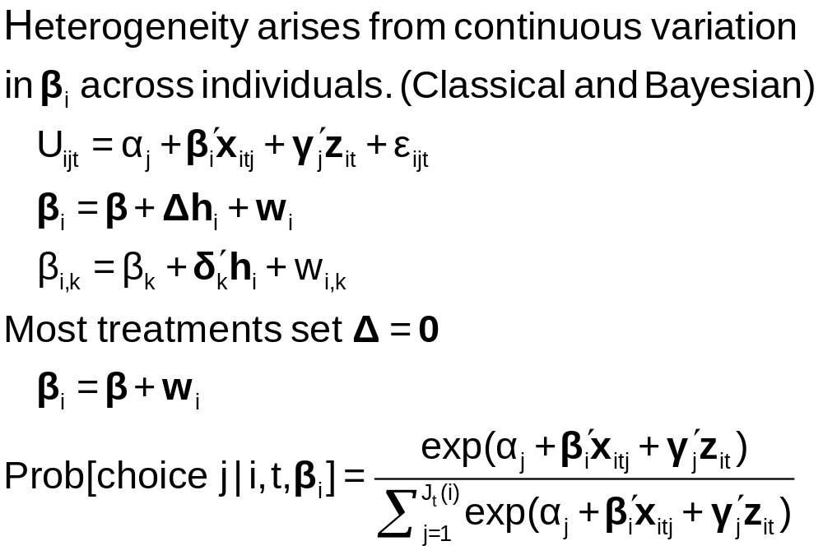
Continuous Random Variation in Preference Weights

Slide 41
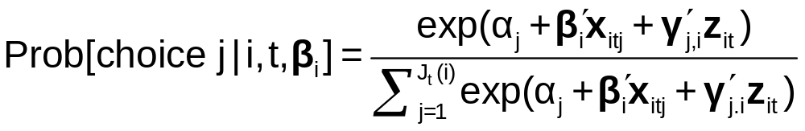
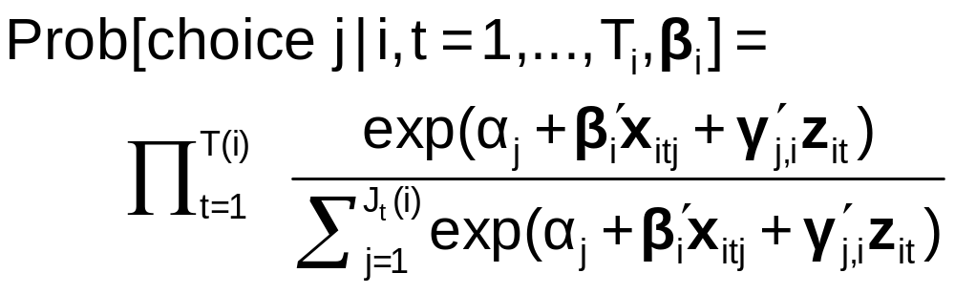
Random Parameters Logit Model
Multiple choice situations: Independent conditioned on the individual specific parameters

Slide 42
Modeling Variations
Parameter specification
  “Nonrandom” – variance = 0
  Correlation across parameters – random parts correlated
  Fixed mean – not to be estimated. Free variance
  Fixed range – mean estimated, triangular from 0 to 2β
  Hierarchical structure - β_{i} = β + δ(k)’z_{i}
Stochastic specification
  Normal, uniform, triangular (tent) distributions
  Strictly positive – lognormal parameters (e.g., on income)
  Autoregressive: v(i,t,k) = u(i,t,k) + r(k)v(i,t-1,k) [this picks up time effects in multiple choice situations, e.g., fatigue.]

Slide 43
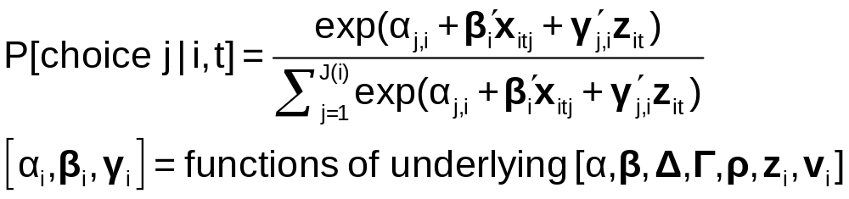
Estimating the Model
Denote by β₁ all “fixed” parameters in the model
Denote by β_{2i,t} all random and hierarchical parameters in the model

Slide 44
Estimating the RPL Model
Estimation: β₁
β_{2it} = β₂ + Δz_{i} + Γv_{i,t}
Uncorrelated: Γ is diagonal
Autocorrelated: v_{i,t} = Rv_{i,t-1} + u_{i,t}
(1) Estimate “structural parameters”
(2) Estimate individual specific utility parameters
(3) Estimate elasticities, etc.

Slide 45
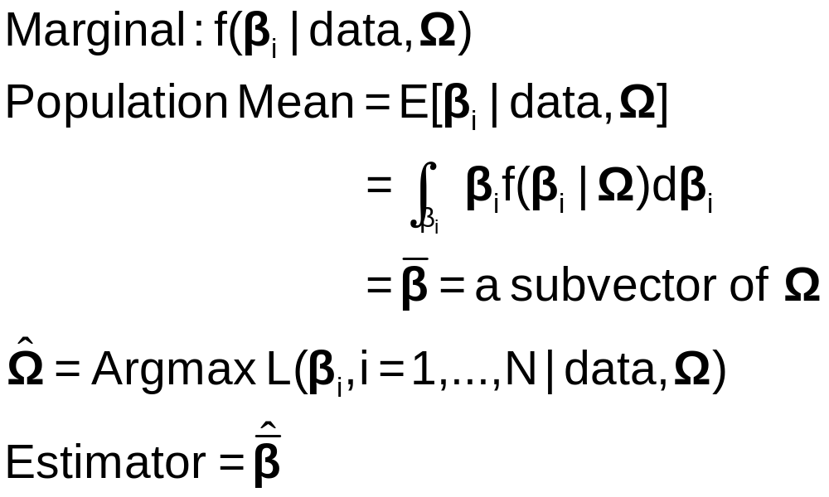
Classical Estimation Platform:
The Likelihood
Expected value over all possible realizations of β_{i} (according to the estimated asymptotic distribution). I.e., over all possible samples.

Slide 46

Simulation Based Estimation
Choice probability = P[data |β(β₁,β₂,Δ,Γ,R,v_{i,t})]
Need to integrate out the unobserved random term
E{P[data | β(β₁,β₂,Δ,Γ,R,v_{i,t})]}
= P[…|v_{i,t}]f(v_{i,t})dv_{i,t}
Integration is done by simulation
  Draw values of v and compute β then probabilities
  Average many draws
  Maximize the sum of the logs of the averages
  (See Train[Cambridge, 2003] on simulation methods.)

Slide 47
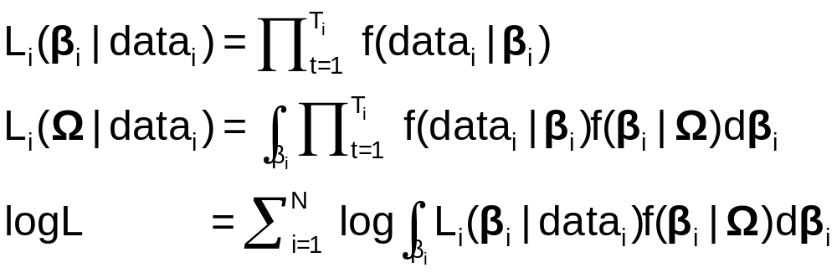
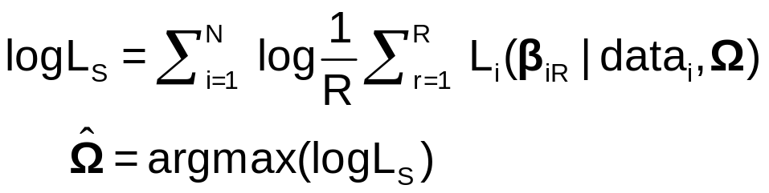
Maximum Simulated Likelihood
True log likelihood
Simulated log likelihood

Slide 48
Customers’ Choice of Energy Supplier
California, Stated Preference Survey
361 customers presented with 8-12 choice situations each
Supplier attributes:
  Fixed price: cents per kWh
  Length of contract
  Local utility
  Well-known company
  Time-of-day rates (11¢ in day, 5¢ at night)
  Seasonal rates (10¢ in summer, 8¢ in winter, 6¢ in spring/fall)

Slide 49
Population Distributions
Normal for:
  Contract length
  Local utility
  Well-known company
Log-normal for:
  Time-of-day rates
  Seasonal rates
Price coefficient held fixed

Slide 50
Estimated Model
Estimate Std error
Price -.883 0.050
Contract mean -.213 0.026
std dev .386 0.028
Local mean 2.23 0.127
std dev 1.75 0.137
Known mean 1.59 0.100
std dev .962 0.098
TOD mean* 2.13 0.054
std dev* .411 0.040
Seasonal mean* 2.16 0.051
std dev* .281 0.022
*Parameters of underlying normal.

Slide 51
Distribution of Brand Value
10% dislike local utility
Standard deviation
=2.0¢
0
2.5¢
Brand value of local utility

Slide 52
Contract Length
Mean: -.24
Standard Deviation: .55
29%
-0.24¢
0
Local Utility
Mean: 2.5
Standard Deviation: 2.0
10%
0
2.5¢
Well known company
Mean 1.8
Standard Deviation: 1.1
5%
0
1.8¢

Slide 53
Time of Day Rates (Customers do not like.)
Time-of-day Rates
-10.4
0
Seasonal Rates
-10.2
0

Slide 54
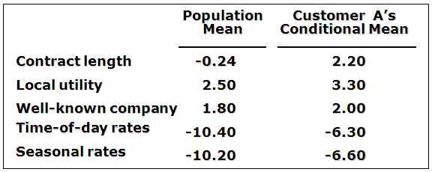
Expected Preferences of Each Customer
Customer likes long-term contract, local utility, and non-fixed rates.
Local utility can retain and make profit from this customer by offering a long-term contract with time-of-day or seasonal rates.

Slide 55
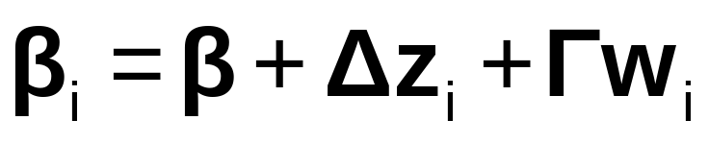
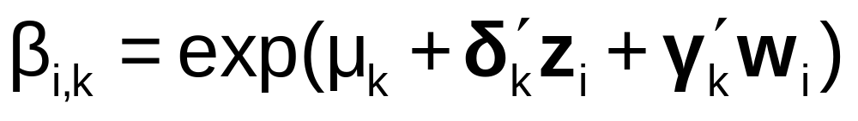
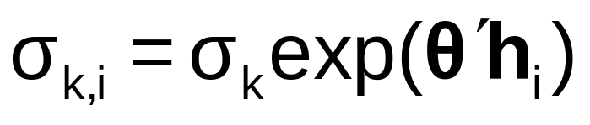
Model Extensions
AR(1): w_{i,k,t} = ρ_{k}w_{i,k,t-1} + v_{i,k,t}
Dynamic effects in the model
Restricting sign – lognormal distribution:
Restricting Range and Sign: Using triangular distribution and range = 0 to 2β.
Heteroscedasticity and heterogeneity

Slide 56
Estimating Individual Parameters
Model estimates = structural parameters, α, β, ρ, Δ, Σ, Γ
Objective, a model of individual specific parameters, β_{i}
Can individual specific parameters be estimated?
  Not quite – β_{i} is a single realization of a random process; one random draw.
  We estimate E[β_{i} | all information about i]
  (This is also true of Bayesian treatments, despite claims to the contrary.)

Slide 57
Estimating Individual Distributions
Form posterior estimates of E[β_{i}|data_{i}]
Use the same methodology to estimate E[β_{i}²|data_{i}] and Var[β_{i}|data_{i}]
Plot individual “confidence intervals” (assuming near normality)
Sample from the distribution and plot kernel density estimates

Slide 58
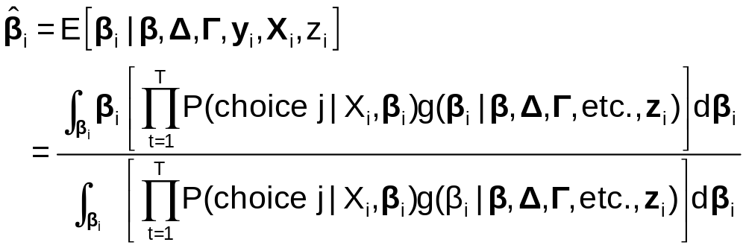
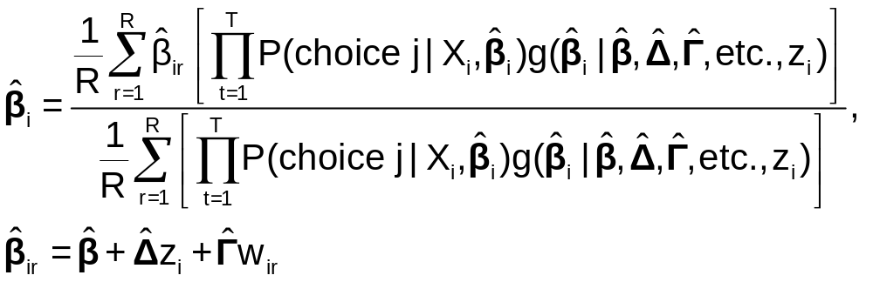
Posterior Estimation of β_{i}
Estimate by simulation

Slide 59
Application: Shoe Brand Choice
Simulated Data: Stated Choice, 400 respondents, 8 choice situations, 3,200 observations
3 choice/attributes + NONE
  Fashion = High / Low
  Quality = High / Low
  Price = 25/50/75,100 coded 1,2,3,4
Heterogeneity: Sex, Age (<25, 25-39, 40+)
Underlying data generated by a 3 class latent class process (100, 200, 100 in classes)
Thanks to www.statisticalinnovations.com (Latent Gold)

Slide 60
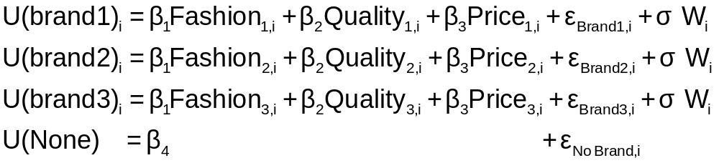
Error Components Logit Modeling
Alternative approach to building cross choice correlation
Common “effects”

Slide 61
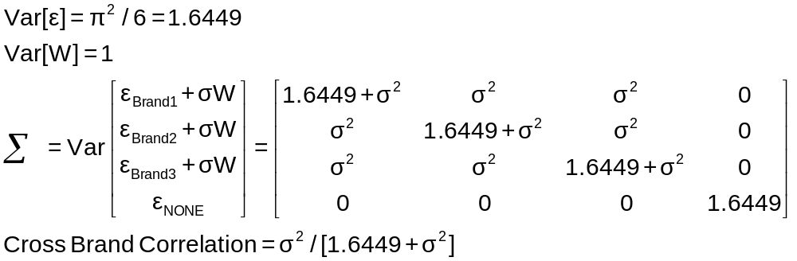
Implied Covariance Matrix

Slide 62
Error Components Logit Model
-----------------------------------------------------------
Error Components (Random Effects) model
Dependent variable CHOICE
Log likelihood function -4158.45044
Estimation based on N = 3200, K = 5
Response data are given as ind. choices
Replications for simulated probs. = 50
Halton sequences used for simulations
ECM model with panel has 400 groups
Fixed number of obsrvs./group= 8
Number of obs.= 3200, skipped 0 obs
--------+--------------------------------------------------
Variable| Coefficient Standard Error b/St.Er. P[|Z|>z]
--------+--------------------------------------------------
|Nonrandom parameters in utility functions
FASH| 1.47913*** .06971 21.218 .0000
QUAL| 1.01385*** .06580 15.409 .0000
PRICE| -11.8052*** .86019 -13.724 .0000
ASC4| .03363 .07441 .452 .6513
SigmaE01| .09585*** .02529 3.791 .0002
--------+--------------------------------------------------
Random Effects Logit Model
Appearance of Latent Random
Effects in Utilities
Alternative E01
+-------------+---+
| BRAND1 | * |
+-------------+---+
| BRAND2 | * |
+-------------+---+
| BRAND3 | * |
+-------------+---+
| NONE | |
+-------------+---+
Correlation = {0.0959² / [1.6449 + 0.0959²]}^{1/2} = 0.0954

Slide 63
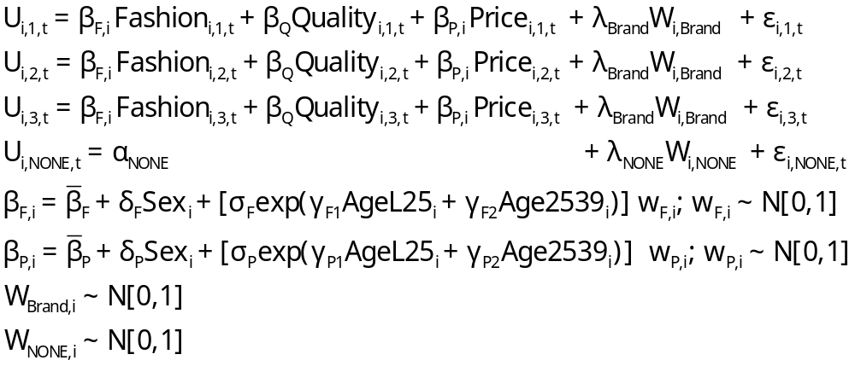
Extending the MNL Model
Utility Functions

Slide 64
Extending the Basic MNL Model
Random Utility

Slide 65
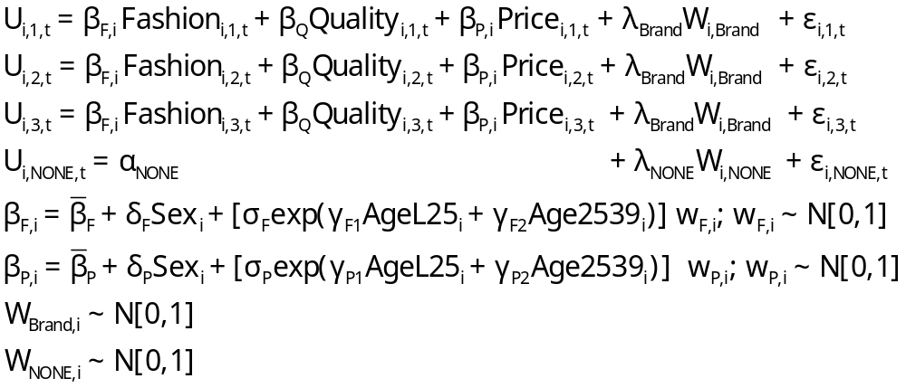
Error Components Logit Model
Error Components

Slide 66
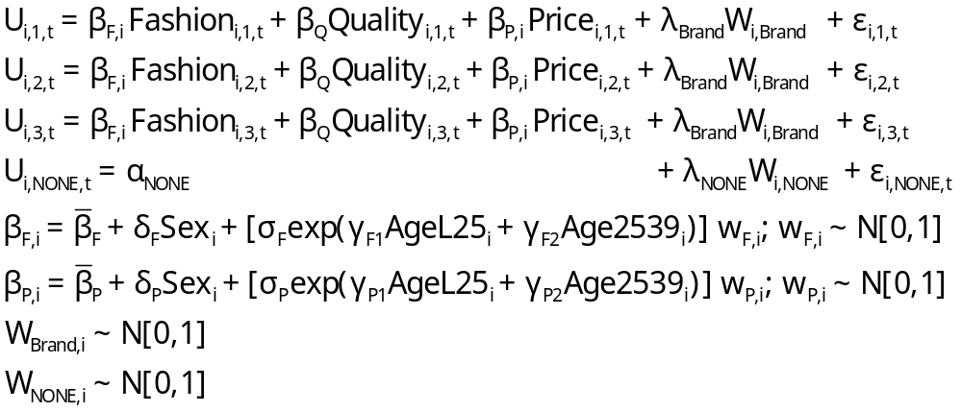
Random Parameters Model

Slide 67
Heterogeneous (in the Means)
Random Parameters Model

Slide 68
Heterogeneity in Both
Means and Variances

Slide 69
Estimated RP/ECL Model
--------+--------------------------------------------------
Variable| Coefficient Standard Error b/St.Er. P[|Z|>z]
--------+--------------------------------------------------
|Random parameters in utility functions
FASH| .62768*** .13498 4.650 .0000
PRICE| -7.60651*** 1.08418 -7.016 .0000
|Nonrandom parameters in utility functions
QUAL| 1.07127*** .06732 15.913 .0000
ASC4| .03874 .09017 .430 .6675
|Heterogeneity in mean, Parameter:Variable
FASH:AGE| 1.73176*** .15372 11.266 .0000
FAS0:AGE| .71872*** .18592 3.866 .0001
PRIC:AGE| -9.38055*** 1.07578 -8.720 .0000
PRI0:AGE| -4.33586*** 1.20681 -3.593 .0003
|Distns. of RPs. Std.Devs or limits of triangular
NsFASH| .88760*** .07976 11.128 .0000
NsPRICE| 1.23440 1.95780 .631 .5284
|Standard deviations of latent random effects
SigmaE01| .23165 .40495 .572 .5673
SigmaE02| .51260** .23002 2.228 .0258
--------+--------------------------------------------------
Note: ***, **, * = Significance at 1%, 5%, 10% level.
-----------------------------------------------------------
Random Effects Logit
Model Appearance of
Latent Random Effects
in Utilities
Alternative E01 E02
+-------------+---+---+
| BRAND1 | * | |
+-------------+---+---+
| BRAND2 | * | |
+-------------+---+---+
| BRAND3 | * | |
+-------------+---+---+
| NONE | | * |
+-------------+---+---+
Heterogeneity in Means.
Delta: 2 rows, 2 cols.
AGE25 AGE39
FASH 1.73176 .71872
PRICE -9.38055 -4.33586

Slide 70
Estimated Elasticities
Multinomial Logit
+---------------------------------------------------+
| Elasticity averaged over observations.|
| Attribute is PRICE in choice BRAND1 |
| Effects on probabilities of all choices in model: |
| * = Direct Elasticity effect of the attribute. |
| Mean St.Dev |
| * Choice=BRAND1 -.9210 .4661 |
| Choice=BRAND2 .2773 .3053 |
| Choice=BRAND3 .2971 .3370 |
| Choice=NONE .2781 .2804 |
+---------------------------------------------------+
| Attribute is PRICE in choice BRAND2 |
| Choice=BRAND1 .3055 .1911 |
| * Choice=BRAND2 -1.2692 .6179 |
| Choice=BRAND3 .3195 .2127 |
| Choice=NONE .2934 .1711 |
+---------------------------------------------------+
| Attribute is PRICE in choice BRAND3 |
| Choice=BRAND1 .3737 .2939 |
| Choice=BRAND2 .3881 .3047 |
| * Choice=BRAND3 -.7549 .4015 |
| Choice=NONE .3488 .2670 |
+---------------------------------------------------+
+--------------------------+
| Effects on probabilities |
| * = Direct effect te. |
| Mean St.Dev |
| PRICE in choice BRAND1 |
| * BRAND1 -.8895 .3647 |
| BRAND2 .2907 .2631 |
| BRAND3 .2907 .2631 |
| NONE .2907 .2631 |
+--------------------------+
| PRICE in choice BRAND2 |
| BRAND1 .3127 .1371 |
| * BRAND2 -1.2216 .3135 |
| BRAND3 .3127 .1371 |
| NONE .3127 .1371 |
+--------------------------+
| PRICE in choice BRAND3 |
| BRAND1 .3664 .2233 |
| BRAND2 .3664 .2233 |
| * BRAND3 -.7548 .3363 |
| NONE .3664 .2233 |
+--------------------------+

Slide 71
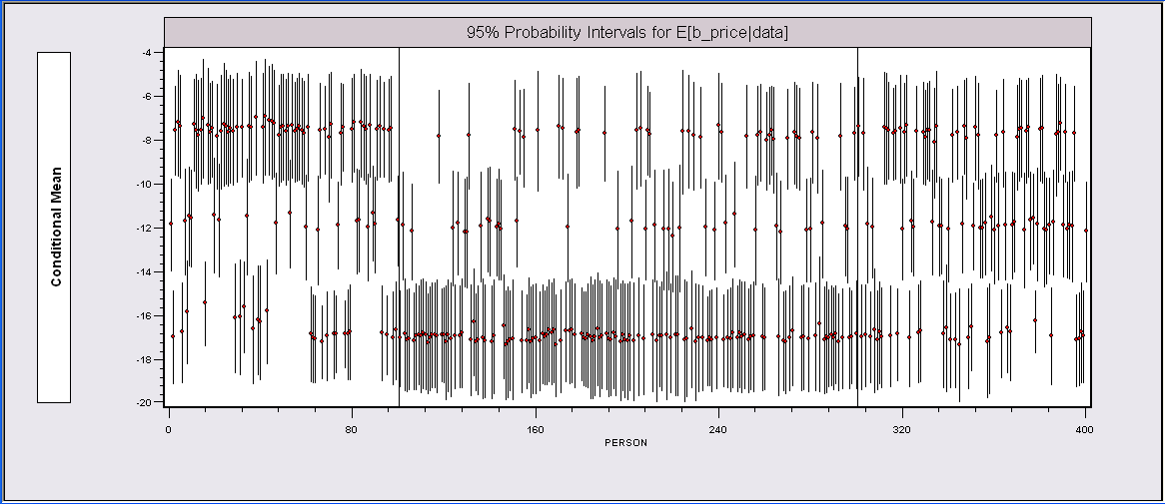
Individual E[β_{i}|data_{i}] Estimates*
The random parameters model is uncovering the latent class feature of the data.
*The intervals could be made wider to account for the sampling
variability of the underlying (classical) parameter estimators.

Slide 72
What is the ‘Individual Estimate?’
Point estimate of mean, variance and range of
random variable β_{i} | data_{i}.
Value is NOT an estimate of β_{i} ; it is an estimate
of E[β_{i} | data_{i}]
This would be the best estimate of the actual
realization β_{i}|data_{i}
An interval estimate would account for the sampling
‘variation’ in the estimator of Ω.
Bayesian counterpart to the preceding: Posterior
mean and variance. Same kind of plot could be done.

Slide 73
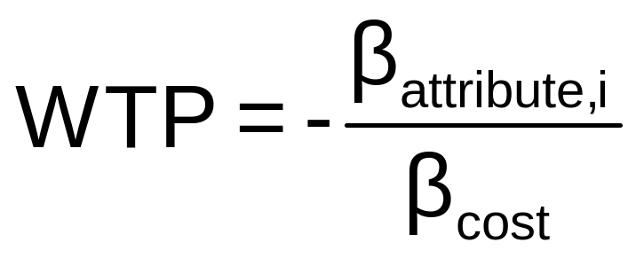
WTP Application (Value of Time Saved)
Estimating Willingness to Pay for
Increments to an Attribute in a
Discrete Choice Model
Random

Slide 74
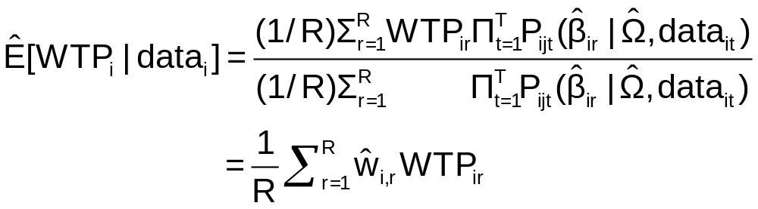
Extending the RP Model to WTP
Use the model to estimate conditional
distributions for any function of
parameters
Willingness to pay = -β_{i,time} / β_{i,cost}
Use simulation method

Slide 75
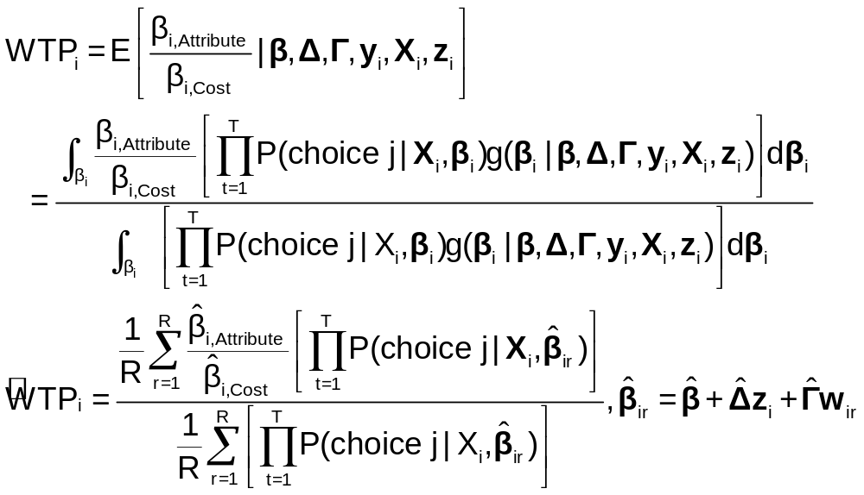
Sumulation of WTP from β_{i}

Slide 76
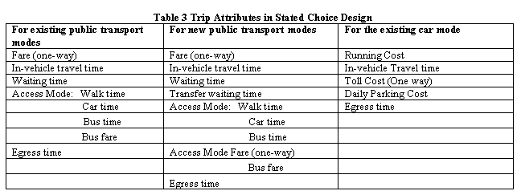
Stated Choice Experiment: Travel
Mode by Sydney Commuters

Slide 77
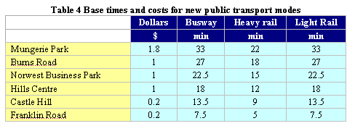
Would You Use a New Mode?

Slide 78
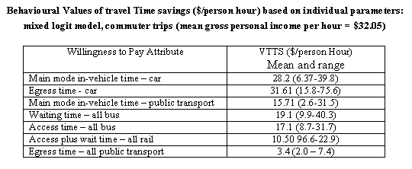
Value of Travel Time Saved

Slide 79
Caveats About Simulation
Using MSL
  Number of draws
  Intelligent vs. random draws
Estimating WTP
  Ratios of normally distributed estimates
  Excessive range
Constraining the ranges of parameters
  Lognormal vs. Normal or something else
  Distributions of parameters (uniform, triangular, etc.

Slide 80
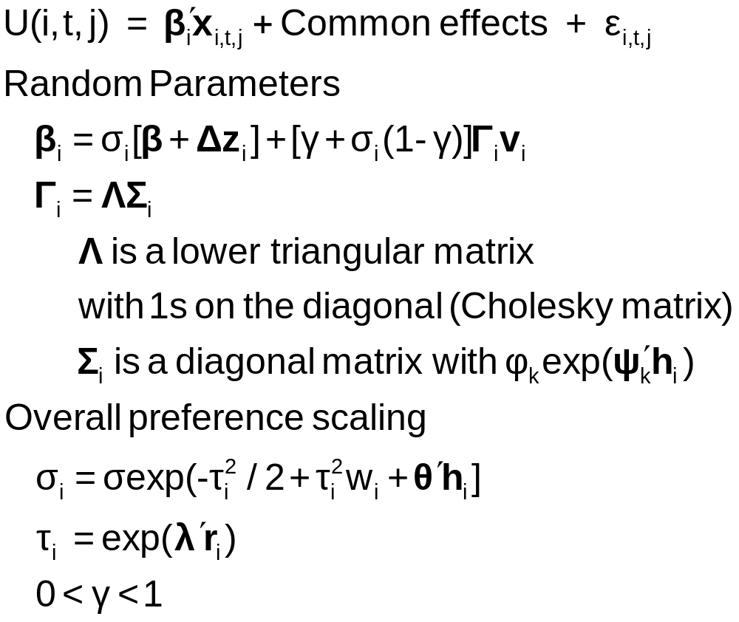
Generalized Mixed Logit Model

Slide 81
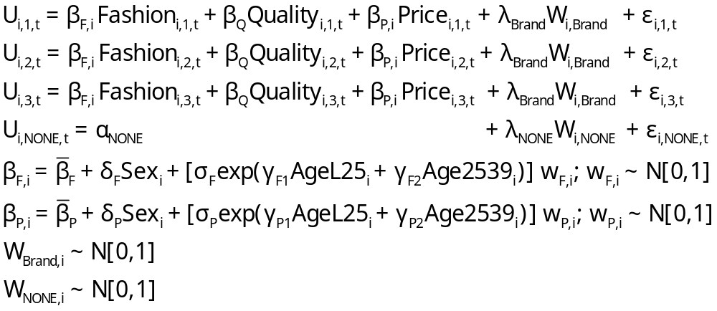
Generalized Multinomial Choice Model

Slide 82
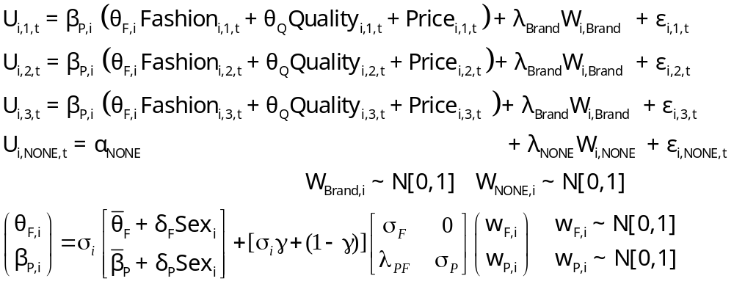
Estimation in Willingness to Pay Space
Both parameters in the WTP calculation are random.

Slide 83
Estimated Model for WTP
--------+--------------------------------------------------
Variable| Coefficient Standard Error b/St.Er. P[|Z|>z]
--------+--------------------------------------------------
|Random parameters in utility functions
QUAL| -.32668*** .04302 -7.593 .0000 1.01373 renormalized
PRICE| 1.00000 ......(Fixed Parameter)...... -11.80230 renormalized
|Nonrandom parameters in utility functions
FASH| 1.14527*** .05788 19.787 .0000 1.4789 not rescaled
ASC4| .84364*** .05554 15.189 .0000 .0368 not rescaled
|Heterogeneity in mean, Parameter:Variable
QUAL:AGE| .05843 .04836 1.208 .2270 interaction terms
QUA0:AGE| -.11620 .13911 -.835 .4035
PRIC:AGE| .23958 .25730 .931 .3518
PRI0:AGE| 1.13921 .76279 1.493 .1353
|Diagonal values in Cholesky matrix, L.
NsQUAL| .13234*** .04125 3.208 .0013 correlated parameters
CsPRICE| .000 ......(Fixed Parameter)...... but coefficient is fixed
|Below diagonal values in L matrix. V = L*Lt
PRIC:QUA| .000 ......(Fixed Parameter)......
|Heteroscedasticity in GMX scale factor
sdMALE| .23110 .14685 1.574 .1156 heteroscedasticity
|Variance parameter tau in GMX scale parameter
TauScale| 1.71455*** .19047 9.002 .0000 overall scaling, tau
|Weighting parameter gamma in GMX model
GammaMXL| .000 ......(Fixed Parameter)......
|Coefficient on PRICE in WTP space form
Beta0WTP| -3.71641*** .55428 -6.705 .0000 new price coefficient
S_b0_WTP| .03926 .40549 .097 .9229 standard deviation
| Sample Mean Sample Std.Dev.
Sigma(i)| .70246 1.11141 .632 .5274 overall scaling
|Standard deviations of parameter distributions
sdQUAL| .13234*** .04125 3.208 .0013
sdPRICE| .000 ......(Fixed Parameter)......
--------+--------------------------------------------------

