Slide 1
Discrete Choice Models
William Greene
Stern School of Business
New York University

Slide 2
Part 12
Stated Preference and Revealed Preference Data

Slide 3
Panel Data
Repeated Choice Situations
Typically RP/SP constructions (experimental)
Accommodating “panel data”
  Multinomial Probit [Marginal, impractical]
  Latent Class
  Mixed Logit

Slide 4
Revealed and Stated Preference Data
Pure RP Data
  Market (ex-post, e.g., supermarket scanner data)
  Individual observations
Pure SP Data
  Contingent valuation
  (?) Validity
Combined (Enriched) RP/SP
  Mixed data
  Expanded choice sets

Slide 5
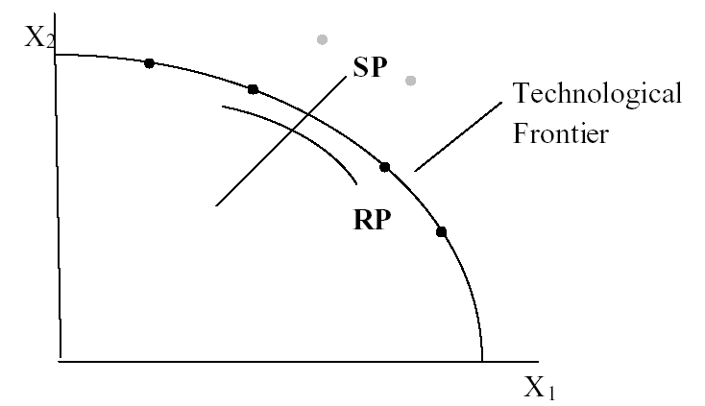
Revealed Preference Data
Advantage: Actual observations on actual behavior
Disadvantage: Limited range of choice sets and attributes – does not allow analysis of switching behavior.

Slide 6
Stated Preference Data
Pure hypothetical – does the subject take it seriously?
No necessary anchor to real market situations
Vast heterogeneity across individuals

Slide 7
Pooling RP and SP Data Sets - 1
Enrich the attribute set by replicating choices
E.g.:
  RP: Bus,Car,Train (actual)
  SP: Bus(1),Car(1),Train(1)
  Bus(2),Car(2),Train(2),…
How to combine?

Slide 8
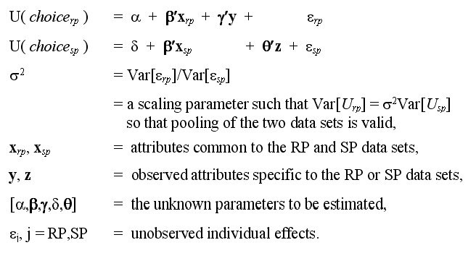
Underlying Random Utility Model

Slide 9
Nested Logit Approach
Mode
RP
Car Train Bus SPCar SPTrain SPBus
Use a two level nested model, and constrain three IV parameters to be equal.

Slide 10
Enriched Data Set – Vehicle Choice
Choosing between Conventional, Electric and LPG/CNG Vehicles in Single-Vehicle Households
David A. Hensher
Institute of Transport Studies
School of Business
The University of Sydney
NSW 2006 Australia
William H. Greene
Department of Economics
The Stern School of Business
New York University
New York USA
22 September 2000

Slide 11
Fuel Types Study
Conventional, Electric, Alternative
1,400 Sydney Households
Automobile choice survey
RP + 3 SP fuel classes
Nested logit – 2 level approach – to handle the scaling issue

Slide 12
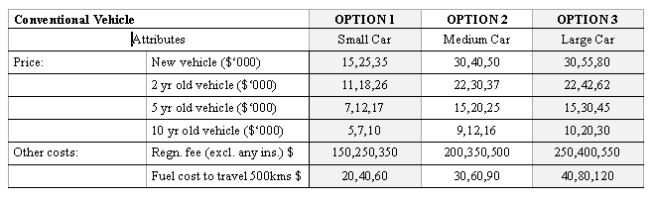
Attribute Space: Conventional

Slide 13
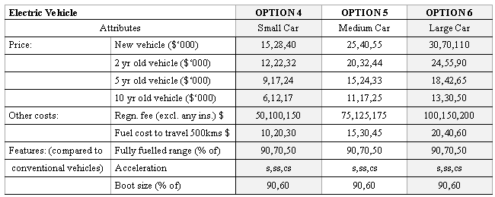
Attribute Space: Electric

Slide 14
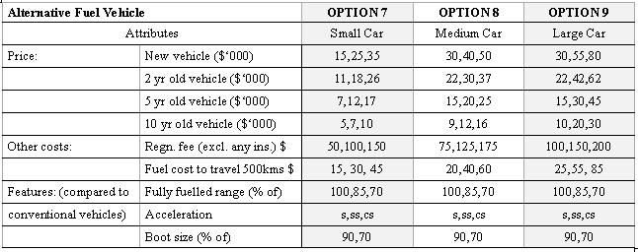
Attribute Space: Alternative

Slide 15
Mixed Logit Approaches
Pivot SP choices around an RP outcome.
Scaling is handled directly in the model
Continuity across choice situations is handled by random elements of the choice structure that are constant through time
  Preference weights – coefficients
  Scaling parameters
    Variances of random parameters
    Overall scaling of utility functions

Slide 16
Generalized Mixed Logit Model
U_{ij} = α _{j} + β_{i}′x_{ij} + δ′z_{i} + ε_{ij}.
U_{ijt} = α_{j} + β_{i}′x_{itj} + δ′z_{it} + ε_{ijt}.
β_{i} = β + Γv_{i}
σ_{i} = exp(-τ²/2 + τw_{i})
β_{i} = σ_{i}β + [γ + σ_{i}(1 - γ)]Γv_{i}

Slide 17
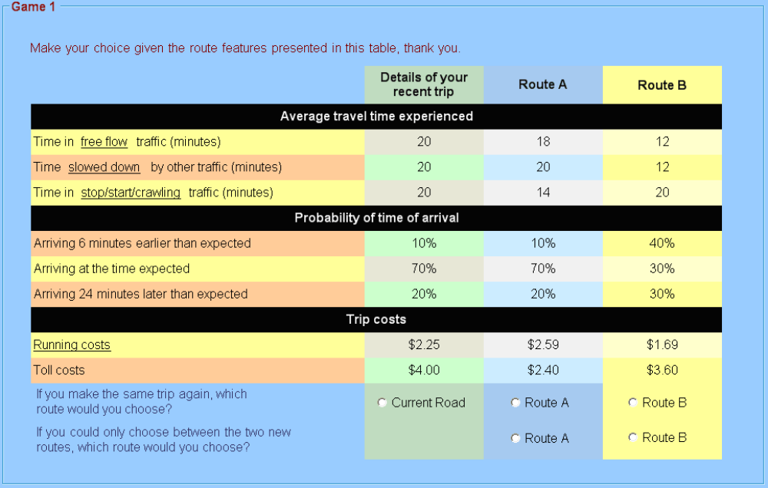
Survey Instrument for Reliability Study

Slide 18
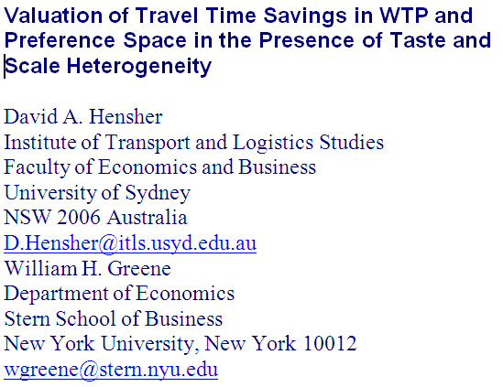

Slide 19
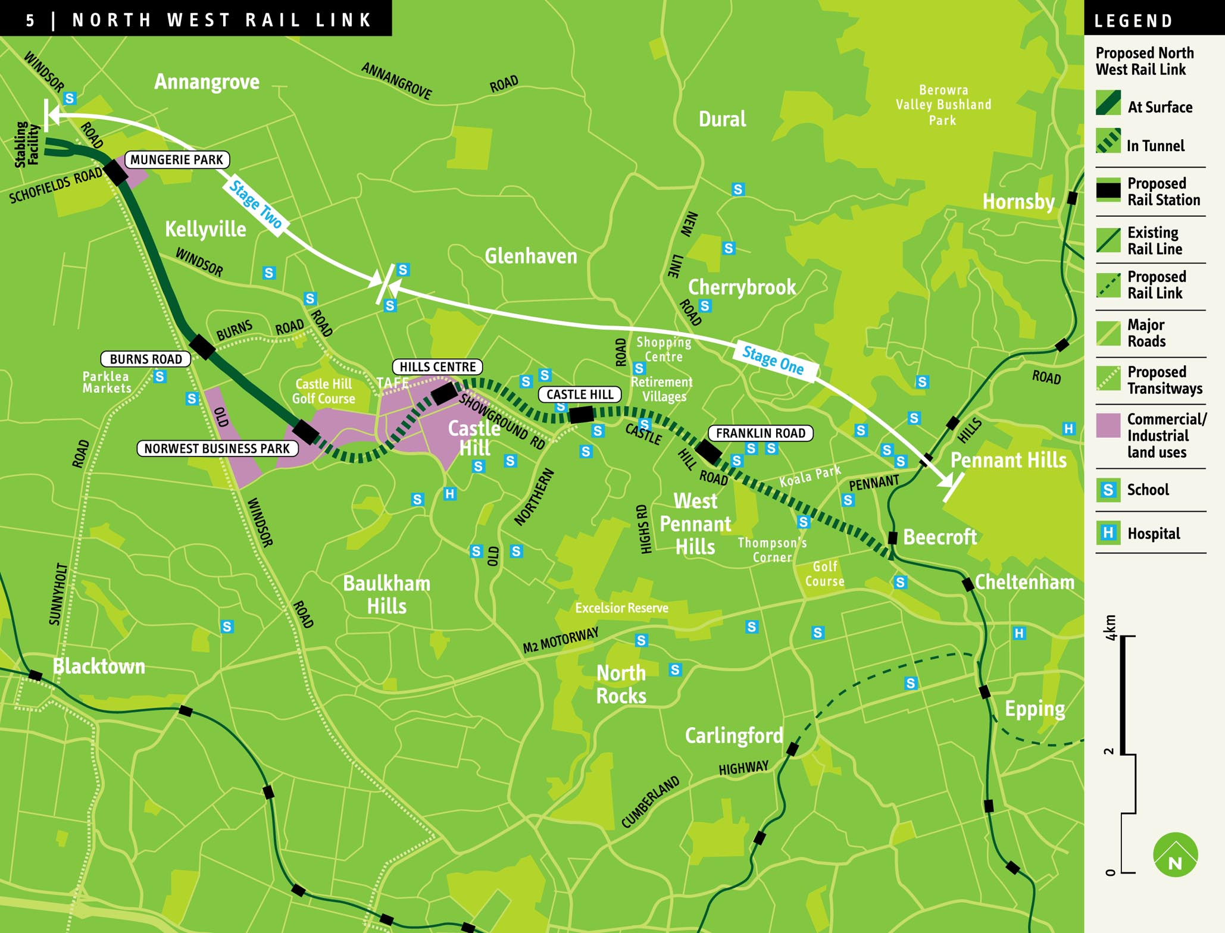
SP Study Using WTP Space

Slide 20
Generalized Mixed Logit Model
One choice setting
U_{ij} = α _{j} + β_{i}′x_{ij} + δ′z_{i} + ε_{ij}.
Stated choice setting, multiple choices
U_{ijt} = α_{j} + β_{i}′x_{itj} + δ′z_{it} + ε_{ijt}.
Random parameters
β_{i} = β + Γv_{i}
Generalized mixed logit
σ_{i} = exp(-τ²/2 + τw_{i})
β_{i} = σ_{i}β + [γ + σ_{i}(1 - γ)]Γv_{i}

Slide 21
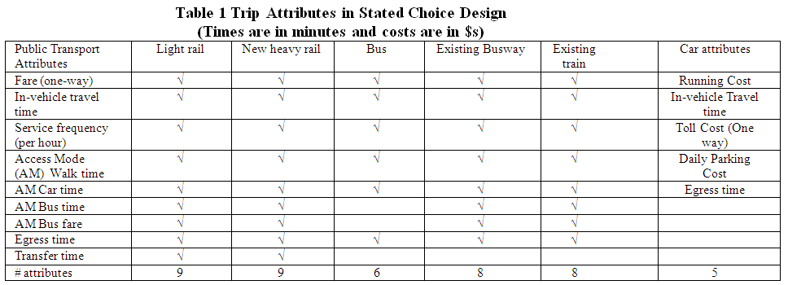
Experimental Design

Slide 22
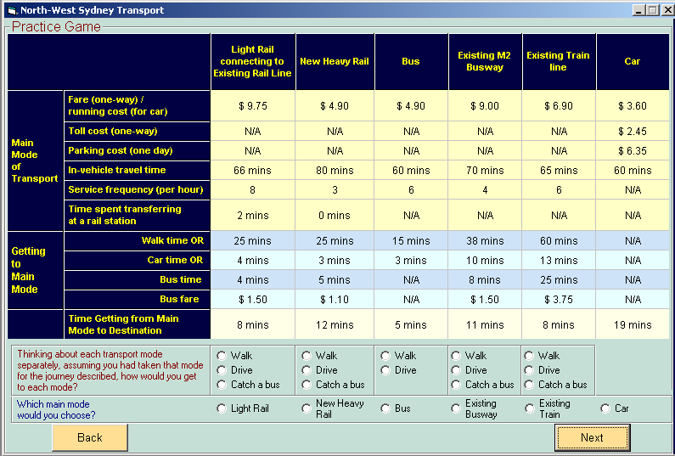
Survey Instrument

Slide 23
Discrete Choice
Combining RP and SP Data

Slide 24
Application
Survey sample of 2,688 trips, 2 or 4 choices per situation
Sample consists of 672 individuals
Choice based sample
Revealed/Stated choice experiment:
Revealed: Drive,ShortRail,Bus,Train
Hypothetical: Drive,ShortRail,Bus,Train,LightRail,ExpressBus
Attributes:
Cost –Fuel or fare
Transit time
Parking cost
Access and Egress time

Slide 25
Data Set
Load data set RPSP.LPJ
9408 observations
We fit separate models for RP and SP subsets of the data, then a combined, nested model that accommodates the different scaling.

Slide 26
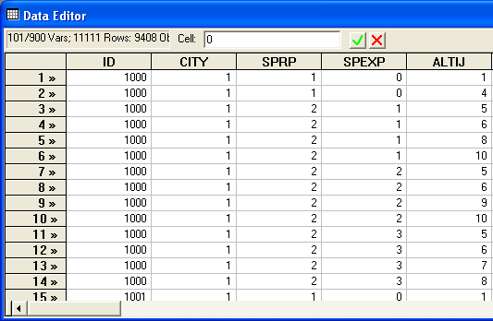
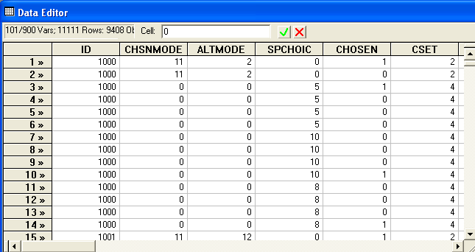
Each person makes four choices from a choice set that includes either two or four alternatives.
The first choice is the RP between two of the RP alternatives
The second-fourth are the SP among four of the six SP alternatives.
There are ten alternatives in total.

Slide 27
A Model for Revealed Preference Data
? Using only Revealed Preference Data
dstats;rhs=autotime,fcost,mptrtime,mptrfare$
NLOGIT ; if[sprp = 1] ? Using only RP data
;lhs=chosen,cset,altij
;choices=RPDA,RPRS,RPBS,RPTN
;descriptives;crosstab
;maxit=100
;model:
U(RPDA) = rdasc + fl*fcost+tm*autotime/
U(RPRS) = rrsasc + fl*fcost+tm*autotime/
U(RPBS) = rbsasc + ptc*mptrfare+mt*mptrtime/
U(RPTN) = ptc*mptrfare+mt*mptrtime$

Slide 28
A Model for Stated Preference Data
? Using only Stated Preference Data
? BASE MODEL
Nlogit ; if[sprp = 2] ? Using only SP data
;lhs=chosen,cset,alt
;choices=SPDA,SPRS,SPBS,SPTN,SPLR,SPBW
;descriptives;crosstab
;maxit=150
;model:
U(SPDA) = dasc +cst*fueld+ tmcar*time+prk*parking
+pincda*pincome +cavda*carav/
U(SPRS) = rsasc+cst*fueld+ tmcar*time+prk*parking/
U(SPBS) = bsasc+cst*fared+ tmpt*time+act*acctime+egt*eggtime/
U(SPTN) = tnasc+cst*fared+ tmpt*time+act*acctime+egt*eggtime/
U(SPLR) = lrasc+cst*fared+ tmpt*time+act*acctime +egt*eggtime/
U(SPBW) = cst*fared+ tmpt*time+act*acctime+egt*eggtime$

Slide 29
A Nested Logit Model for RP/SP Data
NLOGIT
;lhs=chosen,cset,altij
;choices=RPDA,RPRS,RPBS,RPTN,SPDA,SPRS,SPBS,SPTN,SPLR,SPBW
/.592,.208,.089,.111,1.0,1.0,1.0,1.0,1.0,1.0
;tree=mode[rp(RPDA,RPRS,RPBS,RPTN),spda(SPDA),
sprs(SPRS),spbs(SPBS),sptn(SPTN),splr(SPLR),spbw(SPBW)]
;ivset: (rp)=[1.0];ru1
;maxit=150
;model:
U(RPDA) = rdasc + invc*fcost+tmrs*autotime
+ pinc*pincome+CAVDA*CARAV/
U(RPRS) = rrsasc + invc*fcost+tmrs*autotime/
U(RPBS) = rbsasc + invc*mptrfare+mtpt*mptrtime/
U(RPTN) = cstrs*mptrfare+mtpt*mptrtime/
U(SPDA) = sdasc + invc*fueld + tmrs*time+cavda*carav
+ pinc*pincome/
U(SPRS) = srsasc + invc*fueld + tmrs*time/
U(SPBS) = invc*fared + mtpt*time +acegt*spacegtm/
U(SPTN) = stnasc + invc*fared + mtpt*time+acegt*spacegtm/
U(SPLR) = slrasc + invc*fared + mtpt*time+acegt*spacegtm/
U(SPBW) = sbwasc + invc*fared + mtpt*time+acegt*spacegtm$

Slide 30
A Random Parameters Approach
NLOGIT
;lhs=chosen,cset,altij
;choices=RPDA,RPRS,RPBS,RPTN,SPDA,SPRS,SPBS,SPTN,SPLR,SPBW
/.592,.208,.089,.111,1.0,1.0,1.0,1.0,1.0,1.0
; rpl
; pds=4
; halton ; pts=25
; fcn=invc(n)
; model:
U(RPDA) = rdasc + invc*fcost + tmrs*autotime
+ pinc*pincome + CAVDA*CARAV/
U(RPRS) = rrsasc + invc*fcost + tmrs*autotime/
U(RPBS) = rbsasc + invc*mptrfare + mtpt*mptrtime/
U(RPTN) = cstrs*mptrfare + mtpt*mptrtime/
U(SPDA) = sdasc + invc*fueld + tmrs*time+cavda*carav
+ pinc*pincome/
U(SPRS) = srsasc + invc*fueld + tmrs*time/
U(SPBS) = invc*fared + mtpt*time +acegt*spacegtm/
U(SPTN) = stnasc + invc*fared + mtpt*time+acegt*spacegtm/
U(SPLR) = slrasc + invc*fared + mtpt*time+acegt*spacegtm/
U(SPBW) = sbwasc + invc*fared + mtpt*time+acegt*spacegtm$

Slide 31
Connecting Choice
Situations through RPs
--------+--------------------------------------------------
Variable| Coefficient Standard Error b/St.Er. P[|Z|>z]
--------+--------------------------------------------------
|Random parameters in utility functions
INVC| -.58944*** .03922 -15.028 .0000
|Nonrandom parameters in utility functions
RDASC| -.75327 .56534 -1.332 .1827
TMRS| -.05443*** .00789 -6.902 .0000
PINC| .00482 .00451 1.068 .2857
CAVDA| .35750*** .13103 2.728 .0064
RRSASC| -2.18901*** .54995 -3.980 .0001
RBSASC| -1.90658*** .53953 -3.534 .0004
MTPT| -.04884*** .00741 -6.591 .0000
CSTRS| -1.57564*** .23695 -6.650 .0000
SDASC| -.13612 .27616 -.493 .6221
SRSASC| -.10172 .18943 -.537 .5913
ACEGT| -.02943*** .00384 -7.663 .0000
STNASC| .13402 .11475 1.168 .2428
SLRASC| .27250** .11017 2.473 .0134
SBWASC| -.00685 .09861 -.070 .9446
|Distns. of RPs. Std.Devs or limits of triangular
NsINVC| .45285*** .05615 8.064 .0000
--------+--------------------------------------------------

Slide 32
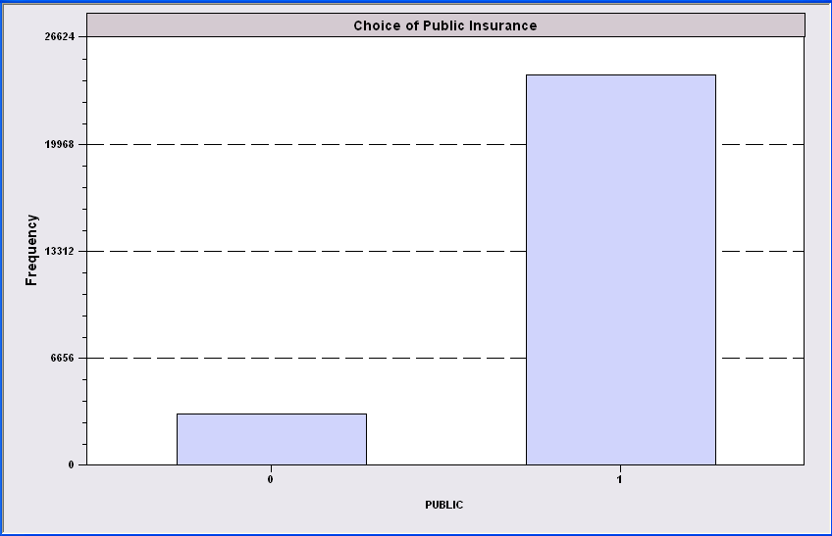
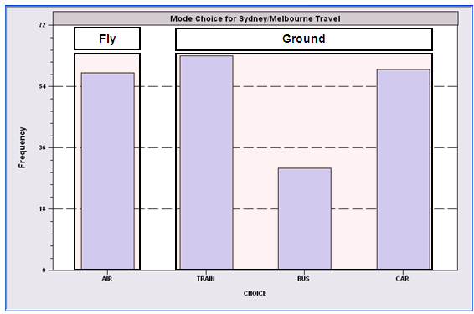
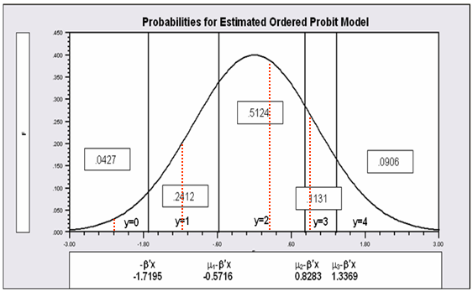
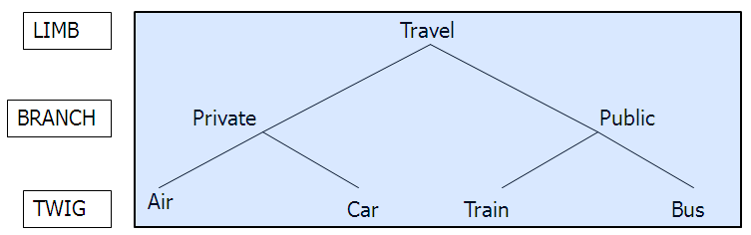
Conclusion
THANK YOU!

