Slide 1
Discrete Choice Modeling
William Greene
Stern School of Business
New York University

Slide 2
Part 2
Estimating and Using
Binary Choice Models

Slide 3
Agenda
A Basic Model for Binary Choice
Specification
Maximum Likelihood Estimation
Estimating Partial Effects
Computing Standard Errors
Interactions and Nonlinearities

Slide 4
A Random Utility Approach
Underlying Preference Scale, U*(x₁ …)
Revelation of Preferences:
  U*(x₁ …) < 0 ===> Choice “0”
  U*(x₁ …) > 0 ===> Choice “1”

Slide 5
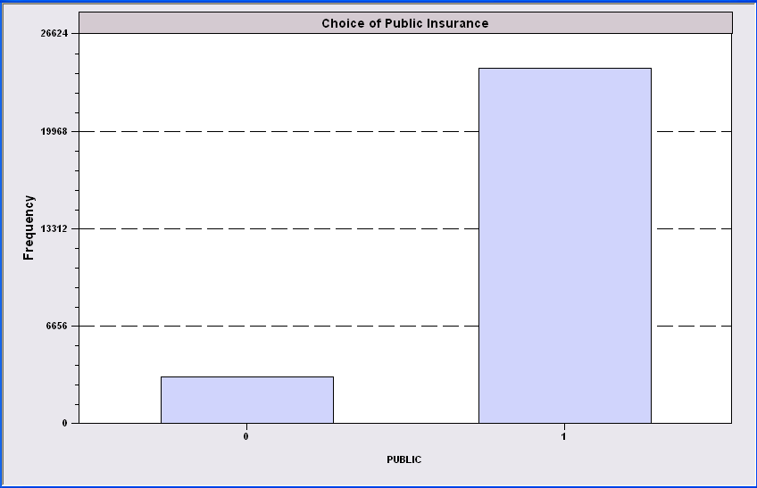
Simple Binary Choice: Buy Insurance

Slide 6

Censored Health Satisfaction Scale
0 = Not Healthy
1 = Healthy

Slide 7
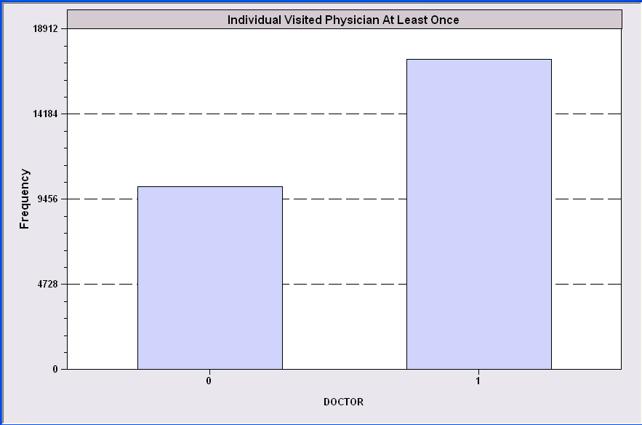
Count Transformed to Indicator

Slide 8

Redefined Multinomial Choice
Fly
Ground

Slide 9
A Model for Binary Choice
Yes or No decision (Buy/Not buy, Do/Not Do)
Example, choose to visit physician or not
Model: Net utility of visit at least once
U_{choice} = α_{choice} +β_{Choice}Age + δ_{Choice}Income + γ_{Choice}Sex + ε_{Choice}
Choose to visit if net utility is positive
Net utility = U_{visit} – U_{not visit} = (α₁-α₀)+ (β₁-β₀)Age + (δ₁-δ₀)Income
+ (γ₁- γ₀)Sex + (ε₁-ε₀)
Visit = 1 if Net utility > 0,
Data: X = [1,age,income,sex]
y = 1 if choose visit, ⬄ U_{visit} > 0, 0 if not.

Slide 10
Choosing Between the Two Alternatives
Modeling the Binary Choice
  U_{visit} = α + β₁ Age + β₂ Income + β₁ Sex + ε
Chooses to visit: U_{visit} > 0
α + β₁ Age + β₂ Income + β₁ Sex + ε > 0
ε > -[α + β₁ Age + β₂ Income + β₁ Sex ]

Slide 11
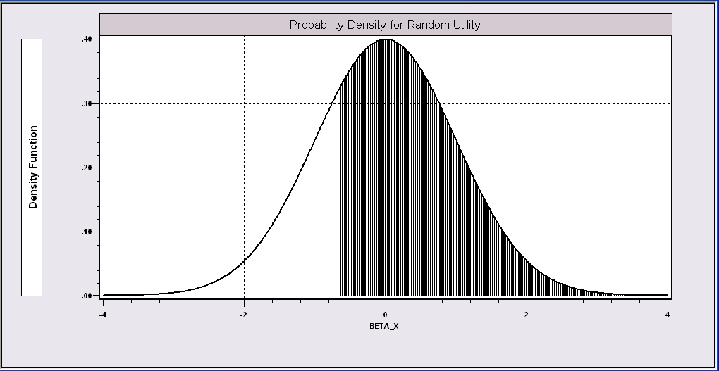
Probability Model for Choice Between Two Alternatives
ε > -[α + β₁Age + β₂Income + β₃Sex ]

Slide 12
What Can Be Learned from the Data?
(A Sample of Consumers, i = 1,…,N)
Are the characteristics “relevant?”
Predicting behavior
  Individual – E.g., will a person buy the add-on
  insurance?
  Aggregate – E.g., what proportion of the population will
  buy the add-on insurance?
Analyze changes in behavior when attributes change –
E.g., how will changes in education change the proportion
who buy the insurance?

Slide 13
Application: Health Care Usage
German Health Care Usage Data, 7,293 Individuals, Varying Numbers of Periods
Variables in the file are
Data downloaded from Journal of Applied Econometrics Archive. This is an unbalanced panel with 7,293 individuals. They can be used for regression, count models, binary choice, ordered choice, and bivariate binary choice. This is a large data set. There are altogether 27,326 observations. The number of observations ranges from 1 to 7. (Frequencies are: 1=1525, 2=1079, 3=825, 4=926, 5=1051, 6=1000, 7=887). (Downloaded from the JAE Archive)
DOCTOR = 1(Number of doctor visits > 0)
HOSPITAL = 1(Number of hospital visits > 0)
HSAT = health satisfaction, coded 0 (low) - 10 (high)
DOCVIS = number of doctor visits in last three months
HOSPVIS = number of hospital visits in last calendar year
PUBLIC = insured in public health insurance = 1; otherwise = 0
ADDON = insured by add-on insurance = 1; otherswise = 0
HHNINC = household nominal monthly net income in German marks / 10000.
(4 observations with income=0 were dropped)
HHKIDS = children under age 16 in the household = 1; otherwise = 0
EDUC = years of schooling
AGE = age in years
FEMALE = 1 for female headed household, 0 for male
EDUC = years of education
Notes:
13

Slide 14
Application
27,326 Observations –
  1 to 7 years, panel
  7,293 households observed
  We use the 1994 year
  887 households, 6209 household observations
Descriptive Statistics
=========================================================
Variable Mean Std.Dev. Minimum Maximum
--------+------------------------------------------------
DOCTOR| .657980 .474456 .000000 1.00000
AGE| 42.6266 11.5860 25.0000 64.0000
HHNINC| .444764 .216586 .034000 3.00000
FEMALE| .463429 .498735 .000000 1.00000

Slide 15
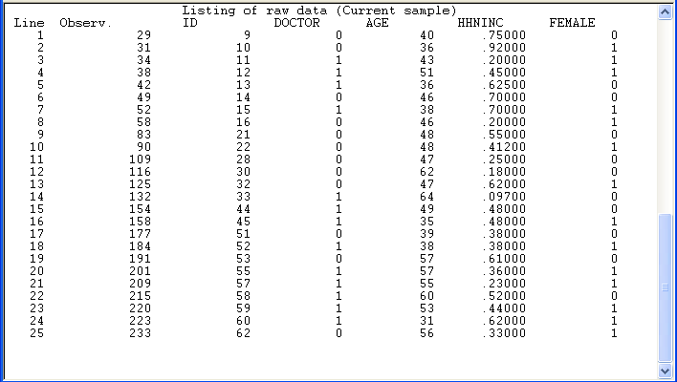
Binary Choice Data

Slide 16
An Econometric Model
Choose to visit iff Uvisit > 0
  Uvisit = α + β₁ Age + β₂ Income + β₃ Sex + ε
  Uvisit > 0 ⇔ ε > -(α + β₁ Age + β₂ Income + β₃ Sex)
Probability model: For any person observed by the analyst,
Prob(visit) =
Prob[ε > -(α + β₁ Age + β₂ Income + β₃ Sex)
Note the relationship between the unobserved ε and the outcome

Slide 17
Normalization
U_{visit} > 0 ⇔ ε > -(α + β₁ Age + β₂ Income + β₃ Sex)
Y = 1 if U_{visit} > 0
Var[ε] = σ²
Now divide everything by σ.
U_{visit} > 0 ⇔ ε/σ
> -[α/σ + (β₁/σ) Age + (β₂/σ)Income + (β₃/σ) Sex] > 0
or w > -[α’ + β₁’Age + β’Income + β’Sex] > 0
Y = 1 if U_{visit} > 0
Var[w] = 1
Same data. The data contain no information about the variance.
We assume Var[ε] = 1.

Slide 18
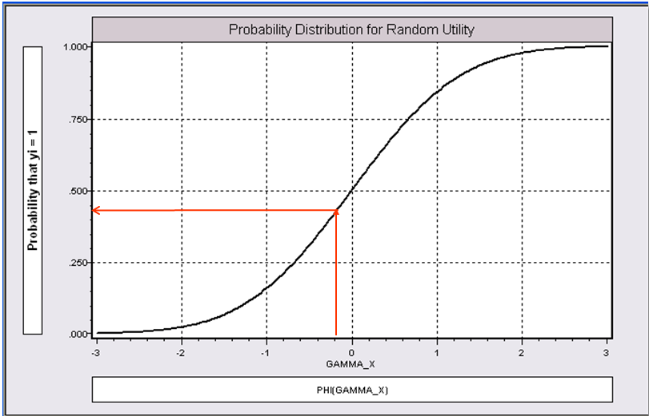
α+β₁Age + β₂ Income + β3 Sex

Slide 19
Fully Parametric
Index Function: U* = β’x + ε
Observation Mechanism: y = 1[U* > 0]
Distribution: ε ~ f(ε); Normal, Logistic, …
Maximum Likelihood Estimation:
Max(β) logL = Σ_{i} log Prob(Y_{i} = y_{i}|x_{i})

Slide 20
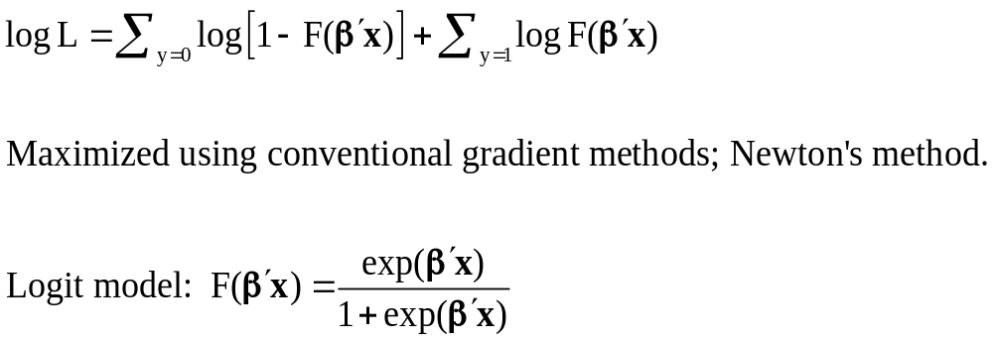
Log Likelihood Function

Slide 21
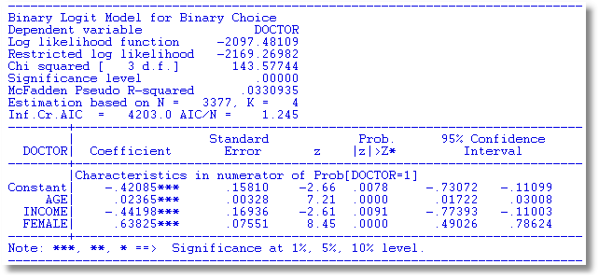
Parametric: Logit Model

Slide 22
Completing the Model: F(ε)
The distribution
  Normal: PROBIT, natural for behavior
  Logistic: LOGIT, allows “thicker tails”
  Gompertz: EXTREME VALUE, asymmetric, underlies the basic logit model for multiple choice
Does it matter?
  Yes, large difference in estimates
  Not much, quantities of interest are more stable.

Slide 23
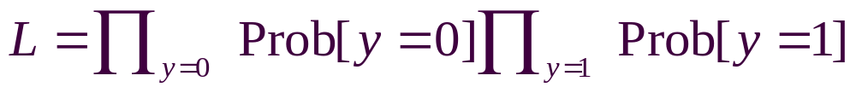
Parametric Model Estimation
How to estimate α, β₁, β₂, β₃?
  It’s not regression
  The technique of maximum likelihood
  Prob[y=1] =
  Prob[ε > -(α + β₁ Age + β₂ Income + β₃ Sex)]
  Prob[y=0] = 1 - Prob[y=1]
Requires a model for the probability

Slide 24
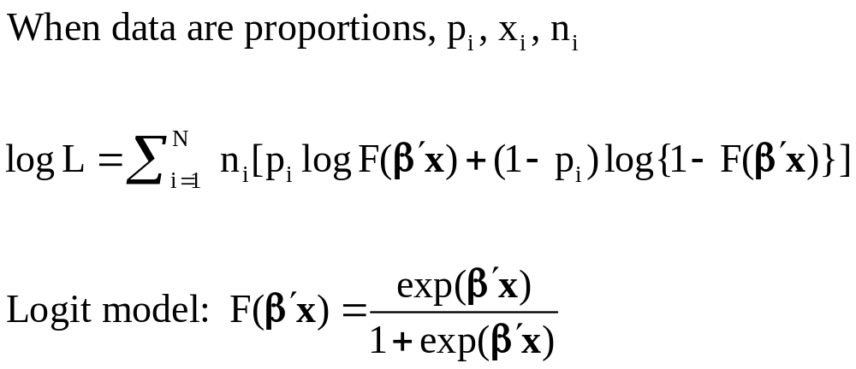
Grouped Data

Slide 25
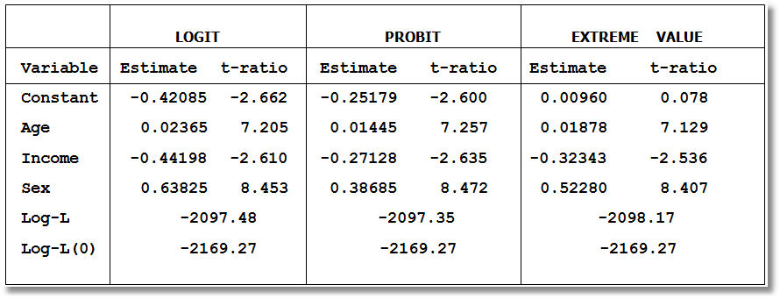
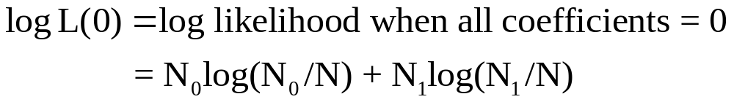
Estimated Binary Choice Models

Slide 26
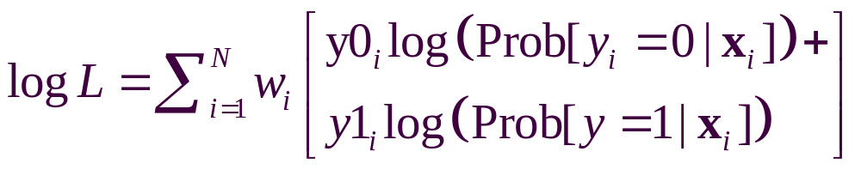
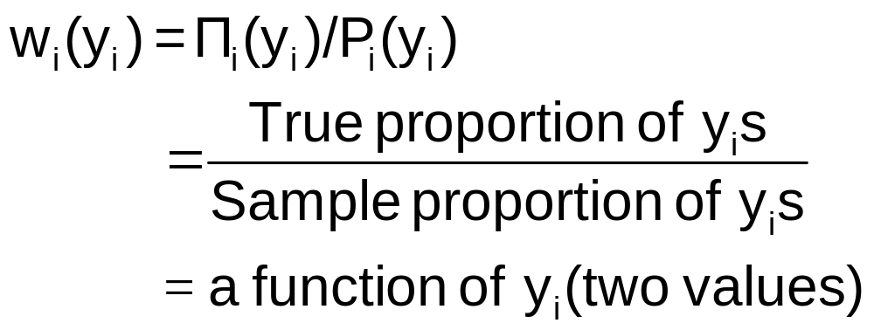
Weighting and Choice Based Sampling
Weighted log likelihood for all data types
Endogenous weights for individual data
“Biased” sampling – “Choice Based”

Slide 27
Redefined Multinomial Choice
Fly
Ground

Slide 28
Choice Based Sample
 | Sample | Population | Weight
Fly | 27.62% | 14% | 0.5068
Ground | 72.38% | 86% | 1.1882

Slide 29
Choice Based Sampling Correction
Maximize Weighted Log Likelihood
Covariance Matrix Adjustment
V = H⁻¹ G H⁻¹ (all three weighted)
H = Hessian
G = Outer products of gradients

Slide 30
Effect of Choice Based Sampling
GC = a general measure of cost
TTME = terminal time
HINC = household income
Unweighted
+---------+--------------+----------------+--------+---------+
|Variable | Coefficient | Standard Error |b/St.Er.|P[|Z|>z] |
+---------+--------------+----------------+--------+---------+
Constant 1.784582594 1.2693459 1.406 .1598
GC .02146879786 .006808094 3.153 .0016
TTME -.09846704221 .016518003 -5.961 .0000
HINC .02232338915 .010297671 2.168 .0302
+---------------------------------------------+
| Weighting variable CBWT |
| Corrected for Choice Based Sampling |
+---------------------------------------------+
+---------+--------------+----------------+--------+---------+
|Variable | Coefficient | Standard Error |b/St.Er.|P[|Z|>z] |
+---------+--------------+----------------+--------+---------+
Constant 1.014022236 1.1786164 .860 .3896
GC .02177810754 .006374383 3.417 .0006
TTME -.07434280587 .017721665 -4.195 .0000
HINC .02471679844 .009548339 2.589 .0096

Slide 31
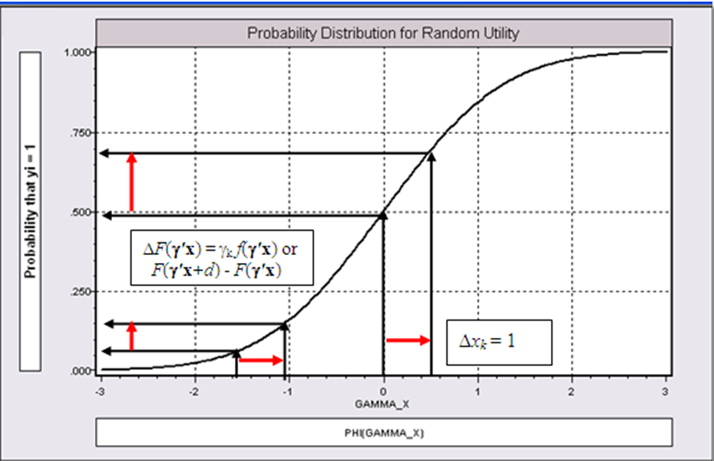
Effect on Predicted Probability of an Increase in Age
α + β₁ (Age+1) + β₂ (Income) + β₃ Sex
(β₁ is positive)

Slide 32
Marginal Effects in Probability Models
Prob[Outcome] = some F(α+β₁Income…)
“Partial effect” = ∂ F(α+β₁Income…) / ∂”x”
(derivative)
  Partial effects are derivatives
  Result varies with model
    Logit: ∂ F(α+β₁Income…) /∂x = Prob * (1-Prob) * β
    Probit: ∂ F(α+β₁Income…)/∂x = Normal density * β
    Extreme Value: ∂ F(α+β₁Income…)/∂x = Prob * (-log Prob) * β
  Scaling usually erases model differences

Slide 33
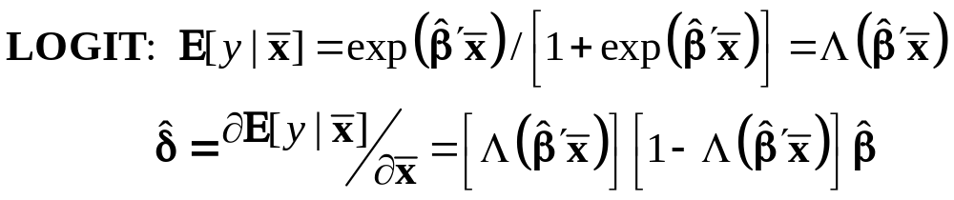
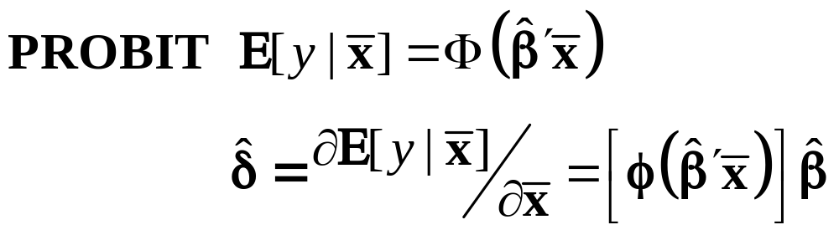
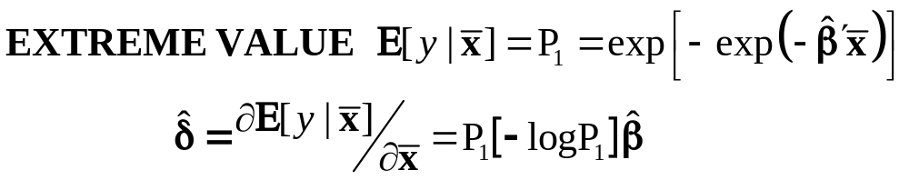
Marginal Effects for Binary Choice

Slide 34
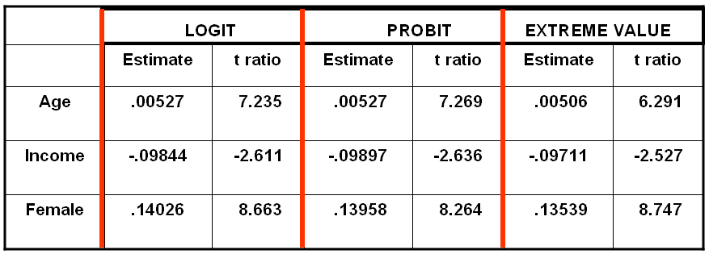
Estimated Partial Effects

Slide 35
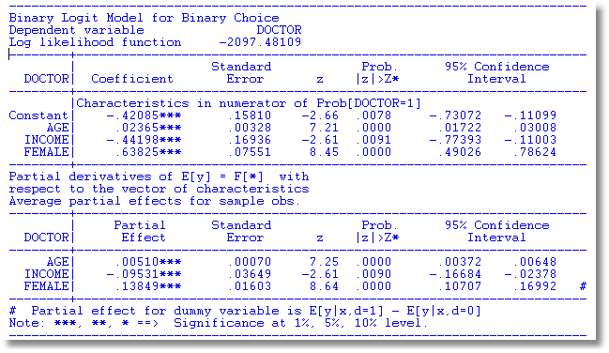
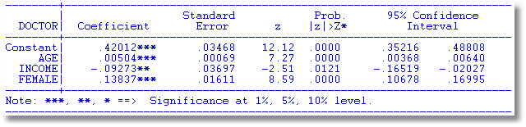
The Linear Probability Model vs. Parametric Logit Model

Slide 36
Linear Probability Model
Why Use It
  It’s easier to compute.
  It’s nonparametric. (It’s semiparametric – it’s not more general than the logit or probit)
  Linear approximation to more general model
Why not use it – use a parametric model?
  The data are heteroscedastic. LPM ignores that.
  The LPM will produce negative probabilities
  Can’t be integrated into more general layered models
  Nonlinear approximation to the more general model

Slide 37
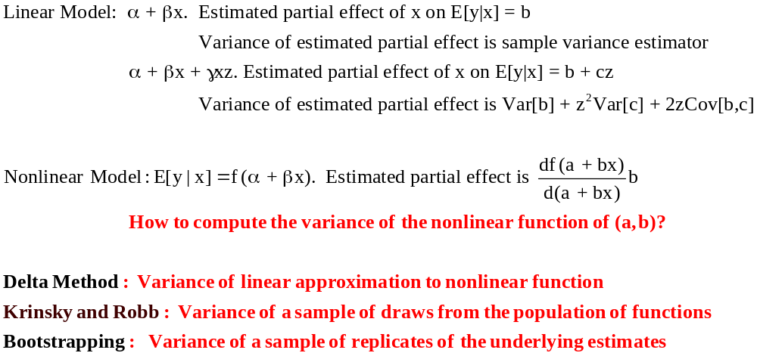
Computing Standard Errors

Slide 38
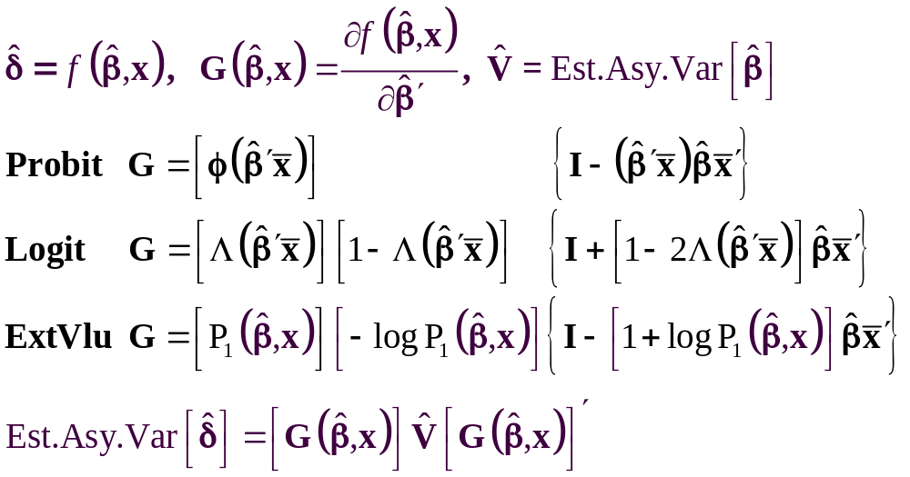
The Delta Method

Slide 39
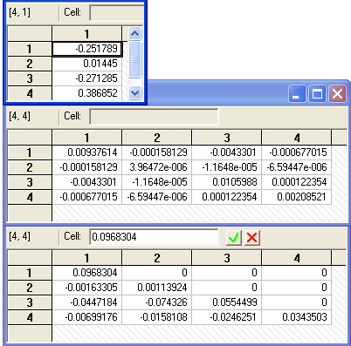
Krinsky and Robb
Estimate β by Maximum Likelihood with b
Estimate asymptotic covariance matrix with V
Draw R observations b(r) from the normal
population N[b,V]
b(r) = b + C*v(r), v(r) drawn from N[0,I]
C = Cholesky matrix, V = CC’
Compute partial effects d(r) using b(r)
Compute the sample variance of d(r),r=1,…,R
Use the sample standard deviations of the R observations to estimate the sampling standard errors for the partial effects.

Slide 40
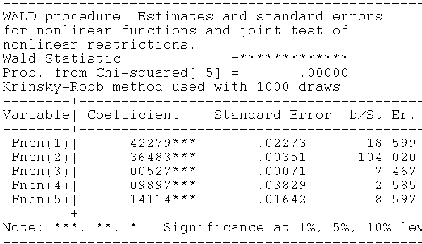
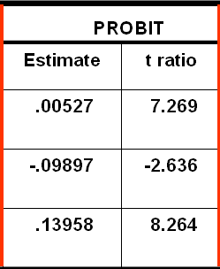
Krinsky and Robb
Delta Method

Slide 41
Bootstrapping
For R repetitions:
Draw N observations with replacement
Refit the model
Recompute the vector of partial effects
Compute the empirical standard deviation of the R observations on the partial effects.

Slide 42
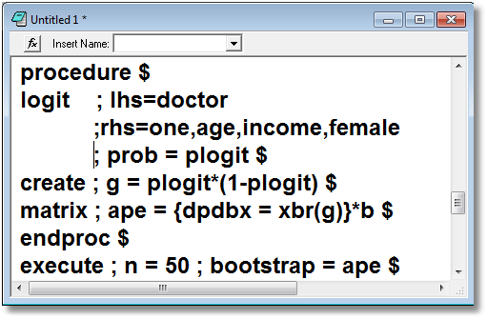
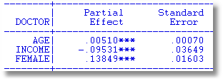
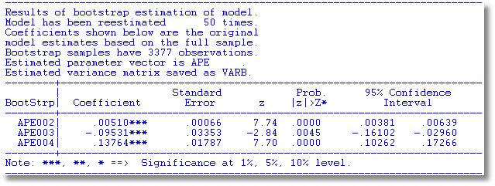
Delta Method

Slide 43
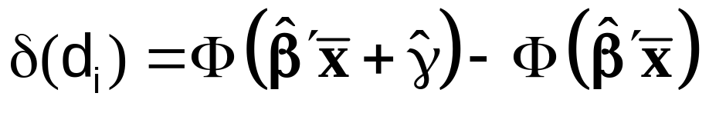
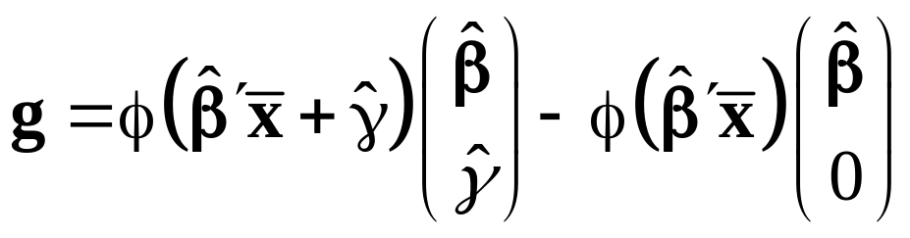
Marginal Effect for a Dummy Variable
Prob[y_{i} = 1|x_{i},d_{i}] = F(β’x_{i}+γd_{i})
= conditional mean
Marginal effect of d
Prob[y_{i} = 1|x_{i},d_{i}=1]-
Prob[y_{i} = 1|x_{i},d_{i}=0]
Probit:

Slide 44
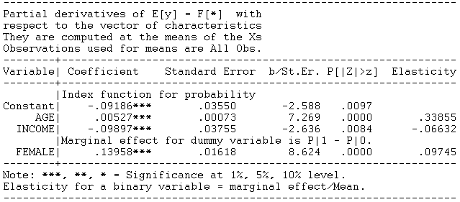
Marginal Effect – Dummy Variable
Note: 0.14114 reported by WALD instead of 0.13958 above is based on the simple derivative formula evaluated at the data means rather than the first difference evaluated at the means.

Slide 45
Computing Effects
Compute at the data means?
  Simple
  Inference is well defined
Average the individual effects
  More appropriate?
  Asymptotic standard errors.
Is testing about marginal effects meaningful?
  f(b’x) must be > 0; b is highly significant
  How could f(b’x)*b equal zero?

Slide 46
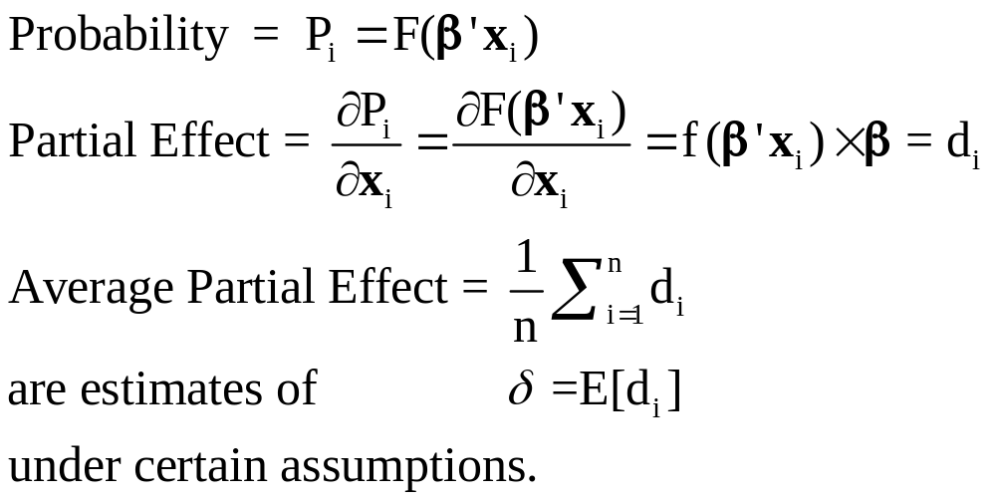
Average Partial Effects

Slide 47
Average Partial Effects
=============================================
Variable Mean Std.Dev. S.E.Mean
=============================================
--------+------------------------------------
ME_AGE| .00511838 .000611470 .0000106
ME_INCOM| -.0960923 .0114797 .0001987
ME_FEMAL| .137915 .0109264 .000189
Neither the empirical standard deviations nor the standard errors of the means for the APEs are close to the estimates from the delta method. The standard errors for the APEs are computed incorrectly by not accounting for the correlation across observations
Std. Error
(.0007250)
(.03754)
(.01689)

Slide 48
Simulating the Model to Examine
Changes in Market Shares
Suppose income increased by 25% for everyone.
+-------------------------------------------------------------+
|Scenario 1. Effect on aggregate proportions. Logit Model |
|Threshold T* for computing Fit = 1[Prob > T*] is .50000 |
|Variable changing = INCOME , Operation = *, value = 1.250 |
+-------------------------------------------------------------+
|Outcome Base case Under Scenario Change |
| 0 18 = .53% 61 = 1.81% 43 |
| 1 3359 = 99.47% 3316 = 98.19% -43 |
| Total 3377 = 100.00% 3377 = 100.00% 0 |
+-------------------------------------------------------------+
• The model predicts 43 fewer people would visit the doctor
NOTE: The same model used for both sets of predictions.

Slide 49
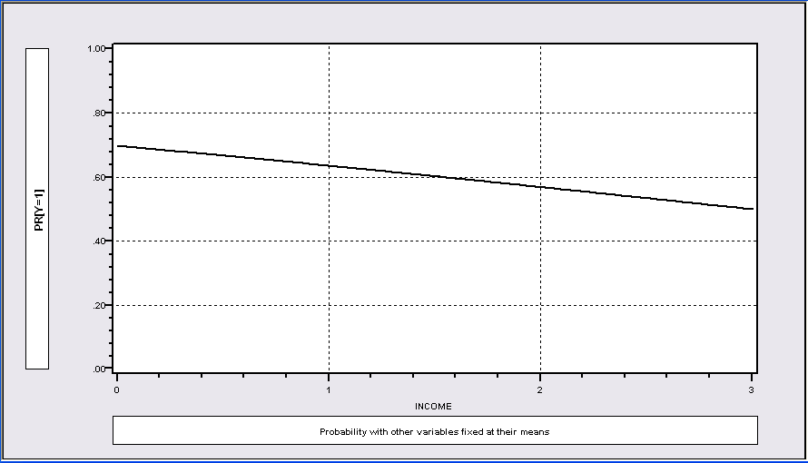
Graphical View of the Scenario

Slide 50
Nonlinear Effect
P = F(age, age², income, female)
----------------------------------------------------------------------
Binomial Probit Model
Dependent variable DOCTOR
Log likelihood function -2086.94545
Restricted log likelihood -2169.26982
Chi squared [ 4 d.f.] 164.64874
Significance level .00000
--------+-------------------------------------------------------------
Variable| Coefficient Standard Error b/St.Er. P[|Z|>z] Mean of X
--------+-------------------------------------------------------------
|Index function for probability
Constant| 1.30811*** .35673 3.667 .0002
AGE| -.06487*** .01757 -3.693 .0002 42.6266
AGESQ| .00091*** .00020 4.540 .0000 1951.22
INCOME| -.17362* .10537 -1.648 .0994 .44476
FEMALE| .39666*** .04583 8.655 .0000 .46343
--------+-------------------------------------------------------------
Note: ***, **, * = Significance at 1%, 5%, 10% level.
----------------------------------------------------------------------

Slide 51
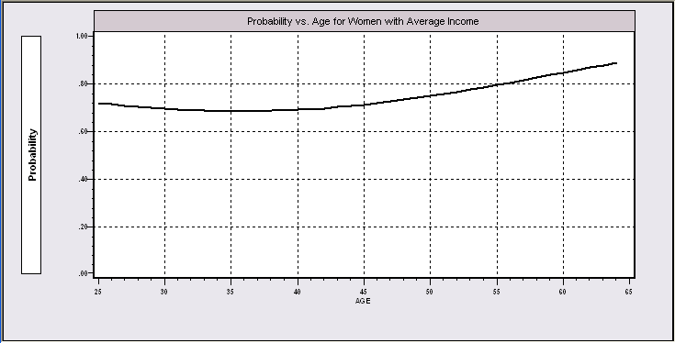
Nonlinear Effects

Slide 52
Partial Effects?
----------------------------------------------------------------------
Partial derivatives of E[y] = F[*] with
respect to the vector of characteristics
They are computed at the means of the Xs
Observations used for means are All Obs.
--------+-------------------------------------------------------------
Variable| Coefficient Standard Error b/St.Er. P[|Z|>z] Elasticity
--------+-------------------------------------------------------------
|Index function for probability
AGE| -.02363*** .00639 -3.696 .0002 -1.51422
AGESQ| .00033*** .729872D-04 4.545 .0000 .97316
INCOME| -.06324* .03837 -1.648 .0993 -.04228
|Marginal effect for dummy variable is P|1 - P|0.
FEMALE| .14282*** .01620 8.819 .0000 .09950
--------+-------------------------------------------------------------
Separate partial effects for Age and Age² make no sense.
They are not varying “partially.”

Slide 53
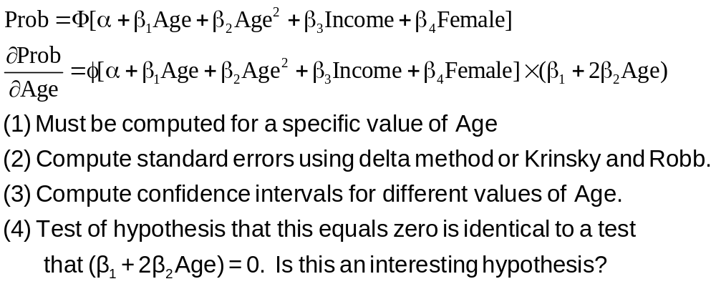
Partial Effect for Nonlinear Terms

Slide 54
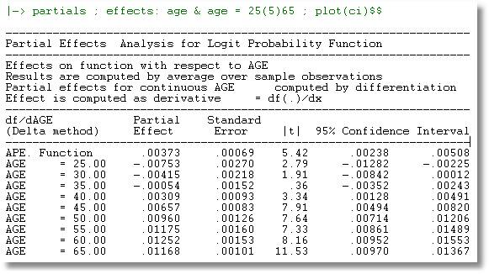
Trace of Partial Effects

Slide 55
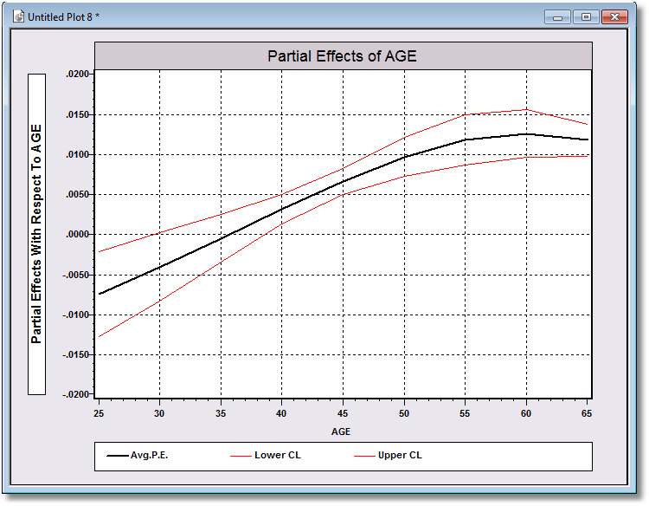
Confidence Limits for Partial Effects

Slide 56
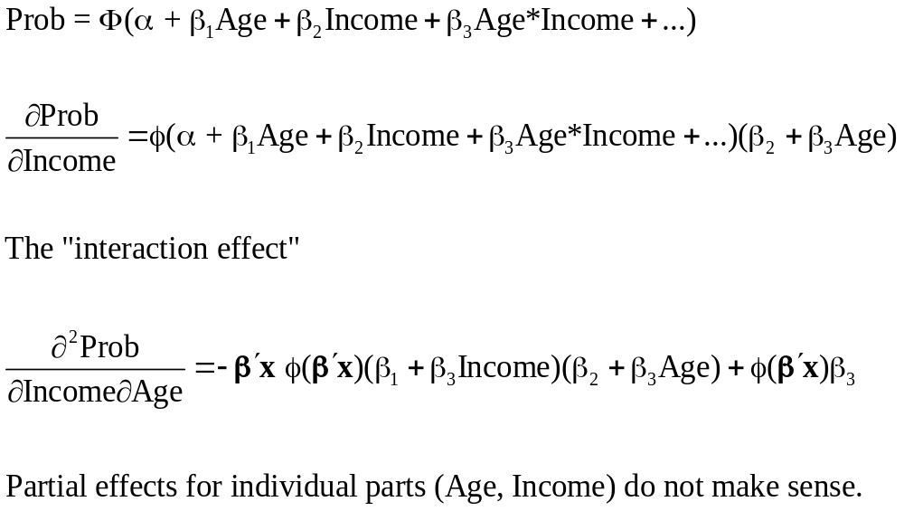
Interaction Effects

Slide 57
Partial Effects?
The software does not know that Age_Inc = Age*Income.
----------------------------------------------------------------------
Partial derivatives of E[y] = F[*] with
respect to the vector of characteristics
They are computed at the means of the Xs
Observations used for means are All Obs.
--------+-------------------------------------------------------------
Variable| Coefficient Standard Error b/St.Er. P[|Z|>z] Elasticity
--------+-------------------------------------------------------------
|Index function for probability
Constant| -.18002** .07421 -2.426 .0153
AGE| .00732*** .00168 4.365 .0000 .46983
INCOME| .11681 .16362 .714 .4753 .07825
AGE_INC| -.00497 .00367 -1.355 .1753 -.14250
|Marginal effect for dummy variable is P|1 - P|0.
FEMALE| .13902*** .01619 8.586 .0000 .09703
--------+-------------------------------------------------------------

Slide 58
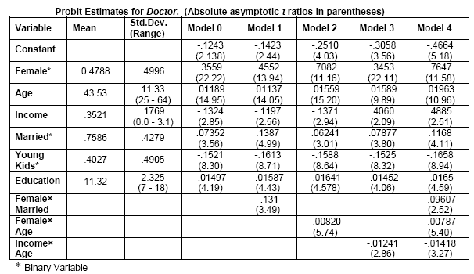
Model for Visit Doctor

Slide 59
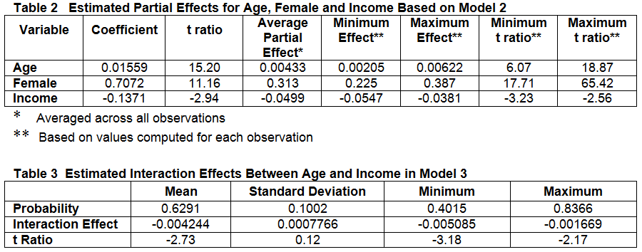
Simple Partial Effects

Slide 60
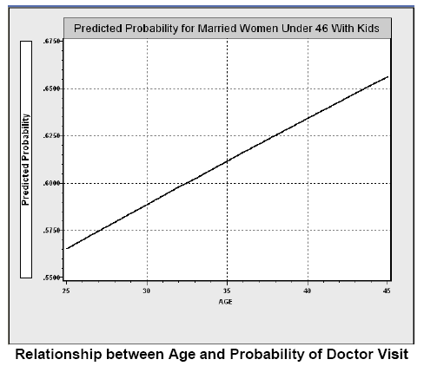
Direct Effect of Age

Slide 61
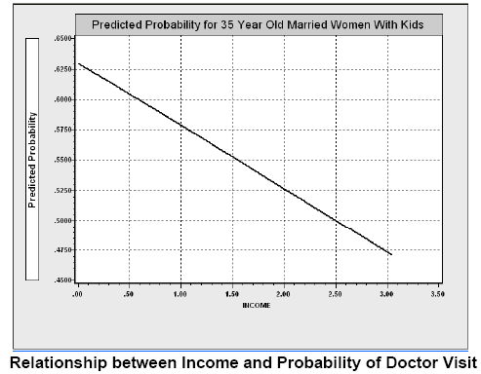
Income Effect

Slide 62
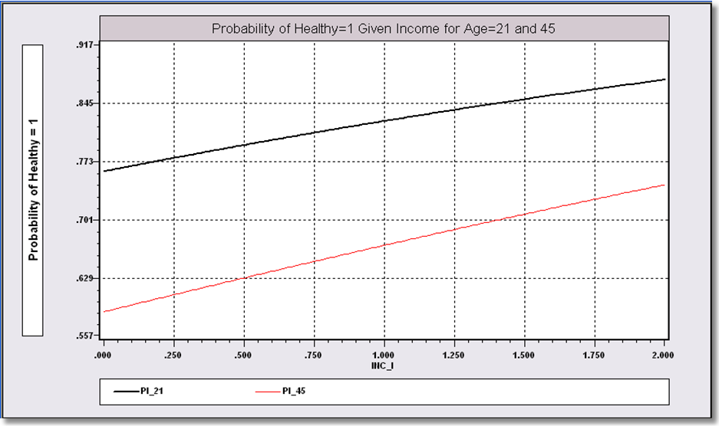
Income Effect on Health for Different Ages

Slide 63
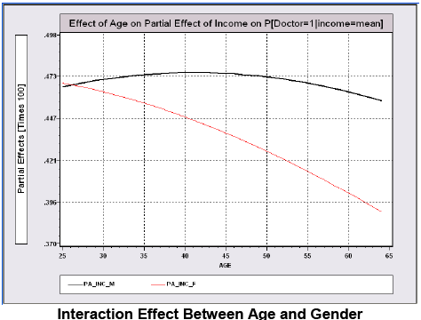
Interaction Effect in Model 0

Slide 64
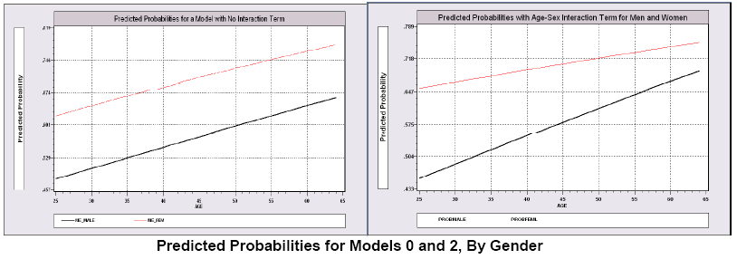
Gender Effects

Slide 65
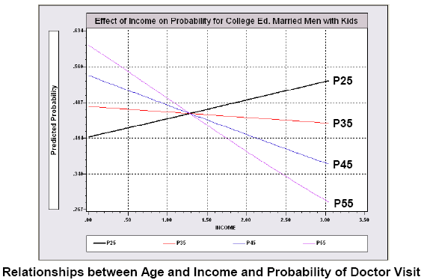
Interaction Effects

