Slide 1
Discrete Choice Modeling
William Greene
Stern School of Business
New York University

Slide 2
Part 3
Inference in Binary Choice Models

Slide 3
Agenda
Measuring the Fit of the Model to the Data
Predicting the Dependent Variable
Hypothesis Tests
  Linear Restrictions
  Structural Change
  Heteroscedasticity
  Model Specification (Logit vs. Probit)
Aggregate Prediction and Model Simulation
Scaling and Heteroscedasticity
Choice Based Sampling
Endogeneity
Sample Selection

Slide 4
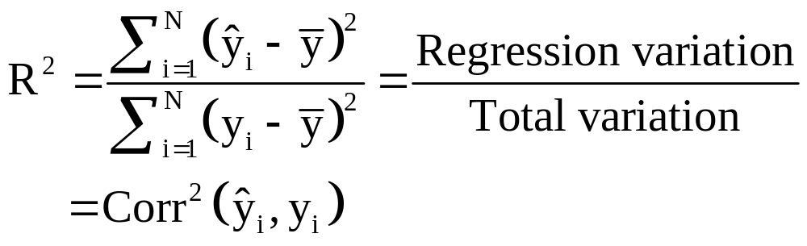
R Squared in Linear Regression

Slide 5
How Well Does the Model Fit?
There is no R squared
  There are no residuals or sums of squares
  The model is not computed to optimize the fit of the model to the data
“Fit measures” computed from log L
  “Pseudo R squared = 1 – logL/logL0
  Also called the “likelihood ratio index”
  Others… - these do not measure fit.

Slide 6
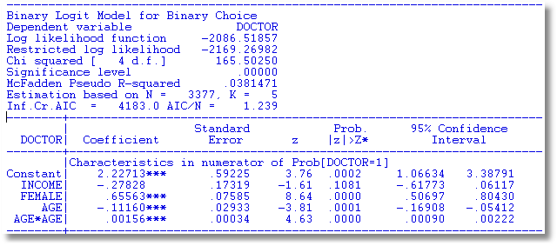
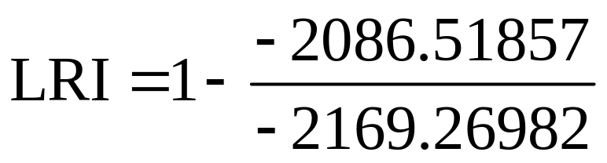
Pseudo R Squared

Slide 7
Fit Measures for Binary Choice
Likelihood Ratio Index
  Bounded by 0 and 1
  Rises when the model is expanded
  Can be strikingly low; .038 in our model.
To Compare Models
  Use logL
  Use information criteria to compare nonnested models
Notes:
7

Slide 8
Fit Measures Based on LogL
----------------------------------------------------------------------
Binary Logit Model for Binary Choice
Dependent variable DOCTOR
Log likelihood function -2085.92452 Full model LogL
Restricted log likelihood -2169.26982 Constant term only LogL0
Chi squared [ 5 d.f.] 166.69058
Significance level .00000
McFadden Pseudo R-squared .0384209 1 – LogL/logL0
Estimation based on N = 3377, K = 6
Information Criteria: Normalization=1/N
Normalized Unnormalized
AIC 1.23892 4183.84905 -2LogL + 2K
Fin.Smpl.AIC 1.23893 4183.87398 -2LogL + 2K + 2K(K+1)/(N-K-1)
Bayes IC 1.24981 4220.59751 -2LogL + KlnN
Hannan Quinn 1.24282 4196.98802 -2LogL + 2Kln(lnN)
--------+-------------------------------------------------------------
Variable| Coefficient Standard Error b/St.Er. P[|Z|>z] Mean of X
--------+-------------------------------------------------------------
|Characteristics in numerator of Prob[Y = 1]
Constant| 1.86428*** .67793 2.750 .0060
AGE| -.10209*** .03056 -3.341 .0008 42.6266
AGESQ| .00154*** .00034 4.556 .0000 1951.22
INCOME| .51206 .74600 .686 .4925 .44476
AGE_INC| -.01843 .01691 -1.090 .2756 19.0288
FEMALE| .65366*** .07588 8.615 .0000 .46343
--------+-------------------------------------------------------------
Information Criteria

Slide 9
Fit Measures Based on Predictions
Direct assessment of the effectiveness of the model at predicting the outcome
Computation
  Use the model to compute predicted probabilities
  Use the model and a rule to compute predicted y = 0 or 1
Fit measure, compare predictions to actuals

Slide 10
Fit Measures – There are many
+----------------------------------------+
| Fit Measures for Binomial Choice Model |
| Logit model for variable DOCTOR |
+----------------------------------------+
| Y=0 Y=1 Total|
| Proportions .34202 .65798 1.00000|
| Sample Size 1155 2222 3377|
+----------------------------------------+
| Log Likelihood Functions for BC Model |
| P=0.50 P=N1/N P=Model| P=.5 => No Model. P=N1/N => Constant only
| LogL = -2340.76 -2169.27 -2085.92| Log likelihood values used in LRI
+----------------------------------------+
| Fit Measures based on Log Likelihood |
| McFadden = 1-(L/L0) = .03842|
| Estrella = 1-(L/L0)^(-2L0/n) = .04909|
| R-squared (ML) = .04816|
| Akaike Information Crit. = 1.23892| Multiplied by 1/N
| Schwartz Information Crit. = 1.24981| Multiplied by 1/N
+----------------------------------------+
| Fit Measures Based on Model Predictions|
| Efron = .04825| Note huge variation. This severely limits
| Ben Akiva and Lerman = .57139| the usefulness of these measures.
| Veall and Zimmerman = .08365|
| Cramer = .04771|
+----------------------------------------+

Slide 11
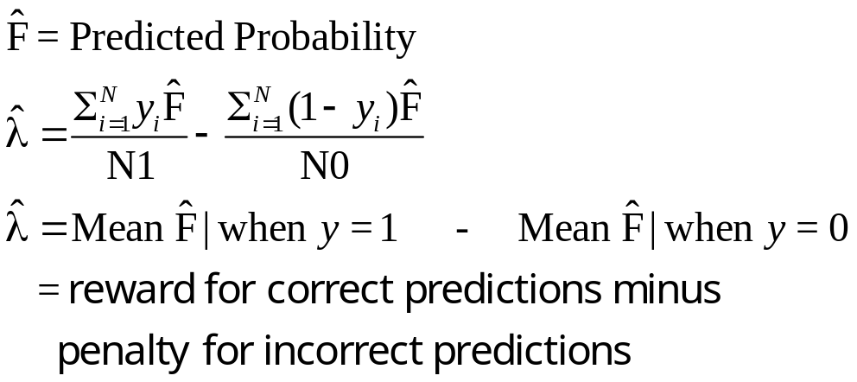
Cramer Fit Measure
+----------------------------------------+
| Fit Measures Based on Model Predictions|
| Efron = .04825|
| Ben Akiva and Lerman = .57139|
| Veall and Zimmerman = .08365|
| Cramer = .04771|
+----------------------------------------+

Slide 12
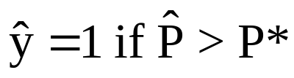
Predicting the Outcome
Predicted probabilities
P = F(a + b₁Age + b₂Income + b₃Female+…)
Predicting outcomes
  Predict y=1 if P is “large”
  Use 0.5 for “large” (more likely than not)
  Generally, use
Count successes and failures

Slide 13
Individual Predictions from a Logit Model
Predicted Values (* => observation was not in estimating sample.)
Observation Observed Y Predicted Y Residual x(i)b Pr[Y=1]
29 .000000 1.0000000 -1.0000000 .0756747 .5189097
31 .000000 1.0000000 -1.0000000 .6990731 .6679822
34 1.0000000 1.0000000 .000000 .9193573 .7149111
38 1.0000000 1.0000000 .000000 1.1242221 .7547710
42 1.0000000 1.0000000 .000000 .0901157 .5225137
49 .000000 .0000000 .000000 -.1916202 .4522410
52 1.0000000 1.0000000 .000000 .7303428 .6748805
58 .000000 1.0000000 -1.0000000 1.0132084 .7336476
83 .000000 1.0000000 -1.0000000 .3070637 .5761684
90 .000000 1.0000000 -1.0000000 1.0121583 .7334423
109 .000000 1.0000000 -1.0000000 .3792791 .5936992
116 1.0000000 .0000000 1.0000000 -.3408756 .2926339
125 .000000 1.0000000 -1.0000000 .9018494 .7113294
132 1.0000000 1.0000000 .000000 1.5735582 .8282903
154 1.0000000 1.0000000 .000000 .3715972 .5918449
158 1.0000000 1.0000000 .000000 .7673442 .6829461
177 .000000 1.0000000 -1.0000000 .1464560 .5365487
184 1.0000000 1.0000000 .000000 .7906293 .6879664
191 .000000 1.0000000 -1.0000000 .7200008 .6726072
Note two types of errors and two types of successes.

Slide 14
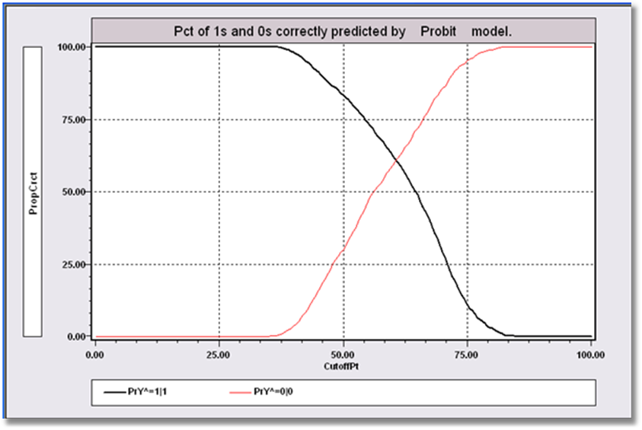
Predictions in Binary Choice
Predict y = 1 if P > P*
Success depends on the assumed P*
By setting P* lower, more observations will be predicted as 1. If P*=0, every observation will be predicted to equal 1, so all 1s will be correctly predicted. But, many 0s will be predicted to equal 1. As P* increases, the proportion of 0s correctly predicted will rise, but the proportion of 1s correctly predicted will fall.

Slide 15
Aggregate Predictions
Prediction table is based on predicting individual observations.
+---------------------------------------------------------+
|Predictions for Binary Choice Model. Predicted value is |
|1 when probability is greater than .500000, 0 otherwise.|
|Note, column or row total percentages may not sum to |
|100% because of rounding. Percentages are of full sample.|
+------+---------------------------------+----------------+
|Actual| Predicted Value | |
|Value | 0 1 | Total Actual |
+------+----------------+----------------+----------------+
| 0 | 3 ( .1%)| 1152 ( 34.1%)| 1155 ( 34.2%)|
| 1 | 3 ( .1%)| 2219 ( 65.7%)| 2222 ( 65.8%)|
+------+----------------+----------------+----------------+
|Total | 6 ( .2%)| 3371 ( 99.8%)| 3377 (100.0%)|
+------+----------------+----------------+----------------+

Slide 16
Aggregate Predictions
Prediction table is based on predicting aggregate shares.
+---------------------------------------------------------+
|Crosstab for Binary Choice Model. Predicted probability |
|vs. actual outcome. Entry = Sum[Y(i,j)*Prob(i,m)] 0,1. |
|Note, column or row total percentages may not sum to |
|100% because of rounding. Percentages are of full sample.|
+------+---------------------------------+----------------+
|Actual| Predicted Probability | |
|Value | Prob(y=0) Prob(y=1) | Total Actual |
+------+----------------+----------------+----------------+
| y=0 | 431 ( 12.8%)| 723 ( 21.4%)| 1155 ( 34.2%)|
| y=1 | 723 ( 21.4%)| 1498 ( 44.4%)| 2222 ( 65.8%)|
+------+----------------+----------------+----------------+
|Total | 1155 ( 34.2%)| 2221 ( 65.8%)| 3377 ( 99.9%)|
+------+----------------+----------------+----------------+
Notes:
16

Slide 17
Hypothesis Tests
Restrictions: Linear or nonlinear functions of the model parameters
Structural ‘change’: Constancy of parameters
Specification Tests:
  Model specification: distribution
  Heteroscedasticity

Slide 18
Hypothesis Testing
There is no F statistic
Comparisons of Likelihood Functions: Likelihood Ratio Tests
Distance Measures: Wald Statistics
Lagrange Multiplier Tests

Slide 19
Base Model
----------------------------------------------------------------------
Binary Logit Model for Binary Choice
Dependent variable DOCTOR
Log likelihood function -2085.92452
Restricted log likelihood -2169.26982
Chi squared [ 5 d.f.] 166.69058
Significance level .00000
McFadden Pseudo R-squared .0384209
Estimation based on N = 3377, K = 6
--------+-------------------------------------------------------------
Variable| Coefficient Standard Error b/St.Er. P[|Z|>z] Mean of X
--------+-------------------------------------------------------------
|Characteristics in numerator of Prob[Y = 1]
Constant| 1.86428*** .67793 2.750 .0060
AGE| -.10209*** .03056 -3.341 .0008 42.6266
AGESQ| .00154*** .00034 4.556 .0000 1951.22
INCOME| .51206 .74600 .686 .4925 .44476
AGE_INC| -.01843 .01691 -1.090 .2756 19.0288
FEMALE| .65366*** .07588 8.615 .0000 .46343
--------+-------------------------------------------------------------
H₀: Age is not a significant
determinant of
Prob(Doctor = 1)
H₀: β₂ = β₃ = β₅ = 0

Slide 20
Likelihood Ratio Tests
Null hypothesis restricts the parameter vector
Alternative releases the restriction
Test statistic: Chi-squared =
2 (LogL|Unrestricted model –
LogL|Restrictions) > 0
Degrees of freedom = number of restrictions

Slide 21
LR Test of H₀
UNRESTRICTED MODEL
Binary Logit Model for Binary Choice
Dependent variable DOCTOR
Log likelihood function -2085.92452
Restricted log likelihood -2169.26982
Chi squared [ 5 d.f.] 166.69058
Significance level .00000
McFadden Pseudo R-squared .0384209
Estimation based on N = 3377, K = 6
RESTRICTED MODEL
Binary Logit Model for Binary Choice
Dependent variable DOCTOR
Log likelihood function -2124.06568
Restricted log likelihood -2169.26982
Chi squared [ 2 d.f.] 90.40827
Significance level .00000
McFadden Pseudo R-squared .0208384
Estimation based on N = 3377, K = 3
Chi squared[3] = 2[-2085.92452 - (-2124.06568)] = 77.46456

Slide 22
Wald Test
Unrestricted parameter vector is estimated
Discrepancy: q= Rb – m (or r(b,m) if nonlinear) is computed
Variance of discrepancy is estimated
Wald Statistic is q’[Var(q)]⁻¹q

Slide 23
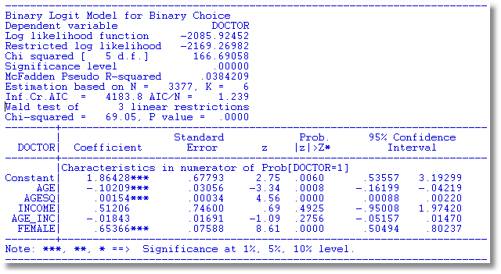
Wald Test

Slide 24
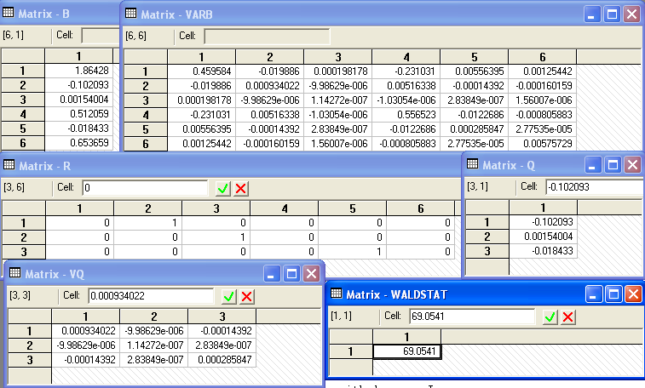
Matrix Computation
Chi squared[3] = 69.0541

Slide 25
Lagrange Multiplier Test
Restricted model is estimated
Derivatives of unrestricted model and variances of derivatives are computed at restricted estimates
Wald test of whether derivatives are zero tests the restrictions
Usually hard to compute – difficult to program the derivatives and their variances.

Slide 26
LM Test for a Logit Model
Compute b₀ (subject to restictions)
(e.g., with zeros in appropriate positions.
Compute P_{i}(b₀) for each observation.
Compute e_{i}(b₀) = [y_{i} – P_{i}(b₀)]
Compute g_{i}(b₀) = x_{i}e_{i} using full x_{i} vector
LM = [Σ_{i}g_{i}(b₀)]’[Σ_{i}g_{i}(b₀)g_{i}(b₀)]⁻¹[Σ_{i}g_{i}(b₀)]

Slide 27
Test Results
Matrix DERIV has 6 rows and 1 columns.
+-------------+
1| .2393443D-05 zero from FOC
2| 2268.60186
3| .2122049D+06
4| .9683957D-06 zero from FOC
5| 849.70485
6| .2380413D-05 zero from FOC
+-------------+
Matrix LM has 1 rows and 1 columns.
1
+-------------+
1| 81.45829 |
+-------------+
Wald Chi squared[3] = 69.0541
LR Chi squared[3] = 2[-2085.92452 - (-2124.06568)] = 77.46456

Slide 28
A Test of Structural Stability
In the original application, separate models were fit for men and women.
We seek a counterpart to the Chow test for linear models.
Use a likelihood ratio test.

Slide 29
Testing Structural Stability
Fit the same model in each subsample
Unrestricted log likelihood is the sum of the subsample log likelihoods: Logl1
Pool the subsamples, fit the model to the pooled sample
Restricted log likelihood is that from the pooled sample: Logl0
Chi-squared = 2*(LogL1 – Logl0)
degrees of freedom = (K-1)*model size.

Slide 30
Structural Change (Over Groups) Test
----------------------------------------------------------------------
Dependent variable DOCTOR
Pooled Log likelihood function -2123.84754
--------+-------------------------------------------------------------
Variable| Coefficient Standard Error b/St.Er. P[|Z|>z] Mean of X
--------+-------------------------------------------------------------
Constant| 1.76536*** .67060 2.633 .0085
AGE| -.08577*** .03018 -2.842 .0045 42.6266
AGESQ| .00139*** .00033 4.168 .0000 1951.22
INCOME| .61090 .74073 .825 .4095 .44476
AGE_INC| -.02192 .01678 -1.306 .1915 19.0288
--------+-------------------------------------------------------------
Male Log likelihood function -1198.55615
--------+-------------------------------------------------------------
Constant| 1.65856* .86595 1.915 .0555
AGE| -.10350*** .03928 -2.635 .0084 41.6529
AGESQ| .00165*** .00044 3.760 .0002 1869.06
INCOME| .99214 .93005 1.067 .2861 .45174
AGE_INC| -.02632 .02130 -1.235 .2167 19.0016
--------+-------------------------------------------------------------
Female Log likelihood function -885.19118
--------+-------------------------------------------------------------
Constant| 2.91277*** 1.10880 2.627 .0086
AGE| -.10433** .04909 -2.125 .0336 43.7540
AGESQ| .00143*** .00054 2.673 .0075 2046.35
INCOME| -.17913 1.27741 -.140 .8885 .43669
AGE_INC| -.00729 .02850 -.256 .7981 19.0604
--------+-------------------------------------------------------------
Chi squared[5] = 2[-885.19118+(-1198.55615) – (-2123.84754] = 80.2004

Slide 31
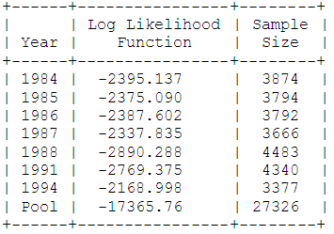
Structural Change Over Time
Health Satisfaction: Panel Data – 1984,1985,…,1988,1991,1994
Healthy(0/1) = f(1, Age, Educ, Income, Married(0/1), Kids(0.1)
The log likelihood for the pooled sample is -17365.76. The sum of the log likelihoods for the seven individual years is -17324.33. Twice the difference is 82.87. The degrees of freedom is 6×6 = 36. The 95% critical value from the chi squared table is 50.998, so the pooling hypothesis is rejected.

Slide 32
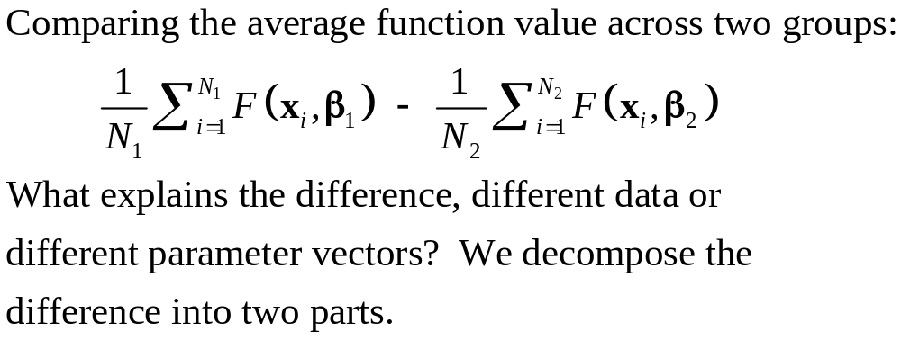
Comparing Groups: Oaxaca Decomposition

Slide 33
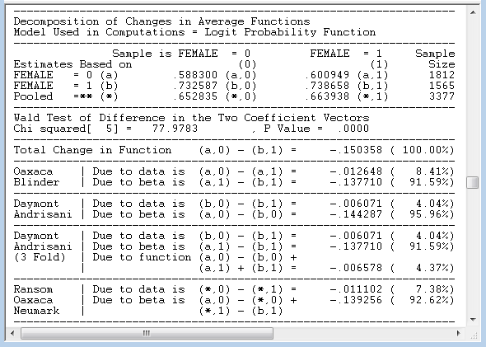
Oaxaca (and other) Decompositions

Slide 34
Scaling in Choice Models
Utility of choice U_{i} = α + β’x_{i} + ε_{i}
ε_{i} = Unobserved random component of utility
Mean: E[ε_{i}] = 0, Var[ε_{i}] = 1
Utility based model specification
Why assume variance = 1?
  Identification issue: Data do not provide information on σ
  Assumption of homoscedasticity across individuals
What if there are subgroups with different variances?
  Cost of ignoring the between group variation?
  Specifically modeling
More general heterogeneity across people
  Cost of the homogeneity assumption
  Modeling issues

Slide 35
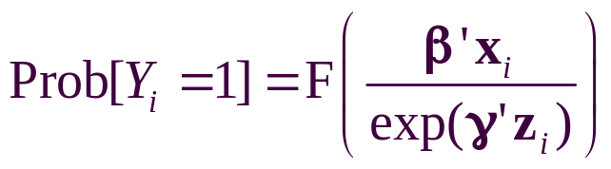
Heteroscedasticity in Binary Choice Models
Random utility: Yi = 1 iff β’x_{i} + εi > 0
Resemblance to regression: How to accommodate heterogeneity in the random unobserved effects across individuals?
Heteroscedasticity – different scaling
  Parameterize: Var[εi] = exp(γ’zi)
  Reformulate probabilities
Probit or Logit:
Partial effects are now very complicated

Slide 36
Heteroscedasticity in Marginal Effects
For the univariate case:
E[y_{i}|x_{i},z_{i}] = Φ[β’x_{i} / exp(γ’z_{i})]
∂ E[y_{i}|x_{i},z_{i}] /∂x_{i} = φ[β’x_{i} / exp(γ’z_{i})] β
∂ E[y_{i}|x_{i},z_{i}] /∂z_{i} = φ[β’x_{i} / exp(γ’z_{i})] times
[- β’x_{i} / exp(γ’z_{i})] γ
If the variables are the same in x and z, these are added. Sign and magnitude are ambiguous

Slide 37
Application: Demographics
----------------------------------------------------------------------
Binary Logit Model for Binary Choice
Dependent variable DOCTOR
Log likelihood function -2096.42765
Restricted log likelihood -2169.26982
Chi squared [ 4 d.f.] 145.68433
Significance level .00000
McFadden Pseudo R-squared .0335791
Estimation based on N = 3377, K = 6
Heteroscedastic Logit Model for Binary Data
--------+-------------------------------------------------------------
Variable| Coefficient Standard Error b/St.Er. P[|Z|>z] Mean of X
--------+-------------------------------------------------------------
|Characteristics in numerator of Prob[Y = 1]
Constant| 1.31369*** .43268 3.036 .0024
AGE| -.05602*** .01905 -2.941 .0033 42.6266
AGESQ| .00082*** .00021 3.838 .0001 1951.22
INCOME| .11564 .47799 .242 .8088 .44476
AGE_INC| -.00704 .01086 -.648 .5172 19.0288
|Disturbance Variance Terms
FEMALE| -.81675*** .12143 -6.726 .0000 .46343
--------+-------------------------------------------------------------

Slide 38
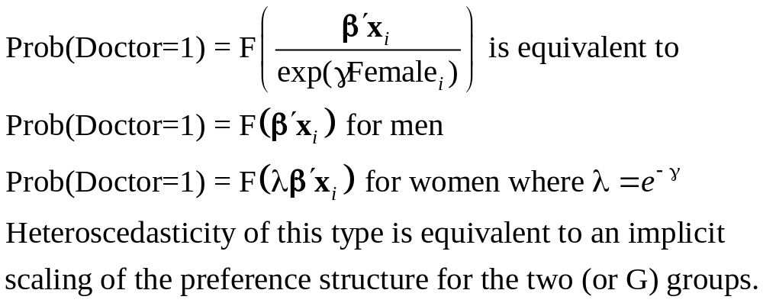
Scaling with a Dummy Variable

Slide 39
Partial Effects in the Scaling Model
------------------------------------------------------------------------------------
Partial derivatives of probabilities with respect to the vector of characteristics.
They are computed at the means of the Xs. Effects are the sum of the mean and var-
iance term for variables which appear in both parts of the function.
--------+---------------------------------------------------------------------------
Variable| Coefficient Standard Error b/St.Er. P[|Z|>z] Elasticity
--------+---------------------------------------------------------------------------
AGE| -.02121*** .00637 -3.331 .0009 -1.32701
AGESQ| .00032*** .717036D-04 4.527 .0000 .92966
INCOME| .13342 .15190 .878 .3797 .08709
AGE_INC| -.00439 .00344 -1.276 .2020 -.12264
FEMALE| .19362*** .04043 4.790 .0000 .13169
|Disturbance Variance Terms
FEMALE| -.05339 .05604 -.953 .3407 -.03632
|Sum of terms for variables in both parts
FEMALE| .14023*** .02509 5.588 .0000 .09538
--------+---------------------------------------------------------------------------
|Marginal effect for variable in probability – Homoscedastic Model
AGE| -.02266*** .00677 -3.347 .0008 -1.44664
AGESQ| .00034*** .747582D-04 4.572 .0000 .99890
INCOME| .11363 .16552 .687 .4924 .07571
AGE_INC| -.00409 .00375 -1.091 .2754 -.11660
|Marginal effect for dummy variable is P|1 - P|0.
FEMALE| .14306*** .01619 8.837 .0000 .09931
--------+---------------------------------------------------------------------------

Slide 40
Testing For Heteroscedasticity
Likelihood Ratio, Wald and Lagrange Multiplier Tests are all straightforward
All tests require a specification of the model of heteroscedasticity
There is no generic ‘test for heteroscedasticity’

Slide 41
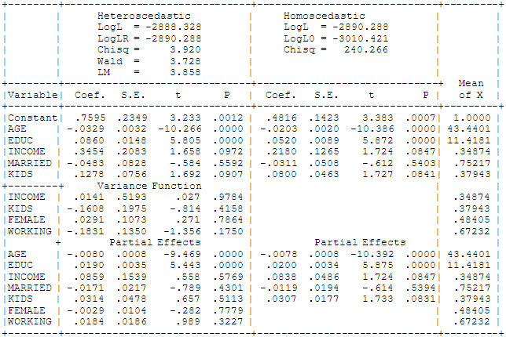
Heteroscedastic Probit Model: Tests

Slide 42
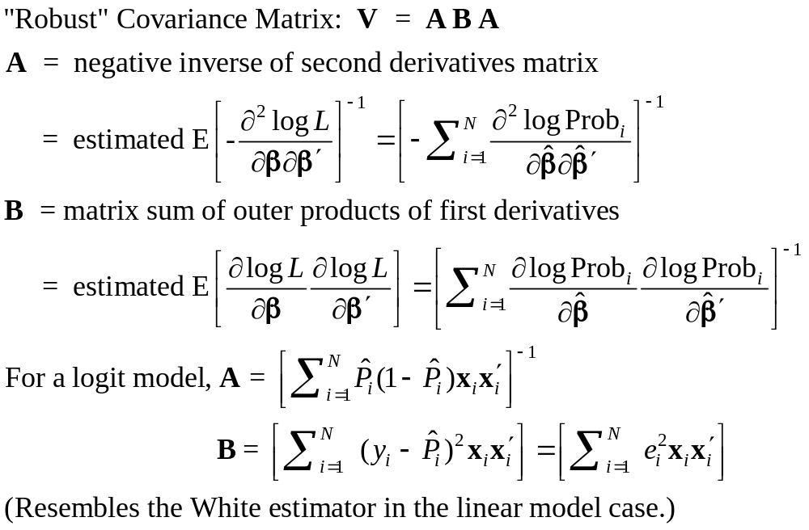
Robust Covariance Matrix(?)

Slide 43
The Robust Matrix is not Robust
To:
  Heteroscedasticity
  Correlation across observations
  Omitted heterogeneity
  Omitted variables (even if orthogonal)
  Wrong distribution assumed
  Wrong functional form for index function
In all cases, the estimator is inconsistent so a “robust” covariance matrix is pointless.
(In general, it is merely harmless.)

Slide 44
Estimated Robust Covariance Matrix
--------+-------------------------------------------------------------
Variable| Coefficient Standard Error b/St.Er. P[|Z|>z] Mean of X
--------+-------------------------------------------------------------
|Robust Standard Errors
Constant| 1.86428*** .68442 2.724 .0065
AGE| -.10209*** .03115 -3.278 .0010 42.6266
AGESQ| .00154*** .00035 4.446 .0000 1951.22
INCOME| .51206 .75103 .682 .4954 .44476
AGE_INC| -.01843 .01703 -1.082 .2792 19.0288
FEMALE| .65366*** .07585 8.618 .0000 .46343
--------+-------------------------------------------------------------
|Conventional Standard Errors Based on Second Derivatives
Constant| 1.86428*** .67793 2.750 .0060
AGE| -.10209*** .03056 -3.341 .0008 42.6266
AGESQ| .00154*** .00034 4.556 .0000 1951.22
INCOME| .51206 .74600 .686 .4925 .44476
AGE_INC| -.01843 .01691 -1.090 .2756 19.0288
FEMALE| .65366*** .07588 8.615 .0000 .46343

Slide 45
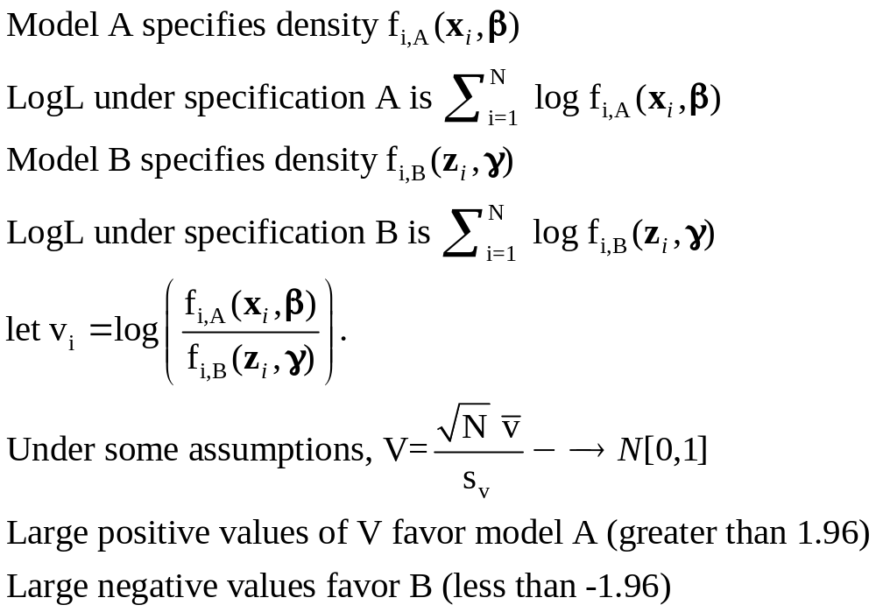
Vuong Test for Nonnested Models
Test of Logit (Model A) vs. Probit (Model B)?
+------------------------------------+
| Listed Calculator Results |
+------------------------------------+
VUONGTST= 1.570052

Slide 46
Endogeneity

Slide 47
Endogenous RHS Variable
U* = β’x + θh + ε
y = 1[U* > 0]
E[ε|h] ≠ 0 (h is endogenous)
  Case 1: h is continuous
  Case 2: h is binary = a treatment effect
Approaches
  Parametric: Maximum Likelihood
  Semiparametric (not developed here):
    GMM
    Various approaches for case 2

Slide 48
Endogenous Continuous Variable
U* = β’x + θh + ε
y = 1[U* > 0] ⇐
h = α’z + u
E[ε|h] ≠ 0 ⬄ Cov[u, ε] ≠ 0
Additional Assumptions:
(u,ε) ~ N[(0,0),(σ_{u}², ρσ_{u}, 1)]
z = a valid set of exogenous
variables, uncorrelated with (u,ε)
Correlation = ρ.
This is the source of the endogeneity
This is not IV estimation.

Slide 49


Endogenous Income
Income responds to
Age, Age², Educ, Married, Kids, Gender
0 = Not Healthy
1 = Healthy
Healthy = 0 or 1
Age, Married, Kids, Gender, Income
Determinants of Income (observed and unobserved) also determine health satisfaction.
Notes:
49

Slide 50
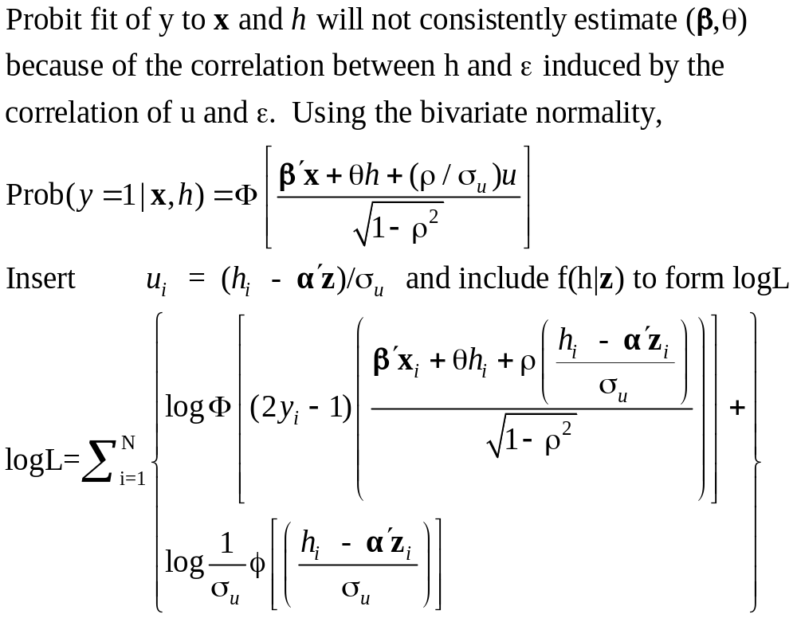
Estimation by ML (Control Function)

Slide 51
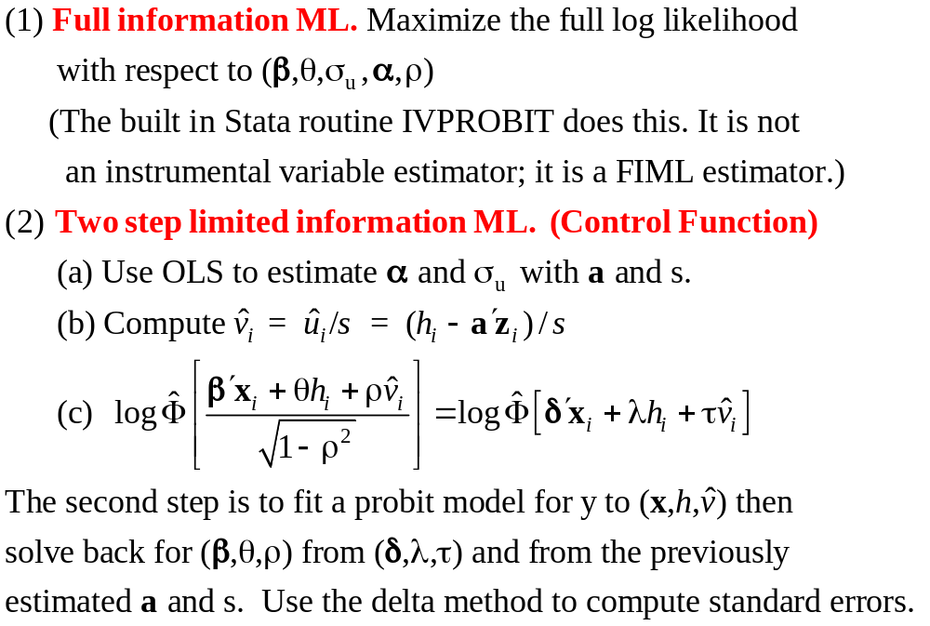
Two Approaches to ML

Slide 52
FIML Estimates
----------------------------------------------------------------------
Probit with Endogenous RHS Variable
Dependent variable HEALTHY
Log likelihood function -6464.60772
--------+-------------------------------------------------------------
Variable| Coefficient Standard Error b/St.Er. P[|Z|>z] Mean of X
--------+-------------------------------------------------------------
|Coefficients in Probit Equation for HEALTHY
Constant| 1.21760*** .06359 19.149 .0000
AGE| -.02426*** .00081 -29.864 .0000 43.5257
MARRIED| -.02599 .02329 -1.116 .2644 .75862
HHKIDS| .06932*** .01890 3.668 .0002 .40273
FEMALE| -.14180*** .01583 -8.959 .0000 .47877
INCOME| .53778*** .14473 3.716 .0002 .35208
|Coefficients in Linear Regression for INCOME
Constant| -.36099*** .01704 -21.180 .0000
AGE| .02159*** .00083 26.062 .0000 43.5257
AGESQ| -.00025*** .944134D-05 -26.569 .0000 2022.86
EDUC| .02064*** .00039 52.729 .0000 11.3206
MARRIED| .07783*** .00259 30.080 .0000 .75862
HHKIDS| -.03564*** .00232 -15.332 .0000 .40273
FEMALE| .00413** .00203 2.033 .0420 .47877
|Standard Deviation of Regression Disturbances
Sigma(w)| .16445*** .00026 644.874 .0000
|Correlation Between Probit and Regression Disturbances
Rho(e,w)| -.02630 .02499 -1.052 .2926
--------+-------------------------------------------------------------

Slide 53
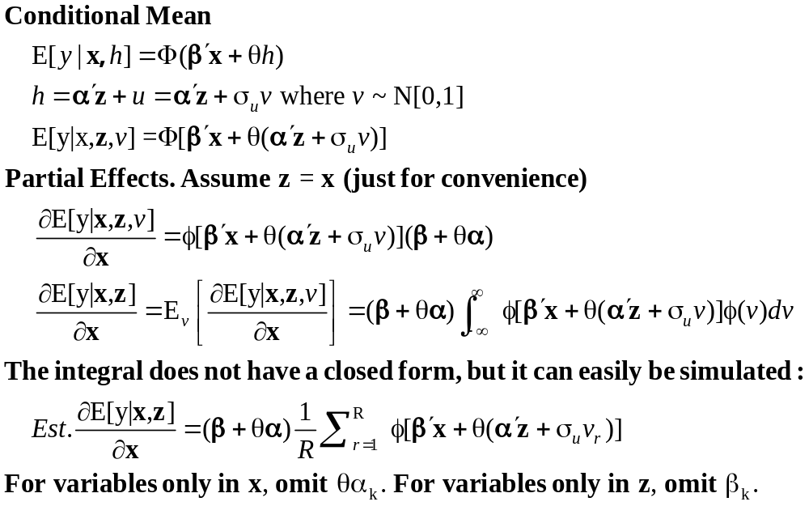
Partial Effects: Scaled Coefficients

Slide 54
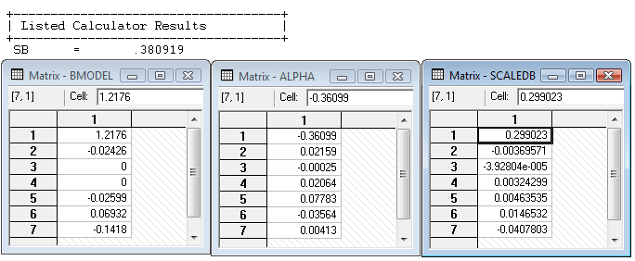
Partial Effects
θ = 0.53778
The scale factor is computed using the model coefficients, means of the variables and 35,000 draws from the standard normal population.

Slide 55
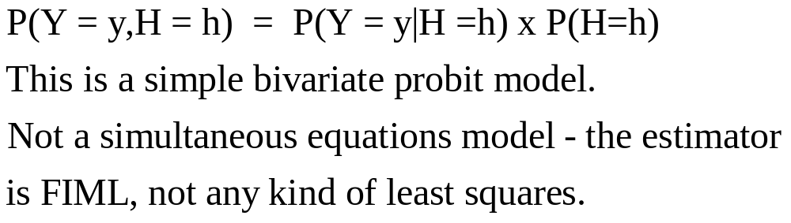

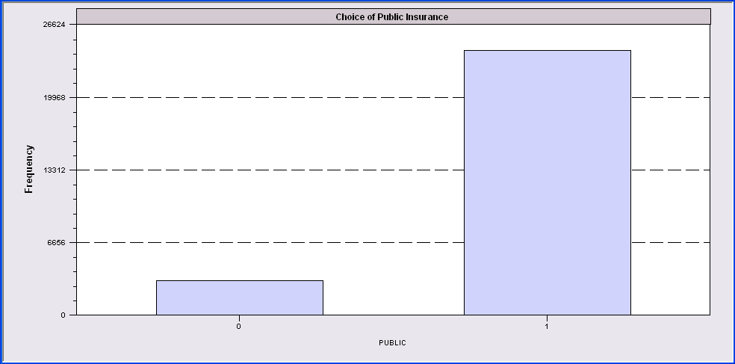
Endogenous Binary Variable
Doctor = F(age,age²,income,female,Public)
Public = F(age,educ,income,married,kids,female)

Slide 56
Endogenous Binary Variable
U* = β’x + θh + ε
y = 1[U* > 0]
h* = α’z + u
h = 1[h* > 0]
E[ε|h*] ≠ 0 ⬄ Cov[u, ε] ≠ 0
Additional Assumptions:
(u,ε) ~ N[(0,0),(σ_{u}², ρσ_{u}, 1)]
z = a valid set of exogenous
variables, uncorrelated with (u,ε)
⇐
Correlation = ρ.
This is the source of the endogeneity
This is not IV estimation. Z may be uncorrelated with X without problems.

Slide 57
FIML Estimates
----------------------------------------------------------------------
FIML Estimates of Bivariate Probit Model
Dependent variable DOCPUB
Log likelihood function -25671.43905
Estimation based on N = 27326, K = 14
--------+-------------------------------------------------------------
Variable| Coefficient Standard Error b/St.Er. P[|Z|>z] Mean of X
--------+-------------------------------------------------------------
|Index equation for DOCTOR
Constant| .59049*** .14473 4.080 .0000
AGE| -.05740*** .00601 -9.559 .0000 43.5257
AGESQ| .00082*** .681660D-04 12.100 .0000 2022.86
INCOME| .08883* .05094 1.744 .0812 .35208
FEMALE| .34583*** .01629 21.225 .0000 .47877
PUBLIC| .43533*** .07357 5.917 .0000 .88571
|Index equation for PUBLIC
Constant| 3.55054*** .07446 47.681 .0000
AGE| .00067 .00115 .581 .5612 43.5257
EDUC| -.16839*** .00416 -40.499 .0000 11.3206
INCOME| -.98656*** .05171 -19.077 .0000 .35208
MARRIED| -.00985 .02922 -.337 .7361 .75862
HHKIDS| -.08095*** .02510 -3.225 .0013 .40273
FEMALE| .12139*** .02231 5.442 .0000 .47877
|Disturbance correlation
RHO(1,2)| -.17280*** .04074 -4.241 .0000
--------+-------------------------------------------------------------

Slide 58
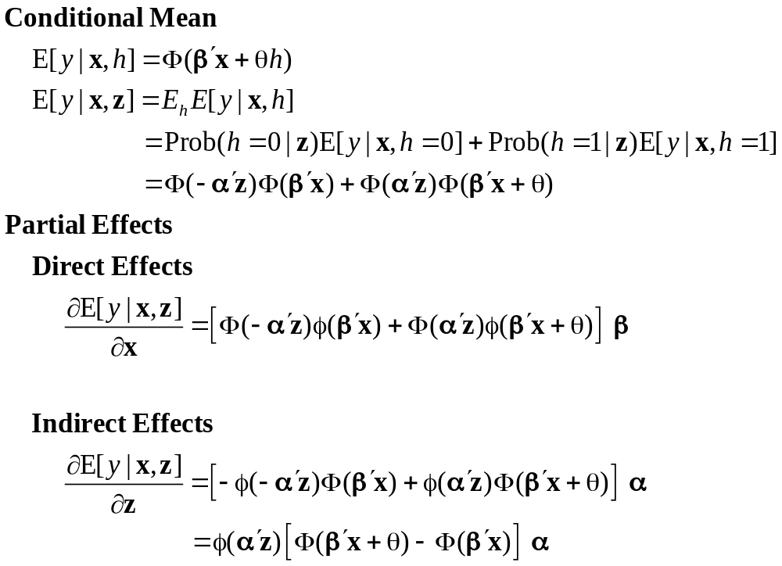
Partial Effects

Slide 59
Identification Issues
Exclusions are not needed for estimation
Identification is, in principle, by “functional form”
Researchers usually have a variable in the treatment equation that is not in the main probit equation “to improve identification”
A fully simultaneous model
  y1 = f(x1,y2), y2 = f(x2,y1)
  Not identified even with exclusion restrictions
  (Model is “incoherent”)

Slide 60
Application: Doctor,Public
+-----------------------------------------------------+
| Joint Frequency Table for Bivariate Probit Model |
| Predicted cell is the one with highest probability |
+-----------------------------------------------------+
| PUBLIC |
+-------------+---------------------------------------+
| DOCTOR | 0 1 Total |
|-------------+-------------+------------+------------+
| 0 | 1403 | 8732 | 10135 |
| Fitted | ( 127) | ( 2715) | ( 2842) |
|-------------+-------------+------------+------------+
| 1 | 1720 | 15471 | 17191 |
| Fitted | ( 645) | ( 23839) | ( 24484) |
|-------------+-------------+------------+------------+
| Total | 3123 | 24203 | 27326 |
| Fitted | ( 772) | ( 26554) | ( 27326) |
|-------------+-------------+------------+------------+

Slide 61
Selection

Slide 62
A Sample Selection Model
U* = β’x + ε
y = 1[U* > 0]
h* = α’z + u
h = 1[h* > 0]
E[ε|h] ≠ 0 ⬄ Cov[u, ε] ≠ 0
(y,x) are observed only when h = 1
Additional Assumptions:
(u,ε) ~ N[(0,0),(σ_{u}², ρσ_{u}, 1)]
z = a valid set of exogenous
variables, uncorrelated with (u,ε)
Correlation = ρ.
This is the source of the “selectivity:

Slide 63
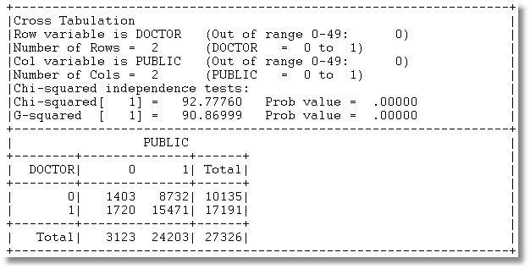
Application: Doctor,Public
3 Groups of observations: (Public=0), (Doctor=0|Public=1), (Doctor=1|Public=1)

Slide 64
Sample Selection
Doctor = F(age,age²,income,female,Public=1)
Public = F(age,educ,income,married,kids,female)

Slide 65
Selected Sample
+-----------------------------------------------------+
| Joint Frequency Table for Bivariate Probit Model |
| Predicted cell is the one with highest probability |
+-----------------------------------------------------+
| PUBLIC |
+-------------+---------------------------------------+
| DOCTOR | 0 1 Total |
|-------------+-------------+------------+------------+
| 0 | 0 | 8732 | 8732 |
| Fitted | ( 0) | ( 511) | ( 511) |
|-------------+-------------+------------+------------+
| 1 | 0 | 15471 | 15471 |
| Fitted | ( 477) | ( 23215) | ( 23692) |
|-------------+-------------+------------+------------+
| Total | 0 | 24203 | 24203 |
| Fitted | ( 477) | ( 23726) | ( 24203) |
|-------------+-------------+------------+------------+
| Counts based on 24203 selected of 27326 in sample |
+-----------------------------------------------------+

Slide 66
ML Estimates
----------------------------------------------------------------------
FIML Estimates of Bivariate Probit Model
Dependent variable DOCPUB
Log likelihood function -23581.80697
Estimation based on N = 27326, K = 13
Selection model based on PUBLIC
Means for vars. 1- 5 are after selection.
--------+-------------------------------------------------------------
Variable| Coefficient Standard Error b/St.Er. P[|Z|>z] Mean of X
--------+-------------------------------------------------------------
|Index equation for DOCTOR
Constant| 1.09027*** .13112 8.315 .0000
AGE| -.06030*** .00633 -9.532 .0000 43.6996
AGESQ| .00086*** .718153D-04 11.967 .0000 2041.87
INCOME| .07820 .05779 1.353 .1760 .33976
FEMALE| .34357*** .01756 19.561 .0000 .49329
|Index equation for PUBLIC
Constant| 3.54736*** .07456 47.580 .0000
AGE| .00080 .00116 .690 .4899 43.5257
EDUC| -.16832*** .00416 -40.490 .0000 11.3206
INCOME| -.98747*** .05162 -19.128 .0000 .35208
MARRIED| -.01508 .02934 -.514 .6072 .75862
HHKIDS| -.07777*** .02514 -3.093 .0020 .40273
FEMALE| .12154*** .02231 5.447 .0000 .47877
|Disturbance correlation
RHO(1,2)| -.19303*** .06763 -2.854 .0043
--------+-------------------------------------------------------------

Slide 67
Estimation Issues
This is a sample selection model applied to a nonlinear model
  There is no lambda
  Estimated by FIML, not two step least squares
  Estimator is a type of BIVARIATE PROBIT MODEL
The model is identified without exclusions (again)

Slide 68
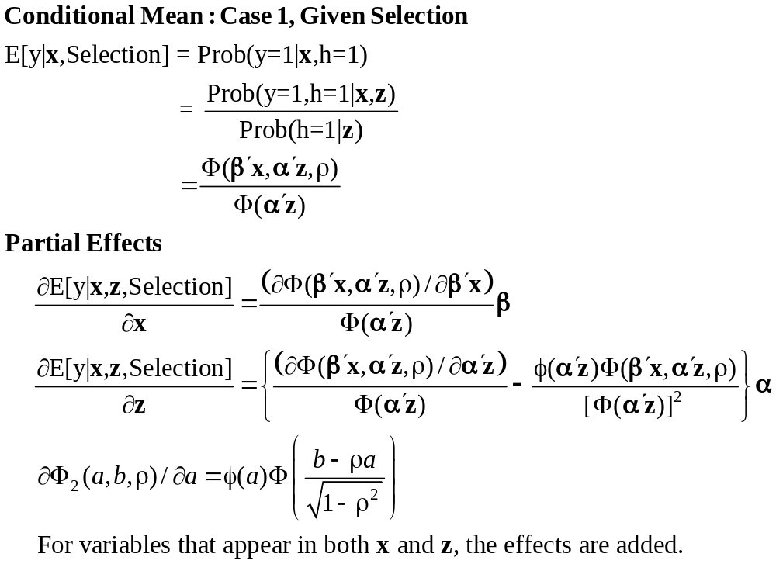
Partial Effects in the Selection Model

