Slide 1
Discrete Choice Modeling
William Greene
Stern School of Business
New York University

Slide 2
Part 4
Panel Data Models

Slide 3


Slide 4


Slide 5


Slide 6
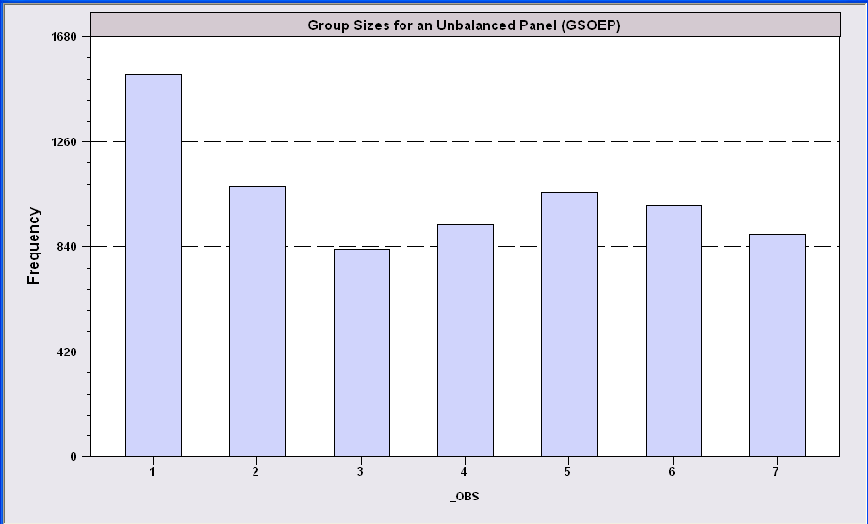
An Unbalanced Panel:
RWM’s GSOEP Data on Health Care
N = 7,293 Households

Slide 7
Application: Health Care Panel Data
German Health Care Usage Data, 7,293 Individuals, Varying Numbers of Periods
Variables in the file are
Data downloaded from Journal of Applied Econometrics Archive. This is an unbalanced panel with 7,293 individuals. They can be used for regression, count models, binary choice, ordered choice, and bivariate binary choice. This is a large data set. There are altogether 27,326 observations. The number of observations ranges from 1 to 7. (Frequencies are: 1=1525, 2=1079, 3=825, 4=926, 5=1051, 6=1000, 7=887). Note, the variable NUMOBS below tells how many observations there are for each person. This variable is repeated in each row of the data for the person. (Downloaded from the JAE Archive)
DOCTOR = 1(Number of doctor visits > 0)
HOSPITAL = 1(Number of hospital visits > 0)
HSAT = health satisfaction, coded 0 (low) - 10 (high)
DOCVIS = number of doctor visits in last three months
HOSPVIS = number of hospital visits in last calendar year
PUBLIC = insured in public health insurance = 1; otherwise = 0
ADDON = insured by add-on insurance = 1; otherswise = 0
HHNINC = household nominal monthly net income in German marks / 10000.
(4 observations with income=0 were dropped)
HHKIDS = children under age 16 in the household = 1; otherwise = 0
EDUC = years of schooling
AGE = age in years
MARRIED = marital status
EDUC = years of education
Notes:
7

Slide 8
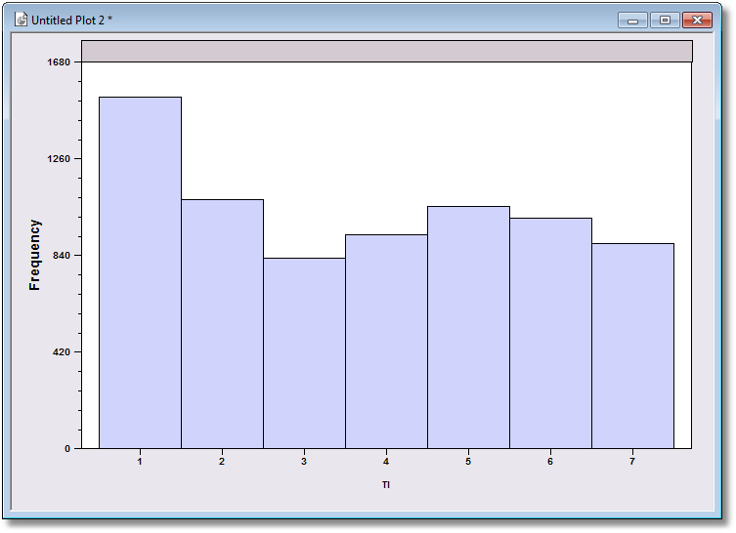
Unbalanced Panel: Group Sizes

Slide 9
Panel Data Models
Benefits
  Modeling heterogeneity
  Rich specifications
  Modeling dynamic effects in individual behavior
Costs
  More complex models and estimation procedures
  Statistical issues for identification and estimation

Slide 10
Fixed and Random Effects
Model: Feature of interest y_{it}
Probability distribution or conditional mean
  Observable covariates x_{it}, z_{i}
  Individual specific unobserved heterogeneity, u_{i}
  Probability or mean, f(x_{it},z_{i},u_{i})
Random effects: E[u_{i}|x_{i1},…,x_{iT},z_{i}] = 0
Fixed effects: E[u_{i}|x_{i1},…,x_{iT},z_{i}] = g(X_{i},z_{i}).
The difference relates to how u_{i} relates to the observable covariates.

Slide 11

Household Income
We begin by analyzing Income using linear regression.

Slide 12
Fixed and Random Effects in Regression
y_{it} = a_{i} + b’x_{it} + e_{it}
  Random effects: Two step FGLS. First step is OLS
  Fixed effects: OLS based on group mean differences
How do we proceed for a binary choice model?
  y_{it}* = a_{i} + b’x_{it} + e_{it}
  y_{it} = 1 if y_{it}* > 0, 0 otherwise. Prob(y_{it}=1)=F(a_{i} + b’x_{it} ).
Neither ols nor two step FGLS works (even approximately) if the model is nonlinear.
  Models are fit by maximum likelihood, not OLS or GLS
  New complications arise that are absent in the linear case.

Slide 13
Pooled Linear Regression - Income
----------------------------------------------------------------------
Ordinary least squares regression ............
LHS=HHNINC Mean = .35208
Standard deviation = .17691
Number of observs. = 27326
Model size Parameters = 2
Degrees of freedom = 27324
Residuals Sum of squares = 796.31864
Standard error of e = .17071
Fit R-squared = .06883
Adjusted R-squared = .06879
Model test F[ 1, 27324] (prob) = 2019.6(.0000)
--------+-------------------------------------------------------------
Variable| Coefficient Standard Error b/St.Er. P[|Z|>z] Mean of X
--------+-------------------------------------------------------------
Constant| .12609*** .00513 24.561 .0000
EDUC| .01996*** .00044 44.940 .0000 11.3206
--------+-------------------------------------------------------------

Slide 14
Fixed Effects
----------------------------------------------------------------------
Least Squares with Group Dummy Variables..........
Ordinary least squares regression ............
LHS=HHNINC Mean = .35208
Standard deviation = .17691
Number of observs. = 27326
Model size Parameters = 7294
Degrees of freedom = 20032
Residuals Sum of squares = 277.15841
Standard error of e = .11763
Fit R-squared = .67591
Adjusted R-squared = .55791
Model test F[***, 20032] (prob) = 5.7(.0000)
--------+-------------------------------------------------------------
Variable| Coefficient Standard Error b/St.Er. P[|Z|>z] Mean of X
--------+-------------------------------------------------------------
EDUC| .03664*** .00289 12.688 .0000 11.3206
--------+-------------------------------------------------------------
For the pooled model, R squared was .06883 and
The estimated coefficient on EDUC was .01996.

Slide 15
Random Effects
----------------------------------------------------------------------
Random Effects Model: v(i,t) = e(i,t) + u(i)
Estimates: Var[e] = .013836
Var[u] = .015308
Corr[v(i,t),v(i,s)] = .525254
Lagrange Multiplier Test vs. Model (3) =*******
( 1 degrees of freedom, prob. value = .000000)
(High values of LM favor FEM/REM over CR model)
Baltagi-Li form of LM Statistic = 4534.78
Sum of Squares 796.363710
R-squared .068775
--------+-------------------------------------------------------------
Variable| Coefficient Standard Error b/St.Er. P[|Z|>z] Mean of X
--------+-------------------------------------------------------------
EDUC| .02051*** .00069 29.576 .0000 11.3206
Constant| .11973*** .00808 14.820 .0000
--------+-------------------------------------------------------------
Note: ***, **, * = Significance at 1%, 5%, 10% level.
----------------------------------------------------------------------
For the pooled model, the estimated coefficient on EDUC was .01996.
For the fixed effects model, the estimated coefficient on EDUC was .03664.

Slide 16
Fixed vs. Random Effects
Linear Models
Fixed Effects
  Robust (consistent) in both cases
  Use OLS
  Convenient
Random Effects
  Inconsistent in FE case: effects correlated with X
  Use FGLS: No necessary distributional assumption
  Smaller number of parameters
  Inconvenient to compute
Nonlinear Models
Fixed Effects
  Usually inconsistent because of IP problem
  Fit by full ML
  Extremely inconvenient
Random Effects
  Inconsistent in FE case: effects correlated with X
  Use full ML: Distributional assumption, usually normal
  Smaller number of parameters
  Always inconvenient to compute

Slide 17
Binary Choice Model
Model is Prob(y_{it} = 1|x_{it}) (z_{i} is embedded in x_{it})
In the presence of heterogeneity,
Prob(y_{it} = 1|x_{it},u_{i}) = F(x_{it},u_{i})

Slide 18
Panel Data Binary Choice Models
Random Utility Model for Binary Choice
U_{it} = α + β’x_{it} + ε_{it} + Person i specific effect
Fixed effects using “dummy” variables
U_{it} = α_{i} + β’x_{it} + ε_{it}
Random effects with omitted heterogeneity
U_{it} = α + β’x_{it} + ε_{it} + u_{i}
Same outcome mechanism: Y_{it} = 1[U_{it} > 0]

Slide 19
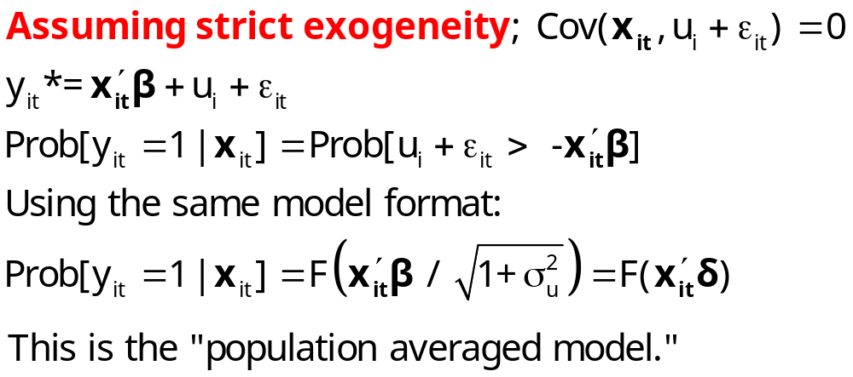
Ignoring Unobserved Heterogeneity

Slide 20
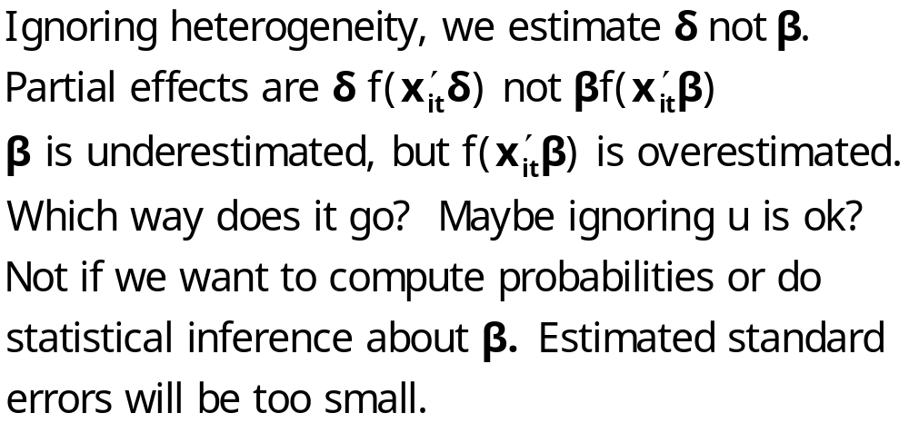
Ignoring Heterogeneity

Slide 21
Pooled vs. A Panel Estimator
----------------------------------------------------------------------
Binomial Probit Model
Dependent variable DOCTOR
--------+-------------------------------------------------------------
Variable| Coefficient Standard Error b/St.Er. P[|Z|>z] Mean of X
--------+-------------------------------------------------------------
Constant| .02159 .05307 .407 .6842
AGE| .01532*** .00071 21.695 .0000 43.5257
EDUC| -.02793*** .00348 -8.023 .0000 11.3206
HHNINC| -.10204** .04544 -2.246 .0247 .35208
--------+-------------------------------------------------------------
Unbalanced panel has 7293 individuals
--------+-------------------------------------------------------------
Constant| -.11819 .09280 -1.273 .2028
AGE| .02232*** .00123 18.145 .0000 43.5257
EDUC| -.03307*** .00627 -5.276 .0000 11.3206
HHNINC| .00660 .06587 .100 .9202 .35208
Rho| .44990*** .01020 44.101 .0000
--------+-------------------------------------------------------------

Slide 22
Partial Effects
----------------------------------------------------------------------
Partial derivatives of E[y] = F[*] with
respect to the vector of characteristics
They are computed at the means of the Xs
Observations used for means are All Obs.
--------+-------------------------------------------------------------
Variable| Coefficient Standard Error b/St.Er. P[|Z|>z] Elasticity
--------+-------------------------------------------------------------
|Pooled
AGE| .00578*** .00027 21.720 .0000 .39801
EDUC| -.01053*** .00131 -8.024 .0000 -.18870
HHNINC| -.03847** .01713 -2.246 .0247 -.02144
--------+-------------------------------------------------------------
|Based on the panel data estimator
AGE| .00620*** .00034 18.375 .0000 .42181
EDUC| -.00918*** .00174 -5.282 .0000 -.16256
HHNINC| .00183 .01829 .100 .9202 .00101
--------+-------------------------------------------------------------

Slide 23
Effect of Clustering
Y_{it} must be correlated with Y_{is} across periods
Pooled estimator ignores correlation
Broadly, y_{it} = E[y_{it}|x_{it}] + w_{it},
  E[y_{it}|x_{it}] = Prob(y_{it} = 1|x_{it})
  w_{it} is correlated across periods
Assuming the marginal probability is the same, the pooled estimator is consistent. (We just saw that it might not be.)
Ignoring the correlation across periods generally leads to underestimating standard errors.

Slide 24
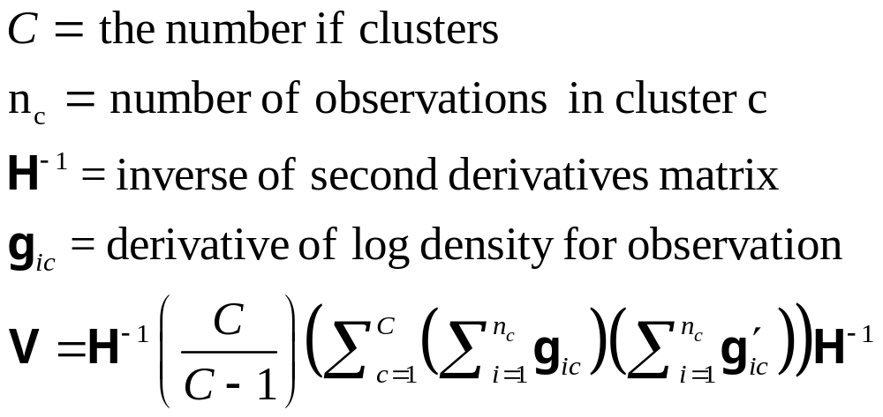
“Cluster” Corrected Covariance Matrix
Robustness is not the justification.

Slide 25
Cluster Correction: Doctor
----------------------------------------------------------------------
Binomial Probit Model
Dependent variable DOCTOR
Log likelihood function -17457.21899
--------+-------------------------------------------------------------
Variable| Coefficient Standard Error b/St.Er. P[|Z|>z] Mean of X
--------+-------------------------------------------------------------
| Conventional Standard Errors
Constant| -.25597*** .05481 -4.670 .0000
AGE| .01469*** .00071 20.686 .0000 43.5257
EDUC| -.01523*** .00355 -4.289 .0000 11.3206
HHNINC| -.10914** .04569 -2.389 .0169 .35208
FEMALE| .35209*** .01598 22.027 .0000 .47877
--------+-------------------------------------------------------------
| Corrected Standard Errors
Constant| -.25597*** .07744 -3.305 .0009
AGE| .01469*** .00098 15.065 .0000 43.5257
EDUC| -.01523*** .00504 -3.023 .0025 11.3206
HHNINC| -.10914* .05645 -1.933 .0532 .35208
FEMALE| .35209*** .02290 15.372 .0000 .47877
--------+-------------------------------------------------------------

Slide 26
Modeling a Binary Outcome
Did firm i produce a product or process innovation in year t ? y_{it} : 1=Yes/0=No
Observed N=1270 firms for T=5 years, 1984-1988
Observed covariates: x_{it} = Industry, competitive pressures, size, productivity, etc.
How to model?
  Binary outcome
  Correlation across time
  Heterogeneity across firms
Notes:
26

Slide 27
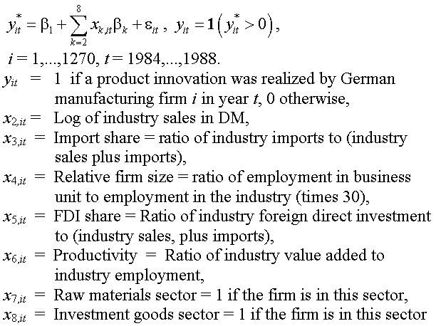
Application: Innovation

Slide 28
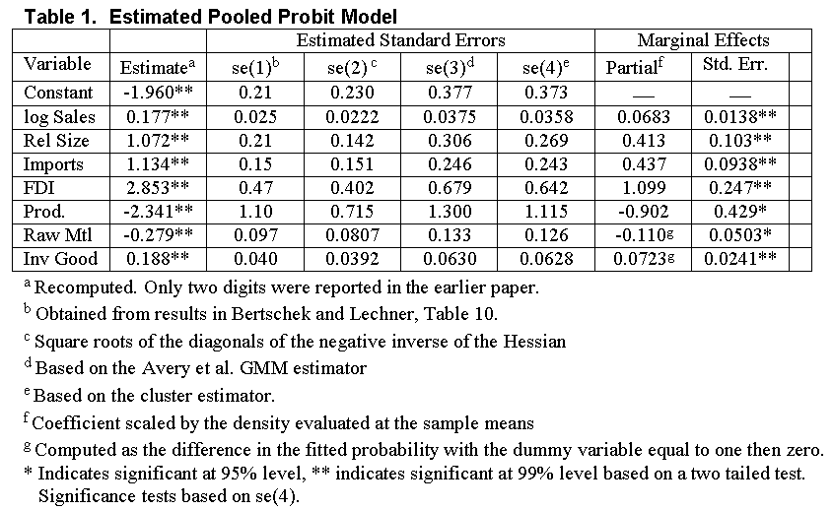

Slide 29
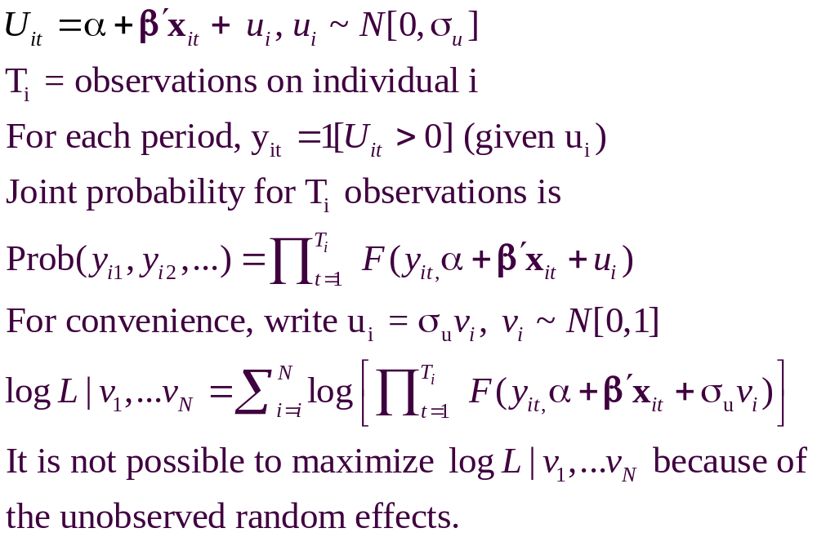
A Random Effects Model

Slide 30
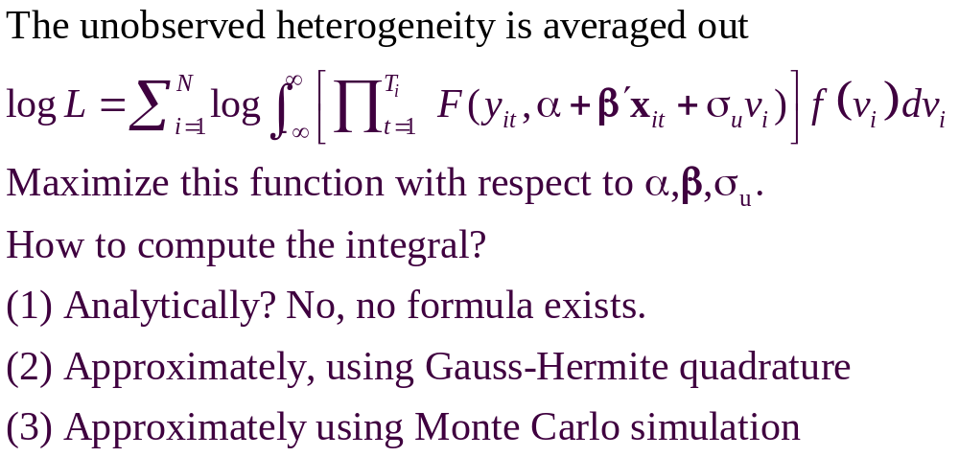
A Computable Log Likelihood

Slide 31
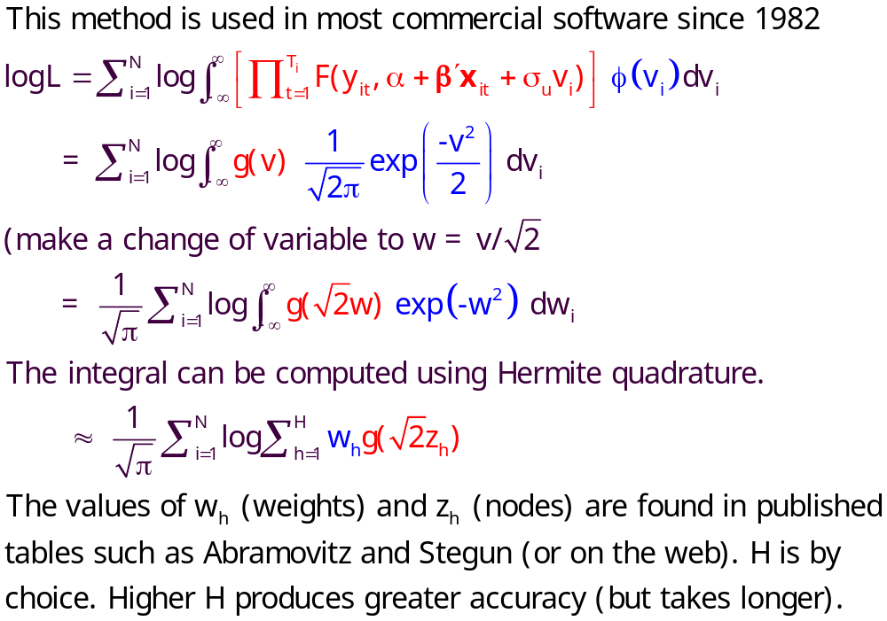
Quadrature – Butler and Moffitt

Slide 32
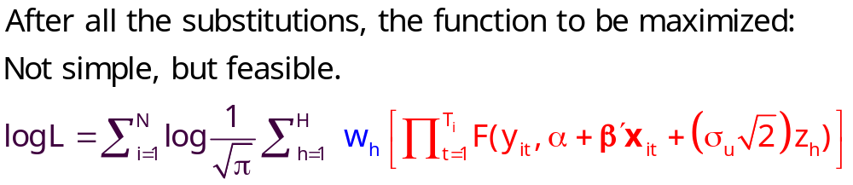
Quadrature Log Likelihood

Slide 33
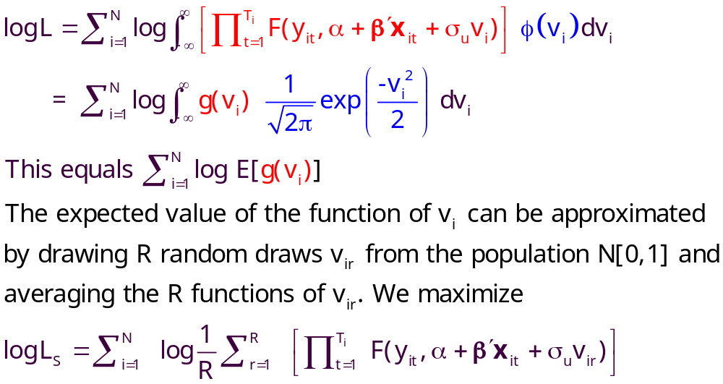
Simulation

Slide 34
Random Effects Model
----------------------------------------------------------------------
Random Effects Binary Probit Model using the Butler and Moffitt method
Log likelihood function -16290.72192 ⬅ Random Effects
Restricted log likelihood -17701.08500 ⬅ Pooled
Chi squared [ 1 d.f.] 2820.72616
Significance level .00000
McFadden Pseudo R-squared .0796766
Estimation based on N = 27326, K = 5
Unbalanced panel has 7293 individuals
--------+-------------------------------------------------------------
Variable| Coefficient Standard Error b/St.Er. P[|Z|>z] Mean of X
--------+-------------------------------------------------------------
Constant| -.11819 .09280 -1.273 .2028
AGE| .02232*** .00123 18.145 .0000 43.5257
EDUC| -.03307*** .00627 -5.276 .0000 11.3206
HHNINC| .00660 .06587 .100 .9202 .35208
Rho| .44990*** .01020 44.101 .0000
--------+-------------------------------------------------------------
|Pooled Estimates
Constant| .02159 .05307 .407 .6842
AGE| .01532*** .00071 21.695 .0000 43.5257
EDUC| -.02793*** .00348 -8.023 .0000 11.3206
HHNINC| -.10204** .04544 -2.246 .0247 .35208
--------+-------------------------------------------------------------

Slide 35
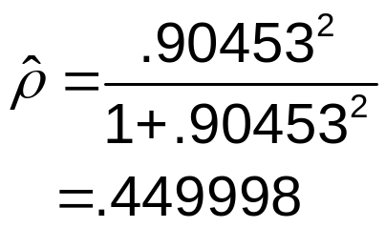
Random Parameter Model
----------------------------------------------------------------------
Random Coefficients Probit Model
Dependent variable DOCTOR (Quadrature Based)
Log likelihood function -16296.68110 (-16290.72192)
Restricted log likelihood -17701.08500
Chi squared [ 1 d.f.] 2808.80780
Significance level .00000
McFadden Pseudo R-squared .0793400
Estimation based on N = 27326, K = 5
Unbalanced panel has 7293 individuals
PROBIT (normal) probability model
Simulation based on 50 Halton draws
--------+-------------------------------------------------
Variable| Coefficient Standard Error b/St.Er. P[|Z|>z]
--------+-------------------------------------------------
|Nonrandom parameters
AGE| .02226*** .00081 27.365 .0000 ( .02232)
EDUC| -.03285*** .00391 -8.407 .0000 (-.03307)
HHNINC| .00673 .05105 .132 .8952 ( .00660)
|Means for random parameters
Constant| -.11873** .05950 -1.995 .0460 (-.11819)
|Scale parameters for dists. of random parameters
Constant| .90453*** .01128 80.180 .0000
--------+-------------------------------------------------------------

Slide 36
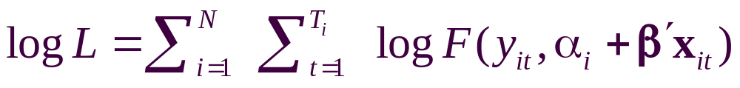
Fixed Effects Models
Estimate with dummy variable coefficients
Uit = α_{i} + β’xit + ε_{it}
Can be done by “brute force” for 10,000s of individuals
F(.) = appropriate probability for the observed outcome
Compute β and α_{i} for i=1,…,N (may be large)
See FixedEffects.pdf in course materials.

Slide 37
Unconditional Estimation
Maximize the whole log likelihood
Difficult! Many (thousands) of parameters.
Feasible – NLOGIT (2001) (“Brute force”)

Slide 38
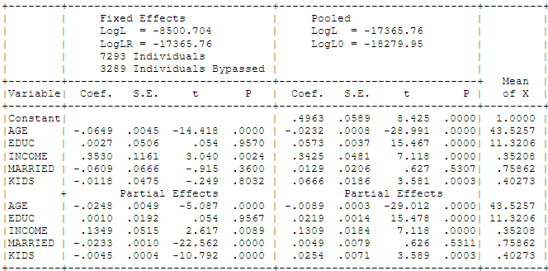
Fixed Effects Health Model
Groups in which y_{it} is always = 0 or always = 1. Cannot compute α_{i}.

Slide 39
Conditional Estimation
Principle: f(y_{i1},y_{i2},… | some statistic) is free of the fixed effects for some models.
Maximize the conditional log likelihood, given the statistic.
Can estimate β without having to estimate α_{i}.
Only feasible for the logit model. (Poisson and a few other continuous variable models. No other discrete choice models.)

Slide 40
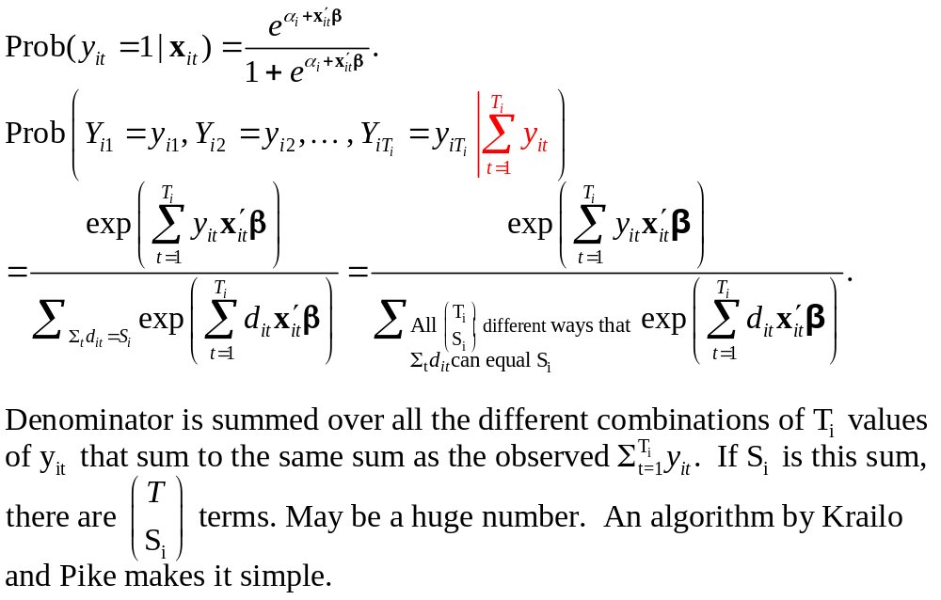
Binary Logit Conditional Probabiities

Slide 41
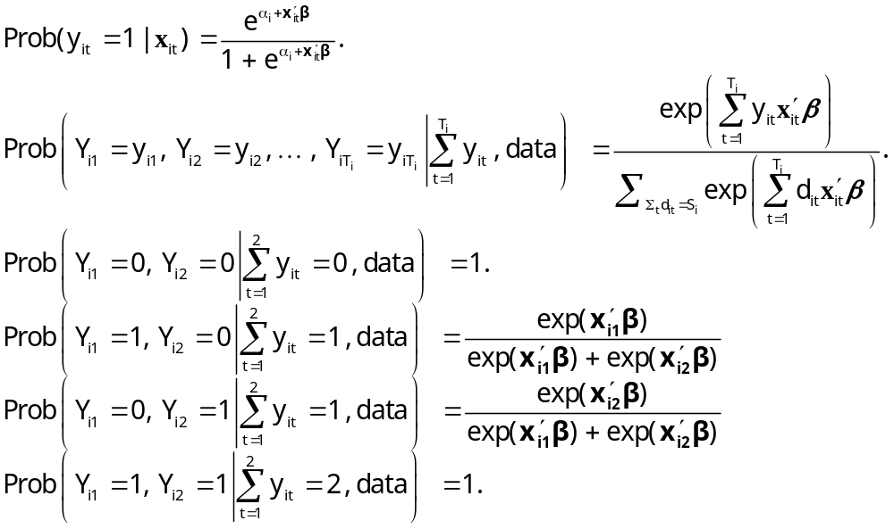
Example: Two Period Binary Logit

Slide 42
Estimating Partial Effects
“The fixed effects logit estimator of β immediately gives us the effect of each element of x_{i} on the log-odds ratio… Unfortunately, we cannot estimate the partial effects… unless we plug in a value for α_{i}. Because the distribution of α_{i} is unrestricted – in particular, E[α_{i}] is not necessarily zero – it is hard to know what to plug in for α_{i}. In addition, we cannot estimate average partial effects, as doing so would require finding E[Λ(x_{it} β+ α_{i})], a task that apparently requires specifying a distribution for α_{i}.”
(Wooldridge, 2002)
Notes:
42

Slide 43
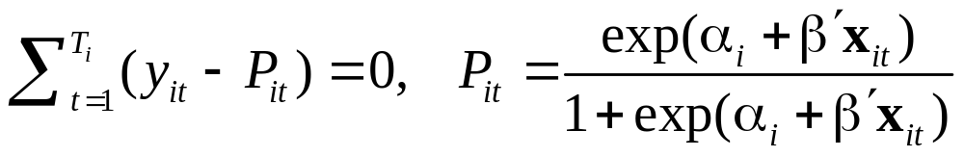
Binary Logit Estimation
Estimate β by maximizing conditional logL
Estimate α_{i} by using the ‘known’ β in the FOC for the unconditional logL
Solve for the N constants, one at a time treating β as known.
No solution when y_{it} sums to 0 or T_{i}
“Works” if E[α_{i}|Σ_{i}y_{it}] = E[α_{i}].

Slide 44
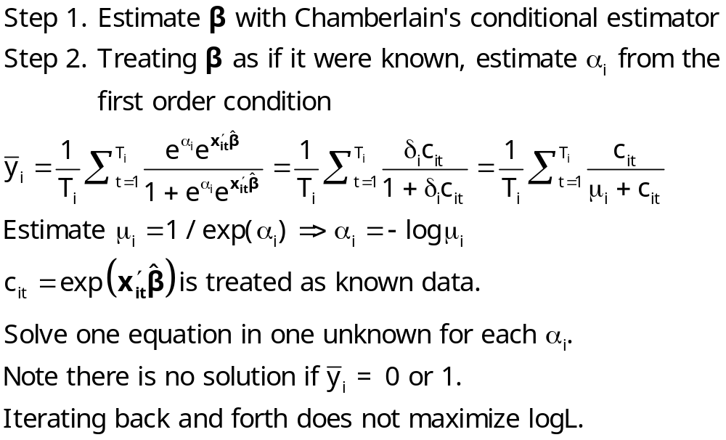
Logit Constant Terms

Slide 45
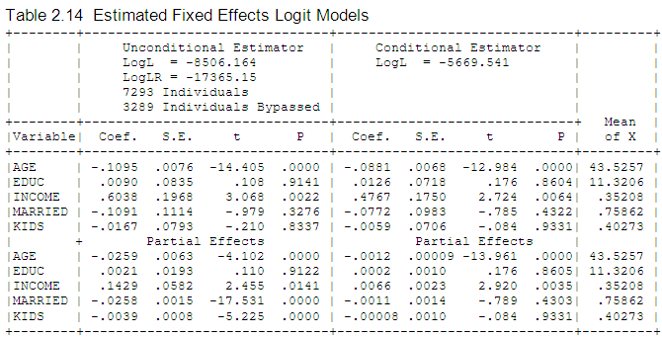
Fixed Effects Logit Health Model: Conditional vs. Unconditional

Slide 46
Advantages and Disadvantages of the FE Model
Advantages
  Allows correlation of effect and regressors
  Fairly straightforward to estimate
  Simple to interpret
Disadvantages
  Model may not contain time invariant variables
  Not necessarily simple to estimate if very large samples (Stata just creates the thousands of dummy variables)
  The incidental parameters problem: Small T bias

Slide 47
Incidental Parameters Problems: Conventional Wisdom
General: The unconditional MLE is biased in samples with fixed T except in special cases such as linear or Poisson regression (even when the FEM is the right model).
  The conditional estimator (that bypasses
  estimation of α_{i}) is consistent.
Specific: Upward bias (experience with probit and logit) in estimators of β

Slide 48
What We KNOW - Analytic
Newey and Hahn: MLE converges in probability to a vector of constants. (Variance diminishes with increase in N).
Abrevaya and Hsiao: Logit estimator converges to 2β when T = 2.
Only the case of T=2 for the binary logit model is known with certainty. All other cases are extrapolations of this result or speculative.

Slide 49
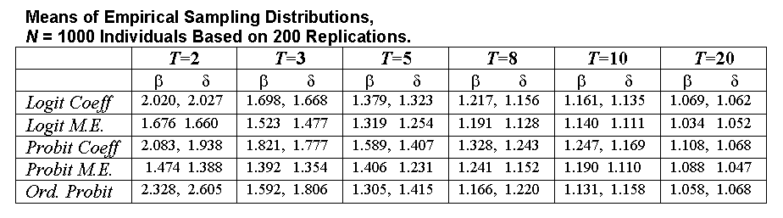
Some Familiar Territory – A Monte Carlo Study of the FE Estimator: Probit vs. Logit
Estimates of Coefficients and Marginal Effects at the Implied Data Means
Results are scaled so the desired quantity being estimated
(β, δ, marginal effects) all equal 1.0 in the population.

Slide 50
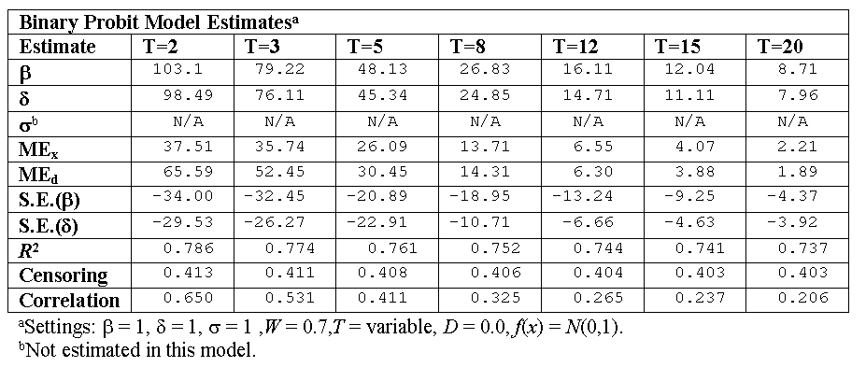
A Monte Carlo Study of the FE Probit Estimator
Percentage Biases in Estimates of Coefficients, Standard
Errors and Marginal Effects at the Implied Data Means

Slide 51
Bias Correction Estimators
Motivation: Undo the incidental parameters bias in the fixed effects probit model:
  (1) Maximize a penalized log likelihood function, or
  (2) Directly correct the estimator of β
Advantages
  For (1) estimates α_{i} so enables partial effects
  Estimator is consistent under some circumstances
  (Possibly) corrects in dynamic models
Disadvantage
  No time invariant variables in the model
  Practical implementation
  Extension to other models? (Ordered probit model (maybe) – see JBES 2009)

Slide 52
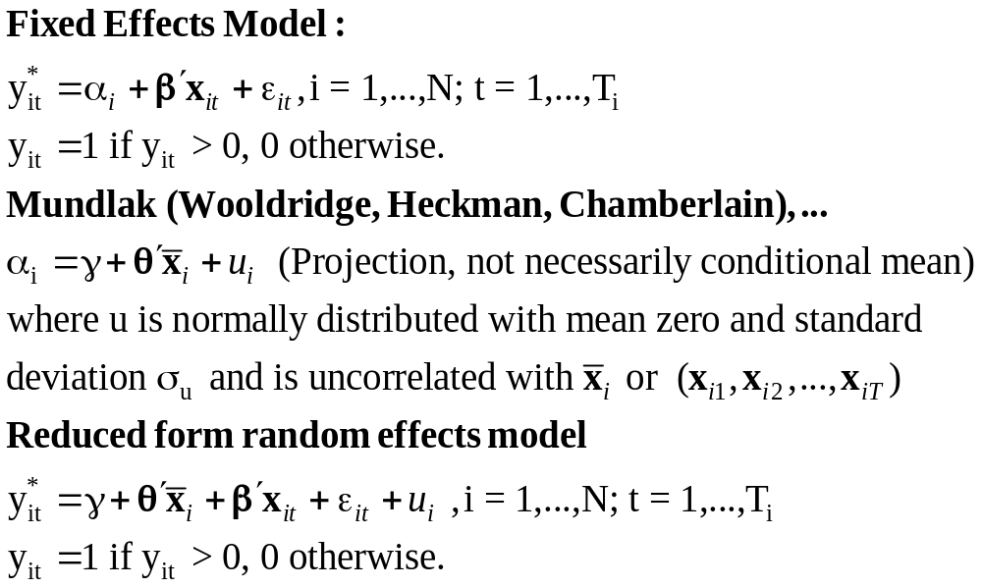
A Mundlak Correction for the FE Model

Slide 53
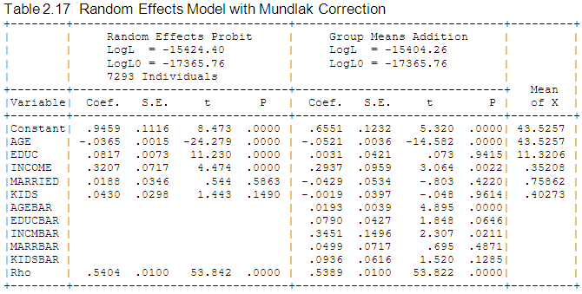
Mundlak Correction

Slide 54
A Variable Addition Test for FE vs. RE
The Wald statistic of 45.27922 and the likelihood ratio statistic of 40.280 are both far larger than the critical chi squared with 5 degrees of freedom, 11.07. This suggests that for these data, the fixed effects model is the preferred framework.

Slide 55
Fixed Effects Models Summary
Incidental parameters problem if T < 10 (roughly)
Inconvenience of computation
Appealing specification
Alternative semiparametric estimators?
  Theory not well developed for T > 2
  Not informative for anything but slopes (e.g., predictions and marginal effects)
Ignoring the heterogeneity definitely produces an inconsistent estimator (even with cluster correction!)
A Hobson’s choice
Mundlak correction is a useful common approach.

Slide 56
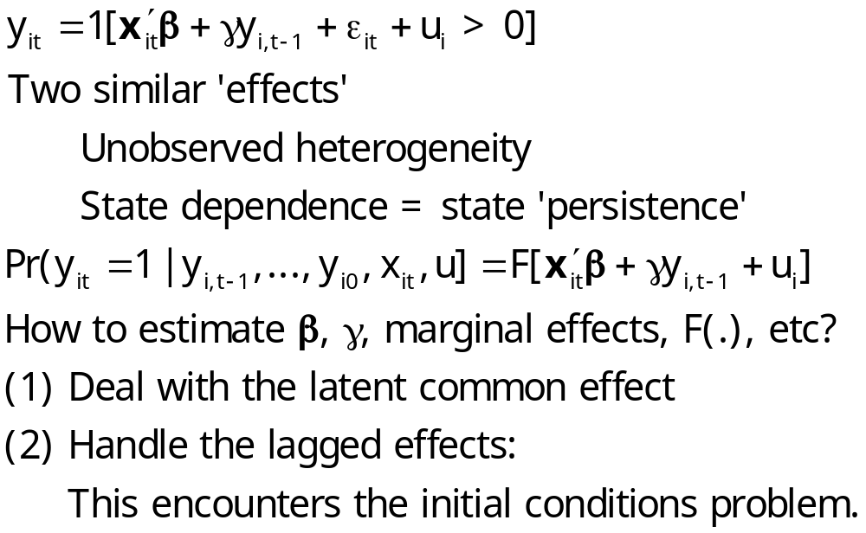
Dynamic Models

Slide 57
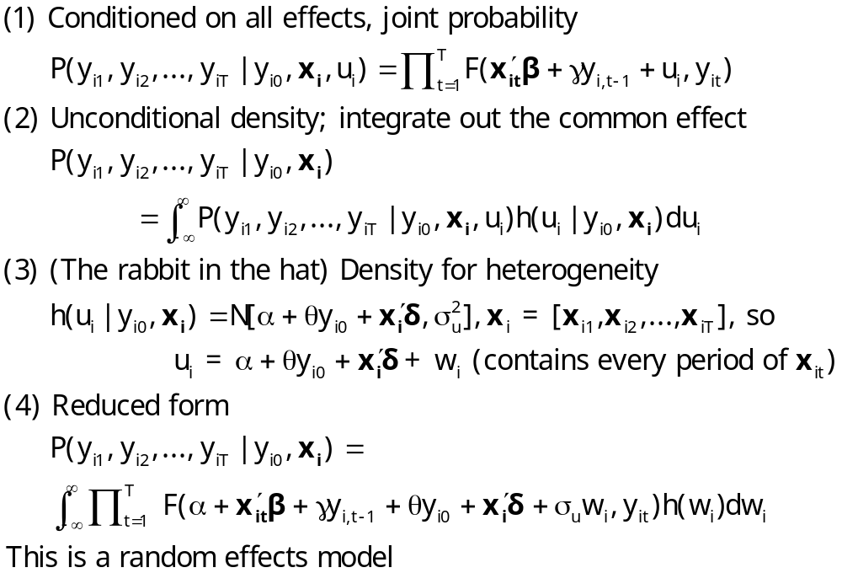
Dynamic Probit Model: A Standard Approach

Slide 58
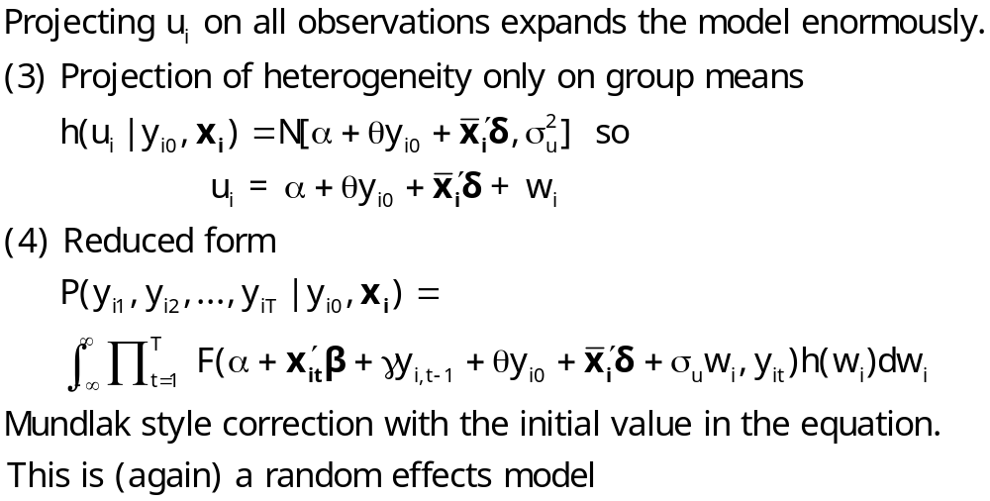
Simplified Dynamic Model

Slide 59
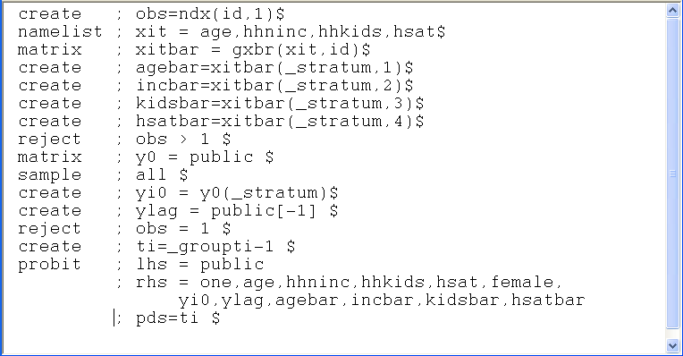
A Dynamic Model for Public Insurance
Age
Household Income
Kids in the household
Health Status
Basic Model
Add initial value, lagged value, group means

Slide 60
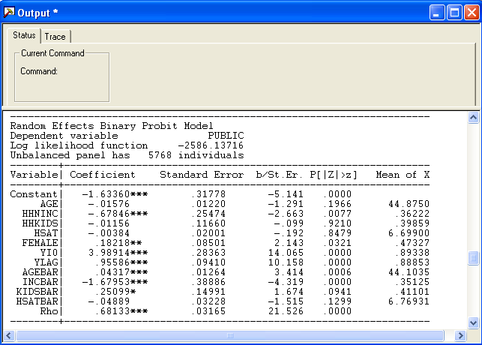
Dynamic Common Effects Model
1525 groups with 1 observation were lost because of the lagged dependent variable.

