Slide 1
Discrete Choice Modeling
William Greene
Stern School of Business
New York University

Slide 2
Part 5
Bivariate and Multivariate
Binary Choice Models

Slide 3
Multivariate Binary Choice Models
Bivariate Probit Models
  Analysis of bivariate choices
  Marginal effects
  Prediction
Simultaneous Equations and Recursive Models
A Sample Selection Bivariate Probit Model
The Multivariate Probit Model
  Specification
  Simulation based estimation
  Inference
  Partial effects and analysis
The ‘panel probit model’

Slide 4
Application: Health Care Usage
German Health Care Usage Data, 7,293 Individuals, Varying Numbers of Periods
Variables in the file are
Data downloaded from Journal of Applied Econometrics Archive. This is an unbalanced panel with 7,293 individuals. They can be used for regression, count models, binary choice, ordered choice, and bivariate binary choice. This is a large data set. There are altogether 27,326 observations. The number of observations ranges from 1 to 7. (Frequencies are: 1=1525, 2=1079, 3=825, 4=926, 5=1051, 6=1000, 7=887). Note, the variable NUMOBS below tells how many observations there are for each person. This variable is repeated in each row of the data for the person. (Downlo0aded from the JAE Archive)
DOCTOR = 1(Number of doctor visits > 0)
HOSPITAL = 1(Number of hospital visits > 0)
HSAT = health satisfaction, coded 0 (low) - 10 (high)
DOCVIS = number of doctor visits in last three months
HOSPVIS = number of hospital visits in last calendar year
PUBLIC = insured in public health insurance = 1; otherwise = 0
ADDON = insured by add-on insurance = 1; otherswise = 0
HHNINC = household nominal monthly net income in German marks / 10000.
(4 observations with income=0 were dropped)
HHKIDS = children under age 16 in the household = 1; otherwise = 0
EDUC = years of schooling
AGE = age in years
MARRIED = marital status
EDUC = years of education

Slide 5
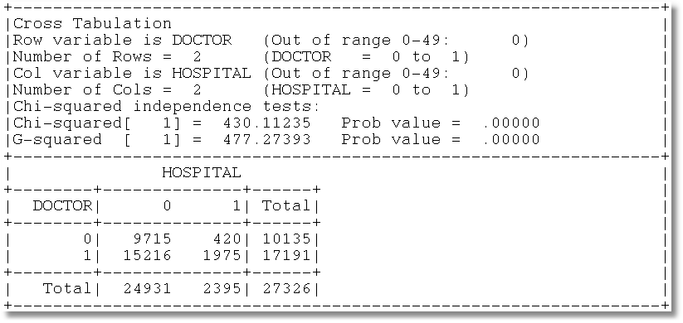
Gross Relation Between Two Binary Variables
Cross Tabulation Suggests Presence or
Absence of a Bivariate Relationship

Slide 6
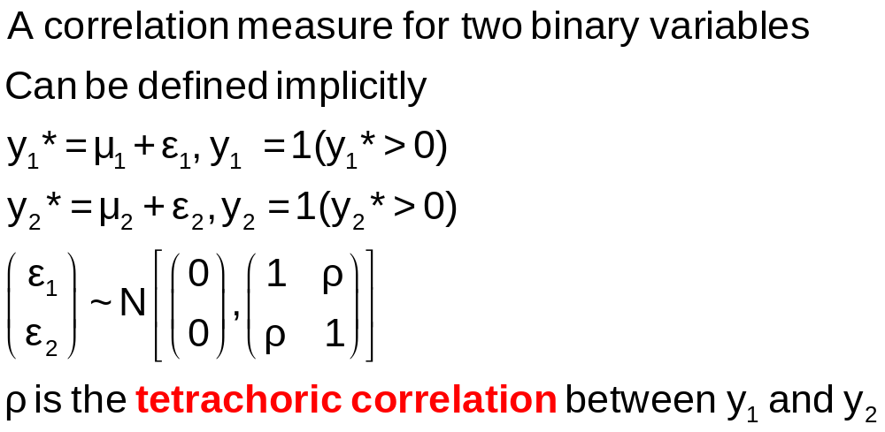
Tetrachoric Correlation

Slide 7
Estimating Tetrachoric Correlation
Numerous ad hoc algorithms suggested in the literature
Do not appear to have noticed the connection to a bivariate probit model
Maximum likelihood estimation is simple under the (necessary) assumption of normality

Slide 8
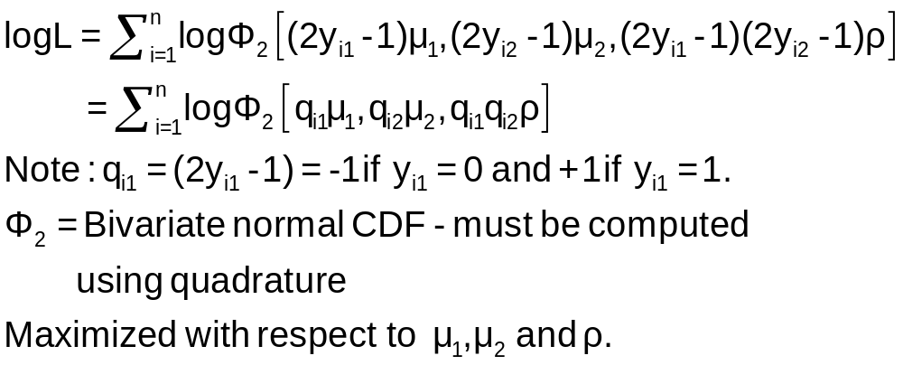
Log Likelihood Function

Slide 9
Estimation
+---------------------------------------------+
| FIML Estimates of Bivariate Probit Model |
| Maximum Likelihood Estimates |
| Dependent variable DOCHOS |
| Weighting variable None |
| Number of observations 27326 |
| Log likelihood function -25898.27 |
| Number of parameters 3 |
+---------------------------------------------+
+---------+--------------+----------------+--------+---------+
|Variable | Coefficient | Standard Error |b/St.Er.|P[|Z|>z] |
+---------+--------------+----------------+--------+---------+
Index equation for DOCTOR
Constant .32949128 .00773326 42.607 .0000
Index equation for HOSPITAL
Constant -1.35539755 .01074410 -126.153 .0000
Tetrachoric Correlation between DOCTOR and HOSPITAL
RHO(1,2) .31105965 .01357302 22.918 .0000

Slide 10
A Bivariate Probit Model
Two Equation Probit Model
(More than two equations comes later)
No bivariate logit – there is no reasonable bivariate counterpart
Why fit the two equation model?
  Analogy to SUR model: Efficient
  Make tetrachoric correlation conditional on covariates – i.e., residual correlation

Slide 11
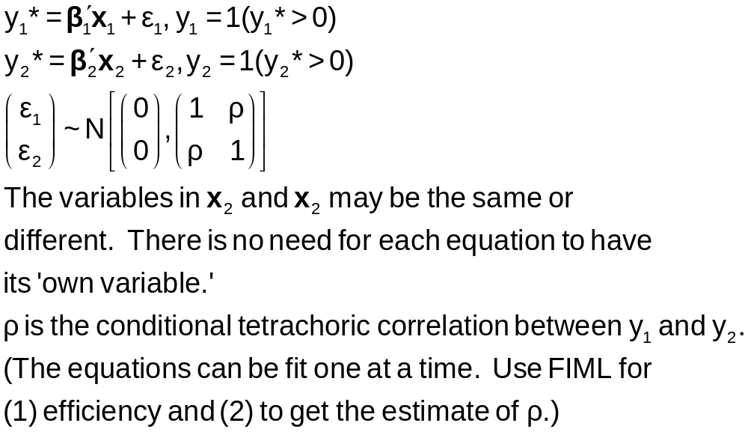
Bivariate Probit Model

Slide 12
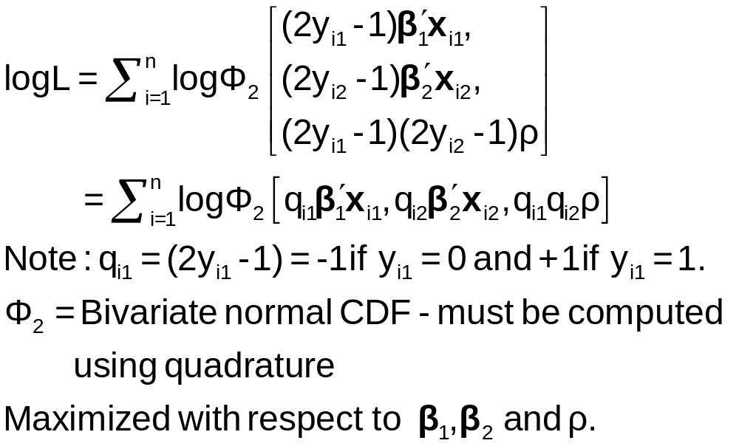
Estimation of the Bivariate Probit Model

Slide 13
Application to Health Care Data
x1=one,age,female,educ,married,working
x2=one,age,female,hhninc,hhkids
BivariateProbit ;lhs=doctor,hospital
;rh1=x1
;rh2=x2;marginal effects $

Slide 14
Parameter Estimates
----------------------------------------------------------------------
FIML Estimates of Bivariate Probit Model
Dependent variable DOCHOS
Log likelihood function -25323.63074
Estimation based on N = 27326, K = 12
--------+-------------------------------------------------------------
Variable| Coefficient Standard Error b/St.Er. P[|Z|>z] Mean of X
--------+-------------------------------------------------------------
|Index equation for DOCTOR
Constant| -.20664*** .05832 -3.543 .0004
AGE| .01402*** .00074 18.948 .0000 43.5257
FEMALE| .32453*** .01733 18.722 .0000 .47877
EDUC| -.01438*** .00342 -4.209 .0000 11.3206
MARRIED| .00224 .01856 .121 .9040 .75862
WORKING| -.08356*** .01891 -4.419 .0000 .67705
|Index equation for HOSPITAL
Constant| -1.62738*** .05430 -29.972 .0000
AGE| .00509*** .00100 5.075 .0000 43.5257
FEMALE| .12143*** .02153 5.641 .0000 .47877
HHNINC| -.03147 .05452 -.577 .5638 .35208
HHKIDS| -.00505 .02387 -.212 .8323 .40273
|Disturbance correlation
RHO(1,2)| .29611*** .01393 21.253 .0000
--------+-------------------------------------------------------------

Slide 15
Predictions: Success and Failure
Joint Frequency Table: Columns = HOSPITAL
Rows = DOCTOR
M = Actual cell count
(N) = (Fitted Values = cell with largest probability)
0 1 TOTAL
0 9715 420 10135
( 4683) ( 0) ( 4683)
1 15216 1975 17191
(22643) ( 0) (22643)
TOTAL 24931 2395 27326
(27326) ( 0) (27326)
Notes:
15

Slide 16
Analysis of Predictions
+--------------------------------------------------------+
| Bivariate Probit Predictions for DOCTOR and HOSPITAL |
| Predicted cell (i,j) is cell with largest probability |
| Neither DOCTOR nor HOSPITAL predicted correctly |
| 558 of 27326 observations |
| Only DOCTOR correctly predicted |
| DOCTOR = 0: 69 of 10135 observations |
| DOCTOR = 1: 1768 of 17191 observations |
| Only HOSPITAL correctly predicted |
| HOSPITAL = 0: 9510 of 24931 observations |
| HOSPITAL = 1: 1768 of 2395 observations |
| Both DOCTOR and HOSPITAL correctly predicted |
| DOCTOR = 0 HOSPITAL = 0: 2306 of 9715 |
| DOCTOR = 1 HOSPITAL = 0: 13115 of 15216 |
| DOCTOR = 0 HOSPITAL = 1: 0 of 420 |
| DOCTOR = 1 HOSPITAL = 1: 0 of 1975 |
+--------------------------------------------------------+
Notes:
16

Slide 17
Marginal Effects
What are the marginal effects
  Effect of what on what?
  Two equation model, what is the conditional mean?
Possible margins?
  Derivatives of joint probability = Φ₂(β₁’x_{i1}, β₂’x_{i2},ρ)
  Partials of E[y_{ij}|x_{ij}] =Φ(β_{j}’x_{ij}) (Univariate probability)
  Partials of E[y_{i1}|x_{i1},x_{i2},y_{i2}=1] = P(y_{i1},y_{i2}=1)/Prob[y_{i2}=1]
Note marginal effects involve both sets of regressors.
If there are common variables, there are two effects
in the derivative that are added.

Slide 18
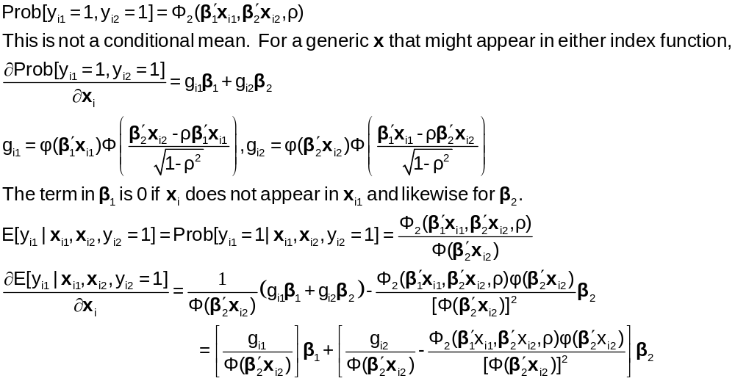
Bivariate Probit Conditional Means

Slide 19
Marginal Effects: Decomposition
+------------------------------------------------------+
| Marginal Effects for Ey1|y2=1 |
+----------+----------+----------+----------+----------+
| Variable | Efct x1 | Efct x2 | Efct z1 | Efct z2 |
+----------+----------+----------+----------+----------+
| AGE | .00383 | -.00035 | .00000 | .00000 |
| FEMALE | .08857 | -.00835 | .00000 | .00000 |
| EDUC | -.00392 | .00000 | .00000 | .00000 |
| MARRIED | .00061 | .00000 | .00000 | .00000 |
| WORKING | -.02281 | .00000 | .00000 | .00000 |
| HHNINC | .00000 | .00217 | .00000 | .00000 |
| HHKIDS | .00000 | .00035 | .00000 | .00000 |
+----------+----------+----------+----------+----------+

Slide 20
Direct Effects
Derivatives of E[y₁|x₁,x₂,y₂=1] wrt x₁
+-------------------------------------------+
| Partial derivatives of E[y1|y2=1] with |
| respect to the vector of characteristics. |
| They are computed at the means of the Xs. |
| Effect shown is total of 4 parts above. |
| Estimate of E[y1|y2=1] = .819898 |
| Observations used for means are All Obs. |
| These are the direct marginal effects. |
+-------------------------------------------+
+---------+--------------+----------------+--------+---------+----------+
|Variable | Coefficient | Standard Error |b/St.Er.|P[|Z|>z] | Mean of X|
+---------+--------------+----------------+--------+---------+----------+
AGE .00382760 .00022088 17.329 .0000 43.5256898
FEMALE .08857260 .00519658 17.044 .0000 .47877479
EDUC -.00392413 .00093911 -4.179 .0000 11.3206310
MARRIED .00061108 .00506488 .121 .9040 .75861817
WORKING -.02280671 .00518908 -4.395 .0000 .67704750
HHNINC .000000 ......(Fixed Parameter)....... .35208362
HHKIDS .000000 ......(Fixed Parameter)....... .40273000

Slide 21
Indirect Effects
Derivatives of E[y₁|x₁,x₂,y₂=1] wrt x₂
+-------------------------------------------+
| Partial derivatives of E[y1|y2=1] with |
| respect to the vector of characteristics. |
| They are computed at the means of the Xs. |
| Effect shown is total of 4 parts above. |
| Estimate of E[y1|y2=1] = .819898 |
| Observations used for means are All Obs. |
| These are the indirect marginal effects. |
+-------------------------------------------+
+---------+--------------+----------------+--------+---------+----------+
|Variable | Coefficient | Standard Error |b/St.Er.|P[|Z|>z] | Mean of X|
+---------+--------------+----------------+--------+---------+----------+
AGE -.00035034 .697563D-04 -5.022 .0000 43.5256898
FEMALE -.00835397 .00150062 -5.567 .0000 .47877479
EDUC .000000 ......(Fixed Parameter)....... 11.3206310
MARRIED .000000 ......(Fixed Parameter)....... .75861817
WORKING .000000 ......(Fixed Parameter)....... .67704750
HHNINC .00216510 .00374879 .578 .5636 .35208362
HHKIDS .00034768 .00164160 .212 .8323 .40273000

Slide 22
Marginal Effects: Total Effects
Sum of Two Derivative Vectors
+-------------------------------------------+
| Partial derivatives of E[y1|y2=1] with |
| respect to the vector of characteristics. |
| They are computed at the means of the Xs. |
| Effect shown is total of 4 parts above. |
| Estimate of E[y1|y2=1] = .819898 |
| Observations used for means are All Obs. |
| Total effects reported = direct+indirect. |
+-------------------------------------------+
+---------+--------------+----------------+--------+---------+----------+
|Variable | Coefficient | Standard Error |b/St.Er.|P[|Z|>z] | Mean of X|
+---------+--------------+----------------+--------+---------+----------+
AGE .00347726 .00022941 15.157 .0000 43.5256898
FEMALE .08021863 .00535648 14.976 .0000 .47877479
EDUC -.00392413 .00093911 -4.179 .0000 11.3206310
MARRIED .00061108 .00506488 .121 .9040 .75861817
WORKING -.02280671 .00518908 -4.395 .0000 .67704750
HHNINC .00216510 .00374879 .578 .5636 .35208362
HHKIDS .00034768 .00164160 .212 .8323 .40273000

Slide 23
Marginal Effects: Dummy Variables
Using Differences of Probabilities
+-----------------------------------------------------------+
| Analysis of dummy variables in the model. The effects are |
| computed using E[y1|y2=1,d=1] - E[y1|y2=1,d=0] where d is |
| the variable. Variances use the delta method. The effect |
| accounts for all appearances of the variable in the model.|
+-----------------------------------------------------------+
|Variable Effect Standard error t ratio (deriv) |
+-----------------------------------------------------------+
FEMALE .079694 .005290 15.065 (.080219)
MARRIED .000611 .005070 .121 (.000511)
WORKING -.022485 .005044 -4.457 (-.022807)
HHKIDS .000348 .001641 .212 (.000348)

Slide 24
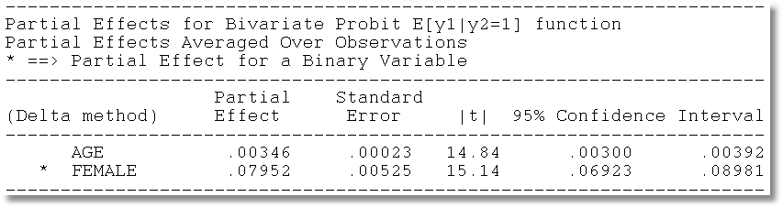
Average Partial Effects

Slide 25
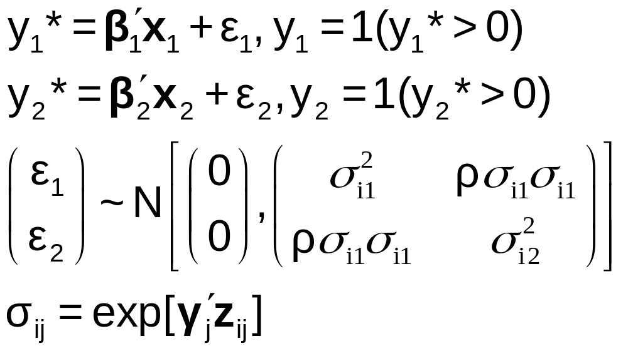
Heteroscedasticity

Slide 26
Model with Heteroscedasticity
----------------------------------------------------------------------
FIML Estimates of Bivariate Probit Model
Log likelihood function -25282.46370 (-25323.63074. ChiSq = 82.336)
--------+-------------------------------------------------------------
Variable| Coefficient Standard Error b/St.Er. P[|Z|>z] Mean of X
--------+-------------------------------------------------------------
|Index equation for DOCTOR
Constant| -.16213** .07022 -2.309 .0210
AGE| .01745*** .00114 15.363 .0000 43.5257
FEMALE| .94019*** .14039 6.697 .0000 .47877
EDUC| -.02277*** .00419 -5.441 .0000 11.3206
MARRIED| .00952 .02743 .347 .7284 .75862
WORKING| -.19688*** .03041 -6.475 .0000 .67705
|Index equation for HOSPITAL
Constant| -1.75985*** .06894 -25.527 .0000
AGE| .00987*** .00136 7.250 .0000 43.5257
FEMALE| -16.5930 32.11025 -.517 .6053 .47877
HHNINC| -.12331 .07497 -1.645 .1000 .35208
HHKIDS| -.00425 .03374 -.126 .8997 .40273
|Variance equation for DOCTOR
FEMALE| .81572*** .11624 7.017 .0000 .47877
MARRIED| -.00893 .05285 -.169 .8659 .75862
|Variance equation for HOSPITAL
FEMALE| 2.66327 1.78858 1.489 .1365 .47877
MARRIED| -.04095** .02031 -2.016 .0438 .75862
|Disturbance correlation
RHO(1,2)| .29295*** .01398 20.951 .0000
--------+-------------------------------------------------------------

Slide 27
Partial Effects: All Sources
----------------------------------------------------------------------
Partial derivatives of E[y1|y2=1] with
respect to the vector of characteristics.
They are computed at the means of the Xs.
Effect shown is total of 4 parts above.
Estimate of E[y1|y2=1] = .916928
Observations used for means are All Obs.
Total effects reported = direct+indirect.
--------+-------------------------------------------------------------
Variable| Coefficient Standard Error b/St.Er. P[|Z|>z] Mean of X
--------+-------------------------------------------------------------
AGE| .00177 .00142 1.248 .2120 43.5257
FEMALE| -.05926 .18914 -.313 .7540 .47877
EDUC| -.00247 .00215 -1.152 .2494 11.3206
MARRIED| .00644 .00422 1.525 .1272 .75862
WORKING| -.02139 .01834 -1.166 .2435 .67705
HHNINC| .00154 .00263 .584 .5592 .35208
HHKIDS| .53016D-04 .00043 .124 .9016 .40273
--------+-------------------------------------------------------------

Slide 28
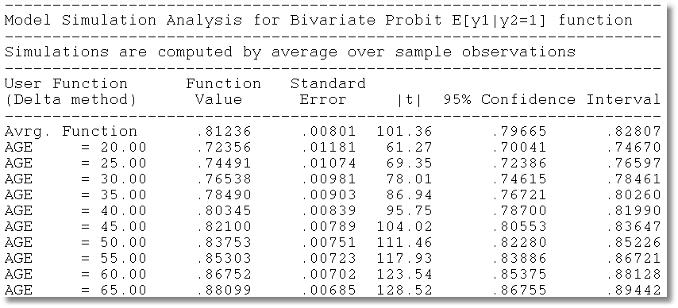
Model Simulation

Slide 29
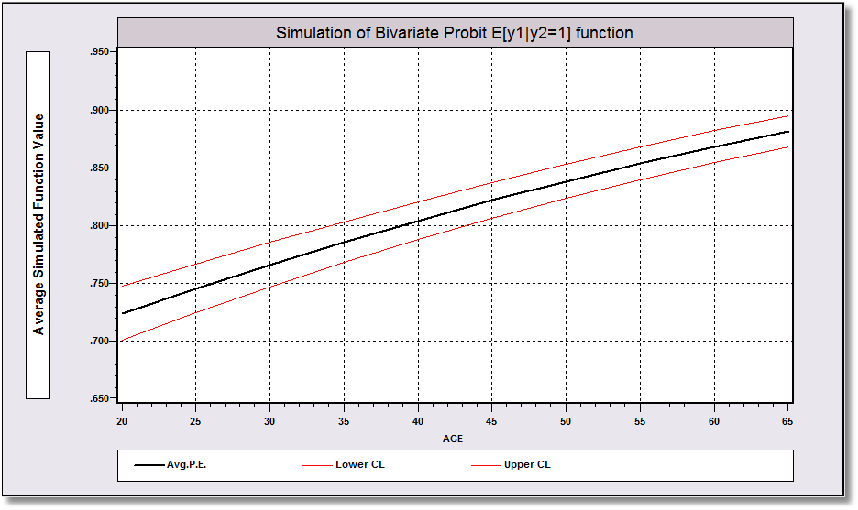
Model Simulation

Slide 30
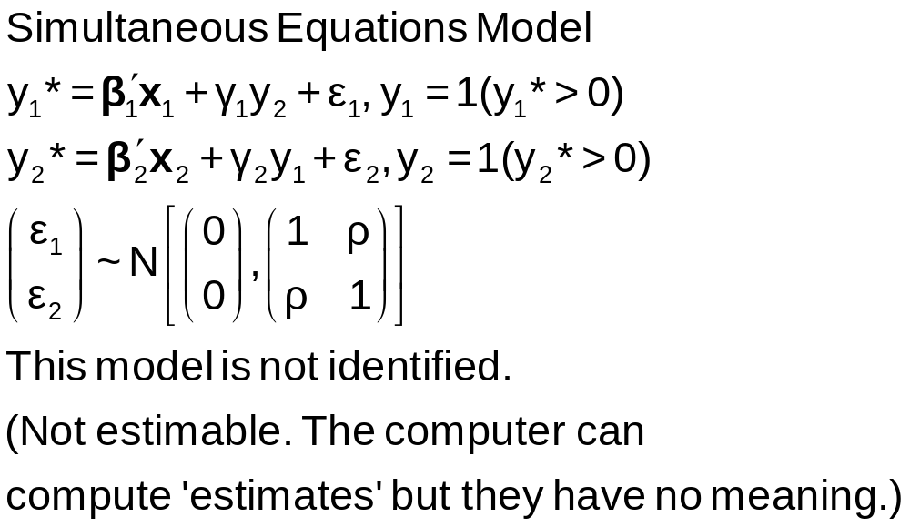
A Simultaneous Equations Model

Slide 31
Fully Simultaneous “Model”
----------------------------------------------------------------------
FIML Estimates of Bivariate Probit Model
Dependent variable DOCHOS
Log likelihood function -20318.69455
--------+-------------------------------------------------------------
Variable| Coefficient Standard Error b/St.Er. P[|Z|>z] Mean of X
--------+-------------------------------------------------------------
|Index equation for DOCTOR
Constant| -.46741*** .06726 -6.949 .0000
AGE| .01124*** .00084 13.353 .0000 43.5257
FEMALE| .27070*** .01961 13.807 .0000 .47877
EDUC| -.00025 .00376 -.067 .9463 11.3206
MARRIED| -.00212 .02114 -.100 .9201 .75862
WORKING| -.00362 .02212 -.164 .8701 .67705
HOSPITAL| 2.04295*** .30031 6.803 .0000 .08765
|Index equation for HOSPITAL
Constant| -1.58437*** .08367 -18.936 .0000
AGE| -.01115*** .00165 -6.755 .0000 43.5257
FEMALE| -.26881*** .03966 -6.778 .0000 .47877
HHNINC| .00421 .08006 .053 .9581 .35208
HHKIDS| -.00050 .03559 -.014 .9888 .40273
DOCTOR| 2.04479*** .09133 22.389 .0000 .62911
|Disturbance correlation
RHO(1,2)| -.99996*** .00048 ******** .0000
--------+-------------------------------------------------------------

Slide 32
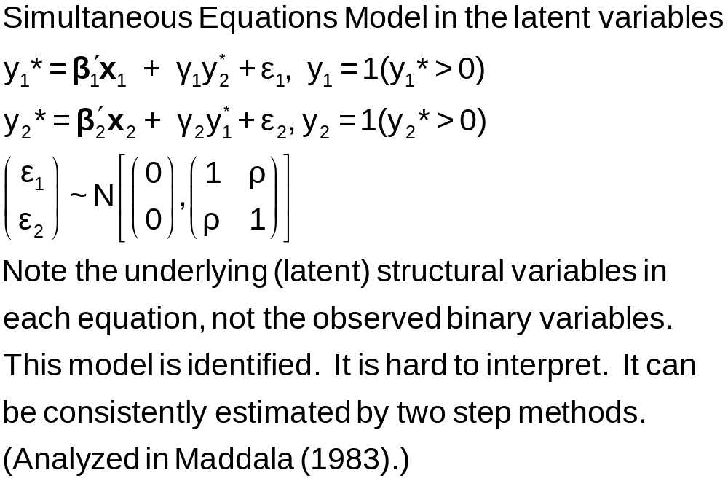
A Latent Simultaneous Equations Model

Slide 33
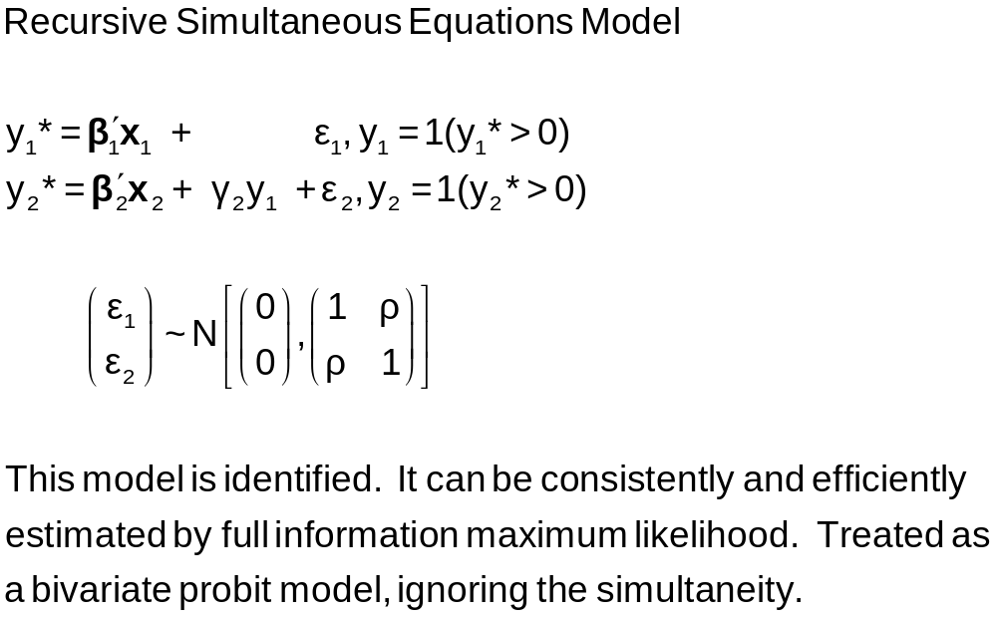
A Recursive Simultaneous Equations Model
Bivariate ; Lhs = y1,y2 ; Rh1=…,y2 ; Rh2 = … $

Slide 34
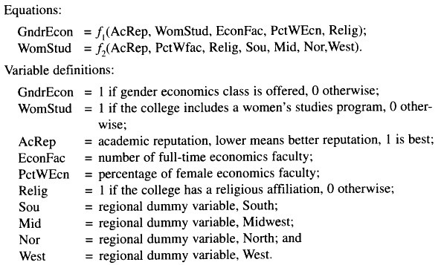
Application: Gender Economics at Liberal Arts Colleges
Journal of Economic Education, fall, 1998.

Slide 35
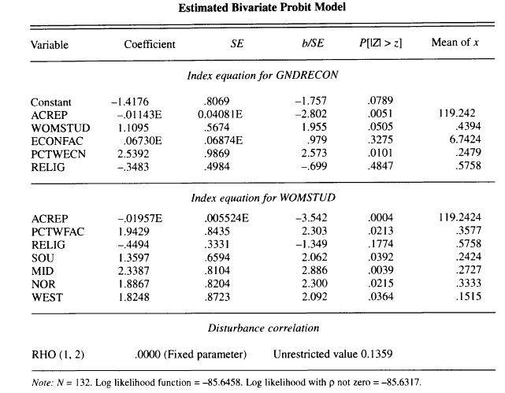
Estimated Recursive Model

Slide 36
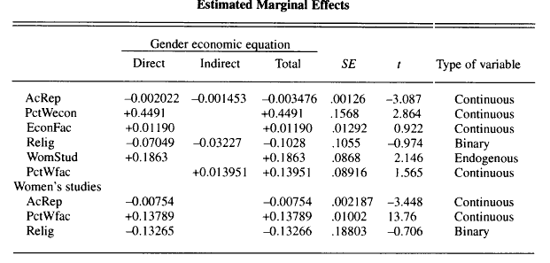
Estimated Effects: Decomposition

Slide 37
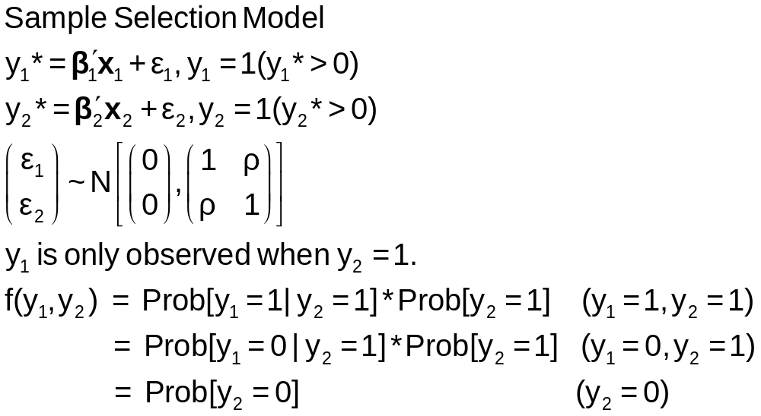
A Sample Selection Model

Slide 38
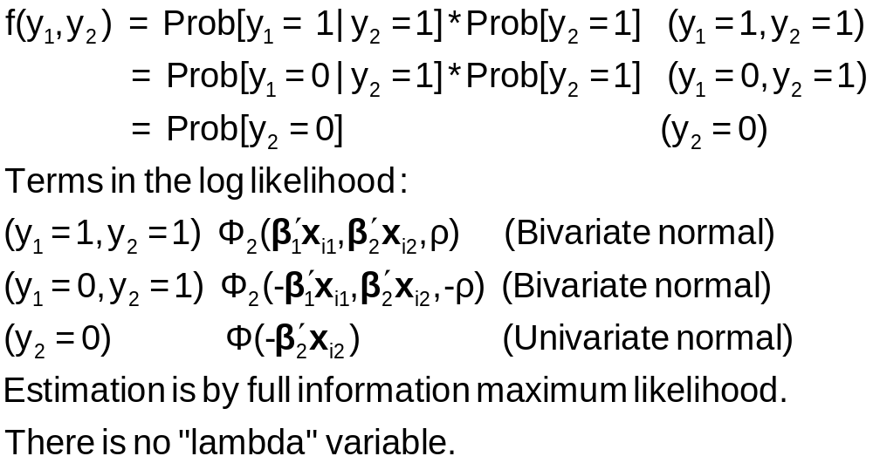
Sample Selection Model: Estimation

Slide 39
Application: Credit Scoring
American Express: 1992
N = 13,444 Applications
  Observed application data
  Observed acceptance/rejection of application
N₁ = 10,499 Cardholders
  Observed demographics and economic data
  Observed default or not in first 12 months
Full Sample is in AmEx.lpj and described in AmEx.lim

Slide 40
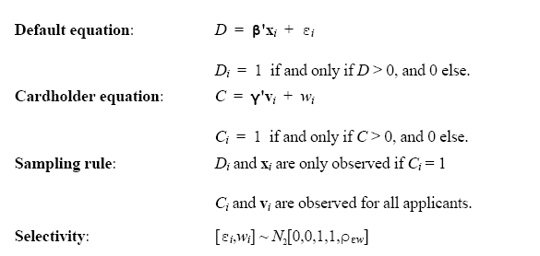
Application: Credit Scoring

Slide 41
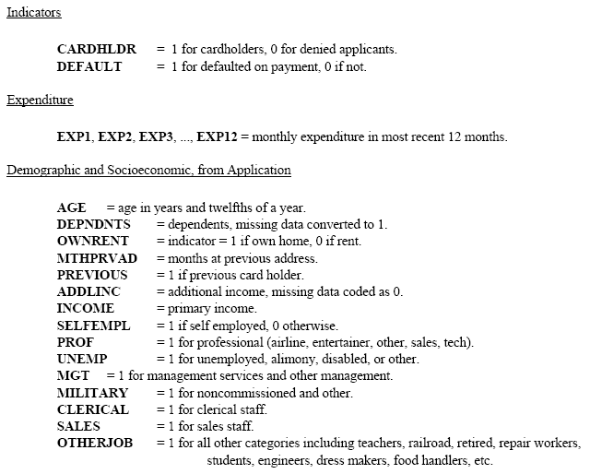

Slide 42
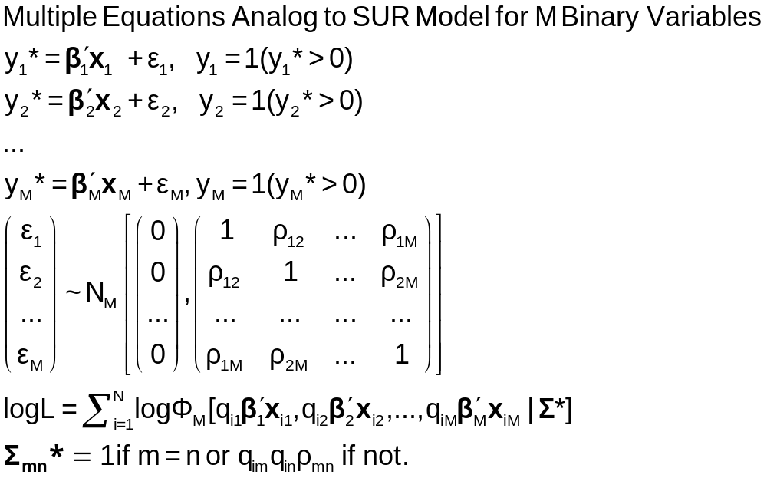
The Multivariate Probit Model

Slide 43
MLE: Simulation
Estimation of the multivariate probit model requires evaluation of M-order Integrals
The general case is usually handled with the GHK simulator. Much current research focuses on efficiency (speed) gains in this computation.
The “Panel Probit Model” is a special case.
  (Bertschek-Lechner, JE, 1999) – Construct a GMM estimator using only first order integrals of the univariate normal CDF
  (Greene, Emp.Econ, 2003) – Estimate the integrals with simulation (GHK) anyway.

Slide 44
----------------------------------------------------------------------
Multivariate Probit Model: 3 equations.
Dependent variable MVProbit
Log likelihood function -4751.09039
--------+-------------------------------------------------------------
Variable| Coefficient Standard Error b/St.Er. P[|Z|>z] Mean of X
--------+-------------------------------------------------------------
|Index function for DOCTOR
Constant| -.35527** .16715 -2.125 .0335 [-0.29987 .16195]
AGE| .01664*** .00194 8.565 .0000 43.9959 [ 0.01644 .00193]
FEMALE| .30931*** .04812 6.427 .0000 .47935 [ 0.30643 .04767]
EDUC| -.01566 .01024 -1.530 .1261 11.0909 [-0.01936 .00962]
MARRIED| -.04487 .05112 -.878 .3801 .78911 [-0.04423 .05139]
WORKING| -.14712*** .05075 -2.899 .0037 .63345 [-0.15390 .05054]
|Index function for HOSPITAL
Constant| -1.61787*** .15729 -10.286 .0000 [-1.58276 .16119]
AGE| .00717** .00283 2.536 .0112 43.9959 [ 0.00662 .00288]
FEMALE| -.00039 .05995 -.007 .9948 .47935 [-0.00407 .05991]
HHNINC| -.41050 .25147 -1.632 .1026 .29688 [-0.41080 .22891]
HHKIDS| -.01547 .06551 -.236 .8134 .44915 [-0.03688 .06615]
|Index function for PUBLIC
Constant| 1.51314*** .18608 8.132 .0000 [ 1.53542 .17060]
AGE| .00661** .00289 2.287 .0222 43.9959 [ 0.00646 .00268]
HSAT| -.06844*** .01385 -4.941 .0000 6.90062 [-0.07069 .01266]
MARRIED| -.00859 .06892 -.125 .9008 .78911 [-.00813 .06908]
|Correlation coefficients
R(01,02)| .28381*** .03833 7.404 .0000 [ was 0.29611 ]
R(01,03)| .03509 .03768 .931 .3517
R(02,03)| -.04100 .04831 -.849 .3960
--------+-------------------------------------------------------------

Slide 45
Marginal Effects
There are M equations: “Effect of what on what?”
NLOGIT computes E[y1|all other ys, all xs]
Marginal effects are derivatives of this with respect to all xs. (EXTREMELY MESSY)
Standard errors are estimated with bootstrapping.

