Slide 1
Discrete Choice Modeling
William Greene
Stern School of Business
New York University

Slide 2
Part 6
Modeling Latent Parameter Heterogeneity

Slide 3
Parameter Heterogeneity
Fixed and Random Effects Models
  Latent common time invariant “effects”
  Heterogeneity in level parameter – constant term – in the model
General Parameter Heterogeneity in Models
  Discrete: There is more than one time of individual in the population – parameters differ across types. Produces a Latent Class Model
  Continuous; Parameters vary randomly across individuals: Produces a Random Parameters Model or a Mixed Model. (Synonyms)

Slide 4
Latent Class Models
There are J types of people, j = 1,…,J
For each type,
Prob(Outcome|type=j) = f(y,x|β_{j})
Individual i is and remains a member of class j
An individual will be drawn at random from the population. Prob(in class j) = π_{j}
From the modeler’s point of view:
Prob(Outcome) = Σ_{j} π_{j} Prob(Outcome|type=j)
= Σ_{j} π_{j} f(y,x|β_{j})

Slide 5
Finite Mixture Model
Prob(Outcome|type=j) = f(y,x|β_{j}) depends on parameter vector
Parameters are randomly, discretely distributed among population members, with
Prob(β = β_{j}) = π_{j}, j = 1,…,J
Integrating out the variation across parameters,
Prob(Outcome) = Σ_{j} π_{j} f(y,x|β_{j})
Same model, slightly different interpretation

Slide 6
Estimation Problems
Estimation of population features
  Latent parameter vectors, β_{j}, j = 1,…,J
  Mixing probabilities, π_{j}, j = 1,…,J
  Probabilities, partial effects, predictions, etc.
  Model structure: The number of classes, J
Classification: Prediction of class membership for individuals

Slide 7
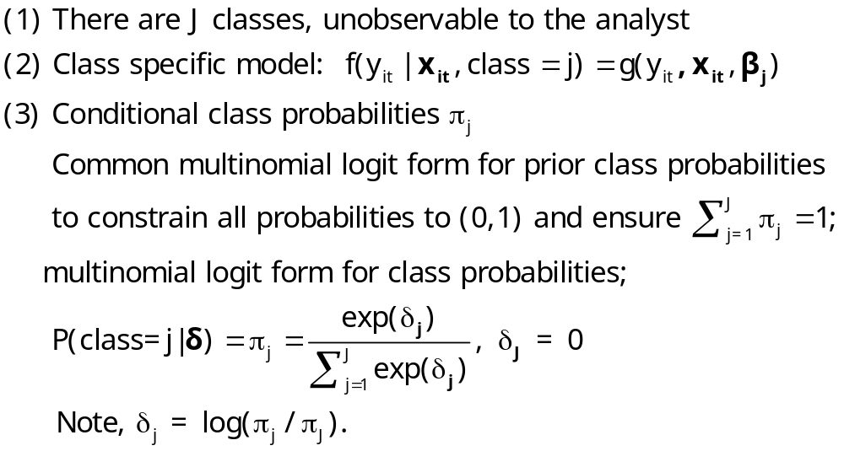
Extended Latent Class Model

Slide 8
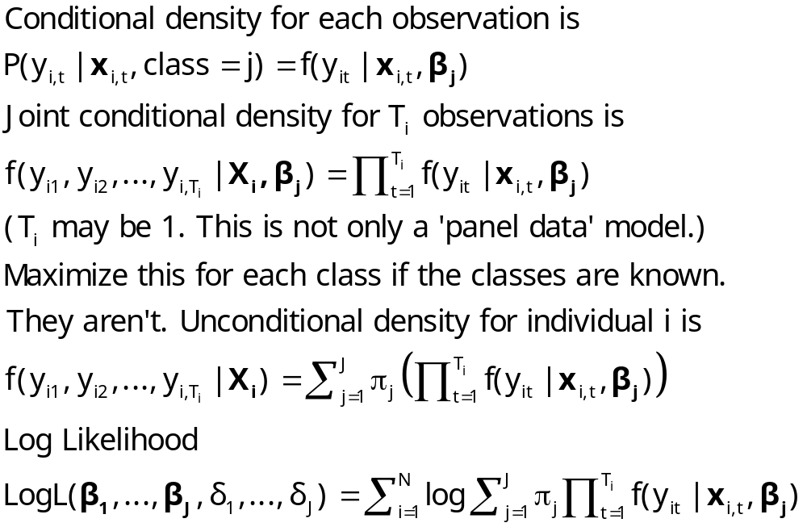
Log Likelihood for an LC Model

Slide 9
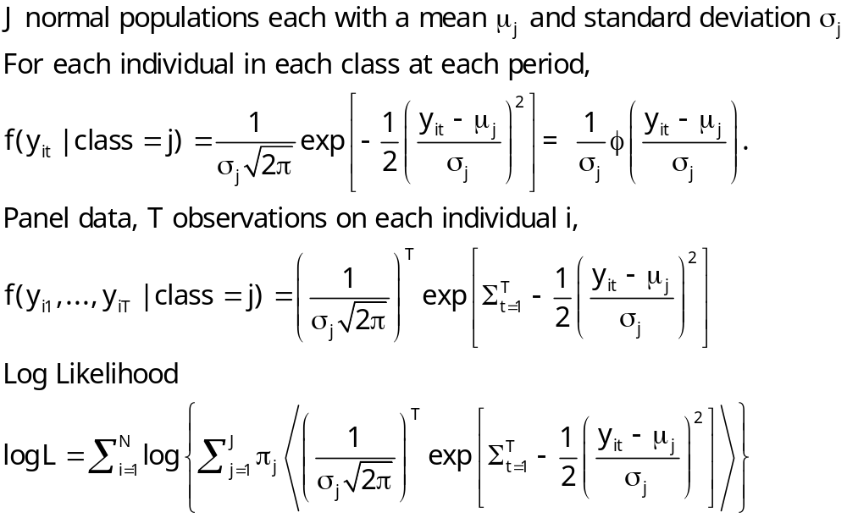
Example: Mixture of Normals

Slide 10
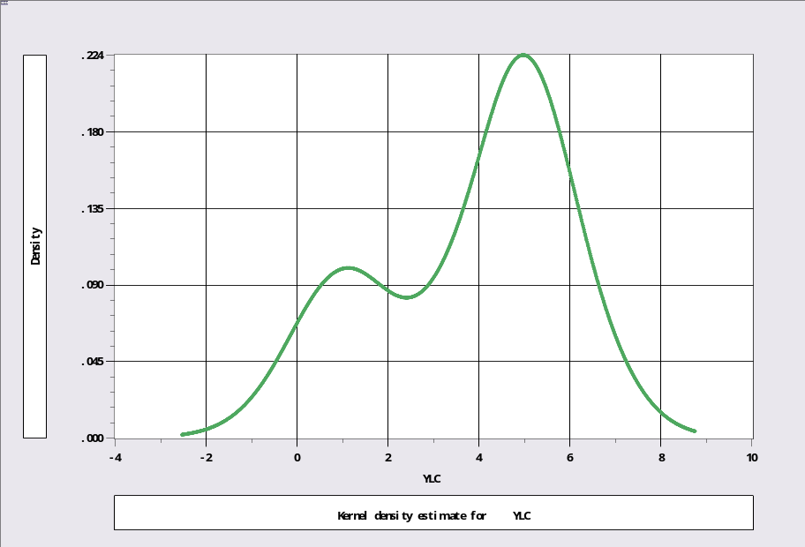
Unmixing a Mixed Sample
N[1,1] and N[5,1]
Sample ; 1 – 1000$
Calc ; Ran(123457)$
Create ; lc1=rnn(1,1) ; lc2=rnn(5,1)$
Create ; class=rnu(0,1)$
Create ; if(class<.3)ylc=lc1 ; (else)ylc=lc2$
Kernel ; rhs=ylc $
Regress ; lhs=ylc;rhs=one;lcm;pts=2;pds=1$

Slide 11
Mixture of Normals
+---------------------------------------------+
| Latent Class / Panel LinearRg Model |
| Dependent variable YLC |
| Number of observations 1000 |
| Log likelihood function -1960.443 |
| Info. Criterion: AIC = 3.93089 |
| LINEAR regression model |
| Model fit with 2 latent classes. |
+---------------------------------------------+
+--------+--------------+----------------+--------+--------+----------+
|Variable| Coefficient | Standard Error |b/St.Er.|P[|Z|>z]| Mean of X|
+--------+--------------+----------------+--------+--------+----------+
+--------+Model parameters for latent class 1 |
|Constant| 4.97029*** .04511814 110.162 .0000 |
|Sigma | 1.00214*** .03317650 30.206 .0000 |
+--------+Model parameters for latent class 2 |
|Constant| 1.05522*** .07347646 14.361 .0000 |
|Sigma | .95746*** .05456724 17.546 .0000 |
+--------+Estimated prior probabilities for class membership |
|Class1Pr| .70003*** .01659777 42.176 .0000 |
|Class2Pr| .29997*** .01659777 18.073 .0000 |
+--------+------------------------------------------------------------+
| Note: ***, **, * = Significance at 1%, 5%, 10% level. |
+---------------------------------------------------------------------+

Slide 12
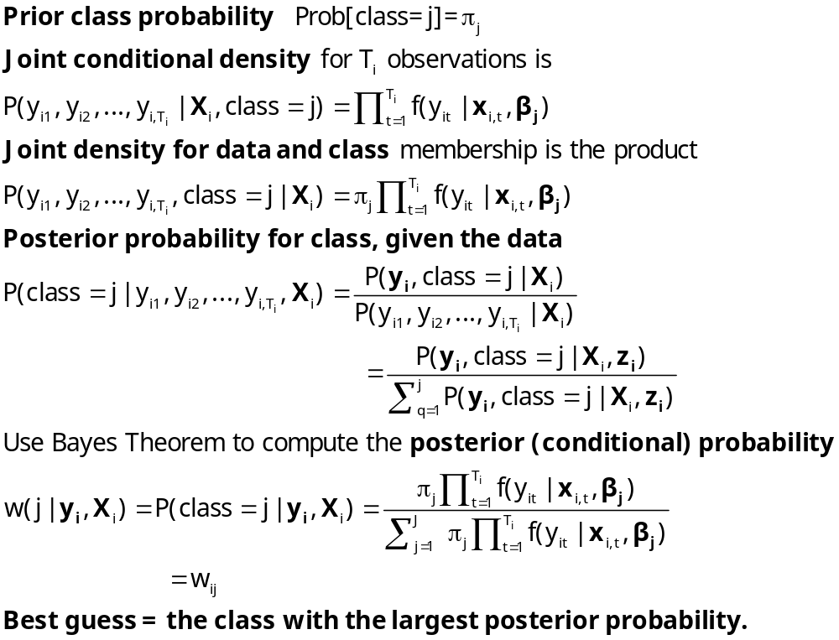
Estimating Which Class

Slide 13
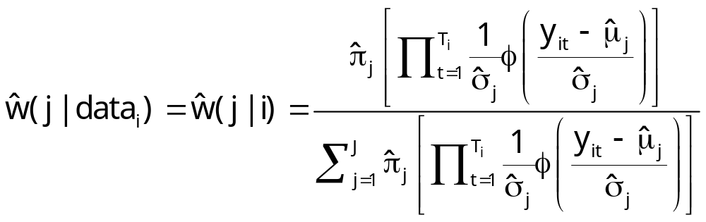
Posterior for Normal Mixture

Slide 14
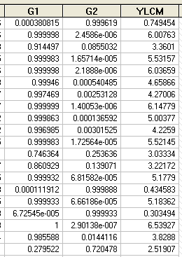
Estimated Posterior Probabilities

Slide 15
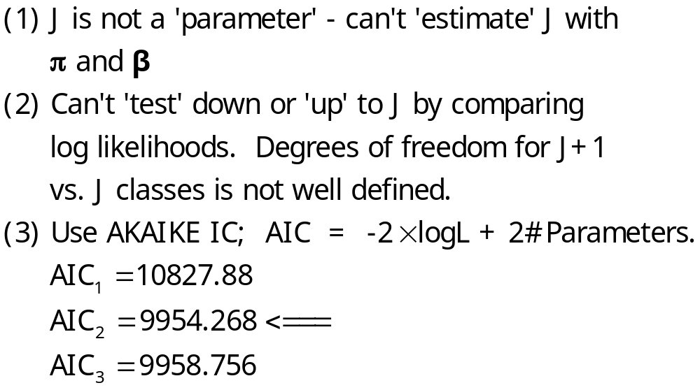
How Many Classes?

Slide 16
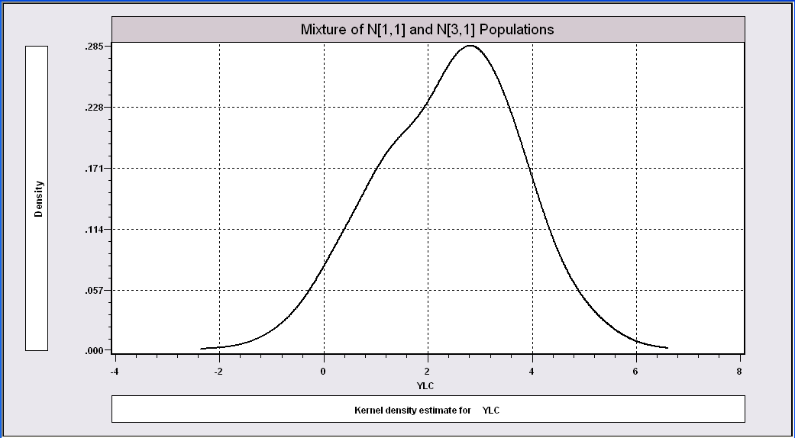
More Difficult When the
Populations are Close Together

Slide 17
The Technique Still Works
----------------------------------------------------------------------
Latent Class / Panel LinearRg Model
Dependent variable YLC
Sample is 1 pds and 1000 individuals
LINEAR regression model
Model fit with 2 latent classes.
--------+-------------------------------------------------------------
Variable| Coefficient Standard Error b/St.Er. P[|Z|>z] Mean of X
--------+-------------------------------------------------------------
|Model parameters for latent class 1
Constant| 2.93611*** .15813 18.568 .0000
Sigma| 1.00326*** .07370 13.613 .0000
|Model parameters for latent class 2
Constant| .90156*** .28767 3.134 .0017
Sigma| .86951*** .10808 8.045 .0000
|Estimated prior probabilities for class membership
Class1Pr| .73447*** .09076 8.092 .0000
Class2Pr| .26553*** .09076 2.926 .0034
--------+-------------------------------------------------------------

Slide 18
LC Regression for Banking Data
Bank Cost Data, 500 Banks, 5 Years:
Variables in the file are
Cit = total cost of transformation of financial and physical resources into
loans and investments = the sum of the five cost items described below;
Q1it = installment loans to individuals for personal and household expenses;
Q2it = real estate loans;
Q3it = business loans;
Q4it = federal funds sold and securities purchased under agreements to resell;
Q5it = other assets;
All variables are in logs in the regression models .

Slide 19
An LCM for US Banks
+---------------------------------------------+
| Latent Class / Panel LinearRg Model |
| Number of observations 2500 |
| Log likelihood function -722.4603 |
| Number of parameters 23 |
| Akaike IC= 1490.921 Bayes IC= 1624.874 |
| Sample is 5 pds and 500 individuals. |
+---------------------------------------------+
+---------+--------------+----------------+--------+---------+
|Variable | Coefficient | Standard Error |b/St.Er.|P[|Z|>z] |
+---------+--------------+----------------+--------+---------+
Model parameters for latent class 1
Constant 2.12699463 .29651372 7.173 .0000
Q1 .12099446 .03964929 3.052 .0023
Q2 .36291987 .03752392 9.672 .0000
Q3 .10728655 .05245420 2.045 .0408
Q4 .12785217 .02482950 5.149 .0000
Q5 .39535779 .06081496 6.501 .0000
Sigma .71931764 .02537027 28.353 .0000
Model parameters for latent class 2
Constant 2.51877624 .06958519 36.197 .0000
Q1 .05918445 .00899501 6.580 .0000
Q2 .44083356 .00930001 47.401 .0000
Q3 .23897724 .01492919 16.007 .0000
Q4 .04896772 .00484760 10.101 .0000
Q5 .16105964 .01307985 12.314 .0000
Sigma .18434496 .00520057 35.447 .0000
Model parameters for latent class 3
Constant 3.83600468 .10233076 37.486 .0000
Q1 .08904293 .01502856 5.925 .0000
Q2 .33710302 .01266856 26.609 .0000
Q3 -.01256845 .01987228 -.632 .5271
Q4 .06333872 .00782013 8.099 .0000
Q5 .42847054 .02326421 18.418 .0000
Sigma .23914408 .00872954 27.395 .0000
Estimated prior probabilities for class membership
Class1Pr .24778109 .02112395 11.730 .0000
Class2Pr .45386105 .03497825 12.976 .0000
Class3Pr .29835786 .03472726 8.591 .0000

Slide 20
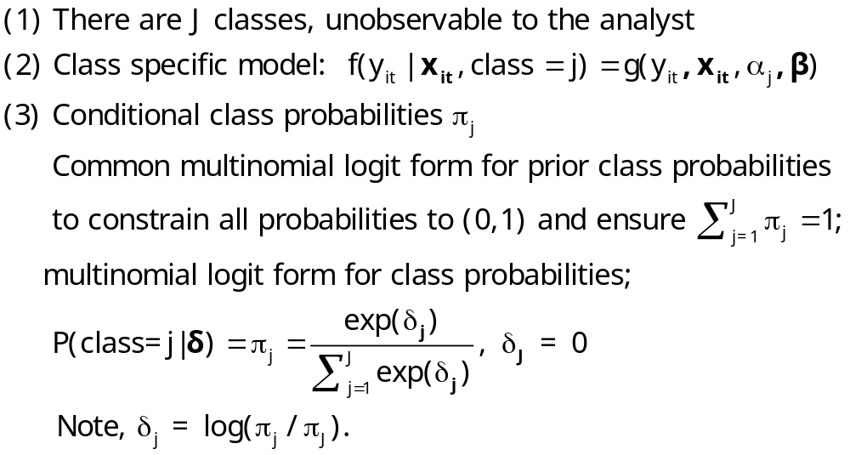
Heckman and Singer Model
Random Effects Model
Random Constants with Discrete Distribution

Slide 21
3 Class Heckman-Singer Form
| Log likelihood function -722.4603 | (Full LC model)
| Log likelihood function -794.2760 | (Restricted – random constant)
+--------+--------------+----------------+--------+--------+----------+
|Variable| Coefficient | Standard Error |b/St.Er.|P[|Z|>z]| Mean of X|
+--------+--------------+----------------+--------+--------+----------+
---------+Model parameters for latent class 1
Constant| 3.28396608 .09620151 34.136 .0000
Q1 | .06662880 .00698098 9.544 .0000 8.58763095
Q2 | .41250826 .00605969 68.074 .0000 10.0931831
Q3 | .13886506 .00908522 15.285 .0000 9.71949206
Q4 | .05974750 .00405876 14.721 .0000 7.78290462
Q5 | .26368046 .00934816 28.207 .0000 7.13715510
Sigma | .75439763 .03173404 23.773 .0000
---------+Model parameters for latent class 2 (Same slopes)
Constant| 3.00580474 .05459323 55.058 .0000
Sigma | .28646077 .01926618 14.869 .0000
---------+Model parameters for latent class 3 (Same slopes)
Constant| 2.91327814 .05028419 57.936 .0000
Sigma | .18372096 .00917844 20.017 .0000
---------+Estimated prior probabilities for class membership
Class1Pr| .23571564 .02199255 10.718 .0000
Class2Pr| .29609849 .07681471 3.855 .0001
Class3Pr| .46818587 .08003086 5.850 .0000

Slide 22
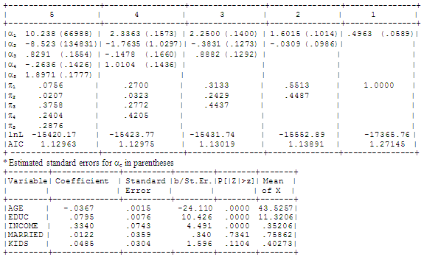
Heckman and Singer’s Model, J=1,…,5

Slide 23
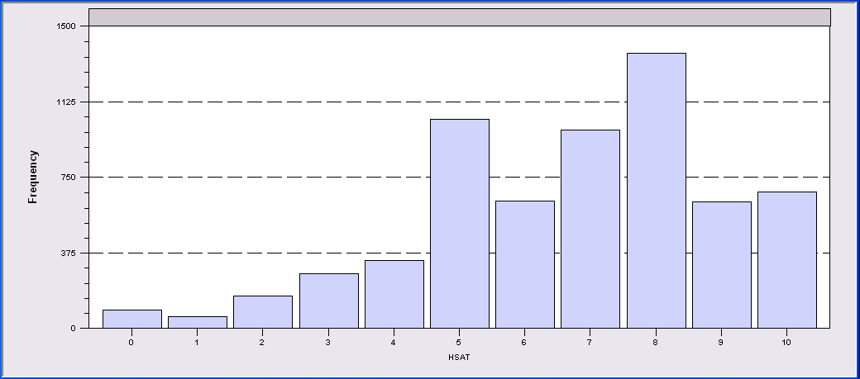
LCM for Health Status
Self Assessed Health Status = 0,1,…,10
Recoded: Healthy = HSAT > 6
Prob = f(Age,Educ,Income,Married,Kids)
2, 3 classes

Slide 24
Too Many Classes
----------------------------------------------------------------------
Latent Class / Panel Probit Model
Dependent variable HEALTHY
Estimation based on N = 6209, K = 20
Unbalanced panel has 887 individuals
PROBIT (normal) probability model
Model fit with 3 latent classes.
--------+-------------------------------------------------------------
Variable| Coefficient Standard Error b/St.Er. P[|Z|>z] Mean of X
--------+-------------------------------------------------------------
|Model parameters for latent class 1
Constant| .01265 .385900D+10 .000 1.0000
AGE| .16523 .138024D+09 .000 1.0000 44.3352
EDUC| .15327 .520918D+08 .000 1.0000 10.9409
HHNINC| .43195 .887276D+09 .000 1.0000 .34930
MARRIED| .06640 .153413D+09 .000 1.0000 .84539
HHKIDS| .17832 .152061D+09 .000 1.0000 .45482
|Model parameters for latent class 2
Constant| .32074 .29082 1.103 .2701
AGE| -.02690*** .00406 -6.622 .0000 44.3352
EDUC| .12215*** .01753 6.969 .0000 10.9409
HHNINC| -.03849 .17139 -.225 .8223 .34930
MARRIED| .20051*** .07749 2.588 .0097 .84539
HHKIDS| .05879 .06565 .895 .3705 .45482
|Model parameters for latent class 3
Constant| .00731 .26582 .027 .9781
AGE| -.03396*** .00446 -7.612 .0000 44.3352
EDUC| .02741* .01466 1.869 .0616 10.9409
HHNINC| .73861*** .24133 3.061 .0022 .34930
MARRIED| .10671 .10520 1.014 .3104 .84539
HHKIDS| .16550** .07838 2.111 .0347 .45482
|Estimated prior probabilities for class membership
Class1Pr| .12387*** .01676 7.390 .0000
Class2Pr| .52530*** .02447 21.468 .0000
Class3Pr| .35083*** .02268 15.466 .0000
--------+-------------------------------------------------------------

Slide 25
Two Class Model
----------------------------------------------------------------------
Latent Class / Panel Probit Model
Dependent variable HEALTHY
Unbalanced panel has 887 individuals
PROBIT (normal) probability model
Model fit with 2 latent classes.
--------+-------------------------------------------------------------
Variable| Coefficient Standard Error b/St.Er. P[|Z|>z] Mean of X
--------+-------------------------------------------------------------
|Model parameters for latent class 1
Constant| .61652** .28620 2.154 .0312
AGE| -.02466*** .00401 -6.143 .0000 44.3352
EDUC| .11759*** .01852 6.351 .0000 10.9409
HHNINC| .10713 .20447 .524 .6003 .34930
MARRIED| .11705 .09574 1.223 .2215 .84539
HHKIDS| .04421 .07017 .630 .5287 .45482
|Model parameters for latent class 2
Constant| .18988 .31890 .595 .5516
AGE| -.03120*** .00464 -6.719 .0000 44.3352
EDUC| .02122 .01934 1.097 .2726 10.9409
HHNINC| .61039*** .19688 3.100 .0019 .34930
MARRIED| .06201 .10035 .618 .5367 .84539
HHKIDS| .19465** .07936 2.453 .0142 .45482
|Estimated prior probabilities for class membership
Class1Pr| .56604*** .02487 22.763 .0000
Class2Pr| .43396*** .02487 17.452 .0000

Slide 26
Partial Effects in LC Model
----------------------------------------------------------------------
Partial derivatives of expected val. with
respect to the vector of characteristics.
They are computed at the means of the Xs.
Conditional Mean at Sample Point .6116
Scale Factor for Marginal Effects .3832
B for latent class model is a wghted avrg.
--------+-------------------------------------------------------------
Variable| Coefficient Standard Error b/St.Er. P[|Z|>z] Elasticity
--------+-------------------------------------------------------------
|Two class latent class model
AGE| -.01054*** .00134 -7.860 .0000 -.76377
EDUC| .02904*** .00589 4.932 .0000 .51939
HHNINC| .12475** .05598 2.228 .0259 .07124
MARRIED| .03570 .02991 1.194 .2326 .04934
HHKIDS| .04196** .02075 2.022 .0432 .03120
--------+-------------------------------------------------------------
|Pooled Probit Model
AGE| -.00846*** .00081 -10.429 .0000 -.63399
EDUC| .03219*** .00336 9.594 .0000 .59568
HHNINC| .16699*** .04253 3.927 .0001 .09865
|Marginal effect for dummy variable is P|1 - P|0.
MARRIED| .02414 .01877 1.286 .1986 .03451
|Marginal effect for dummy variable is P|1 - P|0.
HHKIDS| .06754*** .01483 4.555 .0000 .05195
--------+-------------------------------------------------------------

Slide 27
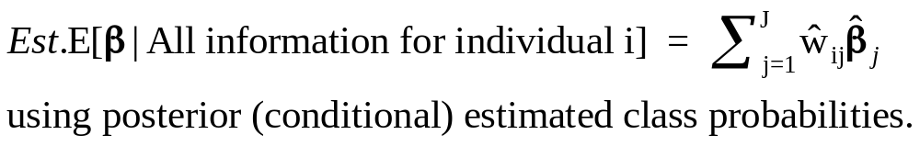
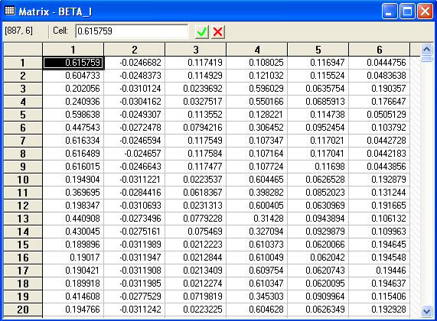
Conditional Means of Parameters

Slide 28
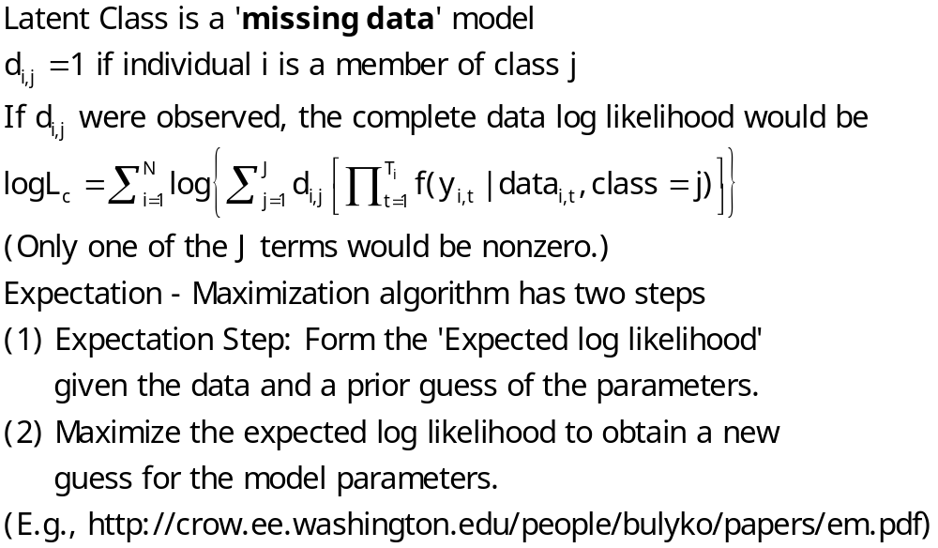
The EM Algorithm

Slide 29
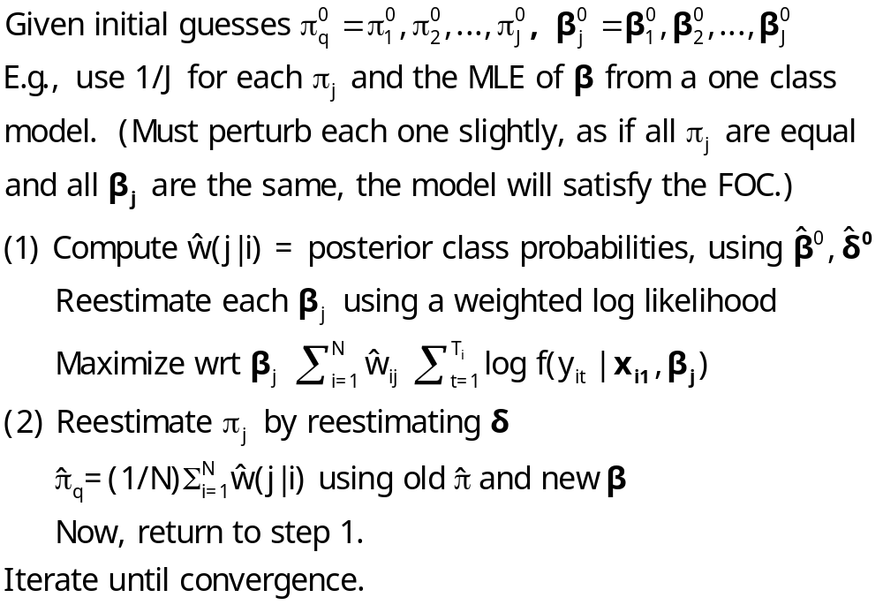
Implementing EM for LC Models

Slide 30
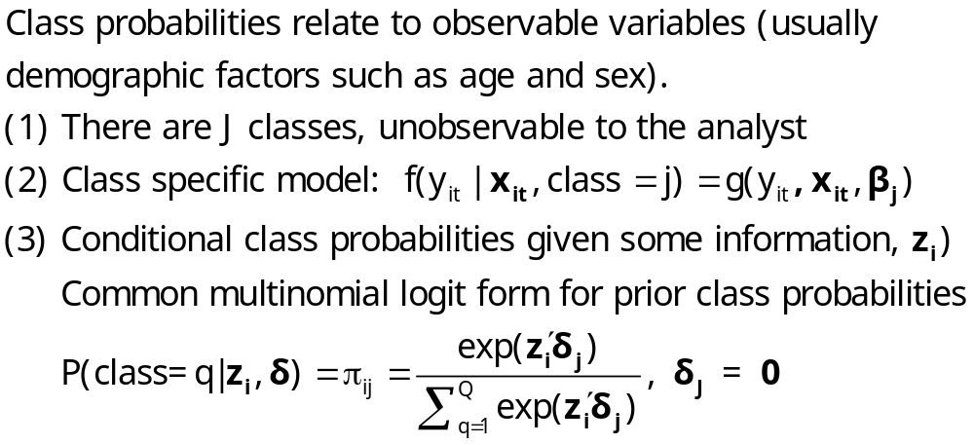
An Extended Latent Class Model
Notes:
30

Slide 31
Health Satisfaction Model
----------------------------------------------------------------------
Latent Class / Panel Probit Model
Dependent variable HEALTHY
Log likelihood function -3465.98697
--------+-------------------------------------------------------------
Variable| Coefficient Standard Error b/St.Er. P[|Z|>z] Mean of X
--------+-------------------------------------------------------------
|Model parameters for latent class 1
Constant| .60050** .29187 2.057 .0396
AGE| -.02002*** .00447 -4.477 .0000 44.3352
EDUC| .10597*** .01776 5.968 .0000 10.9409
HHNINC| .06355 .20751 .306 .7594 .34930
MARRIED| .07532 .10316 .730 .4653 .84539
HHKIDS| .02632 .07082 .372 .7102 .45482
|Model parameters for latent class 2
Constant| .10508 .32937 .319 .7497
AGE| -.02499*** .00514 -4.860 .0000 44.3352
EDUC| .00945 .01826 .518 .6046 10.9409
HHNINC| .59026*** .19137 3.084 .0020 .34930
MARRIED| -.00039 .09478 -.004 .9967 .84539
HHKIDS| .20652*** .07782 2.654 .0080 .45482
|Estimated prior probabilities for class membership
ONE_1| 1.43661*** .53679 2.676 .0074 (.56519)
AGEBAR_1| -.01897* .01140 -1.664 .0960
FEMALE_1| -.78809*** .15995 -4.927 .0000
ONE_2| .000 ......(Fixed Parameter)...... (.43481)
AGEBAR_2| .000 ......(Fixed Parameter)......
FEMALE_2| .000 ......(Fixed Parameter)......
--------+-------------------------------------------------------------

Slide 32
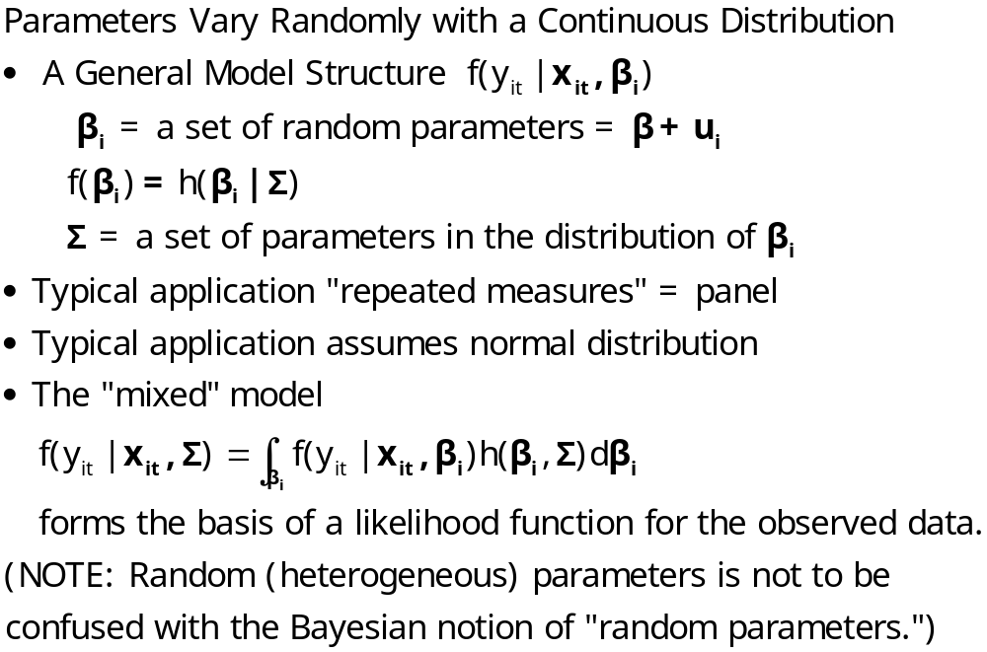
Random Parameters Models
Notes:
32

Slide 33
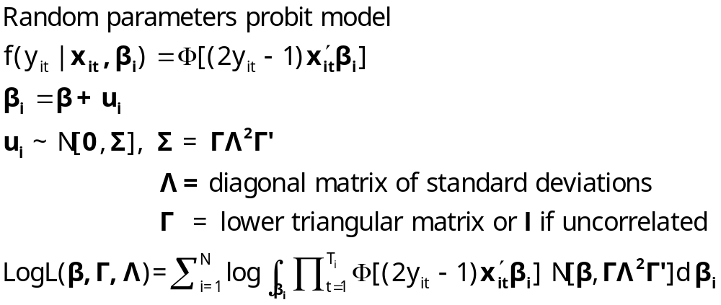
A Mixed Probit Model

Slide 34
Application – Healthy
German Health Care Usage Data, 7,293 Individuals, Varying Numbers of Periods
Variables in the file are
Data downloaded from Journal of Applied Econometrics Archive. This is an unbalanced panel with 7,293 individuals. They can be used for regression, count models, binary choice, ordered choice, and bivariate binary choice. This is a large data set. There are altogether 27,326 observations. The number of observations ranges from 1 to 7. (Frequencies are: 1=1525, 2=2158, 3=825, 4=926, 5=1051, 6=1000, 7=987). Note, the variable NUMOBS below tells how many observations there are for each person. This variable is repeated in each row of the data for the person. (Downlo0aded from the JAE Archive)
DOCTOR = 1(Number of doctor visits > 0)
HSAT = health satisfaction, coded 0 (low) - 10 (high)
DOCVIS = number of doctor visits in last three months
HOSPVIS = number of hospital visits in last calendar year
PUBLIC = insured in public health insurance = 1; otherwise = 0
ADDON = insured by add-on insurance = 1; otherswise = 0
HHNINC = household nominal monthly net income in German marks / 10000.
(4 observations with income=0 were dropped)
HHKIDS = children under age 16 in the household = 1; otherwise = 0
EDUC = years of schooling
AGE = age in years
MARRIED = marital status
EDUC = years of education

Slide 35
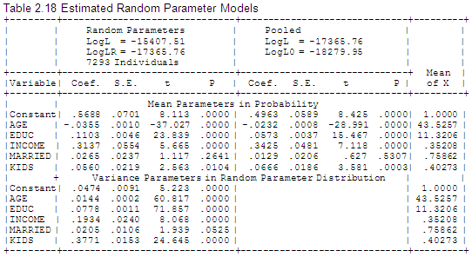
Estimates of a Mixed Probit Model

Slide 36
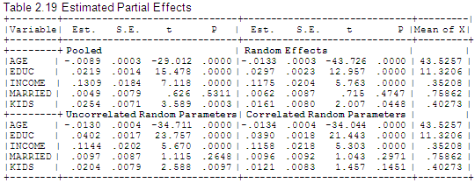
Partial Effects are Also Simulated

Slide 37
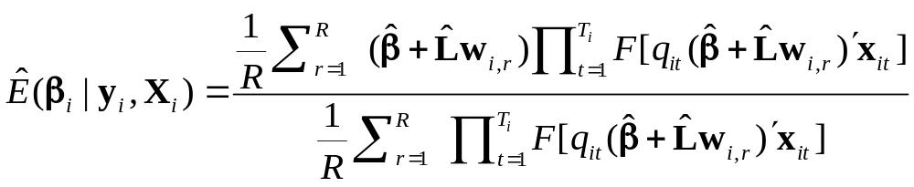
Simulating Conditional Means for Individual Parameters
Posterior estimates of E[parameters(i) | Data(i)]

Slide 38
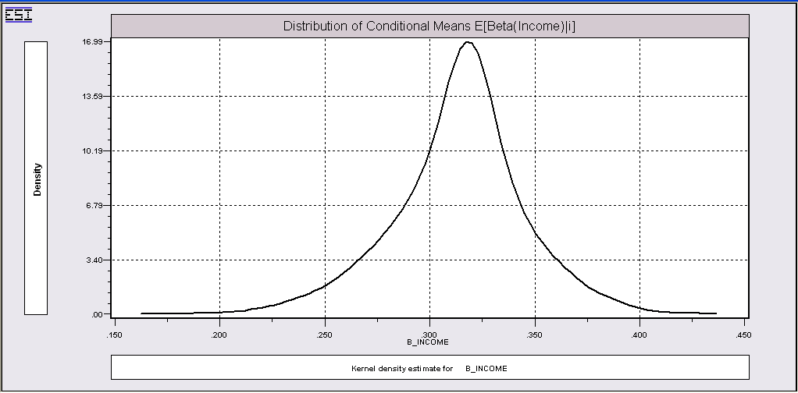
Summarizing Simulated Estimates

Slide 39
Correlated Parameters
----------------------------------------------------------------------
Random Coefficients Probit Model
Dependent variable HEALTHY
PROBIT (normal) probability model
Simulation based on 25 random draws
--------+-------------------------------------------------------------
Variable| Coefficient Standard Error b/St.Er. P[|Z|>z] Mean of X
--------+-------------------------------------------------------------
|Means for random parameters
Constant| .22395 .18073 1.239 .2153
AGE| -.03919*** .00257 -15.256 .0000 44.3352
EDUC| .15526*** .01173 13.236 .0000 10.9409
HHNINC| .28023** .12572 2.229 .0258 .34930
MARRIED| .03971 .05918 .671 .5023 .84539
HHKIDS| .06313 .04713 1.340 .1804 .45482
----------------------------------------------------------------------
Partial derivatives of expected val. with
respect to the vector of characteristics.
They are computed at the means of the Xs.
Conditional Mean at Sample Point .6351
Scale Factor for Marginal Effects .3758
AGE| -.01473*** .00102 -14.420 .0000 -1.02820
EDUC| .05835*** .00444 13.149 .0000 1.00526
HHNINC| .10532** .04722 2.231 .0257 .05793
MARRIED| .01492 .02228 .670 .5029 .01987
HHKIDS| .02373 .01754 1.353 .1761 .01699
--------+-------------------------------------------------------------

Slide 40
Cholesky Matrix
--------+-------------------------------------------------------------
Variable| Coefficient Standard Error b/St.Er. P[|Z|>z] Mean of X
--------+-------------------------------------------------------------
|Means for random parameters
Constant| .22395 .18073 1.239 .2153
AGE| -.03919*** .00257 -15.256 .0000 44.3352
EDUC| .15526*** .01173 13.236 .0000 10.9409
HHNINC| .28023** .12572 2.229 .0258 .34930
MARRIED| .03971 .05918 .671 .5023 .84539
HHKIDS| .06313 .04713 1.340 .1804 .45482
|Diagonal elements of Cholesky matrix
Constant| .66612*** .21850 3.049 .0023
AGE| .01041*** .00183 5.687 .0000
EDUC| .07307*** .00592 12.346 .0000
HHNINC| .18897* .10133 1.865 .0622
MARRIED| .47889*** .03140 15.252 .0000
HHKIDS| .44804*** .03126 14.334 .0000
|Below diagonal elements of Cholesky matrix
lAGE_ONE| -.00211 .00298 -.706 .4799
lEDU_ONE| .07359*** .01403 5.246 .0000
lEDU_AGE| -.01881** .00778 -2.417 .0156
lHHN_ONE| -.32031** .15453 -2.073 .0382
lHHN_AGE| .05302 .12989 .408 .6831
lHHN_EDU| .44021*** .13082 3.365 .0008
lMAR_ONE| -.19247** .07503 -2.565 .0103
lMAR_AGE| -.24710*** .06002 -4.117 .0000
lMAR_EDU| .01475 .05933 .249 .8037
lMAR_HHN| .07949* .04724 1.683 .0924
lHHK_ONE| -.07220 .05686 -1.270 .2041
lHHK_AGE| .21508*** .04456 4.827 .0000
lHHK_EDU| .31374*** .04369 7.181 .0000
lHHK_HHN| -.11592*** .04023 -2.881 .0040
lHHK_MAR| -.35853*** .04154 -8.631 .0000
--------+-------------------------------------------------------------

Slide 41
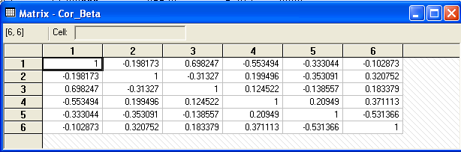
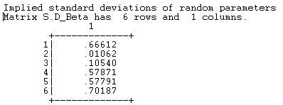
Estimated Parameter Correlation Matrix

Slide 42
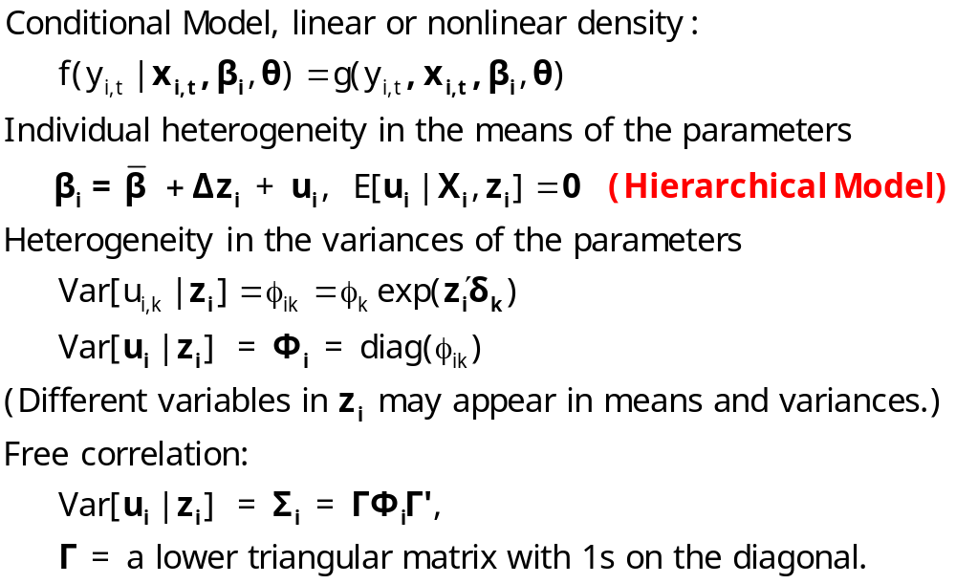
Modeling Parameter Heterogeneity

Slide 43
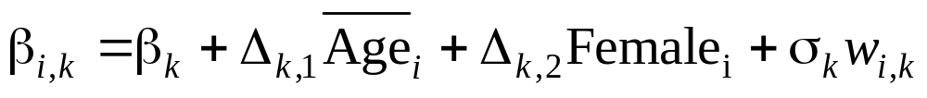
Hierarchical Probit Model
----------------------------------------------------------------------
Random Coefficients Probit Model
--------+-------------------------------------------------------------
Variable| Coefficient Standard Error b/St.Er. P[|Z|>z] Mean of X
--------+-------------------------------------------------------------
|Means for random parameters
Constant| 2.80514*** .84261 3.329 .0009
AGE| -.06321*** .01397 -4.523 .0000 44.3352
EDUC| -.15340*** .05506 -2.786 .0053 10.9409
HHNINC| 2.56154*** .67822 3.777 .0002 .34930
MARRIED| .61453** .26650 2.306 .0211 .84539
HHKIDS| -.19855 .24303 -.817 .4140 .45482
|Scale parameters for dists. of random parameters
Constant| .12981*** .02448 5.303 .0000
AGE| .01424*** .00050 28.712 .0000
EDUC| .00368** .00172 2.142 .0322
HHNINC| .52685*** .05165 10.201 .0000
MARRIED| .16399*** .02111 7.768 .0000
HHKIDS| .13928*** .02845 4.896 .0000
|Heterogeneity in the means of random parameters
cONE_AGE| -.02875 .02082 -1.381 .1673
cONE_FEM| -.98200*** .35328 -2.780 .0054
cAGE_AGE| .00022 .00029 .740 .4592
cAGE_FEM| .01552*** .00510 3.043 .0023
cEDU_AGE| .00575*** .00130 4.438 .0000
cEDU_FEM| -.00877 .02172 -.404 .6864
cHHN_AGE| -.04540*** .01485 -3.057 .0022
cHHN_FEM| -.03645 .25041 -.146 .8843
cMAR_AGE| -.01556** .00610 -2.550 .0108
cMAR_FEM| .20538* .11232 1.828 .0675
cHHK_AGE| .01053* .00552 1.906 .0566
cHHK_FEM| -.25666*** .08923 -2.876 .0040
--------+-------------------------------------------------------------

Slide 44
Mixed Model Estimation
Programs differ on the models fitted, the algorithms, the paradigm, and
the extensions provided to the simplest RPM, β_{i} = β+u_{i}.
MLWin: http://www.cmm.bristol.ac.uk/MLwiN/index.shtml
  Multilevel models
  Regression and some loglinear models
WinBUGS: Mainly for Bayesian Applications
  MCMC
  User specifies the model – constructs the Gibbs Sampler/Metropolis Hastings
SAS: Proc Mixed.
  Classical
  Uses primarily a kind of GLS/GMM (method of moments algorithm for loglinear models)
LIMDEP/NLOGIT
  Classical
  Mixing done by Monte Carlo integration – maximum simulated likelihood
  Numerous linear, nonlinear, loglinear models
Stata: Classical - GLAMM
  Mixing done by quadrature. (Very, very slow for 2 or more dimensions)
  Several loglinear models
Ken Train’s Gauss Code
  Monte Carlo integration
  Used by many researchers
  Mixed Multinomial Logit model only (but free!)

Slide 45
Hierarchical Model
Notes:
45

Slide 46
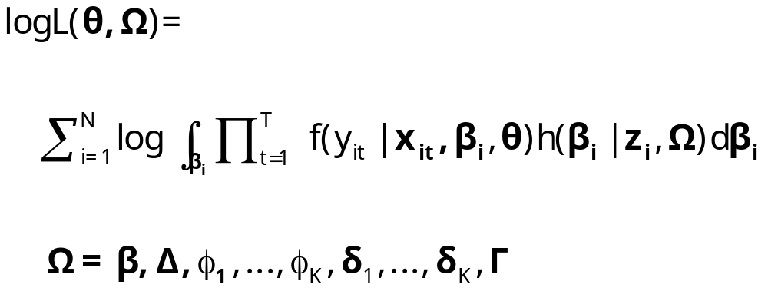
Maximum Simulated Likelihood

Slide 47
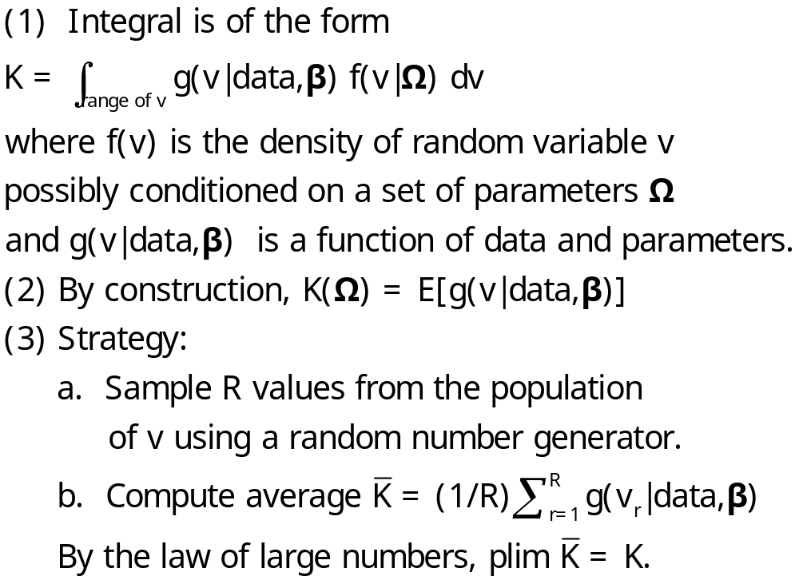
Monte Carlo Integration

Slide 48
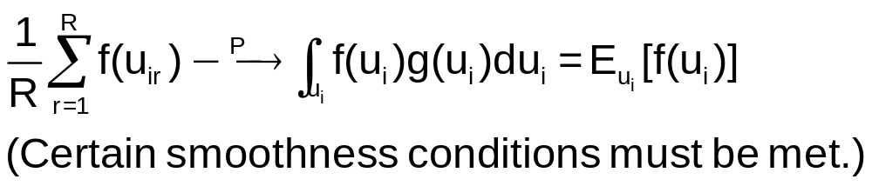
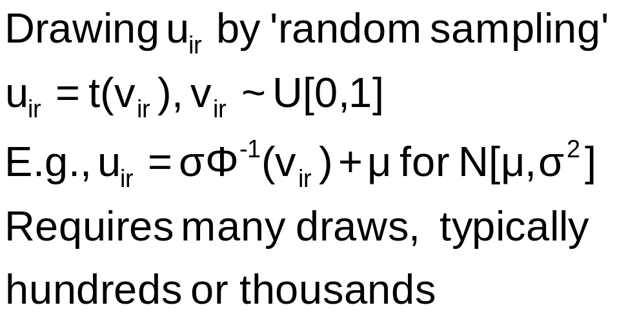
Monte Carlo Integration

Slide 49
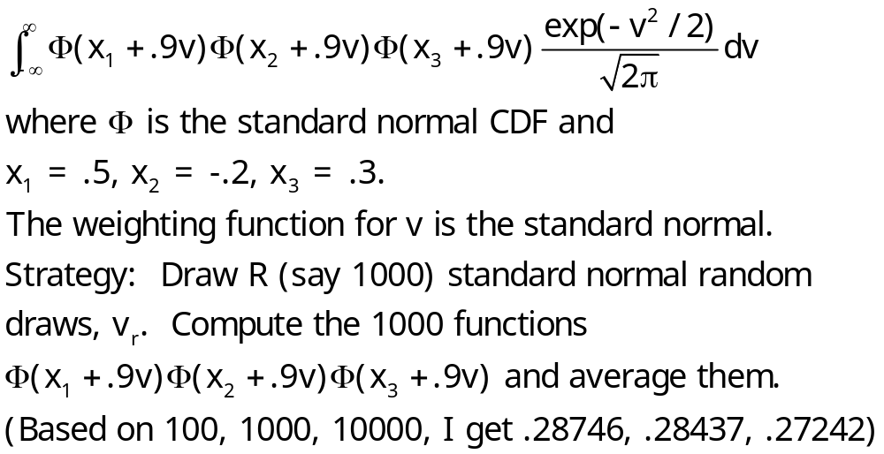
Example: Monte Carlo Integral

Slide 50
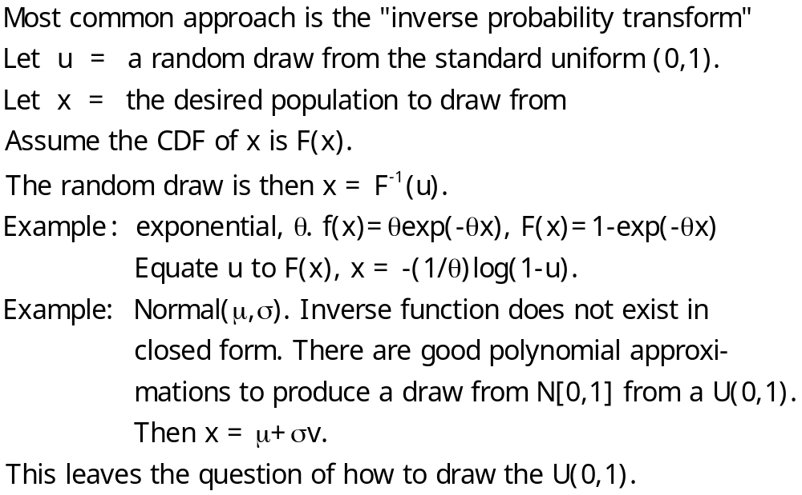
Generating a Random Draw

Slide 51
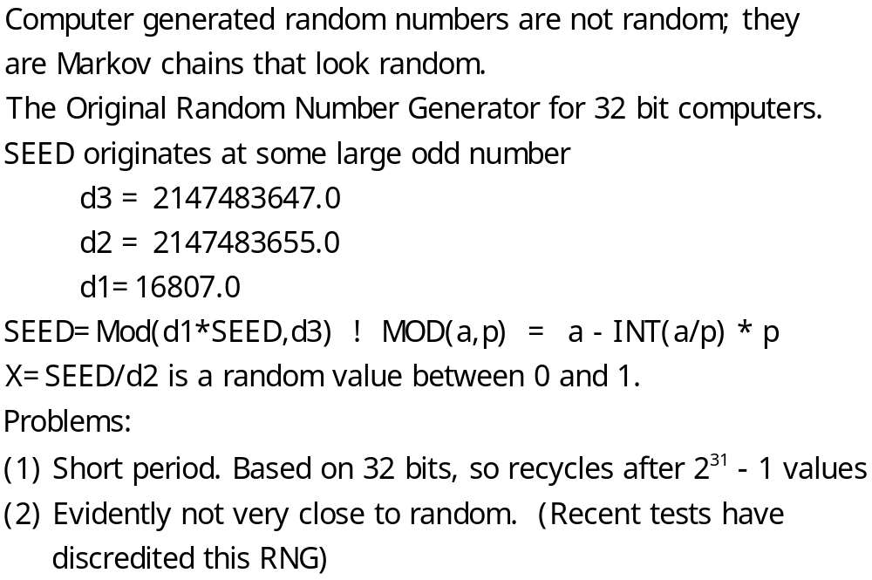
Drawing Uniform Random Numbers

Slide 52
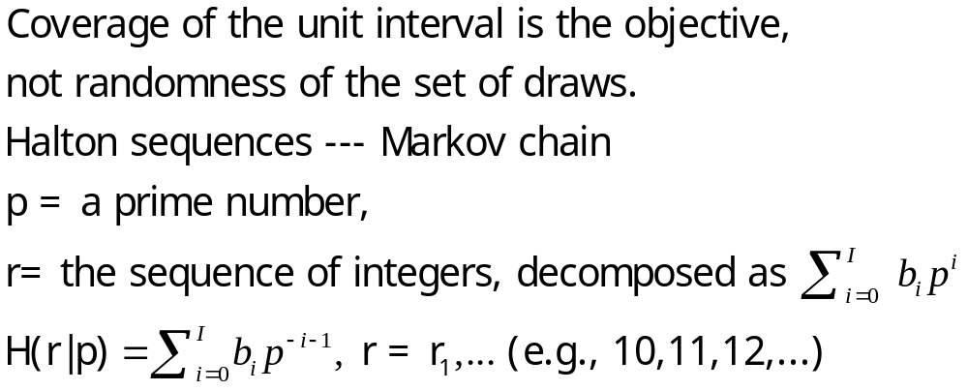
Quasi-Monte Carlo Integration Based on Halton Sequences
For example, using base p=5, the integer r=37 has b₀ = 2, b₁ = 2, and b₃ = 1; (37=1x5² + 2x5¹ + 2x5⁰). Then
H(37|5) = 2×5⁻¹ + 2×5⁻² + 1×5⁻³ = 0.448.

Slide 53
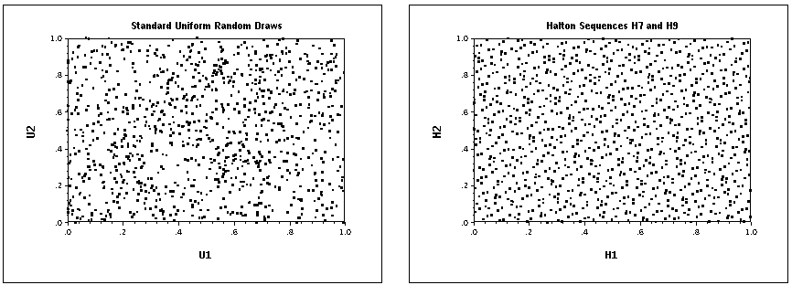
Halton Sequences vs. Random Draws
Requires far fewer draws – for one dimension, about 1/10. Accelerates estimation by a factor of 5 to 10.

Slide 54
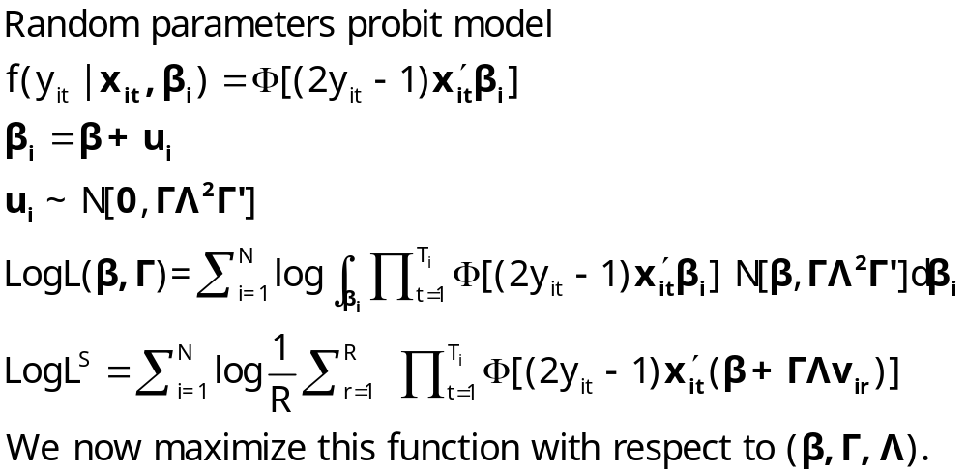
Simulated Log Likelihood for a Mixed Probit Model

