Slide 1
Discrete Choice Modeling
William Greene
Stern School of Business
New York University

Slide 2
Part 7
Ordered Choices

Slide 3


Slide 4
A Taxonomy of Discrete Outcomes
Types of outcomes
  Quantitative, ordered, labels
    Preference ordering: health satisfaction
    Rankings: Competitions, job preferences, contests (horse races)
  Quantitative, counts of outcomes: Doctor visits
  Qualitative, unordered labels: Brand choice
Ordered vs. unordered choices
Multinomial vs. multivariate
Single vs. repeated measurement

Slide 5
Ordered Discrete Outcomes
E.g.: Taste test, credit rating, course grade, preference scale
Underlying random preferences:
  Existence of an underlying continuous preference scale
  Mapping to observed choices
Strength of preferences is reflected in the discrete outcome
Censoring and discrete measurement
The nature of ordered data

Slide 6
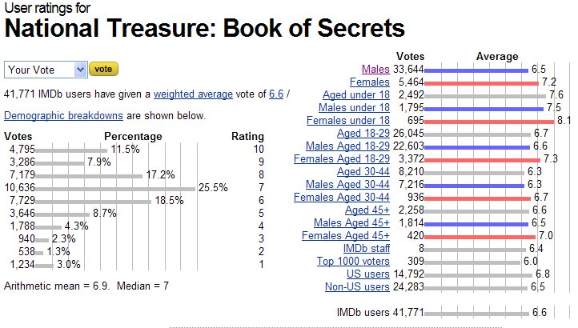
Ordered Preferences at IMDB.com

Slide 7
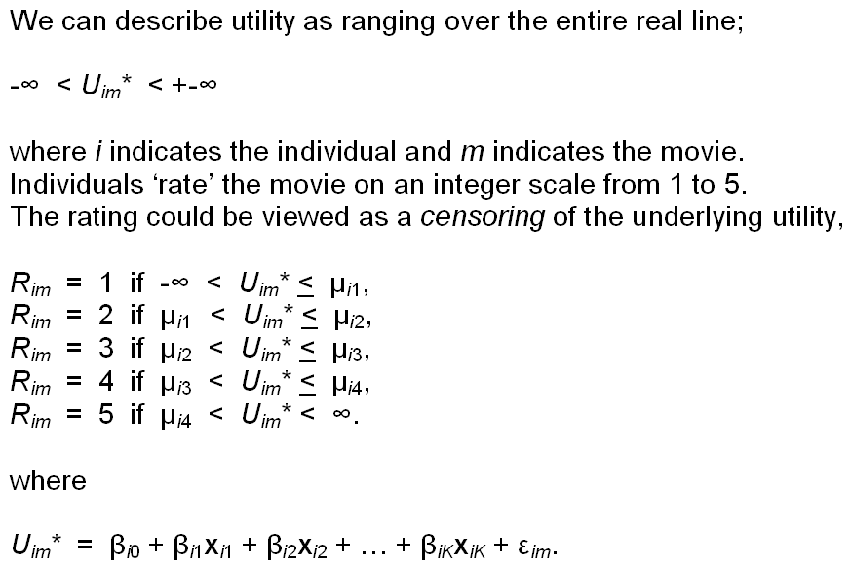
Translating Movie Preferences
Into a Discrete Outcomes

Slide 8

Health Satisfaction (HSAT)
Self administered survey: Health Care Satisfaction? (0 – 10)
Continuous Preference Scale

Slide 9
Modeling Ordered Choices
Random Utility (allowing a panel data setting)
Uit = α + β’xit + ε_{it}
= a_{it} + ε_{it}
Observe outcome j if utility is in region j
Probability of outcome = probability of cell
Pr[Yit=j] = F(μ_{j} – a_{it}) - F(μ_{j-1} – a_{it})

Slide 10
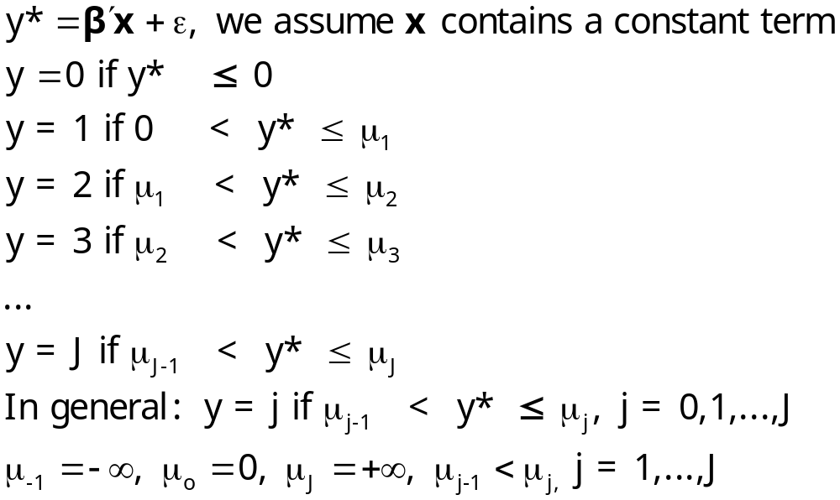
Ordered Probability Model

Slide 11

Combined Outcomes for Health Satisfaction

Slide 12
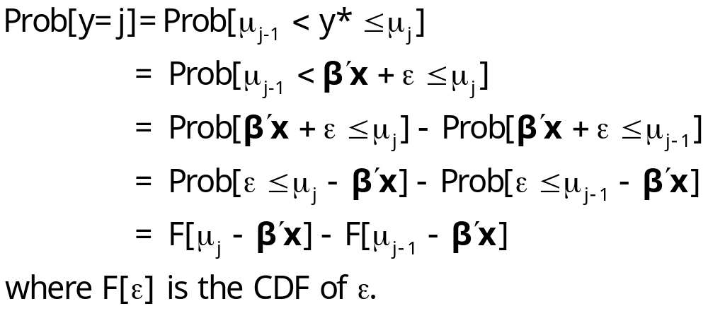
Ordered Probabilities

Slide 13
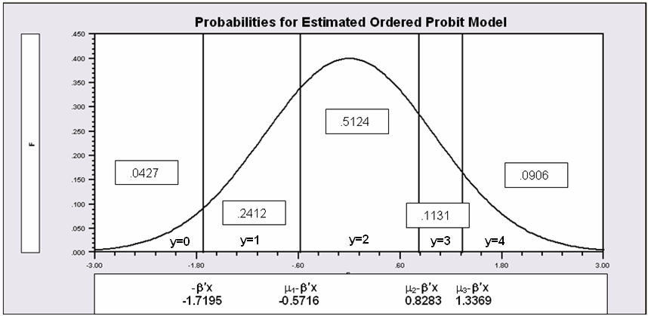
Probabilities for Ordered Choices
μ₁ =1.1479 μ₂ =2.5478 μ₃ =3.0564

Slide 14
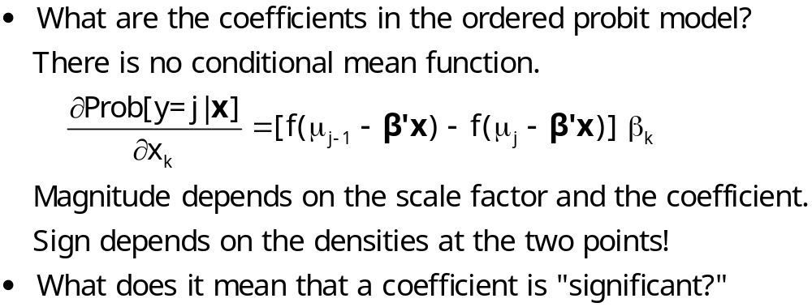
Coefficients

Slide 15
Partial Effects in the
Ordered Probability Model
Assume the β_{k} is positive.
Assume that x_{k} increases.
β’x increases. μ_{j}- β’x shifts to the left for all 5 cells.
Prob[y=0] decreases
Prob[y=1] decreases – the mass shifted out is larger than the mass shifted in.
Prob[y=3] increases – same reason in reverse.
Prob[y=4] must increase.
When β_{k} > 0, increase in x_{k} decreases Prob[y=0] and increases Prob[y=J]. Intermediate cells are ambiguous, but there is only one sign change in the marginal effects from 0 to 1 to … to J

Slide 16
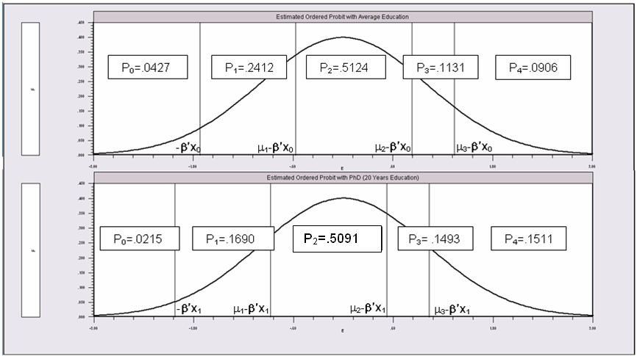
Partial Effects of 8 Years of Education

Slide 17
An Ordered Probability
Model for Health Satisfaction
+---------------------------------------------+
| Ordered Probability Model |
| Dependent variable HSAT |
| Number of observations 27326 |
| Underlying probabilities based on Normal |
| Cell frequencies for outcomes |
| Y Count Freq Y Count Freq Y Count Freq |
| 0 447 .016 1 255 .009 2 642 .023 |
| 3 1173 .042 4 1390 .050 5 4233 .154 |
| 6 2530 .092 7 4231 .154 8 6172 .225 |
| 9 3061 .112 10 3192 .116 |
+---------------------------------------------+
+---------+--------------+----------------+--------+---------+----------+
|Variable | Coefficient | Standard Error |b/St.Er.|P[|Z|>z] | Mean of X|
+---------+--------------+----------------+--------+---------+----------+
Index function for probability
Constant 2.61335825 .04658496 56.099 .0000
FEMALE -.05840486 .01259442 -4.637 .0000 .47877479
EDUC .03390552 .00284332 11.925 .0000 11.3206310
AGE -.01997327 .00059487 -33.576 .0000 43.5256898
HHNINC .25914964 .03631951 7.135 .0000 .35208362
HHKIDS .06314906 .01350176 4.677 .0000 .40273000
Threshold parameters for index
Mu(1) .19352076 .01002714 19.300 .0000
Mu(2) .49955053 .01087525 45.935 .0000
Mu(3) .83593441 .00990420 84.402 .0000
Mu(4) 1.10524187 .00908506 121.655 .0000
Mu(5) 1.66256620 .00801113 207.532 .0000
Mu(6) 1.92729096 .00774122 248.965 .0000
Mu(7) 2.33879408 .00777041 300.987 .0000
Mu(8) 2.99432165 .00851090 351.822 .0000
Mu(9) 3.45366015 .01017554 339.408 .0000

Slide 18
Ordered Probability Effects
+----------------------------------------------------+
| Marginal effects for ordered probability model |
| M.E.s for dummy variables are Pr[y|x=1]-Pr[y|x=0] |
| Names for dummy variables are marked by *. |
+----------------------------------------------------+
+---------+--------------+----------------+--------+---------+----------+
|Variable | Coefficient | Standard Error |b/St.Er.|P[|Z|>z] | Mean of X|
+---------+--------------+----------------+--------+---------+----------+
These are the effects on Prob[Y=00] at means.
*FEMALE .00200414 .00043473 4.610 .0000 .47877479
EDUC -.00115962 .986135D-04 -11.759 .0000 11.3206310
AGE .00068311 .224205D-04 30.468 .0000 43.5256898
HHNINC -.00886328 .00124869 -7.098 .0000 .35208362
*HHKIDS -.00213193 .00045119 -4.725 .0000 .40273000
These are the effects on Prob[Y=01] at means.
*FEMALE .00101533 .00021973 4.621 .0000 .47877479
EDUC -.00058810 .496973D-04 -11.834 .0000 11.3206310
AGE .00034644 .108937D-04 31.802 .0000 43.5256898
HHNINC -.00449505 .00063180 -7.115 .0000 .35208362
*HHKIDS -.00108460 .00022994 -4.717 .0000 .40273000
... repeated for all 11 outcomes
These are the effects on Prob[Y=10] at means.
*FEMALE -.01082419 .00233746 -4.631 .0000 .47877479
EDUC .00629289 .00053706 11.717 .0000 11.3206310
AGE -.00370705 .00012547 -29.545 .0000 43.5256898
HHNINC .04809836 .00678434 7.090 .0000 .35208362
*HHKIDS .01181070 .00255177 4.628 .0000 .40273000

Slide 19
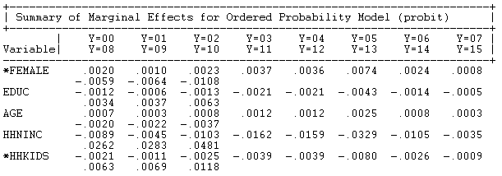
Ordered Probit Marginal Effects

Slide 20
The Single Crossing Effect
The marginal effect for EDUC is negative for Prob(0),…,Prob(7), then positive for Prob(8)…Prob(10). One “crossing.”

Slide 21
Analysis of Model Implications
Partial Effects
Fit Measures
Predicted Probabilities
  Averaged: They match sample proportions.
  By observation
  Segments of the sample
  Related to particular variables

Slide 22
Predictions of the Model:Kids
+----------------------------------------------+
|Variable Mean Std.Dev. Minimum Maximum |
+----------------------------------------------+
|Stratum is KIDS = 0.000. Nobs.= 2782.000 |
+--------+-------------------------------------+
|P0 | .059586 .028182 .009561 .125545 |
|P1 | .268398 .063415 .106526 .374712 |
|P2 | .489603 .024370 .419003 .515906 |
|P3 | .101163 .030157 .052589 .181065 |
|P4 | .081250 .041250 .028152 .237842 |
+----------------------------------------------+
|Stratum is KIDS = 1.000. Nobs.= 1701.000 |
+--------+-------------------------------------+
|P0 | .036392 .013926 .010954 .105794 |
|P1 | .217619 .039662 .115439 .354036 |
|P2 | .509830 .009048 .443130 .515906 |
|P3 | .125049 .019454 .061673 .176725 |
|P4 | .111111 .030413 .035368 .222307 |
+----------------------------------------------+
|All 4483 observations in current sample |
+--------+-------------------------------------+
|P0 | .050786 .026325 .009561 .125545 |
|P1 | .249130 .060821 .106526 .374712 |
|P2 | .497278 .022269 .419003 .515906 |
|P3 | .110226 .029021 .052589 .181065 |
|P4 | .092580 .040207 .028152 .237842 |
+----------------------------------------------+

Slide 23
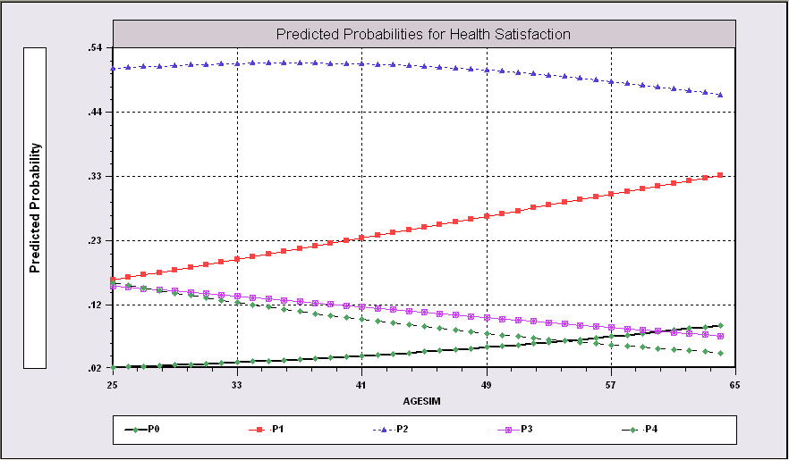
Predictions from the Model Related to Age

Slide 24
Fit Measures
There is no single “dependent variable” to explain.
There is no sum of squares or other measure of “variation” to explain.
Predictions of the model relate to a set of J+1 probabilities, not a single variable.
How to explain fit?
  Based on the underlying regression
  Based on the likelihood function
  Based on prediction of the outcome variable

Slide 25
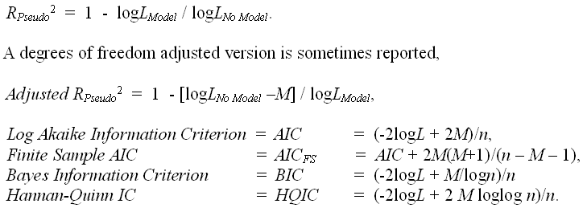
Log Likelihood Based Fit Measures

Slide 26
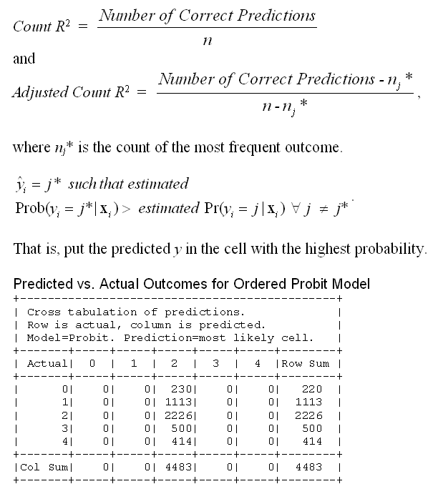

Slide 27
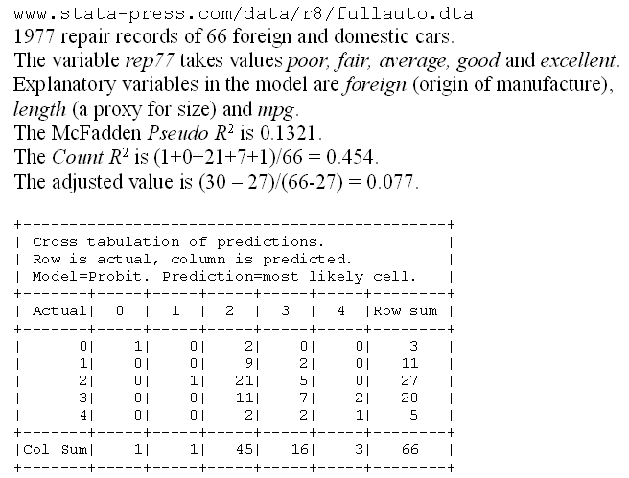
A Somewhat Better Fit

Slide 28
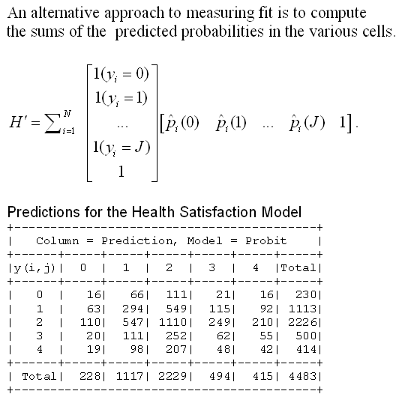
An Aggregate Prediction Measure

Slide 29
Different Normalizations
NLOGIT
  Y = 0,1,…,J, U* = α + β’x + ε
  One overall constant term, α
  J-1 “cutpoints;” μ₋₁ = -∞, μ₀ = 0, μ₁,… μ_{J-1}, μ_{J} = + ∞
Stata
  Y = 1,…,J+1, U* = β’x + ε
  No overall constant, α=0
  J “cutpoints;” μ₀ = -∞, μ₁,… μ_{J}, μ_{J+1} = + ∞

Slide 30

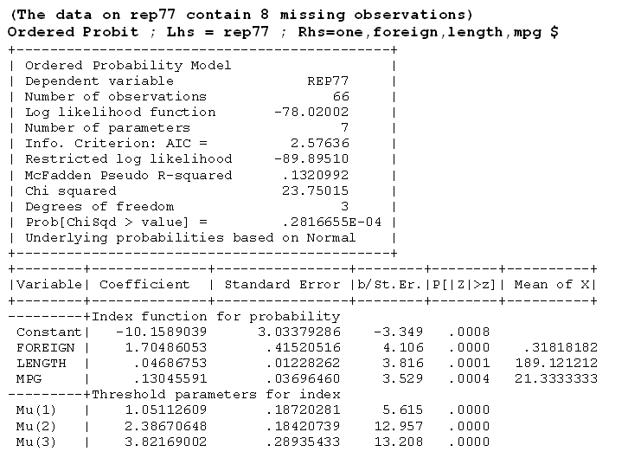


Slide 31

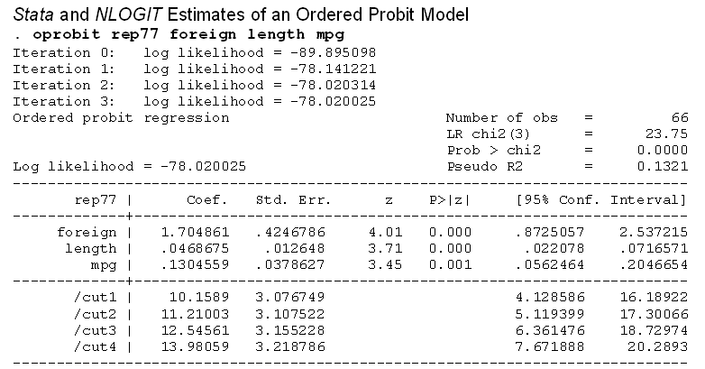


Slide 32
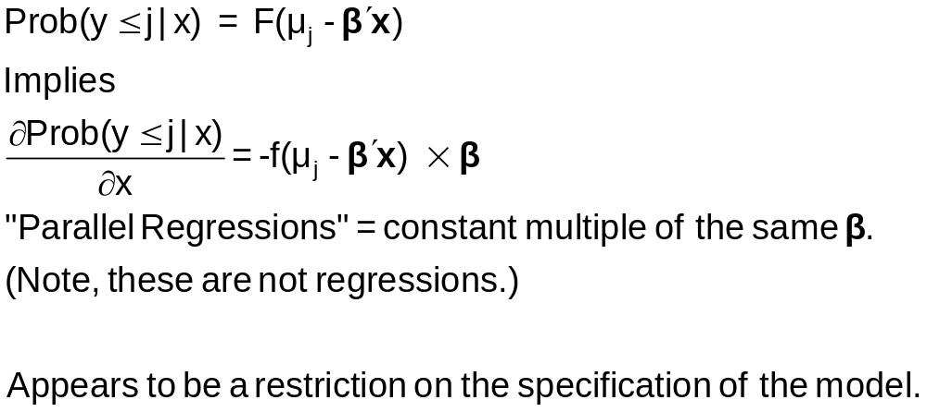
Parallel Regressions

Slide 33
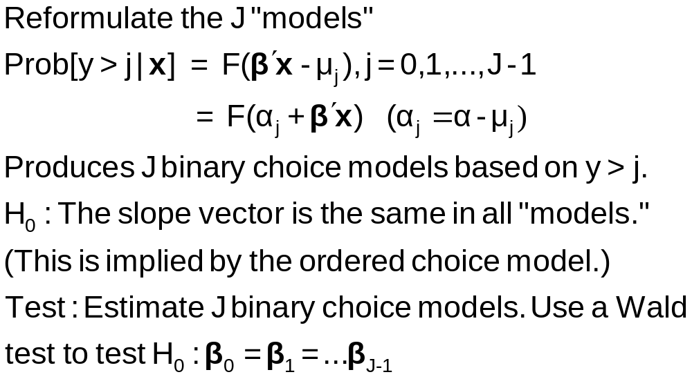
Brant Test for Parallel Regressions

Slide 34
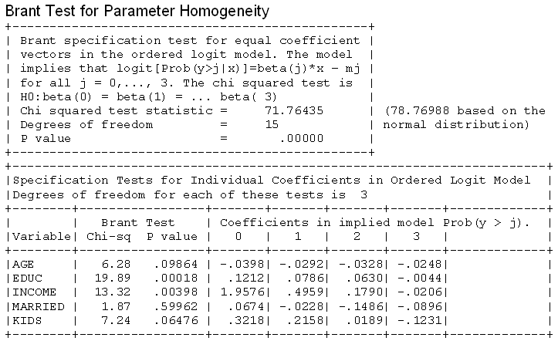
A Specification Test
What failure of the model specification is indicated by rejection?

Slide 35
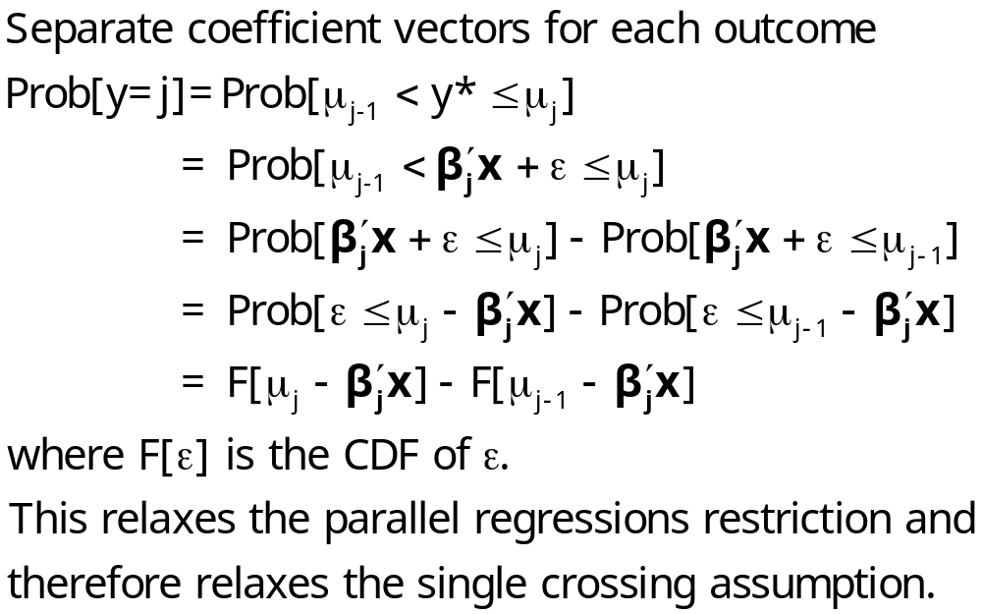
An Alternative Model Specification

Slide 36
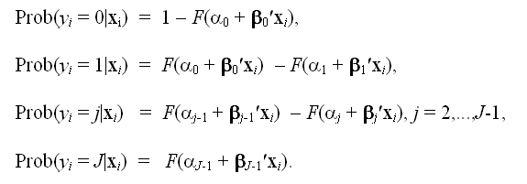
A “Generalized” Ordered Choice Model
Probabilities sum to 1.0
P(0) is positive, P(J) is positive
P(1),…,P(J-1) can be negative
It is not possible to draw (simulate) values on Y for this model. You would need to know the value of Y to know which coefficient vector to use to simulate Y!
The model is internally inconsistent. [“Incoherent” (Heckman)]

Slide 37
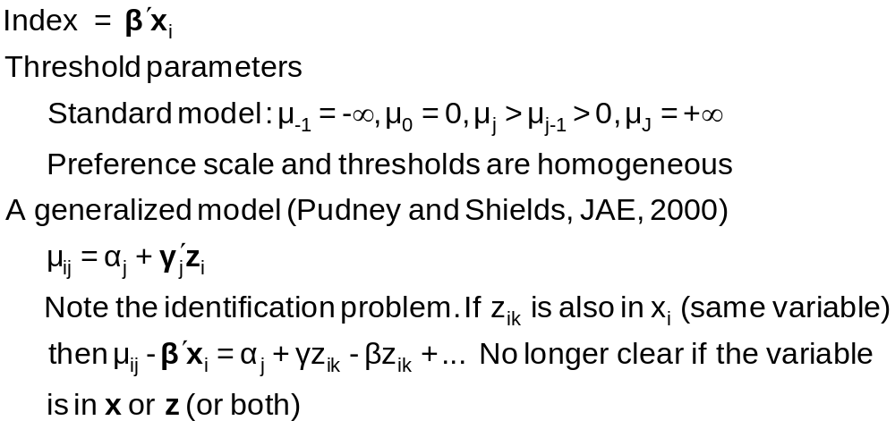
Generalizing the Ordered Probit with Heterogeneous Thresholds

Slide 38
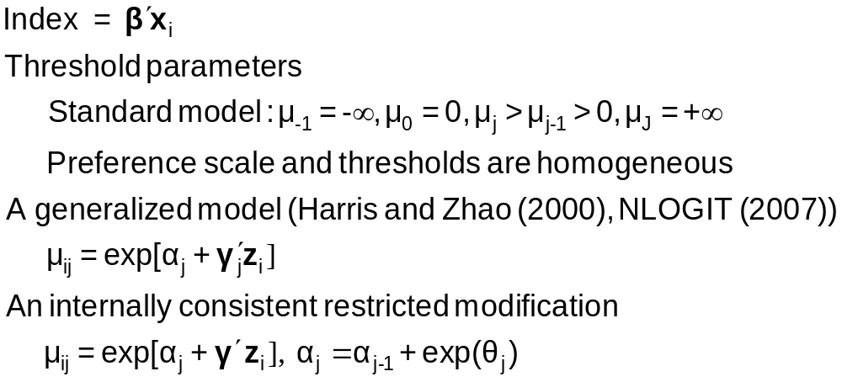
Hierarchical Ordered Probit

Slide 39
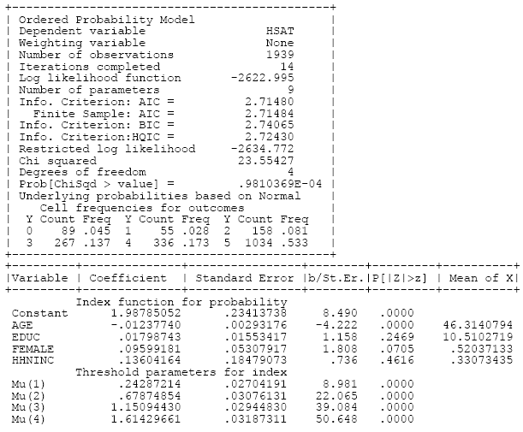
Ordered Choice Model

Slide 40
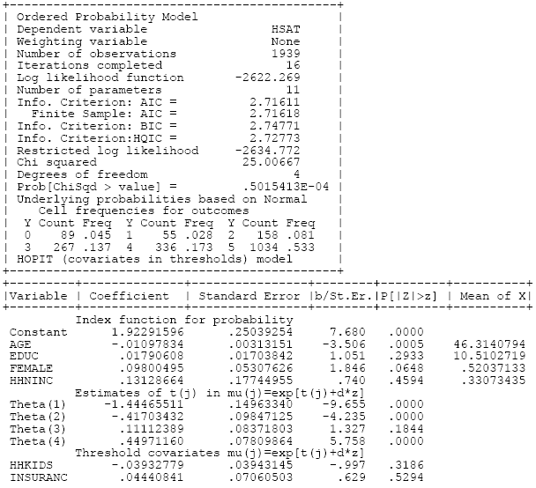
HOPit Model

Slide 41
Heterogeneity in OC Models
Scale Heterogeneity: Heteroscedasticity
Standard Models of Heterogeneity in Discrete Choice Models
  Latent Class Models
  Random Parameters

Slide 42
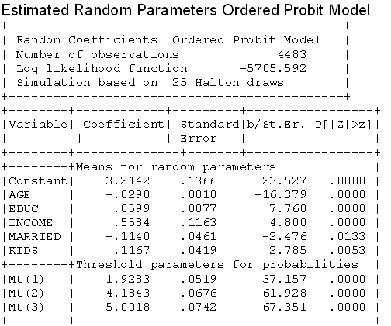
A Random Parameters Model

Slide 43
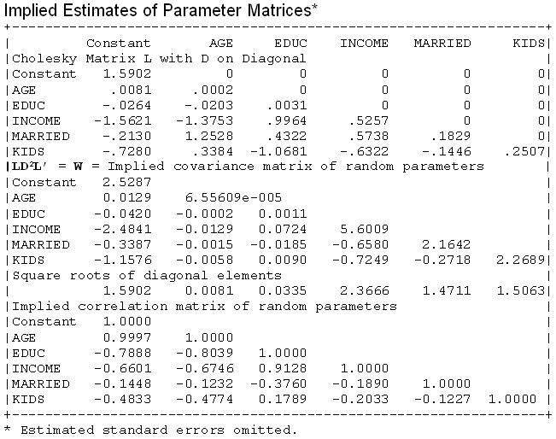

RP Model

Slide 44
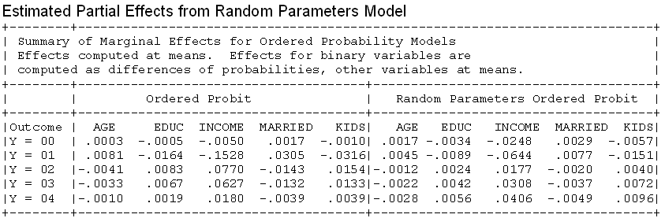
Partial Effects in RP Model

Slide 45
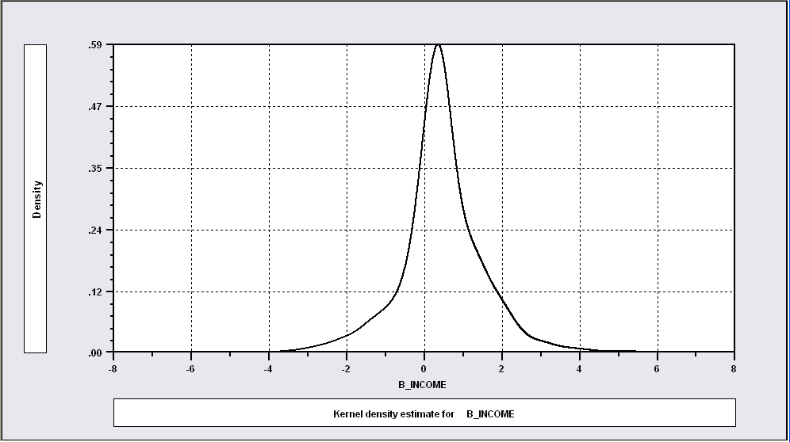
Distribution of Random Parameters
Kernel Density for Estimate of the Distribution of Means of Income Coefficient

Slide 46
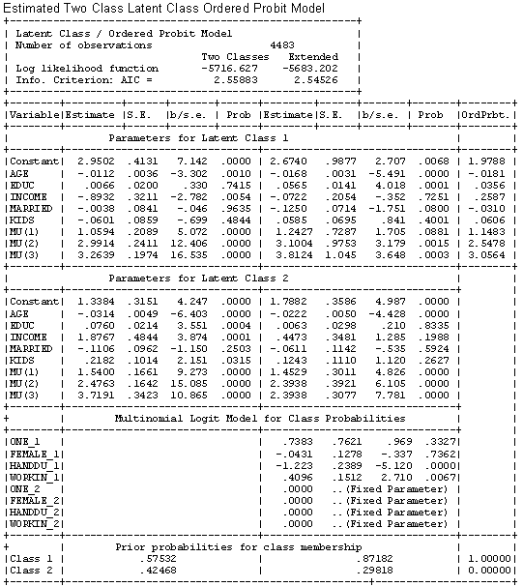
Latent Class Model

Slide 47
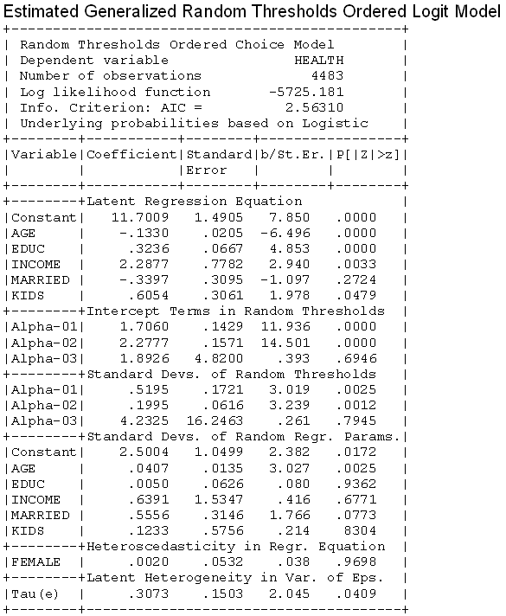
Random
Thresholds

Slide 48
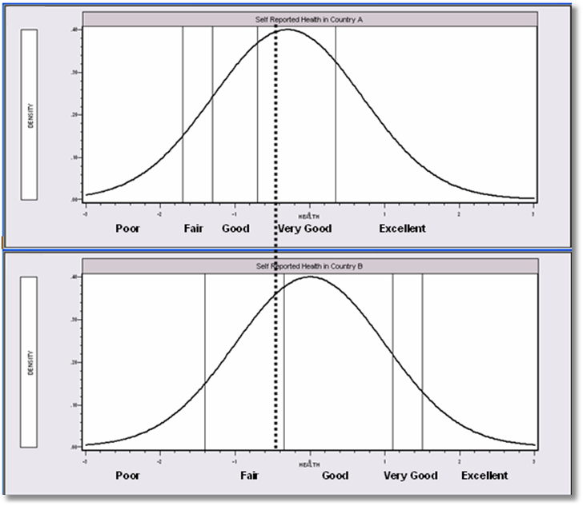
Differential Item Functioning

Slide 49
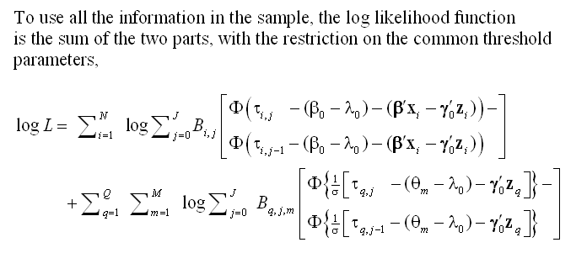
A Vignette Random Effects Model

Slide 50
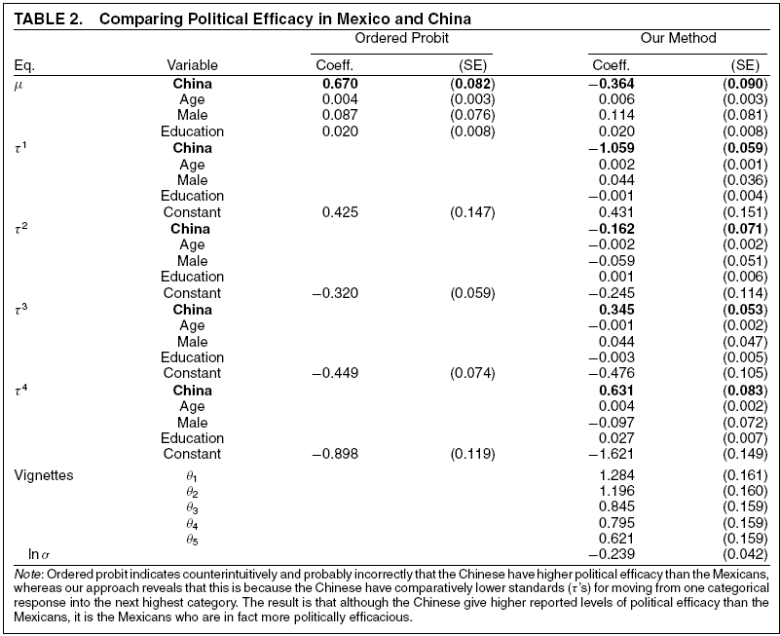
Vignettes

Slide 51
Panel Data
Fixed Effects
  The usual incidental parameters problem
  Practically feasible but methodologically ambiguous
  Partitioning Prob(y_{it} > j|x_{it}) produces estimable binomial logit models. (Find a way to combine multiple estimates of the same β.
Random Effects
  Standard application
  Extension to random parameters – see above

Slide 52
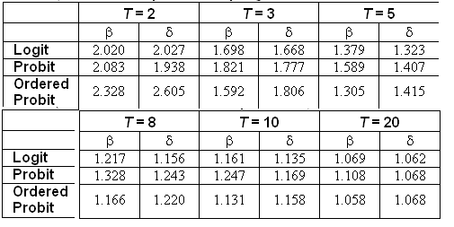
Incidental Parameters Problem
Table 9.1 Monte Carlo Analysis of the Bias of the MLE in Fixed Effects Discrete Choice Models (Means of empirical sampling distributions, N = 1,000 individuals, R = 200 replications)

Slide 53
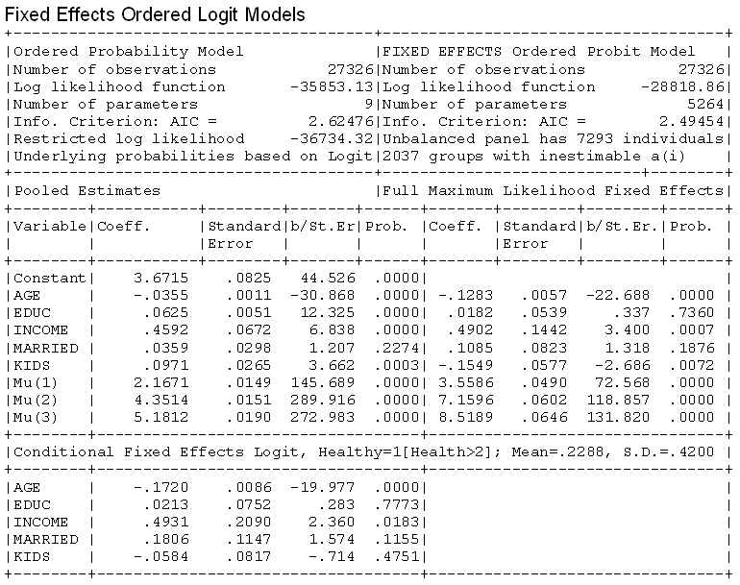

Slide 54
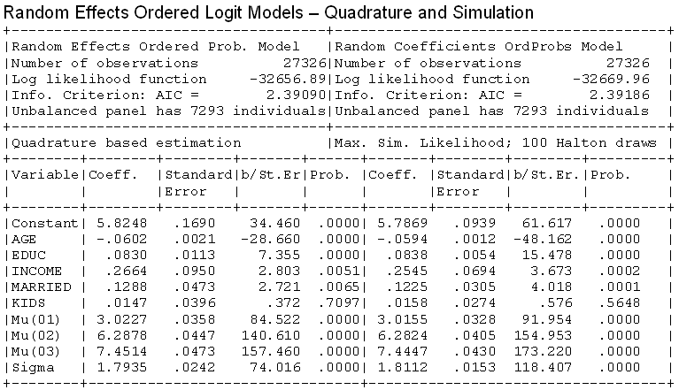
Random Effects

Slide 55
Model Extensions
Multivariate
  Bivariate
  Multivariate
Inflation and Two Part
  Zero inflation
  Sample Selection
  Endogenous Latent Class

Slide 56
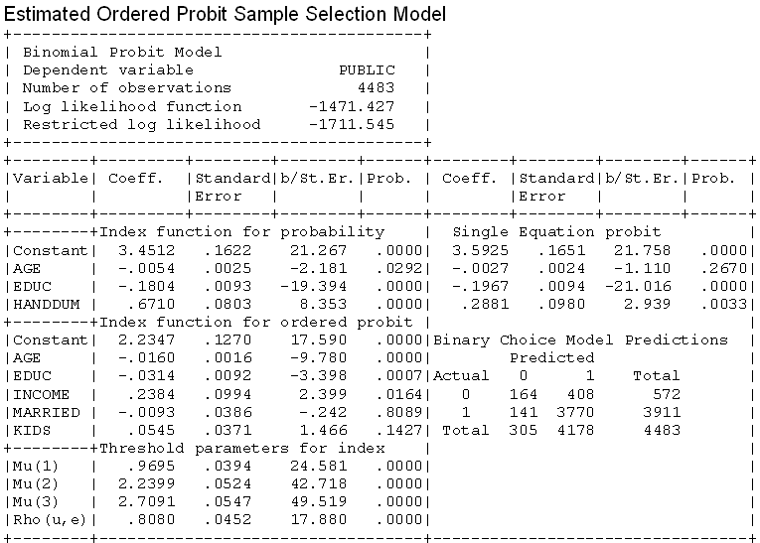
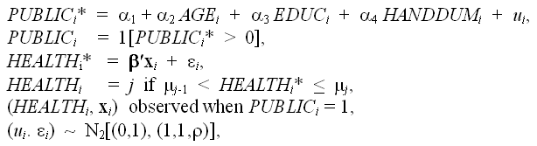
A Sample Selection Model

