Slide 1
Discrete Choice Modeling
William Greene
Stern School of Business
New York University

Slide 2
Part 9
Multinomial Logit Models

Slide 3
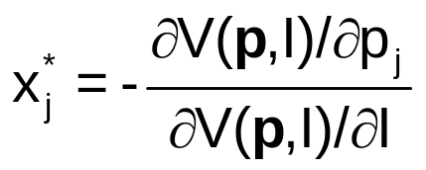
A Microeconomics Platform
Consumers Maximize Utility (!!!)
Fundamental Choice Problem: Maximize U(x₁,x₂,…) subject to prices and budget constraints
A Crucial Result for the Classical Problem:
  Indirect Utility Function: V = V(p,I)
  Demand System of Continuous Choices
The Integrability Problem: Utility is not revealed by demands

Slide 4
Implications for Discrete Choice Models
Theory is silent about discrete choices
Translation of utilities to discrete choice requires:
  Well defined utility indexes: Completeness of rankings
  Rationality: Utility maximization
  Axioms of revealed preferences
Choice sets and consideration sets – consumers simplify choice situations
Implication for choice among a set of discrete alternatives
This allows us to build “models.”
  What common elements can be assumed?
  How can we account for heterogeneity?
However, revealed choices do not reveal utility, only rankings which are scale invariant.

Slide 5
Multinomial Choice Among J Alternatives
• Random Utility Basis
Uitj = α_{ij} + β_{i}’x_{itj} + γ_{ij}z_{it} + ε_{ijt}
i = 1,…,N; j = 1,…,J(i,t); t = 1,…,T(i)
N individuals studied, J(i,t) alternatives in the choice
set, T(i) [usually 1] choice situations examined.
• Maximum Utility Assumption
Individual i will Choose alternative j in choice setting t iff
Uitj > Uitk for all k ≠ j.
• Underlying assumptions
  Smoothness of utilities
  Axioms: Transitive, Complete, Monotonic

Slide 6
Features of Utility Functions
The linearity assumption Uitj = α_{ij} + β_{i}’x_{itj} + γ_{j} z_{it} + ε_{ijt}
To be relaxed later: Uitj = V(x_{itj},z_{it}, β_{i}) + ε_{ijt}
The choice set: Unordered alternatives j = 1,…,J(i,t)
Deterministic and random components
Generic vs. alternative specific components
  Attributes of choices, x_{itj} and characteristics of the chooser, z_{it}.
  Coefficients
    Alternative specific constants α_{ij} may vary by individual
    Preference weights, β_{i} may vary by individual
    Individual components, γ_{j} typically vary by choice, not by person
    Scaling parameters, σ = Var[ε], subject to much modeling

Slide 7
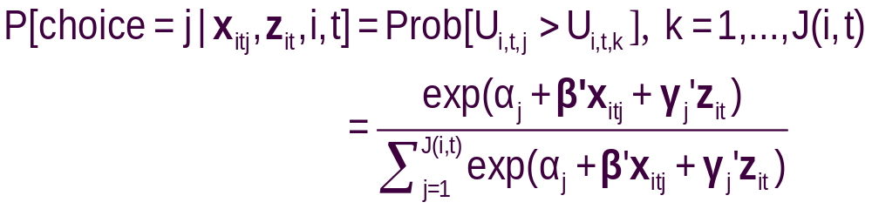
The Multinomial Logit (MNL) Model
Independent extreme value (Gumbel):
  F(εitj) = 1 – Exp(-Exp(εitj)) (random part of each utility)
  Independence across utility functions
  Identical variances (means absorbed in constants)
  Same parameters for all individuals (temporary)
Implied probabilities for observed outcomes

Slide 8
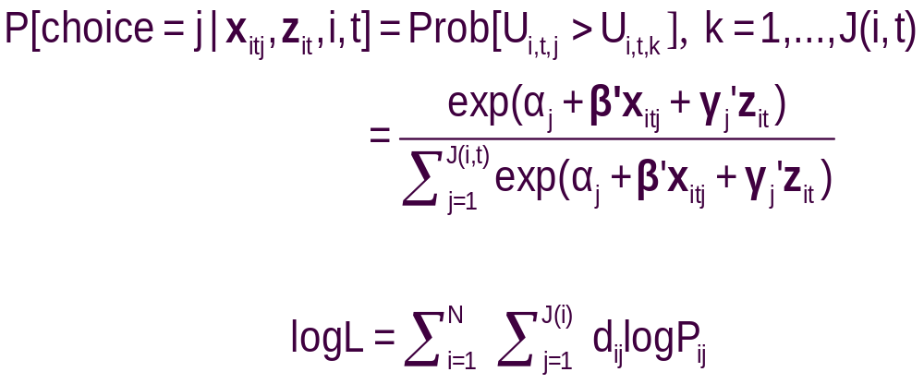
Specifying the Probabilities
• Choice specific attributes (X) vary by choices, multiply by generic
coefficients. E.g., TTME=terminal time, GC=generalized cost of travel mode
Generic characteristics (Income, constants) must be interacted with
choice specific constants.
• Estimation by maximum likelihood; d_{ij} = 1 if person i chooses j

Slide 9
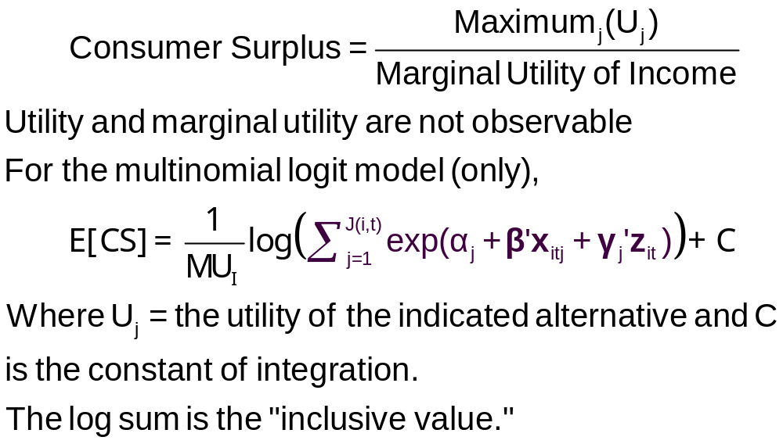
Using the Model to Measure Consumer Surplus

Slide 10
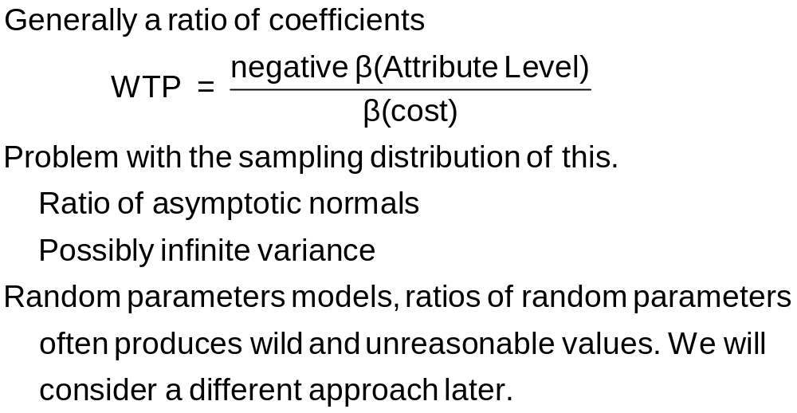
Willingness to Pay

Slide 11
Observed Data
Types of Data
  Individual choice
  Market shares – consumer markets
  Frequencies – vote counts
  Ranks – contests, preference rankings
Attributes and Characteristics
  Attributes are features of the choices such as price
  Characteristics are features of the chooser such as age, gender and income.
Choice Settings
  Cross section
  Repeated measurement (panel data)
    Stated choice experiments
    Repeated observations – THE scanner data on consumer choices

Slide 12
Data on Discrete Choices
CHOICE ATTRIBUTES CHARACTERISTIC
MODE TRAVEL INVC INVT TTME GC HINC
AIR .00000 59.000 100.00 69.000 70.000 35.000
TRAIN .00000 31.000 372.00 34.000 71.000 35.000
BUS .00000 25.000 417.00 35.000 70.000 35.000
CAR 1.0000 10.000 180.00 .00000 30.000 35.000
AIR .00000 58.000 68.000 64.000 68.000 30.000
TRAIN .00000 31.000 354.00 44.000 84.000 30.000
BUS .00000 25.000 399.00 53.000 85.000 30.000
CAR 1.0000 11.000 255.00 .00000 50.000 30.000
AIR .00000 127.00 193.00 69.000 148.00 60.000
TRAIN .00000 109.00 888.00 34.000 205.00 60.000
BUS 1.0000 52.000 1025.0 60.000 163.00 60.000
CAR .00000 50.000 892.00 .00000 147.00 60.000
AIR .00000 44.000 100.00 64.000 59.000 70.000
TRAIN .00000 25.000 351.00 44.000 78.000 70.000
BUS .00000 20.000 361.00 53.000 75.000 70.000
CAR 1.0000 5.0000 180.00 .00000 32.000 70.000

Slide 13
Estimated MNL Model
-----------------------------------------------------------
Discrete choice (multinomial logit) model
Dependent variable Choice
Log likelihood function -199.97662
Estimation based on N = 210, K = 5
Information Criteria: Normalization=1/N
Normalized Unnormalized
AIC 1.95216 409.95325
Fin.Smpl.AIC 1.95356 410.24736
Bayes IC 2.03185 426.68878
Hannan Quinn 1.98438 416.71880
R2=1-LogL/LogL* Log-L fncn R-sqrd R2Adj
Constants only -283.7588 .2953 .2896
Chi-squared[ 2] = 167.56429
Prob [ chi squared > value ] = .00000
Response data are given as ind. choices
Number of obs.= 210, skipped 0 obs
--------+--------------------------------------------------
Variable| Coefficient Standard Error b/St.Er. P[|Z|>z]
--------+--------------------------------------------------
GC| -.01578*** .00438 -3.601 .0003
TTME| -.09709*** .01044 -9.304 .0000
A_AIR| 5.77636*** .65592 8.807 .0000
A_TRAIN| 3.92300*** .44199 8.876 .0000
A_BUS| 3.21073*** .44965 7.140 .0000
--------+--------------------------------------------------

Slide 14
Estimated MNL Model
-----------------------------------------------------------
Discrete choice (multinomial logit) model
Dependent variable Choice
Log likelihood function -199.97662
Estimation based on N = 210, K = 5
Information Criteria: Normalization=1/N
Normalized Unnormalized
AIC 1.95216 409.95325
Fin.Smpl.AIC 1.95356 410.24736
Bayes IC 2.03185 426.68878
Hannan Quinn 1.98438 416.71880
R2=1-LogL/LogL* Log-L fncn R-sqrd R2Adj
Constants only -283.7588 .2953 .2896
Chi-squared[ 2] = 167.56429
Prob [ chi squared > value ] = .00000
Response data are given as ind. choices
Number of obs.= 210, skipped 0 obs
--------+--------------------------------------------------
Variable| Coefficient Standard Error b/St.Er. P[|Z|>z]
--------+--------------------------------------------------
GC| -.01578*** .00438 -3.601 .0003
TTME| -.09709*** .01044 -9.304 .0000
A_AIR| 5.77636*** .65592 8.807 .0000
A_TRAIN| 3.92300*** .44199 8.876 .0000
A_BUS| 3.21073*** .44965 7.140 .0000
--------+--------------------------------------------------

Slide 15
Estimated MNL Model
-----------------------------------------------------------
Discrete choice (multinomial logit) model
Dependent variable Choice
Log likelihood function -199.97662
Estimation based on N = 210, K = 5
Information Criteria: Normalization=1/N
Normalized Unnormalized
AIC 1.95216 409.95325
Fin.Smpl.AIC 1.95356 410.24736
Bayes IC 2.03185 426.68878
Hannan Quinn 1.98438 416.71880
R2=1-LogL/LogL* Log-L fncn R-sqrd R2Adj
Constants only -283.7588 .2953 .2896
Chi-squared[ 2] = 167.56429
Prob [ chi squared > value ] = .00000
Response data are given as ind. choices
Number of obs.= 210, skipped 0 obs
--------+--------------------------------------------------
Variable| Coefficient Standard Error b/St.Er. P[|Z|>z]
--------+--------------------------------------------------
GC| -.01578*** .00438 -3.601 .0003
TTME| -.09709*** .01044 -9.304 .0000
A_AIR| 5.77636*** .65592 8.807 .0000
A_TRAIN| 3.92300*** .44199 8.876 .0000
A_BUS| 3.21073*** .44965 7.140 .0000
--------+--------------------------------------------------

Slide 16
Model Fit Based on Log Likelihood
Three sets of predicted probabilities
  No model: Pij = 1/J (.25)
  Constants only: Pij = (1/N)Σi dij
  [(58,63,30,59)/210=.286,.300,.143,.281)
  Estimated model: Logit probabilities
Compute log likelihood
Measure improvement in log likelihood with R-squared = 1 – LogL/LogL0 (“Adjusted” for number of parameters in the model.)
NOT A MEASURE OF “FIT!”

Slide 17
Estimated MNL Model
-----------------------------------------------------------
Discrete choice (multinomial logit) model
Dependent variable Choice
Log likelihood function -199.97662
Estimation based on N = 210, K = 5
Information Criteria: Normalization=1/N
Normalized Unnormalized
AIC 1.95216 409.95325
Fin.Smpl.AIC 1.95356 410.24736
Bayes IC 2.03185 426.68878
Hannan Quinn 1.98438 416.71880
R2=1-LogL/LogL* Log-L fncn R-sqrd R2Adj
Constants only -283.7588 .2953 .2896
Chi-squared[ 2] = 167.56429
Prob [ chi squared > value ] = .00000
Response data are given as ind. choices
Number of obs.= 210, skipped 0 obs
--------+--------------------------------------------------
Variable| Coefficient Standard Error b/St.Er. P[|Z|>z]
--------+--------------------------------------------------
GC| -.01578*** .00438 -3.601 .0003
TTME| -.09709*** .01044 -9.304 .0000
A_AIR| 5.77636*** .65592 8.807 .0000
A_TRAIN| 3.92300*** .44199 8.876 .0000
A_BUS| 3.21073*** .44965 7.140 .0000
--------+--------------------------------------------------

Slide 18
Fit the Model with Only ASCs
If the choice set varies across observations, this is the only way to obtain the restricted log likelihood.
-----------------------------------------------------------
Discrete choice (multinomial logit) model
Dependent variable Choice
Log likelihood function -283.75877
Estimation based on N = 210, K = 3
Information Criteria: Normalization=1/N
Normalized Unnormalized
AIC 2.73104 573.51754
Fin.Smpl.AIC 2.73159 573.63404
Bayes IC 2.77885 583.55886
Hannan Quinn 2.75037 577.57687
R2=1-LogL/LogL* Log-L fncn R-sqrd R2Adj
Constants only -283.7588 .0000-.0048
Response data are given as ind. choices
Number of obs.= 210, skipped 0 obs
--------+--------------------------------------------------
Variable| Coefficient Standard Error b/St.Er. P[|Z|>z]
--------+--------------------------------------------------
A_AIR| -.01709 .18491 -.092 .9263
A_TRAIN| .06560 .18117 .362 .7173
A_BUS| -.67634*** .22424 -3.016 .0026
--------+--------------------------------------------------

Slide 19
Descriptive Statistics
+-------------------------------------------------------------------------+
| Descriptive Statistics for Alternative AIR :
| Utility Function | | 58.0 observs. |
| Coefficient | All 210.0 obs.|that chose AIR |
| Name Value Variable | Mean Std. Dev.|Mean Std. Dev. |
| ------------------- -------- | -------------------+------------------- |
| GC -.0158 GC | 102.648 30.575| 113.552 33.198 |
| TTME -.0971 TTME | 61.010 15.719| 46.534 24.389 |
| A_AIR 5.7764 ONE | 1.000 .000| 1.000 .000 |
+-------------------------------------------------------------------------+
+-------------------------------------------------------------------------+
| Descriptive Statistics for Alternative TRAIN :
| Utility Function | | 63.0 observs. |
| Coefficient | All 210.0 obs.|that chose TRAIN |
| Name Value Variable | Mean Std. Dev.|Mean Std. Dev. |
| ------------------- -------- | -------------------+------------------- |
| GC -.0158 GC | 130.200 58.235| 106.619 49.601 |
| TTME -.0971 TTME | 35.690 12.279| 28.524 19.354 |
| A_TRAIN 3.9230 ONE | 1.000 .000| 1.000 .000 |
+-------------------------------------------------------------------------+

Slide 20
Model Fit Based on Predictions
Nj = actual number of choosers of “j.”
Nfitj = Σi Predicted Probabilities for “j”
Cross tabulate:
Predicted vs. Actual, cell prediction is cell probability
Predicted vs. Actual, cell prediction is the cell
with the largest probability
Njk = Σi dij × Predicted P(i,k)

Slide 21
Fit Measures Based on Crosstabulation
+-------------------------------------------------------+
| Cross tabulation of actual choice vs. predicted P(j) |
| Row indicator is actual, column is predicted. |
| Predicted total is F(k,j,i)=Sum(i=1,...,N) P(k,j,i). |
| Column totals may be subject to rounding error. |
+-------------------------------------------------------+
NLOGIT Cross Tabulation for 4 outcome Multinomial Choice Model
AIR TRAIN BUS CAR Total
+-------------+-------------+-------------+-------------+-------------+
AIR | 32 | 8 | 5 | 13 | 58 |
TRAIN | 8 | 37 | 5 | 14 | 63 |
BUS | 3 | 5 | 15 | 6 | 30 |
CAR | 15 | 13 | 6 | 26 | 59 |
+-------------+-------------+-------------+-------------+-------------+
Total | 58 | 63 | 30 | 59 | 210 |
+-------------+-------------+-------------+-------------+-------------+
NLOGIT Cross Tabulation for 4 outcome Constants Only Choice Model
AIR TRAIN BUS CAR Total
+-------------+-------------+-------------+-------------+-------------+
AIR | 16 | 17 | 8 | 16 | 58 |
TRAIN | 17 | 19 | 9 | 18 | 63 |
BUS | 8 | 9 | 4 | 8 | 30 |
CAR | 16 | 18 | 8 | 17 | 59 |
+-------------+-------------+-------------+-------------+-------------+
Total | 58 | 63 | 30 | 59 | 210 |
+-------------+-------------+-------------+-------------+-------------+

Slide 22
Using the Most Probable Cell
+-------------------------------------------------------+
| Cross tabulation of actual y(ij) vs. predicted y(ij) |
| Row indicator is actual, column is predicted. |
| Predicted total is N(k,j,i)=Sum(i=1,...,N) Y(k,j,i). |
| Predicted y(ij)=1 is the j with largest probability. |
+-------------------------------------------------------+
NLOGIT Cross Tabulation for 4 outcome Multinomial Choice Model
AIR TRAIN BUS CAR Total
+-------------+-------------+-------------+-------------+-------------+
AIR | 40 | 3 | 0 | 15 | 58 |
TRAIN | 4 | 45 | 0 | 14 | 63 |
BUS | 0 | 3 | 23 | 4 | 30 |
CAR | 7 | 14 | 0 | 38 | 59 |
+-------------+-------------+-------------+-------------+-------------+
Total | 51 | 65 | 23 | 71 | 210 |
+-------------+-------------+-------------+-------------+-------------+
NLOGIT Cross Tabulation for 4 outcome Multinomial Choice Model
AIR TRAIN BUS CAR Total
+-------------+-------------+-------------+-------------+-------------+
AIR | 0 | 58 | 0 | 0 | 58 |
TRAIN | 0 | 63 | 0 | 0 | 63 |
BUS | 0 | 30 | 0 | 0 | 30 |
CAR | 0 | 59 | 0 | 0 | 59 |
+-------------+-------------+-------------+-------------+-------------+
Total | 0 | 210 | 0 | 0 | 210 |
+-------------+-------------+-------------+-------------+-------------+

Slide 23
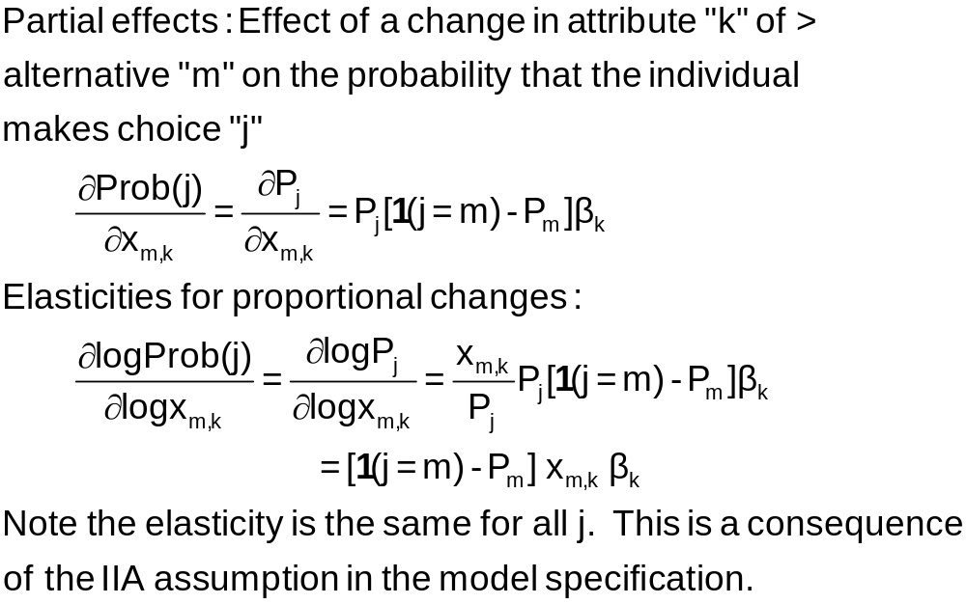
Effects of Changes in Attributes on Probabilities

Slide 24
Elasticities for CLOGIT
+---------------------------------------------------+
| Elasticity averaged over observations.|
| Attribute is INVT in choice AIR |
| Mean St.Dev |
| * Choice=AIR -.2055 .0666 |
| Choice=TRAIN .0903 .0681 |
| Choice=BUS .0903 .0681 |
| Choice=CAR .0903 .0681 |
+---------------------------------------------------+
| Attribute is INVT in choice TRAIN |
| Choice=AIR .3568 .1231 |
| * Choice=TRAIN -.9892 .5217 |
| Choice=BUS .3568 .1231 |
| Choice=CAR .3568 .1231 |
+---------------------------------------------------+
| Attribute is INVT in choice BUS |
| Choice=AIR .1889 .0743 |
| Choice=TRAIN .1889 .0743 |
| * Choice=BUS -1.2040 .4803 |
| Choice=CAR .1889 .0743 |
+---------------------------------------------------+
| Attribute is INVT in choice CAR |
| Choice=AIR .3174 .1195 |
| Choice=TRAIN .3174 .1195 |
| Choice=BUS .3174 .1195 |
| * Choice=CAR -.9510 .5504 |
+---------------------------------------------------+
| Effects on probabilities of all choices in model: |
| * = Direct Elasticity effect of the attribute. |
+---------------------------------------------------+
Note the effect of IIA on the cross effects.
Own effect
Cross effects
Elasticities are computed for each observation; the mean and standard deviation are then computed across the sample observations.

Slide 25
Analyzing Behavior of Market
Shares to Examine Discrete Effects
Scenario: What happens to the number of people who make specific choices if a particular attribute changes in a specified way?
Fit the model first, then using the identical model setup, add
; Simulation = list of choices to be analyzed
; Scenario = Attribute (in choices) = type of change
For the CLOGIT application
; Simulation = * ? This is ALL choices
; Scenario: GC(car)=[*]1.25$ Car_GC rises by 25%

Slide 26
Model Simulation
+---------------------------------------------+
| Discrete Choice (One Level) Model |
| Model Simulation Using Previous Estimates |
| Number of observations 210 |
+---------------------------------------------+
+------------------------------------------------------+
|Simulations of Probability Model |
|Model: Discrete Choice (One Level) Model |
|Simulated choice set may be a subset of the choices. |
|Number of individuals is the probability times the |
|number of observations in the simulated sample. |
|Column totals may be affected by rounding error. |
|The model used was simulated with 210 observations.|
+------------------------------------------------------+
-------------------------------------------------------------------------
Specification of scenario 1 is:
Attribute Alternatives affected Change type Value
--------- ------------------------------- ------------------- ---------
GC CAR Scale base by value 1.250
-------------------------------------------------------------------------
The simulator located 209 observations for this scenario.
Simulated Probabilities (shares) for this scenario:
+----------+--------------+--------------+------------------+
|Choice | Base | Scenario | Scenario - Base |
| |%Share Number |%Share Number |ChgShare ChgNumber|
+----------+--------------+--------------+------------------+
|AIR | 27.619 58 | 29.592 62 | 1.973% 4 |
|TRAIN | 30.000 63 | 31.748 67 | 1.748% 4 |
|BUS | 14.286 30 | 15.189 32 | .903% 2 |
|CAR | 28.095 59 | 23.472 49 | -4.624% -10 |
|Total |100.000 210 |100.000 210 | .000% 0 |
+----------+--------------+--------------+------------------+
Changes in the predicted market shares when GC_CAR increases by 25%.

Slide 27
More Complicated Model Simulation
In vehicle cost of CAR falls by 10%
Market is limited to ground (Train, Bus, Car)
CLOGIT ; Lhs = Mode
; Choices = Air,Train,Bus,Car
; Rhs = TTME,INVC,INVT,GC
; Rh2 = One ,Hinc
; Simulation = TRAIN,BUS,CAR
; Scenario: GC(car)=[*].9$

Slide 28
Model Estimation Step
-----------------------------------------------------------
Discrete choice (multinomial logit) model
Dependent variable Choice
Log likelihood function -172.94366
Estimation based on N = 210, K = 10
R2=1-LogL/LogL* Log-L fncn R-sqrd R2Adj
Constants only -283.7588 .3905 .3807
Chi-squared[ 7] = 221.63022
Prob [ chi squared > value ] = .00000
Response data are given as ind. choices
Number of obs.= 210, skipped 0 obs
--------+--------------------------------------------------
Variable| Coefficient Standard Error b/St.Er. P[|Z|>z]
--------+--------------------------------------------------
TTME| -.10289*** .01109 -9.280 .0000
INVC| -.08044*** .01995 -4.032 .0001
INVT| -.01399*** .00267 -5.240 .0000
GC| .07578*** .01833 4.134 .0000
A_AIR| 4.37035*** 1.05734 4.133 .0000
AIR_HIN1| .00428 .01306 .327 .7434
A_TRAIN| 5.91407*** .68993 8.572 .0000
TRA_HIN2| -.05907*** .01471 -4.016 .0001
A_BUS| 4.46269*** .72333 6.170 .0000
BUS_HIN3| -.02295 .01592 -1.442 .1493
--------+--------------------------------------------------
Alternative specific constants and interactions of ASCs and Household Income

Slide 29
Model Simulation Step
+---------------------------------------------+
| Discrete Choice (One Level) Model |
| Model Simulation Using Previous Estimates |
| Number of observations 210 |
+---------------------------------------------+
+------------------------------------------------------+
|Simulations of Probability Model |
|Model: Discrete Choice (One Level) Model |
|Simulated choice set may be a subset of the choices. |
|Number of individuals is the probability times the |
|number of observations in the simulated sample. |
|Column totals may be affected by rounding error. |
|The model used was simulated with 210 observations.|
+------------------------------------------------------+
-------------------------------------------------------------------------
Specification of scenario 1 is:
Attribute Alternatives affected Change type Value
--------- ------------------------------- ------------------- ---------
INVC CAR Scale base by value .900
-------------------------------------------------------------------------
The simulator located 210 observations for this scenario.
Simulated Probabilities (shares) for this scenario:
+----------+--------------+--------------+------------------+
|Choice | Base | Scenario | Scenario - Base |
| |%Share Number |%Share Number |ChgShare ChgNumber|
+----------+--------------+--------------+------------------+
|TRAIN | 37.321 78 | 35.854 75 | -1.467% -3 |
|BUS | 19.805 42 | 18.641 39 | -1.164% -3 |
|CAR | 42.874 90 | 45.506 96 | 2.632% 6 |
|Total |100.000 210 |100.000 210 | .000% 0 |
+----------+--------------+--------------+------------------+

Slide 30
Compound Scenario:
GC(Car) falls by 10%, TTME (Air,Train) rises by 25%
NLOGIT ; Lhs = Mode
; Choices = Air,Train,Bus,Car
; Rhs = TTME,INVC,INVT,GC
; Rh2 = One ,Hinc
; Simulation = AIR,TRAIN,BUS,CAR
; Scenario: invc(car)=[*].9 /
ttme(air,train)=[*]1.25 $

Slide 31
Compound Scenario:
GC(Car) falls by 10%, TTME (Air,Train) rises by 25%
(at the same time).
+------------------------------------------------------+
|Simulations of Probability Model |
|Model: Discrete Choice (One Level) Model |
|Simulated choice set may be a subset of the choices. |
|Number of individuals is the probability times the |
|number of observations in the simulated sample. |
|Column totals may be affected by rounding error. |
|The model used was simulated with 210 observations.|
+------------------------------------------------------+
-------------------------------------------------------------------------
Specification of scenario 1 is:
Attribute Alternatives affected Change type Value
--------- ------------------------------- ------------------- ---------
INVC CAR Scale base by value .900
TTME AIR TRAIN Scale base by value 1.250
-------------------------------------------------------------------------
The simulator located 210 observations for this scenario.
Simulated Probabilities (shares) for this scenario:
+----------+--------------+--------------+------------------+
|Choice | Base | Scenario | Scenario - Base |
| |%Share Number |%Share Number |ChgShare ChgNumber|
+----------+--------------+--------------+------------------+
|AIR | 27.619 58 | 16.516 35 |-11.103% -23 |
|TRAIN | 30.000 63 | 23.012 48 | -6.988% -15 |
|BUS | 14.286 30 | 18.495 39 | 4.209% 9 |
|CAR | 28.095 59 | 41.977 88 | 13.882% 29 |
|Total |100.000 210 |100.000 210 | .000% 0 |
+----------+--------------+--------------+------------------+

Slide 32
Willingness to Pay
U(alt) = a_{j} + b_{INCOME}*INCOME + b_{Attribute}*Attribute + …
WTP = MU(Attribute)/MU(Income)
When MU(Income) is not available, an approximation
often used is –MU(Cost).
U(Air,Train,Bus,Car)
= α_{alt} + β_{cost} Cost + β_{INVT} INVT + β_{TTME} TTME + ε_{alt}
WTP for less in vehicle time = -β_{INVT} / β_{COST}
WTP for less terminal time = -β_{TIME} / β_{COST}

Slide 33
WTP from CLOGIT Model
-----------------------------------------------------------
Discrete choice (multinomial logit) model
Dependent variable Choice
--------+--------------------------------------------------
Variable| Coefficient Standard Error b/St.Er. P[|Z|>z]
--------+--------------------------------------------------
GC| -.00286 .00610 -.469 .6390
INVT| -.00349*** .00115 -3.037 .0024
TTME| -.09746*** .01035 -9.414 .0000
AASC| 4.05405*** .83662 4.846 .0000
TASC| 3.64460*** .44276 8.232 .0000
BASC| 3.19579*** .45194 7.071 .0000
--------+--------------------------------------------------
WALD ; fn1=WTP_INVT=b_invt/b_gc ; fn2=WTP_TTME=b_ttme/b_gc$
-----------------------------------------------------------
WALD procedure.
--------+--------------------------------------------------
Variable| Coefficient Standard Error b/St.Er. P[|Z|>z]
--------+--------------------------------------------------
WTP_INVT| 1.22006 2.88619 .423 .6725
WTP_TTME| 34.0771 73.07097 .466 .6410
--------+--------------------------------------------------

Slide 34
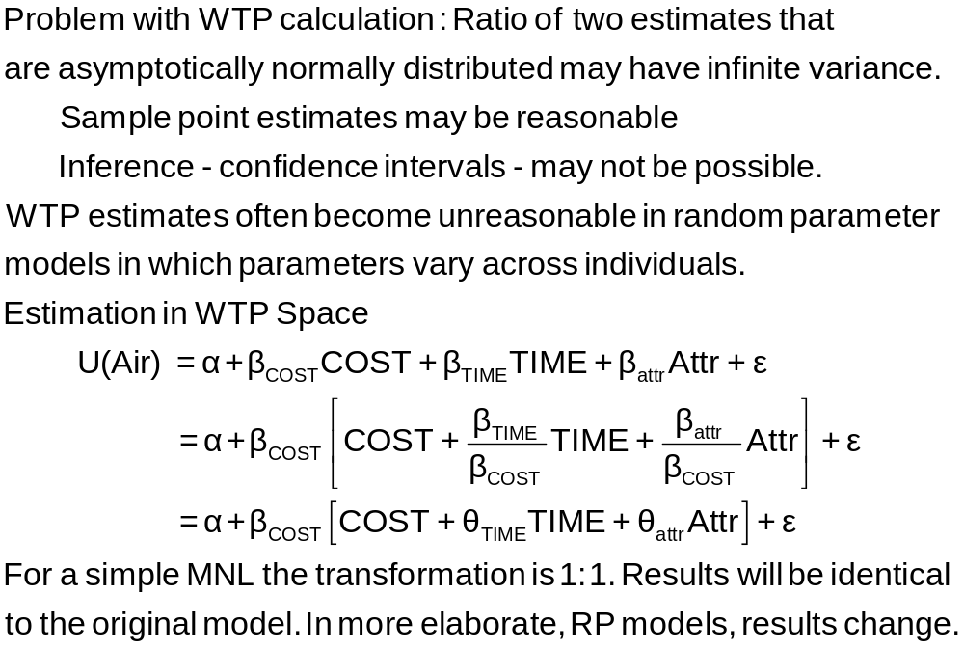
Estimation in WTP Space

Slide 35
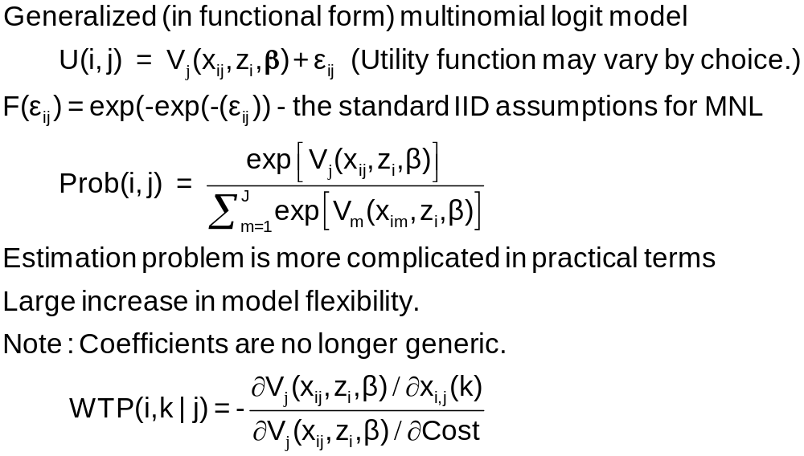
Nonlinear Utility Functions

Slide 36
Assessing Prospect Theoretic Functional Forms and Risk in a Non-linear Logit Framework: Valuing Reliability Embedded Travel Time Savings
David Hensher
The University of Sydney, ITLS
William Greene
Stern School of Business, New York University
8th Annual Advances in Econometrics Conference
Louisiana State University
Baton Rouge, LA
November 6-8, 2009
Notes:
36

Slide 37
Prospect Theory
Marginal value function for an attribute (outcome)
v(x_{m}) = subjective value of attribute
Decision weight w(p_{m}) = impact of a probability on
utility of a prospect
Value function V(x_{m},p_{m}) = v(x_{m})w(p_{m}) = value of a prospect that delivers outcome x_{m} with probability p_{m}
We explore functional forms for w(p_{m}) with
implications for decisions

Slide 38
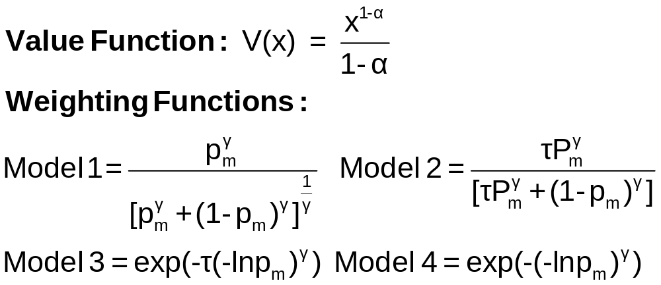
Value and Weighting Functions

Slide 39
Choice Model
U(j) = β_{ref} + β_{cost}Cost + β_{Age}Age + β_{Toll}TollASC
+ β_{curr} w(p_{curr})v(t_{curr})
+ β_{late} w(p_{late}) v(t_{late})
+ β_{early} w(p_{early})v(t_{early}) + ε_{j}
Constraint: β_{curr} = β_{late} = β_{early}
U(j) = β_{ref} + β_{cost}Cost + β_{Age}Age + β_{Toll}TollASC
+ β[ w(p_{curr})v(t_{curr})
+ w(p_{late})v(t_{late})
+ w(p_{early})v(t_{early})] + ε_{j}

Slide 40
Stated Choice Survey
Trip Attributes in Stated Choice Design
  Routes A and B
  Free flow travel time
  Slowed down travel time
  Stop/start/crawling travel time
  Minutes arriving earlier than expected
  Minutes arriving later than expected
  Probability of arriving earlier than expected
  Probability of arriving at the time expected
  Probability of arriving later than expected
  Running cost
  Toll Cost
Demographics: Age, Income, Gender

Slide 41
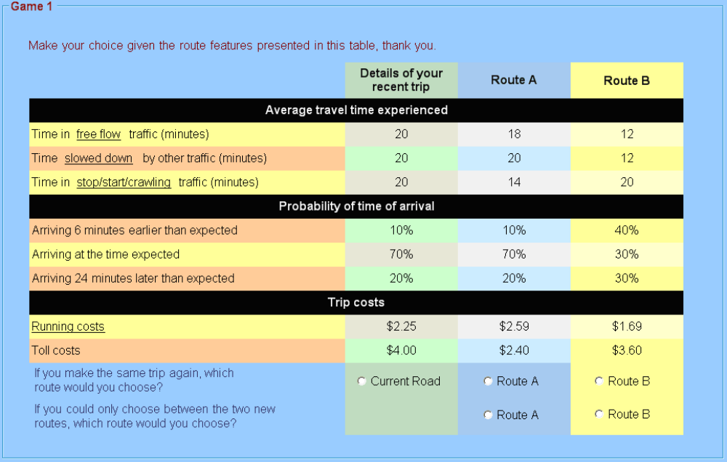
Survey Instrument

Slide 42
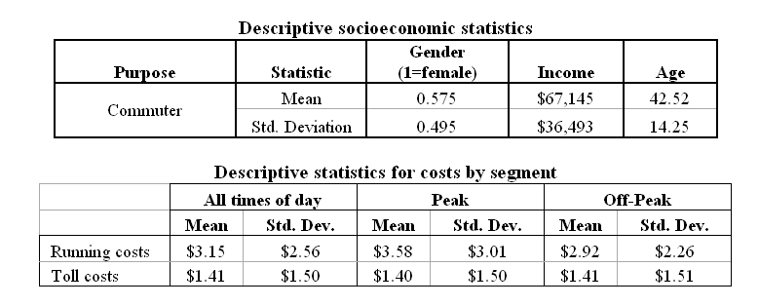
Data

Slide 43
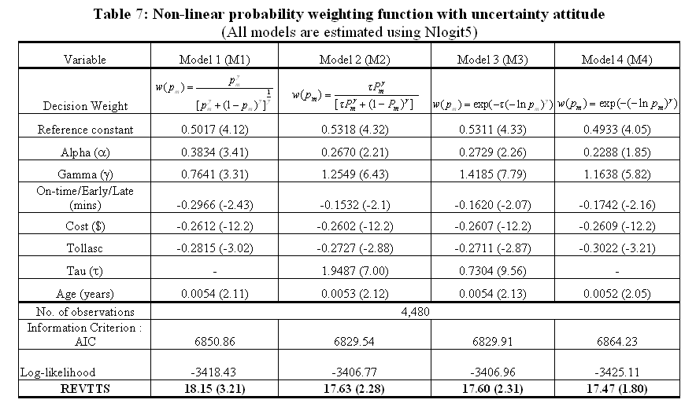
Estimation Results

Slide 44
Choice Based Sampling
Choice` | Air | Train | Bus | Car
True | 0.14 | 0.13 | 0.09 | 0.64
Sample | 0.28 | 0.30 | 0.14 | 0.28
Over/Underrepresenting alternatives in the data set
May cause biases in parameter estimates. (Possibly constants only)
Certainly causes biases in estimated variances
  Weighted log likelihood, weight = πj / Fj for all i.
  Fixup of covariance matrix – use “sandwich” estimator.
; Choices = list of names / list of true proportions $

Slide 45
Choice Based Sampling Estimators
--------+-------------------------------------------------
Variable| Coefficient Standard Error b/St.Er. P[|Z|>z]
+---------+--------------+----------------+--------+------
Unweighted
--------+------------------------------------------------
TTME| -.10289*** .01109 -9.280 .0000
INVC| -.08044*** .01995 -4.032 .0001
INVT| -.01399*** .00267 -5.240 .0000
GC| .07578*** .01833 4.134 .0000
A_AIR| 4.37035*** 1.05734 4.133 .0000
AIR_HIN1| .00428 .01306 .327 .7434
A_TRAIN| 5.91407*** .68993 8.572 .0000
TRA_HIN2| -.05907*** .01471 -4.016 .0001
A_BUS| 4.46269*** .72333 6.170 .0000
BUS_HIN3| -.02295 .01592 -1.442 .1493
---------------------------------------------------------
Weighted
---------+-----------------------------------------------
TTME| -.13611*** .02538 -5.363 .0000
INVC| -.10351*** .02470 -4.190 .0000
INVT| -.01772*** .00323 -5.486 .0000
GC| .10225*** .02107 4.853 .0000
A_AIR| 4.52505*** 1.75589 2.577 .0100
AIR_HIN1| .00746 .01481 .504 .6145
A_TRAIN| 5.53229*** .97331 5.684 .0000
TRA_HIN2| -.06026*** .02235 -2.696 .0070
A_BUS| 4.36579*** .97182 4.492 .0000
BUS_HIN3| -.01957 .01631 -1.200 .2302
--------+--------------------------------------------------

Slide 46
Changes in Estimated Elasticities
+---------------------------------------------------+
| Elasticity averaged over observations.|
| Attribute is INVC in choice CAR |
| Effects on probabilities of all choices in model: |
| * = Direct Elasticity effect of the attribute. |
+---------------------------------------------------+
| Unweighted |
| Mean St.Dev |
| Choice=AIR .3622 .3437 |
| Choice=TRAIN .3622 .3437 |
| Choice=BUS .3622 .3437 |
| * Choice=CAR -1.3266 1.1731 |
+---------------------------------------------------+
| Weighted |
| Mean St.Dev |
| Choice=AIR .8371 .7363 |
| Choice=TRAIN .8371 .7363 |
| Choice=BUS .8371 .7363 |
| * Choice=CAR -1.3362 1.4557 |
+---------------------------------------------------+

Slide 47
The I.I.D Assumption
Uitj = α_{ij} + β’xitj + γ’zit + εijt
  F(εitj) = 1 – Exp(-Exp(εitj)) (random part of each utility)
  Independence across utility functions
  Identical variances (means absorbed in constants)
Restriction on equal scaling may be inappropriate
Correlation across alternatives may be suppressed
Equal cross elasticities is a substantive restriction
Behavioral implication of independence from irrelevant
alternatives is unreasonable (IIA). If an alternative is
removed, probability is spread equally across the
remaining alternatives.

Slide 48
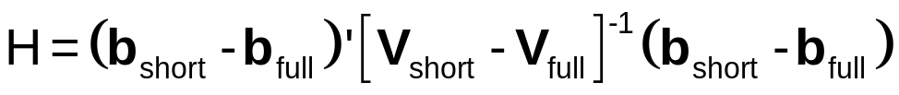
A Hausman Test for IIA
Estimate full model with “irrelevant alternatives”
Estimate the short model eliminating the irrelevant alternatives
  Eliminate individuals who chose the irrelevant alternatives
  Drop attributes that are constant in the surviving choice set.
Do the coefficients change?
  Use a Hausman test:
  Chi-squared, d.f. Number of parameters estimated
Practicalities: Fit the model, then again with
;IAS = the irrelevant alternative(s)

Slide 49
IIA Test
/* Using the internal routine usually means specifying
*/ an unreasonable model. It is also easy to program directly.
clogit;lhs=mode;choices=air,train,bus,car
;rhs=gc,ttme,invc,invt,aasc,tasc,basc$
matrix;bfull=b(1:4);vfull=varb(1:4,1:4)$
create ; j = trn(-4,0)$
reject ; j=1 | chair=1 $
clogit;lhs=mode;choices=train,bus,car
;rhs=gc,ttme,invc,invt,tasc,basc$
matrix;bshort=b(1:4);vshort=varb(1:4,1:4)$
matrix;d=bshort-bfull;v=vshort-vfull$
matrix;list;iiatest=d'<v>d$
calc;list;ctb(.95,4)$

Slide 50
IIA Test for Choice AIR
+--------+--------------+----------------+--------+--------+
|Variable| Coefficient | Standard Error |b/St.Er.|P[|Z|>z]|
+--------+--------------+----------------+--------+--------+
GC | .06929537 .01743306 3.975 .0001
TTME | -.10364955 .01093815 -9.476 .0000
INVC | -.08493182 .01938251 -4.382 .0000
INVT | -.01333220 .00251698 -5.297 .0000
AASC | 5.20474275 .90521312 5.750 .0000
TASC | 4.36060457 .51066543 8.539 .0000
BASC | 3.76323447 .50625946 7.433 .0000
+--------+--------------+----------------+--------+--------+
GC | .53961173 .14654681 3.682 .0002
TTME | -.06847037 .01674719 -4.088 .0000
INVC | -.58715772 .14955000 -3.926 .0001
INVT | -.09100015 .02158271 -4.216 .0000
TASC | 4.62957401 .81841212 5.657 .0000
BASC | 3.27415138 .76403628 4.285 .0000
Matrix IIATEST has 1 rows and 1 columns.
1
+--------------
1| 33.78445 Test statistic
+------------------------------------+
| Listed Calculator Results |
+------------------------------------+
Result = 9.487729 Critical value

Slide 51
Case Study – Omitted Attributes
Do all consumers evaluate all attributes?
  An information processing strategy – minimize processing cost
  Lexicographic preferences – some attributes are irrelevant.
Do we know which attributes are evaluated?
How to incorporate omitted attributes information in the model
  Zero fill in the data? Zero is not a valid PRICE.
  Change the equation – True zeros in utility functions
  Some consumers do not “value” some attributes.

Slide 52
Modeling Attribute Choice
Conventional: U_{j} = β′x_{j}.
  For ignored attributes, set x_{k,ijt} =0. This
  eliminates x_{kj} from the utility function
  Price = 0 is not a reasonable datum.
  Distorts choice probabilities
Appropriate: Formally set β_{k} = 0
  Requires a ‘person specific’ model
  Accommodate as part of model estimation

Slide 53
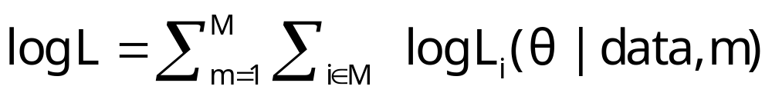
Choice Strategy Heterogeneity
Methodologically, a rather minor point – construct appropriate likelihood given known information
Not a latent class model. Classes are not latent.
Not the ‘variable selection’ issue (the worst form of “stepwise” modeling)
Familiar strategy gives the wrong answer.

Slide 54
Application: Sydney
Commuters’ Route Choice
Stated Preference study – several possible choice situations considered by each person
Multinomial and mixed (random parameters) logit
Consumers included data on which attributes were ignored.
(Ignored attributes coded -888 in NLOGIT are automatically treated by constraining β=0 for that observation.)

Slide 55
Data for Application of Information Strategy
Stated/Revealed preference study, Sydney car commuters. 500+ surveyed, about 10 choice situations for each.
Existing route vs. 3 proposed alternatives.
Attribute design
  Original: respondents presented with 3, 4, 5, or 6 attributes
  Attributes – four level design.
    Free flow time
    Slowed down time
    Stop/start time
    Trip time variability
    Toll cost
    Running cost
  Final: respondents use only some attributes and indicate when surveyed which ones they ignored

Slide 56
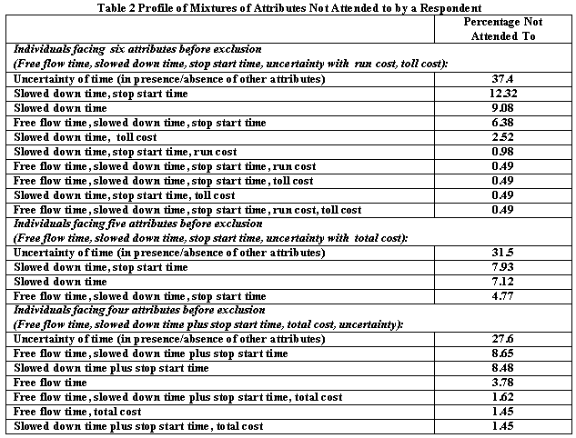

Slide 57
Discrete Choice Model Extensions
Heteroscedasticity and other forms of heterogeneity
  Across individuals
  Across alternatives
Panel data (Repeated measures)
  Random and fixed effects models
  Building into a multinomial logit model
The nested logit model
Latent class model
Mixed logit, error components and multinomial probit models
A Generalized Mixed Logit Model – The frontier
Combining revealed and stated preference data

