Slide 1
Spatial Discrete Choice Models
Professor William Greene
Stern School of Business, New York University

Slide 2
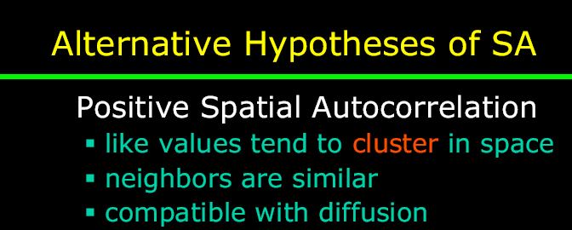
Spatial Correlation

Slide 3
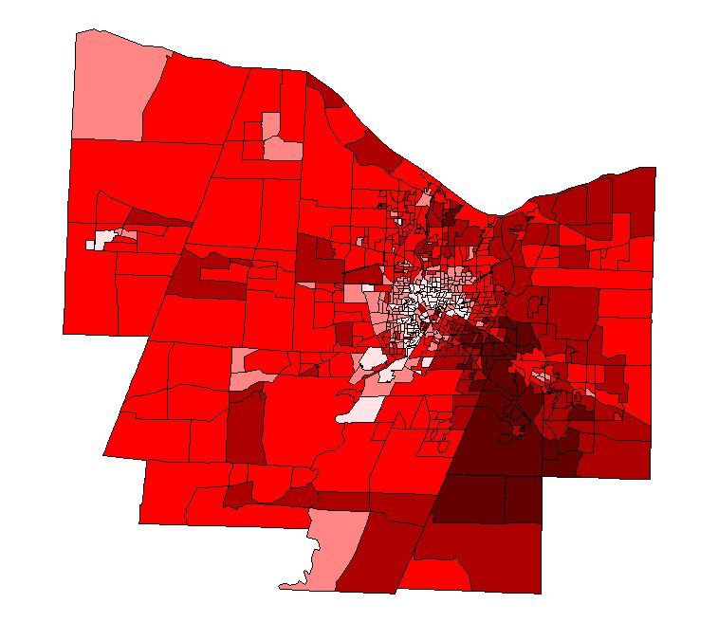
Spatially Autocorrelated Data
Per Capita Income in Monroe County, New York, USA

Slide 4
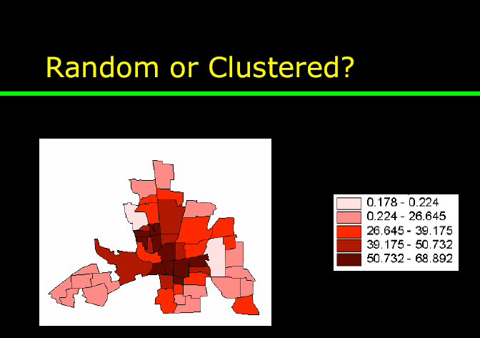
The Hypothesis of Spatial Autocorrelation

Slide 5
Spatial Discrete Choice Modeling: Agenda
❶ Linear Models with Spatial Correlation
❷ Discrete Choice Models
❸ Spatial Correlation in Nonlinear Models
  Basics of Discrete Choice Models
  Maximum Likelihood Estimation
❹ Spatial Correlation in Discrete Choice
  Binary Choice
  Ordered Choice
  Unordered Multinomial Choice
  Models for Counts

Slide 6
Linear Spatial Autocorrelation

Slide 7
Testing for Spatial Autocorrelation

Slide 8
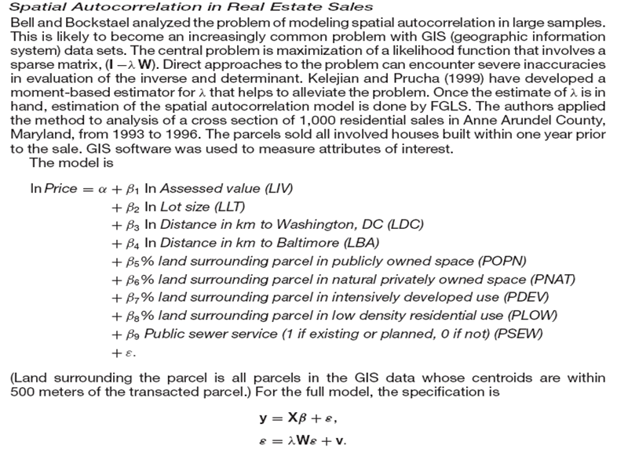

Slide 9
Spatial Autocorrelation

Slide 10
Spatial Autoregression in a Linear Model

Slide 11
Complications of the Generalized
Regression Model
❶ Potentially very large N – GPS data on agriculture
plots
❷ Estimation of λ. There is no natural residual based
estimator
❸ Complicated covariance structure – no simple
transformations

Slide 12
Panel Data Application

Slide 13
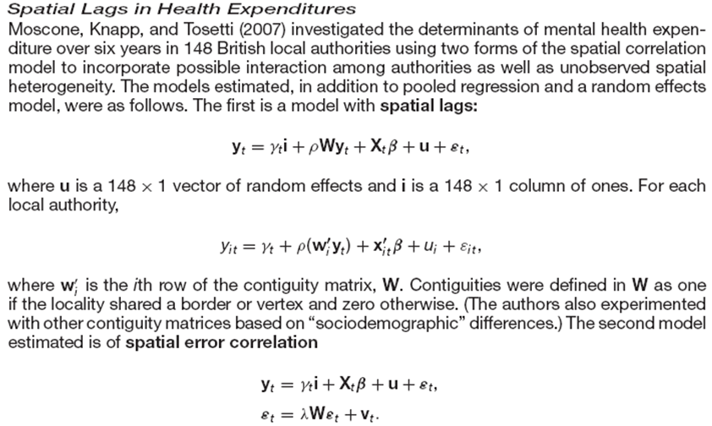
Spatial Autocorrelation in a Panel

Slide 14
Alternative Panel Formulations

Slide 15
Analytical Environment
❶ Generalized linear regression
❷ Complicated disturbance covariance
matrix
❸ Estimation platform
  Generalized least squares
  Maximum likelihood estimation when normally distributed disturbances (still GLS)

Slide 16
Discrete Choices
❶ Land use intensity in Austin, Texas –
Intensity = 1,2,3,4
❷ Land Usage Types in France, 1,2,3
❸ Oak Tree Regeneration in Pennsylvania
Number = 0,1,2,… (Many zeros)
❹ Teenagers physically active = 1 or
physically inactive = 0, in Bay Area, CA.

Slide 17
Discrete Choice Modeling
❶ Discrete outcome reveals a specific choice
❷ Underlying preferences are modeled
❸ Models for observed data are usually not
conditional means
  Generally, probabilities of outcomes
  Nonlinear models – cannot be estimated by any type of linear least squares

Slide 18
Discrete Outcomes
❶ Discrete Revelation of Underlying
Preferences
  Binary choice between two alternatives
  Unordered choice among multiple alternatives
  Ordered choice revealing underlying strength of preferences
❷ Counts of Events

Slide 19
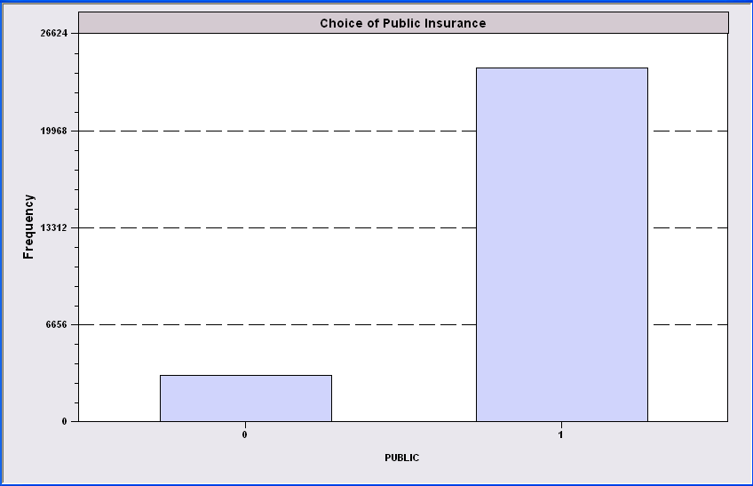
Simple Binary Choice: Insurance

Slide 20

Redefined Multinomial Choice
Fly
Ground

Slide 21
Multinomial Unordered Choice - Transport Mode

Slide 22

Health Satisfaction (HSAT)
Self administered survey: Health Care Satisfaction? (0 – 10)
Continuous Preference Scale

Slide 23
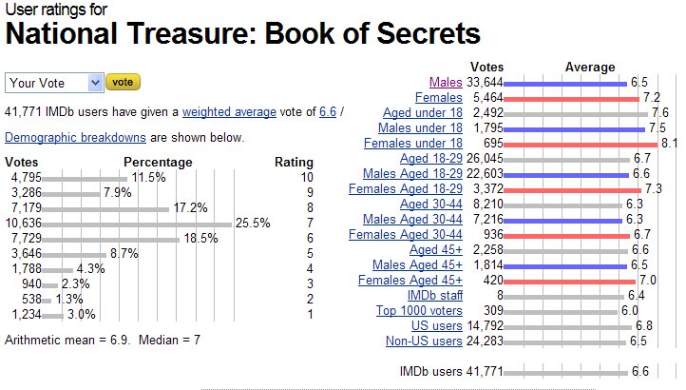
Ordered Preferences at IMDB.com

Slide 24
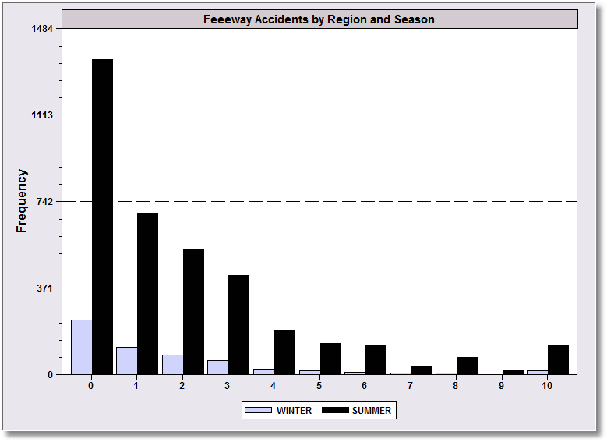
Counts of Events

Slide 25
Modeling Discrete Outcomes
❶ “Dependent Variable” typically labels an
outcome
  No quantitative meaning
  Conditional relationship to covariates
❷ No “regression” relationship in most cases
❸ The “model” is usually a probability

Slide 26
Simple Binary Choice: Insurance
Decision: Yes or No = 1 or 0
Depends on Income, Health, Marital Status, Gender

Slide 27
Multinomial Unordered Choice - Transport Mode
Decision: Which Type, A, T, B, C.
Depends on Income, Price, Travel Time

Slide 28
Health Satisfaction (HSAT)
Self administered survey: Health Care Satisfaction? (0 – 10)
Outcome: Preference = 0,1,2,…,10
Depends on Income, Marital Status, Children, Age, Gender

Slide 29
Counts of Events
Outcome: How many events at each location = 0,1,…,10
Depends on Season, Population, Economic Activity

Slide 30
Nonlinear Spatial Modeling
❶ Discrete outcome y_{it} = 0, 1, …, J for
some finite or infinite (count case) J.
  i = 1,…,n
  t = 1,…,T
❷ Covariates x_{it} .
❸ Conditional Probability (y_{it} = j)
= a function of x_{it}.

Slide 31
Two Platforms
❶ Random Utility for Preference Models
Outcome reveals underlying utility
  Binary: u* = θ’x y = 1 if u* > 0
  Ordered: u* = θ’x y = j if μ_{j-1} < u* < μ_{j}
  Unordered: u*(j) = θ’x_{j} , y = j if u*(j) > u*(k)
❷ Nonlinear Regression for Count Models
Outcome is governed by a nonlinear
regression
  E[y|x] = g(θ,x)

Slide 32
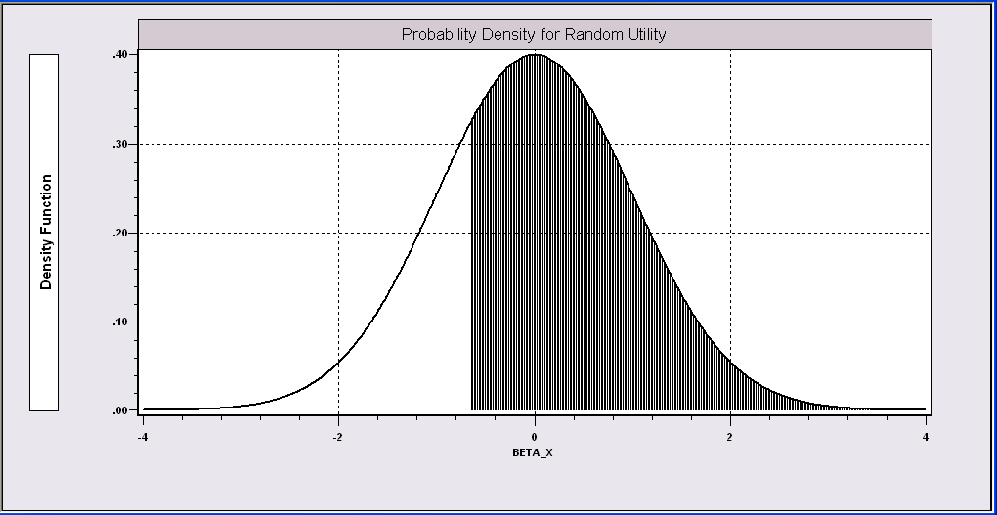
Probit and Logit Models

Slide 33
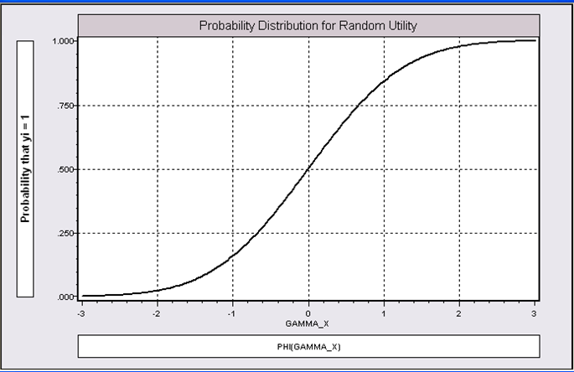
Implied Regression Function

Slide 34
Estimated Binary Choice Models:
The Results Depend on F(ε)
LOGIT PROBIT EXTREME VALUE
Variable Estimate t-ratio Estimate t-ratio Estimate t-ratio
Constant -0.42085 -2.662 -0.25179 -2.600 0.00960 0.078
X1 0.02365 7.205 0.01445 7.257 0.01878 7.129
X2 -0.44198 -2.610 -0.27128 -2.635 -0.32343 -2.536
X3 0.63825 8.453 0.38685 8.472 0.52280 8.407
Log-L -2097.48 -2097.35 -2098.17
Log-L(0) -2169.27 -2169.27 -2169.27

Slide 35
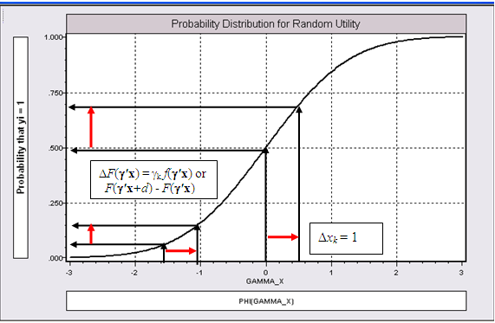
Effect on Predicted Probability
of an Increase in X1
α + β₁ (X1+1) + β₂ (X2) + β₃ X3 (β₁ is positive)

Slide 36
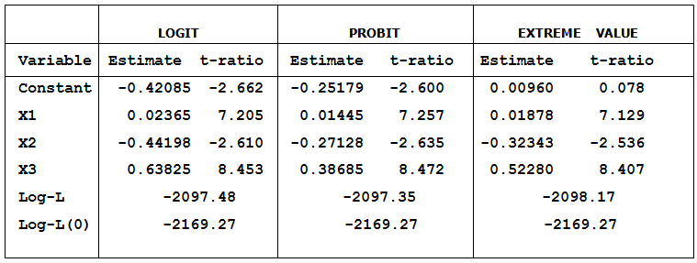
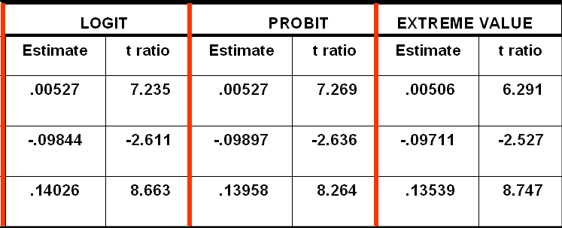
Estimated Partial Effects vs. Coefficients

Slide 37
Applications: Health Care Usage
German Health Care Usage Data, 7,293 Individuals, Varying Numbers of Periods
Variables in the file are
Data downloaded from Journal of Applied Econometrics Archive. This is an unbalanced panel with 7,293 individuals. They can be used for regression, count models, binary choice, ordered choice, and bivariate binary choice. This is a large data set. There are altogether 27,326 observations. The number of observations ranges from 1 to 7. (Frequencies are: 1=1525, 2=2158, 3=825, 4=926, 5=1051, 6=1000, 7=987). (Downloaded from the JAE Archive)
DOCTOR = 1(Number of doctor visits > 0)
HOSPITAL = 1(Number of hospital visits > 0)
HSAT = health satisfaction, coded 0 (low) - 10 (high)
DOCVIS = number of doctor visits in last three months
HOSPVIS = number of hospital visits in last calendar year
PUBLIC = insured in public health insurance = 1; otherwise = 0
ADDON = insured by add-on insurance = 1; otherswise = 0
HHNINC = household nominal monthly net income in German marks / 10000.
(4 observations with income=0 were dropped)
HHKIDS = children under age 16 in the household = 1; otherwise = 0
EDUC = years of schooling
AGE = age in years
FEMALE = 1 for female headed household, 0 for male
EDUC = years of education
Notes:
37

Slide 38
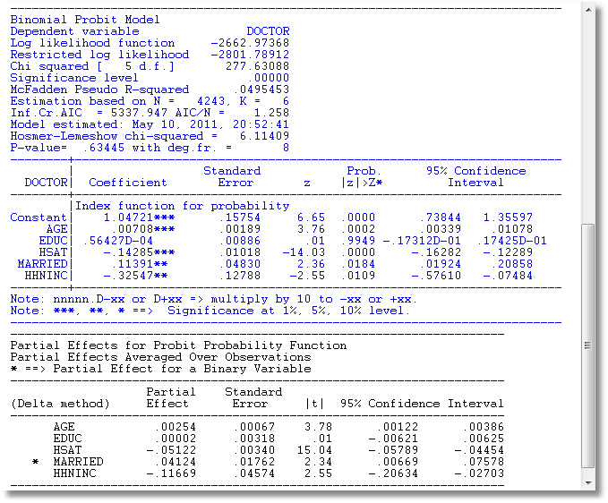
An Estimated Binary Choice Model

Slide 39
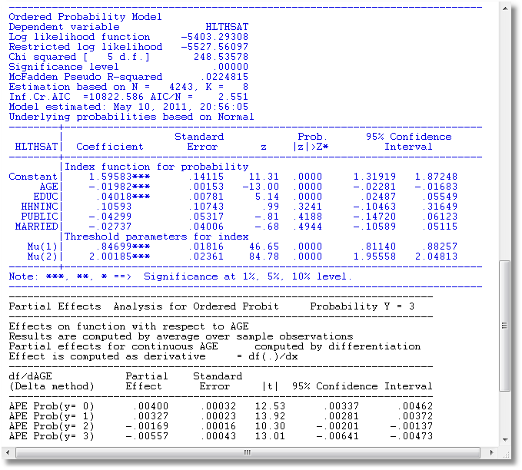
An Estimated Ordered Choice Model

Slide 40
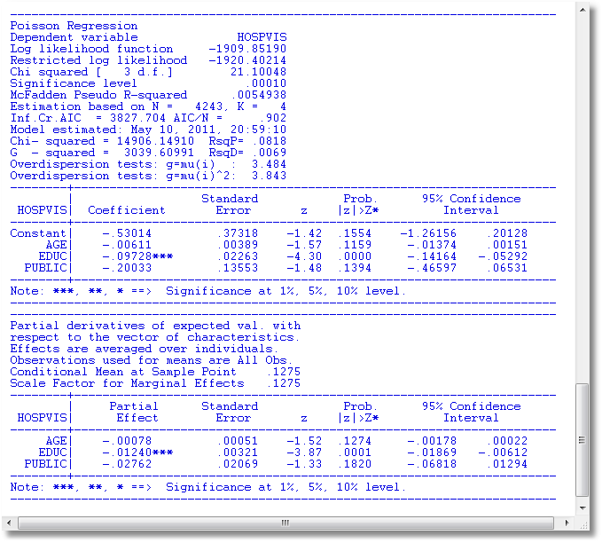
An Estimated Count Data Model

Slide 41
210 Observations on Travel Mode Choice
CHOICE ATTRIBUTES CHARACTERISTIC
MODE TRAVEL INVC INVT TTME GC HINC
AIR .00000 59.000 100.00 69.000 70.000 35.000
TRAIN .00000 31.000 372.00 34.000 71.000 35.000
BUS .00000 25.000 417.00 35.000 70.000 35.000
CAR 1.0000 10.000 180.00 .00000 30.000 35.000
AIR .00000 58.000 68.000 64.000 68.000 30.000
TRAIN .00000 31.000 354.00 44.000 84.000 30.000
BUS .00000 25.000 399.00 53.000 85.000 30.000
CAR 1.0000 11.000 255.00 .00000 50.000 30.000
AIR .00000 127.00 193.00 69.000 148.00 60.000
TRAIN .00000 109.00 888.00 34.000 205.00 60.000
BUS 1.0000 52.000 1025.0 60.000 163.00 60.000
CAR .00000 50.000 892.00 .00000 147.00 60.000
AIR .00000 44.000 100.00 64.000 59.000 70.000
TRAIN .00000 25.000 351.00 44.000 78.000 70.000
BUS .00000 20.000 361.00 53.000 75.000 70.000
CAR 1.0000 5.0000 180.00 .00000 32.000 70.000

Slide 42
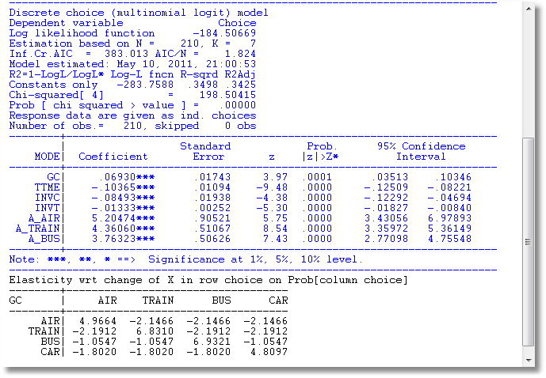
An Estimated Unordered Choice Model

Slide 43
Maximum Likelihood Estimation
Cross Section Case
Binary Outcome

Slide 44
Cross Section Case

Slide 45
Log Likelihoods for Binary Choice Models

Slide 46
Spatially Correlated Observations
Correlation Based on Unobservables

Slide 47
Spatially Correlated Observations
Correlated Utilities

Slide 48
Log Likelihood
❶ In the unrestricted spatial case, the log
likelihood is one term,
❷ LogL = log Prob(y₁|x₁, y₂|x₂, … ,y_{n}|x_{n})
❸ In the discrete choice case, the
probability will be an n fold integral,
usually for a normal distribution.

Slide 49
LogL for an Unrestricted BC Model

Slide 50
Solution Approaches for Binary Choice
❶ Distinguish between private and
social shocks and use pseudo-ML
❷ Approximate the joint density and
use GMM with the EM algorithm
❸ Parameterize the spatial correlation
and use copula methods
❹ Define neighborhoods – make W a
sparse matrix and use pseudo-ML
❺ Others …

Slide 51
Pseudo Maximum Likelihood
Smirnov, A., “Modeling Spatial Discrete Choice,” Regional Science and Urban Economics, 40, 2010.

Slide 52
Pseudo Maximum Likelihood
❶ Assumes away the correlation in the
reduced form
❷ Makes a behavioral assumption
❸ Requires inversion of (I-ρW)
❹ Computation of (I-ρW) is part of the
optimization process - ρ is estimated
with θ .
❺ Does not require multidimensional
integration (for a logit model, requires no
integration)

Slide 53
GMM
Pinske, J. and Slade, M., (1998) “Contracting in Space: An Application of Spatial Statistics to Discrete Choice Models,” Journal of Econometrics, 85, 1, 125-154.
Pinkse, J. , Slade, M. and Shen, L (2006) “Dynamic Spatial Discrete Choice Using One Step GMM: An Application to Mine Operating Decisions”, Spatial Economic Analysis, 1: 1, 53 — 99.

Slide 54
GMM

Slide 55
GMM Approach
❶ Spatial autocorrelation induces
heteroscedasticity that is a function of ρ
❷ Moment equations include the
heteroscedasticity and an additional
instrumental variable for identifying ρ.
❸ LM test of = 0 is carried out under the null
hypothesis that = 0.
❹ Application: Contract type in pricing for 118
Vancouver service stations.

Slide 56
Copula Method and Parameterization
Bhat, C. and Sener, I., (2009) “A copula-based closed-form binary logit choice model
for accommodating spatial correlation across observational units,” Journal of Geographical Systems, 11, 243–272

Slide 57
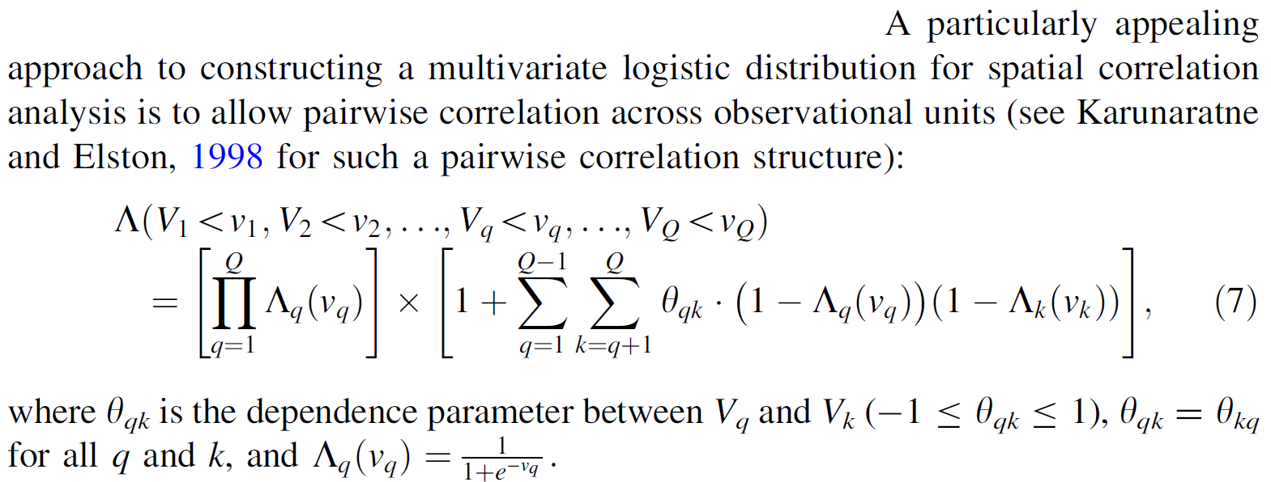
Copula Representation

Slide 58
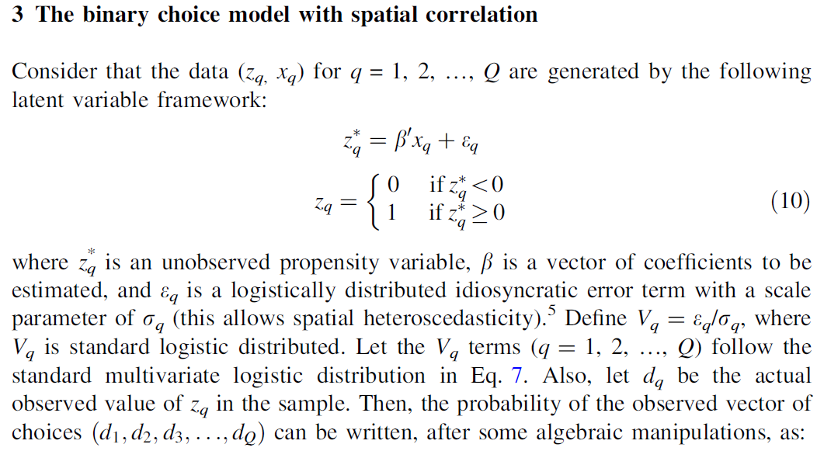
Model

Slide 59
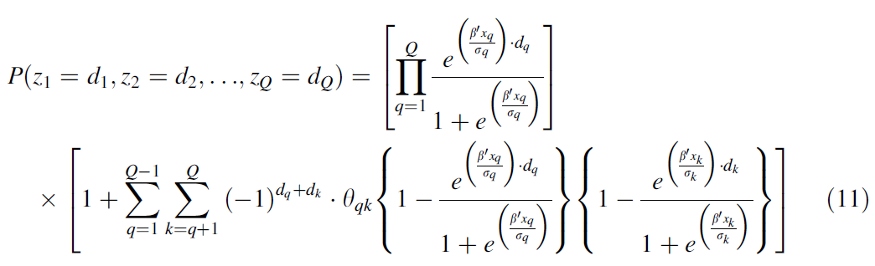
Likelihood

Slide 60
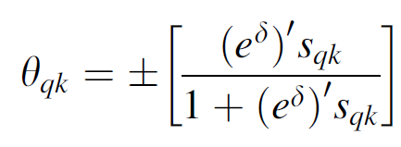
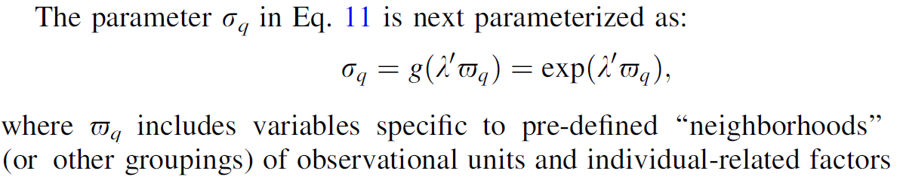
Parameterization

Slide 61
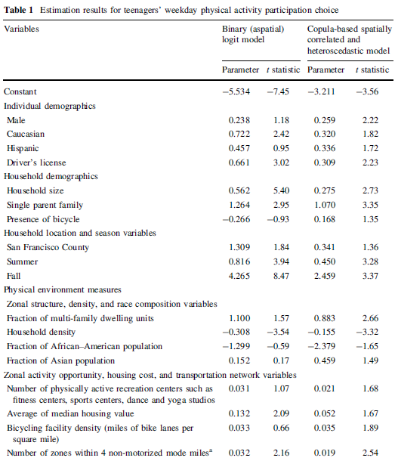

Slide 62
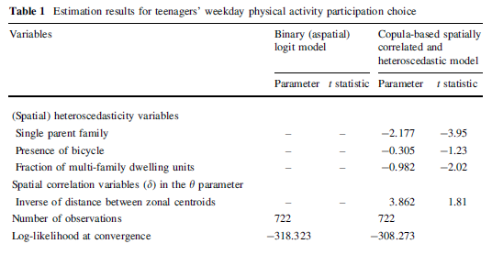

Slide 63
Other Approaches
Case A (1992) Neighborhood influence and technological change. Economics 22:491–508
Beron KJ, Vijverberg WPM (2004) Probit in a spatial context: a monte carlo analysis. In: Anselin L, Florax RJGM, Rey SJ (eds) Advances in spatial econometrics: methodology, tools and applications. Springer, Berlin
❶ Case (1992): Define “regions” or neighborhoods. No
correlation across regions. Produces essentially a
panel data probit model.
❷ Beron and Vijverberg (2003): Brute force integration
using GHK simulator in a probit model.
❸ Others. See Bhat and Sener (2009).

Slide 64


Slide 65
Ordered Probability Model

Slide 66

Outcomes for Health Satisfaction

Slide 67
A Spatial Ordered Choice Model
Wang, C. and Kockelman, K., (2009) Bayesian Inference for Ordered Response Data with a Dynamic Spatial Ordered Probit Model, Working Paper, Department of Civil and Environmental Engineering, Bucknell University.

Slide 68
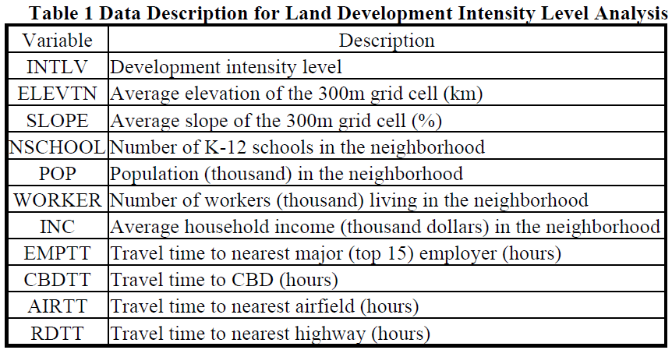
OCM for Land Use Intensity

Slide 69
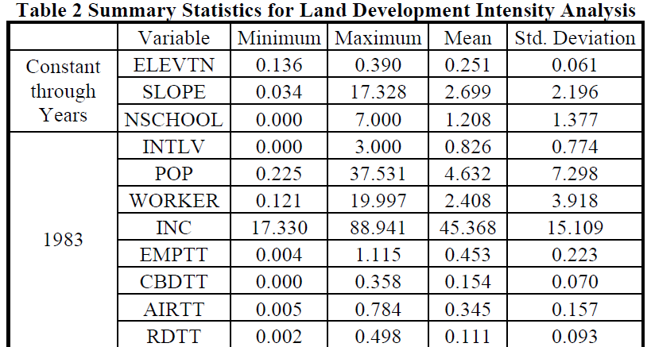
OCM for Land Use Intensity

Slide 70
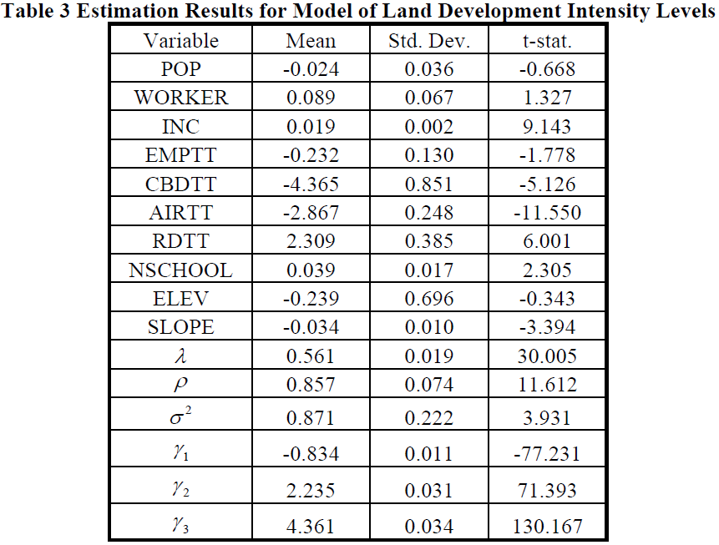
Estimated Dynamic OCM

Slide 71
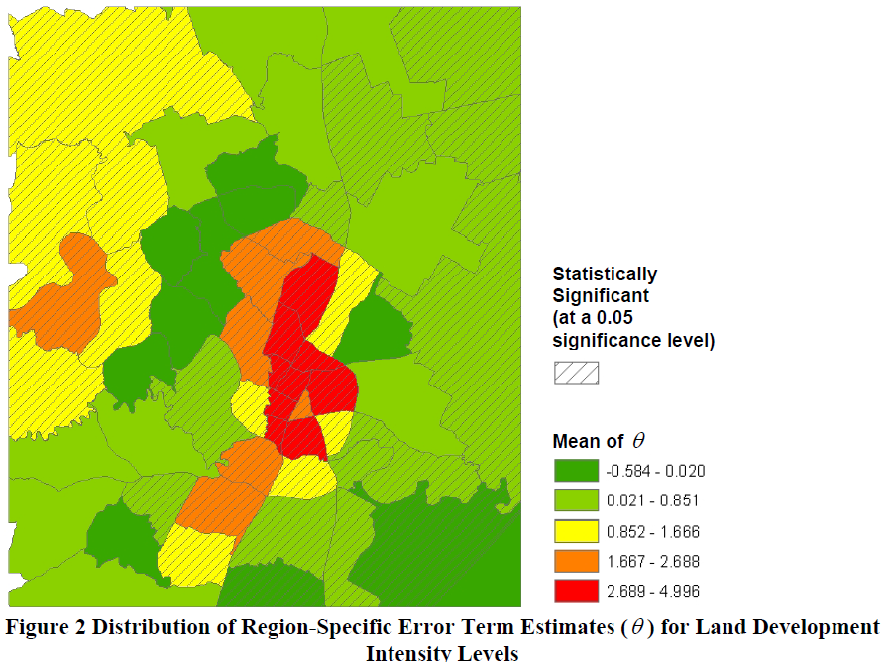

Slide 72
Unordered Multinomial Choice

Slide 73
Multinomial Unordered Choice - Transport Mode
Decision: Which Type, A, T, B, C.
Depends on Income, Price, Travel Time

Slide 74
Spatial Multinomial Probit
Chakir, R. and Parent, O. (2009) “Determinants of land use changes: A spatial multinomial probit approach, Papers in Regional Science, 88, 2, 328-346.

Slide 75
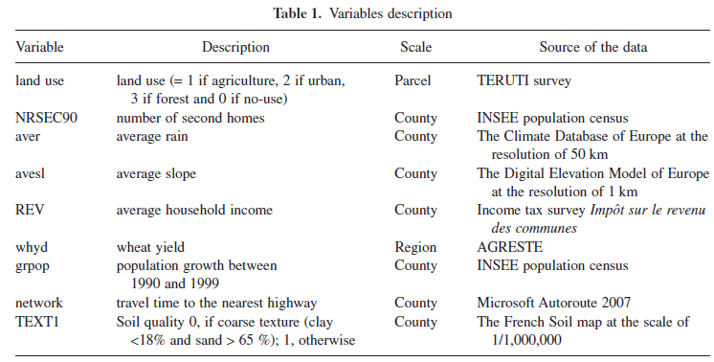

Slide 76
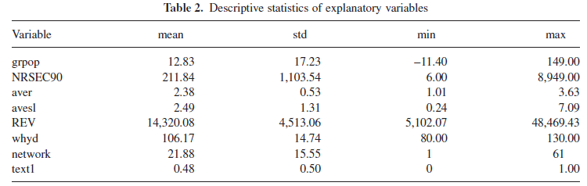

Slide 77
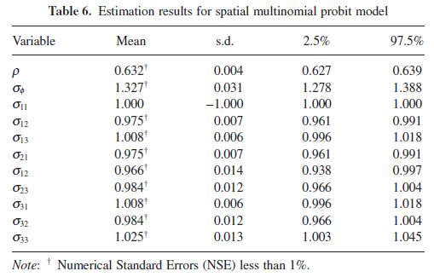
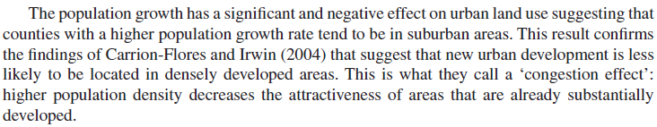

Slide 78
Modeling Counts

Slide 79
Canonical Model
Rathbun, S and Fei, L (2006) “A Spatial Zero-Inflated Poisson Regression Model for Oak Regeneration,” Environmental Ecology Statistics, 13, 2006, 409-426

Slide 80
