Slide 1
Empirical Methods for
Microeconomic Applications
University of Lugano, Switzerland
May 27-31, 2019
William Greene
Department of Economics
Stern School of Business
New York University

Slide 2






1A. Descriptive Tools, Regression, Panel Data

Slide 3
Agenda
Day 1
  A. Descriptive Tools, Regression, Models, Panel Data, Nonlinear Models
  B. Binary choice and nonlinear modeling, panel data
  C. Ordered Choice, endogeneity, control functions, Robust inference, bootstrapping
Day 2
  A. Models for count data, censoring, inflation models
  B. Latent class, mixed models
  C. Multinomial Choice
Day 3
  A. Stated Preference

Slide 4
Agenda for 1A
Models and Parameterization
Descriptive Statistics
Regression
  Functional Form
  Partial Effects
  Hypothesis Tests
  Robust Estimation
Bootstrapping
Panel Data
Nonlinear Models

Slide 5


Slide 6
Cornwell and Rupert Panel Data
Cornwell and Rupert Returns to Schooling Data, 595 Individuals, 7 Years
Variables in the file are
EXP = work experience
WKS = weeks worked
OCC = occupation, 1 if blue collar,
IND = 1 if manufacturing industry
SOUTH = 1 if resides in south
SMSA = 1 if resides in a city (SMSA)
MS = 1 if married
FEM = 1 if female
UNION = 1 if wage set by union contract
ED = years of education
BLK = 1 if individual is black
LWAGE = log of wage = dependent variable in regressions
These data were analyzed in Cornwell, C. and Rupert, P., "Efficient Estimation with Panel Data: An Empirical Comparison of Instrumental Variable Estimators," Journal of Applied Econometrics, 3, 1988, pp. 149-155.
Notes:
6

Slide 7


Slide 8
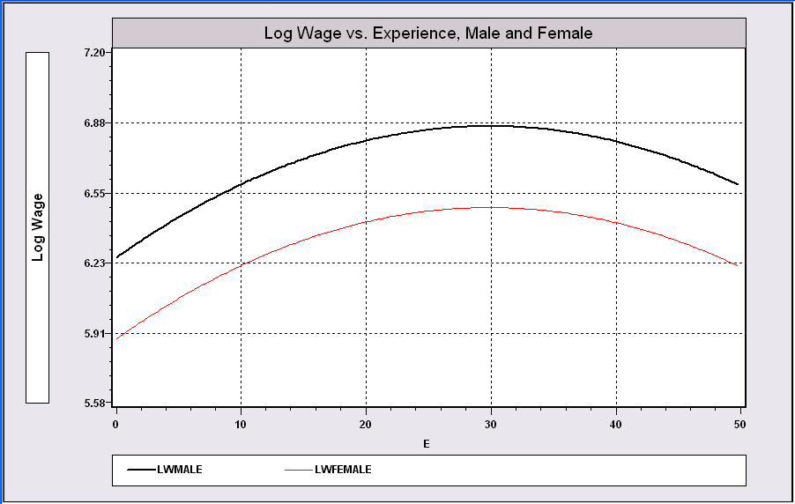
Model Building in Econometrics
Parameterizing the model
  Nonparametric analysis
  Semiparametric analysis
  Parametric analysis
Sharpness of inferences follows from the strength of the assumptions
A Model Relating (Log)Wage
to Gender and Experience

Slide 9
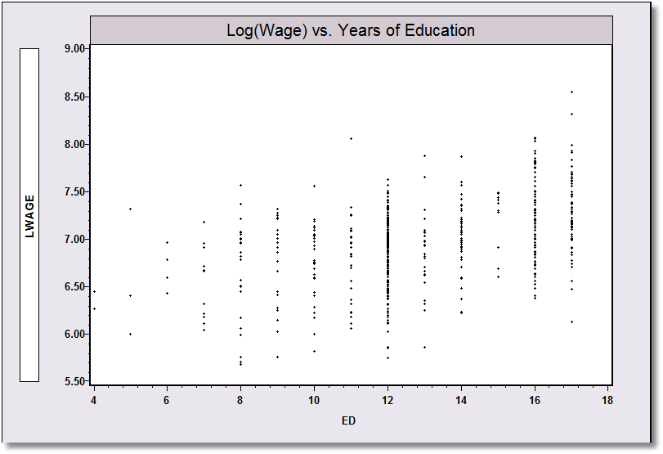
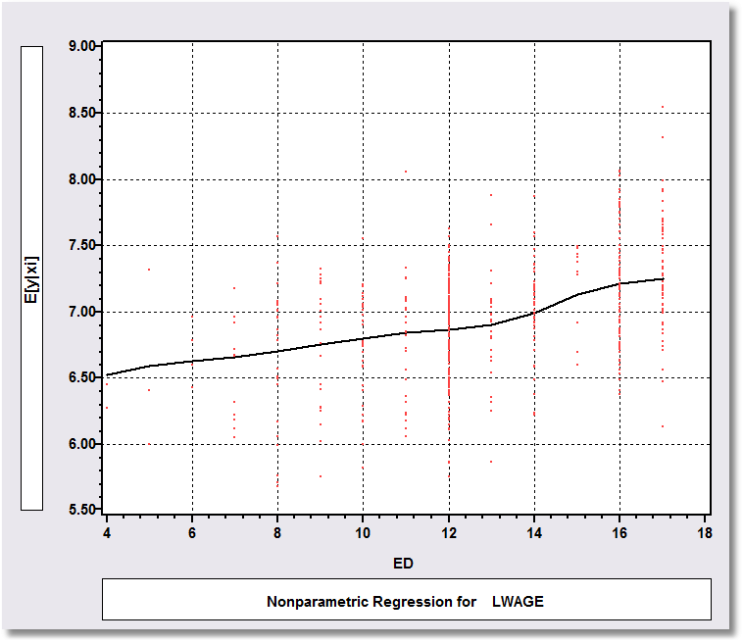
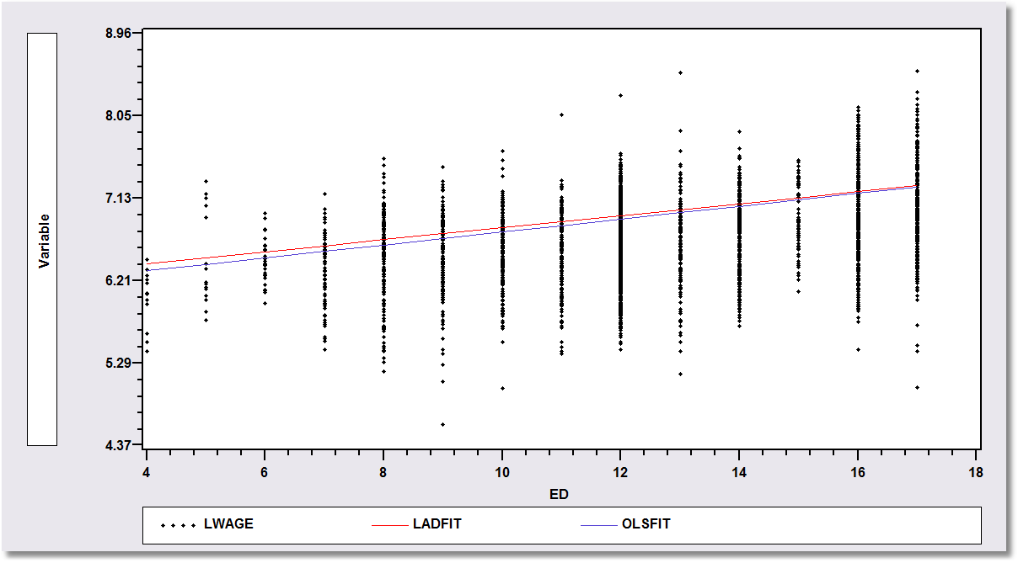
Application: Is there a relationship between Log(wage) and Education?
Nonparametric Regression
Kernel regression of y on x
Semiparametric Regression: Least absolute deviations regression of y on x
Parametric Regression: Least squares – maximum likelihood – regression of y on x

Slide 10
A First Look at the Data
Descriptive Statistics
Basic Measures of Location and Dispersion
Graphical Devices
  Box Plots
  Histogram
  Kernel Density Estimator

Slide 11
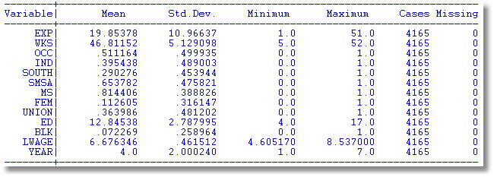
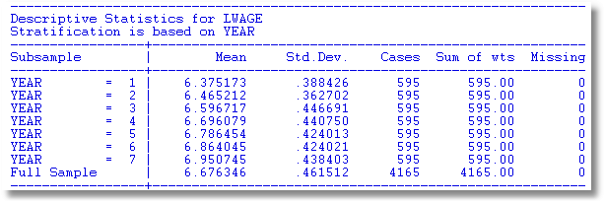

Slide 12
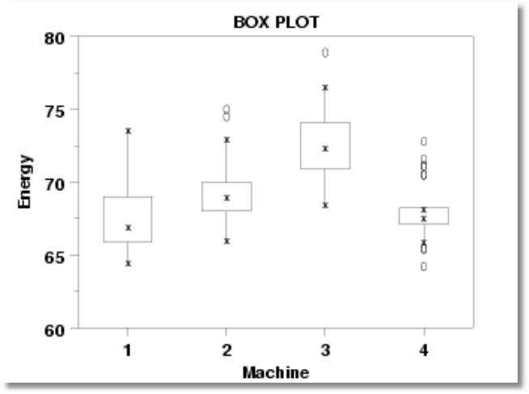
Box Plots

Slide 13
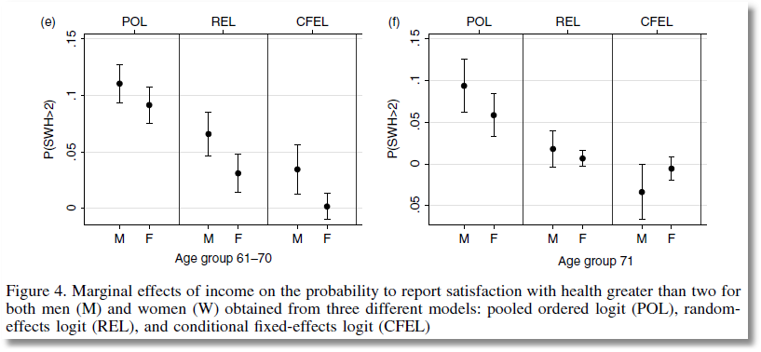
From Jones and Schurer (2011)

Slide 14
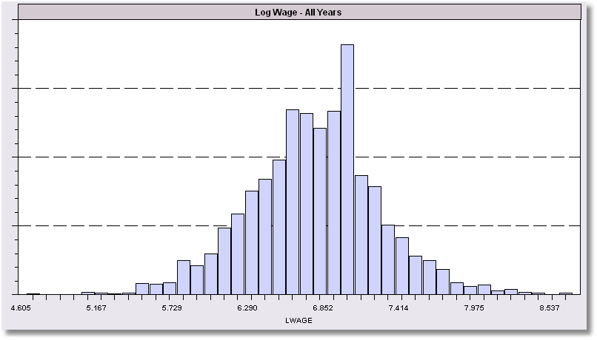
Histogram for LWAGE

Slide 15
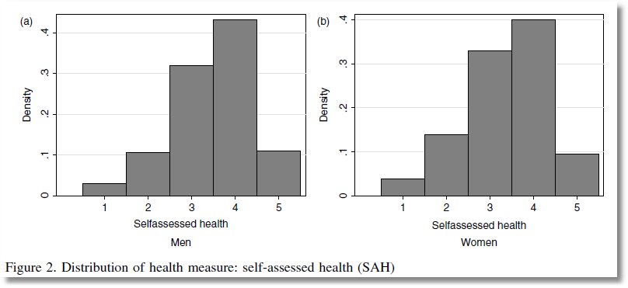

Slide 16
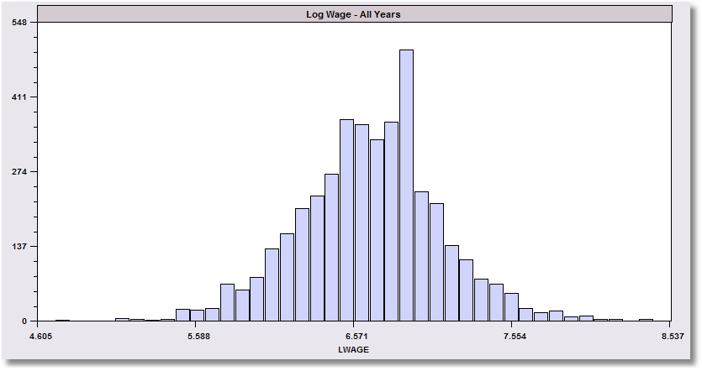
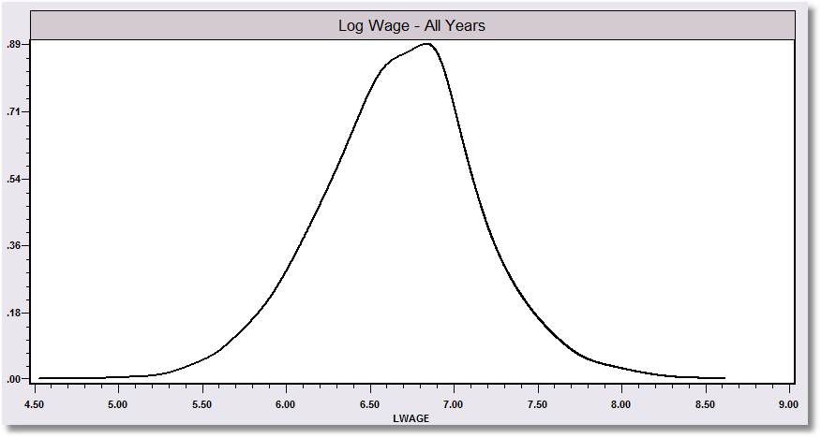
The kernel density estimator is a histogram (of sorts).

Slide 17
Kernel Density Estimator

Slide 18
Kernel Estimator for LWAGE

Slide 19
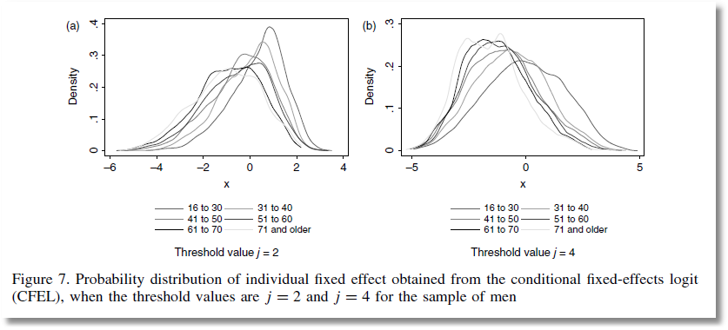
From Jones and Schurer (2011)

Slide 20
Objective: Impact of Education on (log) Wage
Specification: What is the right model to use to analyze this association?
Estimation
Inference
Analysis

Slide 21
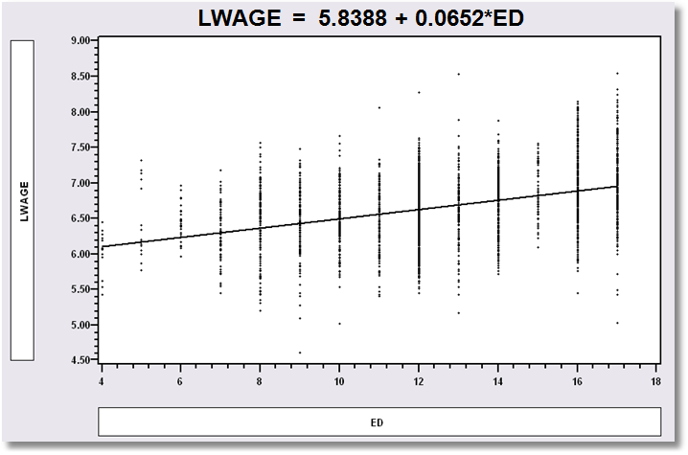
Simple Linear Regression
LWAGE = 5.8388 + 0.0652*ED

Slide 22
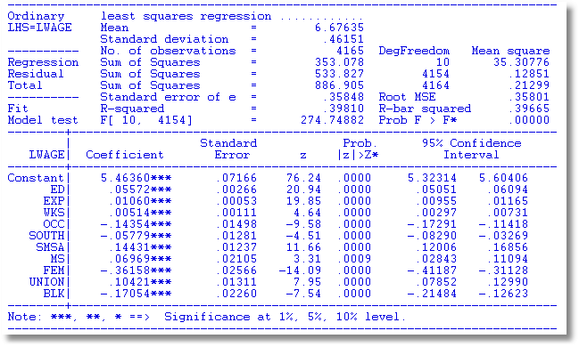
Multiple Regression

Slide 23
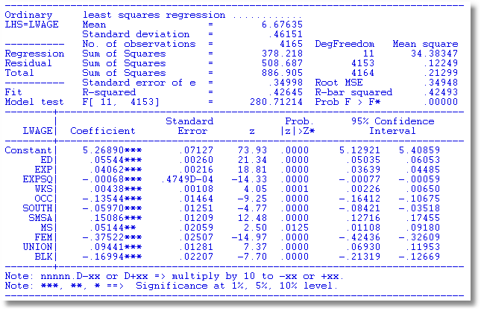
Specification: Quadratic Effect of Experience

Slide 24
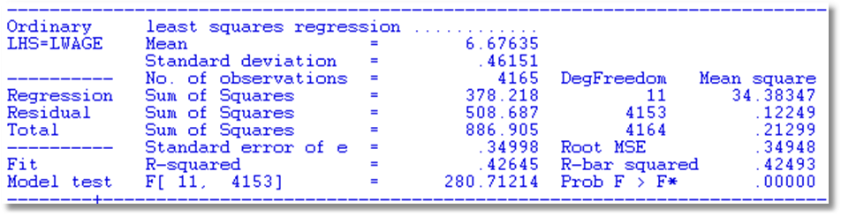
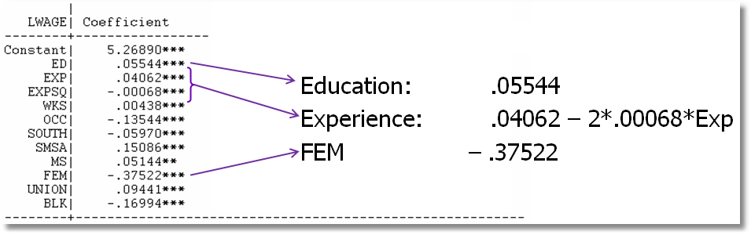
Partial Effects

Slide 25
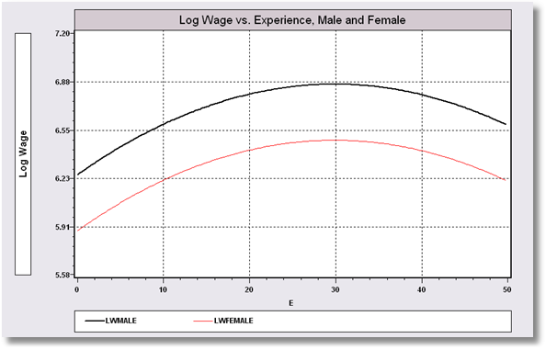
Model Implication: Effect of Experience and Male vs. Female

Slide 26
Hypothesis Test About Coefficients
Hypothesis
  Null: Restriction on β: Rβ – q = 0
  Alternative: Not the null
Approaches
  Fitting Criterion: R² decrease under the null?
  Wald: Rb – q close to 0 under the alternative?

Slide 27
Hypotheses
All Coefficients = 0?
R = [ 0 | I ] q = [0]
ED Coefficient = 0?
R = 0,1,0,0,0,0,0,0,0,0,0,0
q = 0
No Experience effect?
R = 0,0,1,0,0,0,0,0,0,0,0,0
0,0,0,1,0,0,0,0,0,0,0,0
q = 0
0

Slide 28
Hypothesis Test Statistics

Slide 29
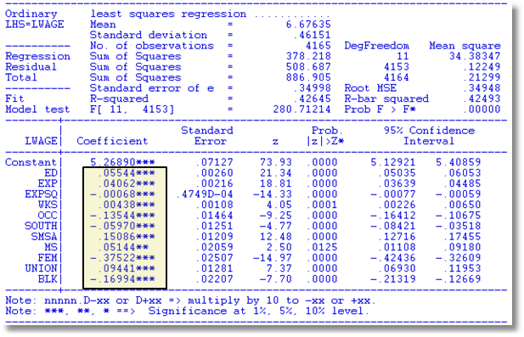
Hypothesis: All Coefficients Equal Zero
All Coefficients = 0?
R = [0 | I] q = [0]
R₁² = .42645
R₀² = .00000
F = 280.7 with [11,4153]
Wald = b₂₋₁₂[V₂₋₁₂]⁻¹b₂₋₁₂
= 3087.83355
Note that Wald = JF
= 11(280.7)

Slide 30
Hypothesis: Education Effect = 0
ED Coefficient = 0?
R = 0,1,0,0,0,0,0,0,0,0,0,0
q = 0
R₁² = .42645
R₀² = .36355 (not shown)
F = 455.396
Wald = (.05544-0)²/(.0026)²
= 455.396
Note F = t² and Wald = F
For a single hypothesis about 1 coefficient.

Slide 31
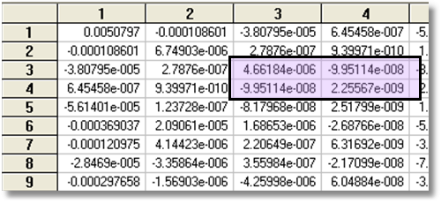
Hypothesis: Experience Effect = 0
No Experience effect?
R = 0,0,1,0,0,0,0,0,0,0,0,0
0,0,0,1,0,0,0,0,0,0,0,0
q = 0
0
R₀² = .34101, R₁² = .42645
F = 309.33
Wald = 618.601 (W* = 5.99)

Slide 32
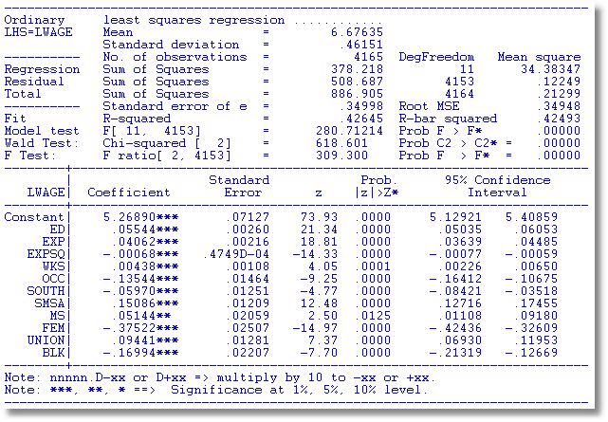
Built In Test

Slide 33
Robust Covariance Matrix
What does robustness mean?
Robust to: Heteroscedasticty
Not robust to:
  Autocorrelation
  Individual heterogeneity
  The wrong model specification
‘Robust inference’

Slide 34
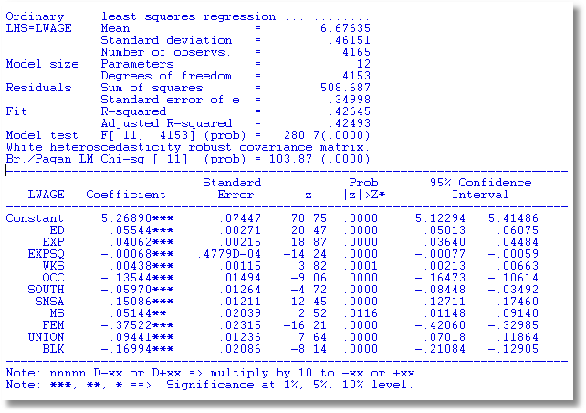
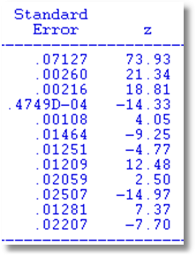
Robust Covariance Matrix
Uncorrected

Slide 35
Bootstrapping and Quantile Regresion

Slide 36
Estimating the Asymptotic
Variance of an Estimator
Known form of asymptotic variance: Compute from known results
Unknown form, known generalities about properties: Use bootstrapping
  Root N consistency
  Sampling conditions amenable to central limit theorems
  Compute by resampling mechanism within the sample.

Slide 37
Bootstrapping
Method:
1. Estimate parameters using full sample: → b
2. Repeat R times:
Draw n observations from the n, with replacement
Estimate β with b(r).
3. Estimate variance with
V = (1/R)Σ_{r} [b(r) - b][b(r) - b]’
(Some use mean of replications instead of b. Advocated (without motivation) by original designers of the method.)

Slide 38
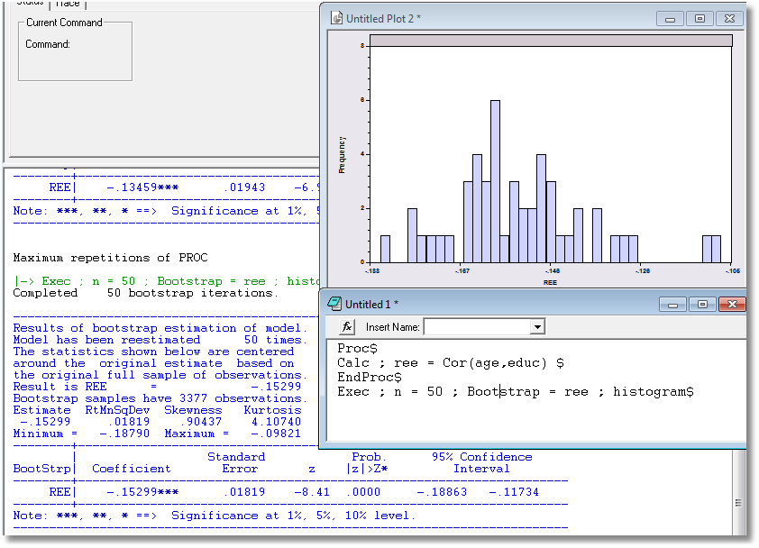
Application: Correlation between Age and Education

Slide 39
Bootstrap Regression - Replications
namelist;x=one,y,pg$ Define X
regress;lhs=g;rhs=x$ Compute and display b
proc Define procedure
regress;quietly;lhs=g;rhs=x$ … Regression (silent)
endproc Ends procedure
execute;n=20;bootstrap=b$ 20 bootstrap reps
matrix;list;bootstrp $ Display replications

Slide 40
Results of Bootstrap Procedure
--------+-------------------------------------------------------------
Variable| Coefficient Standard Error t-ratio P[|T|>t] Mean of X
--------+-------------------------------------------------------------
Constant| -79.7535*** 8.67255 -9.196 .0000
Y| .03692*** .00132 28.022 .0000 9232.86
PG| -15.1224*** 1.88034 -8.042 .0000 2.31661
--------+-------------------------------------------------------------
Completed 20 bootstrap iterations.
----------------------------------------------------------------------
Results of bootstrap estimation of model.
Model has been reestimated 20 times.
Means shown below are the means of the
bootstrap estimates. Coefficients shown
below are the original estimates based
on the full sample.
bootstrap samples have 36 observations.
--------+-------------------------------------------------------------
Variable| Coefficient Standard Error b/St.Er. P[|Z|>z] Mean of X
--------+-------------------------------------------------------------
B001| -79.7535*** 8.35512 -9.545 .0000 -79.5329
B002| .03692*** .00133 27.773 .0000 .03682
B003| -15.1224*** 2.03503 -7.431 .0000 -14.7654
--------+-------------------------------------------------------------

Slide 41
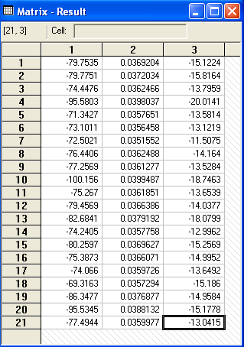
Bootstrap Replications
Full sample result
Bootstrapped sample results

Slide 42
Quantile Regression
Q(y|x,α) = β′x, α = quantile
Estimated by linear programming
Q(y|x,.50) = β′x, .50 ➔ median regression
Median regression estimated by LAD (estimates same parameters as mean regression if symmetric conditional distribution)
Why use quantile (median) regression?
  Semiparametric
  Robust to some extensions (heteroscedasticity?)
  Complete characterization of conditional distribution

Slide 43
Estimated Variance for
Quantile Regression
Asymptotic Theory
Bootstrap – an ideal application

Slide 45
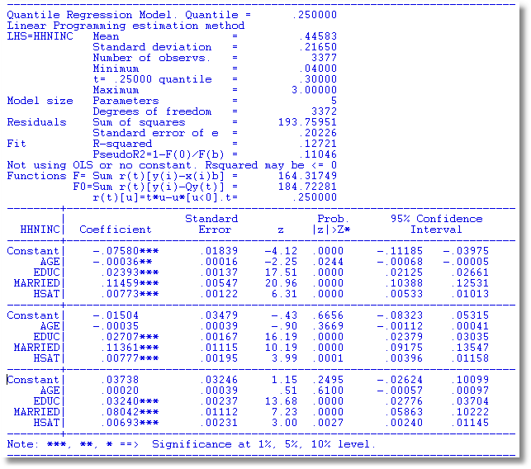
α = .25
α = .50
α = .75

Slide 46
OLS vs. Least Absolute Deviations
----------------------------------------------------------------------
Least absolute deviations estimator...............
Residuals Sum of squares = 1537.58603
Standard error of e = 6.82594
Fit R-squared = .98284
Adjusted R-squared = .98180
Sum of absolute deviations = 189.3973484
--------+-------------------------------------------------------------
Variable| Coefficient Standard Error b/St.Er. P[|Z|>z] Mean of X
--------+-------------------------------------------------------------
|Covariance matrix based on 50 replications.
Constant| -84.0258*** 16.08614 -5.223 .0000
Y| .03784*** .00271 13.952 .0000 9232.86
PG| -17.0990*** 4.37160 -3.911 .0001 2.31661
--------+-------------------------------------------------------------
Ordinary least squares regression ............
Residuals Sum of squares = 1472.79834
Standard error of e = 6.68059 Standard errors are based on
Fit R-squared = .98356 50 bootstrap replications
Adjusted R-squared = .98256
--------+-------------------------------------------------------------
Variable| Coefficient Standard Error t-ratio P[|T|>t] Mean of X
--------+-------------------------------------------------------------
Constant| -79.7535*** 8.67255 -9.196 .0000
Y| .03692*** .00132 28.022 .0000 9232.86
PG| -15.1224*** 1.88034 -8.042 .0000 2.31661
--------+-------------------------------------------------------------

Slide 47
Benefits of Panel Data
Time and individual variation in behavior unobservable in cross sections or aggregate time series
Observable and unobservable individual heterogeneity
Rich hierarchical structures
More complicated models
Features that cannot be modeled with only cross section or aggregate time series data alone
Dynamics in economic behavior

Slide 48



Slide 49


Slide 50
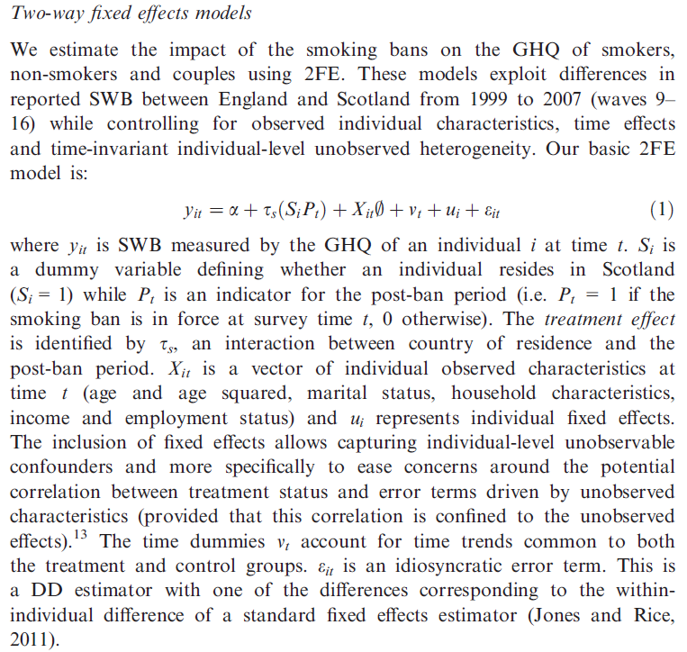

Slide 51


Slide 52


Slide 53


Slide 54
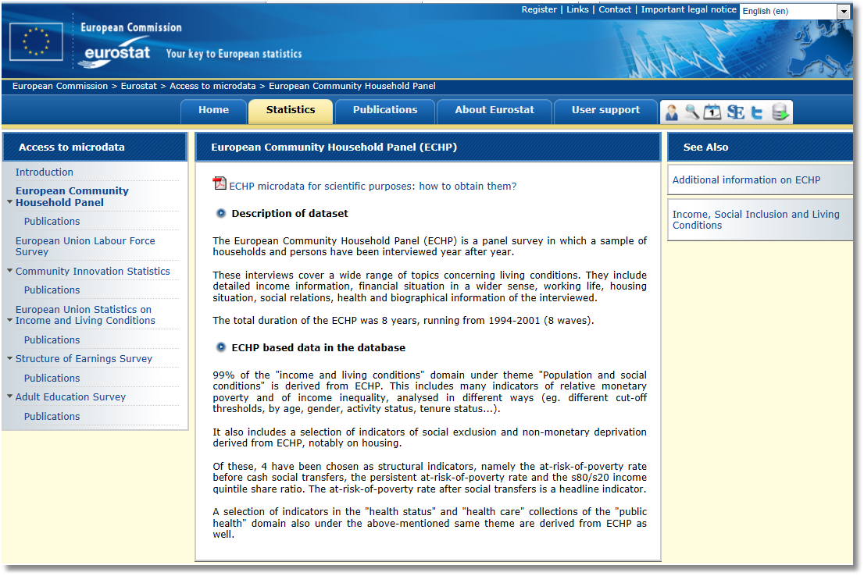

Slide 55


Slide 56
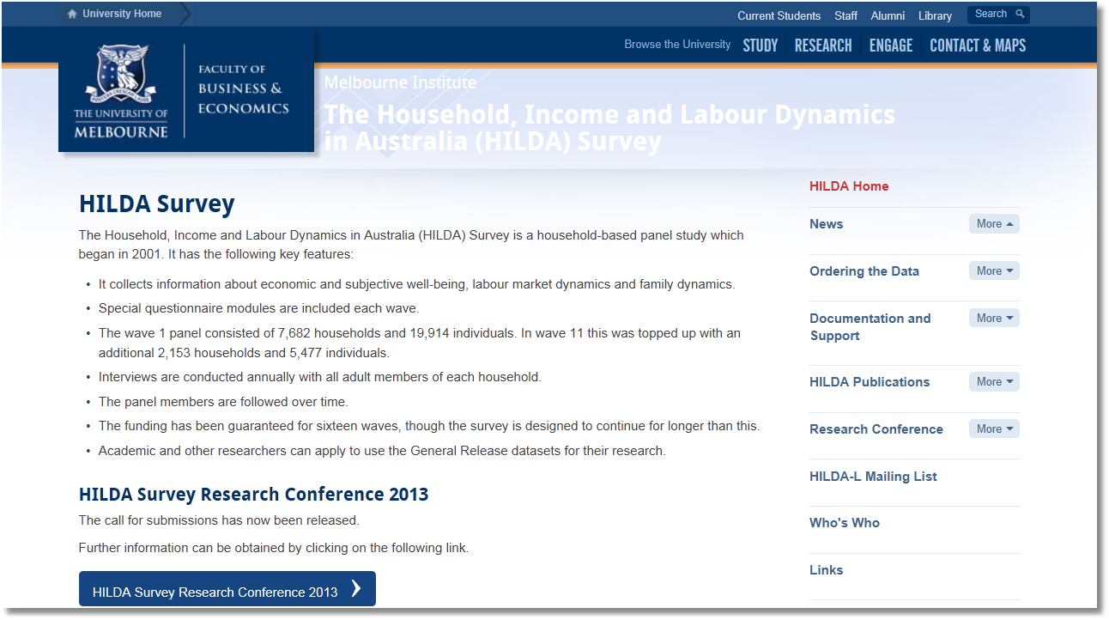

Slide 57


Slide 58


Slide 59


Slide 60
Application: Health Care Usage
German Health Care Usage Data, 7,293 Individuals, Varying Numbers of Periods
This is an unbalanced panel with 7,293 individuals.
There are altogether 27,326 observations. The number of observations ranges from 1 to 7.
Frequencies are: 1=1525, 2=2158, 3=825, 4=926, 5=1051, 6=1000, 7=987.
Downloaded from the JAE Archive.
Variables in the file include
DOCTOR = 1(Number of doctor visits > 0)
HOSPITAL = 1(Number of hospital visits > 0)
HSAT = health satisfaction, coded 0 (low) - 10 (high)
DOCVIS = number of doctor visits in last three months
HOSPVIS = number of hospital visits in last calendar year
PUBLIC = insured in public health insurance = 1; otherwise = 0
ADDON = insured by add-on insurance = 1; otherswise = 0
INCOME = household nominal monthly net income in German marks / 10000.
(4 observations with income=0 will sometimes be dropped)
HHKIDS = children under age 16 in the household = 1; otherwise = 0
EDUC = years of schooling
AGE = age in years
MARRIED = marital status
Notes:
60

Slide 61
Balanced and Unbalanced Panels
Distinction: Balanced vs. Unbalanced Panels
A notation to help with mechanics
  z_{i,t}, i = 1,…,N; t = 1,…,T_{i}
The role of the assumption
  Mathematical and notational convenience:
    Balanced, n=NT
    Unbalanced:
  Is the fixed T_{i} assumption ever necessary? Almost never.
Is unbalancedness due to nonrandom attrition from an otherwise balanced panel? This would require special considerations.

Slide 62
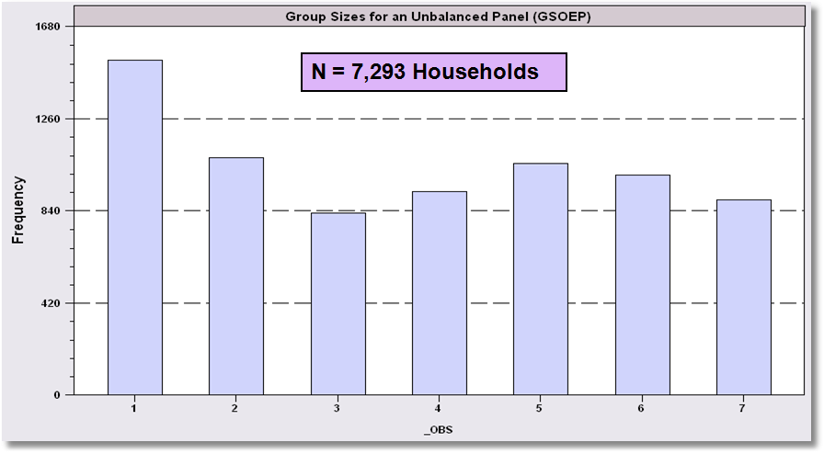
An Unbalanced Panel: RWM’s GSOEP Data on Health Care

Slide 63
Nonlinear Models
Specifying the model
  Multinomial Choice
How do the covariates relate to the outcome of interest
What are the implications of the estimated model?

Slide 64
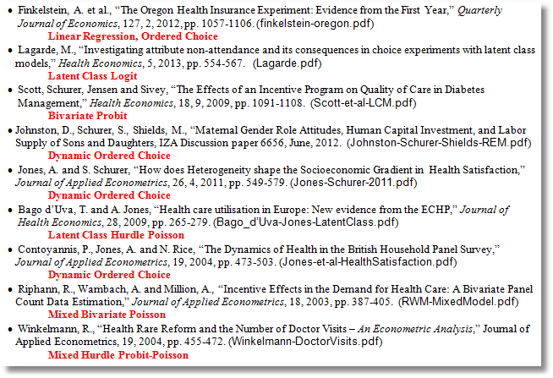

Slide 65
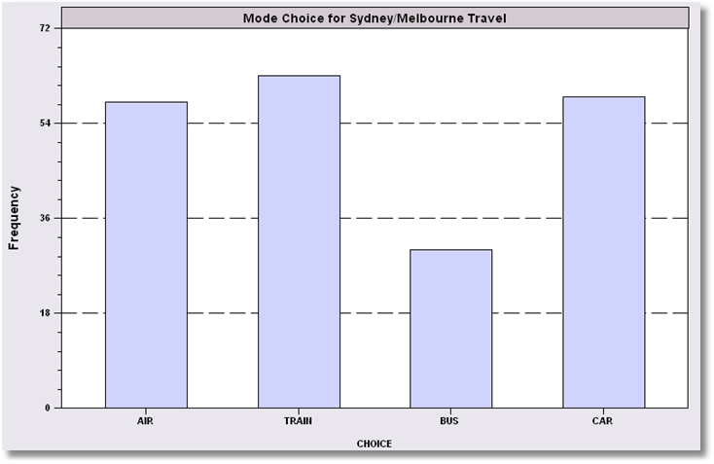
Unordered Choices of 210 Travelers

Slide 66
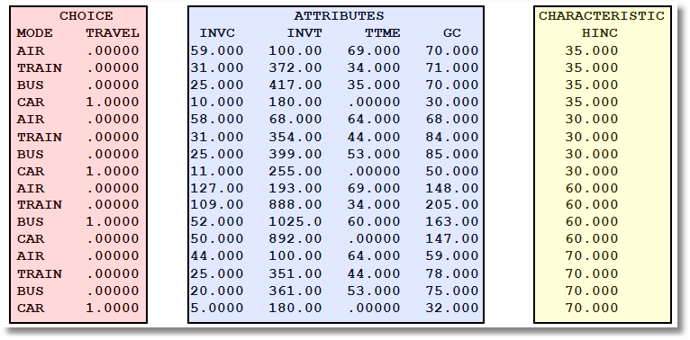
Data on Discrete Choices

Slide 67
Specifying the Probabilities
• Choice specific attributes (X) vary by choices, multiply by generic
coefficients. E.g., TTME=terminal time, GC=generalized cost of travel mode
Generic characteristics (Income, constants) must be interacted with
choice specific constants.
• Estimation by maximum likelihood; d_{ij} = 1 if person i chooses j

Slide 68
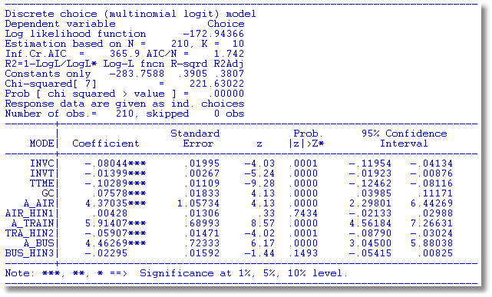
Estimated MNL Model

