Slide 1
Empirical Methods for
Microeconomic Applications
University of Lugano, Switzerland
May 27-31, 2019
William Greene
Department of Economics
Stern School of Business
New York University

Slide 2






1B. Binary Choice – Nonlinear Modeling

Slide 3
Agenda
Models for Binary Choice
Specification
Maximum Likelihood Estimation
Estimating Partial Effects
Measuring Fit
Testing Hypotheses
Panel Data Models

Slide 4
Application: Health Care Usage
German Health Care Usage Data (GSOEP)
Data downloaded from Journal of Applied Econometrics Archive. This is an unbalanced panel with 7,293 individuals, Varying Numbers of Periods They can be used for regression, count models, binary choice, ordered choice, and bivariate binary choice. There are altogether 27,326 observations. The number of observations ranges from 1 to 7. Frequencies are: 1=1525, 2=2158, 3=825, 4=926, 5=1051, 6=1000, 7=987.
Variables in the file are
DOCTOR = 1(Number of doctor visits > 0)
HOSPITAL = 1(Number of hospital visits > 0)
HSAT = health satisfaction, coded 0 (low) - 10 (high)
DOCVIS = number of doctor visits in last three months
HOSPVIS = number of hospital visits in last calendar year
PUBLIC = insured in public health insurance = 1; otherwise = 0
ADDON = insured by add-on insurance = 1; otherwise = 0
HHNINC = household nominal monthly net income in German marks / 10000.
(4 observations with income=0 were dropped)
HHKIDS = children under age 16 in the household = 1; otherwise = 0
EDUC = years of schooling
AGE = age in years
FEMALE = 1 for female headed household, 0 for male
Notes:
4

Slide 5


Slide 6
Application
27,326 Observations
  1 to 7 years, panel
  7,293 households observed
  We use the 1994 year, 3,337 household observations
Descriptive Statistics
=========================================================
Variable Mean Std.Dev. Minimum Maximum
--------+------------------------------------------------
DOCTOR| .657980 .474456 .000000 1.00000
AGE| 42.6266 11.5860 25.0000 64.0000
HHNINC| .444764 .216586 .340000E-01 3.00000
FEMALE| .463429 .498735 .000000 1.00000

Slide 7
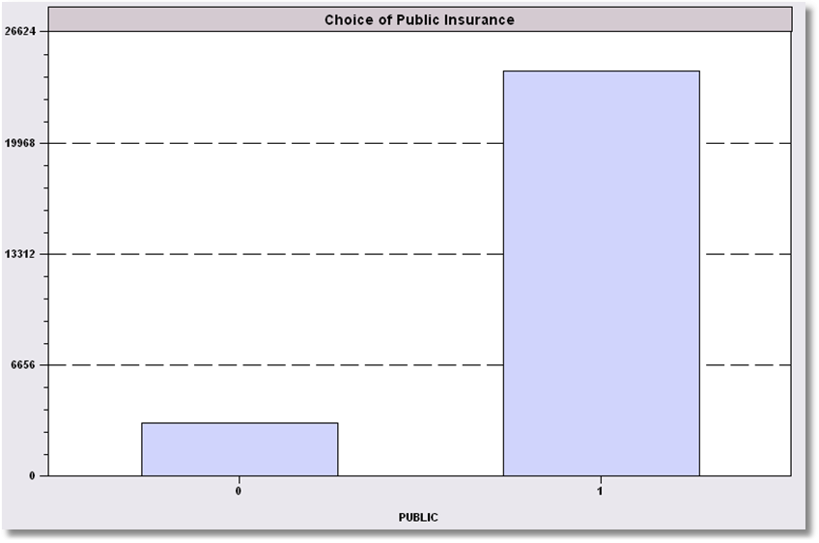
Simple Binary Choice: Insurance

Slide 8

Censored Health Satisfaction Scale
0 = Not Healthy
1 = Healthy

Slide 9

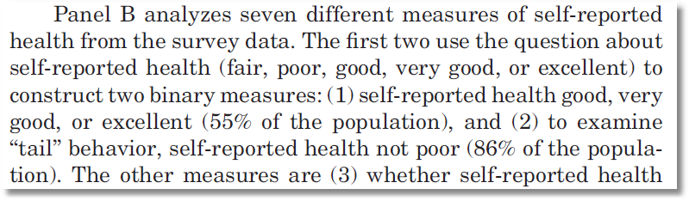
Oregon Health Insurance Experiment

Slide 10
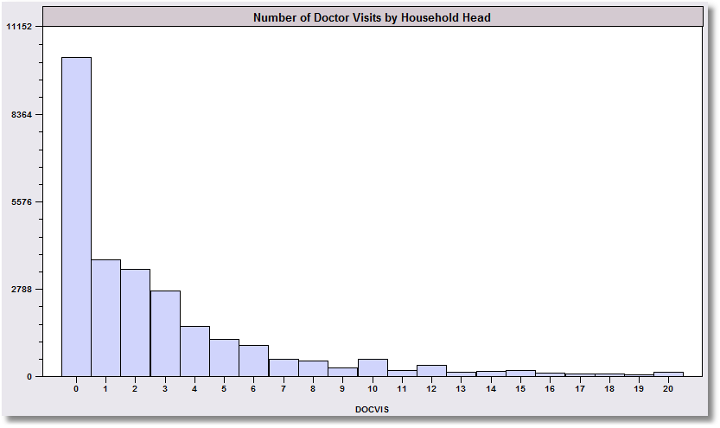
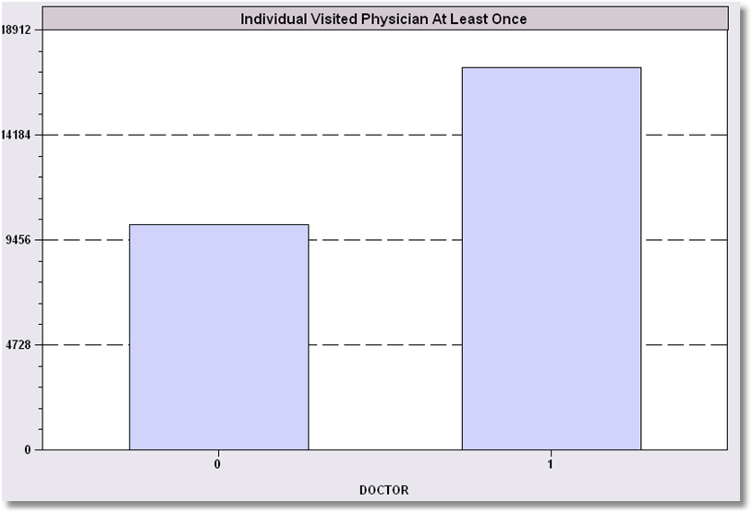
Count Transformed to Indicator

Slide 11
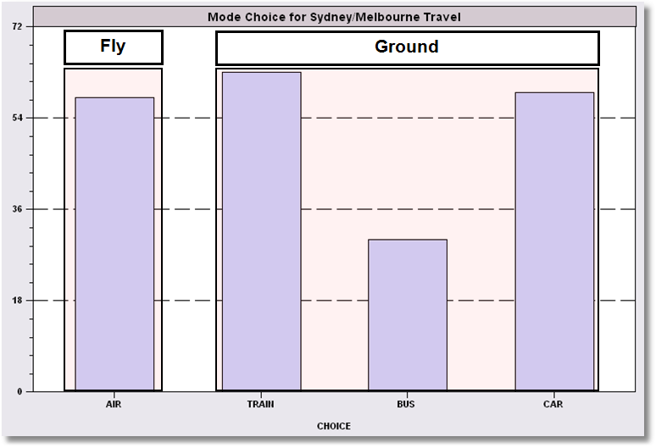
Redefined Multinomial Choice

Slide 12
A Random Utility Approach
Underlying Preference Scale, U*(choices)
Revelation of Preferences:
  U*(choices) < 0 Choice “0”
  U*(choices) > 0 Choice “1”

Slide 13
A Model for Binary Choice
Yes or No decision (Buy/NotBuy, Do/NotDo)
Example, choose to visit physician or not
Model: Net utility of visit at least once
U_{visit} = α+β₁Age + β₂Income + γSex + ε
Choose to visit if net utility is positive
Net utility = U_{visit} – U_{not visit}
Data: X = [1,age,income,sex]
y = 1 if choose visit, ⬄ U_{visit} > 0, 0 if not.
Random Utility

Slide 14
Choosing Between Two Alternatives
Modeling the Binary Choice
  U_{visit} = α + β₁ Age + β₂ Income + β₃ Sex + ε
Chooses to visit: U_{visit} > 0
α + β₁ Age + β₂ Income + β₃ Sex + ε > 0
ε > -[α + β₁ Age + β₂ Income + β₃ Sex ]

Slide 15
An Econometric Model
Choose to visit iff Uvisit > 0
  Uvisit = α + β₁ Age + β₂ Income + β₃ Sex + ε
  Uvisit > 0 ⇔ ε > -(α + β₁ Age + β₂ Income + β₃ Sex)
  ε < α + β₁ Age + β₂ Income + β₃ Sex
Probability model: For any person observed by the analyst,
Prob(visit) = Prob[ε < α + β₁ Age + β₂ Income + β₃ Sex]
Note the relationship between the unobserved ε and the outcome

Slide 16
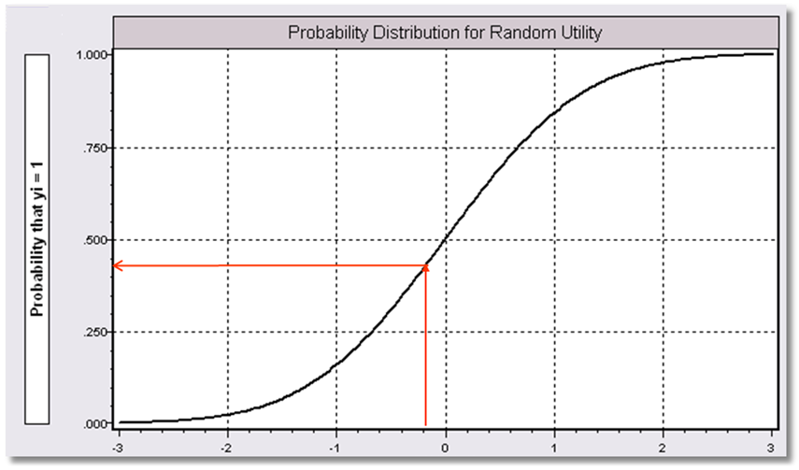
α+β₁Age + β₂ Income + β3 Sex

Slide 17
Modeling Approaches
Nonparametric – “relationship”
  Minimal Assumptions
  Minimal Conclusions
Semiparametric – “index function”
  Stronger assumptions
  Robust to model misspecification (heteroscedasticity)
  Still weak conclusions
Parametric – “Probability function and index”
  Strongest assumptions – complete specification
  Strongest conclusions
  Possibly less robust. (Not necessarily)
The Linear Probability “Model”

Slide 18
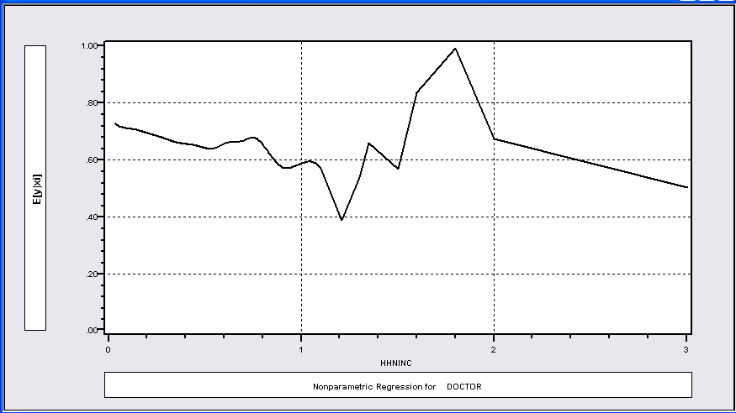
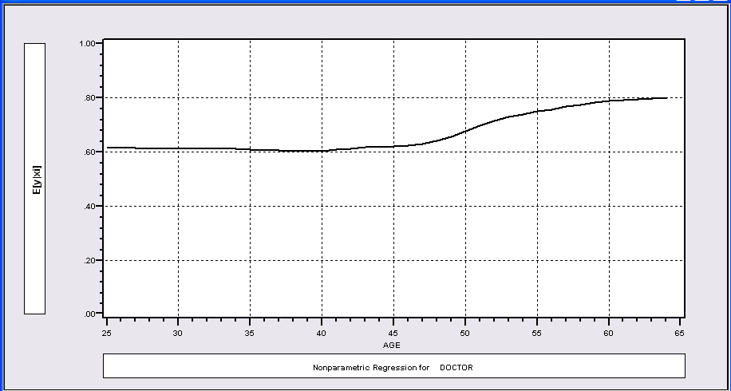
Nonparametric Regressions
P(Visit)=f(Age)
P(Visit)=f(Income)

Slide 19
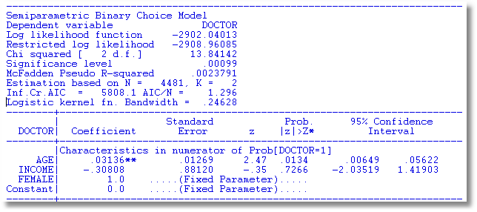
Klein and Spady Semiparametric
No specific distribution assumed
Note necessary normalizations. Coefficients are relative to FEMALE.
Prob(y_{i} = 1 | x_{i} ) =G(β’x) G is estimated by kernel methods

Slide 20
Fully Parametric
Index Function: U* = β’x + ε
Observation Mechanism: y = 1[U* > 0]
Distribution: ε ~ f(ε); Normal, Logistic, …
Maximum Likelihood Estimation:
Max(β) logL = Σ_{i} log Prob(Y_{i} = y_{i}|x_{i})

Slide 21
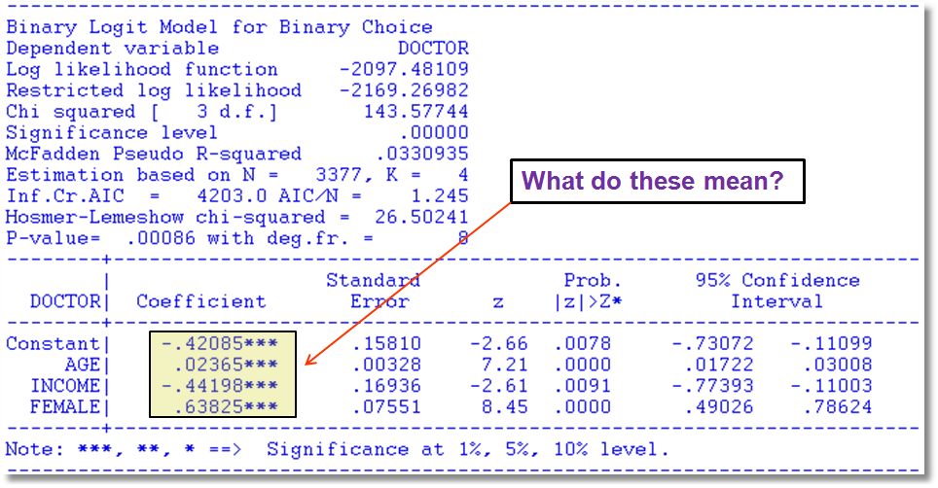
Fully Parametric Logit Model

Slide 22
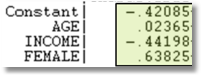

Parametric vs. Semiparametric
Parametric Logit Klein/Spady Semiparametric
.02365/.63825 = .04133
-.44198/.63825 = -.69249

Slide 23
Parametric Model Estimation
How to estimate α, β₁, β₂, β₃?
  It’s not regression
  The technique of maximum likelihood
  Prob[y=1] =
  Prob[ε > -(α + β₁ Age + β₂ Income + β₃ Sex)]
  Prob[y=0] = 1 - Prob[y=1]
  Requires a model for the probability

Slide 24
Completing the Model: F(ε)
The distribution
  Normal: PROBIT, natural for behavior
  Logistic: LOGIT, allows “thicker tails”
  Gompertz: EXTREME VALUE, asymmetric
  Others: mostly experimental
Does it matter?
  Yes, large difference in estimates
  Not much, quantities of interest are more stable.

Slide 25
Fully Parametric Logit Model

Slide 26
Estimated Binary Choice Models
LOGIT PROBIT EXTREME VALUE
Variable Estimate t-ratio Estimate t-ratio Estimate t-ratio
Constant -0.42085 -2.662 -0.25179 -2.600 0.00960 0.078
Age 0.02365 7.205 0.01445 7.257 0.01878 7.129
Income -0.44198 -2.610 -0.27128 -2.635 -0.32343 -2.536
Sex 0.63825 8.453 0.38685 8.472 0.52280 8.407
Log-L -2097.48 -2097.35 -2098.17
Log-L(0) -2169.27 -2169.27 -2169.27

Slide 27
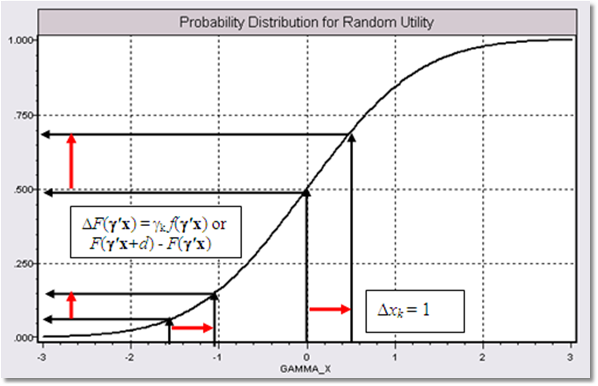
Effect on Predicted Probability of an Increase in Age
α + β₁ (Age+1) + β₂ (Income) + β₃ Sex
(β₁ > 0)

Slide 28
Partial Effects in Probability Models
Prob[Outcome] = some F(α+β₁Income…)
“Partial effect” = ∂F(α+β₁Income…) / ∂”x” (derivative)
  Partial effects are derivatives
  Result varies with model
    Logit: ∂F(α+β₁Income…) /∂x = Prob * (1-Prob) × β
    Probit: ∂ F(α+β₁Income…)/∂x = Normal density × β
    Extreme Value: ∂ F(α+β₁Income…)/∂x = Prob * (-log Prob) × β
  Scaling usually erases model differences

Slide 29
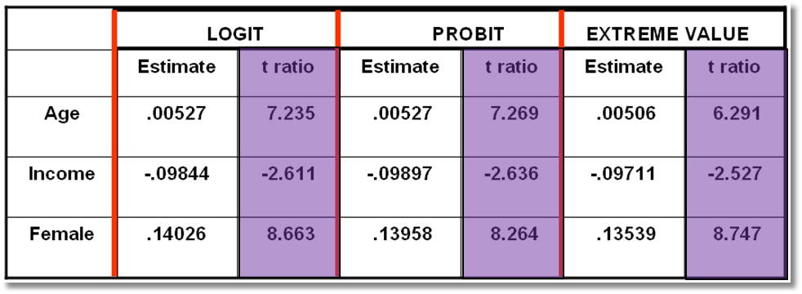

Estimated Partial Effects
LPM Estimates Partial Effects

Slide 30
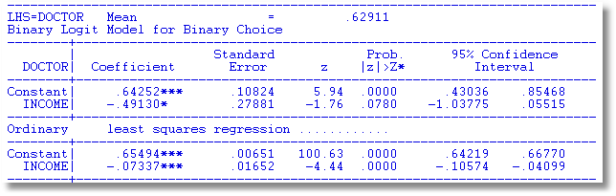
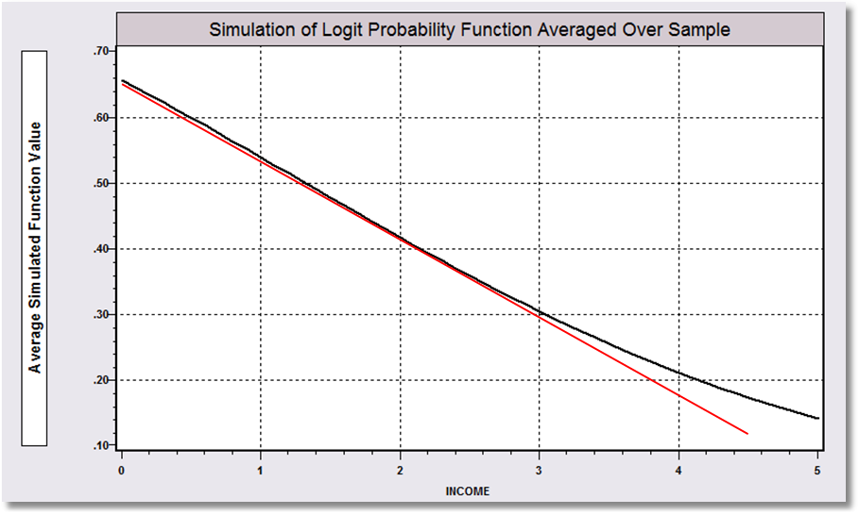
Linear Probability vs. Logit Binary Choice Model

Slide 31
The Linear Probability Model
Ultimately, I think the preference for one or the other is largely generational, with people who went to graduate school prior to the Credibility Revolution preferring the probit or logit [model] …
Marc F Bellemare: A Rant on Estimation with Binary Dependent Variables (Technical) http://marcfbellemare.com/wordpress/8951

Slide 32
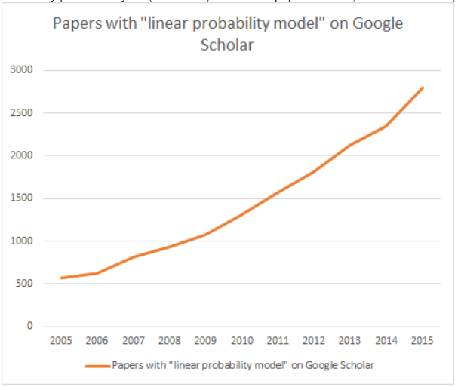

Slide 33
Maybe Not
… the right way to approach things is probably to estimate all three if possible, to present your preferred specification, and to explain in a footnote … that your results are robust to the choice of estimator.

Slide 34
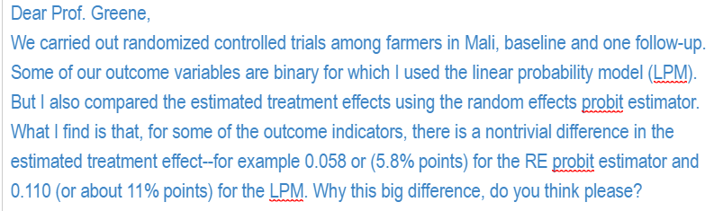

Slide 35
Partial Effect for a Dummy Variable
Prob[y_{i} = 1|x_{i},d_{i}] = F(β’x_{i}+γd_{i})
= conditional mean
Partial effect of d
Prob[y_{i} = 1|x_{i},d_{i}=1] - Prob[y_{i} = 1|x_{i},d_{i}=0]
Partial effect at the data means
Probit:

Slide 36
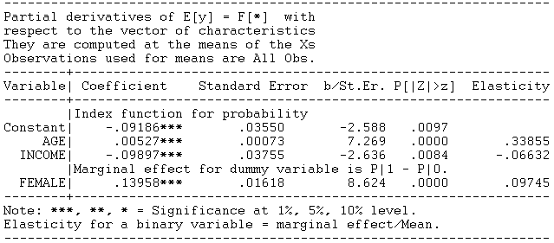
Probit Partial Effect – Dummy Variable

Slide 37
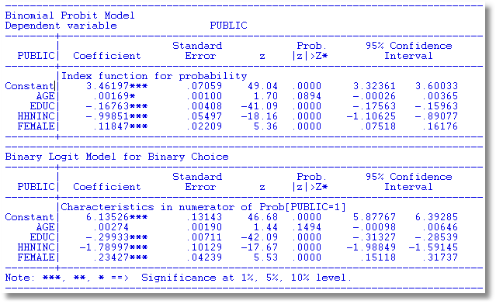
Binary Choice Models

Slide 38
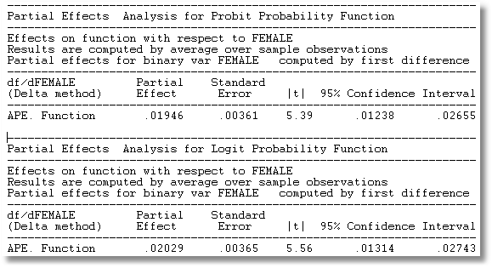
Average Partial Effects
Other things equal, the take up rate is about .02 higher in female headed households. The gross rates do not account for the facts that female headed households are a little older and a bit less educated, and both effects would push the take up rate up.

Slide 39
Computing Partial Effects
Compute at the data means?
  Simple
  Inference is well defined.
Average the individual effects
  More appropriate?
  Asymptotic standard errors are problematic.

Slide 40
Average Partial Effects

Slide 41
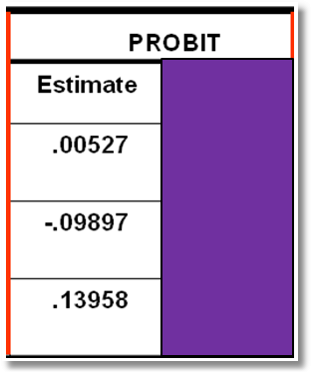
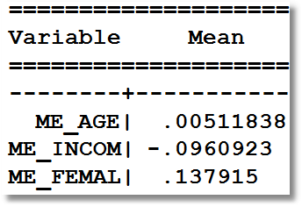
APE vs. Partial Effects at Means
Partial Effects at Means
Average Partial Effects

Slide 42
A Nonlinear Effect
P = F(age, age², income, female)
----------------------------------------------------------------------
Binomial Probit Model
Dependent variable DOCTOR
Log likelihood function -2086.94545
Restricted log likelihood -2169.26982
Chi squared [ 4 d.f.] 164.64874
Significance level .00000
--------+-------------------------------------------------------------
Variable| Coefficient Standard Error b/St.Er. P[|Z|>z] Mean of X
--------+-------------------------------------------------------------
|Index function for probability
Constant| 1.30811*** .35673 3.667 .0002
AGE| -.06487*** .01757 -3.693 .0002 42.6266
AGESQ| .00091*** .00020 4.540 .0000 1951.22
INCOME| -.17362* .10537 -1.648 .0994 .44476
FEMALE| .39666*** .04583 8.655 .0000 .46343
--------+-------------------------------------------------------------
Note: ***, **, * = Significance at 1%, 5%, 10% level.
----------------------------------------------------------------------

Slide 43
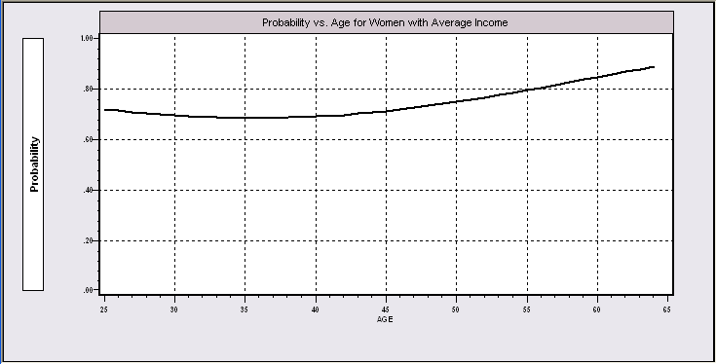
Nonlinear Effects
This is the probability implied by the model.

Slide 44
Partial Effects?
----------------------------------------------------------------------
Partial derivatives of E[y] = F[*] with
respect to the vector of characteristics
They are computed at the means of the Xs
Observations used for means are All Obs.
--------+-------------------------------------------------------------
Variable| Coefficient Standard Error b/St.Er. P[|Z|>z] Elasticity
--------+-------------------------------------------------------------
|Index function for probability
AGE| -.02363*** .00639 -3.696 .0002 -1.51422
AGESQ| .00033*** .729872D-04 4.545 .0000 .97316
INCOME| -.06324* .03837 -1.648 .0993 -.04228
|Marginal effect for dummy variable is P|1 - P|0.
FEMALE| .14282*** .01620 8.819 .0000 .09950
--------+-------------------------------------------------------------
Separate “partial effects” for Age and Age² make no sense.
They are not varying “partially.”

Slide 45
Practicalities of Nonlinearities
PROBIT ; Lhs=doctor
; Rhs=one,age,agesq,income,female
; Partial effects $
PROBIT ; Lhs=doctor
; Rhs=one,age,age*age,income,female $
PARTIALS ; Effects : age $

Slide 46
Partial Effect for Nonlinear Terms

Slide 47
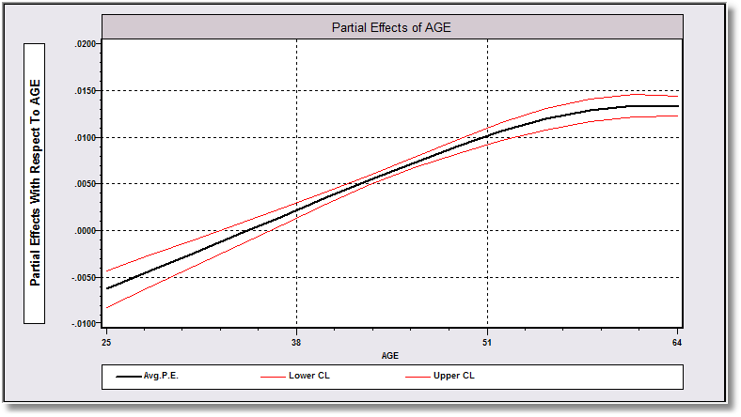
Average Partial Effect: Averaged over Sample Incomes and Genders for Specific Values of Age

Slide 48
Interaction Effects

Slide 49
Partial Effects?
The software does not know that Age_Inc = Age*Income.
----------------------------------------------------------------------
Partial derivatives of E[y] = F[*] with
respect to the vector of characteristics
They are computed at the means of the Xs
Observations used for means are All Obs.
--------+-------------------------------------------------------------
Variable| Coefficient Standard Error b/St.Er. P[|Z|>z] Elasticity
--------+-------------------------------------------------------------
|Index function for probability
Constant| -.18002** .07421 -2.426 .0153
AGE| .00732*** .00168 4.365 .0000 .46983
INCOME| .11681 .16362 .714 .4753 .07825
AGE_INC| -.00497 .00367 -1.355 .1753 -.14250
|Marginal effect for dummy variable is P|1 - P|0.
FEMALE| .13902*** .01619 8.586 .0000 .09703
--------+-------------------------------------------------------------

Slide 50
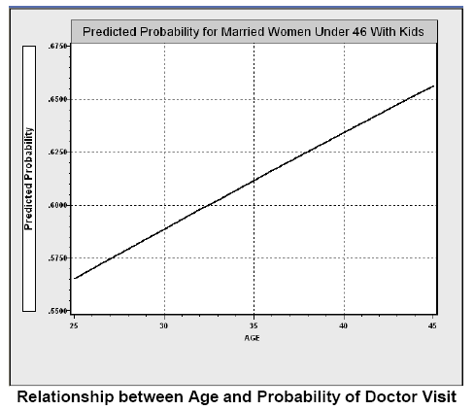
Direct Effect of Age

Slide 51
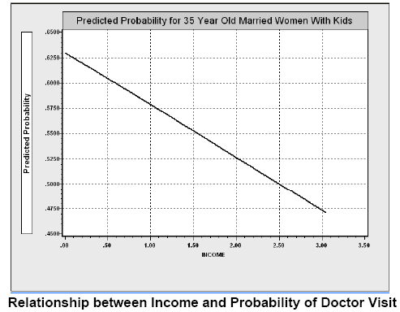
Income Effect

Slide 52
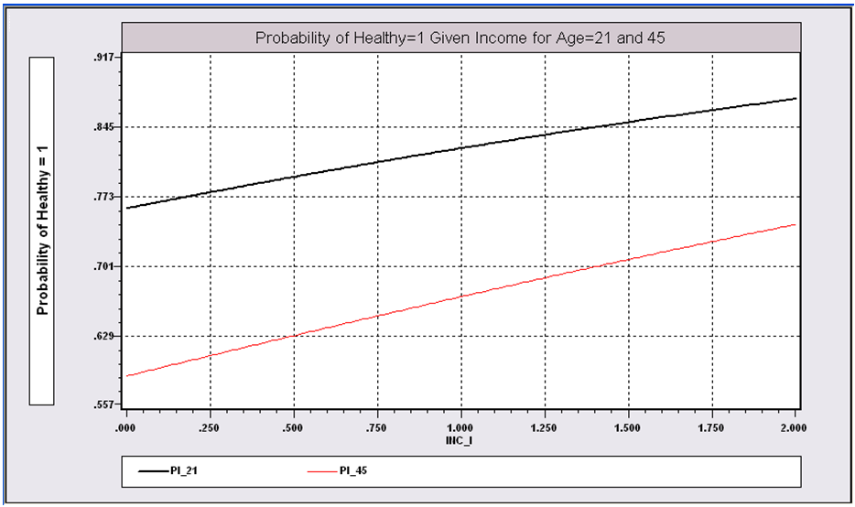
Income Effect on Health for Different Ages

Slide 53
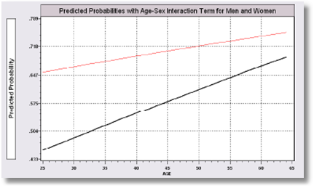
Gender – Age Interaction Effects

Slide 54
Interaction Effect

Slide 55
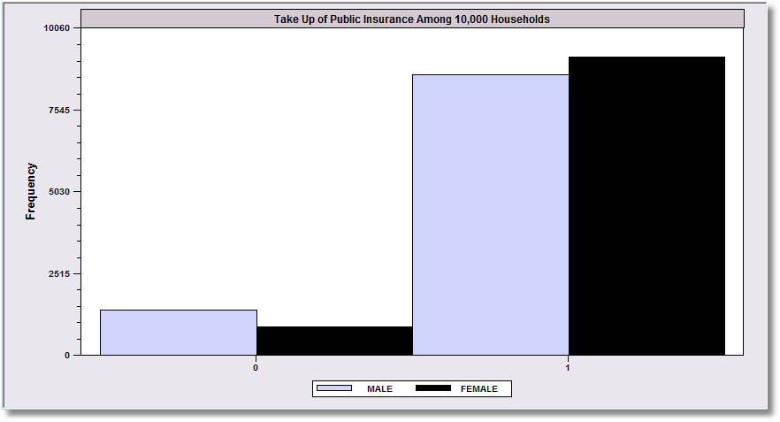
Margins and Odds Ratios
.8617
.9144
.1383
.0856
Overall take up rate of public insurance is greater for females than
males. What does the binary choice model say about the difference?

Slide 56
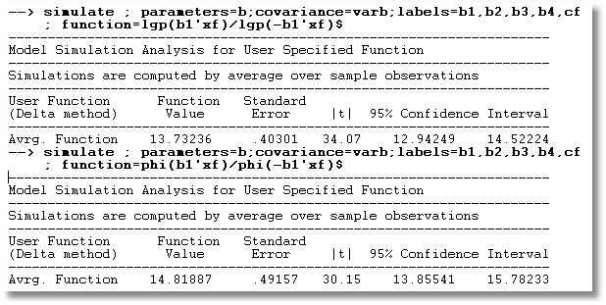
Odds Ratios for Insurance Takeup Model
Logit vs. Probit

Slide 57
Odds Ratios
This calculation is not meaningful if the model is not a binary logit model

Slide 58
Odds Ratio
Exp(γ) = multiplicative change in the odds ratio when z changes by 1 unit.
dOR(x,z)/dx = OR(x,z)*β, not exp(β)
The “odds ratio” is not a partial effect – it is not a derivative.
It is only meaningful when the odds ratio is itself of interest and the change of the variable by a whole unit is meaningful.
“Odds ratios” might be interesting for dummy variables

Slide 59
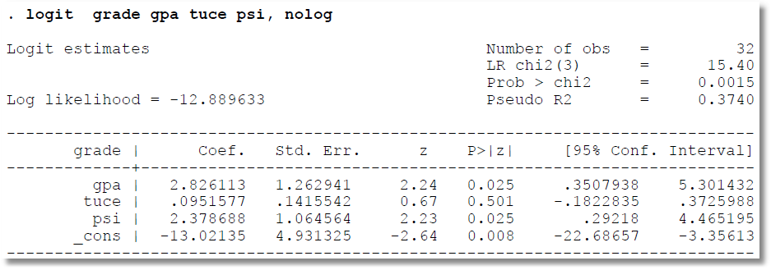
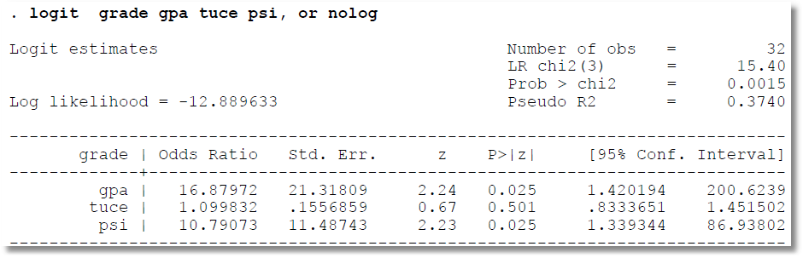
Odds Ratio = exp(b)

Slide 60
Standard Error = exp(b)*Std.Error(b)
Delta Method

Slide 61
z and P values are taken from
original coefficients, not the OR

Slide 62
Confidence limits are exp(b-1.96s) to exp(b+1.96s), not OR ± S.E.

Slide 63
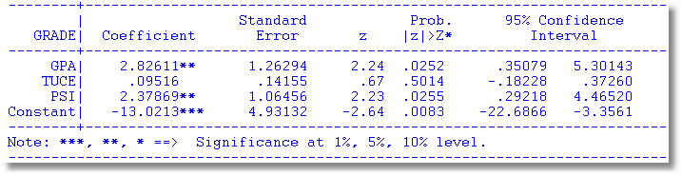
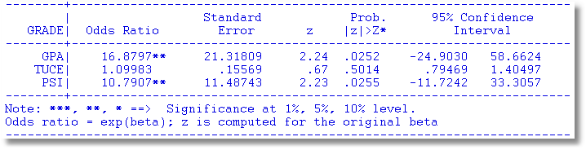

Slide 64
Margins are about units of measurement
Partial Effect
Odds Ratio
Takeup rate for female headed households is about 91.7%
Other things equal, female headed households are about .02 (about 2.1%) more likely to take up the public insurance
The odds that a female headed household takes up the insurance is about 14.
The odds go up by about 26% for a female headed household compared to a male headed household.

Slide 65

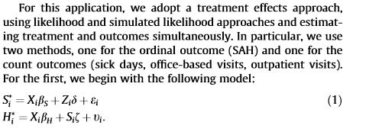

Slide 66
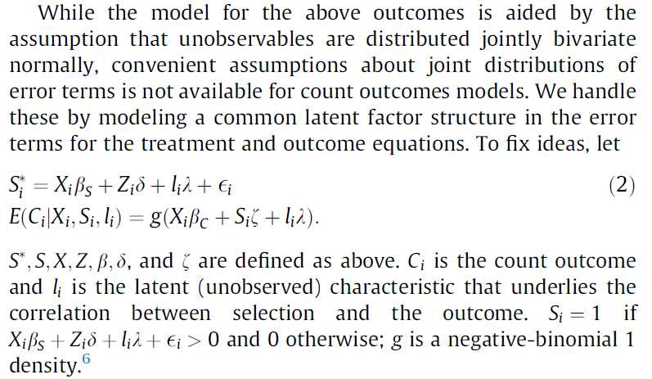


Slide 67

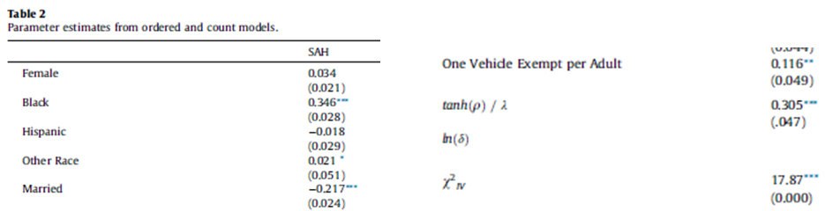

Slide 68
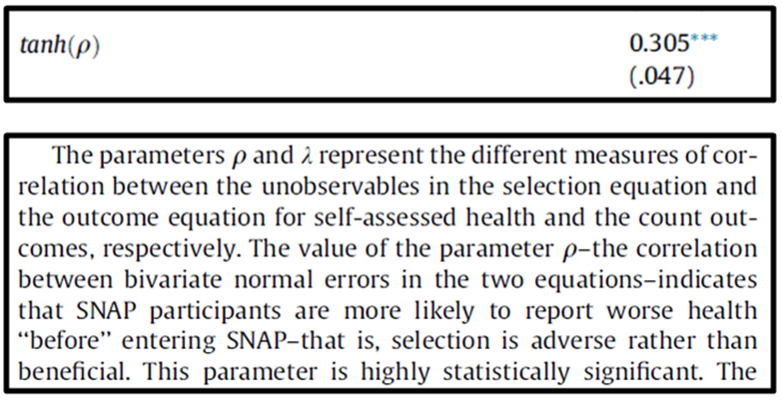

Slide 69
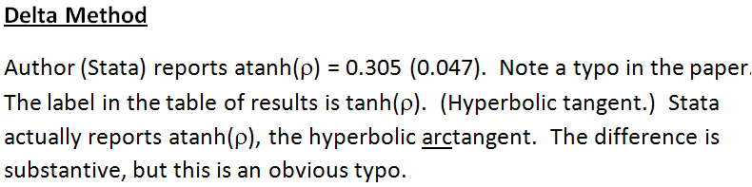
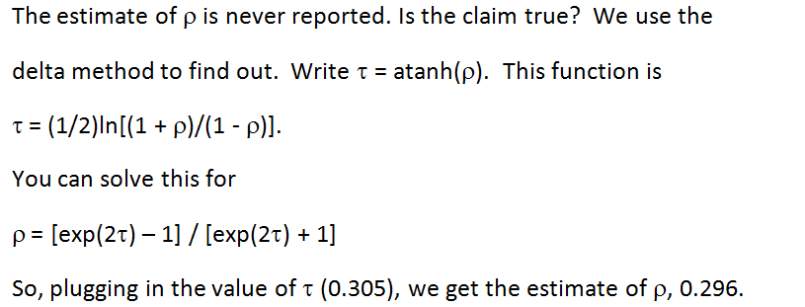

Slide 70
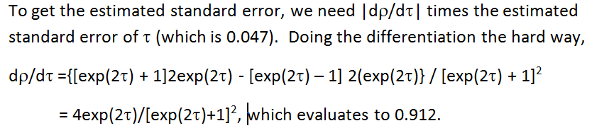

Slide 71
Measures of Fit in Binary Choice Models

Slide 72
How Well Does the Model Fit?
There is no R squared.
  Least squares for linear models is computed to maximize R²
  There are no residuals or sums of squares in a binary choice model
  The model is not computed to optimize the fit of the model to the data
How can we measure the “fit” of the model to the data?
  “Fit measures” computed from the log likelihood
    “Pseudo R squared” = 1 – logL/logL0
    Also called the “likelihood ratio index”
    Others… - these do not measure fit.
  Direct assessment of the effectiveness of the model at predicting the outcome

Slide 73
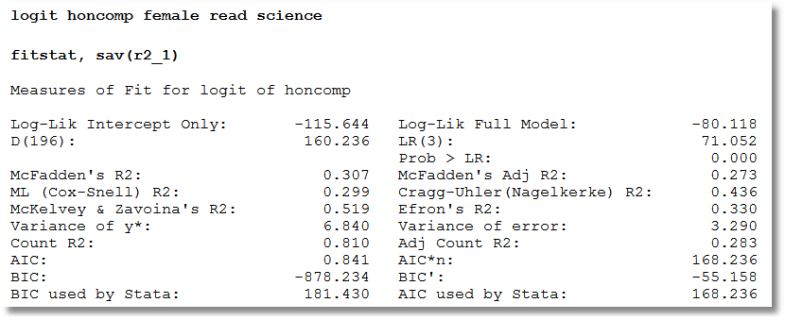
Fitstat
8 R-Squareds that range from .273 to .810

Slide 74
Pseudo R Squared
1 – LogL(model)/LogL(constant term only)
Also called “likelihood ratio index
Bounded by 0 and 1-ε
Increases when variables are added to the model
Values between 0 and 1 have no meaning
Can be surprisingly low.
Should not be used to compare nonnested models
  Use logL
  Use information criteria to compare nonnested models
Notes:
74

Slide 75
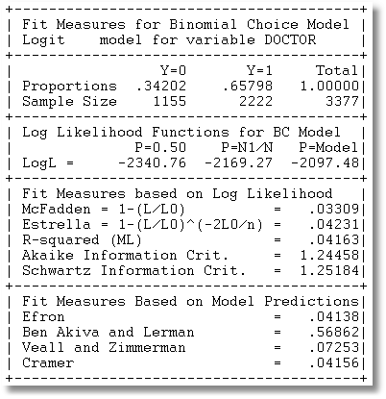
Fit Measures for a Logit Model

Slide 76
Fit Measures Based on Predictions
Computation
  Use the model to compute predicted probabilities
  Use the model and a rule to compute predicted y = 0 or 1
Fit measure compares predictions to actuals

Slide 77
Predicting the Outcome
Predicted probabilities
P = F(a + b₁Age + b₂Income + b₃Female+…)
Predicting outcomes
  Predict y=1 if P is “large”
  Use 0.5 for “large” (more likely than not)
  Generally, use
Count successes and failures

Slide 78
Cramer Fit Measure
+----------------------------------------+
| Fit Measures Based on Model Predictions|
| Efron = .04825|
| Veall and Zimmerman = .08365|
| Cramer = .04771|
+----------------------------------------+

Slide 79
Hypothesis Testing in Binary Choice Models

Slide 80
Hypothesis Tests
Restrictions: Linear or nonlinear functions of the model parameters
Structural ‘change’: Constancy of parameters
Specification Tests:
  Model specification: distribution
  Heteroscedasticity: Generally parametric

Slide 81
Hypothesis Testing
There is no F statistic
Comparisons of Likelihood Functions: Likelihood Ratio Tests
Distance Measures: Wald Statistics
Lagrange Multiplier Tests

Slide 82
Requires an Estimator of the Covariance Matrix for b

Slide 83
Robust Covariance Matrix(?)

Slide 84
The Robust Matrix is not Robust
To:
  Heteroscedasticity
  Correlation across observations
  Omitted heterogeneity
  Omitted variables (even if orthogonal)
  Wrong distribution assumed
  Wrong functional form for index function
In all cases, the estimator is inconsistent so a “robust” covariance matrix is pointless.
(In general, it is merely harmless.)

Slide 85
Estimated Robust Covariance Matrix for Logit Model
--------+-------------------------------------------------------------
Variable| Coefficient Standard Error b/St.Er. P[|Z|>z] Mean of X
--------+-------------------------------------------------------------
|Robust Standard Errors
Constant| 1.86428*** .68442 2.724 .0065
AGE| -.10209*** .03115 -3.278 .0010 42.6266
AGESQ| .00154*** .00035 4.446 .0000 1951.22
INCOME| .51206 .75103 .682 .4954 .44476
AGE_INC| -.01843 .01703 -1.082 .2792 19.0288
FEMALE| .65366*** .07585 8.618 .0000 .46343
--------+-------------------------------------------------------------
|Conventional Standard Errors Based on Second Derivatives
Constant| 1.86428*** .67793 2.750 .0060
AGE| -.10209*** .03056 -3.341 .0008 42.6266
AGESQ| .00154*** .00034 4.556 .0000 1951.22
INCOME| .51206 .74600 .686 .4925 .44476
AGE_INC| -.01843 .01691 -1.090 .2756 19.0288
FEMALE| .65366*** .07588 8.615 .0000 .46343

Slide 86
Base Model
----------------------------------------------------------------------
Binary Logit Model for Binary Choice
Dependent variable DOCTOR
Log likelihood function -2085.92452
Restricted log likelihood -2169.26982
Chi squared [ 5 d.f.] 166.69058
Significance level .00000
McFadden Pseudo R-squared .0384209
Estimation based on N = 3377, K = 6
--------+-------------------------------------------------------------
Variable| Coefficient Standard Error b/St.Er. P[|Z|>z] Mean of X
--------+-------------------------------------------------------------
Constant| 1.86428*** .67793 2.750 .0060
AGE| -.10209*** .03056 -3.341 .0008 42.6266
AGESQ| .00154*** .00034 4.556 .0000 1951.22
INCOME| .51206 .74600 .686 .4925 .44476
AGE_INC| -.01843 .01691 -1.090 .2756 19.0288
FEMALE| .65366*** .07588 8.615 .0000 .46343
--------+-------------------------------------------------------------
H₀: Age is not a significant
determinant of
Prob(Doctor = 1)
H₀: β₂ = β₃ = β₅ = 0

Slide 87
Likelihood Ratio Tests
Null hypothesis restricts the parameter vector
Alternative releases the restriction
Test statistic: Chi-squared =
2 (LogL|Unrestricted model –
LogL|Restrictions) > 0
Degrees of freedom = number of restrictions

Slide 88
LR Test of H₀
UNRESTRICTED MODEL
Binary Logit Model for Binary Choice
Dependent variable DOCTOR
Log likelihood function -2085.92452
Restricted log likelihood -2169.26982
Chi squared [ 5 d.f.] 166.69058
Significance level .00000
McFadden Pseudo R-squared .0384209
Estimation based on N = 3377, K = 6
RESTRICTED MODEL
Binary Logit Model for Binary Choice
Dependent variable DOCTOR
Log likelihood function -2124.06568
Restricted log likelihood -2169.26982
Chi squared [ 2 d.f.] 90.40827
Significance level .00000
McFadden Pseudo R-squared .0208384
Estimation based on N = 3377, K = 3
Chi squared[3] = 2[-2085.92452 - (-2124.06568)] = 77.46456

Slide 89
Wald Test
Unrestricted parameter vector is estimated
Discrepancy: q= Rb – m
Variance of discrepancy is estimated:
Var[q] = RVR’
Wald Statistic is q’[Var(q)]⁻¹q = q’[RVR’]⁻¹q

Slide 90
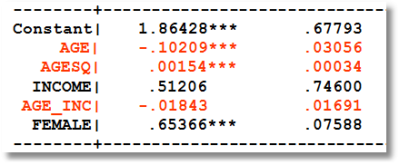
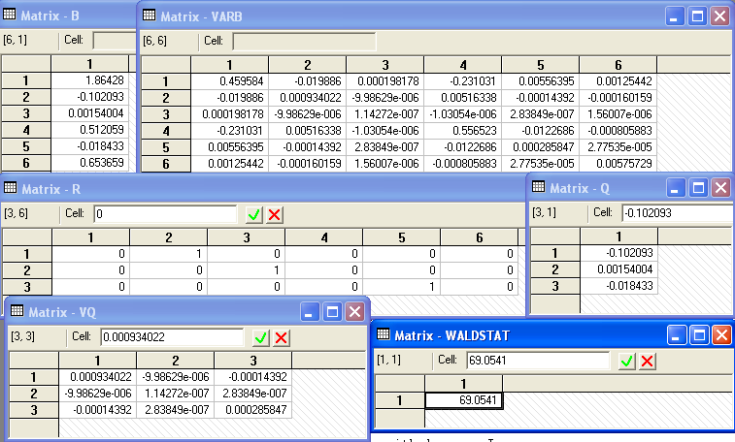
Carrying Out a Wald Test
b₀
V₀
R
Rb₀ - m
Wald
RV₀R′
Chi squared[3] = 69.0541

Slide 91
Lagrange Multiplier Test
Restricted model is estimated
Derivatives of unrestricted model and variances of derivatives are computed at restricted estimates
Wald test of whether derivatives are zero tests the restrictions
Usually hard to compute – difficult to program the derivatives and their variances.

Slide 92
LM Test for a Logit Model
Compute b₀ (subject to restictions)
(e.g., with zeros in appropriate positions.
Compute P_{i}(b₀) for each observation.
Compute e_{i}(b₀) = [y_{i} – P_{i}(b₀)]
Compute g_{i}(b₀) = x_{i}e_{i} using full x_{i} vector
LM = [Σ_{i}g_{i}(b₀)]′[Σ_{i}g_{i}(b₀)g_{i}(b₀)′]⁻¹[Σ_{i}g_{i}(b₀)]

Slide 93
Test Results
Matrix DERIV has 6 rows and 1 columns.
+-------------+
1| .2393443D-05 zero from FOC
2| 2268.60186
3| .2122049D+06
4| .9683957D-06 zero from FOC
5| 849.70485
6| .2380413D-05 zero from FOC
+-------------+
Matrix LM has 1 rows and 1 columns.
1
+-------------+
1| 81.45829 |
+-------------+
Wald Chi squared[3] = 69.0541
LR Chi squared[3] = 2[-2085.92452 - (-2124.06568)] = 77.46456

Slide 94
A Test of Structural Stability
In the original application, separate models were fit for men and women.
We seek a counterpart to the Chow test for linear models.
Use a likelihood ratio test.

Slide 95
Testing Structural Stability
Fit the same model in each subsample
Unrestricted log likelihood is the sum of the subsample log likelihoods: LogL1
Pool the subsamples, fit the model to the pooled sample
Restricted log likelihood is that from the pooled sample: LogL0
Chi-squared = 2*(LogL1 – LogL0)
degrees of freedom = (K-1)*model size.

Slide 96
Structural Change (Over Groups) Test
----------------------------------------------------------------------
Dependent variable DOCTOR
Pooled Log likelihood function -2123.84754
--------+-------------------------------------------------------------
Variable| Coefficient Standard Error b/St.Er. P[|Z|>z] Mean of X
--------+-------------------------------------------------------------
Constant| 1.76536*** .67060 2.633 .0085
AGE| -.08577*** .03018 -2.842 .0045 42.6266
AGESQ| .00139*** .00033 4.168 .0000 1951.22
INCOME| .61090 .74073 .825 .4095 .44476
AGE_INC| -.02192 .01678 -1.306 .1915 19.0288
--------+-------------------------------------------------------------
Male Log likelihood function -1198.55615
--------+-------------------------------------------------------------
Constant| 1.65856* .86595 1.915 .0555
AGE| -.10350*** .03928 -2.635 .0084 41.6529
AGESQ| .00165*** .00044 3.760 .0002 1869.06
INCOME| .99214 .93005 1.067 .2861 .45174
AGE_INC| -.02632 .02130 -1.235 .2167 19.0016
--------+-------------------------------------------------------------
Female Log likelihood function -885.19118
--------+-------------------------------------------------------------
Constant| 2.91277*** 1.10880 2.627 .0086
AGE| -.10433** .04909 -2.125 .0336 43.7540
AGESQ| .00143*** .00054 2.673 .0075 2046.35
INCOME| -.17913 1.27741 -.140 .8885 .43669
AGE_INC| -.00729 .02850 -.256 .7981 19.0604
--------+-------------------------------------------------------------
Chi squared[5] = 2[-885.19118+(-1198.55615) – (-2123.84754] = 80.2004

Slide 97
Inference About
Partial Effects

Slide 98
Partial Effects for Binary Choice

Slide 99
The Delta Method

Slide 100
Computing Effects
Compute at the data means?
  Simple
  Inference is well defined
Average the individual effects
  More appropriate?
  Asymptotic standard errors a bit more complicated.

Slide 101
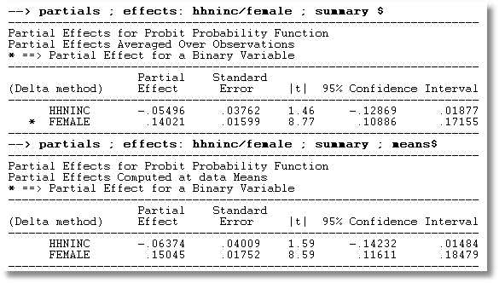
APE vs. Partial Effects at the Mean

Slide 102
Partial Effect for Nonlinear Terms

Slide 103
Average Partial Effect: Averaged over Sample Incomes and Genders for Specific Values of Age

Slide 104
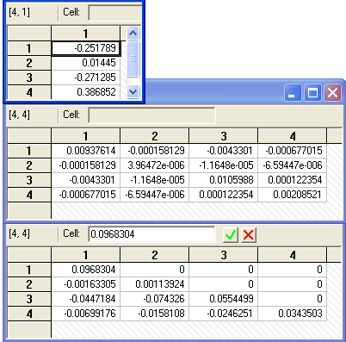
Krinsky and Robb
Estimate β by Maximum Likelihood with b
Estimate asymptotic covariance matrix with V
Draw R observations b(r) from the normal
population N[b,V]
b(r) = b + C*v(r), v(r) drawn from N[0,I]
C = Cholesky matrix, V = CC’
Compute partial effects d(r) using b(r)
Compute the sample variance of d(r),r=1,…,R
Use the sample standard deviations of the R observations to estimate the sampling standard errors for the partial effects.

Slide 105
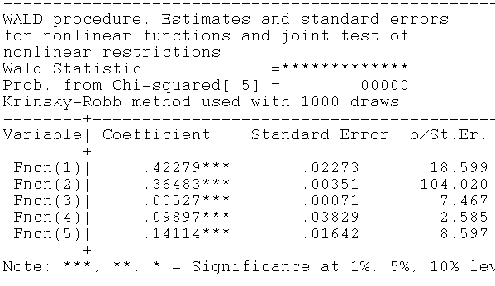
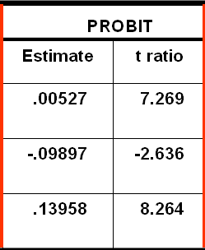
Krinsky and Robb
Delta Method

Slide 106
Panel Data Models

Slide 107

Unbalanced Panels
Most theoretical results are for balanced panels.
Most real world panels are unbalanced.
Often the gaps are caused by attrition.
The major question is whether the gaps are ‘missing completely at random.’ If not, the observation mechanism is endogenous, and at least some methods will produce questionable results.
Researchers rarely have any reason to treat the data as nonrandomly sampled. (This is good news.)
GSOEP
Group Sizes

Slide 108
Unbalanced Panels and Attrition ‘Bias’
Test for ‘attrition bias.’ (Verbeek and Nijman, Testing for Selectivity Bias in Panel Data Models, International Economic Review, 1992, 33, 681-703.
  Variable addition test using covariates of presence in the panel
  Nonconstructive – what to do next?
Do something about attrition bias. (Wooldridge, Inverse Probability Weighted M-Estimators for Sample Stratification and Attrition, Portuguese Economic Journal, 2002, 1: 117-139)
  Stringent assumptions about the process
  Model based on probability of being present in each wave of the panel
We return to these in discussion of applications of ordered choice models

Slide 109
Fixed and Random Effects
Model: Feature of interest y_{it}
Probability distribution or conditional mean
  Observable covariates x_{it}, z_{i}
  Individual specific heterogeneity, u_{i}
  Probability or mean, f(x_{it},z_{i},u_{i})
Random effects: E[u_{i}|x_{i1},…,x_{iT},z_{i}] = 0
Fixed effects: E[u_{i}|x_{i1},…,x_{iT},z_{i}] = g(X_{i},z_{i}).
The difference relates to how u_{i} relates to the observable covariates.

Slide 110
Fixed and Random Effects in Regression
y_{it} = a_{i} + b’x_{it} + e_{it}
  Random effects: Two step FGLS. First step is OLS
  Fixed effects: OLS based on group mean differences
How do we proceed for a binary choice model?
  y_{it}* = a_{i} + b’x_{it} + e_{it}
  y_{it} = 1 if y_{it}* > 0, 0 otherwise.
Neither ols nor two step FGLS works (even approximately) if the model is nonlinear.
  Models are fit by maximum likelihood, not OLS or GLS
  New complications arise that are absent in the linear case.

Slide 111
Fixed vs. Random Effects
Linear Models
Fixed Effects
  Robust to both cases
  Use OLS
  Convenient
Random Effects
  Inconsistent in FE case: effects correlated with X
  Use FGLS: No necessary distributional assumption
  Smaller number of parameters
  Inconvenient to compute
Nonlinear Models
Fixed Effects
  Usually inconsistent because of ‘IP’ problem
  Fit by full ML
  Complicated
Random Effects
  Inconsistent in FE case : effects correlated with X
  Use full ML: Distributional assumption
  Smaller number of parameters
  Always inconvenient to compute

Slide 112
Binary Choice Model
Model is Prob(y_{it} = 1|x_{it}) (z_{i} is embedded in x_{it})
In the presence of heterogeneity,
Prob(y_{it} = 1|x_{it},u_{i}) = F(x_{it},u_{i})

Slide 113
Panel Data Binary Choice Models
Random Utility Model for Binary Choice
U_{it} = α + β’x_{it} + ε_{it} + Person i specific effect
Fixed effects using “dummy” variables
U_{it} = α_{i} + β’x_{it} + ε_{it}
Random effects using omitted heterogeneity
U_{it} = α + β’x_{it} + ε_{it} + u_{i}
Same outcome mechanism: Y_{it} = 1[U_{it} > 0]

Slide 114
Ignoring Unobserved Heterogeneity
(Random Effects)

Slide 115
Ignoring Heterogeneity in the RE Model

Slide 116
Ignoring Heterogeneity (Broadly)
Presence will generally make parameter estimates look smaller than they would otherwise.
Ignoring heterogeneity will definitely distort standard errors.
Partial effects based on the parametric model may not be affected very much.
Is the pooled estimator ‘robust?’ Less so than in the linear model case.

Slide 117
Effect of Clustering
Y_{it} must be correlated with Y_{is} across periods
Pooled estimator ignores correlation
Broadly, y_{it} = E[y_{it}|x_{it}] + w_{it},
  E[y_{it}|x_{it}] = Prob(y_{it} = 1|x_{it})
  w_{it} is correlated across periods
Ignoring the correlation across periods generally leads to underestimating standard errors.

Slide 118
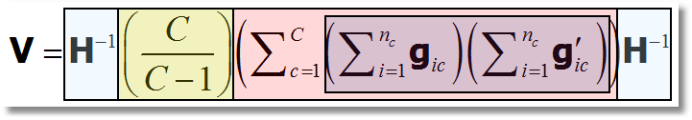
‘Cluster’ Corrected Covariance Matrix

Slide 119
Cluster Correction: Doctor
----------------------------------------------------------------------
Binomial Probit Model
Dependent variable DOCTOR
Log likelihood function -17457.21899
--------+-------------------------------------------------------------
Variable| Coefficient Standard Error b/St.Er. P[|Z|>z] Mean of X
--------+-------------------------------------------------------------
| Conventional Standard Errors
Constant| -.25597*** .05481 -4.670 .0000
AGE| .01469*** .00071 20.686 .0000 43.5257
EDUC| -.01523*** .00355 -4.289 .0000 11.3206
HHNINC| -.10914** .04569 -2.389 .0169 .35208
FEMALE| .35209*** .01598 22.027 .0000 .47877
--------+-------------------------------------------------------------
| Corrected Standard Errors
Constant| -.25597*** .07744 -3.305 .0009
AGE| .01469*** .00098 15.065 .0000 43.5257
EDUC| -.01523*** .00504 -3.023 .0025 11.3206
HHNINC| -.10914* .05645 -1.933 .0532 .35208
FEMALE| .35209*** .02290 15.372 .0000 .47877
--------+-------------------------------------------------------------

Slide 120
Modeling a Binary Outcome
Did firm i produce a product or process innovation in year t ? y_{it} : 1=Yes/0=No
Observed N=1270 firms for T=5 years, 1984-1988
Observed covariates: x_{it} = Industry, competitive pressures, size, productivity, etc.
How to model?
  Binary outcome
  Correlation across time
  A “Panel Probit Model”
Convenient Estimators for the Panel Probit Model, I. Bertshcek and M. Lechner, Journal of Econometrics, 1998
Notes:
120

Slide 121
Application: Innovation

Slide 123
A Random Effects Model

Slide 124
A Computable Log Likelihood

Slide 125
Quadrature – Butler and Moffitt

Slide 126


Quadrature Log Likelihood
9 Point Hermite Quadrature
Weights
Nodes

Slide 127
Simulation

Slide 128
Random Effects Model: Quadrature
----------------------------------------------------------------------
Random Effects Binary Probit Model
Dependent variable DOCTOR
Log likelihood function -16290.72192 ⬅ Random Effects
Restricted log likelihood -17701.08500 ⬅ Pooled
Chi squared [ 1 d.f.] 2820.72616
Significance level .00000
McFadden Pseudo R-squared .0796766
Estimation based on N = 27326, K = 5
Unbalanced panel has 7293 individuals
--------+-------------------------------------------------------------
Variable| Coefficient Standard Error b/St.Er. P[|Z|>z] Mean of X
--------+-------------------------------------------------------------
Constant| -.11819 .09280 -1.273 .2028
AGE| .02232*** .00123 18.145 .0000 43.5257
EDUC| -.03307*** .00627 -5.276 .0000 11.3206
INCOME| .00660 .06587 .100 .9202 .35208
Rho| .44990*** .01020 44.101 .0000
--------+-------------------------------------------------------------
|Pooled Estimates using the Butler and Moffitt method
Constant| .02159 .05307 .407 .6842
AGE| .01532*** .00071 21.695 .0000 43.5257
EDUC| -.02793*** .00348 -8.023 .0000 11.3206
INCOME| -.10204** .04544 -2.246 .0247 .35208
--------+-------------------------------------------------------------

Slide 129
Random Effects Model: Simulation
----------------------------------------------------------------------
Random Coefficients Probit Model
Dependent variable DOCTOR (Quadrature Based)
Log likelihood function -16296.68110 (-16290.72192)
Restricted log likelihood -17701.08500
Chi squared [ 1 d.f.] 2808.80780
Simulation based on 50 Halton draws
--------+-------------------------------------------------
Variable| Coefficient Standard Error b/St.Er. P[|Z|>z]
--------+-------------------------------------------------
|Nonrandom parameters
AGE| .02226*** .00081 27.365 .0000 ( .02232)
EDUC| -.03285*** .00391 -8.407 .0000 (-.03307)
HHNINC| .00673 .05105 .132 .8952 ( .00660)
|Means for random parameters
Constant| -.11873** .05950 -1.995 .0460 (-.11819)
|Scale parameters for dists. of random parameters
Constant| .90453*** .01128 80.180 .0000
--------+-------------------------------------------------------------
Using quadrature, a = -.11819. Implied ρ from these estimates is
.90454²/(1+.90453²) = .449998 compared to .44990 using quadrature.

Slide 130
Fixed Effects Models
U_{it} = α_{i} + β’xit + ε_{it}
For the linear model, α_{i} and β (easily) estimated separately using least squares
For most nonlinear models, it is not possible to condition out the fixed effects. (Mean deviations does not work.)
Even when it is possible to estimate β without α_{i}, in order to compute partial effects, predictions, or anything else interesting, some kind of estimate of α_{i} is still needed.

Slide 131
Fixed Effects Models
Estimate with dummy variable coefficients
Uit = α_{i} + β’xit + ε_{it}
Can be done by “brute force” even for 10,000s of individuals
F(.) = appropriate probability for the observed outcome
Compute β and α_{i} for i=1,…,N (may be large)

Slide 132
Unconditional Estimation
Maximize the whole log likelihood
Difficult! Many (thousands) of parameters.
Feasible – NLOGIT (2001) (‘Brute force’)
(One approach is just to create the thousands of dummy variables – SAS.)

Slide 133

Fixed Effects Health Model
Groups in which y_{it} is always = 0 or always = 1. Cannot compute α_{i}.

Slide 134
Conditional Estimation
Principle: f(y_{i1},y_{i2},… | some statistic) is free of the fixed effects for some models.
Maximize the conditional log likelihood, given the statistic.
Can estimate β without having to estimate α_{i}.
Only feasible for the logit model. (Poisson and a few other continuous variable models. No other discrete choice models.)

Slide 135
Binary Logit Conditional Probabiities

Slide 136
Example: Two Period Binary Logit

Slide 137
Estimating Partial Effects
“The fixed effects logit estimator of β immediately gives us the effect of each element of x_{i} on the log-odds ratio… Unfortunately, we cannot estimate the partial effects… unless we plug in a value for α_{i}. Because the distribution of α_{i} is unrestricted – in particular, E[α_{i}] is not necessarily zero – it is hard to know what to plug in for α_{i}. In addition, we cannot estimate average partial effects, as doing so would require finding E[Λ(x_{it} β+ α_{i})], a task that apparently requires specifying a distribution for α_{i}.”
(Wooldridge, 2010)
Notes:
137

Slide 138
Advantages and Disadvantages of the FE Model
Advantages
  Allows correlation of effect and regressors
  Fairly straightforward to estimate
  Simple to interpret
Disadvantages
  Model may not contain time invariant variables
  Not necessarily simple to estimate if very large samples (Stata just creates the thousands of dummy variables)
  The incidental parameters problem: Small T bias

Slide 139
Incidental Parameters Problems: Conventional Wisdom
General: The unconditional MLE is biased in samples with fixed T except in special cases such as linear or Poisson regression (even when the FEM is the right model).
  The conditional estimator (that bypasses
  estimation of α_{i}) is consistent.
Specific: Upward bias (experience with probit and logit) in estimators of β. Exactly 100% when T = 2. Declines as T increases.

Slide 140
Some Familiar Territory – A Monte Carlo Study of the FE Estimator: Probit vs. Logit
Estimates of Coefficients and Marginal Effects at the Implied Data Means
Results are scaled so the desired quantity being estimated
(β, δ, marginal effects) all equal 1.0 in the population.

Slide 141
Bias Correction Estimators
Motivation: Undo the incidental parameters bias in the fixed effects probit model:
  (1) Maximize a penalized log likelihood function, or
  (2) Directly correct the estimator of β
Advantages
  For (1) estimates α_{i} so enables partial effects
  Estimator is consistent under some circumstances
  (Possibly) corrects in dynamic models
Disadvantage
  No time invariant variables in the model
  Practical implementation
  Extension to other models? (Ordered probit model (maybe) – see JBES 2009)

Slide 142
A Mundlak Correction for the FE Model
“Correlated Random Effects”

Slide 143

Mundlak Correction

Slide 144
A Variable Addition Test for FE vs. RE
The Wald statistic of 45.27922 and the likelihood ratio statistic of 40.280 are both far larger than the critical chi squared with 5 degrees of freedom, 11.07. This suggests that for these data, the fixed effects model is the preferred framework.

Slide 145
Fixed Effects Models Summary
Incidental parameters problem if T < 10 (roughly)
Inconvenience of computation
Appealing specification
Alternative semiparametric estimators?
  Theory not well developed for T > 2
  Not informative for anything but slopes (e.g., predictions and marginal effects)
Ignoring the heterogeneity definitely produces an inconsistent estimator (even with cluster correction!)
Mundlak correction is a useful common approach. (Many recent applications)

