Slide 1
Empirical Methods for
Microeconomic Applications
University of Lugano, Switzerland
May 27-31, 2019
William Greene
Department of Economics
Stern School of Business
New York University

Slide 2






1C. Extensions of Binary Choice Models

Slide 3
Agenda for 1C
Endogenous RHS Variables
Sample Selection
Dynamic Binary Choice Model
Bivariate Binary Choice
Simultaneous Equations
Ordered Choices
  Ordered Choice Model
  Application to BHPS

Slide 4
Endogeneity

Slide 5

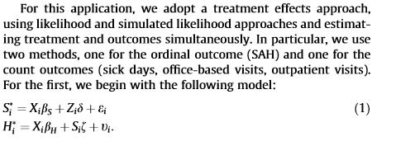

Slide 6
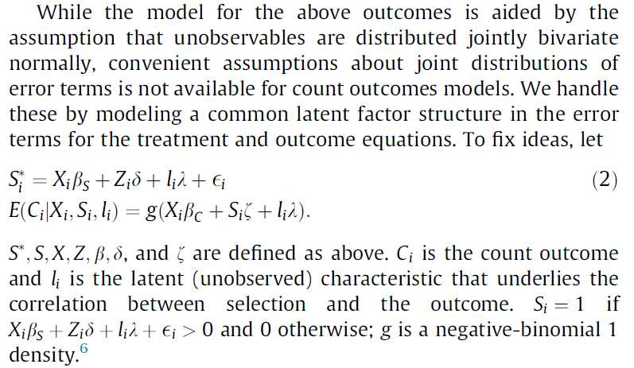


Slide 7
Endogenous RHS Variable
U* = β’x + θh + ε
y = 1[U* > 0]
E[ε|h] ≠ 0 (h is endogenous)
  Case 1: h is continuous
  Case 2: h is binary, e.g., a treatment effect
Approaches
  Parametric: Maximum Likelihood
  Semiparametric (not developed here):
    GMM
    Various approaches for case 2

Slide 8
Endogenous Continuous Variable
U* = β’x + θh + ε
y = 1[U* > 0] ⇐
h = α’z + u
E[ε|h] ≠ 0 ⬄ Cov[u, ε] ≠ 0
Additional Assumptions:
(u,ε) ~ N[(0,0),(σ_{u}², ρσ_{u}, 1)]
z = a valid set of exogenous
variables, uncorrelated with (u,ε)
Correlation = ρ.
This is the source of the endogeneity

Slide 9


Endogenous Income in Health
Income responds to
Age, Age², Educ, Married, Kids, Gender
0 = Not Healthy
1 = Healthy
Healthy = 0 or 1
Age, Married, Kids, Gender, Income
Determinants of Income (observed and unobserved) also determine health satisfaction.
Notes:
9

Slide 10
Estimation by ML (Control Function)

Slide 11
Two Approaches to ML

Slide 12
FIML Estimates
----------------------------------------------------------------------
Probit with Endogenous RHS Variable
Dependent variable HEALTHY
Log likelihood function -6464.60772
--------+-------------------------------------------------------------
Variable| Coefficient Standard Error b/St.Er. P[|Z|>z] Mean of X
--------+-------------------------------------------------------------
|Coefficients in Probit Equation for HEALTHY
Constant| 1.21760*** .06359 19.149 .0000
AGE| -.02426*** .00081 -29.864 .0000 43.5257
MARRIED| -.02599 .02329 -1.116 .2644 .75862
HHKIDS| .06932*** .01890 3.668 .0002 .40273
FEMALE| -.14180*** .01583 -8.959 .0000 .47877
INCOME| .53778*** .14473 3.716 .0002 .35208
|Coefficients in Linear Regression for INCOME
Constant| -.36099*** .01704 -21.180 .0000
AGE| .02159*** .00083 26.062 .0000 43.5257
AGESQ| -.00025*** .944134D-05 -26.569 .0000 2022.86
EDUC| .02064*** .00039 52.729 .0000 11.3206
MARRIED| .07783*** .00259 30.080 .0000 .75862
HHKIDS| -.03564*** .00232 -15.332 .0000 .40273
FEMALE| .00413** .00203 2.033 .0420 .47877
|Standard Deviation of Regression Disturbances
Sigma(w)| .16445*** .00026 644.874 .0000
|Correlation Between Probit and Regression Disturbances
Rho(e,w)| -.02630 .02499 -1.052 .2926
--------+-------------------------------------------------------------

Slide 13
Partial Effects: Scaled Coefficients

Slide 14
Endogenous Binary Variable
U* = β’x + θh + ε
y = 1[U* > 0]
h* = α’z + u
h = 1[h* > 0]
E[ε|h*] ≠ 0 ⬄ Cov[u, ε] ≠ 0
Additional Assumptions:
(u,ε) ~ N[(0,0),(σ_{u}², ρσ_{u}, 1)]
z = a valid set of exogenous
variables, uncorrelated with (u,ε)
⇐
Correlation = ρ.
This is the source of the endogeneity

Slide 15

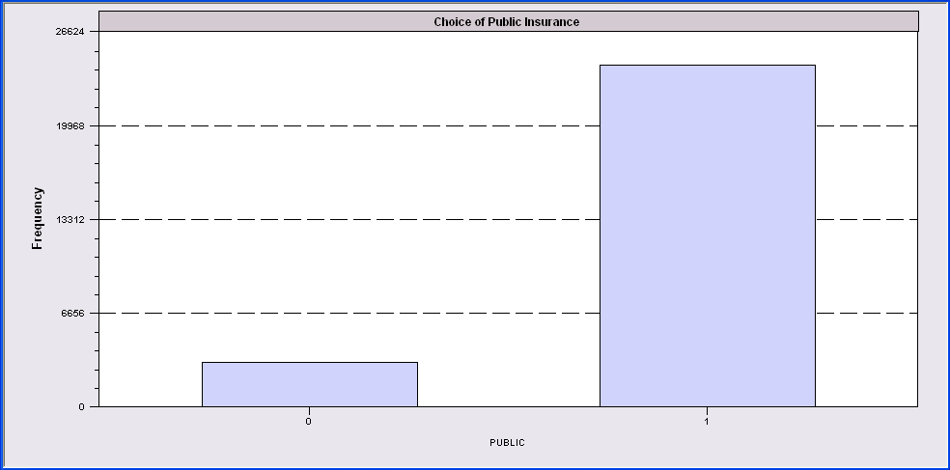
Endogenous Binary Variable
Doctor = F(age,age²,income,female,Public)
Public = F(age,educ,income,married,kids,female)

Slide 16
FIML Estimates
----------------------------------------------------------------------
FIML Estimates of Bivariate Probit Model
Dependent variable DOCPUB
Log likelihood function -25671.43905
Estimation based on N = 27326, K = 14
--------+-------------------------------------------------------------
Variable| Coefficient Standard Error b/St.Er. P[|Z|>z] Mean of X
--------+-------------------------------------------------------------
|Index equation for DOCTOR
Constant| .59049*** .14473 4.080 .0000
AGE| -.05740*** .00601 -9.559 .0000 43.5257
AGESQ| .00082*** .681660D-04 12.100 .0000 2022.86
INCOME| .08883* .05094 1.744 .0812 .35208
FEMALE| .34583*** .01629 21.225 .0000 .47877
PUBLIC| .43533*** .07357 5.917 .0000 .88571
|Index equation for PUBLIC
Constant| 3.55054*** .07446 47.681 .0000
AGE| .00067 .00115 .581 .5612 43.5257
EDUC| -.16839*** .00416 -40.499 .0000 11.3206
INCOME| -.98656*** .05171 -19.077 .0000 .35208
MARRIED| -.00985 .02922 -.337 .7361 .75862
HHKIDS| -.08095*** .02510 -3.225 .0013 .40273
FEMALE| .12139*** .02231 5.442 .0000 .47877
|Disturbance correlation
RHO(1,2)| -.17280*** .04074 -4.241 .0000
--------+-------------------------------------------------------------

Slide 17
Partial Effects

Slide 18
Identification Issues
Exclusions are not needed for estimation
Identification is, in principle, by “functional form”
Researchers usually have a variable in the treatment equation that is not in the main probit equation “to improve identification”
A fully simultaneous model
  y1 = f(x1,y2), y2 = f(x2,y1)
  Not identified even with exclusion restrictions
  (Model is “incoherent”)

Slide 19
Selection

Slide 20
A Sample Selection Model
U* = β’x + ε
y = 1[U* > 0]
h* = α’z + u
h = 1[h* > 0]
E[ε|h] ≠ 0 ⬄ Cov[u, ε] ≠ 0
(y,x) are observed only when h = 1
Additional Assumptions:
(u,ε) ~ N[(0,0),(σ_{u}², ρσ_{u}, 1)]
z = a valid set of exogenous
variables, uncorrelated with (u,ε)
Correlation = ρ.
This is the source of the “selectivity:

Slide 21
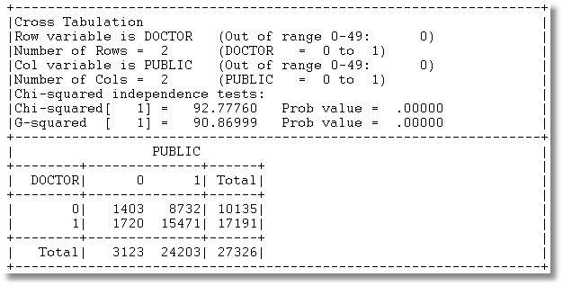
Application: Doctor,Public
3 Groups of observations: (Public=0), (Doctor=0|Public=1), (Doctor=1|Public=1)

Slide 22
Sample Selection
Doctor = F(age,age²,income,female,Public=1)
Public = F(age,educ,income,married,kids,female)

Slide 23
Sample Selection Model: Estimation

Slide 24
ML Estimates
----------------------------------------------------------------------
FIML Estimates of Bivariate Probit Model
Dependent variable DOCPUB
Log likelihood function -23581.80697
Estimation based on N = 27326, K = 13
Selection model based on PUBLIC
Means for vars. 1- 5 are after selection.
--------+-------------------------------------------------------------
Variable| Coefficient Standard Error b/St.Er. P[|Z|>z] Mean of X
--------+-------------------------------------------------------------
|Index equation for DOCTOR
Constant| 1.09027*** .13112 8.315 .0000
AGE| -.06030*** .00633 -9.532 .0000 43.6996
AGESQ| .00086*** .718153D-04 11.967 .0000 2041.87
INCOME| .07820 .05779 1.353 .1760 .33976
FEMALE| .34357*** .01756 19.561 .0000 .49329
|Index equation for PUBLIC
Constant| 3.54736*** .07456 47.580 .0000
AGE| .00080 .00116 .690 .4899 43.5257
EDUC| -.16832*** .00416 -40.490 .0000 11.3206
INCOME| -.98747*** .05162 -19.128 .0000 .35208
MARRIED| -.01508 .02934 -.514 .6072 .75862
HHKIDS| -.07777*** .02514 -3.093 .0020 .40273
FEMALE| .12154*** .02231 5.447 .0000 .47877
|Disturbance correlation
RHO(1,2)| -.19303*** .06763 -2.854 .0043
--------+-------------------------------------------------------------

Slide 25
Estimation Issues
This is a sample selection model applied to a nonlinear model
  There is no lambda
  Estimated by FIML, not two step least squares
  Estimator is a type of BIVARIATE PROBIT MODEL
The model is identified without exclusions (again)

Slide 26
A Dynamic
Model

Slide 27
Dynamic Models

Slide 28
Dynamic Probit Model: A Standard Approach

Slide 29
Simplified Dynamic Model

Slide 30
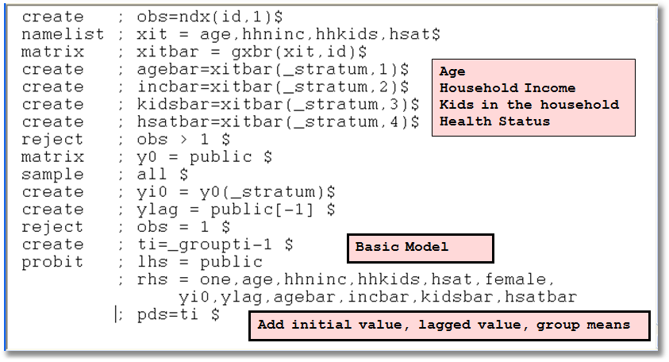
A Dynamic Model for Public Insurance

Slide 31
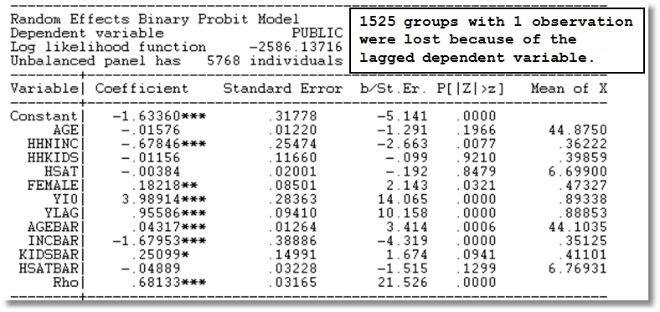
Dynamic Common Effects Model

Slide 32
Bivariate
Model

Slide 33
Gross Relation Between Two Binary Variables
+-----------------------------------------------------------------+
|Cross Tabulation |
|Row variable is DOCTOR (Out of range 0-49: 0) |
|Number of Rows = 2 (DOCTOR = 0 to 1) |
|Col variable is HOSPITAL (Out of range 0-49: 0) |
|Number of Cols = 2 (HOSPITAL = 0 to 1) |
+-----------------------------------------------------------------+
| HOSPITAL |
+--------+--------------+------+ |
| DOCTOR| 0 1| Total| |
+--------+--------------+------+ |
| 0| 9715 420| 10135| |
| 1| 15216 1975| 17191| |
+--------+--------------+------+ |
| Total| 24931 2395| 27326| |
+-----------------------------------------------------------------+
Cross Tabulation Suggests Presence or
Absence of a Bivariate Relationship

Slide 34
Tetrachoric Correlation

Slide 35
Log Likelihood Function for Tetrachoric Correlation

Slide 36
Estimation
+---------------------------------------------+
| FIML Estimates of Bivariate Probit Model |
| Maximum Likelihood Estimates |
| Dependent variable DOCHOS |
| Weighting variable None |
| Number of observations 27326 |
| Log likelihood function -25898.27 |
| Number of parameters 3 |
+---------------------------------------------+
+---------+--------------+----------------+--------+---------+
|Variable | Coefficient | Standard Error |b/St.Er.|P[|Z|>z] |
+---------+--------------+----------------+--------+---------+
Index equation for DOCTOR
Constant .32949128 .00773326 42.607 .0000
Index equation for HOSPITAL
Constant -1.35539755 .01074410 -126.153 .0000
Tetrachoric Correlation between DOCTOR and HOSPITAL
RHO(1,2) .31105965 .01357302 22.918 .0000

Slide 37
A Bivariate Probit Model
Two Equation Probit Model
No bivariate logit – there is no reasonable bivariate counterpart
Why fit the two equation model?
  Analogy to SUR model: Efficient
  Make tetrachoric correlation conditional on covariates – i.e., residual correlation

Slide 38
Bivariate Probit Model

Slide 39
Estimation of the Bivariate Probit Model

Slide 40
Parameter Estimates
----------------------------------------------------------------------
FIML Estimates of Bivariate Probit Model for DOCTOR and HOSPITAL
Dependent variable DOCHOS
Log likelihood function -25323.63074
Estimation based on N = 27326, K = 12
--------+-------------------------------------------------------------
Variable| Coefficient Standard Error b/St.Er. P[|Z|>z] Mean of X
--------+-------------------------------------------------------------
|Index equation for DOCTOR
Constant| -.20664*** .05832 -3.543 .0004
AGE| .01402*** .00074 18.948 .0000 43.5257
FEMALE| .32453*** .01733 18.722 .0000 .47877
EDUC| -.01438*** .00342 -4.209 .0000 11.3206
MARRIED| .00224 .01856 .121 .9040 .75862
WORKING| -.08356*** .01891 -4.419 .0000 .67705
|Index equation for HOSPITAL
Constant| -1.62738*** .05430 -29.972 .0000
AGE| .00509*** .00100 5.075 .0000 43.5257
FEMALE| .12143*** .02153 5.641 .0000 .47877
HHNINC| -.03147 .05452 -.577 .5638 .35208
HHKIDS| -.00505 .02387 -.212 .8323 .40273
|Disturbance correlation (Conditional tetrachoric correlation)
RHO(1,2)| .29611*** .01393 21.253 .0000
----------------------------------------------------------------------
| Tetrachoric Correlation between DOCTOR and HOSPITAL
RHO(1,2)| .31106 .01357 22.918 .0000
--------+-------------------------------------------------------------

Slide 41
Marginal Effects
What are the marginal effects
  Effect of what on what?
  Two equation model, what is the conditional mean?
Possible margins?
  Derivatives of joint probability = Φ₂(β₁’x_{i1}, β₂’x_{i2},ρ)
  Partials of E[y_{ij}|x_{ij}] =Φ(β_{j}’x_{ij}) (Univariate probability)
  Partials of E[y_{i1}|x_{i1},x_{i2},y_{i2}=1] = P(y_{i1},y_{i2}=1)/Prob[y_{i2}=1]
Note marginal effects involve both sets of regressors.
If there are common variables, there are two effects
in the derivative that are added.

Slide 42
Bivariate Probit Conditional Means

Slide 43
Direct Effects
Derivatives of E[y₁|x₁,x₂,y₂=1] wrt x₁
+-------------------------------------------+
| Partial derivatives of E[y1|y2=1] with |
| respect to the vector of characteristics. |
| They are computed at the means of the Xs. |
| Effect shown is total of 4 parts above. |
| Estimate of E[y1|y2=1] = .819898 |
| Observations used for means are All Obs. |
| These are the direct marginal effects. |
+-------------------------------------------+
+---------+--------------+----------------+--------+---------+----------+
|Variable | Coefficient | Standard Error |b/St.Er.|P[|Z|>z] | Mean of X|
+---------+--------------+----------------+--------+---------+----------+
AGE .00382760 .00022088 17.329 .0000 43.5256898
FEMALE .08857260 .00519658 17.044 .0000 .47877479
EDUC -.00392413 .00093911 -4.179 .0000 11.3206310
MARRIED .00061108 .00506488 .121 .9040 .75861817
WORKING -.02280671 .00518908 -4.395 .0000 .67704750
HHNINC .000000 ......(Fixed Parameter)....... .35208362
HHKIDS .000000 ......(Fixed Parameter)....... .40273000

Slide 44
Indirect Effects
Derivatives of E[y₁|x₁,x₂,y₂=1] wrt x₂
+-------------------------------------------+
| Partial derivatives of E[y1|y2=1] with |
| respect to the vector of characteristics. |
| They are computed at the means of the Xs. |
| Effect shown is total of 4 parts above. |
| Estimate of E[y1|y2=1] = .819898 |
| Observations used for means are All Obs. |
| These are the indirect marginal effects. |
+-------------------------------------------+
+---------+--------------+----------------+--------+---------+----------+
|Variable | Coefficient | Standard Error |b/St.Er.|P[|Z|>z] | Mean of X|
+---------+--------------+----------------+--------+---------+----------+
AGE -.00035034 .697563D-04 -5.022 .0000 43.5256898
FEMALE -.00835397 .00150062 -5.567 .0000 .47877479
EDUC .000000 ......(Fixed Parameter)....... 11.3206310
MARRIED .000000 ......(Fixed Parameter)....... .75861817
WORKING .000000 ......(Fixed Parameter)....... .67704750
HHNINC .00216510 .00374879 .578 .5636 .35208362
HHKIDS .00034768 .00164160 .212 .8323 .40273000

Slide 45
Marginal Effects: Total Effects
Sum of Two Derivative Vectors
+-------------------------------------------+
| Partial derivatives of E[y1|y2=1] with |
| respect to the vector of characteristics. |
| They are computed at the means of the Xs. |
| Effect shown is total of 4 parts above. |
| Estimate of E[y1|y2=1] = .819898 |
| Observations used for means are All Obs. |
| Total effects reported = direct+indirect. |
+-------------------------------------------+
+---------+--------------+----------------+--------+---------+----------+
|Variable | Coefficient | Standard Error |b/St.Er.|P[|Z|>z] | Mean of X|
+---------+--------------+----------------+--------+---------+----------+
AGE .00347726 .00022941 15.157 .0000 43.5256898
FEMALE .08021863 .00535648 14.976 .0000 .47877479
EDUC -.00392413 .00093911 -4.179 .0000 11.3206310
MARRIED .00061108 .00506488 .121 .9040 .75861817
WORKING -.02280671 .00518908 -4.395 .0000 .67704750
HHNINC .00216510 .00374879 .578 .5636 .35208362
HHKIDS .00034768 .00164160 .212 .8323 .40273000

Slide 46
Marginal Effects: Dummy Variables
Using Differences of Probabilities
+-----------------------------------------------------------+
| Analysis of dummy variables in the model. The effects are |
| computed using E[y1|y2=1,d=1] - E[y1|y2=1,d=0] where d is |
| the variable. Variances use the delta method. The effect |
| accounts for all appearances of the variable in the model.|
+-----------------------------------------------------------+
|Variable Effect Standard error t ratio (deriv) |
+-----------------------------------------------------------+
FEMALE .079694 .005290 15.065 (.080219)
MARRIED .000611 .005070 .121 (.000511)
WORKING -.022485 .005044 -4.457 (-.022807)
HHKIDS .000348 .001641 .212 (.000348)
Computed using difference of probabilities
Computed using scaled coefficients

Slide 47
Simultaneous Equations

Slide 48
A Simultaneous Equations Model
bivariate probit;lhs=doctor,hospital
;rh1=one,age,educ,married,female,hospital
;rh2=one,age,educ,married,female,doctor$
Error 809: Fully simultaneous BVP model is not identified

Slide 49
Fully Simultaneous ‘Model’
(Obtained by bypassing internal control)
----------------------------------------------------------------------
FIML Estimates of Bivariate Probit Model
Dependent variable DOCHOS
Log likelihood function -20318.69455
--------+-------------------------------------------------------------
Variable| Coefficient Standard Error b/St.Er. P[|Z|>z] Mean of X
--------+-------------------------------------------------------------
|Index equation for DOCTOR
Constant| -.46741*** .06726 -6.949 .0000
AGE| .01124*** .00084 13.353 .0000 43.5257
FEMALE| .27070*** .01961 13.807 .0000 .47877
EDUC| -.00025 .00376 -.067 .9463 11.3206
MARRIED| -.00212 .02114 -.100 .9201 .75862
WORKING| -.00362 .02212 -.164 .8701 .67705
HOSPITAL| 2.04295*** .30031 6.803 .0000 .08765
|Index equation for HOSPITAL
Constant| -1.58437*** .08367 -18.936 .0000
AGE| -.01115*** .00165 -6.755 .0000 43.5257
FEMALE| -.26881*** .03966 -6.778 .0000 .47877
HHNINC| .00421 .08006 .053 .9581 .35208
HHKIDS| -.00050 .03559 -.014 .9888 .40273
DOCTOR| 2.04479*** .09133 22.389 .0000 .62911
|Disturbance correlation
RHO(1,2)| -.99996*** .00048 ******** .0000
--------+-------------------------------------------------------------

Slide 50
A Latent Simultaneous Equations Model

Slide 51
A Recursive Simultaneous Equations Model

Slide 52


Slide 53
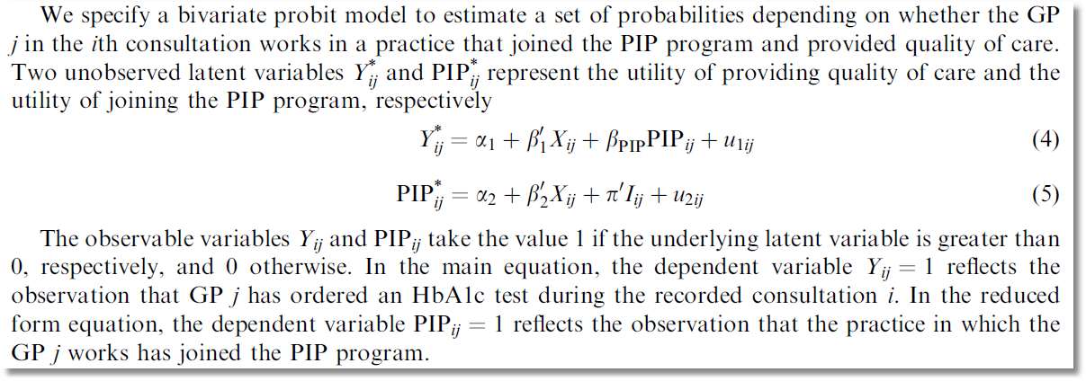
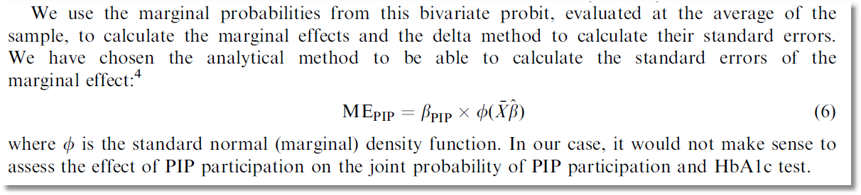

Slide 54
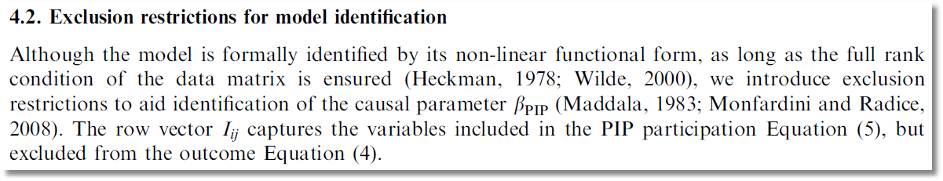

Slide 55
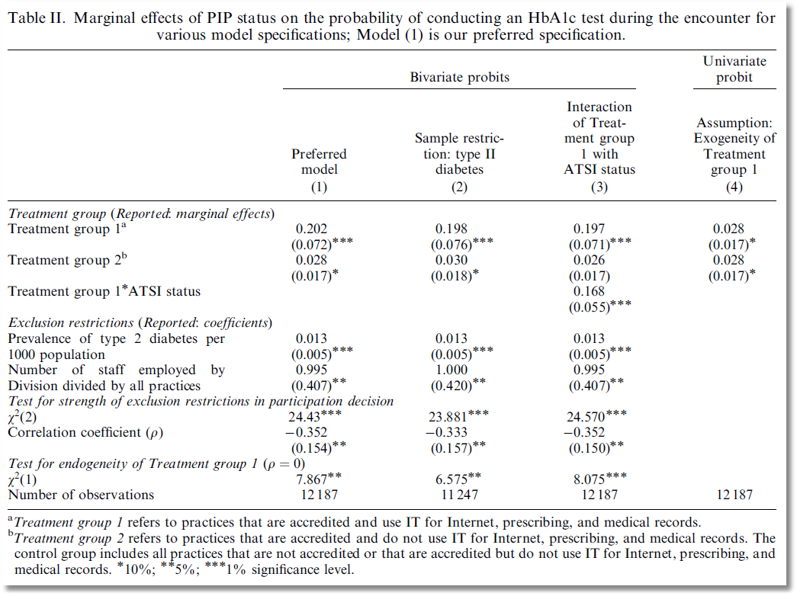

Slide 56
Ordered Choices

Slide 57
Ordered Discrete Outcomes
E.g.: Taste test, credit rating, course grade, preference scale
Underlying random preferences:
  Existence of an underlying continuous preference scale
  Mapping to observed choices
Strength of preferences is reflected in the discrete outcome
Censoring and discrete measurement
The nature of ordered data

Slide 58
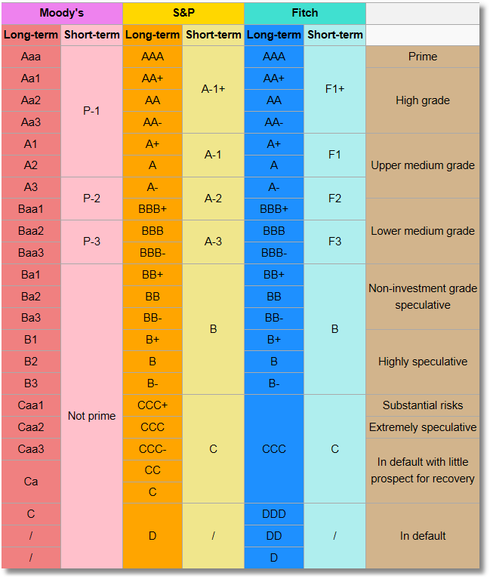
Bond Ratings

Slide 59
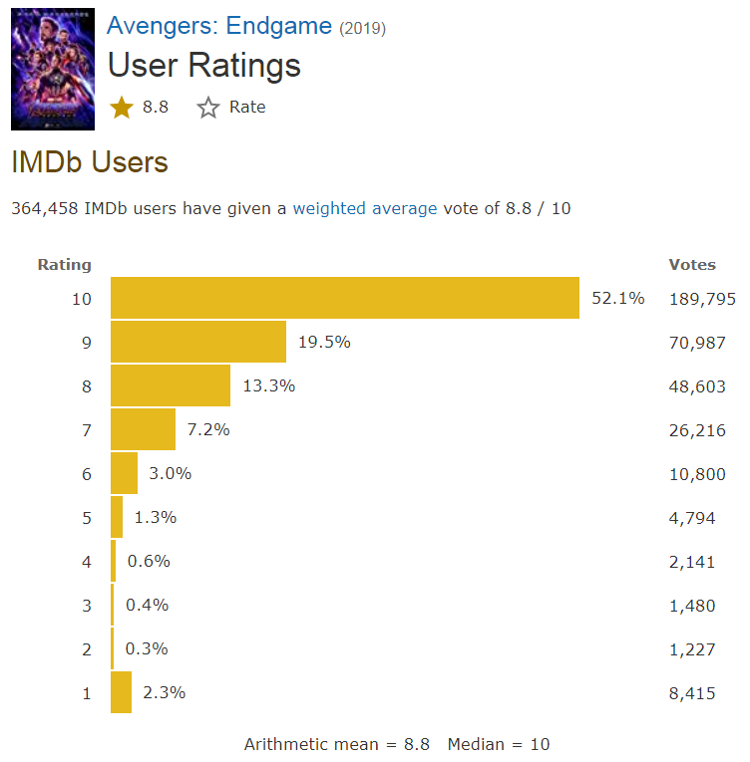
Ordered Choices at IMDb

Slide 60
Health Satisfaction (HSAT)
Self administered survey: Health Satisfaction (0 – 10)
Continuous Preference Scale

Slide 61
Modeling Ordered Choices
Random Utility (allowing a panel data setting)
Uit = α + β’x_{it} + ε_{it}
= a_{it} + ε_{it}
Observe outcome j if utility is in region j
Probability of outcome = probability of cell
Pr[Yit=j] = Prob[Yit < j] - Prob[Yit < j-1]
= F(μ_{j} – a_{it}) - F(μ_{j-1} – a_{it})

Slide 62
Ordered Probability Model

Slide 63

Combined Outcomes for Health Satisfaction

Slide 64
Probabilities for Ordered Choices

Slide 65
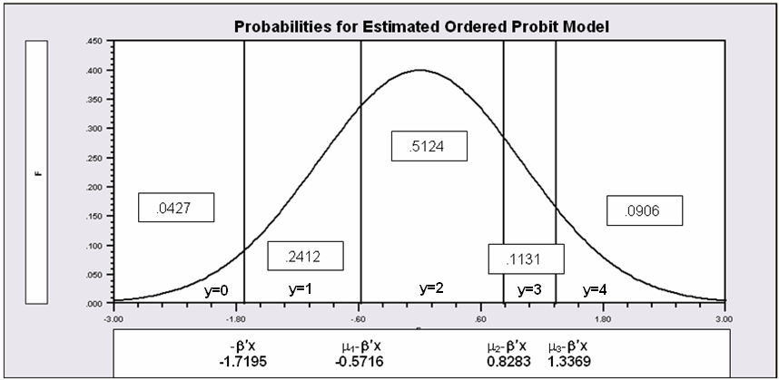
Probabilities for Ordered Choices
μ₁ =1.1479 μ₂ =2.5478 μ₃ =3.0564

Slide 66
Coefficients

Slide 67
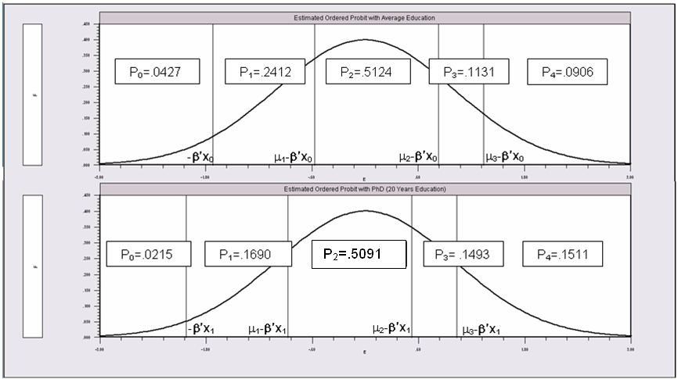
Effects of 8 More Years of Education

Slide 68
An Ordered Probability
Model for Health Satisfaction
+---------------------------------------------+
| Ordered Probability Model |
| Dependent variable HSAT |
| Number of observations 27326 |
| Underlying probabilities based on Normal |
| Cell frequencies for outcomes |
| Y Count Freq Y Count Freq Y Count Freq |
| 0 447 .016 1 255 .009 2 642 .023 |
| 3 1173 .042 4 1390 .050 5 4233 .154 |
| 6 2530 .092 7 4231 .154 8 6172 .225 |
| 9 3061 .112 10 3192 .116 |
+---------------------------------------------+
+---------+--------------+----------------+--------+---------+----------+
|Variable | Coefficient | Standard Error |b/St.Er.|P[|Z|>z] | Mean of X|
+---------+--------------+----------------+--------+---------+----------+
Index function for probability
Constant 2.61335825 .04658496 56.099 .0000
FEMALE -.05840486 .01259442 -4.637 .0000 .47877479
EDUC .03390552 .00284332 11.925 .0000 11.3206310
AGE -.01997327 .00059487 -33.576 .0000 43.5256898
HHNINC .25914964 .03631951 7.135 .0000 .35208362
HHKIDS .06314906 .01350176 4.677 .0000 .40273000
Threshold parameters for index
Mu(1) .19352076 .01002714 19.300 .0000
Mu(2) .49955053 .01087525 45.935 .0000
Mu(3) .83593441 .00990420 84.402 .0000
Mu(4) 1.10524187 .00908506 121.655 .0000
Mu(5) 1.66256620 .00801113 207.532 .0000
Mu(6) 1.92729096 .00774122 248.965 .0000
Mu(7) 2.33879408 .00777041 300.987 .0000
Mu(8) 2.99432165 .00851090 351.822 .0000
Mu(9) 3.45366015 .01017554 339.408 .0000

Slide 69
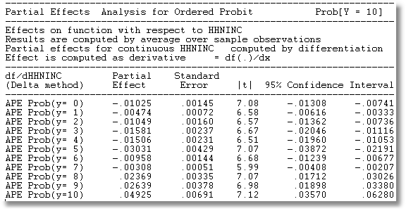
Ordered Probit Partial Effects
Partial effects at means of the data
Average Partial Effect of HHNINC

Slide 70
Predictions of the Model:Kids
+----------------------------------------------+
|Variable Mean Std.Dev. Minimum Maximum |
+----------------------------------------------+
|Stratum is KIDS = 0.000. Nobs.= 2782.000 |
+--------+-------------------------------------+
|P0 | .059586 .028182 .009561 .125545 |
|P1 | .268398 .063415 .106526 .374712 |
|P2 | .489603 .024370 .419003 .515906 |
|P3 | .101163 .030157 .052589 .181065 |
|P4 | .081250 .041250 .028152 .237842 |
+----------------------------------------------+
|Stratum is KIDS = 1.000. Nobs.= 1701.000 |
+--------+-------------------------------------+
|P0 | .036392 .013926 .010954 .105794 |
|P1 | .217619 .039662 .115439 .354036 |
|P2 | .509830 .009048 .443130 .515906 |
|P3 | .125049 .019454 .061673 .176725 |
|P4 | .111111 .030413 .035368 .222307 |
+----------------------------------------------+
|All 4483 observations in current sample |
+--------+-------------------------------------+
|P0 | .050786 .026325 .009561 .125545 |
|P1 | .249130 .060821 .106526 .374712 |
|P2 | .497278 .022269 .419003 .515906 |
|P3 | .110226 .029021 .052589 .181065 |
|P4 | .092580 .040207 .028152 .237842 |
+----------------------------------------------+
This is a restricted model with outcomes collapsed into 5 cells.

Slide 71
Fit Measures
There is no single “dependent variable” to explain.
There is no sum of squares or other measure of “variation” to explain.
Predictions of the model relate to a set of J+1 probabilities, not a single variable.
How to explain fit?
  Based on the underlying regression
  Based on the likelihood function
  Based on prediction of the outcome variable

Slide 72
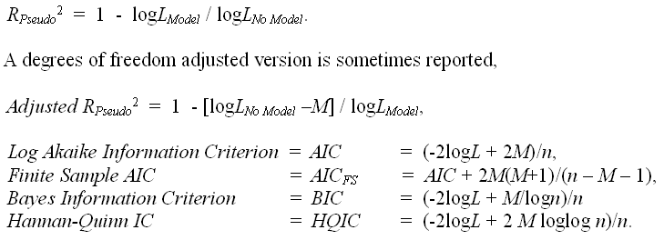
Log Likelihood Based Fit Measures

Slide 73
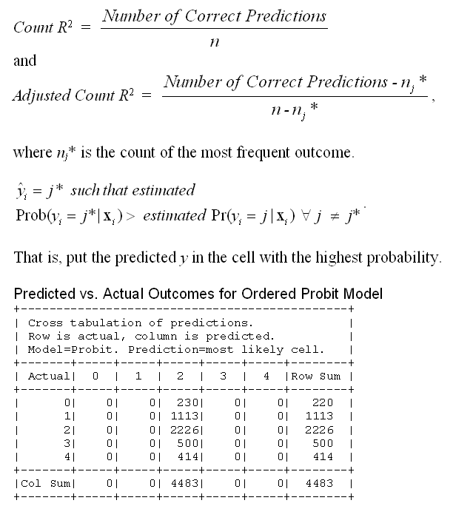
Fit Measure Based on Counting Predictions
This model always predicts the same cell.

Slide 74
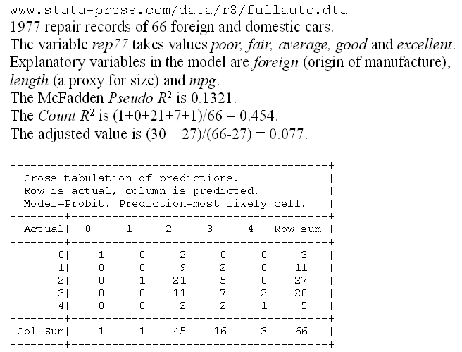
A Somewhat Better Fit

Slide 75
Generalizing the Ordered Probit with Heterogeneous Thresholds

Slide 76
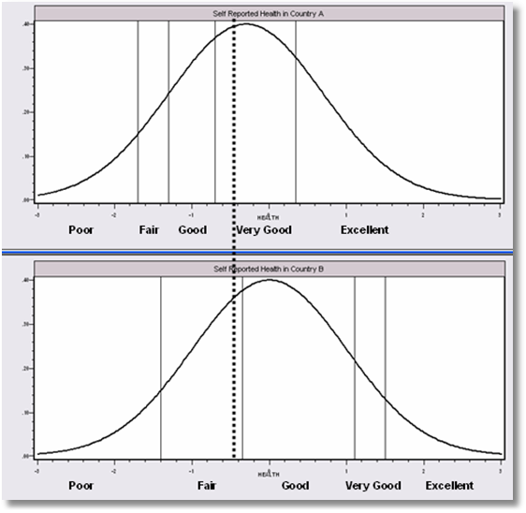
Differential Item Functioning
People in this country are optimistic – they report this value as ‘very good.’
People in this country are pessimistic – they report this same value as ‘fair’

Slide 77
Panel Data
Fixed Effects
  The usual incidental parameters problem
  Partitioning Prob(y_{it} > j|x_{it}) produces estimable binomial logit models. (Find a way to combine multiple estimates of the same β.
Random Effects
  Standard application

Slide 78
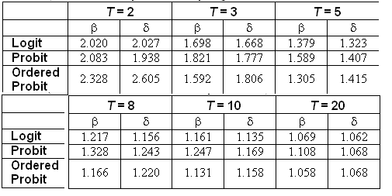
Incidental Parameters Problem
Table 9.1 Monte Carlo Analysis of the Bias of the MLE in Fixed Effects Discrete Choice Models (Means of empirical sampling distributions, N = 1,000 individuals, R = 200 replications)

Slide 79
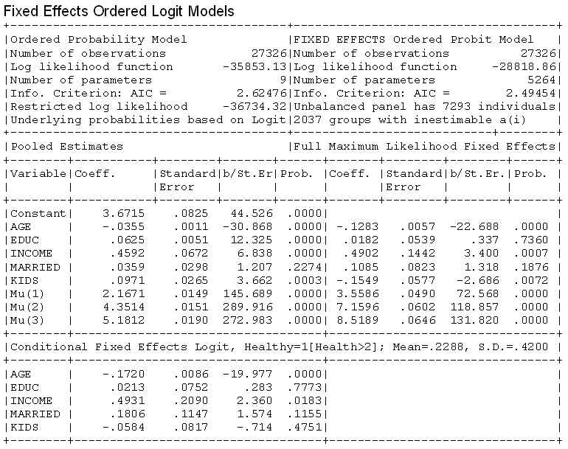

Slide 80
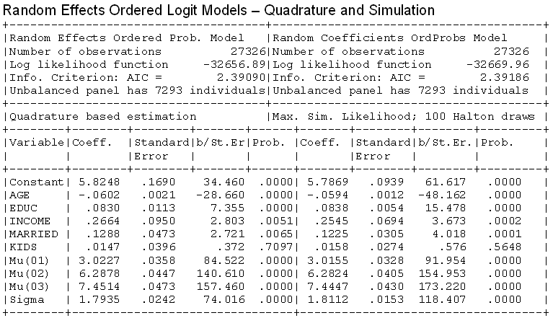
Random Effects

Slide 81

Dynamic Ordered Probit Model

Slide 82
Model for Self Assessed Health
British Household Panel Survey (BHPS)
  Waves 1-8, 1991-1998
  Self assessed health on 0,1,2,3,4 scale
  Sociological and demographic covariates
  Dynamics – inertia in reporting of top scale
Dynamic ordered probit model
  Balanced panel – analyze dynamics
  Unbalanced panel – examine attrition

Slide 83
Dynamic Ordered Probit Model
It would not be appropriate to include h_{i,t-1} itself in the model as this is a label, not a measure

Slide 84
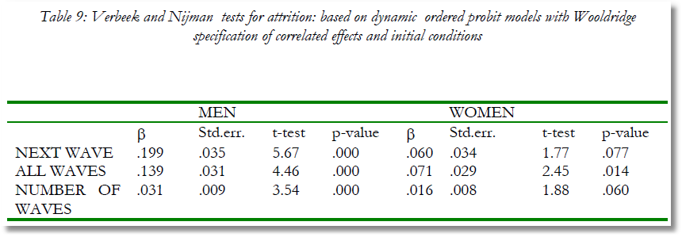
Testing for Attrition Bias
Three dummy variables added to full model with unbalanced panel suggest presence of attrition effects.

Slide 85

Attrition Model with IP Weights
Assumes (1) Prob(attrition|all data) = Prob(attrition|selected variables) (ignorability)
(2) Attrition is an ‘absorbing state.’ No reentry.
Obviously not true for the GSOEP data above.
Can deal with point (2) by isolating a subsample of those present at wave 1 and the monotonically shrinking subsample as the waves progress.

Slide 86
Inverse Probability Weighting

Slide 87

Estimated Partial Effects by Model

Slide 88
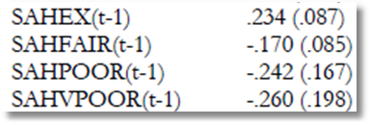
Partial Effect for a Category
These are 4 dummy variables for state in the previous period. Using first differences, the 0.234 estimated for SAHEX means transition from EXCELLENT in the previous period to GOOD in the previous period, where GOOD is the omitted category. Likewise for the other 3 previous state variables. The margin from ‘POOR’ to ‘GOOD’ was not interesting in the paper. The better margin would have been from EXCELLENT to POOR, which would have (EX,POOR) change from (1,0) to (0,1).

