Slide 1
Empirical Methods for
Microeconomic Applications
University of Lugano, Switzerland
May 27-31, 2019
William Greene
Department of Economics
Stern School of Business
New York University

Slide 2






2A. Models for Count Data, Inflation Models

Slide 3
Agenda for 2A
Count Data Models
Poisson Regression
Overdispersion and NB Model
Zero Inflation
Hurdle Models
Panel Data

Slide 4
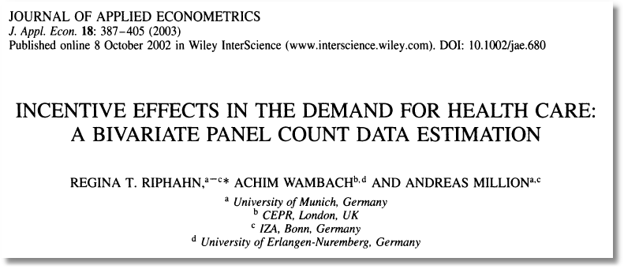

Slide 5

Doctor Visits

Slide 6
Basic Model for Counts of Events
E.g., Visits to site, number of purchases, number of doctor visits
Regression approach
  Quantitative outcome measured
  Discrete variable, model probabilities
  Nonnegative random variable
Poisson probabilities – “loglinear model”

Slide 8
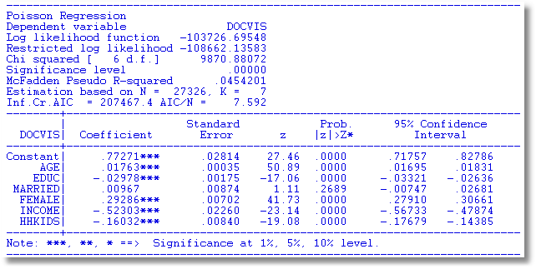
Poisson Model for Doctor Visits

Slide 9
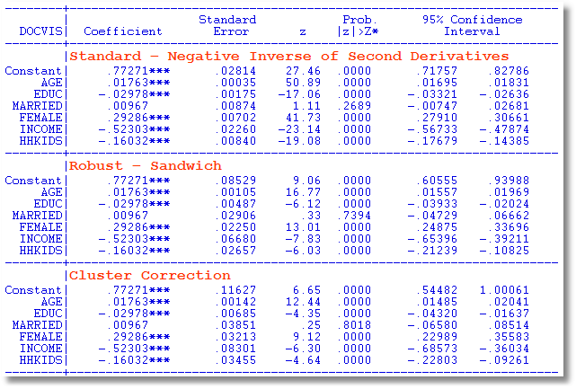
Alternative Covariance Matrices

Slide 10
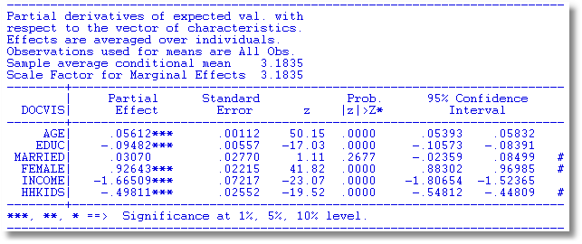
Partial Effects

Slide 11
Poisson Model Specification Issues
Equi-Dispersion: Var[y_{i}|x_{i}] = E[y_{i}|x_{i}].
Overdispersion: If λ_{i} = exp[β’x_{i} + ε_{i}],
  E[y_{i}|x_{i}] = γexp[β’x_{i}]
  Var[y_{i}] > E[y_{i}] (overdispersed)
  ε_{i} ~ log-Gamma ➔ Negative binomial model
  ε_{i} ~ Normal[0,σ²] ➔ Normal-mixture model
  ε_{i} is viewed as unobserved heterogeneity (“frailty”).
    Normal model may be more natural.
    Estimation is a bit more complicated.

Slide 12
Overdispersion
In the Poisson model, Var[y|x]=E[y|x]
Equidispersion is a strong assumption
Negbin II: Var[y|x]=E[y|x] + σ²E[y|x]²
How does overdispersion arise:
  NonPoissonness
  Omitted Heterogeneity

Slide 13
Negative Binomial Regression

Slide 14
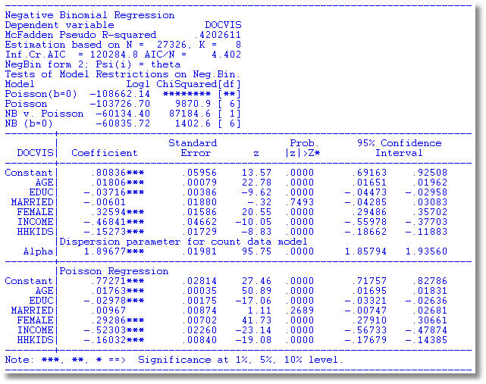
NegBin Model for Doctor Visits

Slide 15

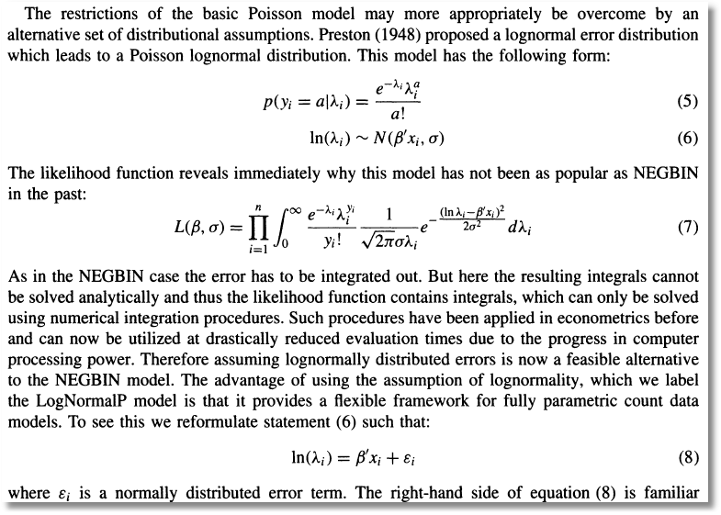

Slide 16
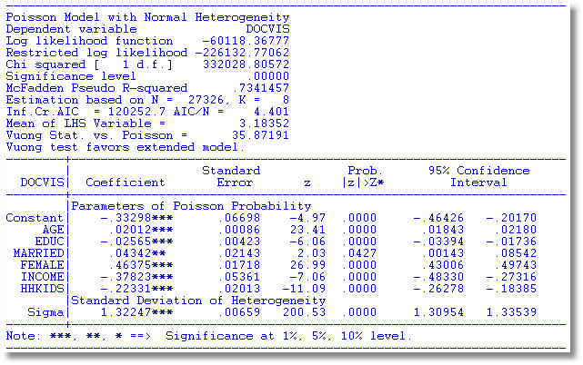
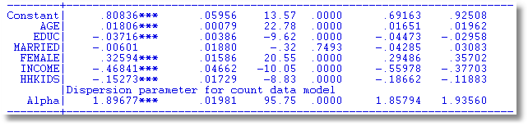

Slide 17
Negative Binomial Specification
Prob(Y_{i}=j|x_{i}) has greater mass to the right and left
of the mean
Conditional mean function is the same as the
Poisson: E[y_{i}|x_{i}] = λ_{i}=Exp(β’x_{i}),
so marginal effects have the same form.
Variance is Var[y_{i}|x_{i}] = λ_{i}(1 + α λ_{i}), α is the
overdispersion parameter;
α = 0 reverts to the Poisson.
Poisson is consistent when NegBin is appropriate.
Therefore, this is a case for the ROBUST
covariance matrix estimator. (Neglected
heterogeneity that is uncorrelated with x_{i}.)

Slide 18
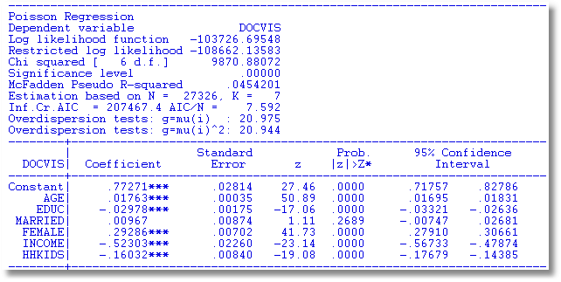
Testing for Overdispersion
Regression based test: Regress (y-mean)² on mean: Slope should = 1.

Slide 19
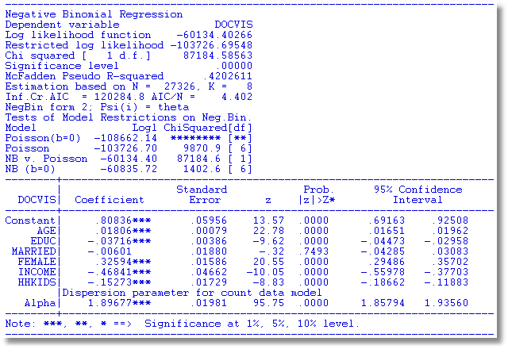
Wald Test for Overdispersion

Slide 20
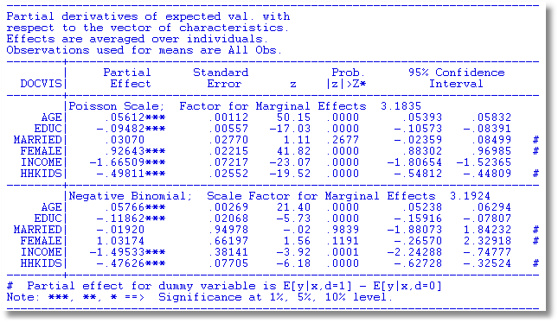
Partial Effects Should Be the Same

Slide 21

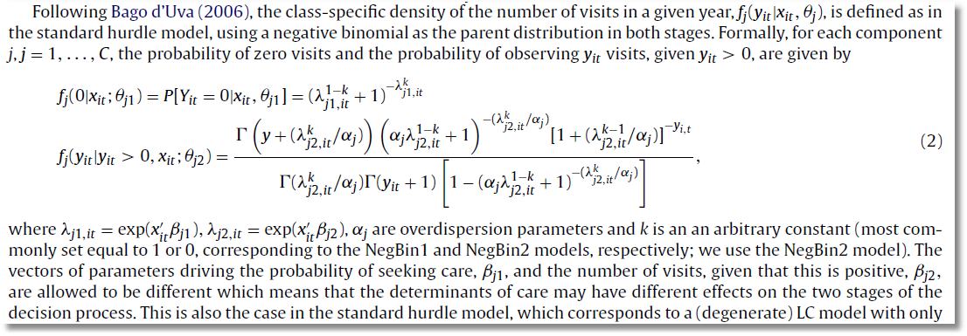

Slide 23
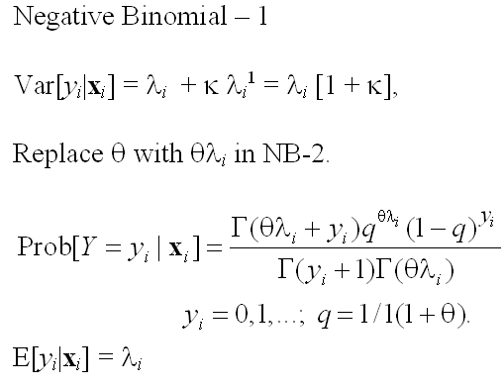
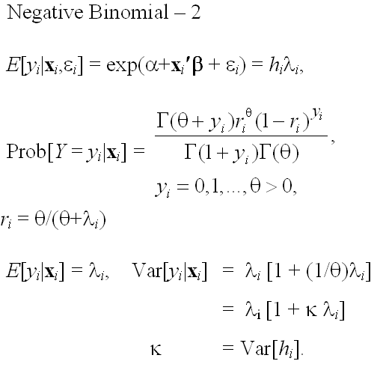
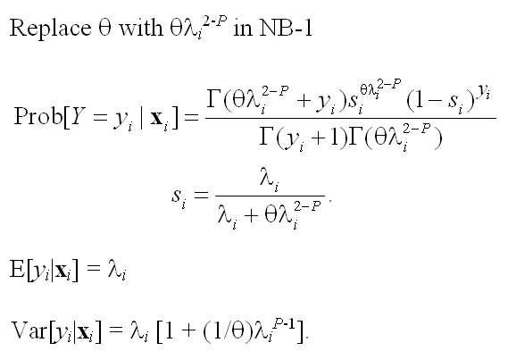
Model Formulations for Negative Binomial
E[y_{i} |x_{i} ]=λ_{i}

Slide 24
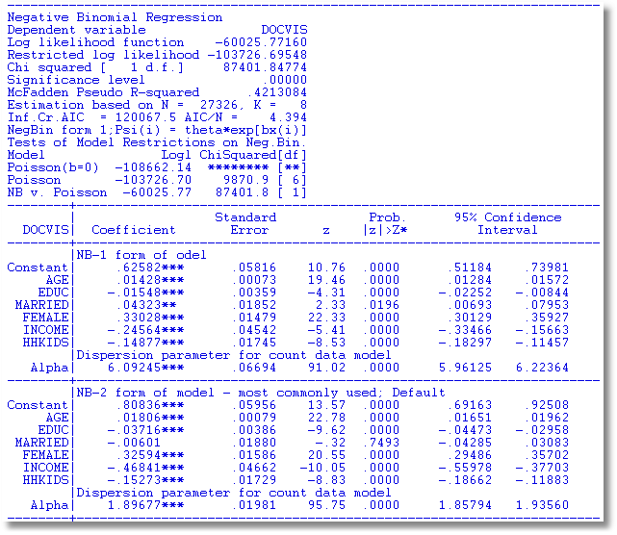
NegBin-1 Model

Slide 25
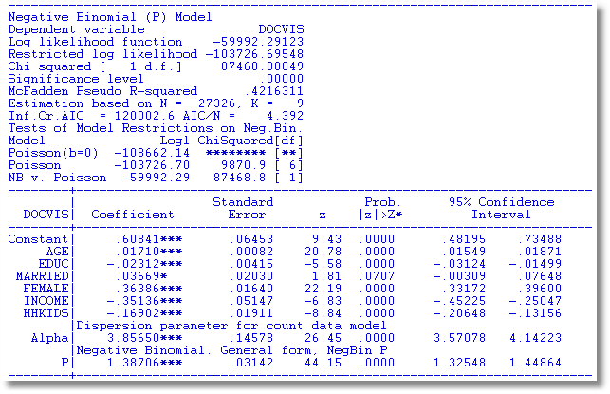
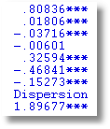
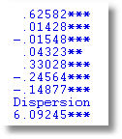
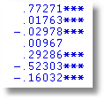
NegBin-P Model
NB-2 NB-1 Poisson

Slide 26
Zero Inflation?

Slide 27
Zero Inflation – ZIP Models
Two regimes: (Recreation site visits)
  Zero (with probability 1). (Never visit site)
  Poisson with Pr(0) = exp[- β’x_{i}]. (Number of visits, including zero visits this season.)
Unconditional:
  Pr[0] = P(regime 0) + P(regime 1)*Pr[0|regime 1]
  Pr[j | j >0] = P(regime 1)*Pr[j|regime 1]
This is a “latent class model”

Slide 28
Two Forms of Zero Inflation Models

Slide 29
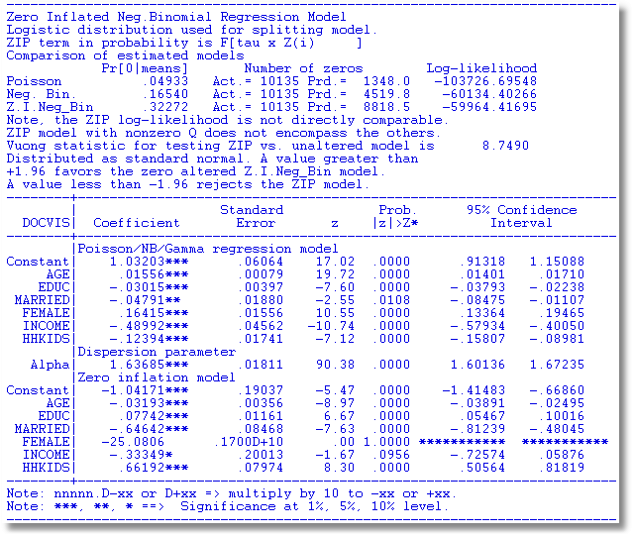
An Unidentified ZINB Model

Slide 30
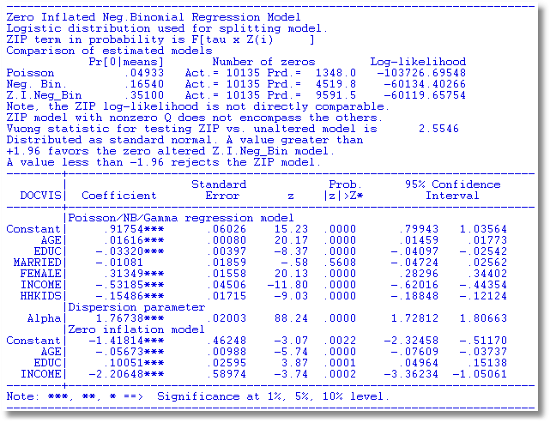

Slide 31
Notes on Zero Inflation Models
Poisson is not nested in ZIP. tau = 0 in ZIP(tau) or γ = 0 in ZIP does not produce Poisson; it produces ZIP with P(regime 0) = ½.
  Standard tests are not appropriate
  Use Vuong statistic. ZIP model almost always wins.
Zero Inflation models extend to NB models – ZINB(tau) and ZINB are standard models
  Creates two sources of overdispersion
  Generally difficult to estimate
  Tau form is not a good model – not generally used

Slide 33
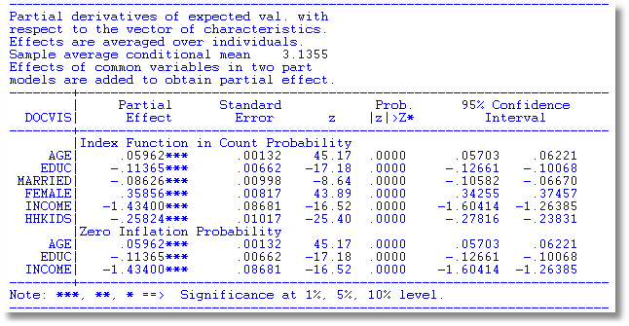
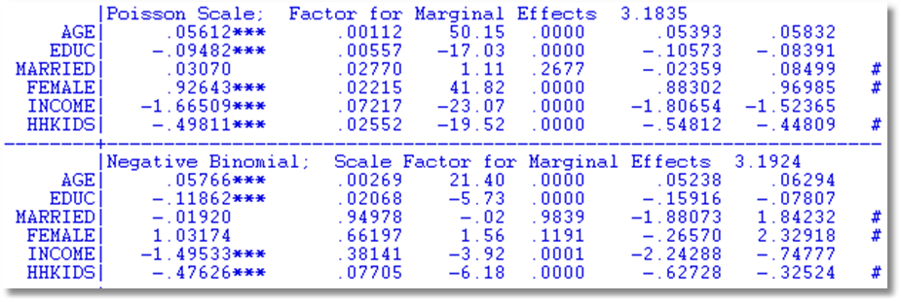
Partial Effects for Different Models
Notes:
33

Slide 34
The Vuong Statistic for Nonnested Models

Slide 35
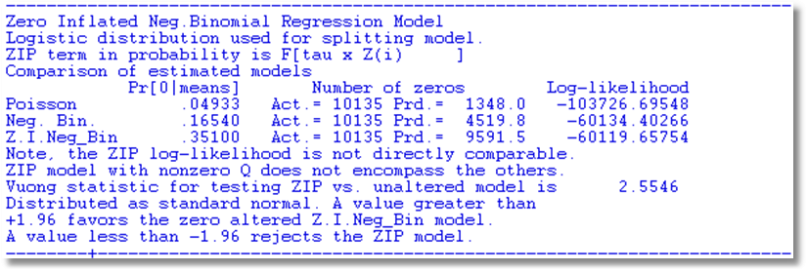

Slide 36
A Hurdle Model
Two part model:
  Model 1: Probability model for more than zero occurrences
  Model 2: Model for number of occurrences given that the number is greater than zero.
Applications common in health economics
  Usage of health care facilities
  Use of drugs, alcohol, etc.

Slide 38
Hurdle Model

Slide 39
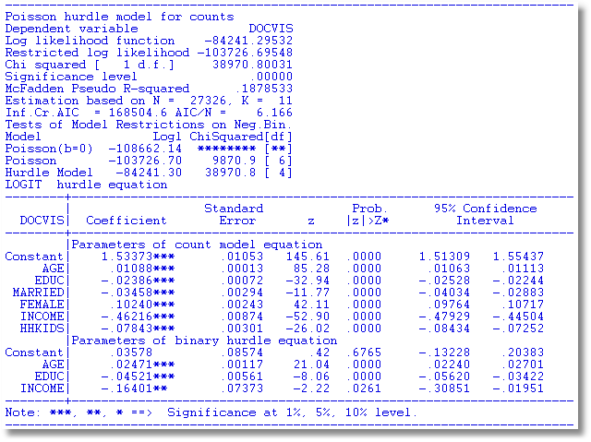
Hurdle Model for Doctor Visits

Slide 40
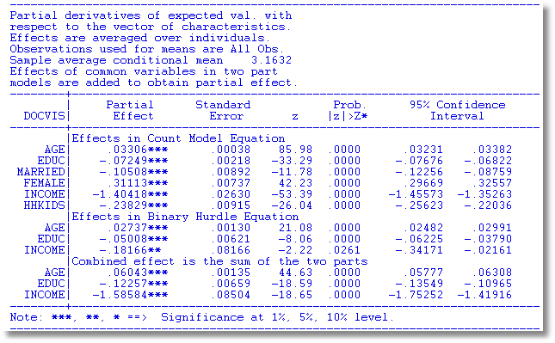
Partial Effects

Slide 43
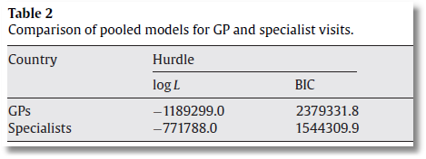
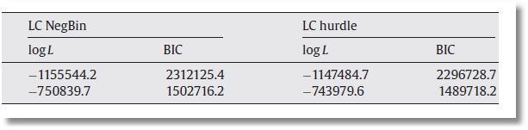

Slide 44

Application of Several of the Models
Discussed in this Section

Slide 45
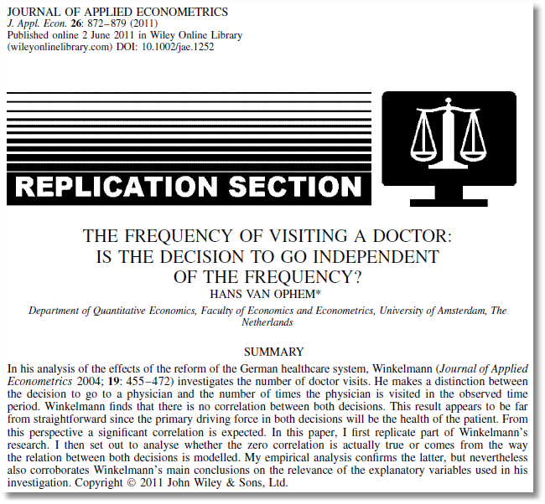
Winkelmann finds that there is no correlation between the decisions… A significant correlation is expected … [T]he correlation comes from the way the relation between the decisions is modeled.

Slide 46
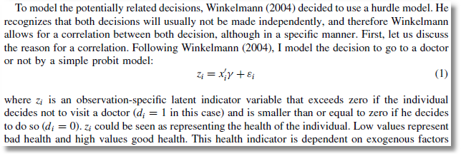
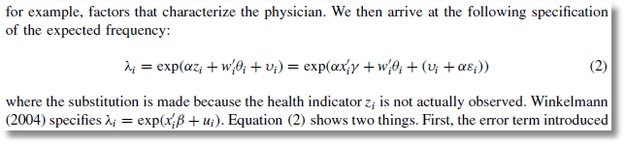
Probit Participation Equation
Poisson-Normal Intensity Equation

Slide 47
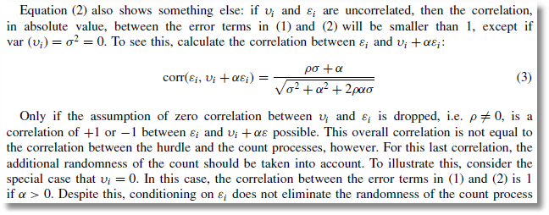
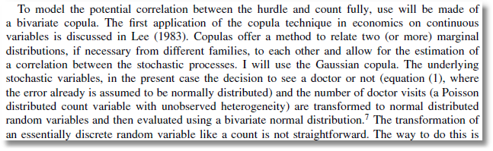
Bivariate-Normal Heterogeneity in Participation and Intensity Equations
Gaussian Copula for Participation and Intensity Equations

Slide 48
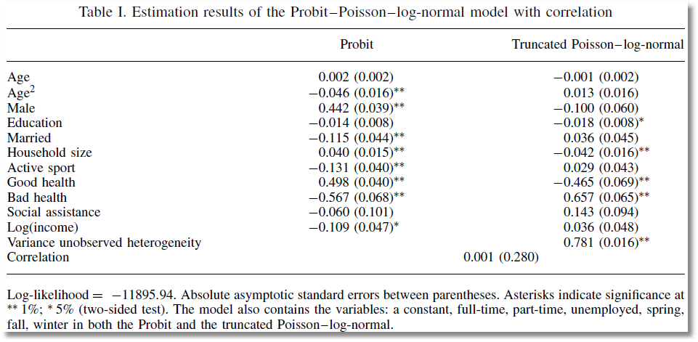
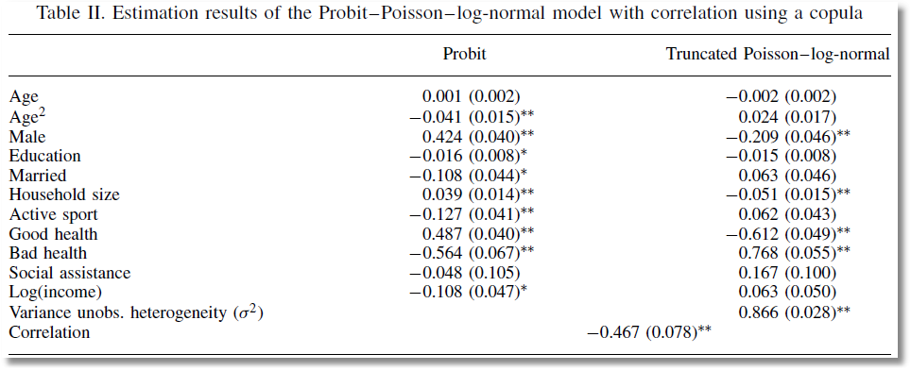
Correlation between Heterogeneity Terms
Correlation between Counte

Slide 49
Panel Data Models
Heterogeneity; λ_{it} = exp(β’x_{it} + c_{i})
  Fixed Effects
    Poisson: Standard, no incidental parameters issue
    NB
      Hausman, Hall, Griliches (1984) put FE in variance, not the mean
      Use “brute force” to get a conventional FE model
  Random Effects
    Poisson
      Log-gamma heterogeneity becomes an NB model
      Contemporary treatments are using normal heterogeneity with simulation or quadrature based estimators
    NB with random effects is equivalent to two “effects” one time varying one time invariant. The model is probably overspecified
Random Parameters: Mixed models, latent class models, hiererchical – all extended to Poisson and NB

Slide 50
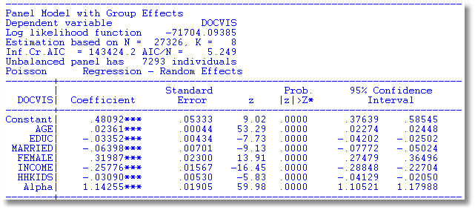
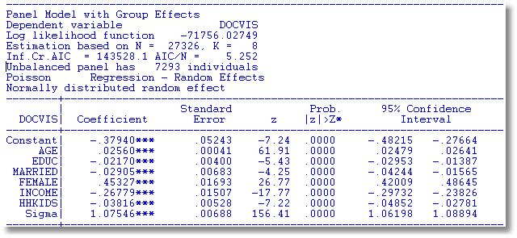
Random Effects

Slide 51
A Peculiarity of the FENB Model
‘True’ FE model has λ_{i}=exp(α_{i}+x_{it}’β). Cannot be fit if there are time invariant variables.
Hausman, Hall and Griliches (Econometrica, 1984) has α_{i} appearing in θ.
  Produces different results
  Implies that the FEM can contain time invariant variables.

Slide 52
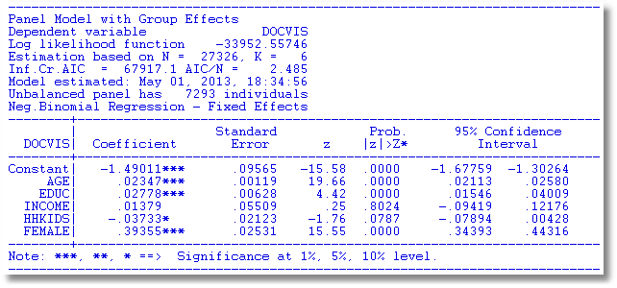
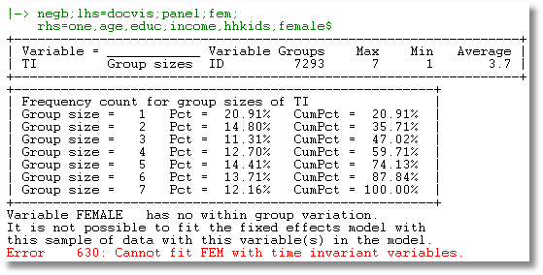

Slide 53

See: Allison and Waterman (2002),
Guimaraes (2007)
Greene, Econometric Analysis (2011)

Slide 54
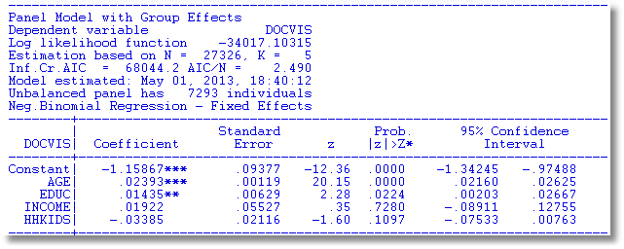
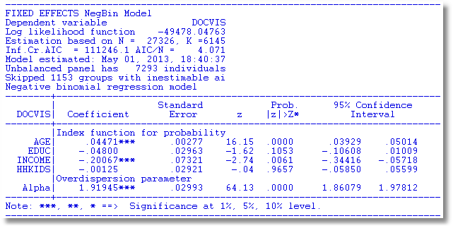

Slide 55
Censoring and Truncation in Count Models
Observations > 10 seem to come from a different process. What to do with them?
Censored Poisson: Treat any observation > 10 as 10.
Truncated Poisson: Examine the distribution only with observations less than or equal to 10.
  Intensity equation in hurdle models
  On site counts for recreation usage.
Censoring and truncation both change the model. Adjust the distribution (log likelihood) to account for the censoring or truncation.

Slide 56
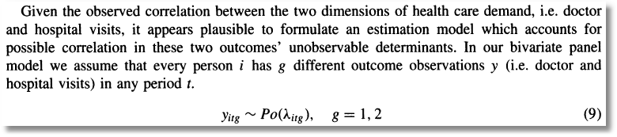
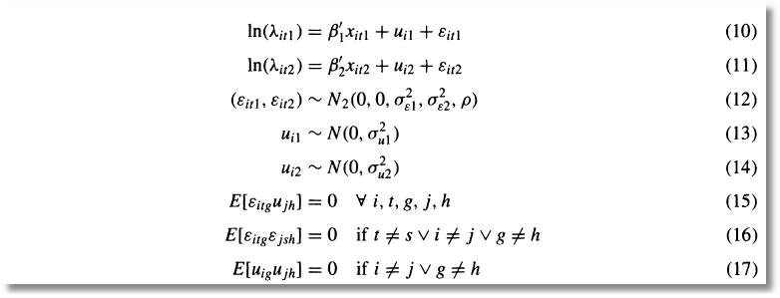
Bivariate Random Effects

Slide 57
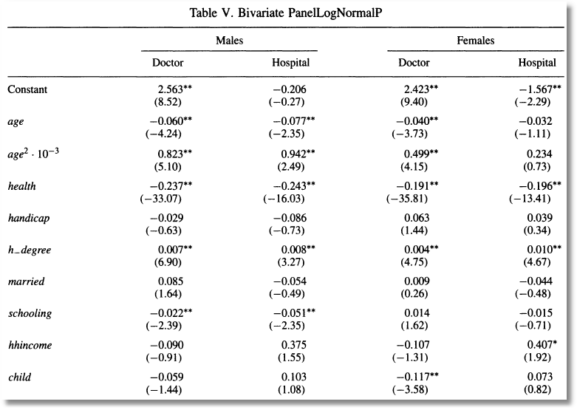
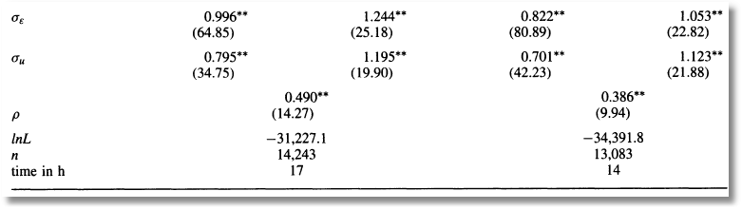

Slide 58
