Slide 1
Empirical Methods for
Microeconomic Applications
University of Lugano, Switzerland
May 27-31, 2019
William Greene
Department of Economics
Stern School of Business
New York University

Slide 2






2B. Heterogeneity: Latent Class and Mixed Models

Slide 3


Slide 4
Agenda for 2B
Latent Class and Finite Mixtures
Random Parameters
Multilevel Models

Slide 5
Latent Classes
A population contains a mixture of individuals of different types (classes)
Common form of the data generating mechanism within the classes
Observed outcome y is governed by the common process F(y|x,θ_{j} )
Classes are distinguished by the parameters, θ_{j}.

Slide 6

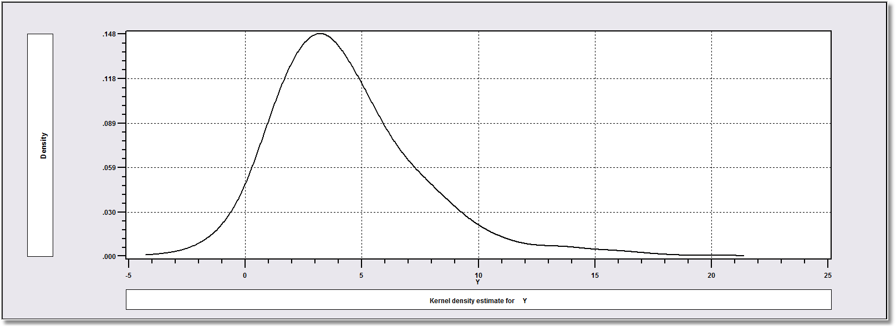
How Finite Mixture Models Work
Density? Note significant mass below zero. Not a gamma or lognormal or any other familiar density.

Slide 7
Find the ‘Best’ Fitting Mixture of Two Normal Densities

Slide 8
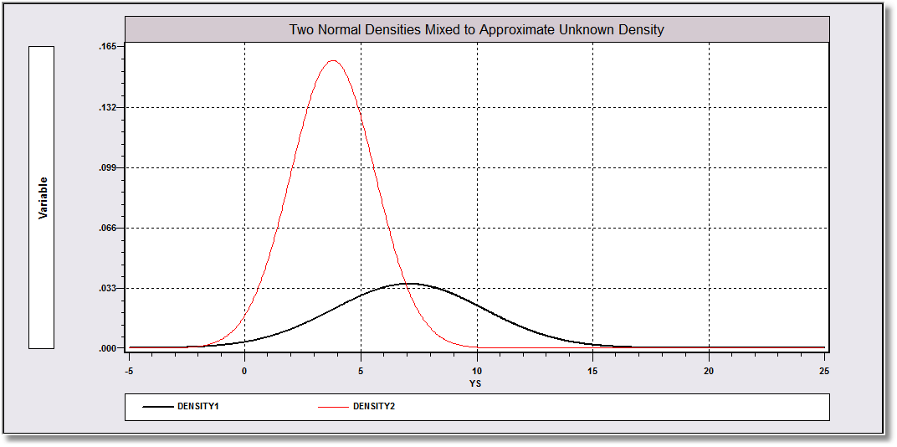
Mixing probabilities .715 and .285

Slide 9
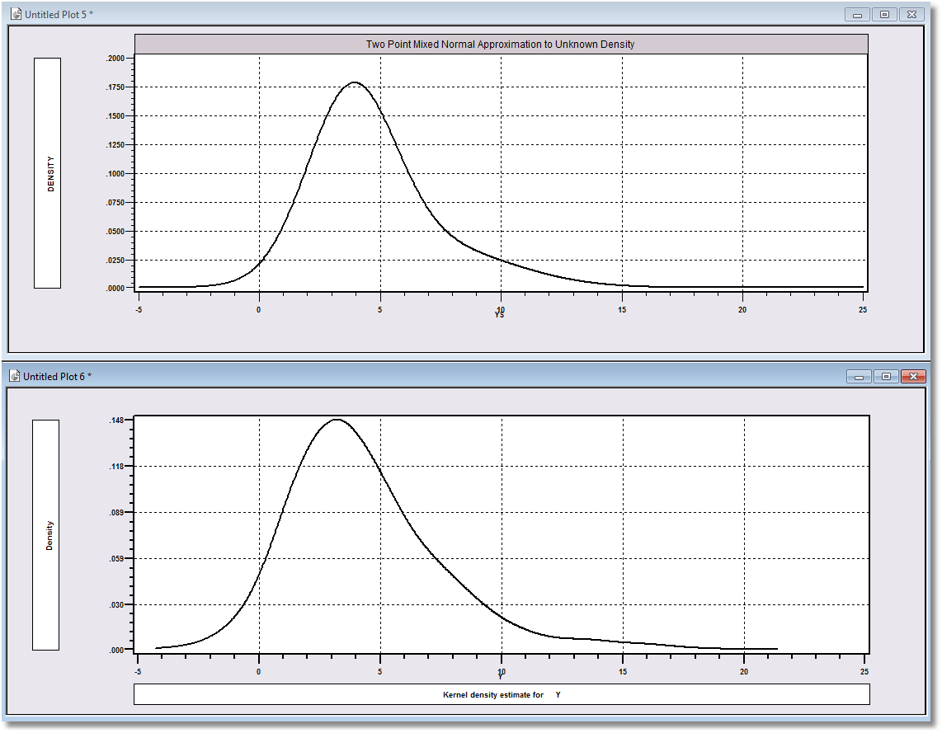
Approximation
Actual Distribution

Slide 10
A Practical Distinction
Finite Mixture (Discrete Mixture):
  Functional form strategy
  Component densities have no meaning
  Mixing probabilities have no meaning
  There is no question of “class membership”
  The number of classes is uninteresting – enough to get a good fit
Latent Class:
  Mixture of subpopulations
  Component densities are believed to be definable “groups”
  (Low Users and High Users in Bago d’Uva and Jones application)
  The classification problem is interesting – who is in which class?
  Posterior probabilities, P(class|y,x) have meaning
  Question of the number of classes has content in the context of the analysis

Slide 11
The Latent Class Model

Slide 12
Log Likelihood for an LC Model

Slide 13
Estimating Which Class

Slide 14
‘Estimating’ β_{i}

Slide 15
How Many Classes?

Slide 16
The Extended Latent Class Model
Notes:
16

Slide 17

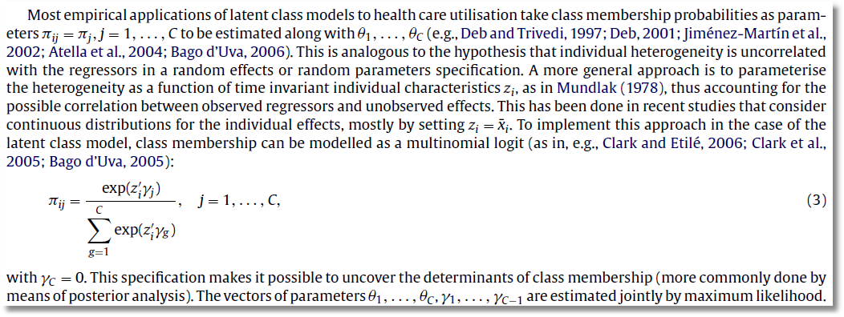
Unfortunately, this argument is incorrect.

Slide 18

Zero Inflation?

Slide 19
Zero Inflation – ZIP Models
Two regimes: (Recreation site visits)
  Zero (with probability 1). (Never visit site)
  Poisson with Pr(0) = exp[- β’x_{i}]. (Number of visits, including zero visits this season.)
Unconditional:
  Pr[0] = P(regime 0) + P(regime 1)*Pr[0|regime 1]
  Pr[j | j >0] = P(regime 1)*Pr[j|regime 1]
This is a “latent class model”

Slide 20


Slide 21
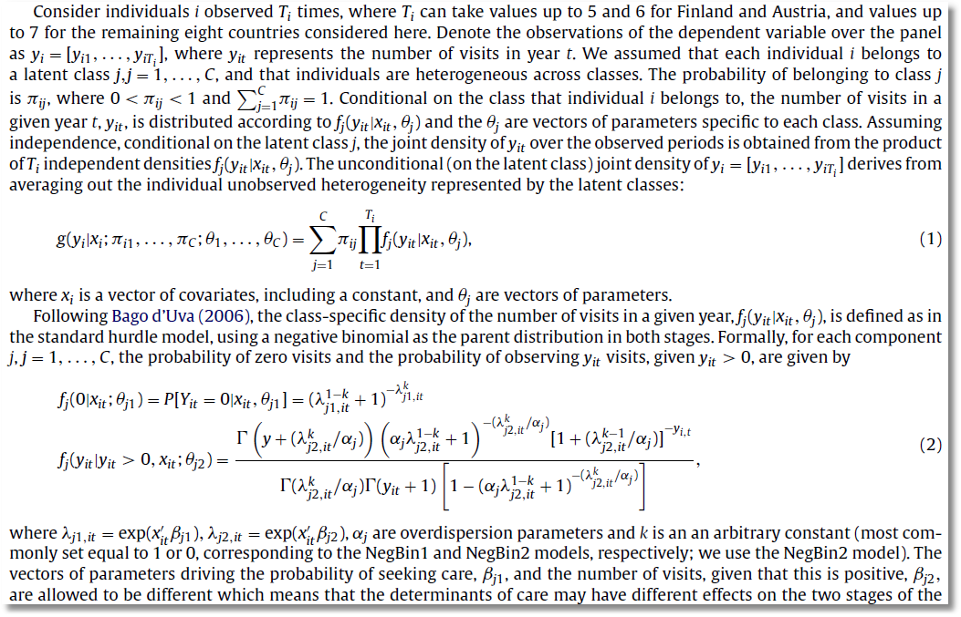

Slide 22
A Latent Class Hurdle NB2 Model
Analysis of ECHP panel data (1994-2001)
Two class Latent Class Model
  Typical in health economics applications
Hurdle model for physician visits
  Poisson hurdle for participation and negative binomial intensity given participation
  Contrast to a negative binomial model

Slide 23
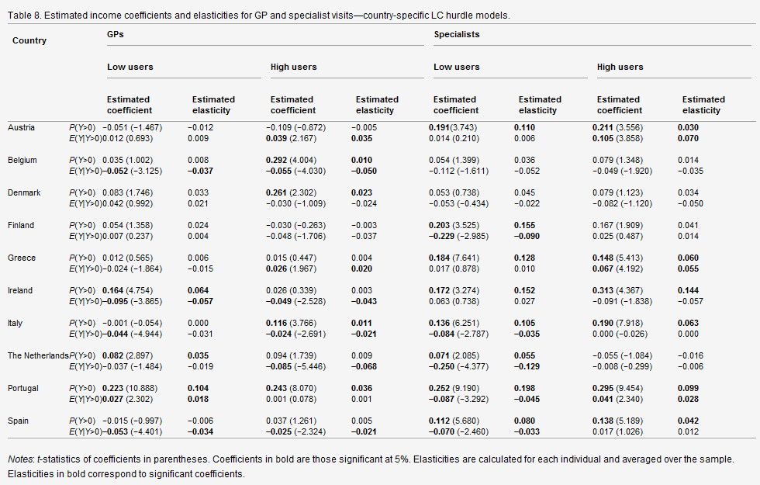

Slide 24
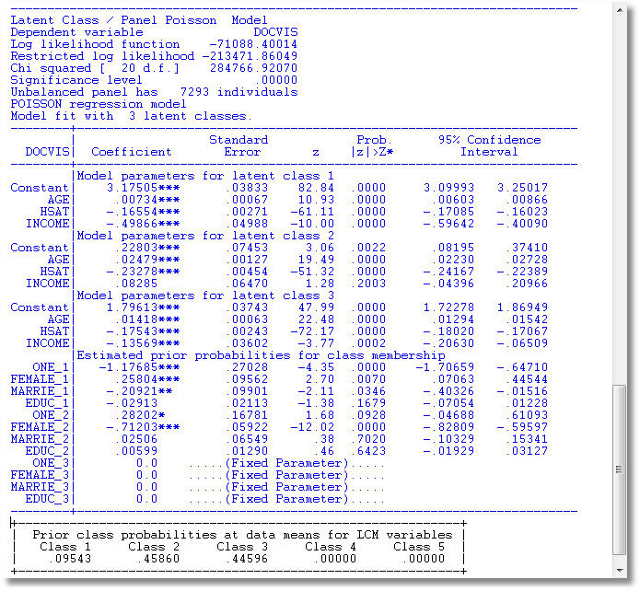
LC Poisson Regression for Doctor Visits

Slide 25
Heckman and Singer’s RE Model
Random Effects Model
Random Constants with Discrete Distribution

Slide 26
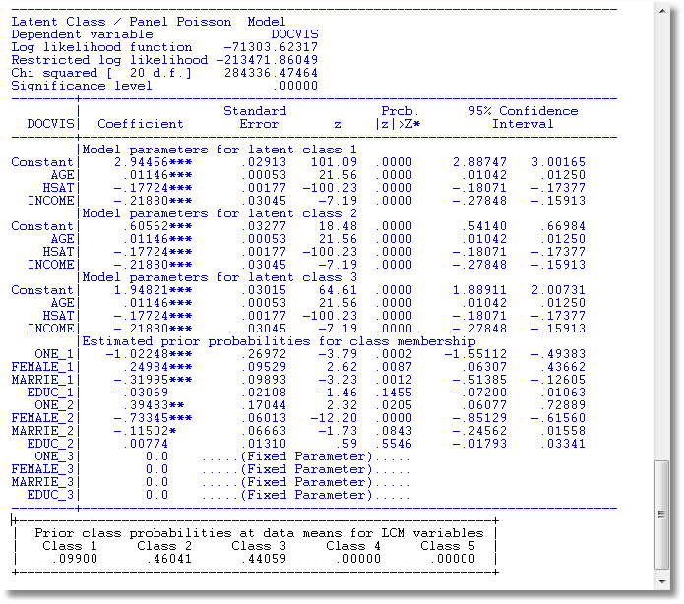
3 Class Heckman-Singer Form

Slide 27
Modeling Obesity with a
Latent Class Model
Mark Harris
Department of Economics, Curtin University
Bruce Hollingsworth
Department of Economics, Lancaster University
William Greene
Stern School of Business, New York University
Pushkar Maitra
Department of Economics, Monash University

Slide 28
Two Latent Classes: Approximately Half of European Individuals

Slide 29
An Ordered Probit Approach
A Latent Regression Model for “True BMI”
BMI* = β′x + ε, ε ~ N[0,σ²], σ² = 1
“True BMI” = a proxy for weight is unobserved
Observation Mechanism for Weight Type
WT = 0 if BMI* < 0 Normal
1 if 0 < BMI* < μ Overweight
2 if μ < BMI* Obese

Slide 30
Latent Class Modeling
Several ‘types’ or ‘classes. Obesity be due to genetic reasons (the FTO gene) or lifestyle factors
Distinct sets of individuals may have differing reactions to various policy tools and/or characteristics
The observer does not know from the data which class an individual is in.
Suggests a latent class approach for health outcomes
(Deb and Trivedi, 2002, and Bago d’Uva, 2005)

Slide 31
Latent Class Application
Two class model (considering FTO gene):
  More classes make class interpretations much more difficult
  Parametric models proliferate parameters
Endogenous class membership: Two classes allow us to correlate the equations driving class membership and observed weight outcomes via unobservables.
Theory for more than two classes not yet developed.

Slide 32
Endogeneity of Class Membership

Slide 33
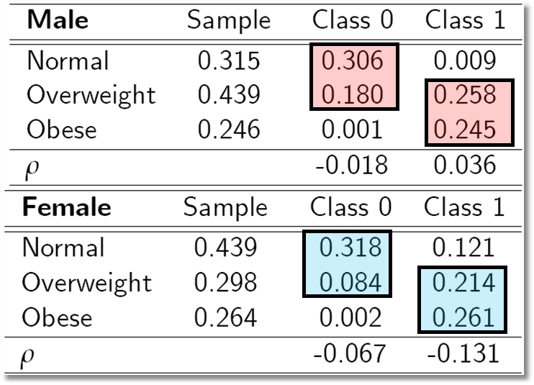
Outcome Probabilities
Class 0 dominated by normal and overweight probabilities ‘normal weight’ class
Class 1 dominated by probabilities at top end of the scale ‘non-normal weight’
Unobservables for weight class membership, negatively correlated with those determining weight levels:

Slide 34
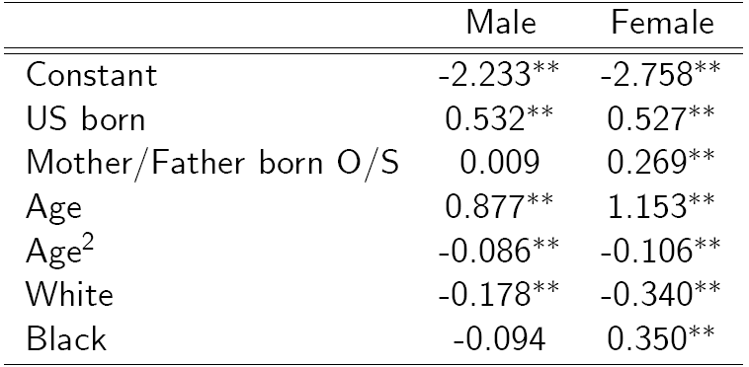
Classification (Latent Probit) Model

Slide 35
Inflated Responses in Self-Assessed Health
Mark Harris
Department of Economics, Curtin University
Bruce Hollingsworth
Department of Economics, Lancaster University
William Greene
Stern School of Business, New York University

Slide 36
SAH vs. Objective Health Measures
Favorable SAH categories seem artificially high.
• 60% of Australians are either overweight or obese (Dunstan et. al, 2001)
• 1 in 4 Australians has either diabetes or a condition of impaired glucose metabolism
• Over 50% of the population has elevated cholesterol
• Over 50% has at least 1 of the “deadly quartet” of health conditions
(diabetes, obesity, high blood pressure, high cholestrol)
• Nearly 4 out of 5 Australians have 1 or more long term health conditions
(National Health Survey, Australian Bureau of Statistics 2006)
• Australia ranked #1 in terms of obesity rates
Similar results appear to appear for other countries

Slide 37
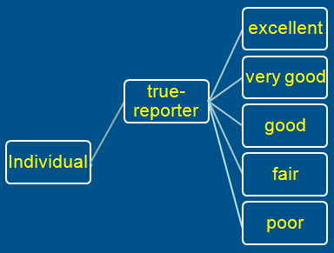
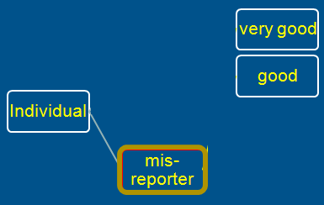
A Two Class Latent Class Model
True Reporter
Misreporter

Slide 38
Mis-reporters choose either good or very good
The response is determined by a probit model
Y=3
Y=2

Slide 39
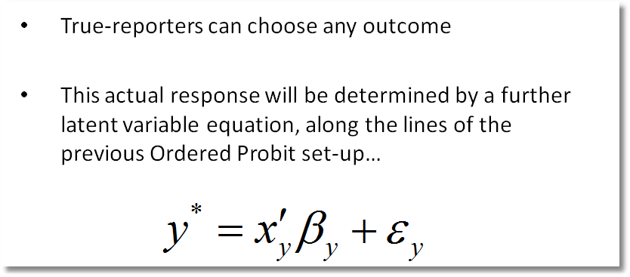
Y=4
Y=3
Y=2
Y=1
Y=0

Slide 40
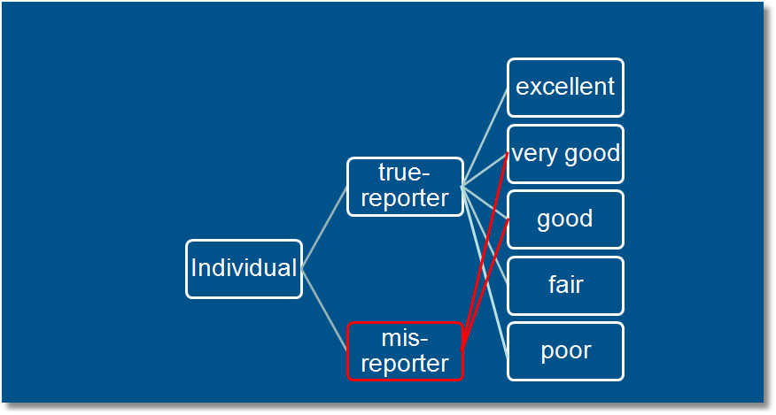
Observed Mixture of Two Classes

Slide 41
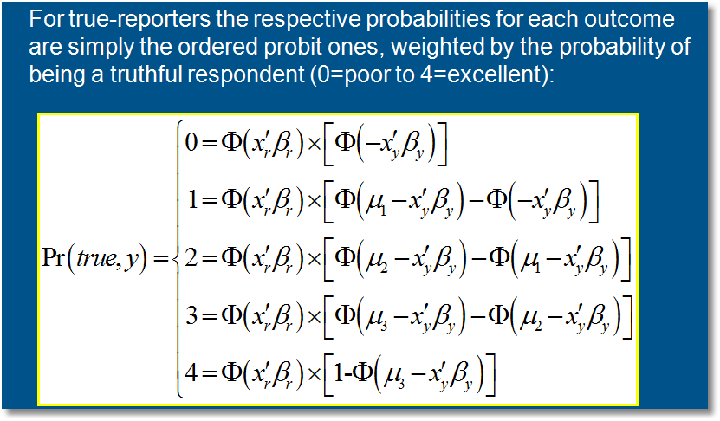
Pr(true,y) = Pr(true) * Pr(y | true)

Slide 42
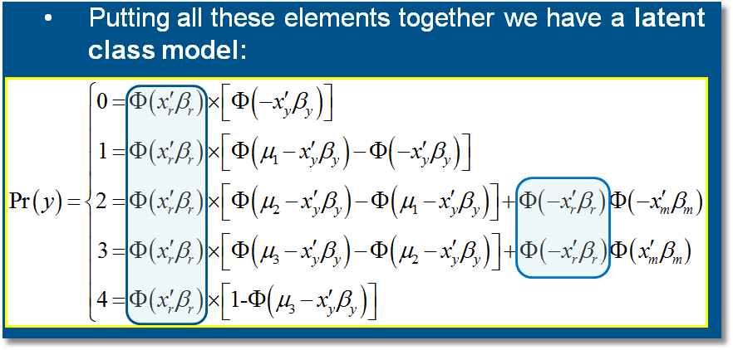

Slide 43
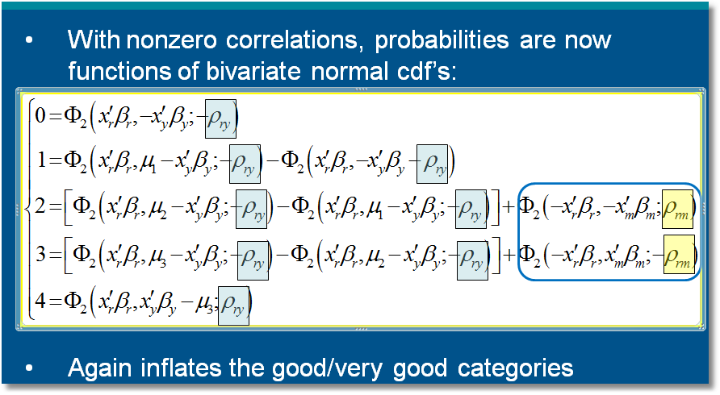

Slide 44
General Result

Slide 45


Slide 46
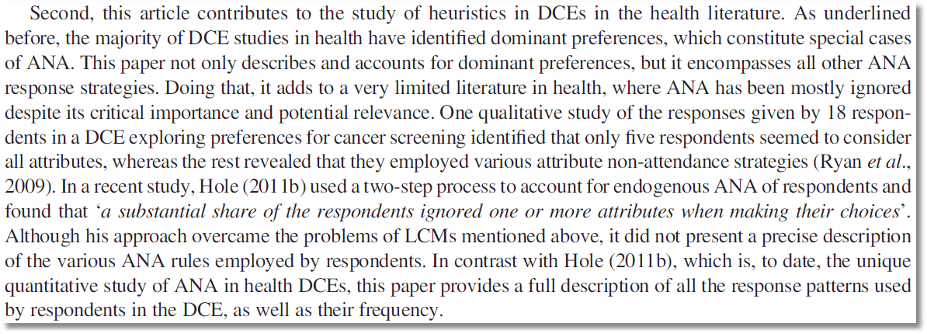

Slide 47
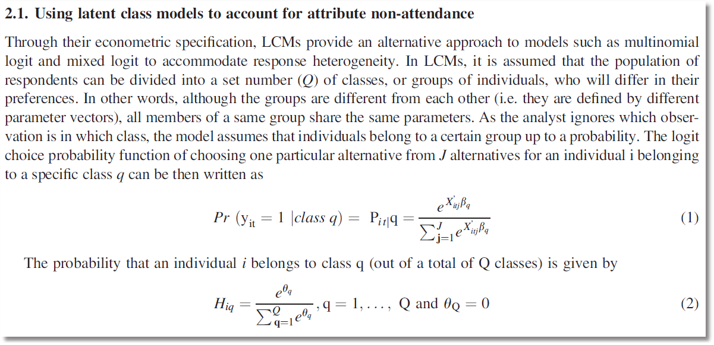

Slide 48
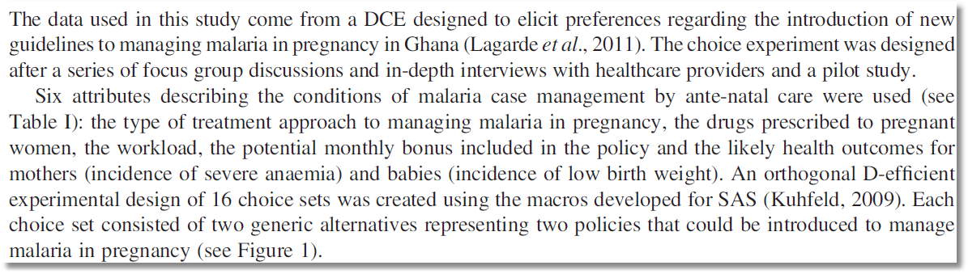

Slide 49
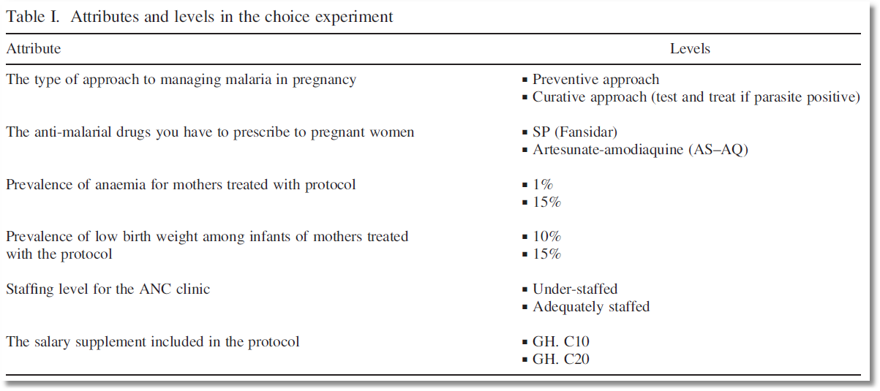
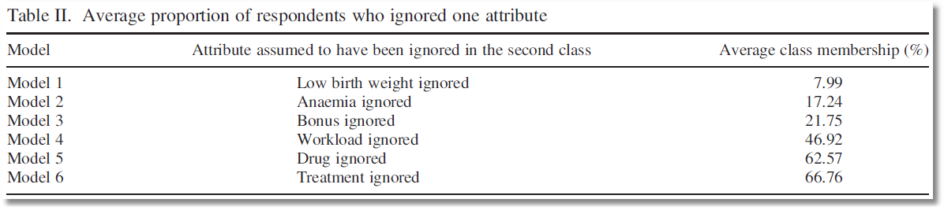

Slide 50
RANDOM Parameter
Models

Slide 51
A Recast Random Effects Model

Slide 52
A Computable Log Likelihood

Slide 53
Simulation

Slide 54
Random Effects Model: Simulation
----------------------------------------------------------------------
Random Coefficients Probit Model
Dependent variable DOCTOR (Quadrature Based)
Log likelihood function -16296.68110 (-16290.72192)
Restricted log likelihood -17701.08500
Chi squared [ 1 d.f.] 2808.80780
Simulation based on 50 Halton draws
--------+-------------------------------------------------
Variable| Coefficient Standard Error b/St.Er. P[|Z|>z]
--------+-------------------------------------------------
|Nonrandom parameters
AGE| .02226*** .00081 27.365 .0000 ( .02232)
EDUC| -.03285*** .00391 -8.407 .0000 (-.03307)
HHNINC| .00673 .05105 .132 .8952 ( .00660)
|Means for random parameters
Constant| -.11873** .05950 -1.995 .0460 (-.11819)
|Scale parameters for dists. of random parameters
Constant| .90453*** .01128 80.180 .0000
--------+-------------------------------------------------------------
Implied ρ from these estimates is .90454²/(1+.90453²) = .449998.

Slide 55
Recast the Entire Parameter Vector

Slide 56
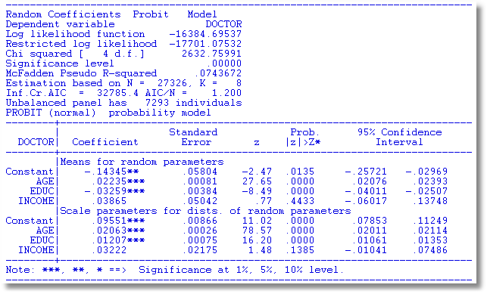
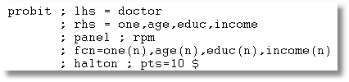

Slide 57
Modeling Parameter Heterogeneity

Slide 58
Hierarchical Probit Model
U_{it} = β_{1i} + β_{2i}Age_{it} + β_{3i}Educ_{it} + β_{4i}Income_{it} + ε_{it}.
β_{1i}=β₁+Δ₁₁ Female_{i} + Δ₁₂ Married_{i} + u_{1i}
β_{2i}=β₂+Δ₂₁ Female_{i} + Δ₂₂ Married_{i} + u_{2i}
β_{3i}=β₃+Δ₃₁ Female_{i} + Δ₃₂ Married_{i} + u_{3i}
β_{4i}=β₄+Δ₄₁ Female_{i} + Δ₄₂ Married_{i} + u_{4i}
Y_{it} = 1[U_{it} > 0]
All random variables normally distributed.

Slide 59
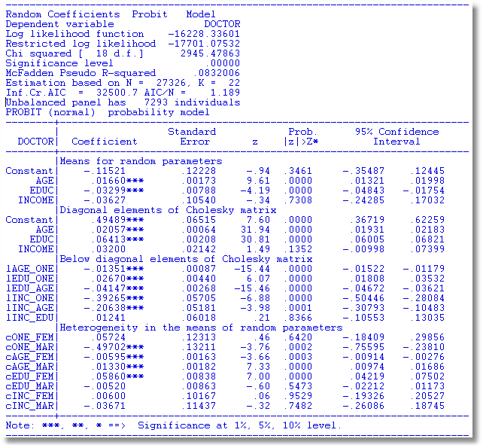

Slide 60
Simulating Conditional Means for Individual Parameters
Posterior estimates of E[parameters(i) | Data(i)]

Slide 61
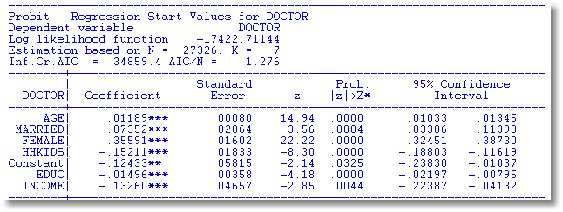
Probit

Slide 62
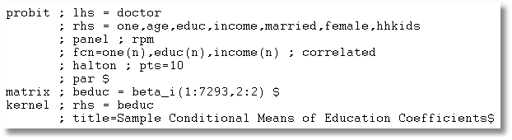

Slide 63
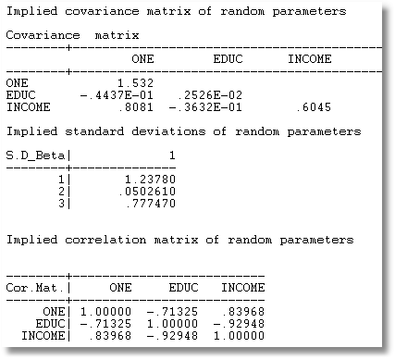
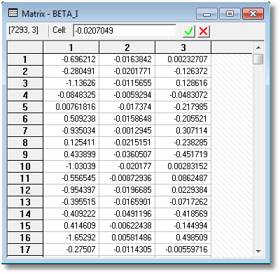

Slide 64
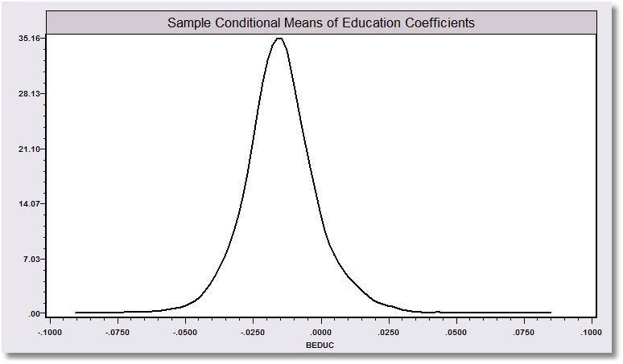
“Individual Coefficients”

