Slide 1
Empirical Methods for
Microeconomic Applications
University of Lugano, Switzerland
May 27-31, 2013
William Greene
Department of Economics
Stern School of Business

Slide 2






3A. Stated Preference Experiments

Slide 3
Agenda for 3A
Stated Preference Applications
SP Data
Application: Energy Supply
Application: Attribute Nonattendance – The 2^{K} Model
Application: Infant Care Guidelines
Application: Combined RP and SP Data

Slide 4
Application: Shoe Brand Choice
Simulated Data: Stated Choice,
  400 respondents,
  8 choice situations, 3,200 observations
3 choice/attributes + NONE
  Fashion = High / Low
  Quality = High / Low
  Price = 25/50/75,100 coded 1,2,3,4
Heterogeneity: Sex (Male=1), Age (<25, 25-39, 40+)
Underlying data generated by a 3 class latent class process (100, 200, 100 in classes)

Slide 5

Stated Choice Experiment: Unlabeled Alternatives, One Observation
t=1
t=2
t=3
t=4
t=5
t=6
t=7
t=8

Slide 6


Slide 7
Customers’ Choice of Energy Supplier
California, Stated Preference Survey
361 customers presented with 8-12 choice situations
Supplier attributes:
  Fixed price: cents per kWh
  Length of contract
  Local utility
  Well-known company
  Time-of-day rates (11¢ in day, 5¢ at night)
  Seasonal rates (10¢ in summer, 8¢ in winter, 6¢ in spring/fall)

Slide 8
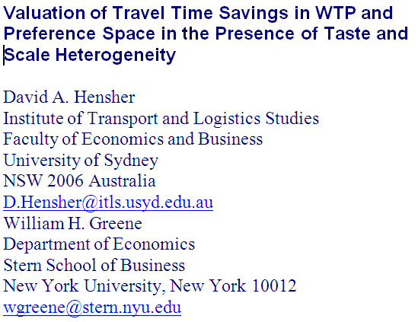

Slide 9
Revealed and Stated Preference Data
Pure RP Data
  Market (ex-post, e.g., supermarket scanner data)
  Individual observations
Pure SP Data
  Contingent valuation
Combined (Enriched) RP/SP
  Mixed data
  Expanded choice sets

Slide 10
Panel Data
Repeated Choice Situations
Typically RP/SP constructions (experimental)
Accommodating “panel data”
  Multinomial Probit [Marginal, impractical]
  Latent Class
  Mixed Logit

Slide 11
Customers’ Choice of Energy Supplier
California, Stated Preference Survey
361 customers presented with 8-12 choice situations
Supplier attributes:
  Fixed price: cents per kWh
  Length of contract
  Local utility
  Well-known company
  Time-of-day rates (11¢ in day, 5¢ at night)
  Seasonal rates (10¢ in summer, 8¢ in winter, 6¢ in spring/fall)

Slide 12
Population Parameter Distributions
Normal for:
  Contract length
  Local utility
  Well-known company
Log-normal for:
  Time-of-day rates
  Seasonal rates
Price coefficient held fixed

Slide 13
Estimated Model
Estimate Std error
Price -.883 0.050
Contract mean -.213 0.026
std dev .386 0.028
Local mean 2.23 0.127
std dev 1.75 0.137
Known mean 1.59 0.100
std dev .962 0.098
TOD mean* 2.13 0.054
std dev* .411 0.040
Seasonal mean* 2.16 0.051
std dev* .281 0.022
*Parameters of underlying normal. β_{i} = exp(mean+sd*w_{i})

Slide 14
Distribution of Brand Value
Standard deviation
=1.75¢
10% dislike local utility
0
2.23¢
Brand value of local utility

Slide 15
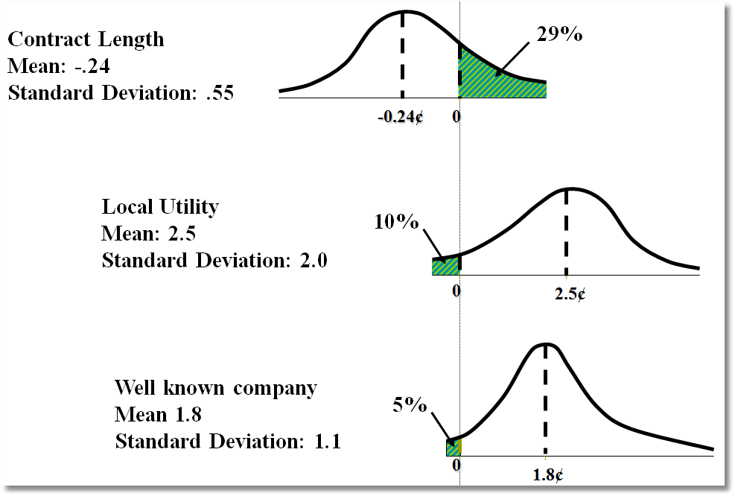
Random Parameter Distributions

Slide 16
Time of Day Rates (Customers do not like - lognormal)
Time-of-day Rates
-10.4
0
Seasonal Rates
-10.2
0

Slide 17
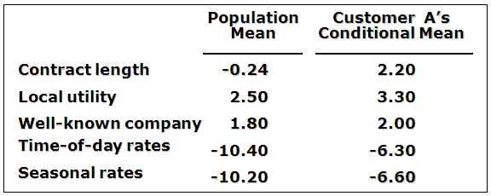
Expected Preferences of Each Customer
Customer likes long-term contract, local utility, and non-fixed rates.
Local utility can retain and make profit from this customer by offering a long-term contract with time-of-day or seasonal rates.

Slide 18

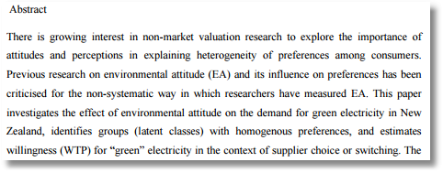
Willingness to Pay for Green Energy

Slide 19


Slide 20
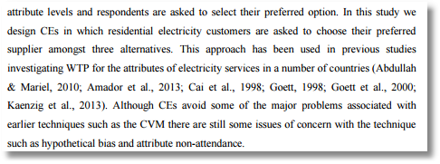

Slide 21
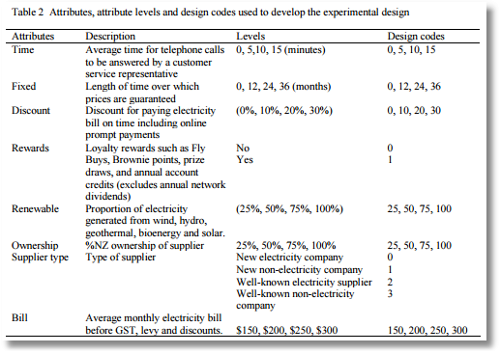

Slide 22
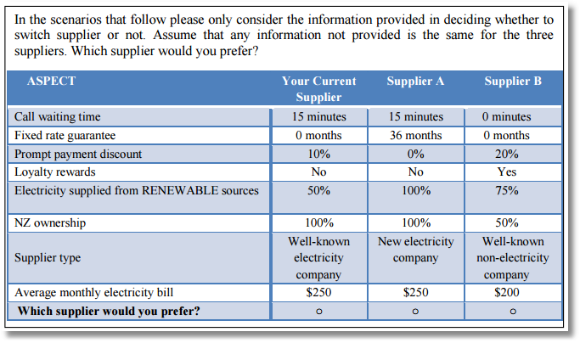

Slide 23
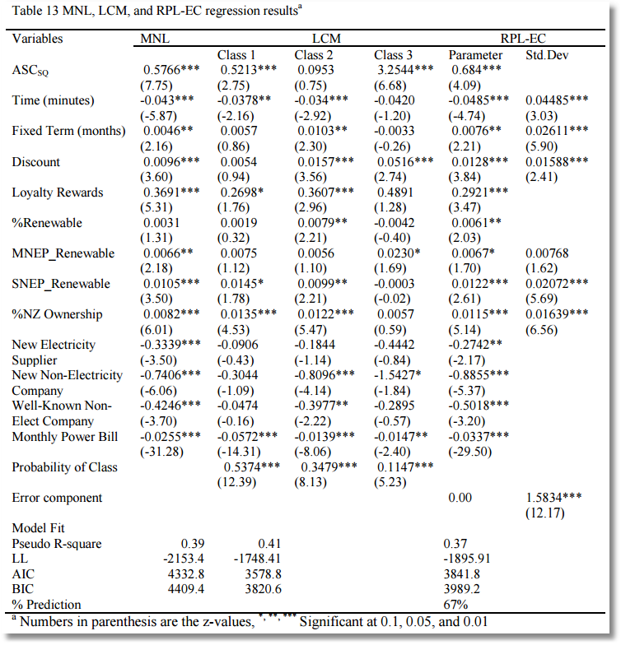

Slide 24
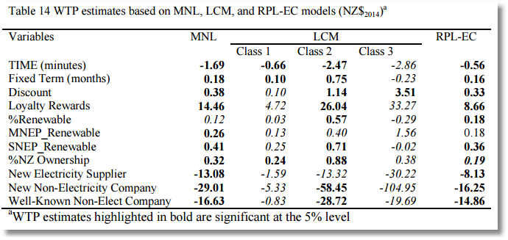

Slide 25
Application
Survey sample of 2,688 trips, 2 or 4 choices per situation
Sample consists of 672 individuals
Choice based sample
Revealed/Stated choice experiment:
Revealed: Drive,ShortRail,Bus,Train
Hypothetical: Drive,ShortRail,Bus,Train,LightRail,ExpressBus
Attributes:
Cost –Fuel or fare
Transit time
Parking cost
Access and Egress time

Slide 26
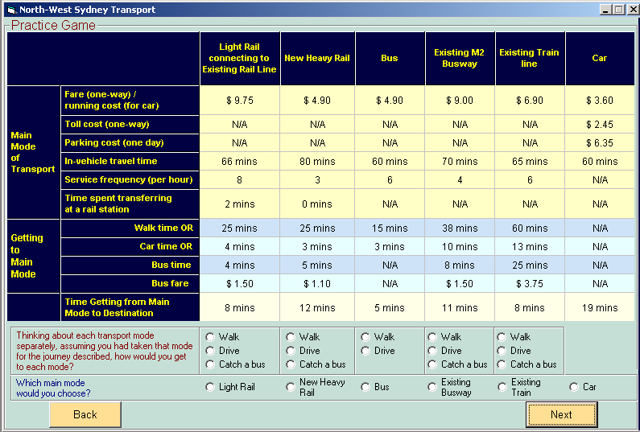
Stated Preference Instrument

Slide 27
Choice Strategy
Latent Class Modeling 
Applications 
Hensher, D.A., Rose, J. and Greene, W. (2005) The Implications on Willingness to Pay of Respondents Ignoring Specific Attributes (DoD#6) Transportation, 32 (3), 203-222.
Hensher, D.A. and Rose, J.M. (2009) Simplifying Choice through Attribute Preservation or Non-Attendance: Implications for Willingness to Pay, Transportation Research Part E, 45, 583-590.
Rose, J., Hensher, D., Greene, W. and Washington, S. Attribute Exclusion Strategies in Airline Choice: Accounting for Exogenous Information on Decision Maker Processing Strategies in Models of Discrete Choice, Transportmetrica, 2011
Hensher, D.A. and Greene, W.H. (2010) Non-attendance and dual processing of common-metric attributes in choice analysis: a latent class specification, Empirical Economics 39 (2), 413-426
Campbell, D., Hensher, D.A. and Scarpa, R. Non-attendance to Attributes in Environmental Choice Analysis: A Latent Class Specification, Journal of Environmental Planning and Management, proofs 14 May 2011.
Hensher, D.A., Rose, J.M. and Greene, W.H. Inferring attribute non-attendance from stated choice data: implications for willingness to pay estimates and a warning for stated choice experiment design, 14 February 2011, Transportation, online 2 June 2001 DOI 10.1007/s11116-011-9347-8.

Slide 28
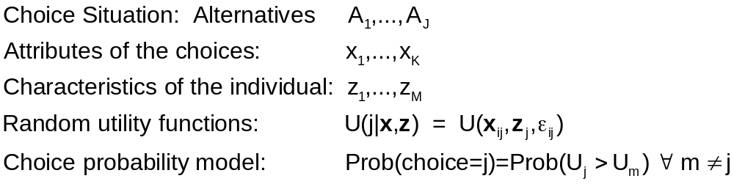
Decision Strategy in
Multinomial Choice
Latent Class Modeling 
Applications 

Slide 29
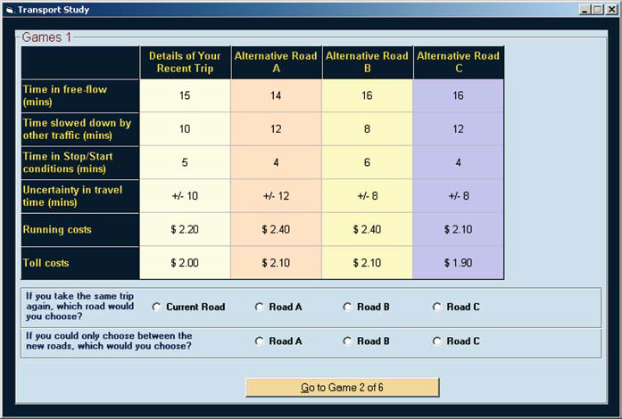
A Stated Choice Experiment
Latent Class Modeling 
Applications 

Slide 30
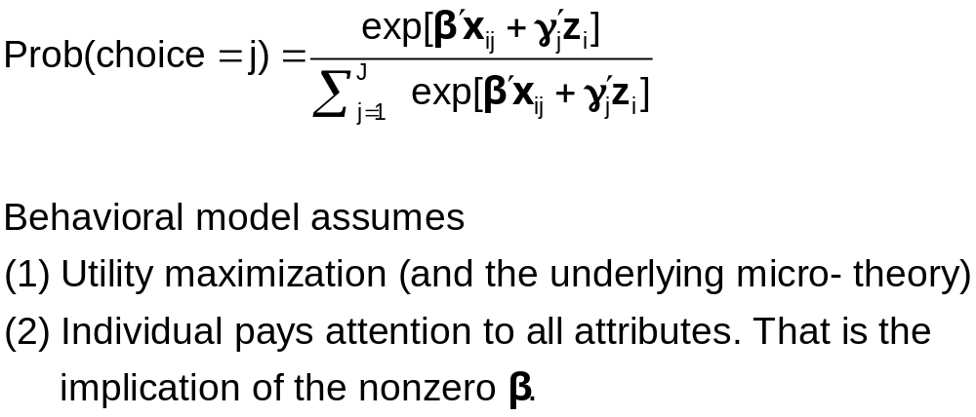
Multinomial Logit Model
Latent Class Modeling 
Applications 

Slide 31
Individual Explicitly Ignores Attributes
Latent Class Modeling 
Applications 
Hensher, D.A., Rose, J. and Greene, W. (2005) The Implications on Willingness to Pay of Respondents Ignoring Specific Attributes (DoD#6) Transportation, 32 (3), 203-222.
Hensher, D.A. and Rose, J.M. (2009) Simplifying Choice through Attribute Preservation or Non-Attendance: Implications for Willingness to Pay, Transportation Research Part E, 45, 583-590.
Rose, J., Hensher, D., Greene, W. and Washington, S. Attribute Exclusion Strategies in Airline Choice: Accounting for Exogenous Information on Decision Maker Processing Strategies in Models of Discrete Choice, Transportmetrica, 2011
Choice situations in which the individual explicitly states that they ignored certain attributes in their decisions.

Slide 32
Stated Choice Experiment
Latent Class Modeling 
Applications 
Ancillary questions: Did you ignore any of these attributes?

Slide 33
Appropriate Modeling Strategy
Latent Class Modeling 
Applications 
Fix ignored attributes at zero? Definitely not!
  Zero is an unrealistic value of the attribute (price)
  The probability is a function of x_{ij} – x_{il}, so the substitution distorts the probabilities
Appropriate model: for that individual, the specific coefficient is zero – consistent with the utility assumption. A person specific, exogenously determined model
Surprisingly simple to implement

Slide 34
Individual Implicitly Ignores Attributes
Latent Class Modeling 
Applications 
Hensher, D.A. and Greene, W.H. (2010) Non-attendance and dual processing of common-metric attributes in choice analysis: a latent class specification, Empirical Economics 39 (2), 413-426
Campbell, D., Hensher, D.A. and Scarpa, R. Non-attendance to Attributes in Environmental Choice Analysis: A Latent Class Specification, Journal of Environmental Planning and Management, proofs 14 May 2011.
Hensher, D.A., Rose, J.M. and Greene, W.H. Inferring attribute non-attendance from stated choice data: implications for willingness to pay estimates and a warning for stated choice experiment design, 14 February 2011, Transportation, online 2 June 2001 DOI 10.1007/s11116-011-9347-8.

Slide 35
Stated Choice Experiment
Latent Class Modeling 
Applications 
Individuals seem to be ignoring attributes. Uncertain to the analyst

Slide 36
The 2^{K} model
Latent Class Modeling 
Applications 
The analyst believes some attributes are ignored. There is no indicator.
Classes distinguished by which attributes are ignored
Same model applies, now a latent class. For K attributes there are 2^{K} candidate coefficient vectors

Slide 37
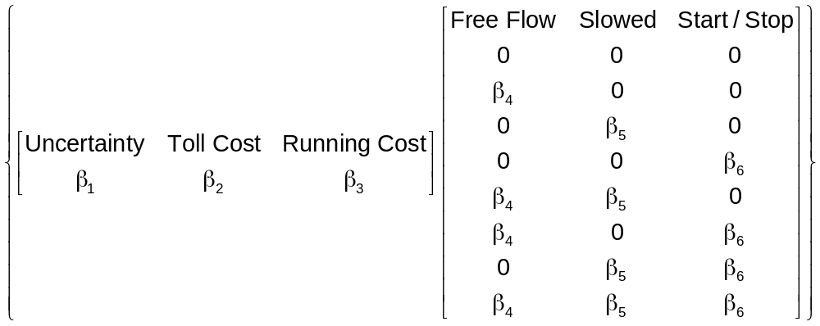
A Latent Class Model
Latent Class Modeling 
Applications 

Slide 38
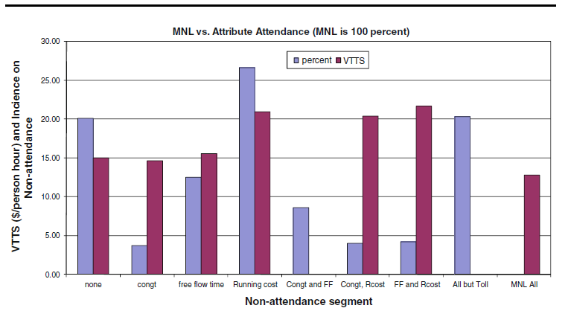
Results for the 2^{K} model
Latent Class Modeling 
Applications 

Slide 40
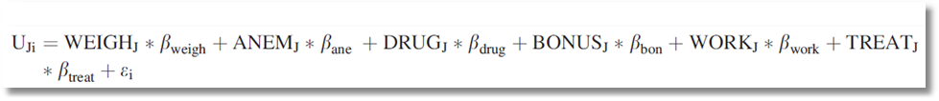
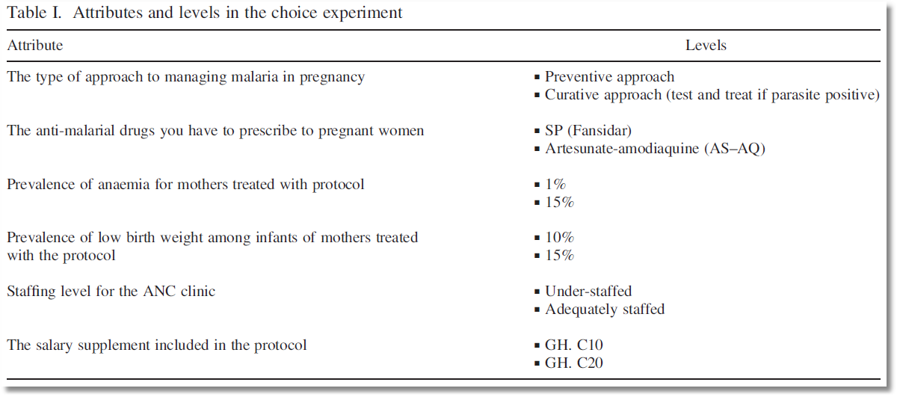
Choice Model with 6 Attributes

Slide 41
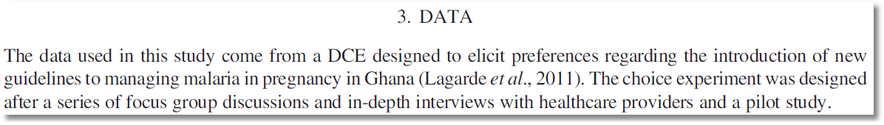
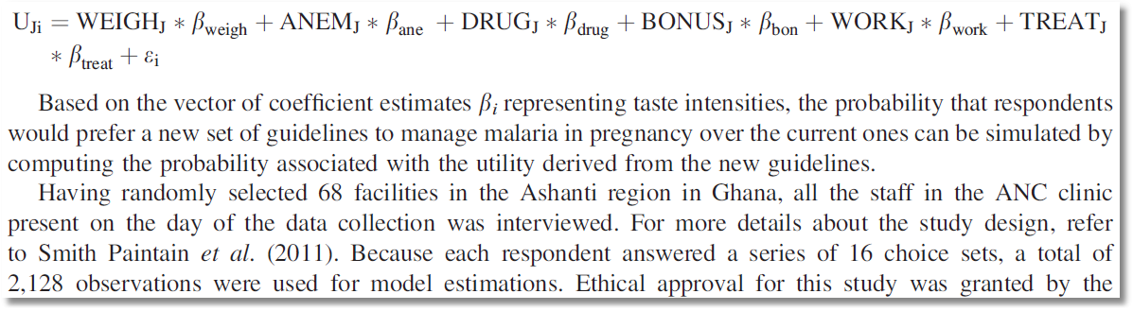
Stated Choice Experiment

Slide 42
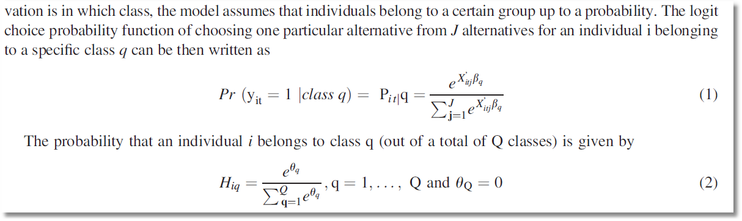
Latent Class Model – Prior Class Probabilities

Slide 43
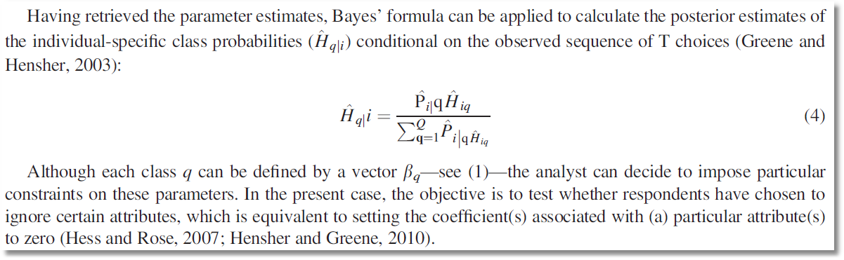
Latent Class Model – Posterior Class Probabilities

Slide 44
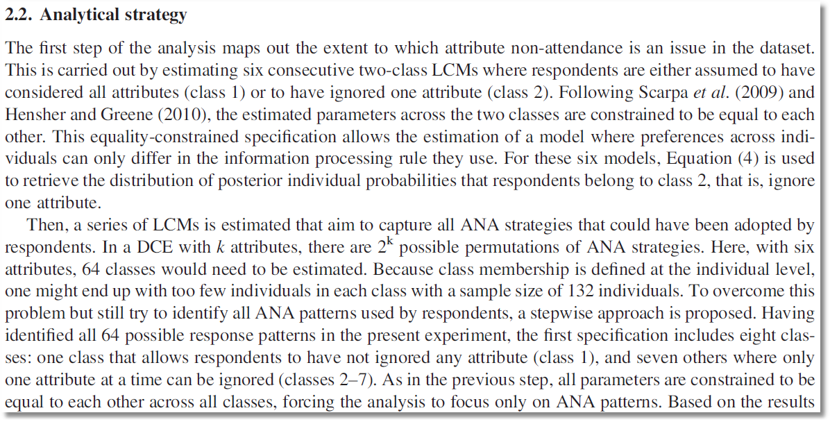
6 attributes implies 64 classes. Strategy to reduce the computational burden on a small sample

Slide 45
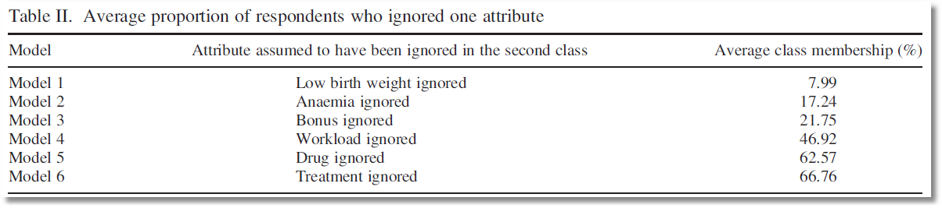
Posterior probabilities of membership in the nonattendance class for 6 models

Slide 46
Pooling RP and SP Data Sets
Enrich the attribute set by replicating choices
E.g.:
  RP: Bus,Car,Train (actual)
  SP: Bus(1),Car(1),Train(1)
  Bus(2),Car(2),Train(2),…
How to combine?

Slide 47
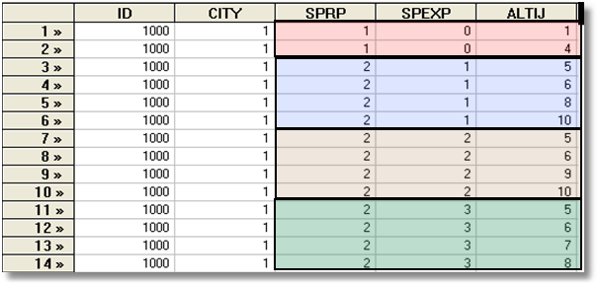
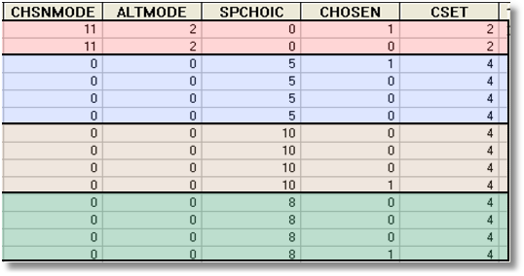
Each person makes four choices from a choice set that includes either 2 or 4 alternatives.
The first choice is the RP between two of the 4 RP alternatives
The second-fourth are the SP among four of the 6 SP alternatives.
There are 10 alternatives in total.
A Stated Choice Experiment with Variable Choice Sets

Slide 48
Enriched Data Set – Vehicle Choice
Choosing between Conventional, Electric and LPG/CNG Vehicles in Single-Vehicle Households
David A. Hensher William H. Greene
Institute of Transport Studies Department of Economics
School of Business Stern School of Business
The University of Sydney New York University
NSW 2006 Australia New York USA
September 2000

Slide 49
Fuel Types Study
Conventional, Electric, Alternative
1,400 Sydney Households
Automobile choice survey
RP + 3 SP fuel classes

Slide 50
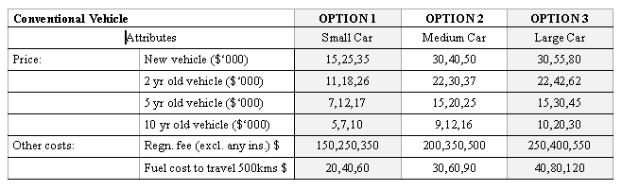
Attribute Space: Conventional

Slide 51
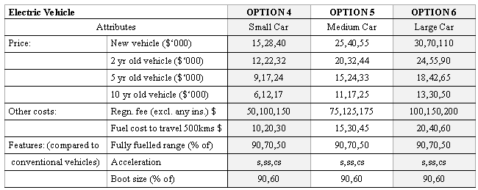
Attribute Space: Electric

Slide 52
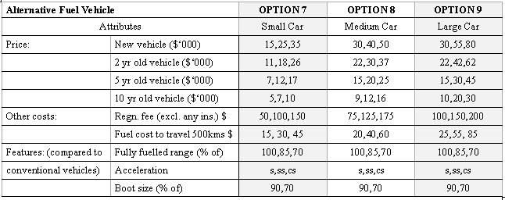
Attribute Space: Alternative

Slide 53
Mixed Logit Approaches
Pivot SP choices around an RP outcome.
Scaling is handled directly in the model
Continuity across choice situations is handled by random elements of the choice structure that are constant through time
  Preference weights – coefficients
  Scaling parameters
    Variances of random parameters
    Overall scaling of utility functions

Slide 54
Survey Instrument

Slide 56
Generalized Mixed Logit Model
One choice setting
U_{ij} = α _{j} + β_{i}′x_{ij} + δ′z_{i} + ε_{ij}.
Stated choice setting, multiple choices
U_{ijt} = α_{j} + β_{i}′x_{itj} + δ′z_{it} + ε_{ijt}.
Random parameters
β_{i} = β + Γv_{i}
Generalized mixed logit
σ_{i} = exp(-τ²/2 + τw_{i})
β_{i} = σ_{i}β + [γ + σ_{i}(1 - γ)]Γv_{i}

Slide 57
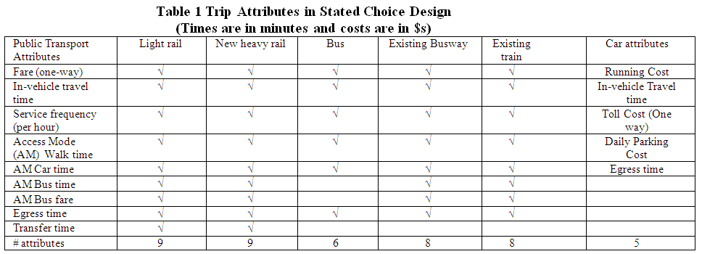
Experimental Design

Slide 58
Hybrid Choice Models
Incorporates latent variables in choice model
Extends development of discrete choice model to incorporate other aspects of preference structure of the chooser
Develops endogeneity of the preference structure.

Slide 59
Endogeneity
"Recent Progress on Endogeneity in Choice Modeling" with Jordan Louviere & Kenneth Train & Moshe Ben-Akiva & Chandra Bhat & David Brownstone & Trudy Cameron & Richard Carson & J. Deshazo & Denzil Fiebig & William Greene & David Hensher & Donald Waldman, 2005. Marketing Letters Springer, vol. 16(3), pages 255-265, December.
Narrow view: U(i,j) = b’x(i,j) + ε(i,j), x(i,j) correlated with ε(i,j)
(Berry, Levinsohn, Pakes, brand choice for cars, endogenous price attribute.)
Implications for estimators that assume it is.
Broader view: Sounds like heterogeneity.
  Preference structure: RUM vs. RRM
  Heterogeneity in choice strategy – e.g., omitted attribute models
  Heterogeneity in taste parameters: location and scaling
  Heterogeneity in functional form: Possibly nonlinear utility functions

Slide 60
Heterogeneity
Narrow view: Random variation in marginal utilities and scale
  RPM, LCM
  Scaling model
  Generalized Mixed model
Broader view: Heterogeneity in preference weights
  RPM and LCM with exogenous variables
  Scaling models with exogenous variables in variances
  Looks like hierarchical models

Slide 61
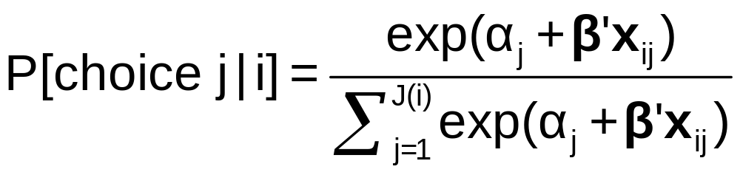
The MNL Model

Slide 62
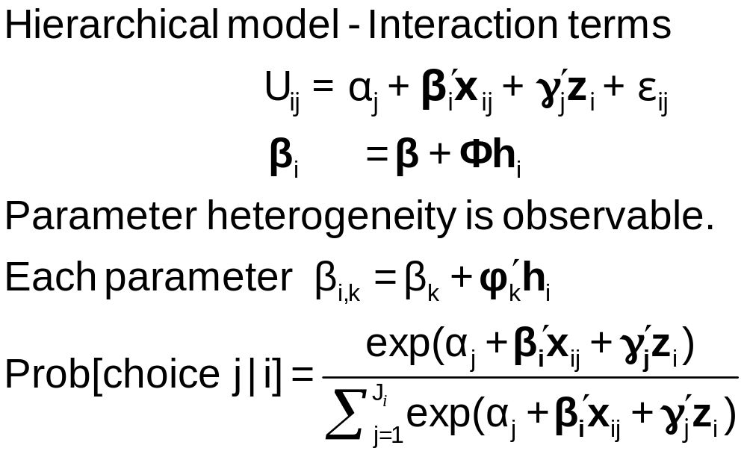
Observable Heterogeneity in
Preference Weights

Slide 63
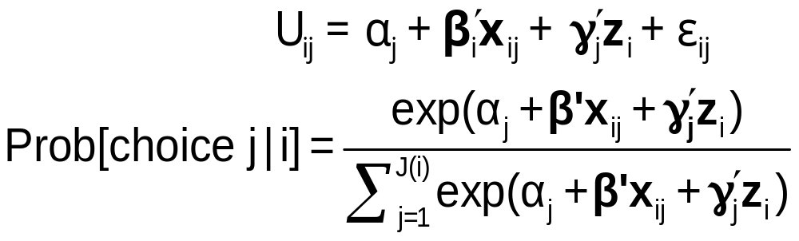
Observable Heterogeneity in Utility Levels
Choice, e.g., among brands of cars
x_{itj} = attributes: price, features
z_{i} = observable characteristics: age, sex, income

Slide 64
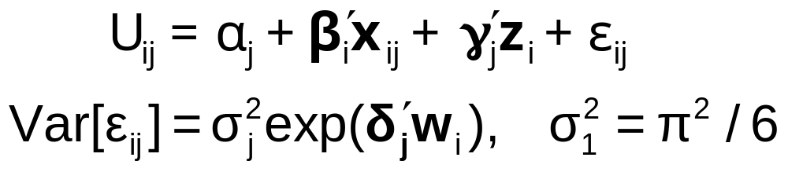
‘Quantifiable’ Heterogeneity in Scaling
w_{i} = observable characteristics: age, sex, income, etc.

Slide 65
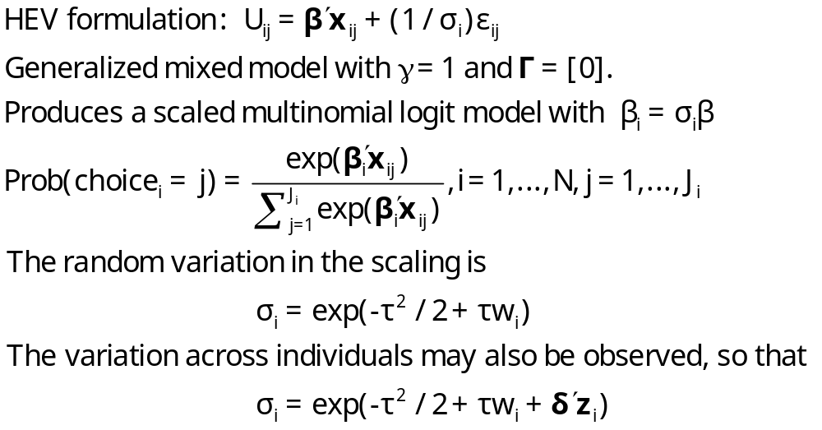
Unobserved Heterogeneity in Scaling

Slide 66
A Helpful Way to View
Hybrid Choice Models
Adding attitude variables to the choice model
In some formulations, it makes them look like random parameter models

Slide 67
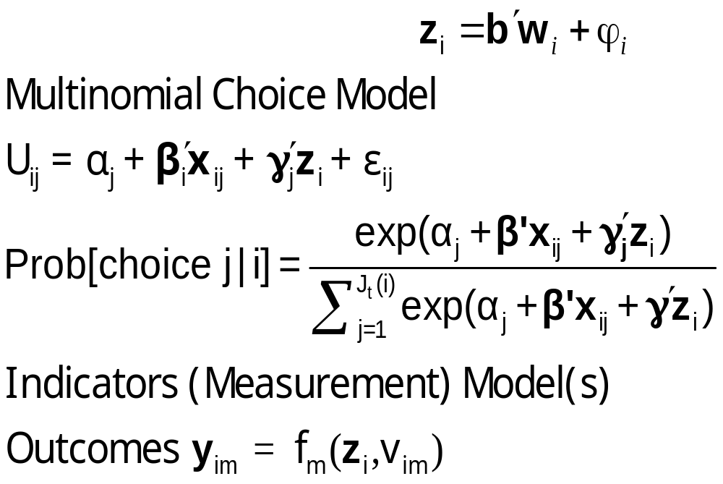
Unbservable Heterogeneity in Utility Levels and Other Preference Indicators

Slide 68


Slide 69
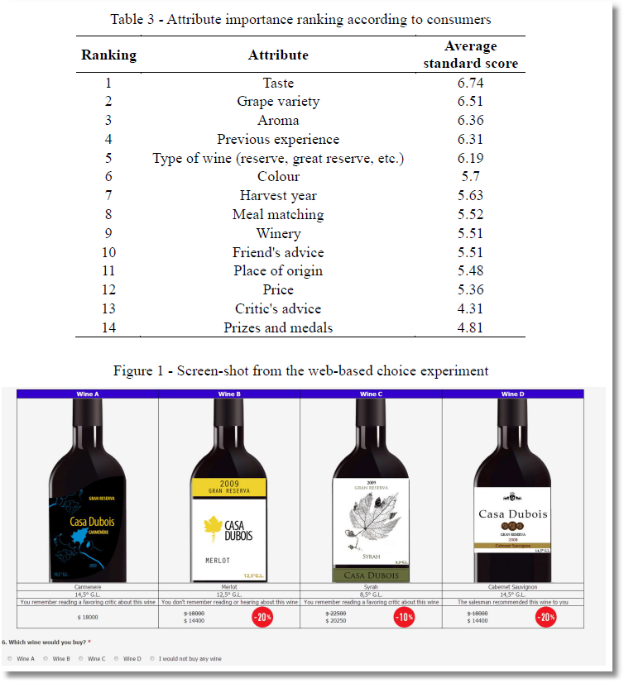

Slide 70
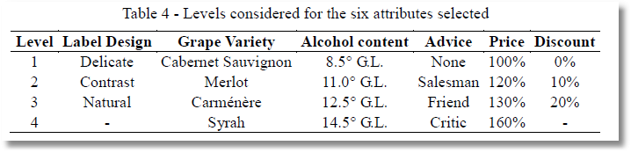

Slide 71
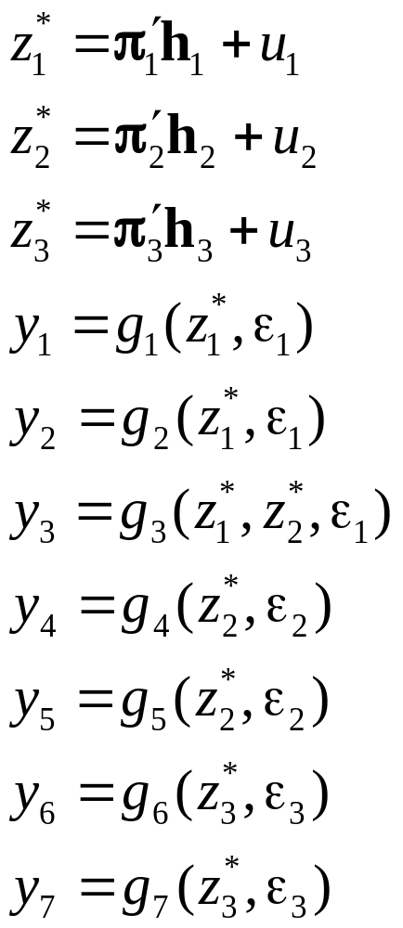
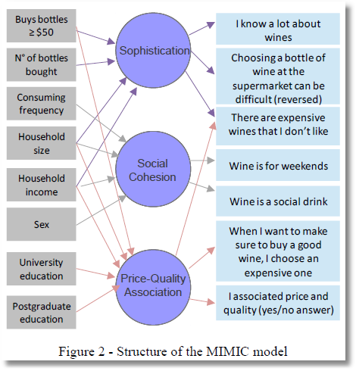
Observed Latent Observed
x → z* → y

Slide 72
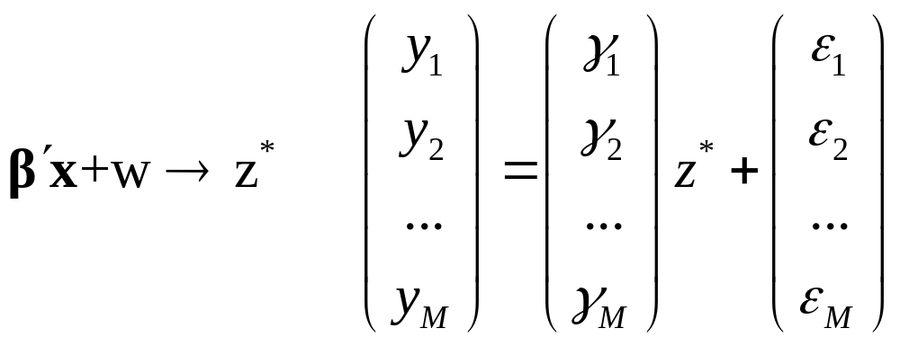
MIMIC Model
Multiple Causes and Multiple Indicators
X z* Y

Slide 73
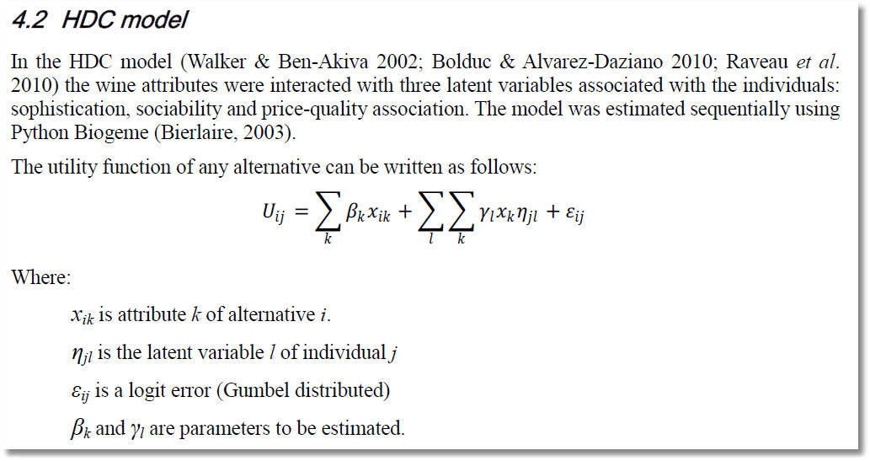
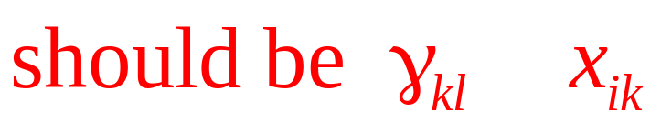
Note. Alternative i, Individual j.

Slide 74
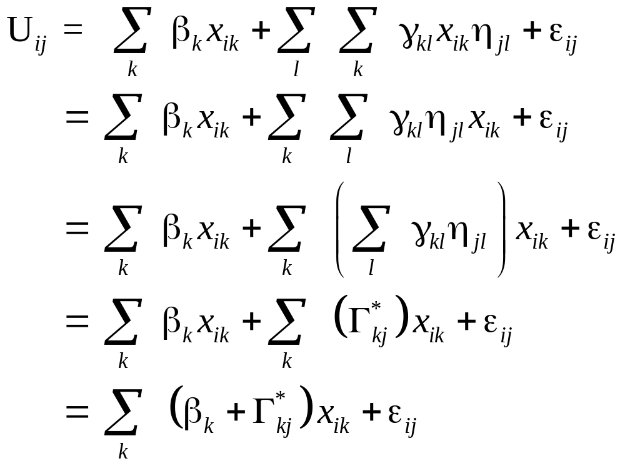
This is a mixed logit model. The interesting extension is the source of the individual heterogeneity in the random parameters.

