Slide 1



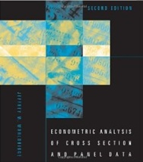
Microeconometric Modeling
William Greene
Stern School of Business
New York University
New York NY USA
1.3 Linear Panel Data
Regression Models

Slide 2
Concepts
Models
Unbalanced Panel
Cluster Estimator
Block Bootstrap
Difference in Differences
Incidental Parameters
Problem
Endogeneity
Instrumental Variable
Control Function Estimator
Mundlak Form
Correlated Random Effects
Hausman Test
Lagrange Multiplier (LM) Test
Variable Addition (Wu) Test
Linear Regression
Fixed Effects LR Model
Random Effects LR Model

Slide 3


Slide 4


Slide 5


BHPS Has Evolved

Slide 6

German Socioeconomic Panel

Slide 7

Household Income and Labour Dynamics In Australia

Slide 8

Balanced and Unbalanced Panels
Distinction: Balanced vs. Unbalanced Panels
A notation to help with mechanics
  z_{i,t}, i = 1,…,N; t = 1,…,T_{i}
The role of the assumption
  Mathematical and notational convenience:
    Balanced, n=NT
    Unbalanced:
  The fixed T_{i} assumption almost never necessary.
  If unbalancedness is due to nonrandom attrition from an otherwise balanced panel, then this will require special considerations.

Slide 9
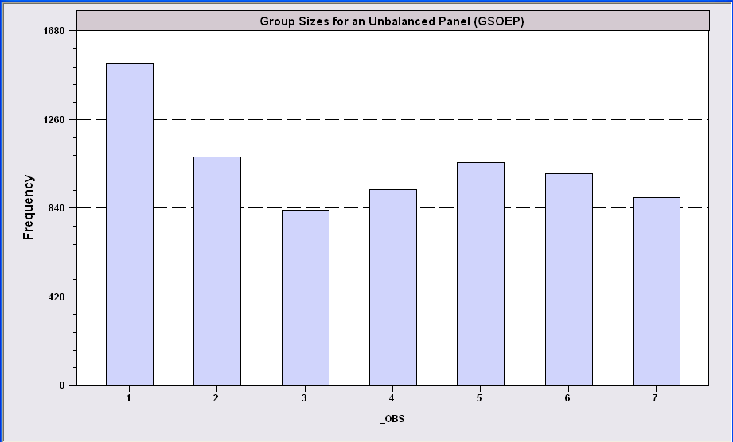
An Unbalanced Panel: RWM’s GSOEP Data on Health Care
N = 7,293 Households
Some households exited then returned

Slide 10


Slide 11
Cornwell and Rupert Data
Cornwell and Rupert Returns to Schooling Data, 595 Individuals, 7 Years
(Extracted from NLSY.) Variables in the file are
EXP = work experience
WKS = weeks worked
OCC = occupation, 1 if blue collar,
IND = 1 if manufacturing industry
SOUTH = 1 if resides in south
SMSA = 1 if resides in a city (SMSA)
MS = 1 if married
FEM = 1 if female
UNION = 1 if wage set by union contract
ED = years of education
LWAGE = log of wage = dependent variable in regressions
These data were analyzed in Cornwell, C. and Rupert, P., "Efficient Estimation with Panel Data: An Empirical Comparison of Instrumental Variable Estimators," Journal of Applied Econometrics, 3, 1988, pp. 149-155. See Baltagi, page 122 for further analysis. The data were downloaded from the website for Baltagi's text.
Notes:
11

Slide 12
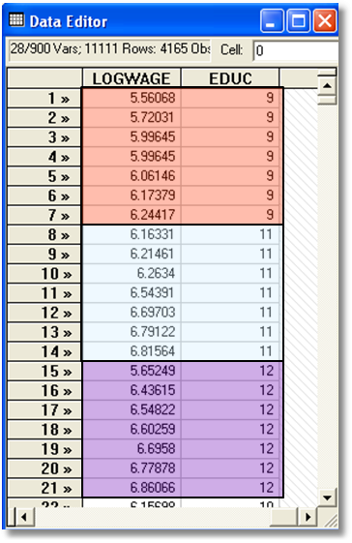

Slide 13
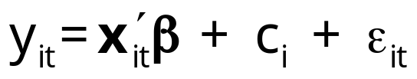
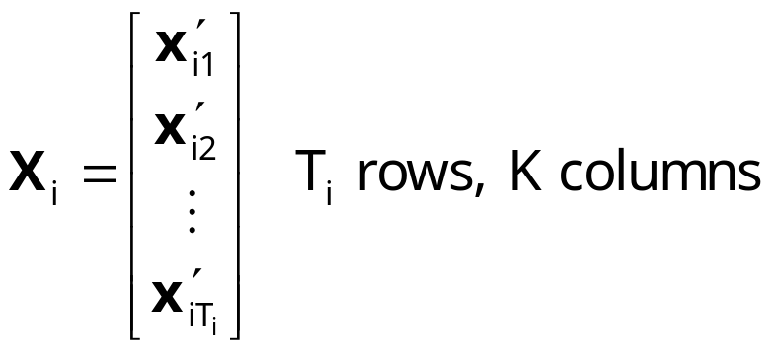
Common Effects Models
Unobserved individual effects in regression: E[y_{it} | x_{it}, c_{i}]
  Notation:
Linear specification:
  Fixed Effects: E[c_{i} | X_{i} ] = g(X_{i}). Cov[x_{it},c_{i}] ≠0
  effects are correlated with included variables.
  Random Effects: E[c_{i} | X_{i} ] = μ; effects are uncorrelated with included variables. If X_{i} contains a constant term, μ=0 WLOG. Common: Cov[x_{it},c_{i}] =0, but E[c_{i} | X_{i} ] = μ is needed for the full model

Slide 14
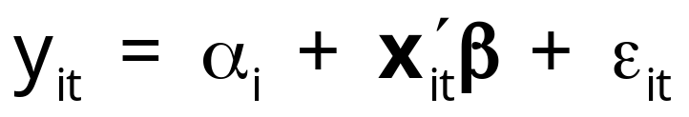
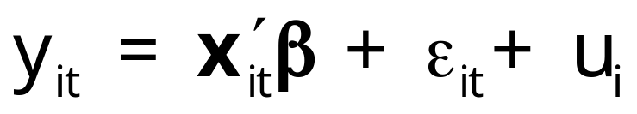
Convenient Notation
Fixed Effects – the ‘dummy variable model’
Random Effects – the ‘error components model’
Individual specific constant terms.
Compound (“composed”) disturbance

Slide 15
Estimating β
β is the partial effect of interest
Can it be estimated (consistently) in the
presence of (unmeasured) c_{i}?
  Does pooled least squares “work?”
  Strategies for “controlling for c_{i}” using the
  sample data.

Slide 16
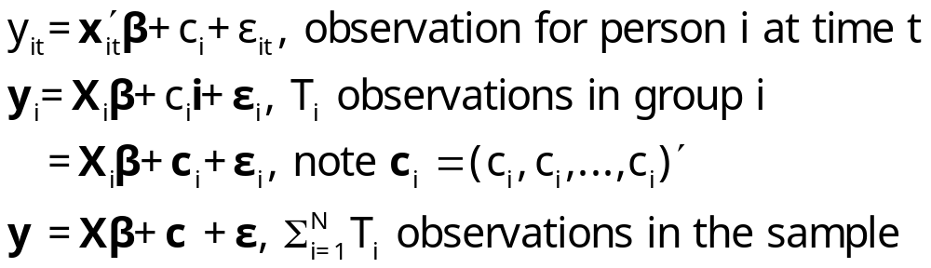
The Pooled Regression
Presence of omitted effects
Potential bias/inconsistency of OLS –
Depends on ‘fixed’ or ‘random’
  If FE, X is endogenous: Omitted Variables Bias
  If RE, OLS is OK but standard errors are incorrect.

Slide 17
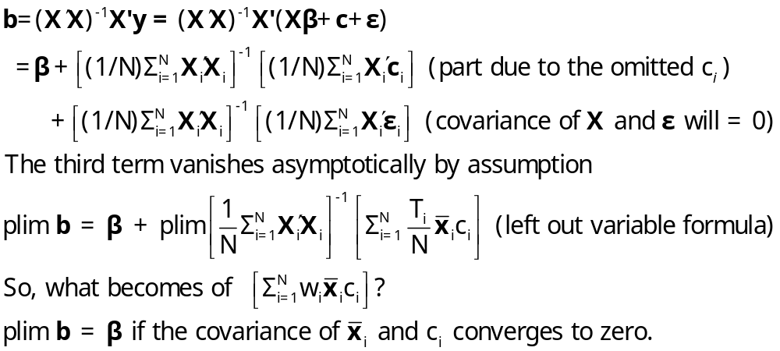
OLS with Individual Effects
The omitted variable(s) are the group means

Slide 18
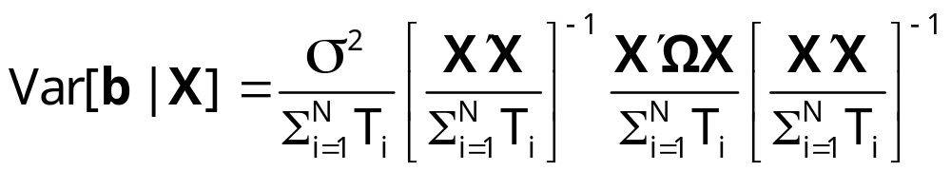
Ordinary Least Squares
Standard results for OLS in a generalized regression model
  Consistent if RE, inconsistent if FE.
  Unbiased for something in either case.
  Inefficient in all cases.
True Variance

Slide 19
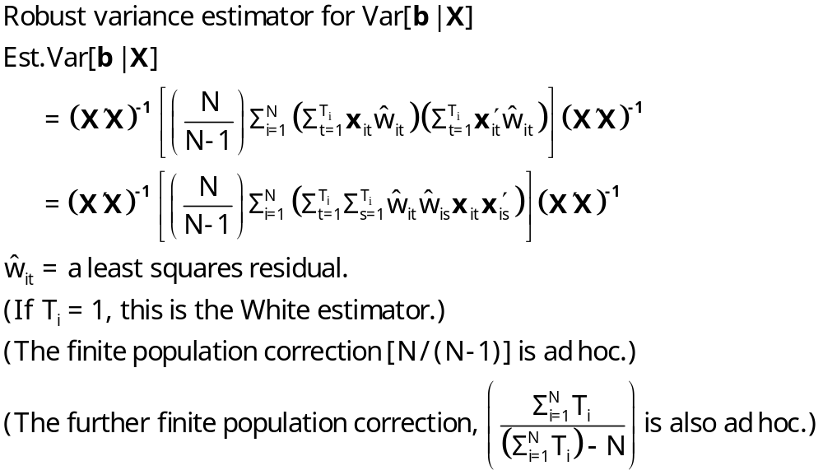
A Cluster Estimator

Slide 20

Alternative OLS Variance Estimators
Cluster correction increases SEs
+---------+--------------+----------------+--------+---------+
|Variable | Coefficient | Standard Error |b/St.Er.|P[|Z|>z] |
+---------+--------------+----------------+--------+---------+
Constant 5.40159723 .04838934 111.628 .0000
EXP .04084968 .00218534 18.693 .0000
EXPSQ -.00068788 .480428D-04 -14.318 .0000
OCC -.13830480 .01480107 -9.344 .0000
SMSA .14856267 .01206772 12.311 .0000
MS .06798358 .02074599 3.277 .0010
FEM -.40020215 .02526118 -15.843 .0000
UNION .09409925 .01253203 7.509 .0000
ED .05812166 .00260039 22.351 .0000
Robust
Constant 5.40159723 .10156038 53.186 .0000
EXP .04084968 .00432272 9.450 .0000
EXPSQ -.00068788 .983981D-04 -6.991 .0000
OCC -.13830480 .02772631 -4.988 .0000
SMSA .14856267 .02423668 6.130 .0000
MS .06798358 .04382220 1.551 .1208
FEM -.40020215 .04961926 -8.065 .0000
UNION .09409925 .02422669 3.884 .0001
ED .05812166 .00555697 10.459 .0000

Slide 21
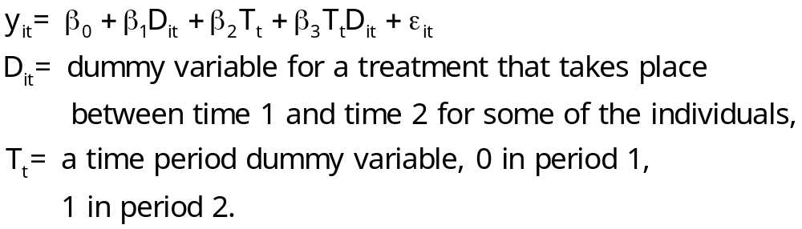
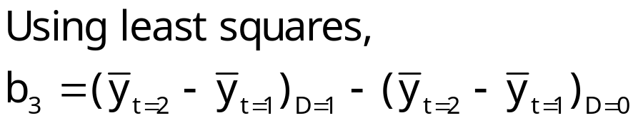
Difference-in-Differences Model
With two periods and strict exogeneity of D and T,
This is a linear regression model. If there are no regressors,

Slide 22
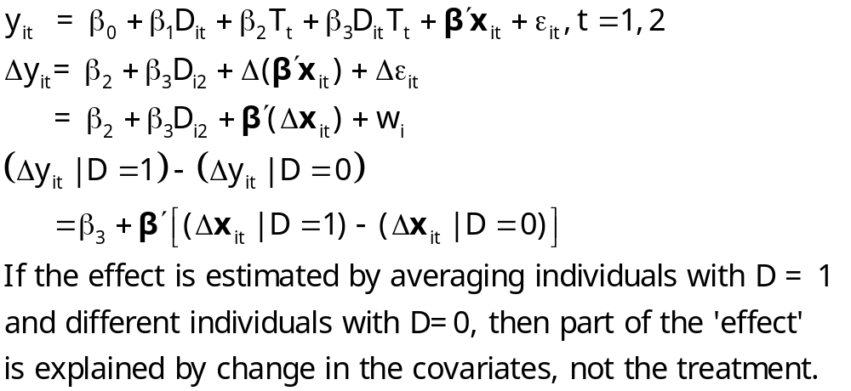
Difference in Differences

Slide 23
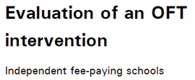

UK Office of Fair Trading, May 2012; Stephen Davies
http://dera.ioe.ac.uk/14610/1/oft1416.pdf

Slide 24
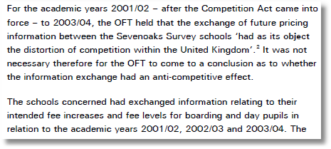

Outcome is the fees charged.
Activity is collusion on fees.

Slide 25
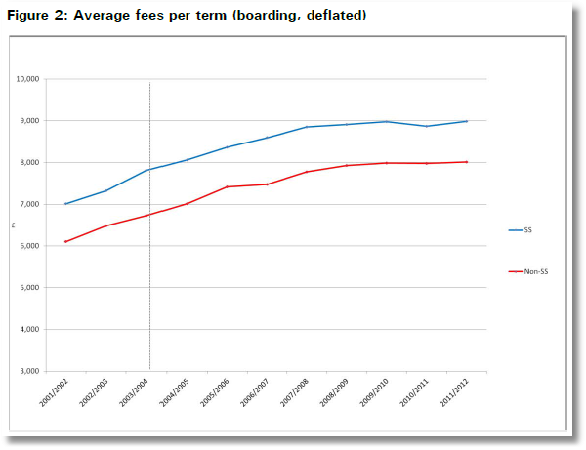
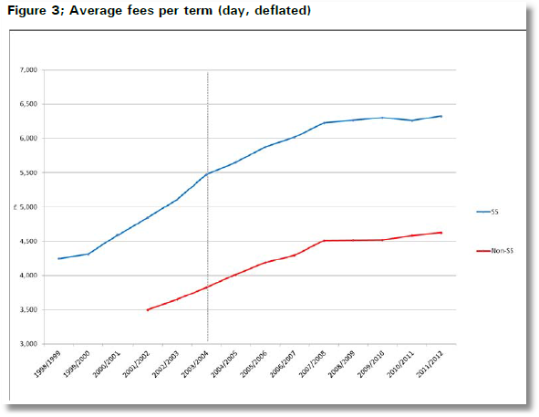
Treatment Schools: Treatment is an intervention by the Office of Fair Trading
Control Schools were not involved in the conspiracy
Treatment is not voluntary

Slide 26
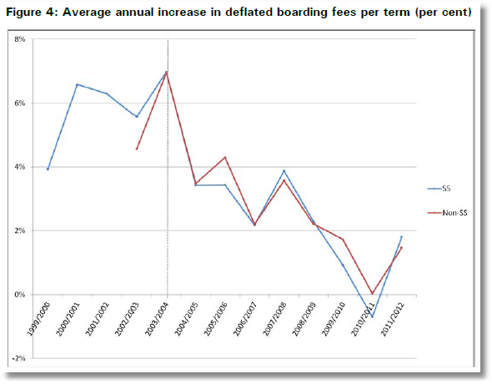
Apparent Impact of the Intervention

Slide 27
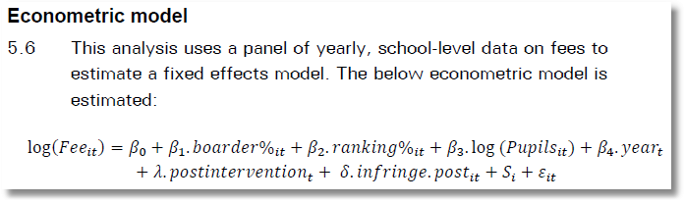

Slide 28
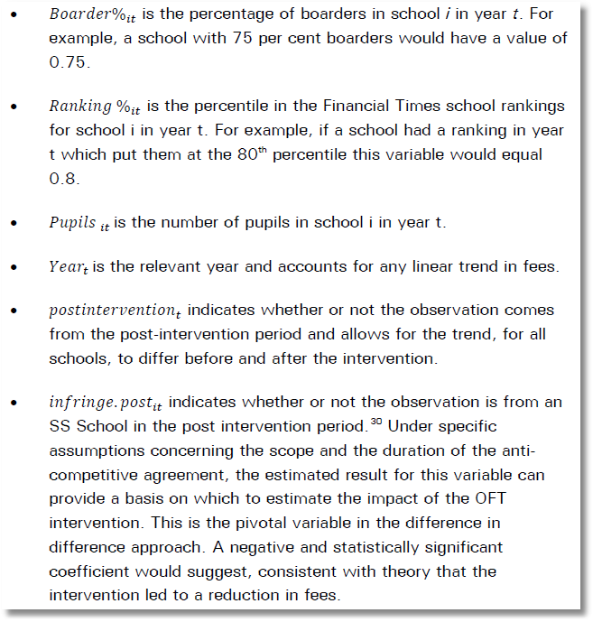
Treatment (Intervention) Effect = β₁ +
β₂ if SS school

Slide 29
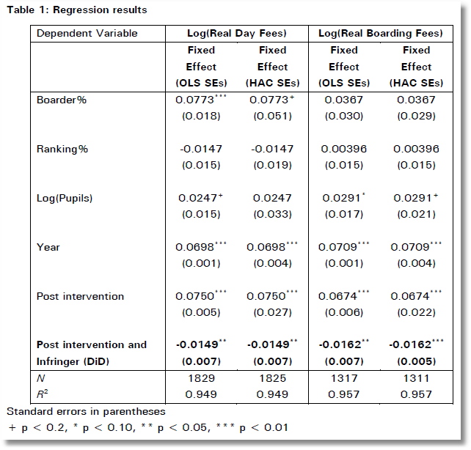
In order to test robustness two versions of the fixed effects model were run. The first is Ordinary Least Squares, and the second is heteroscedasticity and auto-correlation robust (HAC) standard errors in order to check for heteroscedasticity and autocorrelation.

Slide 30
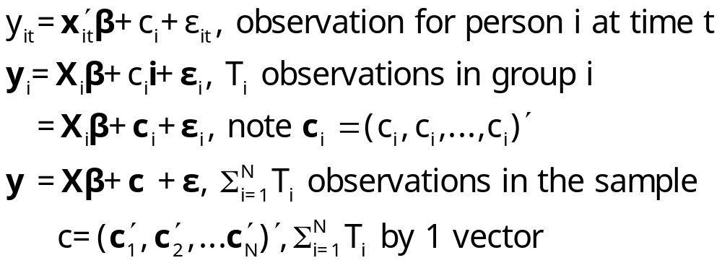
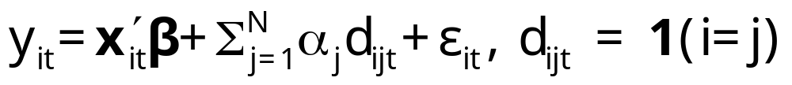
Estimation with Fixed Effects
The fixed effects model
c_{i} is arbitrarily correlated with x_{it} but E[ε_{it}|X_{i},c_{i}]=0
Dummy variable representation

Slide 31
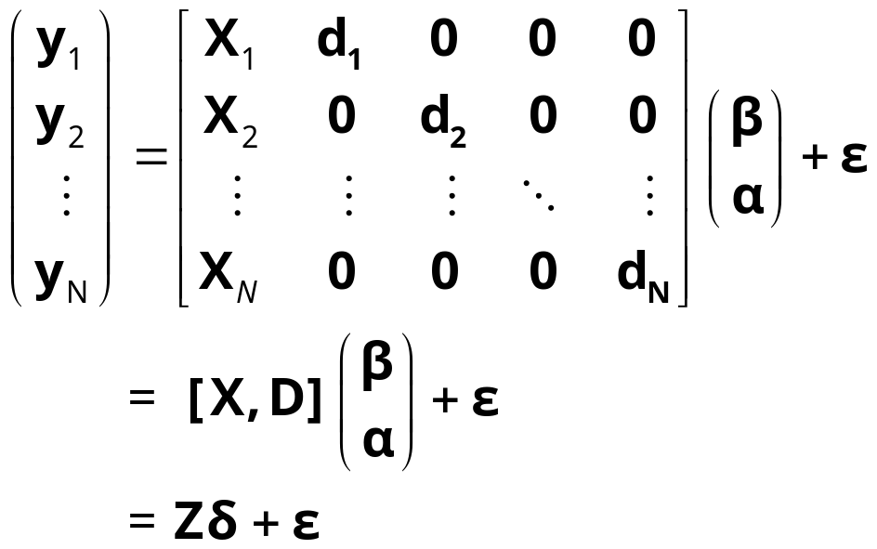
The Fixed Effects Model
y_{i} = X_{i}β + d_{i}α_{i} + ε_{i}, for each individual
  E[c_{i} | X_{i} ] = g(X_{i}); Effects are correlated with included variables.
  Cov[x_{it},c_{i}] ≠0

Slide 32
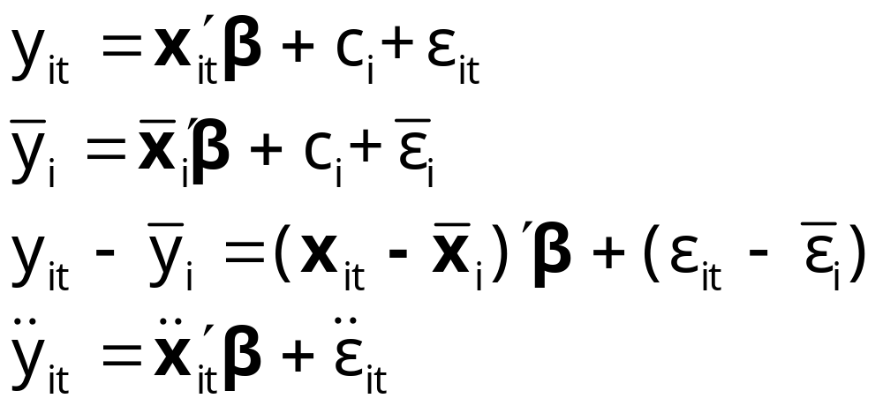
The Within Transformation Removes the Effects
Wooldridge notation for data in deviations from group means

Slide 33
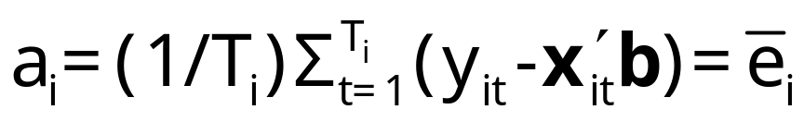
Least Squares Dummy Variable Estimator
b is obtained by ‘within’ groups least squares (group mean deviations)
Normal equations for a are D’Xb+D’Da=D’y
a = (D’D)⁻¹D’(y – Xb)
Notes: This is simple algebra – the estimator is just OLS
Least squares is an estimator, not a model. (Repeat twice.)
Note what a_{i} is when T_{i} = 1. Follow this with y_{it}-a_{i}-x_{it}’b=0 if T_{i}=1.

Slide 34
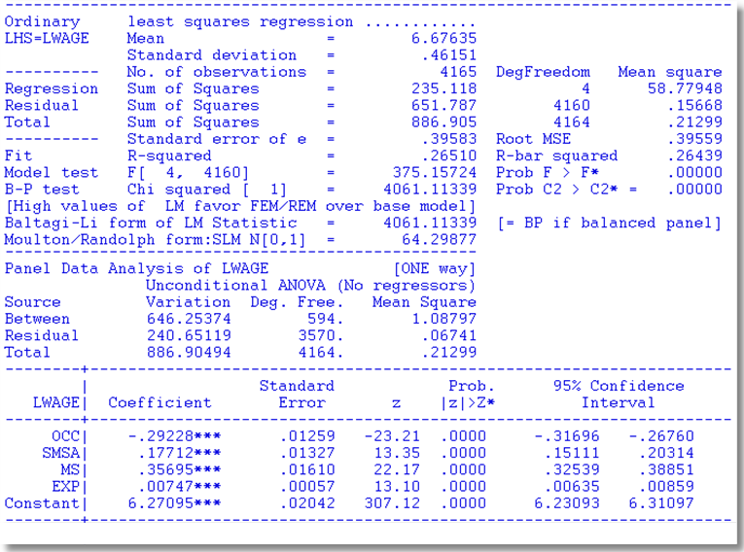
Application Cornwell and Rupert

Slide 35
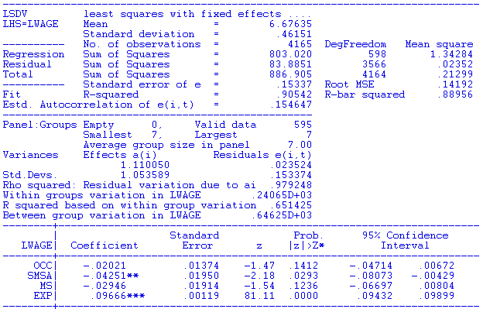

LSDV Results
Note huge changes in the coefficients. SMSA and MS change signs. Significance changes completely.
Pooled OLS

Slide 36
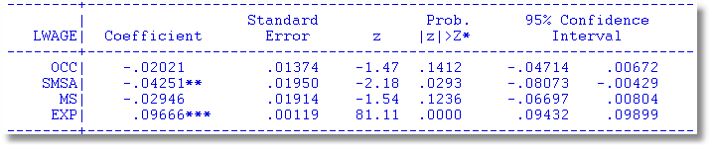
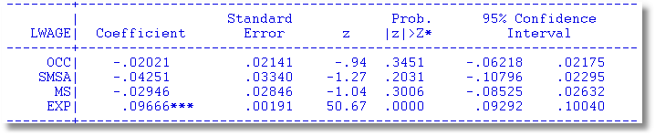

Robust Covariance Matrix for LSDV
Cluster Estimator for Within Estimator
Effect is less pronounced than for OLS

Slide 37
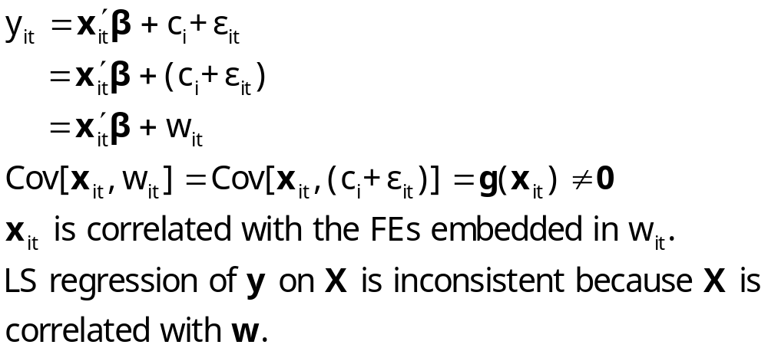
Endogeneity in the FEM

Slide 38
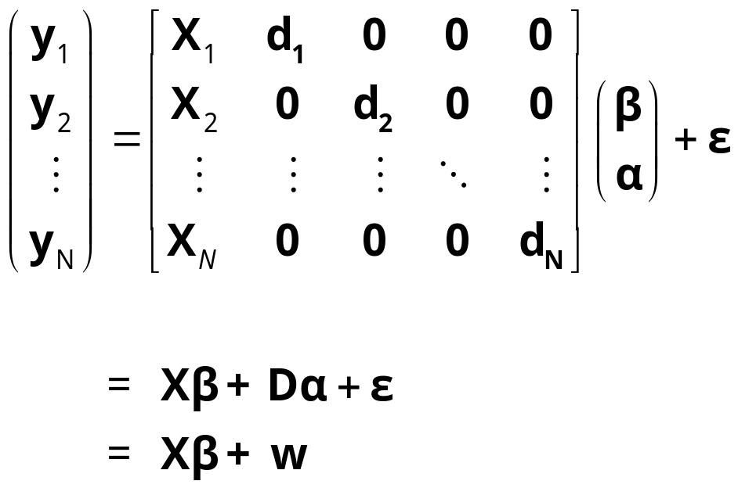
Endogeneity
y_{i} = X_{i}β + d_{i}α_{i} + ε_{i} for each individual
  E[w_{i} | X_{i} ] = g(X_{i});
  Effects are correlated with included variables. Cov[x_{it},w_{i}] ≠0
  X is endogenous because of the correlation between x_{it} and w_{i}

Slide 39
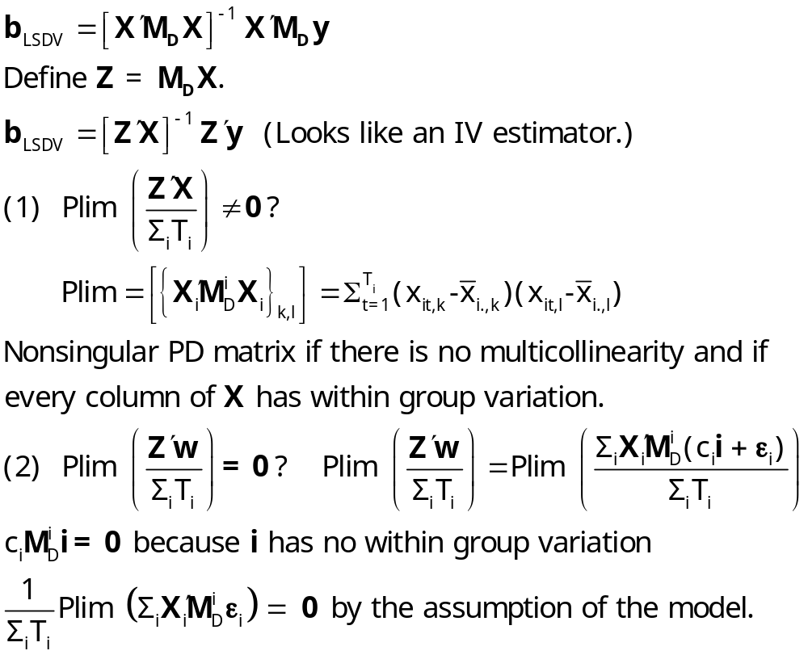
The within (LSDV) estimator is an
instrumental variable (IV) estimator

Slide 40
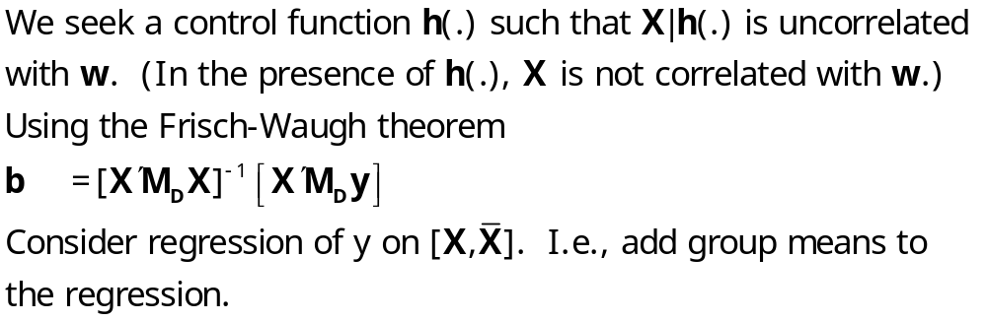
LSDV is a Control Function Estimator

Slide 41
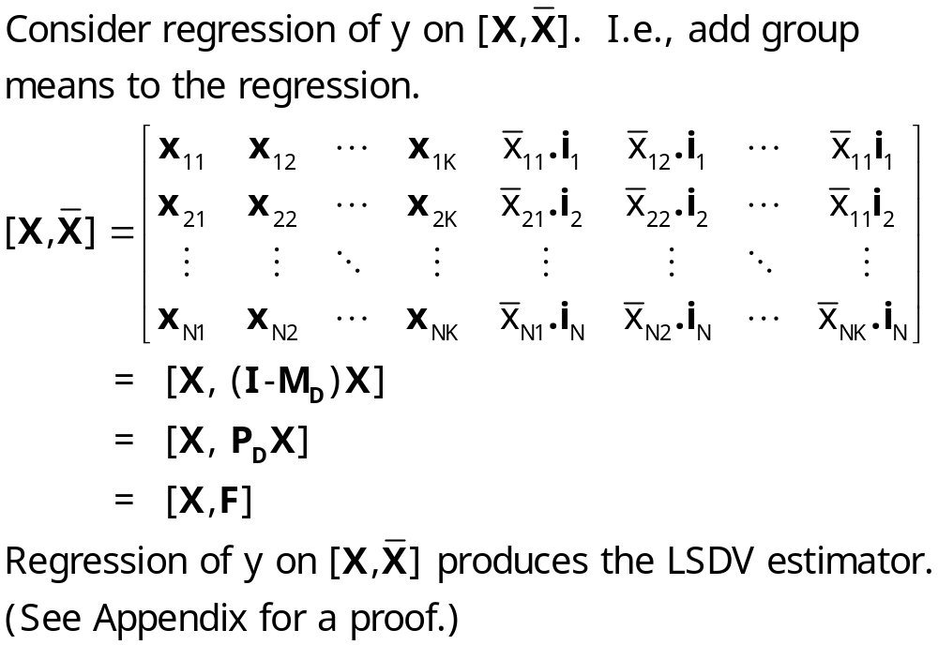
LSDV is a Control Function Estimator

Slide 42
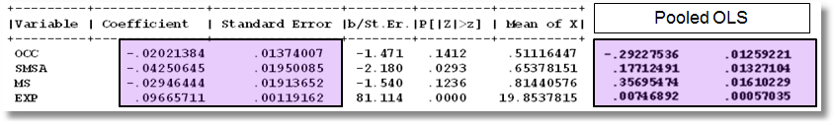
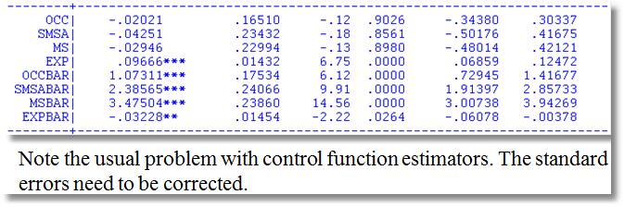
The problem here is the estimator of the disturbance variance. The matrix is OK.
Note, for example, .01374007/.01950085 (top panel)
= .16510 /.23432 (bottom panel).

Slide 43
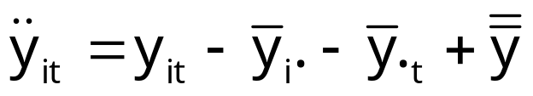
Two Way Fixed Effects
A two way FE model. Individual dummy variables and time dummy variables.
  y_{it} = α_{i} + γ_{t} + x_{it}’β + ε_{it}
  Normalization needed as the individual and time dummies both sum to one. Reformulate model:
  y_{it} = μ + α_{i}* + γ_{t}* + x_{it}’β + ε_{it} with
  Σ_{i} α_{i}* =0, Σ_{t} γ_{t}* = 0
  Full estimation:
  Practical estimation. Add T-1 dummies
  Complication: Unbalanced panels are complicated
  Complication in recent applications: Vary large N and very large T

Slide 44
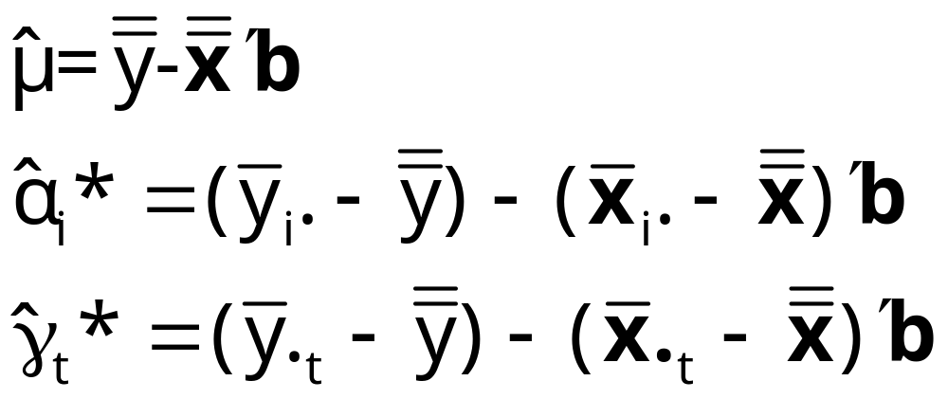
Fixed Effects Estimators
Slope estimators, as usual with transformed data

Slide 45
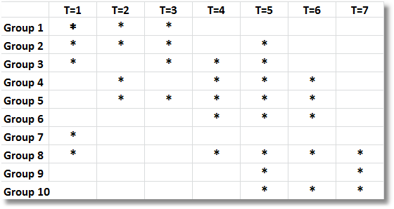
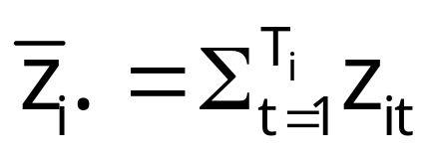

Unbalanced Panel Data
(First 10 households in healthcare data)

Slide 46
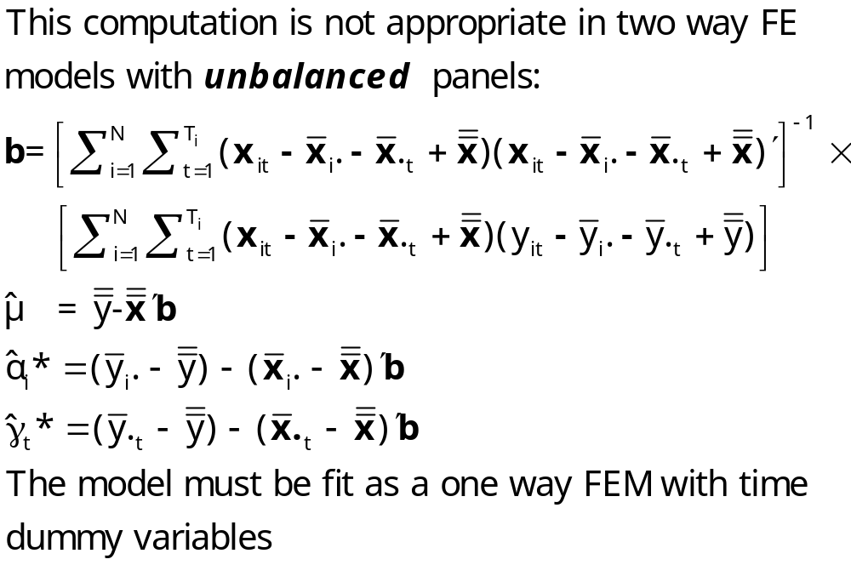
Two Way FE with Unbalanced Data

Slide 47
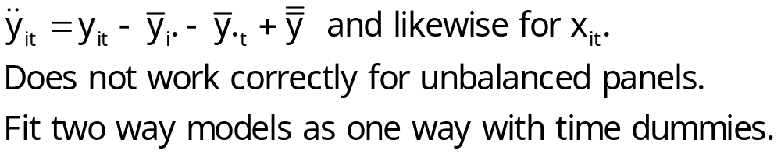
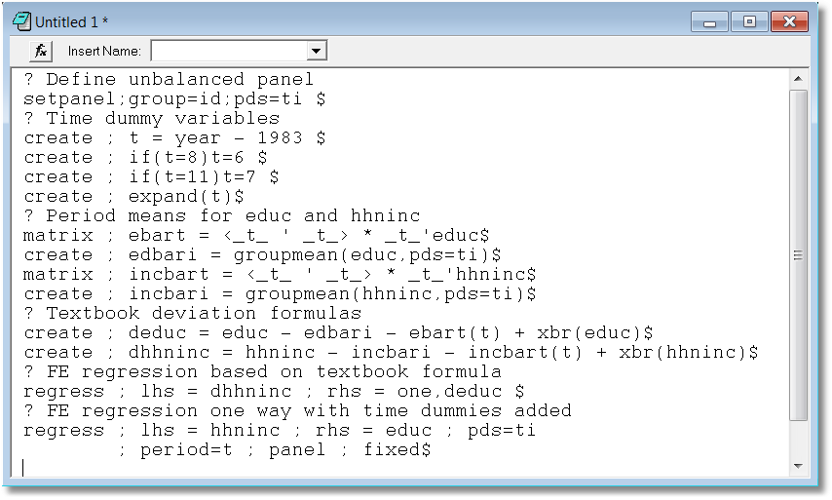

Slide 48
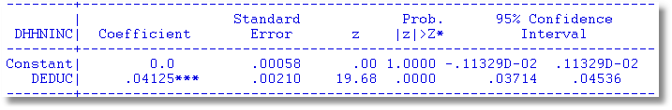
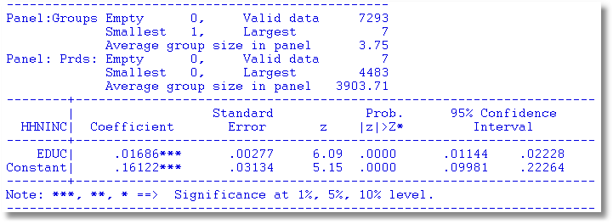
Textbook formula application. This is incorrect.
Two way fixed effects as one way with time dummies

Slide 49
The Random Effects Model
The random effects model
c_{i} is uncorrelated with x_{it} for all t;
  E[c_{i} |X_{i}] = 0
  E[ε_{it}|X_{i},c_{i}]=0

Slide 50
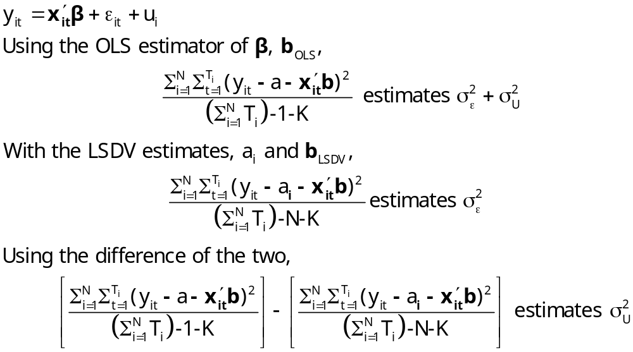
Estimators for the Variances

Slide 51
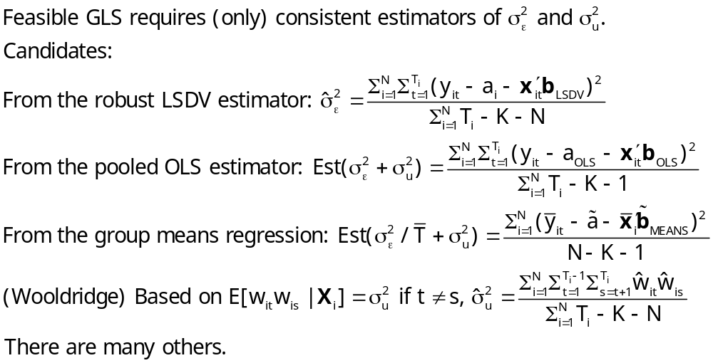
Feasible GLS
x´ does not contain a constant term in the preceding.

Slide 52
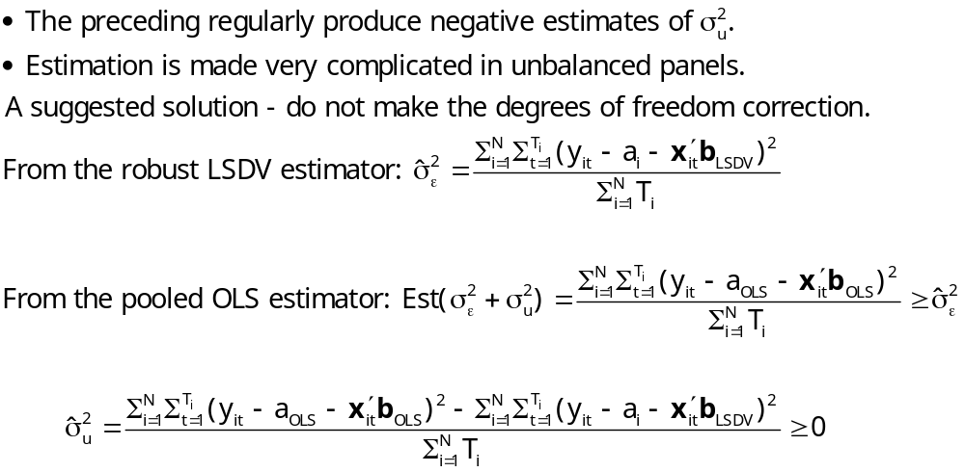
Practical Problems with FGLS

Slide 53

Computing Variance Estimators for Cornwell and Rupert

Slide 54

Mundlak’s Estimator
Mundlak, Y., “On the Pooling of Time Series and Cross Section Data, Econometrica, 46, 1978, pp. 69-85.

Slide 55
Mundlak Form of FE Model
+--------+--------------+----------------+--------+--------+----------+
|Variable| Coefficient | Standard Error |b/St.Er.|P[|Z|>z]| Mean of X|
+--------+--------------+----------------+--------+--------+----------+
x(i,t)
OCC | -.02021384 .01375165 -1.470 .1416 .51116447
SMSA | -.04250645 .01951727 -2.178 .0294 .65378151
MS | -.02946444 .01915264 -1.538 .1240 .81440576
EXP | .09665711 .00119262 81.046 .0000 19.8537815
z(i)
FEM | -.34322129 .05725632 -5.994 .0000 .11260504
ED | .05099781 .00575551 8.861 .0000 12.8453782
Means of x(I,t) and constant
Constant| 5.72655261 .10300460 55.595 .0000
OCCB | -.10850252 .03635921 -2.984 .0028 .51116447
SMSAB | .22934020 .03282197 6.987 .0000 .65378151
MSB | .20453332 .05329948 3.837 .0001 .81440576
EXPB | -.08988632 .00165025 -54.468 .0000 19.8537815
Estimates: Var[e] = .0235632
Var[u] = .0773825

Slide 56

Mundlak’s Approach for an FE Model with Time Invariant Variables

Slide 57

Testing for Effects: An LM Test

Slide 58

LM Tests

Slide 59
A Hausman Test for FE vs. RE
Estimator | Random Effects E[c_{i}|X_{i}] = 0 | Fixed Effects E[c_{i}|X_{i}] ≠ 0
FGLS (Random Effects) | Consistent and Efficient | Inconsistent
LSDV (Fixed Effects) | Consistent Inefficient | Consistent Possibly Efficient

Slide 60

Hausman Test for Effects

Slide 62
A Variable Addition Test
Asymptotically equivalent to Hausman
Also equivalent to Mundlak formulation
In the random effects model, using FGLS
  Only applies to time varying variables
  Add expanded group means to the regression (i.e., observation i,t gets same group means for all t.
  Use standard F or Wald test to test for coefficients on means equal to 0. Large F or chi-squared weighs against random effects specification.

Slide 63

Variable Addition

Slide 64

Means Added – Wu Test

