Slide 1




Microeconometric Modeling
William Greene
Stern School of Business
New York University
New York NY USA
2.1 Binary Choice Models

Slide 2
Concepts
Models
Random Utility
Maximum Likelihood
Parametric Model
Partial Effect
Average Partial Effect
Odds Ratio
Linear Probability Model
Cluster Correction
Pseudo R squared
Likelihood Ratio, Wald, LM
Exclusion Restrictions
Incoherent Model
Probit
Logit
Bivariate Probit
Recursive Bivariate Probit
Panel Probit

Slide 3

Central Proposition
A Utility Based Approach
Observed outcomes partially reveal underlying preferences
There exists an underlying preference scale defined over alternatives, U*(choices)
Revelation of preferences between two choices labeled 0 and 1 reveals the ranking of the underlying utility
  U*(choice 1) > U*(choice 0) Choose 1
  U*(choice 1) < U*(choice 0) Choose 0
Net utility = U = U*(choice 1) - U*(choice 0). U > 0 => choice 1

Slide 4
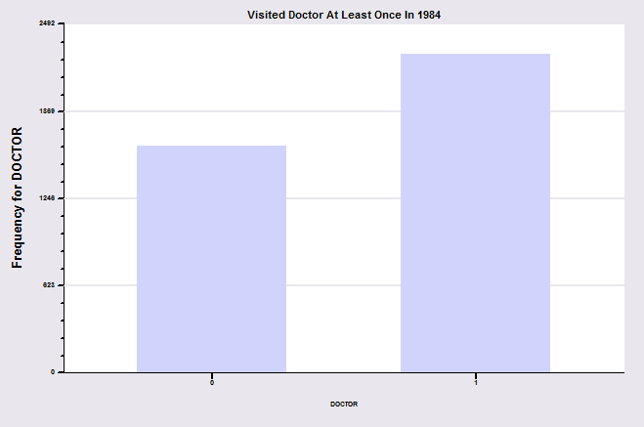
Binary Outcome: Visit Doctor
In the 1994 year of the GSOEP, 2222 of 3377 individuals visited the doctor at least once.

Slide 5
A Random Utility Model for the Binary Choice
Yes or No decision | Visit or not visit the doctor
Model: Net utility of visit at least once
Net utility depends on observables and unobservables
U_{doctor} = Net utility = U*_{visit} – U*_{not visit}
U_{doctor} = α + β₁Age + β₂Income + β₃Sex + ε
Choose to visit at least once if net utility is positive
Observed Data: X = Age, Income, Sex
y = 1 if choose visit, ⬄ U_{doctor} > 0, 0 if not.
Random Utility

Slide 6
Modeling the Binary Choice Between
the Two Alternatives
Net Utility U_{doctor} = U*_{visit} – U*_{not} _{visit}
U_{doctor} = α + β₁ Age + β₂ Income + β₃ Sex + ε
Chooses to visit: U_{doctor} > 0
α + β₁ Age + β₂ Income + β₃ Sex + ε > 0
Choosing to visit is a random outcome because of ε
ε > -(α + β₁ Age + β₂ Income + β₃ Sex)

Slide 7
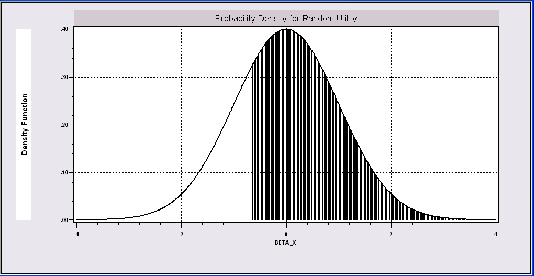
Probability Model for Choice Between Two Alternatives
People with the same (Age,Income,Sex) will make different choices between ε is random. We can model the probability that the random event “visits the doctor”will occur.
Probability is governed by ε, the random part of the utility function.
Event DOCTOR=1 occurs if ε > -(α + β₁Age + β₂Income + β₃Sex)
We model the probability of this event.

Slide 8
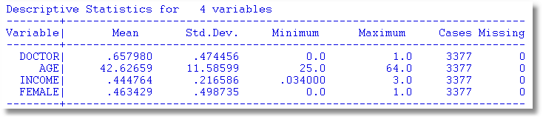
An Application
27,326 Observations in GSOEP Sample
  1 to 7 years, panel
  7,293 households observed
  We use the 1994 year; 3,377 household observations

Slide 9
An Econometric Model
Choose to visit iff U_{doctor} > 0
  Udoctor = α + β₁ Age + β₂ Income + β₃ Sex + ε
  Udoctor > 0 ⇔ ε > -(α + β₁ Age + β₂ Income + β₃ Sex)
  ε < α + β₁ Age + β₂ Income + β₃ Sex)
Probability model: For any person observed by the analyst,
Prob(doctor=1) = Prob(ε < α + β₁ Age + β₂ Income + β₃ Sex)
Note the relationship between the unobserved ε and the observed outcome DOCTOR.

Slide 10
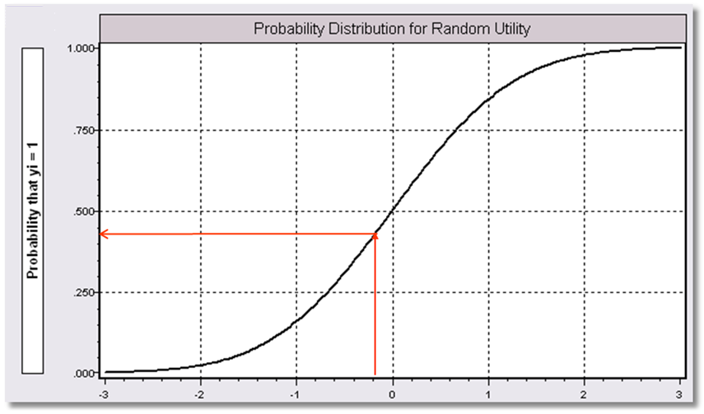
Index = α+β₁Age + β₂ Income + β3 Sex
Probability = a function of the Index.
P(Doctor = 1) = f(Index)
Internally consistent probabilities:
(1) (Coherence) 0 < Probability < 1
(2) (Monotonicity) Probability increases with Index.

Slide 11
A Fully Parametric Model
Index Function: U = β’x + ε
Observation Mechanism: y = 1[U > 0]
Distribution: ε ~ f(ε); Normal, Logistic, …
Maximum Likelihood Estimation:
Max(β) logL = Σ_{i} log Prob(Y_{i} = y_{i}|x_{i})
We will focus on parametric models
We examine the linear probability “model” in passing.

Slide 12
Parametric Model Estimation
How to estimate α, β₁, β₂, β₃?
  The technique of maximum likelihood
  Prob[doctor=1] = Prob[ε > -(α + β₁ Age + β₂ Income + β₃ Sex)]
  Prob[doctor=0] = 1 – Prob[doctor=1]
Requires a model for the probability

Slide 13
Completing the Model: F(ε)
The distribution
  Normal: PROBIT, natural for behavior
  Logistic: LOGIT, allows “thicker tails”
  Gompertz: EXTREME VALUE, asymmetric
  Others…
Does it matter?
  Yes, large difference in estimates
  Not much, quantities of interest are more stable.
Misspecification – is OLS robust to the distributional assumption?

Slide 14
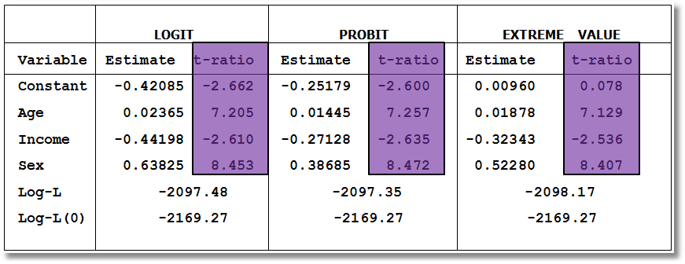
Estimated Binary Choice Models for Three Distributions
Log-L(0) = log likelihood for a model that has only a constant term.
Ignore the t ratios for now.

Slide 15
Partial Effects in Probability Models
Prob[Outcome] = some F(α+β₁Income…)
“Partial effect” = ∂F(α+β₁Income…) / ∂”x” (derivative)
  Partial effects are derivatives
  Result varies with model
    Logit: ∂F(α+β₁Income…) /∂x = Prob * (1-Prob) × β
    Probit: ∂ F(α+β₁Income…)/∂x = Normal density × β
    Extreme Value: ∂ F(α+β₁Income…)/∂x = Prob * (-log Prob) × β
  Scaling usually erases model differences

Slide 16
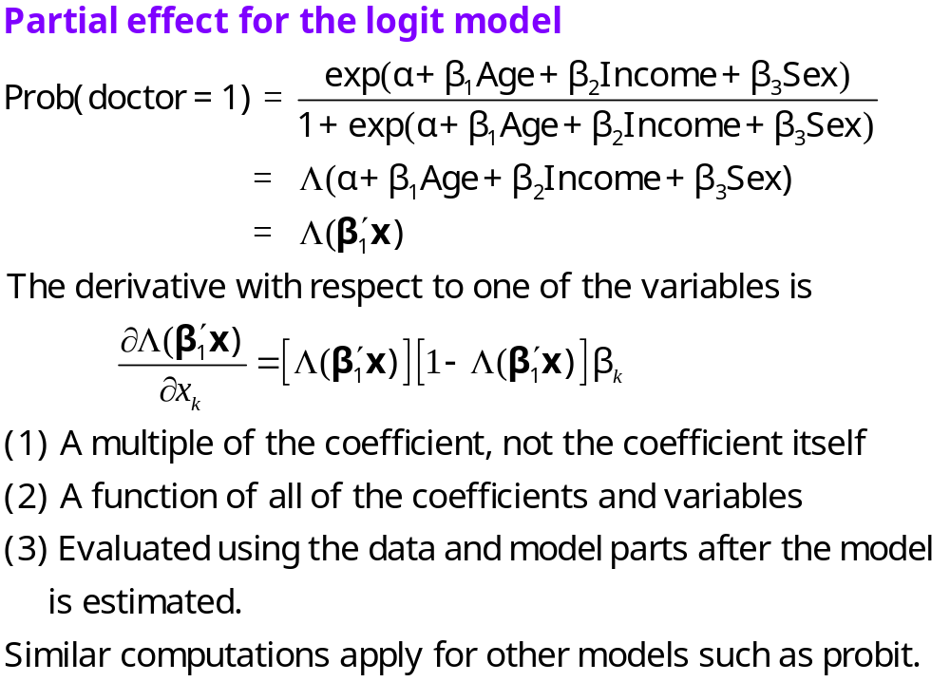

Slide 17
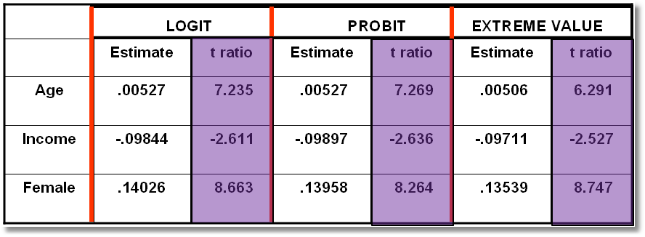
Estimated Partial Effects for Three Models
(Standard errors to be considered later)

Slide 18
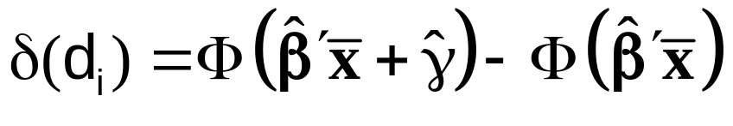
Partial Effect for a Dummy Variable Computed
Using Means of Other Variables
Prob[y_{i} = 1|x_{i},d_{i}] = F(β’x_{i}+γd_{i}) where d is a dummy variable such as Sex in our doctor model.
For the probit model, Prob[y_{i} = 1|x_{i},d_{i}] = Φ(β′x+γd), Φ = the normal CDF.
Partial effect of d
Prob[y_{i} = 1|x_{i}, d_{i}=1] - Prob[y_{i} = 1|x_{i}, d_{i}=0]
=

Slide 19
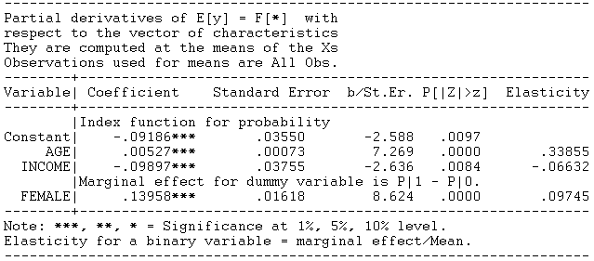
Partial Effect – Dummy Variable

Slide 20
Computing Partial Effects
Compute at the data means (PEA)
  Simple
  Inference is well defined.
  Not realistic for some variables, such as Sex
Average the individual effects (APE)
  More appropriate
  Asymptotic standard errors are slightly more complicated.

Slide 21
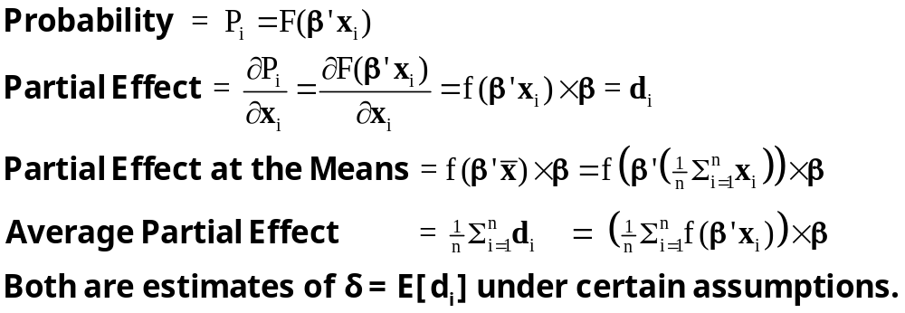
Partial Effects

Slide 22
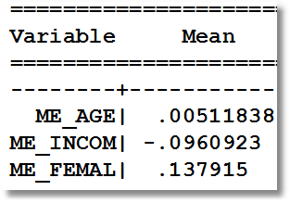
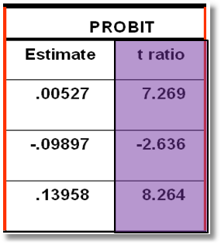
Average Partial Effects Partial Effects at Data Means
The two approaches often give similar answers, though sometimes the results differ substantially.

Slide 23
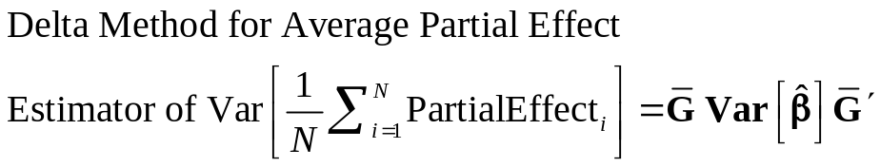
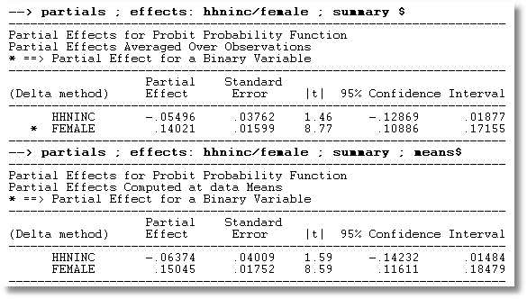
APE vs. Partial Effects at the Mean

Slide 24


Slide 25
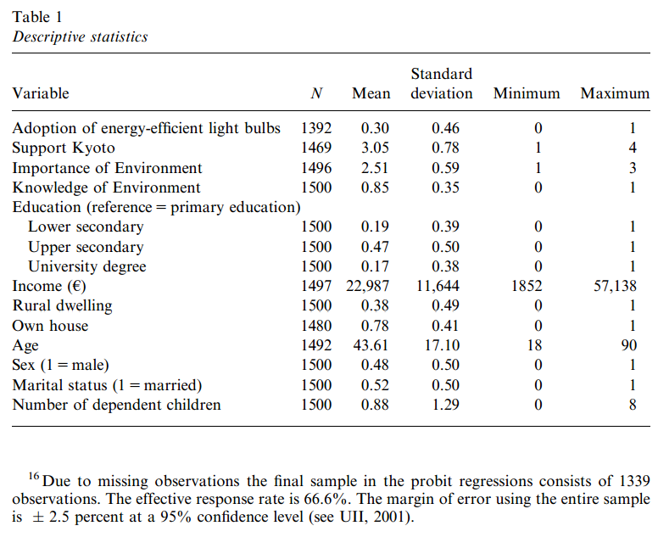
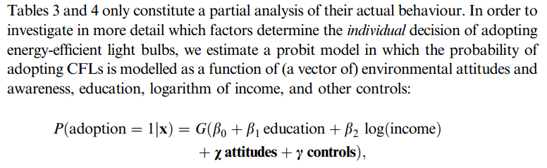

Slide 26
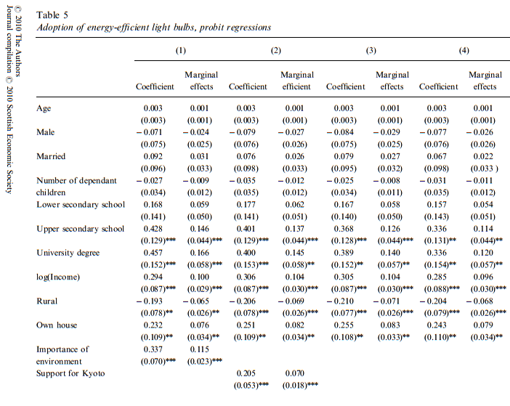

Slide 27
How Well Does the Model Fit the Data?
There is no R squared for a probability model.
  Least squares for linear models is computed to maximize R²
  There are no residuals or sums of squares in a binary choice model
  The model is not computed to optimize the fit of the model to the data
How can we measure the “fit” of the model to the data?
  “Fit measures” computed from the log likelihood
    Pseudo R squared = 1 – logL/logL0
    Also called the “likelihood ratio index”
  Direct assessment of the effectiveness of the model at predicting the outcome

Slide 28
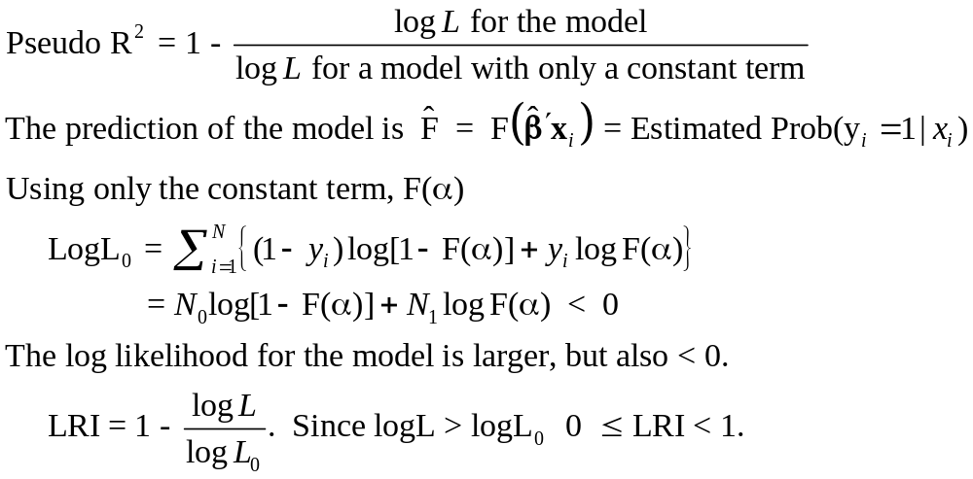
Pseudo R² = Likelihood Ratio Index

Slide 29
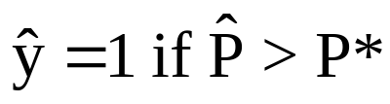
Fit Measures Based on Predictions
Computation
  Use the model to compute predicted probabilities
  P = F(a + b₁Age + b₂Income + b₃Female+…)
  Use a rule to compute predicted y = 0 or 1
  Predict y=1 if P is “large” enough
  Generally use 0.5 for “large” (more likely than not)
Fit measure compares predictions to actuals
Count successes and failures

Slide 30
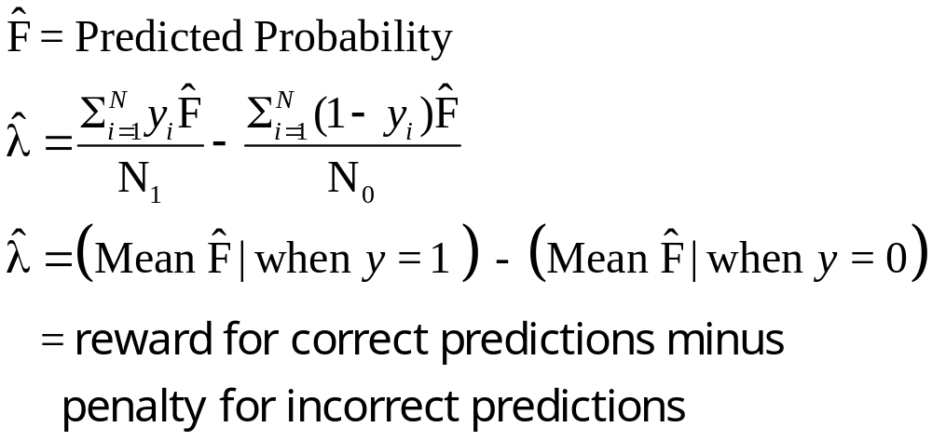
Cramer Fit Measure
+----------------------------------------+
| Fit Measures Based on Model Predictions|
| Efron = .04825|
| Ben Akiva and Lerman = .57139|
| Veall and Zimmerman = .08365|
| Cramer = .04771|
+----------------------------------------+

Slide 31
Hypothesis Tests
We consider “nested” models and parametric tests
Test statistics based on the usual 3 strategies
  Wald statistics: Use the unrestricted model
  Likelihood ratio statistics: Based on comparing the two models
  Lagrange multiplier: Based on the restricted model.
Test statistics require the log likelihood and/or the first and second derivatives of logL

Slide 32
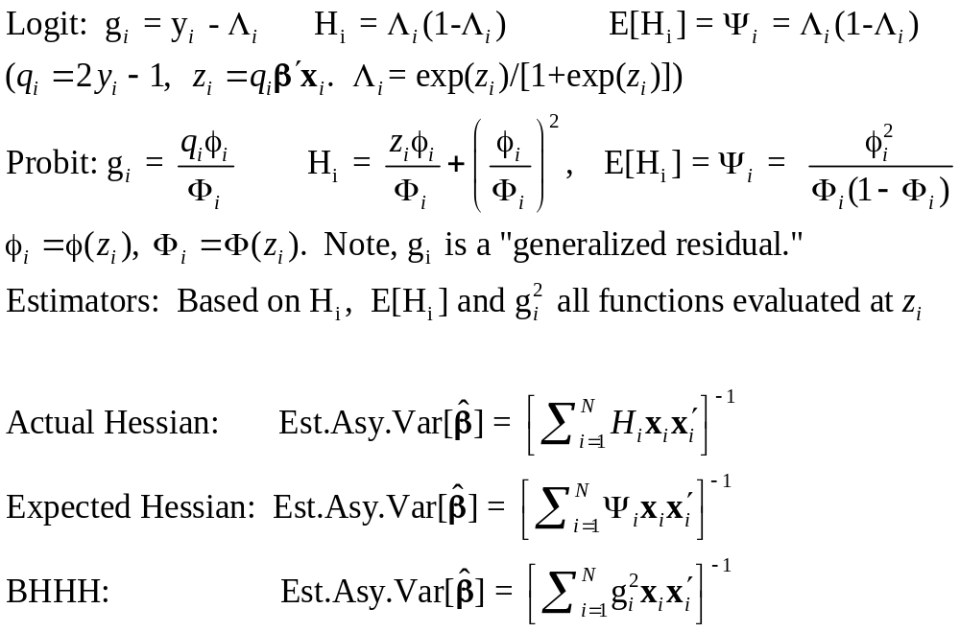
Computing test statistics requires the log likelihood and/or standard errors based on the Hessian of LogL

Slide 33
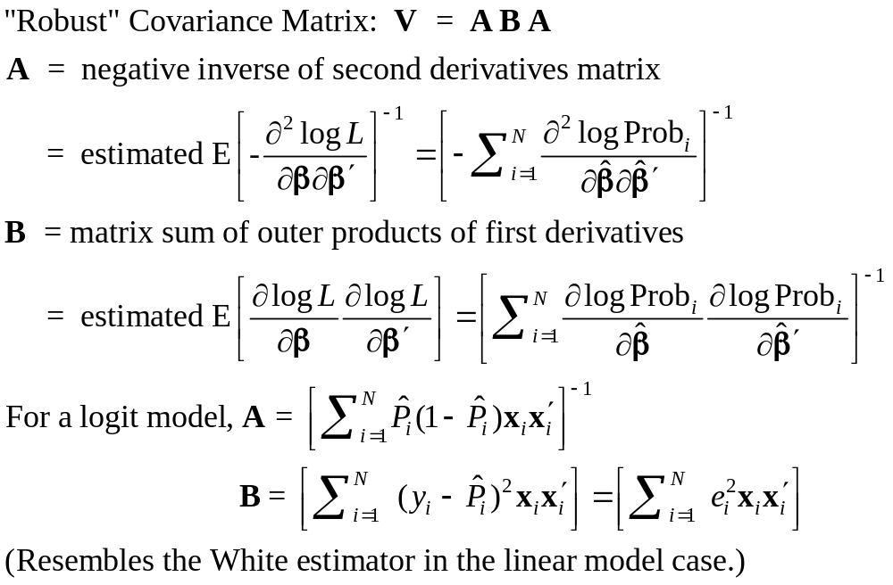
Robust Covariance Matrix
(Robust to the model specification? Latent heterogeneity? Correlation across observations? Not always clear)

Slide 34
Robust Covariance Matrix for Logit Model
Doesn’t change much. The model is well specified.
--------+--------------------------------------------------------------------
| Standard Prob. 95% Confidence
DOCTOR| Coefficient Error z |z|>Z* Interval
--------+--------------------------------------------------------------------
Conventional Standard Errors
Constant| 1.86428*** .67793 2.75 .0060 .53557 3.19299
AGE| -.10209*** .03056 -3.34 .0008 -.16199 -.04219
AGE^2.0| .00154*** .00034 4.56 .0000 .00088 .00220
INCOME| .51206 .74600 .69 .4925 -.95008 1.97420
|Interaction AGE*INCOME
_ntrct02| -.01843 .01691 -1.09 .2756 -.05157 .01470
FEMALE| .65366*** .07588 8.61 .0000 .50494 .80237
--------+--------------------------------------------------------------------
Robust Standard Errors
Constant| 1.86428*** .68518 2.72 .0065 .52135 3.20721
AGE| -.10209*** .03118 -3.27 .0011 -.16321 -.04098
AGE^2.0| .00154*** .00035 4.44 .0000 .00086 .00222
INCOME| .51206 .75171 .68 .4958 -.96127 1.98539
|Interaction AGE*INCOME
_ntrct02| -.01843 .01705 -1.08 .2796 -.05185 .01498
FEMALE| .65366*** .07594 8.61 .0000 .50483 .80249

Slide 35
Base Model for Hypothesis Tests
----------------------------------------------------------------------
Binary Logit Model for Binary Choice
Dependent variable DOCTOR
Log likelihood function -2085.92452
Restricted log likelihood -2169.26982
Chi squared [ 5 d.f.] 166.69058
Significance level .00000
McFadden Pseudo R-squared .0384209
Estimation based on N = 3377, K = 6
Information Criteria: Normalization=1/N
Normalized Unnormalized
AIC 1.23892 4183.84905
--------+-------------------------------------------------------------
Variable| Coefficient Standard Error b/St.Er. P[|Z|>z] Mean of X
--------+-------------------------------------------------------------
|Characteristics in numerator of Prob[Y = 1]
Constant| 1.86428*** .67793 2.750 .0060
AGE| -.10209*** .03056 -3.341 .0008 42.6266
AGESQ| .00154*** .00034 4.556 .0000 1951.22
INCOME| .51206 .74600 .686 .4925 .44476
AGE_INC| -.01843 .01691 -1.090 .2756 19.0288
FEMALE| .65366*** .07588 8.615 .0000 .46343
--------+-------------------------------------------------------------
H₀: Age is not a significant
determinant of
Prob(Doctor = 1)
H₀: β₂ = β₃ = β₅ = 0

Slide 36
Likelihood Ratio Test
Null hypothesis restricts the parameter vector
Alternative relaxes the restriction
Test statistic: Chi-squared =
2 (LogL|Unrestricted model – LogL|Restrictions) > 0
Degrees of freedom = number of restrictions

Slide 37
LR Test of H₀: β₂ = β₃ = β₅ = 0
UNRESTRICTED MODEL
Binary Logit Model for Binary Choice
Dependent variable DOCTOR
Log likelihood function -2085.92452
Restricted log likelihood -2169.26982
Chi squared [ 5 d.f.] 166.69058
Significance level .00000
McFadden Pseudo R-squared .0384209
Estimation based on N = 3377, K = 6
Information Criteria: Normalization=1/N
Normalized Unnormalized
AIC 1.23892 4183.84905
RESTRICTED MODEL
Binary Logit Model for Binary Choice
Dependent variable DOCTOR
Log likelihood function -2124.06568
Restricted log likelihood -2169.26982
Chi squared [ 2 d.f.] 90.40827
Significance level .00000
McFadden Pseudo R-squared .0208384
Estimation based on N = 3377, K = 3
Information Criteria: Normalization=1/N
Normalized Unnormalized
AIC 1.25974 4254.13136
Chi squared[3] = 2[-2085.92452 - (-2124.06568)] = 77.46456

Slide 38
Wald Test of H₀: β₂ = β₃ = β₅ = 0
Unrestricted parameter vector is estimated
Discrepancy: q= Rb – m is computed
(or r(b,m) if nonlinear)
Variance of discrepancy is estimated:
Var[q] = R V R’
Wald Statistic is q’[Var(q)]⁻¹q = q’[RVR’]⁻¹q

Slide 39
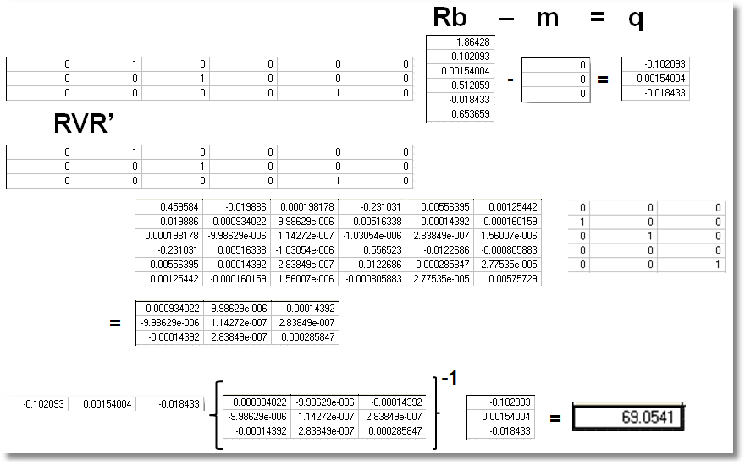
Wald Test
Chi squared[3] = 69.0541

Slide 40
Lagrange Multiplier Test of H₀: β₂ = β₃ = β₅ = 0
Restricted model is estimated
Derivatives of unrestricted model and variances of derivatives are computed at restricted estimates
Wald test of whether derivatives are zero tests the restrictions
Usually hard to compute – difficult to program the derivatives and their variances.

Slide 41
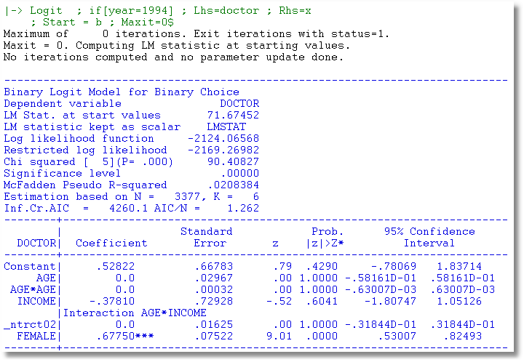

Slide 42
Application: Health Care Usage
German Health Care Usage Data, 7,293 Individuals, Varying Numbers of Periods
Variables in the file are
Data downloaded from Journal of Applied Econometrics Archive. This is an unbalanced panel with 7,293 individuals. They can be used for regression, count models, binary choice, ordered choice, and bivariate binary choice. This is a large data set. There are altogether 27,326 observations. The number of observations ranges from 1 to 7. (Frequencies are: 1=1525, 2=1079, 3=825, 4=926, 5=1051, 6=1000, 7=887). Note, the variable NUMOBS below tells how many observations there are for each person. This variable is repeated in each row of the data for the person.
DOCTOR = 1(Number of doctor visits > 0)
HOSPITAL = 1(Number of hospital visits > 0)
HSAT = health satisfaction, coded 0 (low) - 10 (high)
DOCVIS = number of doctor visits in last three months
HOSPVIS = number of hospital visits in last calendar year
PUBLIC = insured in public health insurance = 1; otherwise = 0
ADDON = insured by add-on insurance = 1; otherswise = 0
HHNINC = household nominal monthly net income in German marks / 10000.
(4 observations with income=0 were dropped)
HHKIDS = children under age 16 in the household = 1; otherwise = 0
EDUC = years of schooling
AGE = age in years
MARRIED = marital status
EDUC = years of education

Slide 43
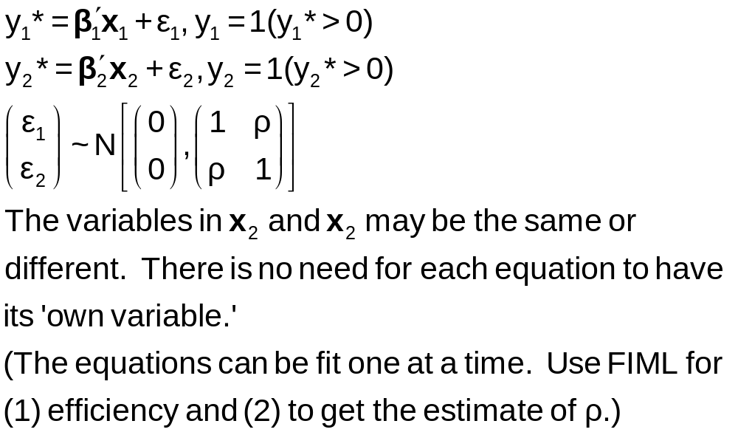
The Bivariate Probit Model

Slide 44
Application to Health Care Data
x1=one,age,female,educ,married,working
x2=one,age,female,hhninc,hhkids
BivariateProbit ; lhs=doctor,hospital
; rh1=x1
; rh2=x2;marginal effects $

Slide 45
Parameter Estimates
----------------------------------------------------------------------
FIML Estimates of Bivariate Probit Model
Dependent variable DOCTOR HOSPITAL
Log likelihood function -25323.63074
Estimation based on N = 27326, K = 12
--------+-------------------------------------------------------------
Variable| Coefficient Standard Error b/St.Er. P[|Z|>z] Mean of X
--------+-------------------------------------------------------------
|Index equation for DOCTOR
Constant| -.20664*** .05832 -3.543 .0004
AGE| .01402*** .00074 18.948 .0000 43.5257
FEMALE| .32453*** .01733 18.722 .0000 .47877
EDUC| -.01438*** .00342 -4.209 .0000 11.3206
MARRIED| .00224 .01856 .121 .9040 .75862
WORKING| -.08356*** .01891 -4.419 .0000 .67705
|Index equation for HOSPITAL
Constant| -1.62738*** .05430 -29.972 .0000
AGE| .00509*** .00100 5.075 .0000 43.5257
FEMALE| .12143*** .02153 5.641 .0000 .47877
HHNINC| -.03147 .05452 -.577 .5638 .35208
HHKIDS| -.00505 .02387 -.212 .8323 .40273
|Disturbance correlation
RHO(1,2)| .29611*** .01393 21.253 .0000
--------+-------------------------------------------------------------

Slide 46
Marginal Effects
What are the marginal effects
  Effect of what on what?
  Two equation model, what is the conditional mean?
Possible margins?
  Derivatives of joint probability = Φ₂(β₁’x_{i1}, β₂’x_{i2},ρ)
  Partials of E[y_{ij}|x_{ij}] =Φ(β_{j}’x_{ij}) (Univariate probability)
  Partials of E[y_{i1}|x_{i1},x_{i2},y_{i2}=1] = P(y_{i1},y_{i2}=1)/Prob[y_{i2}=1]
Note marginal effects involve both sets of regressors.
If there are common variables, there are two effects
in the derivative that are added.
(See Appendix for formulations.)

Slide 47
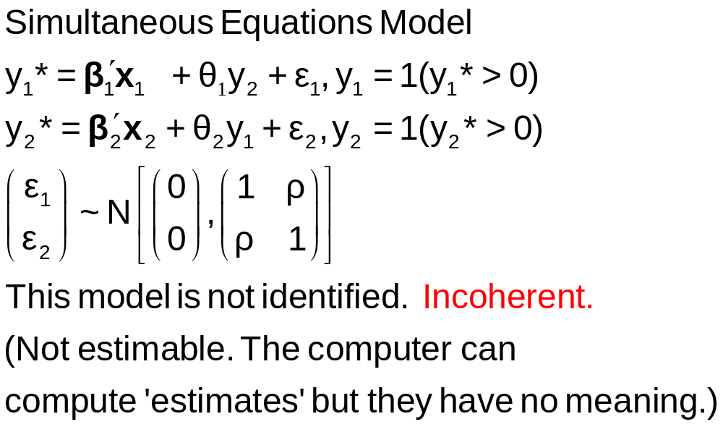
A Simultaneous Equations Model

Slide 48
Fully Simultaneous “Model”
----------------------------------------------------------------------
FIML Estimates of Bivariate Probit Model
Dependent variable DOCHOS
Log likelihood function -20318.69455
--------+-------------------------------------------------------------
Variable| Coefficient Standard Error b/St.Er. P[|Z|>z] Mean of X
--------+-------------------------------------------------------------
|Index equation for DOCTOR
Constant| -.46741*** .06726 -6.949 .0000
AGE| .01124*** .00084 13.353 .0000 43.5257
FEMALE| .27070*** .01961 13.807 .0000 .47877
EDUC| -.00025 .00376 -.067 .9463 11.3206
MARRIED| -.00212 .02114 -.100 .9201 .75862
WORKING| -.00362 .02212 -.164 .8701 .67705
HOSPITAL| 2.04295*** .30031 6.803 .0000 .08765
|Index equation for HOSPITAL
Constant| -1.58437*** .08367 -18.936 .0000
AGE| -.01115*** .00165 -6.755 .0000 43.5257
FEMALE| -.26881*** .03966 -6.778 .0000 .47877
HHNINC| .00421 .08006 .053 .9581 .35208
HHKIDS| -.00050 .03559 -.014 .9888 .40273
DOCTOR| 2.04479*** .09133 22.389 .0000 .62911
|Disturbance correlation
RHO(1,2)| -.99996*** .00048 ******** .0000
--------+-------------------------------------------------------------

Slide 49
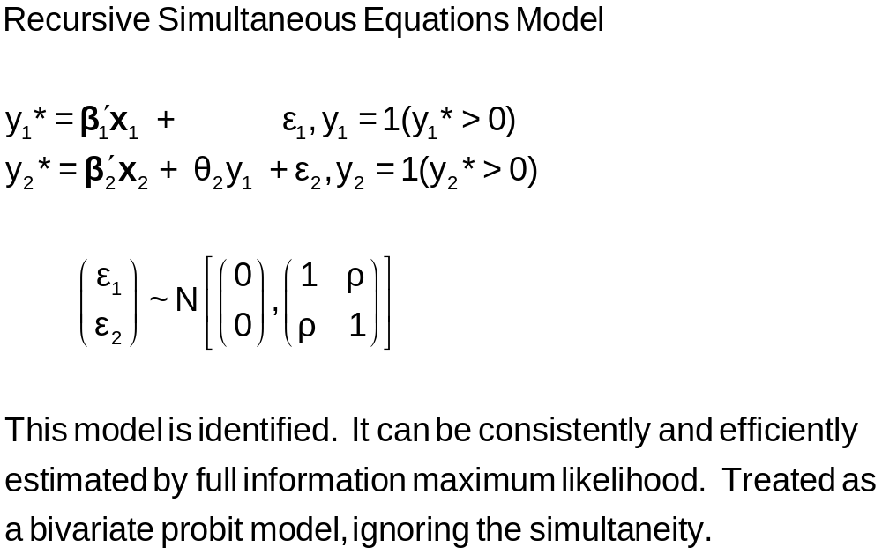
A Recursive Simultaneous
Equations Model
Bivariate ; Lhs = y1,y2 ; Rh1=…,y2 ; Rh2 = … $

Slide 50


Slide 51
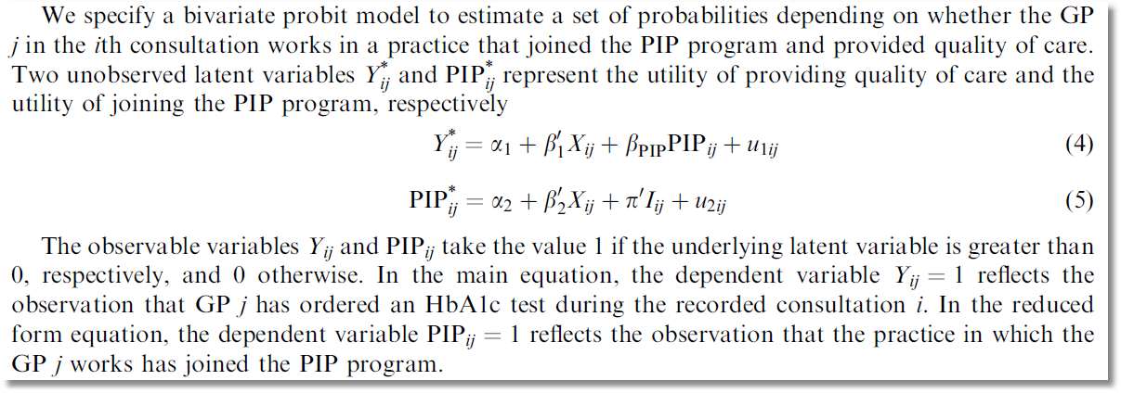
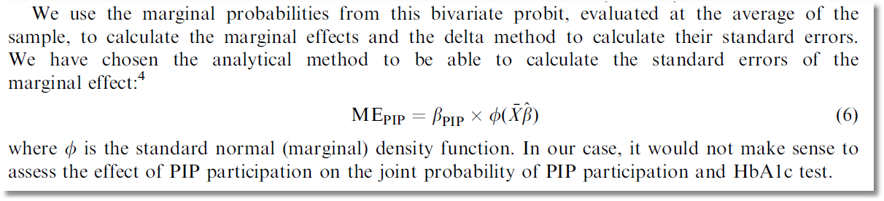

Slide 52

Causal Inference?
Causal Inference?
There is no partial (marginal) effect for PIP.
PIP cannot change partially (marginally). It changes because something
else changes. (X or I or u₂.)
The calculation of ME_{PIP} does not make sense.

Slide 53
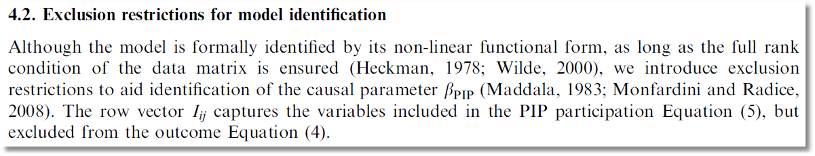

Slide 54
