Slide 1




Microeconometric Modeling
William Greene
Stern School of Business
New York University
New York NY USA
2.2 Nonlinear Panel Data
Models

Slide 2
Concepts
Models
Delta Method
Average Partial Effect
Krinsky and Robb Method
Interaction Term
Endogenous RHS Variable
Control Function
FIML
2 Step ML
Scaled Coefficient
Fractional Response Model
Probit
Logit

Slide 3
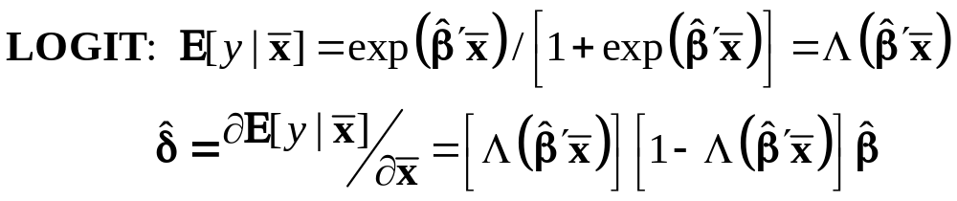
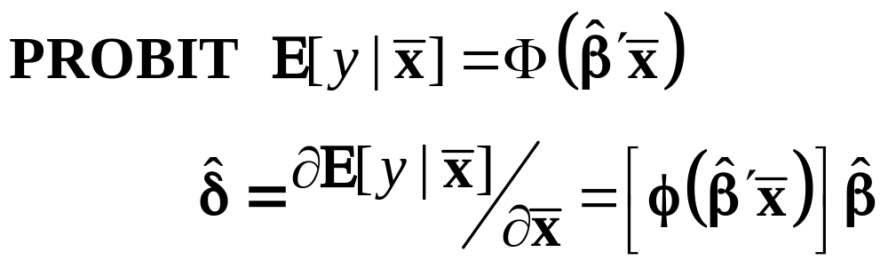
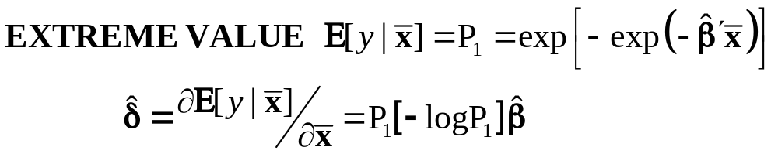
Marginal Effects for Binary Choice

Slide 4
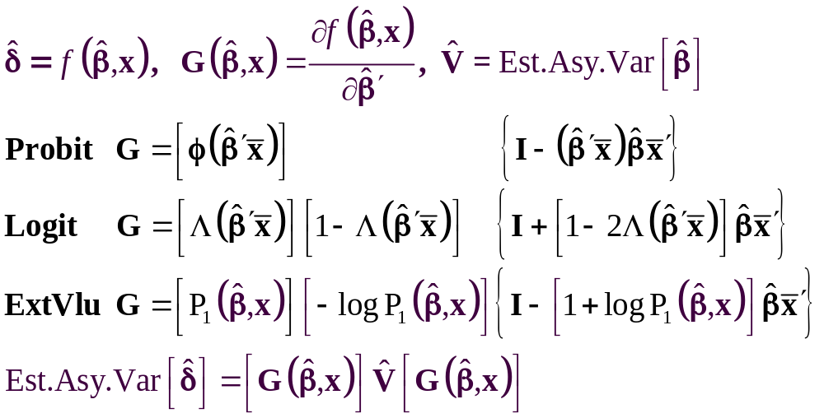
The Delta Method

Slide 5
Computing Effects
Compute at the data means?
  Simple
  Inference is well defined
Average the individual effects
  More appropriate?
  Asymptotic standard errors more complicated.
Is testing about marginal effects meaningful?
  f(b’x) must be > 0; b is highly significant
  How could f(b’x)*b equal zero?

Slide 6
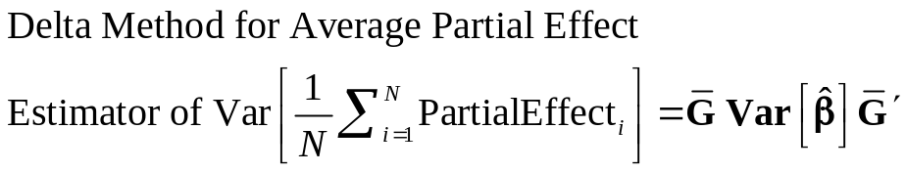
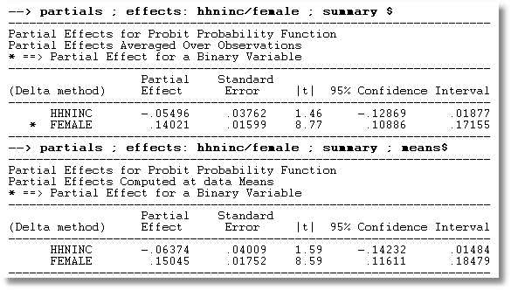
APE vs. Partial Effects at the Mean

Slide 7
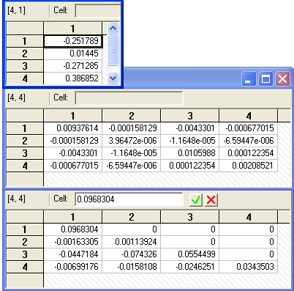
Method of Krinsky and Robb
Estimate β by Maximum Likelihood with b
Estimate asymptotic covariance matrix with V
Draw R observations b(r) from the normal
population N[b,V]
b(r) = b + C*v(r), v(r) drawn from N[0,I]
C = Cholesky matrix, V = CC’
Compute partial effects d(r) using b(r)
Compute the sample variance of d(r),r=1,…,R
Use the sample standard deviations of the R observations to estimate the sampling standard errors for the partial effects.

Slide 8
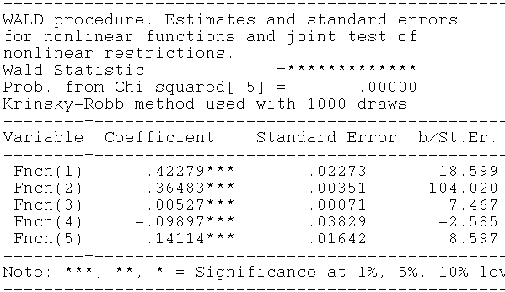
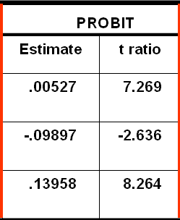
Krinsky and Robb
Delta Method

Slide 9
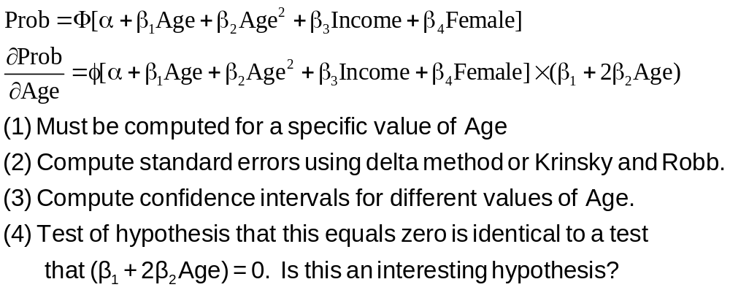
Partial Effect for Nonlinear Terms

Slide 10
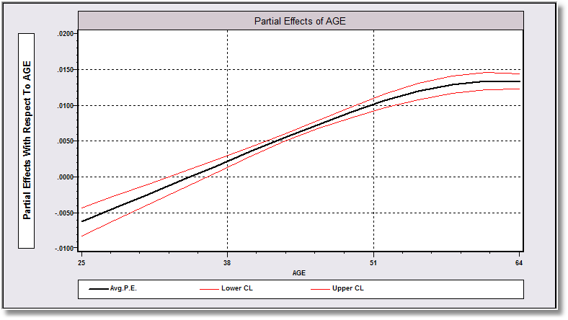
Average Partial Effect: Averaged over Sample Incomes and Genders for Specific Values of Age

Slide 11
Endogeneity

Slide 12
Endogenous RHS Variable
U* = β’x + θh + ε
y = 1[U* > 0]
E[ε|h] ≠ 0 (h is endogenous)
  Case 1: h is binary = a treatment effect
  Case 2: h is continuous

Slide 13
Endogenous Binary Variable
U* = β’x + θh + ε
y = 1[U* > 0]
h* = α’z + u
h = 1[h* > 0]
E[ε|h*] ≠ 0 ⬄ Cov[u, ε] ≠ 0
Additional Assumptions:
(u,ε) ~ N[(0,0),(σ_{u}², ρσ_{u}, 1)]
z = a valid set of exogenous
variables, uncorrelated with (u,ε)
⇐
Correlation = ρ.
This is the source of the endogeneity
This is not IV estimation. Z may be uncorrelated with X without problems.

Slide 14
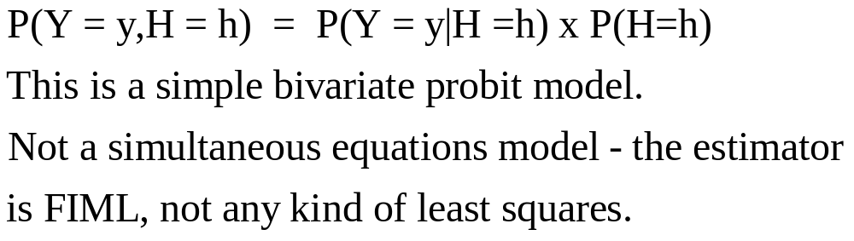

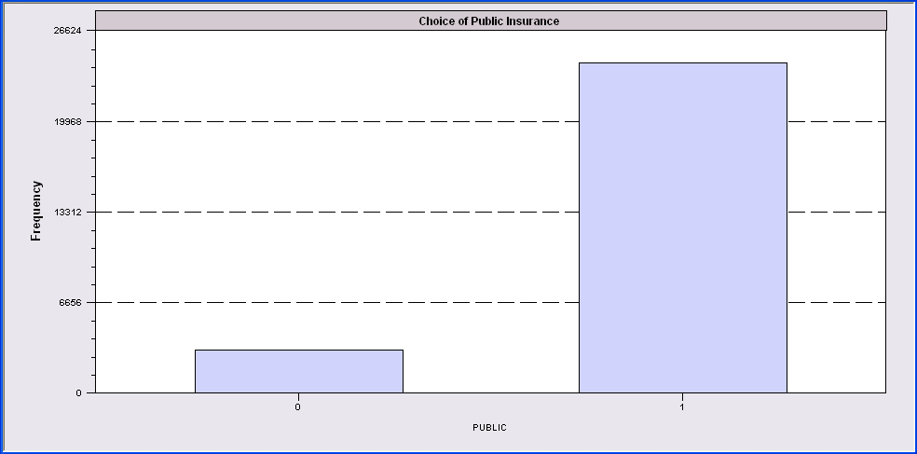
Endogenous Binary Variable
Doctor = F(age,age²,income,female,Public)
Public = F(age,educ,income,married,kids,female)

Slide 15
Identification Issues
Exclusions are not needed for estimation
Identification is, in principle, by “functional form”
Researchers usually have a variable in the treatment equation that is not in the main probit equation “to improve identification”
A fully simultaneous model
  y1 = f(x1,y2), y2 = f(x2,y1)
  Not identified even with exclusion restrictions
  (Model is “incoherent”)

Slide 16
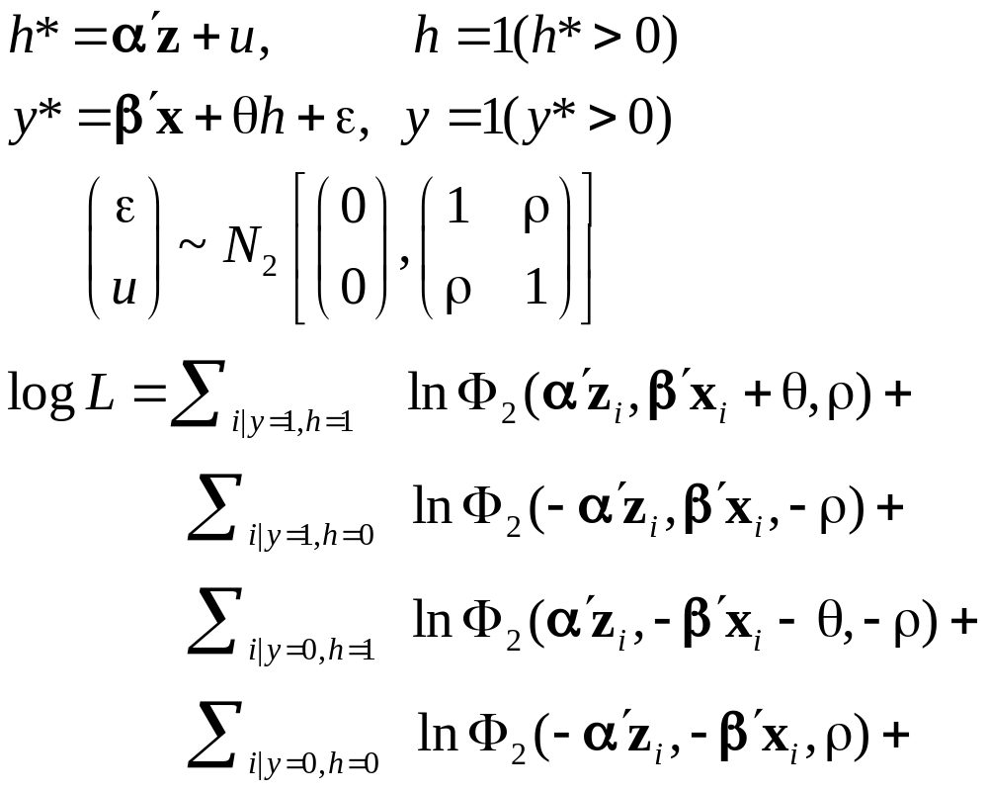
Log Likelihood for the RBP Model

Slide 17
FIML Estimates
-----------------------------------------------------------------------------
FIML - Recursive Bivariate Probit Model
Dependent variable PUBDOC
Log likelihood function -25671.32339
Estimation based on N = 27326, K = 14
Inf.Cr.AIC = 51370.6 AIC/N = 1.880
--------+--------------------------------------------------------------------
PUBLIC| Standard Prob. 95% Confidence
DOCTOR| Coefficient Error z |z|>Z* Interval
--------+--------------------------------------------------------------------
|Index equation for PUBLIC........................................
Constant| 3.55056*** .07446 47.68 .0000 3.40462 3.69650
AGE| .00067 .00115 .58 .5626 -.00159 .00293
EDUC| -.16835*** .00416 -40.48 .0000 -.17650 -.16020
INCOME| -.98735*** .05172 -19.09 .0000 -1.08872 -.88598
MARRIED| -.00997 .02922 -.34 .7329 -.06724 .04729
HHKIDS| -.08094*** .02510 -3.22 .0013 -.13014 -.03174
FEMALE| .12140*** .02231 5.44 .0000 .07768 .16512
|Index equation for DOCTOR........................................
Constant| .58983*** .14474 4.08 .0000 .30615 .87351
AGE| -.05740*** .00601 -9.56 .0000 -.06917 -.04563
AGESQ| .00082*** .6817D-04 12.10 .0000 .00069 .00096
INCOME| .08900* .05097 1.75 .0808 -.01091 .18890
FEMALE| .34580*** .01629 21.22 .0000 .31386 .37773
PUBLIC| .43595*** .07358 5.92 .0000 .29174 .58016
|Disturbance correlation.............................................
RHO(1,2)| -.17317*** .04075 -4.25 .0000 -.25303 -.09330
--------+--------------------------------------------------------------------

Slide 18
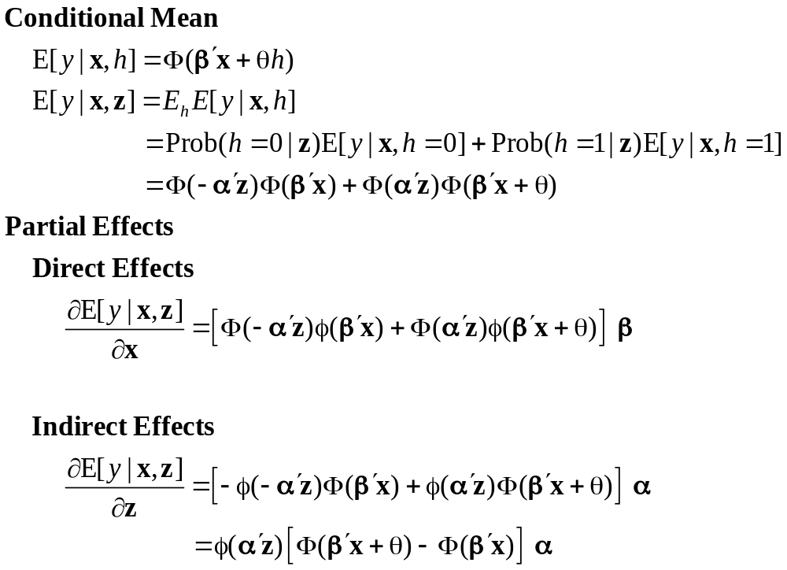
Partial Effects

Slide 19
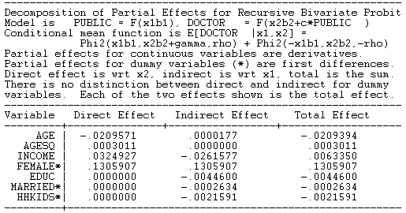
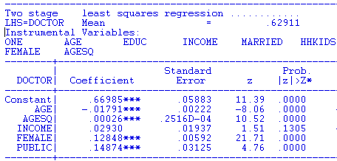
FIML Partial
Effects
Two Stage Least Squares Effects

Slide 20
Identification Issues
Exclusions are not needed for estimation
Identification is, in principle, by “functional form”
Researchers usually have a variable in the treatment equation that is not in the main probit equation “to improve identification”
A fully simultaneous model
  y1 = f(x1,y2), y2 = f(x2,y1)
  Not identified even with exclusion restrictions
  (Model is “incoherent”)

Slide 21
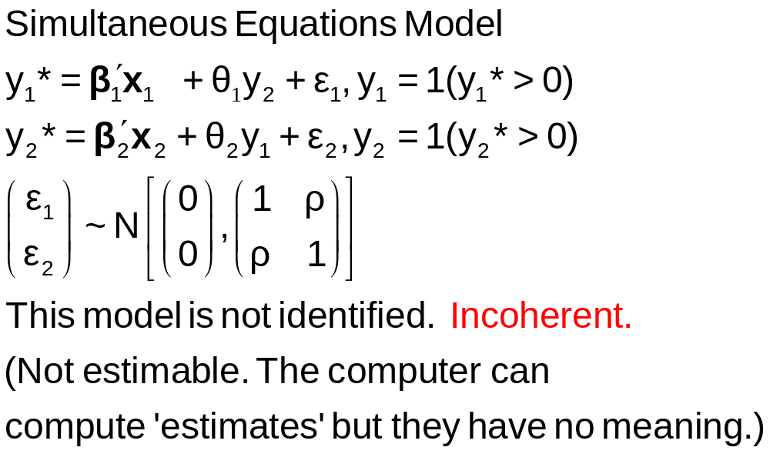
A Simultaneous Equations Model

Slide 22
Fully Simultaneous “Model”
----------------------------------------------------------------------
FIML Estimates of Bivariate Probit Model
Dependent variable DOCHOS
Log likelihood function -20318.69455
--------+-------------------------------------------------------------
Variable| Coefficient Standard Error b/St.Er. P[|Z|>z] Mean of X
--------+-------------------------------------------------------------
|Index equation for DOCTOR
Constant| -.46741*** .06726 -6.949 .0000
AGE| .01124*** .00084 13.353 .0000 43.5257
FEMALE| .27070*** .01961 13.807 .0000 .47877
EDUC| -.00025 .00376 -.067 .9463 11.3206
MARRIED| -.00212 .02114 -.100 .9201 .75862
WORKING| -.00362 .02212 -.164 .8701 .67705
HOSPITAL| 2.04295*** .30031 6.803 .0000 .08765
|Index equation for HOSPITAL
Constant| -1.58437*** .08367 -18.936 .0000
AGE| -.01115*** .00165 -6.755 .0000 43.5257
FEMALE| -.26881*** .03966 -6.778 .0000 .47877
HHNINC| .00421 .08006 .053 .9581 .35208
HHKIDS| -.00050 .03559 -.014 .9888 .40273
DOCTOR| 2.04479*** .09133 22.389 .0000 .62911
|Disturbance correlation
RHO(1,2)| -.99996*** .00048 ******** .0000
--------+-------------------------------------------------------------

Slide 23
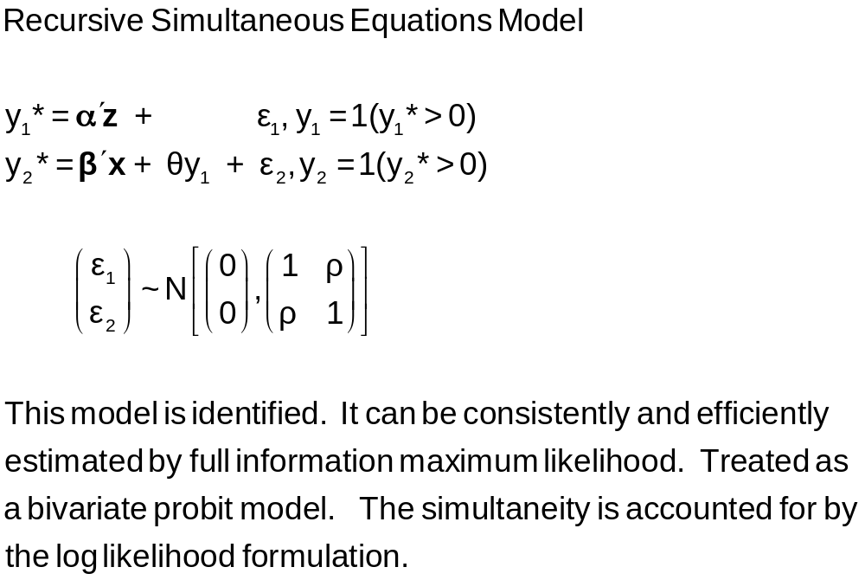
A Recursive Bivariate Probit Model
Treatment Effects

Slide 24
-----------------------------------------------------------------------------
FIML - Recursive Bivariate Probit Model
Dependent variable PUBDOC
Log likelihood function -25671.32339
Estimation based on N = 27326, K = 14
Inf.Cr.AIC = 51370.6 AIC/N = 1.880
--------+--------------------------------------------------------------------
PUBLIC| Standard Prob. 95% Confidence
DOCTOR| Coefficient Error z |z|>Z* Interval
--------+--------------------------------------------------------------------
|Index equation for PUBLIC....................................
Constant| 3.55056*** .07446 47.68 .0000 3.40462 3.69650
AGE| .00067 .00115 .58 .5626 -.00159 .00293
EDUC| -.16835*** .00416 -40.48 .0000 -.17650 -.16020
INCOME| -.98735*** .05172 -19.09 .0000 -1.08872 -.88598
MARRIED| -.00997 .02922 -.34 .7329 -.06724 .04729
HHKIDS| -.08094*** .02510 -3.22 .0013 -.13014 -.03174
FEMALE| .12140*** .02231 5.44 .0000 .07768 .16512
|Index equation for DOCTOR....................................
Constant| .58983*** .14474 4.08 .0000 .30615 .87351
AGE| -.05740*** .00601 -9.56 .0000 -.06917 -.04563
AGESQ| .00082*** .6817D-04 12.10 .0000 .00069 .00096
INCOME| .08900* .05097 1.75 .0808 -.01091 .18890
FEMALE| .34580*** .01629 21.22 .0000 .31386 .37773
PUBLIC| .43595*** .07358 5.92 .0000 .29174 .58016
|Disturbance correlation.........................................
RHO(1,2)| -.17317*** .04075 -4.25 .0000 -.25303 -.09330
--------+--------------------------------------------------------------------

Slide 25
Treatment Effects
y₁ is a “treatment”
Treatment effect of y₁ on y₂.
Prob(y₂=1)_{y1=1} – Prob(y₂=1)_{y1=0}
= Φ(β’x + θ) - Φ(β’x)
Treatment effect on the treated involves an unobserved counterfactual. Compare being treated to being untreated for someone who was actually treated.
Prob(y₂=1|y₁=1)_{y1=1} - Prob(y₂=1|y₁=1)_{y1=0}

Slide 26
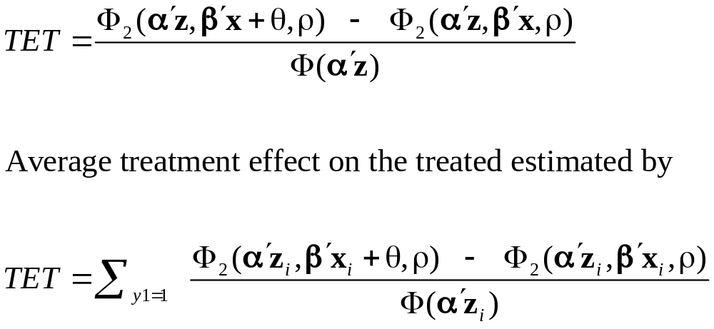
Treatment Effect on the Treated

Slide 27
Treatment Effects
---------------------------------------------------------------------
Partial Effects Analysis for RcrsvBvProb: ATE of PUBLIC on DOCTOR
---------------------------------------------------------------------
Effects on function with respect to PUBLIC
Results are computed by average over sample observations
Partial effects for binary var PUBLIC computed by first difference
---------------------------------------------------------------------
df/dPUBLIC Partial Standard
(Delta Method) Effect Error |t| 95% Confidence Interval
---------------------------------------------------------------------
APE. Function .16446 .02820 5.83 .10920 .21973
---------------------------------------------------------------------
Partial Effects Analysis for RcrsvBvProb: ATET of PUBLIC on DOCTOR
---------------------------------------------------------------------
Effects on function with respect to PUBLIC
Results are computed by average over sample observations
Partial effects for binary var PUBLIC computed by first difference
---------------------------------------------------------------------
df/dPUBLIC Partial Standard
(Delta Method) Effect Error |t| 95% Confidence Interval
---------------------------------------------------------------------
APE. Function .15417 .02482 6.21 .10553 .20282

Slide 28


Slide 29
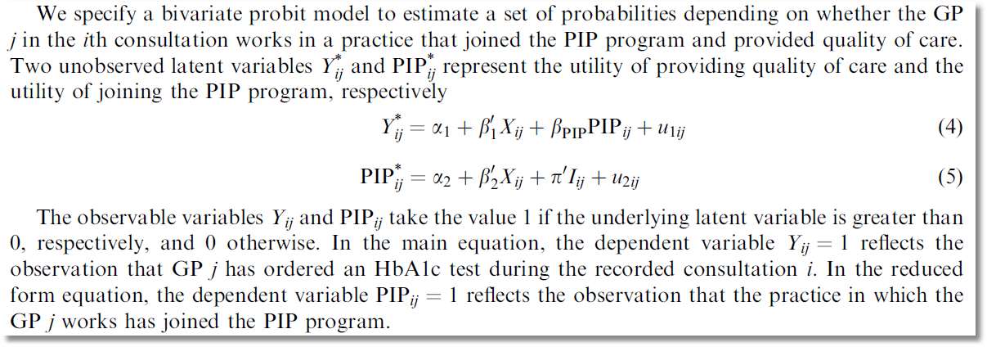
recursive

Slide 30

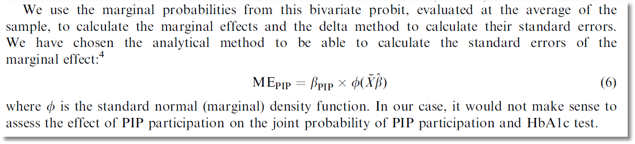
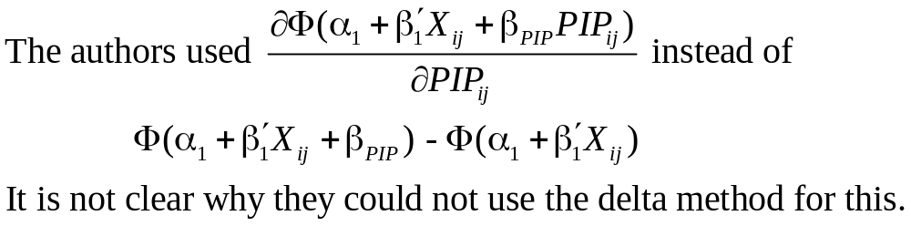
Causal Inference

Slide 31
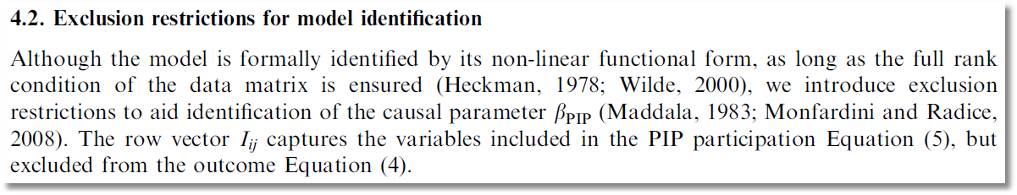

Slide 32
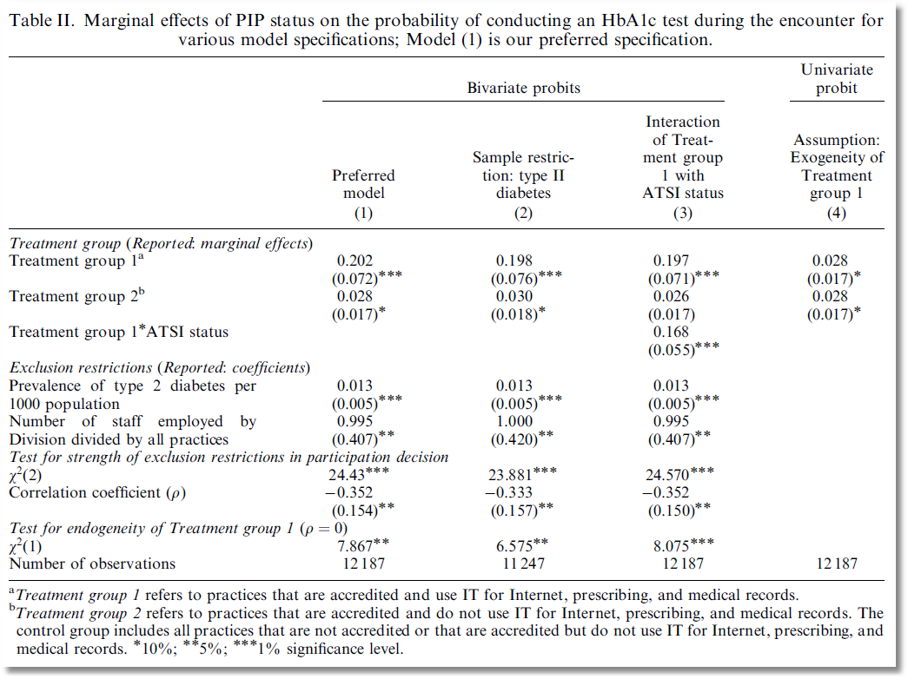

Slide 33
Endogenous Continuous Variable
U* = β’x + θh + ε
y = 1[U* > 0] ⇐
h = α’z + u
E[ε|h] ≠ 0 ⬄ Cov[u, ε] ≠ 0
Additional Assumptions:
(u,ε) ~ N[(0,0),(σ_{u}², ρσ_{u}, 1)]
z = a valid set of exogenous
variables, uncorrelated with (u,ε)
Correlation = ρ.
This is the source of the endogeneity
This is not IV estimation. Z may be uncorrelated with X without problems.

Slide 34


Endogenous Income
Income responds to
Age, Age², Educ, Married, Kids, Gender
0 = Not Healthy
1 = Healthy
Healthy = 0 or 1
Age, Married, Kids, Gender, Income
Determinants of Income (observed and unobserved) also determine health satisfaction.
Notes:
34

Slide 35
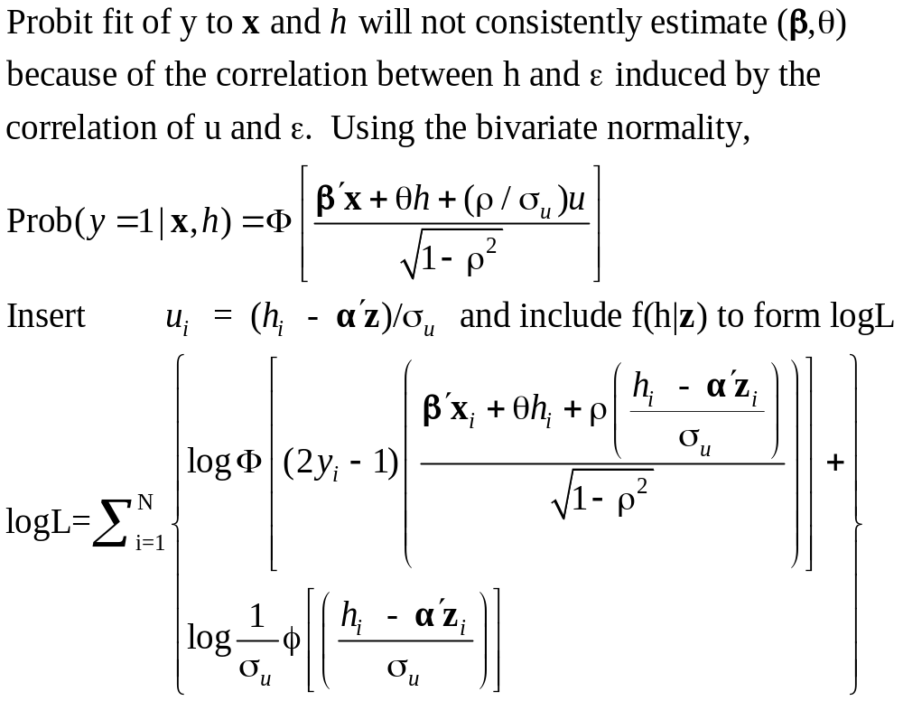
Estimation by ML (Control Function)

Slide 36
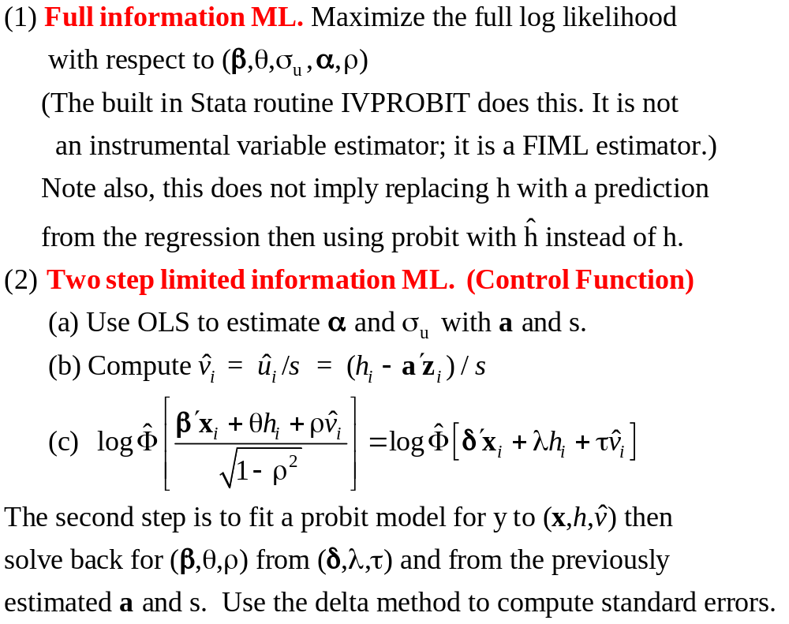
Two Approaches to ML

Slide 37
FIML Estimates
----------------------------------------------------------------------
Probit with Endogenous RHS Variable
Dependent variable HEALTHY
Log likelihood function -6464.60772
--------+-------------------------------------------------------------
Variable| Coefficient Standard Error b/St.Er. P[|Z|>z] Mean of X
--------+-------------------------------------------------------------
|Coefficients in Probit Equation for HEALTHY
Constant| 1.21760*** .06359 19.149 .0000
AGE| -.02426*** .00081 -29.864 .0000 43.5257
MARRIED| -.02599 .02329 -1.116 .2644 .75862
HHKIDS| .06932*** .01890 3.668 .0002 .40273
FEMALE| -.14180*** .01583 -8.959 .0000 .47877
INCOME| .53778*** .14473 3.716 .0002 .35208
|Coefficients in Linear Regression for INCOME
Constant| -.36099*** .01704 -21.180 .0000
AGE| .02159*** .00083 26.062 .0000 43.5257
AGESQ| -.00025*** .944134D-05 -26.569 .0000 2022.86
EDUC| .02064*** .00039 52.729 .0000 11.3206
MARRIED| .07783*** .00259 30.080 .0000 .75862
HHKIDS| -.03564*** .00232 -15.332 .0000 .40273
FEMALE| .00413** .00203 2.033 .0420 .47877
|Standard Deviation of Regression Disturbances
Sigma(w)| .16445*** .00026 644.874 .0000
|Correlation Between Probit and Regression Disturbances
Rho(e,w)| -.02630 .02499 -1.052 .2926
--------+-------------------------------------------------------------

Slide 38
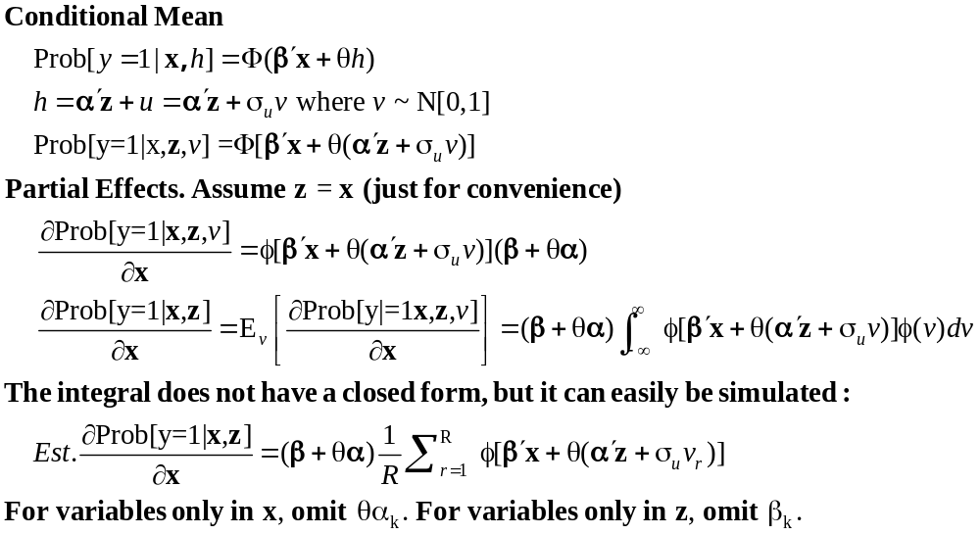
Partial Effects: Scaled Coefficients

Slide 39
FIML Partial
Effects
Two Stage Least Squares Effects

