Slide 1




Microeconometric Modeling
William Greene
Stern School of Business
New York University
New York NY USA
3.2 Models for Count Data

Slide 2
Concepts
Models
Count Data
Loglinear Model
Partial Effects
Overdispersion
Frailty/Heterogeneity
Nonlinear Least Squares
Maximum Likelihood
Vuong Statistic
Zero Inflation Model
2 Part Model
Adverse Selection
Moral Hazard
Participation Equation
Normal Mixture
Poisson Regression
Negative Binomial Regression
Normal-Poisson Model
NegBin2
NegBinP
ZIP and ZINB
Hurdle Model
Fixed Effects
Random Effects
Bivariate Random Effects Model

Slide 3
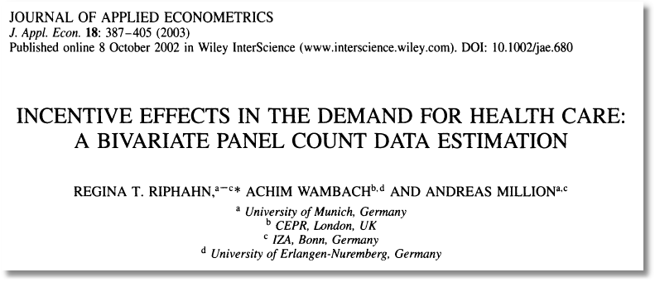

Slide 4

Doctor Visits

Slide 5
Basic Modeling for Counts of Events
E.g., Visits to site, number of purchases, number of doctor visits
Regression approach
  Quantitative outcome measured
  Discrete variable, model probabilities
Poisson probabilities – “loglinear model”

Slide 6
Poisson Model for Doctor Visits
----------------------------------------------------------------------
Poisson Regression
Dependent variable DOCVIS
Log likelihood function -103727.29625
Restricted log likelihood -108662.13583
Chi squared [ 6 d.f.] 9869.67916
Significance level .00000
McFadden Pseudo R-squared .0454145
Estimation based on N = 27326, K = 7
Information Criteria: Normalization=1/N
Normalized Unnormalized
AIC 7.59235 207468.59251
Chi- squared =255127.59573 RsqP= .0818
G - squared =154416.01169 RsqD= .0601
Overdispersion tests: g=mu(i) : 20.974
Overdispersion tests: g=mu(i)^2: 20.943
--------+-------------------------------------------------------------
Variable| Coefficient Standard Error b/St.Er. P[|Z|>z] Mean of X
--------+-------------------------------------------------------------
Constant| .77267*** .02814 27.463 .0000
AGE| .01763*** .00035 50.894 .0000 43.5257
EDUC| -.02981*** .00175 -17.075 .0000 11.3206
FEMALE| .29287*** .00702 41.731 .0000 .47877
MARRIED| .00964 .00874 1.103 .2702 .75862
HHNINC| -.52229*** .02259 -23.121 .0000 .35208
HHKIDS| -.16032*** .00840 -19.081 .0000 .40273
--------+-------------------------------------------------------------

Slide 7
Partial Effects
----------------------------------------------------------------------
Partial derivatives of expected val. with
respect to the vector of characteristics.
Effects are averaged over individuals.
Observations used for means are All Obs.
Conditional Mean at Sample Point 3.1835
Scale Factor for Marginal Effects 3.1835
--------+-------------------------------------------------------------
Variable| Coefficient Standard Error b/St.Er. P[|Z|>z] Mean of X
--------+-------------------------------------------------------------
AGE| .05613*** .00131 42.991 .0000 43.5257
EDUC| -.09490*** .00596 -15.923 .0000 11.3206
FEMALE| .93237*** .02555 36.491 .0000 .47877
MARRIED| .03069 .02945 1.042 .2973 .75862
HHNINC| -1.66271*** .07803 -21.308 .0000 .35208
HHKIDS| -.51037*** .02879 -17.730 .0000 .40273
--------+-------------------------------------------------------------

Slide 8
Poisson Model Specification Issues
Equi-Dispersion: Var[y_{i}|x_{i}] = E[y_{i}|x_{i}].
Overdispersion: If λ_{i} = exp[β’x_{i} + ε_{i}],
  E[y_{i}|x_{i}] = γexp[β’x_{i}]
  Var[y_{i}] > E[y_{i}] (overdispersed)
  ε_{i} ~ log-Gamma ➔ Negative binomial model
  ε_{i} ~ Normal[0,σ²] ➔ Normal-mixture model
  ε_{i} is viewed as unobserved heterogeneity (“frailty”).
    Normal model may be more natural.
    Estimation is a bit more complicated.

Slide 9
Poisson Model for Doctor Visits
----------------------------------------------------------------------
Poisson Regression
Dependent variable DOCVIS
Log likelihood function -103727.29625
Restricted log likelihood -108662.13583
Chi squared [ 6 d.f.] 9869.67916
Significance level .00000
McFadden Pseudo R-squared .0454145
Estimation based on N = 27326, K = 7
Information Criteria: Normalization=1/N
Normalized Unnormalized
AIC 7.59235 207468.59251
Chi- squared =255127.59573 RsqP= .0818
G - squared =154416.01169 RsqD= .0601
Overdispersion tests: g=mu(i) : 20.974
Overdispersion tests: g=mu(i)^2: 20.943
--------+-------------------------------------------------------------
Variable| Coefficient Standard Error b/St.Er. P[|Z|>z] Mean of X
--------+-------------------------------------------------------------
Constant| .77267*** .02814 27.463 .0000
AGE| .01763*** .00035 50.894 .0000 43.5257
EDUC| -.02981*** .00175 -17.075 .0000 11.3206
FEMALE| .29287*** .00702 41.731 .0000 .47877
MARRIED| .00964 .00874 1.103 .2702 .75862
HHNINC| -.52229*** .02259 -23.121 .0000 .35208
HHKIDS| -.16032*** .00840 -19.081 .0000 .40273
--------+-------------------------------------------------------------

Slide 10
Negative Binomial Specification
Prob(Y_{i}=j|x_{i}) has greater mass to the right and left
of the mean
Conditional mean function is the same as the
Poisson: E[y_{i}|x_{i}] = λ_{i}=Exp(β’x_{i}), so marginal
effects have the same form.
Variance is Var[y_{i}|x_{i}] = λ_{i}(1 + α λ_{i}), α is the
overdispersion parameter; α = 0 reverts
to the Poisson.
Poisson is consistent when NegBin is appropriate.
Therefore, this is a case for the ROBUST
covariance matrix estimator. (Neglected
heterogeneity that is uncorrelated with x_{i}.)

Slide 11
NegBin Model for Doctor Visits
----------------------------------------------------------------------
Negative Binomial Regression
Dependent variable DOCVIS
Log likelihood function -60134.50735 NegBin LogL
Restricted log likelihood -103727.29625 Poisson LogL
Chi squared [ 1 d.f.] 87185.57782 Reject Poisson model
Significance level .00000
McFadden Pseudo R-squared .4202634
Estimation based on N = 27326, K = 8
Information Criteria: Normalization=1/N
Normalized Unnormalized
AIC 4.40185 120285.01469
NegBin form 2; Psi(i) = theta
--------+-------------------------------------------------------------
Variable| Coefficient Standard Error b/St.Er. P[|Z|>z] Mean of X
--------+-------------------------------------------------------------
Constant| .80825*** .05955 13.572 .0000
AGE| .01806*** .00079 22.780 .0000 43.5257
EDUC| -.03717*** .00386 -9.622 .0000 11.3206
FEMALE| .32596*** .01586 20.556 .0000 .47877
MARRIED| -.00605 .01880 -.322 .7477 .75862
HHNINC| -.46768*** .04663 -10.029 .0000 .35208
HHKIDS| -.15274*** .01729 -8.832 .0000 .40273
|Dispersion parameter for count data model
Alpha| 1.89679*** .01981 95.747 .0000
--------+-------------------------------------------------------------

Slide 12
Partial Effects
+---------------------------------------------------------------------
Scale Factor for Marginal Effects 3.1835 POISSON
--------+-------------------------------------------------------------
Variable| Coefficient Standard Error b/St.Er. P[|Z|>z] Mean of X
--------+-------------------------------------------------------------
AGE| .05613*** .00131 42.991 .0000 43.5257
EDUC| -.09490*** .00596 -15.923 .0000 11.3206
FEMALE| .93237*** .02555 36.491 .0000 .47877
MARRIED| .03069 .02945 1.042 .2973 .75862
HHNINC| -1.66271*** .07803 -21.308 .0000 .35208
HHKIDS| -.51037*** .02879 -17.730 .0000 .40273
--------+-------------------------------------------------------------
Scale Factor for Marginal Effects 3.1924 NEGATIVE BINOMIAL
--------+-------------------------------------------------------------
AGE| .05767*** .00317 18.202 .0000 43.5257
EDUC| -.11867*** .01348 -8.804 .0000 11.3206
FEMALE| 1.04058*** .06212 16.751 .0000 .47877
MARRIED| -.01931 .06382 -.302 .7623 .75862
HHNINC| -1.49301*** .16272 -9.176 .0000 .35208
HHKIDS| -.48759*** .06022 -8.097 .0000 .40273
--------+-------------------------------------------------------------

Slide 13
Zero Inflation – ZIP Models
Two regimes: (Recreation site visits)
  Zero (with probability 1). (Never visit site)
  Poisson with Pr(0) = exp[- β’x_{i}]. (Number of visits, including zero visits this season.)
Unconditional:
  Pr[0] = P(regime 0) + P(regime 1)*Pr[0|regime 1]
  Pr[j | j >0] = P(regime 1)*Pr[j|regime 1]
“Two inflation” – Number of children
These are “latent class models”

Slide 14
Zero Inflation Models

Slide 15
Notes on Zero Inflation Models
Poisson is not nested in ZIP. γ = 0 in ZIP does not produce Poisson; it produces ZIP with P(regime 0) = ½.
  Standard tests are not appropriate
  Use Vuong statistic. ZIP model almost always wins.
Zero Inflation models extend to NB models –ZINB is a standard model
  Creates two sources of overdispersion
  Generally difficult to estimate

Slide 16
ZIP Model
----------------------------------------------------------------------
Zero Altered Poisson Regression Model
Logistic distribution used for splitting model.
ZAP term in probability is F[tau x Z(i) ]
Comparison of estimated models
Pr[0|means] Number of zeros Log-likelihood
Poisson .04933 Act.= 10135 Prd.= 1347.9 -103727.29625
Z.I.Poisson .36565 Act.= 10135 Prd.= 9991.8 -83843.36088
Vuong statistic for testing ZIP vs. unaltered model is 44.6739
Distributed as standard normal. A value greater than
+1.96 favors the zero altered Z.I.Poisson model.
A value less than -1.96 rejects the ZIP model.
--------+-------------------------------------------------------------
Variable| Coefficient Standard Error b/St.Er. P[|Z|>z] Mean of X
--------+-------------------------------------------------------------
|Poisson/NB/Gamma regression model
Constant| 1.47301*** .01123 131.119 .0000
AGE| .01100*** .00013 83.038 .0000 43.5257
EDUC| -.02164*** .00075 -28.864 .0000 11.3206
FEMALE| .10943*** .00256 42.728 .0000 .47877
MARRIED| -.02774*** .00318 -8.723 .0000 .75862
HHNINC| -.42240*** .00902 -46.838 .0000 .35208
HHKIDS| -.08182*** .00323 -25.370 .0000 .40273
|Zero inflation model
Constant| -.75828*** .06803 -11.146 .0000
FEMALE| -.59011*** .02652 -22.250 .0000 .47877
EDUC| .04114*** .00561 7.336 .0000 11.3206
--------+-------------------------------------------------------------

Slide 17
The Vuong Statistic for Nonnested Models

Slide 18
A Hurdle Model
Two part model:
  Model 1: Probability model for more than zero occurrences
  Model 2: Model for number of occurrences given that the number is greater than zero.
Applications common in health economics
  Usage of health care facilities
  Use of drugs, alcohol, etc.

Slide 20
Hurdle Model

Slide 21
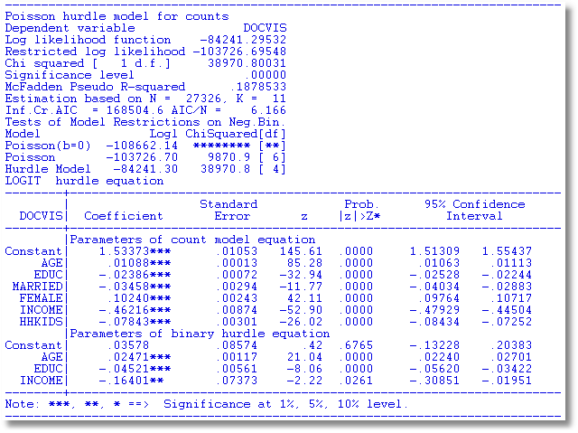
Hurdle Model for Doctor Visits

Slide 22
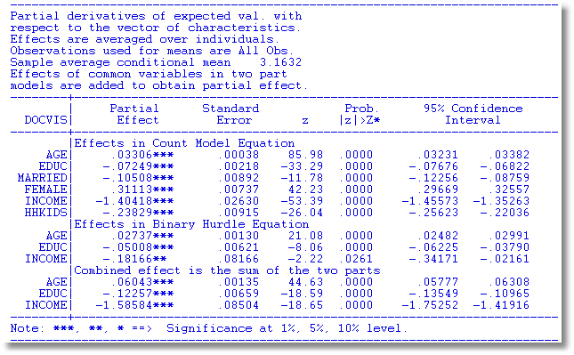
Partial Effects

Slide 23


Slide 24
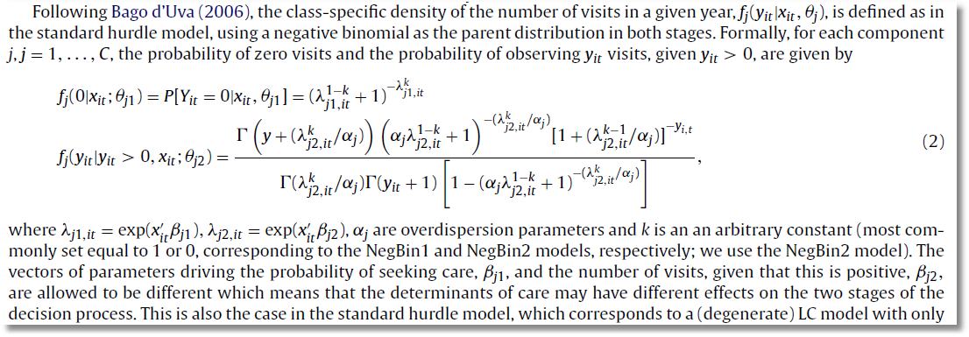

Slide 26
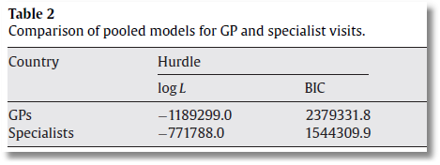
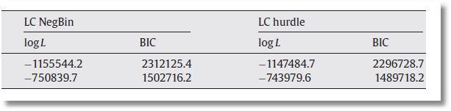

Slide 27
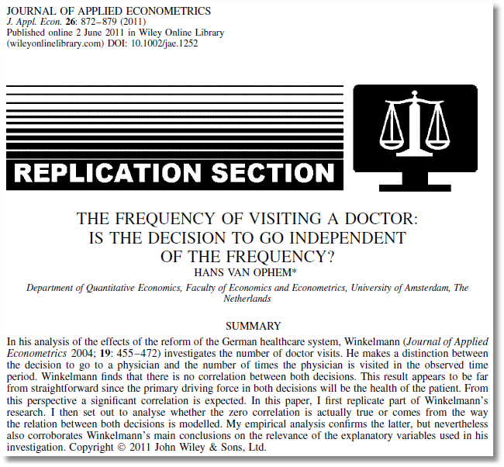
See also:
van Ophem H. 2000. Modeling selectivity in count data models. Journal of Business and Economic Statistics
18: 503–511.
Winkelmann finds that there is no correlation between the decisions… A significant correlation is expected … [T]he correlation comes from the way the relation between the decisions is modeled.

Slide 28
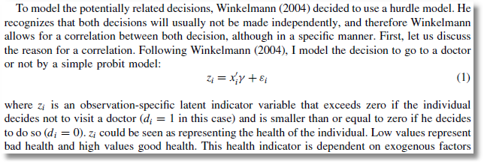
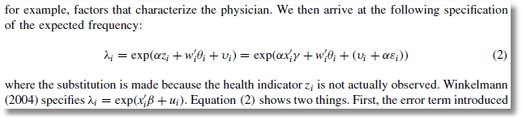
Probit Participation Equation
Poisson-Normal Intensity Equation

Slide 29
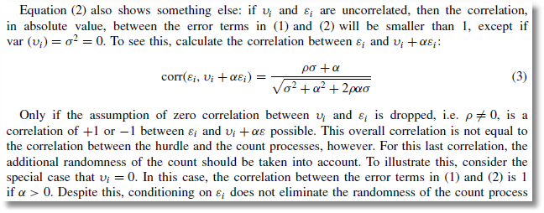
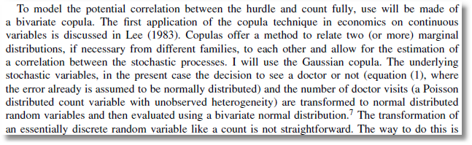
Bivariate-Normal Heterogeneity in Participation and Intensity Equations
Gaussian Copula for Participation and Intensity Equations

Slide 30
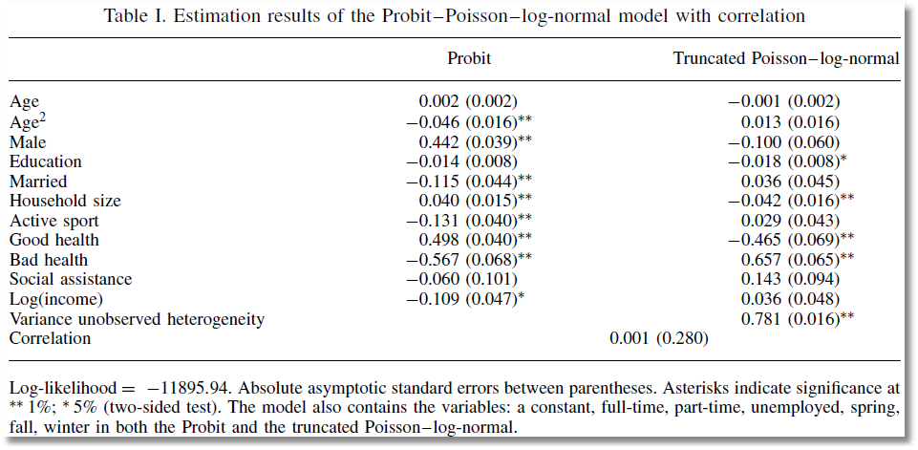
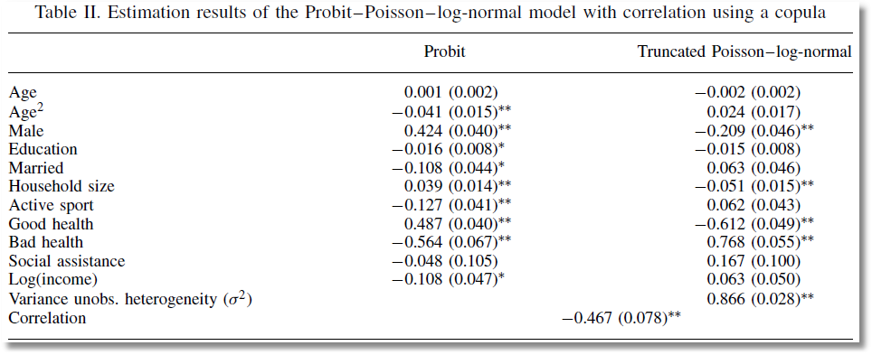
Correlation between Heterogeneity Terms
Correlation between Counts

Slide 31

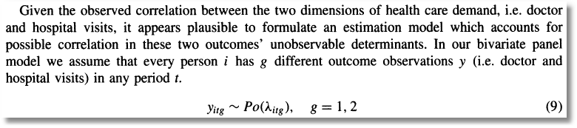
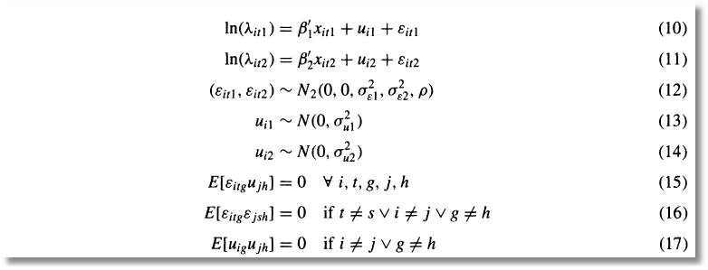
Bivariate Random Effects

Slide 32
