Slide 1




Microeconometric Modeling
William Greene
Stern School of Business
New York University
New York NY USA
4.2 Latent Class Models

Slide 2

Concepts
Models
Latent Class
Prior and Posterior Probabilities
Classification Problem
Finite Mixture
Normal Mixture
Health Satisfaction
EM Algorithm
ZIP Model
Hurdle Model
NB2 Model
Obesity/BMI Model
Misreporter
Value of Travel Time Saved
Decision Strategy
Multinomial Logit Model
Latent Class MNL
Heckman – Singer Model
Latent Class Ordered Probit
Attribute Nonattendance Model
2^{K} Model

Slide 3
Latent Classes
A population contains a mixture of individuals of different types (classes)
Common form of the data generating mechanism within the classes
Observed outcome y is governed by the common process F(y|x,θ_{j} )
Classes are distinguished by the parameters, θ_{j}.

Slide 4

Zero Inflation?

Slide 5
Zero Inflation – ZIP Models
Two regimes: (Recreation site visits)
  Zero (with probability 1). (Never visit site)
  Poisson with Pr(0) = exp[- β’x_{i}]. (Number of visits, including zero visits this season.)
Unconditional:
  Pr[0] = P(regime 0) + P(regime 1)*Pr[0|regime 1]
  Pr[j | j >0] = P(regime 1)*Pr[j|regime 1]
This is a “latent class model”

Slide 6
The Latent Class Model

Slide 7
Log Likelihood for an LC Model

Slide 8
Estimating Which Class

Slide 9
‘Estimating’ β_{i}

Slide 10
How Many Classes?

Slide 11
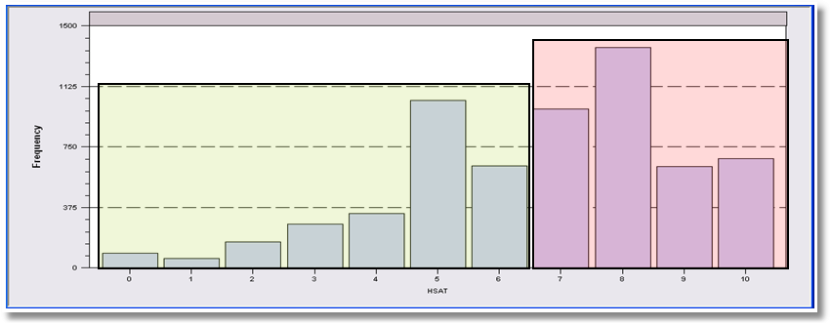
LCM for Health Status
Self Assessed Health Status = 0,1,…,10
Recoded: Healthy = HSAT > 6
Using only groups observed T=7 times; N=887
Prob = Φ(Age,Educ,Income,Married,Kids)
2, 3 classes

Slide 12
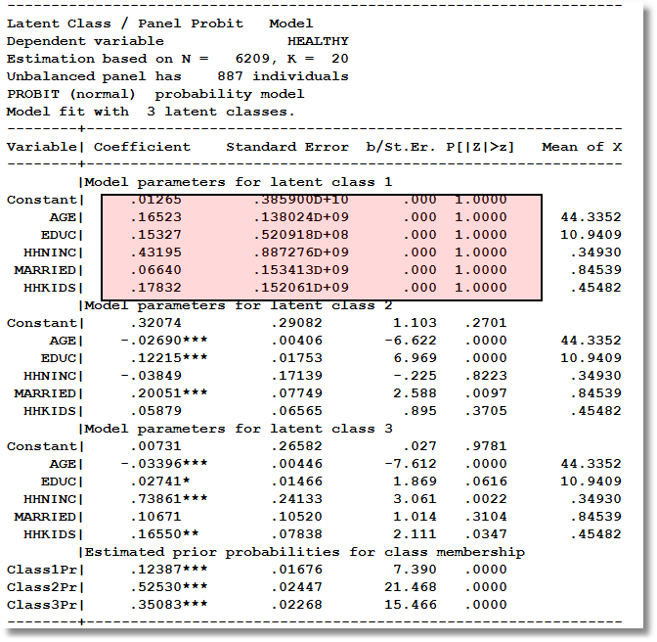
Too Many Classes

Slide 13
Two Class Model
----------------------------------------------------------------------
Latent Class / Panel Probit Model
Dependent variable HEALTHY
Unbalanced panel has 887 individuals
PROBIT (normal) probability model
Model fit with 2 latent classes.
--------+-------------------------------------------------------------
Variable| Coefficient Standard Error b/St.Er. P[|Z|>z] Mean of X
--------+-------------------------------------------------------------
|Model parameters for latent class 1
Constant| .61652** .28620 2.154 .0312
AGE| -.02466*** .00401 -6.143 .0000 44.3352
EDUC| .11759*** .01852 6.351 .0000 10.9409
HHNINC| .10713 .20447 .524 .6003 .34930
MARRIED| .11705 .09574 1.223 .2215 .84539
HHKIDS| .04421 .07017 .630 .5287 .45482
|Model parameters for latent class 2
Constant| .18988 .31890 .595 .5516
AGE| -.03120*** .00464 -6.719 .0000 44.3352
EDUC| .02122 .01934 1.097 .2726 10.9409
HHNINC| .61039*** .19688 3.100 .0019 .34930
MARRIED| .06201 .10035 .618 .5367 .84539
HHKIDS| .19465** .07936 2.453 .0142 .45482
|Estimated prior probabilities for class membership
Class1Pr| .56604*** .02487 22.763 .0000
Class2Pr| .43396*** .02487 17.452 .0000

Slide 14
An Extended Latent Class Model
Notes:
14

Slide 15

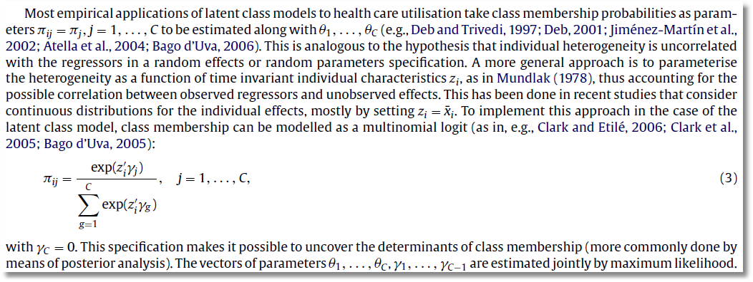

Slide 16
Hurdle Models
Two decisions:
  Whether or not to participate: y=0 or +.
  If participate, how much. y|y>0
One ‘regime’ – individual always makes both decisions.
Implies different models for zeros and positive values
  Prob(0) = 1 – F(γ′z), Prob(+) = F(γ′z)
  Prob(y|+) = P(y)/[1 – P(0)]

Slide 17


Slide 18


Slide 19
A Latent Class Hurdle NB2 Model
Analysis of ECHP panel data (1994-2001)
Two class Latent Class Model
  Typical in health economics applications
Hurdle model for physician visits
  Poisson hurdle for participation and negative binomial intensity given participation
  Contrast to a negative binomial model

Slide 20
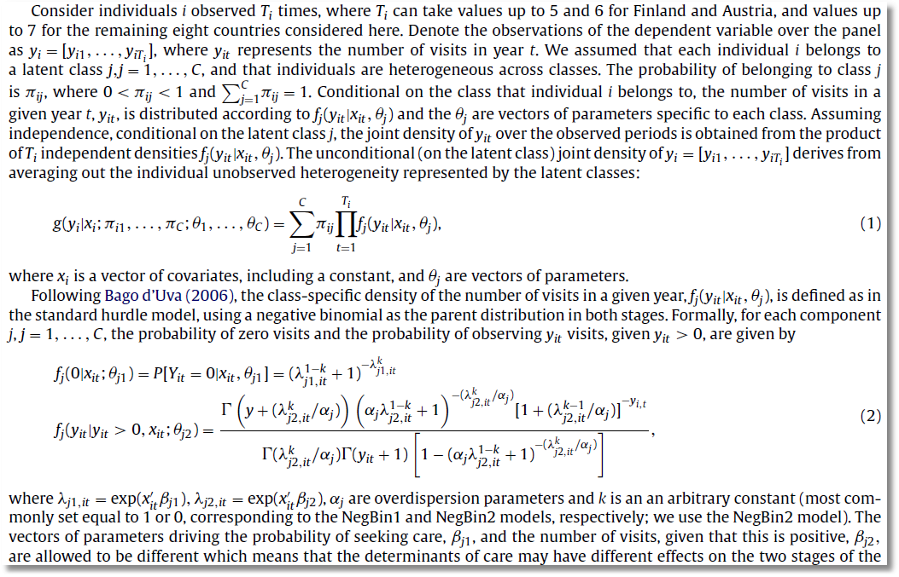

Slide 21
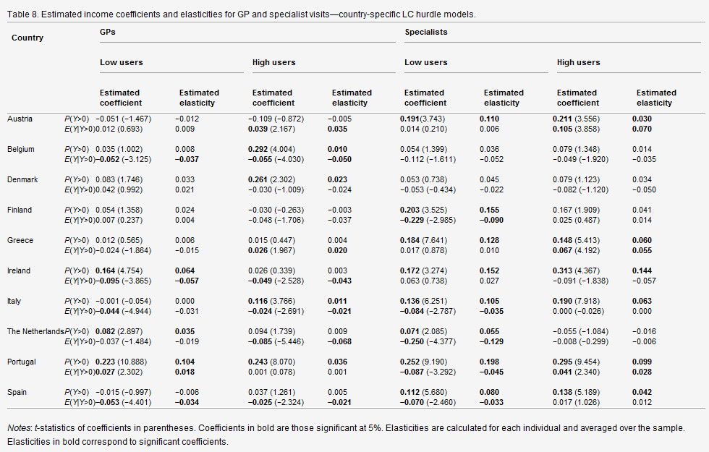

Slide 22
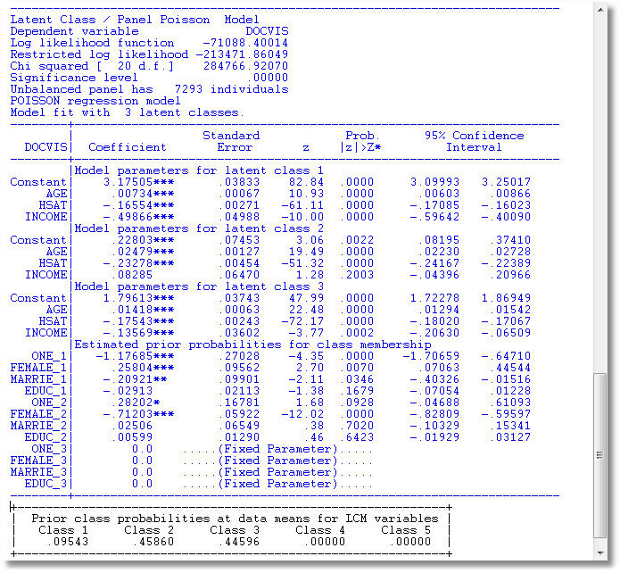
LC Poisson Regression for Doctor Visits

Slide 23
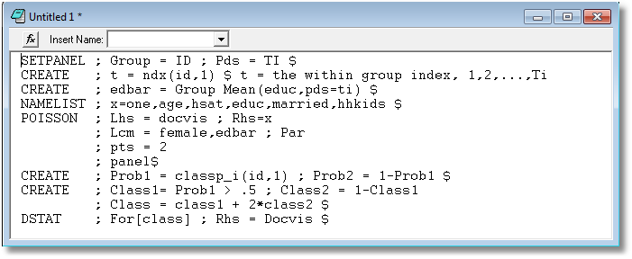
Is the LCM Finding High and Low Users?

Slide 24
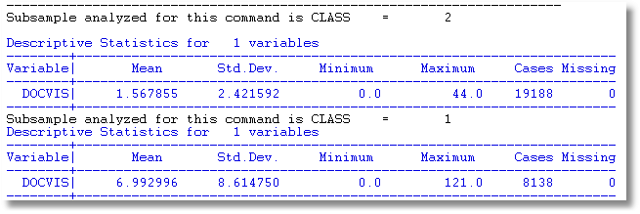
Is the LCM Finding High and Low Users? Apparently So.

Slide 25
A Latent Class MNL Model
Within a “class”
Class sorting is probabilistic (to the analyst) determined by individual characteristics

Slide 26
Estimates from the LCM
Taste parameters within each class β_{q}
Parameters of the class probability model, θ_{q}
For each person:
  Posterior estimates of the class they are in q|i
  Posterior estimates of their taste parameters E[β_{q}|i]
  Posterior estimates of their behavioral parameters, elasticities, marginal effects, etc.

Slide 27
Using the Latent Class Model
Computing posterior (individual specific) class probabilities
Computing posterior (individual specific) taste parameters

Slide 28
Application: Shoe Brand Choice
Simulated Data: Stated Choice, 400 respondents, 8 choice situations, 3,200 observations
3 choice/attributes + NONE
  Fashion = High / Low
  Quality = High / Low
  Price = 25/50/75,100 coded 1,2,3,4
Heterogeneity: Sex (Male=1), Age (<25, 25-39, 40+)
Underlying data generated by a 3 class latent class process (100, 200, 100 in classes)
Thanks to www.statisticalinnovations.com (Latent Gold)

Slide 29
Shoe Brand Choice
Shoe Choice
Choice Situation
Purchase
Opt Out
Choose Brand
Brand
None
Brand1
Brand2
Brand3

Slide 30
One Class MNL Estimates
-----------------------------------------------------------
Discrete choice (multinomial logit) model
Dependent variable Choice
Log likelihood function -4158.50286
Estimation based on N = 3200, K = 4
R2=1-LogL/LogL* Log-L fncn R-sqrd R2Adj
Constants only -4391.1804 .0530 .0510
Response data are given as ind. choices
Number of obs.= 3200, skipped 0 obs
--------+--------------------------------------------------
Variable| Coefficient Standard Error b/St.Er. P[|Z|>z]
--------+--------------------------------------------------
FASH|1| 1.47890*** .06777 21.823 .0000
QUAL|1| 1.01373*** .06445 15.730 .0000
PRICE|1| -11.8023*** .80406 -14.678 .0000
ASC4|1| .03679 .07176 .513 .6082
--------+--------------------------------------------------

Slide 31
Three Class LCM
Normal exit from iterations. Exit status=0.
-----------------------------------------------------------
Latent Class Logit Model
Dependent variable CHOICE
Log likelihood function -3649.13245
Restricted log likelihood -4436.14196
Chi squared [ 20 d.f.] 1574.01902
Significance level .00000
McFadden Pseudo R-squared .1774085
Estimation based on N = 3200, K = 20
R2=1-LogL/LogL* Log-L fncn R-sqrd R2Adj
No coefficients -4436.1420 .1774 .1757
Constants only -4391.1804 .1690 .1673
At start values -4158.5428 .1225 .1207
Response data are given as ind. choices
Number of latent classes = 3
Average Class Probabilities
.506 .239 .256
LCM model with panel has 400 groups
Fixed number of obsrvs./group= 8
Number of obs.= 3200, skipped 0 obs
--------+--------------------------------------------------
LogL for one class MNL = -4158.503
Based on the LR statistic it would seem unambiguous to reject the one class model. The degrees of freedom for the test are uncertain, however.

Slide 32
Estimated LCM: Utilities
--------+--------------------------------------------------
Variable| Coefficient Standard Error b/St.Er. P[|Z|>z]
--------+--------------------------------------------------
|Utility parameters in latent class -->> 1
FASH|1| 3.02570*** .14549 20.796 .0000
QUAL|1| -.08782 .12305 -.714 .4754
PRICE|1| -9.69638*** 1.41267 -6.864 .0000
ASC4|1| 1.28999*** .14632 8.816 .0000
|Utility parameters in latent class -->> 2
FASH|2| 1.19722*** .16169 7.404 .0000
QUAL|2| 1.11575*** .16356 6.821 .0000
PRICE|2| -13.9345*** 1.93541 -7.200 .0000
ASC4|2| -.43138** .18514 -2.330 .0198
|Utility parameters in latent class -->> 3
FASH|3| -.17168 .16725 -1.026 .3047
QUAL|3| 2.71881*** .17907 15.183 .0000
PRICE|3| -8.96483*** 1.93400 -4.635 .0000
ASC4|3| .18639 .18412 1.012 .3114

Slide 33
Estimated LCM: Class Probability Model
--------+--------------------------------------------------
Variable| Coefficient Standard Error b/St.Er. P[|Z|>z]
--------+--------------------------------------------------
|This is THETA(01) in class probability model.
Constant| -.90345** .37612 -2.402 .0163
_MALE|1| .64183* .36245 1.771 .0766
_AGE25|1| 2.13321*** .32096 6.646 .0000
_AGE39|1| .72630* .43511 1.669 .0951
|This is THETA(02) in class probability model.
Constant| .37636 .34812 1.081 .2796
_MALE|2| -2.76536*** .69325 -3.989 .0001
_AGE25|2| -.11946 .54936 -.217 .8279
_AGE39|2| 1.97657*** .71684 2.757 .0058
|This is THETA(03) in class probability model.
Constant| .000 ......(Fixed Parameter)......
_MALE|3| .000 ......(Fixed Parameter)......
_AGE25|3| .000 ......(Fixed Parameter)......
_AGE39|3| .000 ......(Fixed Parameter)......
--------+--------------------------------------------------

Slide 34
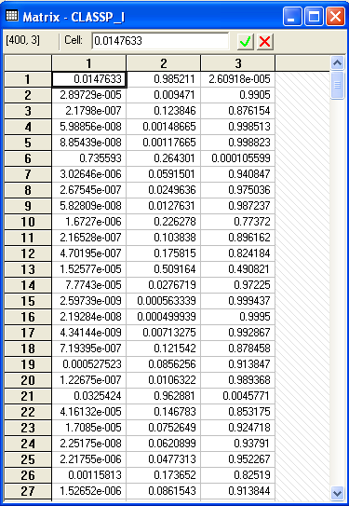
Estimated LCM: Conditional (Posterior) Class Probabilities

Slide 35
Average Estimated Class Probabilities
MATRIX ; list ; 1/400 * classp_i'1$
Matrix Result has 3 rows and 1 columns.
1
+--------------
1| .50555
2| .23853
3| .25593
This is how the data were simulated. Class probabilities are .5, .25, .25. The model ‘worked.’

Slide 36
Elasticities
+---------------------------------------------------+
| Elasticity averaged over observations.|
| Effects on probabilities of all choices in model: |
| * = Direct Elasticity effect of the attribute. |
| Attribute is PRICE in choice BRAND1 |
| Mean St.Dev |
| * Choice=BRAND1 -.8010 .3381 |
| Choice=BRAND2 .2732 .2994 |
| Choice=BRAND3 .2484 .2641 |
| Choice=NONE .2193 .2317 |
+---------------------------------------------------+
| Attribute is PRICE in choice BRAND2 |
| Choice=BRAND1 .3106 .2123 |
| * Choice=BRAND2 -1.1481 .4885 |
| Choice=BRAND3 .2836 .2034 |
| Choice=NONE .2682 .1848 |
+---------------------------------------------------+
| Attribute is PRICE in choice BRAND3 |
| Choice=BRAND1 .3145 .2217 |
| Choice=BRAND2 .3436 .2991 |
| * Choice=BRAND3 -.6744 .3676 |
| Choice=NONE .3019 .2187 |
+---------------------------------------------------+
Elasticities are computed by averaging individual elasticities computed at the expected (posterior) parameter vector.
This is an unlabeled choice experiment. It is not possible to attach any significance to the fact that the elasticity is different for Brand1 and Brand 2 or Brand 3.

Slide 37
Decision Strategy in Multinomial Choice

Slide 38
Multinomial Logit Model

Slide 39
Individual Implicitly Ignores Attributes
Hensher, D.A. and Greene, W.H. (2010) Non-attendance and dual processing of common-metric attributes in choice analysis: a latent class specification, Empirical Economics 39 (2), 413-426
Campbell, D., Hensher, D.A. and Scarpa, R. Non-attendance to Attributes in Environmental Choice Analysis: A Latent Class Specification, Journal of Environmental Planning and Management, proofs 14 May 2011.
Hensher, D.A., Rose, J.M. and Greene, W.H. Inferring attribute non-attendance from stated choice data: implications for willingness to pay estimates and a warning for stated choice experiment design, 14 February 2011, Transportation, online 2 June 2001 DOI 10.1007/s11116-011-9347-8.

Slide 40
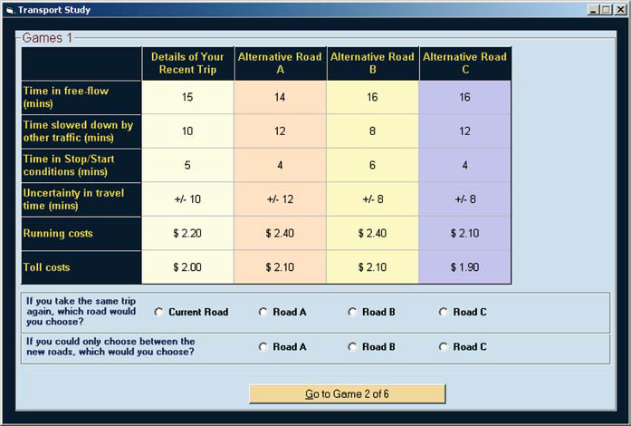
Stated Choice Experiment
Individuals seem to be ignoring attributes. Unknown to the analyst

Slide 41
The 2^{K} model
The analyst believes some attributes are ignored. There is no indicator.
Classes distinguished by which attributes are ignored
Same model applies, now a latent class. For K attributes there are 2^{K} candidate coefficient vectors

Slide 42
Latent Class Models with
Cross Class Restrictions
8 Class Model: 6 structural utility parameters, 7 unrestricted prior probabilities.
Reduced form has 8(6)+8 = 56 parameters. (π_{j} = exp(α_{j})/∑_{j}exp(α_{j}), α_{J} = 0.)
EM Algorithm: Does not provide any means to impose cross class restrictions.
“Bayesian” MCMC Methods: May be possible to force the restrictions – it will not be simple.
Conventional Maximization: Simple

Slide 43
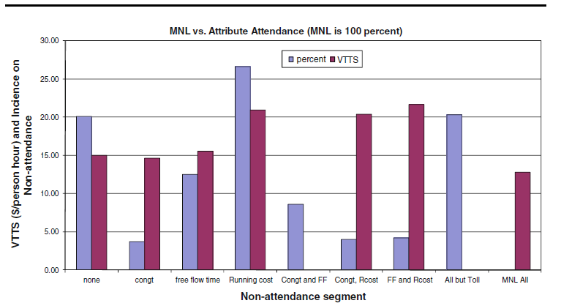
Results for the 2^{K} model

Slide 44


Slide 45
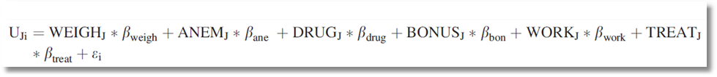
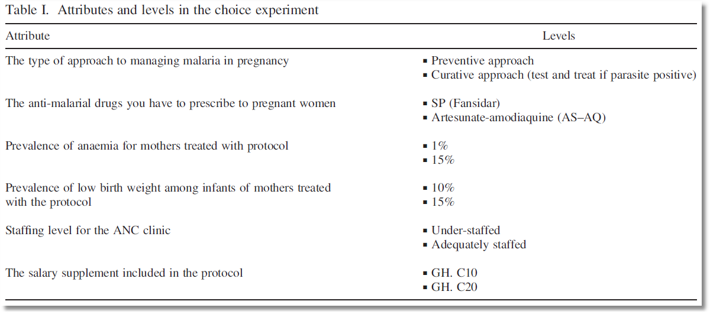
Choice Model with 6 Attributes

Slide 46
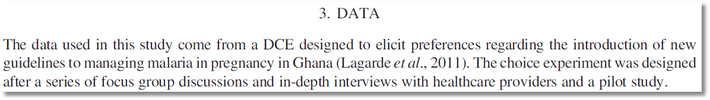
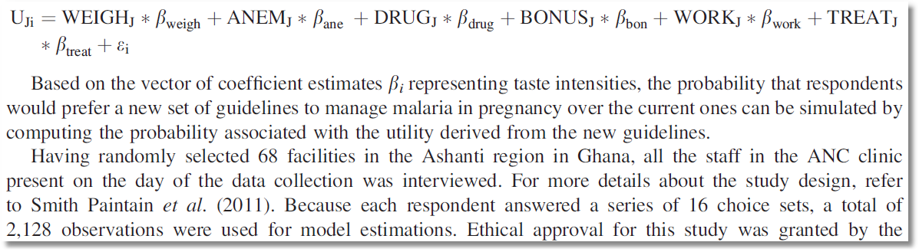
Stated Choice Experiment

Slide 47
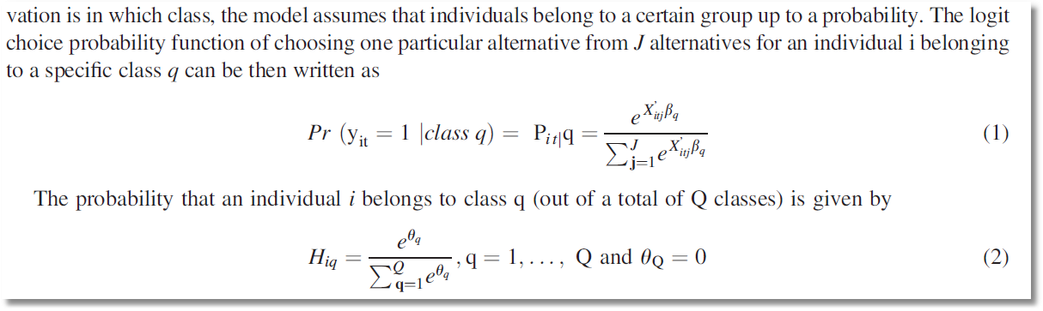
Latent Class Model – Prior Class Probabilities

Slide 48
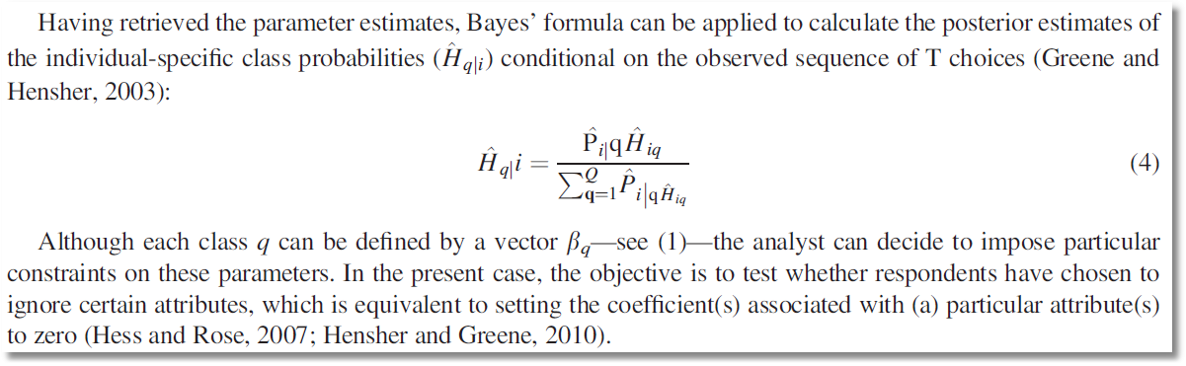
Latent Class Model – Posterior Class Probabilities

Slide 49
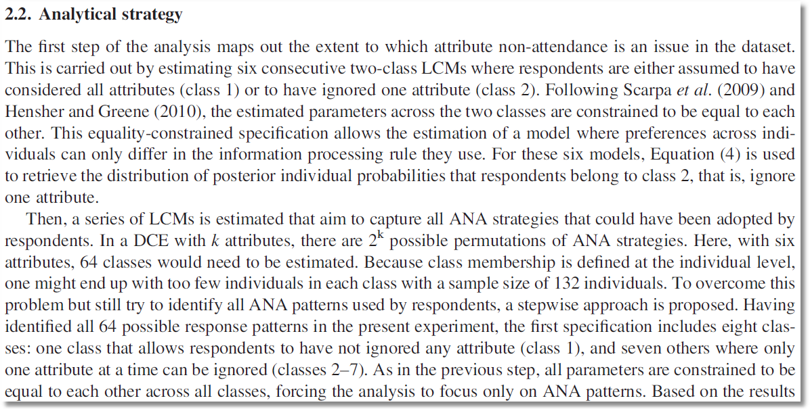
6 attributes implies 64 classes. Strategy to reduce the computational burden on a small sample

Slide 50
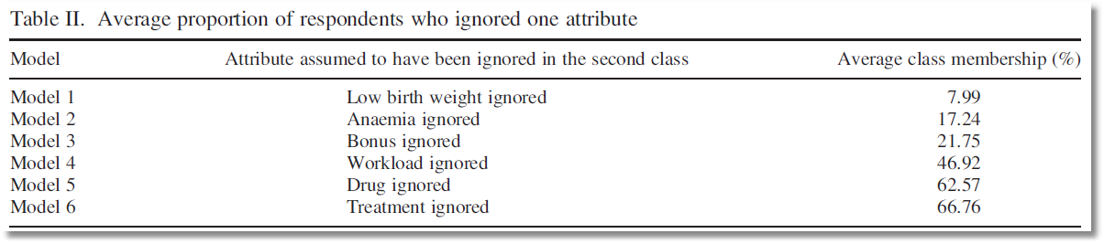
Posterior probabilities of membership in the nonattendance class for 6 models

