Slide 1




Microeconometric Modeling
William Greene
Stern School of Business
New York University
New York NY USA
4.3 Mixed Models and
Random Parameters

Slide 2

Concepts
Models
Random Effects
Simulation
Random Parameters
Maximum Simulated Likelihood
Cholesky Decomposition
Heterogeneity
Hierarchical Model
Conditional Means
Population Distribution
Nested Logit
Willingness to Pay (WTP)
Random Parameters and WTP
WTP Space
Endogeneity
Market Share Data
Random Parameters
RP Logit
Error Components Logit
Generalized Mixed Logit
Berry-Levinsohn-Pakes Model
Hybrid Choice
MIMIC Model

Slide 3
A Recast Random Effects Model

Slide 4
The Entire Parameter Vector is Random

Slide 5
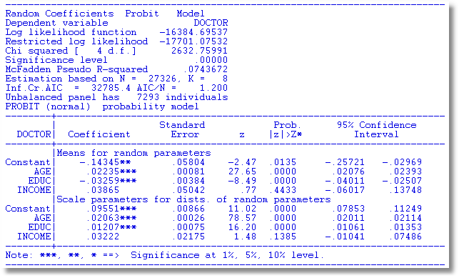
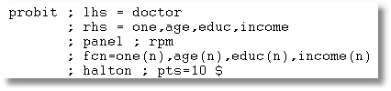

Slide 6
Modeling Parameter Heterogeneity

Slide 7
A Hierarchical Probit Model
U_{it} = β_{1i} + β_{2i}Age_{it} + β_{3i}Educ_{it} + β_{4i}Income_{it} + ε_{it}.
β_{1i}=β₁+Δ₁₁ Female_{i} + Δ₁₂ Married_{i} + u_{1i}
β_{2i}=β₂+Δ₂₁ Female_{i} + Δ₂₂ Married_{i} + u_{2i}
β_{3i}=β₃+Δ₃₁ Female_{i} + Δ₃₂ Married_{i} + u_{3i}
β_{4i}=β₄+Δ₄₁ Female_{i} + Δ₄₂ Married_{i} + u_{4i}
Y_{it} = 1[U_{it} > 0]
All random variables normally distributed.

Slide 8
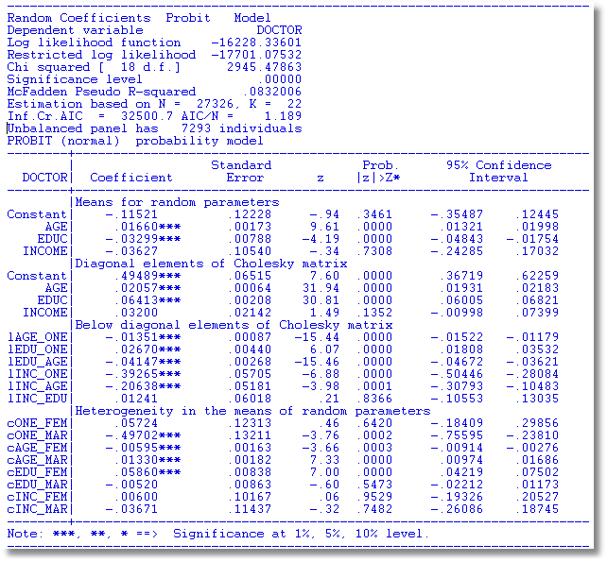

Slide 9
Estimating Individual Parameters
Model estimates = structural parameters, α, β, ρ, Δ, Σ, Γ
Objective, a model of individual specific parameters, β_{i}
Can individual specific parameters be estimated?
  Not quite – β_{i} is a single realization of a random process; one random draw.
  We estimate E[β_{i} | all information about i]
  (This is also true of Bayesian treatments, despite claims to the contrary.)

Slide 10
Estimating β_{i}

Slide 11
Conditional Estimate of β_{i}

Slide 12
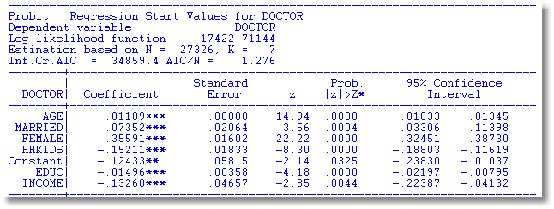

Slide 13
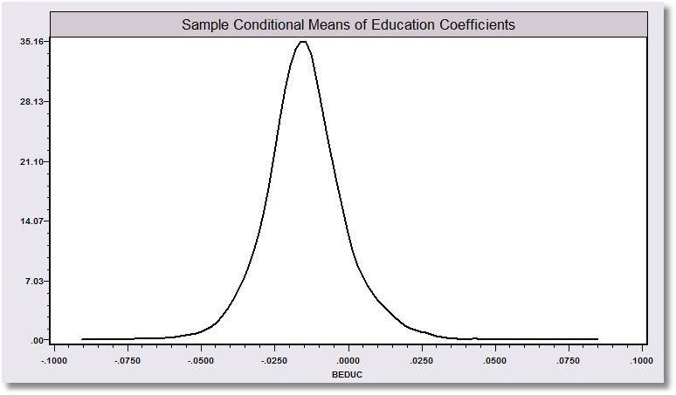
“Individual Coefficients”

Slide 14
The Random Parameters Logit Model
Multiple choice situations: Independent conditioned on the individual specific parameters

Slide 15
Continuous Random Variation in Preference Weights

Slide 16
Customers’ Choice of Energy Supplier
California, Stated Preference Survey
361 customers presented with 8-12 choice situations each
Supplier attributes:
  Fixed price: cents per kWh
  Length of contract
  Local utility
  Well-known company
  Time-of-day rates (11¢ in day, 5¢ at night)
  Seasonal rates (10¢ in summer, 8¢ in winter, 6¢ in spring/fall)
(TrainCalUtilitySurvey.lpj)

Slide 17
Population Distributions
Normal for:
  Contract length
  Local utility
  Well-known company
Log-normal for:
  Time-of-day rates
  Seasonal rates
Price coefficient held fixed

Slide 18
Estimated Model
Estimate Std error
Price -.883 0.050
Contract mean -.213 0.026
std dev .386 0.028
Local mean 2.23 0.127
std dev 1.75 0.137
Known mean 1.59 0.100
std dev .962 0.098
TOD mean* 2.13 0.054
std dev* .411 0.040
Seasonal mean* 2.16 0.051
std dev* .281 0.022
*Parameters of underlying normal.

Slide 19
Distribution of Brand Value
Standard deviation
=2.0¢
10% dislike local utility
0
2.5¢
Brand value of local utility

Slide 20
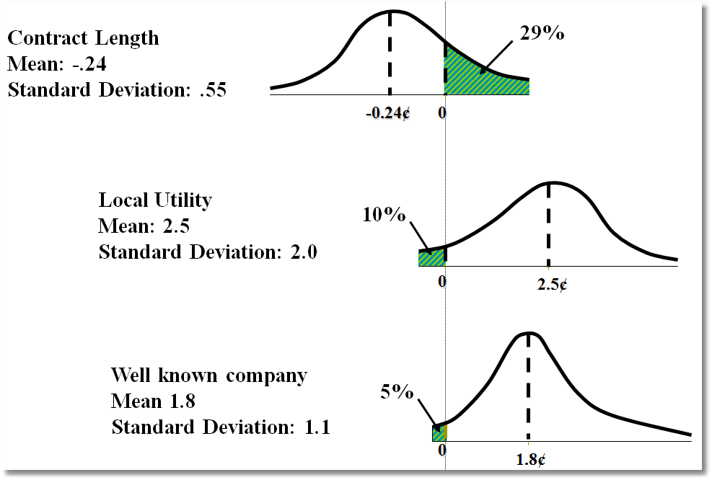
Random Parameter Distributions

Slide 21
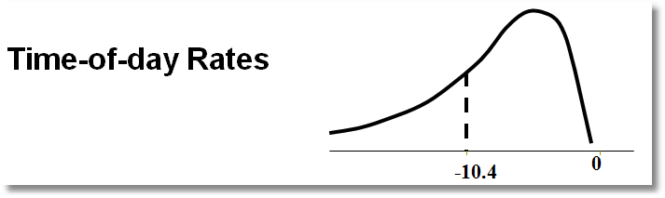
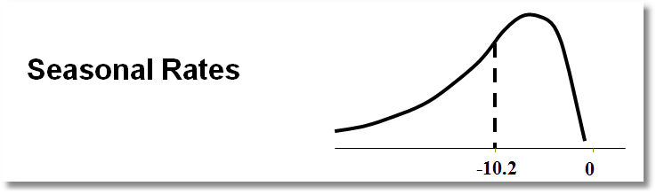
Time of Day Rates (Customers do not like – lognormal coefficient. Multiply variable by -1.)

Slide 22
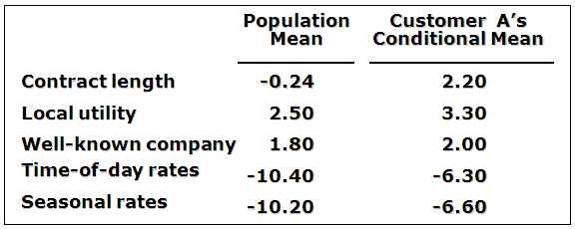
Expected Preferences of Each Customer
Customer likes long-term contract, local utility, and non-fixed rates.
Local utility can retain and make profit from this customer by offering a long-term contract with time-of-day or seasonal rates.

Slide 23
Application: Shoe Brand Choice
Simulated Data: Stated Choice,
  400 respondents,
  8 choice situations, 3,200 observations
3 choice/attributes + NONE
  Fashion = High / Low
  Quality = High / Low
  Price = 25/50/75,100 coded 1,2,3,4
Heterogeneity: Sex (Male=1), Age (<25, 25-39, 40+)
Underlying data generated by a 3 class latent class process (100, 200, 100 in classes)

Slide 24

Stated Choice Experiment: Unlabeled Alternatives, One Observation
t=1
t=2
t=3
t=4
t=5
t=6
t=7
t=8

Slide 25
Random Parameters Logit Model

Slide 26
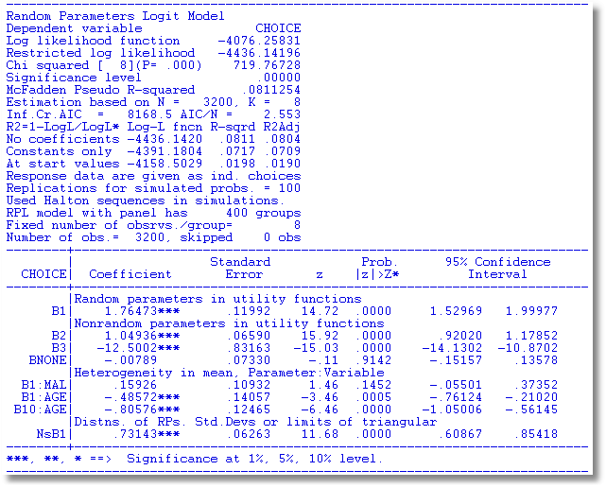

Slide 27
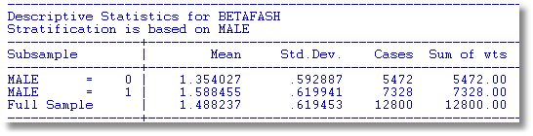
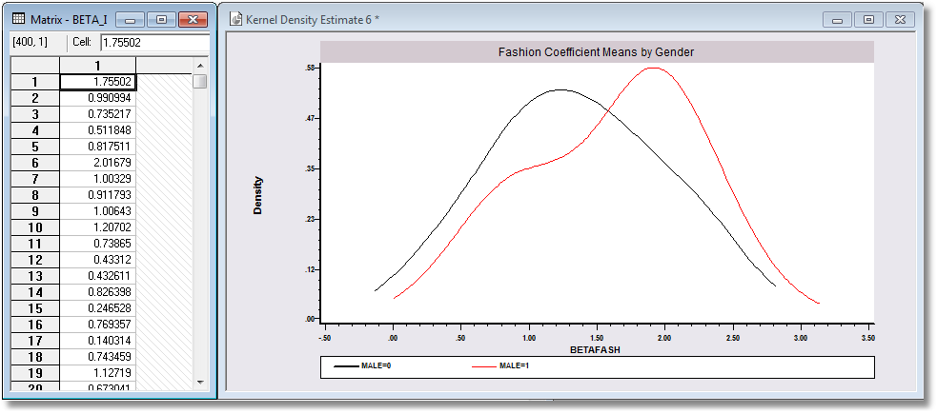

Slide 28
WTP Application (Value of Time Saved)
Estimating Willingness to Pay for Increments to an Attribute in a Discrete Choice Model
WTP = MU(attribute) / MU(Income)
Random

Slide 29
Extending the RP Model to WTP
Use the model to estimate conditional
distributions for any function of
parameters
Willingness to pay = -β_{i,time} / β_{i,cost}
Use simulation method

Slide 30
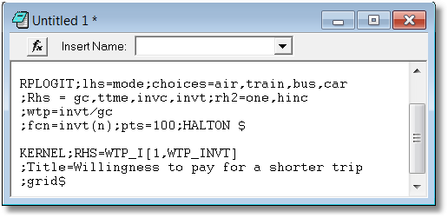
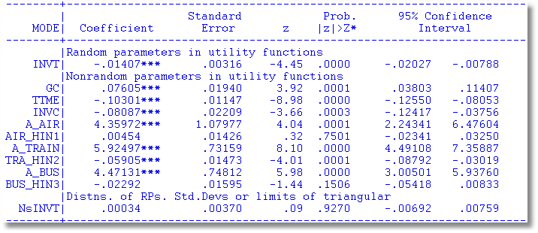

Slide 31
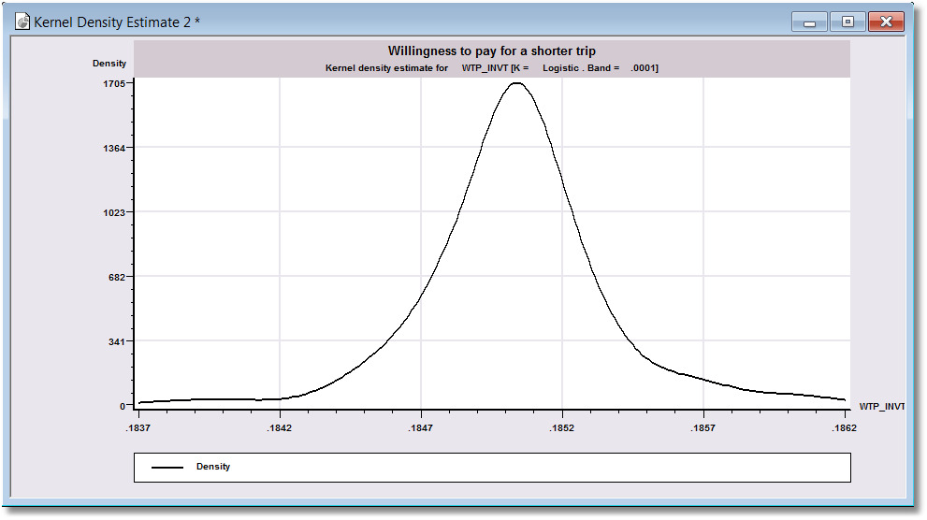
WTP

Slide 32


Slide 33
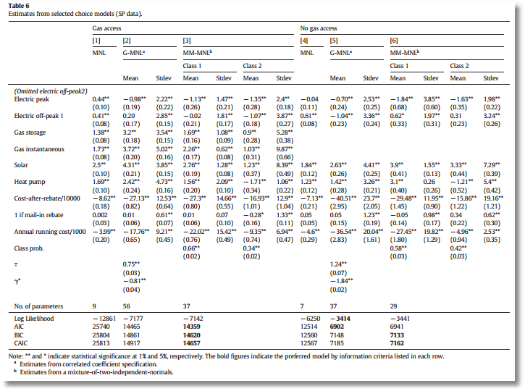

Slide 34
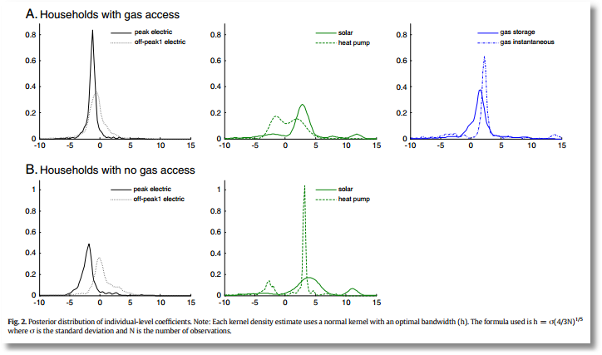

Slide 35
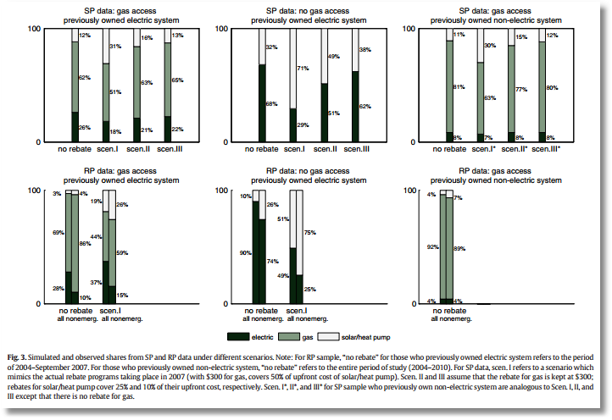

Slide 36


Slide 37
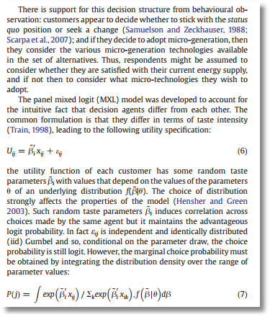
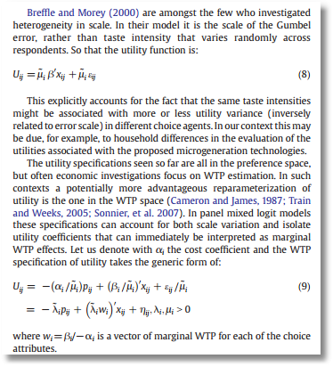

Slide 38


Slide 39
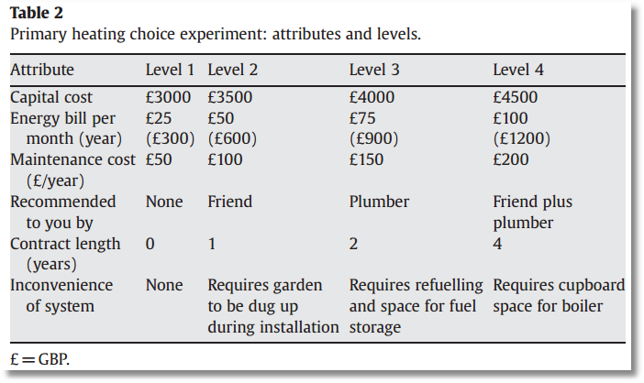

Slide 40
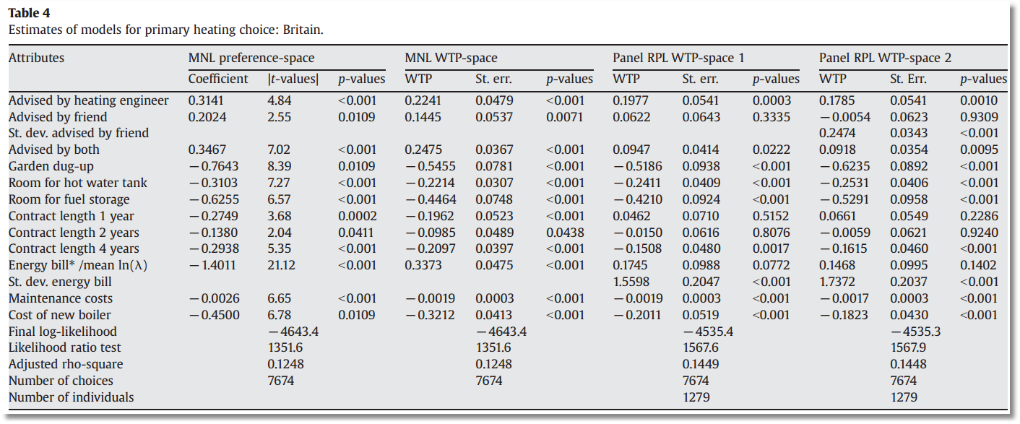

Slide 41
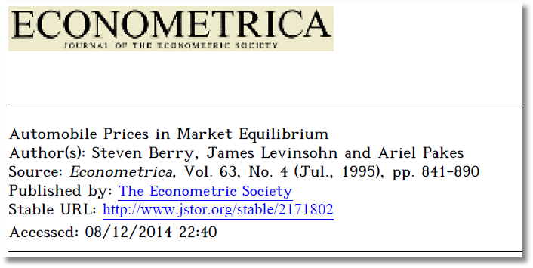
Appendix
Aggregate Data and Multinomial Choice:
The Model of Berry, Levinsohn and Pakes

Slide 42
Resources
Automobile Prices in Market Equilibrium, S. Berry, J. Levinsohn, A. Pakes, Econometrica, 63, 4, 1995, 841-890. (BLP)
  http://people.stern.nyu.edu/wgreene/Econometrics/BLP.pdf
A Practitioner’s Guide to Estimation of Random-Coefficients Logit Models of Demand, A. Nevo, Journal of Economics and Management Strategy, 9, 4, 2000, 513-548
  http://people.stern.nyu.edu/wgreene/Econometrics/Nevo-BLP.pdf
A New Computational Algorithm for Random Coefficients Model with Aggregate-level Data, Jinyoung Lee, UCLA Economics, Dissertation, 2011
  http://people.stern.nyu.edu/wgreene/Econometrics/Lee-BLP.pdf
  Elasticities of Market Shares and Social Health Insurance Choice in Germany: A Dynamic Panel Data Approach, M. Tamm et al., Health Economics, 16, 2007, 243-256.
  http://people.stern.nyu.edu/wgreene/Econometrics/Tamm.pdf

Slide 43
Theoretical Foundation
Consumer market for J differentiated brands of a good
  j =1,…, J_{t} brands or types
  i = 1,…, N consumers
  t = i,…,T “markets” (like panel data)
Consumer i’s utility for brand j (in market t) depends on
  p = price
  x = observable attributes
  f = unobserved attributes
  w = unobserved heterogeneity across consumers
  ε = idiosyncratic aspects of consumer preferences
Observed data consist of aggregate choices, prices and features of the brands.

Slide 44
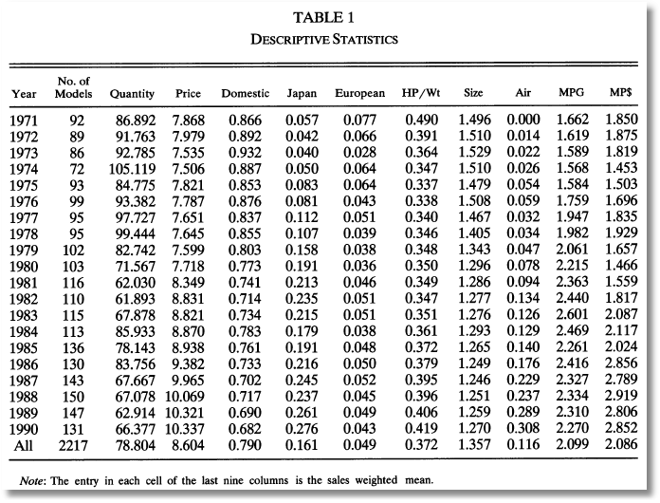
BLP Automobile Market
J_{t}
t

Slide 45
Random Utility Model
Utility: U_{ijt}=U(w_{i},p_{jt},x_{jt},f_{jt}|θ), i = 1,…,(large)N, j=1,…,J
  w_{i} = individual heterogeneity; time (market) invariant. w has a continuous distribution across the population.
  p_{jt}, x_{jt}, f_{jt}, = price, observed attributes, unobserved features of brand j; all may vary through time (across markets)
Revealed Preference: Choice j provides maximum utility
Across the population, given market t, set of prices p_{t} and features (X_{t},f_{t}), there is a set of values of w_{i} that induces choice j, for each j=1,…,J_{t}; then, s_{j}(p_{t},X_{t},f_{t}|θ) is the market share of brand j in market t.
There is an outside good that attracts a nonnegligible market share, j=0. Therefore,

Slide 46
Functional Form
(Assume one market for now so drop “’t.”)
U_{ij}=U(w_{i},p_{j},x_{j},f_{j}|θ)= x_{j}'β – αp_{j} + f_{j} + ε_{ij}
= δ_{j} + ε_{ij}
E_{consumers i}[ε_{ij}] = 0, δ_{j} is E[Utility].
Will assume logit form to make integration unnecessary. The expectation has a closed form.

Slide 47
Heterogeneity
Assumptions so far imply IIA. Cross price elasticities depend only on market shares.
Individual heterogeneity: Random parameters
U_{ij}=U(w_{i},p_{j},x_{j},f_{j}|θ_{i})= x_{j}'β_{i} – αp_{j} + f_{j} + ε_{ij}
β_{ik} = β_{k} + σ_{k}v_{ik}.
The mixed model only imposes IIA for a particular consumer, but not for the market as a whole.

Slide 48
Endogenous Prices: Demand side
U_{ij}=U(w_{i},p_{j},x_{j},f_{j}|θ)= x_{j}'β_{i} – αp_{j} + f_{j} + ε_{ij}
f_{j} is unobserved
Utility responds to the unobserved f_{j}
Price p_{j} is partly determined by features f_{j}.
In a choice model based on observables, price is correlated with the unobservables that determine the observed choices.

Slide 49
Endogenous Price: Supply Side
There are a small number of competitors in this market
Price is determined by firms that maximize profits given the features of its products and its competitors.
mc_{j} = g(observed cost characteristics c,
unobserved cost characteristics h)
At equilibrium, for a profit maximizing firm that produces one product,
s_{j} + (p_{j}-mc_{j})∂s_{j}/∂p_{j} = 0
Market share depends on unobserved cost characteristics as well as unobserved demand characteristics, and price is correlated with both.

Slide 50
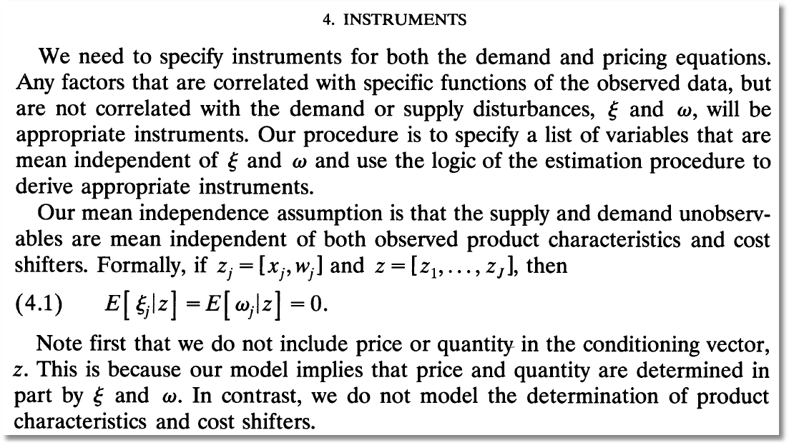
Instrumental Variables
(ξ and ω are our h and f.)

Slide 51
Econometrics: Essential Components

Slide 52
Econometrics

Slide 53
GMM Estimation Strategy - 1

Slide 54
GMM Estimation Strategy - 2

Slide 55
BLP Iteration

Slide 56

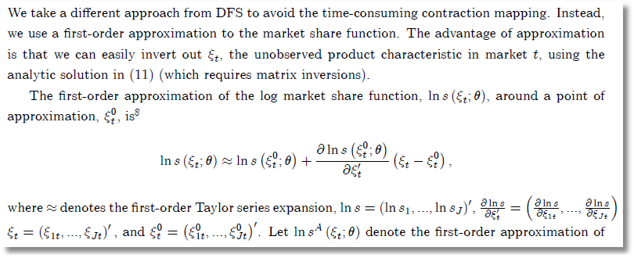
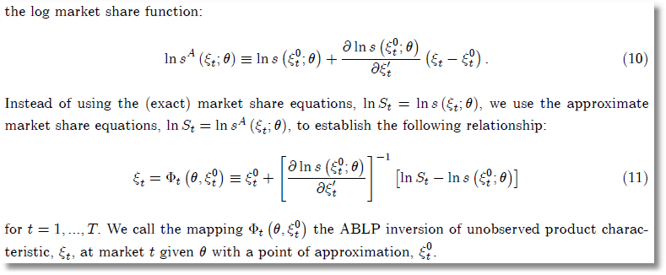
ABLP Iteration
ξ_{t} is
our f_{t}.
θ is our
(β,Σ)
No superscript is our (M); superscript 0 is our (M-1).

Slide 57
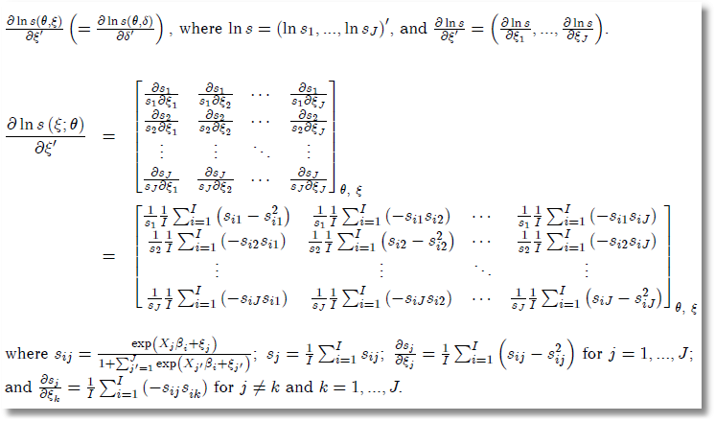
Side Results

Slide 58
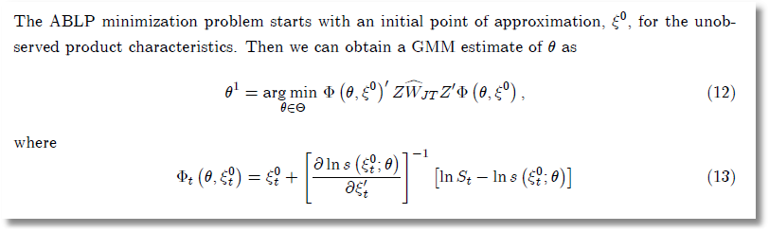
ABLP Iterative Estimator

Slide 59
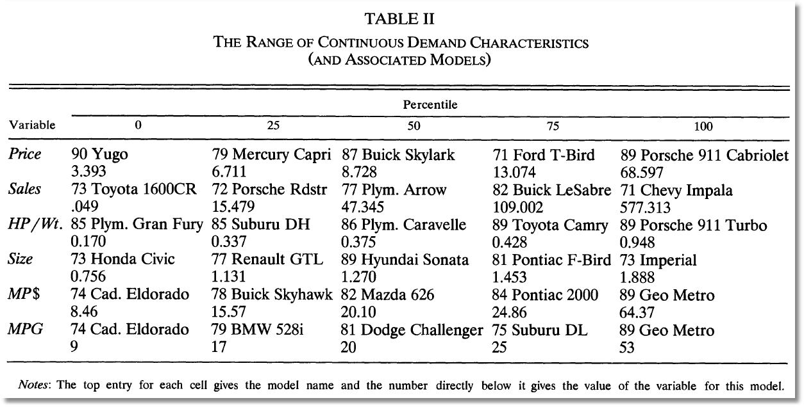
BLP Design Data

Slide 60
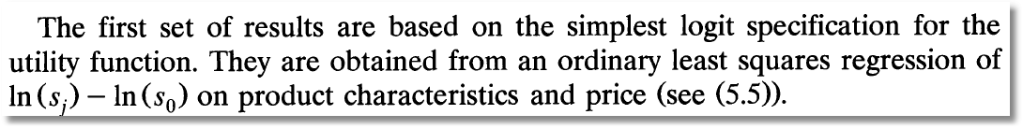
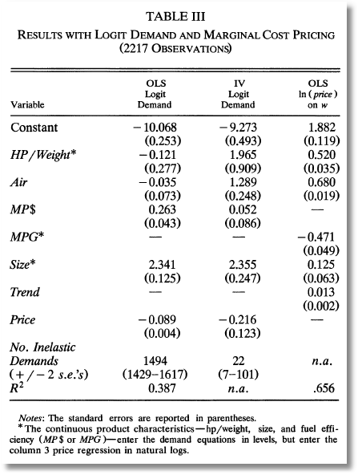
Exogenous price and nonrandom parameters

Slide 61
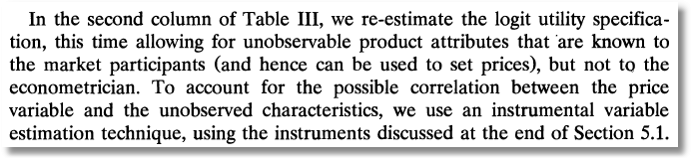
IV Estimation

Slide 62
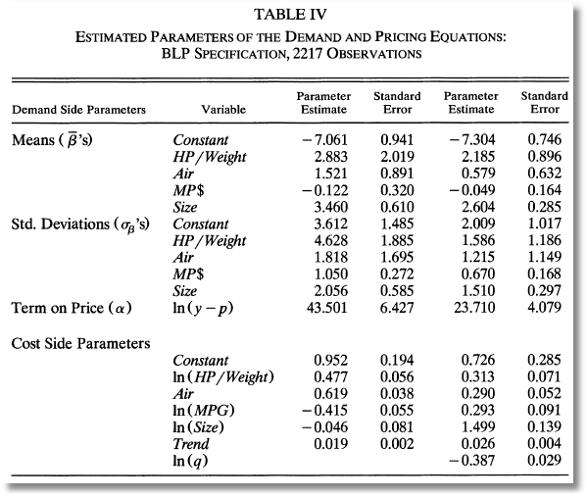
Full Model

Slide 63
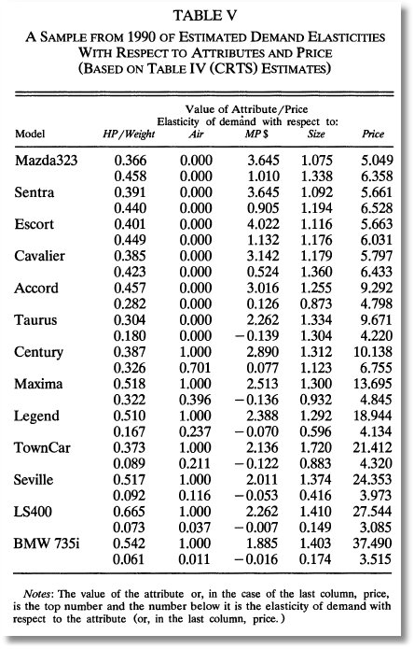
Some Elasticities

