Slide 1




Microeconometric Modeling
William Greene
Stern School of Business
New York University
New York NY USA
5.1 Modeling Stated
Preference Data

Slide 2

Concepts
Models
Revealed Preference
Stated Preference
Attribute Nonattendance
Random Utility
Attribute Space
Experimental Design
Choice Experiment
Environmental Attitude
Multinomial Logit Model
Latent Class MNL
Nested Logit
Mixed Logit
Error Components Logit

Slide 3
Revealed Preference Data
Advantage: Actual observations on actual behavior
  Market (ex-post, e.g., supermarket scanner data)
  Individual observations
Disadvantage: Limited range of choice sets and attributes – does not allow analysis of switching behavior.

Slide 4
Stated Preference Data
Purely hypothetical – does the subject take it seriously?
No necessary anchor to real market situations
Vast heterogeneity across individuals
  E.g., contingent valuation

Slide 5
Strategy
Repeated choice situations to explore the attribute space
Typically combined RP/SP constructions
  Mixed data
  Expanded choice sets
Accommodating “panel data”
  Multinomial Probit [marginal, impractical]
  Latent Class
  Mixed Logit

Slide 6
Application: Shoe Brand Choice
Simulated Data: Stated Choice,
  400 respondents,
  8 choice situations, 3,200 observations
3 choice/attributes + NONE
  Fashion = High / Low
  Quality = High / Low
  Price = 25/50/75,100 coded 1,2,3,4
Heterogeneity: Sex (Male=1), Age (<25, 25-39, 40+)
Underlying data generated by a 3 class latent class process (100, 200, 100 in classes)

Slide 7

Stated Choice Experiment: Unlabeled Alternatives, One Observation
t=1
t=2
t=3
t=4
t=5
t=6
t=7
t=8

Slide 8

Application: Pregnancy Care Guidelines

Slide 9
Application: Travel Mode
Survey sample of 2,688 trips, 2 or 4 choices per situation
Sample consists of 672 individuals
Choice based sample
Revealed/Stated choice experiment:
Revealed: Drive,ShortRail,Bus,Train
Hypothetical: Drive,ShortRail,Bus,Train,LightRail,ExpressBus
Attributes:
Cost –Fuel or fare
Transit time
Parking cost
Access and Egress time

Slide 10
Customers’ Choice of Energy Supplier
California, Stated Preference Survey
361 customers presented with 8-12 choice situations each
Supplier attributes:
  Fixed price: cents per kWh
  Length of contract
  Local utility
  Well-known company
  Time-of-day rates (11¢ in day, 5¢ at night)
  Seasonal rates (10¢ in summer, 8¢ in winter, 6¢ in spring/fall)

Slide 11
Combining RP and SP Data Sets - 1
Enrich the attribute set by replicating choices
E.g.:
  RP: Bus,Car,Train (actual)
  SP: Bus(1),Car(1),Train(1)
  Bus(2),Car(2),Train(2),…
How to combine?

Slide 12
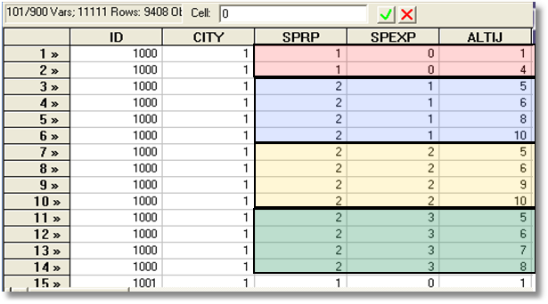
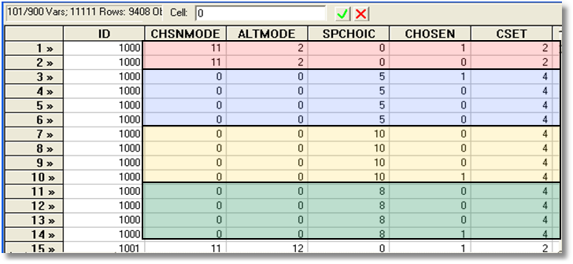
Each person makes four choices from a choice set that includes either two or four alternatives.
The first choice is the RP between two of the RP alternatives
The second-fourth are the SP among four of the six SP alternatives.
There are ten alternatives in total.

Slide 13

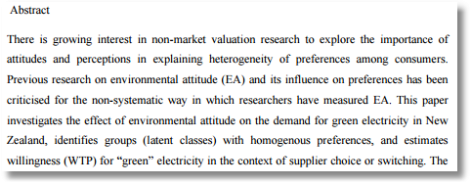
Willingness to Pay for Green Energy

Slide 14
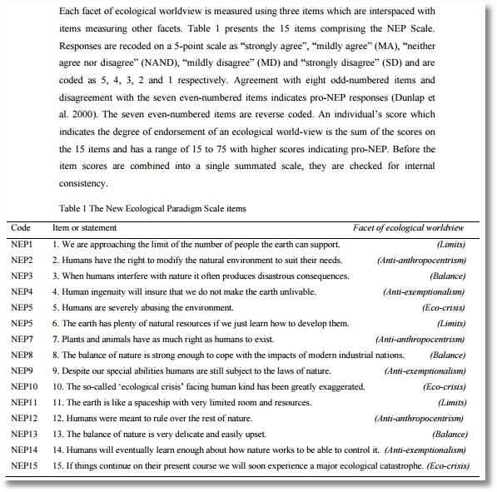

Slide 15
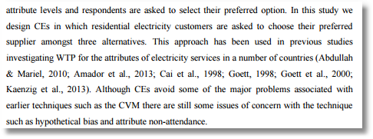

Slide 16
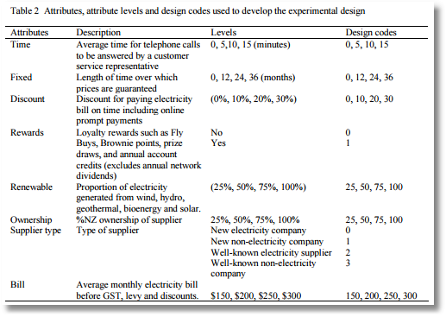

Slide 17
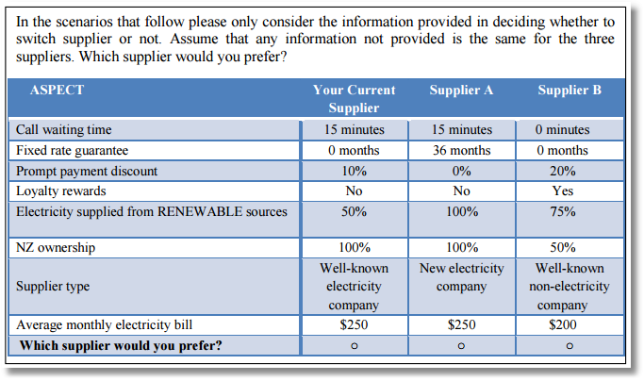

Slide 18
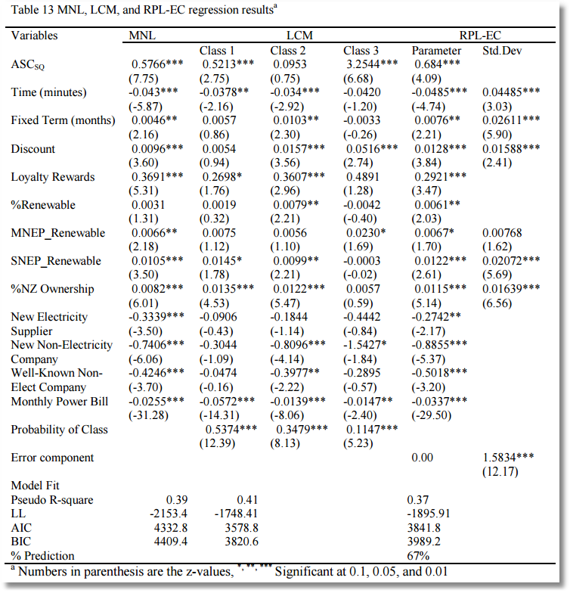

Slide 19
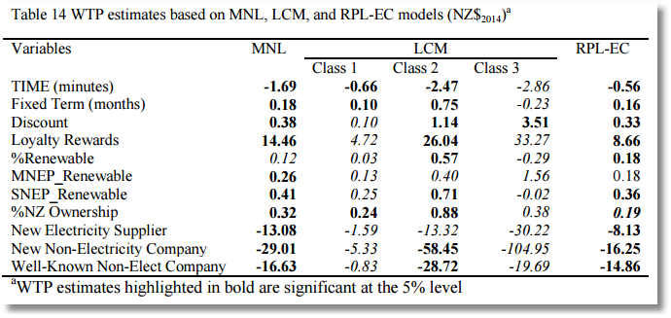

Slide 20
Stated Choice Experiment: Travel
Mode by Sydney Commuters

