Slide 1
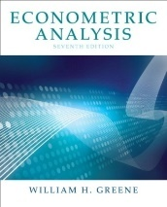

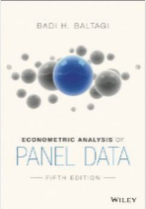
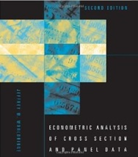
Microeconometric Modeling
William Greene
Stern School of Business
New York University
New York NY USA
5.2 Discrete Choice Models
for Spatial Data

Slide 2
Concepts
Models
Spatial Data
Spatial Autocorrelation
Spatial Autoregression
GLS
Panel Data
Nonlinear Model
Random Utility
Count Data
Copula Function
Onobservables
Spatial Weight Matrix
Binary Choice
LM Test
Pesudo Maximum Likelihood
Partial Maximum Likelihood
Random Parameters
Spatial Regression
Probit
Dynamic Probit
Logit
Heteroscedastic Probit
Spatial Probit
Bivariate Probit
Ordered Probit
Multinomial Logit
Poisson Regression
Zero Inflation Model
Sample Selection Model
Stochastic Frontier

Slide 3
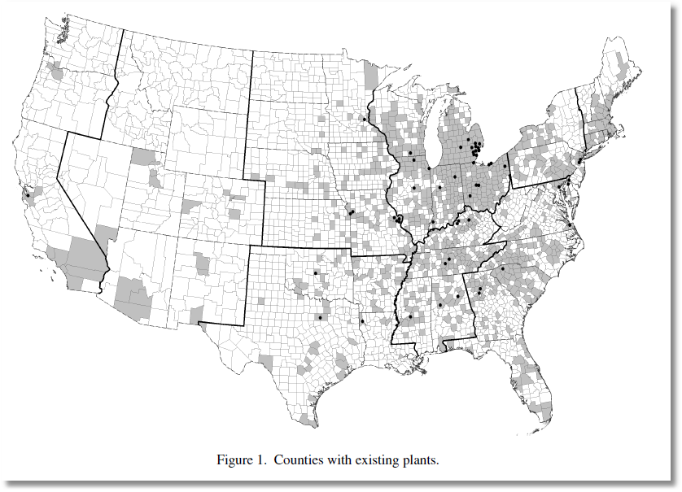
Y=1[New Plant Located in County]
Klier and McMillen: Clustering of Auto Supplier Plants in the United States. JBES, 2008

Slide 4
Outcome Models for Spatial Data
❶ Spatial Regression Models
❷ Estimation and Analysis
❸ Nonlinear Models and Spatial Regression
❹ Nonlinear Models: Specification, Estimation
  Discrete Choice: Binary, Ordered, Multinomial, Counts
  Sample Selection
  Stochastic Frontier

Slide 5
Spatial Autocorrelation

Slide 6
Spatial Autocorrelation in Regression

Slide 7
Spatial Autoregression in a Linear Model

Slide 8
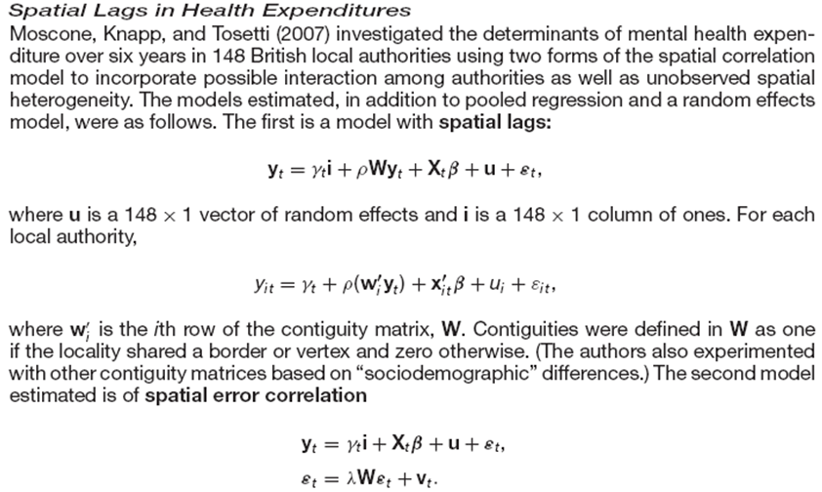
Spatial Autocorrelation in a Panel

Slide 9
Modeling Discrete Outcomes
❶ “Dependent Variable” typically labels an outcome
  No quantitative meaning
  Conditional relationship to covariates
❷ No “regression” relationship in most cases.
• Models are often not conditional means.
• The “model” is usually a probability
❸ Nonlinear models – usually not estimated by any type
of linear least squares

Slide 10
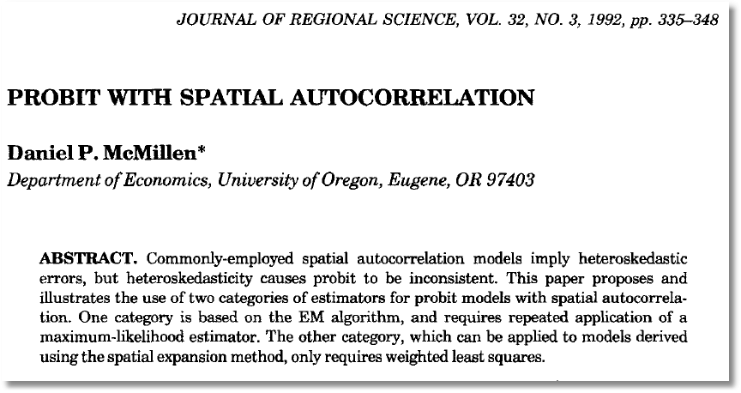

Slide 13
GMM
Pinske, J. and Slade, M., (1998) “Contracting in Space: An Application of Spatial Statistics to Discrete Choice Models,” Journal of Econometrics, 85, 1, 125-154.
Pinkse, J. , Slade, M. and Shen, L (2006) “Dynamic Spatial Discrete Choice Using One Step GMM: An Application to Mine Operating Decisions”, Spatial Economic Analysis, 1: 1, 53 — 99.

Slide 14
GMM

Slide 15

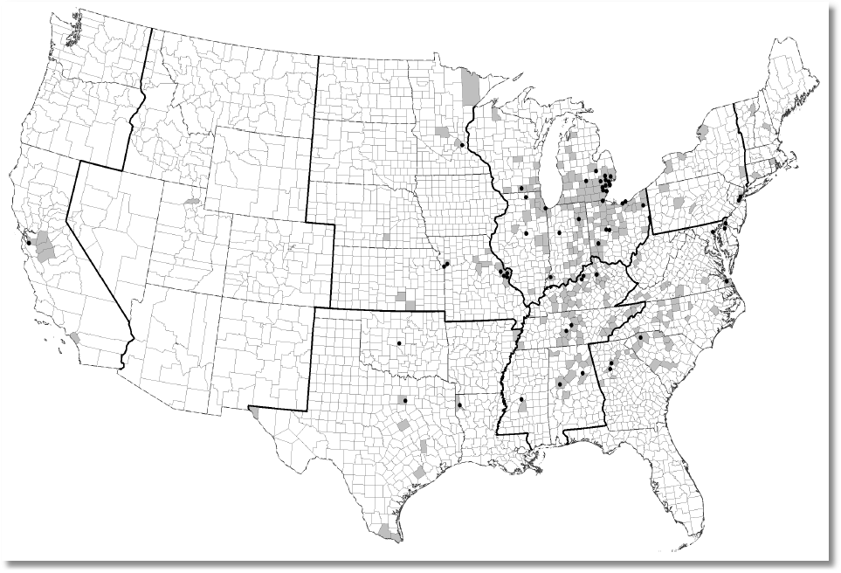

Slide 19
LM Test?
If  = 0, g = 0 because A_{ii} = 0
At the initial logit values, g = 0
Thus, if  = 0, g = 0
How to test  = 0 using an LM style test.
Same problem shows up in RE models
But, here,  is in the interior of the parameter space!

Slide 20
A Spatial Ordered Choice Model
Wang, C. and Kockelman, K., (2009) Bayesian Inference for Ordered Response Data with a Dynamic Spatial Ordered Probit Model, Working Paper, Department of Civil and Environmental Engineering, Bucknell University.

Slide 21

An Ordered Probability Model

Slide 22
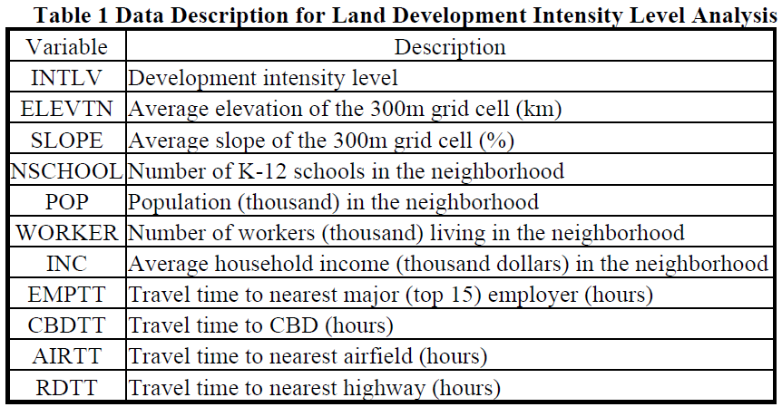
OCM for Land Use Intensity

Slide 23
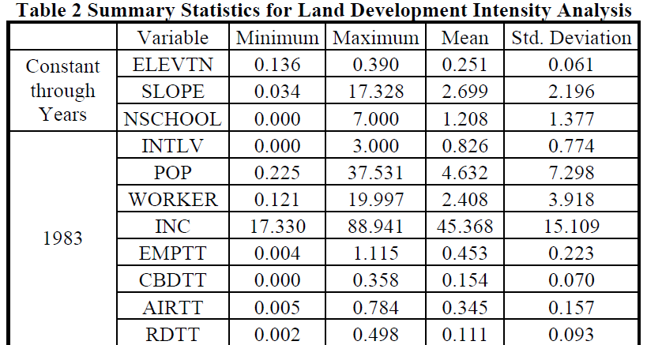
OCM for Land Use Intensity

Slide 24
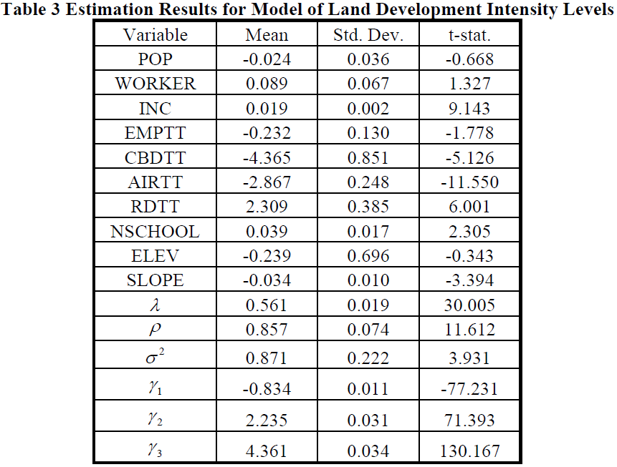
Estimated Dynamic OCM

Slide 25

Unordered Multinomial Choice

Slide 26
Spatial Multinomial Probit
Chakir, R. and Parent, O. (2009) “Determinants of land use changes: A spatial multinomial probit approach, Papers in Regional Science, 88, 2, 328-346.

Slide 27
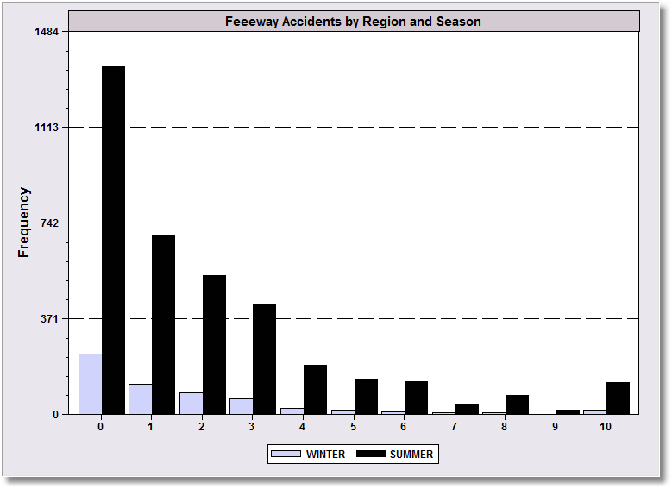
Canonical Model
Rathbun, S and Fei, L (2006) “A Spatial Zero-Inflated Poisson Regression Model for Oak Regeneration,” Environmental Ecology Statistics, 13, 2006, 409-426

Slide 28
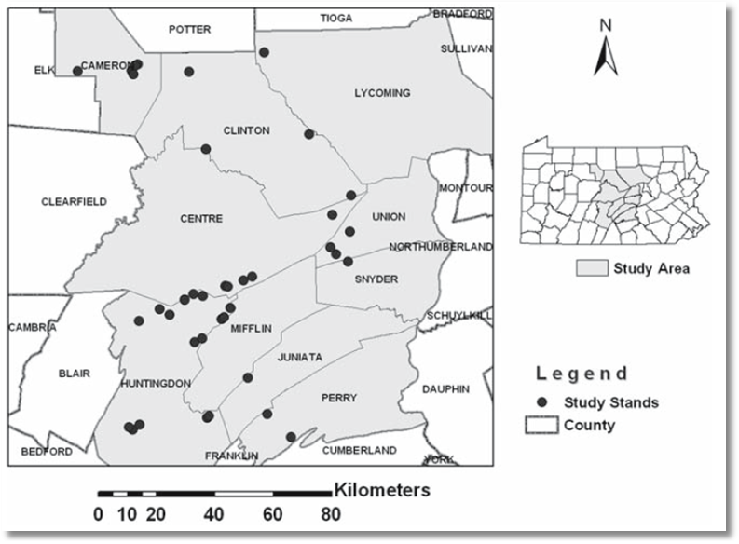
Canonical Model for Counts
Rathbun, S and Fei, L (2006) “A Spatial Zero-Inflated Poisson Regression Model for Oak Regeneration,” Environmental Ecology Statistics, 13, 2006, 409-426

Slide 29
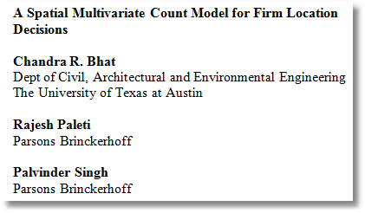
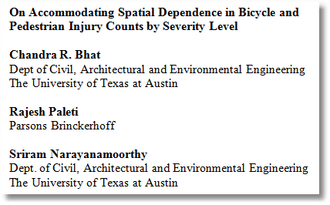
A Blend of Ordered Choice and Count Data Models
Numbers of firms locating in Texas counties: Count data (Poisson)
Bicycle and pedestrian injuries in census tracts in Manhattan. (Count data and ordered outcomes)

Slide 30
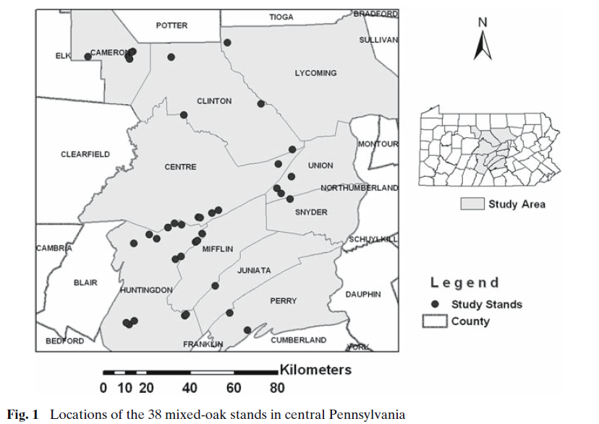

Slide 31
