Slide 1
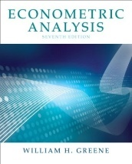

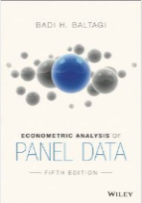
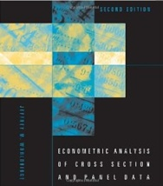
Microeconometric Modeling
William Greene
Stern School of Business
New York University
New York NY USA

Slide 2

Concepts
Models
Theoretical Specification
Estimation
  Maximum Likelihood
  Simulated Maximum Likelihood
  Generalized Method of Moments
Inference: Robust
Specification Analysis
Prediction and Simulation
Linear Model
Binary Choice
Ordered Choice
Models for Count Data
Multinomial Choice
Models for Spatial Data
Mixed and Random Parameters
Latent Class Models
Cross Section
Panel Data

Slide 3
Agenda
Applications from: Health Economics, Transport, Environmental Economics, Industrial Organization, Labor Markets
1.1| Descriptive Statistics and the Linear Model
1.2| Bootstrapping, Quantile Regression, Stochastic Frontier
1.3| Panel Data, Fixed and Random Effects, Clustering, Robust Inference
2.1| Binary Choice Models, Probit and Logit
2.2| Inference in Nonlinear Models, Delta Method, Krinsky and Robb
2.3| Nonlinear Panel Data Models, Random Effects, Incidental Parameters
3.1| Models for Ordered Choices, Ordered Probit, Hierarchical Models
3.2| Models for Count Data, Poisson, Negative Binomial, Zero Inflation
3.3| Multinomial Choice, Multinomial Logit, Fixed Effects, Best/Worst
4.1| Nested Logit, Multinomial Probit, Error Components Logit
4.2| Latent Class Models, Attribute Nonattendance
4.3| Mixed Models and Random Parameters
5.1| Stated Preference Data, Stated and Revealed Preference
5.2| Models for Spatial Data, Linear Regression, Discrete Choice

