Slide 1




Microeconometric Modeling
William Greene
Stern School of Business
New York University
New York NY USA
1.1 Descriptive Statistics
and Linear Regression

Slide 2
Data Description
Linear Regression Model
Basic Statistics
Tables
Histogram
Box Plot
Histogram
Kernel Density Estimator
Linear Model
Specification & Estimation
  Nonlinearities
  Interactions
Inference - Testing
  Wald
  F
  LM
Prediction and Model Fit
Endogeneity
  2SLS
  Control Function
  Hausman Test

Slide 3
Cornwell and Rupert Panel Data
Cornwell and Rupert Returns to Schooling Data, 595 Individuals, 7 Years
Variables in the file are
EXP = work experience
WKS = weeks worked
OCC = occupation, 1 if blue collar,
IND = 1 if manufacturing industry
SOUTH = 1 if resides in south
SMSA = 1 if resides in a city (SMSA)
MS = 1 if married
FEM = 1 if female
UNION = 1 if wage set by union contract
ED = years of education
LWAGE = log of wage = dependent variable in regressions
These data were analyzed in Cornwell, C. and Rupert, P., "Efficient Estimation with Panel Data: An Empirical Comparison of Instrumental Variable Estimators," Journal of Applied Econometrics, 3, 1988, pp. 149-155.
Notes:
3

Slide 4


Slide 5
Objective: Impact of Education on (log) Wage
Specification: What is the right model to use to analyze this association?
Estimation
Inference
Analysis

Slide 6
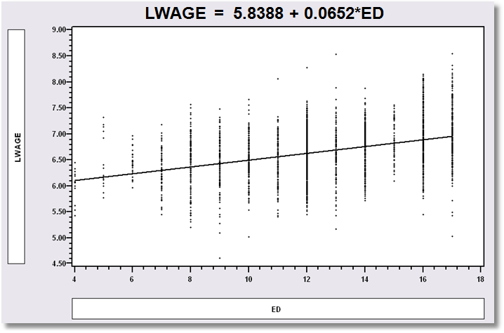
Simple Linear Regression
LWAGE = 5.8388 + 0.0652*ED

Slide 7
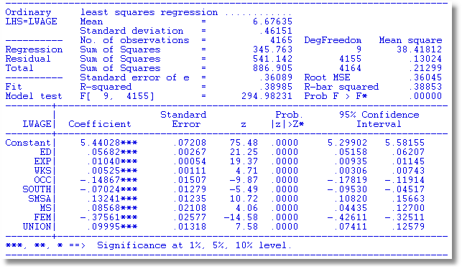
Multiple Regression

Slide 8

Nonlinear Specification:
Quadratic Effect of Experience

Slide 9
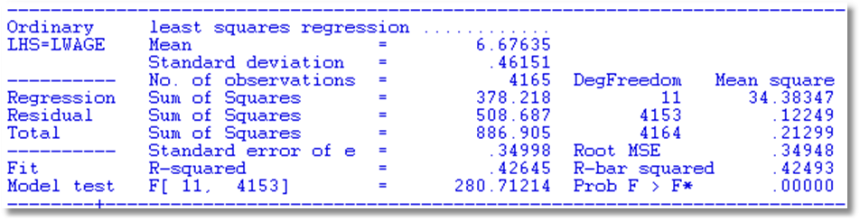
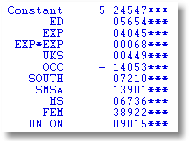
Partial Effects
Coefficients do not tell the story
Education: .05654
Experience .04045 - 2*.00068*Exp
FEM -.38922

Slide 10
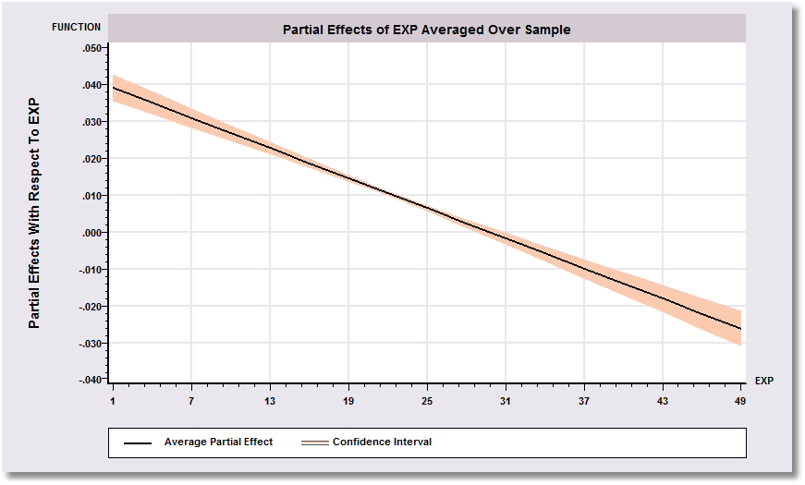
Effect of Experience = .04045 - 2*.00068*Exp
Positive from 1 to 30, negative after.

Slide 11
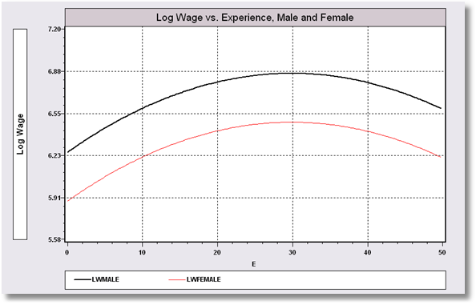
Model Implication: Effect of Experience and Male vs. Female

Slide 12
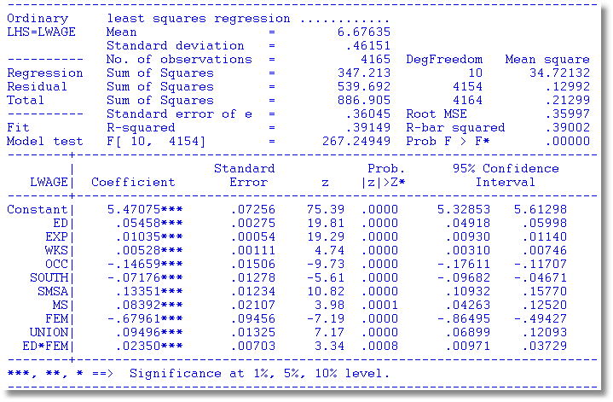
Interaction Effect
Gender Difference in Partial Effects

Slide 13
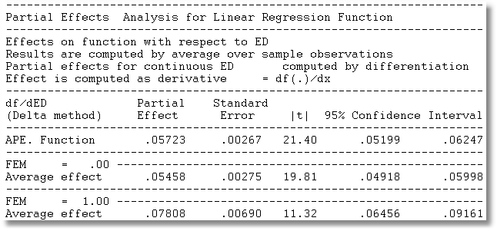
Partial Effect of a Year of Education
∂E[logWage]/∂ED=β_{ED} + β_{ED*FEM} *FEM
Note, the effect is positive.
Effect is larger for women.

Slide 14
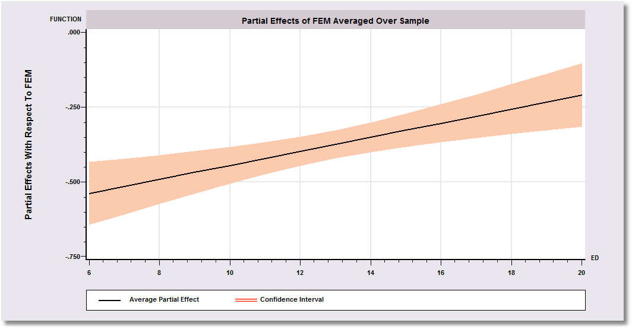
Gender Effect Varies by Years of Education

Slide 15
Endogeneity
y = Xβ+ε,
Definition: E[ε|x]≠0
Why not? The most common reasons:
  Omitted variables
  Unobserved heterogeneity (equivalent to omitted variables)
  Measurement error on the RHS (equivalent to omitted variables)
  Endogenous sampling and attrition

Slide 16
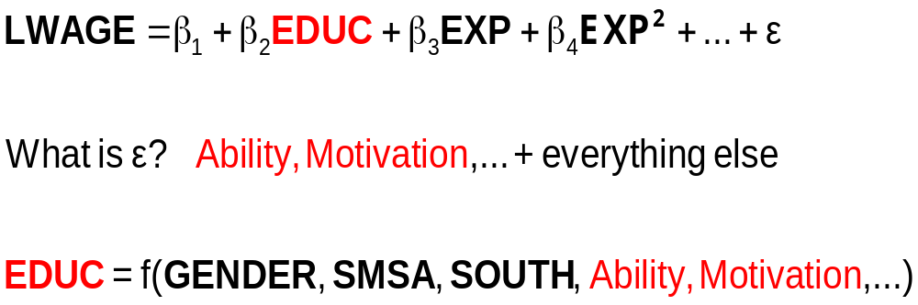
The Effect of Education on LWAGE

Slide 17
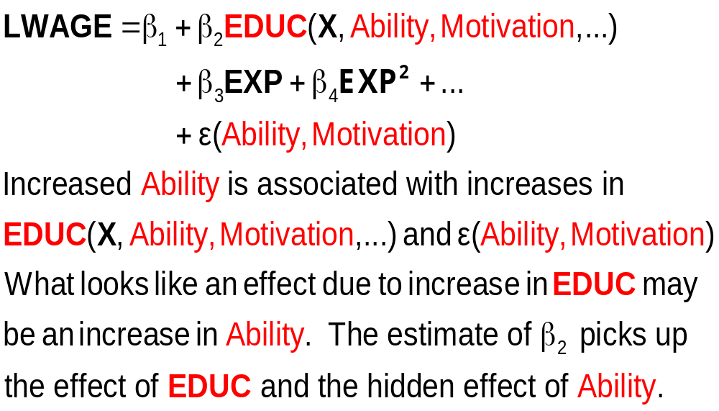
What Influences LWAGE?

Slide 18
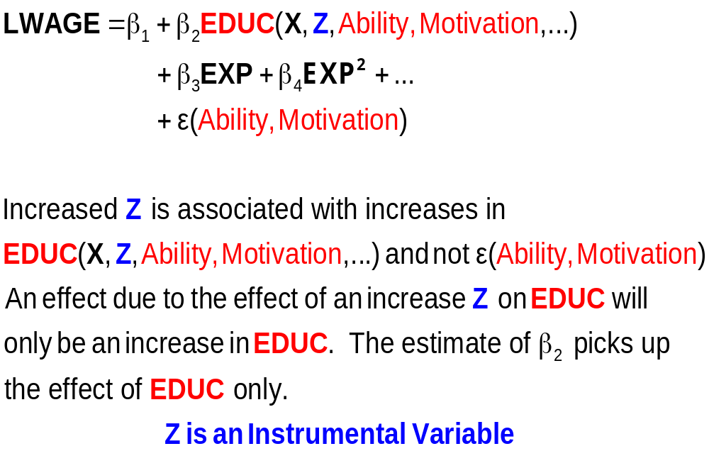
An Exogenous Influence

Slide 19
Instrumental Variables
Structure
  LWAGE (ED,EXP,EXPSQ,WKS,OCC,
  SOUTH,SMSA,UNION)
  ED (MS, FEM)
  Reduced Form:
  LWAGE[ ED (MS, FEM),
  EXP,EXPSQ,WKS,OCC,
  SOUTH,SMSA,UNION ]

Slide 20
Two Stage Least Squares Strategy
  Reduced Form:
  LWAGE[ ED (MS, FEM,X),
  EXP,EXPSQ,WKS,OCC,
  SOUTH,SMSA,UNION ]
Strategy
  (1) Purge ED of the influence of everything but MS,
  FEM (and the other variables). Predict ED using all
  exogenous information in the sample (X and Z).
  (2) Regress LWAGE on this prediction of ED and
  everything else.
  Standard errors must be adjusted for the predicted ED

Slide 21
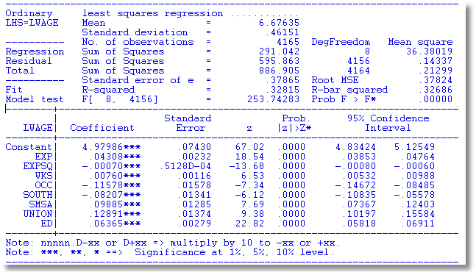
OLS

Slide 22
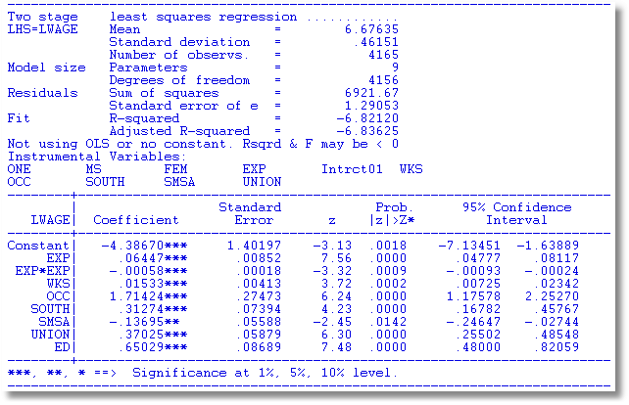
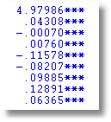
The extreme result for the coefficient on ED is probably due to the fact that the instruments, MS and FEM are dummy variables. There is not enough variation in these variables.

Slide 23
Source of Endogeneity
  LWAGE = f(ED,
  EXP,EXPSQ,WKS,OCC,
  SOUTH,SMSA,UNION) + ε
  ED = f(MS,FEM,
  EXP,EXPSQ,WKS,OCC,
  SOUTH,SMSA,UNION) + u

Slide 24
Remove the Endogeneity by Using a Control Function
  LWAGE = f(ED,
  EXP,EXPSQ,WKS,OCC,
  SOUTH,SMSA,UNION) + u + ε
  LWAGE = f(ED,
  EXP,EXPSQ,WKS,OCC,
  SOUTH,SMSA,UNION) + u + ε
  Strategy
    Estimate u
    Add u to the equation. ED is uncorrelated with ε when u is in the equation.

Slide 25
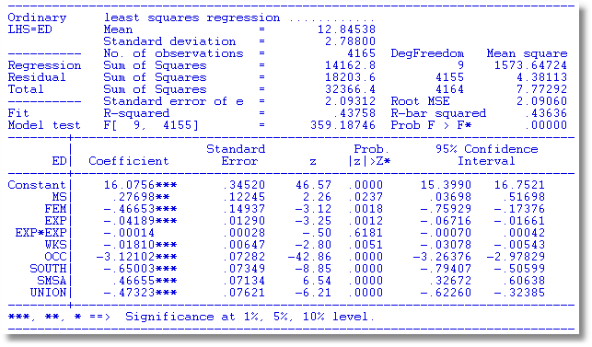
Auxiliary Regression for
ED to Obtain Residuals

Slide 26
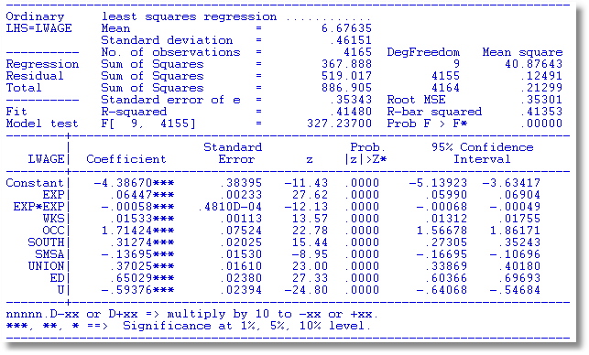
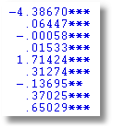
OLS with Residual (Control Function) Added
2SLS

Slide 27
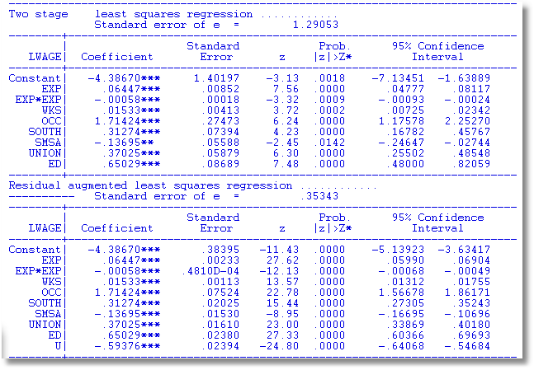
A Warning About Control Functions
Sum of squares is not computed correctly because U is in the regression.
A general result. Control function estimators usually require a fix to the estimated covariance matrix for the estimator.

Slide 28
An Endogeneity Test? (Hausman)
Exogenous Endogenous
OLS Consistent, Efficient Inconsistent
2SLS Consistent, Inefficient Consistent
Base a test on d = b_{2SLS} - b_{OLS}
Use a Wald statistic, d’[Var(d)]⁻¹d
What to use for the variance matrix?
Hausman: V_{2SLS} - V_{OLS}

Slide 29
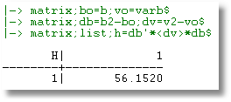
Hausman Test
Chi squared with 1 degree of freedom

Slide 30
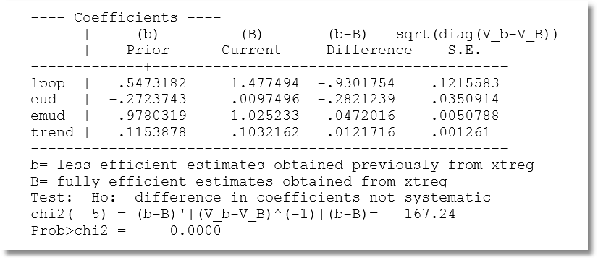
Hausman Test: One at a Time?

Slide 31

Endogeneity Test: Wu
Considerable complication in Hausman test (Greene (2012), pp. 234-237)
Simplification: Wu test.
Regress y on X and estimated for the endogenous part of X. Then use an ordinary Wald test.
Variable addition test

Slide 32
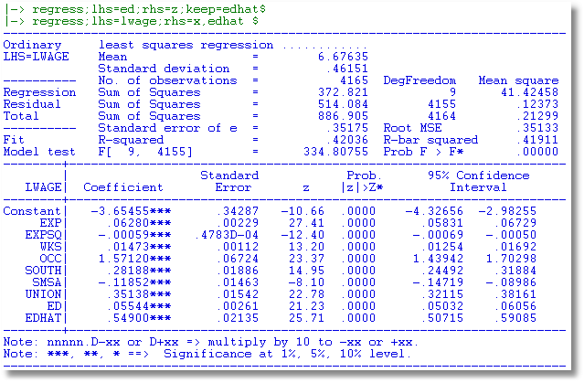
Wu Test

