Slide 1




Microeconometric Modeling
William Greene
Stern School of Business
New York University
New York NY USA
1.2 Extensions of the
Linear Regression
Model

Slide 2

Concepts
Models
Multiple Imputation
Robust Covariance Matrices
Bootstrap
Maximum Likelihood
Method of Moments
Estimating Individual Outcomes
Linear Regression Model
Quantile Regression
Stochastic Frontier

Slide 3

Regression with Conventional Standard Errors

Slide 4
Robust Covariance Matrices
Robust standard errors, not estimates
Robust to: Heteroscedasticty
Not robust to: (all considered later)
  Correlation across observations
  Individual unobserved heterogeneity
  Incorrect model specification
‘Robust inference’ means hypothesis tests and confidence intervals using robust covariance matrices

Slide 5
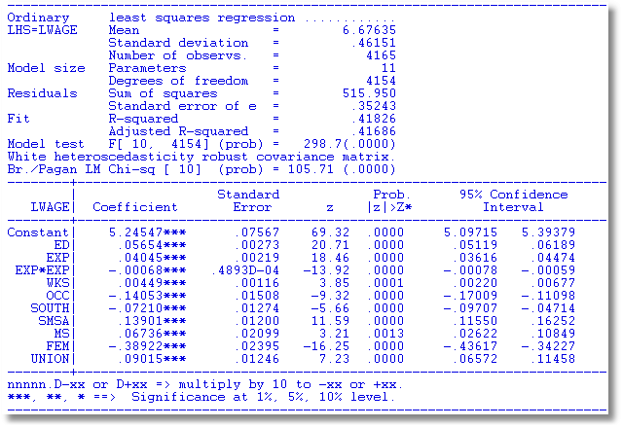
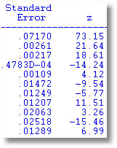
A Robust Covariance Matrix
Uncorrected

Slide 6
Bootstrap Estimation of the Asymptotic
Variance of an Estimator
Known form of asymptotic variance:
Compute from known results
Unknown form, known generalities about properties: Use bootstrapping
  Root N consistency
  Sampling conditions amenable to central limit theorems
  Compute by resampling mechanism within the sample.

Slide 7
Bootstrapping Algorithm
1. Estimate parameters using full sample: → b
2. Repeat R times:
Draw n observations from the n, with replacement
Estimate β with b(r).
3. Estimate variance with
V = (1/R)Σ_{r} [b(r) - b][b(r) - b]’
(Some use mean of replications instead of b. Advocated (without motivation) by original designers of the method.)

Slide 8
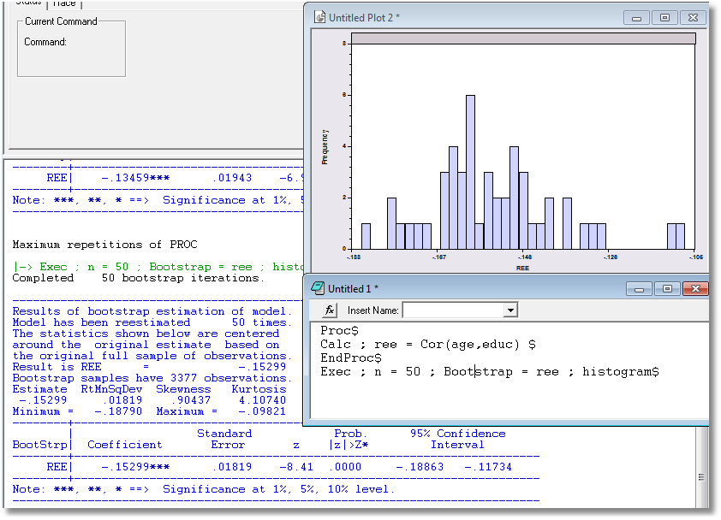
Application: Correlation between Age and Education

Slide 9
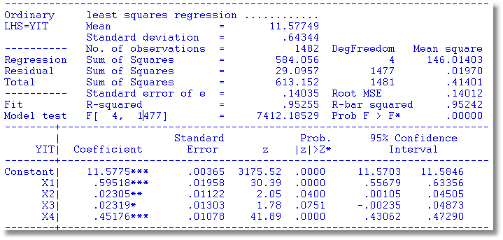
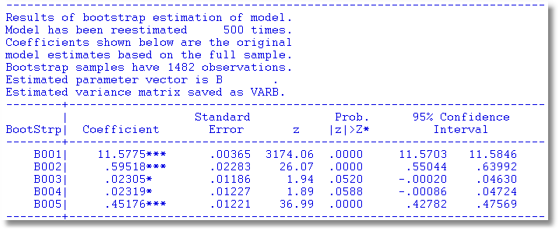
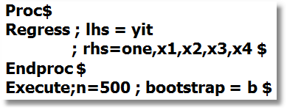
Bootstrapped Regression

Slide 10
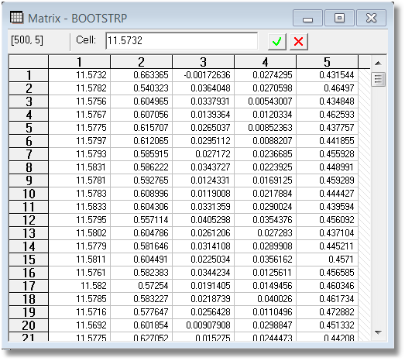
Bootstrap Replications

Slide 11
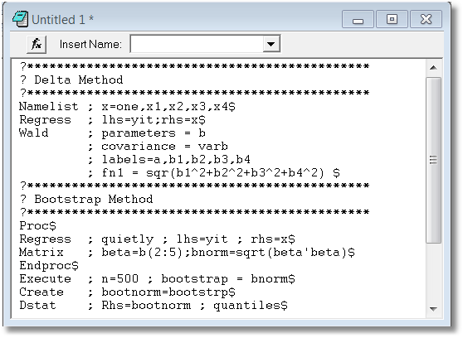
Bootstrapped Confidence Intervals
Estimate Norm(β)=(β₁² + β₂² + β₃² + β₄²)^{1/2}

Slide 12
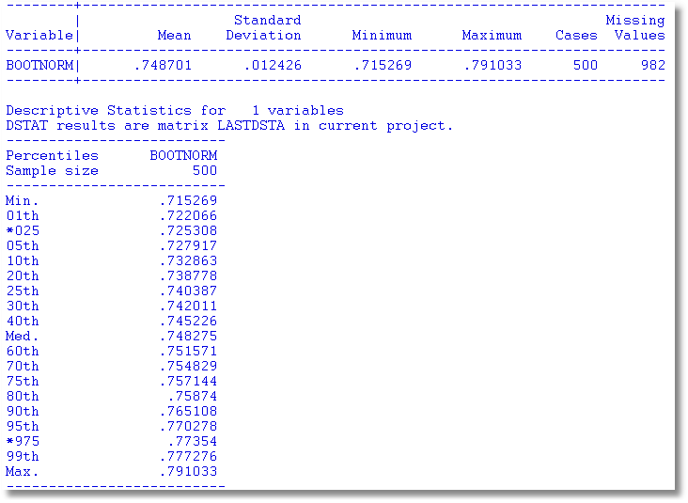
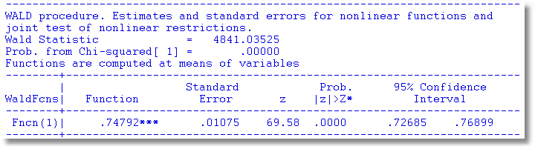

Slide 13
Quantile Regression
Q(y|x,α) = β′x, α = quantile
Estimated by linear programming
Q(y|x,.50) = β′x, .50 ➔ median regression
Median regression estimated by LAD (estimates same parameters as mean regression if symmetric conditional distribution)
Why use quantile (median) regression?
  Semiparametric
  Robust to some extensions (heteroscedasticity?)
  Complete characterization of conditional distribution

Slide 14
Estimated Variance for Quantile Regression

Slide 15
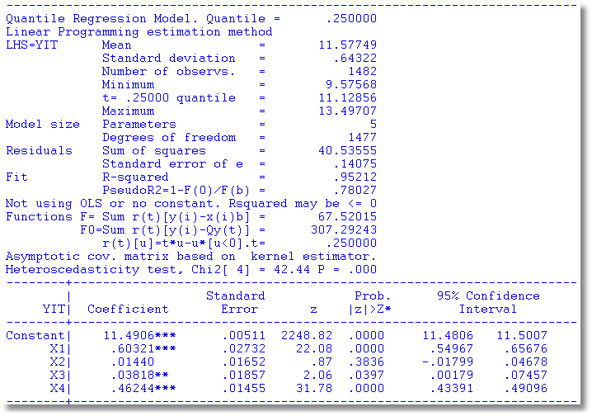
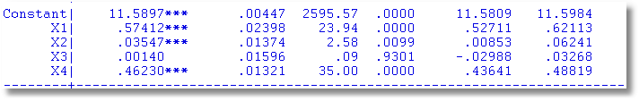
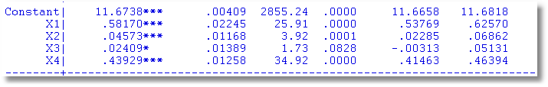
Quantile Regressions
α = .25
α = .50
α = .75

Slide 16
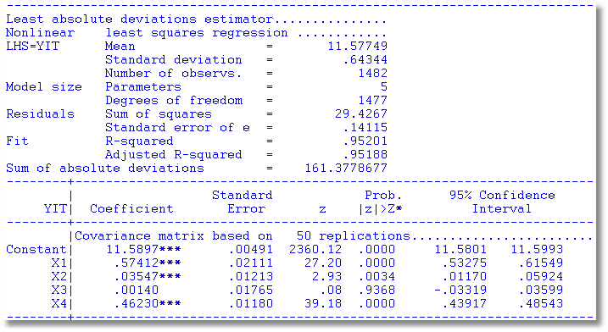
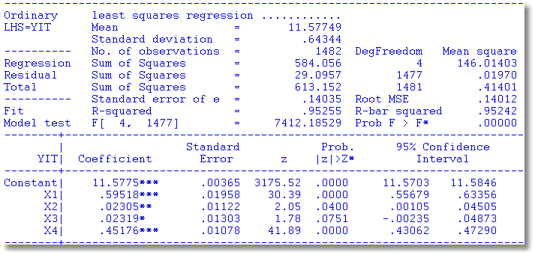
OLS vs. Least Absolute Deviations

Slide 17
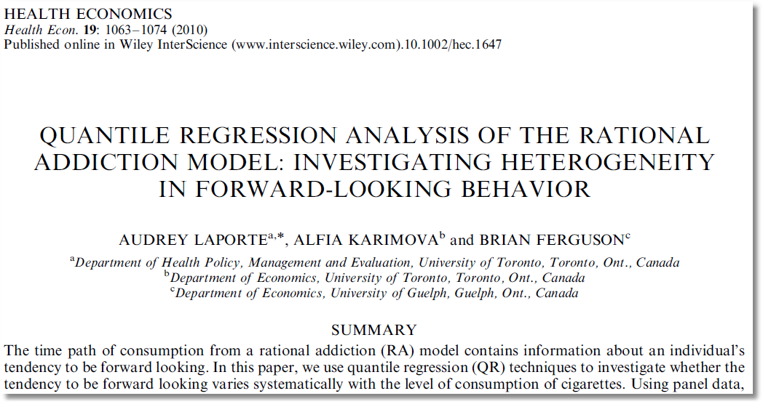

Slide 18
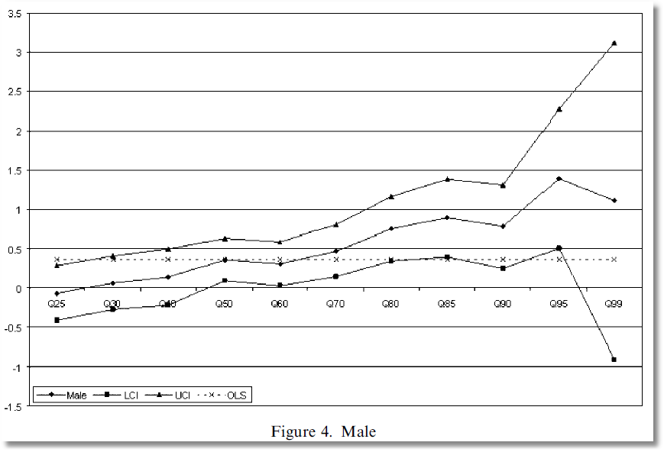
Coefficient on MALE dummy variable in quantile regressions

