Slide 1




Microeconometric Modeling
William Greene
Stern School of Business
New York University
New York NY USA
2.2 Nonlinear Panel Data
Models

Slide 2
Concepts
Models
Mundlak Approach
Nonlinear Least Squares
Quasi Maximum Likelihood
Delta Method
Average Partial Effect
Krinsky and Robb Method
Interaction Term
Endogenous RHS Variable
Control Function
FIML
2 Step ML
Scaled Coefficient
Direct and Indirect Effect
GHK Simulator
Fractional Response Model
Probit
Logit
Multivariate Probit

Slide 3
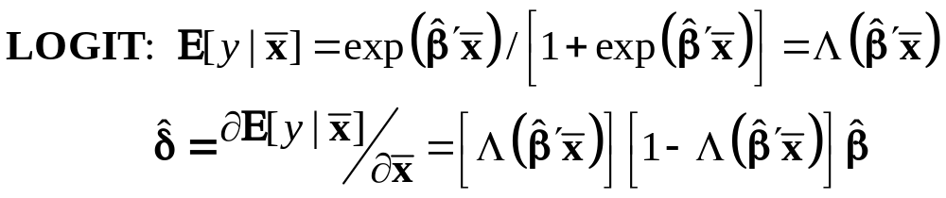
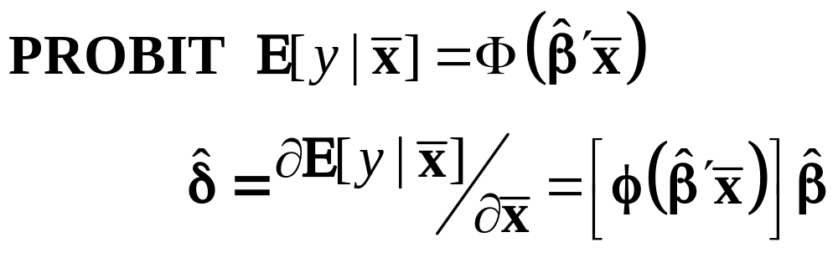
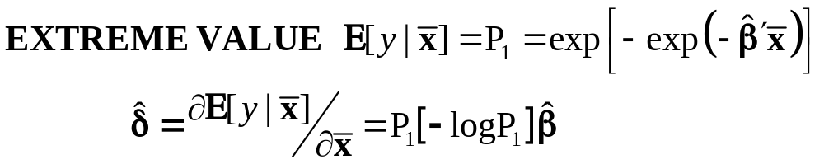
Marginal Effects for Binary Choice

Slide 4
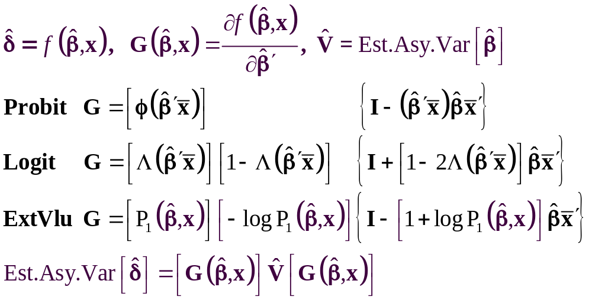
The Delta Method

Slide 5
Computing Effects
Compute at the data means?
  Simple
  Inference is well defined
Average the individual effects
  More appropriate?
  Asymptotic standard errors more complicated.
Is testing about marginal effects meaningful?
  f(b’x) must be > 0; b is highly significant
  How could f(b’x)*b equal zero?

Slide 6
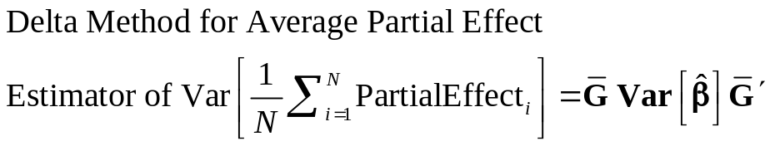
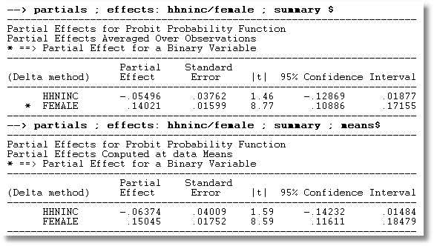
APE vs. Partial Effects at the Mean

Slide 7
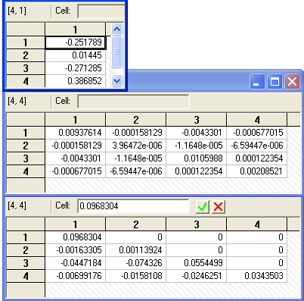
Method of Krinsky and Robb
Estimate β by Maximum Likelihood with b
Estimate asymptotic covariance matrix with V
Draw R observations b(r) from the normal
population N[b,V]
b(r) = b + C*v(r), v(r) drawn from N[0,I]
C = Cholesky matrix, V = CC’
Compute partial effects d(r) using b(r)
Compute the sample variance of d(r),r=1,…,R
Use the sample standard deviations of the R observations to estimate the sampling standard errors for the partial effects.

Slide 8
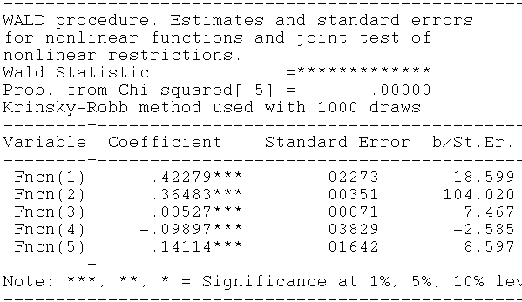
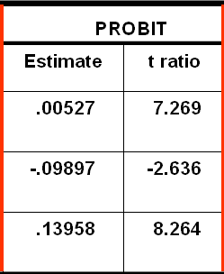
Krinsky and Robb
Delta Method

Slide 9
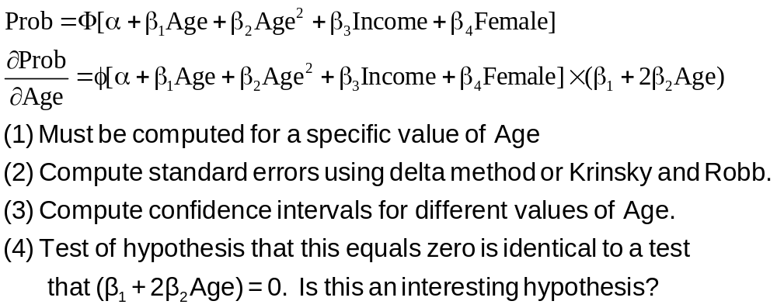
Partial Effect for Nonlinear Terms

Slide 10
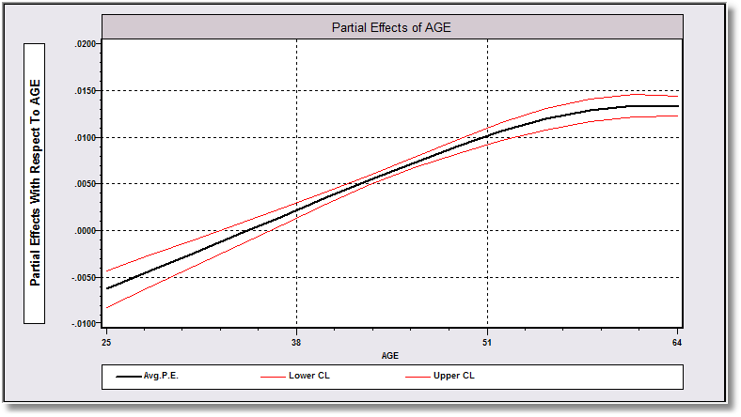
Average Partial Effect: Averaged over Sample Incomes and Genders for Specific Values of Age

Slide 11
Endogenous RHS Variable
U* = β’x + θh + ε
y = 1[U* > 0]
E[ε|h] ≠ 0 (h is endogenous)
  Case 1: h is continuous
  Case 2: h is binary = a treatment effect
Approaches
  Parametric: Maximum Likelihood
  Semiparametric (not developed here):
    GMM
    Various approaches for case 2

Slide 12
Endogenous Continuous Variable
U* = β’x + θh + ε
y = 1[U* > 0] ⇐
h = α’z + u
E[ε|h] ≠ 0 ⬄ Cov[u, ε] ≠ 0
Additional Assumptions:
(u,ε) ~ N[(0,0),(σ_{u}², ρσ_{u}, 1)]
z = a valid set of exogenous
variables, uncorrelated with (u,ε)
Correlation = ρ.
This is the source of the endogeneity
This is not IV estimation. Z may be uncorrelated with X without problems.

Slide 13


Endogenous Income
Income responds to
Age, Age², Educ, Married, Kids, Gender
0 = Not Healthy
1 = Healthy
Healthy = 0 or 1
Age, Married, Kids, Gender, Income
Determinants of Income (observed and unobserved) also determine health satisfaction.
Notes:
13

Slide 14
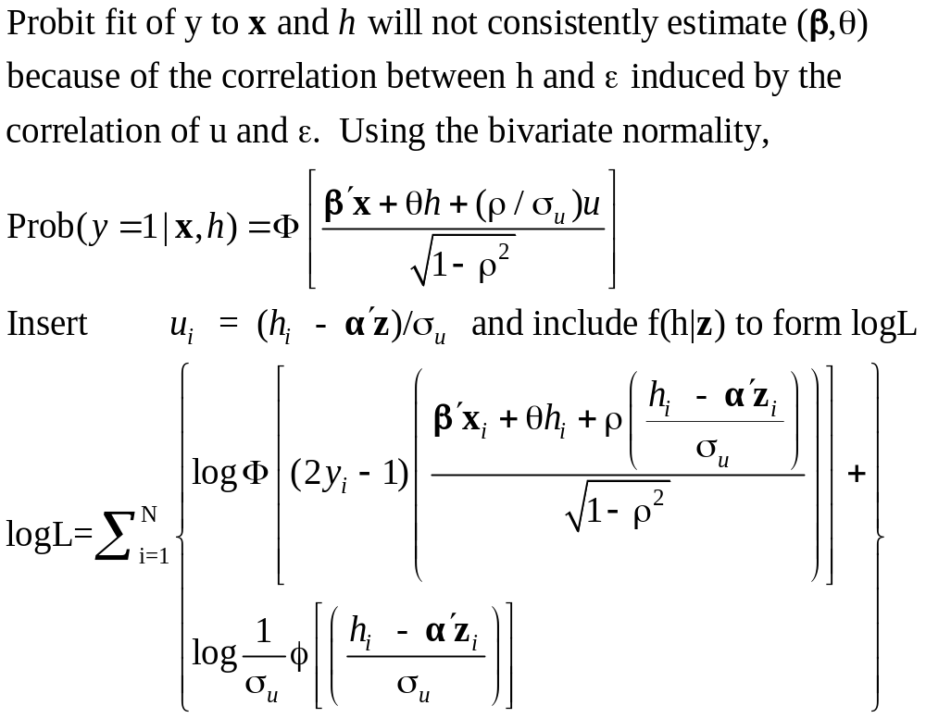
Estimation by ML (Control Function)

Slide 15
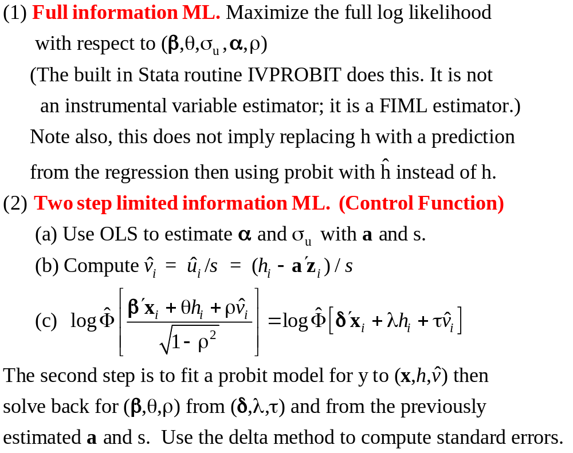
Two Approaches to ML

Slide 16
FIML Estimates
----------------------------------------------------------------------
Probit with Endogenous RHS Variable
Dependent variable HEALTHY
Log likelihood function -6464.60772
--------+-------------------------------------------------------------
Variable| Coefficient Standard Error b/St.Er. P[|Z|>z] Mean of X
--------+-------------------------------------------------------------
|Coefficients in Probit Equation for HEALTHY
Constant| 1.21760*** .06359 19.149 .0000
AGE| -.02426*** .00081 -29.864 .0000 43.5257
MARRIED| -.02599 .02329 -1.116 .2644 .75862
HHKIDS| .06932*** .01890 3.668 .0002 .40273
FEMALE| -.14180*** .01583 -8.959 .0000 .47877
INCOME| .53778*** .14473 3.716 .0002 .35208
|Coefficients in Linear Regression for INCOME
Constant| -.36099*** .01704 -21.180 .0000
AGE| .02159*** .00083 26.062 .0000 43.5257
AGESQ| -.00025*** .944134D-05 -26.569 .0000 2022.86
EDUC| .02064*** .00039 52.729 .0000 11.3206
MARRIED| .07783*** .00259 30.080 .0000 .75862
HHKIDS| -.03564*** .00232 -15.332 .0000 .40273
FEMALE| .00413** .00203 2.033 .0420 .47877
|Standard Deviation of Regression Disturbances
Sigma(w)| .16445*** .00026 644.874 .0000
|Correlation Between Probit and Regression Disturbances
Rho(e,w)| -.02630 .02499 -1.052 .2926
--------+-------------------------------------------------------------

Slide 17
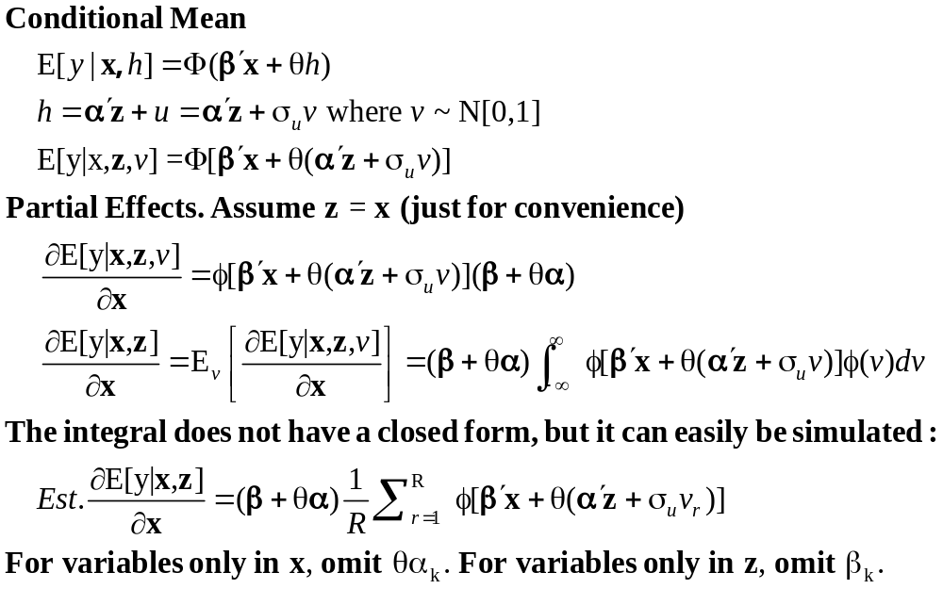
Partial Effects: Scaled Coefficients

Slide 18
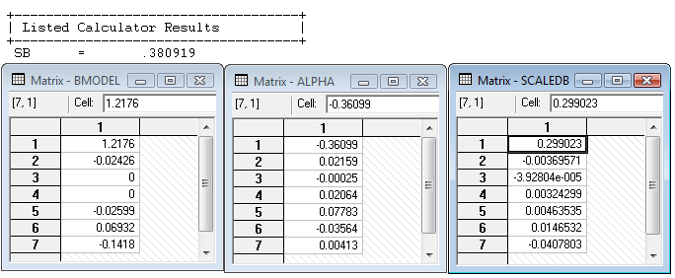
Partial Effects
θ = 0.53778
The scale factor is computed using the model coefficients, means of the variables and 35,000 draws from the standard normal population.

Slide 19
Endogenous Binary Variable
U* = β’x + θh + ε
y = 1[U* > 0]
h* = α’z + u
h = 1[h* > 0]
E[ε|h*] ≠ 0 ⬄ Cov[u, ε] ≠ 0
Additional Assumptions:
(u,ε) ~ N[(0,0),(σ_{u}², ρσ_{u}, 1)]
z = a valid set of exogenous
variables, uncorrelated with (u,ε)
⇐
Correlation = ρ.
This is the source of the endogeneity
This is not IV estimation. Z may be uncorrelated with X without problems.

Slide 20
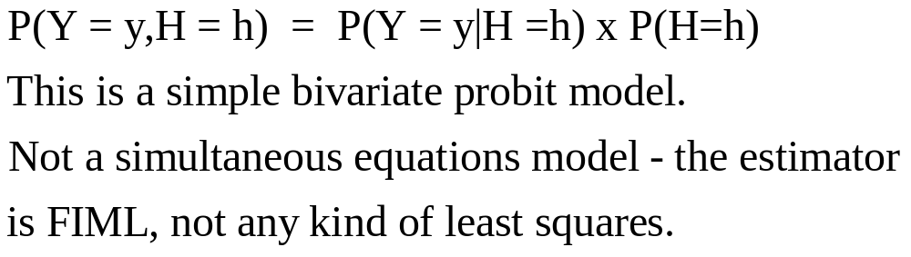

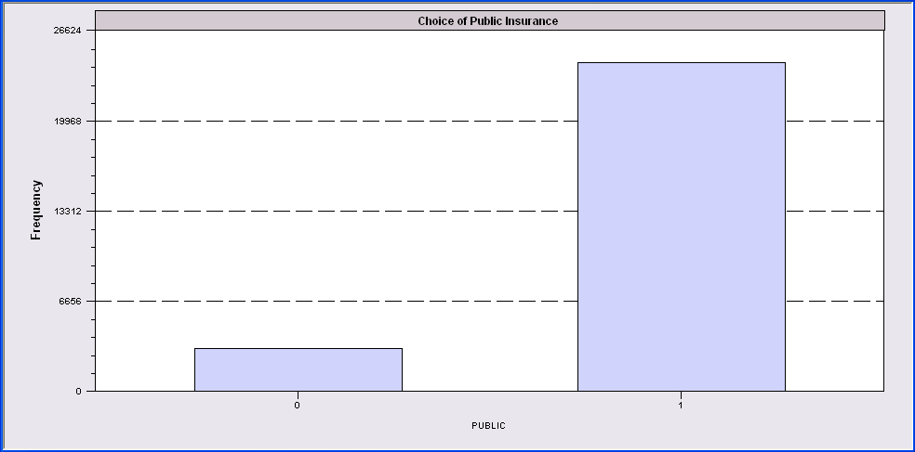
Endogenous Binary Variable
Doctor = F(age,age²,income,female,Public)
Public = F(age,educ,income,married,kids,female)

Slide 21
FIML Estimates
----------------------------------------------------------------------
FIML Estimates of Bivariate Probit Model
Dependent variable DOCPUB
Log likelihood function -25671.43905
Estimation based on N = 27326, K = 14
--------+-------------------------------------------------------------
Variable| Coefficient Standard Error b/St.Er. P[|Z|>z] Mean of X
--------+-------------------------------------------------------------
|Index equation for DOCTOR
Constant| .59049*** .14473 4.080 .0000
AGE| -.05740*** .00601 -9.559 .0000 43.5257
AGESQ| .00082*** .681660D-04 12.100 .0000 2022.86
INCOME| .08883* .05094 1.744 .0812 .35208
FEMALE| .34583*** .01629 21.225 .0000 .47877
PUBLIC| .43533*** .07357 5.917 .0000 .88571
|Index equation for PUBLIC
Constant| 3.55054*** .07446 47.681 .0000
AGE| .00067 .00115 .581 .5612 43.5257
EDUC| -.16839*** .00416 -40.499 .0000 11.3206
INCOME| -.98656*** .05171 -19.077 .0000 .35208
MARRIED| -.00985 .02922 -.337 .7361 .75862
HHKIDS| -.08095*** .02510 -3.225 .0013 .40273
FEMALE| .12139*** .02231 5.442 .0000 .47877
|Disturbance correlation
RHO(1,2)| -.17280*** .04074 -4.241 .0000
--------+-------------------------------------------------------------

Slide 22
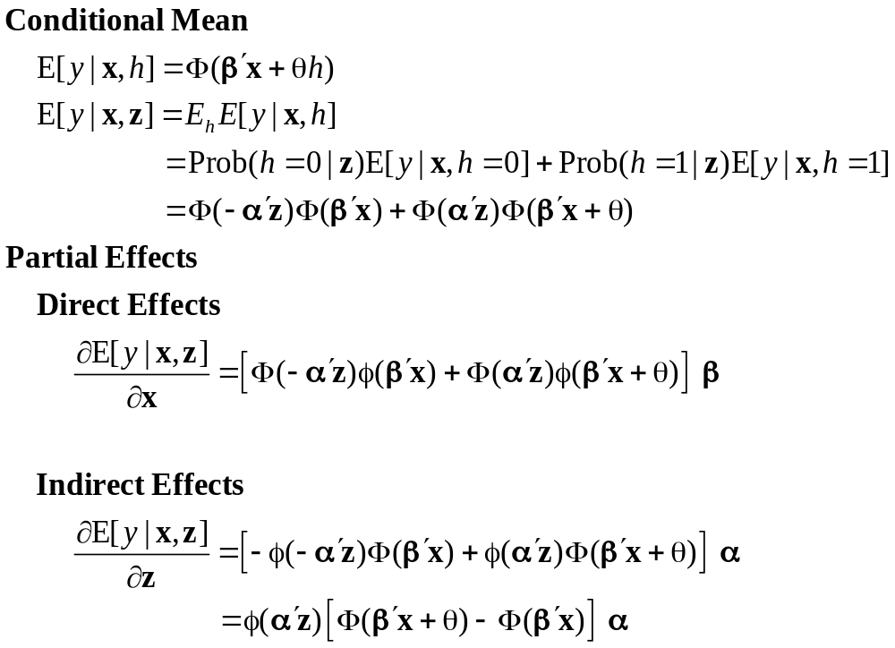
Partial Effects

Slide 23
Identification Issues
Exclusions are not needed for estimation
Identification is, in principle, by “functional form”
Researchers usually have a variable in the treatment equation that is not in the main probit equation “to improve identification”
A fully simultaneous model
  y1 = f(x1,y2), y2 = f(x2,y1)
  Not identified even with exclusion restrictions
  (Model is “incoherent”)

