Slide 1




Microeconometric Modeling
William Greene
Stern School of Business
New York University
New York NY USA
2.3 Panel Data Models
for Binary Choice

Slide 2
Concepts
Models
Unbalanced Panel
Attrition Bias
Inverse Probability Weight
Heterogeneity
Population Averaged Model
Clustering
Pooled Model
Quadrature
Maximum Simulated Likelihood
Conditional Estimator
Incidental Parameters Problem
Partial Effects
Bias Correction
Mundlak Specification
Variable Addition Test
Random Effects Progit
Fixed Effects Probit
Fixed Effects Logit
Dynamic Probit
Mundlak Formulation
Correlated Random Effects Model

Slide 3


Slide 4
Application: Health Care Panel Data
German Health Care Usage Data
Data downloaded from Journal of Applied Econometrics Archive. This is an unbalanced panel with 7,293 individuals. They can be used for regression, count models, binary choice, ordered choice, and bivariate binary choice. There are altogether 27,326 observations. The number of observations ranges from 1 to 7. (Frequencies are: 1=1525, 2=2158, 3=825, 4=926, 5=1051, 6=1000, 7=987).
Variables in the file are
DOCTOR = 1(Number of doctor visits > 0)
HOSPITAL = 1(Number of hospital visits > 0)
HSAT = health satisfaction, coded 0 (low) - 10 (high)
DOCVIS = number of doctor visits in last three months
HOSPVIS = number of hospital visits in last calendar year
PUBLIC = insured in public health insurance = 1; otherwise = 0
ADDON = insured by add-on insurance = 1; otherswise = 0
HHNINC = household nominal monthly net income in German marks / 10000.
(4 observations with income=0 were dropped)
HHKIDS = children under age 16 in the household = 1; otherwise = 0
EDUC = years of schooling
AGE = age in years
MARRIED = marital status
Notes:
4

Slide 5
Unbalanced Panels and Attrition ‘Bias’
Test for ‘attrition bias.’ (Verbeek and Nijman, Testing for Selectivity Bias in Panel Data Models, International Economic Review, 1992, 33, 681-703.
  Variable addition test using covariates of presence in the panel
  Nonconstructive – what to do next?
Do something about attrition bias. (Wooldridge, Inverse Probability Weighted M-Estimators for Sample Stratification and Attrition, Portuguese Economic Journal, 2002, 1: 117-139)
  Stringent assumptions about the process
  Model based on probability of being present in each wave of the panel

Slide 6
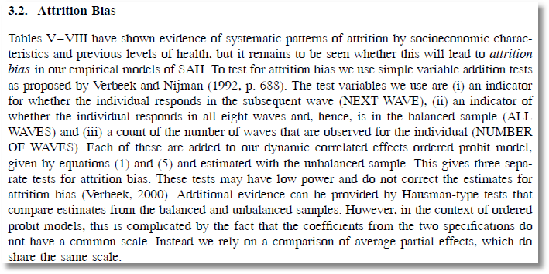
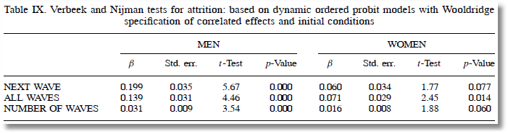

Slide 7
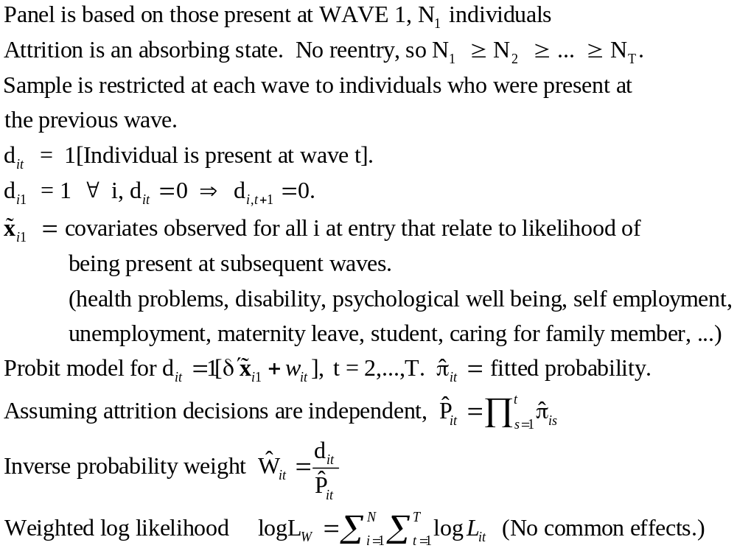
Inverse Probability Weighting

Slide 8
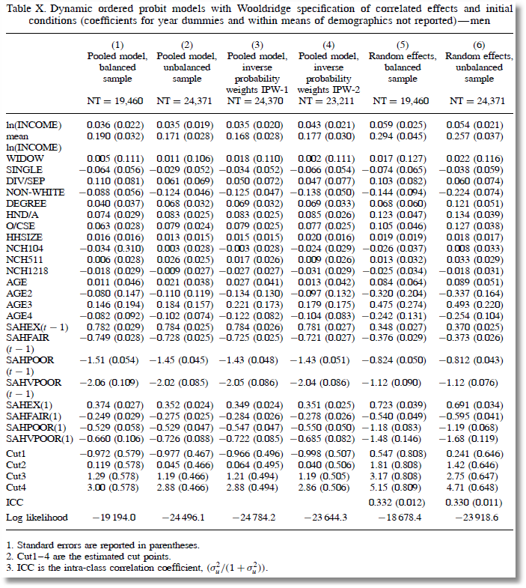

Slide 9
Panel Data Binary Choice Models
Random Utility Model for Binary Choice
U_{it} = α + β’x_{it} + ε_{it} + Person i specific effect
Fixed effects using “dummy” variables
U_{it} = α_{i} + β’x_{it} + ε_{it}
Random effects using omitted heterogeneity
U_{it} = α + β’x_{it} + ε_{it} + u_{i}
Same outcome mechanism: Y_{it} = 1[U_{it} > 0]

Slide 10
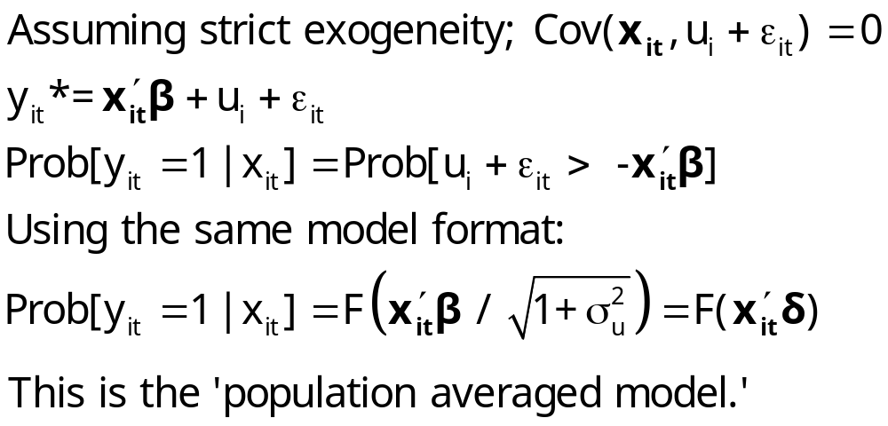
Ignoring Unobserved Heterogeneity

Slide 11
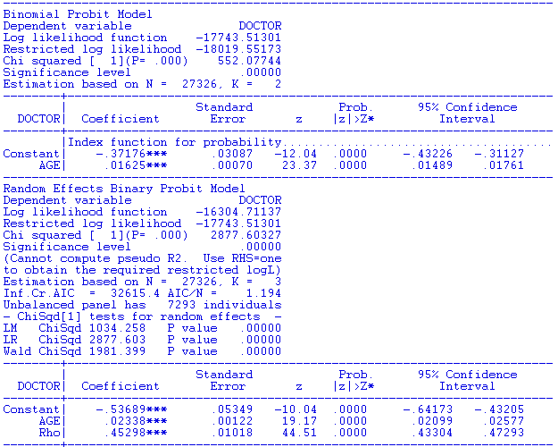
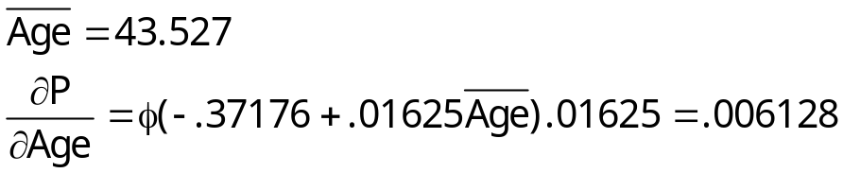
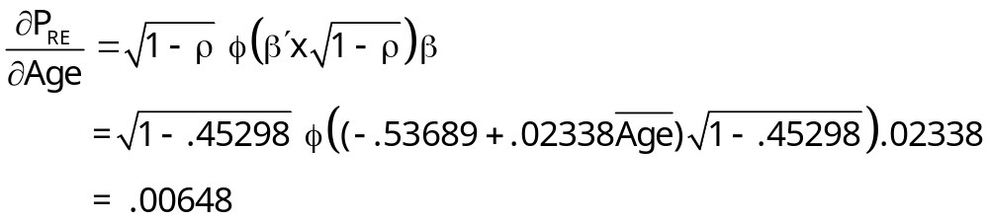
Population average coefficient is off by 43% but the partial effect is off by 6%

Slide 12
Ignoring Heterogeneity (Broadly)
Presence will generally make parameter estimates look smaller than they would otherwise.
Ignoring heterogeneity will definitely distort standard errors.
Partial effects based on the parametric model may not be affected very much.
Is the pooled estimator ‘robust?’ Less so than in the linear model case.

Slide 13
The Effect of Clustering
Y_{it} must be correlated with Y_{is} across periods
Pooled estimator ignores correlation
Broadly, y_{it} = E[y_{it}|x_{it}] + w_{it},
  E[y_{it}|x_{it}] = Prob(y_{it} = 1|x_{it})
  w_{it} is correlated across periods
Assuming the marginal probability is the same, the pooled estimator is consistent. (We just saw that it might not be.)
Ignoring the correlation across periods generally leads to underestimating standard errors.

Slide 14
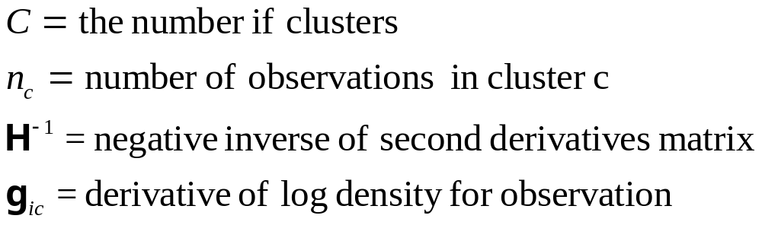
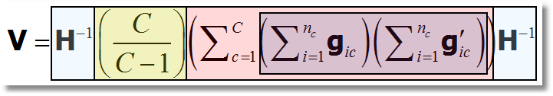
‘Cluster’ Corrected Covariance Matrix

Slide 15
Cluster Correction: Doctor
----------------------------------------------------------------------
Binomial Probit Model
Dependent variable DOCTOR
Log likelihood function -17457.21899
--------+-------------------------------------------------------------
Variable| Coefficient Standard Error b/St.Er. P[|Z|>z] Mean of X
--------+-------------------------------------------------------------
| Conventional Standard Errors
Constant| -.25597*** .05481 -4.670 .0000
AGE| .01469*** .00071 20.686 .0000 43.5257
EDUC| -.01523*** .00355 -4.289 .0000 11.3206
HHNINC| -.10914** .04569 -2.389 .0169 .35208
FEMALE| .35209*** .01598 22.027 .0000 .47877
--------+-------------------------------------------------------------
| Corrected Standard Errors
Constant| -.25597*** .07744 -3.305 .0009
AGE| .01469*** .00098 15.065 .0000 43.5257
EDUC| -.01523*** .00504 -3.023 .0025 11.3206
HHNINC| -.10914* .05645 -1.933 .0532 .35208
FEMALE| .35209*** .02290 15.372 .0000 .47877
--------+-------------------------------------------------------------

Slide 16
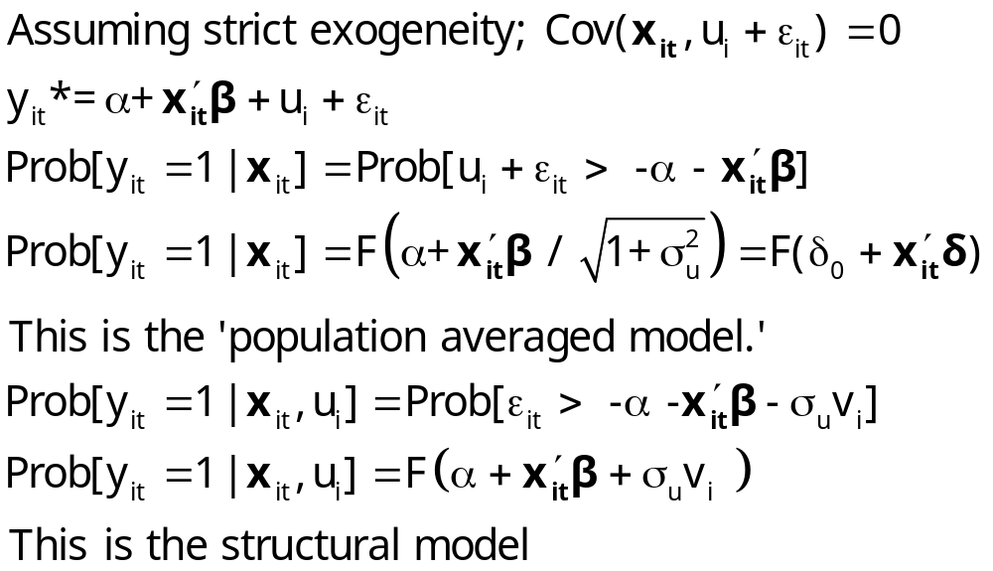
Random Effects

Slide 17
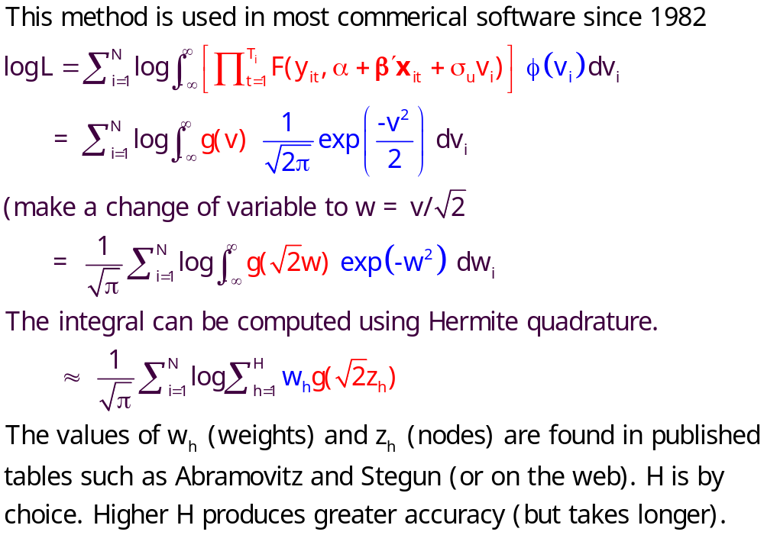
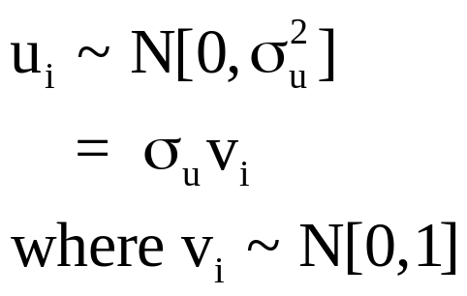
Quadrature – Butler and Moffitt (1982)

Slide 18
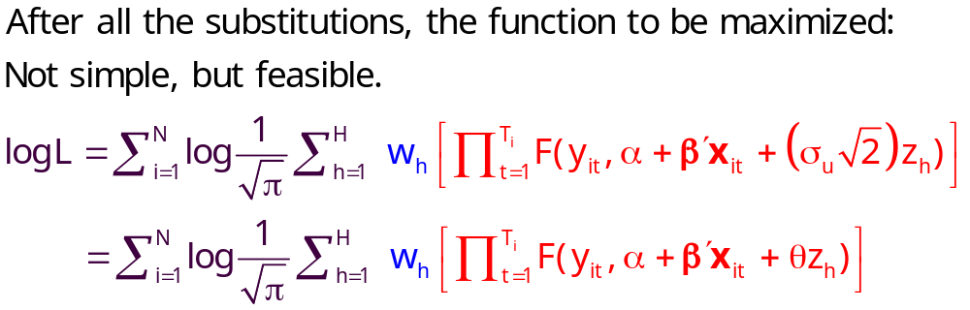
Quadrature Log Likelihood

Slide 19
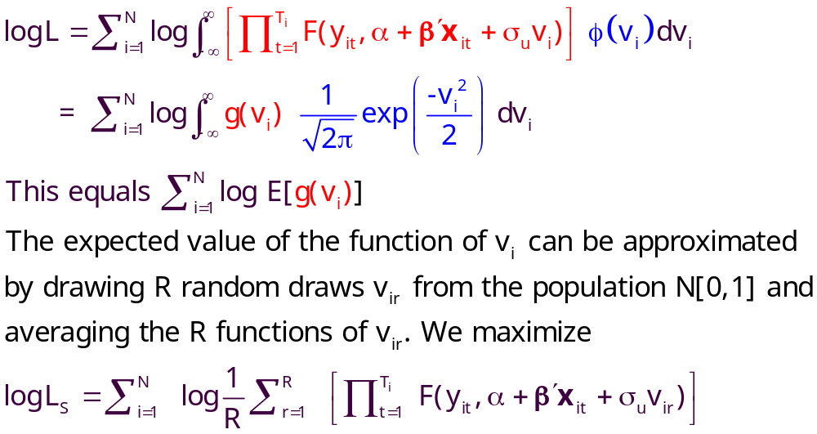
Simulation Based Estimator

Slide 20
Random Effects Model: Quadrature
----------------------------------------------------------------------
Random Effects Binary Probit Model
Dependent variable DOCTOR
Log likelihood function -16290.72192 ⬅ Random Effects
Restricted log likelihood -17701.08500 ⬅ Pooled
Chi squared [ 1 d.f.] 2820.72616
Estimation based on N = 27326, K = 5
Unbalanced panel has 7293 individuals
--------+-------------------------------------------------------------
Variable| Coefficient Standard Error b/St.Er. P[|Z|>z] Mean of X
--------+-------------------------------------------------------------
Constant| -.11819 .09280 -1.273 .2028
AGE| .02232*** .00123 18.145 .0000 43.5257
EDUC| -.03307*** .00627 -5.276 .0000 11.3206
HHNINC| .00660 .06587 .100 .9202 .35208
Rho| .44990*** .01020 44.101 .0000
--------+-------------------------------------------------------------
|Pooled Estimates
Constant| .02159 .05307 .407 .6842
AGE| .01532*** .00071 21.695 .0000 43.5257
EDUC| -.02793*** .00348 -8.023 .0000 11.3206
HHNINC| -.10204** .04544 -2.246 .0247 .35208
--------+-------------------------------------------------------------

Slide 21
Random Parameter Model
----------------------------------------------------------------------
Random Coefficients Probit Model
Dependent variable DOCTOR (Quadrature Based)
Log likelihood function -16296.68110 (-16290.72192)
Restricted log likelihood -17701.08500
Chi squared [ 1 d.f.] 2808.80780
Simulation based on 50 Halton draws
--------+-------------------------------------------------
Variable| Coefficient Standard Error b/St.Er. P[|Z|>z]
--------+-------------------------------------------------
|Nonrandom parameters
AGE| .02226*** .00081 27.365 .0000 ( .02232)
EDUC| -.03285*** .00391 -8.407 .0000 (-.03307)
HHNINC| .00673 .05105 .132 .8952 ( .00660)
|Means for random parameters
Constant| -.11873** .05950 -1.995 .0460 (-.11819)
|Scale parameters for dists. of random parameters
Constant| .90453*** .01128 80.180 .0000
--------+-------------------------------------------------------------
Using quadrature, a = -.11819. Implied ρ from these estimates is
.90454²/(1+.90453²) = .449998 compared to .44990 using quadrature.

Slide 22
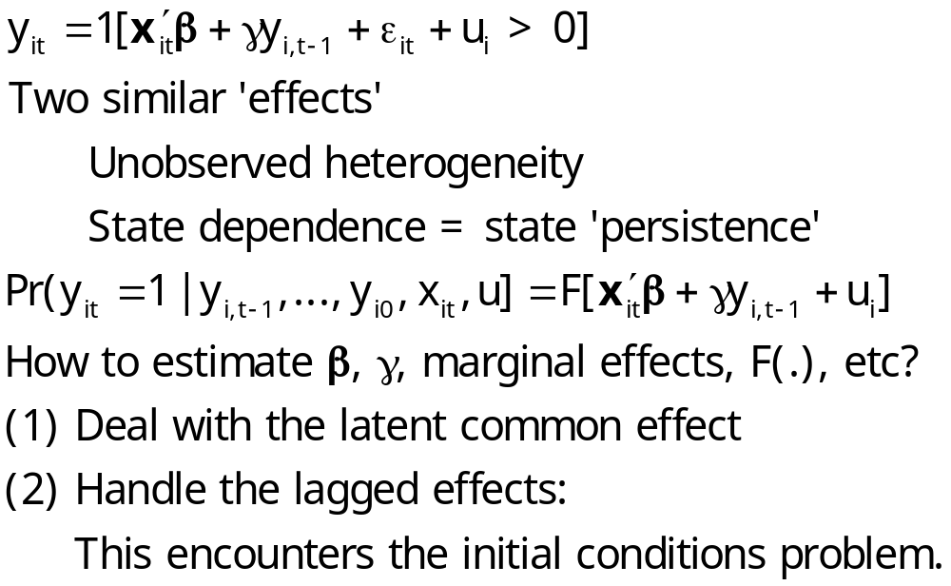
A Dynamic Model

Slide 23
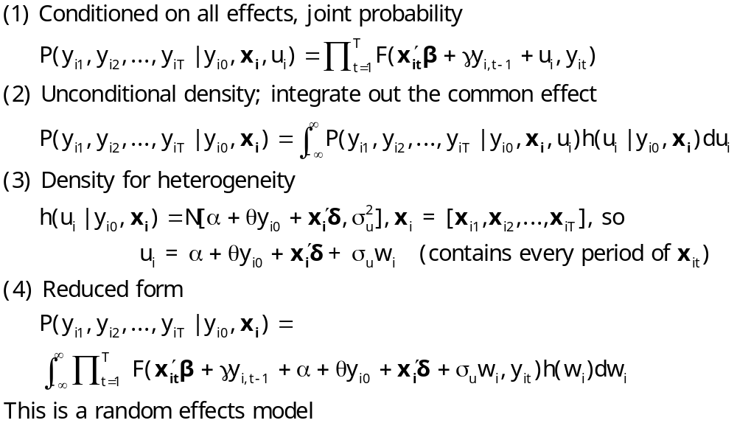
Dynamic Probit Model: A Standard Approach

Slide 24
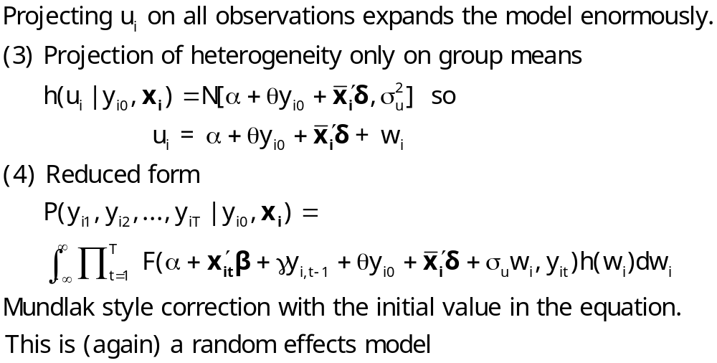
Simplified Dynamic Model

Slide 25
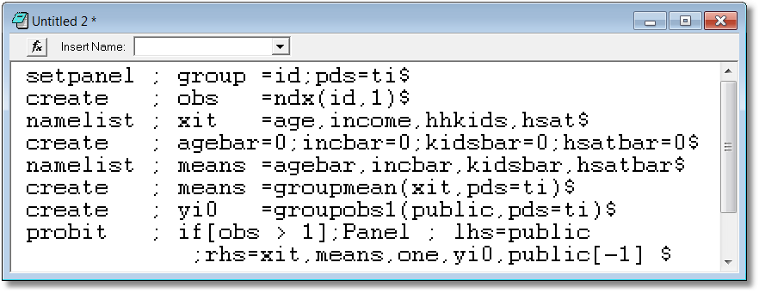
A Dynamic Model for Public Insurance
Age
Household Income
Kids in the household
Health Status
Add initial value, lagged value, group means

Slide 26
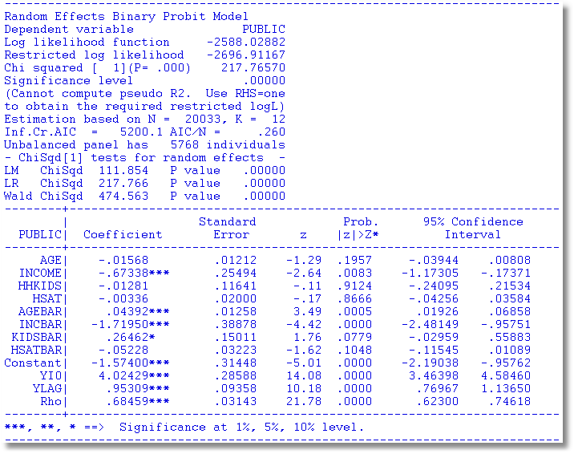
Dynamic Common Effects Model

Slide 27
Fixed Effects Modeling
Advantages:
  Allows correlation of covariates and heterogeneity
Disadvantages:
  Complications of computing all those dummy variable coefficients – solved problem (Greene, 2004)
  No time invariant variables – not solvable in the FE context
  Incidental Parameters problem – persistent small T bias, does not go away
Strategies
  Unconditional estimation
  Conditional estimation – Rasch/Chamberlain
  Hybrid conditional/unconditional estimation
  Bias corrrections
  Mundlak estimator

Slide 28
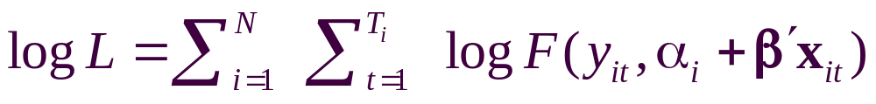
Fixed Effects Models
Estimate with dummy variable coefficients
Uit = α_{i} + β’xit + ε_{it}
Can be done by “brute force” for 10,000s of individuals
F(.) = appropriate probability for the observed outcome
Compute β and α_{i} for i=1,…,N (may be large)
See FixedEffects.pdf in course materials.

Slide 29
Unconditional Estimation
Maximize the whole log likelihood
Difficult! Many (thousands) of parameters.
Feasible – NLOGIT (2004) (“Brute force”)

Slide 30
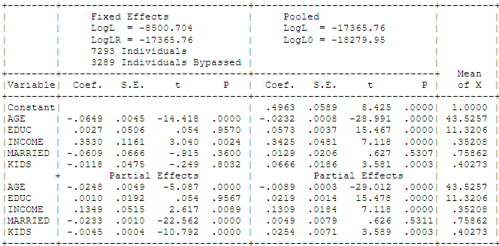
Fixed Effects Health Model
Groups in which y_{it} is always = 0 or always = 1. Cannot compute α_{i}.

Slide 31
Conditional Estimation
Principle: f(y_{i1},y_{i2},… | some statistic) is free of the fixed effects for some models.
Maximize the conditional log likelihood, given the statistic.
Can estimate β without having to estimate α_{i}.
Only feasible for the logit model. (Poisson and a few other continuous variable models. No other discrete choice models.)

Slide 32
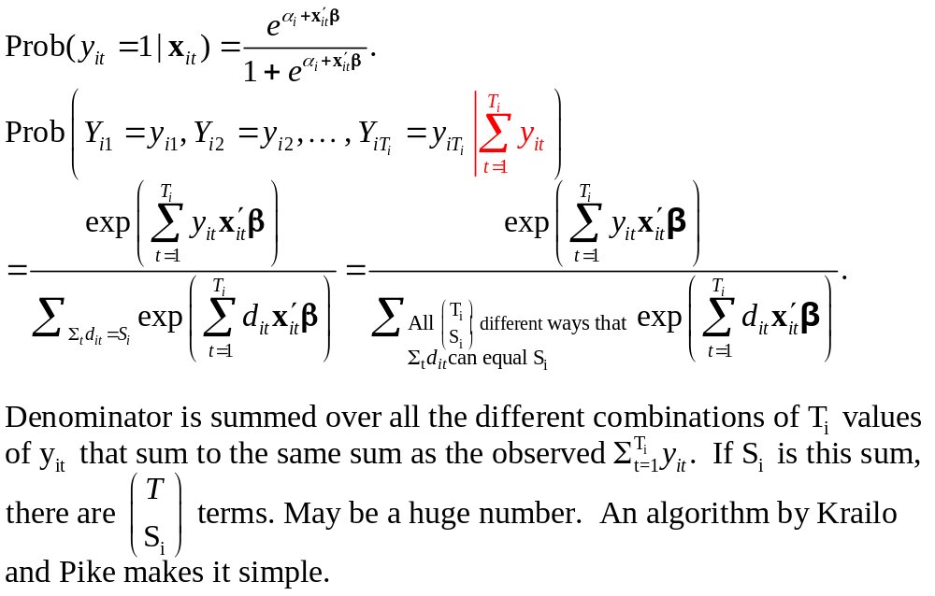
Binary Logit Conditional Probabilities

Slide 33
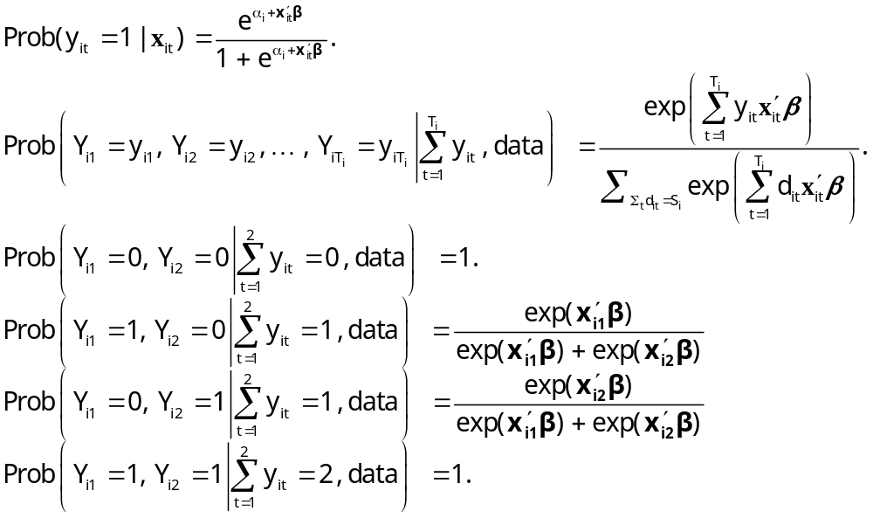
Example: Two Period Binary Logit

Slide 34
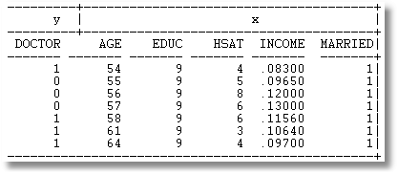
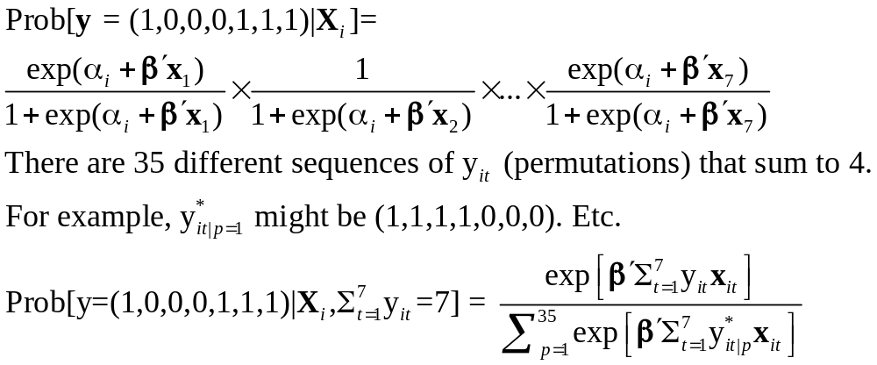
Example: Seven Period Binary Logit

Slide 35
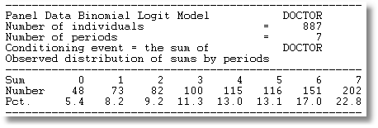
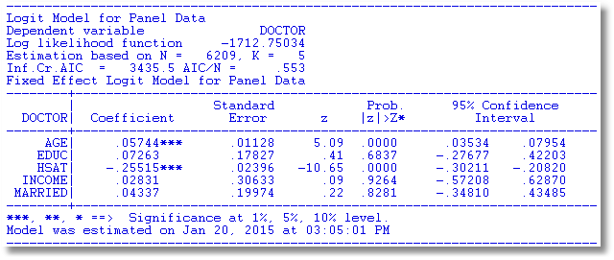

Slide 36
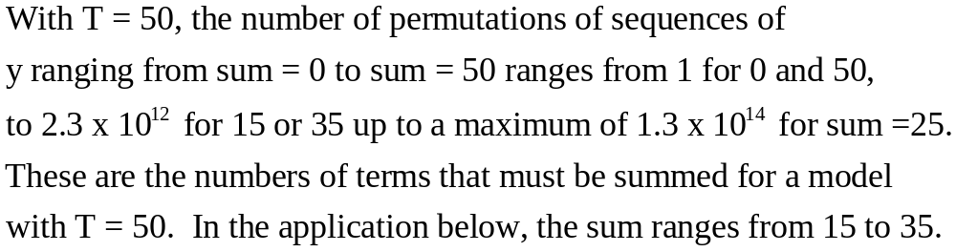
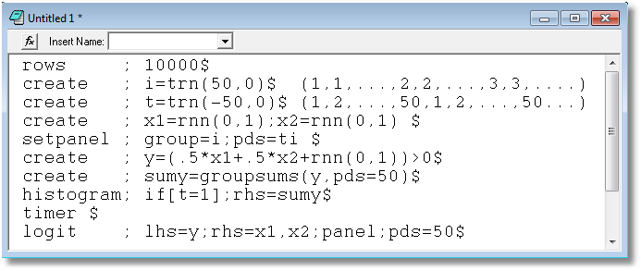

Slide 37
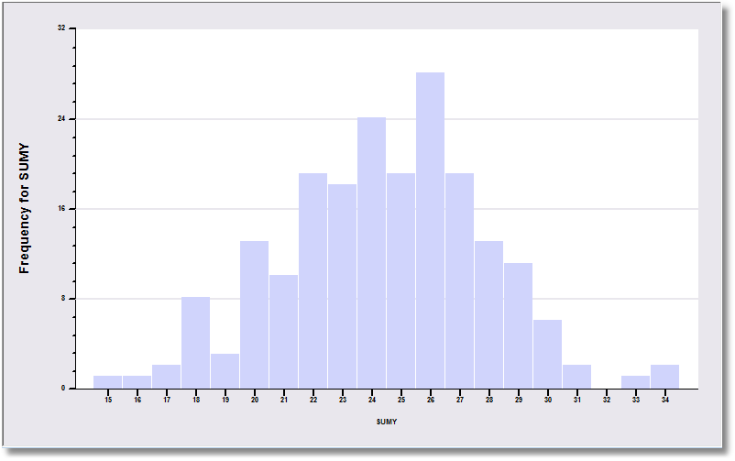
The sample is 200 individuals each observed 50 times.

Slide 38
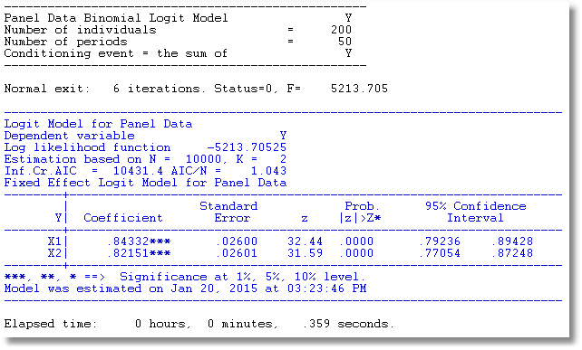
The data are generated from a probit process with b1 = b2 = .5. But, it is fit as a logit model. The coefficients obey the familiar relationship, 1.6*probit.

Slide 39
Estimating Partial Effects
“The fixed effects logit estimator of β immediately gives us the effect of each element of x_{i} on the log-odds ratio… Unfortunately, we cannot estimate the partial effects… unless we plug in a value for α_{i}. Because the distribution of α_{i} is unrestricted – in particular, E[α_{i}] is not necessarily zero – it is hard to know what to plug in for α_{i}. In addition, we cannot estimate average partial effects, as doing so would require finding E[Λ(x_{it} β+ α_{i})], a task that apparently requires specifying a distribution for α_{i}.”
(Wooldridge, 2010)
Notes:
39

Slide 40
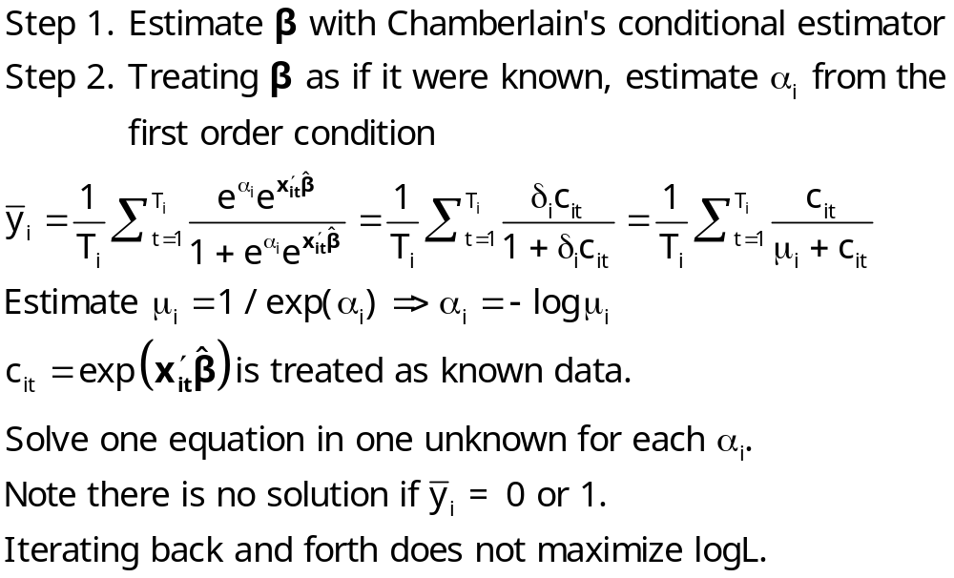
MLE for Logit Constant Terms

Slide 41
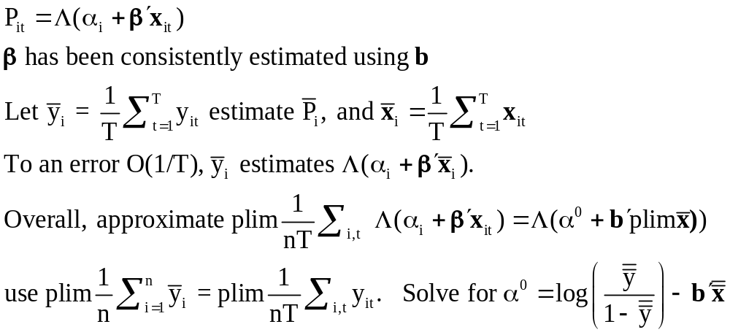
An Approximate Solution for E[α_{i}]

Slide 42
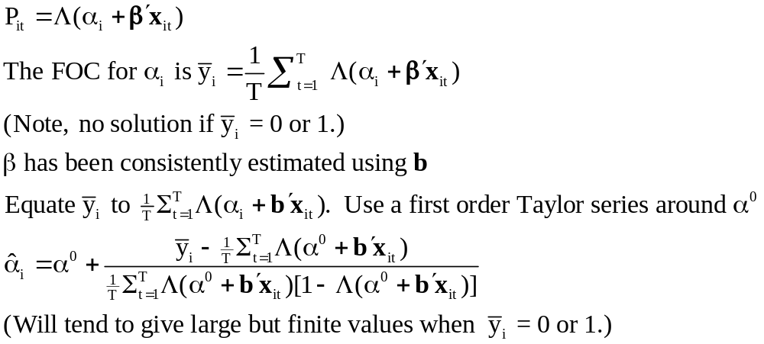
An Approximate Solution for α_{i}

Slide 43
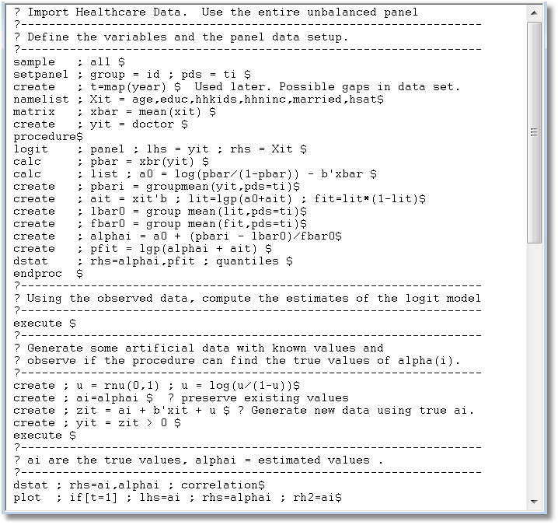

Slide 44
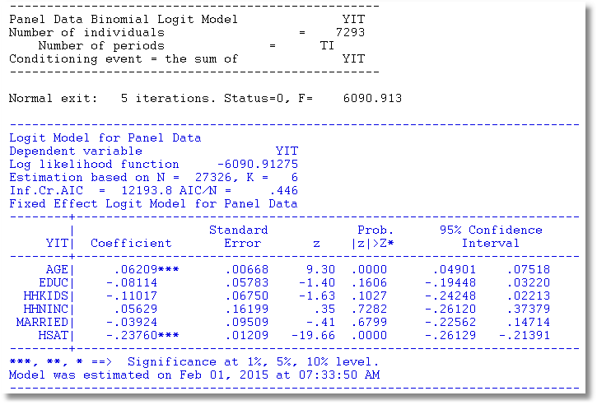

Slide 45
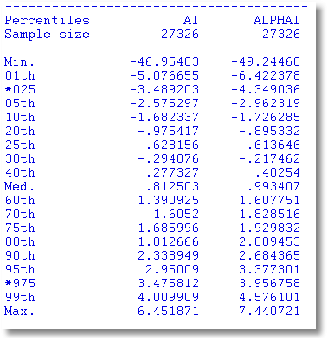

Slide 46
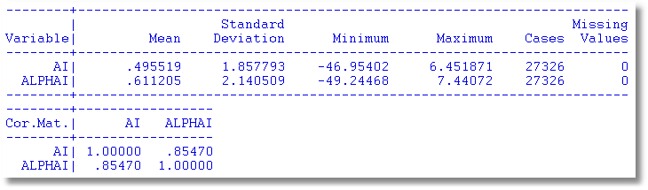
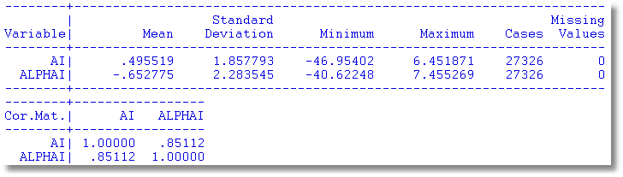
Systematic overestimation by alphai, or random noise? A second run of the experiment:

Slide 47
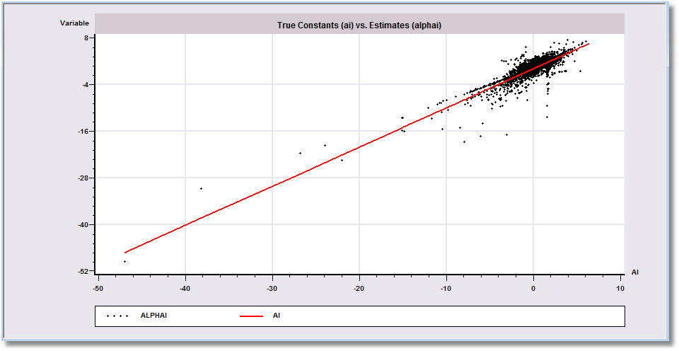

Slide 48
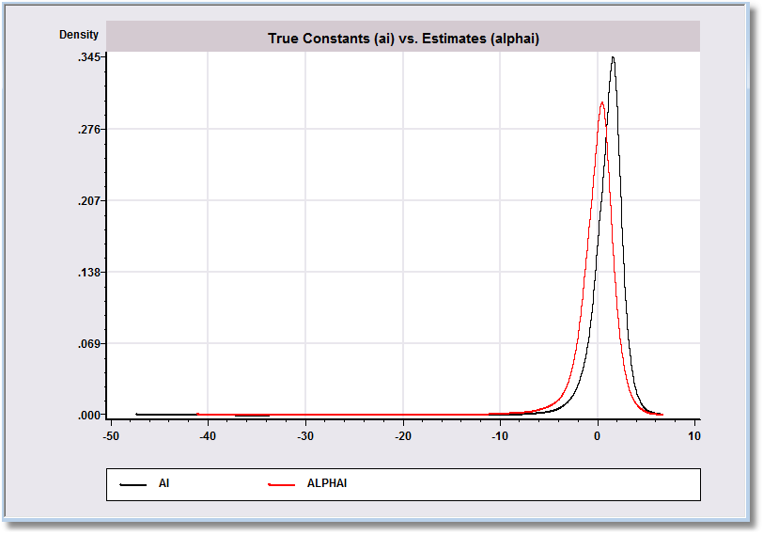

Slide 49
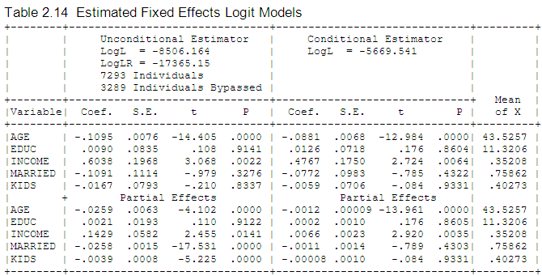
Fixed Effects Logit Health Model: Conditional vs. Unconditional

Slide 50
Incidental Parameters Problems: Conventional Wisdom
General: The unconditional MLE is biased in samples with fixed T except in special cases such as linear or Poisson regression (even when the FEM is the right model).
  The conditional estimator (that bypasses
  estimation of α_{i}) is consistent.
Specific: Upward bias (experience with probit and logit) in estimators of β

Slide 51
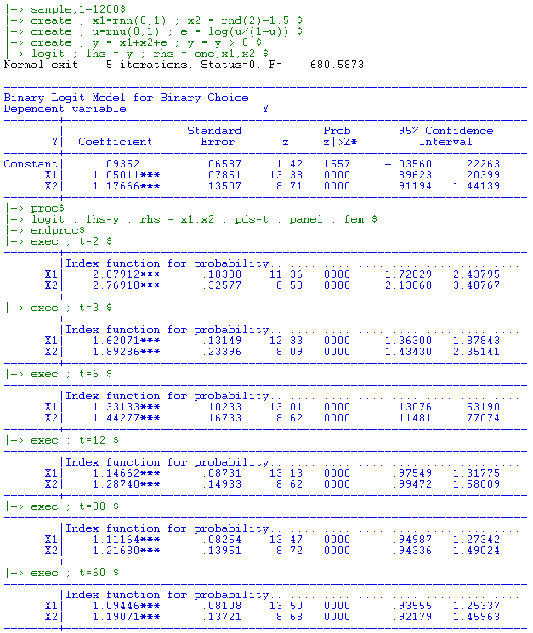

Slide 52
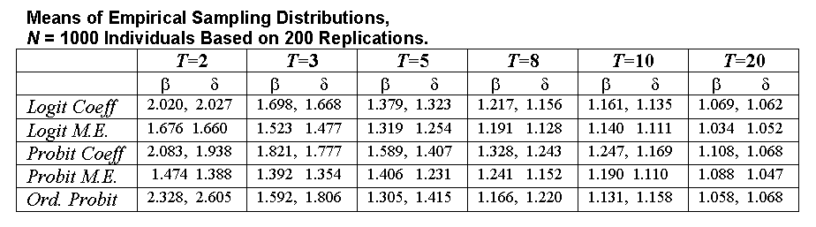
A Monte Carlo Study of the
FE Estimator: Probit vs. Logit
Estimates of Coefficients and Marginal Effects at the Implied Data Means
Results are scaled so the desired quantity being estimated
(β, δ, marginal effects) all equal 1.0 in the population.

Slide 53
Bias Correction Estimators
Motivation: Undo the incidental parameters bias in the fixed effects probit model:
  (1) Maximize a penalized log likelihood function, or
  (2) Directly correct the estimator of β
Advantages
  For (1) estimates α_{i} so enables partial effects
  Estimator is consistent under some circumstances
  (Possibly) corrects in dynamic models
Disadvantage
  No time invariant variables in the model
  Practical implementation
  Extension to other models? (Ordered probit model (maybe) – see JBES 2009)

Slide 54
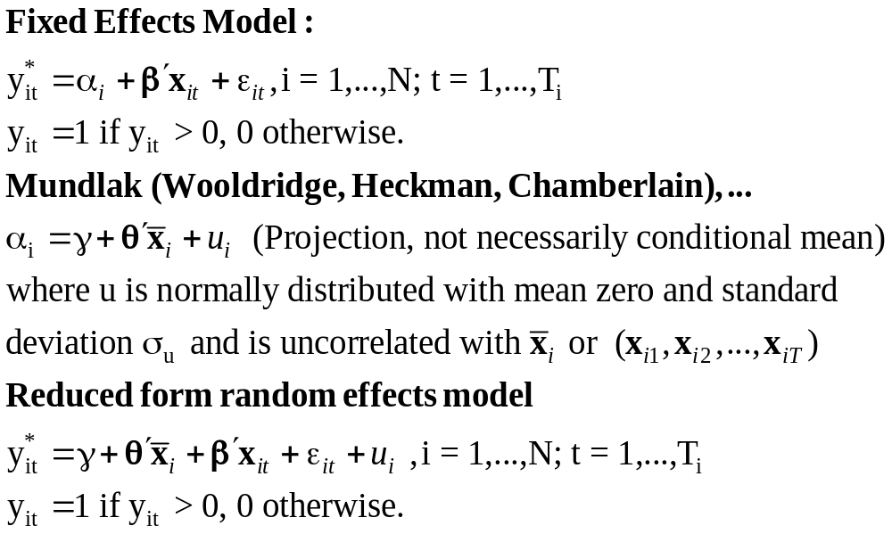
A Mundlak Correction for the FE Model

Slide 55
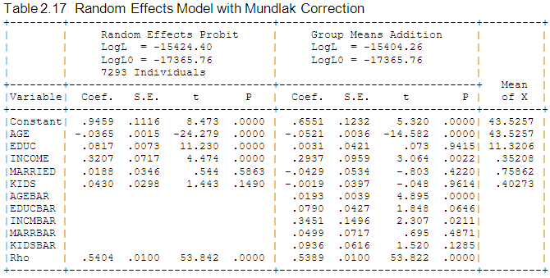
Mundlak Correction

Slide 56
A Variable Addition Test for FE vs. RE
The Wald statistic of 45.27922 and the likelihood ratio statistic of 40.280 are both far larger than the critical chi squared with 5 degrees of freedom, 11.07. This suggests that for these data, the fixed effects model is the preferred framework.

