Slide 1




Microeconometric Modeling
William Greene
Stern School of Business
New York University
New York NY USA
3.1 Models for Ordered
Choices

Slide 2

Concepts
Models
Ordered Choice
Subjective Well Being
Health Satisfaction
Random Utility
Fit Measures
Normalization
Threshold Values (Cutpoints0
Differential Item Functioning
Anchoring Vignette
Panel Data
Incidental Parameters Problem
Attrition Bias
Inverse Probability Weighting
Transition Matrix
Ordered Probit and Logit
Generalized Ordered Probit
Hierarchical Ordered Probit
Vignettes
Fixed and Random Effects OPM
Dynamic Ordered Probit
Sample Selection OPM

Slide 3
Ordered Discrete Outcomes
E.g.: Taste test, credit rating, course grade, preference scale
Underlying random preferences:
  Existence of an underlying continuous preference scale
  Mapping to observed choices
Strength of preferences is reflected in the discrete outcome
Censoring and discrete measurement
The nature of ordered data

Slide 4
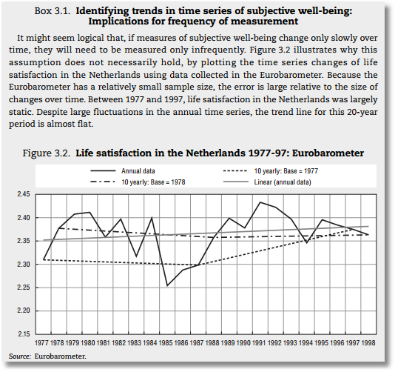


Slide 5

Health Satisfaction (HSAT)
Self administered survey: Health Care Satisfaction (0 – 10)
Continuous Preference Scale

Slide 6
Modeling Ordered Choices
Random Utility (allowing a panel data setting)
Uit = α + β’xit + ε_{it}
= a_{it} + ε_{it}
Observe outcome j if utility is in region j
Probability of outcome = probability of cell
Pr[Yit=j] = F(μ_{j} – a_{it}) - F(μ_{j-1} – a_{it})

Slide 7
Ordered Probability Model

Slide 8

Combined Outcomes for Health Satisfaction

Slide 9
Ordered Probabilities

Slide 10
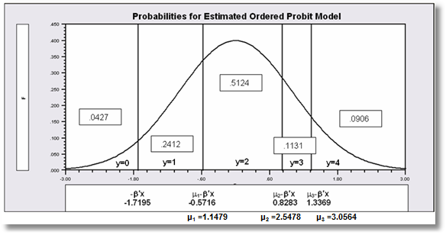

Slide 11
Coefficients

Slide 12
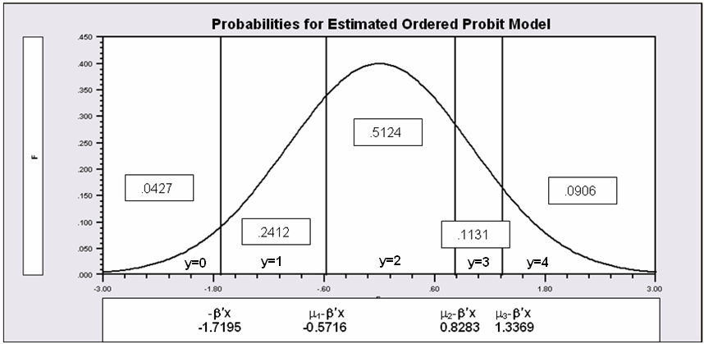
Partial Effects in the Ordered Choice Model
Assume the β_{k} is positive.
Assume that x_{k} increases.
β’x increases. μ_{j}- β’x shifts to the left for all 5 cells.
Prob[y=0] decreases
Prob[y=1] decreases – the mass shifted out is larger than the mass shifted in.
Prob[y=3] increases – same reason in reverse.
Prob[y=4] must increase.
When β_{k} > 0, increase in x_{k} decreases Prob[y=0] and increases Prob[y=J]. Intermediate cells are ambiguous, but there is only one sign change in the marginal effects from 0 to 1 to … to J

Slide 13
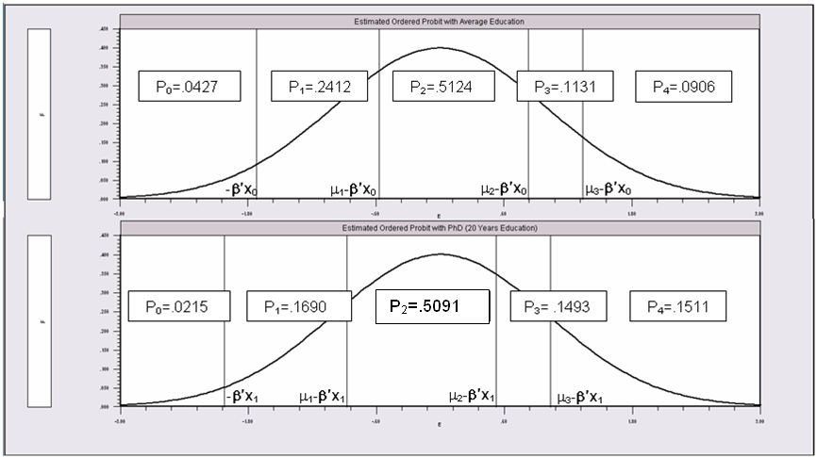
Partial Effects of 8 Years of Education

Slide 14
Analysis of Model Implications
Partial Effects
Fit Measures
Predicted Probabilities
  Averaged: They match sample proportions.
  By observation
  Segments of the sample
  Related to particular variables

Slide 15
Panel Data
Fixed Effects
  The usual incidental parameters problem
  Practically feasible but methodologically ambiguous
  Partitioning Prob(y_{it} > j|x_{it}) produces estimable binomial logit models. (Find a way to combine multiple estimates of the same β.
Random Effects
  Standard application
  Extension to random parameters – see above

Slide 16
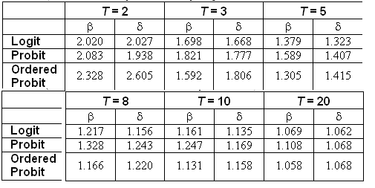
Incidental Parameters Problem
Table 9.1 Monte Carlo Analysis of the Bias of the MLE in Fixed Effects Discrete Choice Models (Means of empirical sampling distributions, N = 1,000 individuals, R = 200 replications)

Slide 17

A Study of Health Status in the Presence of Attrition

Slide 18
Model for Self Assessed Health
British Household Panel Survey (BHPS)
  Waves 1-8, 1991-1998
  Self assessed health on 0,1,2,3,4 scale
  Sociological and demographic covariates
  Dynamics – inertia in reporting of top scale
Dynamic ordered probit model
  Balanced panel – analyze dynamics
  Unbalanced panel – examine attrition

Slide 19
Dynamic Ordered Probit Model
It would not be appropriate to include h_{i,t-1} itself in the model as this is a label, not a measure

Slide 20
Random Effects Dynamic Ordered Probit Model

Slide 21
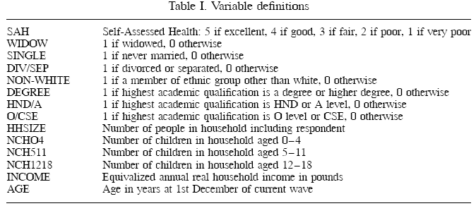
Data

Slide 22
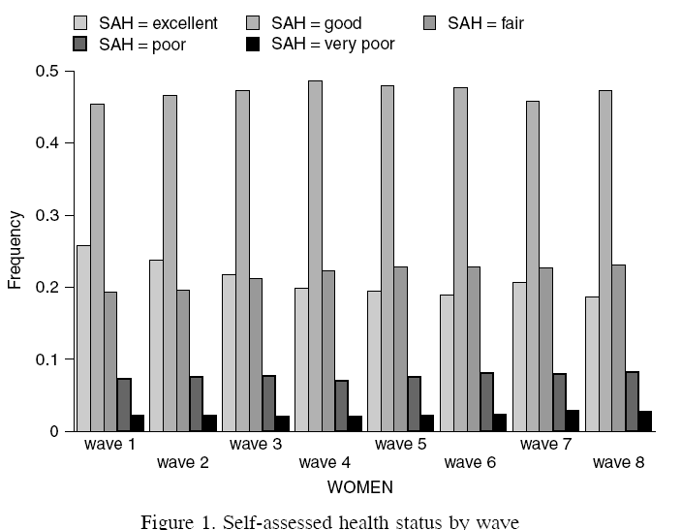
Variable of Interest

Slide 23
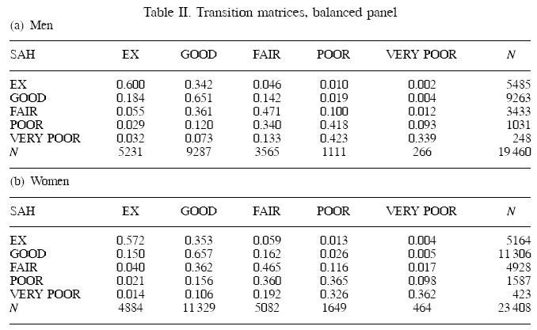
Dynamics

Slide 24
Probability Weighting Estimators
A Patch for Attrition
(1) Fit a participation probit equation for each wave.
(2) Compute p(i,t) = predictions of participation for each individual in each period.
  Special assumptions needed to make this work
Ignore common effects and fit a weighted pooled log likelihood: Σ_{i} Σ_{t} [d_{it}/p(i,t)]logLP_{it}.

Slide 25

Attrition Model with IP Weights
Assumes (1) Prob(attrition|all data) = Prob(attrition|selected variables) (ignorability)
(2) Attrition is an ‘absorbing state.’ No reentry.
Obviously not true for the GSOEP data above.
Can deal with point (2) by isolating a subsample of those present at wave 1 and the monotonically shrinking subsample as the waves progress.

Slide 26

Estimated Partial Effects by Model

