Slide 1




Microeconometric Modeling
William Greene
Stern School of Business
New York University
New York NY USA
3.3 Discrete Choice; The
Multinomial Logit
Model

Slide 2
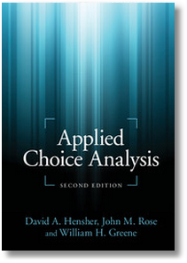
Concepts
Models
Random Utility
Multinomial Choice
Attributes and Characteristics
Stated and Revealed Preference
Unlabeled Choice
IID and IIA
Consumer Surplus
Choice Based Sampling
Alternative Specific Constants
Partial Effects and Elasticities
Simulation
WTP Space
Hausman – McFadden Test for IIA
Random Regret
Minimum Distance Estimator
Scaled MNL Model
Nonlinear Utility Functions
Multinomial Logit Model
Conditional Logit
Fixed Effects Multinomial Logit
Best/Worst
Nested Logit
Exploded Logit
Heteroscedastic Extreme Value (HEV)
Generalized Mixed Logit

Slide 3
A Microeconomics Platform
Consumers Maximize Utility (!!!)
Fundamental Choice Problem: Maximize U(x₁,x₂,…) subject to prices and budget constraints
A Crucial Result for the Classical Problem:
  Indirect Utility Function: V = V(p,I)
  Demand System of Continuous Choices
  Observed data usually consist of choices, prices, income
The Integrability Problem: Utility is not revealed by demands

Slide 4
Implications for Discrete Choice Models
Theory is silent about discrete choices
Translation of utilities to discrete choice requires:
  Well defined utility indexes: Completeness of rankings
  Rationality: Utility maximization
  Axioms of revealed preferences
Consumers often act to simplify choice situations
This allows us to build “models.”
  What common elements can be assumed?
  How can we account for heterogeneity?
However, revealed choices do not reveal utility, only rankings which are scale invariant.

Slide 5
Multinomial Choice
Among J Alternatives
• Random Utility Basis
Uitj = α_{ij} + β_{i}’x_{itj} + γ_{ij}z_{it} + ε_{ijt}
i = 1,…,N; j = 1,…,J(i,t); t = 1,…,T(i)
N individuals studied, J(i,t) alternatives in the choice
set, T(i) [usually 1] choice situations examined.
• Maximum Utility Assumption
Individual i will Choose alternative j in choice setting t if and only if
Uitj > Uitk for all k ≠ j.
• Underlying assumptions
  Smoothness of utilities
  Axioms of utility maximization: Transitive, Complete, Monotonic

Slide 6
Features of Utility Functions
The linearity assumption U_{itj} = α_{ij} + β_{i}′x_{itj} + γ_{j}′z_{it} + ε_{ijt}
To be relaxed later: U_{itj} = V(x_{itj},z_{it},β_{i}) + ε_{ijt}
The choice set:
  Individual (i) and situation (t) specific
  Unordered alternatives j = 1,…,J(i,t)
Deterministic (x,z,γ_{j}) and random components (α_{ij},β_{i},ε_{ijt})
Attributes of choices, x_{itj} and characteristics of the chooser, z_{it}.
  Alternative specific constants α_{ij} may vary by individual
  Preference weights, β_{i} may vary by individual
  Individual components, γ_{j} typically vary by choice, not by person
  Scaling parameters, σ_{ij} = Var[ε_{ijt}], subject to much modeling

Slide 7

Unordered Choices of 210 Travelers

Slide 8
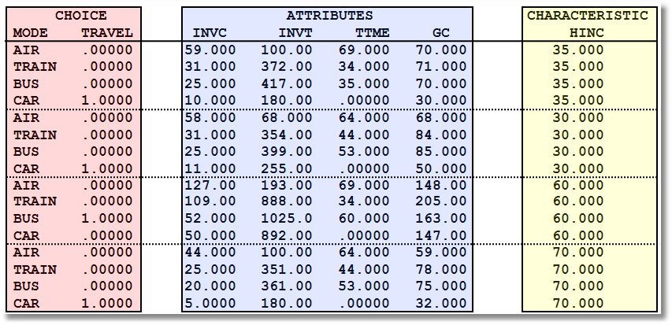
Data on Multinomial Discrete Choices

Slide 9
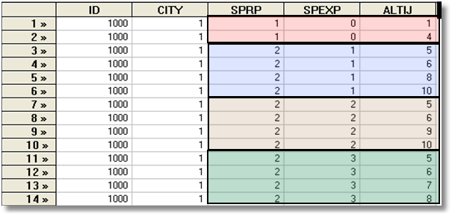
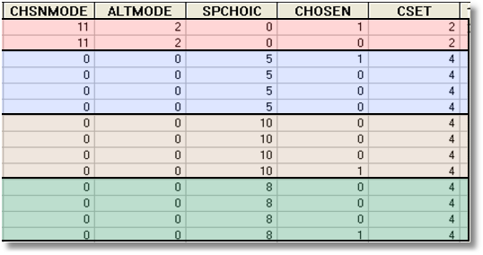
Each person makes four choices from a choice set that includes either two or four alternatives.
The first choice is the RP between two of the RP alternatives
The second-fourth are the SP among four of the six SP alternatives.
There are ten alternatives in total.
A Stated Choice Experiment with Variable Choice Sets

Slide 10

Stated Choice Experiment: Unlabeled Alternatives, One Observation
t=1
t=2
t=3
t=4
t=5
t=6
t=7
t=8

Slide 11
Unlabeled Choice Experiments
This an unlabelled choice experiment: Compare
Choice = (Air, Train, Bus, Car)
To
Choice = (Brand 1, Brand 2, Brand 3, None)
Brand 1 is only Brand 1 because it is first in
the list.
What does it mean to substitute Brand 1 for
Brand 2?
What does the own elasticity for Brand 1 mean?

Slide 12
The Multinomial Logit (MNL) Model
Independent extreme value (Gumbel):
  F(εitj) = Exp(-Exp(-εitj)) (random part of each utility)
  Independence across utility functions
  Identical variances (means absorbed in constants)
  Same parameters for all individuals (temporary)
Implied probabilities for observed outcomes

Slide 13
Specifying the Probabilities
• Choice specific attributes (X) vary by choices, multiply by generic
coefficients. E.g., TTME=terminal time, GC=generalized cost of travel mode
Generic characteristics (Income, constants) must be interacted with
choice specific constants.
• Estimation by maximum likelihood; d_{ij} = 1 if person i chooses j

Slide 14
Observed Data
Types of Data
  Individual choice
  Market shares – consumer markets
  Frequencies – vote counts
  Ranks – contests, preference rankings
Attributes and Characteristics
  Attributes are features of the choices such as price
  Characteristics are features of the chooser such as age, gender and income.
Choice Settings
  Cross section
  Repeated measurement (panel data)
    Stated choice experiments
    Repeated observations – THE scanner data on consumer choices

Slide 15
An Estimated MNL Model
-----------------------------------------------------------
Discrete choice (multinomial logit) model
Dependent variable Choice
Log likelihood function -199.97662
Estimation based on N = 210, K = 5
Information Criteria: Normalization=1/N
Normalized Unnormalized
AIC 1.95216 409.95325
Fin.Smpl.AIC 1.95356 410.24736
Bayes IC 2.03185 426.68878
Hannan Quinn 1.98438 416.71880
R2=1-LogL/LogL* Log-L fncn R-sqrd R2Adj
Constants only -283.7588 .2953 .2896
Chi-squared[ 2] = 167.56429
Prob [ chi squared > value ] = .00000
Response data are given as ind. choices
Number of obs.= 210, skipped 0 obs
--------+--------------------------------------------------
Variable| Coefficient Standard Error b/St.Er. P[|Z|>z]
--------+--------------------------------------------------
GC| -.01578*** .00438 -3.601 .0003
TTME| -.09709*** .01044 -9.304 .0000
A_AIR| 5.77636*** .65592 8.807 .0000
A_TRAIN| 3.92300*** .44199 8.876 .0000
A_BUS| 3.21073*** .44965 7.140 .0000
--------+--------------------------------------------------

Slide 16
Estimated MNL Model
-----------------------------------------------------------
Discrete choice (multinomial logit) model
Dependent variable Choice
Log likelihood function -199.97662
Estimation based on N = 210, K = 5
Information Criteria: Normalization=1/N
Normalized Unnormalized
AIC 1.95216 409.95325
Fin.Smpl.AIC 1.95356 410.24736
Bayes IC 2.03185 426.68878
Hannan Quinn 1.98438 416.71880
R2=1-LogL/LogL* Log-L fncn R-sqrd R2Adj
Constants only -283.7588 .2953 .2896
Chi-squared[ 2] = 167.56429
Prob [ chi squared > value ] = .00000
Response data are given as ind. choices
Number of obs.= 210, skipped 0 obs
--------+--------------------------------------------------
Variable| Coefficient Standard Error b/St.Er. P[|Z|>z]
--------+--------------------------------------------------
GC| -.01578*** .00438 -3.601 .0003
TTME| -.09709*** .01044 -9.304 .0000
A_AIR| 5.77636*** .65592 8.807 .0000
A_TRAIN| 3.92300*** .44199 8.876 .0000
A_BUS| 3.21073*** .44965 7.140 .0000
--------+--------------------------------------------------

Slide 17
Model Fit Based on Log Likelihood
Three sets of predicted probabilities
  No model: Pij = 1/J (.25)
  Constants only: Pij = (1/N)Σi dij
  (58,63,30,59)/210=.286,.300,.143,.281
  Constants only model matches sample shares
  Estimated model: Logit probabilities
Compute log likelihood
Measure improvement in log likelihood with
Pseudo R-squared = 1 – LogL/LogL₀
(“Adjusted” for number of parameters in the model.)

Slide 18
Fit the Model with Only ASCs
If the choice set varies across observations, this is the only way to obtain the restricted log likelihood.
-----------------------------------------------------------
Discrete choice (multinomial logit) model
Dependent variable Choice
Log likelihood function -283.75877
Estimation based on N = 210, K = 3
Information Criteria: Normalization=1/N
Normalized Unnormalized
AIC 2.73104 573.51754
Fin.Smpl.AIC 2.73159 573.63404
Bayes IC 2.77885 583.55886
Hannan Quinn 2.75037 577.57687
R2=1-LogL/LogL* Log-L fncn R-sqrd R2Adj
Constants only -283.7588 .0000-.0048
Response data are given as ind. choices
Number of obs.= 210, skipped 0 obs
--------+--------------------------------------------------
Variable| Coefficient Standard Error b/St.Er. P[|Z|>z]
--------+--------------------------------------------------
A_AIR| -.01709 .18491 -.092 .9263
A_TRAIN| .06560 .18117 .362 .7173
A_BUS| -.67634*** .22424 -3.016 .0026
--------+--------------------------------------------------

Slide 19
Estimated MNL Model
-----------------------------------------------------------
Discrete choice (multinomial logit) model
Dependent variable Choice
Log likelihood function -199.97662
Estimation based on N = 210, K = 5
Information Criteria: Normalization=1/N
Normalized Unnormalized
AIC 1.95216 409.95325
Fin.Smpl.AIC 1.95356 410.24736
Bayes IC 2.03185 426.68878
Hannan Quinn 1.98438 416.71880
R2=1-LogL/LogL* Log-L fncn R-sqrd R2Adj
Constants only -283.7588 .2953 .2896
Chi-squared[ 2] = 167.56429
Prob [ chi squared > value ] = .00000
Response data are given as ind. choices
Number of obs.= 210, skipped 0 obs
--------+--------------------------------------------------
Variable| Coefficient Standard Error b/St.Er. P[|Z|>z]
--------+--------------------------------------------------
GC| -.01578*** .00438 -3.601 .0003
TTME| -.09709*** .01044 -9.304 .0000
A_AIR| 5.77636*** .65592 8.807 .0000
A_TRAIN| 3.92300*** .44199 8.876 .0000
A_BUS| 3.21073*** .44965 7.140 .0000
--------+--------------------------------------------------

Slide 20
Model Fit Based on Predictions
Nj = actual number of choosers of “j.”
Nfitj = Σi Predicted Probabilities for “j”
Cross tabulate:
Predicted vs. Actual, cell prediction is cell probability
Predicted vs. Actual, cell prediction is the cell
with the largest probability
Njk = Σi dij × Predicted P(i,k)

Slide 21
Fit Measures Based on Crosstabulation
+-------------------------------------------------------+
| Cross tabulation of actual choice vs. predicted P(j) |
| Row indicator is actual, column is predicted. |
| Predicted total is F(k,j,i)=Sum(i=1,...,N) P(k,j,i). |
| Column totals may be subject to rounding error. |
+-------------------------------------------------------+
NLOGIT Cross Tabulation for 4 outcome Multinomial Choice Model
AIR TRAIN BUS CAR Total
+-------------+-------------+-------------+-------------+-------------+
AIR | 32 | 8 | 5 | 13 | 58 |
TRAIN | 8 | 37 | 5 | 14 | 63 |
BUS | 3 | 5 | 15 | 6 | 30 |
CAR | 15 | 13 | 6 | 26 | 59 |
+-------------+-------------+-------------+-------------+-------------+
Total | 58 | 63 | 30 | 59 | 210 |
+-------------+-------------+-------------+-------------+-------------+
NLOGIT Cross Tabulation for 4 outcome Constants Only Choice Model
AIR TRAIN BUS CAR Total
+-------------+-------------+-------------+-------------+-------------+
AIR | 16 | 17 | 8 | 16 | 58 |
TRAIN | 17 | 19 | 9 | 18 | 63 |
BUS | 8 | 9 | 4 | 8 | 30 |
CAR | 16 | 18 | 8 | 17 | 59 |
+-------------+-------------+-------------+-------------+-------------+
Total | 58 | 63 | 30 | 59 | 210 |
+-------------+-------------+-------------+-------------+-------------+

Slide 22
j = Train
m = Car
k = Price

Slide 23
k = Price
j = Train
j = Train
m = Car

Slide 25
+---------------------------------------------------+
| Elasticity averaged over observations.|
| Attribute is INVT in choice AIR |
| Mean St.Dev |
| * Choice=AIR -.2055 .0666 |
| Choice=TRAIN .0903 .0681 |
| Choice=BUS .0903 .0681 |
| Choice=CAR .0903 .0681 |
+---------------------------------------------------+
| Attribute is INVT in choice TRAIN |
| Choice=AIR .3568 .1231 |
| * Choice=TRAIN -.9892 .5217 |
| Choice=BUS .3568 .1231 |
| Choice=CAR .3568 .1231 |
+---------------------------------------------------+
| Attribute is INVT in choice BUS |
| Choice=AIR .1889 .0743 |
| Choice=TRAIN .1889 .0743 |
| * Choice=BUS -1.2040 .4803 |
| Choice=CAR .1889 .0743 |
+---------------------------------------------------+
| Attribute is INVT in choice CAR |
| Choice=AIR .3174 .1195 |
| Choice=TRAIN .3174 .1195 |
| Choice=BUS .3174 .1195 |
| * Choice=CAR -.9510 .5504 |
+---------------------------------------------------+
| Effects on probabilities of all choices in model: |
| * = Direct Elasticity effect of the attribute. |
+---------------------------------------------------+
Note the effect of IIA on the cross effects.
Own effect
Cross effects
Elasticities are computed for each observation; the mean and standard deviation are then computed across the sample observations.

Slide 26
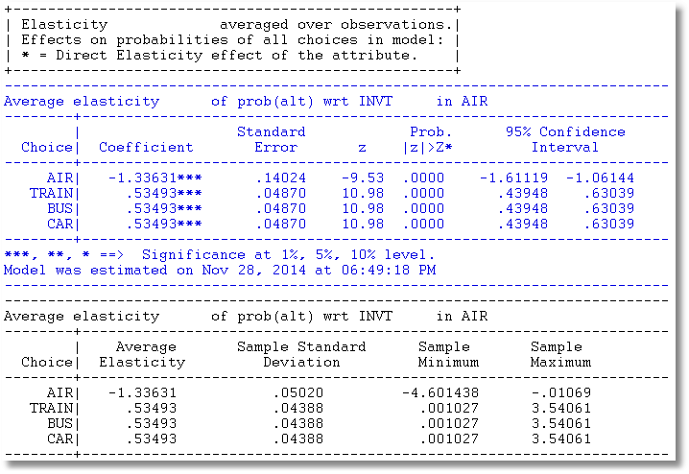
Use Krinsky and Robb to compute standard errors for Elasticities

Slide 27
Analyzing the Behavior of Market
Shares to Examine Discrete Effects
Scenario: What happens to the number of people who make specific choices if a particular attribute changes in a specified way?
Fit the model first, then using the identical model setup, add
; Simulation = list of choices to be analyzed
; Scenario = Attribute (in choices) = type of change
For the CLOGIT application
; Simulation = * ? This is ALL choices
; Scenario: GC(car)=[*]1.25$ Car_GC rises by 25%

Slide 28
Model Simulation
+---------------------------------------------+
| Discrete Choice (One Level) Model |
| Model Simulation Using Previous Estimates |
| Number of observations 210 |
+---------------------------------------------+
+------------------------------------------------------+
|Simulations of Probability Model |
|Model: Discrete Choice (One Level) Model |
|Simulated choice set may be a subset of the choices. |
|Number of individuals is the probability times the |
|number of observations in the simulated sample. |
|Column totals may be affected by rounding error. |
|The model used was simulated with 210 observations.|
+------------------------------------------------------+
-------------------------------------------------------------------------
Specification of scenario 1 is:
Attribute Alternatives affected Change type Value
--------- ------------------------------- ------------------- ---------
GC CAR Scale base by value 1.250
-------------------------------------------------------------------------
The simulator located 209 observations for this scenario.
Simulated Probabilities (shares) for this scenario:
+----------+--------------+--------------+------------------+
|Choice | Base | Scenario | Scenario - Base |
| |%Share Number |%Share Number |ChgShare ChgNumber|
+----------+--------------+--------------+------------------+
|AIR | 27.619 58 | 29.592 62 | 1.973% 4 |
|TRAIN | 30.000 63 | 31.748 67 | 1.748% 4 |
|BUS | 14.286 30 | 15.189 32 | .903% 2 |
|CAR | 28.095 59 | 23.472 49 | -4.624% -10 |
|Total |100.000 210 |100.000 210 | .000% 0 |
+----------+--------------+--------------+------------------+
Changes in the predicted market shares when GC_CAR increases by 25%.

Slide 29
More Complicated Model Simulation
In vehicle cost of CAR falls by 10%
Market is limited to ground (Train, Bus, Car)
CLOGIT ; Lhs = Mode
; Choices = Air,Train,Bus,Car
; Rhs = TTME,INVC,INVT,GC
; Rh2 = One ,Hinc
; Simulation = TRAIN,BUS,CAR
; Scenario: GC(car)=[*].9$

Slide 30
Model Estimation Step
-----------------------------------------------------------
Discrete choice (multinomial logit) model
Dependent variable Choice
Log likelihood function -172.94366
Estimation based on N = 210, K = 10
R2=1-LogL/LogL* Log-L fncn R-sqrd R2Adj
Constants only -283.7588 .3905 .3807
Chi-squared[ 7] = 221.63022
Prob [ chi squared > value ] = .00000
Response data are given as ind. choices
Number of obs.= 210, skipped 0 obs
--------+--------------------------------------------------
Variable| Coefficient Standard Error b/St.Er. P[|Z|>z]
--------+--------------------------------------------------
TTME| -.10289*** .01109 -9.280 .0000
INVC| -.08044*** .01995 -4.032 .0001
INVT| -.01399*** .00267 -5.240 .0000
GC| .07578*** .01833 4.134 .0000
A_AIR| 4.37035*** 1.05734 4.133 .0000
AIR_HIN1| .00428 .01306 .327 .7434
A_TRAIN| 5.91407*** .68993 8.572 .0000
TRA_HIN2| -.05907*** .01471 -4.016 .0001
A_BUS| 4.46269*** .72333 6.170 .0000
BUS_HIN3| -.02295 .01592 -1.442 .1493
--------+--------------------------------------------------
Alternative specific constants and interactions of ASCs and Household Income

Slide 31
+---------------------------------------------+
| Discrete Choice (One Level) Model |
| Model Simulation Using Previous Estimates |
| Number of observations 210 |
+---------------------------------------------+
+------------------------------------------------------+
|Simulations of Probability Model |
|Model: Discrete Choice (One Level) Model |
|Simulated choice set may be a subset of the choices. |
|Number of individuals is the probability times the |
|number of observations in the simulated sample. |
|The model used was simulated with 210 observations.|
+------------------------------------------------------+
-------------------------------------------------------------------------
Specification of scenario 1 is:
Attribute Alternatives affected Change type Value
--------- ------------------------------- ------------------- ---------
INVC CAR Scale base by value .900
-------------------------------------------------------------------------
The simulator located 210 observations for this scenario.
Simulated Probabilities (shares) for this scenario:
+----------+--------------+--------------+------------------+
|Choice | Base | Scenario | Scenario - Base |
| |%Share Number |%Share Number |ChgShare ChgNumber|
+----------+--------------+--------------+------------------+
|TRAIN | 37.321 78 | 35.854 75 | -1.467% -3 |
|BUS | 19.805 42 | 18.641 39 | -1.164% -3 |
|CAR | 42.874 90 | 45.506 96 | 2.632% 6 |
|Total |100.000 210 |100.000 210 | .000% 0 |
+----------+--------------+--------------+------------------+
Model Simulation Step

Slide 32
Willingness to Pay

Slide 33
Willingness to Pay
U(alt) = a_{j} + b_{INCOME}*INCOME + b_{Attribute}*Attribute + …
WTP = MU(Attribute)/MU(Income)
When MU(Income) is not available, an approximation
often used is –MU(Cost).
U(Air,Train,Bus,Car)
= α_{alt} + β_{cost} Cost + β_{INVT} INVT + β_{TTME} TTME + ε_{alt}
WTP for less in vehicle time = -β_{INVT} / β_{COST}
WTP for less terminal time = -β_{TIME} / β_{COST}

Slide 34
WTP from CLOGIT Model
-----------------------------------------------------------
Discrete choice (multinomial logit) model
Dependent variable Choice
--------+--------------------------------------------------
Variable| Coefficient Standard Error b/St.Er. P[|Z|>z]
--------+--------------------------------------------------
GC| -.00286 .00610 -.469 .6390
INVT| -.00349*** .00115 -3.037 .0024
TTME| -.09746*** .01035 -9.414 .0000
AASC| 4.05405*** .83662 4.846 .0000
TASC| 3.64460*** .44276 8.232 .0000
BASC| 3.19579*** .45194 7.071 .0000
--------+--------------------------------------------------
WALD ; fn1=WTP_INVT=b_invt/b_gc ; fn2=WTP_TTME=b_ttme/b_gc$
-----------------------------------------------------------
WALD procedure.
--------+--------------------------------------------------
Variable| Coefficient Standard Error b/St.Er. P[|Z|>z]
--------+--------------------------------------------------
WTP_INVT| 1.22006 2.88619 .423 .6725
WTP_TTME| 34.0771 73.07097 .466 .6410
--------+--------------------------------------------------
Very different estimates suggests this might not be a very good model.

Slide 35
Estimation in WTP Space

Slide 36
The I.I.D Assumption
U_{itj} = α_{ij} + β’x_{itj} + γ’z_{it} + ε_{ijt}
  F(ε_{itj}) = Exp(-Exp(-εitj)) (random part of each utility)
  Independence across utility functions
  Identical variances (means absorbed in constants)
Restriction on equal scaling may be inappropriate
Correlation across alternatives may be suppressed
Equal cross elasticities is a substantive restriction
Behavioral implication of IID is independence from irrelevant
alternatives. If an alternative is removed, probability is
spread equally across the remaining alternatives. This is
unreasonable

Slide 37
IIA Implication of IID

Slide 38
+---------------------------------------------------+
| Elasticity averaged over observations.|
| Attribute is INVT in choice AIR |
| Mean St.Dev |
| * Choice=AIR -.2055 .0666 |
| Choice=TRAIN .0903 .0681 |
| Choice=BUS .0903 .0681 |
| Choice=CAR .0903 .0681 |
+---------------------------------------------------+
| Attribute is INVT in choice TRAIN |
| Choice=AIR .3568 .1231 |
| * Choice=TRAIN -.9892 .5217 |
| Choice=BUS .3568 .1231 |
| Choice=CAR .3568 .1231 |
+---------------------------------------------------+
| Attribute is INVT in choice BUS |
| Choice=AIR .1889 .0743 |
| Choice=TRAIN .1889 .0743 |
| * Choice=BUS -1.2040 .4803 |
| Choice=CAR .1889 .0743 |
+---------------------------------------------------+
| Attribute is INVT in choice CAR |
| Choice=AIR .3174 .1195 |
| Choice=TRAIN .3174 .1195 |
| Choice=BUS .3174 .1195 |
| * Choice=CAR -.9510 .5504 |
+---------------------------------------------------+
| Effects on probabilities of all choices in model: |
| * = Direct Elasticity effect of the attribute. |
+---------------------------------------------------+
Behavioral Implication of IIA
Own effect
Cross effects
Note the effect of IIA on the cross effects.
Elasticities are computed for each observation; the mean and standard deviation are then computed across the sample observations.

Slide 39
A Hausman and McFadden Test for IIA
Estimate full model with “irrelevant alternatives”
Estimate the short model eliminating the irrelevant alternatives
  Eliminate individuals who chose the irrelevant alternatives
  Drop attributes that are constant in the surviving choice set.
Do the coefficients change? Under the IIA assumption, they should not.
  Use a Hausman test:
  Chi-squared, d.f. Number of parameters estimated

Slide 40
IIA Test for Choice AIR
+--------+--------------+----------------+--------+--------+
|Variable| Coefficient | Standard Error |b/St.Er.|P[|Z|>z]|
+--------+--------------+----------------+--------+--------+
GC | .06929537 .01743306 3.975 .0001
TTME | -.10364955 .01093815 -9.476 .0000
INVC | -.08493182 .01938251 -4.382 .0000
INVT | -.01333220 .00251698 -5.297 .0000
AASC | 5.20474275 .90521312 5.750 .0000
TASC | 4.36060457 .51066543 8.539 .0000
BASC | 3.76323447 .50625946 7.433 .0000
+--------+--------------+----------------+--------+--------+
GC | .53961173 .14654681 3.682 .0002
TTME | -.06847037 .01674719 -4.088 .0000
INVC | -.58715772 .14955000 -3.926 .0001
INVT | -.09100015 .02158271 -4.216 .0000
TASC | 4.62957401 .81841212 5.657 .0000
BASC | 3.27415138 .76403628 4.285 .0000
Matrix IIATEST has 1 rows and 1 columns.
1
+--------------
1| 33.78445 Test statistic
+------------------------------------+
| Listed Calculator Results |
+------------------------------------+
Result = 9.487729 Critical value
IIA is rejected

Slide 41

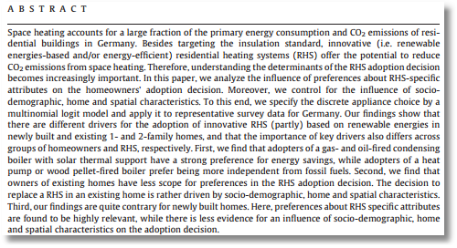

Slide 42
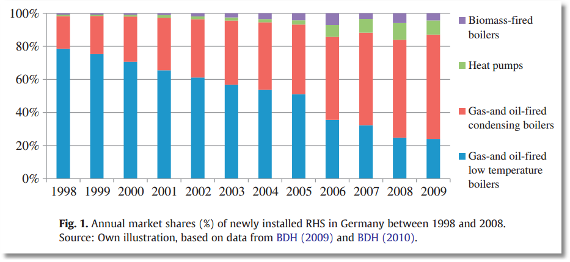

Slide 43
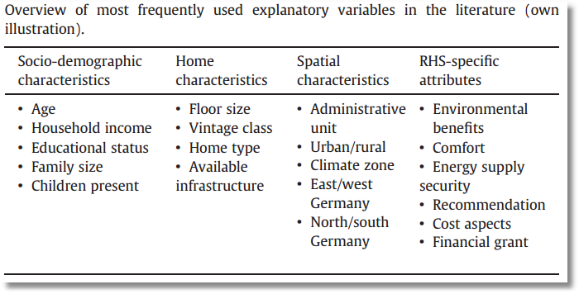

Slide 44
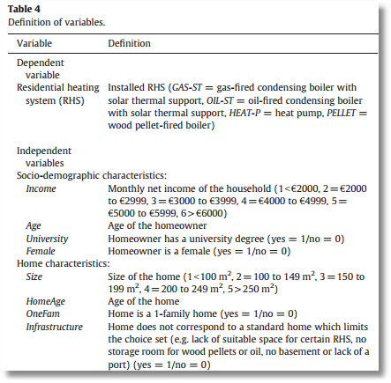
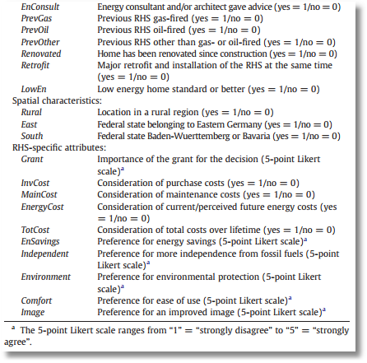

Slide 45
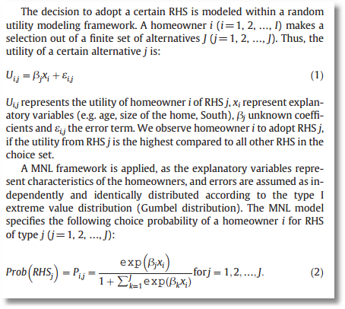
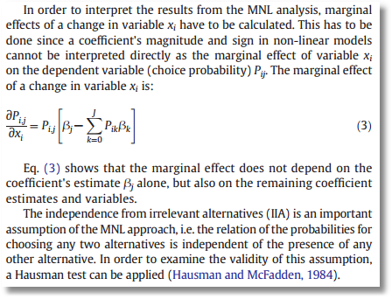

Slide 46
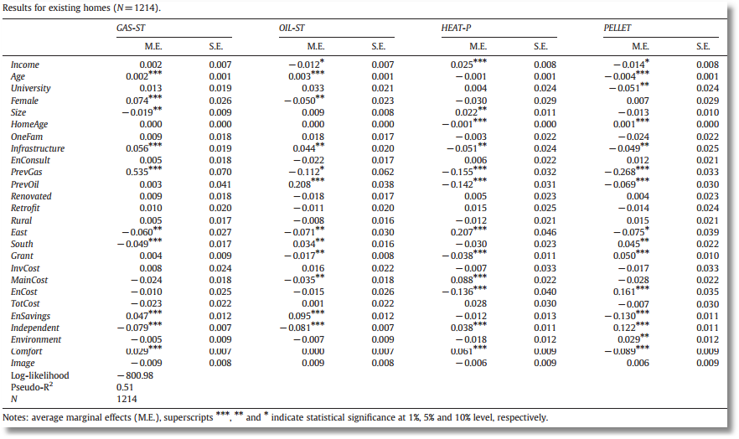

Slide 47
Fixed Effects Multinomial Logit:
Application of Minimum Distance Estimation

Slide 48
Binary Logit Conditional Probabiities

Slide 49
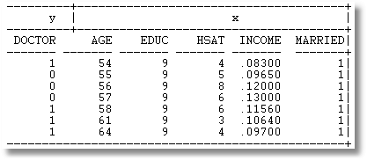
Example: Seven Period Binary Logit

Slide 50
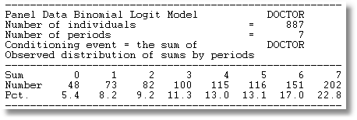
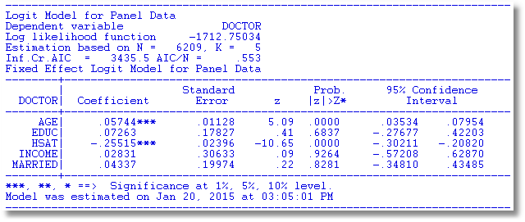

Slide 51
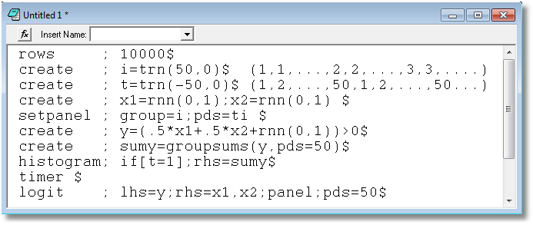

Slide 52
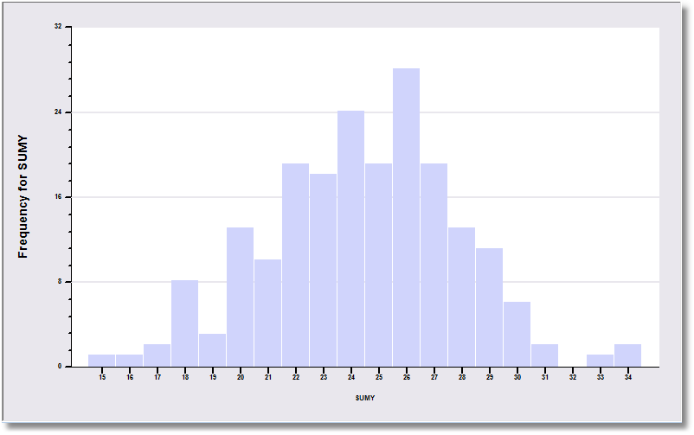
The sample is 200 individuals each observed 50 times.

Slide 53
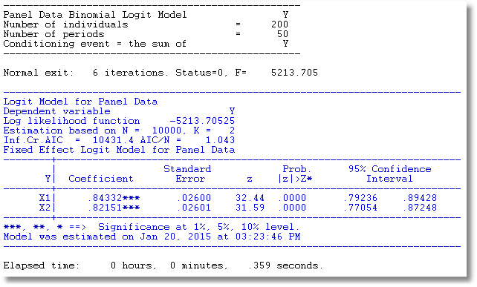
The data are generated from a probit process with b1 = b2 = .5. But, it is fit as a logit model. The coefficients obey the familiar relationship, 1.6*probit.

Slide 54
Multinomial Logit Model: J+1 choices including a base choice.

Slide 55
Estimation Strategy
Conditional ML of the full MNL model. Impressively complicated.
A Minimum Distance (MDE) Strategy
  Each alternative treated as a binary choice vs. the base provides an estimator of β
    Select subsample that chose either option j or the base
    Estimate β using this binary choice setting
    This provides J different estimators of the same β
  Optimally combine the different estimators of β

Slide 56
Minimum Distance Estimation

Slide 57
MDE Estimation

Slide 58
MDE Estimation

