Slide 1




Microeconometric Modeling
William Greene
Stern School of Business
New York University
New York NY USA
4.1 Nested Logit and
Multinomial Probit
Models

Slide 2

Concepts
Models
Correlation
Random Utility
RU1 and RU2
Tree
2 Step vs. FIML
Decomposition of Elasticity
Degenerate Branch
Scaling
Normalization
Stata/MPROBIT
Multinomial Logit
Nested Logit
Best/Worst Nested Logit
Error Components Logit
Multinomial Probit

Slide 3
Extended Formulation of the MNL
Sets of similar alternatives
Compound Utility: U(Alt)=U(Alt|Branch)+U(branch)
Behavioral implications – Correlations within branches
LIMB
Travel
BRANCH
Private
Public
TWIG
Air
Car
Train
Bus

Slide 4
Correlation Structure for a Two Level Model
Within a branch
  Identical variances (IIA (MNL) applies)
  Covariance (all same) = variance at higher level
Branches have different variances (scale factors)
Nested logit probabilities: Generalized Extreme Value
Prob[Alt,Branch] = Prob(branch) * Prob(Alt|Branch)

Slide 5
Probabilities for a Nested Logit Model

Slide 6
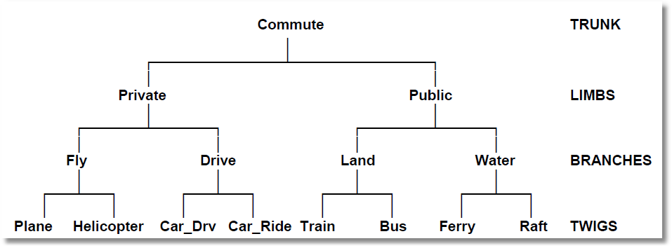
Higher Level Trees
E.g., Location (Neighborhood)
Housing Type (Rent, Buy, House, Apt)
Housing (# Bedrooms)

Slide 7
Estimation Strategy for
Nested Logit Models
Two step estimation (ca. 1980s)
  For each branch, just fit MNL
    Loses efficiency – replicates coefficients
  For branch level, fit separate model, just including y and the inclusive values in the branch level utility function
    Again loses efficiency
Full information ML (current)
Fit the entire model at once, imposing all restrictions

Slide 8
MNL Baseline
-----------------------------------------------------------
Discrete choice (multinomial logit) model
Dependent variable Choice
Log likelihood function -172.94366
Estimation based on N = 210, K = 10
R2=1-LogL/LogL* Log-L fncn R-sqrd R2Adj
Constants only -283.7588 .3905 .3787
Chi-squared[ 7] = 221.63022
Prob [ chi squared > value ] = .00000
Response data are given as ind. choices
Number of obs.= 210, skipped 0 obs
--------+--------------------------------------------------
Variable| Coefficient Standard Error b/St.Er. P[|Z|>z]
--------+--------------------------------------------------
GC| .07578*** .01833 4.134 .0000
TTME| -.10289*** .01109 -9.280 .0000
INVT| -.01399*** .00267 -5.240 .0000
INVC| -.08044*** .01995 -4.032 .0001
A_AIR| 4.37035*** 1.05734 4.133 .0000
AIR_HIN1| .00428 .01306 .327 .7434
A_TRAIN| 5.91407*** .68993 8.572 .0000
TRA_HIN3| -.05907*** .01471 -4.016 .0001
A_BUS| 4.46269*** .72333 6.170 .0000
BUS_HIN4| -.02295 .01592 -1.442 .1493
--------+--------------------------------------------------

Slide 9
FIML Parameter Estimates
-----------------------------------------------------------
FIML Nested Multinomial Logit Model
Dependent variable MODE
Log likelihood function -166.64835
The model has 2 levels.
Random Utility Form 1:IVparms = LMDAb|l
Number of obs.= 210, skipped 0 obs
--------+--------------------------------------------------
Variable| Coefficient Standard Error b/St.Er. P[|Z|>z]
--------+--------------------------------------------------
|Attributes in the Utility Functions (beta)
GC| .06579*** .01878 3.504 .0005
TTME| -.07738*** .01217 -6.358 .0000
INVT| -.01335*** .00270 -4.948 .0000
INVC| -.07046*** .02052 -3.433 .0006
A_AIR| 2.49364** 1.01084 2.467 .0136
AIR_HIN1| .00357 .01057 .337 .7358
A_TRAIN| 3.49867*** .80634 4.339 .0000
TRA_HIN3| -.03581*** .01379 -2.597 .0094
A_BUS| 2.30142*** .81284 2.831 .0046
BUS_HIN4| -.01128 .01459 -.773 .4395
|IV parameters, lambda(b|l),gamma(l)
PRIVATE| 2.16095*** .47193 4.579 .0000
PUBLIC| 1.56295*** .34500 4.530 .0000
--------+--------------------------------------------------

Slide 10
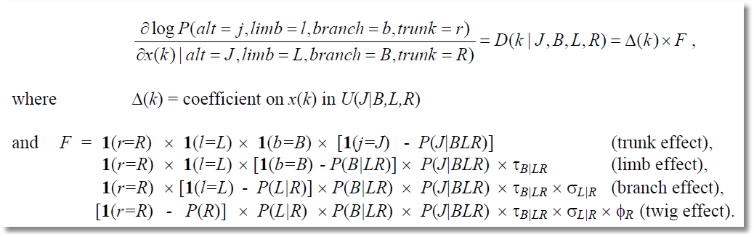
Elasticities Decompose Additively

Slide 11
+-----------------------------------------------------------------------+
| Elasticity averaged over observations. |
| Attribute is INVC in choice AIR |
| Decomposition of Effect if Nest Total Effect|
| Trunk Limb Branch Choice Mean St.Dev|
| Branch=PRIVATE |
| * Choice=AIR .000 .000 -2.456 -3.091 -5.547 3.525 |
| Choice=CAR .000 .000 -2.456 2.916 .460 3.178 |
| Branch=PUBLIC |
| Choice=TRAIN .000 .000 3.846 .000 3.846 4.865 |
| Choice=BUS .000 .000 3.846 .000 3.846 4.865 |
+-----------------------------------------------------------------------+
| Attribute is INVC in choice CAR |
| Branch=PRIVATE |
| Choice=AIR .000 .000 -.757 .650 -.107 .589 |
| * Choice=CAR .000 .000 -.757 -.830 -1.587 1.292 |
| Branch=PUBLIC |
| Choice=TRAIN .000 .000 .647 .000 .647 .605 |
| Choice=BUS .000 .000 .647 .000 .647 .605 |
+-----------------------------------------------------------------------+
| Attribute is INVC in choice TRAIN |
| Branch=PRIVATE |
| Choice=AIR .000 .000 1.340 .000 1.340 1.475 |
| Choice=CAR .000 .000 1.340 .000 1.340 1.475 |
| Branch=PUBLIC |
| * Choice=TRAIN .000 .000 -1.986 -1.490 -3.475 2.539 |
| Choice=BUS .000 .000 -1.986 2.128 .142 1.321 |
+-----------------------------------------------------------------------+
| * indicates direct Elasticity effect of the attribute. |
+-----------------------------------------------------------------------+

Slide 12
Testing vs. the MNL
Log likelihood for the NL model
Constrain IV parameters to equal 1 with
; IVSET(list of branches)=[1]
Use likelihood ratio test
For the example:
  LogL (NL) = -166.68435
  LogL (MNL) = -172.94366
  Chi-squared with 2 d.f. = 2(-166.68435-(-172.94366))
  = 12.51862
  The critical value is 5.99 (95%)
  The MNL (and a fortiori, IIA) is rejected

Slide 13
An Error Components Model

Slide 14
Error Components
Logit Model
-----------------------------------------------------------
Error Components (Random Effects) model
Dependent variable MODE
Log likelihood function -182.27368
Response data are given as ind. choices
Replications for simulated probs. = 25
Halton sequences used for simulations
ECM model with panel has 70 groups
Fixed number of obsrvs./group= 3
Hessian is not PD. Using BHHH estimator
Number of obs.= 210, skipped 0 obs
--------+--------------------------------------------------
Variable| Coefficient Standard Error b/St.Er. P[|Z|>z]
--------+--------------------------------------------------
|Nonrandom parameters in utility functions
GC| .07293*** .01978 3.687 .0002
TTME| -.10597*** .01116 -9.499 .0000
INVT| -.01402*** .00293 -4.787 .0000
INVC| -.08825*** .02206 -4.000 .0001
A_AIR| 5.31987*** .90145 5.901 .0000
A_TRAIN| 4.46048*** .59820 7.457 .0000
A_BUS| 3.86918*** .67674 5.717 .0000
|Standard deviations of latent random effects
SigmaE01| .27336 3.25167 .084 .9330
SigmaE02| 1.21988 .94292 1.294 .1958
--------+--------------------------------------------------

Slide 15
The Multinomial Probit Model

Slide 16
Multinomial Probit Probabilities

Slide 17
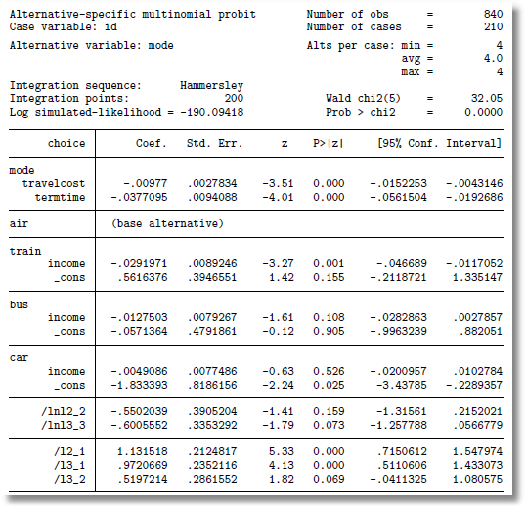
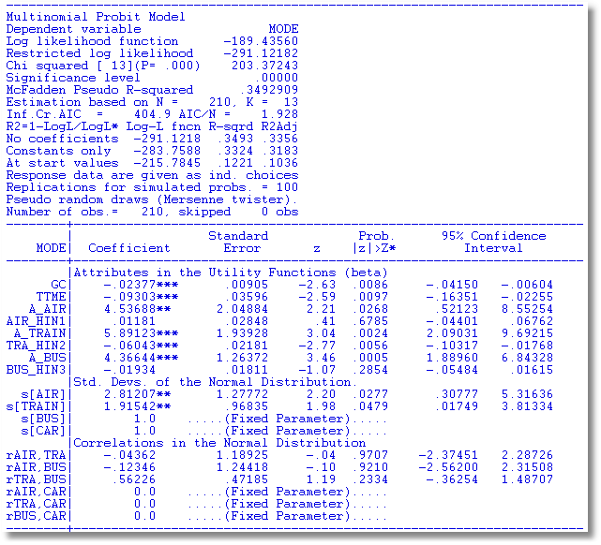
The problem of just reporting coefficients
Stata: AIR = “base alternative” Normalizes on CAR

Slide 18
Multinomial Probit Model
+---------------------------------------------+
| Multinomial Probit Model |
| Dependent variable MODE |
| Number of observations 210 ||
| Log likelihood function -184.7619 | Not comparable to MNL
| Response data are given as ind. choice. |
+---------------------------------------------+
+--------+--------------+----------------+--------+--------+
|Variable| Coefficient | Standard Error |b/St.Er.|P[|Z|>z]|
+--------+--------------+----------------+--------+--------+
---------+Attributes in the Utility Functions (beta)
GC | .10822534 .04339733 2.494 .0126
TTME | -.08973122 .03381432 -2.654 .0080
INVC | -.13787970 .05010551 -2.752 .0059
INVT | -.02113622 .00727190 -2.907 .0037
AASC | 3.24244623 1.57715164 2.056 .0398
TASC | 4.55063845 1.46158257 3.114 .0018
BASC | 4.02415398 1.28282031 3.137 .0017
---------+Std. Devs. of the Normal Distribution.
s[AIR] | 3.60695794 1.42963795 2.523 .0116
s[TRAIN]| 1.59318892 .81711159 1.950 .0512
s[BUS] | 1.00000000 ......(Fixed Parameter).......
s[CAR] | 1.00000000 ......(Fixed Parameter).......
---------+Correlations in the Normal Distribution
rAIR,TRA| .30491746 .49357120 .618 .5367
rAIR,BUS| .40383018 .63548534 .635 .5251
rTRA,BUS| .36973127 .42310789 .874 .3822
rAIR,CAR| .000000 ......(Fixed Parameter).......
rTRA,CAR| .000000 ......(Fixed Parameter).......
rBUS,CAR| .000000 ......(Fixed Parameter).......

Slide 19
Multinomial Probit Elasticities
+---------------------------------------------------+
| Elasticity averaged over observations.|
| Attribute is INVC in choice AIR |
| Effects on probabilities of all choices in model: |
| * = Direct Elasticity effect of the attribute. |
| Mean St.Dev |
| * Choice=AIR -4.2785 1.7182 |
| Choice=TRAIN 1.9910 1.6765 |
| Choice=BUS 2.6722 1.8376 |
| Choice=CAR 1.4169 1.3250 |
| Attribute is INVC in choice TRAIN |
| Choice=AIR .8827 .8711 |
| * Choice=TRAIN -6.3979 5.8973 |
| Choice=BUS 3.6442 2.6279 |
| Choice=CAR 1.9185 1.5209 |
| Attribute is INVC in choice BUS |
| Choice=AIR .3879 .6303 |
| Choice=TRAIN 1.2804 2.1632 |
| * Choice=BUS -7.4014 4.5056 |
| Choice=CAR 1.5053 2.5220 |
| Attribute is INVC in choice CAR |
| Choice=AIR .2593 .2529 |
| Choice=TRAIN .8457 .8093 |
| Choice=BUS 1.7532 1.3878 |
| * Choice=CAR -2.6657 3.0418 |
+---------------------------------------------------+
Multinomial Logit
+---------------------------+
| INVC in AIR |
| Mean St.Dev |
| * -5.0216 2.3881 |
| 2.2191 2.6025 |
| 2.2191 2.6025 |
| 2.2191 2.6025 |
| INVC in TRAIN |
| 1.0066 .8801 |
| * -3.3536 2.4168 |
| 1.0066 .8801 |
| 1.0066 .8801 |
| INVC in BUS |
| .4057 .6339 |
| .4057 .6339 |
| * -2.4359 1.1237 |
| .4057 .6339 |
| INVC in CAR |
| .3944 .3589 |
| .3944 .3589 |
| .3944 .3589 |
| * -1.3888 1.2161 |
+---------------------------+

