Slide 1




Microeconometric Modeling
William Greene
Stern School of Business
New York University
New York NY USA
4.3 Mixed Models and
Random Parameters

Slide 2

Concepts
Models
Random Effects
Simulation
Random Parameters
Maximum Simulated Likelihood
Cholesky Decomposition
Heterogeneity
Hierarchical Model
Conditional Means
Population Distribution
Nested Logit
Willingness to Pay (WTP)
Random Parameters and WTP
WTP Space
Endogeneity
Market Share Data
Random Parameters
RP Logit
Error Components Logit
Generalized Mixed Logit
Berry-Levinsohn-Pakes Model
Hybrid Choice
MIMIC Model

Slide 3
A Recast Random Effects Model

Slide 4
The Entire Parameter Vector is Random

Slide 5
Maximum Simulated Likelihood
True log likelihood
Simulated log likelihood

Slide 6
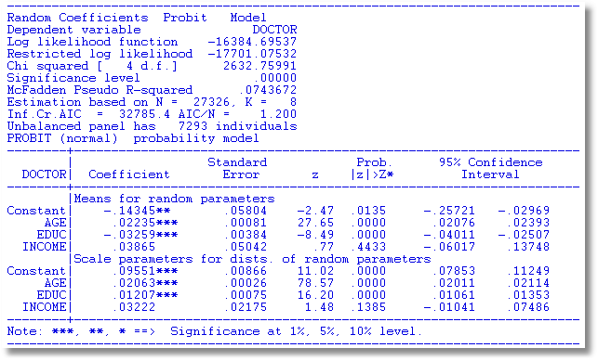
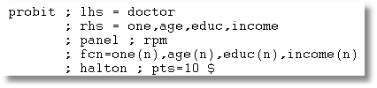

Slide 7
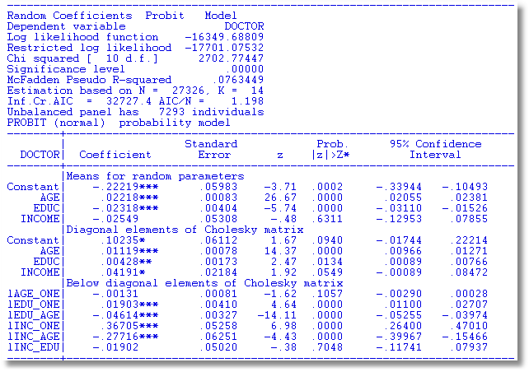
S
M

Slide 8
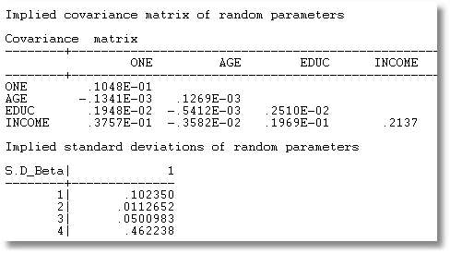
MSS′M′

Slide 9
Modeling Parameter Heterogeneity

Slide 10
A Hierarchical Probit Model
U_{it} = β_{1i} + β_{2i}Age_{it} + β_{3i}Educ_{it} + β_{4i}Income_{it} + ε_{it}.
β_{1i}=β₁+Δ₁₁ Female_{i} + Δ₁₂ Married_{i} + u_{1i}
β_{2i}=β₂+Δ₂₁ Female_{i} + Δ₂₂ Married_{i} + u_{2i}
β_{3i}=β₃+Δ₃₁ Female_{i} + Δ₃₂ Married_{i} + u_{3i}
β_{4i}=β₄+Δ₄₁ Female_{i} + Δ₄₂ Married_{i} + u_{4i}
Y_{it} = 1[U_{it} > 0]
All random variables normally distributed.

Slide 11
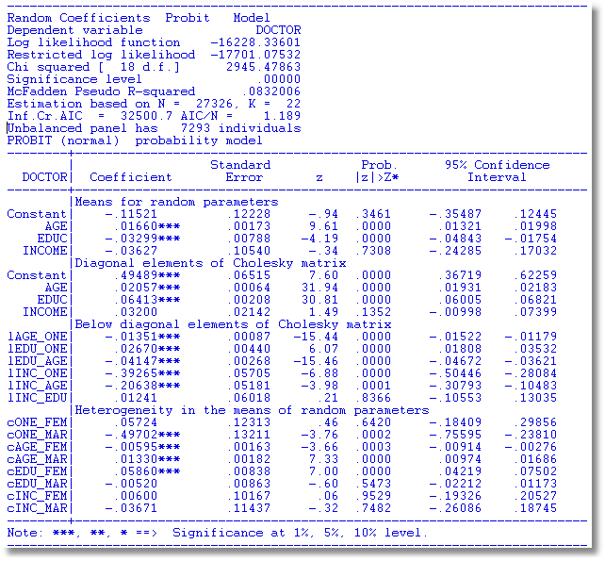

Slide 12
Estimating Individual Parameters
Model estimates = structural parameters, α, β, ρ, Δ, Σ, Γ
Objective, a model of individual specific parameters, β_{i}
Can individual specific parameters be estimated?
  Not quite – β_{i} is a single realization of a random process; one random draw.
  We estimate E[β_{i} | all information about i]
  (This is also true of Bayesian treatments, despite claims to the contrary.)

Slide 13
Estimating β_{i}

Slide 14
Conditional Estimate of β_{i}

Slide 15
Conditional Estimate of β_{i}

Slide 16
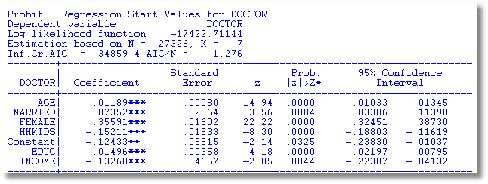

Slide 17
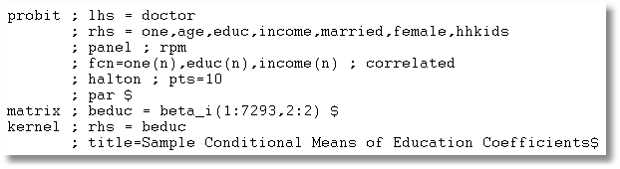

Slide 18
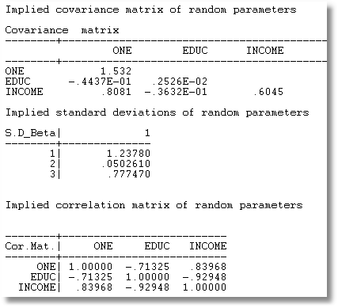
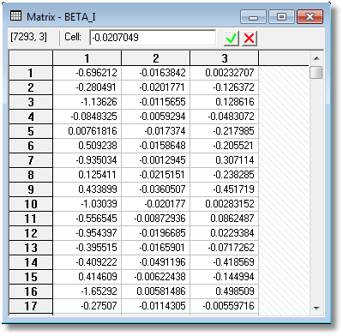

Slide 19
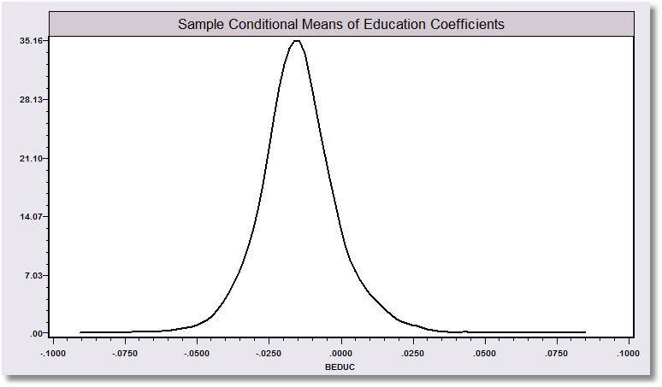
“Individual Coefficients”

Slide 20
The Random Parameters Logit Model
Multiple choice situations: Independent conditioned on the individual specific parameters

Slide 21
Continuous Random Variation in Preference Weights

Slide 22
Customers’ Choice of Energy Supplier
California, Stated Preference Survey
361 customers presented with 8-12 choice situations each
Supplier attributes:
  Fixed price: cents per kWh
  Length of contract
  Local utility
  Well-known company
  Time-of-day rates (11¢ in day, 5¢ at night)
  Seasonal rates (10¢ in summer, 8¢ in winter, 6¢ in spring/fall)
(TrainCalUtilitySurvey.lpj)

Slide 23
Population Distributions
Normal for:
  Contract length
  Local utility
  Well-known company
Log-normal for:
  Time-of-day rates
  Seasonal rates
Price coefficient held fixed

Slide 24
Estimated Model
Estimate Std error
Price -.883 0.050
Contract mean -.213 0.026
std dev .386 0.028
Local mean 2.23 0.127
std dev 1.75 0.137
Known mean 1.59 0.100
std dev .962 0.098
TOD mean* 2.13 0.054
std dev* .411 0.040
Seasonal mean* 2.16 0.051
std dev* .281 0.022
*Parameters of underlying normal.

Slide 25
Distribution of Brand Value
Standard deviation
=2.0¢
10% dislike local utility
0
2.5¢
Brand value of local utility

Slide 26
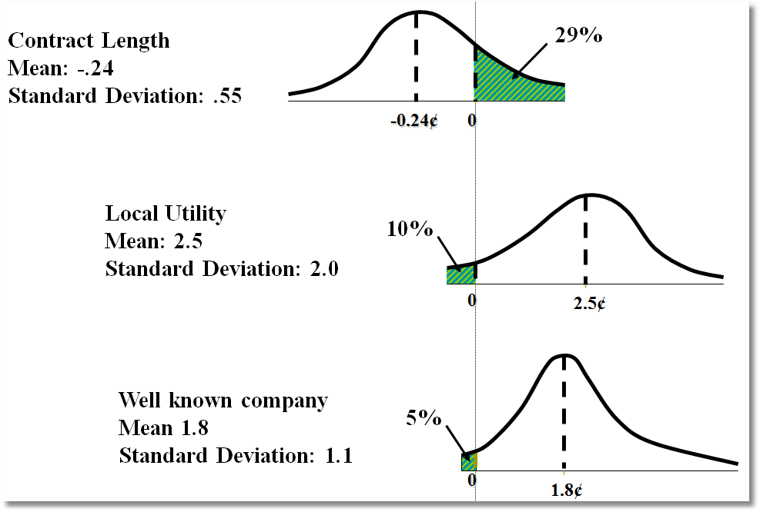
Random Parameter Distributions

Slide 27
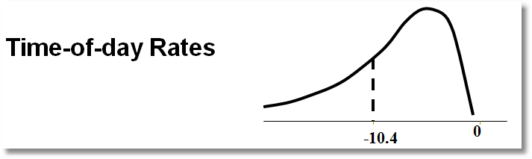
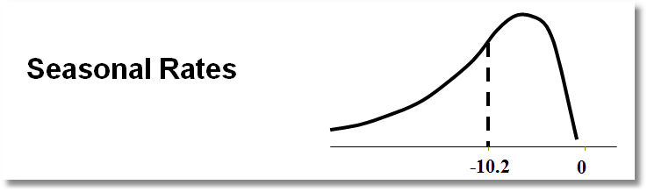
Time of Day Rates (Customers do not like – lognormal coefficient. Multiply variable by -1.)

Slide 28
Posterior Estimation of β_{i}
Estimate by simulation

Slide 29
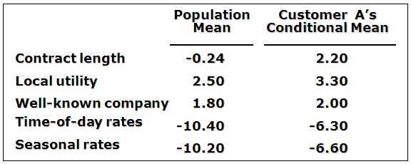
Expected Preferences of Each Customer
Customer likes long-term contract, local utility, and non-fixed rates.
Local utility can retain and make profit from this customer by offering a long-term contract with time-of-day or seasonal rates.

Slide 30
Application: Shoe Brand Choice
Simulated Data: Stated Choice,
  400 respondents,
  8 choice situations, 3,200 observations
3 choice/attributes + NONE
  Fashion = High / Low
  Quality = High / Low
  Price = 25/50/75,100 coded 1,2,3,4
Heterogeneity: Sex (Male=1), Age (<25, 25-39, 40+)
Underlying data generated by a 3 class latent class process (100, 200, 100 in classes)

Slide 31

Stated Choice Experiment: Unlabeled Alternatives, One Observation
t=1
t=2
t=3
t=4
t=5
t=6
t=7
t=8

Slide 32
Random Parameters Logit Model

Slide 33
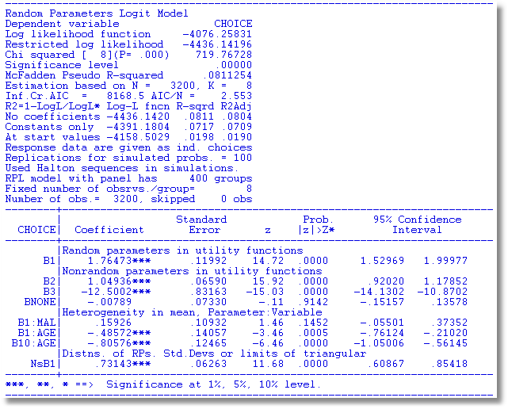

Slide 34
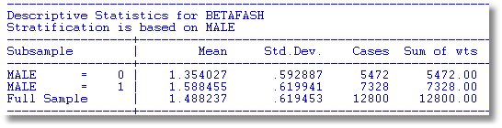
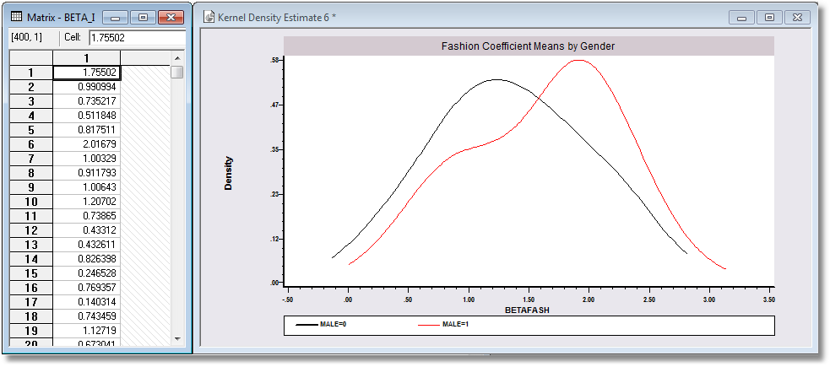

Slide 35
Error Components Logit Modeling
Alternative approach to building cross choice correlation
Common ‘effects.’ W_{i} is a ‘random individual effect.’

Slide 36
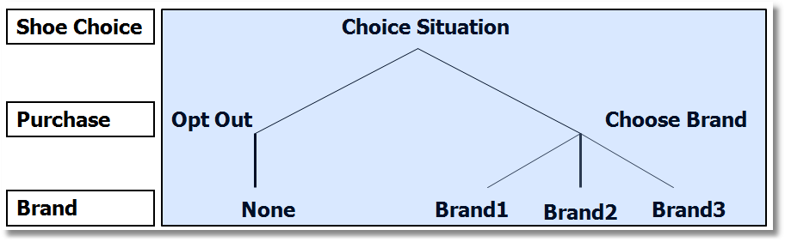
Implied Covariance Matrix
Nested Logit Formulation

Slide 37
Error Components Logit Model
-----------------------------------------------------------
Error Components (Random Effects) model
Dependent variable CHOICE
Log likelihood function -4158.45044
Estimation based on N = 3200, K = 5
Response data are given as ind. choices
Replications for simulated probs. = 50
Halton sequences used for simulations
ECM model with panel has 400 groups
Fixed number of obsrvs./group= 8
Number of obs.= 3200, skipped 0 obs
--------+--------------------------------------------------
Variable| Coefficient Standard Error b/St.Er. P[|Z|>z]
--------+--------------------------------------------------
|Nonrandom parameters in utility functions
FASH| 1.47913*** .06971 21.218 .0000
QUAL| 1.01385*** .06580 15.409 .0000
PRICE| -11.8052*** .86019 -13.724 .0000
ASC4| .03363 .07441 .452 .6513
SigmaE01| .09585*** .02529 3.791 .0002
--------+--------------------------------------------------
Random Effects Logit Model
Appearance of Latent Random
Effects in Utilities
Alternative E01
+-------------+---+
| BRAND1 | * |
+-------------+---+
| BRAND2 | * |
+-------------+---+
| BRAND3 | * |
+-------------+---+
| NONE | |
+-------------+---+
Correlation = {0.0959² / [1.6449 + 0.0959²]}^{1/2} = 0.0954

Slide 38
Extended MNL Model
Utility Functions

Slide 39
Extending the Basic MNL Model
Random Utility

Slide 40
Error Components Logit Model
Error Components

Slide 41
Random Parameters Model
Random Parameters

Slide 42
Heterogeneous (in the Means)
Random Parameters Model
Heterogeneity in Means

Slide 43
---------------------------------------------------------------
Random Parms/Error Comps. Logit Model
Dependent variable CHOICE
Log likelihood function -4019.23544 (-4158.50286 for MNL)
Restricted log likelihood -4436.14196 (Chi squared = 278.5)
Chi squared [ 12 d.f.] 833.81303
Significance level .00000
McFadden Pseudo R-squared .0939795
Estimation based on N = 3200, K = 12
Information Criteria: Normalization=1/N
Normalized Unnormalized
AIC 2.51952 8062.47089
R2=1-LogL/LogL* Log-L fncn R-sqrd R2Adj
No coefficients -4436.1420 .0940 .0928
Constants only -4391.1804 .0847 .0836
At start values -4158.5029 .0335 .0323
Response data are given as ind. choices
Replications for simulated probs. = 50
Halton sequences used for simulations
RPL model with panel has 400 groups
Fixed number of obsrvs./group= 8
Number of obs.= 3200, skipped 0 obs
---------------------------------------------------------------

Slide 44
Estimated RP/ECL Model
--------+--------------------------------------------------
Variable| Coefficient Standard Error b/St.Er. P[|Z|>z]
--------+--------------------------------------------------
|Random parameters in utility functions
FASH| .62768*** .13498 4.650 .0000
PRICE| -7.60651*** 1.08418 -7.016 .0000
|Nonrandom parameters in utility functions
QUAL| 1.07127*** .06732 15.913 .0000
ASC4| .03874 .09017 .430 .6675
|Heterogeneity in mean, Parameter:Variable
FASH:AGE| 1.73176*** .15372 11.266 .0000
FAS0:AGE| .71872*** .18592 3.866 .0001
PRIC:AGE| -9.38055*** 1.07578 -8.720 .0000
PRI0:AGE| -4.33586*** 1.20681 -3.593 .0003
|Distns. of RPs. Std.Devs or limits of triangular
NsFASH| .88760*** .07976 11.128 .0000
NsPRICE| 1.23440 1.95780 .631 .5284
|Heterogeneity in standard deviations
|(cF1, cF2, cP1, cP2 omitted...)
|Standard deviations of latent random effects
SigmaE01| .23165 .40495 .572 .5673
SigmaE02| .51260** .23002 2.228 .0258
--------+--------------------------------------------------
Note: ***, **, * = Significance at 1%, 5%, 10% level.
-----------------------------------------------------------
Random Effects Logit
Model Appearance of
Latent Random Effects
in Utilities
Alternative E01 E02
+-------------+---+---+
| BRAND1 | * | |
+-------------+---+---+
| BRAND2 | * | |
+-------------+---+---+
| BRAND3 | * | |
+-------------+---+---+
| NONE | | * |
+-------------+---+---+
Heterogeneity in Means.
Delta: 2 rows, 2 cols.
AGE25 AGE39
FASH 1.73176 .71872
PRICE -9.38055 -4.33586

Slide 45
Estimated Elasticities
Multinomial Logit
+---------------------------------------------------+
| Elasticity averaged over observations.|
| Attribute is PRICE in choice BRAND1 |
| Effects on probabilities of all choices in model: |
| * = Direct Elasticity effect of the attribute. |
| Mean St.Dev |
| * Choice=BRAND1 -.9210 .4661 |
| Choice=BRAND2 .2773 .3053 |
| Choice=BRAND3 .2971 .3370 |
| Choice=NONE .2781 .2804 |
+---------------------------------------------------+
| Attribute is PRICE in choice BRAND2 |
| Choice=BRAND1 .3055 .1911 |
| * Choice=BRAND2 -1.2692 .6179 |
| Choice=BRAND3 .3195 .2127 |
| Choice=NONE .2934 .1711 |
+---------------------------------------------------+
| Attribute is PRICE in choice BRAND3 |
| Choice=BRAND1 .3737 .2939 |
| Choice=BRAND2 .3881 .3047 |
| * Choice=BRAND3 -.7549 .4015 |
| Choice=NONE .3488 .2670 |
+---------------------------------------------------+
+--------------------------+
| Effects on probabilities |
| * = Direct effect te. |
| Mean St.Dev |
| PRICE in choice BRAND1 |
| * BRAND1 -.8895 .3647 |
| BRAND2 .2907 .2631 |
| BRAND3 .2907 .2631 |
| NONE .2907 .2631 |
+--------------------------+
| PRICE in choice BRAND2 |
| BRAND1 .3127 .1371 |
| * BRAND2 -1.2216 .3135 |
| BRAND3 .3127 .1371 |
| NONE .3127 .1371 |
+--------------------------+
| PRICE in choice BRAND3 |
| BRAND1 .3664 .2233 |
| BRAND2 .3664 .2233 |
| * BRAND3 -.7548 .3363 |
| NONE .3664 .2233 |
+--------------------------+

Slide 46
WTP Application (Value of Time Saved)
Estimating Willingness to Pay for Increments to an Attribute in a Discrete Choice Model
WTP = MU(attribute) / MU(Income)
Random

Slide 47
Extending the RP Model to WTP
Use the model to estimate conditional
distributions for any function of
parameters
Willingness to pay = -β_{i,time} / β_{i,cost}
Use simulation method

Slide 48
Simulation of WTP from β_{i}

Slide 49
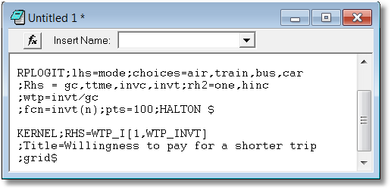
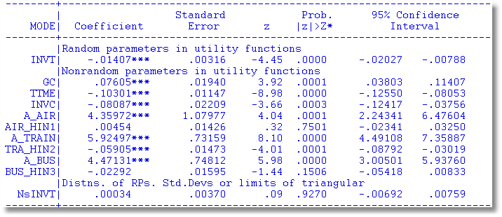

Slide 50
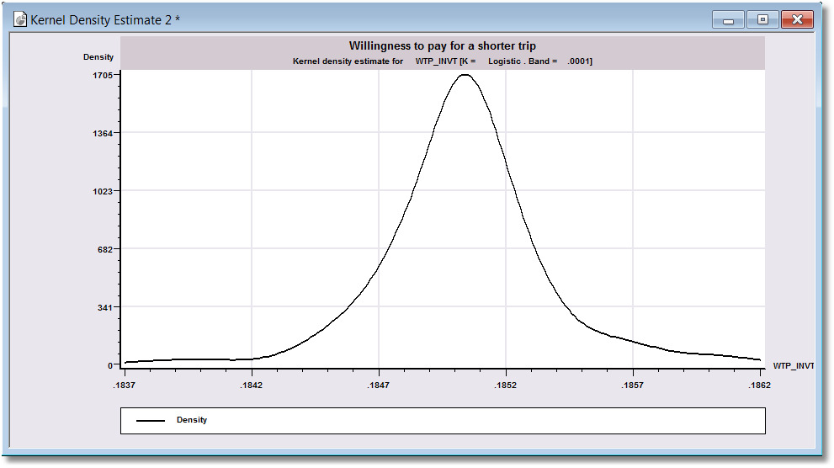
WTP

Slide 51


Slide 52
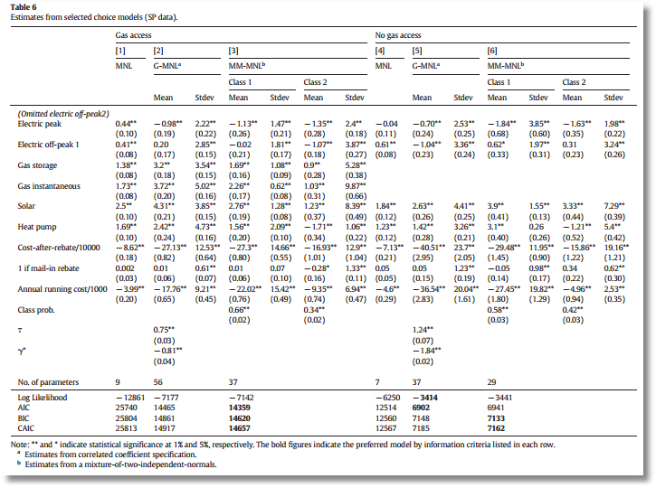

Slide 53
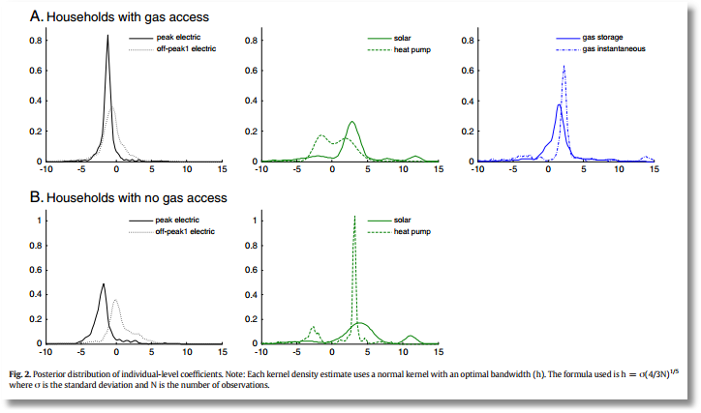

Slide 54
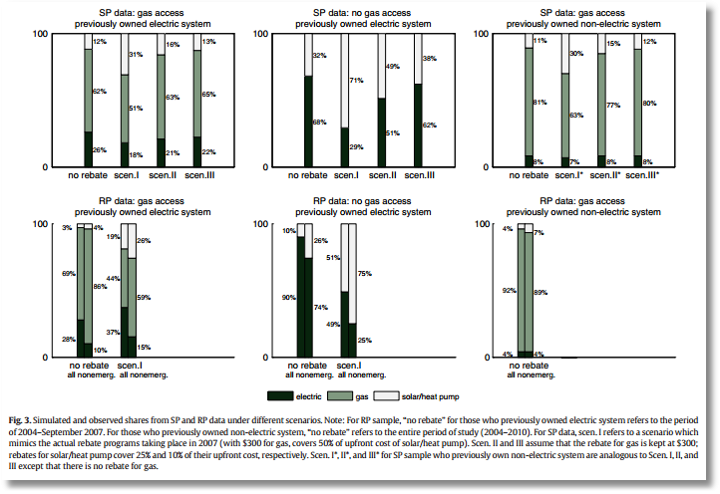

Slide 55


Slide 56
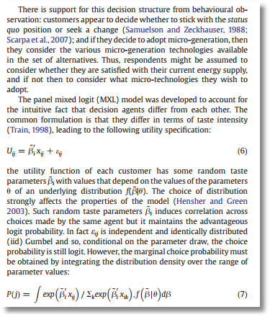
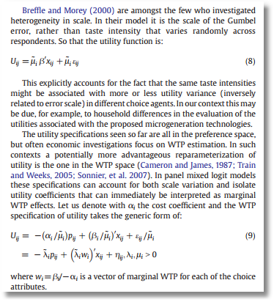

Slide 57


Slide 58
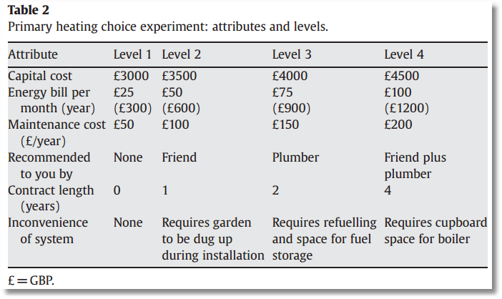

Slide 59
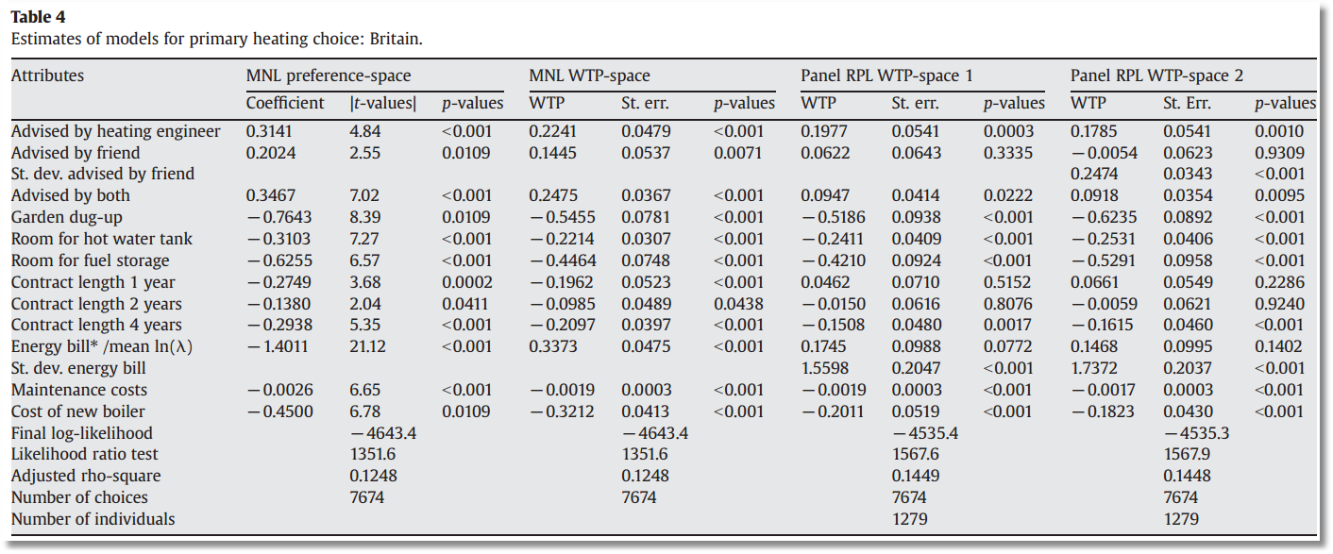

Slide 60

Aggregate Data and Multinomial Choice:
The Model of Berry, Levinsohn and Pakes

Slide 61
Resources
Automobile Prices in Market Equilibrium, S. Berry, J. Levinsohn, A. Pakes, Econometrica, 63, 4, 1995, 841-890. (BLP)
  http://people.stern.nyu.edu/wgreene/Econometrics/BLP.pdf
A Practitioner’s Guide to Estimation of Random-Coefficients Logit Models of Demand, A. Nevo, Journal of Economics and Management Strategy, 9, 4, 2000, 513-548
  http://people.stern.nyu.edu/wgreene/Econometrics/Nevo-BLP.pdf
A New Computational Algorithm for Random Coefficients Model with Aggregate-level Data, Jinyoung Lee, UCLA Economics, Dissertation, 2011
  http://people.stern.nyu.edu/wgreene/Econometrics/Lee-BLP.pdf
  Elasticities of Market Shares and Social Health Insurance Choice in Germany: A Dynamic Panel Data Approach, M. Tamm et al., Health Economics, 16, 2007, 243-256.
  http://people.stern.nyu.edu/wgreene/Econometrics/Tamm.pdf

Slide 62
Theoretical Foundation
Consumer market for J differentiated brands of a good
  j =1,…, J_{t} brands or types
  i = 1,…, N consumers
  t = i,…,T “markets” (like panel data)
Consumer i’s utility for brand j (in market t) depends on
  p = price
  x = observable attributes
  f = unobserved attributes
  w = unobserved heterogeneity across consumers
  ε = idiosyncratic aspects of consumer preferences
Observed data consist of aggregate choices, prices and features of the brands.

Slide 63
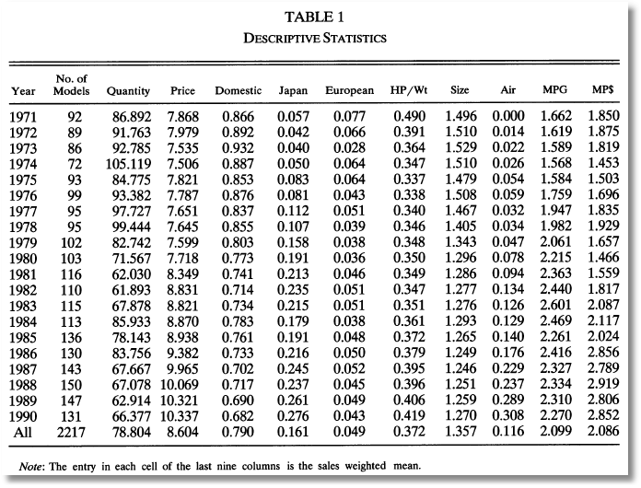
BLP Automobile Market
J_{t}
t

Slide 64
Random Utility Model
Utility: U_{ijt}=U(w_{i},p_{jt},x_{jt},f_{jt}|θ), i = 1,…,(large)N, j=1,…,J
  w_{i} = individual heterogeneity; time (market) invariant. w has a continuous distribution across the population.
  p_{jt}, x_{jt}, f_{jt}, = price, observed attributes, unobserved features of brand j; all may vary through time (across markets)
Revealed Preference: Choice j provides maximum utility
Across the population, given market t, set of prices p_{t} and features (X_{t},f_{t}), there is a set of values of w_{i} that induces choice j, for each j=1,…,J_{t}; then, s_{j}(p_{t},X_{t},f_{t}|θ) is the market share of brand j in market t.
There is an outside good that attracts a nonnegligible market share, j=0. Therefore,

Slide 65
Functional Form
(Assume one market for now so drop “’t.”)
U_{ij}=U(w_{i},p_{j},x_{j},f_{j}|θ)= x_{j}'β – αp_{j} + f_{j} + ε_{ij}
= δ_{j} + ε_{ij}
E_{consumers i}[ε_{ij}] = 0, δ_{j} is E[Utility].
Will assume logit form to make integration unnecessary. The expectation has a closed form.

Slide 66
Heterogeneity
Assumptions so far imply IIA. Cross price elasticities depend only on market shares.
Individual heterogeneity: Random parameters
U_{ij}=U(w_{i},p_{j},x_{j},f_{j}|θ_{i})= x_{j}'β_{i} – αp_{j} + f_{j} + ε_{ij}
β_{ik} = β_{k} + σ_{k}v_{ik}.
The mixed model only imposes IIA for a particular consumer, but not for the market as a whole.

Slide 67
Endogenous Prices: Demand side
U_{ij}=U(w_{i},p_{j},x_{j},f_{j}|θ)= x_{j}'β_{i} – αp_{j} + f_{j} + ε_{ij}
f_{j} is unobserved
Utility responds to the unobserved f_{j}
Price p_{j} is partly determined by features f_{j}.
In a choice model based on observables, price is correlated with the unobservables that determine the observed choices.

Slide 68
Endogenous Price: Supply Side
There are a small number of competitors in this market
Price is determined by firms that maximize profits given the features of its products and its competitors.
mc_{j} = g(observed cost characteristics c,
unobserved cost characteristics h)
At equilibrium, for a profit maximizing firm that produces one product,
s_{j} + (p_{j}-mc_{j})∂s_{j}/∂p_{j} = 0
Market share depends on unobserved cost characteristics as well as unobserved demand characteristics, and price is correlated with both.

Slide 69
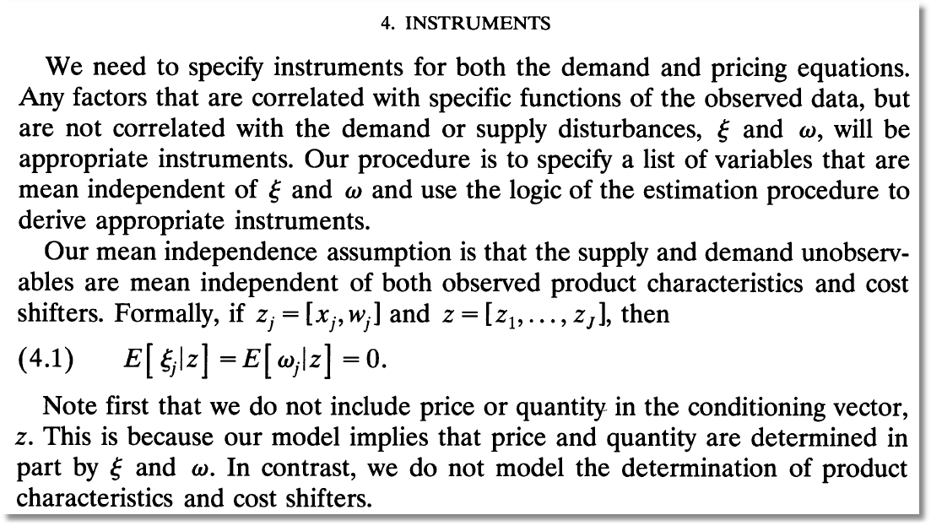
Instrumental Variables
(ξ and ω are our h and f.)

Slide 70
Econometrics: Essential Components

Slide 71
Econometrics

Slide 72
GMM Estimation Strategy - 1

Slide 73
GMM Estimation Strategy - 2

Slide 74
BLP Iteration

Slide 75

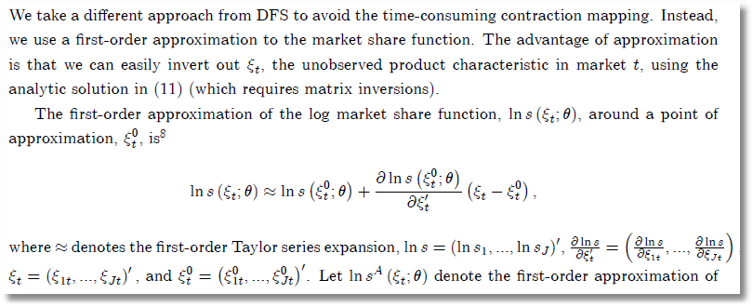
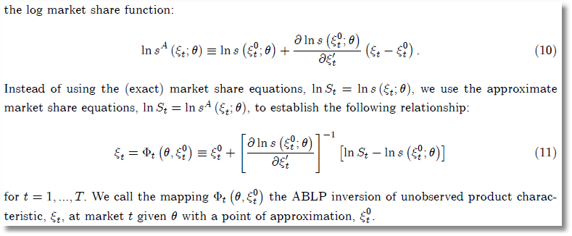
ABLP Iteration
ξ_{t} is
our f_{t}.
θ is our
(β,Σ)
No superscript is our (M); superscript 0 is our (M-1).

Slide 76
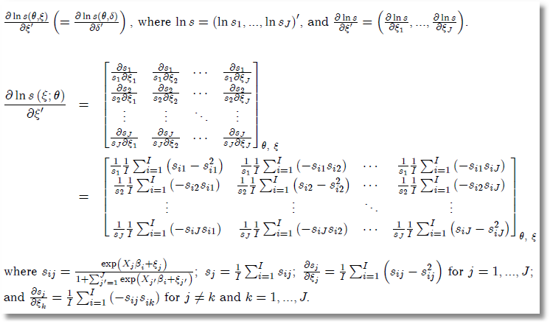
Side Results

Slide 77
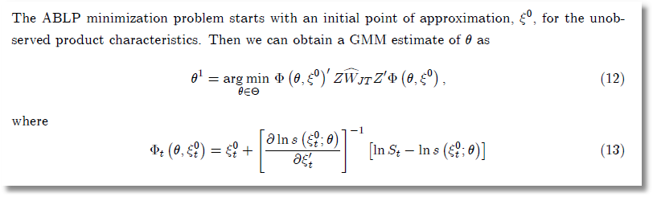
ABLP Iterative Estimator

Slide 78
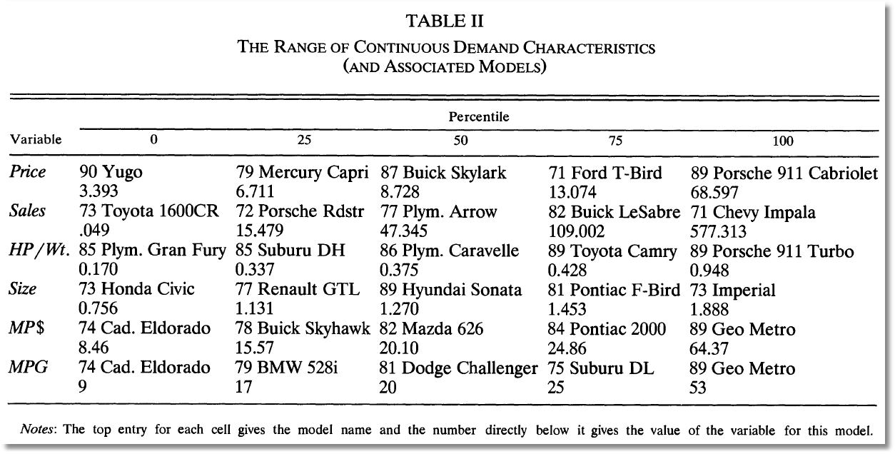
BLP Design Data

Slide 79
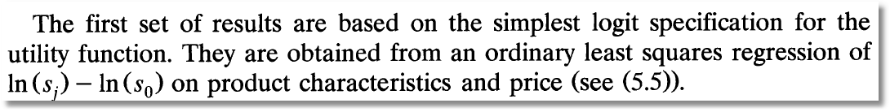
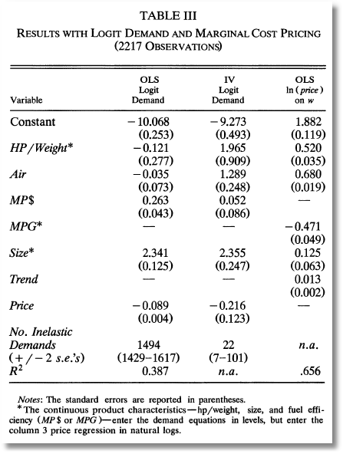
Exogenous price and nonrandom parameters

Slide 80
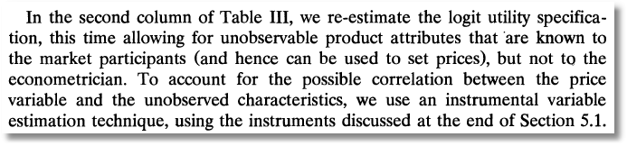
IV Estimation

Slide 81
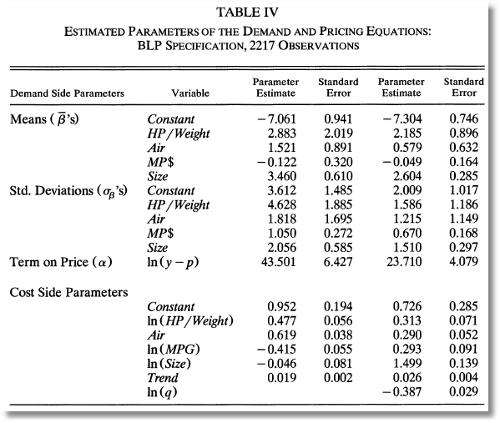
Full Model

Slide 82
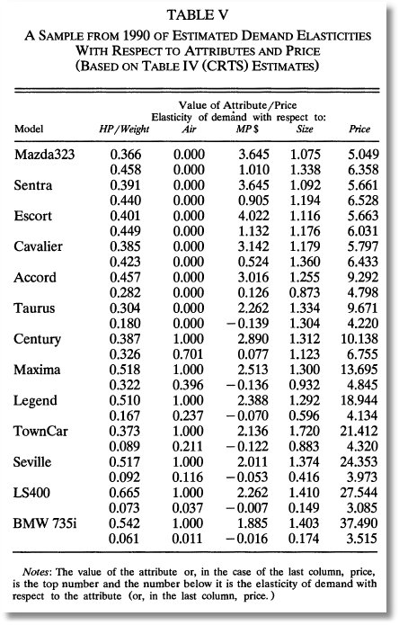
Some Elasticities

