Slide 1
January 2019 Data Update 9: Playing the pricing game!
Aswath Damodaran

Slide 2
Setting up the contrast
In my last eight posts, I find that
  The rise in risk premiums in both equity and bond markets in 2018 have pushed up costs of equity and capital
  Companies across the globe are finding it difficult to generate returns on their investments that exceed their costs of funding
  Many of them, especially in mature businesses, are returning more cash, much of it in the form of buybacks.
To complete my data update series, by looking at how market pricing varies across companies, sectors and geographies, and what lessons investors can draw from the data.

Slide 3
Value versus Price

Slide 4
Different Investment Philosophies
Efficient Marketers: The two processes will generate the same number, and any gap that exists will be purely random and quickly closed.
Investors: If you are an investor, whether value or growth, and you truly mean it, your view is that the pricing process, for one reason or the other, can deliver a price different from your estimate of value and that the gap that exists will close, as the price converges to value.
Traders: If you are a trader, you play the pricing game, effectively using your skills at gauging momentum and forecasting the effects of corporate news on prices, to buy at a low price and sell at a high price.

Slide 5
The Dangers of Delusional Thinking
Market participants are most exposed to danger when they are delusional about the game that they are playing.
  Most portfolio managers, for instance, claim to be investors, playing the value game, while using pricing screens (PE and growth, PBV and ROE) and adding to their holdings of momentum stocks.
  Many traders seem to think that they will be viewed as deeper and more accomplished if they talk the value talk, while using charts and technical indicators in the closet.
Bottom line: Play the game that you came to play, without apologies or subterfuge, and play it well. There is no one righteous path to investment riches.

Slide 6
The Pricing Process

Slide 7
Let the data talk..
Pricing is relative. Absolute rules make no sense in a relative world.
Markets have a lot in common, but the differences can be revealing.
Book value is over rated.
Most stocks that look cheap deserve to be cheap.
In pricing, what is priced in matters more than what should be priced in.

Slide 8
1. Absolute Rules in a Relative World: PE

Slide 9
And EV/EBITDA

Slide 10
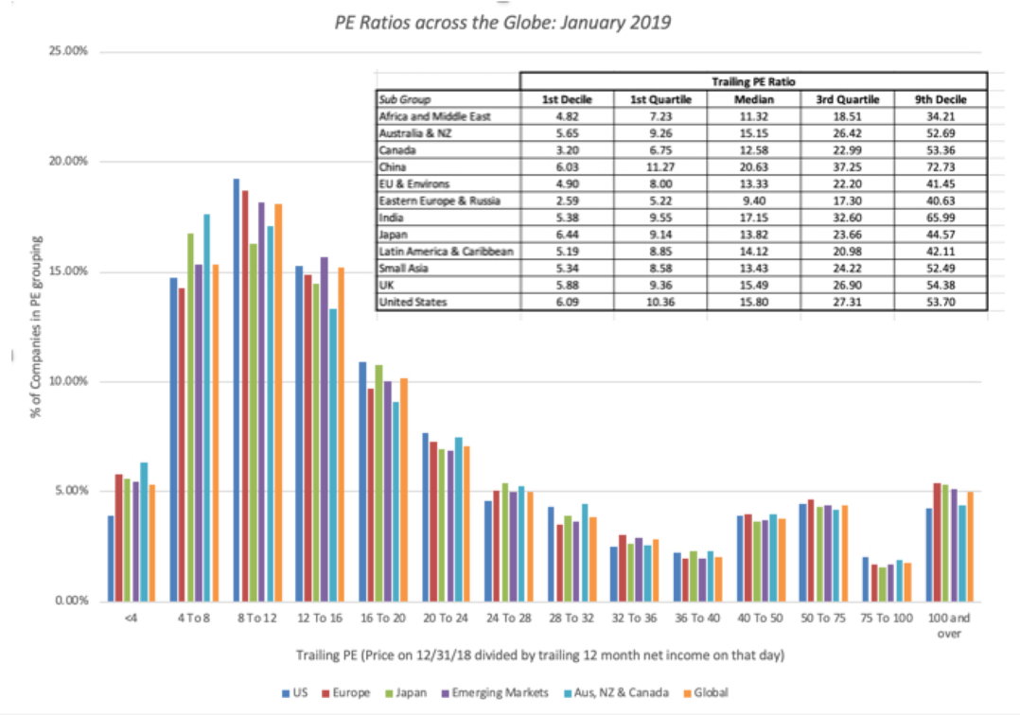
2. Markets have much in common…

Slide 11
But the differences can be revealing & trip you up…
Ignoring the commonalities across markets is a problem, but ignoring differences creates its own share of problems.
A naïve investment strategy of buying the stocks with the lowest PE ratios across the globe, without heed to regions, will result in a portfolio weighted heavily with Russian, African and Middle Eastern companies.

Slide 12
3. Book Value is an overrated metric
Stocks that trade at less than book value are considered cheap, and companies that build up book value are considered to be value creating. At the root of the "book value" focus are two assumptions, sometimes stated but often implicit.
  Book value is a measure of liquidation value, an estimate of what investors would get if they shut down the company today and sold its assets.
  Accountants are consistent and conservative in estimating asset value, unlike markets, which are prone to mood swings.

Slide 13
Price to Book Ratios: Global

Slide 14
PBV across Industries

Slide 15
4. Most stocks that look cheap deserve to be cheap…

Slide 16
Looking for mismatches
Multiple | Key Driver | Valuation Mismatch
PE ratio | Expected growth | Low PE stock with high expected growth rate in earnings per share
PBV ratio | ROE | Low PBV stock with high ROE
EV/EBITDA | Reinvestment rate | Low EV/EBITDA stock with low reinvestment needs
EV/capital | Return on capital | Low EV/capital stock with high return on capital
EV/sales | After-tax operating margin | Low EV/sales ratio with a high after-tax operating margin

Slide 17
5. What is being priced dominates what should be priced…
Markets, for the most part, are sensible, pricing in fundamentals when pricing stocks, but there will be exceptions, and sometimes large ones, where entire sectors are priced on variables that have little to do with fundamentals, at least on the surface.
This is especially true if the companies in a sector are early in their life cycles and have little to show in revenues, very little (or even negative) book value and are losing money on every earnings measure.
Desperation drives investors to look for other variables to explain prices, resulting in companies being priced based upon website visitors (at the peak of the dot com boom), numbers of users (at the start of the social media craze) and numbers of subscribers.

Slide 18
Pricing Twitter in 2013
In 2013, ahead of its IPO, I valued Twitter’s equity at about $11 billion (or $17-18 per share)
I priced Twitter ahead of its IPO in 2013, looking at its user base (about 240 million at the time) and what markets were paying per user at the time (about $130) to arrive at a pricing of $24 billion, much closer to the actual pricing, right after the IPO.
It is therefore neither surprising nor newsworthy that venture capitalists and equity research analysts are more focused on these pricing metrics, when assessing how much to pay for stocks, and companies, knowing this, play along.

Slide 19
Conclusion
I do believe in intrinsic value, and think of myself, more as an investor than a trader, but I am not a valuation snob.
I chose the path I did because it works for me and reflects my beliefs, but it would be both arrogant and wrong for me to argue that being a trader and playing the pricing game is somehow less worthy of respect or returns.
In fact, the end game for both investors and traders is to make money, and if you can make money by screening stocks using PE ratios and timing your entry/exit by looking at charts, all the more power to you!

