Slide 1
for the fun of it: open house for My spring 2025 classes
I teach, therefore I am…

Slide 2
a ritual (I know.. I know..)
I am a teacher at heart, and every year, for two decades, I have invited people to join me in the classes that I teach at the Stern School of Business at New York University.
Since I teach these classes only in the spring, and the first sessions for each of the classes will be in late January, this would be a good time to provide some details on the classes, including content and structure.
If you have read these missives in prior years, much of what I say will sound familiar, but I have added new content and updated the links you will need to partake in the classes.

Slide 3
Why I teach…
I like the stage: Every teacher, to some extent, has a little bit of a repressed actor in him or her, and I do enjoy being in front of an audience, with the added benefit that I get to review the audience, with my grades, rather than the other way around.
I like to change mindsets: I do not expect my students to agree with all or even much of what I have to say, I would like to think that I sometimes change the way they think about finance, and perhaps even their professions.
I like not having a boss: I would be a terrible employee, since I am headstrong, opinionated and awfully lazy, especially when I must do things I don’t like to do. As a teacher, I am my own boss and find my foibles completely understandable.

Slide 4
How I teach…
Class narrative: This may be a quirk of mine, but I will stay away from teaching classes that are collections of topics. In my view, having a unifying narrative not only makes a class more fun to teach, but also more memorable.
Bulking up your Reasoning muscle: In keeping with the old saying that it is better to teach someone to fish, than to give them fish, I believe it is my job to equip my students with the capacity to answer questions that they may face in the future, on their own.
Make it real:. I like to think that my classes are firmly grounded, with my examples grounded in real companies and real time.
Transparently wrong vs opaquely right: When I was a student, I remember being frustrated by teachers, who so thoroughly hedged themselves, with the one hand and the other hand playing out, that they left me unclear about what they were saying.

Slide 5
What I teach…
In my first two years of teaching, I was a visiting professor at the University of California at Berkeley, and like many visiting faculty around the world, I was asked to plug in holes in the teaching schedule.
I taught six different classes ranging from a corporate finance class to undergraduates to a central banking for executive MBAs, and while I spent almost all of my time struggling to stay ahead of my students, with the material, it set me on a pathway to being a generalist.
While I could have specialized, once I came to NYU, I continued to teach classes across the finance spectrum, from corporate finance to valuation to investing, and I am glad that I did so. I am a natural dabbler, and I enjoy teaching very different subject material to my classes.

Slide 6
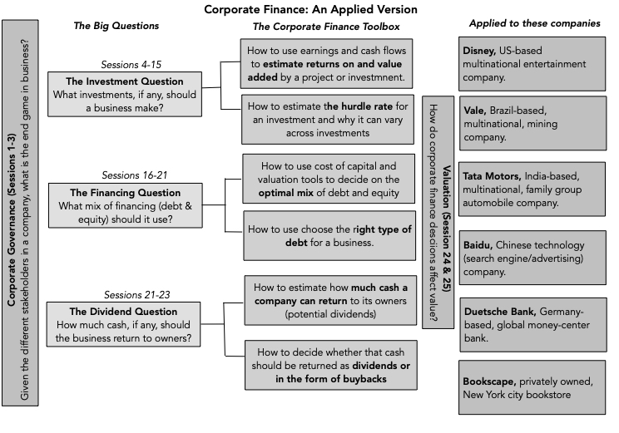
The one finance class that everyone needs…

Slide 7
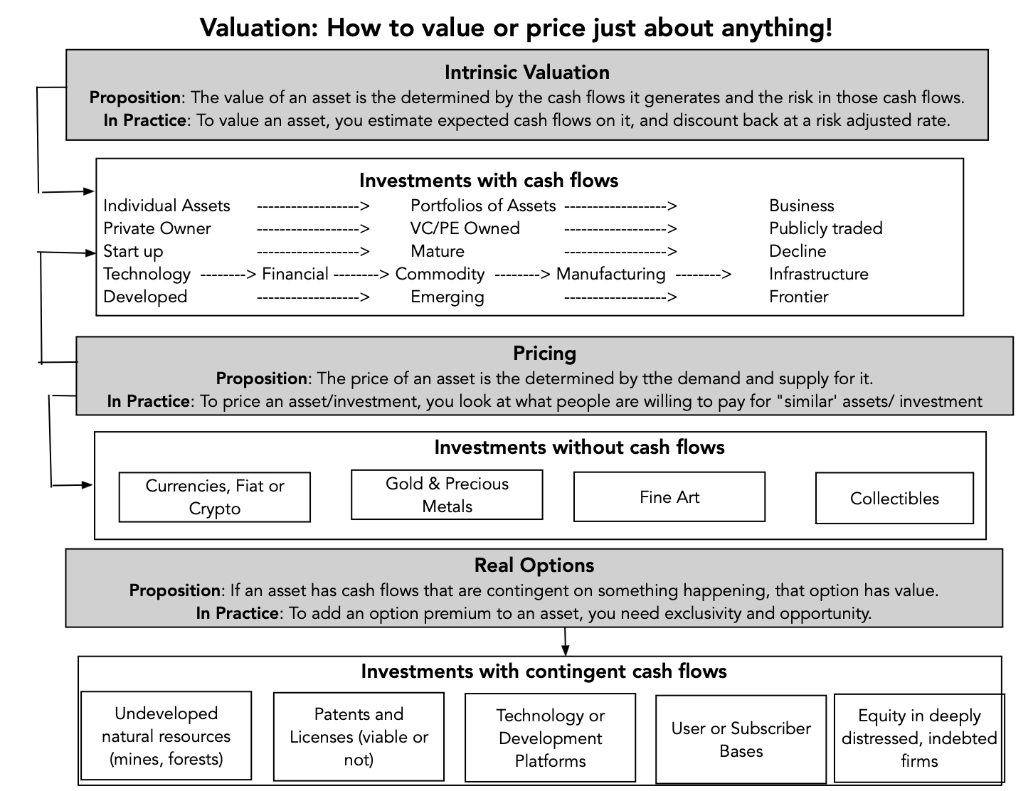
A worthwhile follow on?

Slide 8
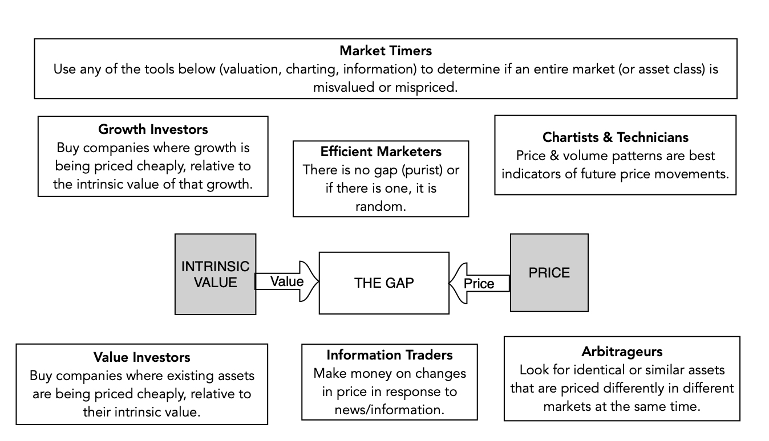
An Investing big picture class!

Slide 9
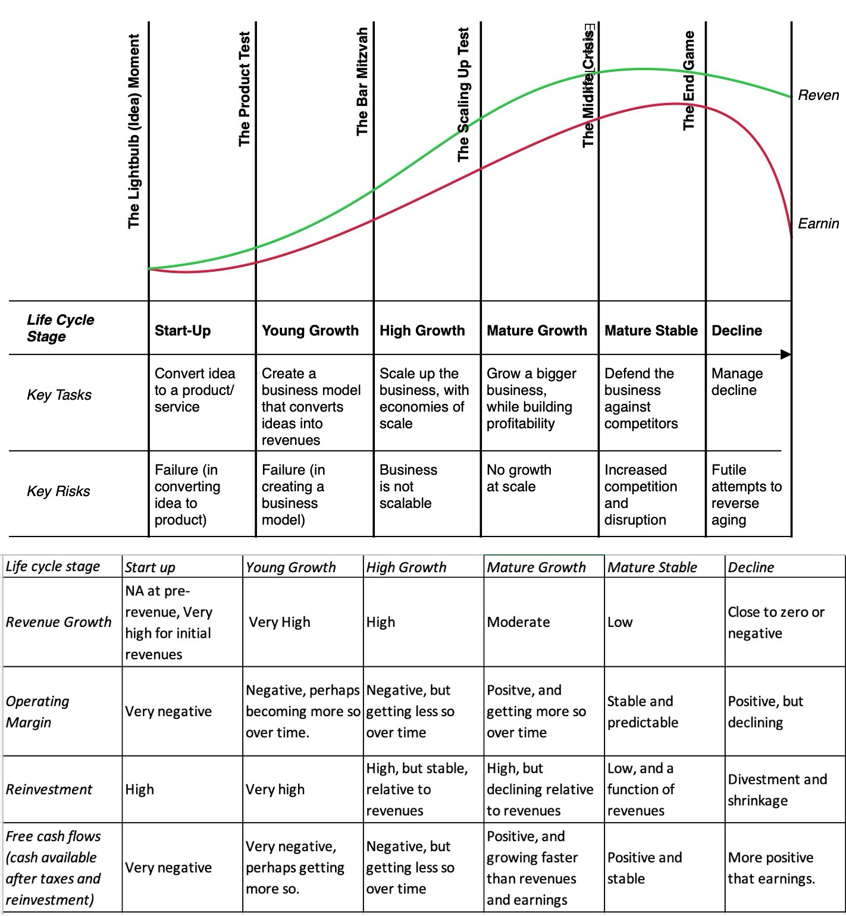
A new entrant

Slide 10
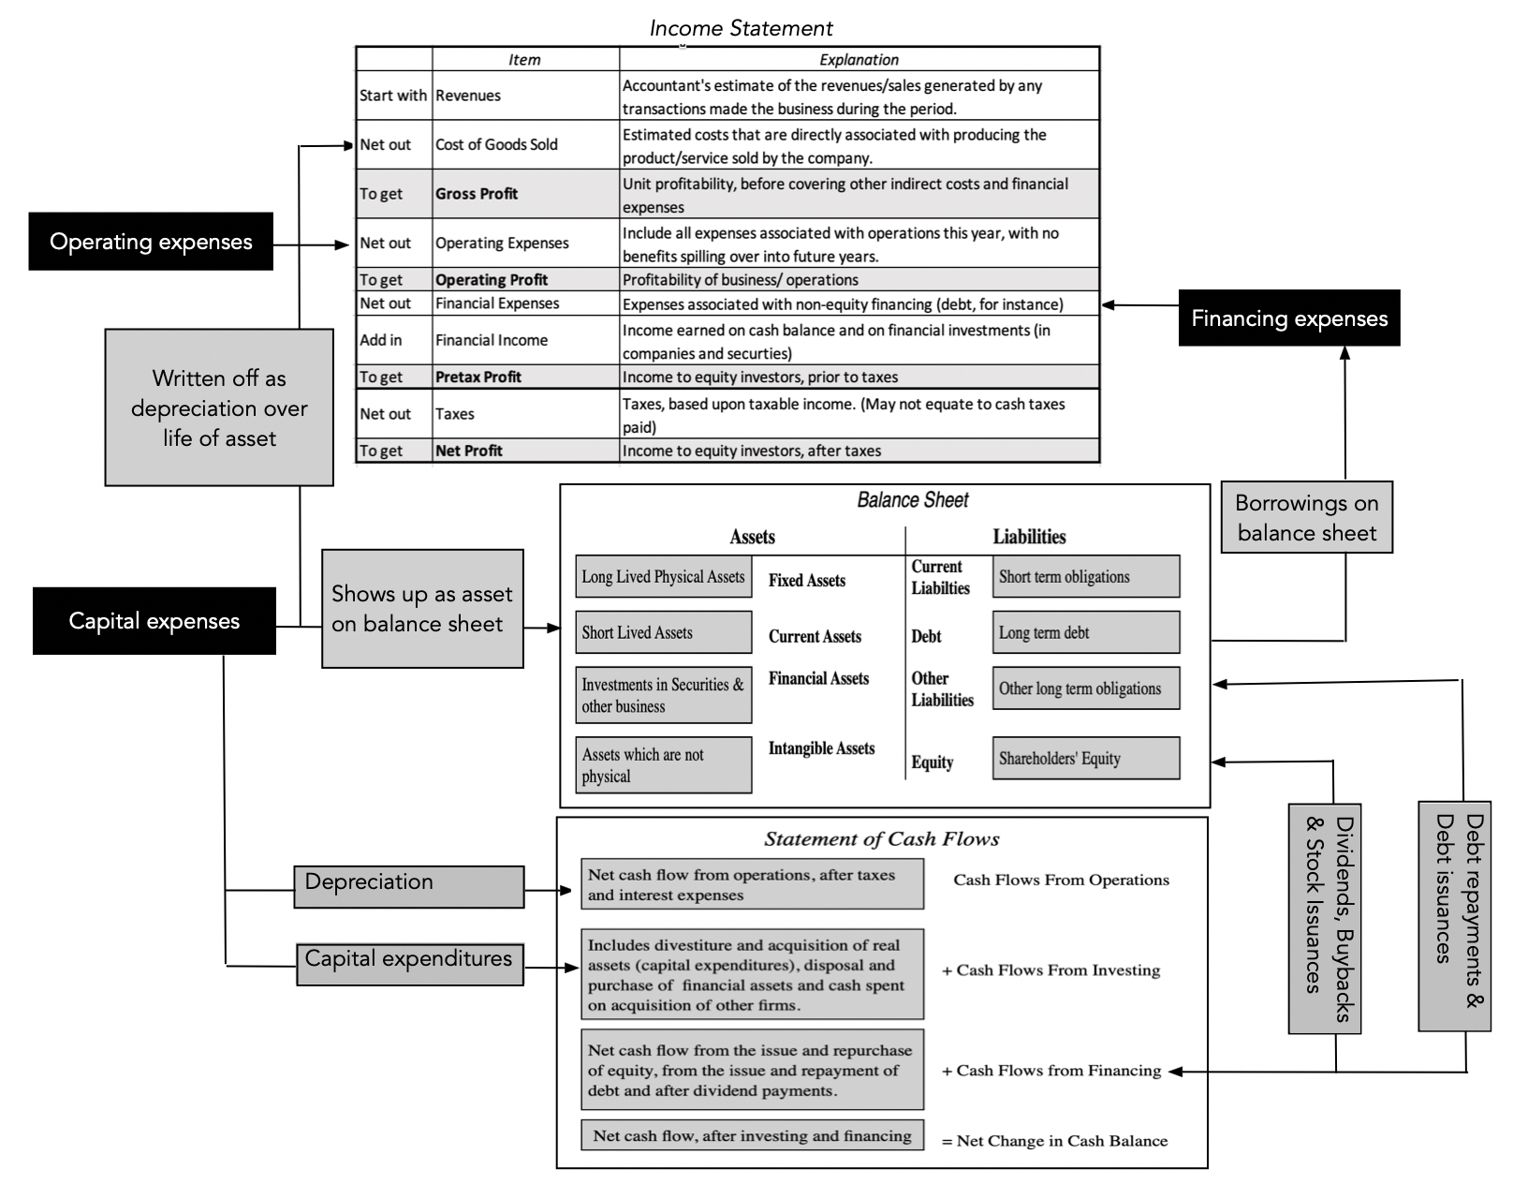
Accounting as raw data!

Slide 11
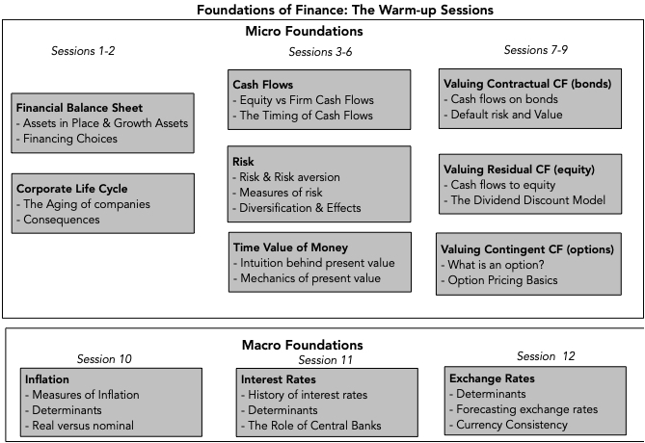
Spring training for finance!

Slide 12
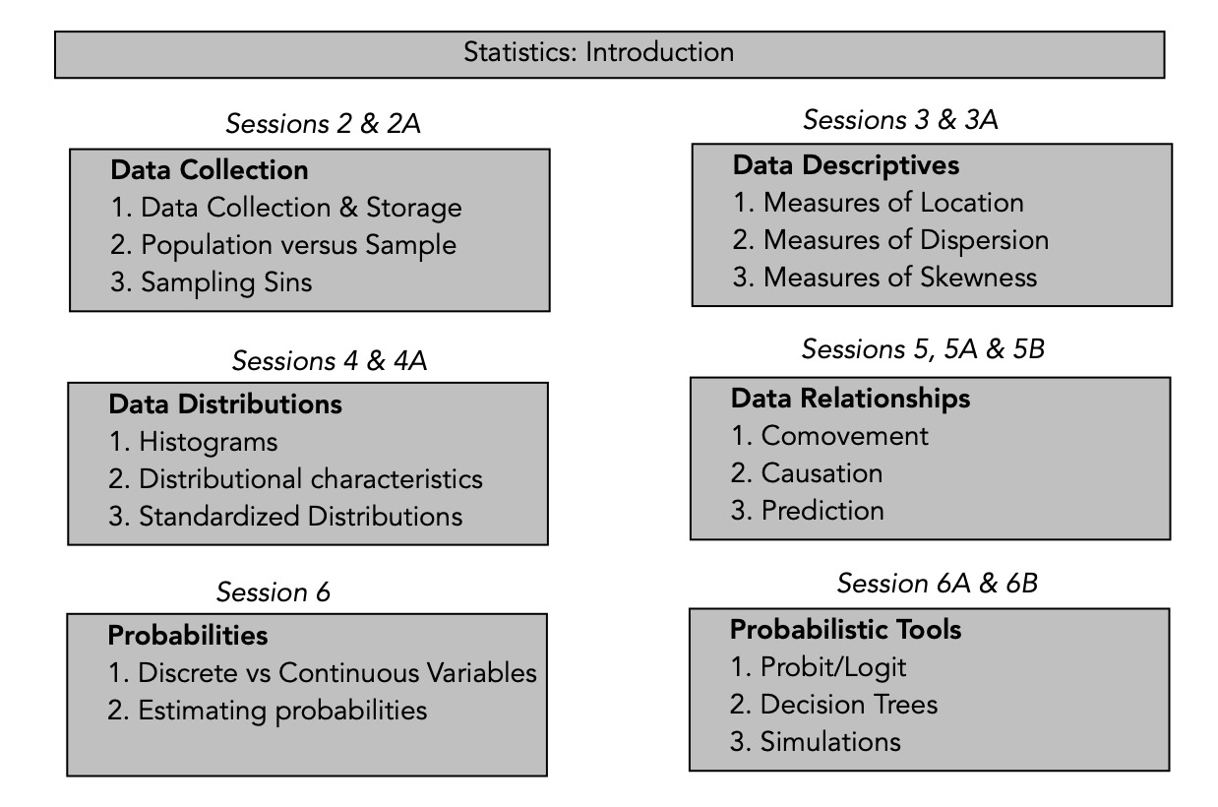
Playing moneyball?

Slide 13
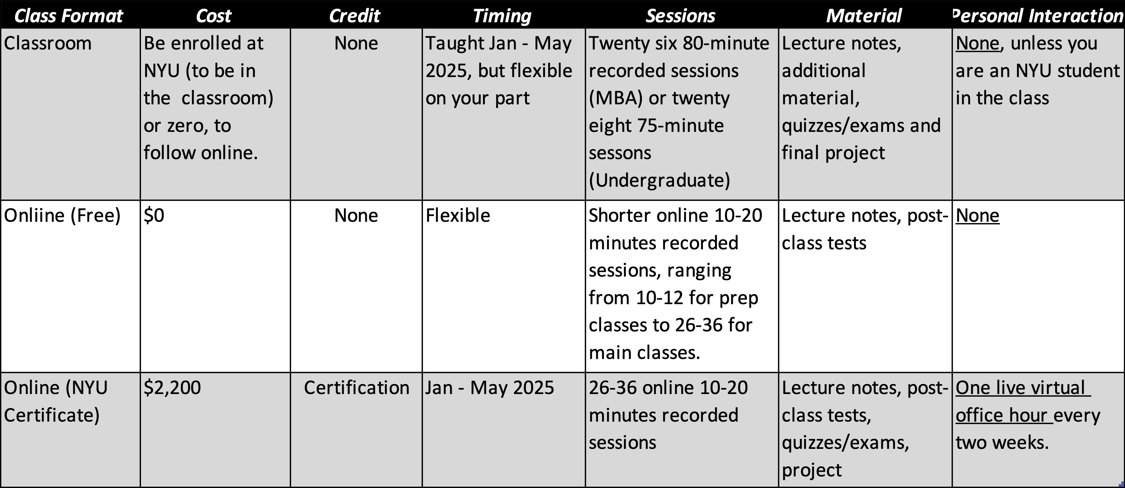
Class formats

Slide 14
Gateways to classes
Class | Spring 2025 regular | Online (free) | NYU Certificate | WhatsApp Discussion Group
Corporate Finance | Link | Link | Link | Link
Valuation | Link | Link | Link | Link
Investment Philosophies | NA | Link | Link | Link
Corporate Life Cycle | NA | Link | NA | Link
Accounting | NA | Link | NA
Foundations of Finance | NA | Link | NA
Statistics | NA | Link | NA

Slide 15
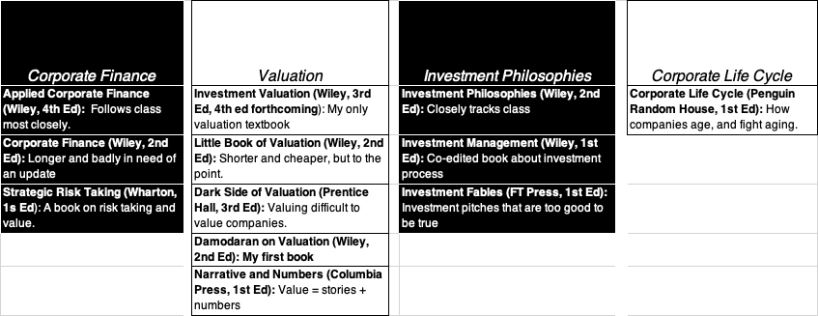
Class material: Books are optional, but..
Webpage for classes
Valuation: https://pages.stern.nyu.edu/~adamodar/New_Home_Page/equity.html
Corporate Finance: https://pages.stern.nyu.edu/~adamodar/New_Home_Page/corpfin.html
Investment Philosophies: https://pages.stern.nyu.edu/~adamodar/New_Home_Page/invphil.htm

Slide 16
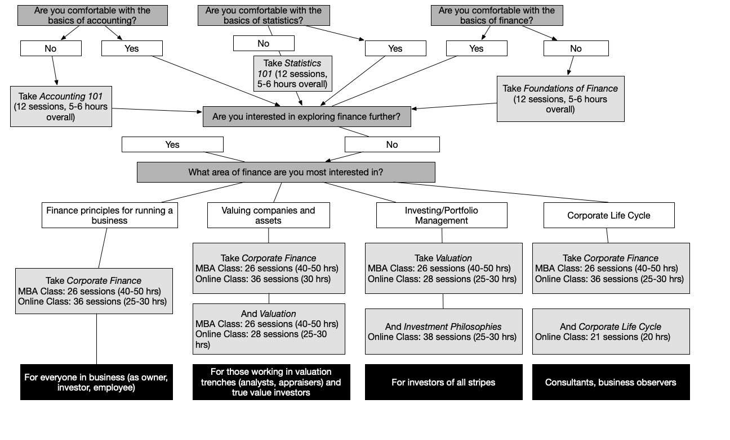
A class guide

Slide 17
Reality checks
Online and asynchronous: Unless you happen to be a NYU Stern student, you will be taking these classes online and asynchronously (not in real time). As someone who has been teaching online for close to two decades now, I have learned that watching a class on a computer or display screen is far more draining than being in a physical class, which is one reason that I have created the online versions of the classes with much shorter session lengths.
Completion blues: The biggest impediment to finishing classes online, which explains why completion rates are often 5% or lower, even for the best structured online classes, is maintaining the discipline to continue with a class, even after you fall behind. While my regular classes follow a time line, you don't have to stick with that calendar constraint, and can finish the class over a longer period, if you want, but you have to work at it.
Learning by doing: Learning, especially in my subject area, requires doing, and if all you do is watch the lecture videos, without following through (by trying out what you have learned on real companies of your choosing), the material will not stick.

Slide 18
Help Desk..
I will be teaching close to 800 students across my three NYU classes, in the spring, and they will get the bulk of my attention, in terms of grading and responses to emails and questions.
With my limited bandwidth and time, I am afraid that I will not be able to answer most of your questions, if you are taking the free classes online; with the certificate classes, there will be zoom office hours once every two weeks for a live Q&A. If you do have a question about specifics, do try my email, and if I am not falling behind, I will try to answer you.
I have created Whatsapp forums for you, if you are interested, to be able to interact with other students who are in the same position that you are in, and hopefully, there will be someone in the forum who can address your doubts.

Slide 19
In closing..
I hope to see you (in person or virtually) in one of my classes, and I also hope that you find the content useful.
  If you are taking one of my free classes, please recognize that I share my content, not out of altruism, but because like most teachers, I want a bigger audience.
  If you are taking the NYU certificate classes, and you find the price tag daunting, I am afraid that I cannot do much more than commiserate, since the university has its own imperatives.
  If you do feel that you want to thank me, the best way you can do this is to pass it on, perhaps by teaching someone around you.

