Slide 1
Valuation: Art, SCIENCE, CRAFT or magic?
Website: http://www.damodaran.com
Blog: http://aswathdamodaran.blogspot.com
Twitter: @AswathDamodaran
App (iPad/iPhone): uValue (in iTunes app store)
Aswath Damodaran
www.damodaran.com

Slide 2
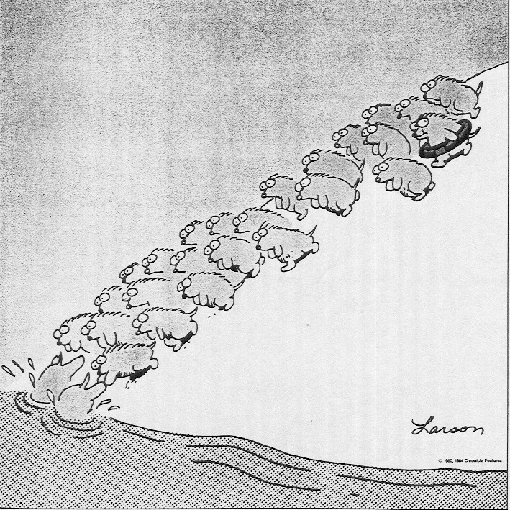
Some Initial Thoughts
" One hundred thousand lemmings cannot be wrong"
Graffiti

Slide 3
Theme 1: Characterizing Valuation as a discipline
In a science, if you get the inputs right, you should get the output right. The laws of physics and mathematics are universal and there are no exceptions. Valuation is not a science.
In an art, there are elements that can be taught but there is also a magic that you either have or you do not. The essence of an art is that you are either a great artist or you are not. Valuation is not an art.
A craft is a skill that you learn by doing. The more you do it, the better you get at it. Valuation is a craft.

Slide 4
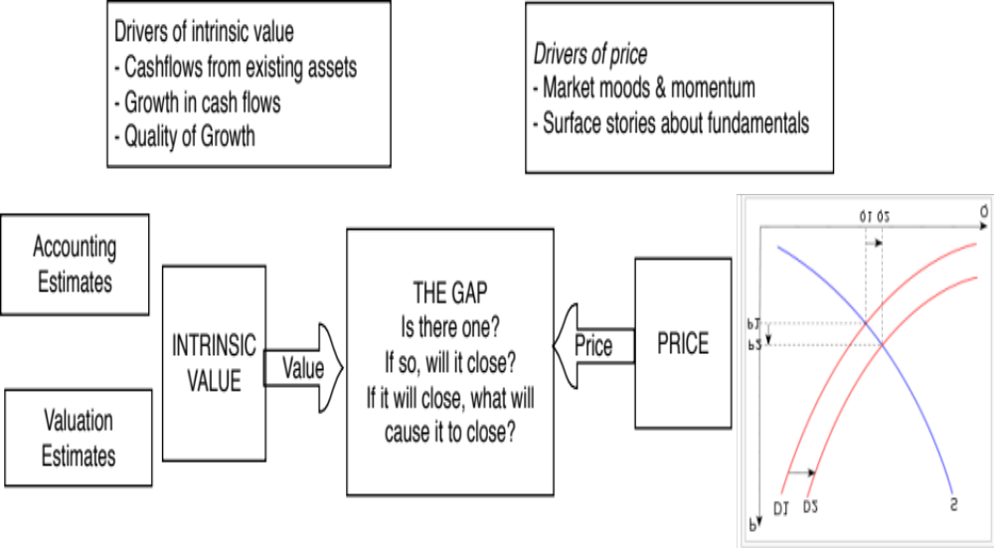
Theme 2: Valuing an asset is not the same as pricing that asset
Notes:
There are three levels at which this class will approach valuation.
At the most elevated level, it will talk about different approaches to valuation, there financial underpinnings and why they may give different answers to valuation. Rather than taking the dogmatic view that DCF valuation is the only approach that a rational person will choose, we will consider why we may prefer relative valuation in some scenarios at least.
At its second level, the class will emphasize how you are and what your task is can affect the value that you attach to an asset. The same firm can have different values to different people, depending upon the information and biases they bring to the process. Some people (managers, acquirers) may have more degrees of freedom when it comes to how a firm is managed and run.
At its most detailed level, all of the philosophical understanding of valuation in the world and deep thinking is of little use unless you can actually value a business (with number). This is where the rubber meets the road. There are many who have trouble at this stage because they are unwilling to make mistakes. Valutation is about using the information you have (not the information you wish you had) to make reasonable estimates of the future.

Slide 5
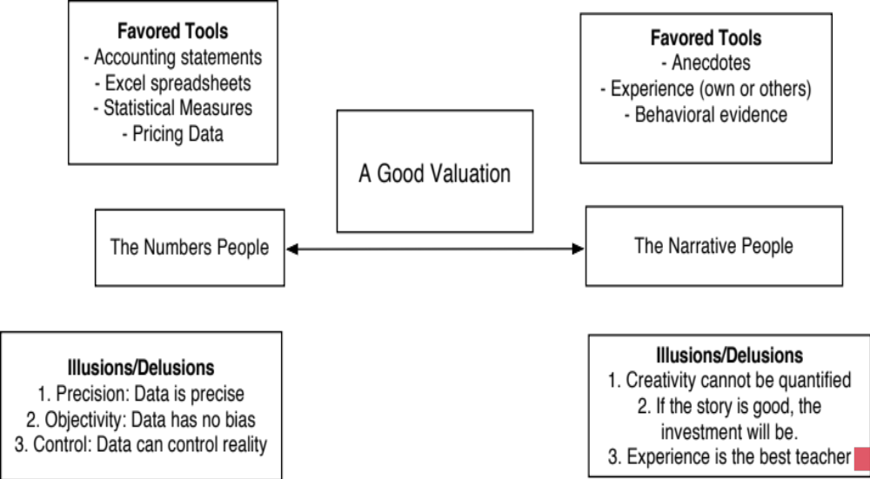
Theme 3: Good valuation = Story + Numbers

Slide 6
Misconceptions about Valuation
Myth 1: A valuation is an objective search for “true” value
  Truth 1.1: All valuations are biased. The only questions are how much and in which direction.
  Truth 1.2: The direction and magnitude of the bias in your valuation is directly proportional to who pays you and how much you are paid.
Myth 2.: A good valuation provides a precise estimate of value
  Truth 2.1: There are no precise valuations
  Truth 2.2: The payoff to valuation is greatest when valuation is least precise.
Myth 3: . The more quantitative a model, the better the valuation
  Truth 3.1: One’s understanding of a valuation model is inversely proportional to the number of inputs required for the model.
  Truth 3.2: Simpler valuation models do much better than complex ones.

Slide 7
Approaches to Valuation
Intrinsic valuation, relates the value of an asset to the present value of expected future cashflows on that asset. In its most common form, this takes the form of a discounted cash flow valuation.
Relative valuation, estimates the value of an asset by looking at the pricing of 'comparable' assets relative to a common variable like earnings, cashflows, book value or sales.
Contingent claim valuation, uses option pricing models to measure the value of assets that share option characteristics.
Notes:
There are some who suggest that there is a fourth way to approach valuation, which is to value the assets of a firm individually. Asset based valuation, however, requires that you use either discounted cash flow or relative valuation models to value the individual assets. Consequently, we view it as a subset of these approaches.

Slide 8
Discounted Cash Flow Valuation
What is it: In discounted cash flow valuation, the value of an asset is the present value of the expected cash flows on the asset.
Philosophical Basis: Every asset has an intrinsic value that can be estimated, based upon its characteristics in terms of cash flows, growth and risk.
Information Needed: To use discounted cash flow valuation, you need
  to estimate the life of the asset
  to estimate the cash flows during the life of the asset
  to estimate the discount rate to apply to these cash flows to get present value
Market Inefficiency: Markets are assumed to make mistakes in pricing assets across time, and are assumed to correct themselves over time, as new information comes out about assets.
Notes:
Discounted cash flow valuation is geared for assets that derive their value from the cashflows that they are expected to generate - most businesses and financial assets fall into this category.
The inputs needed for all discounted cash flow models - cash flows, discount rates and asset life - are the same, though the ease with which they can be estimated may vary from asset to asset.
When we use discounted cash flow valuation, we are assuming that we can estimate intrinsic value and that market prices can deviate from intrinsic values. We also assume that prices will revert back to intrinsic value sooner or later - this is why a long time horizon is a pre-requisite.

Slide 9
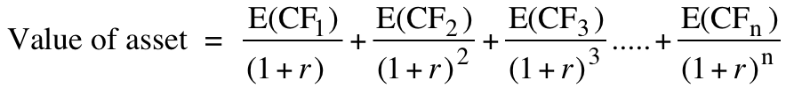
Intrinsic Value: Four Basic Propositions
The value of an asset is the present value of the expected cash flows on that asset, over its expected life:
The IT Proposition: If “it” does not affect the cash flows or alter risk (thus changing discount rates), “it” cannot affect value.
The DUH Proposition: For an asset to have value, the expected cash flows have to be positive some time over the life of the asset.
The DON’T FREAK OUT Proposition: Assets that generate cash flows early in their life will be worth more than assets that generate cash flows later; the latter may however have greater growth and higher cash flows to compensate.
The VALUE IS NOT PRICE Proposition: The value of an asset may be very different from its price.
Notes:
Cash is king. A firm with negative cash flows today can be a very valuable firm but only if there is reason to believe that cash flows in the future will be large enough to compensate for the negative cash flows today. The riskier a firm and the longer you have to wait for the cash flows, the greater the cashflows eventually have to be….

Slide 10
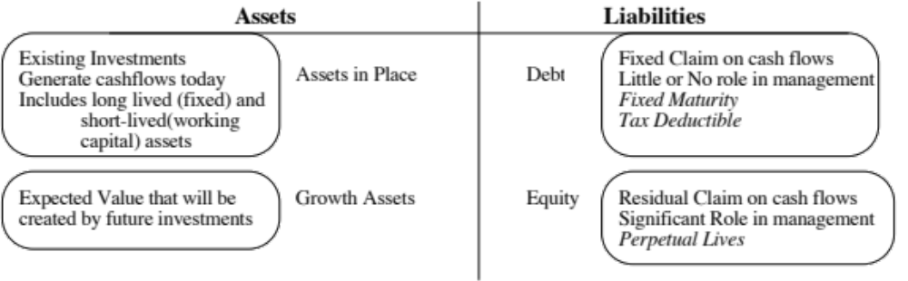
DCF Choices: Equity Valuation versus Firm Valuation
Firm Valuation: Value the entire business
Equity valuation: Value just the equity claim in the business
Notes:
A business and the equity in the business can be very different numbers…
A firm like GE in 2005 had a value of $ 500 billion for its business but its equity is worth only $ 300 billion - the difference is due to the substantial debt that GE has used to fund its expansion.
You can have valuable businesses, where the equity is worth nothing because the firm has borrowed too much….

Slide 11
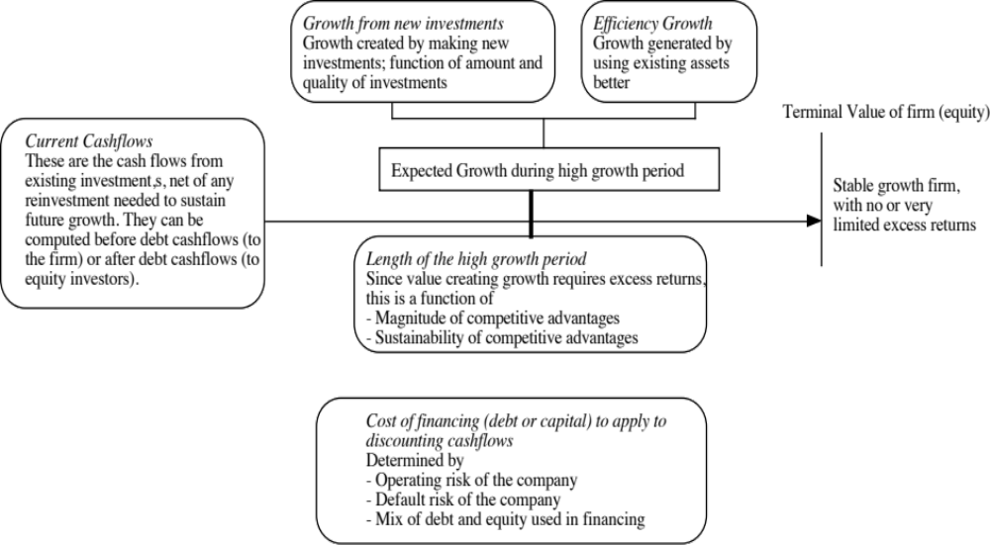
The Drivers of Value…

Slide 12
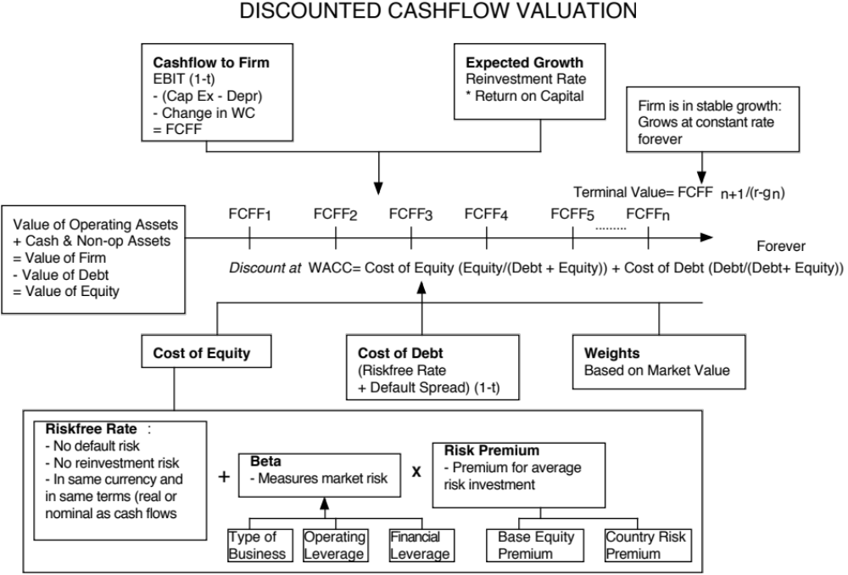

Slide 13
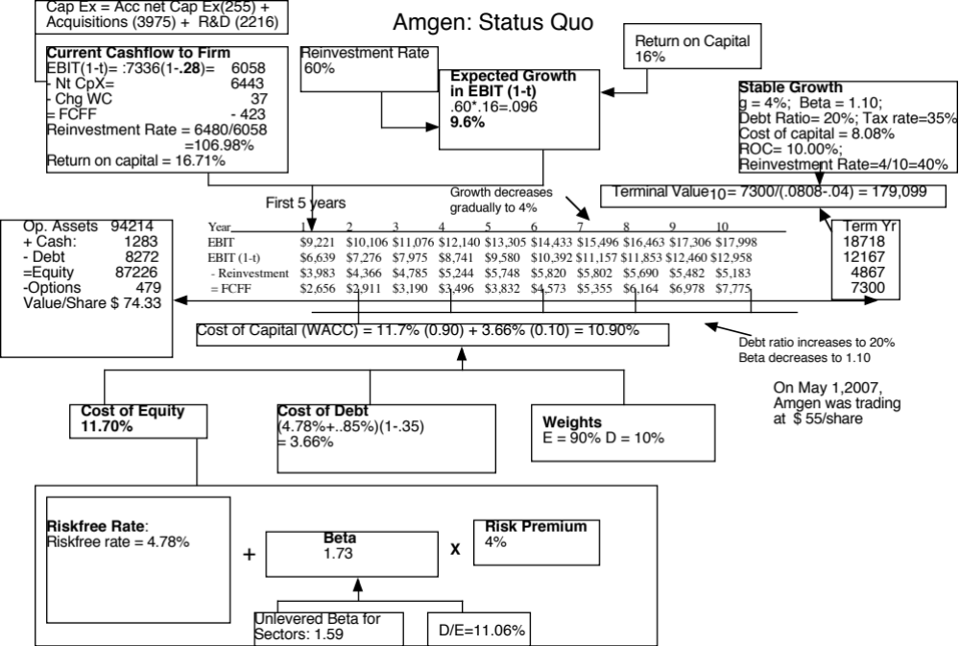

Slide 14
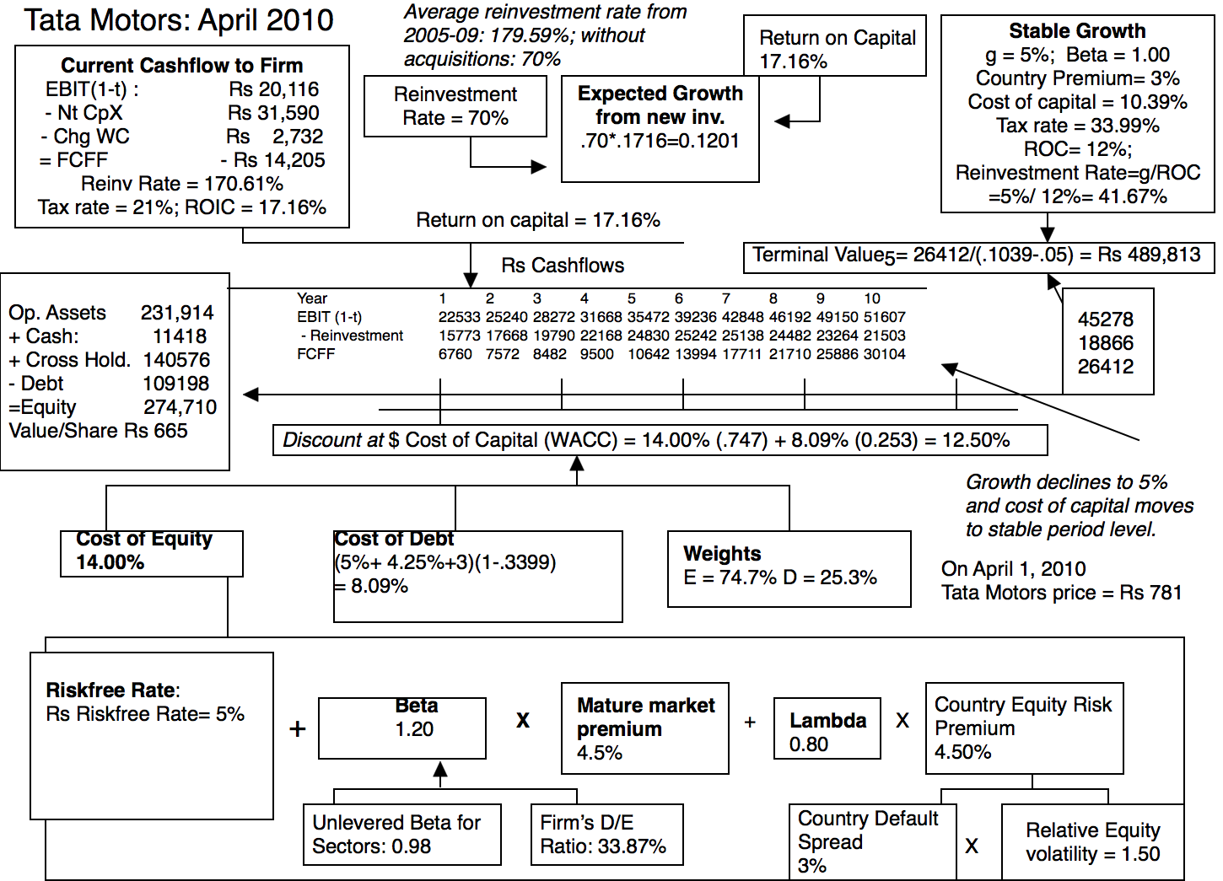

Slide 15
DCF Inputs
“Garbage in, garbage out”

Slide 16
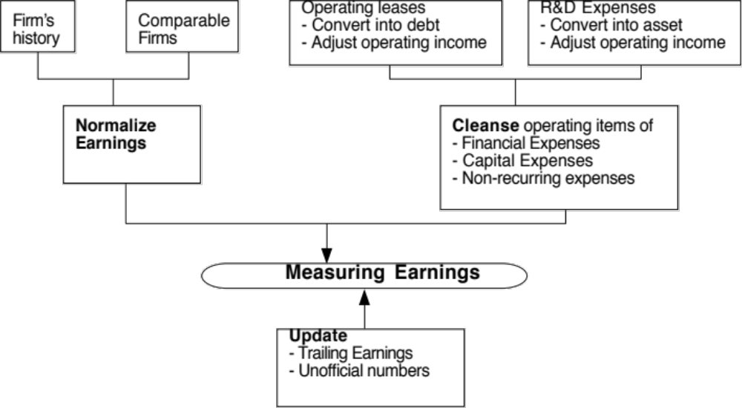
I. Measure earnings right..

Slide 17
Operating Leases at Amgen in 2007
Amgen has lease commitments and its cost of debt (based on it’s A rating) is 5.63%.
Year Commitment Present Value
1 $96.00 $90.88
2 $95.00 $85.14
3 $102.00 $86.54
4 $98.00 $78.72
5 $87.00 $66.16
6-12 $107.43 $462.10 ($752 million prorated)
Debt Value of leases = $869.55
Debt outstanding at Amgen = $7,402 + $ 870 = $8,272 million
Adjusted Operating Income = Stated OI + Lease expense this year – Depreciation
= 5,071 m + 69 m - 870/12 = $5,068 million (12 year life for assets)
Approximate Operating income= stated OI + PV of Lease commitment * Pre-tax cost of debt
= $5,071 m + 870 m (.0563) = $ 5,120 million
Notes:
The Home Depot reports its lease commitments in its financial statements. The present value of operating lease expenses is computed using the pre-tax cost of debt. (An argument can be made that the unsecured cost of debt should be used.)

Slide 18
Capitalizing R&D Expenses: Amgen
R & D was assumed to have a 10-year life.
Year R&D Expense Unamortized portion Amortization this year
Current 3366.00 1.00 3366.00
-1 2314.00 0.90 2082.60 $231.40
-2 2028.00 0.80 1622.40 $202.80
-3 1655.00 0.70 1158.50 $165.50
-4 1117.00 0.60 670.20 $111.70
-5 865.00 0.50 432.50 $86.50
-6 845.00 0.40 338.00 $84.50
-7 823.00 0.30 246.90 $82.30
-8 663.00 0.20 132.60 $66.30
-9 631.00 0.10 63.10 $63.10
-10 558.00 0.00 $55.80
Value of Research Asset = $10,112.80 $1,149.90
Adjusted Operating Income = $5,120 + 3,366 - 1,150 = $7,336 million
Notes:
The amortizable life is an assumption based upon Cisco’s business (telecom equipment and software). It would be shorter in other businesses (such as computer chips) and longer in businesses that need regulatory approval (such as pharmaceuticals).
Note that the amortization is 1/5 of the R&D expense each year.
We are also assuming that R&D expenses are spent at the end of each year - not realistic, but simplifies analysis - that is why there is no amortization of the current year’s expense.
The effect of capitalizing R&D will be greatest at firms where R&D is growing over time and be non-existent at firms with flat R&D.

Slide 19
II. Get the big picture (not the accounting one) when it comes to cap ex and working capital
Capital expenditures should include
  Research and development expenses, once they have been re-categorized as capital expenses.
  Acquisitions of other firms, whether paid for with cash or stock.
Working capital should be defined not as the difference between current assets and current liabilities but as the difference between non-cash current assets and non-debt current liabilities.
On both items, start with what the company did in the most recent year but do look at the company’s history and at industry averages.

Slide 20
Amgen’s Net Capital Expenditures
The accounting net cap ex at Amgen is small:
  Accounting Capital Expenditures = $1,218 million
  - Accounting Depreciation = $ 963 million
  Accounting Net Cap Ex = $ 255 million
We define capital expenditures broadly to include R&D and acquisitions:
  Accounting Net Cap Ex = $ 255 million
  Net R&D Cap Ex = (3366-1150) = $2,216 million
  Acquisitions in 2006 = $3,975 million
  Total Net Capital Expenditures = $ 6,443 million
Acquisitions have been a volatile item. Amgen was quiet on the acquisition front in 2004 and 2005 and had a significant acquisition in 2003.

Slide 21
III. The government bond rate is not always the risk free rate
When valuing Amgen in US dollars, the US$ ten-year bond rate of 4.78% was used as the risk free rate. We assumed that the US treasury was default free.
When valuing Tata Motors in Indian rupees in 2010, the Indian government bond rate of 8% was not default free. Using the Indian government’s local currency rating of Ba2 yielded a default spread of 3% for India and a riskfree rate of 5% in Indian rupees.
Risk free rate in Indian Rupees = 8% - 3% = 5%

Slide 22
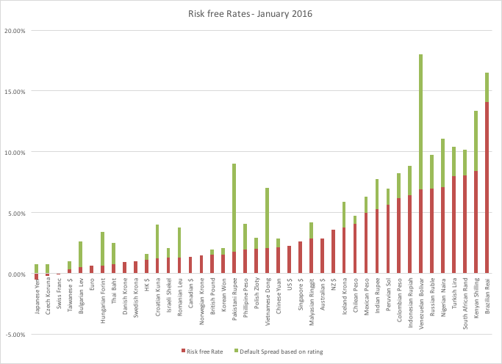
Risk free rates will vary across currencies: January 2015

Slide 23
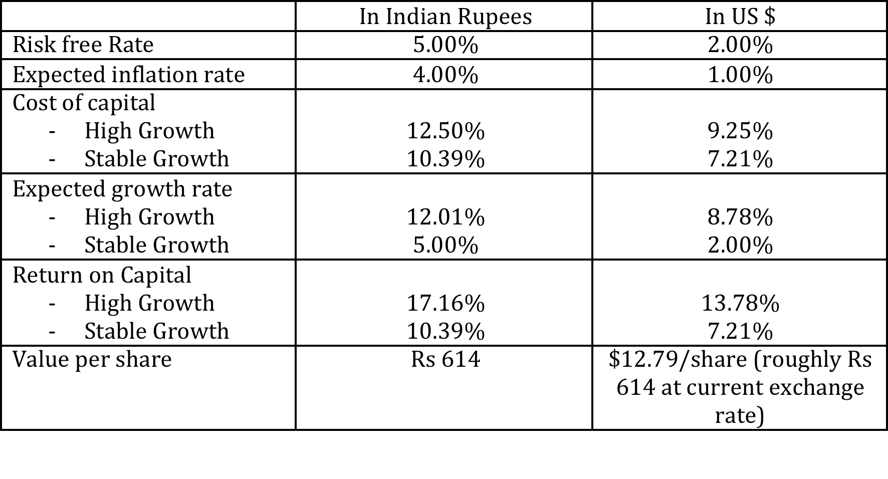
But valuations should not

Slide 24
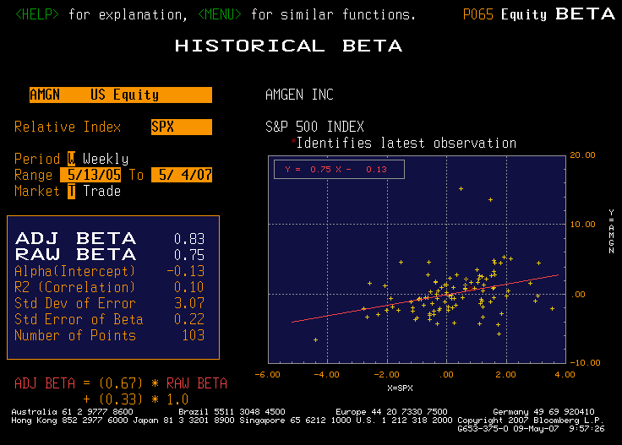
IV. Betas do not come from regressions… and are noisy…

Slide 25
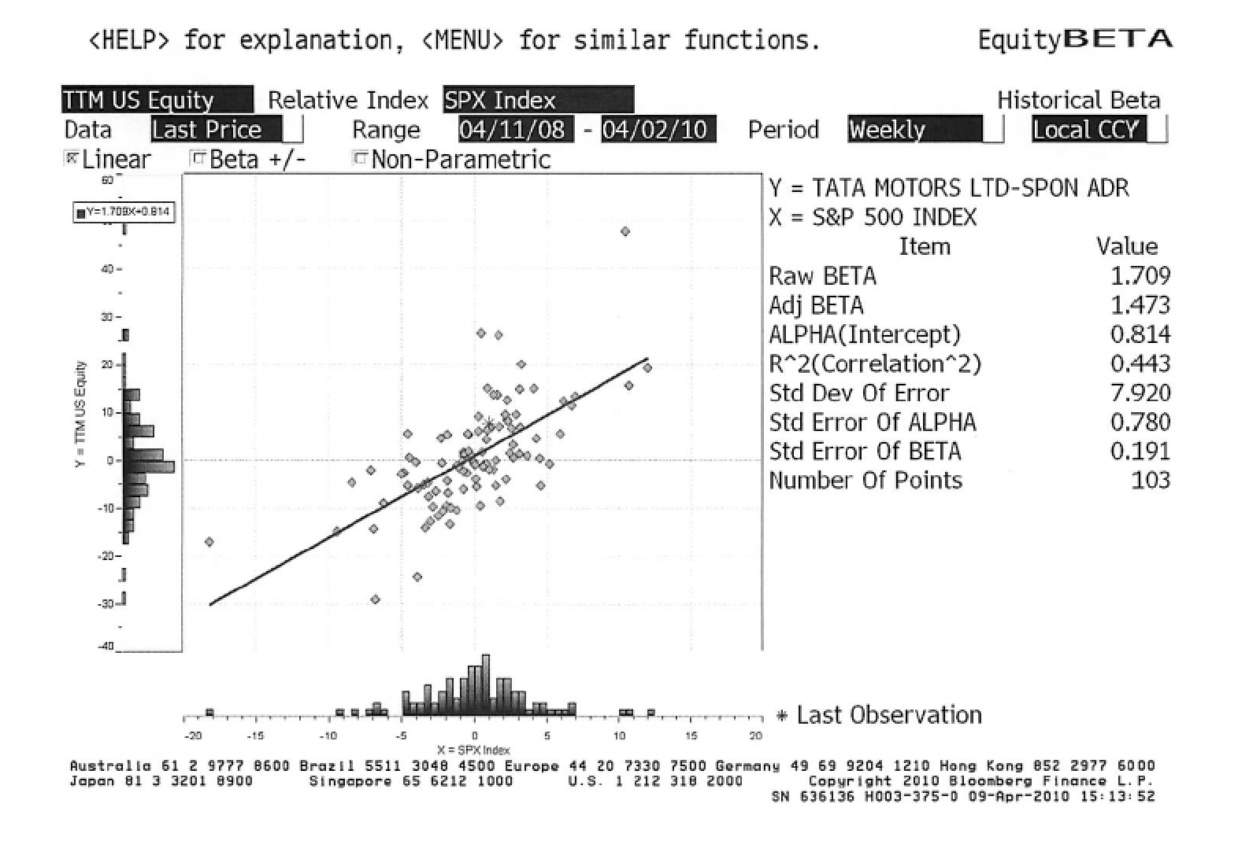
Look better for some companies, but only because they are run against narrow indices

Slide 26
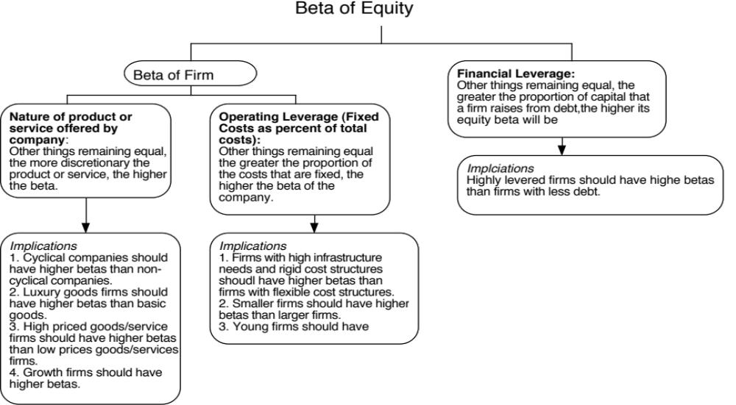
Determinants of Betas
Notes:
These are the three fundamentals that drive betas.
Firms that produce luxury goods (such as Gucci and Tiffanys) should have higher betas than firms that cater to more basic needs (Walmart). These firms tend to have revenues that are much more sensitive to changes in economic conditions.
Firms in businesses with high fixed cost structures (like airlines) should have higher betas than firms with more flexible cost structures.
Firms that borrow more money will have higher equity betas than otherwise similar firms that do not borrow money.

Slide 27
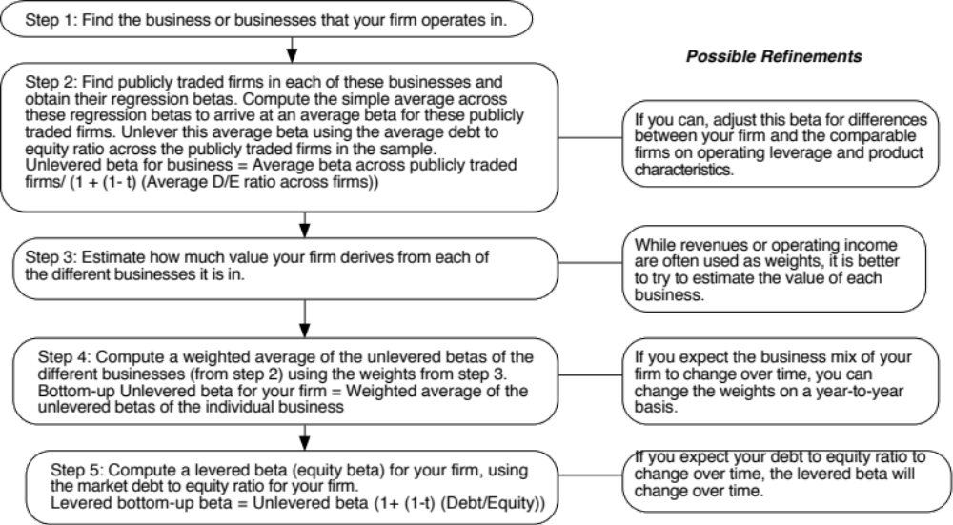
Bottom-up Betas
Notes:
Three measurement issues come up:
How broadly or narrowly do we define comparable firms?
We would argue for a broader rather than a narrow definition, because the savings in standard error increase with the number of firms.
How do we deal with differences in operating leverage and business mix that may persist across these firms?
Assume that there are no differences in operating leverage and business mix or that the differences average out.
Adjust for the differences quantitatively. For instance, you could decompose the unlevered beta further into a business beta and the operating leverage effect:
Unlevered beta = Business beta (1 + (Fixed Cost/Variable costs))
How do we compute an average - simple or weighted?
I prefer simple averages. Otherwise, your betas reflect those of the largest and most stable firms in the business.

Slide 28
Working through with our companies
Amgen
  The unlevered beta for pharmaceutical firms is 1.59. Using Amgen’s debt to equity ratio of 11%, the bottom up beta for Amgen is
  Bottom-up Beta = 1.59 (1+ (1-.35)(.11)) = 1.73
Tata Motors
  The unlevered beta for automobile firms is 0.98. Using Tata Motor’s debt to equity ratio of 33.87%, the bottom up beta for Tata Motors is
  Bottom-up Beta = 0.98 (1+ (1-.3399)(.3387)) = 1.20

Slide 29
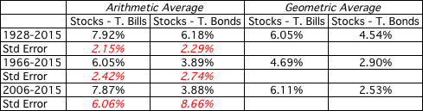
V. And the past is not always a good indicator of the future.
If you are going to use a historical risk premium, make it
  Long term (because of the standard error)
  Consistent with your risk free rate
  A “compounded” average
No matter which estimate you use, recognize that it is backward looking, is noisy and may reflect selection bias.

Slide 30
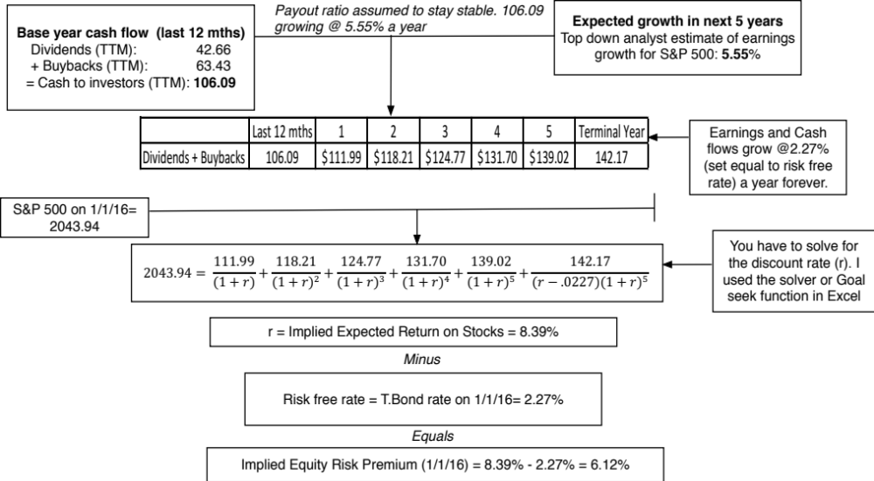
But in the future..

Slide 31
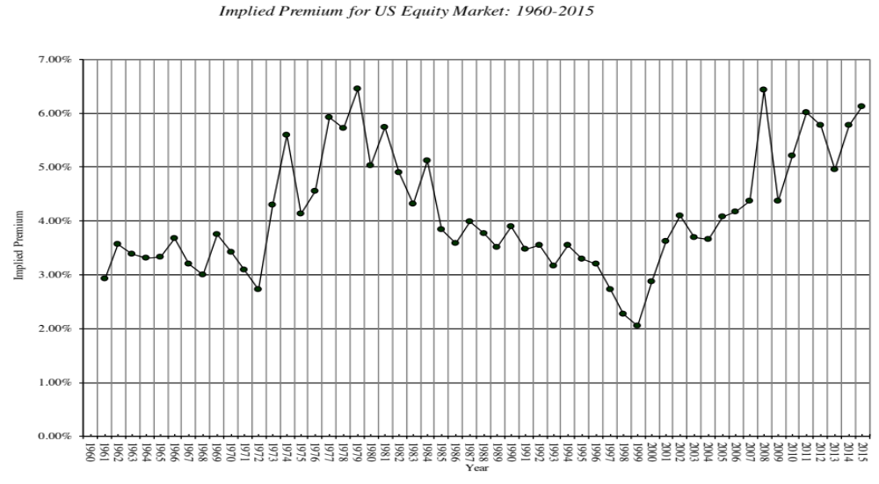
Implied Premiums in the US: 1960-2015
Notes:
As the index changes (and it is the input most likely to change by large amounts in short periods), the implied premium will change. Note that as premiums rise, stock prices drop. Notice two historical phenomena: (1) Equity risk premiums spiked in the 1970s as inflation increased in the US (2) Equity risk premiums bottomed out at 2% at the end of 1999 at the peak of the dot-com boom.
Would you settle for a 2% premium? If your answer is no, you believe that stocks are overvalued.

Slide 32
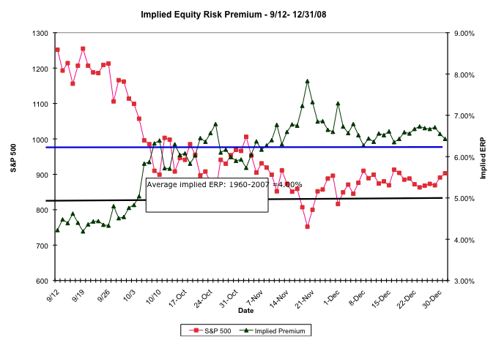
The Anatomy of a Crisis: Implied ERP from September 12, 2008 to January 1, 2009
Notes:
Equity risk premiums changed more in three months than they had in the previous 20 years put together. A wake-up call for those who stick with fixed premiums? That depends on whether we assume that this is an aberration or a break with the past.

Slide 33
Implied Premium for India using the Sensex: April 2010
Level of the Index = 17559
FCFE on the Index = 3.5% (Estimated FCFE for companies in index as % of market value of equity)
Other parameters
  Riskfree Rate = 5% (Rupee)
  Expected Growth (in Rupee)
    Next 5 years = 20% (Used expected growth rate in Earnings)
    After year 5 = 5%
Solving for the expected return:
  Expected return on Equity = 11.72%
  Implied Equity premium for India =11.72% - 5% = 6.72%

Slide 34
VI. There is a downside to globalization…
Emerging markets offer growth opportunities but they are also riskier. If we want to count the growth, we have to also consider the risk.
Two ways of estimating the country risk premium:
  Sovereign Default Spread: In this approach, the country equity risk premium is set equal to the default spread of the bond issued by the country.
    Equity Risk Premium for mature market = 4.50%
    Default Spread for India = 3.00% (based on rating)
    Equity Risk Premium for India = 4.50% + 3.00%
  Adjusted for equity risk: The country equity risk premium is based upon the volatility of the equity market relative to the government bond rate.
    Country risk premium= Default Spread* Std Deviation_{Country Equity} / Std Deviation_{Country Bond}
    Standard Deviation in Sensex = 21%
    Standard Deviation in Indian government bond= 14%
    Default spread on Indian Bond= 3%
    Additional country risk premium for India = 3% (21/14) = 4.5%

Slide 35
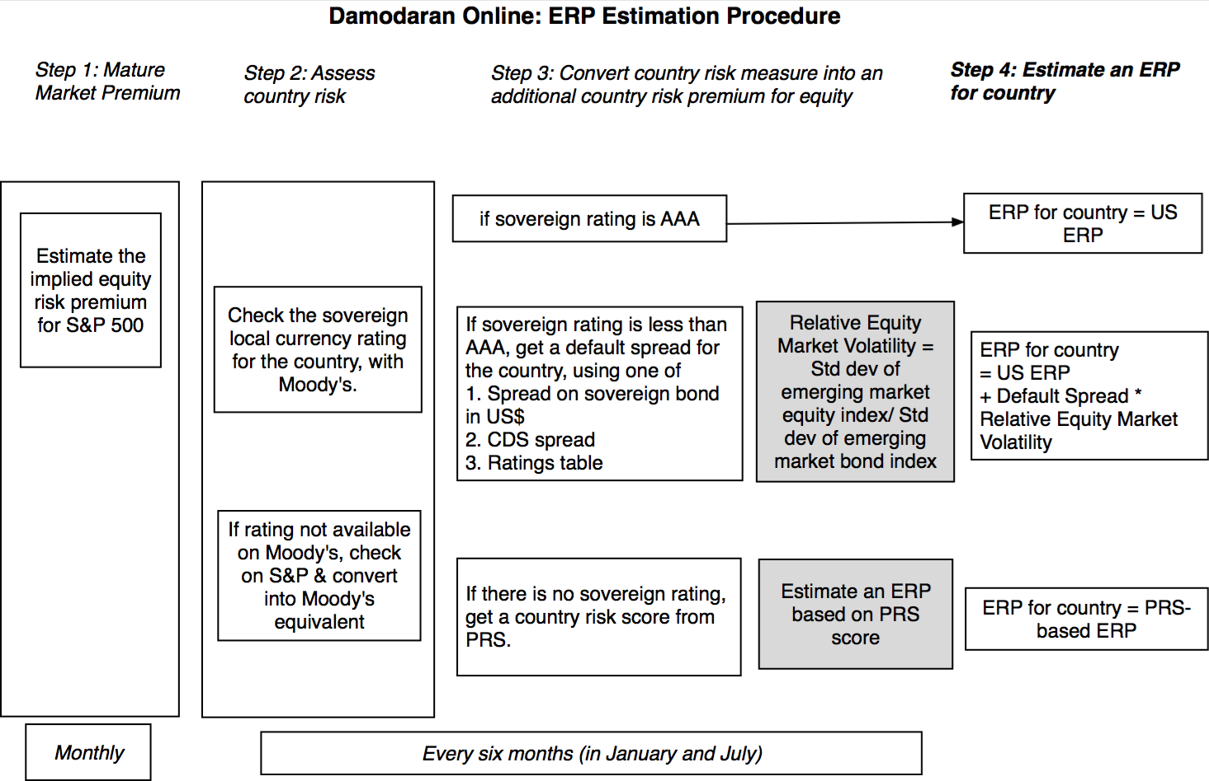
ERP Estimation: A Picture

Slide 36
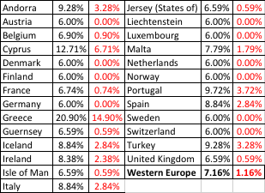
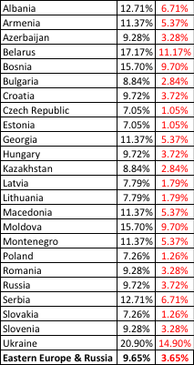
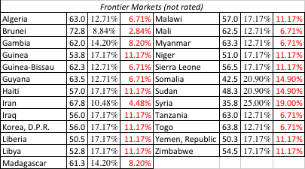

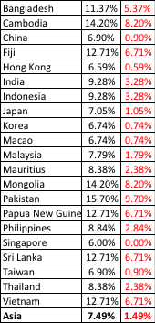

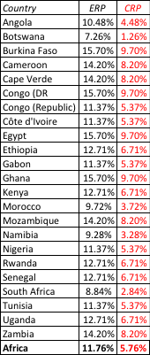
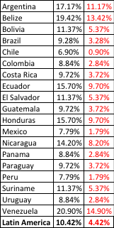
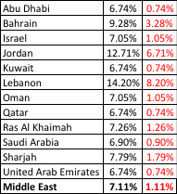

ERP : Jan 2016
Black #: Total ERP
Red #: Country risk premium
AVG: GDP weighted average
Notes:
Updated country risk premiums.

Slide 37
VII. And it is not just emerging market companies that are exposed to this risk..
The “default” approach in valuation has been to assign country risk based upon your country of incorporation. Thus, if you are incorporated in a developed market, the assumption has been that you are not exposed to emerging market risks. If you are incorporated in an emerging market, you are saddled with the entire country risk.
As companies globalize and look for revenues in foreign markets, this practice will under estimate the costs of equity of developed market companies with significant emerging market risk exposure and over estimate the costs of equity of emerging market companies with significant developed market risk exposure.

Slide 38
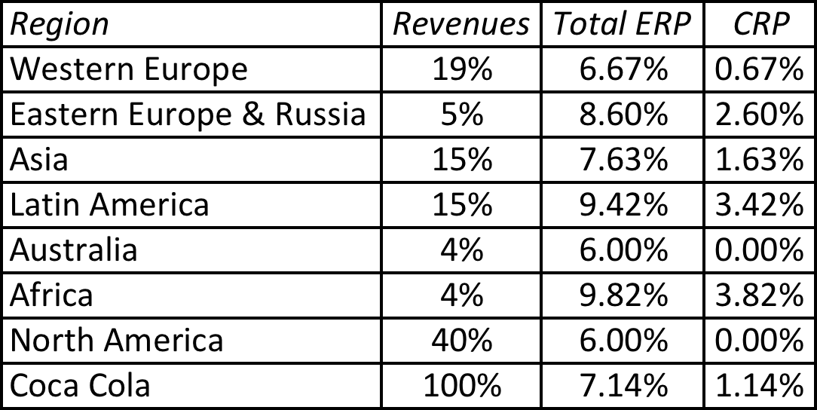
Globalization’s flip side: Operation-based ERP
Developed market companies are not immune from emerging market risk:
And emerging market companies are not all made equal.
 | Tata Motors | TCS
% of production/operations in India | High | High
% of revenues in India | 91.37% (in 2009) Estimated 70% (in 2010) | 7.62%
Lambda | 0.80 | 0.20
Flexibility in moving operations | Low. Significant physical assets. | High. Human capital is mobile.
Notes:
In the case of Embraer, its limited revenues in Brazil give it a low equity risk premium.
In the case of Ambev, the computation is messier because it has revenues in many Latin American markets. We use revenue weights to weight the CRP.

Slide 39
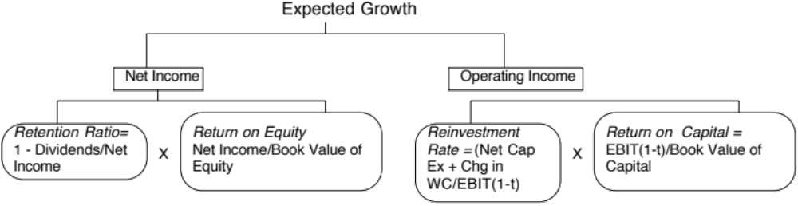
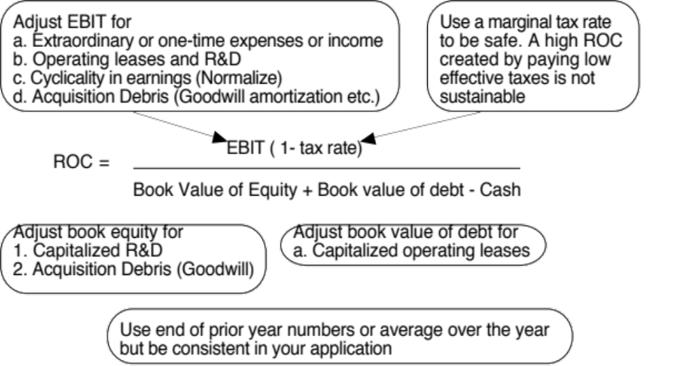
VIII. Growth has to be earned (not endowed or estimated)

Slide 40
The Quality of Growth
Notes:
Looking across all firms, you can see that almost a third of all firms earn more than 5% less than their cost of capital. It is true that we are looking at one year’s returns, but many of these firms have been earning less than their cost of capital for years.

Slide 41
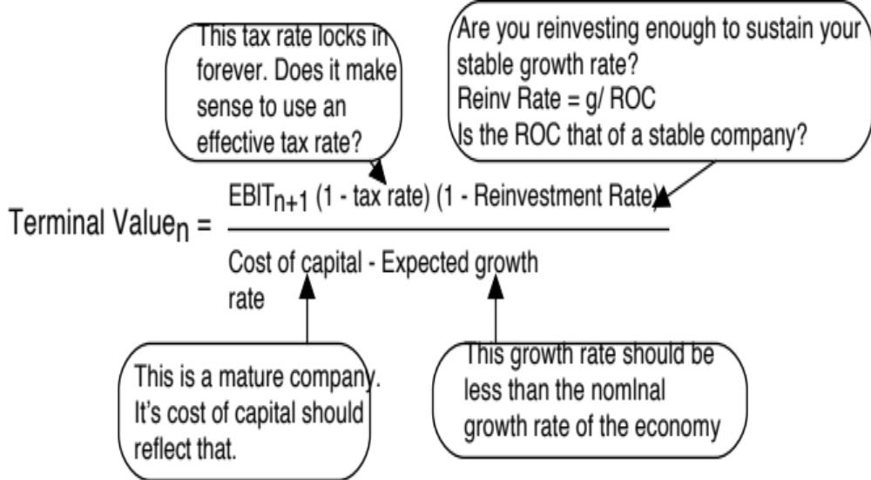
IX. All good things come to an end..And the terminal value is not an ATM…

Slide 42
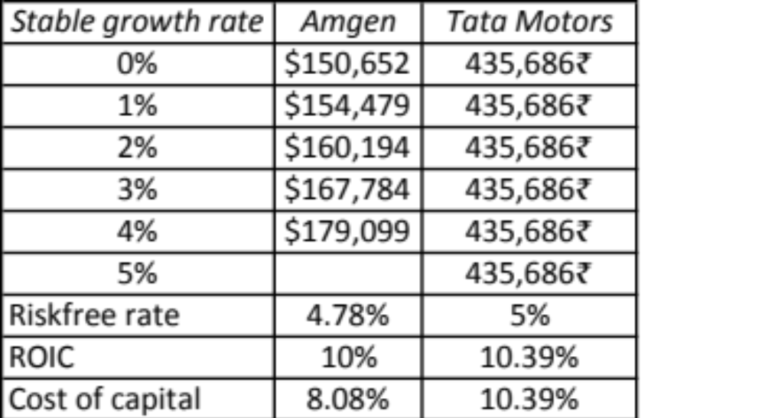
Terminal Value and Growth

Slide 43
The loose ends in valuation…
Aswath Damodaran

Slide 44
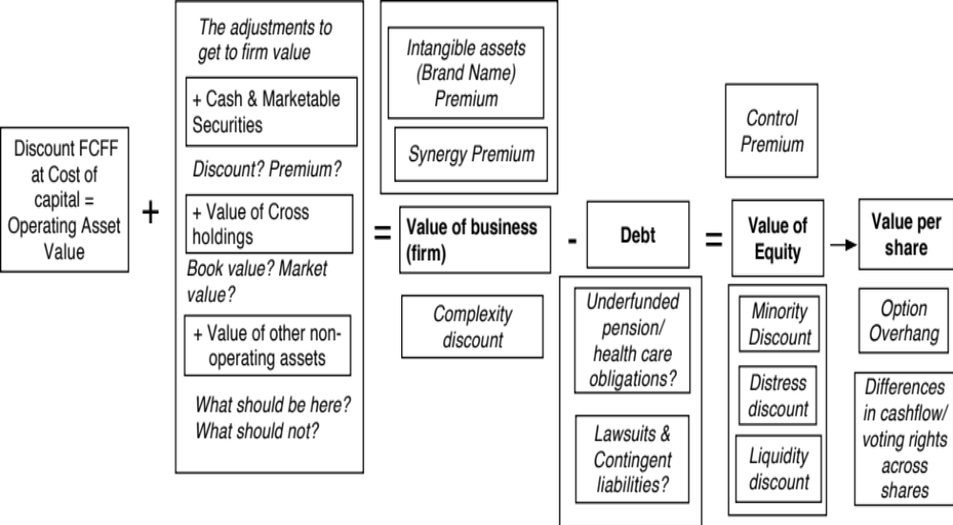
Getting from DCF to value per share: The Loose Ends

Slide 45
1. The Value of Cash
An Exercise in Cash Valuation
Company A Company B Company C
Enterprise Value $ 1 billion $ 1 billion $ 1 billion
Cash $ 100 mil $ 100 mil $ 100 mil
Return on Capital 10% 5% 22%
Cost of Capital 10% 10% 12%
Trades in US US Argentina
In which of these companies is cash most likely to trade at face value, at a discount and at a premium?

Slide 46
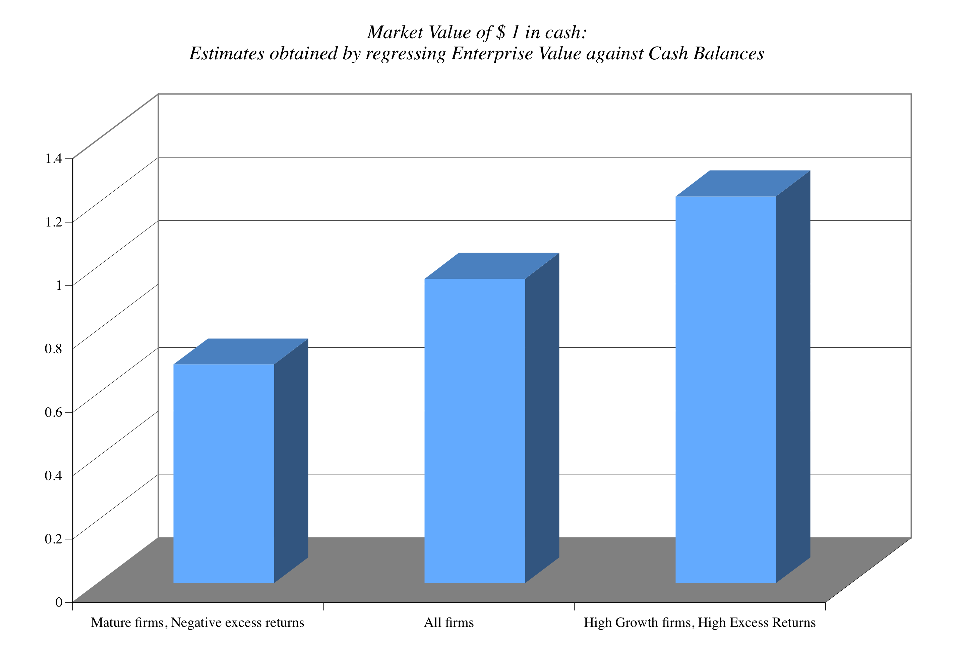
Cash: Discount or Premium?

Slide 47
2. Dealing with Holdings in Other firms
Holdings in other firms can be categorized into
  Minority passive holdings, in which case only the dividend from the holdings is shown in the balance sheet
  Minority active holdings, in which case the share of equity income is shown in the income statements
  Majority active holdings, in which case the financial statements are consolidated.
We tend to be sloppy in practice in dealing with cross holdings. After valuing the operating assets of a firm, using consolidated statements, it is common to add on the balance sheet value of minority holdings (which are in book value terms) and subtract out the minority interests (again in book value terms), representing the portion of the consolidated company that does not belong to the parent company.
Notes:
How you deal with cross holdings depends upon which scenario you face.

Slide 48
How to value holdings in other firms.. In a perfect world..
In a perfect world, we would strip the parent company from its subsidiaries and value each one separately. The value of the combined firm will be
  Value of parent company + Proportion of value of each subsidiary
To do this right, you will need to be provided detailed information on each subsidiary to estimate cash flows and discount rates.
Notes:
If a holding is not consolidated, you have to work to bring the holding into your valuation explicitly since the income from the holding will not be shown as part of operating income. If you are doing equity valuation, you have to be careful to strip out the portion of the net income that is attributable to the holdings - dividends, for instance.
If a holding is consolidated, you are valuing a combined firm - the parent and the subsidiary. You have to ensure that you subtract out the portion of the subsidiary that does not belong to you.

Slide 49
Two compromise solutions…
The market value solution: When the subsidiaries are publicly traded, you could use their traded market capitalizations to estimate the values of the cross holdings. You do risk carrying into your valuation any mistakes that the market may be making in valuation.
The relative value solution: When there are too many cross holdings to value separately or when there is insufficient information provided on cross holdings, you can convert the book values of holdings that you have on the balance sheet (for both minority holdings and minority interests in majority holdings) by using the average price to book value ratio of the sector in which the subsidiaries operate.

Slide 50
Tata Motor’s Cross Holdings

Slide 51
3. Other Assets that have not been counted yet..
Unutilized assets: If you have assets or property that are not being utilized (vacant land, for example), you have not valued it yet. You can assess a market value for these assets and add them on to the value of the firm.
Overfunded pension plans: If you have a defined benefit plan and your assets exceed your expected liabilities, you could consider the over funding with two caveats:
  Collective bargaining agreements may prevent you from laying claim to these excess assets.
  There are tax consequences. Often, withdrawals from pension plans get taxed at much higher rates.
Do not double count an asset. If you count the income from an asset in your cash flows, you cannot count the market value of the asset in your value.

Slide 52
4. Brand name, great management, superb product …Don’t double count!
There is often a temptation to add on premiums for intangibles. Here are a few examples.
  Brand name
  Great management
  Loyal workforce
  Technological prowess
There are two potential dangers:
  For some assets, the value may already be in your value and adding a premium will be double counting.
  For other assets, the value may be ignored but incorporating it will not be easy.

Slide 53
Valuing Brand Name
Coca Cola With Cott Margins
Current Revenues = $21,962.00 $21,962.00
Length of high-growth period 10 10
Reinvestment Rate = 50% 50%
Operating Margin (after-tax) 15.57% 5.28%
Sales/Capital (Turnover ratio) 1.34 1.34
Return on capital (after-tax) 20.84% 7.06%
Growth rate during period (g) = 10.42% 3.53%
Cost of Capital during period = 7.65% 7.65%
Stable Growth Period
Growth rate in steady state = 4.00% 4.00%
Return on capital = 7.65% 7.65%
Reinvestment Rate = 52.28% 52.28%
Cost of Capital = 7.65% 7.65%
Value of Firm = $79,611.25 $15,371.24

Slide 54
5. The Value of Control: It’s not always worth 20%!!
The value of the control premium that will be paid to acquire a block of equity will depend upon two factors -
  Probability that control of firm will change: This refers to the probability that incumbent management will be replaced. this can be either through acquisition or through existing stockholders exercising their muscle.
  Value of Gaining Control of the Company: The value of gaining control of a company arises from two sources - the increase in value that can be wrought by changes in the way the company is managed and run, and the side benefits and perquisites of being in control
  Value of Gaining Control = Present Value (Value of Company with change in control - Value of company without change in control) + Side Benefits of Control

Slide 55
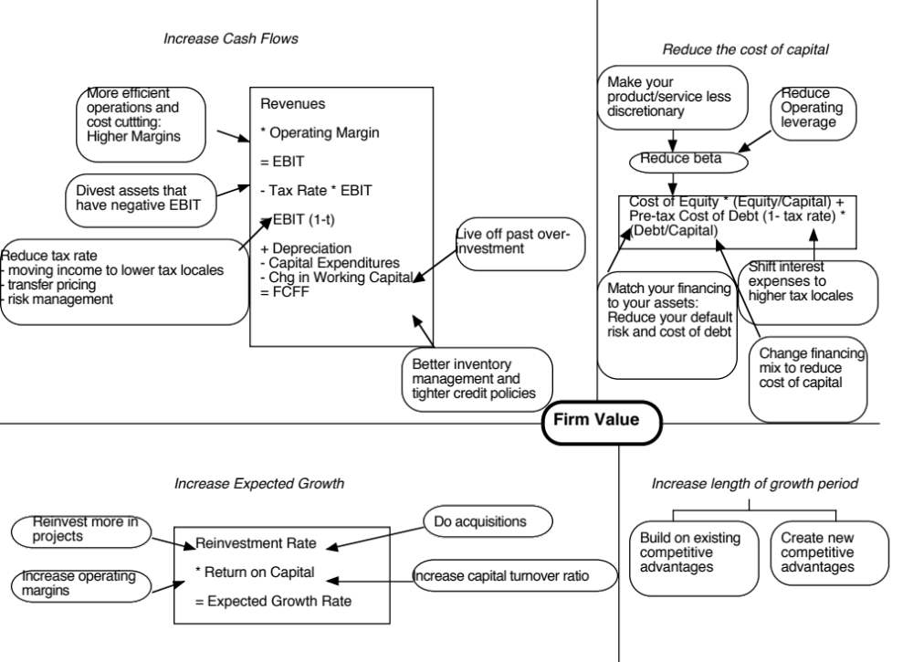

Slide 56
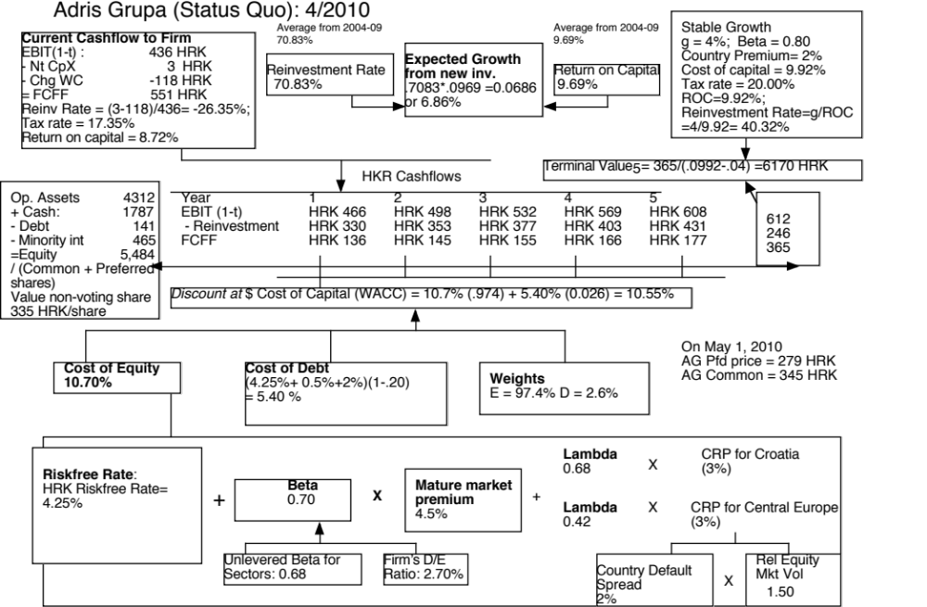

Slide 57
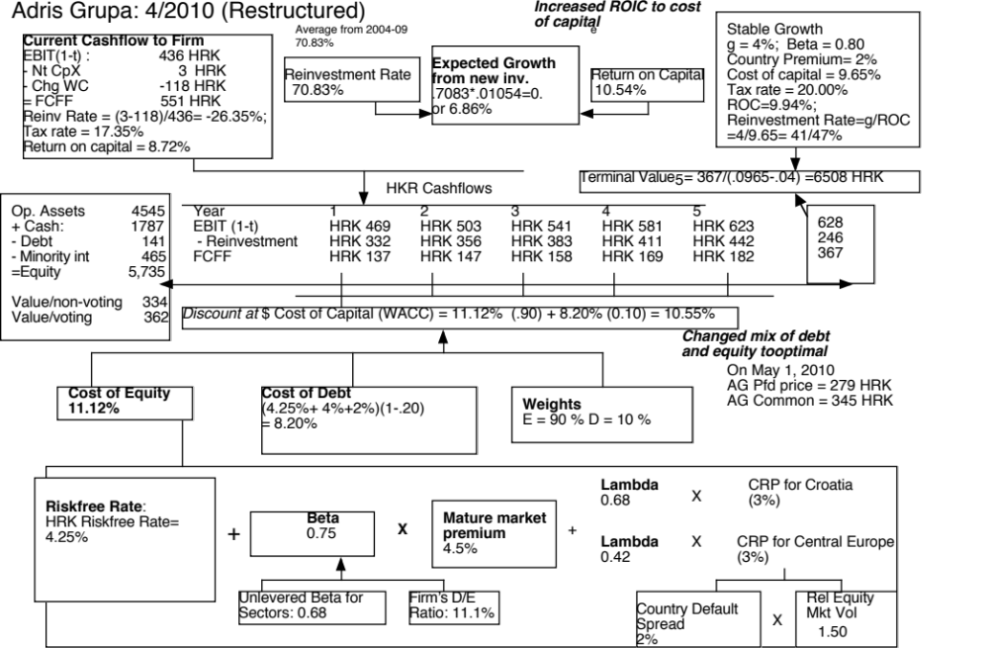

Slide 58
Value of Control and the Value of Voting Rights
Adris Grupa has two classes of shares outstanding: 9.616 million voting shares and 6.748 million non-voting shares.
  To value a non-voting share, we assume that all non-voting shares essentially have to settle for status quo value. All shareholders, common and preferred, get an equal share of the status quo value.
  Status Quo Value of Equity = 5,484 million HKR
  Value for a non-voting share = 5484/(9.616+6.748) = 334 HKR/share
To value a voting share, we first value control in Adris Grup as the difference between the optimal and the status quo value:
  Value of control at Adris Grupa = 5,735 – 5484 = 249 million HKR
  Value per voting share =334 HKR + 249/9.616 = 362 HKR

Slide 59
The Dark Side of Valuation:
Valuing difficult-to-value companies

Slide 60
The Dark Side of Valuation…
Valuing stable, money making companies with consistent and clear accounting statements, a long and stable history and lots of comparable firms is easy to do.
The true test of your valuation skills is when you have to value “difficult” companies. In particular, the challenges are greatest when valuing:
  Young companies, early in the life cycle, in young businesses
  Companies that don’t fit the accounting mold
  Companies that face substantial truncation risk (default or nationalization risk)

Slide 61
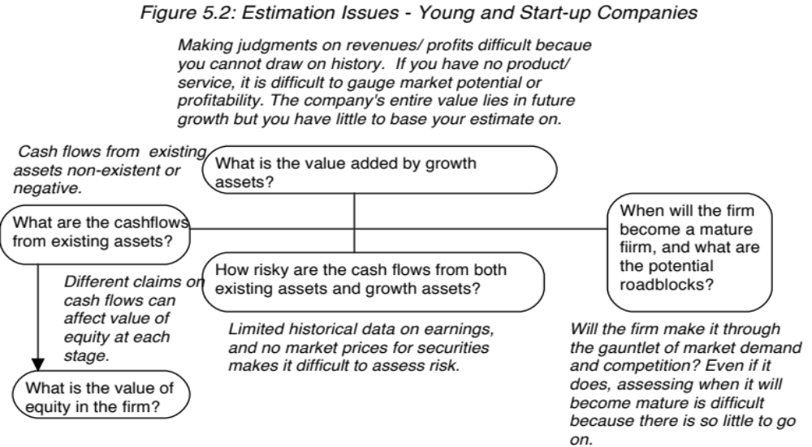
I. The challenge with young companies…
Notes:
Consider a young, start-up firm in a new business or industry…The financial statements provide scanty information because the firm’s operations are small, there is no historical data because the firm has not been around for very long and there are either no comparable firms or they all look like the firm being valued.

Slide 62
Upping the ante.. Young companies in young businesses…
When valuing a business, we generally draw on three sources of information
  The firm’s current financial statement
    How much did the firm sell?
    How much did it earn?
  The firm’s financial history, usually summarized in its financial statements.
    How fast have the firm’s revenues and earnings grown over time?
    What can we learn about cost structure and profitability from these trends?
    Susceptibility to macro-economic factors (recessions and cyclical firms)
  The industry and comparable firm data
    What happens to firms as they mature? (Margins.. Revenue growth… Reinvestment needs… Risk)
It is when valuing these companies that you find yourself tempted by the dark side, where
  “Paradigm shifts” happen…
  New metrics are invented …
  The story dominates and the numbers lag…
Notes:
We look for information in three places - a firm’s financial statements, its history and comparable firms.

Slide 63
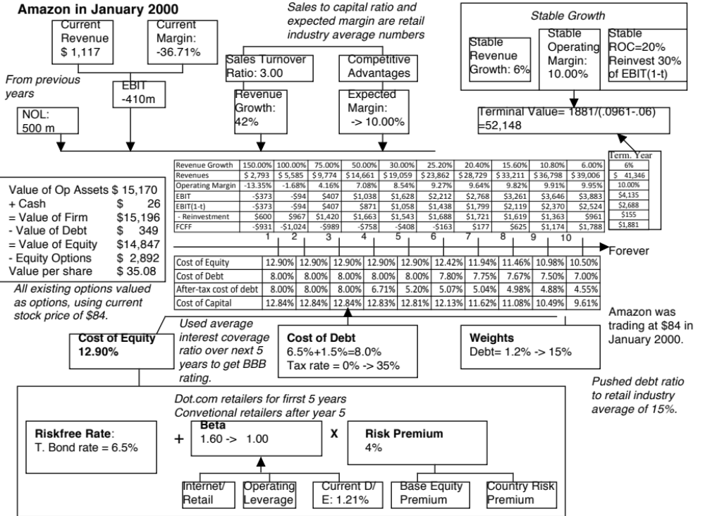
Notes:
To estimate a bottom-up beta for Amazon in January 2000, we used the average beta of internet retailers for the first five years as the bottom-up beta but assume that the beta will move towards the average beta for specialty retailers over time. The high operating leverage that is typical of an internet retailer (high infrastructure and technology costs) provides an intuitive explanation for why they should have higher betas than their brick-and-mortar counterparts.
When a firm has operating losses, the interest coverage ratio is negative. Using the interest coverage ratio table on the next page would yield a D rating for the firm. In January 2000, this seemed a little harsh. For better or worse, bondholders and lenders to the firm seemed to be lending based upon expected operating income in the future rather than past operating income. The interest coverage ratio was therefore defined as follows:
Interest coverage ratio = Average EBIT next 5 years/ Current interest expense
The interest coverage ratio yielded a synthetic rating of BBB and a default spread of 1.50% in January 2000.
3. The pre-tax cost of debt is equal to the after-tax cost for the next 2 years because the firm is expected to keep losing money. In year 3, Amazon is expected to make an operating profit, but it wil have net operating losses that shelter the income leading to no taxes. In year 4, Amazon is able to partially cover the operating income with carried-forward net operating losses… Starting in year 6, we lower the cost of debt since the firm is expected to become a profitable firm with substantial increases in operating income in the subsequent years.
Year 1 2 3 4 5
EBIT -$373 -$94 $407 $1,038 $1,628
Taxes $0 $0 $0 $167 $570
EBIT(1-t) -$373 -$94 $407 $871 $1,058
Tax rate 0% 0% 0% 16.13% 35%
NOL $500 $873 $967 $560 $0
The value per share in January 2000 is $ 34. This valuation was done with all of the inputs at the high end of my expectations and can be considered optimistic. Notwithstanding this, the stock is still overvalued. In fact, the optimism shows when you see that the free cashflows to the firm are negative for the first 6 years… I am assuming that Amazon will have no trouble raising the capital to fund these cashflows…

Slide 64
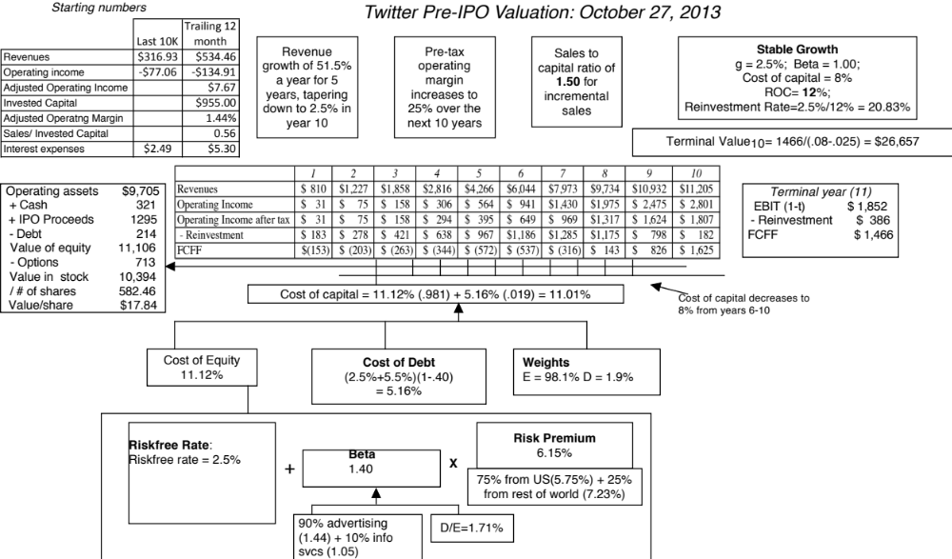

Slide 65
Lesson 1: Have a narrative

Slide 66
Your narrative and counters
My narrative for Uber: Uber will expand the car service market moderately, primarily in urban environments, and use its competitive advantages to get a significant but not dominant market share and maintain its profit margins.
Bill Gurley’s counter narrative
  Not just car service company.: Uber is a car company, not just a car service company, and there may be a day when consumers will subscribe to a Uber service, rather than own their own cars. It could also expand into logistics, i.e., moving and transportation businesses.
  Not just urban: Uber can create new demands for car service in parts of the country where taxis are not used (suburbia, small towns).
  Global networking benefits: By linking with technology and credit card companies, Uber can have global networking benefits.

Slide 67
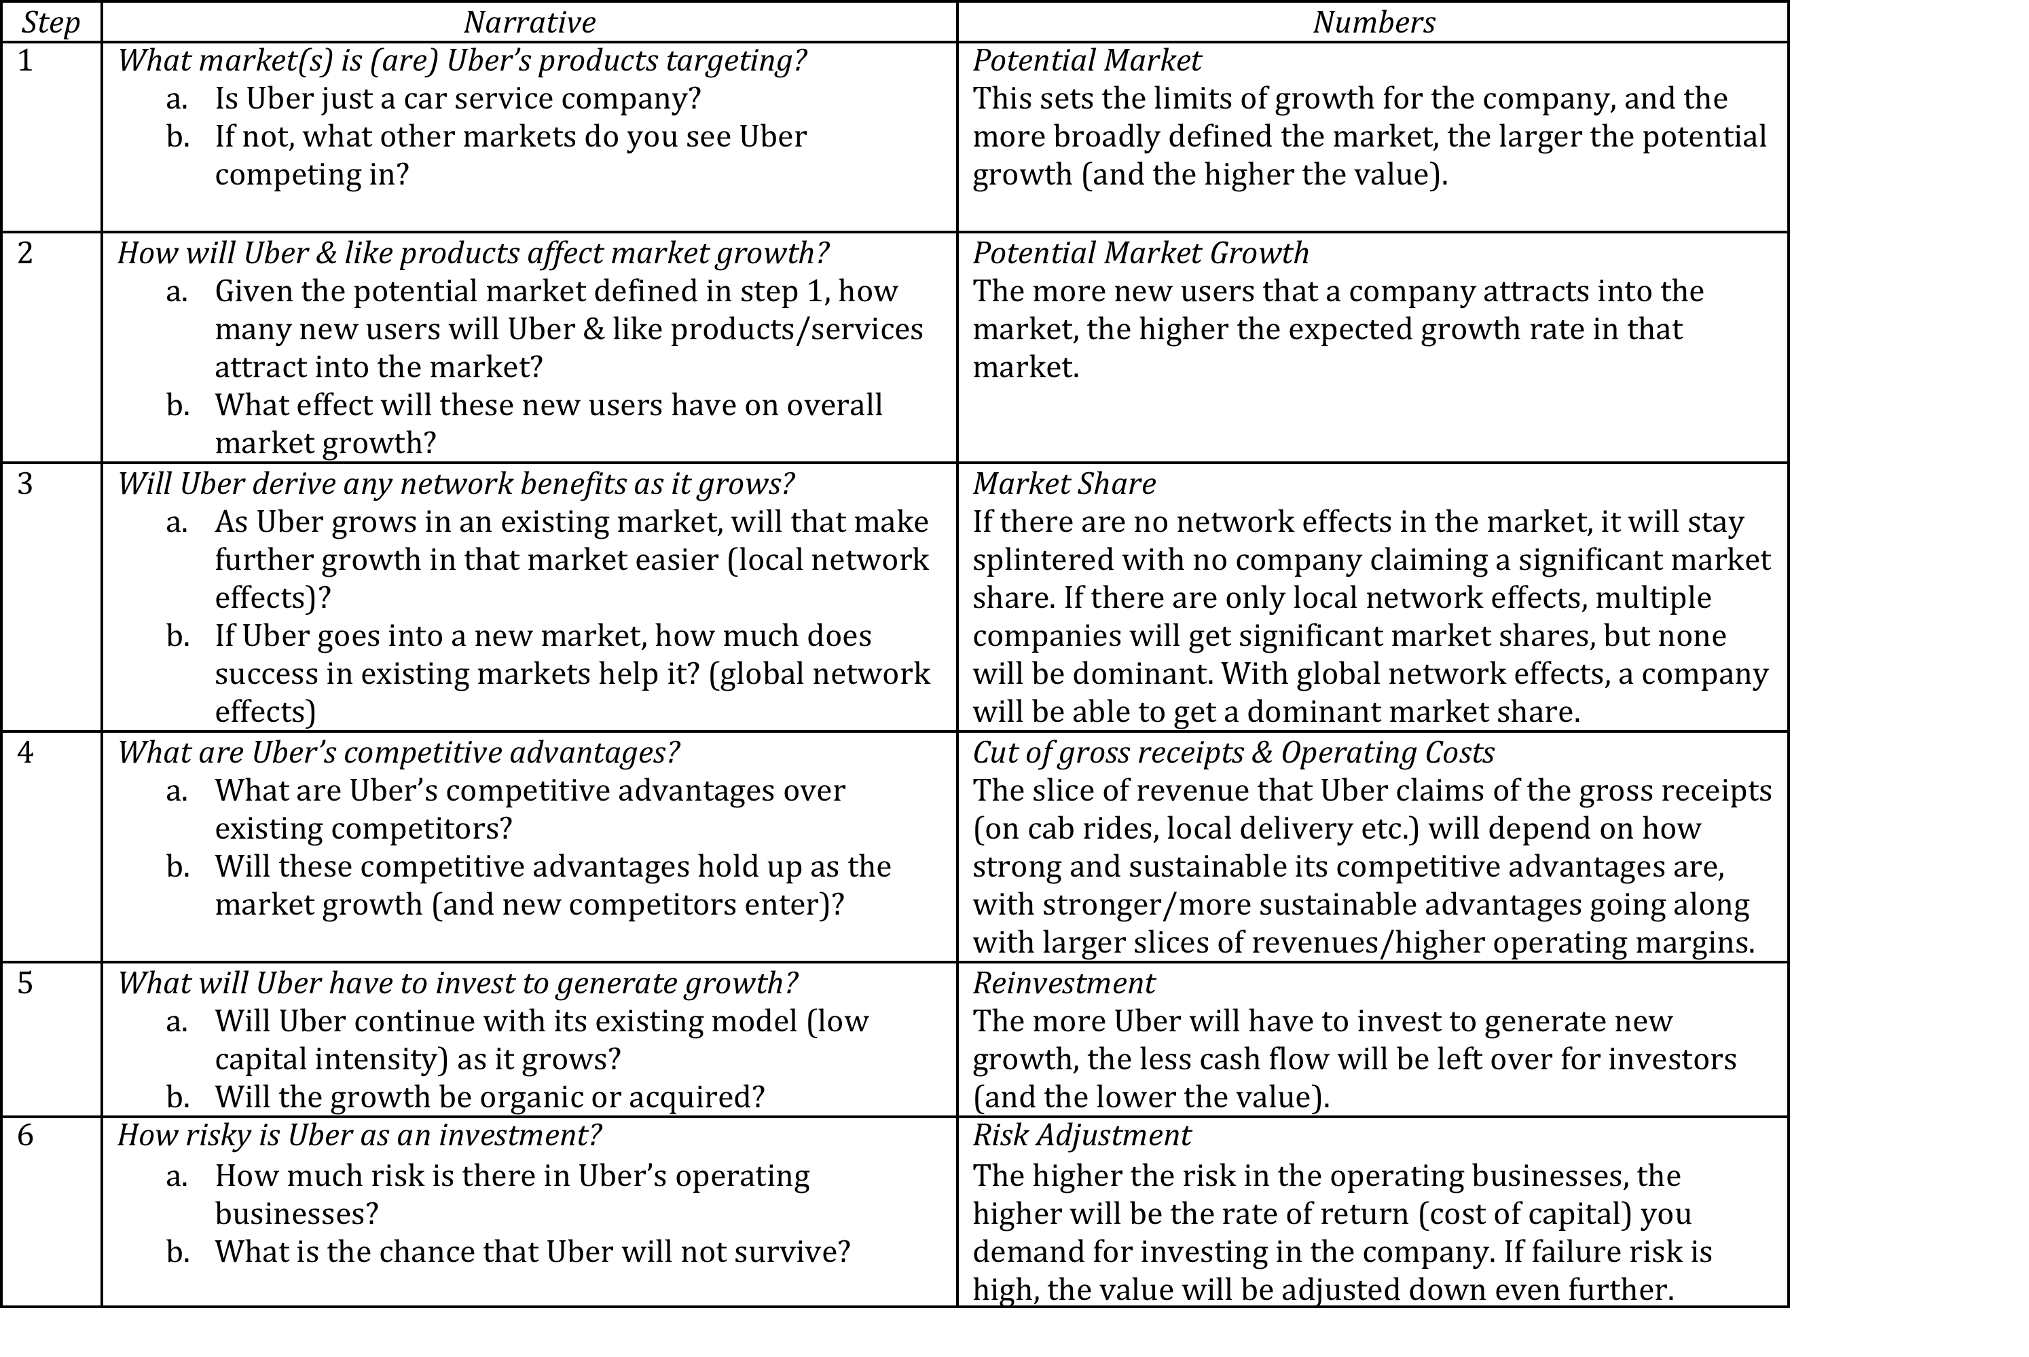
The narrative to numbers

Slide 68
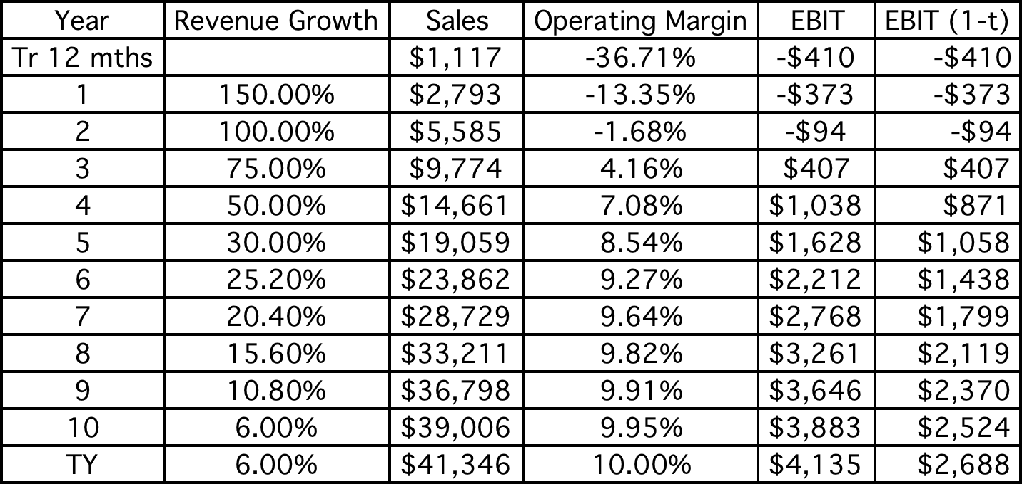
Lesson 2: Less is more
Principle of parsimony: Estimate fewer inputs when faced with uncertainty.
Use “auto pilot” approaches to estimate future years

Slide 69
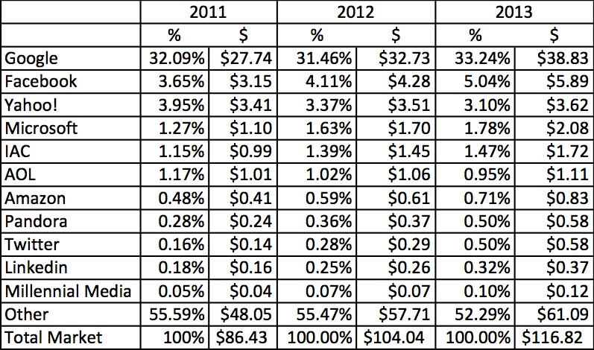
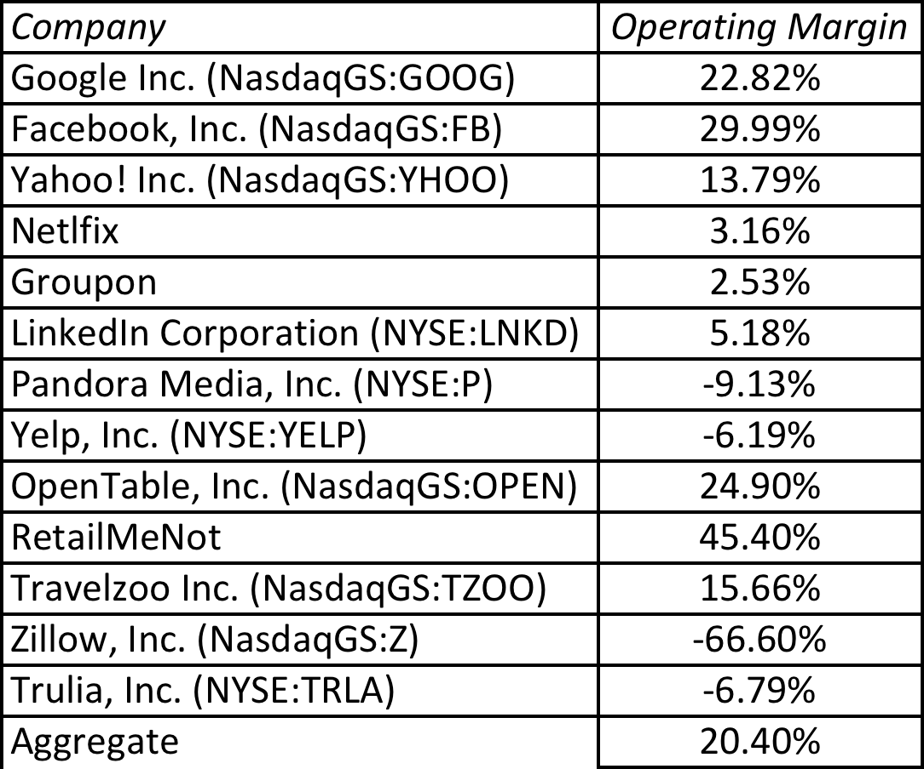
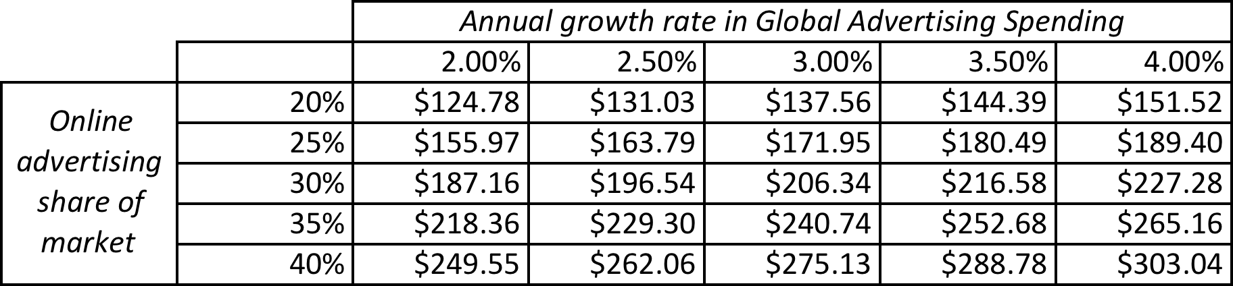
A tougher task at Twitter
My estimate for Twitter: Operating margin of 25% in year 10
My estimate for 2023: Overall market will be close to $200 billion and Twitter will about 5.7% ($11.5 billion)

Slide 70
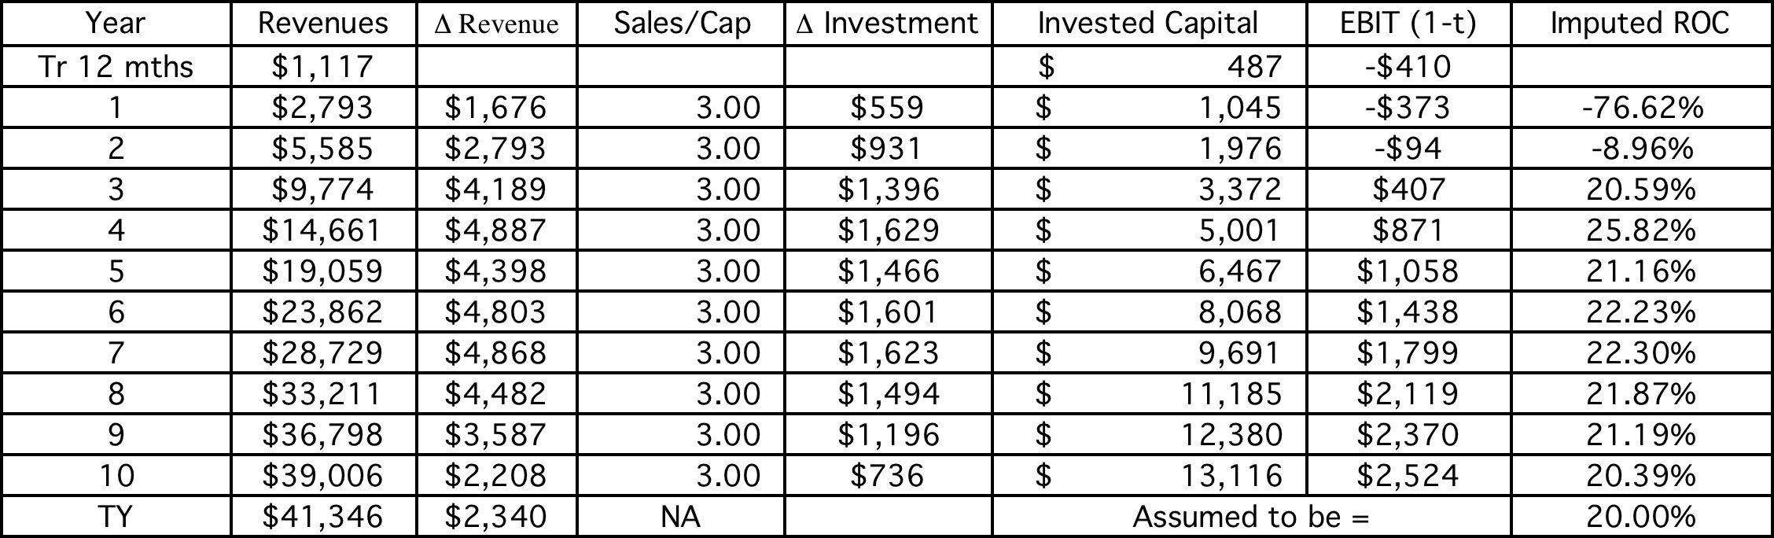
Lesson 3: Build in “internal” checks for reasonableness…
Check total revenues, relative to the market that it serves… Your market share obviously cannot exceed 100% but there may be tighter constraints.
  Are the margins and imputed returns on capital ‘reasonable’ in the outer years?

Slide 71
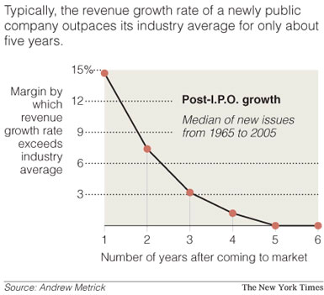
Lesson 4: Scaling up is hard to do…

Slide 72
Lesson 5: Don’t forget to pay for growth…

Slide 73
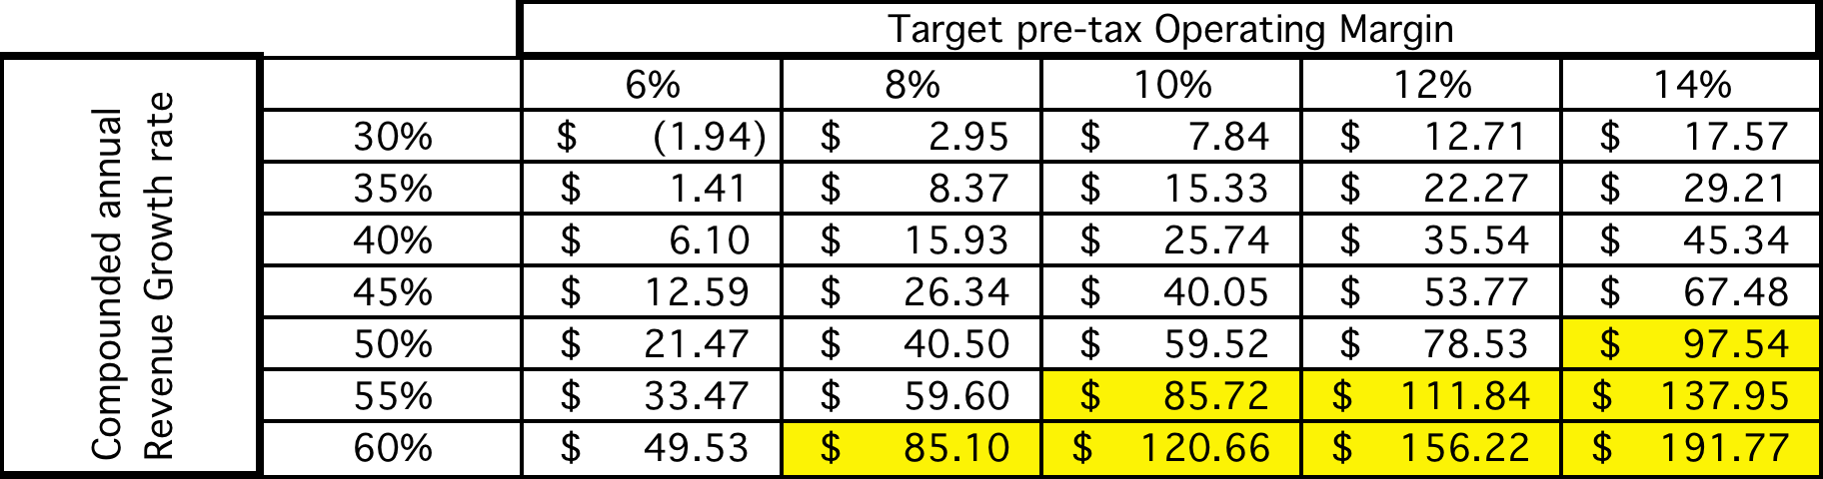
Lesson 6: There are always scenarios where the market price can be justified…
Notes:
Is $ 84 feasible? The answer is yes - a combination of compounded 10-year revenue growth of 60% and margins of 8%, revenue growth of 55% and margins of 10%, revenue growth of 50% and margins of 14% all yield values greater than $ 84…. The problem is that to generate higher revenue growth, Amazon will have to settle for lower margins…
Is $84 likely? The answer is no…

Slide 74
Lesson 7: Don’t forget to mop up…
Watch out for “other” equity claims: If you buy equity in a young, growth company, watch out for other (often hidden) claims on the equity that don’t take the form of common shares. In particular, watch for options granted to managers, employees, venture capitalists and others (you will be surprised…).
  Value these options as options (not at exercise value)
  Take into consideration expectations of future option grants when computing expected future earnings/cash flows.
Not all shares are equal: If there are differences in cash flow claims (dividends or liquidation) or voting rights across shares, value these differences.
  Voting rights matter even at well run companies

Slide 75
Lesson 8: You will be wrong 100% of the time… and it really is not (always) your fault…
No matter how careful you are in getting your inputs and how well structured your model is, your estimate of value will change both as new information comes out about the company, the business and the economy.
As information comes out, you will have to adjust and adapt your model to reflect the information. Rather than be defensive about the resulting changes in value, recognize that this is the essence of risk.
A test: If your valuations are unbiased, you should find yourself increasing estimated values as often as you are decreasing values. In other words, there should be equal doses of good and bad news affecting valuations (at least over time).

Slide 76
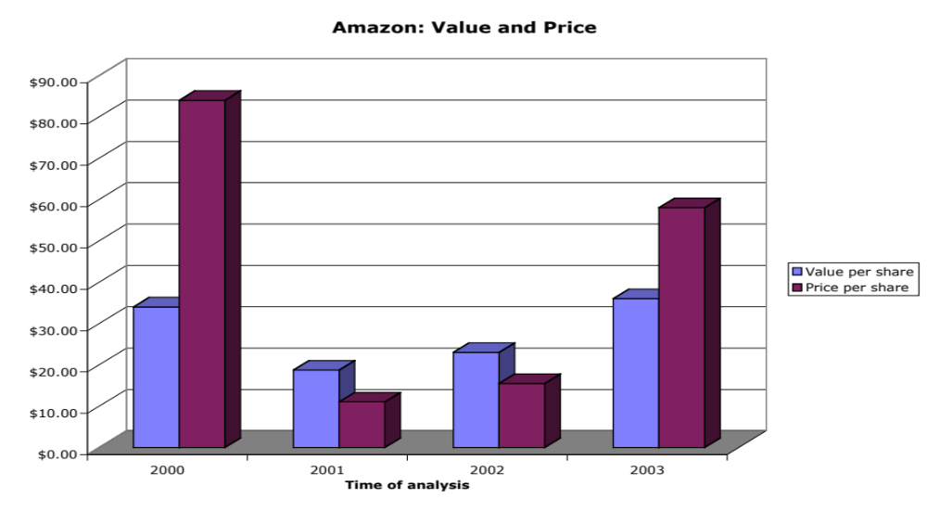
And the market is often “more wrong”….
Notes:
A valuation in September 2003 yielded an estimate of value per share of $36 but the stock had shot up to $ 58… Time to sell and start the cycle all over again… The more things change, the more they stay the same…

Slide 77

II. Dealing with decline and distress…

Slide 78


Slide 79

Adjusting the value of LVS for distress..
In February 2009, LVS was rated B+ by S&P. Historically, 28.25% of B+ rated bonds default within 10 years. LVS has a 6.375% bond, maturing in February 2015 (7 years), trading at $529. If we discount the expected cash flows on the bond at the riskfree rate, we can back out the probability of distress from the bond price:
Solving for the probability of bankruptcy, we get:
π_{Distress} = Annual probability of default = 13.54%
  Cumulative probability of surviving 10 years = (1 - .1354)10 = 23.34%
  Cumulative probability of distress over 10 years = 1 - .2334 = .7666 or 76.66%
If LVS is becomes distressed:
  Expected distress sale proceeds = $2,769 million < Face value of debt
  Expected equity value/share = $0.00
Expected value per share = $8.12 (1 - .7666) + $0.00 (.7666) = $1.92

Slide 80

III. Valuing cyclical and commodity companies

Slide 81

Notes:
With commodity companies, you ride the price of the commodity. As commodity prices rise, current earnings will rise, but what goes up will come down. The key is normalizing the commodity price, easier said than done, but necessary. Here are some strategies:
Look at the average price over a long period (10 years or more)
Estimate what a fair price would be, given demand and supply, for the commodity.

Slide 82


Slide 83

Exxon Mobil Valuation: Simulation

Slide 84

IV. Valuing Companies across the ownership cycle

Slide 85


Slide 86
Total Risk versus Market Risk
Adjust the beta to reflect total risk rather than market risk. This adjustment is a relatively simple one, since the R squared of the regression measures the proportion of the risk that is market risk.
  Total Beta = Market Beta / Correlation of the sector with the market
To estimate the beta for Kristin Kandy, we begin with the bottom-up unlevered beta of food processing companies:
  Unlevered beta for publicly traded food processing companies = 0.78
  Average correlation of food processing companies with market = 0.333
  Unlevered total beta for Kristin Kandy = 0.78/0.333 = 2.34
  Debt to equity ratio for Kristin Kandy = 0.3/0.7 (assumed industry average)
  Total Beta = 2.34 ( 1- (1-.40)(30/70)) = 2.94
  Total Cost of Equity = 4.50% + 2.94 (4%) = 16.26%
Notes:
This assumes that
The owner of the private business has all of his or her wealth invested in the business
The reality is that most individuals will fall somewhere between the two extremes.
If you were a private business looking at potential acquirers - one is a publicly traded firm and the other is an individual . Which one is likely to pay the higher price and why?
If both acquirers have the same cash flow expectations, the publicly traded firm will win out (Blockbuster Video, Browning-Ferris are good examples of publicly traded firms which bought small private businesses to grow to their current stature.)

Slide 87
Relative Valuation
Aswath Damodaran

Slide 88
Relative valuation is pervasive…
Most asset valuations are relative.
Most equity valuations on Wall Street are relative valuations.
  Almost 85% of equity research reports are based upon a multiple and comparables.
  More than 50% of all acquisition valuations are based upon multiples
  Rules of thumb based on multiples are not only common but are often the basis for final valuation judgments.
While there are more discounted cashflow valuations in consulting and corporate finance, they are often relative valuations masquerading as discounted cash flow valuations.
  The objective in many discounted cashflow valuations is to back into a number that has been obtained by using a multiple.
  The terminal value in a significant number of discounted cashflow valuations is estimated using a multiple.

Slide 89
The Reasons for the allure…
“If you think I’m crazy, you should see the guy who lives across the hall”
  Jerry Seinfeld talking about Kramer in a Seinfeld episode
“ A little inaccuracy sometimes saves tons of explanation”
  H.H. Munro
“ If you are going to screw up, make sure that you have lots of company”
  Ex-portfolio manager
Notes:
Most valuations that you see are relative valuations. There are two reasons why relative valuations are so popular:
If your objective is to buy or sell something, not matter what the price, you can justify your decision using relative valuation. There will always be some other assets out there which are more underpriced or overpriced than the asset you are buying or selling.
In contrast to the detail and time needed for discounted cashflow valuation, relative valuation is quicker and seems to require fewer assumptions about the future. (This, we will argue, is really an illusion.)

Slide 90
The Four Steps to Deconstructing Multiples
Define the multiple
  In use, the same multiple can be defined in different ways by different users. When comparing and using multiples, estimated by someone else, it is critical that we understand how the multiples have been estimated
Describe the multiple
  Too many people who use a multiple have no idea what its cross sectional distribution is. If you do not know what the cross sectional distribution of a multiple is, it is difficult to look at a number and pass judgment on whether it is too high or low.
Analyze the multiple
  It is critical that we understand the fundamentals that drive each multiple, and the nature of the relationship between the multiple and each variable.
Apply the multiple
  Defining the comparable universe and controlling for differences is far more difficult in practice than it is in theory.
Notes:
While we can rail about the fact that a valuation based upon multiples is not as detailed as a discounted cashflow valuation,, the reality is that analysts will continue to use multiples to value companies and that we will often have to use these valuations.
Given this reality, we have to think about how best to use multiples. These four steps represent a way in which we can deconstruct any multiple, understand how to use it well and discover when it is being misused.

Slide 91
Definitional Tests
Is the multiple consistently defined?
  Proposition 1: Both the value (the numerator) and the standardizing variable ( the denominator) should be to the same claimholders in the firm. In other words, the value of equity should be divided by equity earnings or equity book value, and firm value should be divided by firm earnings or book value.
Is the multiple uniformly estimated?
  The variables used in defining the multiple should be estimated uniformly across assets in the “comparable firm” list.
  If earnings-based multiples are used, the accounting rules to measure earnings should be applied consistently across assets. The same rule applies with book-value based multiples.
Notes:
Consistent definition:
Consider two widely used multiples that are consistently defined. In the price-earnings ratio (PE), the numerator is equity value per share and the denominator is equity earnings per share. In the enterprise value/ EBITDA multiple, the numerator is firm value and the denominator is a pre-tax cash flow to all claimholders in the firm. In contrast, the price to EBITDA multiple is inconsistent. Why is this a problem? If you are comparing firms with different debt ratios, the firms will more debt will look cheaper on a price to EBITDA basis.
Uniformally Estimated:
This is actually much more difficult than it looks. Even if accounting standards are the same across firms, you run into two problems:
The degree to which firms bend accounting rules for their own purposes varies across firms. Some firms are inherently more conservative in reporting earnings than others.
The financial year ends at different points for different firms. If the denominator is the earnings in the most recent financial year, the multiple may not be comparable if some firms have December year-ends and some have June year-ends.

Slide 92
Example 1: Price Earnings Ratio: Definition
PE = Market Price per Share / Earnings per Share
There are a number of variants on the basic PE ratio in use. They are based upon how the price and the earnings are defined.
Price: is usually the current price
is sometimes the average price for the year
EPS: EPS in most recent financial year
EPS in trailing 12 months (Trailing PE)
Forecasted EPSnnext year (Forward PE)
Forecasted EPS in future year
Notes:
This is only the tip of the iceberg. You can have EPS before and after extraordinary items, primary and diluted EPS..
When you are negotiating with someone else and you are both using PE ratios to make your case, the first step is to make sure that you are using the same PE ratio.
There is also the tendency on the part of analysts to pick the definition of pE that best fits their biases. For instance, bullish analysts in the 1990s almost always used forward PE whereas bearish analysts used trailing PE. Since earnings were rising the former were generally much lower than the latter.

Slide 93
Example 2: Enterprise Value /EBITDA Multiple
The enterprise value to EBITDA multiple is obtained by netting cash out against debt to arrive at enterprise value and dividing by EBITDA.
Why do we net out cash from firm value?
What happens if a firm has cross holdings which are categorized as:
  Minority interests?
  Majority active interests?
Notes:
The problem with using firm value is that cash is included in the numerator but not in the denominator. That is why the enterprise value version makes more sense…
A broad problem is posed when firms have holdings in other firms. If such holdings are passive, Value to EBITDA multiples will be overstated, since the numerator will include the value of your holdings, while the EBITDA will not include any of the income from these holdings. If such holdings are majority active and consolidated, the value to EBITDA will be understated because the numerator will include only the portion of the equity you own in the subsidiary but the EBITDA will include all of the EBITDA in the subsidiary.
The safest thing to do (assuming you can do this) is to net out the market value of your holdings from the numerator (for both active and passive holdings) and the EBITDA of your holdings from the denominator ( for majority active holdings)

Slide 94
Descriptive Tests
What is the average and standard deviation for this multiple, across the universe (market)?
What is the median for this multiple?
  The median for this multiple is often a more reliable comparison point.
How large are the outliers to the distribution, and how do we deal with the outliers?
  Throwing out the outliers may seem like an obvious solution, but if the outliers all lie on one side of the distribution (they usually are large positive numbers), this can lead to a biased estimate.
Are there cases where the multiple cannot be estimated? Will ignoring these cases lead to a biased estimate of the multiple?
How has this multiple changed over time?
Notes:
Before you use a multiple and develop rules of thumb (8 times EBITDA is cheap), you need to get a sense of the cross-sectional distribution.
Multiples have skewed distributions. Because a multiple cannot be less than zero but can potentially be infinite, the averages for multiples will be much higher than their medians, and the difference will increase as the outliers become larger. Many services cap outliers to prevent them from altering the averages too much, results…
The PE ratio cannot be estimated when the earnings per share are negative. Thus, if you have a sample of 20 firms and 10 have negative earnings, you will be able to compute the PE ratio for only the 10 that have positive earnings and will throw out the remaining firms. This will induce a bias in your sample. One way to avoid this is to take the cumulative values for market capitalization and net income for all 20 firms, and compute a PE ratio based upon the cumulated values. The resulting PE ratio will generally be much higher….

Slide 95
1. Multiples have skewed distributions…
Notes:
This graph for all U.S. firms with data available on the Value Line CD ROM (contains about 7200 firms in the overall sample). Notice that the distributions are skewed to the left and that we have capped the PE ratios at 100….

Slide 96
2. Making statistics “dicey”
 | Current PE | Trailing PE | Forward PE
Number of firms | 7887 | 7887 | 7887
Number with PE | 3403 | 3398 | 2820
Average | 72.13 | 60.49 | 35.25
Median | 20.88 | 19.74 | 18.32
Minimum | 0.25 | 0.4 | 1.15
Maximum | 23,100. | 23,100. | 5,230.91
Standard deviation | 509.6 | 510.41 | 139.75
Standard error | 8.74 | 8.76 | 2.63
Skewness | 31. | 32.77 | 25.04
25th percentile | 13.578 | 13.2 | 14.32
75th percentile | 33.86 | 31.16 | 25.66
Notes:
Four things to note…
Notice the number of firms that we have lost in the sample as we compute PE ratios.
You lose even more firms as you go to forward PE, because you need analyst estimates of expected earnings per share to compute this. Any firms not followed by analysts will not have a forward PE…
The means were computed without capping the PE ratios… the outliers (notice the maximum values for the ratios) push the average to almost twice the median.
The median forward PE is higher than the trailing PE which is higher than the current PE…

Slide 97
3. Markets have a lot in common : Comparing Global PEs
Notes:
This compares the percentages of firms in each market that trade in each PE ratio class… In 2012, it is difficult to tell them apart. That is a change from a few years ago, when US and European stocks traded at much higher PE ratios than emerging market stocks. The convergence of PE ratios globally may reflect the blurring of the line between developed and emerging markets.

Slide 98

4. Simplistic rules almost always break down…6 times EBITDA may not be cheap…
Notes:
As with the other multiples, a heavily skewed distribution. Suggests that the rule of thumb that is often used by Wall Street (EBITDA multiple less than 8 is cheap) should be used with caution.

Slide 99
But it may be in 2015, unless you are in Japan, Australia or Canada

Slide 100
Analytical Tests
What are the fundamentals that determine and drive these multiples?
  Proposition 2: Embedded in every multiple are all of the variables that drive every discounted cash flow valuation - growth, risk and cash flow patterns.
  In fact, using a simple discounted cash flow model and basic algebra should yield the fundamentals that drive a multiple
How do changes in these fundamentals change the multiple?
  The relationship between a fundamental (like growth) and a multiple (such as PE) is seldom linear. For example, if firm A has twice the growth rate of firm B, it will generally not trade at twice its PE ratio
  Proposition 3: It is impossible to properly compare firms on a multiple, if we do not know the nature of the relationship between fundamentals and the multiple.

Slide 101




PE Ratio: Understanding the Fundamentals
To understand the fundamentals, start with a basic equity discounted cash flow model.
With the dividend discount model,
Dividing both sides by the current earnings per share,
If this had been a FCFE Model,
Notes:
To get to the heart of equity multiples, we start with an equity DCF model. In this case, we consider the simplest equity valuation model - a stable growth dividend discount model. Restated in terms of the PE ratio, we find that the PE ratio fo a stable growth firm can be written in terms of three variables:
The expected growth rate in earnings per share
The riskiness of the equity, which determines the cost of equity
The efficiency with which the firm generates growth,which is measured by how much the firm can pay out or afford to pay out after reinvested to create the growth.

Slide 102

The Determinants of Multiples…

Slide 103
Application Tests
Given the firm that we are valuing, what is a “comparable” firm?
  While traditional analysis is built on the premise that firms in the same sector are comparable firms, valuation theory would suggest that a comparable firm is one which is similar to the one being analyzed in terms of fundamentals.
  Proposition 4: There is no reason why a firm cannot be compared with another firm in a very different business, if the two firms have the same risk, growth and cash flow characteristics.
Given the comparable firms, how do we adjust for differences across firms on the fundamentals?
  Proposition 5: It is impossible to find an exactly identical firm to the one you are valuing.
Notes:
In practice, we all too often define comparable as a firm in the same industry or business. This is too narrow a definition. You can have firms in different businesses that have similar cashflow, growth and risk characteristics. These firms can be viewed as comparable firms.
You will never find two identical firms, no matter how hard you search. You therefore have to always control for the residual differences when making comparisons.

Slide 104

An Example: Comparing PE Ratios across a Sector: PE
Notes:
In this sample, note that some of the firms in the sample are emerging market firms any may be exposed to more risk (political risk, economic risk, inflation risk…)

Slide 105
PE, Growth and Risk
Dependent variable is: PE
R squared = 66.2% R squared (adjusted) = 63.1%
Variable Coefficient SE t-ratio Probability
Constant 13.1151 3.471 3.78 0.0010
Growth rate 121.223 19.27 6.29 ≤ 0.0001
Emerging Market -13.8531 3.606 -3.84 0.0009
Emerging Market is a dummy: 1 if emerging market
0 if not
Applying to Telebras,
Predicted PE = 13.15 + 121.22 (.075) – 13.85 = 8.39
After controlling for lower growth & higher risk, the stock is overvalued.
Notes:
Higher growth telecomm companies have higher PE ratios..
One way to read this regression: If you have two companies - one with a growth rate of 10% and one with a growth rate of 20%, the latter should have a PE that is 12.1 higher..
If the firm happens to be an emerging market firm, though, you would expect its PE ratio to be 13.85 lower than a firm with similar growth in a developed market.

Slide 106

PE Ratio: Standard Regression for US stocks - January 2015
The regression is run with growth and payout entered as decimals, i.e., 25% is entered as 0.25)
Notes:
This regression has about 1600 firms. While the low R-squared may be troubling, it should not be unexpected, given the scatter plot on the previous page.
The signs of the coefficients are consistent with our priors for growth and higher growth have higher PE ratios. With risk and payout, though, the signs on the coefficient are wrong. Higher risk and lower payout firms firms seems to have higher (instead of lower) PE ratios.

Slide 107
PE ratio regressions across markets
Region | Regression – January 2015 | R²
US | PE = 6.48 + 98.58 g_{EPS} + 16.77 Payout - 3.25 Beta | 35.5%
Europe | PE = 19.32 + 43.89 g_{EPS} + 5.14 Payout - 4.45 Beta | 17.4%
Japan | PE = 7.85+ 32.48 g_{EPS} + 31.32 Payout - 1.165 Beta | 25.2%
Emerging Markets | PE = 10.90 + 57.47 g_{EPS} + 7.62 Payout - 2.36 Beta | 27.0%
Global | PE = 12.49 + 56.89 g_{EPS} + 10.40 Payout - 3.10 Beta | 23.3%
g_{EPS}=Expected Growth: Expected growth in EPS or Net Income: Next 5 years
Beta: Regression or Bottom up Beta
Payout ratio: Dividends/ Net income from most recent year. Set to zero, if net income < 0
Notes:
Note how much in common these regressions have… though the effects of growth, risk and quality of growth may vary across markets, the direction of the effect is the same.

Slide 108
Conventional usage…
Sector | Multiple Used | Rationale
Cyclical Manufacturing | PE, Relative PE | Often with normalized earnings
Growth firms | PEG ratio | Big differences in growth rates
Young growth firms w/ losses | Revenue Multiples | What choice do you have?
Infrastructure | EV/EBITDA | Early losses, big DA
REIT | P/CFE (where CFE = Net income + Depreciation) | Big depreciation charges on real estate
Financial Services | Price/ Book equity | Marked to market?
Retailing | Revenue multiples | Margins equalize sooner or later

Slide 109

A closing thought…

