Slide 1



The Corporate Life cycle
A class about how businesses age, and the implications for corporate finance, valuation, investing and managing.

Slide 2
The ”Big” Idea
In every discipline, practitioners search for a framework that helps them explain the whys, the why nots and the what ifs of that discipline.
In corporate finance and valuation, we have seen many such attempts to build universal theories, and in our view, the structure that offers the most promise is the corporate life cycle, where companies go through the cycle of being born, growing up, growing old and eventually perishing.
It is one that we find ourselves coming back to, repeatedly, as we try to understand the behavior and misbehavior of businesses, differences across investing perspectives and the allure of the next big thing.

Slide 3
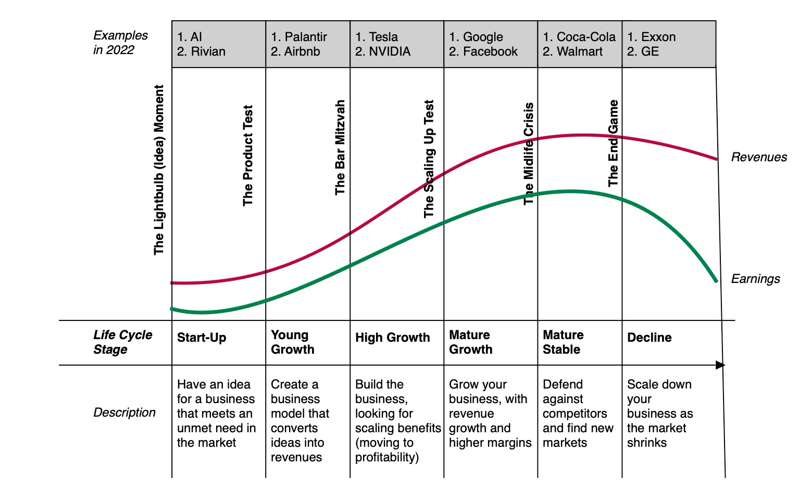
The Corporate Life cycle

Slide 4
Measuring corporate age
Chronological age: You can look at how old a business is, from founding date to today. Implicitly, you assume that older companies are further along the life cycle than younger firms.
Industry/Sector: You can look at the industry and country that a company operates in, and assume that companies that operate in some industries (say technology) and some countries (India) are earlier in the life cycle than companies that operate in others (industries or countries).
Operating metrics: You can look at a company’s revenue growth, operating margins and reinvestment policy to determine age; younger companies have higher revenue growth, changing (usually rising) margins and large reinvestment (relative to their earnings)

Slide 5
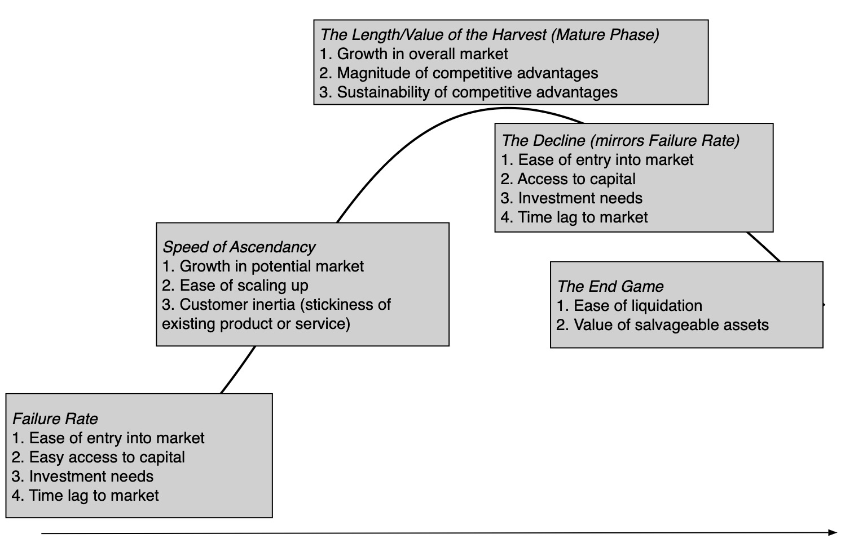
Corporate Life cycle determinants

Slide 6
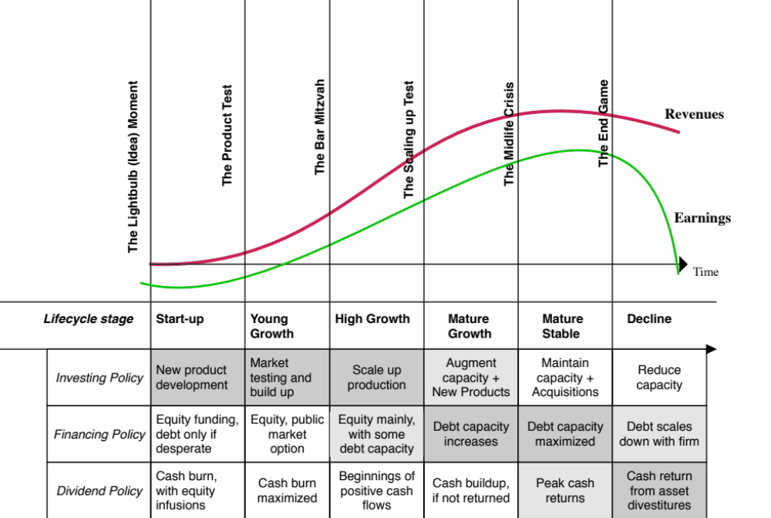
Corporate finance across the life cycle

Slide 7
Valuation across the life cycle

Slide 8
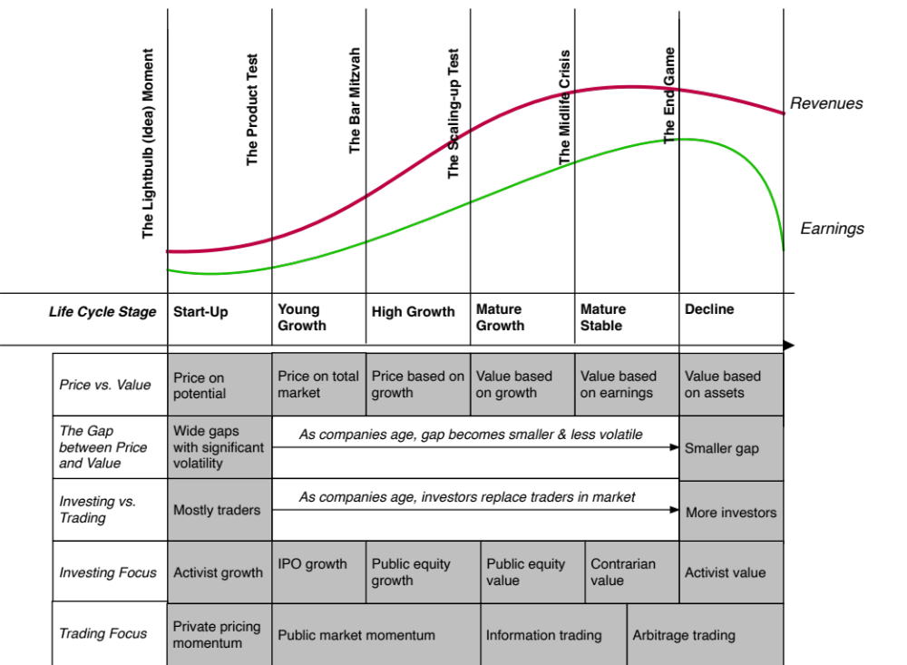
Investing across the life cycle

Slide 9
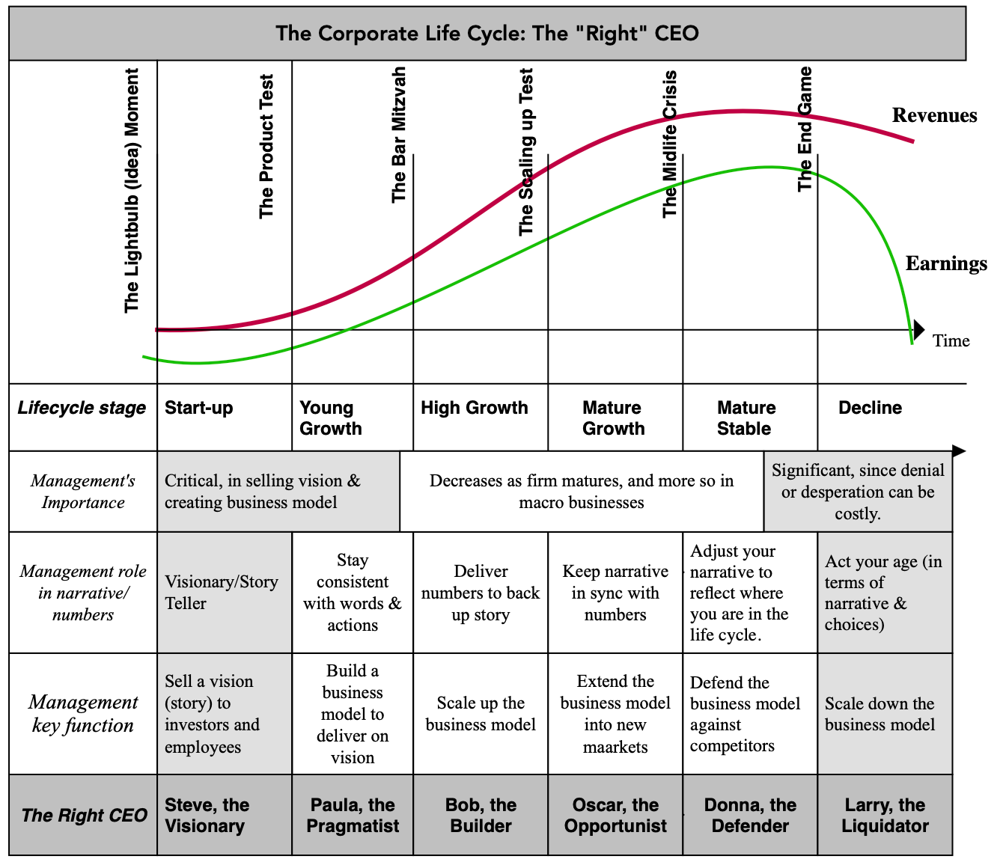
Managing across the life cycle

Slide 10
Aging gracefully? The choices
Acceptance: Accept where you are in the life cycle, and act your age.
Denial: Deny that you are aging, blaming bad luck and outsiders for aging symptoms, and repeat what you used to do when you were younger.
Desperation: Gamble on long-odds bets to become young again, especially with other people’s money.
Rebirth: Find that much sought after path back to youth, by reinventing your business or entering new ones.
Zombieland: Mistake your end game as survival, at any cost.

