Slide 1



Chapter 1: A search for a unifying theory

Slide 2
A Theory that Explains everything
It is the dream of researchers and practitioners to create a construct that explains all observed behavior whatever area they work in.
  In the physical sciences, that search is abetted by nature, which imposes its order on phenomena.
  In the social sciences, the search has been less focused, partly because human behavior does not always follow predictable patterns.
It is easy to understand why we search for universal theories that explain everything, since they offer the promise of restoring order to chaos, but that search comes with risk.
  The most significant risk is overreach, where sensible theories get pushed to breaking point.
  The second is bias, as a theory’s most ardent supporters become selective in their assessment of evidence, choosing to see only what they want to in the data.

Slide 3
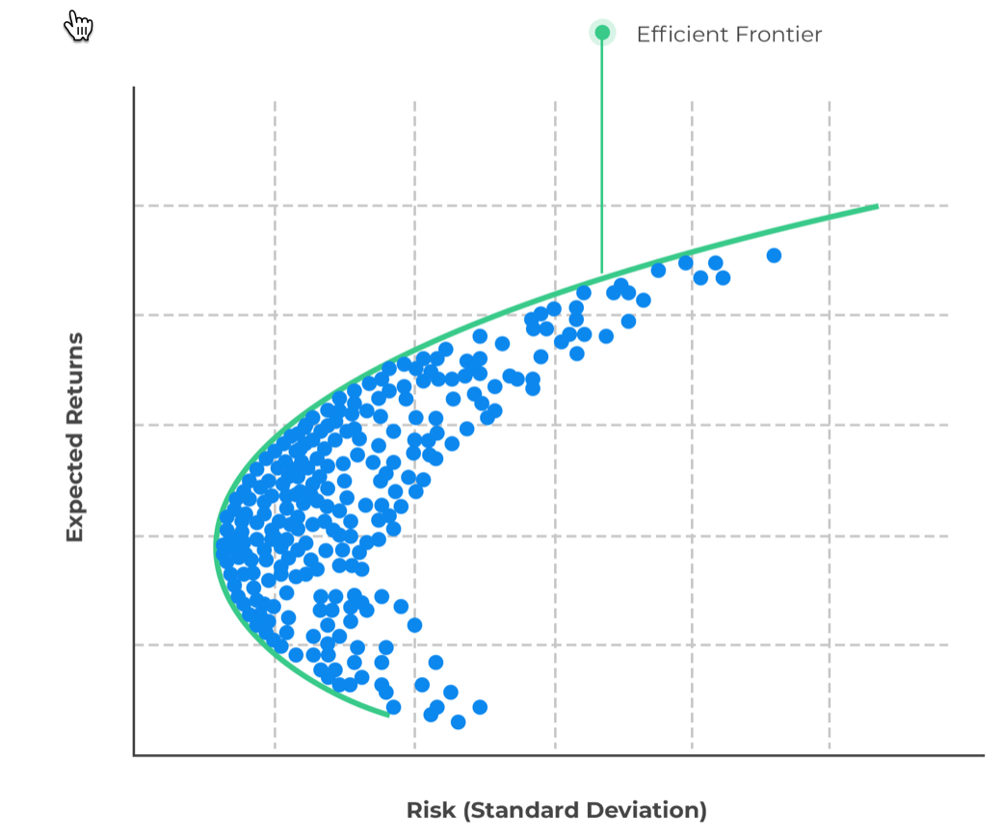
The search in finance & Investing –
1. Economic theories

Slide 4
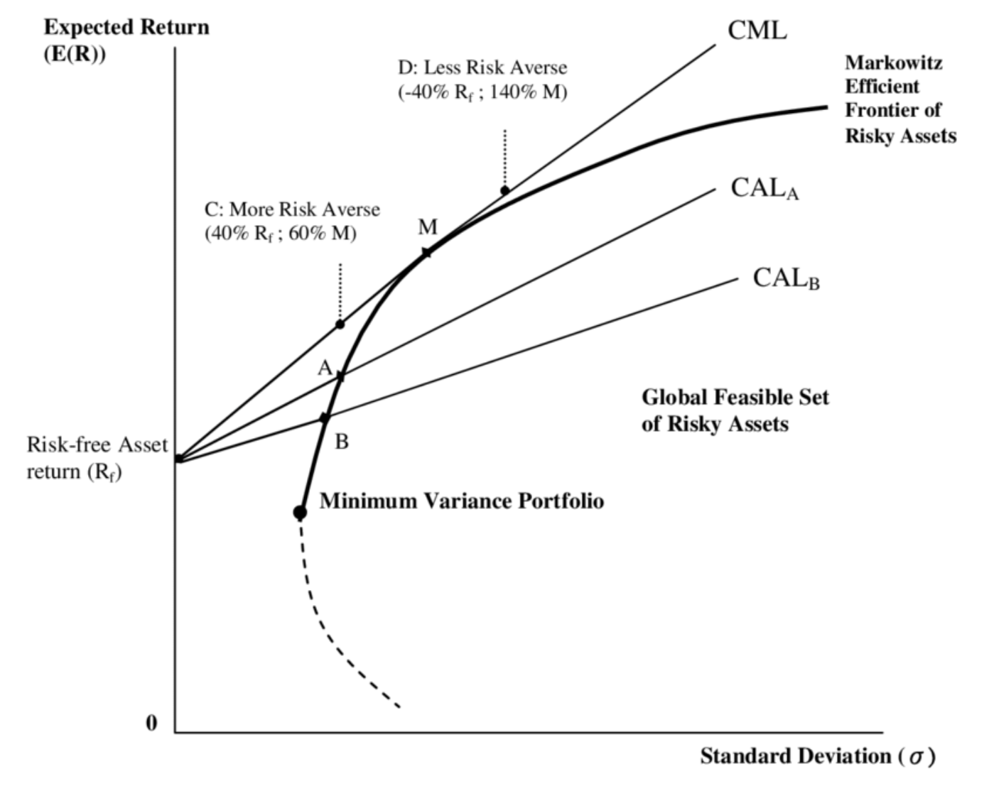
And the CAPM

Slide 5
2. data-driven Models
With an abundance of data (market and company-level) that has been easy to access for decades, you could argue that finance discovered big data well before the rest of the world caught on to its allure.
  In 1992, Fama and French looked at returns on all US stocks between 1962 and 1990 and noted that a significant portion of the variation in annual returns across stocks, during this period, could be explained by two characteristics, their market capitalizations and their book to market equity ratios.
By 2019, there were over 400 factors that had been identified as explaining price movements and differences in returns in major finance journals, leading some researchers to coin the term the “factor zoo” and argue that most of these “market-explaining” factors are more attributable to data mining than to market behavior.

Slide 6
3. Behavioral Models
In the 1970s, Kahneman and Tversky initiated this trend by incorporating well established patterns in human behavior into markets to provide explanations for phenomena and behavior that had either been unexplainable or treated as anomalous.
In the decades since, behavioral finance has found its way to the heart of finance, with Richard Thaler, Robert Shiller and a host of others extending its reach to explain business and investor decision making.
However, for much of its existence, albeit with exceptions, behavioral finance has had two problems.
  The first is that it has expended more resources in explaining past investor and business behavior than in providing prescriptive solutions for either group.
  The second is as with data-driven approaches, where data mining has led to a proliferation of factors, the number of behavioral quirks that have been identified in investing has also exploded.

Slide 7
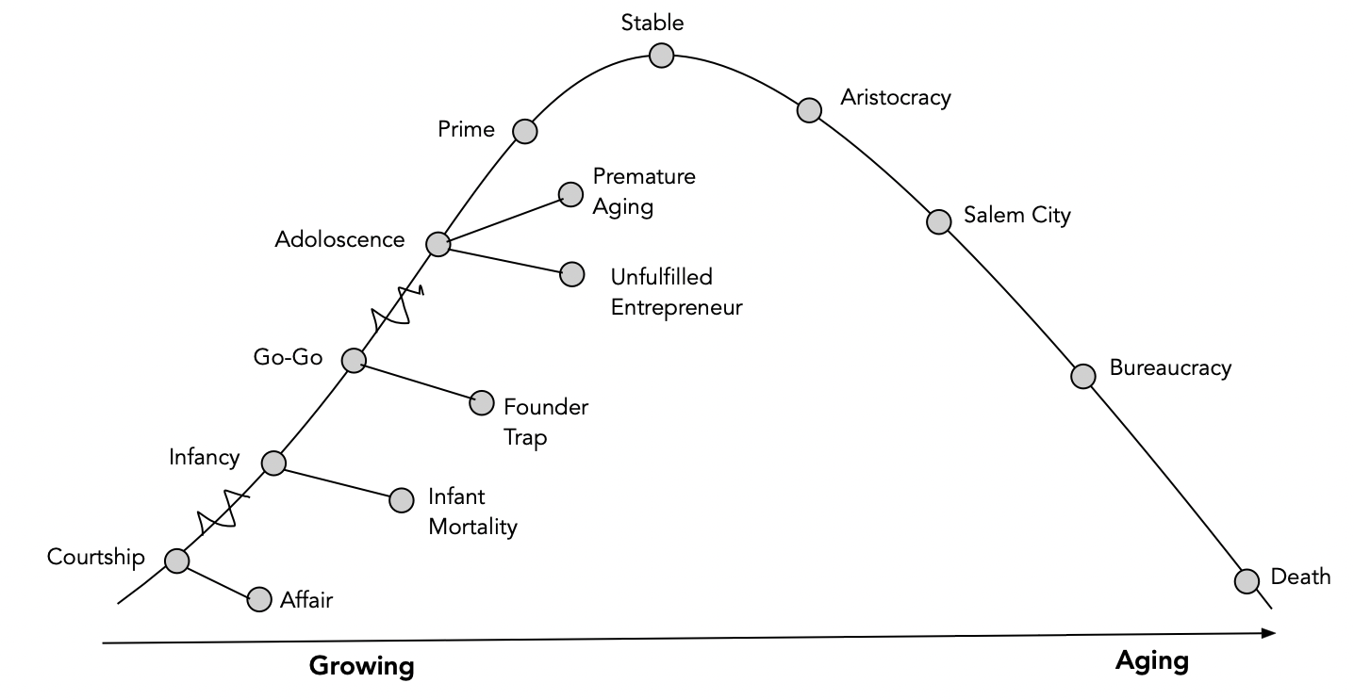
The Corporate life cycle: The Adizes version

Slide 8
The corporate life cycle in finance
Accounting researchers, for instance, have used the corporate life cycle to explain how accounting ratios measuring leverage and profitability change over the life cycle, and used that evidence to provide measurement metrics.
Corporate governance researchers have found evidence that corporate governance challenges are greater for young firms and that governance practices improve as they mature.
In valuation, we have used the corporate life cycle construct to examine why the challenges in valuation can be different for companies at different stages, and how to adapt valuation models to meet these challenges.

Slide 9
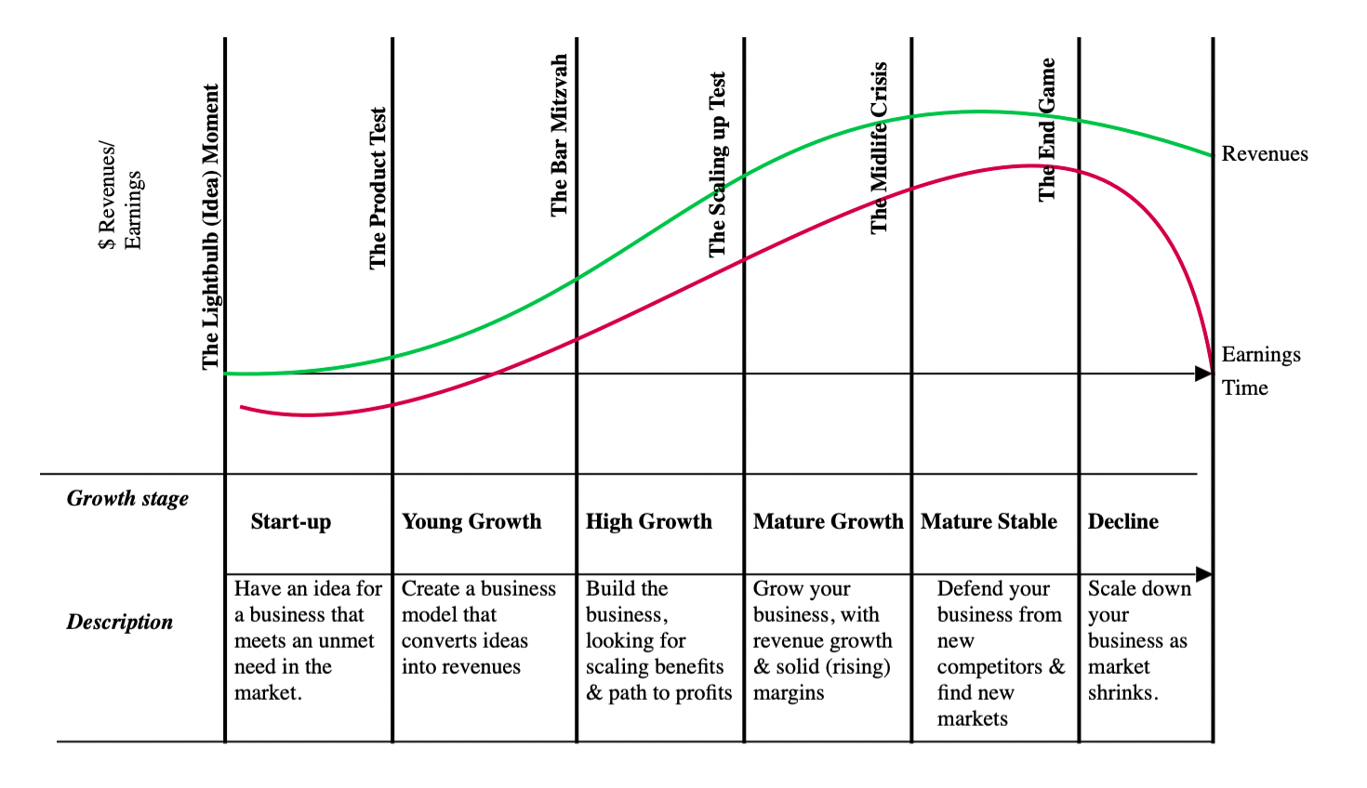
The corporate life cycle: A Standardized version

Slide 10
Implications for corporate finance
Corporate finance lays out the first financial principles that govern how to run a business, and every decision that a business makes falls under its purview.
  We look at the investment decision in more detail, across the life cycle, examining both how investment type and investment challenges vary, as companies age.
  We examine the trade-off that determines how much a business should borrow and how the mix and type of financing changes as companies age.
  We describe the process that can be used to determine how much cash a business can return, and then apply it to evaluate how much cash (if any) a business should return, given its place in the life cycle.
Along the way, we examine the consequences for businesses that choose to adopt corporate financial policies that at are at odds with their ages.

Slide 11
Implications for valuation
The value of a business is always a function of the expected cash flows investors will receive from the business and the uncertainty that they will receive those cash flows.
That universal truth, though, can play out very differently across the life cycle, requiring different skill sets as companies go from start-ups to high growth to middle age to decline.
Rather than invent new models and metrics, we use the same models and make our adjustments on what inputs we spend our time estimating, and how we adapt to the estimation process to reflect the challenges at each stage.

Slide 12
Implications for investing
Investors invest in stocks because they want to earn high returns on their investments, while protecting, as best as they can, against downside risks, but that is perhaps the only thing they have in common, since investors come in with very different views on how markets work (or fail to work), leading to them targeting very different types of stocks in their portfolio.
We will look at how different investment philosophies (value, growth, trading) focus on companies in different stages of the life cycle, and and why they can co-exist in a market.
We hope to show why no one investment philosophy can claim to be the “best” one, since each one requires different mindsets and skills, to be successful, as well as how your choice of investment philosophy will lead you to target firms in very different phases of the life cycle.

Slide 13
Implications for managing
While there is a tendency in both academia and practice to assume that there is one prototype for a great CEO, the corporate life cycle pushes back.
The skills and personality traits you would like to see in the top manager(s) of a growth company with be very different from those that you would look for in the top manager(s) in a mature or declining company.
We also look at the special challenges of running a business in decline and trying to decide the right path from denial to acceptance to a reach for reincarnation.

