Slide 1



VALUING AND PRICING YOUNG AND START-UP FIRMS

Slide 2
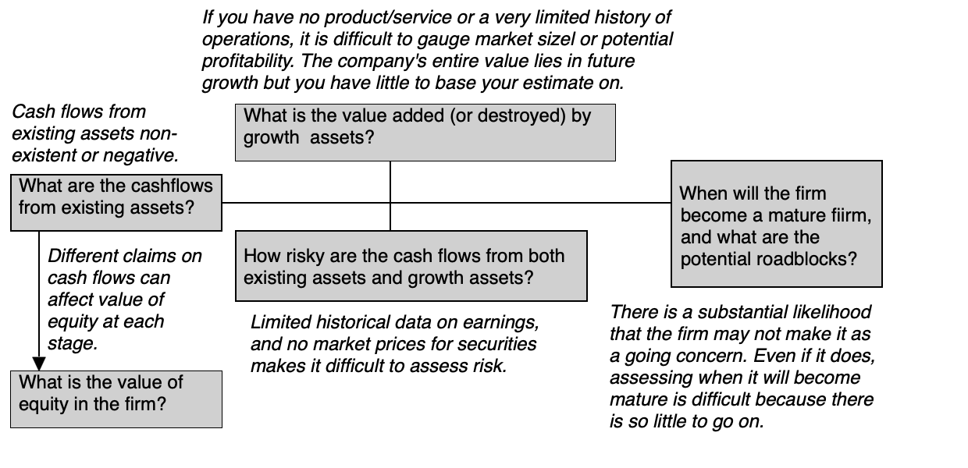
Young companies: the challenges

Slide 3
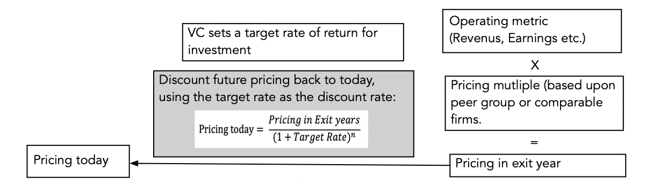

One Response: The VC Approach

Slide 4
And its perils
VC valuation (pricing) avoids the serious challenges of estimating operating details for the long term by cutting off the estimates prematurely (with a short forecast period) and using a multiple that is usually based on what comparable companies are trading at currently.
There is a degree of sloppiness is associated with the use of a target rate to discount the firm’s future value. While the target rate is supposed to include both operating and failure risk, it is not clear how they are incorporated into the stated rates.
In short, a venture capital valuation is more a forward pricing, discounted back at an arbitrarily high discount rate with no connection to the actual risk in a business.

Slide 5
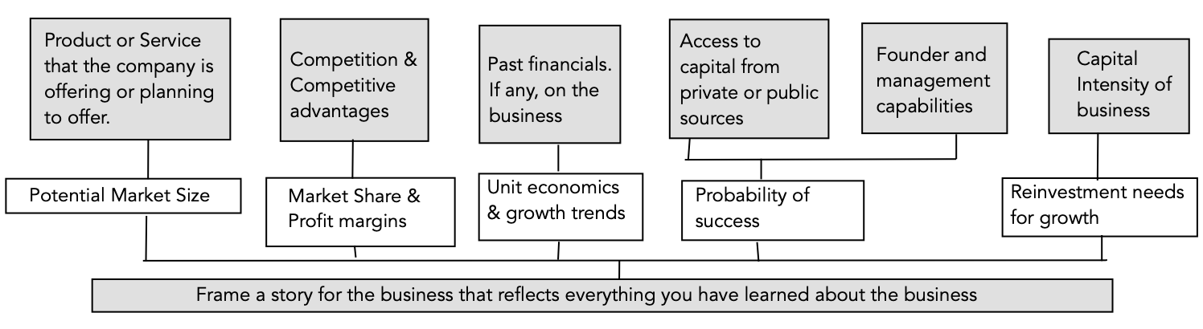
Intrinsic value step 1: tell a story!

Slide 6
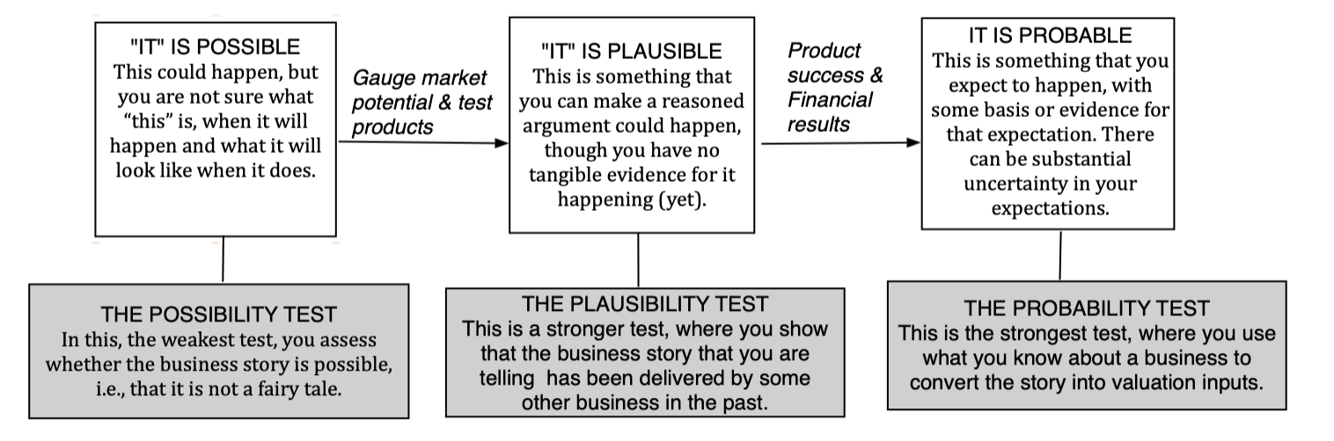
Step 2: The 3P test

Slide 7
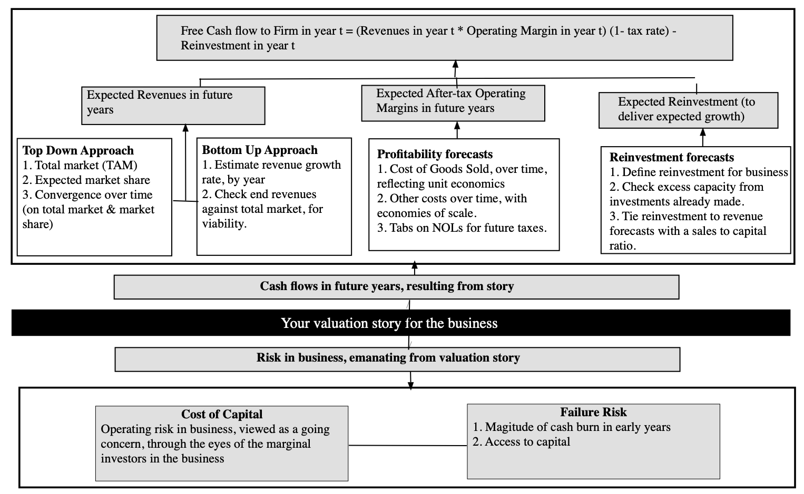
Step 3: Story pieces to value inputs

Slide 8
Step 4A: value the business – Key indicators
Cash flow patterns: The expected cash flows that underpin your valuation will reflect assumptions made about revenue growth, operating margins, and reinvestment. Specifically, businesses with high revenue growth and negative margins that are slow to turn positive, will be saddled with negative earnings in the early years, and incorporating the reinvestment needed to deliver the revenue growth will make cash flows more negative.
Discount rate check: Separating the risk in a young business into operating and failure risk, we estimate a cost of capital to reflect only the former. Thus, you should not be surprised to see costs of capital in young company valuation that are much lower than the target rates that venture capitalists concoct, and more reflective of costs of capital of established companies in public markets, if investors are diversified.
Failure risk: The failure risk is the input that reflects the likelihood that many young businesses will not make it, either because they run out of cash and lose access to fresh capital or because their business models never turn to profitability.

Slide 9
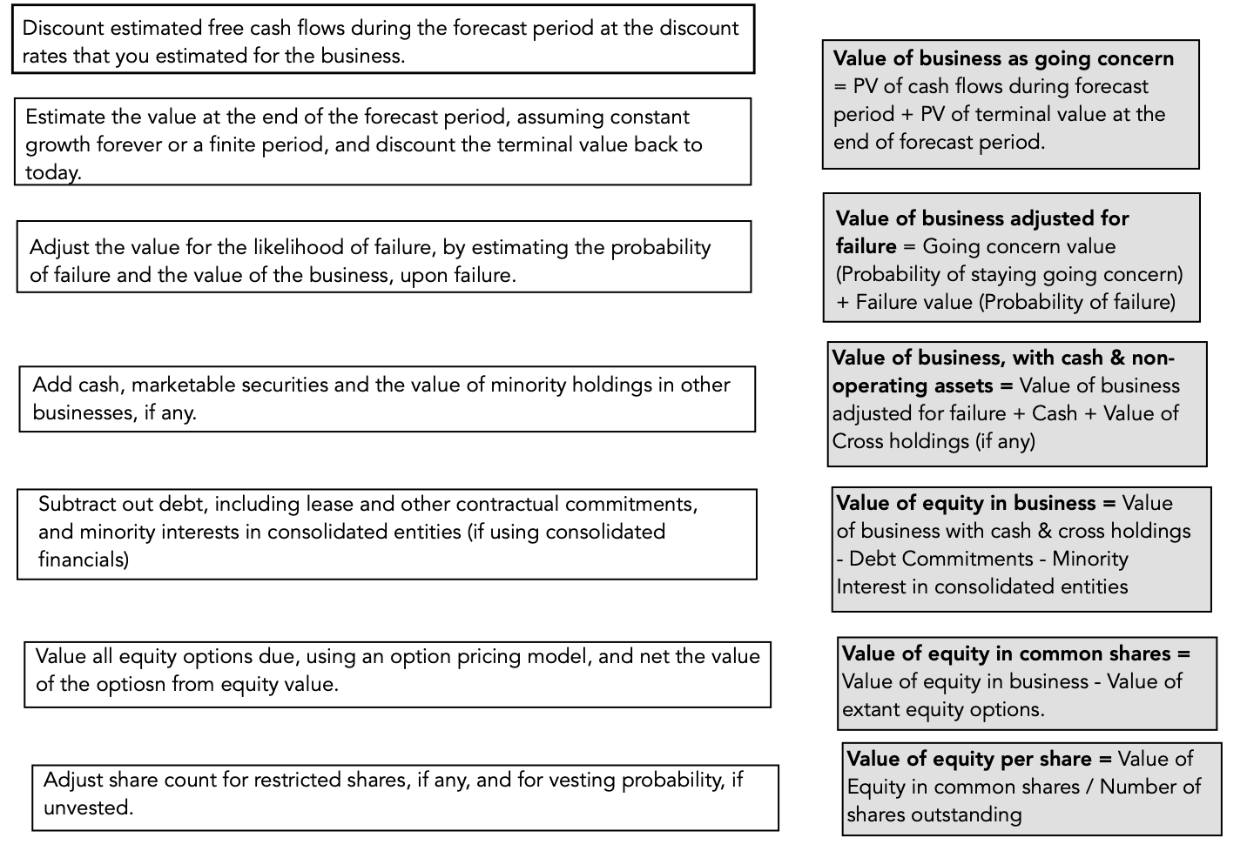
Step 4B: From business to equity value

Slide 10
Step 5: Keep the feedback loop open
When building a valuation story and converting that story into inputs and a value, especially with a young growth business or start up, it is often easy to develop blind spots, and get attached to your own stories.
As a final step in the process, we would recommend keeping the feedback loop open, seeking out feedback from people who think least like you and sometimes are better versed in the business details of the company you are valuing.
Rather then become defensive, incorporate what you learn from others into your story.

Slide 11
Valuing Zomato for its IPO – BACKGROUND INFORMATION
Transaction fees, from food ordering and delivery, as the company keeps roughly 20-25% of the total order value for itself
Advertising, since restaurants listed on Zomato also spend more on advertising, based upon customer visits and resetting revenues, to get additional visibility.
Subscription services, with 1.5 million members, where in return for a subscription fee, they get discounts and special deals
Restaurant raw materials, through HyperPure, a service directed at restaurants, offering groceries and meats that are source-checked for quality

Slide 12
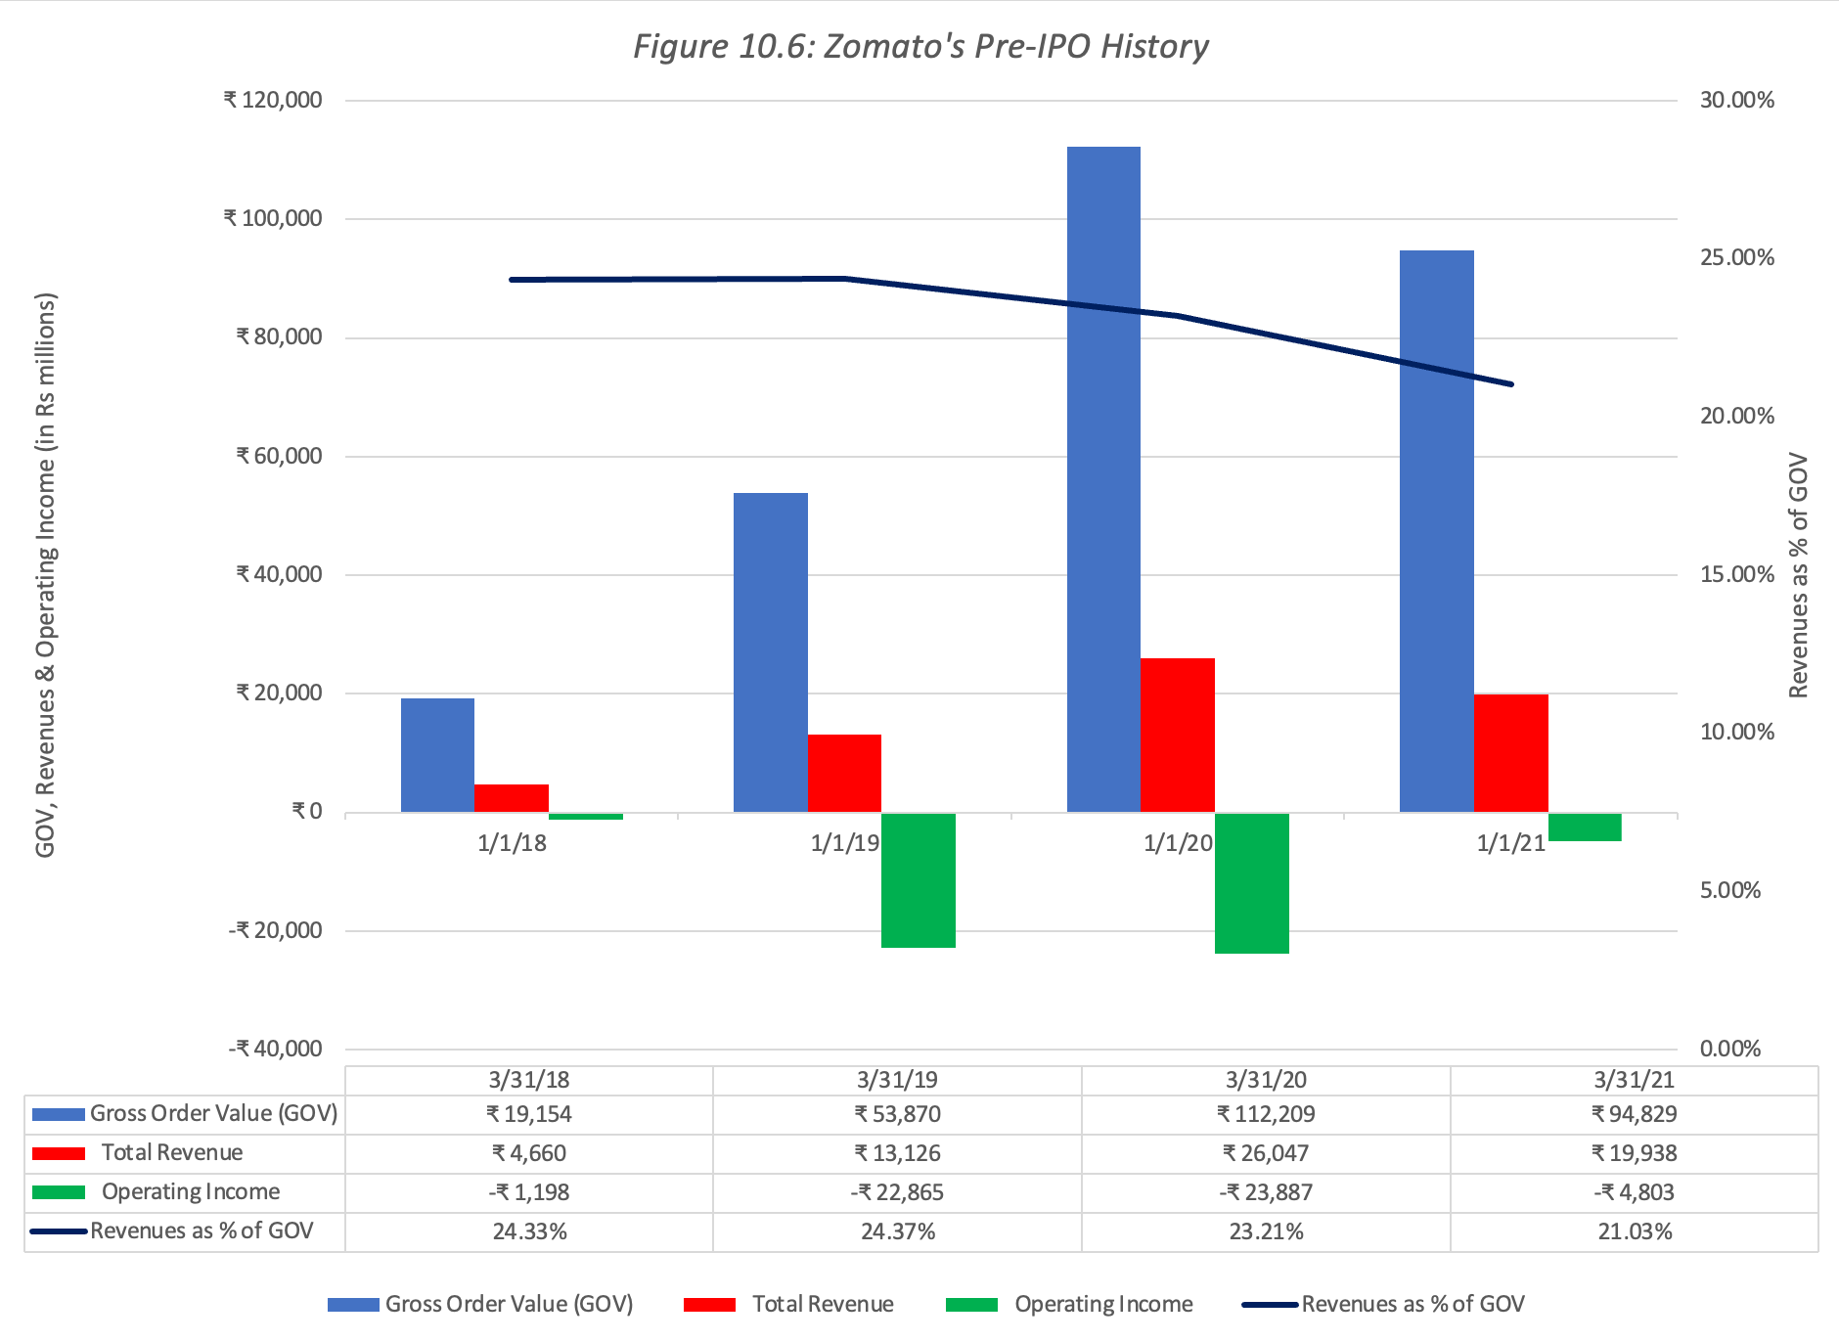
ZOMATO – HISTORICAL DATA

Slide 13
MY ZOMATO STORY
In our Zomato story, the Indian food delivery/restaurant market will grow, as Indians become more prosperous and have increased online access, and this market will be dominated by a handful of players, with Zomato as one of the dominant players.
As an intermediary with strong unit economics, Zomato will be see high operating margins, over time, and be able to continue to grow with relatively little reinvestment, most of it in the form of acquisitions.
The operating risk in Zomato will be average, but as a money-losing company, there remains a non-trivial chance of failure, albeit one that will be low because of the cash buffer that the company will have after the IPO.

Slide 14
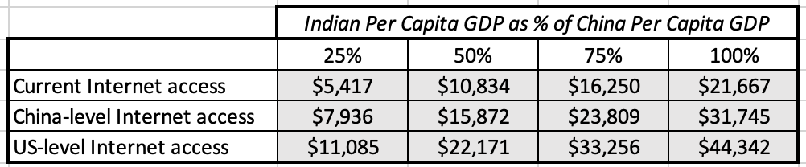
1. Revenue growth
The Indian food delivery market will grow:
We believe that the networking benefits inherent in the online food delivery business will lead to concentration and that Zomato will be one of the dominant players.
In the base case, we will estimate the total market for online food delivery will increase to $25 billion in a decade, with Zomato commanding a 40% market share in steady state, and that

Slide 15
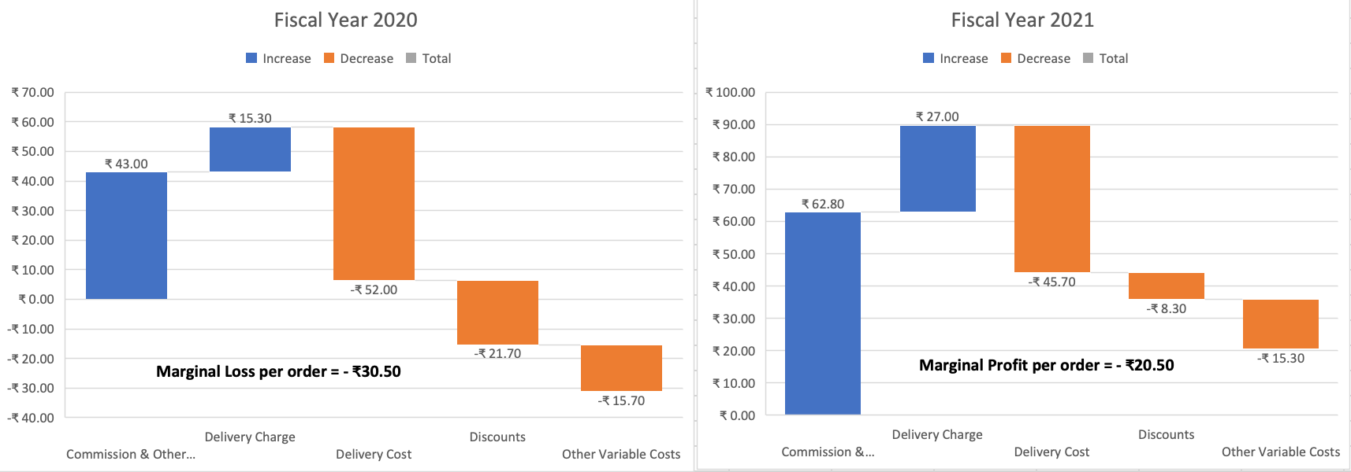
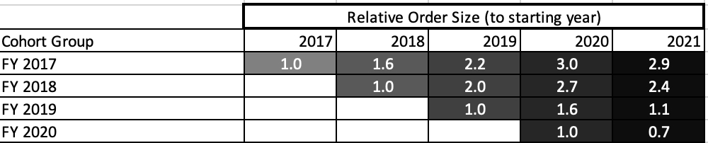
II. Operating margins – unit economics
In the base case, we assume that the pre-tax operating margin for Zomato will trend towards 35%, as the company approaches maturity.

Slide 16
III. Reinvestment
To estimate the reinvestment that Zomato will need to deliver its expected growth, we will assume that the company will remain an intermediary and that its reinvestment will continue to take the form of acquisitions and investments in technology.
In the base case, we will assume that the company will be able to deliver Rs 5 for every rupee of capital invested next year, largely due to the rebound from COVID, before becoming Rs 3 for every rupee invested in years 2-5, before and settling in at Rs 2.5 for every rupee invested beyond.

Slide 17
IV. Risk
On the operating risk dimension, Zomato will remain primarily an Indian company, dependent on Indian macroeconomic growth to succeed, and the cost of capital should reflect that risk.
Zomato is a money losing company, but it is not a start-up, facing imminent failure.
  On the plus side, its size and access to capital, as well as its post-IPO augmented cash balance, push down the risk of failure.
  On the minus side, this is a company that is still burning through cash and will need access to capital in future years to continue to survive.
In the base case, we will give Zomato a Rupee Cost of capital of 10.25% in the early years, before adjusting it down to about 9% in steady state, and attach a likelihood of failure of 10%, to the company.

Slide 18
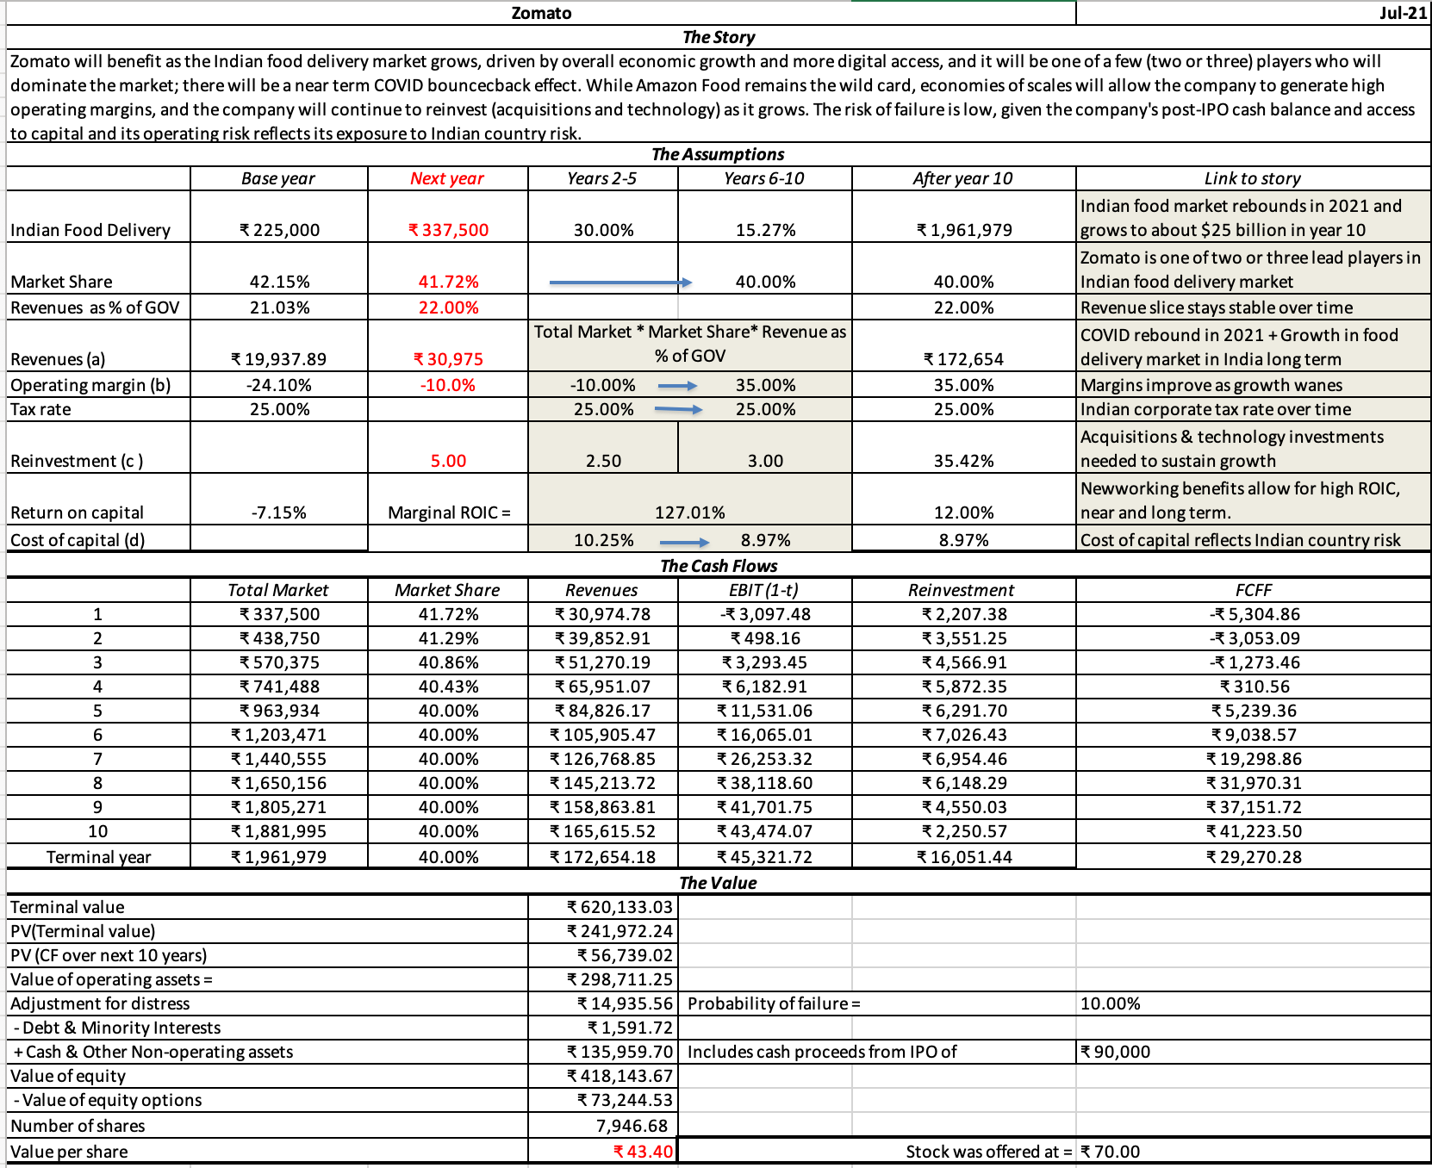
Zomato: IPO Equity value

Slide 19
Add-ons and augmentations 1. Monte carlo simulations
Determine “probabilistic” variables: In any analysis, there are potentially dozens of inputs, some of which are predictable and some of which are not. It makes sense to focus attention on a few variables that have a significant impact on value.
Define probability distributions for these variables: You can use a mix of historical data, industry averages and common sense.
Check for correlation across variables: When there is strong correlation, positive or negative, across inputs, you have two choices.
  One is to pick only one of the two inputs to vary; it makes sense to focus on the input that has the bigger impact on value.
  The other is to build the correlation explicitly into the simulation; this does require more sophisticated simulation packages and adds more detail to the estimation process.
Run the simulation: For the first simulation, you draw one outcome from each distribution and compute the value based upon those outcomes. This process can be repeated as many times as desired, though the marginal contribution of each simulation drops off as the number of simulations increases.

Slide 20
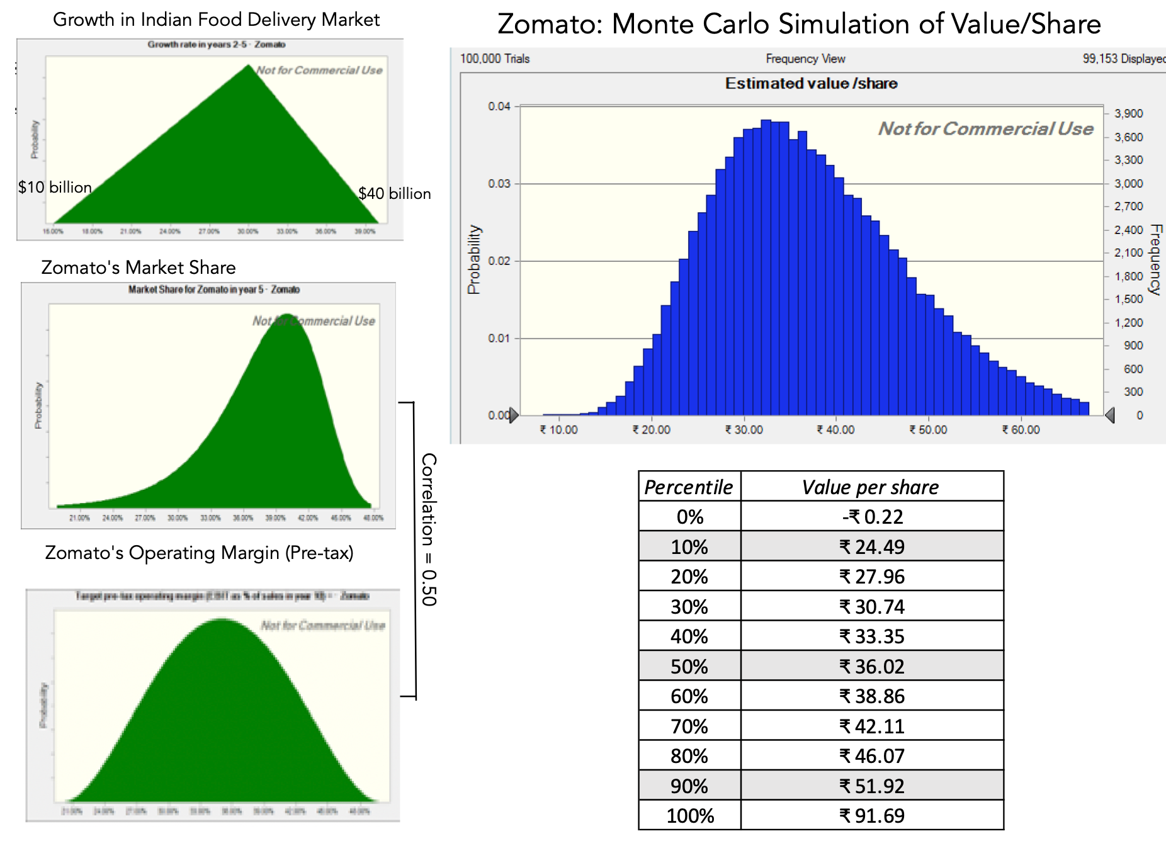
Zomato simulation

Slide 21
2. Optionality
There is a potential upside to the uncertainty that you face, when valuing young businesses, and that comes from the possibility that if the stars align, and the products offered by the business find wider acceptance than expected, it can use that success to enter new businesses that do not seem viable today or are not even in consideration.
This “optionality” will add a premium to the value that you estimate for the business, and that premium will increase, as uncertainty becomes more rampant.
  There is some truth to the argument, but its weight rests on not just the number of users and subscribers on the platform, but also in how loyal they are to the platform and how intense their usage is.
  It also depends on whether the platform company is accumulating data on the users that can be used as a competitive advantage when entering other businesses, with more data more exclusive to the company, creating more value than data that others have access to.

Slide 22
Zomato’s optionality?
Zomato's platform has the benefit of large numbers, but it falls short on both intensity and proprietary data. Thus, Zomato app users are on the system only when they order food, and the engagement is often restricted to food ordering and delivery.
If Zomato plans to expand its offerings to its platform-users, it is very likely that these add-on businesses will be food-related, perhaps extending into grocery shopping, creating some option value.
Even if you believe that there is optionality, attaching a numerical value to that option is one of the most difficult tasks in investment.
In short, if we were tempted to pay a premium over the intrinsic valuation (₹43) that we estimated for Zomato earlier, to reflect its large user base and optionality, that premium should be small, given user characteristics.

Slide 23
Pricing challenges
Standardized Price: For a metric to be used as a scalar, it has to have a positive value, at the minimum, and have a close connection to business value, even if positive. That requirement crimps your choices when pricing young companies.
Peer Group Assembly: With start-ups and very young businesses, almost all of the peer group businesses can be privately owned, and the pricing information on these businesses will reflect their most recent venture capital rounds (which can be both dated and misleading). Even as these companies advance on the life cycle, and become publicly traded, defining them narrowly can make it difficult to find peer groups.
Controlling for Differences: Assuming that you can find a scalar for pricing and are able to assemble a peer group of businesses like yours that are priced, you will still have to determine what it is that investors are looking at, when setting prices, and then figure out how to control for differences on those determinants.

Slide 24
The responses
Standardized Price: One alternative is to use an operating metric that you can observe at the business that you believe will provide you with the pathway to revenues and profitability. Another alternative is to forecast the financials of a business and use the forecasted values as your scalar.
Peer Group Assembly: If you are pricing a start-up that is still privately owned and all the peer group is also privately owned, you often have no choice but to stick with the flawed and often stale pricing from more recent venture capital rounds at the peer group. Once a start-up is publicly traded, we would recommend defining its business broadly and loosening the criteria for “similar” firm, to get more companies in the peer group, even if it means bringing in companies from other markets or sectors.
Controlling for Differences: The problem is that outside of revenue growth, young businesses have profit margins and reinvestment measures that are unreliable and shifting. If your intent is to find out what the market is pricing into young businesses, you can use statistical tools to eke out correlations between market prices and observable variables.

Slide 25
Pricing Zomato
 | Doordash (2020) | Doordash (2030 Forecast) | Zomato (2020) | Zomato (2030 Forecast)
Market Capitalization | $57,860 |  | $8,600
Enterprise Value | $53,640 |  | $7,500
Gross Bookings | $18,897 | $72,072 | $1,264 | $10,038
Revenues | $3,601 | $9,009 | $266 | $2,208
Gross Income | $1,864 | $4,955 | $140 | $1,325
EBIT | -$412 | $1,802 | -$64 | $773
Platform Users | 20 | 50 | 40 | 200
 | Current | Forward | Current | Forward
EV/GOV | 2.84 | 0.74 | 5.93 | 0.75
EV/Revenues | 14.90 | 5.95 | 28.20 | 3.40
EV/ Gross Income | 28.78 | 10.83 | 53.57 | 5.66
EV/ User | 2682.00 | 1072.80 | 187.50 | 37.50

