Slide 1



VALUING High growth firms

Slide 2
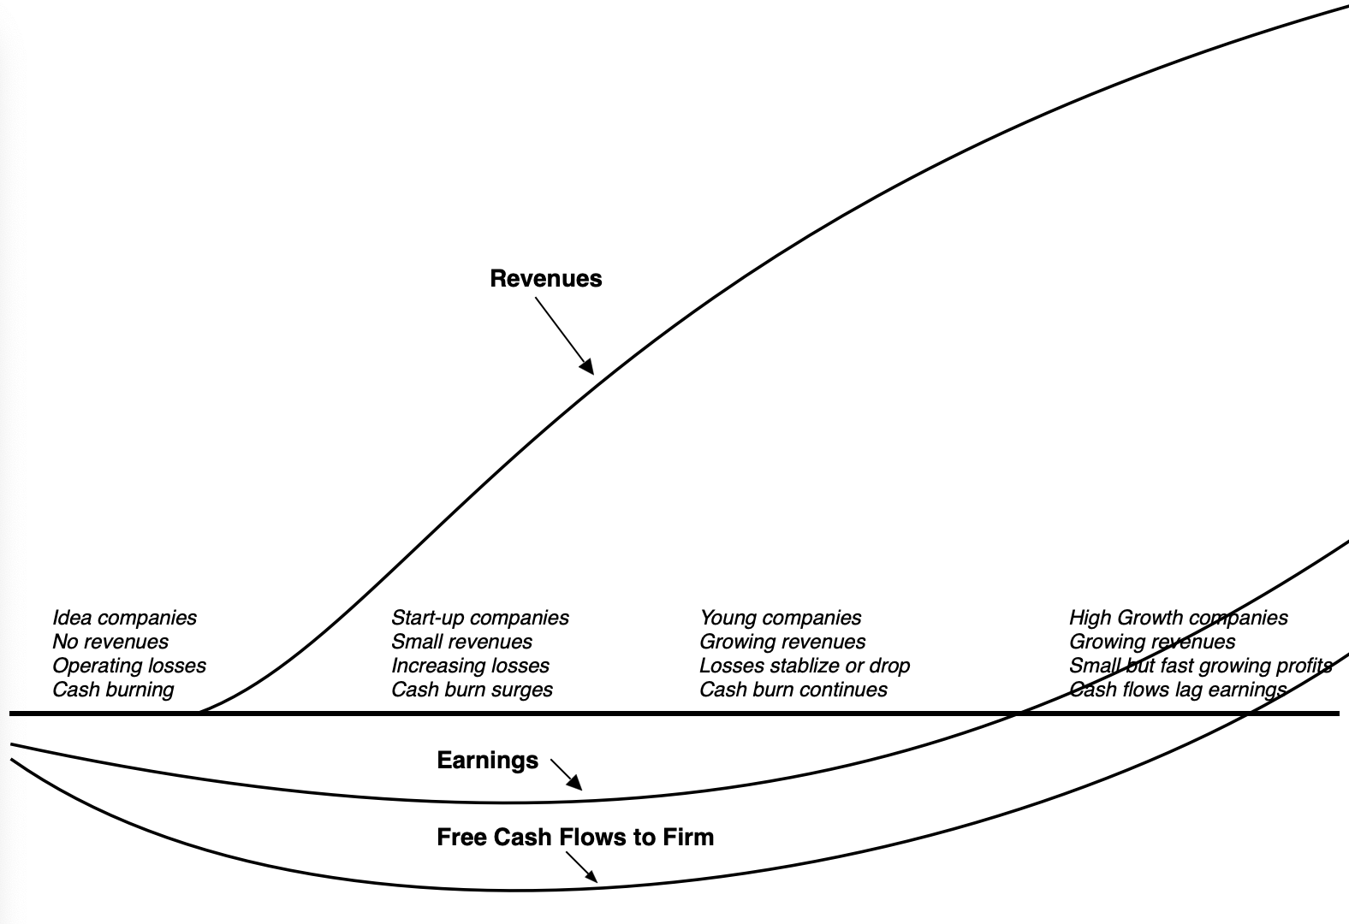
The High Growth phase

Slide 3
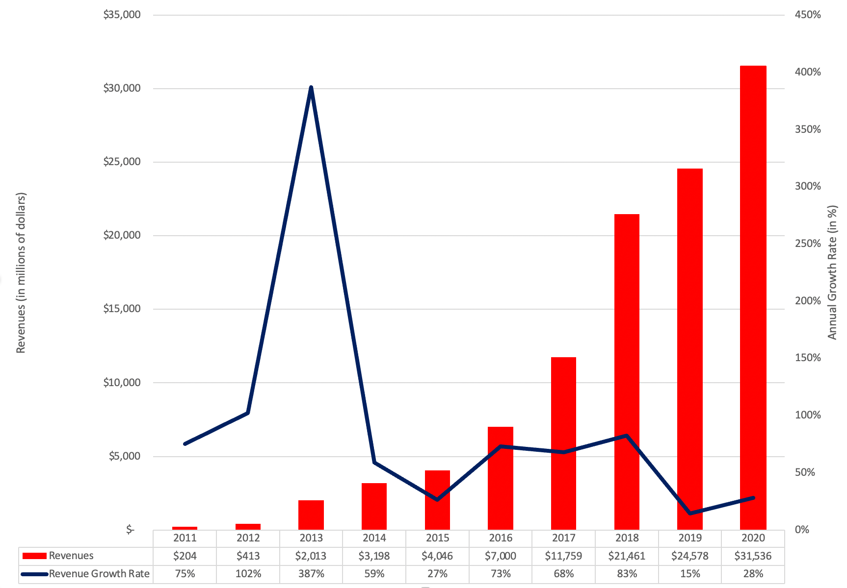
Valuing high growth firms: The scaling effect

Slide 4
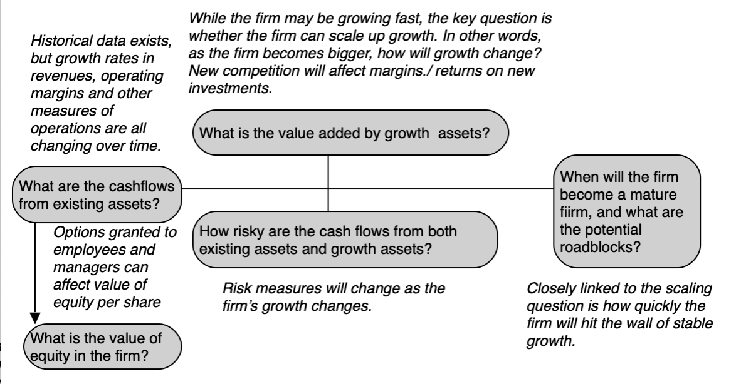
With added challenges

Slide 5
The Intrinsic value response: 1. Tell a story!
With high growth companies, the key parts of the story will relate to the business model being built and how that model will play out in terms of scalability (growth), profitability (margins) and reinvestment (growth efficiency).
With high growth companies, when spinning your business narrative, the focus will still stay on potential, but more weight must be given to the financial history of the company and its corporate governance structure.
In some cases, this record can make you more enthusiastic about the company’s prospects (revenue growth and profitability) and in others, it can lead you to scale back your story.

Slide 6
Step 2: The 3P test
On revenues, the biggest questions arise, as you make assumptions that revenues can be scaled up. To make this assessment, you can look at market size, and what you are giving your company as market share, given your growth assumptions, and potential competition.
On operating profit margins, the positive trend lines in profits can lead to over optimism about operating profit margins, but it has to be tempered by unit economics.
On reinvestment, assessing whether a company is reinvesting enough to deliver its growth can be difficult, since historical reinvestment is likely to be volatile and obscured by investments and acquisitions that are paid for with the company’s stock. There may be clues in the industry averages and in the business model.

Slide 7
Step 3A: Story pieces to value inputs –
Revenue growth
Revenue growth rates will decrease as companies get larger, and every growth company will get larger over time if our forecasts of growth come to fruition.
The following should be considered in estimating revenue growth:
  Absolute revenue changes: One simple test is to compute the absolute change in revenues each period, rather than to trust the percentage growth rate.
  Trend lines: Looking at past revenue growth rates, by year, for the firm in question should give us a sense of how growth rates have changed as the company size changed in the past.
  Sector data: The final tool is to look at revenue growth rates of more mature firms in the business to get a sense of what a reasonable growth rate will be as the firm becomes larger.

Slide 8
Step 3B: Profitability
Let’s start with the most likely case, which is that the current margin is either negative or too low relative to the sustainable long-term margin. This can happen for three reasons.
  One is that the firm has up-front fixed costs that must be incurred in the initial phases of growth, with the payoff in terms of revenue and growth in later periods
  The second reason is the mingling of expenses incurred to generate growth with operating expenses. As the firm matures, this problem will get smaller, leading to higher margins and profits.
  The third reason is that there might be a lag between expenses being incurred and revenues being generated.
The other possibility, where the current margin is too high and will decrease over time, is less likely, but it can occur, especially with growth companies that have a niche product in a small market. As the firm grows, this will change, and margins will decrease.

Slide 9
Step 3C: Reinvestment
Since high growth firms tend to have changing margins, we will adopt the same road map we used for young growth companies, where we estimated reinvestment based on the change in revenues and the sales-to-capital ratio:
  Reinvestment_{t} = Change in Revenues_{t}/ (Sales/Capital)
The sales-to-capital ratio can be estimated using the company’s data (which is more stable than the net capital expenditure or working capital numbers) and the sector averages.
We can build lags between the reinvestment and revenue change into the computation by using revenues in a future period to estimate reinvestment in the current one.

Slide 10
Step 3D: Risk Profile
The key to maintaining balance in growth company valuations is to adjust the discount rates over time to keep them consistent with the growth and margin assumptions that we make in each period.
  Growth firms should have high costs for equity and debt when revenue growth is highest, but the costs of debt and equity should decline as revenue growth moderates and margins improve.
  As earnings improve and growth drops, another phenomenon comes into play. The firm generates more cash flows than it needs, which it can use to both pay dividends and service debt financing.
In summary, the cost of capital for a growth company should be a year-specific number that keeps pace with the rest of the changes we forecast at the firm

Slide 11
Step 3E: Closure
Do not wait too long to put a firm into stable growth.
  Both scale and competition conspire to lower growth rates quickly at even the most promising growth companies.
  Growth periods that exceed ten years, especially when accompanied by high growth rates over these periods, are uncommon, because only a few companies have been able to accomplish this over time.
When you put your firm into stable growth, give it the characteristics of a stable growth firm.
  With discount rates, as noted in the preceding section, this takes the form of using lower costs of debt and equity and a higher debt ratio.
  With reinvestment, the key assumption is the return on capital that we assume for the stable growth phase.
  While some analysts believe that the return on capital should be set equal to the cost of capital in stable growth, we would preserve some company-specific flexibility.

Slide 12
Step 4: Value the business
The nature of cash flows at growth companies[md]low or negative in the early years and higher later[md]will ensure that the terminal value is a high proportion of value, accounting for 80%, 90% or even more than 100% of value.
  Some analysts use this fact as ammunition against using discounted cash flow valuations, suggesting that assumptions about the high-growth phase will be drowned out by terminal value assumptions.
  The base year value for the terminal value calculation (earnings and cash flows in year 5 or 10) is a function of the assumptions during the high-growth phase. Changing these assumptions will have dramatic effects (as it should) on value.

Slide 13
Step 5: Keep the feedback loop open
When you estimate a value for a high growth company that is very different from the market price, in either direction, it should be natural that you pause and consider why:
  You are wrong: The difference between price and value may be because your estimates of inputs, include revenue growth, margins and reinvestment are wrong, and that the market consensus is right.
  The market is wrong: The value-price difference can arise because the market, caught up in mood and momentum, has pushed the stock price to a level that does not reflect its intrinsic value.
  You are both wrong, but one of you is less wrong: The truth is that neither you nor the market has a crystal ball, and that you are making your best estimates for the future.
The healthiest response, in our view, when value and price are different, is to assume that you may be missing something that the market is seeing but having examined the data and made the appropriate tweaks, you can end up with value still being different from the price.

Slide 14
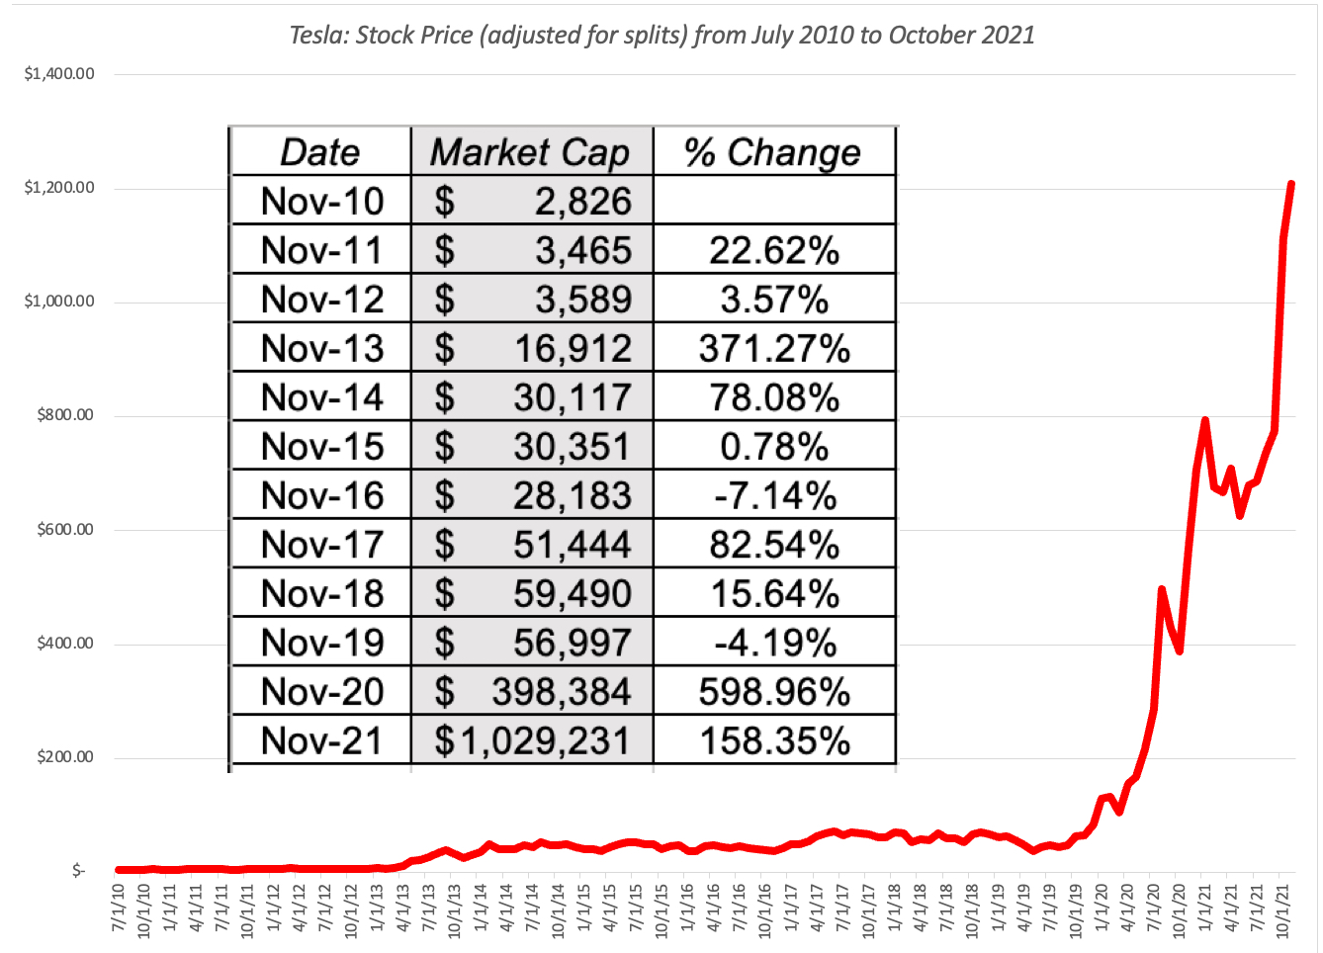
Valuing tesla in November 2021 – The market Lead in..

Slide 15
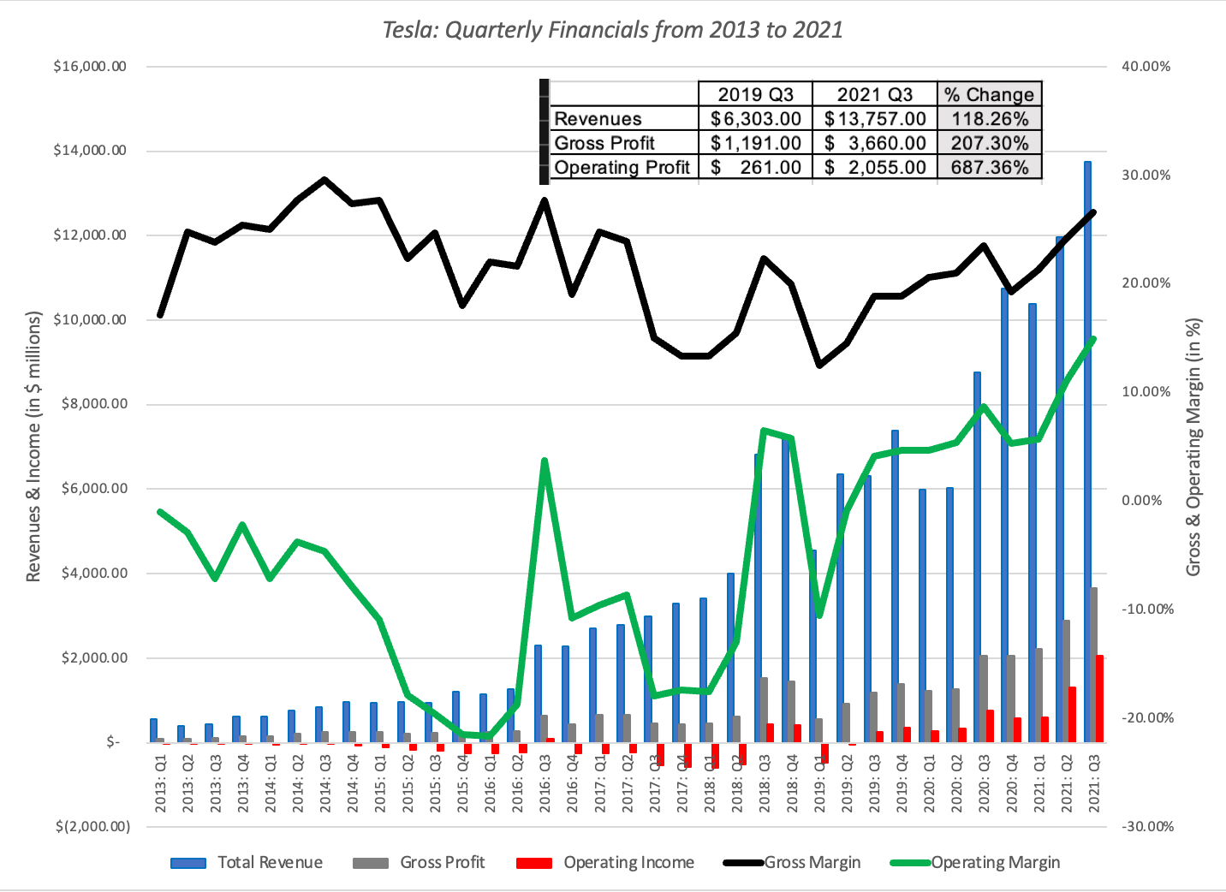
With the financial back up..

Slide 16
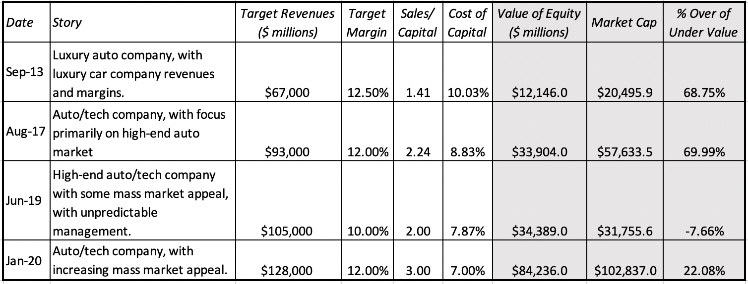
My Tesla stories 0ver time!

Slide 17
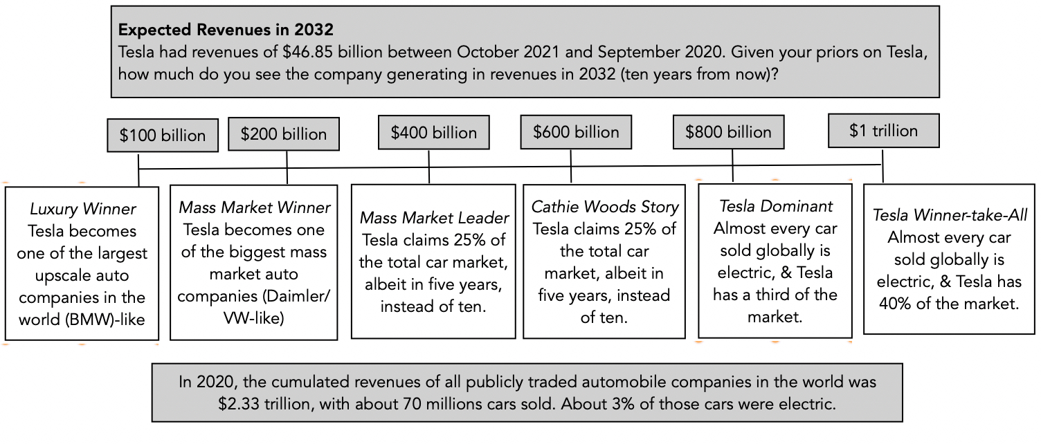
MY UPDATED TESLA STORY - REVENUES

Slide 18
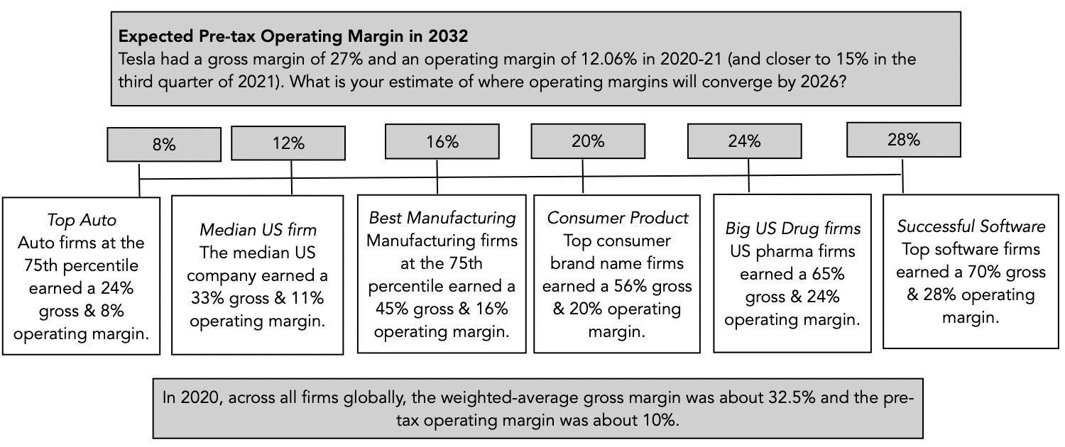
AND PROFITABILITY…

Slide 19
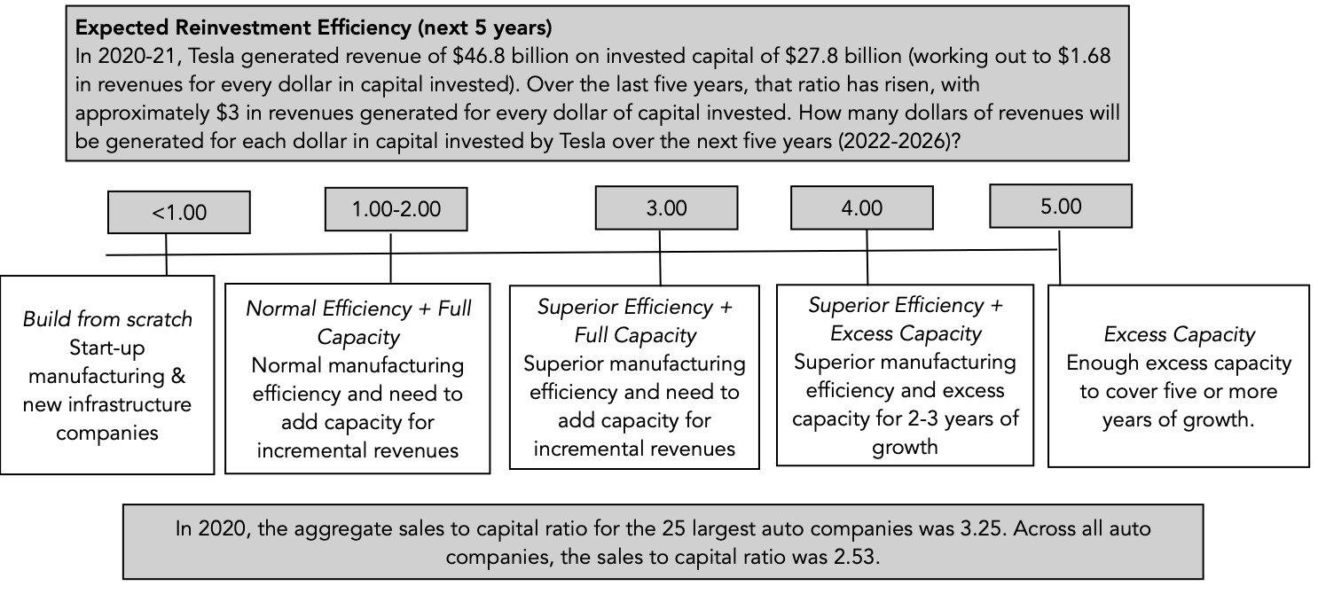
WITH REINVESTMENT…

Slide 20
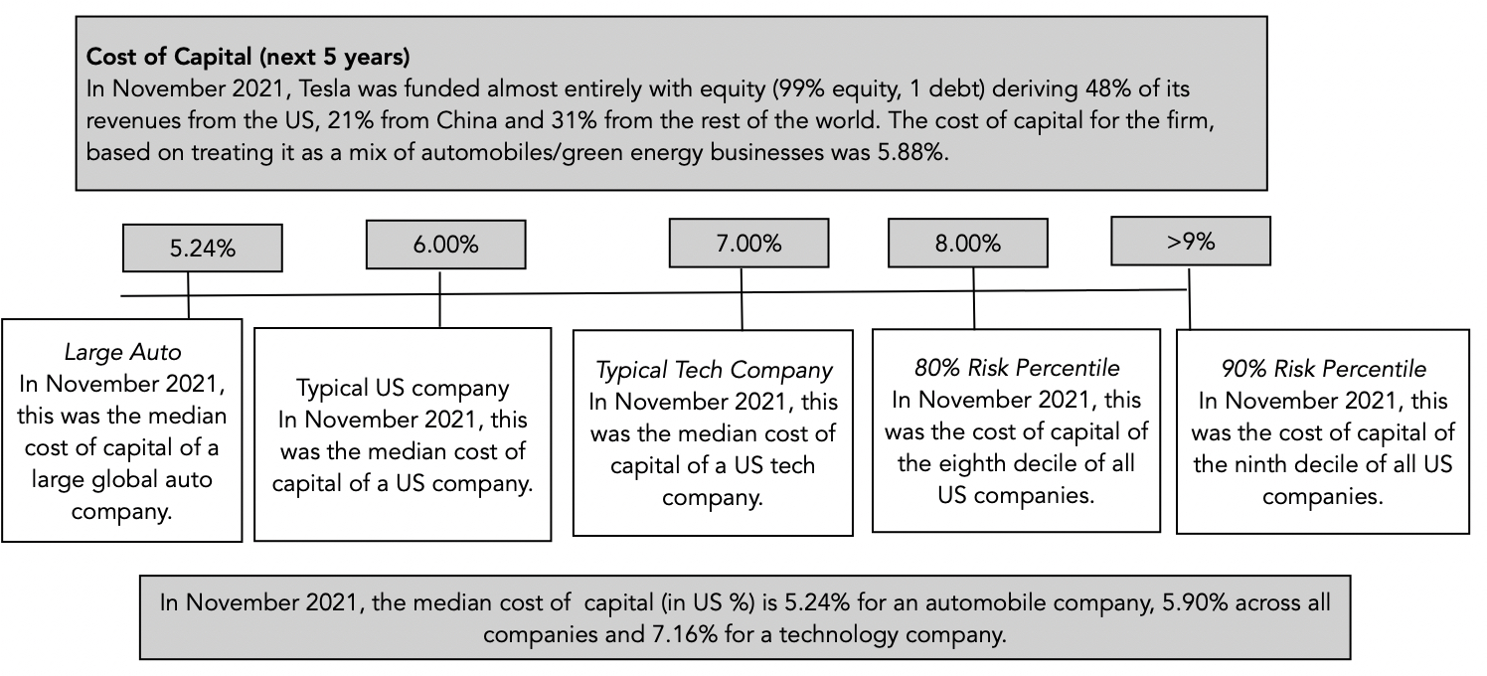
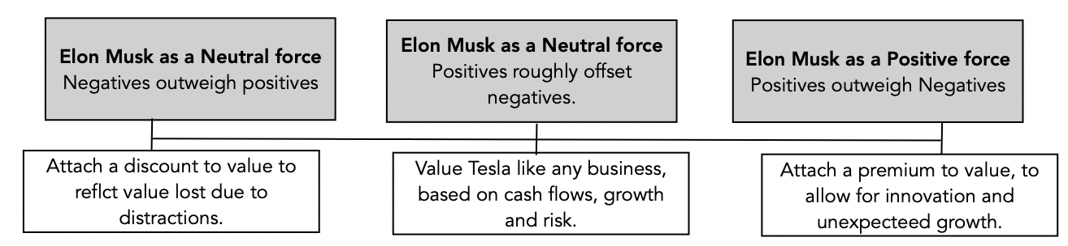
RISK (AND PERSONALITY)

Slide 21
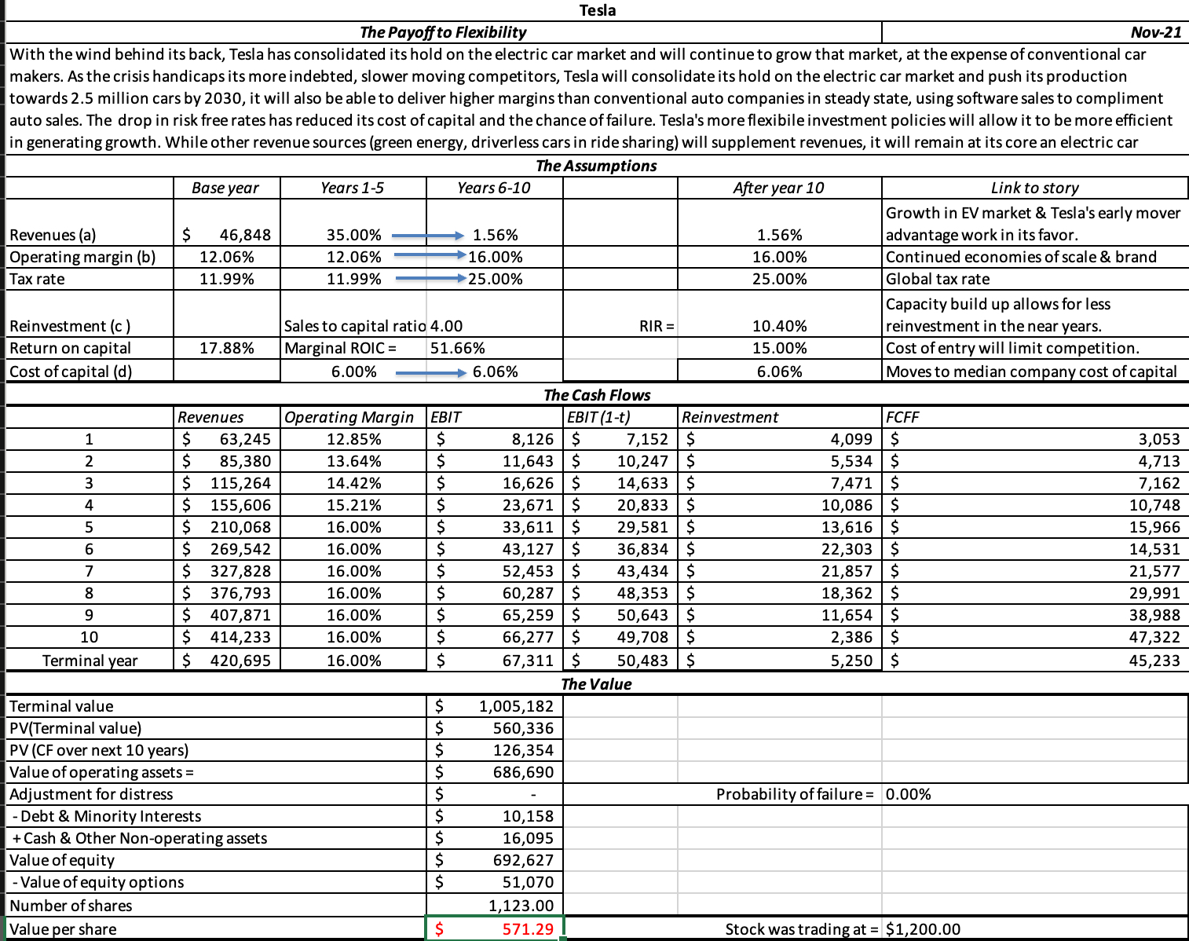
TESLA VALUATION IN NOVEMBER 2021

Slide 22
PRICING CHALLENGES
Forward Numbers: The first is to scale market values to expected operating outcomes in the future. Thus, rather than divide price per share today by current earnings per share, you can divide by expected earnings per share in five or even ten years and compare these forward multiples across the peer group.
Growth-adjusted Multiples: High growth firms will look expensive, if you look at just PE ratios. One approach that can, at least on surface, deal with this problem is to bring in the growth into the pricing multiple:
  PEG ratio = PE ratio/ Expected growth rate

Slide 23
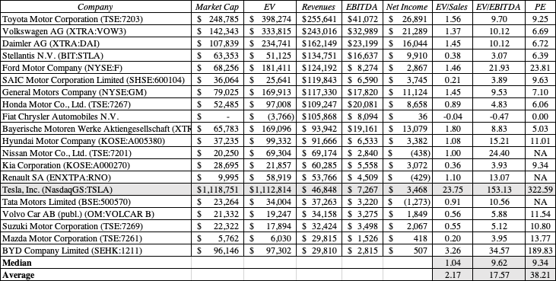
PRICING TESLA IN NOVEMBER 2021 – AUTO PRICING

Slide 24
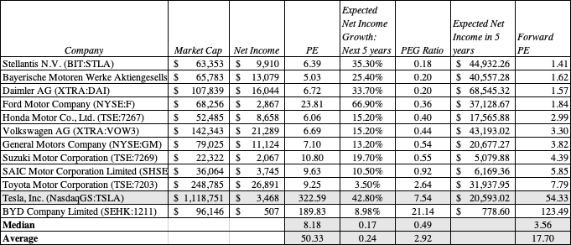
AUTO PEG RATIOS

Slide 25
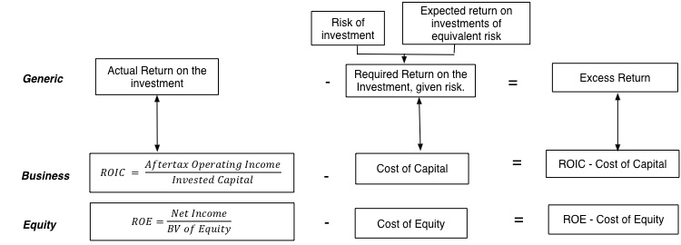
ADD-ONS AND ADDENDUMS: 1. VALUE OF GROWTH
While many investors view growth as an unalloyed good, it requires a tradeoff, where a company invests more back into itself in the near term, denying payouts (dividends or buybacks) to its investors, during that period, for higher earnings in the future.
The net effect of growth will depend on how much is reinvested back, relative to what the company can harvest as future growth.

Slide 26
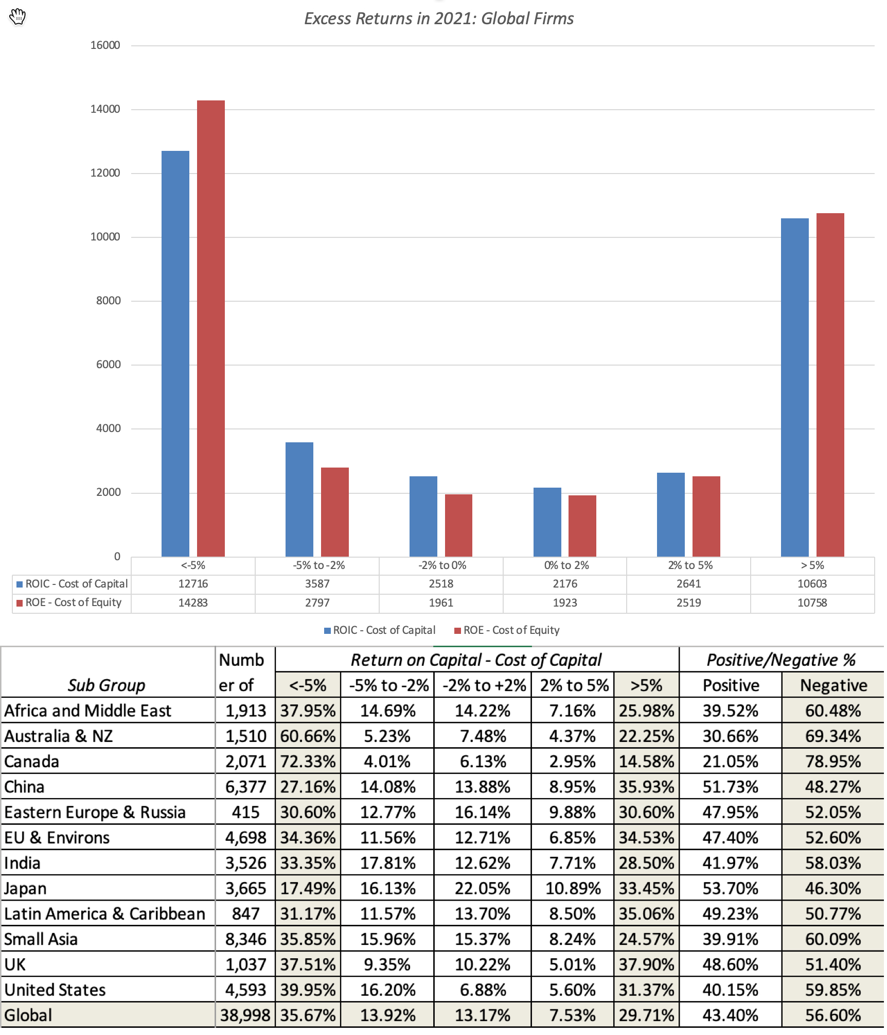
Excess returns across global firms…

Slide 27
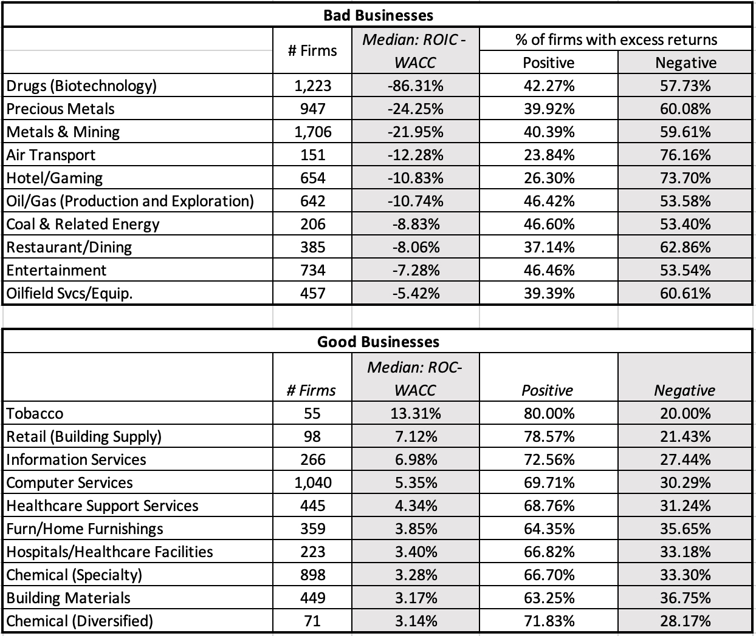
With best and worst industries…

Slide 28
2. Breakeven analysis
You can hold all else constant, and change one variable (growth, revenues, risk) and find the breakeven value for that variable that will yield the current market price. The problem with this approach is that it requires to isolate one out of many key inputs to come to your conclusion.
A more expansive approach to backing out market expectations is to pick two or even three of the most critical inputs into valuation and look for combinations of assumptions on these variables that yield the market price.
A third variant is to go back to the story that you built your valuation around, and see how, as you change the story, the valuation changes.

Slide 29
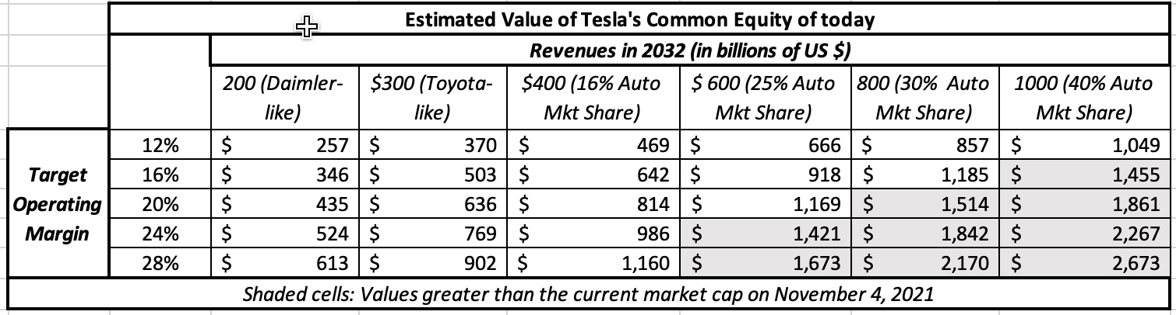
Tesla Break-even in November 2021

