Slide 1



VALUING Mature firms

Slide 2
MATURE FIRM CHARACTERISTICS
Revenue growth is approaching the growth rate in the economy: While the growth rate for earnings for mature firms can be high, because of improved efficiencies, the revenue growth is more difficult to alter.
Margins are established: Another feature shared by mature companies is that they tend to have stable margins (at least across cycles)
Competitive advantages: While some mature firms see excess returns go to zero or become negative with the advent of competition, other mature firms retain significant competitive advantages (and excess returns).
Debt capacity: The capacity to borrow money should increase at mature firms, although there can be big differences in how these firms react to this surge in debt capacity
Cash buildup and return: As earnings improve and reinvestment needs drop off, mature companies generate more cash from their operations than they need.
Inorganic growth: As companies get larger and internal investment opportunities do not provide the growth boost that they used to, many mature companies look for quick fixes that will allow them to continue maintaining high growth. One option, albeit an expensive one, is to buy growth in the form of acquisitions.

Slide 3
Valuation challenges – assets in place
Managed earnings: Mature companies are adept at using the discretionary power offered in accounting rules to manage earnings.
Management inefficiencies: Mature companies have long periods of stable operating history.
  However, past earnings reflect how the firm was managed over the period, and to the extent that managers might not have made the right investment or financing choices, the reported earnings will be lower than could have been generated under better or optimal management.
  If there is the possibility of such a management change on the horizon, we will undervalue existing assets using reported earnings.

Slide 4
Valuation challenges – growth assets
As companies mature, internal investments start to become scarce, relative to what the firm has available to invest.
As companies get larger, the new investments they make also must be sizeable to have any impact on overall growth. Although finding multibillion-dollar internal projects is difficult, finding acquisitions of that size is easier, and these affect the growth rate almost immediately.
The third reason applies in businesses that have a long lead time between investment and payoff. In these businesses, there will be a lag between the initial investment in a new asset and the growth generated by that investment. With an acquisition, we are in effect speeding up the payoffs.

Slide 5
Valuation challenges - Risk
Most mature companies have been publicly traded for extended periods, giving us access to more historical price data, as well as data on earnings variability over time.
They also have settled risk profiles, which stabilizes the data, and makes estimating equity risk parameters from historical data more defensible with this group of companies than it was with the growth companies that we analyzed in the preceding two chapters.
However, there are three estimation issues that can affect discount rate estimates.
  The first is that mature companies accumulate debt from multiple places, leading to complex mixes of debt, in fixed-rate and floating-rate, in multiple currencies.
  The second issue is that discount rates (costs of debt, equity, and capital) are affected by the firm’s mix of debt and equity.
  The third factor comes into play for firms that follow the acquisitive route to growth. Acquiring a firm in a different business or with a different risk profile can alter the firm’s discount rate.

Slide 6
VALUATION CHALLENGES: CLOSURE
Because mature firms have growth rates that are close to that of the economy, the computation of terminal value might seem both more imminent, and simpler, with a mature company than with a growth company.
Although this is generally true, two factors can still cause distortions in the computation:
  Stable growth rates, unstable risk, and investment profile: To qualify as a stable-growth firm that can be valued using the terminal value equation, the firm should have the risk profile of a stable firm (close to average risk) and should behave like a stable firm (in terms of reinvestment).
  Lock in inefficiencies in perpetuity:. If we lock in current values on profit margins, returns on investment, and discount rates, when estimating terminal value, and the firm is poorly run, we undervalue the firm by assuming that the current practices will continue forever.

Slide 7
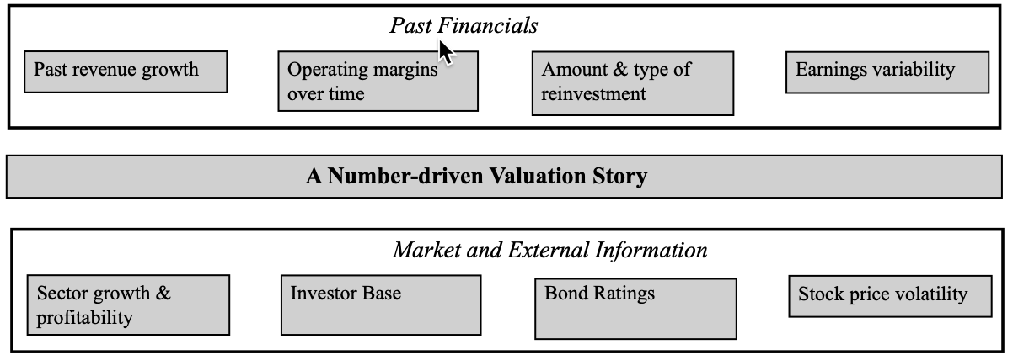
VALUATION REPONSES:
1. TELL A STORY

Slide 8
2. THE 3P TEST
If your story for a mature business is an extension of its history, it may seem like there is little need for a 3P test, and that is true, with two exceptions.
  The first is if macroeconomic or regulatory changes are imminent that could change the business economics, creating breaks with historical data.
  The second is if the business that the firm is in is being disrupted by a new technology or business model.
If you are assuming a change from a historical path, even if that change is merited and plausible, you need to test to see whether management can be changed.

Slide 9
3. STORY TO INPUTS
Revenue Growth: If you are extrapolating past growth, check to see if markets/competition has changed. If you decide to break with historical growth rates and endow a mature business with much higher or lower growth in the future, you will need a strong story line to explain why this might happen.
Profitability: AFor most mature firms, the most prudent choice is to assume that margins will stay at historic norms. i.e., averages over the last five or ten years, for instance. Unlike high growth companies, where economies of scale and improving business models. If you do make an argument of a major shift in margins at a mature business, you must be prepared with an explanation in terms of business model or a changing market, as to why this might happen.
Reinvestment: Mature businesses often shift away from internal (or organic) growth to acquisitions as their primary mechanism to continue to grow. To value these businesses, you need to consider whether these acquisitions will create value, and that assessment will require that you treat acquisitions just as you would capital expenditures, and forecast how much the company will spend, on average, on acquisitions in future years.
Risk: When the cost of capital reflects the existing business and financing mix that the mature firm is using, and if it decides to change one or both mixes, the cost of capital will have to change.

Slide 10
4. Value the business
Since mature businesses derive the bulk of their value from investments that they have already made, it stands to reason that there will be less divergence of opinion, across investors, about that value.
However, this value will become more sensitive to two other choices that the firm makes:
  Financing mix: With mature businesses, changing the mix of debt and equity in running the business will have more greater impact on the value that you arrive at for the business, than with young or high growth businesses.
  Cash balances and cash return: Mature companies, on the other hand, generate large and positive cash flows that they can choose to return, and if they do not, cash accumulates in these businesses.
The bottom line is that the value you estimate for a mature firm is far more dependent on your assumptions about financing and dividend policy than is the value that you estimate for a young or high growth firm.

Slide 11
5. Keep the feedback loop open
With mature companies that are being disrupted, if your estimates of intrinsic value consistently stay above the market price, and the market prices drifts down, rather than towards your estimated value, it may be worth examining whether you are incorporating the effects of disruption sufficiently into your value.
When you value a mature business, using its existing financial statements as the basis for forecasting cash flows, and incorporating its existing financing mix and dividend policy, you are accepting incumbent management policy as a given.
  If an activist investor, i.e., an investor with enough funds to take a significant stake in the company, takes a position in the company and pushes for change, that should be a trigger for you to reexamine the valuation of the business, as well.

Slide 12
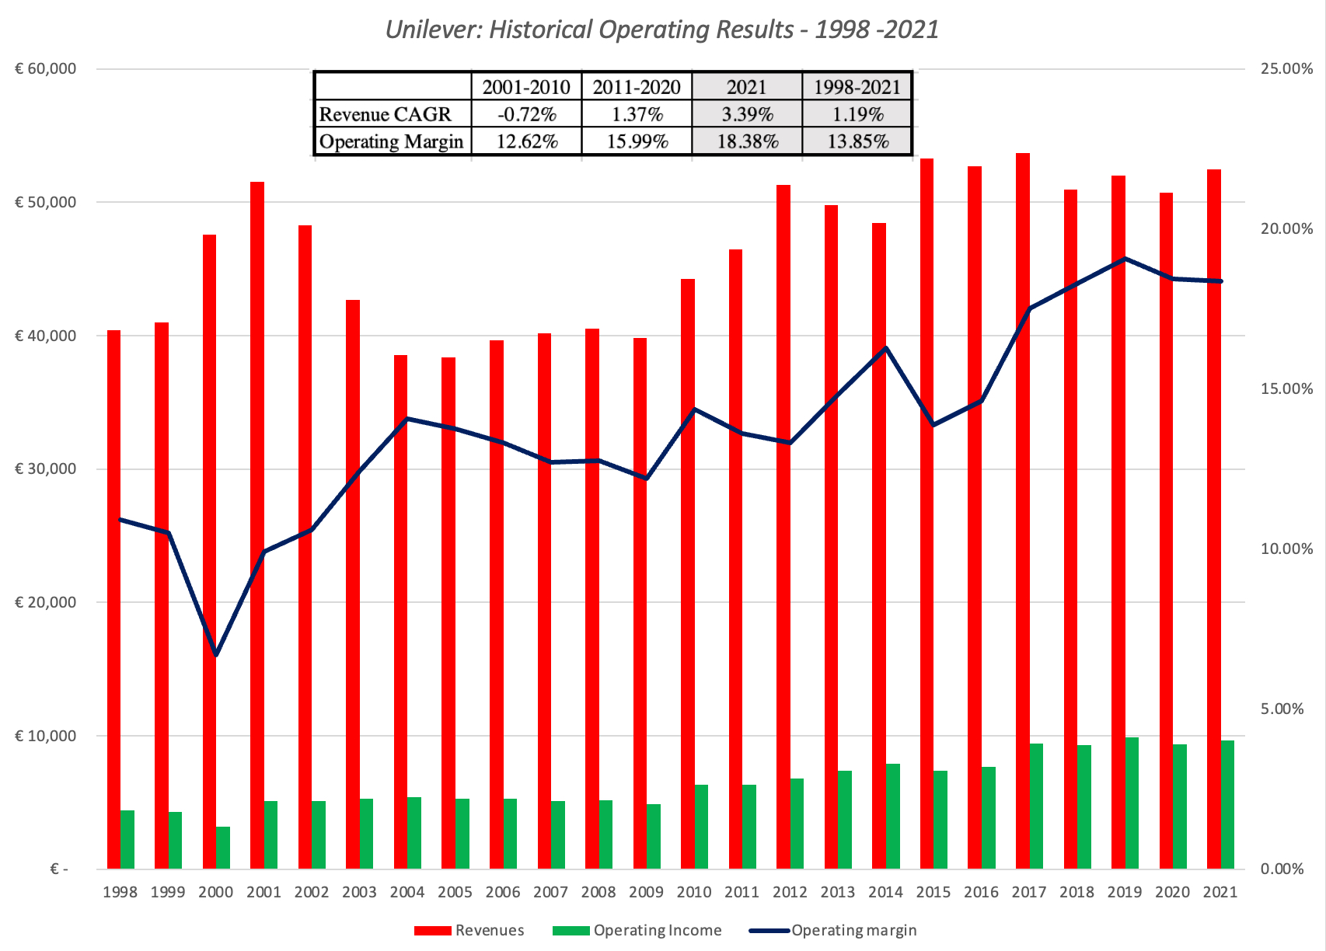
Valuing a mature firm: Unlever
Unilever has made some large acquisitions, including buying Bestfoods for $24.3 billion, in 2000, Horlicks for $3.8 billion, 2018, and Dollar Shave Club for $1.0 billion in 2016, and many small ones. These acquisitions clearly have not contributed to revenue growth in a noticeable way.

Slide 13
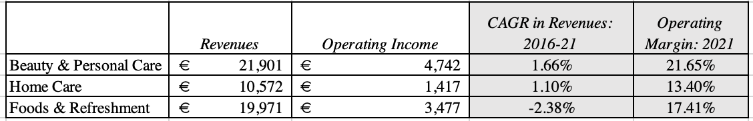
Unilever – Business assessment
All three businesses are low growth, with the food business shrinking between 2016 and 2021, and the beauty and personal care business is the most profitable part of the company, with an operating margin of 21.66% in 2016, while the home care business lags the most, in terms of profitability.

Slide 14
My Unilever story
Revenue growth: We will assume that revenues will grow at 2% a year, which is higher than the historical growth rate, but also reflective of the higher inflation expectations at the time of this valuation.
Operating margins: For next year, we expect Unilever to maintain the operating margin of 18.38% that it delivered in 2021, and we expect those margins to stabilize around 18%, over the next few years.
Reinvestment: With low growth, there will be relatively little reinvestment needed, and to estimate that reinvestment, which we expect will take the form of small acquisitions, we will assume €1.80 in revenue, for every euro invested.
Cost of capital: At Unilever current financing mix, which is about 78% equity and 22% debt, and given the current geographic exposure for revenues, we estimated a cost of capital of 8.97%, and assume that it will stay at that level in perpetuity.
Failure risk: Given Unilever’s history of large, positive earnings and ample cash reserves, we do not believe that there is any risk that the company will fail.

Slide 15
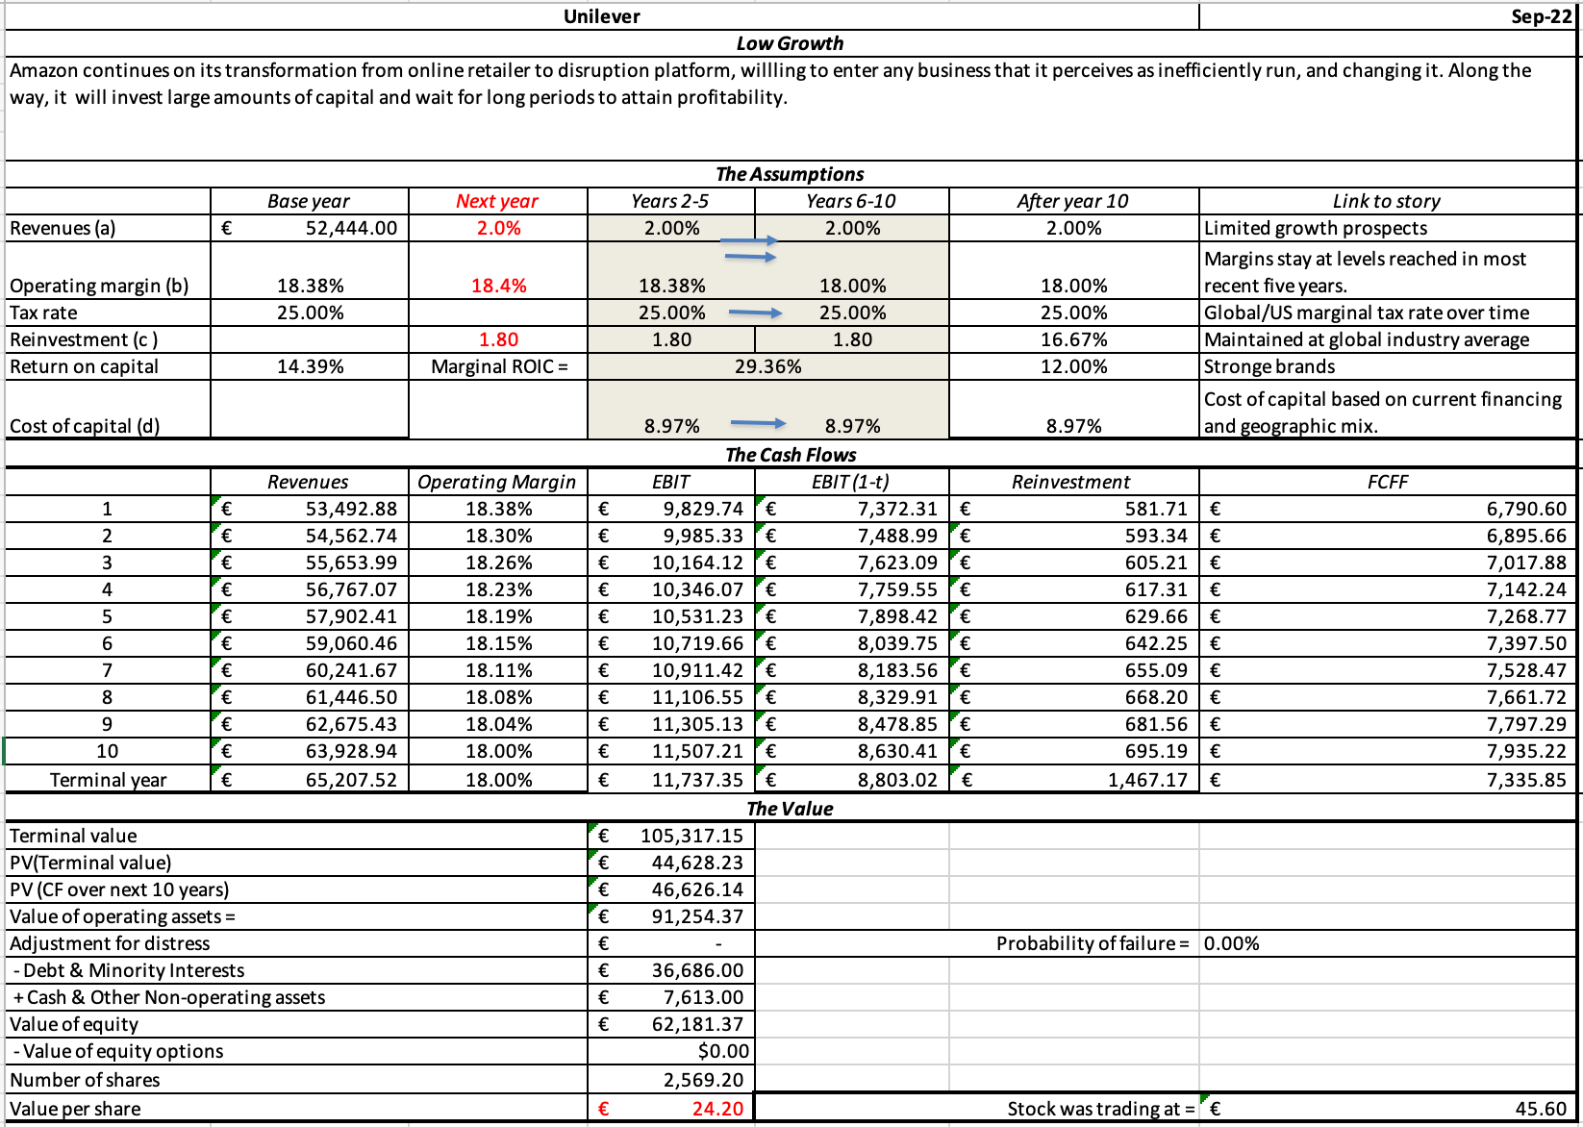
My Unilever value…

Slide 16
Pricing mature firms - challenges
Scaling the Price: When scaling the pricing of mature companies, we have a luxury of choices (revenues, earnings, book value)
Peer Group Construction: As sectors age, there tend to be more mature firms that operate within them, but with globalization, those firms are often multinationals that are incorporated in different countries and operate in different regions.
Controlling for Differences:. Even if you control your sample to include only money-making mature companies, not all mature companies are equally well positioned to protect their profitability.

Slide 17
Pricing mature companies – the responses
Fight bias: One way to avoid bias is to pick the pricing multiple that you will use in pricing a company, before observing the results you get with each one. In making this choice, you should consider conventional practice (in terms of which multiple has been used most frequently in the past in a sector) as well as use business sense.
Go global: That will require you to
  Clean up for accounting differences across countries, when comparing earnings or book value multiples and
  Find ways to measure country risk, from operations, and incorporate it into the discount rate.
Control for competitive moats and exposure to disruption: When comparing pricing across companies in a peer group, you have to find ways measuring competitive advantages at companies.

Slide 18
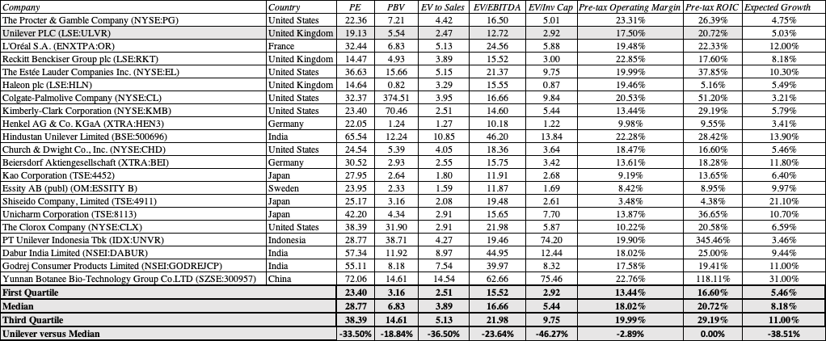
Pricing unilever – Peer group

Slide 19
And controlling for differences…
You should expect to see companies with higher margins, returns on capital and earnings growth rates to trade at higher multiples.
To get a measure of how much Unilever’s low growth may explain its lower pricing, we ran a regression of the PE ratios of the companies in the sector against their expected growth rates:
  PE = 19.30 +152.65 (Growth Rate) (3.77) (3.41)
  The R² = 37.94% and the predicted PE for Unilever is below
  PE for Unilever
  = 19.30 + 152.65 (5.03%) = 26.98
At 19.13 times earnings, Unilever still looks underpriced.

Slide 20
Add-ons and addendums: 1. Disruption target?
Sizeable economic footprint: The probability of a business being disrupted increases proportionately with the amount of money that is spent on that business.
Inefficient production and delivery mechanisms: A common characteristic that disrupted businesses share is that they are inefficiently run, and neither producers nor consumers seem happy.
Outdated competitive barriers and inertia: If these businesses are so big and inefficiently run, you may wonder what has allowed them to continue in existence for as long they have. The strongest force that they have going for them is inertia, where consumers have been programmed to accept the status quo. Adding to the protections are regulatory or licensing requirements that have long outlived their original purpose and serve to protect incumbents from insurgencies, and/or significant barriers (capital, knowledge, technology) to entering the business.

Slide 21
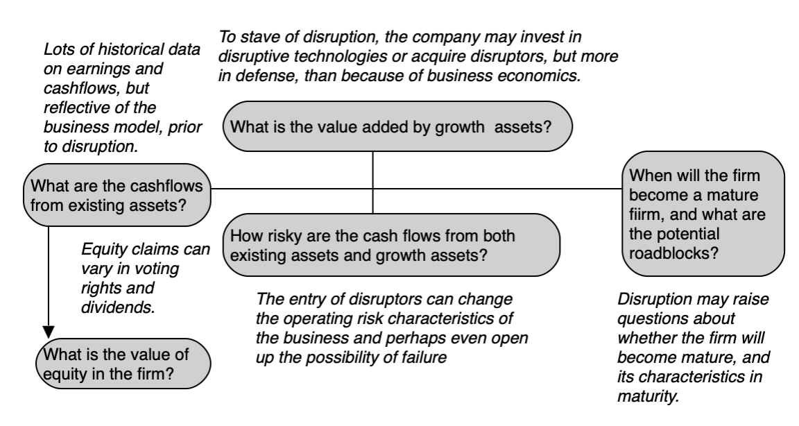
And response…

Slide 22
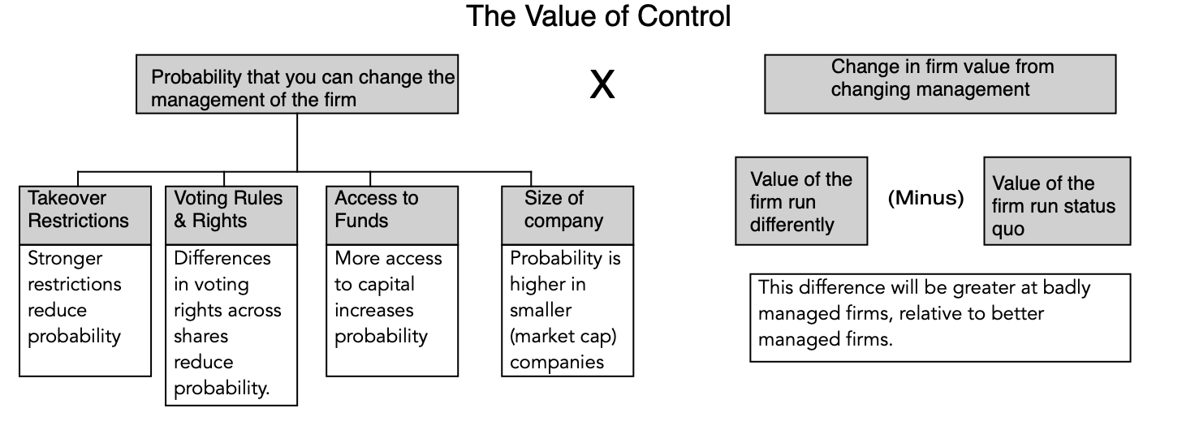
2. Value of control

Slide 23
And ways of increasing value
Potential Problem | Manifestations | Possible fixes | Value Consequence
Existing assets are poorly managed | Operating margins are lower than peer group and return on capital is lower than the cost of capital | Manage existing assets better. This may require divesting some poorly performing assets. | Higher operating margin and return on capital on existing assets -> Higher operating income Efficiency growth -> in near term as return on capital improves
Management is under investing (It is too conservative in exploiting growth opportunities) | Low reinvestment rate and high return on capital in high growth perioduntil marginal return on capital | Reinvest more in new investments, even if it means lower return on capital (albeit > cost of capital) | Higher growth rate and higher reinvestment rate during high growth period -> Higher value because growth is value creating.
Management is over investing (It is investing in value destroying new investments) | High reinvestment rate and return on capital that is lower than cost of capital | Reduce reinvestment rate is at least equal to cost of capital | Lower growth rate and lower reinvestment rate during high growth period -> Higher value because growth is no longer value destroying
Management is not exploiting possible strategic advantages | Short or non-existent high growth period with low or no excess returns. | Build on competitive advantages | Longer high growth period, with larger excess returns -> Higher value
Management is too conservative in its use of debt | Debt ratio is lower than optimal (or industry average) | Increase debt financing | Higher debt ratio and lower cost of capital -> Higher firm value
Management is overusing debt | Debt ratio is higher than optimal | Reduce debt financing | Lower debt ratio and lower cost of capital -> Higher firm value
Management is using wrong type of financing | Cost of debt is higher than it should be, given the firm’s earning power | Match debt up to assets, using swaps, derivatives or refinancing | Lower cost of debt and cost of capital -> Higher firm value
Management holds excess cash and is not trusted by the market with the cash. | Cash and marketable securities are a large percent of firm value; Firm has poor track record on investments. | Return cash to stockholders, either as dividends or stock buybacks | Firm value is reduced by cash paid out, but stockholders gain because the cash was discounted in the firm’s hands.
Management has made investments in unrelated companies. | Substantial cross holdings in other companies that are being undervalued by the market. | As a first step, try to be more transparent about cross holdings. If that is not sufficient, divest cross holdings | Firm value is reduced by divested cross holdings but increased by cash received from divestitures. When cross holdings are under valued, the latter should exceed the former.

Slide 24
The activist threat at Unilever
Unilever shareholders have become restless with management, and a failed bid for GSK in 2022 crystallized their views that change was due at the company.
That dissatisfaction drew activist investors to its stock, with Nelson Peltz not only acquiring a 1.5% stake in the firm, but quickly finding a slot on the board of directors.
  Peltz’s argument seems to be that Unilever has too many brands in its product portfolio, spread out across too many geographies and businesses.
  Whether he succeeds or not is almost beside the point, since it is about making management accountable.

Slide 25
Value of control at unilever
Valuation Input | Status Quo | Restructured | Rationale
Revenue Growth | 2% for years 1-10 | 3% for years 1-5, 2% in years 6-10 | Higher growth in India & China
Operating Margin (pre-tax) | 18% | 20% | More focus on (higher- margin) personal care division
Sales to Capital | 1.80 | 2.50 | Fewer acquisitions
Cost of capital | 8.97% -> 8.97% | 8.00% -> 8.00% | Optimizing financing mix

Slide 26
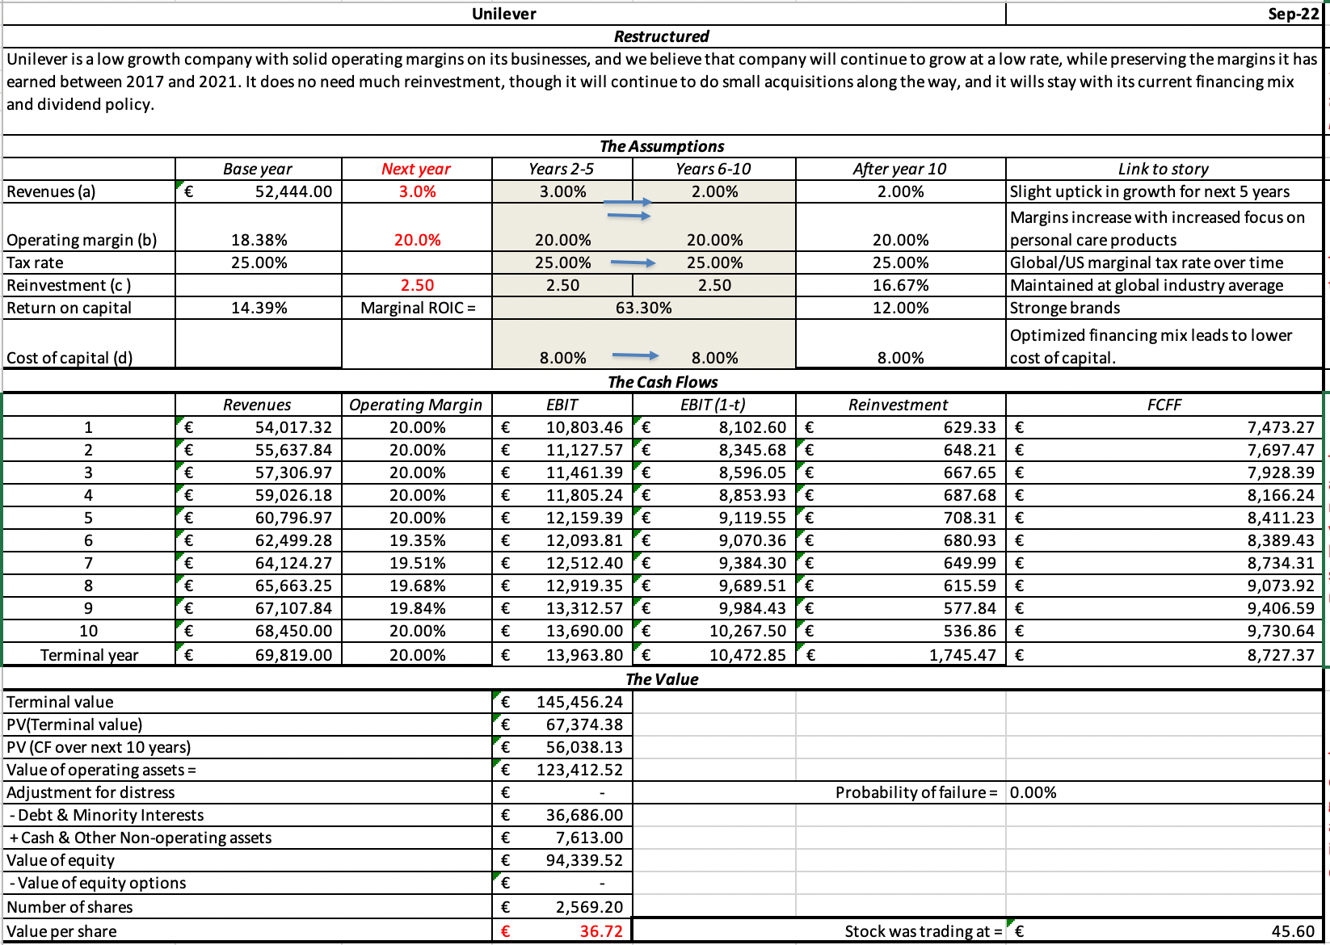
Unilever restructured…
Our estimate of value per share increases from €24.20, in the status quo value, to €36.72 in the optimal value, an increase of about a third.

