Slide 1



Chapter 13: VALUING declining firms

Slide 2
declining FIRM CHARACTERISTICS
Stagnant or declining revenues: Perhaps the most telling sign of a company in decline is its inability to increase revenues over extended periods, even when times are good. Falling revenues or revenues that grow at less than the inflation rate indicates operating weakness.
Shrinking or negative margins: The stagnant revenues at declining firms are often accompanied by shrinking operating margins, partly because of declining pricing power and partly because these companies are dropping the prices that they charge for their products and services, to keep revenues from falling further.
Asset divestitures: If one of the features of a declining firm is that existing assets are sometimes worth more to others, who intend to put them to different and better uses, it stands to reason that asset divestitures will be more frequent at declining firms than at firms earlier in the life cycle.
Interspersed with acquisitions in search of growth: In what seem like a contradictory development, you are also more likely to see acquisitions, at least at some declining firms, with many driven by desperation and titled as defensive mergers.
Big payouts - dividends and stock buybacks: Declining firms, and especially those with low debt burdens, not only pay out large dividends, sometimes exceeding their earnings, but also buy back stock.
The downside of financial leverage: If debt is a double-edged sword, declining firms often are exposed to the wrong edge. With stagnant and declining earnings from existing assets and little potential for earnings growth, it is not surprising that some declining firms face overwhelming debt burdens.

Slide 3
Valuation challenges – assets in place
Earning less than cost of capital: In many declining firms, existing assets, even if profitable, earn less than the cost of capital. The natural consequence is that discounting the cash flows back at the cost of capital will yield a value that is less than the capital invested in those assets
Divestiture effects: If existing assets earn less than the cost of capital, the logical response is to sell or divest these assets and hope that the best buyer will pay a high price for them.
  These divestitures of assets create discontinuities in past data and make forecasting more difficult.
  All the operating numbers from last year, including revenues, margins, and reinvestment are affected by the divestiture, but the numbers for the year reflect the operating results from the portion of the year before the divestiture.
  Similarly, risk parameters such as betas, where we use past prices or returns, can be affected by divestitures of assets midway through the period.

Slide 4
Valuation challenges – growth assets
If a firm’s business has turned bad, i.e., investments earn less than the cost of capital, a sensible management will try to shrink the firm, by divesting assets that earn well below the cost of capital.
Divestitures can lead to negative growth rates, while bringing cash into the firm, at least for the foreseeable future. Analysts who have learned their valuation fundamentals at healthier companies often are uncomfortable with the notion of negative growth rates and cash flows that exceed earnings, but that combination characterizes many declining firms.
Some declining firms are in denial about their standing in the life cycle, and they continue to invest in new assets, as if they had growth potential, with perverse effects on value. A declining firm that tries to invest larger and larger amounts in new assets with low expected returns and in overpriced acquisitions, may be able to grow

Slide 5
Valuation challenges - Risk
The large dividends and buybacks that characterize some declining firms can have an effect on the overall value of equity and debt ratios we use in the computation.
  Returning large amounts of cash to stockholders reduces the market value of equity, through the market price, with dividends, and the number of shares, with stock buybacks.
  If debt is not repaid proportionately, the debt ratio increases, which affects costs of debt, equity, and capital.
The divestitures of some assets, and the acquisitions of other assets can lead to changes in operating risk and costs of capital.
The presence of distress can have significant effects on both the cost of equity and debt. The cost of debt increases as default risk increases, and some rated firms will see their ratings drop to junk status. As debt-to-equity ratios climb, the cost of equity should also increase as equity investors see much more volatility in earnings.

Slide 6
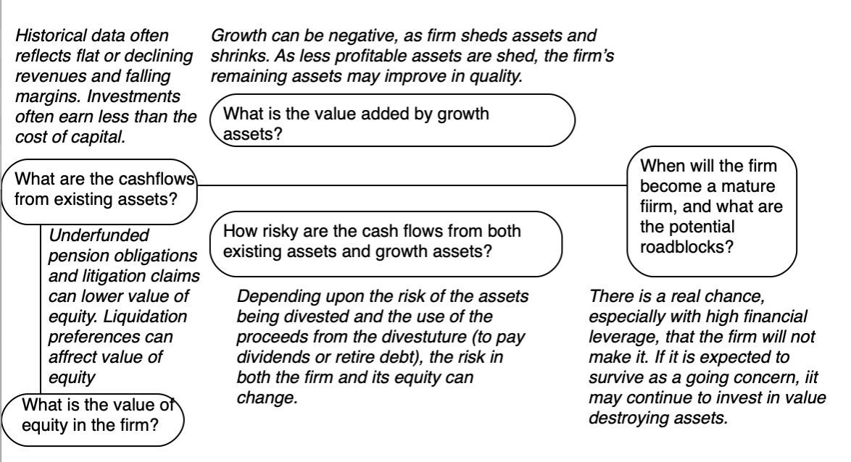
Declining firm valuation: summarizing the issues

Slide 7
VALUATION REPONSES:
1. TELL A STORY
The valuation of a declining company starts with a story, albeit one that reflects the realities that the company faces. That will include a shrinking market for its products and services, increased competition for what’s left of the market and worries about survival.
The starting point for your story must be with a diagnosis of what it is that is causing the company’s market or revenues to shrink, which can range from social or health costs (tobacco) to an aging market to disruption from outside.
Your story also should incorporate your expectations about how the management at a declining firm will respond.
  The first, and perhaps most frequent one, is denial, where management refuses to face up to decline, attributing any symptoms of operating malaise (k.
  The second is desperation, where management tries everything it can to reverse decline, including acquiring growth companies in other businesses and investing in the disruptive technologies that caused their decline in the first place.
  The third is acceptance, where managers accept their standing in the life cycle, and adopt corporate financial policies that reflect that standing.
  The fourth is reinvention, where managers uncover the core competencies and competitive advantages that allowed their firms to succeed in the first place and use them to create new business models or enter new markets, thus opening the doors to fresh leases on corporate life.

Slide 8
2. THE 3P TEST
When valuing declining companies, listening to management stories about what they plan to do with these companies, can easily lead to fairy tales.
It is your job to assess whether a turnaround plan, as presented by management, is a fairy tale or plausible, and if plausible, whether the management team in place is the one that can deliver on its probable outcomes. In making this assessment, there are at least three factors that come into play:
  Company-specific versus Sector problems: Generally, it is easier to map and deliver turnaround strategies for the company-specific decline, rather than for macro- or sector-wide decline
  Competitive actions: It is easier to map a turnaround plan, when a few companies are in decline, but most in the sector are healthy, than it is to map turnaround plans, when most companies in a sector are fighting decline at the same time.
  Management history and capabilities: If you believe that a turnaround plan is plausible, you still must assess whether the company has the management in place and the resources (capital, infrastructure, personnel), that it needs, to execute the plan.

Slide 9
3. STORY TO INPUTS
 | Expected Management Response to Declining Business
 | Denial | Desperation | Acceptance | Reinvention
Revenue Growth | Negative | Positive blips from acquisitions or investments | Negative | Positive, but may take time to unfold
Profitability | Long-term decline | May see short term boosts but will fade to long-term decline. | Short-term decline, then stability | Decline in near-term but increase over time to reflect new business margins.
Reinvestment | Continue with status quo, in existing business | Significant and unpredictable reinvestment (acquisitions) | Negative (divestitures) | Negative, in existing business, but positive in new business(es)
Risk | Stable operating risk + Increased failure risk | Volatile operating risk + Increased failure risk | Stable operating risk + Stable failure risk | Melded operating risk, to reflect new business entered.

Slide 10
4. Value the business
For management in denial, a combination of shrinking revenues and declining margins, in the long term, will cause long term declines in earnings and cash flows, pushing the company either into distress (where equity will be worth nothing) or into a terminal value, as a bad business, where equity will be worth very little.
For management in acceptance, revenues will shrink, and margins will compress in the short term, before stabilizing into a steady state terminal value, reflective of a smaller, but healthier, company or into a liquidation value, if that yields a higher payoff.
For management in desperation, there is no predictable pattern to earnings and cash flows, but whatever benefits to value that may accrue from temporary surges in growth or profitability, usually from acquisitions, will fade, and over time, be more than offset by the cost of the reinvestment needed to deliver that surge, creating value destruction on steroids.
For management intent on reinvention, there will be no short-term reprieve from shrinking revenues and margin pressure, but to the extent that the reinvention works, the firm’s revenue growth, margins and reinvestment, will change over time to incorporate the effects of the new business or market entered.

Slide 11
5. Keep the feedback loop open
If you are assuming a management in denial, in your valuation, a change in top management, a reconstruction of the board of directors or a new CEO will comprise a break from the past, and should lead to a reassessment, though you will have to decide which path the new management will be taking.
If you have valued a company on the presumption that it is run by desperate managers, chasing growth at any cost, the entry of activist investors into the shareholder ranks creates the possibility of push back, and perhaps even change at the company.
If your valuation of a declining company is built on the assumption that managers will follow a sensible path, either by accepting decline as an inevitable and working within its limits, or by reinventing the firm, by pushing into new businesses or market, there is always a chance, given that these can both take a long time to unfold, that investors don’t have the faith to hold on, and that these paths will be abandoned before they have a chance to deliver results.

Slide 12
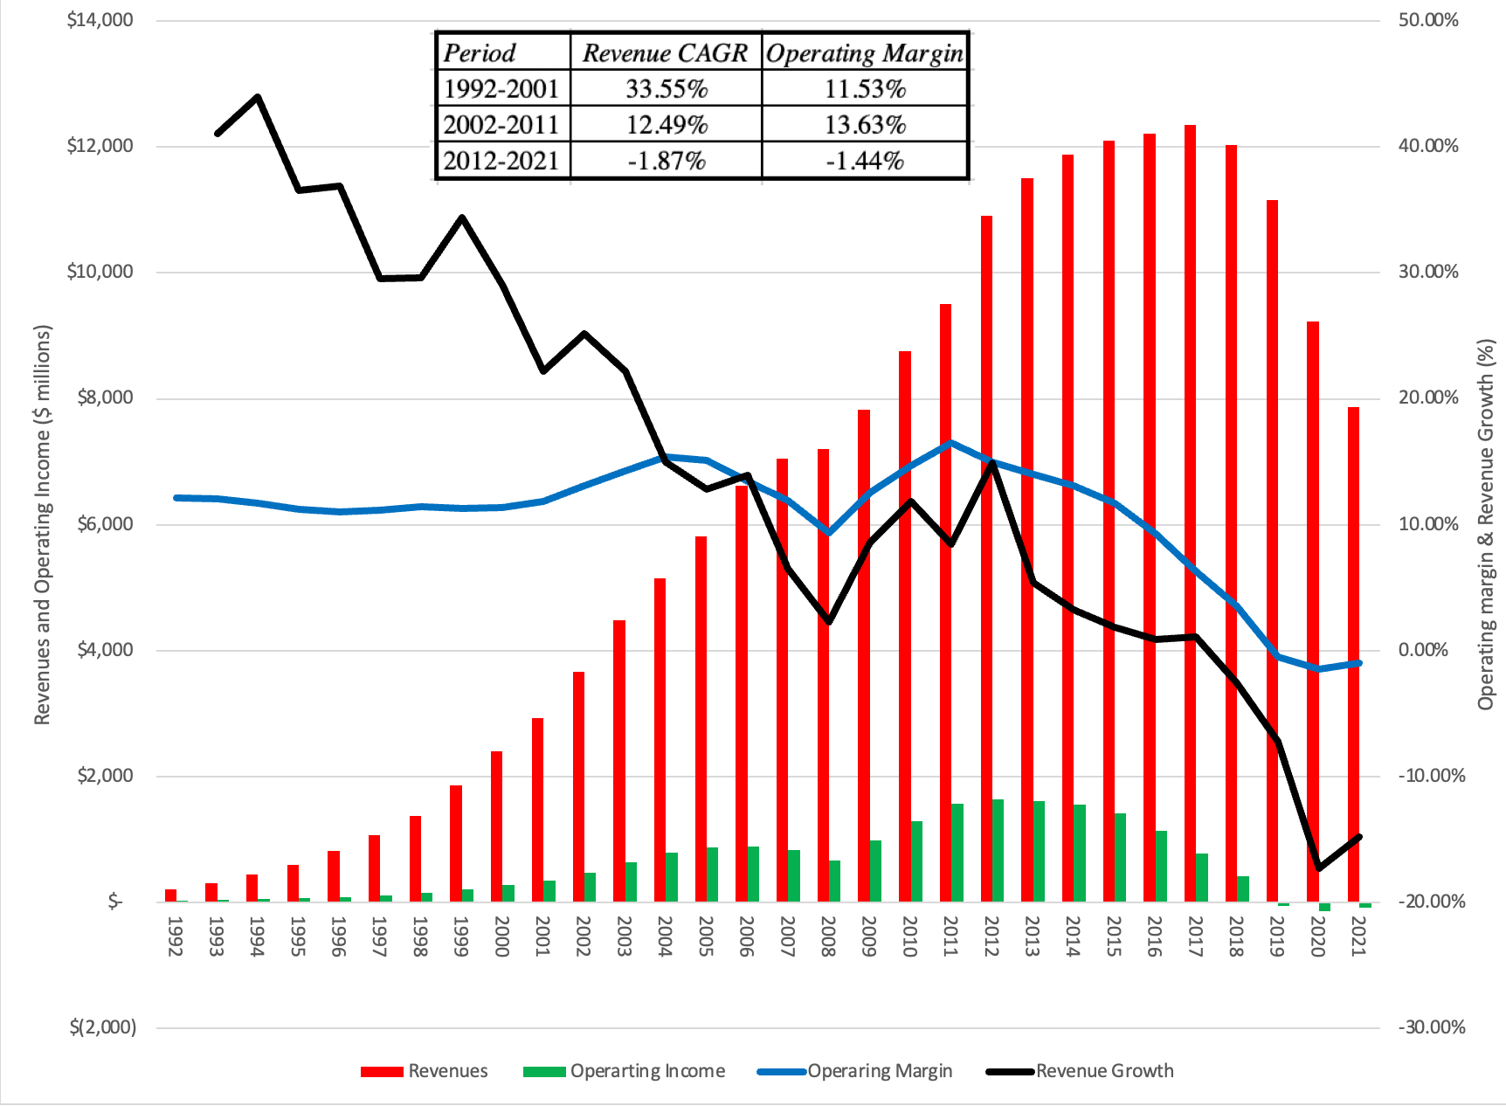
Valuing a Declining firm: Bed, Bath & Beyond

Slide 13
My BB&B story
Revenue Growth/Levels: We will assume a 10% drop in revenues in year 1, followed by 5% drops every year in the following four years, and a gradual come back to positive growth only in year 9.
Operating Margins: We will assume that the operating margins at these remaining stores will converge on the average margin across US retailers of 5.54%, well below the double-digit margins enjoyed by BB&B stores in their heyday.
Reinvestment: Since we are assuming that the company will shrink, there will be no new reinvestment. Instead, there will be cash flows from the divestitures and store shutdowns that augment operating cash flows and be available for return to shareholders or paying down debt.
Risk: As the company shuts stores, we assume that the lease debt for the firm will decline, and as the company returns to profitability, it will be able to reduce its debt burden to manageable levels. Given that it is being rated at well below junk, though, there remains a significant chance of failure, which we estimate to be 23.74%, based upon its current (Moody’s) bond rating of B1.
Steady State/Stable Growth: In our story, we do see a soft landing for BB&B, assuming it makes through the next decade, where it will be able to find a niche market, as a smaller business, where it can maintain stable growth, while earnings a return on invested capital close to the average for mature retail firms.

Slide 14
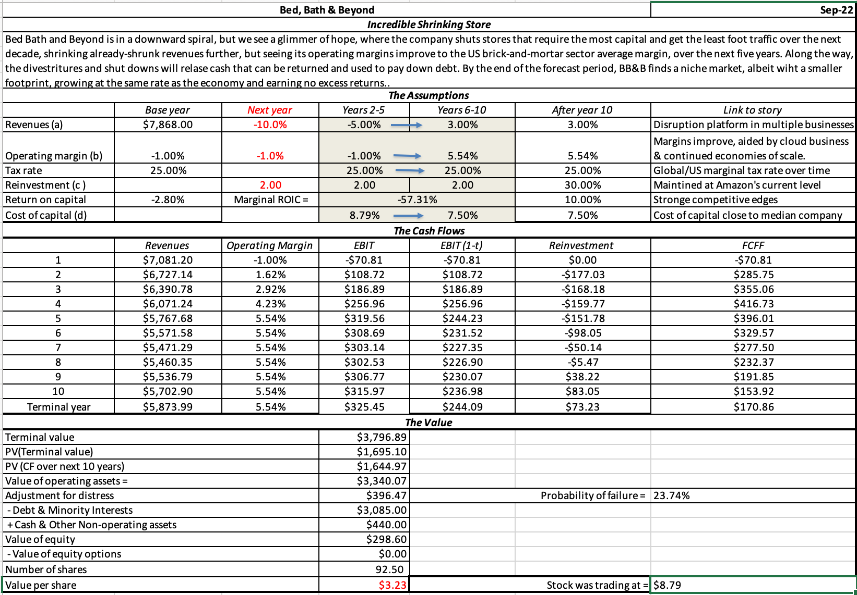
My BB&B value…

Slide 15
Pricing declining firms - challenges
If these companies are outliers in their sectors (they are declining companies in sectors with primarily healthy companies), the results of this pricing will be predictable.
  The declining company will look cheap, because it will trade at lower multiples than the rest of the sector.
  To make a legitimate comparison, we must examine differences in risk, revenue growth, and expected profitability over time.
If the entire sector is declining, you must control for the degree of decline across companies.
With forward pricing metrics, the problems shift to the distress issue. This works only if you assume that good health is guaranteed and that there is no chance of default.
If, as many do, you use book value of assets as a proxy for their liquidation value, you should not be surprised again to see declining companies look like bargains. In a declining business, buyers will be unwilling to pay book value for assets, as liquidation value, given the poor underlying business economics.

Slide 16
Pricing declining companies – Pricing metric
Book Value: For declining companies that have built large tangible asset bases, it does make sense to scale their market values, representing what investors estimate it to be worth, to their book values, indicating what accountants estimate the company has invested in its asset.
Replacement Cost: In a variant of the first approach, you can estimate what it would cost someone to replicate the existing assets of the business, in a replacement cost measure, and scale the enterprise value to this replacement cost.
Forward Operating Numbers: There is a third option, and this should be a familiar one since we also used it with start-ups and high growth companies, where rather than scale the market values of declining companies to current operating numbers, you scale them to your future estimates of them. This approach can be useful, if you believe that a declining firm can stabilize or turn around its operations, and that market is pricing in the expectation that it will.

Slide 17
Pricing declining firms – peer group
Other declining companies: To value a distressed firm, you may be able to find a group of declining and/or distressed firms in the same business and look at how much the market is willing to pay for them. Although this approach has promise, it works only if many firms in a sector slip into financial trouble at the same time. In addition, by categorizing firms as declining or not, you run the risk of lumping together firms that are declining to different degrees, with distress adding a wild card to the mix.
Healthy companies in the sector: If you have a firm that is declining and/or distressed in a sector filled with healthy companies, you have no choice but to create a peer group of companies that are in much better operating and financial shape than your company.
  On the surface, your company will look cheap, using revenue earnings or book value multiples, relative to the peer group, but that is because of differences in financial health across these companies.
  Consequently, you should also collect the data on these operating metrics, including revenue growth, profitability and reinvestment, for all of the companies in the peer group, since you will need to control for differences.

Slide 18
And controlling for differences…
Operating performance: Shrinking revenues and compressing operating margins will knock down the market pricing of a company. At the minimum, you must consider how differences in revenue growth and operating margins play out in the pricing of companies in the peer group.
Distress: Declining companies are more likely to be exposed to distress risk than healthy companies, and since distress leads to forced liquidations and bad outcomes for equity investors, you would expect the pricing to reflect that.
Management: To the extent that market participants are factoring in management response, the pricing should be lower for declining companies with management in denial than management in acceptance, and for companies with desperate than with purposeful management.

Slide 19
Pricing BB&B
 | Market Cap | EV | PE | EV /Sales | Revenue Growth (next 2 years) | Operating Margin
Average |  |  | 11.70 | 1.26 | 5.98% | 8.69%
First Quartile |  |  | 5.13 | 0.60 | 0.67% | 5.42%
Median |  |  | 7.25 | 0.97 | 3.85% | 8.22%
Third Quartile |  |  | 17.22 | 1.74 | 9.78% | 12.03%
Bed Bath & Beyond | $698 | $3,867 | NA | 0.52 | -12.70% | -5.24%

Slide 20
Add-ons and addendums:
1. Aggregated vs disaggregated
One of the features of discounted cash flow valuation is that it is additive. In other words, if you have to value a company in three businesses, you can either value the combined company, by adding up its cash flows across the three businesses and discounting at a discount rate that is a value-weighted average across the business, or you can value each of the three businesses, using the cash flows and discount rate of that business in the valuation, and add up those values. In theory, at least, you should get the same value for the company doing either.
We will term the first aggregated valuation and the second disaggregated valuation and explore the differences. If your exposure in valuation has always been to aggregated valuations, there are two reasons why it is the dominant approach.
  As investors, we invest in entire companies, not in their disaggregated parts.
  Most information disclosure is on an aggregated business, with GE and Coca Cola’s reporting full financial statements (income statements, balance sheets and statement of cash flows) for the entire companies.

Slide 21
Reasons for SOTP valuation
Fundamental Differences: With multi-business companies and multinationals, one advantage of valuing each business or geographic segment separately is that you can then assign different risk, cash flow and growth profiles to each one rather than trying to create one weighted profile for the whole company.
Growth Differences: If some businesses and geographic segments are growing much more quickly than others within the same company, it becomes difficult to do an aggregated valuation that reflects these different growth rates. For instance, a bottom-up beta that represents a weighted average of the businesses that a company is in, will have to change over time, if some businesses grow more than others.
Transactional Reasons: In some cases, you will need to value a portion of a company, rather than an entire company, because that portion will be sold or spun off and requires a value specific to it. This need becomes acute when you are valuing a company that is on the verge of being broken up into parts.
Management Reasons: Within a company, it makes sense to value each part of the business separately, both to monitor the performance of different divisional managers but also to improve that performance.

Slide 22
SOTP Valuation
Step | Company Valuation | SOTP Valuation
Tell a story | A story for the entire company, based on its mix of operations and management in place. | A story for each “part’ of the company, based upon that part’s operations and a stand-alone management of that part.
The 3P Test | Check the company’s story to ensure it is possible, plausible & probable | Check each part’s story to ensure it is possible, plausible & probable.
Valuation of the company | Convert story to valuation inputs for the company and use those inputs to estimate the value of the entire firm | Convert story to valuation inputs for each part of the company and use those inputs to value that part. Sum up the valuations of the parts and net out the value drag from unallocated costs.
Equity Value | Add cash and cross holdings & net out debt | Add cash and cross holdings & net out debt

Slide 23
SOTP Pricing
Step | Company Pricing | SOTP Pricing
Pick a pricing multiple | Pick a scalar (revenues, earnings etc.) for the price and estimate the pricing multiples for the company. | Pick a scalar (revenues, earnings etc.) for each part of the company, preserving the freedom to pick different scalars for different parts.
Find a peer group | Find other publicly traded companies that are “like” your company on valuation fundamentals (risk, growth, cashflows) | For each part of your company, find other publicly traded companies that are “like that “part”, on valuation fundamentals (risk, growth, cashflows)
Control for differences | Control for differences between your company & the peer group companies on the fundamentals. | Control for differences between the part of the company you are pricing, and the peer group for that part on fundamentals.
Price the company | Apply the peer-based pricing to your scalar to price the company | Apply the peer-based pricing to the scalar chosen to price each part, aggregate the pricing across the parts.

Slide 24
2. Liquidation valuation/ pricing
If you are then wondering why a liquidation pricing would yield a different number for a company than a conventional pricing, where you price the overall company, relative to its peer group, there are three major reasons.
  When a company’s going concern value comes under threat, it is possible that the collective proceeds you receive from selling individual assets to the highest bidder will be higher.
  The second is that a liquidation, especially if forced (because of debt coming due or distress concerns) will often result in discounted prices, as potential buyers recognize your immediate need for cash and extract bargain prices.
  The third is that a liquidation can create tax consequences for a company, especially when older assets that have low or even negligible book values are sold.
For most healthy firms, the going-concern value will trump liquidation value.

Slide 25
Liquidation valuation challenges
Estimating liquidation value is complicated when the assets of the firm have business entanglements, and thus cannot be valued individually.
Furthermore, the likelihood that assets will fetch their fair market value will decrease as the urgency of the liquidation increases.
  A firm in a hurry to liquidate its assets may have to accept a discount on fair market value as a price for speedy execution.
  As a note of caution, it is almost never appropriate to treat the book value of the assets as the liquidation value.

Slide 26
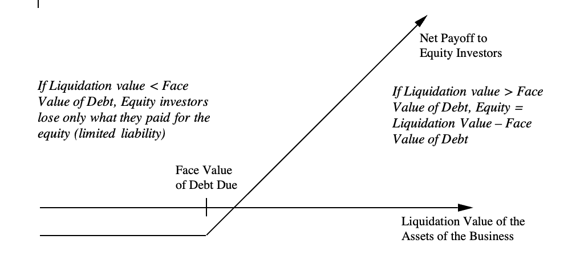
Distressed equity as an option

Slide 27
With implications…
Basket Case Equities: While a money-losing, indebted firm will be viewed as troubled by investors, accountants, and analysts, its equity is not worthless. In fact, just as deep out-of-the-money traded options command value because of the possibility that the value of the underlying asset may increase above the strike price in the remaining lifetime of the option, equity commands value because of the time premium on the option (the time until the bonds mature and come due) and the possibility that the value of the assets may increase above the face value of the bonds before they come due.
Risk becomes an ally: When a business becomes distressed enough that its equity becomes an option, risk works to your benefit for a simple and intuitive reason.
Debt/Equity Agency Issues: The equity-as-option view can also help understand why equity investors and lenders can diverge on how best to run a business, and that divergence will get worse as a company’s operations deteriorate and it borrows more.

