Slide 1



Investment philosophies 101

Slide 2
What is an investment philosophy?
An investment philosophy is a coherent way of thinking about markets, how they work (and sometimes do not) and the types of mistakes that you believe consistently underlie investor behavior.
Why do we need to make assumptions about investor mistakes? Most active investment strategies are designed to take advantage of errors made by some or all investors in pricing stocks.
Those mistakes themselves are driven by far more basic assumptions about human behavior, and that behavior plays out as market mistakes that you hope to exploit for profits.

Slide 3
Step 1: Human Behavior or misbehavior
Individual versus Group Misbehavior: If investor mistakes arise from individualized irrationalities, there is a much greater chance that they will average out across all investors.
Learning-related mistakes: In a rational market, the learning occurs almost instantaneously, albeit with error, but if markets learn slowly, they will make pricing errors during the period, though there is disagreement about whether they will overshoot or undershoot.
Reaction to information: When a company reports earnings or announces its intent to acquire another firm, investors have to make judgments about how this information will affect the company’s future earnings and risk and reprice its shares, and there are two contrasting views of how they may miss. In the first, they overreact to news announcements, pushing up prices too much on good news and down too much on bad news. In the second, they underreact to news announcements, pushing up prices too little on good news and down behavetoo little on bad news
Dealing with uncertainty: Uncertainty is part and parcel of business and investing, but investors often cope with it in unhealthy (and irrational) ways. Some go into denial, some get paralyzed, and some choose avoidance, completely removing investments with too much uncertainty from their choice sets.
Framing: Kahneman and Tversky, pioneers in the behavioral finance field, noted that investors are prone to weight losses more than equivalent gains, when investing, in what they framed loss aversion, and argued that it explained why they tend to hold on to losing investments too long.

Slide 4
Step 2: Market mistakes
Unless market misbehavior shows up as a mispricing in the market that you can exploit, it cannot be the basis for an investment philosophy. In this second step of developing an investment philosophy, you must expand on how the misbehavior that you believe characterizes markets will play out as market mispricing.
To exploit mispricing in most markets, that mispricing to be corrected, and to develop an investment philosophy that has coherence, you need to have beliefs about both why and when the correction must happen.
While all active investment philosophies assume that markets make mistakes, they differ in their views on what parts of the market the inefficiencies are most likely to show up and how long they will last.
  Some investment philosophies assume that markets are correct most of the time but that they overreact when new and large pieces of information are released about individual firms – they go up too much on good news and down too much on bad news.
  Other investment philosophies are founded on the belief that markets can make mistakes in the aggregate – the entire market can be under or overvalued – and that some investors (mutual fund managers, for example) are more likely to make these mistakes than others. Still other investment philosophies may assume that while markets do a go
  Markets do a good job of pricing stocks where there is a substantial amount of information – financial statements, analyst reports and financial press coverage –they systematically misprice stocks on which such information is not available.

Slide 5
Step 3: Develop investment tactics/ strategies
Once you have an investment philosophy in place, you develop investment strategies that build on the core philosophy.
Consider, for instance, the views on market overreaction where you have two investors who believe that market overreact, but one believes that it is more likely on company-specific information and the other that it occurs more frequently with macroeconomic news stories.
  The first investor, who believes that markets overreact to news, may develop a strategy of buying stocks after large negative earnings surprises (where the announced earnings come in well below expectations) and selling stocks after positive earnings surprises.
  The second investor who believes that markets make mistakes in response to macroeconomic news stories, will buy (sell) stocks (perhaps even the entire index) right after unexpectedly bad (good) macroeconomic news.
It is worth noting that the same investment philosophy can spawn multiple investment strategies.

Slide 6
Step 4: A Test of fit
In the abstract, you could look at investment philosophies and pick the one that has delivered the most winners in the past, and make it your own, and that is what many choose to do.
They also tend to find, very quickly, that past success notwithstanding, the “winning” philosophy does not deliver the returns that they thought that it would.
  One reason for that is that for each philosophy, success will require not just a blind replication of methods but a set of personal characteristics and capital access that you do not have.
  There is no one “best” investment philosophy that that fits all investors, but there is an investment philosophy that best fits you.

Slide 7
Why do you need an investment philosophy?
In the absence of an investment philosophy, you will tend to shift from strategy to strategy simply based upon a strong sales pitch from a proponent or perceived recent success. There are three negative consequences for your portfolio:
  Lacking a rudder or a core set of beliefs, you will be easy prey for charlatans and pretenders, with each one claiming to have found the magic strategy that beats the market.
  As you switch from strategy to strategy, you will have to change your portfolio, resulting in high transactions costs and you will pay more in taxes.
  While there may be strategies that do work for some investors, they may not be appropriate for you, given your objectives, risk aversion and personal characteristics. In addition to having a portfolio that under performs the market, you are likely to find yourself with an ulcer or worse.
With a strong sense of core beliefs, you will have far more control over your destiny.

Slide 8
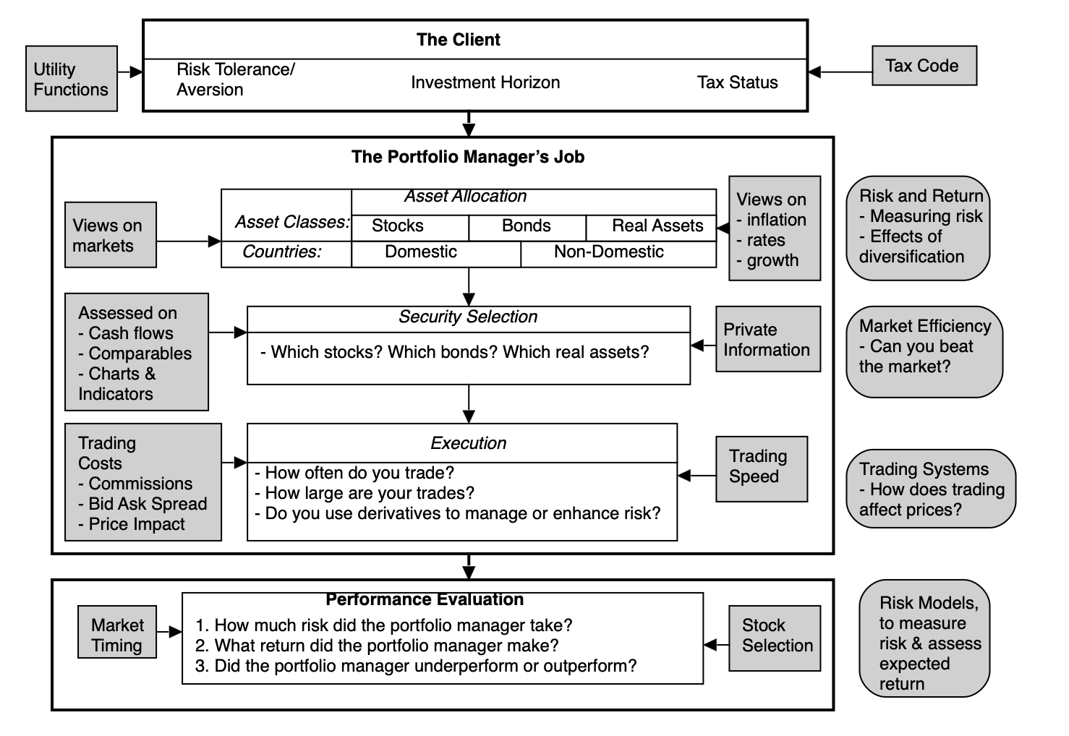
The Investment process

Slide 9
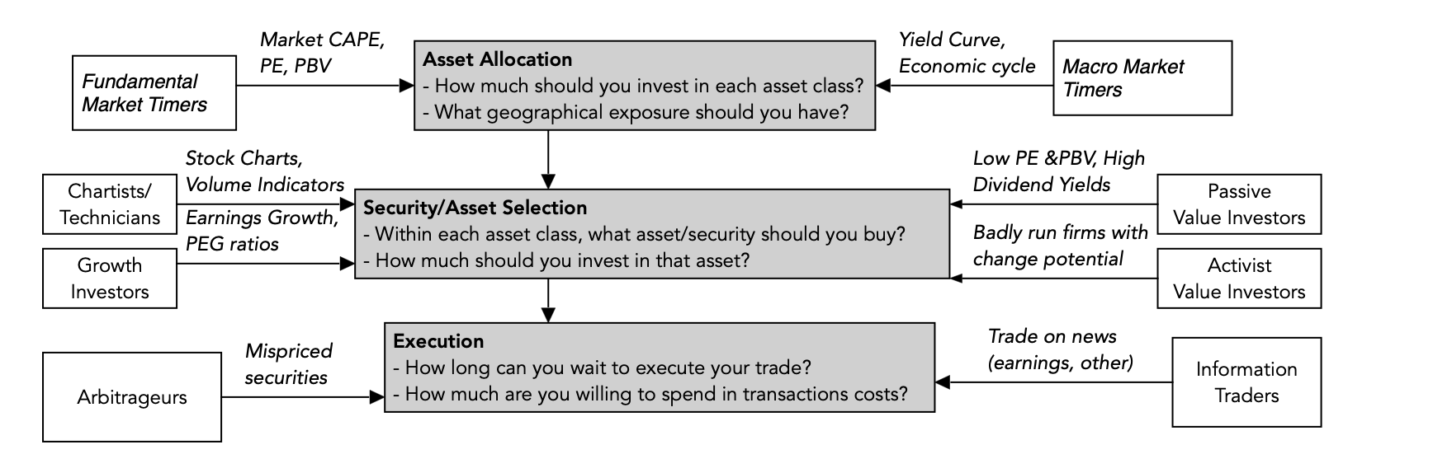
Investment philosophies in the processs

Slide 10
Market timing vs stock/Asset selection
The broadest categorization of investment philosophies is on whether they are based upon timing overall markets or finding individual assets that are mispriced.
Within each, though, are numerous strands that take very different views about markets.
While the overall market goes through up and down cycles, and all stocks are impacted, it turns out that the cycle effect varies for companies at different stages in the life cycle.
  Generally, when the market is buoyant, and investors are seeking out risky investments, young companies benefit the most, since they are the riskiest and most in need of capital.
  Conversely, when markets are down, and risk capital moves to the sidelines, it is more mature companies that hold their value better, as investors are drawn to safety.
  If you are a good market timer, you can magnify the benefits of timing by also shifting your holdings from older to younger companies, ahead of up markets and from younger back to more mature companies, if you expect a down market.

Slide 11
Investing vs trading
 | The Pricing Game | The Value Game
Underlying philosophy | The price is the only real number that you can act on. No one knows what the value of an asset is and estimating it is of little use. | Every asset has a fair or true value. You can estimate that value, albeit with error, and price must converge on value (eventually).
To play the game | You try to guess which direction the price will move in the next period(s) and trade ahead of the movement. To win the game, you must be right more often than wrong about direction and to exit before the winds shift. | You try to estimate the value of an asset, and if it is under(over) value, you buy (sell) the asset. To win the game, you must be right about value (for the most part) and the market price has to move to that value
Key drivers | Price is determined by demand & supply, which in turn are affected by mood and momentum. | Value is determined by cash flows, growth and risk.
Information effect | Incremental information (news, stories, rumors) that shifts the mood will move the price, even if it has no real consequences for long term value. | Only information that alter cash flows, growth and risk in a material way can affect value.
Tools of the game | 1. Technical indicators 2. Price charts 3. Multiples & Comparable firms 4. Investor psychology | 1. Ratio analysis 2. DCF valuation 3. Excess Return models
Time horizon | Can be very short term (minutes) to mildly short term (weeks, months). | Long term
Key skill | Be able to gauge market mood/momentum shifts earlier than the rest of the market. | Be able to “value” assets, given uncertainty.
Key personality traits | 1. Market amnesia 2. Quick acting 3. Gambling instincts | 1. Faith in “value” 2. Patience 3. Immunity from peer pressure
Biggest Danger(s) | Momentum shifts can occur quickly, wiping out months of profits in a few hours. | The price may not converge on value, even if your value is “right”.
Added bonus | Capacity to move prices (with lots of money and lots of followers). | Can provide the catalyst that can move price to value.
Most Delusional Player | A trader who thinks he is trading based on value. | A value investor who thinks he can reason with markets.

Slide 12
And link to life cycle
It is true that there are both traders and investors in companies at every stage of the life cycle, but the mix will shift, as companies age.
  We argued that it is easier to both price and value mature companies, relative to young companies.
  With young companies, with uncertainty running rampant on every dimension of the business model and with little historical data, there are few who are willing to even trying valuing companies, leaving the arena almost entirely to traders.
  As companies mature, and uncertainty lessens, investors are more likely to be enter the process, and traders may leave, as volatility in stock prices drop and trading opportunities decrease.

Slide 13
Trading on momentum
Research on past prices, especially from the equity markets, is supportive of price patterns, albeit contradictory findings:
  If you define the short term as ranging from minutes to hours to even a few days, there is evidence of mild positive correlation, with prices continuing to move in the same direction. Extending the short term to weeks, rather than days, there seems to be some evidence that prices reverse.
  In the medium term, defined as months or even a year, rather than a single month, there seems to be a tendency towards positive serial correlation...
  When long term is defined in terms of many years, there is substantial negative correlation in returns, suggesting that markets reverse themselves over very long periods
In the middle of the last decade, high frequency trading, where institutional investors used powerful computers and timely data to make very large trades, enjoyed a moment in the limelight.

Slide 14
Link to life cycle
Almost all the market activity in young companies comes from traders, rather than investors, we would expect momentum, if it exists, to be stronger at young companies, than at mature firms, and reversals, when they happen, to be more drastic as well.
Thus, the price swings that you see at young companies is not just a reflection of the underlying business uncertainties at these companies but is magnified by the dominance of traders in these firms.
The push and pull between momentum (positive correlation) and reversal (negative correlation) across time horizons also provides an explanation for why price-based trading is never monolithic.

Slide 15
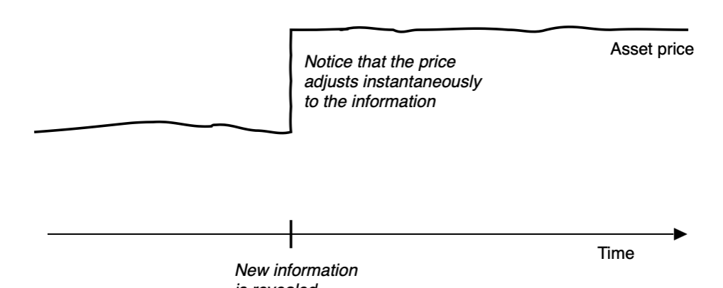
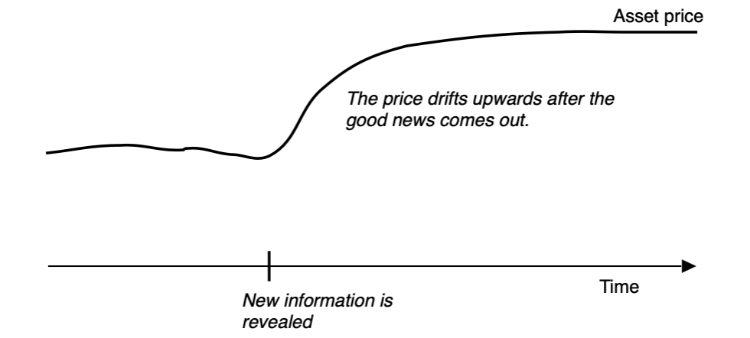
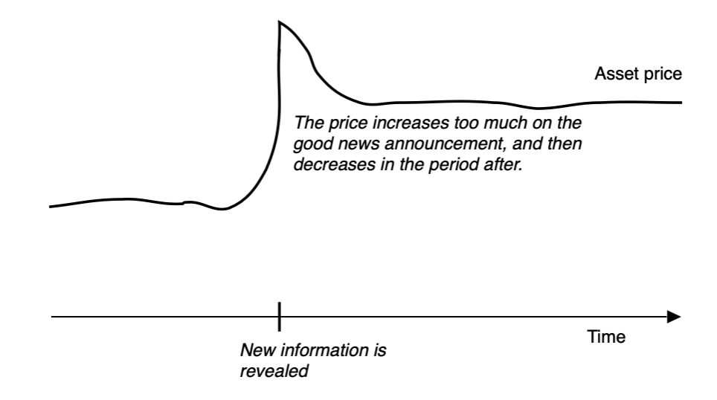
Trading on information

Slide 16
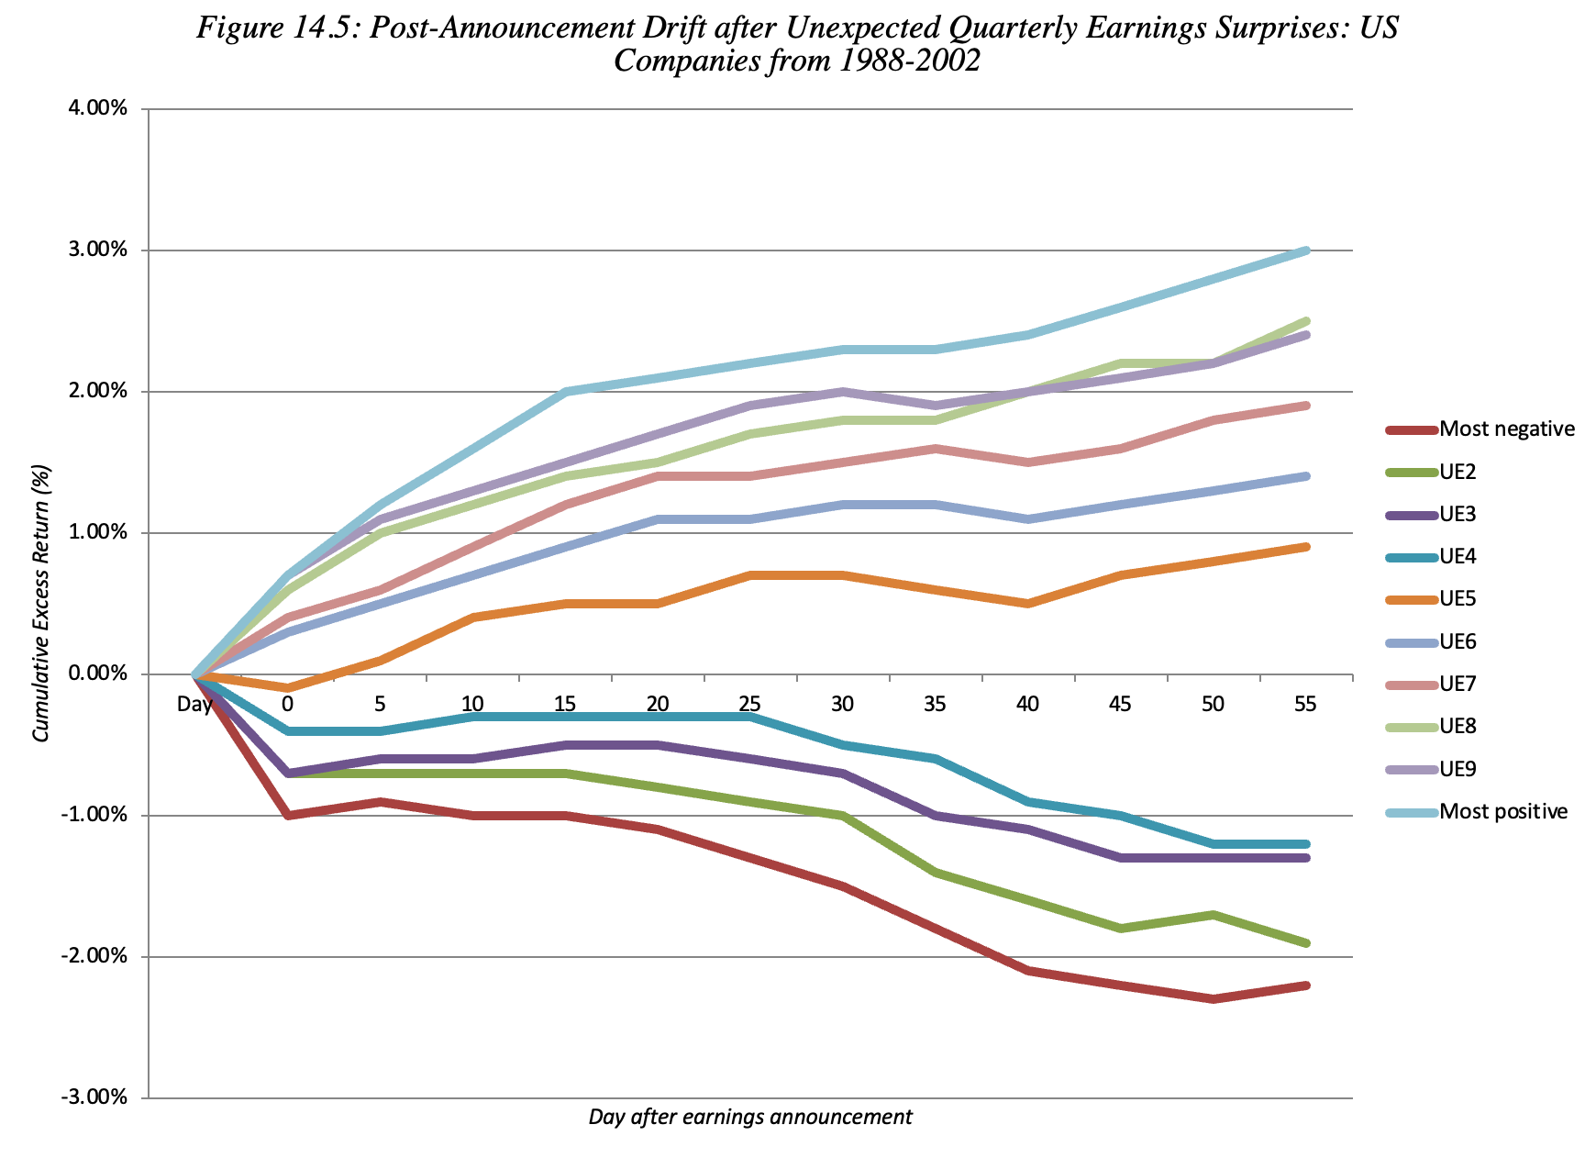
An example: Earnings announcements

Slide 17
Link to life cycle
We would argue that the market learning mistakes that we observe across all companies can be greater at young businesses, than at their mature counterparts.
  Studies of the market reaction to earnings reports note that the post-announcement drift is greater at small firms, rather than at large firms, at firms where there is greater uncertainty about future earnings and at firms where institutional investors hold a smaller percent of the shares.
  Though it is may be coincidental, young firms tend to have smaller market capitalization, have greater uncertainty about future earnings and are less held by institutions.

Slide 18
Arbitrage trading
In pure arbitrage, you risk nothing and earn more than the riskless rate. For pure arbitrage to be feasible, you need two assets with identical cashflows, different market values at the same point in time and a given point in time in the future at which the values must converge.
In near arbitrage, where you have assets that have identical or almost identical cash flows, trading at different prices, but there is no guarantee that the prices will converge and there exist significant constraints on forcing convergence.
In speculative arbitrage, which is not arbitrage in the first place. Here, investors take advantage of what they see as mispriced and similar (though not identical) assets, buying the cheaper one and selling the more expensive one.

Slide 19
Arbitrage challenges
Not quite identical:. In practice, though, many settle for close or very similar, rather than identical, and while the differences between the investments may be small, they can still explain price differences.
Non-tradability: To lock in profits from arbitrage on two investments that you believe are identical, but are listed at different prices, you must be able to trade both investments.
Trading Costs: In a related challenge, there are some arbitrage opportunities, where identical assets trade at different prices, where the costs of trading on the differences, including transactions costs and price impact, are large enough to overwhelm the observed price difference.

Slide 20
Link to life cycle
Arbitrage opportunities are more likely to be available at companies in the earlier stages of the life cycle and in decline.
  For companies at the earlier stages in the life cycle, pricing errors may come from the investors who are drawn to these companies, their low profile and the markets they trade in.
  For companies at the other end of the life cycle, you are more likely to find pricing errors across different securities issued by declining firms, and mispricing across securities.
While the lower profiles and lighter liquidity at younger firms make arbitrage opportunities more likely to show up on their traded securities, the higher transactions costs (bid ask spreads and price impact) that you face in trading these securities may also mean that you will find it more difficult to convert these opportunities to profits.
To the extent that some investors can create cost or information advantages over the rest of the market, on these stocks, they may be able to still find ways to generate arbitrage profits.

Slide 21
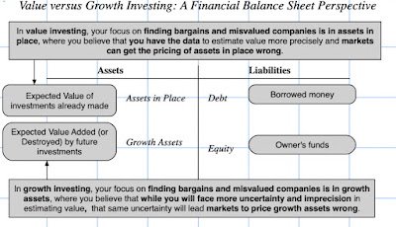
Investing: Value vs Growth
This distinction also connects which of these two philosophies, that you adhere to, directly to the corporate life cycle, with value investors drawn to mature companies, which derive much or all of their value from assets in place, and growth investors to younger companies, where the bulk of the value comes from growth assets.

Slide 22
Activist vs Passive investing
In a passive strategy, you invest in a stock or company and wait for your investment to pay off. Assuming that your strategy is successful, this will come from the market recognizing and correcting a mis valuation. In an activist strategy, you invest in a company and then try to change the way the company is run to make it more valuable.
There is a link between activism in investing and where a firm is in the life cycle.
  As we noted earlier, the venture capitalists in start-ups and very young companies are almost never passive investors, for many reasons.
  As companies mature, this activism will tend to fade, especially as the shareholder base for the company becomes more institutional and passive; most institutional investors who dislike how a firm is run tend to vote with their feet, i.e., sell their holdings and move on.
  As companies enter decline, you are likely to see activism pick up again, as investors try to alter their operating direction, and in some cases, buy them out and make the changes themselves, and in others, push them to liquidate or break up.

