Slide 1



Chapter 15: Investing in youth

Slide 2
Venture capital
For start-ups and very young companies, it is venture capitalists who help founders build these businesses, supplying capital in exchange for receiving shares of ownership in these companies.
  We noted that venture capitalists play a key role in the transition of idea businesses to successful money makers, but do they generate returns commensurate with the risk that they are exposed to in these investments?
We will argue that venture capitalists are more traders than investors, playing the pricing game, and then look at the winners and losers in that game.

Slide 3
VC: A Pricing game
Recent pricing of the same company: In the most limited version of this game, a prospective or existing investor in a private business looks at what investors in the most recent prior round have priced the company to gauge whether they are getting a reasonable price.
Pricing of “similar” private companies: In a slightly more expanded version of this process, you would look at what investors are paying for similar companies in the “same business”, with all the subjective judgments of what comprises “similar” and “same business”, scale this price to revenues, or lacking that, a common metric (users, subscribers, downloads etc. for that space), and price your company.
Pricing of public companies, with post-value adjustments: In the rare cases where a private business has enough operating substance today, in the form of revenues or even earnings, in a space where there are public companies, you could use the pricing of public companies as your basis for pricing private businesses.

Slide 4
With limitations
Small Samples: If your pricing is based upon other private company investments, your sample sizes will tend to be much smaller, if you are a VC than if you a public company investor.
With Infrequent Updating: The small sample problem is exacerbated by the fact that unlike public companies, where trading is frequent and prices get updated for most of the companies in our sample almost continuously, private company transactions are few and far between.
And Opaque Transactions: There is a third problem that makes VC pricing complicated. Unlike public equities, where shares of equity give you identical claims and the total market value is the share price times number of shares outstanding, extrapolating from a VC investment for a share in a company to the overall value of equity can be and often is complicated.

Slide 5
And Consequences
VC pricing estimates will have more noise (error) attached to them.
VC pricing will be more subjective, since you have the freedom to choose your comparable firms and often can use discretion to adjust for the infrequent data updating and the complexity of equity investments.
The pricing will lag the market. It is a well-established fact that the capital coming into the VC business ebbs and flows across time, with the number of transactions increasing in up markets and dropping in down markets.
Since VC pricing is based upon small samples with infrequent transactions, it is susceptible to feedback loops, where one badly priced transaction (in either direction) can trigger many more badly priced transactions. It does price spirals, if they occur, will be more pronounced in both directions.
Unlike public market investors, where the pricing game can be played in minutes or even fractions of a minute on liquid stocks, private market pricing requires patience and more of it, the younger a company is.

Slide 6
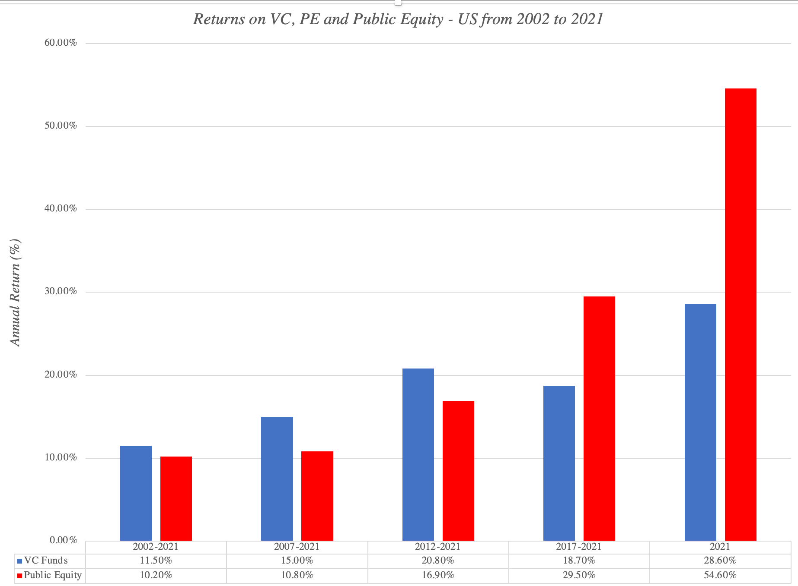
VC Returns, across investors

Slide 7
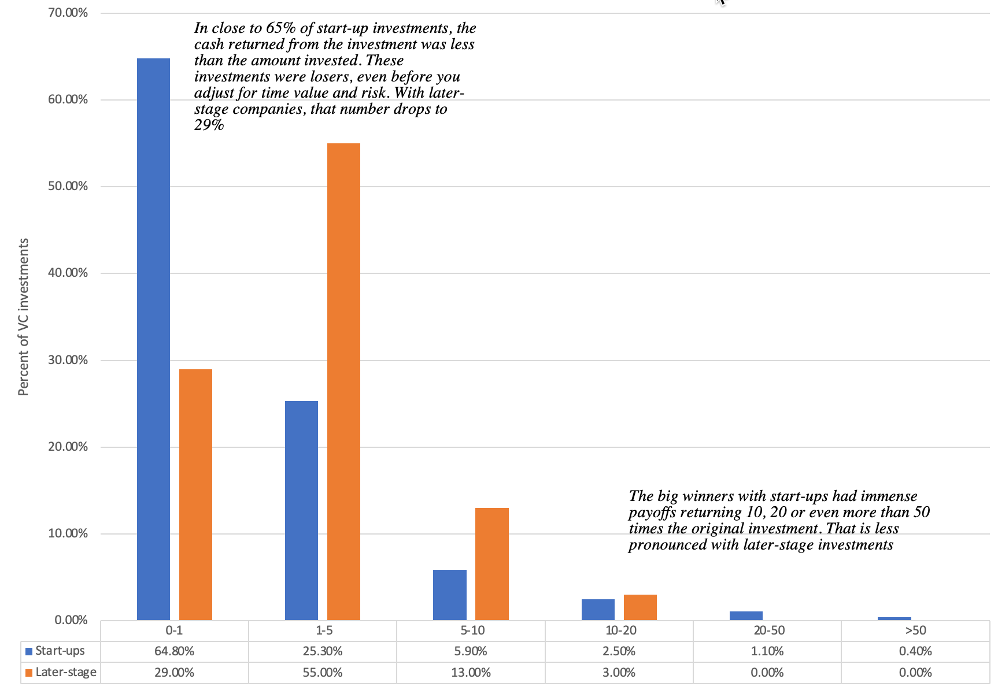
With skewed payoffs..

Slide 8
And more staying power
The most successful VCs not only earn higher returns than the top public market investors but that there is more consistency in the VC business, insofar as the best of the VCs are able to generate higher returns across longer time periods.
  That would suggest that venture capitalists bring more durable competitive advantages to the investing game than public market investors.
  That continuity can be explained by the most successful VCs being able to get better terms and getting invited to more transactions.

Slide 9
VC success characteristics
They are better at pricing (relatively): The price that you can attach to a VC investment can vary widely across investors and while all these prices are undoubtedly wrong (because they are estimates), some of them are less wrong than others.
They have more influence in the companies that they invest in: Venure capitalists can take a more active role in the companies that they invest in, from informally advising managers to more formal roles as board members, helping these companies decide what metrics to focus on, how to improve these metrics and how (and when) to cash in on them (from an IPO or a sale).
They have better timing: The pricing game is all about timing, and the VC pricing game is more emphatically so. To be successful, you not only have to time your entry into a business right but even more critically, time your exit from it.

Slide 10
Determinants of VC success
Good judges of narrative: If you are an investor in young companies, you not only have to be good at assessing founder stories, and passing them through the 3P test, but you much also craft your own narrative for the company, to drive your investment in it.
Good judges of managers/founders: In a young company, you are entirely reliant on the founder and management team to deliver on the valuation story, and what sets the very best venture capitalists apart is their capacity to gauge the capacity and trustworthiness of a founder to deliver on a story.
Protective of their investments as the firm grows: As the firm grows and attracts new investment, you as the venture capitalist will have to protect your share of the business from the demands of those who bring in fresh capital.
Good Assessors of failure risk: Most small private businesses fail, either because the products or services they offer do not find a ready audience or because of poor management. Good venture capitalists seem to have the capacity to find the combination of ideas and management that make success more likely, albeit not guaranteed.
Spread your bets: That said, the rate of failure will remain high among venture capital investments, making it critical that you spread your bets. The earlier the stage of financing – seed money, for example – the more important it is that you diversify.

Slide 11
Growth investing and trading: Public equities
Public market growth investors use proxies and screens to find high-growth stocks that are undervalued by the market.
  Some invest in initial public offerings, with the intent of capturing any excess returns associated with the stock going up after the offering.
  Others design investment strategies that seek to find companies that are expected to deliver the highest growth in revenues or earnings.
  Still others consider a more nuanced strategy of buying growth stocks, but only at a reasonable price.

Slide 12
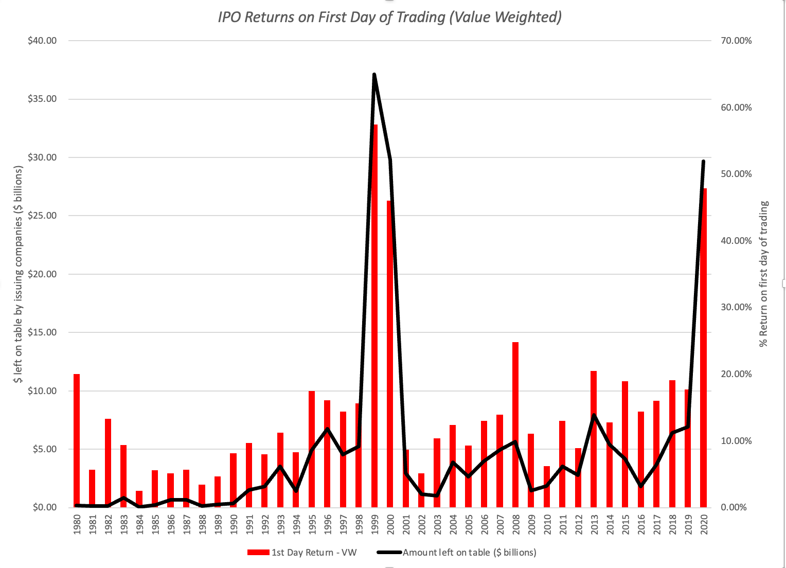
Initial public offerings: Offering day returns

Slide 13
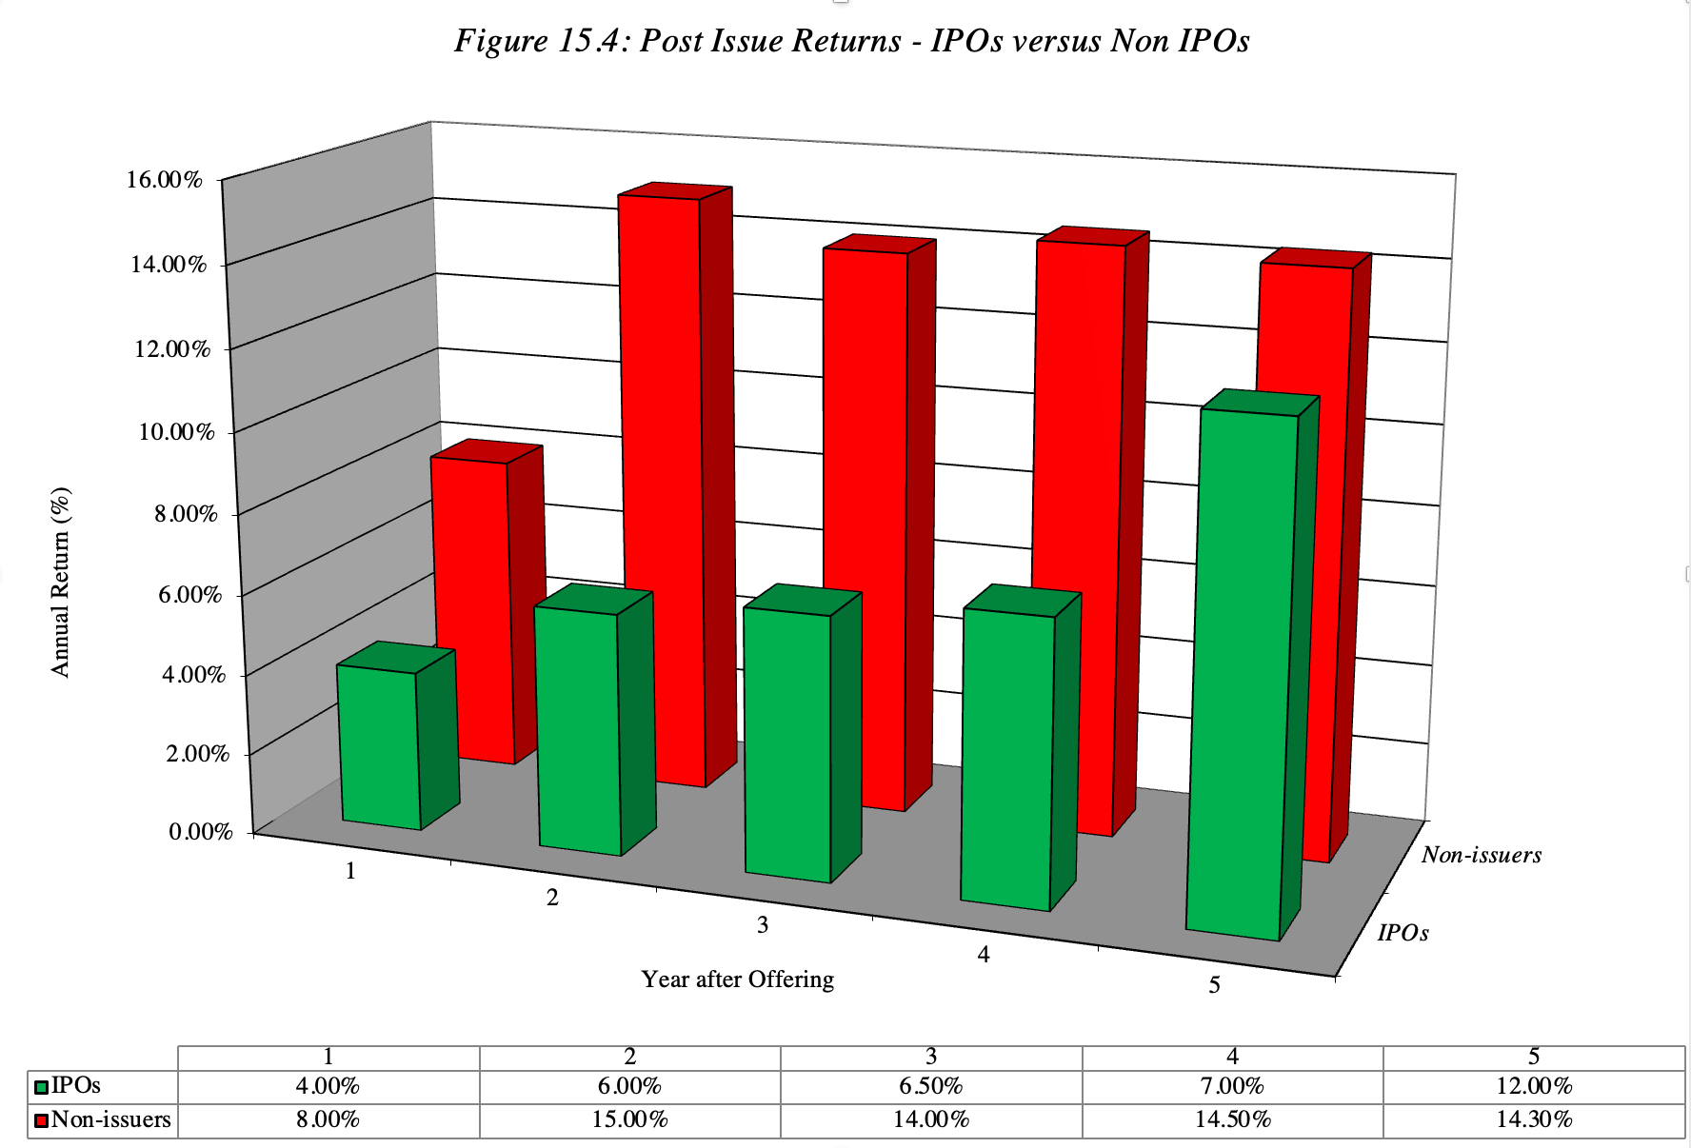
Post-IPO Returns

Slide 14
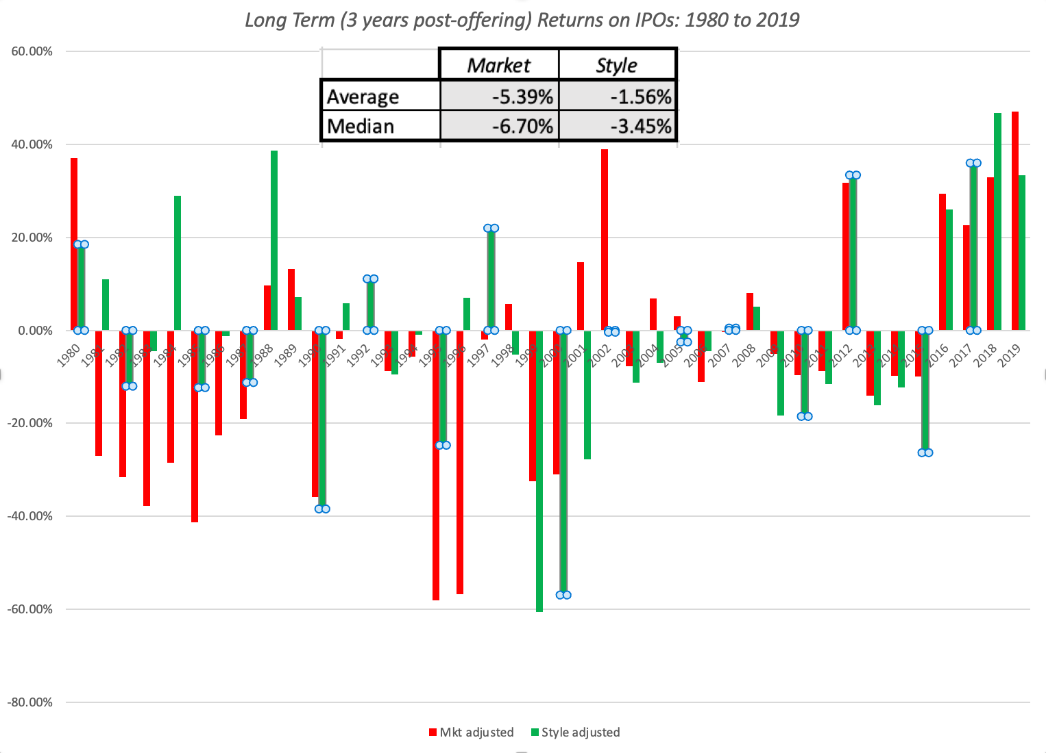
More on Post-ipo returns…

Slide 15
The IPO Bludgeon strategy
While there is substantial evidence that IPOs are, on average, underpriced at their offerings, the evidence on investors being able to take advantage of these pricing errors and frictions is much weaker.
When investors subscribe to initial public offerings, the number of shares that they are allotted will depend upon whether and by how much the offering is underpriced. Thus, your portfolio will be underweighted in underpriced initial public offering and overweighted in overpriced offerings.
Is there a way in which you can win this allotment game? There are two strategies that you can adopt, though neither guarantees success.
  The first is to be the beneficiary of a biased allotment system, where the investment bank gives you more than your share of your requested shares in underpriced offerings.
  The second is to bet against the herd and sell short on IPOs just after they go public, hoping to make money from the price decline in the following months.

Slide 16
Ride the wave strategy
There are periods where the market is flooded with initial public offerings, with significant underpricing, and periods where there are very few offerings, with a concurrent drop off in underpricing as well.
This strategy is effectively a momentum strategy, and the risks are similar.
  First, while it is true that the strategy generates returns, on average, across the entire “hot” period, whether you make money or not depends largely upon quickly you recognize the beginning of a hot IPO market (with delayed entry translating into lower returns) and its end (since the IPO listings towards the very end of the hot market are the ones most likely to fail).
  Second, the initial public offerings during any period tend to share a common sector focus. Investing only in these public offerings will result in a portfolio that is not diversified in periods of plenty, with an over weighting in whichever sector is in favor at that point in time.

Slide 17
The Discriminating IPO investor
Rather than invest in every IPO listing across time or in hot markets, you will invest only in those IPOs where the odds of underpricing are greatest.
  This will require an investment of time and resources prior to the offering, where you use the information in the prospectus and other public filings to value the company, using either intrinsic or relative valuation models.
There are two potential pitfalls with this strategy.
  Your valuation and pricing skills must be well honed, because valuing or pricing a company going public is generally much more difficult than doing the same with one that is already listed.
  IPO markets go through cycles, with the number of underpriced offerings dropping to a handful in cold markets. Thus, your task may end up finding the least overpriced IPOs rather than underpriced ones, and then working out an exit strategy for selling these stocks, before the correction hits.

Slide 18
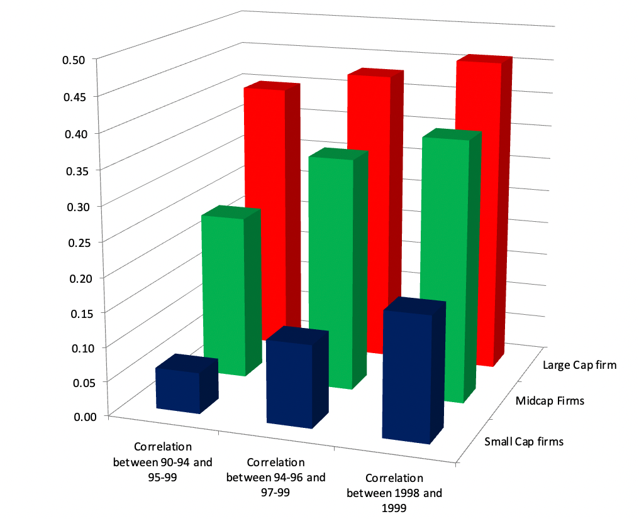
Growth Investing: Historical growth

Slide 19
Growth investing: Expected growth
Value is ultimately determined by future growth and not past growth. It seems reasonable, therefore, that you would be better served investing in stocks where expected growth is high rather than historical growth.
In a market with thousands or even hundreds of listings, you cannot estimate expected growth for each firm in the market. Instead, you must rely on analyst estimates of expected growth for companies.
That information, though, is accessible now to most investors and you could buy stocks with high expected growth rates in earnings. For this strategy to generate high returns, the following conditions must hold:
  Analysts must be proficient at forecasting long term earnings growth.
  The market price should not already reflect or price this growth, since if it does, your portfolio of high growth companies will not generate excess returns.
On both conditions, the evidence works against the strategy.

Slide 20
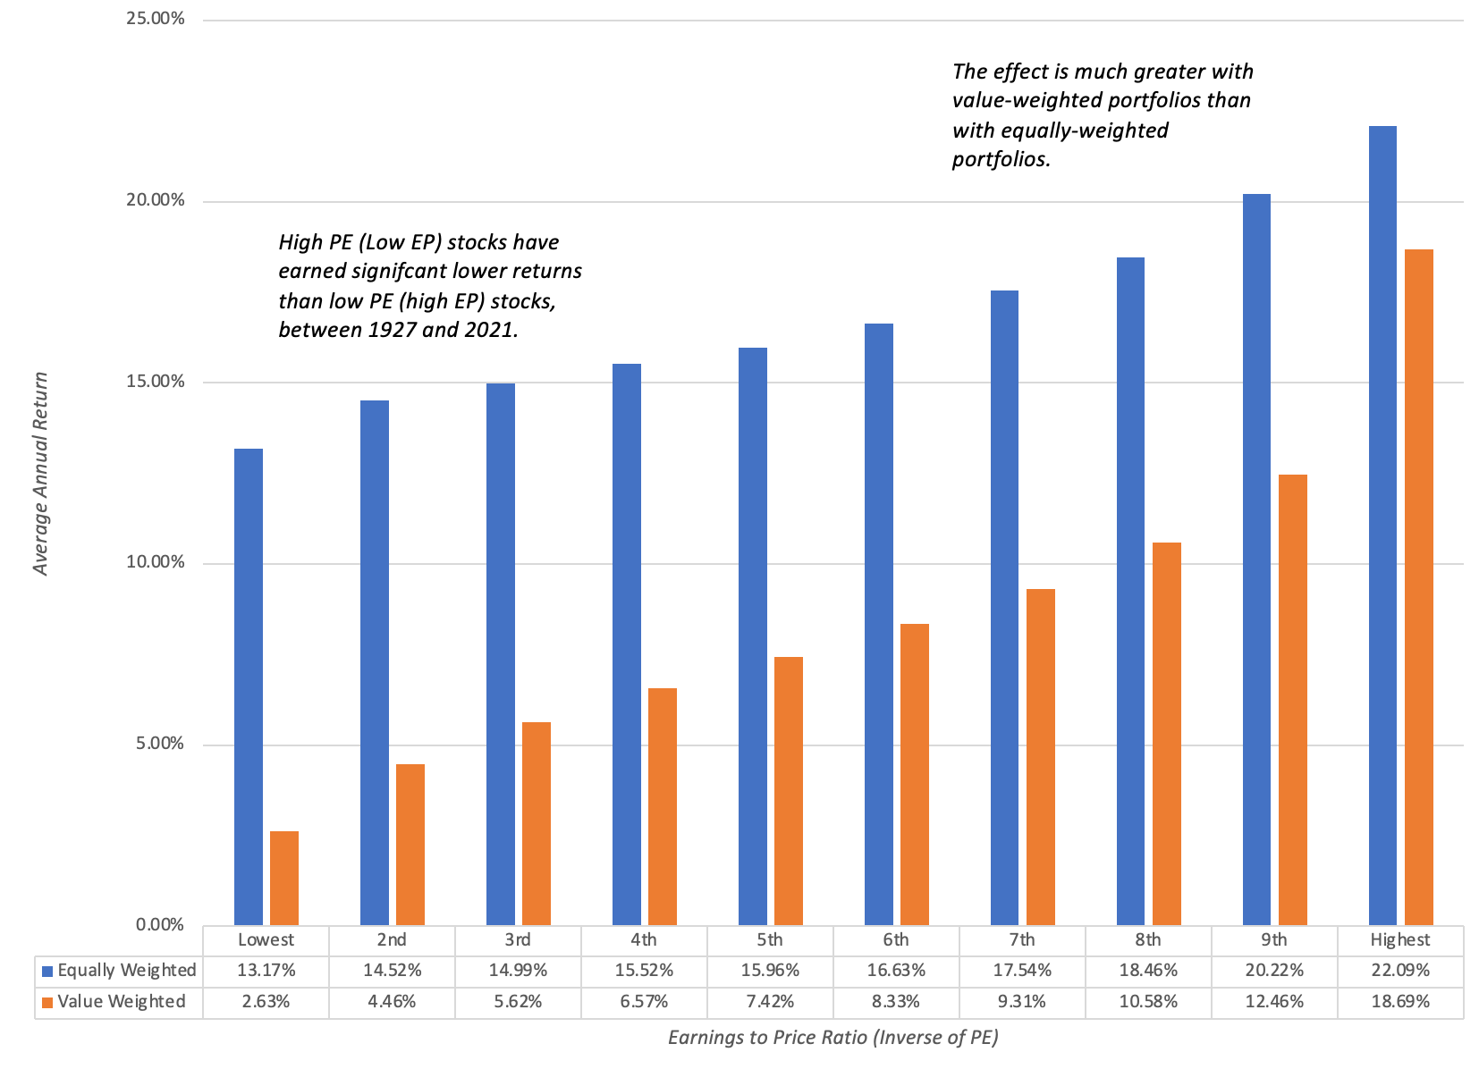
Growth investing: Buy High PE stocks

Slide 21
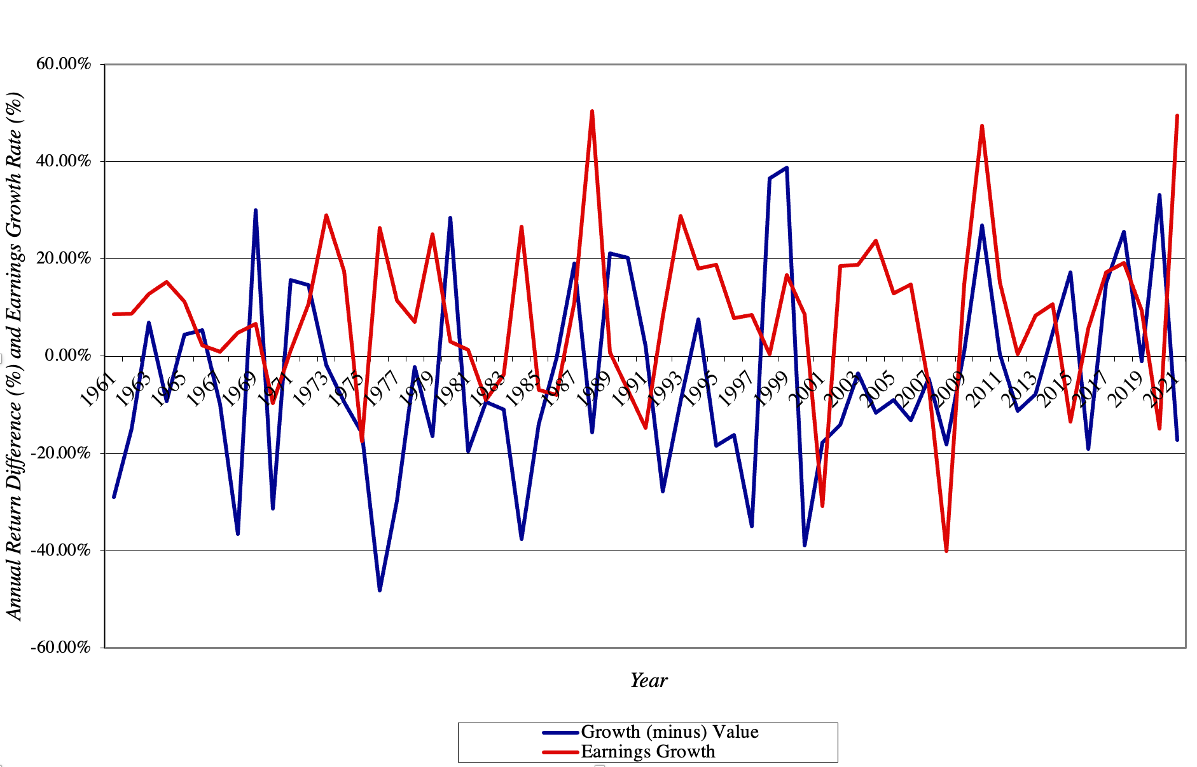
With cycleS – Earnings growth

Slide 22
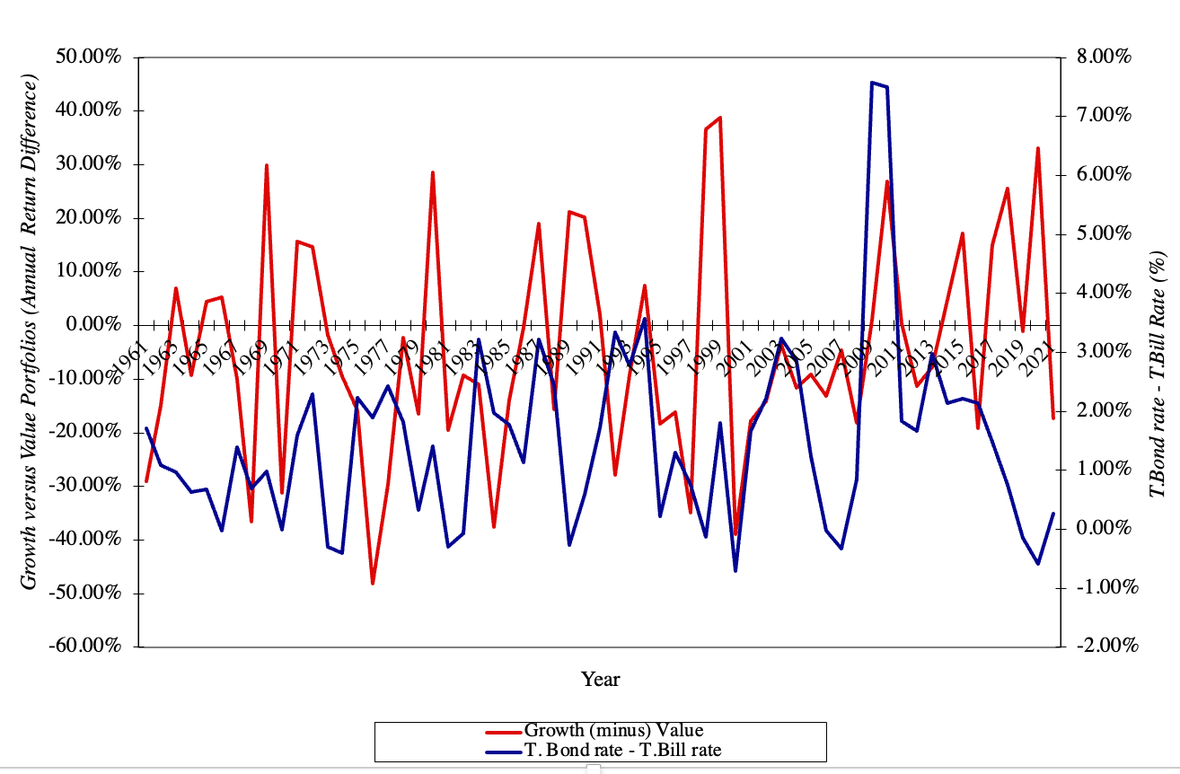
Cycles: Yield curve

Slide 23
Growth trading strategies
You could growth trading strategies based upon earnings momentum, i.e., the rate of change in earnings growth, rather than level of the growth rate, where you trade stocks that have high earnings momentum, and ride the stock price up on that momentum.
  While some of these strategies are based purely upon earnings growth rates, most of them are based upon how earnings measure up to analyst expectations.
  In fact, one momentum strategy is to buy stocks where analysts are revising earnings forecasts upwards, and hope that stock prices follow these earnings revisions.

Slide 24
Growth trading evidence
Several studies in the United States conclude that it is possible to use forecast revisions made by analysts to earn excess returns.
As researchers have probed the earnings revision data, there are some interesting facts that are coming to the fore.
  First, forecast revisions that diverge more from the consensus, i.e., bold forecasts, have a much biggest impact on price and are more likely to be accurate than forecast revisions that stay close to the pack.
  Second, timeliness matters, with analysts who revise their earnings estimates earlier having a much bigger price impact than those revisions that occur later in the cycle.
  Third, earnings revisions made by analysts who work at bigger banks/brokerage houses have a much bigger price impact, perhaps because they have wider reach and exposure, than analysts who work with smaller entities.
In sum, there is evidence that companies where analysts are revising earnings upwards can ride momentum to generate higher returns, though how much of those returns will persist, after transactions costs and trading frictions, remains an open question.

Slide 25
Growth trading Pitfalls
The limitation of an earnings revision strategy is its dependence on two of the weakest links in financial markets – earnings reports that come from firms and analyst forecasts of these earnings.
Even if the excess returns persist, you also need to consider why they might exist in the first place.
  To the extent that analysts influence trades made by their clients, they are likely to affect prices when they revise earnings.
  The more influential they are, the greater the effect they will have on prices, but the question is whether the effect is lasting.
Finally, you should recognize that it is a short-term strategy that yields small excess returns over investment horizons ranging from a few weeks to a few months. The increasing skepticism of markets towards both earnings reports from firms and forecasts by analysts bodes ill for these strategies.

Slide 26
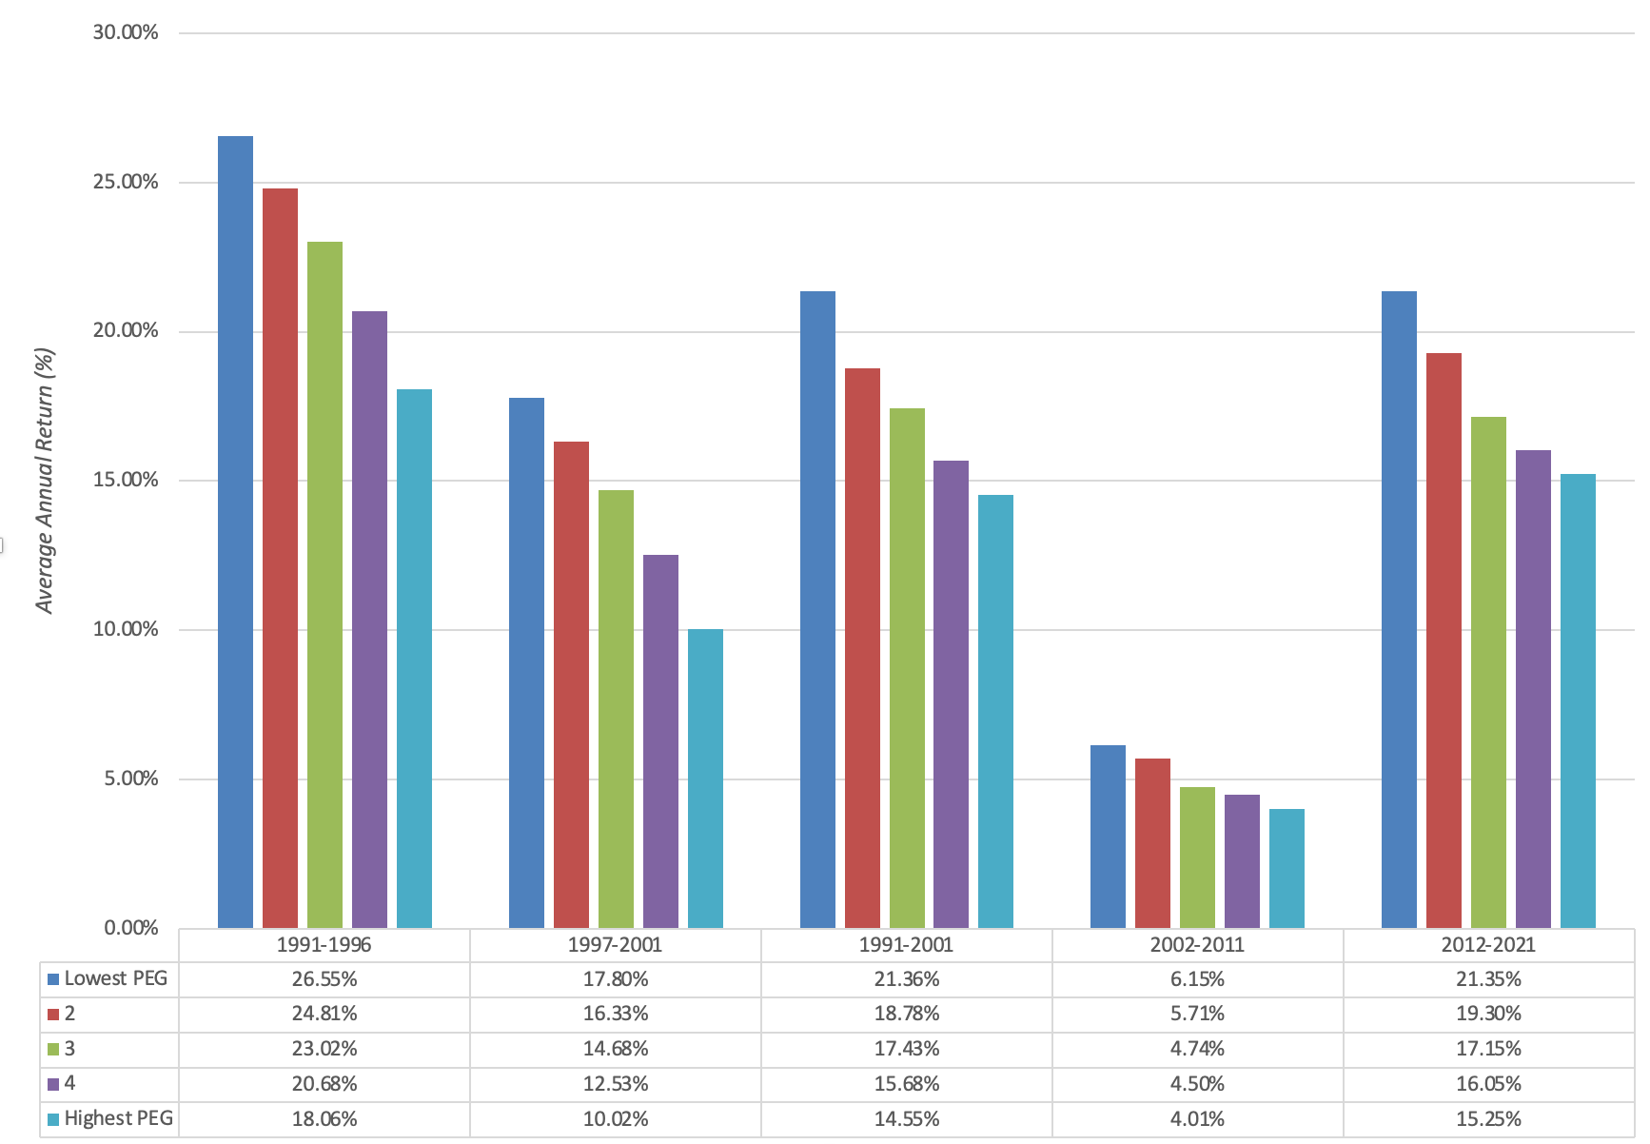
Growth at a reasonable price (GARP)

Slide 27
Growth Investing: Determinants of success
Better Growth Estimates: Since growth is the key dimension of value in these companies, obtaining better estimates of expected growth should improve your odds of success. If you are a growth investor following a small set of companies, you may try to estimate growth yourself. If you can estimate growth more precisely than the overall market, you should get a payoff.
Long Time Horizon: While a long-time horizon improves your odds of success, as an investor, across all companies, it is even more critical when investing in younger and growth companies., since a much higher proportion of the trading in high growth stocks comes from traders, playing mood and momentum games, than from investors, and these traders can take a stock that is undervalued or overvalued, and make it even more so, in the short term.
Macro Forecasting Skills: There are extended cycles where the growth screens work exceptionally well and other cycles where they are counterproductive. If you can time these cycles, in earnings or overall economic growth, you could augment your returns substantially. Since many of these cycles are related to how the overall market is doing, this boils down to your market timing ability.

