Slide 1



Chapter 16: Investing in Middle age

Slide 2
Value Investing: The variants
The Screeners: Investors in this camp believe that mature companies, especially those with stable earnings and solid cash flows, are often undervalued by investors because they are boring and predictable.
The Contrarians: Contrarian value investors start with the presumption that mature companies are, for the most part, fairly valued by the market, but that they get mis-valued in the aftermath of big information announcements (earnings reports, change in management etc.), with markets overreacting to the news in these announcements.
The Buy-and-Hold: The adherents to this third strand of value investing believe that companies in good businesses, and run by superior managers, will outperform the market over the long term.

Slide 3
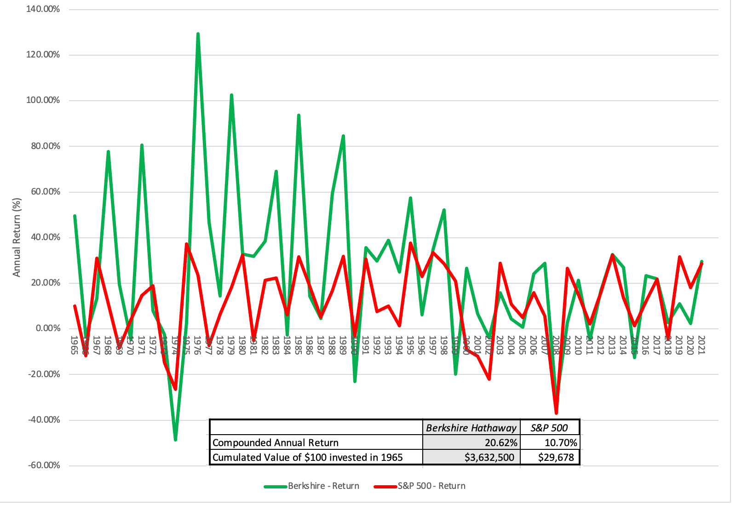
The case for value investing: The story strand

Slide 4
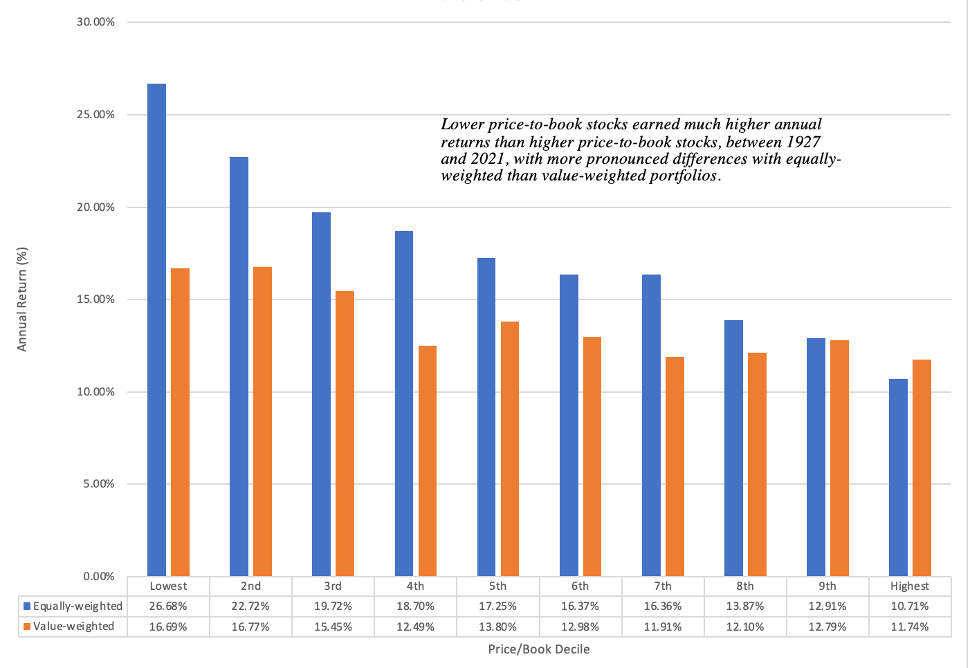
The case for value investing: The numbers strand

Slide 5
With varying explanations
It is a proxy for missed risk: In their 1992 paper, Fama and French argued that companies that trade at low price to book ratios are more likely to be distressed and that risk and return models were not doing an adequate job of capturing that risk. They were arguing that rather than be a stamp of approval for value investing, these studies indicate risks that may not show up in near term returns or in traditional risk and return models.
It is a sign of market inefficiency: During the 1980s, as behavioral finance became more popular, academics also became more willing to accept and even welcome the notion that markets make systematic mistakes and that investors less susceptible to these behavioral quirks could take advantage of these mistakes.

Slide 6
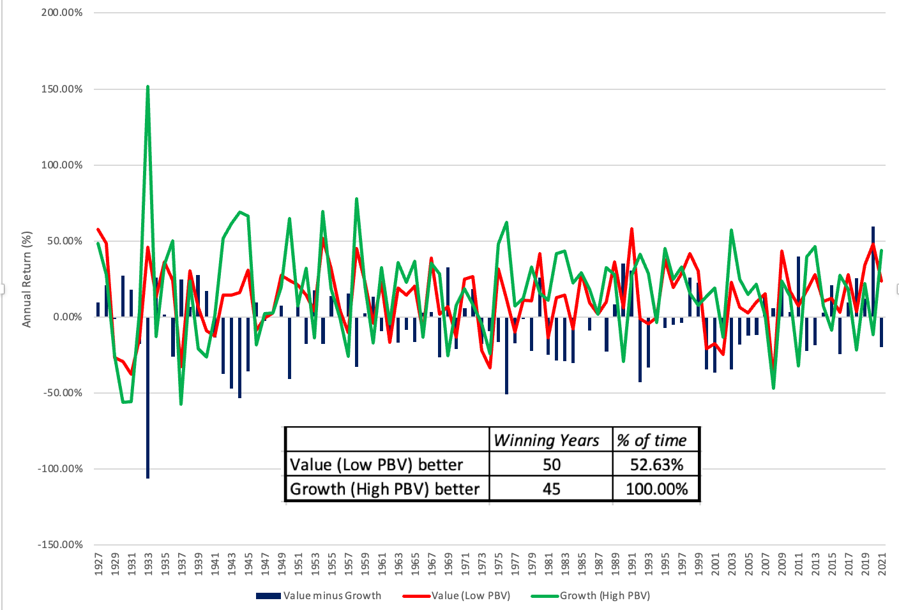
The PushbacK:
1. A volatile value premium

Slide 7
2. The payoff to active value investing
Investing in low PE or low PBV stocks would not be considered true value investing, by most of its adherents.
In fact, most value investors would argue that the while you may start with these stocks, the real payoff to value investing comes in from the additional analysis that you do, whether it be in bringing in other quantitative screens (following up on Ben Graham) and qualitative ones (good management, moats).
If we call this active value investing, the true test of value investing then becomes whether following value investing precepts and practices and picking stocks generates returns that exceed the returns on a value index fund, created by investing in an index fund invested in low price to book or low PE stocks.

Slide 8
2A: Screening for value
Henry Oppenheimer examined the returns on stocks, picked using the Graham screens, between 1970 and 1983, and found that they delivered average annual returns of 29.4% a year, as opposed to 11.5% of the index.
There are other studies that do come to the same conclusion, looking at screening over the period, but they all suffer from two fundamental problems.
  The first is that one of the value screens that invariably gets used is low PE and low PBV, and we already know that these stocks delivered significantly higher returns than the rest of the.
  The second is that the ultimate test of a philosophy is not in whether its strategies work on paper, but in whether the investors who use those strategies make money on actual portfolios.

Slide 9
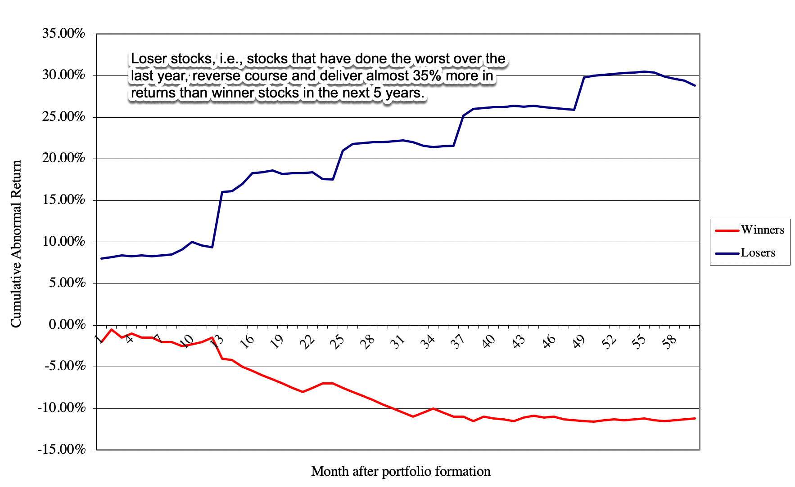
2B: The contrarians

Slide 10
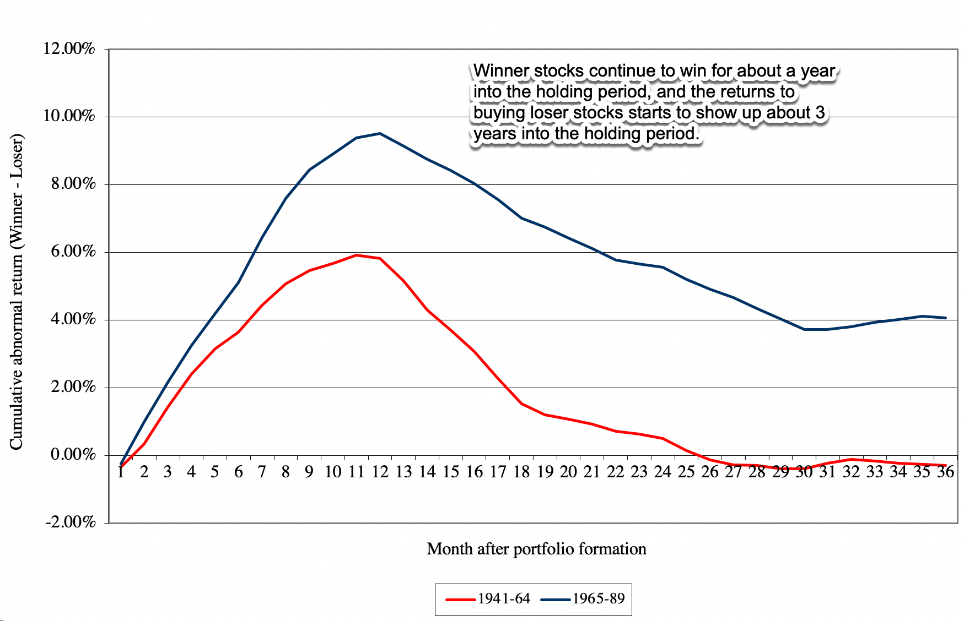
With a caveat..

Slide 11
2C: The value indexers
Many value investors will blanch at the idea of letting indexed value investors into this group, but there can be no denying the fact that funds have flowed into tilted index funds, with many of the tilts reflecting historical value factors (low price to book, small cap, low volatility).
The sales pitch for these funds is more often that you can not only get a higher return, because of your factor tilts, but also a bigger bang (return) for your risk (standard deviation) rather than a higher return per se (higher ratios of returns to standard deviation).
The jury is still out, and our view is that tilted index funds are an oxymoron, and that these funds should be categorized as minimalist value funds, where you try to minimize your activity, to lower your costs.
  The earliest studies of mutual funds looked at them as a group, and concluded that they collectively underperformed the market.
  None of these studies have found any evidence that value fund managers are more likely to beat their index counterparts than their growth fund counterparts.

Slide 12
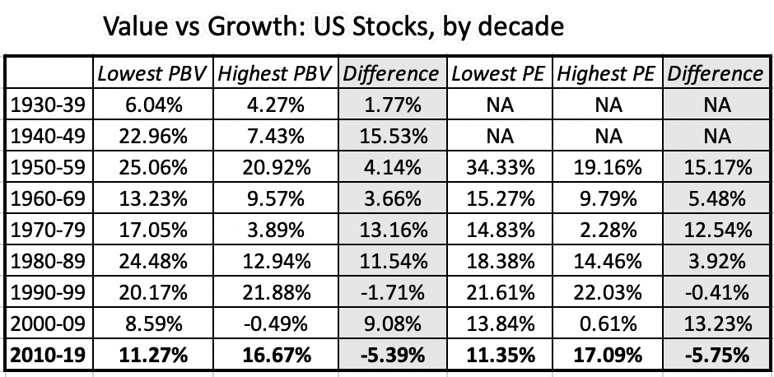
3. Value investing in the 21st century

Slide 13
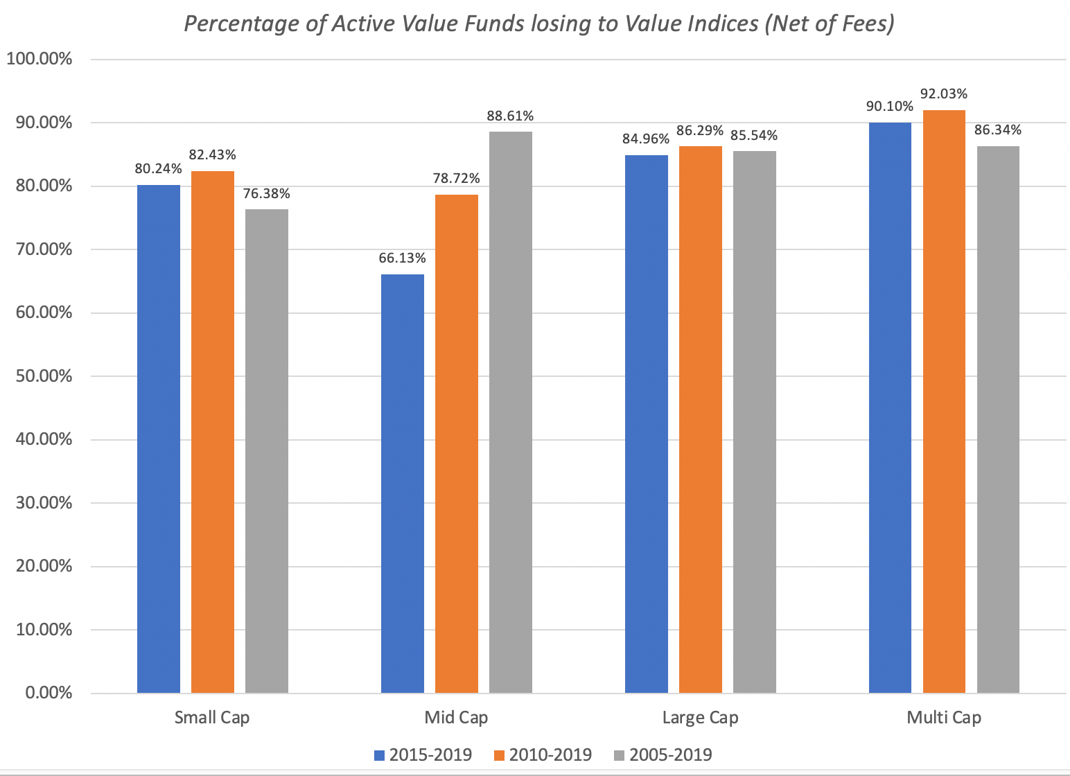
The active value investing postscript

Slide 14
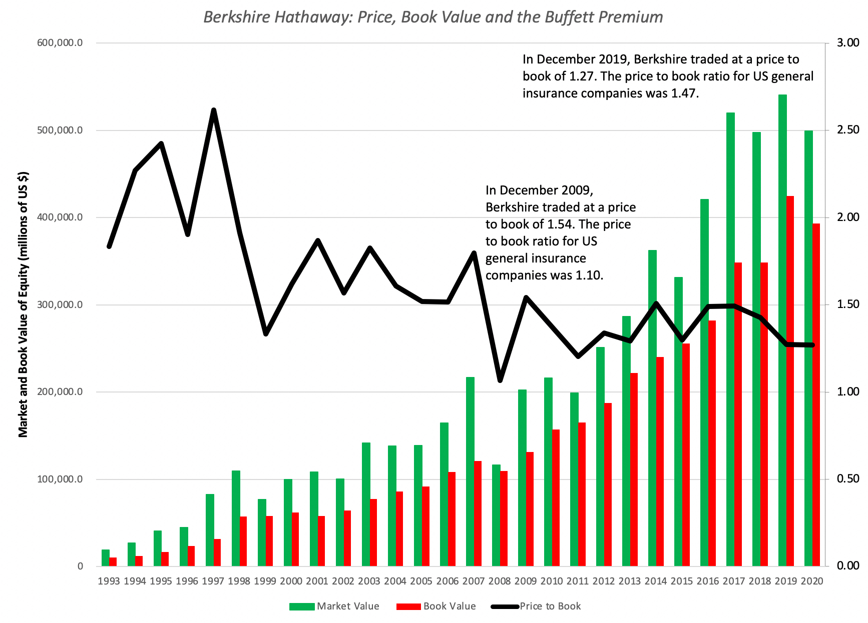
And a fading buffett premium..

Slide 15
Explanations and excuses
This is a passing phase! Even in its glory days, during the last century, there were extended periods (like the 1990s) when low PE and low PBV stocks underperformed, relative to high PE and high PBV stocks.
The Fed did it!: Starting with the 2008 crisis and stretching into the last decade, central banks around the world have become much more active players in markets. With quantitative easing, the Fed and other central banks have contributed not only to keeping interest rates lower (than they should be, given fundamentals) but also provided protection for risk taking at the expense of conservative investing.
The Investment World has become flatter! As data has become easier to get, accounting more standardized and analytical tools more accessible, there is very little competitive advantage to computing ratios (PE, PBV, debt ratio etc.) from financial statements and running screens to find cheap stocks.
The global economy has changed! At the risk of sounding cliched, the shift in economic power to more globalized companies, built on technology and immense user platforms, has made many old time value investing nostrums useless.

Slide 16
Reassessing value investing
It has become rigid: Value investing's focus on dividends has caused adherents to concentrate their holdings in utilities, financial service companies and older consumer product companies, as younger companies have shifted away to returning cash in buybacks.
It has become ritualistic: The rituals of value investing are well established, from the annual trek to Omaha, to the claim that your investment education is incomplete unless you have read Ben Graham's Intelligent Investor and Security Analysis to an almost unquestioning belief that anything said by Warren Buffett or Charlie Munger must be right.
It has become righteous: While investors of all stripes believe that their "investing ways" will yield payoffs, some value investors seem to feel entitled to high returns because they have followed all the rules and rituals. In fact, they view investors who deviate from the script as shallow speculators but are convinced that they will fail in the "long term".

Slide 17
Good versus bad companies
Let’s start with what makes a company a good one.
  You could start with profitability, arguing that a more profitable business is better than a less profitable one, but that may not be true if the business is capital intensive (and the profits generated are small relative to the capital invested) or a risky business, where you are waiting for the other shoe to drop.
  You could look at growth, but growth, as we noted earlier in this book, can be good, bad or neutral and a company can have high growth, while destroying value.
  To us, the best measure the corporate quality is a high excess return, i.e., a return on capital that is vastly higher than its cost of capital.

Slide 18
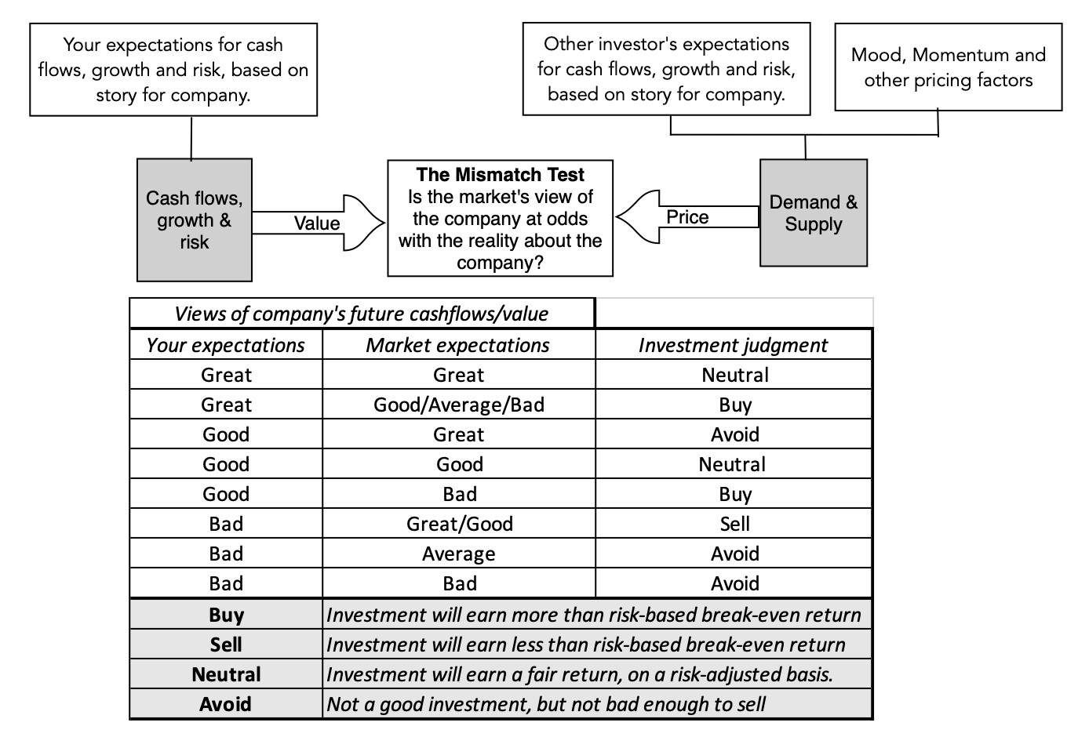
It is an expectations game!

Slide 19
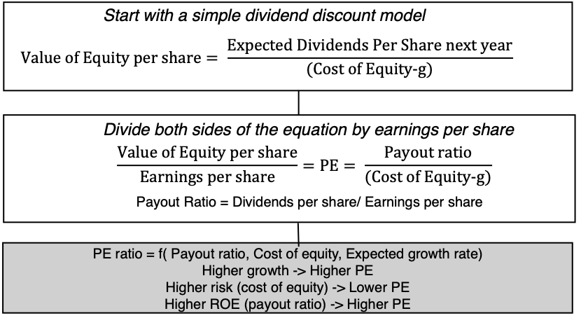
Screening for value: Start with intrinsic value

Slide 20
Pricing mismatches!
Multiple | Cheap Company | Expensive Company
PE | Low PE, High growth, Low Equity Risk, High Payout | High PE, Low growth, High Equity Risk, Low Payout
PEG | Low PEG, Low Growth, Low Equity Risk, High Payout | High PEG, High Growth, High Equity Risk, Low Payout
PBV | Low PBV, High Growth, Low Equity Risk, High ROE | High PBV, Low Growth, High Equity Risk, Low ROE
EV/Invested Capital | Low EV/IC, High Growth, Low Operating Risk, High ROIC | High EV/IC, Low Growth, High Operating Risk, Low ROIC
EV/Sales | Low EV/Sales, High Growth, Low Operating Risk, High Operating Margin | Hifh EV/Sales, Low Growth, High Operating Risk, High Operating Margin
EV/EBITDA | Low EV/EBITDA, High Growth, Low Operating Risk, Low Tax Rate | High EV/EBITDA, Low Growth, High Operating Risk, High Tax Rate

Slide 21
Investing lessons
Company’s Business | Company’s Managers | Company Pricing | Investment Decision
Good (Strong competitive advantages, Growing market) | Good (Optimize investment, financing, dividend decisions) | Good (Price < Value) | Emphatic Buy
Good (Strong competitive advantages, Growing market) | Bad (Sub-optimal investment, financing, dividend decisions) | Good (Price < Value) | Buy & hope for management change
Bad (No competitive advantages, Stagnant or shrinking market) | Good (Optimize investment, financing, dividend decisions) | Good (Price < Value) | Buy & hope that management does not change
Bad (No competitive advantages, Stagnant or shrinking market) | Bad (Sub-optimal investment, financing, dividend decisions) | Good (Price < Value) | Buy, hope for management change & pray it survives
Good (Strong competitive advantages, Growing market) | Good (Optimize investment, financing, dividend decisions) | Bad (Price > Value) | Admire but don’t buy
Good (Strong competitive advantages, Growing market) | Bad (Sub-optimal investment, financing, dividend decisions) | Bad (Price > Value) | Wait for management change
Bad (No competitive advantages, Stagnant or shrinking market) | Good (Optimize investment, financing, dividend decisions) | Bad (Price > Value) | Sell
Bad (No competitive advantages, Stagnant or shrinking market) | Bad (Sub-optimal investment, financing, dividend decisions) | Bad (Price > Value) | Emphatic Sell

Slide 22
Value investing: A new Paradigm
Be clearer about the distinction between value and price: While value and price are often used interchangeably by some market commentators and investors, they are the results of very different processes and require different tools to assess and forecast.
Rather than avoid uncertainty, face up to it: Many value investors view uncertainty as "bad" and "something to be avoided", and it is this perspective that has led them away from investing in growth companies, where you have to grapple with forecasting the future and towards investing in mature companies with tangible assets.
  In fact, we looked at uncertainty, as it plays out across the life cycle, and noted that it changes, both in terms of magnitude and type, as companies age.
  While it is true that there is less uncertainty, when valuing more mature companies in stable markets, you are more likely to find market mistakes in companies where the uncertainty is greatest about the future, either because they are young or distressed, or because the macroeconomic environment is challenging.

Slide 23
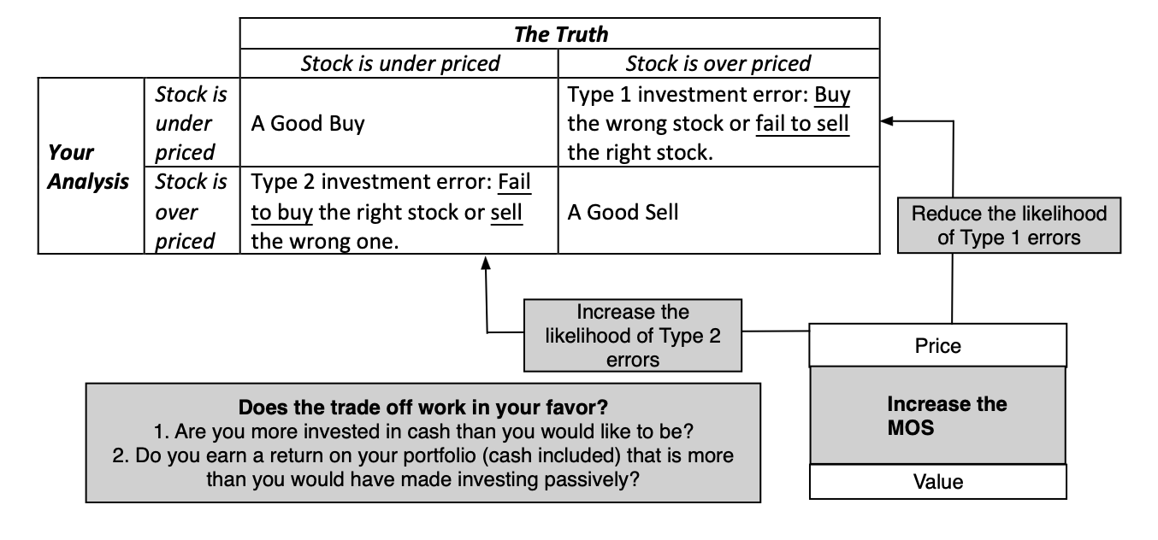
As for margin of safety, it is a trade off…

Slide 24
Don’t take accounting numbers at face value
It is undeniable that value investing has an accounting focus, with earnings and book value playing a central role in investing strategies.
There is good reason to trust those numbers less now than in decades past, for a few reasons.
  One is that companies have become much more aggressive in playing accounting games, using pro forma income statements to skew the numbers in their favor.
  The second is that as the center of gravity in the economy has shifted away from manufacturing companies to technology and service companies, accounting has struggled to keep up.

Slide 25
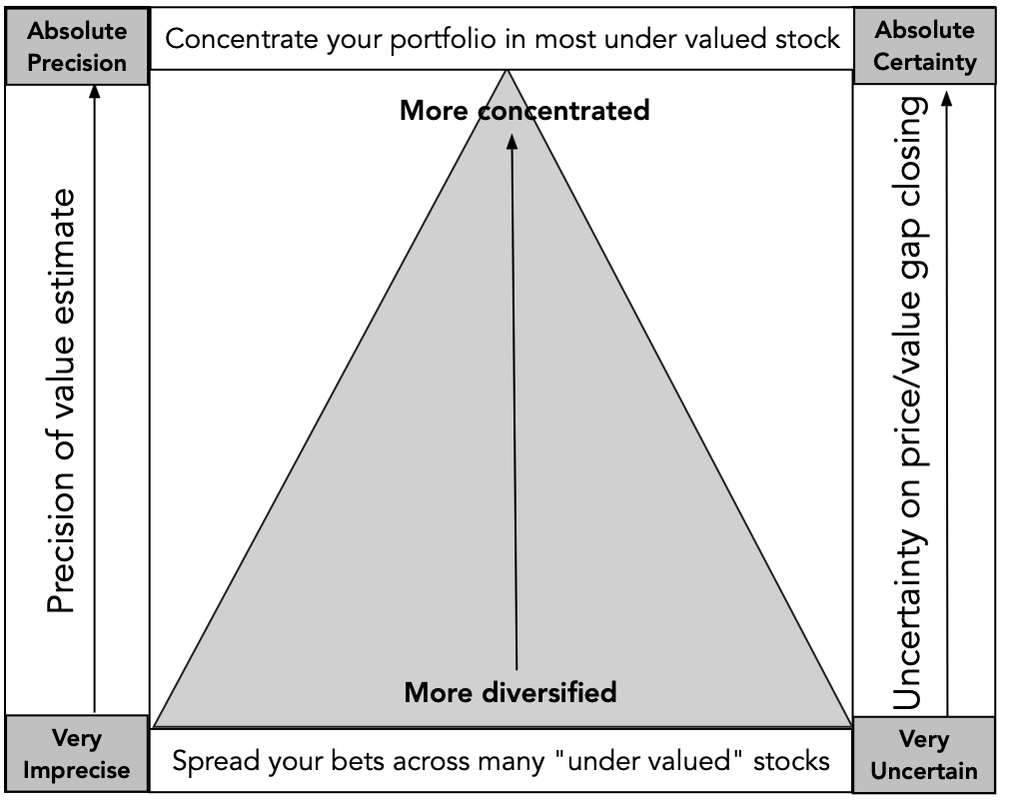
AND SPREAD YOUR BETS…

