Slide 1



Chapter 17: Investing in DECLINE

Slide 2
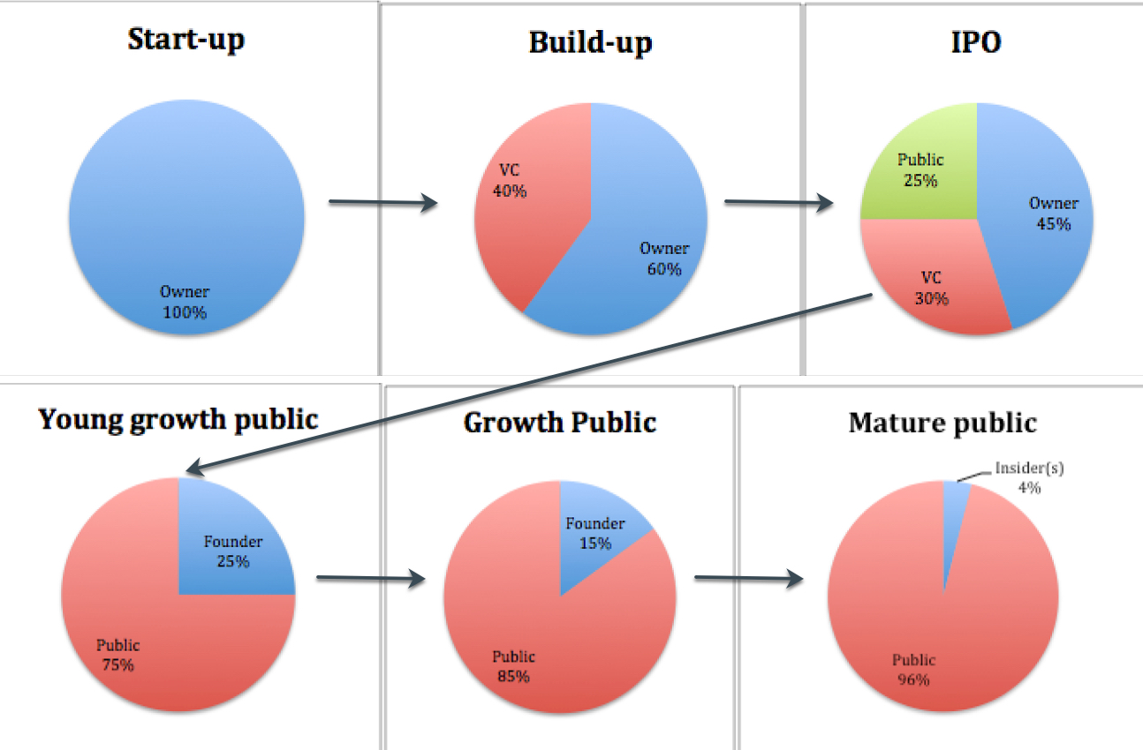
PE and Activists: The life cycle connection
While there is no reason why private equity, in its non-VC form, and activist investors cannot target companies across the life cycle, the nature of how they add value will result in them targeting mature and declining firms, for their buyouts.

Slide 3
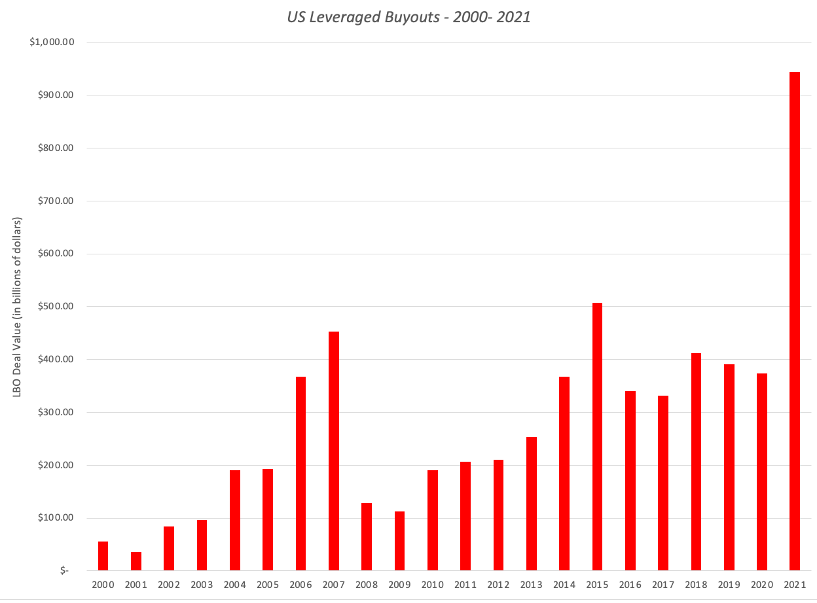
Private equity trends: LBOs

Slide 4
Largest PE investors in 2021
Institution | Headquarters | Capital raised ($ millions)
KKR | New York | $ 126,508.00
Blackstone | New York | $ 82,457.00
EQT | Stockholm | $ 57,287.00
CVC Capital Partners | Luxembourg | $ 55,414.00
Thoma Bravo | San Francisco | $ 50,257.00
The Carlyle Group | Washington DC | $ 48,441.00
General Atlantic | New York | $ 44,832.00
Clearlake Capital Group | Santa Monica | $ 42,350.00
Hellman & Friedman | San Francisco | $ 40,925.00
Insight Partners | New York | $ 40,131.00

Slide 5
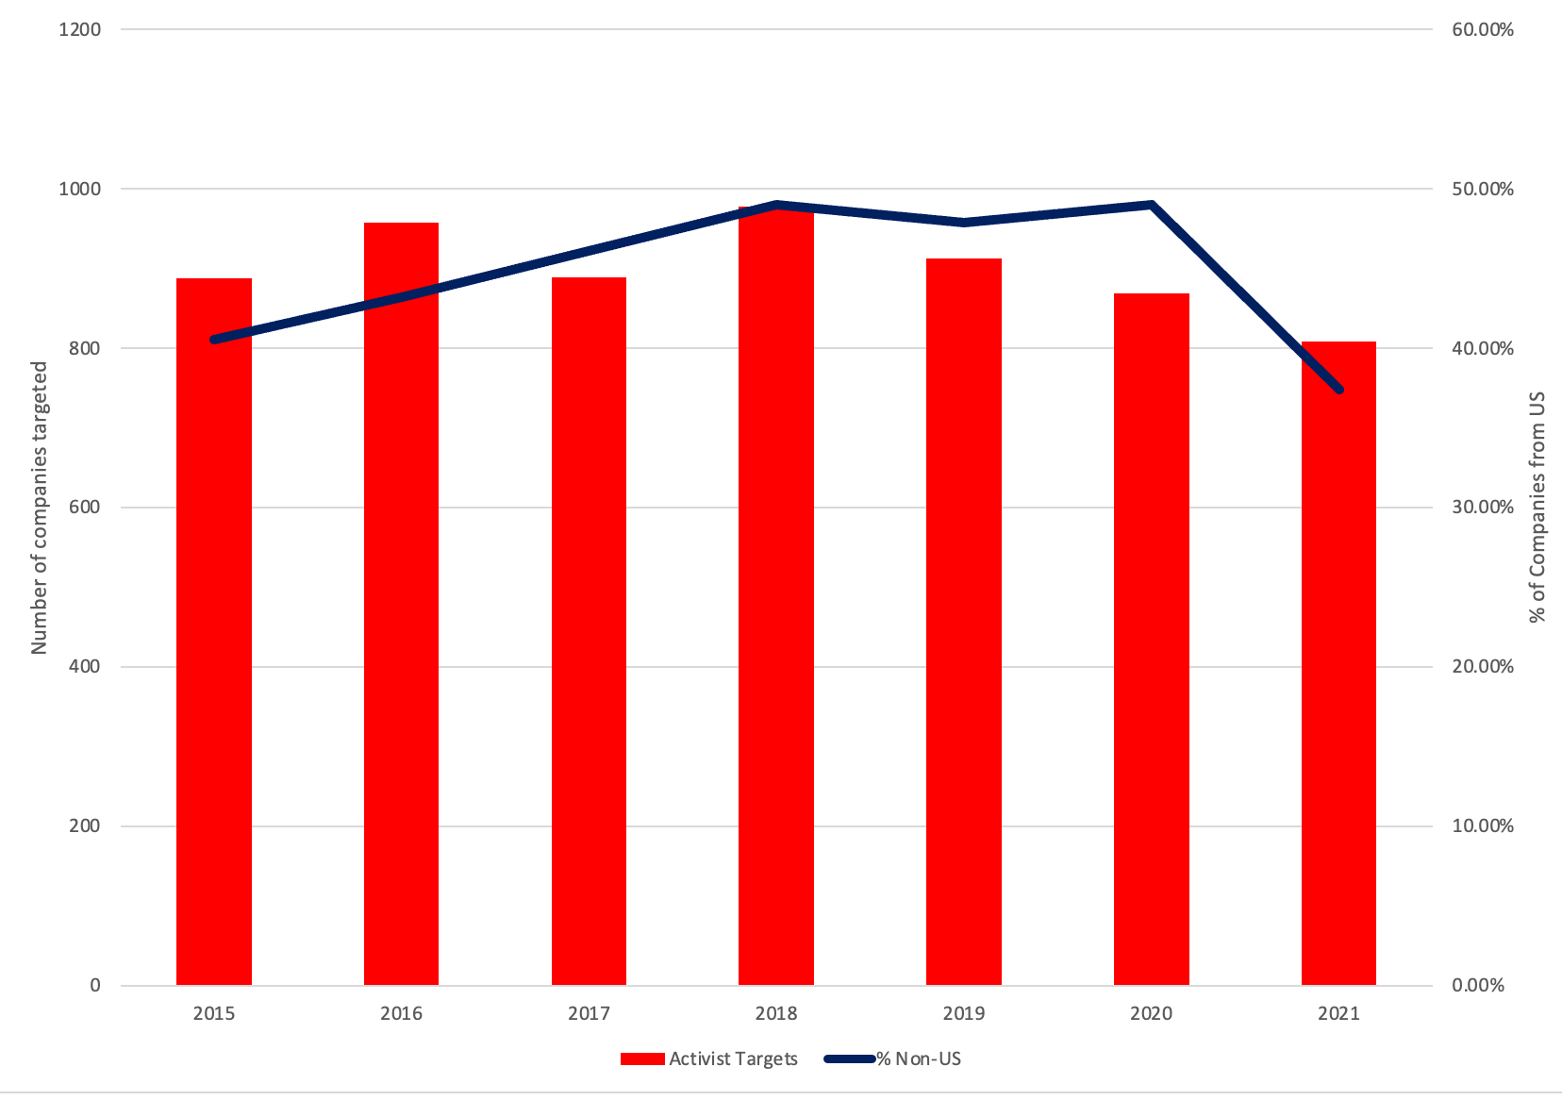
Activist targets, by year

Slide 6
The ”best” targets for PE & activists
Large free cash flows: Given that many buyouts are funded with debt, they look for large positive free cash flows from operations that can be used to service and pay down debt.
Cheap: While the objective in a buyout may be fixing up a poorly run firm and flipping it back to the market, at a much higher price, private equity firms improve their odds of high returns, if they can acquire target firms at low prices.
Potential for operating improvement: One simple, and flawed, measure of the potential for operating improvement is a comparison of the operating margins or returns on invested capital of the targeted firm to that of its peer group, and here too, the evidence is supportive of the notion that companies that lag their peer group in profitability and investment returns are more likely to be targeted in buyouts.

Slide 7
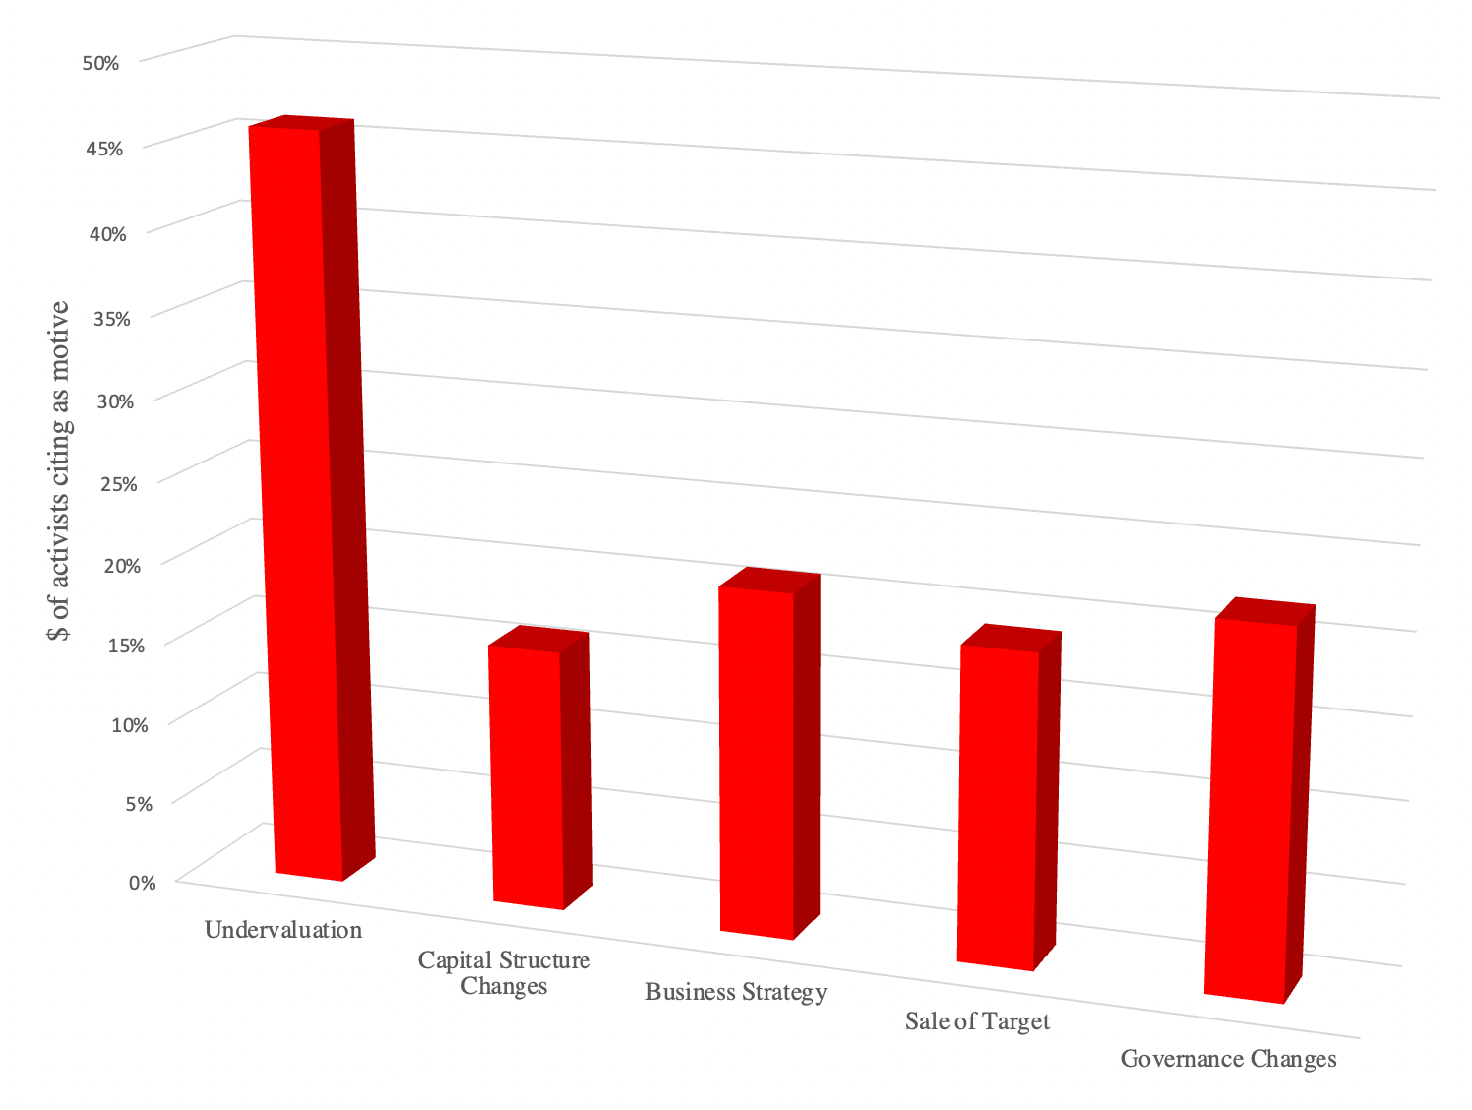
Motives behind targeting…

Slide 8
And targeting by sector, and market cap
Activist Targets (by Sector)
Sector | 2018 | 2019 | 2020
Basic Materials | 9% | 11% | 9%
Communication Services | 3% | 4% | 3%
Consumer Cyclical | 16% | 15% | 13%
Consumer Defensive | 5% | 6% | 4%
Energy | 6% | 5% | 4%
Financial Services | 11% | 12% | 13%
Investment Funds | 3% | 5% | 5%
Healthcare | 10% | 10% | 10%
Industrials | 17% | 14% | 18%
Real Estate | 5% | 4% | 5%
Technology | 11% | 12% | 12%
Utilities | 3% | 3% | 4%
Activist Targets (by Market Cap)
 | 2018 | 2019 | 2020
Large Cap (>$10 b) | 23% | 21% | 27%
Mid Cap ($2-$10 b) | 17% | 18% | 16%
Small Cap ($250 m - $2 b) | 23% | 24% | 25%
Micro Cap ($50-$250 m) | 18% | 19% | 18%
Nano Cap (< $50 m) | 18% | 18% | 14%

Slide 9
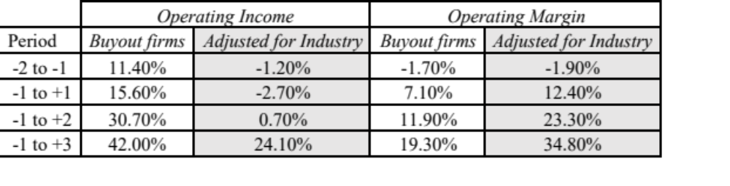
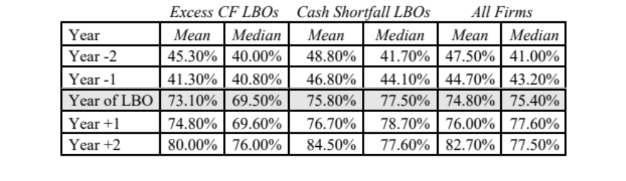
PE actions at targets
Asset Redeployment: Private equity investors reduce capital expenditures marginally, do not cut back on R&D or other investments and redeploy assets to other businesses.
Profitability: Profit margins improve
Financial leverage: Debt increases..

Slide 10
Activist Demands and success rates..
Activist Demand | # Campaigns | % of Sample | % Success Rate
Strategic and Operating Changes
Sale of Company to 3rd party | 159 | 31.55% | 32.08%
Operating restructuring | 69 | 13.69% | 34.78%
Convert to private (from public) | 52 | 10.52% | 40.38%
Capital Structure and Dividend Policy
More dividends & buybacks | 78 | 15.48% | 16.67%
Increase debt load | 22 | 4.37% | 31.82%
M&A
Back out of announced merger | 63 | 12.50% | 28.57%
Corporate Governance
Remove CEO, Separate CEO from Board Chair | 27 | 5.36% | 18.52%
Reduce executive compensation | 20 | 3.97% | 15.00%
Increase disclosure | 14 | 2.78% | 35.71%

Slide 11
More on activism…
The failure rate in activist investing is very high, with two-thirds of activist investors quitting before making any formal demands of the target.
Among those activist investors who persist, less than 20% request a board seat, about 10% threaten a proxy fight and only 7% carry through on that threat.
Activists who push through and make demands of managers are most successful (success rate in percent next to each action) when they demand the taking private of a target (41%), the sale of a target (32%), restructuring of inefficient operations (35%) or additional disclosure (36%). They are least successful when they ask for higher dividends/buybacks (17%), removal of the CEO (19%) or executive compensation changes (15%).
Overall, activists succeed about 29% of the time in their demands of management.

Slide 12
The effects of activism..
Asset deployment and operating performance: There is evidence that firms targeted by individual activists do see an improvement in return on capital and other profitability measures, relative to their peer groups, whereas firms targeted by hedge fund activists don’t see a similar jump in profitability measures.
Capital Structure: On financial leverage, there is a moderate increase of about 10% in debt ratios at firms that are targeted by activist hedge funds, but the increase is not dramatic nor is it statistically significant. There are dramatic increases in financial leverage at a small subset of firms that are targets of activism.
Dividend policy: The firms that are targeted by activists generally increase their dividends and return more cash to stockholders, with the cash returned as a percentage of earnings increasing by about 10% to 20%.
Corporate governance: The biggest effect is on corporate governance.
  The likelihood of CEO turnover jumps at firms that have been targeted by activists, increasing 5.5% over the year prior to the activism. In addition,
  CEO compensation decreases in the targeted firms in the years after the activism, with pay tied more closely to performance.

Slide 13
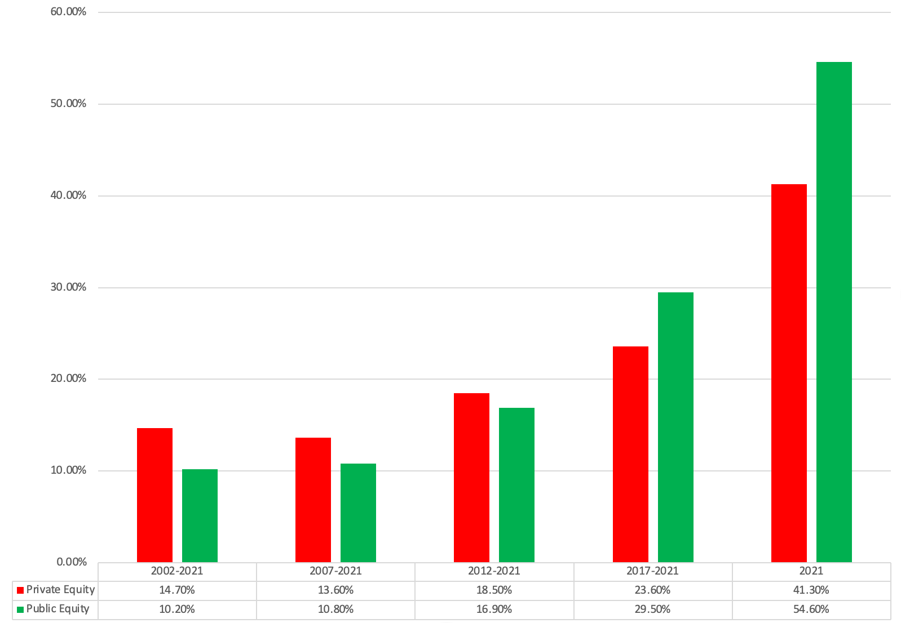
The returns to PE..

Slide 14
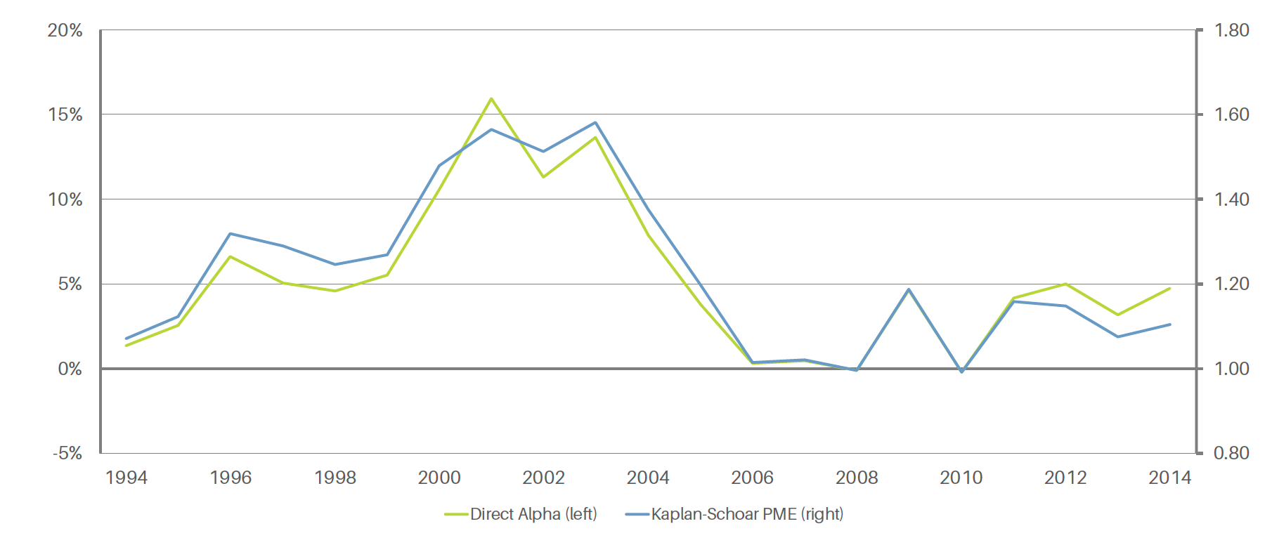
And PE alphas over time…

Slide 15
The returns to activism…
Activist mutual funds seem to have had the lowest payoff to their activism, with little change accruing to the corporate governance, performance or stock prices of targeted firms.
  Markets seem to recognize this, with studies that have examined proxy fights finding that there is little or no stock price reaction to proxy proposals by activist institutional investors.
  Activist hedge funds, on the other hand, seem to earn substantial excess returns, ranging from 7-8% on an annualized basis at the low end to 20% or more at the high end.
  Individual activists seem to fall somewhere in the middle, earning higher returns than institutions but lower returns than hedge funds.
While the average excess returns earned by hedge funds and individual activists is positive, there is substantial volatility in these returns and the magnitude of the excess return is sensitive to the benchmark used and the risk adjustment process..

Slide 16
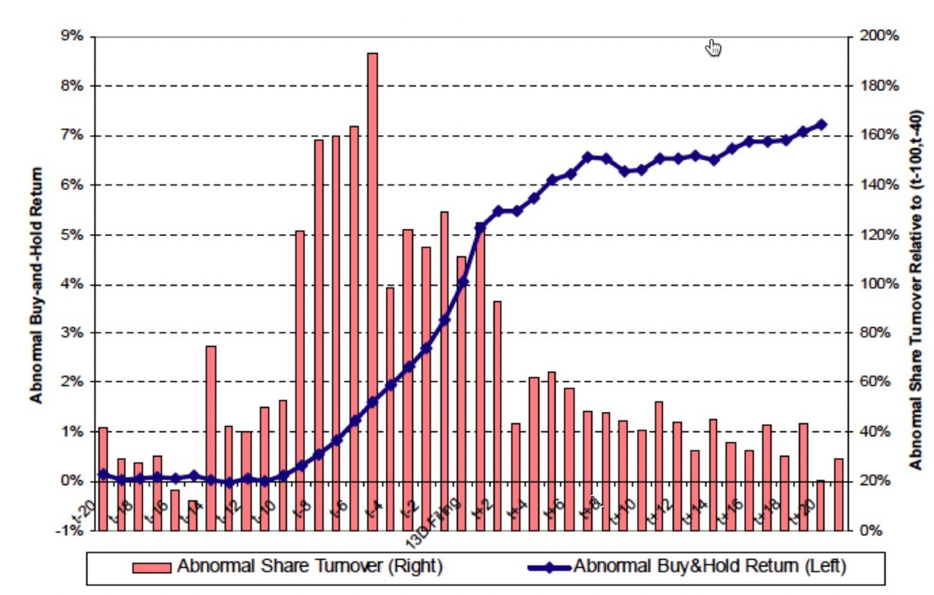
Excess returns around buyouts..

Slide 17
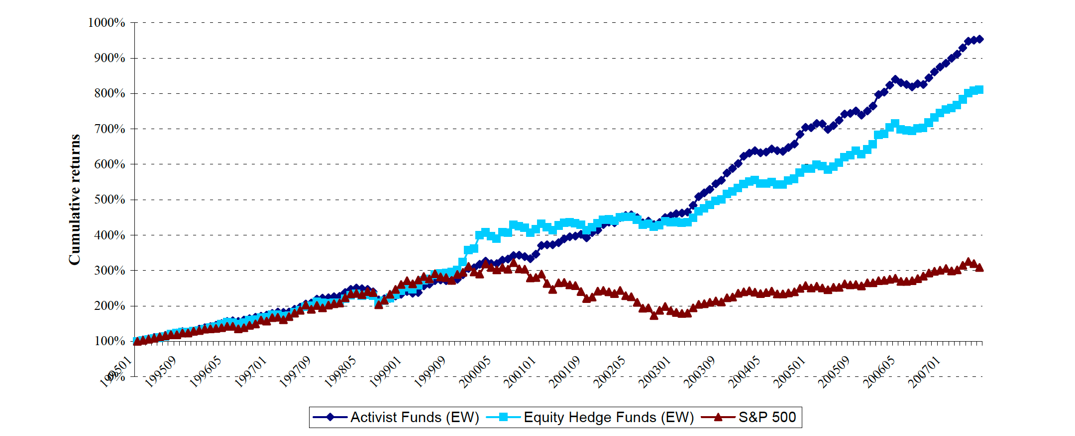
Returns on activist hedge funds: 1995 - 2007

Slide 18
Vulture investing
The Liquidators: We valued private companies, we noted that the values of some of these companies, as going concerns, run by management in denial, can be lower than the values of their assets, in liquidation. There are investors who notice this disparity, target these companies for acquisitions, and once acquired, liquidate them.
The Break-up Specialists: Break-up specialists start with the same premise that liquidators do, i.e., that their targeted companies should not continue as going concerns, but rather than liquidate assets, they aim to split up, break up or spin off the company into sub-parts, each of which continues to operate as a going concern.
The Traders: This group includes those who believe that while declining companies may face dark future, there are trading profits to be made, during decline and distress. In some cases, those profits can come from understanding the legal process of bankruptcy, and the restructuring of companies that occur around the process, and trading ahead of the market on developments in both, either on equity or on debt.

Slide 19
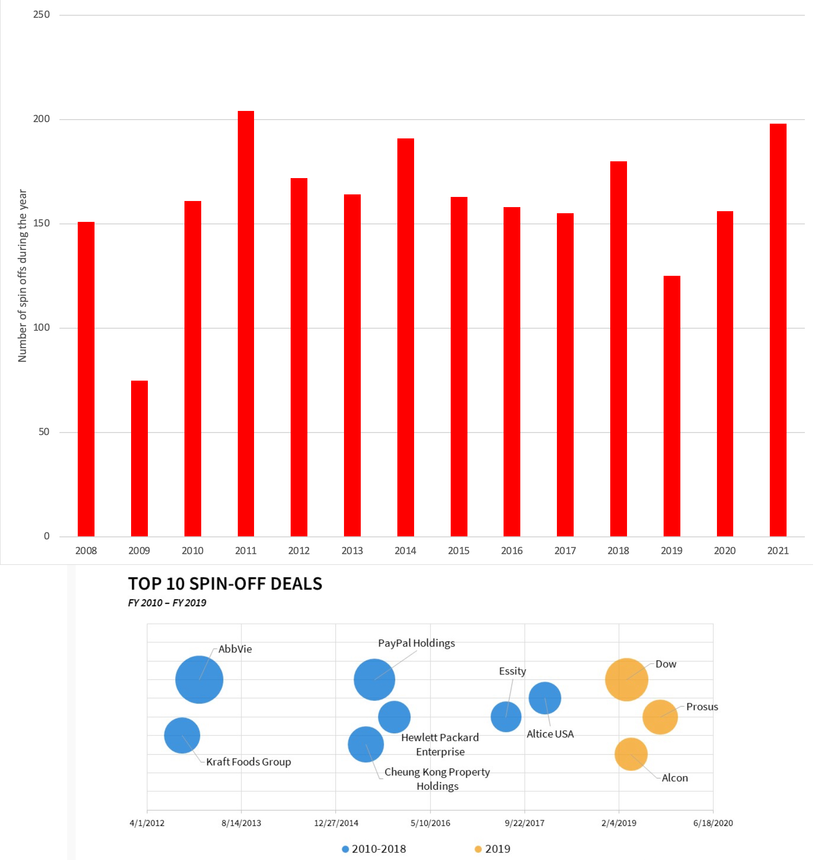
Trends in vulture investing..

Slide 20
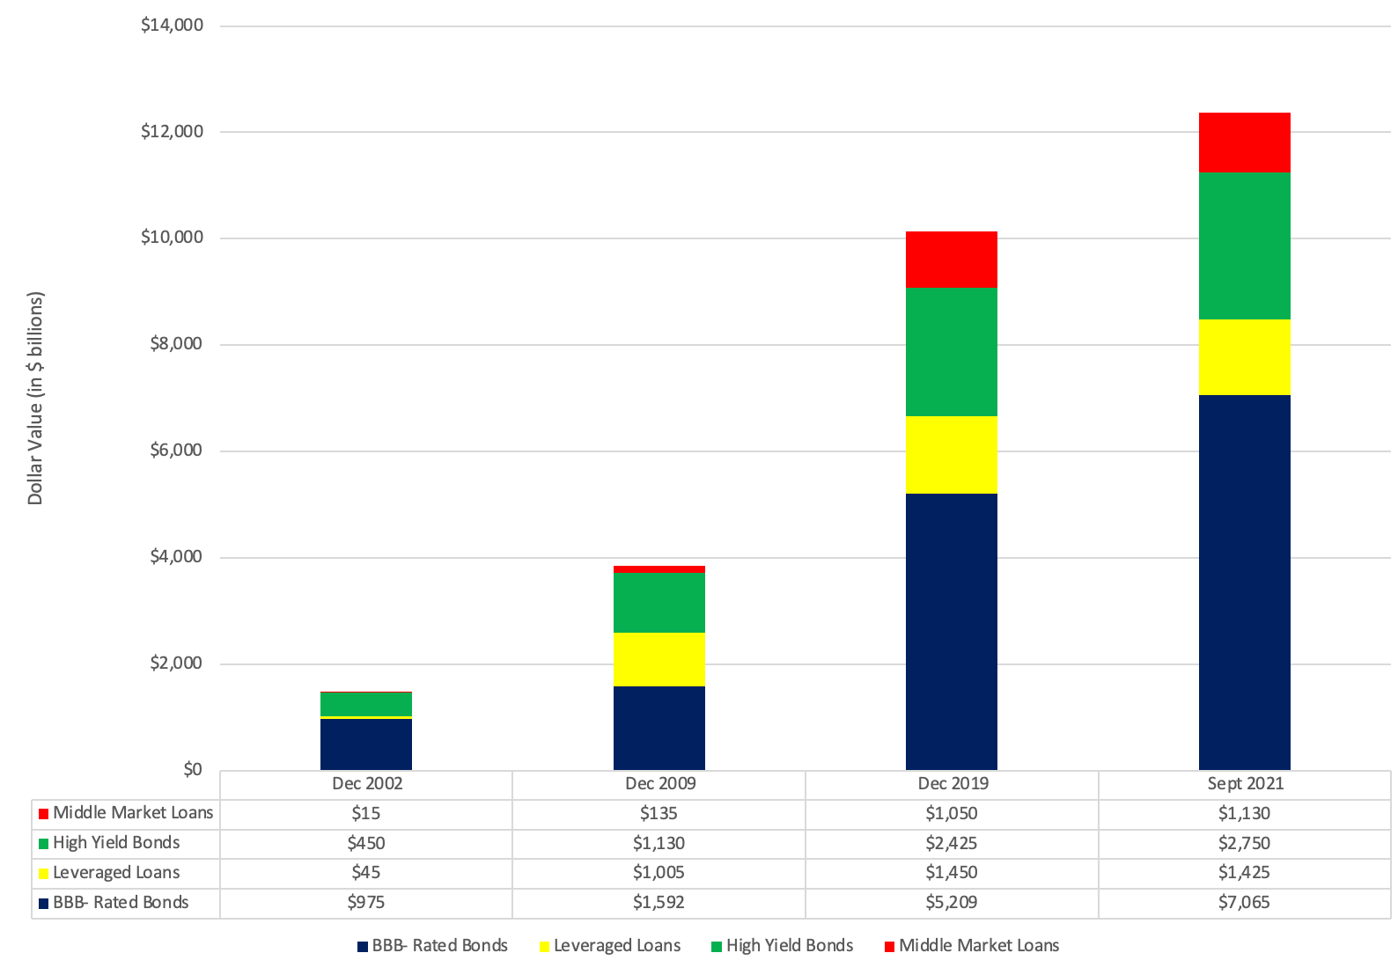
With low-rated corporate debt

Slide 21
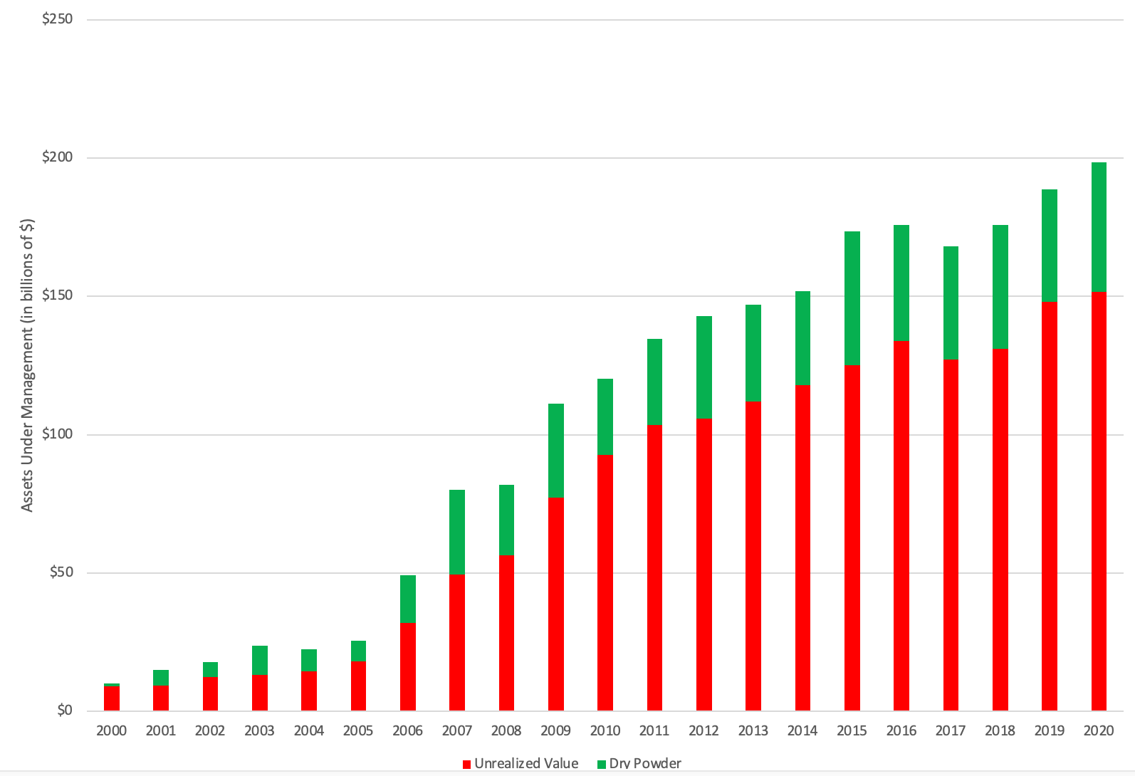
Distressed debt funds..

Slide 22
Voluntary liquidation: The process
The board of directors will have to assent to the liquidation, and once received, a liquidator is appointed.
The liquidator sells the assets in the market for cash and equivalents, and usually has the legal power to act on behalf of the company.
Once the assets have been liquidated, the liquidator will follow the order of obligations, starting with the most senior debt first, then subordinated debt and mezzanine financing and the residual cash goes to equity investors.

Slide 23
The payoff to voluntary liquidation: Keys to success
As you acquire the target firm, you must ensure that you do not bid up the price to a level that is higher than liquidation value, an obvious requirement, but one that is often difficult to meet, in practice.
The costs associated with liquidation, including any discounts that you may have to offer for speedier asset sales and taxes due, must be controlled, to leave you with excess profits.
Liquidation investing is more likely to succeed when the target company’s assets are more liquid, to begin with, and when the market value is much lower than the liquidation value.

Slide 24
Spin offs and splits ups
Spin off: In a spin off, the parent company takes a portion of its business (a subsidiary, a geography etc.) and creates an independent company, with a stand-alone governance structure. The shareholders in the parent company receive a proportional shareholding in the spun off entity.
Split off: A split-off follows the same script as a spin off, in terms of the parent company creating an independent company that owns a portion of its business. However, shareholders in the parent company are then given a choice of exchanging their shares in the parent company for the split-off company’s shares or staying on as shareholders in just the public company.
Split up: In a split-up, the parent company is broken down into two or more entities, and the parent company is liquidated, with its shareholders receiving shares in the new entities that emerge.

Slide 25
Benefits to Breaking up..
Market mistakes: The simplest rationale for a breakup is that the market is mistakenly valuing the whole company at less than the sum of its pieces.
Contaminated Parts: One division of a company may be saddled with actual, perceived or potential liabilities that are so large that they drag down the valuations of the rest of the company. This was the rationale for tobacco companies, faced with potential billion-dollar payouts on lawsuits brought by smokers, spinning of their non-tobacco businesses.
The efficiency story: If multi-businesses are less well run than the competition, perhaps because managers are spread too thin across business or because there is cross subsidization, then breaking them up into their individual businesses should increase efficiency, profits and value.
The simplicity story: Breaking up the companies in bite size pieces that are easier to value, and that may increase what investors are willing to pay, especially if you are in a "crisis" market.
The tax story: When tax codes are complex, companies may be able to lower their tax bills by breaking themselves up.

Slide 26
Costs of breaking up..
Loss of economies of scale: Combining businesses into a company can create cost savings. Thus, a group of consumer product businesses may benefit from being consolidated into one unit, with shared advertising and distribution costs. Breaking up with result in a loss of these savings.
Reduced access to capital (and higher cost): If external capital markets (stock and bond) are undeveloped or under stress, combining businesses into a consolidated company can provide access to capital. How? The excess cash flows from cash rich businesses can be used to finance reinvestment needs in cash poor businesses.
Lost synergies: In some multi-business companies, businesses feed off each other's successes, thus making the whole greater than the sum of its parts.

Slide 27
Distress and Bankruptcy: the choices
Liquidation: The liquidation process, under bankruptcy, is similar in structure to a voluntary liquidation with two potentially significant differences. First, the liquidator is appointed by and answerable to the bankruptcy court, rather than the board of directors or equity investors. Second, court-driven liquidations tend to be more costly, with liquidation costs becoming a bigger drag on proceeds.
Reorganization: Any plan that emerges must be voted on, and accepted, by creditors, bondholders and shareholders, and confirmed by the court. Ultimately, the court can disregard the vote and still confirm the plan if it finds that the plan treats creditors and stockholders fairly.
Merger: There is a third option, albeit only in a subset of cases, where a merger with a healthy firm reduces distress or makes it less imminent and allows for an exit from the bankruptcy process.

Slide 28
With pathways to excess returns
Operating comeback: The most painless way out of bankruptcy is a return to operating profitability, perhaps even with growth, at the distressed firm. In some cases, this recovery can be driven by a
Liquidation/Merger Valuation: In cases where an operating comeback is not in the cards, investors in a distressed company can benefit if a liquidation delivers much more in proceeds than expected, or if a potential buyer of the business is willing to pay a premium.
Reorganization sweepstakes: In both private and court-overseen reorganizations, there will be a restructuring of claims, and some claimholders will be made better off at the expense of others.
Market mispricing: To the extent that markets make mistakes on their price judgments, traders can exploit these differences by buying underpriced or selling short on overpriced securities. In some cases, traders may even be able to lock in the mispricing and deliver guaranteed profits, i.e., arbitrage.

Slide 29
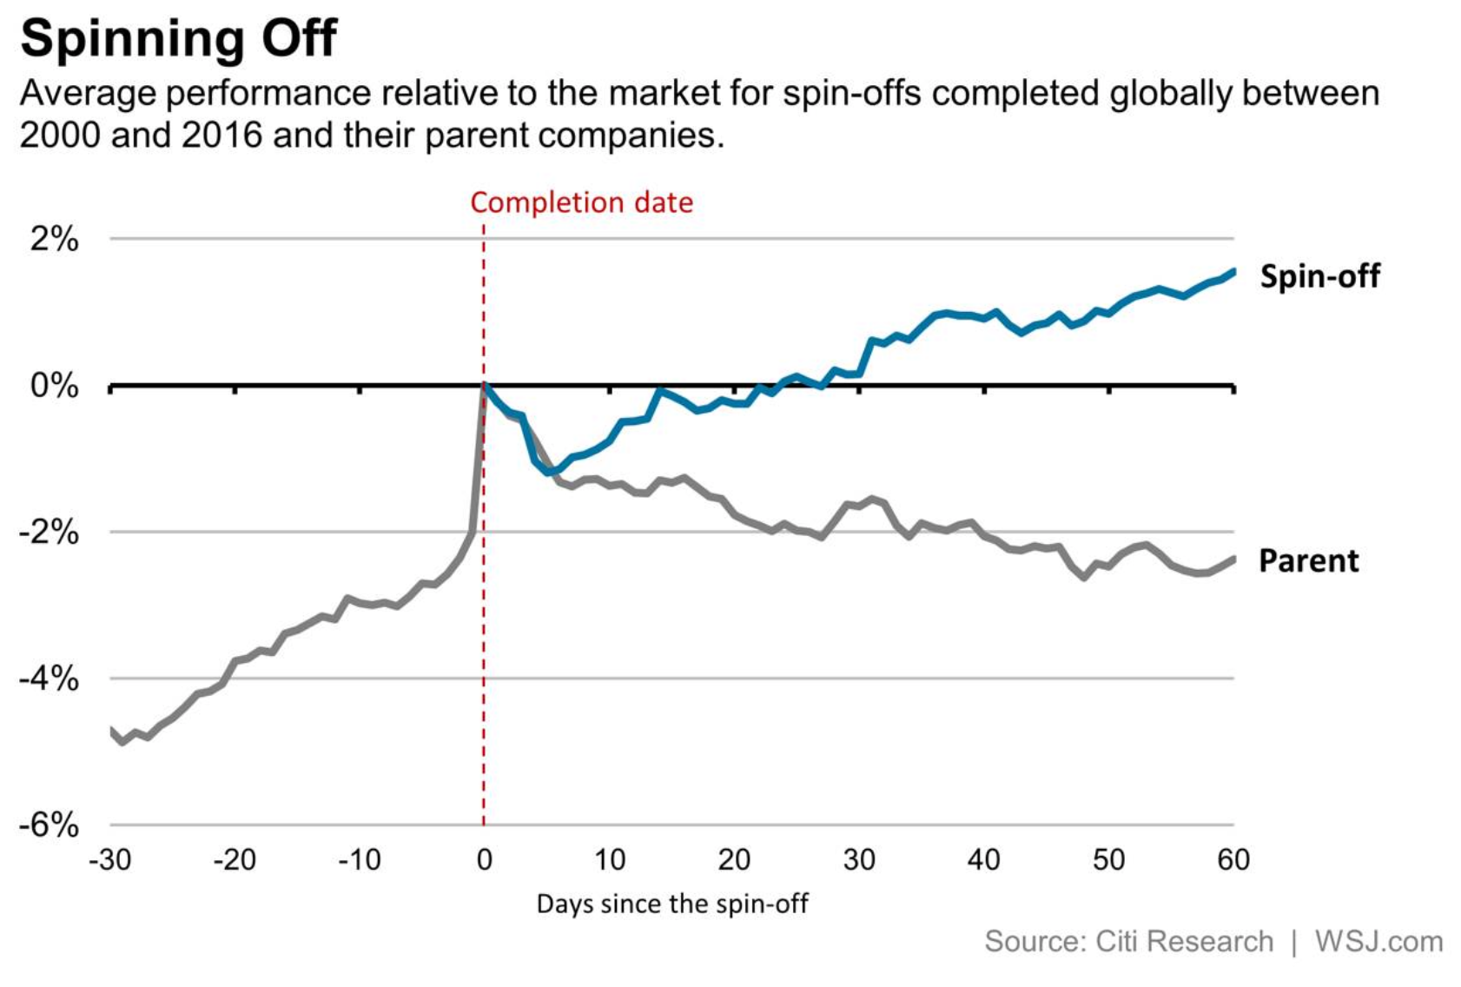
Returns to spin offs…

Slide 30
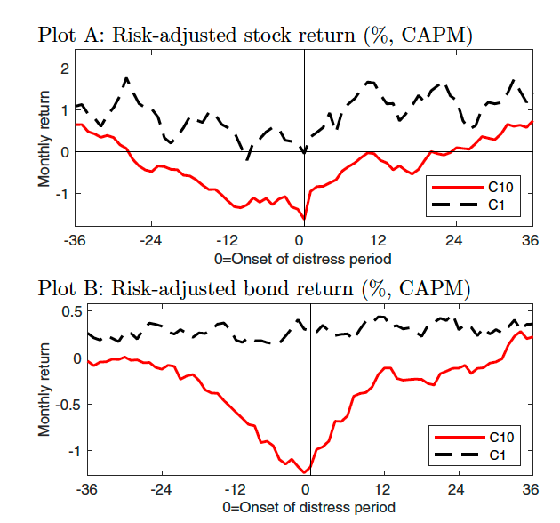
And around distress

Slide 31
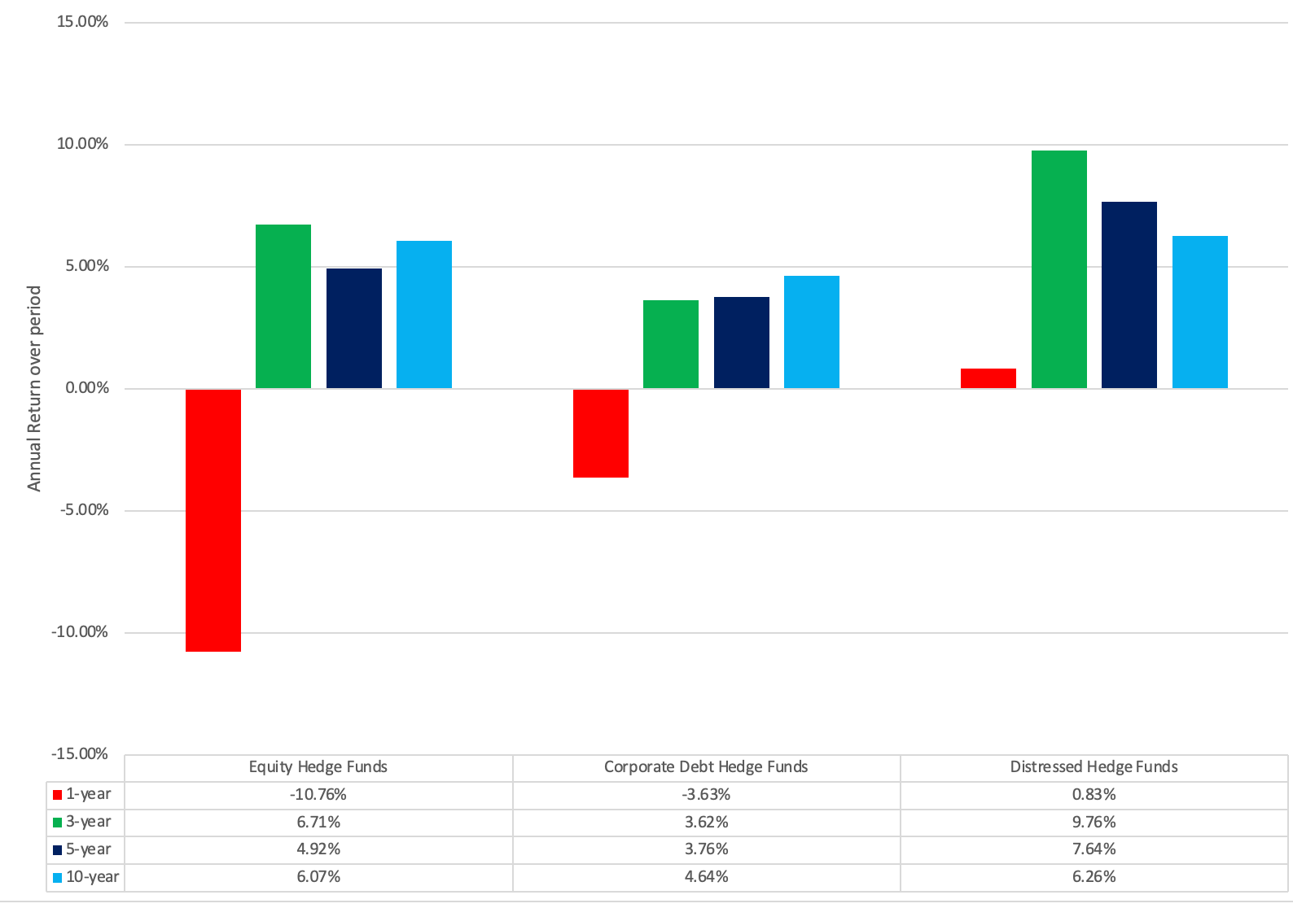
And To vulture investing overall!

