Slide 1



Chapter 18: managing across the life cycle

Slide 2
What do managers do?
Storyteller: it is the top manager’s job to craft and tell the story to investors, employees and to consumers.
Business manager: It is of course the top management’s job to manage the business that they are put in touch of, but that can span the spectrum from building a business model, for young companies, to working on ways to scale up a business for high growth firms to defending a business model for mature businesses to scaling down the model, as the company enters the declining phase.
People leader: Organizations are composed of people, including suppliers, employees and customers, and it is the top management’s job to lead these people, though the nature of that leadership will also shift as a company ages.
Public face: With investors, top managers frame the vision/narrative for young companies and are key to drawing in fresh capital, whereas with mature firms, especially if they are publicly traded, managers interactions are with institutional investors, where they try to manage expectations and frame results. With regulators and politicians, the top managements’ role is sometimes to play defense, when their companies are in the crosshairs and facing regulatory questioning, and sometimes to play offense against competitors.
Succession planner: There is a final aspect of top management that is often ignored but can be key to extending a company’s life cycle, and that is preparing for a succession, where a new management is readied, for a handover, when it comes due.

Slide 3
How much does management matter?
Macro versus micro: Businesses that are driven more by macroeconomic movements, such as those in interest rates or commodity prices, will be less affected by who manages them than companies whose success can be traced to company-specific actions on which products to produce, how to price them and where to market them.
Corporate Life Cycle: At the risk of generalizing, management matters more at start-ups and very young companies, since it must deliver not just on vision but on business-building than at mature firms, that have strong competitive advantages and are in good financial position, where management can be on autopilot.
Competitive advantage: In companies with long-standing and legacy competitive advantages, management has more of a caretaking role, than at companies that constantly need to reinvent their competitive advantages.
Transition: Management matters more when businesses are at transition points, i.e., start-ups that are seeking out venture capital for the first time, or companies on the verge of an initial public offering or mature/declining firms ahead of a restructuring, since management actions can not only make a significant difference between success and failure, but investor reactions can also be governed by how much they trust management.
Upside and Downside: There is one final parameter that management at companies can be judged upon, and that is whether they operate in businesses where success is keyed by whether you create upside of by protecting against downside, with the former falling under the category of taking advantage of opportunities and the latter under risk management.

Slide 4
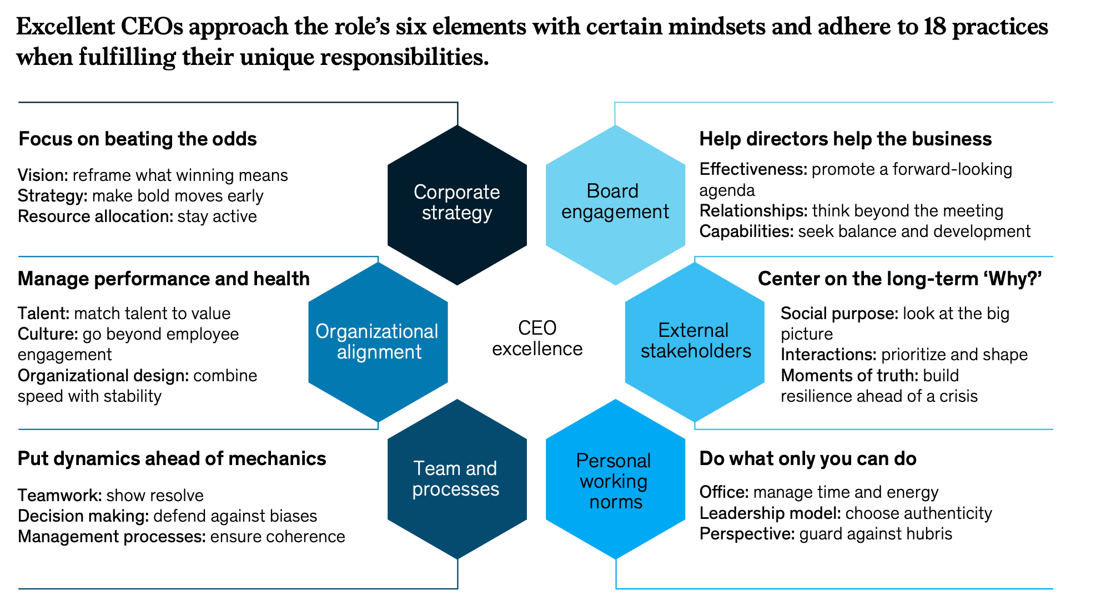
The “Great CEO” myth

Slide 5
And why it fails..
Selective and anecdotal evidence: Even if all successful CEOs share the qualities listed in the HBR/McKinsey papers, not all people or even most people with these qualities become successful CEOs. So, is there a missing ingredient that allowed them to succeed? If so, what is it?
All good qualities: We find it odd that there are no questionable qualities listed on the successful CEO list, especially given the evidence that over confidence seems to be a common feature among CEOs, and that it is this over confidence that allows them to take act decisively and adopt long term perspectives. Put simply, it is possible that the quality that binds together successful CEOs the most is luck, a quality that neither Harvard Business School nor McKinsey can pass on or teach.
Exceptions to the rule: There are clearly some successful CEOs who not only do not possess many of the listed qualities, but often have the inverse.
Flawed success: Finally, even the CEOs listed as success stores have had to deal with failure during their lifetimes, or have seen their legacies tarnished, in hindsight.

Slide 6
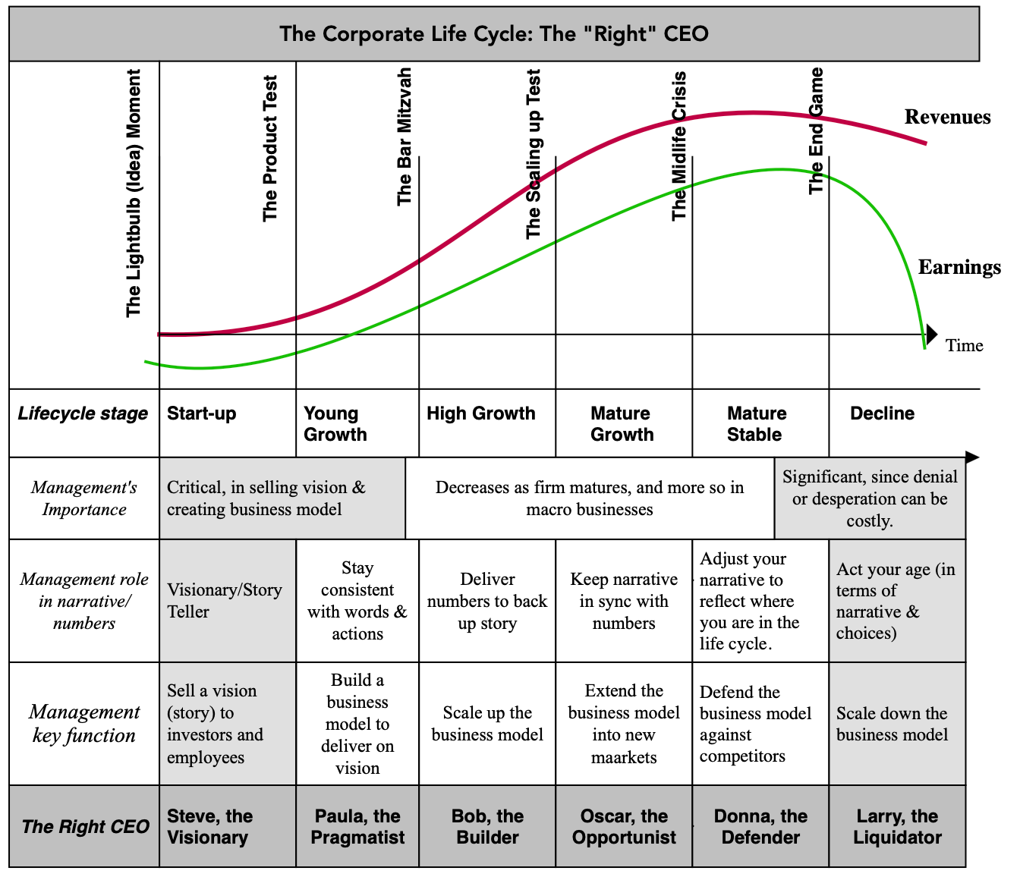
The “right” CEO for a company

Slide 7
Management mismatches: Reasons
Aging Management and/or company: Companies and managers age, and as they do, they change. With companies, we noted that as they move from start-ups to growth to maturity, the focus shifts from building business models to defending them, and from more risk taking to less. With top managers, aging creates its own dynamics, with studies showing that as managers age, they are generally less likely (or willing) to take risks or engage in innovations that may undercut existing products.
A Changing Business, Static Management: There is a more subtle problem, where a company is well matched to its CEO at a point in time, but then evolves across the life cycle, but the CEO does not. The firm’s evolution in the life cycle can come from changes in its make-up, perhaps as its business model evolves, or from disruption of the overall business by an external force, which can convert a mature and predictable business into a risky and declining business.
Hiring Mistakes: When looking for replacements for top managers who are stepping down, boards of directors often look for executives who they believe will be successful stewards of the company, but they can make mistakes. If the board of directors hires someone who is has been a successful CEO, but that success came at another company at a very different stage in its life cycle, it risks a mismatch.
A Gamble on Rebirth: In some cases, a board of director picks a mismatched CEO intentionally, with the hope that the CEO characteristics rub off on the company. This is often the case when you have a mature or declining company that thinks hiring a visionary as a CEO will lead to its reincarnation as a growth company.

Slide 8
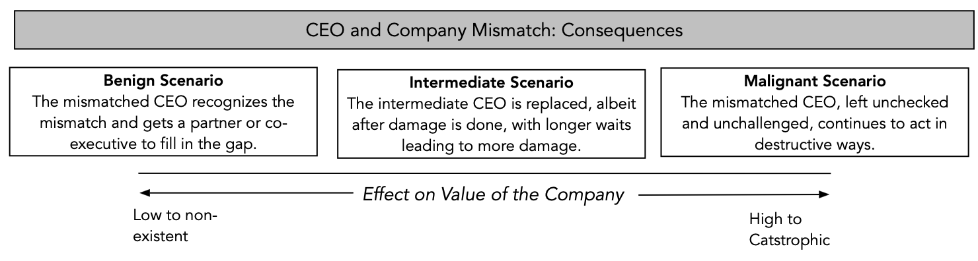
Management mismatches and value effects

Slide 9
1. Mismatches at start-ups
Purist founder: The first is at a start-up with a purist founder, who refuses to change or adapt the planned product or service to either meet market or business needs. In technology companies, this can sometimes come from founders who are technocrats, whose objective becomes creating the “perfect” software or hardware product rather than a “good enough” one that meets customer demands and is easier to build a business model around.
Control fixation: Start-ups and young companies need cash flows to convert ideas to products and then to build business models, but they lack the capacity to carry debt. Consequently, success often requires founders to give up ownership shares to investors, in return for capital. Founders who are focused on maintaining complete control will either raise capital in dysfunctional ways or starve themselves of funds, sacrificing business promise for control.
Low Interest/Skills in Business Building: Once an idea has been converted into a product or service that consumers want, you must work on building business models to deliver that product. That work often involves grunt work and attention to detail, and that is not what some founders want to spend their time on or have the skills to do. Without someone in charge of business-building, businesses will not be able to commercialize even their product or service offerings.

Slide 10
2. Mismatches at high growth firms
Scaling up at any cost: In some companies, managers become so centered on growing revenues that it becomes the driver of every business decision. These companies will succeed in delivering on growth, but often at the expense of finding pathways to profitability and with huge investments in acquisitions or new products.
Refusing to scale: At the other extreme, an obsession with turning earnings and cash flow positive can result in managers turning aside value creating opportunities to scale up their businesses, because it may mean losing money or having negative cash flows for longer.

Slide 11
3. Mismatches at mature growth
Scaling over profits: Since mature growth businesses come into this phase after periods of high growth, where growth was always given priority over profits, top managers at these businesses can sometime stay stuck in that paradigm. That will lead them to invest more than they should in new projects or big acquisitions and create companies that are growing too much and earning too little.
Chasing the past: When businesses are in high growth, they usually have more investment opportunities than they have capital available, have light or no debt loads and return no cash to investors. As they transition to mature growth, those circumstances will change, as improving earnings give rise to debt capacity as well as allow for cash return (in dividends or buybacks) to owners. Managers at these businesses sometimes fight these trends, choose not to borrow, or return cash, because that is what has worked for them in the past.

Slide 12
4. Mismatches at mature firms
Growth delusions: While low growth is the outcome that you should expect to see at most mature businesses, there are some that are run by top managers who yearn for a return to high growth, and act accordingly. Lacking internal projects of enough size to make a growth difference, they seek out acquisitions, with a skew towards bigger deals.
Empire Builders: There are some companies where top managers become more intent on building empires, rather than viable and profitable businesses. This is especially the case, when you have CEOs, with long tenure and a captive board of directors, who are interested in expanding company size, defined in terms of revenues or even employees, at any cost.
Moat Mix-ups and Neglect: If top management misidentifies the moats in a business, believing, for instance, that brand name is its competitive advantage when it is really economies of scale, its actions will reflect that misidentification and put its competitive advantages at risk.

Slide 13
5. Mismatches at declining firms
Denial: When management of a declining business is in denial about its permanence, attributing the decline in revenues and profit margins to extraordinary circumstances, macro developments or luck, it will act accordingly, staying with past practices on investing, financing and dividends. If that management stays in place, the truth will eventually catch up with the company, but not before more money has been sunk into a business that is un-investable.
Desperation: Management may be aware that their business is in decline, but it may be incentivized, by money or fame, to make big bets, with low odds, hoping for a hit. While the owners of these businesses lose much of the time, the managers who get hits become superstars (and get labeled as turnaround specialists) and increase their earning power, perhaps at other firms.
Survival at any cost: In some declining businesses, top managers believe that it is corporate survival that should be given priority over corporate health, and they act accordingly. In the process, they create zombie or walking dead companies that survive, but as bad businesses that shed value over tim

Slide 14
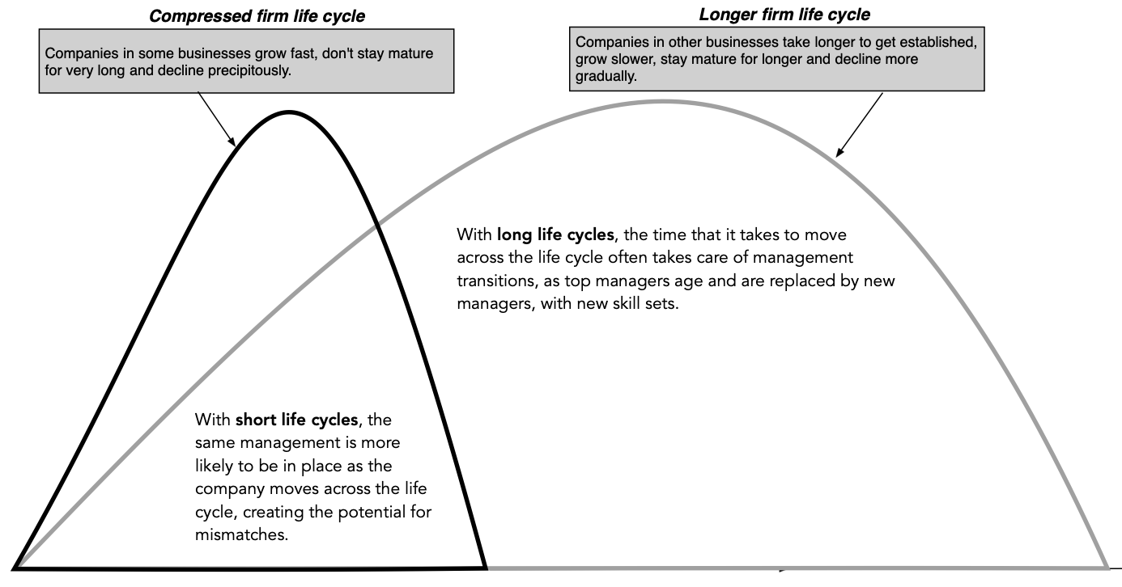
The compressed life cycle and management mismatches

Slide 15
Fixing mismatches: Changing management
Private businesses: While the owner/manager overlap can make change impossible in some cases, there are processes for change in both founder-run and family-owned businesses.
  With founder-run businesses, that change can sometimes come from venture capitalists and outside investors who have ownership stakes in the business and can use those stakes to remove and replace founder/managers.
  With family-run businesses, the change must come from the family, motivated by poor performance in the business, and can either involve replacing family-member managers with other family members or with outsiders.
Public companies: Once companies become publicly traded, the management change process must go through the board of directors of the company. To the extent that board members are picked by incumbent managers, there will be a built-in bias towards preserving existing management.

Slide 16
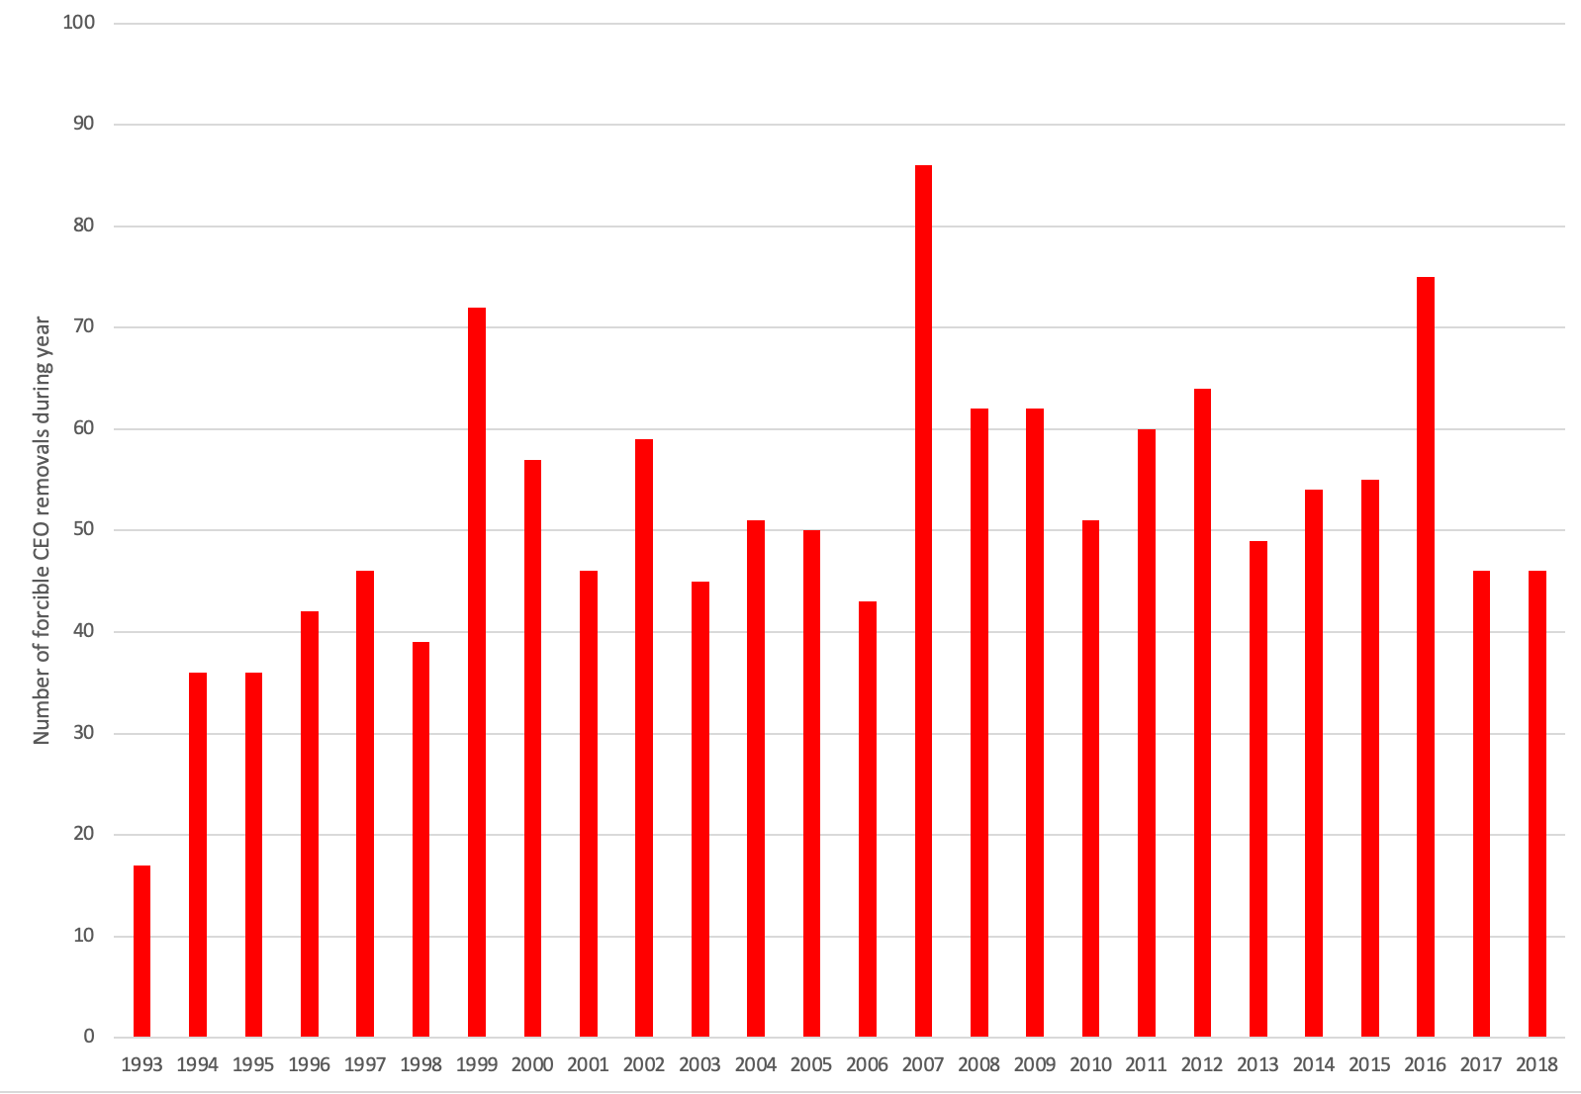
Forcible CEO turnover

Slide 17
Management change catalysts
With start-ups and very young companies in the private domain, the catalyst for change is often a venture capitalist or a group of venture capitalists with skin in the game,.
With young, high growth companies, right after they go public and in the early years as a public market, the push for change usually comes from inside investors in the companies, shareholders who own large stakes in the company.
With high growth companies, change is often pushed to the forefront by individual or institutional investors with a large stake, and an activist tilt.
With mature growth companies, the catalyst for change can come from new management is put in place, often as the result of natural transitions, where the existing CEO retires or dies.
With mature companies that are publicly traded, the catalyst for change will be activist investors and hedge funds, often in response to disappointing operating and stock market performance.
With declining firms, private equity firms become catalysts pushing to buy out these firms, and make them private, while they make operating and financial changes at these firms.

Slide 18
Management change: challenges
a. Institutional Constraints
  Capital constraints: The quickest and sometimes most decisive way to change management, is to raise capital to acquire firms that are poorly managed, and any constraints on that process can impede change. It should come as no surprise that management changes are less frequent in economies where capital markets – equity and debt - are not well developed.
  State Constraints on Takeovers and Shareholder Votes: In many countries, the state takes the side of incumbent managers, making it more difficult to change management. In some countries, there are restrictions or even outright bans on both hostile acquisitions and on
b. Firm-specific Constraints
  There are some firms where incumbent managers, no matter mismatched, are protected from stockholder pressure by actions taken by these firms that skew the rules of the corporate governance game
  The push towards stakeholder wealth maximization and ESG at some companies has made it more difficult for shareholders to make changes at these companies.

Slide 19
Likelihood of management change
In one of the first papers to assess the likelihood of takeovers by comparing target firms in acquisitions to firms that were not targets, Palepu (1986) noted that target firms in takeovers were smaller than non-target firms and invested inefficiently.
In a later paper, North (2001) concluded that firms with low insider/managerial ownership were more likely to be targeted in acquisitions. Neither paper specifically focused on hostile acquisitions, though.
Nuttall (1999) found that target firms in hostile acquisitions tended to trade at lower price to book ratios than other firms and Weir (1997) added to this finding by noting that target firms in hostile acquisitions also earned lower returns on invested capital.
Finally, Pinkowitz (2003) finds no evidence to support the conventional wisdom that firms with substantial cash balances are more likely to become targets of hostile acquisitions.

Slide 20
And of CEO firing…
Stock price and earnings performance, with forced turnover more likely in firms that have performed poorly relative to their peer group and to expectations. One manifestation of poor management is overpaying on acquisitions, and there is evidence that CEOs of acquiring firms that pay too much on acquisitions are far more likely to be replaced than CEOs who do not do such acquisitions.
The second factor is the structure of the board, with forced CEO changes more likely to occur when the board is small, is composed of outsiders and when the CEO is not also the chairman of the board of directors.
The third and related factor is the ownership structure; forced CEO changes are more common in companies with high institutional and low insider holdings. They also seem to occur more frequently in firms that are more dependent upon equity markets for new capital.
The final factor is industry structure, with CEOs more likely to be replaced in competitive industries.

Slide 21
Governance early in the life cycle…
In start-ups and very young companies:
  Founder CEOs either step down or are pushed out at much higher rates than in more established companies.
  Founder CEOs who nurse their companies to more established status, and to public offerings, are more entrenched that their counterparts at mature companies.
In young, growth companies, founder-CEOs are often put on a pedestal, relative to CEOs of established companies, and while that may be understandable, in some cases, it can take the form of founder worship.

Slide 22
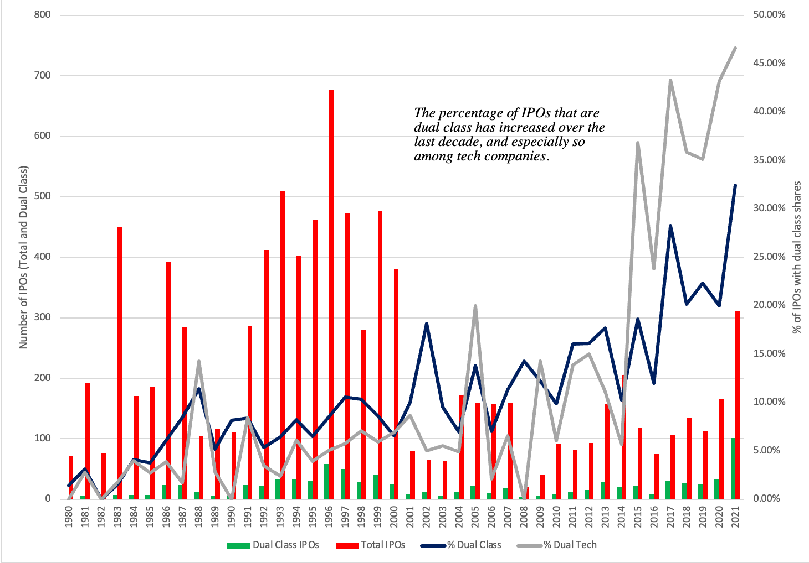
Compounded by dual-class shares

Slide 23
Governance at mature firms
More shares are held by institutions and fewer by insiders and individuals. Institutional stockholders, for the most part, are passive, and vote with their feet (by selling stock in firms that they believe are not well managed).
That said, the likelihood of changing management has increased over the last few decades, for many reasons.
  The first is the capital that private equity and hedge funds control is much greater than it was three or four decades ago, making it easier for them to not only target more firms, for change, but also much bigger ones.
  The second is that technology and information sharing has made it easier to build coalitions for change.
As investors in a company become global, you are finding companies that would not have faced questioning and challenges from their local market investors, being exposed to those questions from a global investor base.

Slide 24
Governance at declining firms
The first challenge is in the nature of the changes that will be delivered by new management, since decline implies layoffs and shutdowns, both of which create side costs for stakeholder groups and society.
It is no surprise that Hollywood’s biggest villains in business-centered movies are private equity investors, doing leveraged buyouts of companies.
  The challenge with changing the ways declining companies are run is not in the changes themselves, but in the packaging and presenting of those changes, many of which create pain for stakeholders in the firm (employees, suppliers) or for society.
  It is one the reasons that private equity firms that are often the agents of change in this space, buyout public firms in decline and try to make the changes as private firms, where they receive less scrutiny and perhaps less backlash.
The second is that in decline, especially if accompanied by distress, firms become entangled in the legal system, which slows change. If the bankruptcy process is slow and costly enough, change will become uneconomic, and these companies will be left to fend for themselves, using up resources and capital that could find better uses.

Slide 25
Governance at family group companies
Power must become more diffuse within the family, away from a powerful family leader and more towards a family committee, to allow for the different perspectives needed to become successful in businesses at other stages in the life cycle.
  There must be a serious reassessment of where different businesses, within the family group, are in the life cycle, with special attention to those that are transitioning from one phase to another.
  If top management positions are restricted to family members, the challenge for the family will be finding people with the characteristics needed to run businesses across the life cycle spectrum.
Finally, if a mismatch arises between a family member CEO and the business, he or she is responsible for running, there has to be a willingness to remove that family member from power, sure to raise family tensions and create fights.

Slide 26
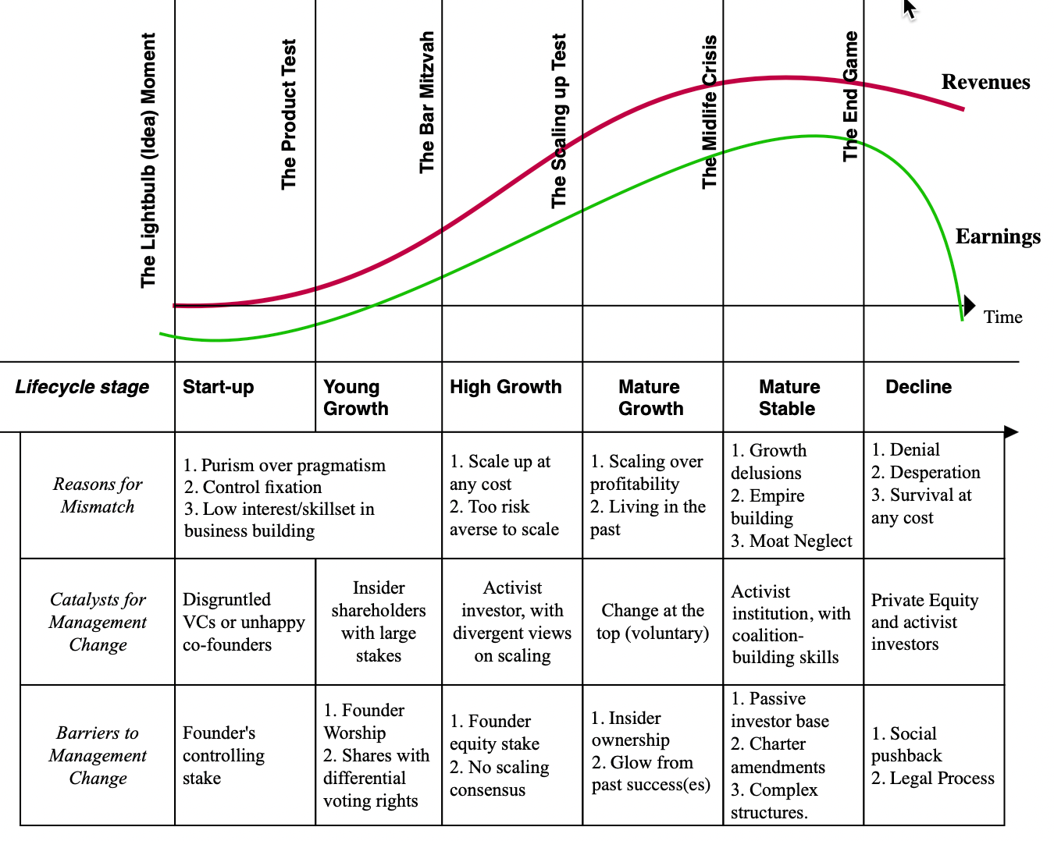
Management change across the life cycle

