Slide 1



Chapter 19: Fighting aging – upside & downside

Slide 2
The acceptance playbook
Narrative that fits: An accepting management will tell a corporate story that reflects where it is in the life cycle. With a mature business, that story will be one of low growth, perhaps with optimistic takes on margins and returns, and with a declining business, it will be one where the company reduces its asset base and becomes smaller, in response to a shrinking market.
Consistency in investing policy: A business story, grounded in reality, has credibility only if it is backed up actions that reflect belief in the story.
Consistency in financing and cash return: A management in acceptance will follow this script, refusing to borrow money, or doing so only if they have no options, when they are managing young growth companies, and borrowing more, while buying back stock, as managers of mature firms.
With investors who buy into that narrative: When companies are at peace with where they are in the life cycle, they will tend to attract investors who are like minded, making it easier to maintain policies that make sense.

Slide 3
And why acceptance is difficult..
Boredom: It is undeniably more exciting being at the helm of a growing company than a mature or declining one, and like moths drawn to a flame, managers at mature and even declining companies are drawn to the excitement of growth.
Hope: Human beings are hardwired for optimism and to hope that things will get better, and managers are many mature and declining companies believe that they are victims of circumstances or extraordinary events.
Management incentives: To the extent that compensation is tied to absolute levels of earnings or revenues, or to growth in those numbers, managers will be incentivized to push for growth, even if it costs too much, leaving shareholders worse off.
Peer Group Pressure: Even if managers can overcome these barriers to acceptance, they will face an additional barrier to staying on the path of acceptance, and especially so if they operate in businesses, where most of their competitors continue to strive for growth.

Slide 4
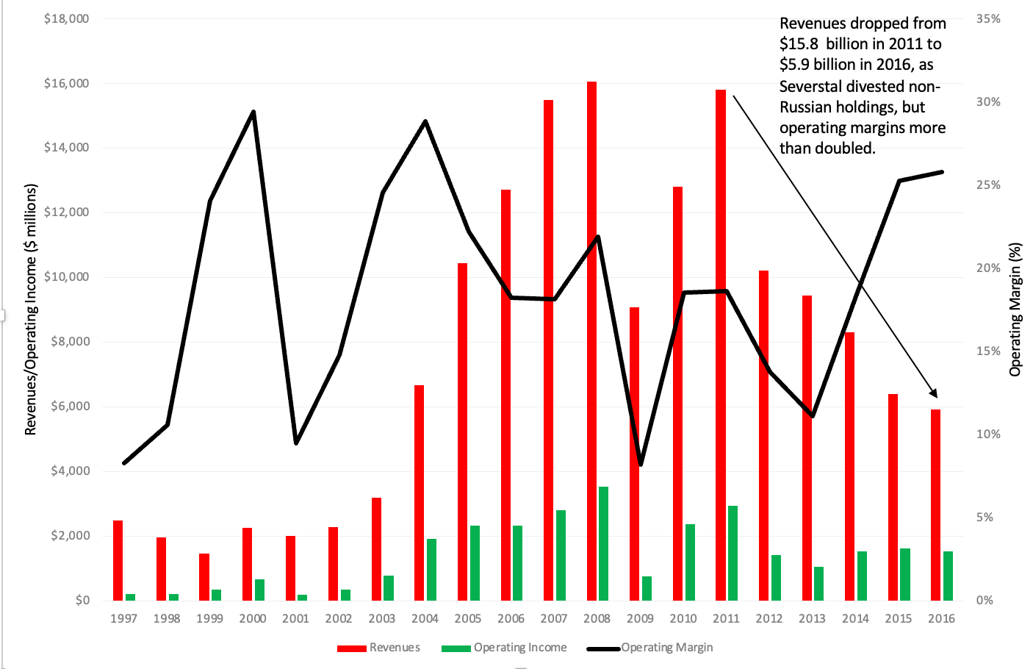
An Example of acceptance: Severstal

Slide 5
Determinants of acceptance
Skin in the game: One characteristic that companies, that respond quickly to changed circumstances, share is that that they are either privately or family owned, or if public, their managers own significant shares of ownership in these companies..
Extended Operating Pain: As the poor operating performance stretches into many years, it becomes more and more difficult to sustain these excuses, and the truth eventually comes through.
Pressure from investors: It is for this reason that it is healthy for a market to have activist investors, challenging management and holding them accountable.
Market Mood and Momentum: In good times, when markets are buoyant and stock prices are rising, companies will find themselves with more slack, and the cost of pushing for growth, by taking bad investments, even if you are a mature or declining company, may be overlooked. As market mood changes, and you see share prices dropping, that buffer disappears quickly, and corporate weaknesses and limitations are more likely to be exposed.
Access to and use of debt: In the 1980s, as the first wave of leveraged buyouts hit the market, Michael Jensen argued that debt could operate as a disciplining force in some companies.

Slide 6
Fighting aging: renewals
Corporate name changes: Since companies spend significant amounts trying to build recognition of their names, there is an obvious cost to abandoning a recognizable name, but there are cases where the benefits can exceed the costs.
  Expand or update product offerings: An operating pivot…
  Remove toxic connections: If a corporate name has become toxic, either due to news stories around it or corporate actions, and that
  Latch on to hot sectors: A new business
Strategic makeovers: In some companies, facing a low growth future, the first step in altering that future is to provide blueprints to investors and consumers of the changes they plan to make. The reaction will depend largely on the credibility of the management mapping out changes, and it is often more credible when it is a new CEO and management making the claim, rather than the incumbent management.
Remarketing and Rebranding: This approach is more likely to be attempted in a consumer product companies, and especially when brand names and consumer perception of products, rather than tangible differences across competitive products, determine market share and success.
Product Redesign: For some companies with aging brands, the key to growth is redesigning their products and services to make them appealing to different customer bases.

Slide 7
Payoff to renewal
Cosmetic versus Real Change: Cosmetic changes at companies, such as corporate name changes, can have effects on investor perception, but in our view, those effects will fade over time.
Market Price versus Operating Focus: While we understand why investors need to be part of any renewal, the more a renewal plan is grounded in operating changes that add value, the greater will be its chance of success in returning the firm to growth.
Individual or Herd Behavior: In some cases, the impetus for renewal comes to individual firms that are struggling in sectors that are doing well, and in others, it is a collective problem, where many or most firms in a sector are facing operating challenges at the same time. It is easier to map out renewal plans, when the problems at company-specific than if they sector-wide, for a simple reason. When many firms in a sector or group are facing slowdown in growth at the same time, the plans for renewal that they come up with will be very similar, and that can affect the payoffs.
Old versus New Customers: In an understandable desire to draw in new customers, companies sometimes make changes which alienate existing customers, creating net negative effects for the firm.

Slide 8
Revamps: Different forms
New Products/Services: When a company finds itself hitting a wall, when it comes to growth, either because of competition or disruption, it can sometimes find a pathway back by expanding its offerings. (NY Times)
New Markets: For some companies, the key to rediscovering growth comes from finding new markets for its products, either in the form of new customers for its existing products or new geographies to grow. (Goya & Bajaj)
New Business Models: In some cases, a company may be able to alter its growth trajectory by modifying the business model that it uses to make and sell its products or services. (Adobe)

Slide 9
Payoff to revamps
The New York Times has succeeded with its online entry, while most other newspapers that have tried have failed, because it builds on the content that the paper gets from its unparalleled staff of reporters around the world, opinion columnists with wide following and even its puzzle (crossword, Wordle) content.
Goya’s successful expansion in the 1980s came from its unique positioning as one of the only Hispanic food manufacturers in the US market, and its strong brand name identification in its core market.
For Bajaj Auto, the lower cost structure coming in its Indian manufacturing facilities gave it a leg up, especially when competing with Italian or Japanese scooter manufacturers, and explains why it was able to capture market share so quickly in the global market.
With Adobe, the subscription model caught on quickly, because its software was already dominant in the market, and its products (Photoshop, Adobe etc.) benefited broadly from the online shift.
If there is a lesson here, it is that companies planning revamps must begin with an assessment of their moats (competitive advantages) and strengths, and try to exploit them, when developing new products/services, seeking out new markets or creating new business models.

Slide 10
Rebirths: the allure
There are companies that have beaten the odds of the business life cycle, fought off decline, and been reborn as successful ventures.
  Two examples that come to mind are IBM’s fall from glory in the 1980s and its subsequent rebirth as a healthy, profitable firm in the 1990s and Apple’s climb back from the dark days of 1997 to the top of the market capitalization table in 2012.
As we think of these and other examples, it is worth noting that the very fact that we can name these companies suggests that they are the exceptions rather than the rule.
Notwithstanding that sobering reality, it is still useful to put these success stories under the microscope, not only to get an understanding of what allowed these companies to succeed, but also to develop forward-looking criteria that we may be able to use in investing.

Slide 11
Ingredients for a rebirth
Acceptance that the old ways don’t work any more: To have a corporate rebirth, a company must come to an acceptance that the old ways, successful though they might have been in the past, don’t work any more
A Change Agent: This is a cliché, but change starts at the top, often a CEO who leans into change.
A Plan for Change: Pointing out that the existing ways don’t work anymore is important, but it is futile unless accompanied by a new mission and focus. At IBM, Gerstner changed the mindset of the company (and its employees) early in his tenure, an
Building on company’s strengths: If there is a common theme that runs across renewals, revamps and now rebirths, it is that a company that is trying to reinvent itself in a new business must build around its strengths
Shake up the status quo: At many companies, rebirth will mean that you may have to give up revenues and earnings that you generate from existing products businesses, and those who run those businesses will push back, pointing to cannibalization as a reason to go slow on new businesses
Luck: Much as we would like to attribute success to great skill and failure to poor management, it remains true that the X factor in rebirth success is luck.

Slide 12
The downside: steep falls
Personality-driven: If a business is built around a personality, a founder CEO who operates as the public face of the company, and who plays the lead role in every significant decision made by the business, it is exposed to the danger that losing that person will make the company less valuable, and in some cases, not salvageable.
Political Connections: When the connections are with those in power, they can used to pump up growth and profitability, but with a caveat. Being labeled a company that works well because of its connections with one side of a political divide can create danger if the other side ever claims power or if those connections weaken.
Concentrated Success (product, geography, customer): There are some large and very successful companies that can trace their operating and market success to one or two of their products or from sales to one or two very large customers..
Disruption of business: The first three factors exposing companies to steep falls are largely self-inflicted, but there are forces outside the firm that can cause steep fall offs in revenues, and we can loosely lump them together under the head of disruption.
Acts of God: For much of human existence, the biggest threats to businesses came from acts of God, as natural disasters such as floods, fires and hurricanes laid waste to thriving businesses.

Slide 13
The downside: sudden death
Legal Jeopardy: As we have seen several times in the last few decades, a company that is growing and profitable, with a high value attached to its business, can lose it all in the face of a large lawsuit that lays claim to its primary assets or contends that the products and services sold by the company have created significant costs for consumers and society.
Regulatory Actions: In businesses like financial services and telecom, where companies need regulatory approval to stay in business, violating a regulatory constraint or rule can lead to not just punishment, but a shut down.
Fraud and Criminal Behavior: A third reason for corporate shut down is fraud, either legal or accounting, where companies that have been misleading or lying to investors and consumers for years, and the lies are exposed. Consider how quickly Enron went from being a company with a market capitalization of $70 billion to a corporate shell with no assets and no business, in the aftermath of its behavior in the 1990s.

Slide 14
The downside: Zombieland
A Broken Business Model: The company's business model is dead, with the causes varying from company to company: management ineptitude, superb competition, macroeconomic shocks or just plain bad luck. Whatever the reasons, there is little hope of a turnaround and even less of a comeback. The manifestations are there for all to see, including sharply shrinking revenues, declining margins and repeated failures at new business ventures/products/investments.
Management in Denial, and Entrenched: The managers of the company, though, act as if they can turn the ship around, throwing good money after bad, introducing new products and services and claiming to have found the fountain of youth. They are fortified by weak or non-existent corporate governance systems and sometimes by family ties (if the business is family controlled or owned).
Enabling Ecosystem: The managers are aided and enabled by consultants (who collect fees from selling their rejuvenating tonics), bankers (who make money off desperation ploys) and journalists (either out of ignorance or because there is nothing better to write about than a company thrashing around for a solution).
Resources to waste: While almost all declining companies share the three characteristics listed above, the walking dead companies are set apart by the fact that they have access to the resources to continue their path to nowhere and must be kept alive for legal, regulatory or tax reasons. Those resources can take the form of cash on hand, lifelines from governments and/or capital markets that have taken leave of their senses.

Slide 15
The blackberry example
In December 2011, we wrote about Blackberry (then called Research in Motion), and argued that it needed to act its age, accept that it would never be a serious mass-market competitor in the smart phone market and settle for being a niche player. That piece, which occurred when Blackberry had a market capitalization of $7.3 billion, argued that Blackberry should give up on introducing new tablets or phones and revert to a single model (which we termed the Blackberry Boring) catering to paranoid corporates (who do not want their employees accessing Facebook or playing games on smart phones). We also suggested that Blackberry settle on a five-year liquidation plan to return cash to stockholders.
We were accused of being morbid and overly pessimistic, but when we looked at Blackberry three years later, its market cap had dropped to $5.3 billion, and in the three years since the first post, the company had spent $4.3 billion in R&D, while its annual revenues have dropped from $18.4 billion in 2011-12 to $4.1 billion in 2014-15, and its operating income of $1.85 billion in 2011-12 has become an operating loss of -2.7 billion in 2014-15. Blackberry’s new model may have been technological marvels, but the smart phone market had moved on, where a phone is only as powerful as the ecosystem of apps and other accessories available for it is.
In sum, the problems at walking dead companies get worse, the longer they stay alive, and their options will only get worse

Slide 16
Making your choice
As managers of a business, you must play the hand you have been dealt, not the one that you wish you had, and that is at the heart of good management.
  Management quality: There are companies with endowed competitive advantages, such as access to low-cost natural resources or a centuries-old brand name, where management really adds very little to success, and if anything, can do more harm than good.
  Dangers of Anecdotal Evidence: While there is story telling value, especially with a skillful narrator, we believe not only that the lessons from both successes and failures have limited extrapolative power, but also that luck and timing may be sometimes all that separates the two groups.
  Market feedback: Much as you believe that markets are getting you wrong, it pays to listen to what they are saying, since they represent collective expectations.

