Slide 1



Chapter 2: The Corporate life cycle - Basics

Slide 2
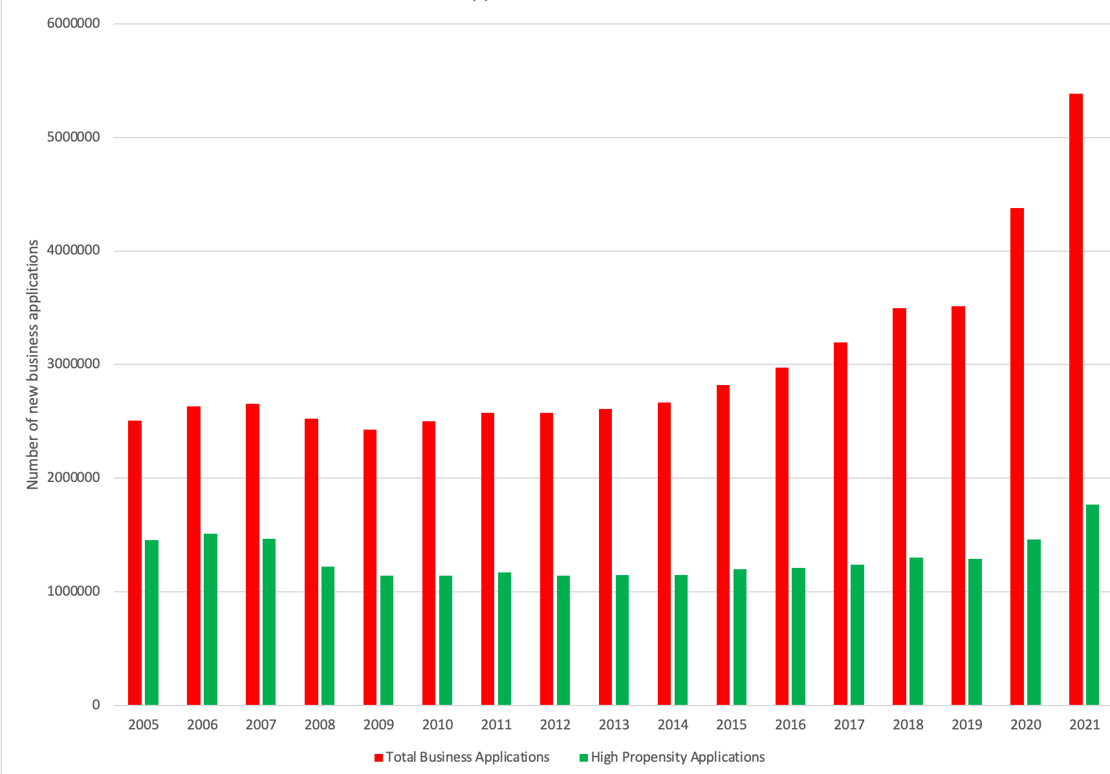
Phase 1: Start-up

Slide 3
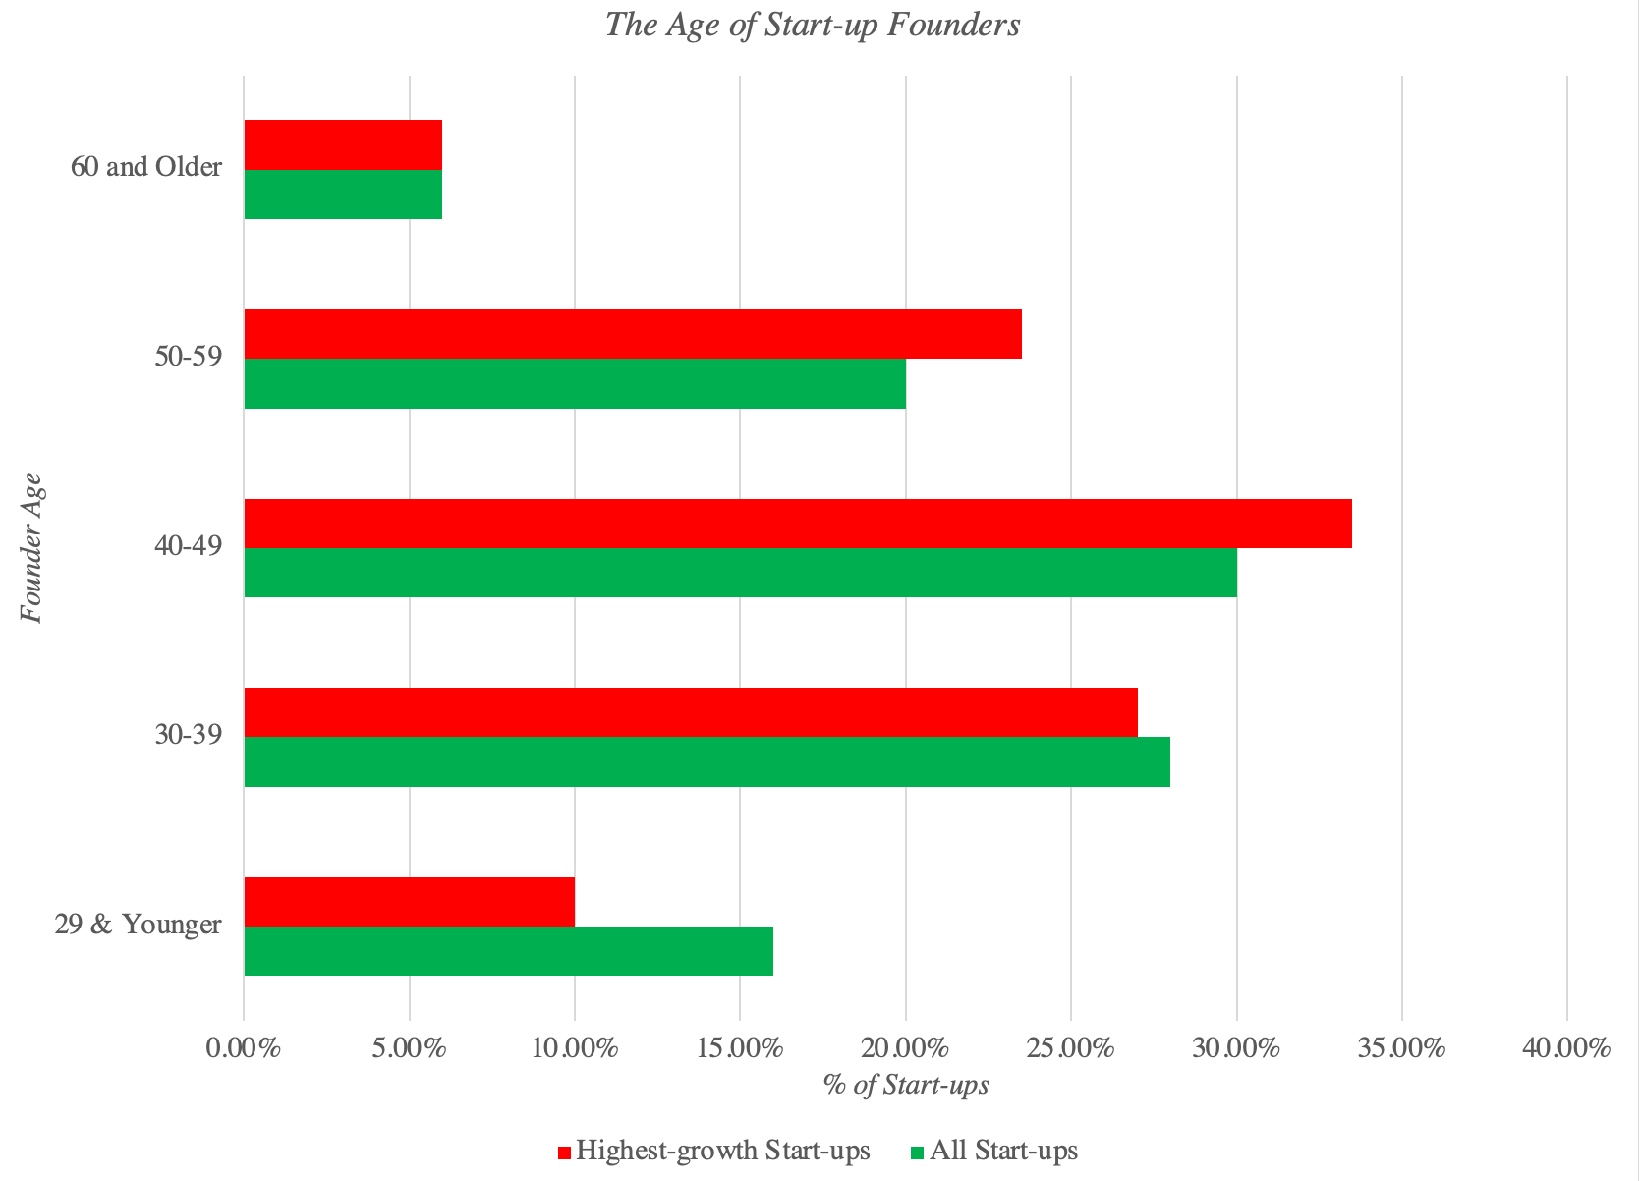
With The founder effect… Age

Slide 4
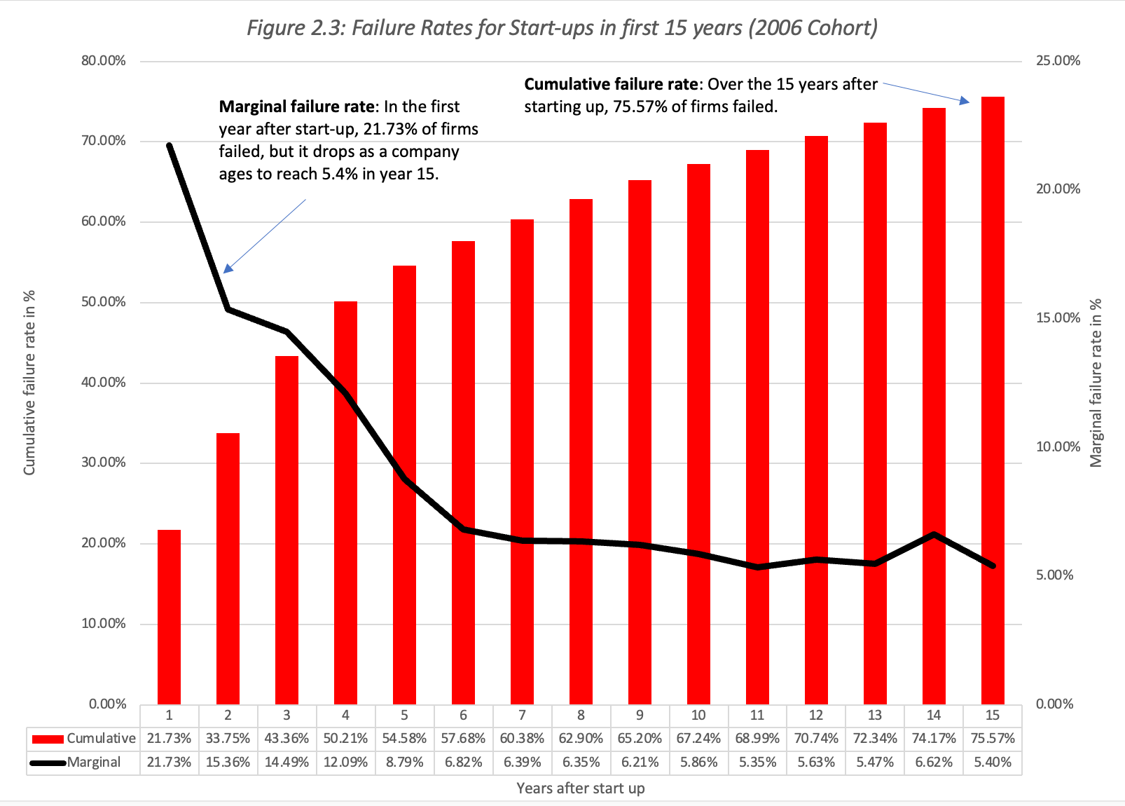
The business challenge..

Slide 5
The Financial, capital and ownership challenges
Early on, absent revenues, and faced with large and rising expenses on employees, product development and R&D), young companies not only will lose money, but they will burn through cash.
Start-ups and pre-revenue companies are destined to lose money, with extent of their losses being driven by two variables.
  The first is market potential, with companies that see more potential being more willing to lose more money, while the try convert ideas to products.
  The second is founder ambition, with more ambition translating into bigger dreams, larger costs and greater losses.
Unless founders have deep pockets, family backing or wealthy benefactors, there will come a time when outsiders (venture capitalists and private equity investors) must be approached for the capital needed to cover the cash burn, if you intend to keep going.
This “angel financing”, if available, will come with a cost, as investors will demand significant ownership stakes in return for providing capital.

Slide 6
phase 2: Young growth – the business challenge
In terms of operating challenges, the founders/owners of the businesses will have to start working on the business basics, ranging from production choices to supply chains to marketing plans.
  In some cases, the investors who provide angel financing may be able to offer help on these dimensions, based upon their experiences with prior businesses that they have successfully built up.
  In other cases, founders may have to bring in someone from the outside with business-building experience, again offering an ownership stake as an incentive.
  This tension between a founder’s desire to maintain control and investors’ wanting to change the way a business is run can lead to what Noam Wasserman has labeled the Founder’s dilemma.
The business model choices that are made at this stage of the life cycle require tradeoffs, but once made, these business modeling decisions can become difficult to change later.

Slide 7
The financial challenge
On the financial front, businesses going through young growth will see the beginnings of tangible results, with the first streams of revenues coming in, and even growing at high rates. Those revenues, though, will often be overwhelmed by continuing and growing expenses.
The clues to how the firm will do, as it grows lie in:
  Growth versus Operating Expenses: While expenses will run ahead of revenues for most firms in this stage of the life cycle, it does matter whether those expenses are associated with the products or services that are being sold in the current period or are being driven by the company’s growth ambitions.
  Unit Economics: The unit economics of a business measure the marginal profitability of the extra unit that is sold, capturing the difference between revenue generated on that unit and the costs of producing that unit.
  Stock based compensation: Young companies have negative cash flows, and as they seek to hire and keep employees, they can often stay competitive only by offering stock-based compensation in the form of shares or options in the underlying businesses.

Slide 8
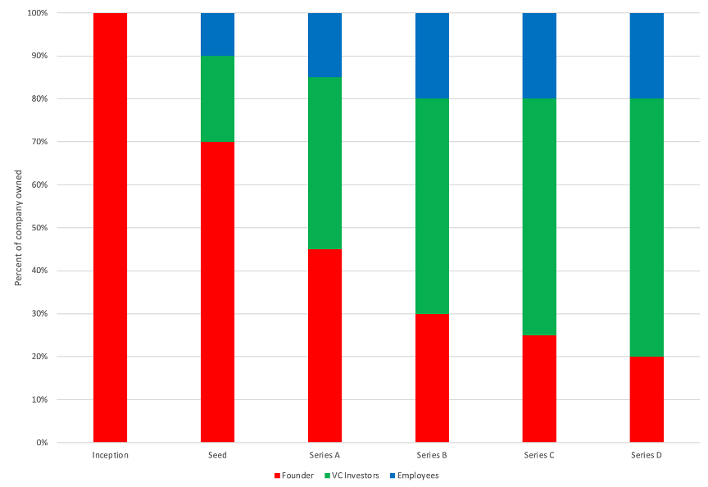
The capital and ownership challenge
As businesses make the transition from idea to product and try to build business models that can deliver profits, they will continue to lose money and have increasingly negative cash flows.
That will require capital infusions, and a dilution of founder holdings in the company

Slide 9
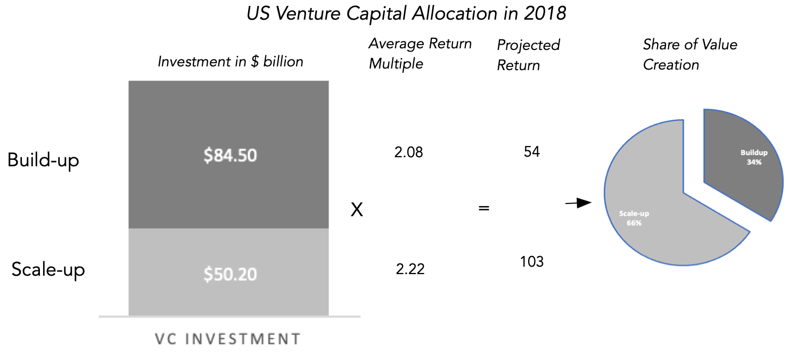
Phase 3: High growth – the business challenge
The scaling up test has an operating component, but it also brings the trade-off between control and capital, prevalent in the first two stages of the cycle, to the surface.
Scaling up may require so much capital that founders who access that capital will have to give up enough of their ownership stakes to outside investors, to lose control of their businesses.

Slide 10
The financial challenge
In financial terms, this is the phase where the business model will be tested and measured.
  If successful, revenue growth will continue at high rates, but expenses will grow at lower rates (economies of scale), generating less negative and, in some cases, even positive profits.
  The question of how quickly this will happen will depend in large part on the unit economics of the business, which we referenced in the last section.
The bottom line is that not all successful businesses scale up, and when they fail to do so, it can be just as much because the business is not scalable as it is because founders do not want to give up control.
The businesses that choose to not scale up should not be viewed as failures, since small businesses that are self-sustaining and meet a market need represent a key part of any economy.

Slide 11
The capital & ownership challenge
Businesses that can grow revenues and deliver profits have created business models that work, and while they can choose to stay private, the incentives to enter public markets will increase, especially as they scale up.
  One reason is to allow founders, existing investors and employees to cash out on their ownership holdings, by selling their shares or exercising their options, in more liquid, public markets.
  Another is to that young companies that are still burning cash and need to raise capital can do so often at better terms (in terms of ownership given up in exchange) in public markets than from venture capitalists.
The extent of the push to go public will be greater in regions of the world with liquid capital markets, for larger businesses, and in sectors that investors see as attractive investment destinations.

Slide 12
Phase 4: Mature growth – the business challenge
The operating challenges for businesses at this stage that choose to continue growth is that growth must be on a much large scale. In short, growing revenues at 25% a year is much simpler when base year revenues are $10 million than when they are $1 billion.
The companies that can pull of this unusual feat are exceptional and often get anointed as market stars.
For all firms at this stage, the other challenge is improving operating margins, with part of that improvement coming from fine tuning business models to make them more efficient and part from more economies of scale.

Slide 13
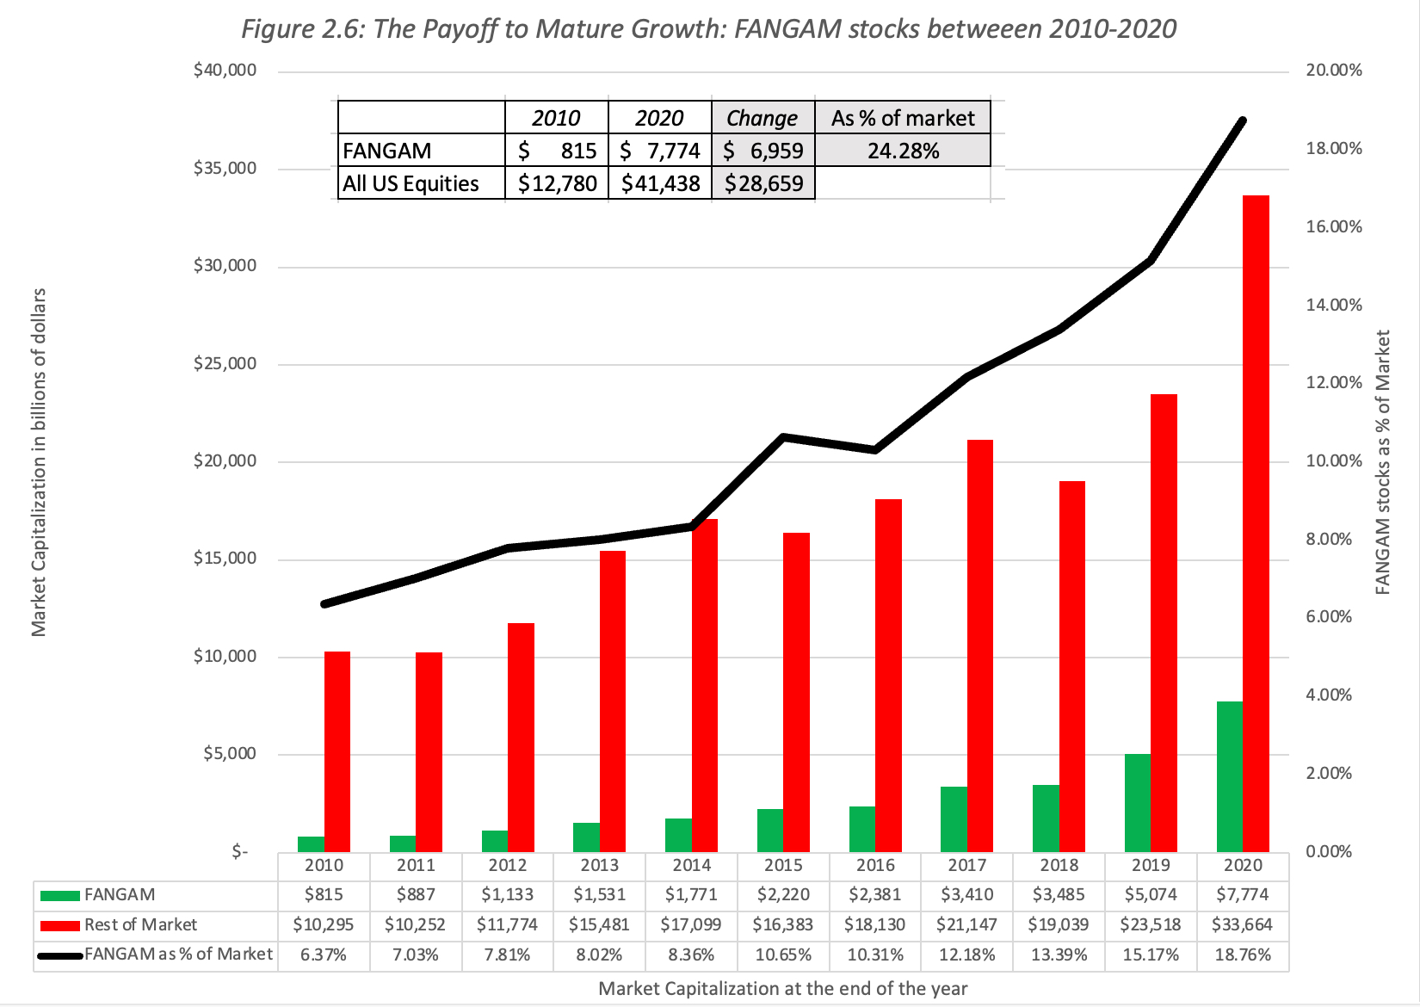
The Fangam success stories
 | Revenues (in $ billions)
 | In 2010 | In 2020 | CAGR over decade
Facebook | $ 1,974 | $ 117,900 | 50.53%
Amazon | $ 34,204 | $ 469,800 | 29.95%
Netflix | $ 2,163 | $ 29,700 | 29.95%
Google | $ 29,321 | $ 257,600 | 24.27%
Apple | $ 65,225 | $ 378,300 | 19.22%
Microsoft | $ 62,484 | $ 184,900 | 11.46%

Slide 14
The financial challenge
With continued revenue growth and improving margins, businesses are in the sweet spot in the life cycle, where even with a moderate revenue growth rate, earnings growth will run ahead of revenue growth.
  For these firms, slowing growth also yields a bonus, generating higher and more positive cash flows, as reinvestment needs decrease.
  To the extent that these firms choose not to return cash to their owners, they are also the firms with burgeoning cash balances.
For successful businesses, this stage of the life cycle represents the best of all worlds in the life cycle, with the excitement of growth accompanied by the comfort of positive earnings and solid cash flows.
That said, it is an adjustment phase, where young companies that have had to ration capital across competing investments find themselves with cash on their hand and not enough investment opportunities.

Slide 15
The capital & ownership challenge
As growth companies mature, they become largely self-sufficient, when it comes to cash flows, eliminating the need for capital raises.
In many cases, the mix of public market investors in the company will change in this stage, with institutional investors replacing individual investors and traders, and they may put a different set of demands on managers.
If the company’s cash flows have turned positive, and/or it is gaining the capacity to borrow money, some of these institutional investors may put pressure on the company to start borrowing and to initiate dividends or stock buybacks.
For founders, who stay on as top managers, this is a period where they may face the downsides of being public.
  First, accounting and regulatory disclosures become more onerous, as the company’s investments get more extensive, and disclosure requirements ramp up.
  Second, founders and top managers will spend more time on investor relations, framing the news around earnings announcements and providing guidance.
  Third, they will have to deal with shareholder pressures on investing, financing and dividend policy, though having dual voting class shares can reduce the need to act, in response.

Slide 16
Phase 5: Mature stable – the business challenge
The biggest challenge for mature businesses is a mindset shift, as they shift from playing offense, where their focus is on entering new markets or gaining market share, to playing defense, where the primary objective becomes protecting existing market share and profit margins from competition.
The capacity of a business to play defense will be determined, in large part, by its competitive advantages or moats, and these moats can come from a variety of sources. No matter what the source, though, protecting these competitive advantages becomes the paramount task of managers at these businesses.
In the last two decades, this task has been made more difficult by disruptors, young companies with nothing to lose and innovative business models (low capital intensity, technology driven) can do end runs around conventional moats.

Slide 17
The financial challenge
On the financial front, the combination of low growth and stable margins, at least for companies with strong moats, create a period of stability in earnings, albeit with low growth.
  These stable and large earnings allow these companies to return more cash to their owners, in the form of dividends and buybacks, if public, or for owners to cash out, if privately or family owned.
  In addition, to the extent that there are tax benefits to borrowing, where interest is tax deductible, this is also the phase where debt capacity is maximized, though not all mature companies choose to use it.
Inertia will drive corporate finance policy, where companies take investments, finance them and pay out dividends, just as they have in the past.
In valuation, extrapolating historical trend lines on revenues, operating margins and other variables can give reasonable estimates of value.
That stability in mature firms can hide inefficiencies and there are times, however, where continuing with past practices, when managing a mature business, can be value destructive.

Slide 18
The capital & ownership challenges
Mature firms, especially if publicly traded, have a history with markets, and over time, they have collected a shareholder base that reflects their choices.
  Put simply, firms that have developed a practice of paying large and growing dividends will accumulate investors who prefer large and growing dividends.
  This phenomenon is called the clientele effect, and while it can create stability in the firm, it can become a problem, if the company must change, either because of external challenges like disruption or new competition or due to internal decisions to adopt a different path.
When a mature company changes its dividend or financing policy, even for good business reasons, it is entirely possible that the initial market reaction will be negative, as existing investors abandon the firm, and while it may eventually dissipate, the investor base will look different, after the change.

Slide 19
Phase 6: Decline – the business challenge
In terms of operations, the primary challenge for declining firms is dealing with a shrinking revenue base, since costs don’t always scale down with revenues, and there will be lower profit margins.
If your response is that firms should find growth, it is difficult to see how you accomplish that, while preserving at least a semblance of financial health, when there are market or macro forces aligned against you.
  For a subset of firms, though, shrinking revenues and declining margins will conspire to cause profits to drop faster than revenues. If these firms borrowed money during their mature phase, a failure to pay down debt as revenues and earnings scale down will create moments of reckoning, where bankruptcy beckons.
  In a few declining firms, managers will aspire for a rebirth or at least a revamp, allowing these firms to not just slow decline, but to reverse it. While the odds against these attempts succeeding may be low, there will be a few that succeed.

Slide 20
The financial challenge
In decline, the trend lines for key operating metrics will be negative, as revenues decline, and operating margins come under pressure.
That said, though, there are many mature firms and even some high growth firms that can have years where revenues drop and operating margins decline, and it is a collection of circumstances that set declining firms apart from those that just had a “bad” year or years:
  Trend lines over time: One or even two years of revenue decline can be explained away as extraordinary, but a string that lasts five or ten years is indicative of decay in the underlying business.
  Macro drivers: There are mature or even growth companies that can extended streaks of declining revenues, if those revenues are driven by a macro variable that moves in cycles.
Companies in decline can add fuel to the fire, if they carry large debt loads that stay intact, even as operations deteriorate. Those companies will become distressed, which can further speed up deterioration in operations and sometimes end in bankruptcy.

Slide 21
The capital & Ownership challenges
Activism will increase as firms go into decline, with three groups at play.
  The first, which includes private equity and activist hedge funds, will push for changes in operating and financing policy, and sometimes acquire entire businesses to make that change happen, in buyouts.
  The second group will include investors who see more value in the company in liquidating its assets or breaking it up than letting it continue as a going concern.
  The third group will focus on distressed firms and trade its securities (both equity and debt), either because they are mispriced or to exploit frictions in the legal process.
The early and end stages of the corporate life cycle represent opposite ends of capital flows, with capital being raised by young firms and returned by declining firms, but they both tend to attract investors who are more likely to make their presence felt and push for changes.

